Slide 1
Nuclear Astrophysics at the underground LUNA 400 kV facility: the state of the art
Alessandra Guglielmetti
Università degli Studi di Milano and INFN Milano, ITALY
alessandra.guglielmetti@unimi.it
The LUNA 400 kV facility at Gran Sasso
A selection of recent results: proton captures on neon and oxygen isotopes (²⁰Ne(p,γ)²¹Na, ²¹Ne(p,γ)²²Na, ¹⁷O(p,γ)¹⁸F)
A selection of on going measurements (¹⁴N(p,γ)¹⁵O)
Future perspectives for 2025

Slide 2
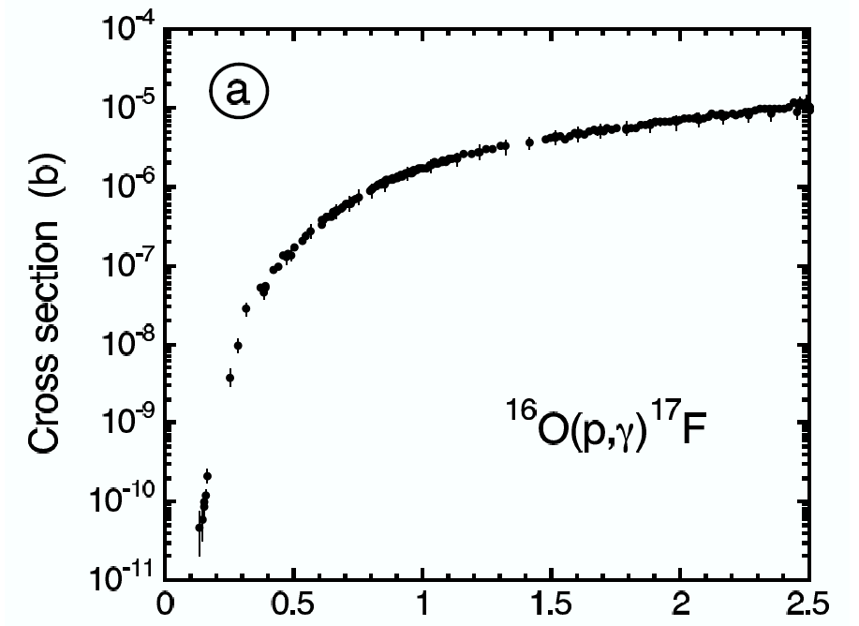
The challenge of nuclear astrophysics: different approaches
In most astrophysical scenarios, the kinetic energy of interacting nuclei is much lower than the Coulomb repulsive potential:
→ Nuclear reactions occur through quantum-mechanical tunneling
→ Cross sections decrease steeply with energy
→ In a laboratory the reaction signal is extremely low at astrophysical energies and easily lost in environmental background
      Recoil separators
Direct approaches:
Underground laboratories
Indirect approaches

Slide 3
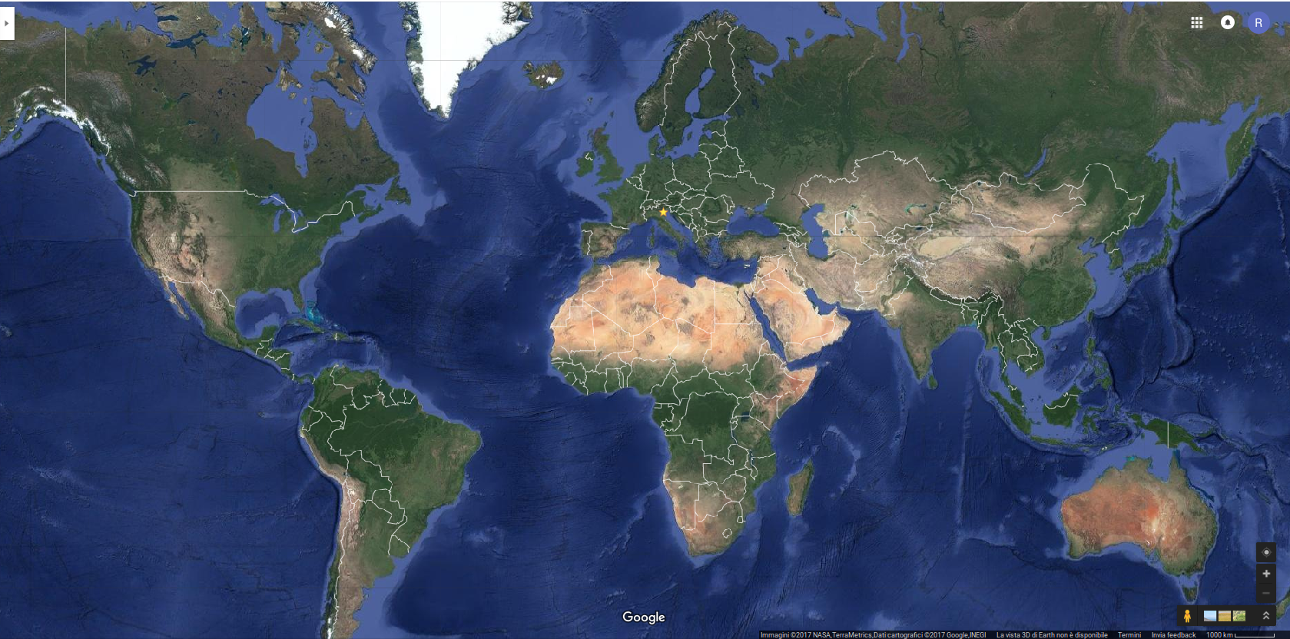
Underground nuclear laboratories
Felsenkeller
110 m.w.e.
5 MV – H ⁺, He⁺, C⁺
I ~ 30 μA
Since 2019
CASPAR
4300 m.w.e.
1 MV – H ⁺, He⁺
I ~ 250 μA
Since 2017
LUNA
3800 m.w.e.
Since 1991
JUNA
6700 m.w.e.
0.4 MV H⁺, He⁺, He⁺⁺
I ~ 1 – 12 mA
Since 2021

Slide 4
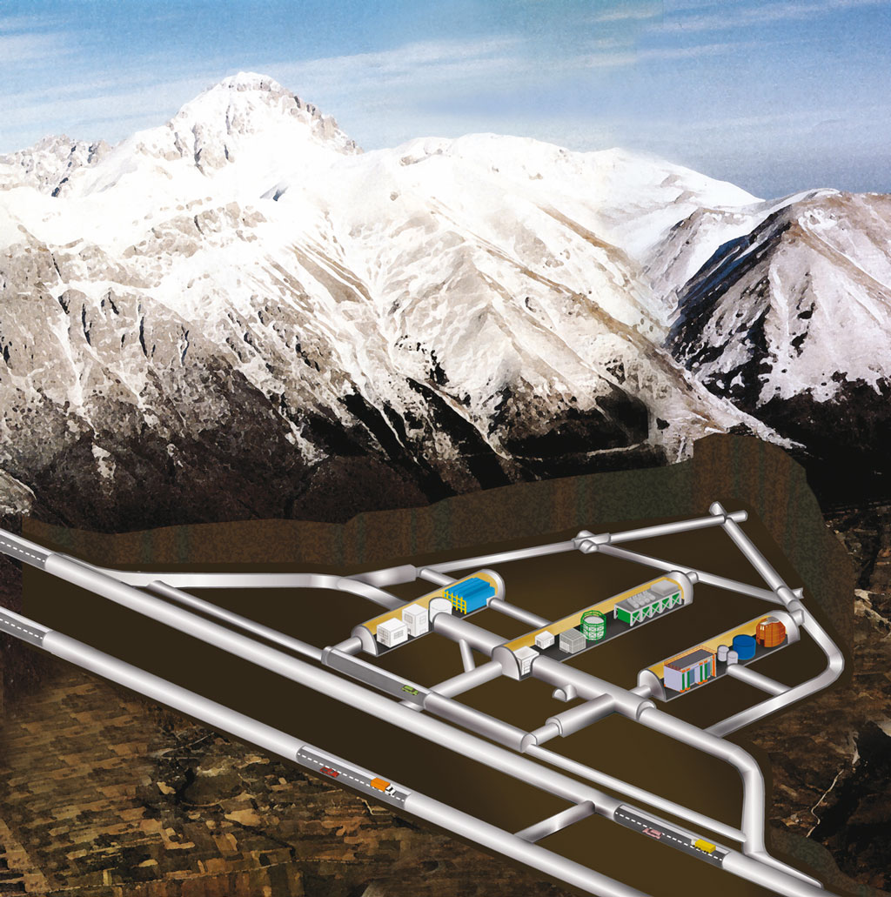
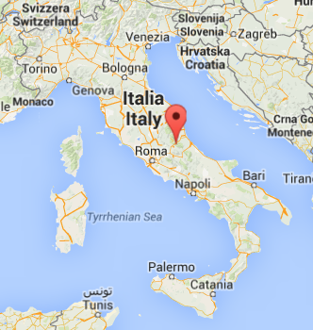
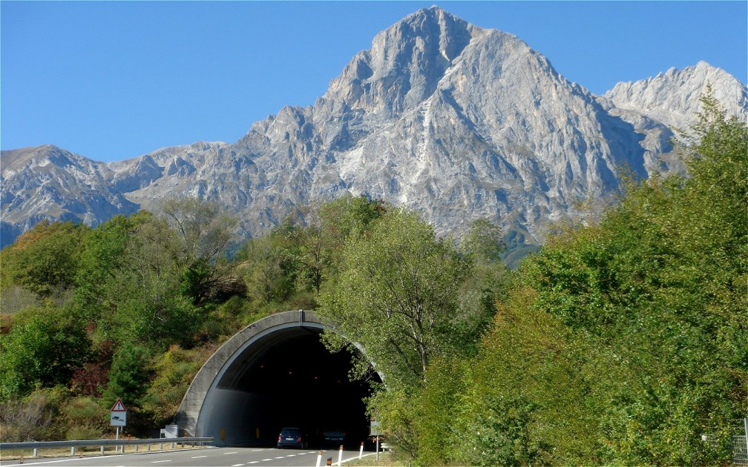
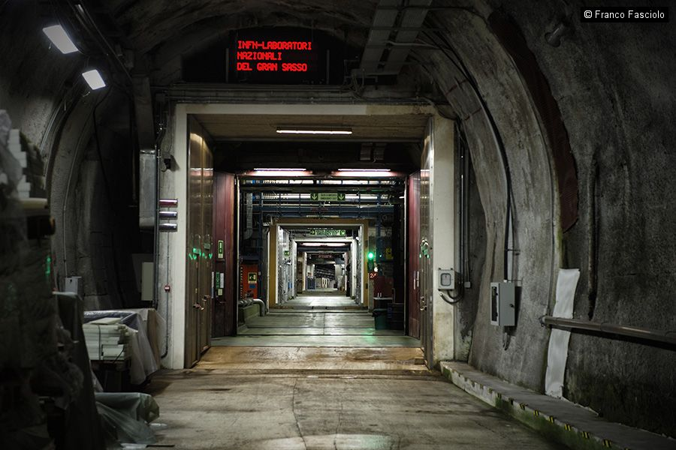
The LNGS underground lab and LUNA
Attenuation of cosmic rays: μ → 10⁻⁶
n → 10⁻³
~ 1400 m
(3800 m.w.e.)
LUNA 1
50 kV
(1991-2001)
LUNA 2
400 kV
(2000 → …)
LUNA MV
12 – 16 Dec. 2022
Key reactions in Nuclear Astrophysics – ECT* Trento
4
Notes:
In 20 years he has established the THM as a world renowned approach in NA

Slide 5
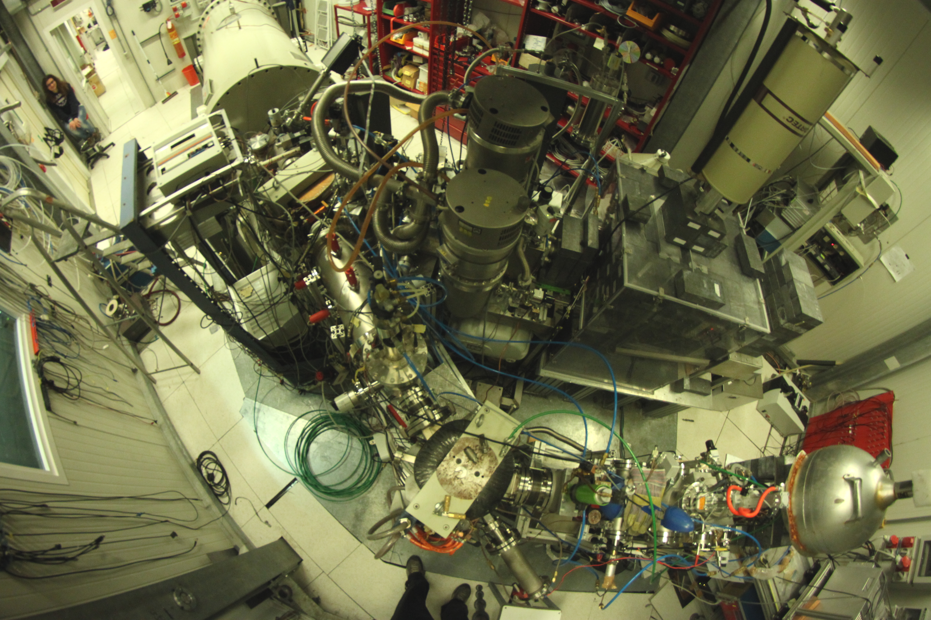
The LUNA 400 kV setup
Windowless gas target:
→ 3 differential pumping stages
→ Gas recirculation and purification system
400 kV ACCELERATOR:
→ H⁺ and He⁺ beams
→ I ~ 250 µA
→ ΔE = 100 eV
Solid Target
Notes:
In 20 years he has established the THM as a world renowned approach in NA

Slide 6

LUNA: background reduction (γ)
Cross section measurement requirements
E_{γ}>3MeV: reduction of a factor 2000 simply going underground
HPGe
HPGe
3MeV < Eγ < 8MeV:
0.5 Counts/s
3MeV < Eγ < 8MeV:
0.0002 Counts/s
μ
μ
E_{γ}<3MeV→passive shielding
Underground passive shielding is more effective since μ flux, that create secondary γ’s in the shield, is suppressed.
A reduction of 5 o.o.m. was obtained
Pb
Cu

Slide 7
LUNA: background reduction (α)
With a Si detector:
Underground+Pb vs. Overground: factor ~10-15 reduction in the range 200 keV - 2.5 MeV

Slide 8
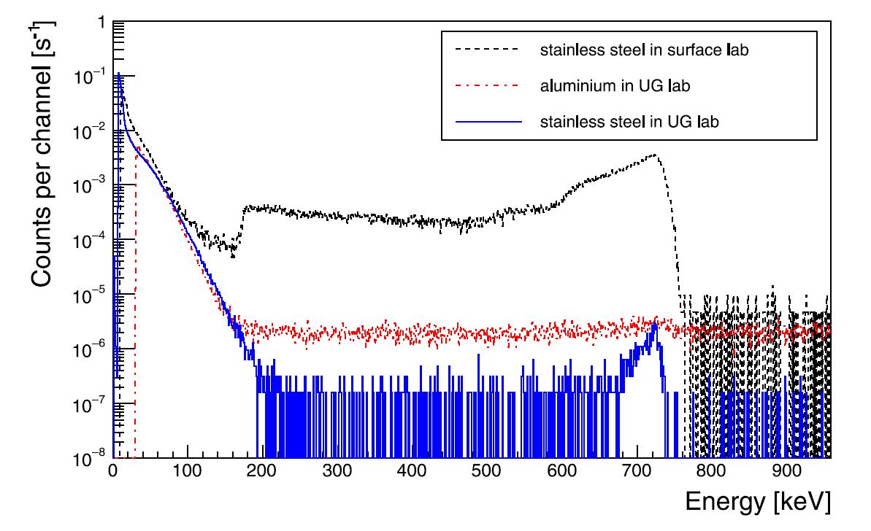
LUNA: background reduction (n)
With a ³He counter: 10⁴ reduction using stainless steel

Slide 9
Reactions studied at LUNA 50 kV and 400 kV
Big Bang Nucleosynthesis
pp chain
p+p → ²H + e⁺ + ν_{e}
7Be
p+2H → 3He + γ
3
6Li
⁷Li
86%
14%
2
³He+³He → ⁴He + 2p
³He+⁴He → ⁷Be + γ
3He
4He
1
13.98%
0.02%
p
2H
³H
⁷Be+e⁻ → ⁷Li + γ + ν_{e}
⁷Be+p → ⁸B + γ
n
1. ²H + p → ³He + γ
2. ⁴He + ²H → ⁶Li + γ
3. ³He+⁴He -> ⁷Be + γ
⁷Li+p → ⁴He +⁴He
⁸B → ⁴He+⁴He+e⁺+ν_{e}
Notes:
In 20 years he has established the THM as a world renowned approach in NA

Slide 10
Reactions studied so far at LUNA 400 kV
CNO CYCLE
NeNa and MgAl CYCLES
(p,γ)
(p,α)
(p,γ)
(p,γ)
(p,α)
(p,γ)
13C
¹⁴N
17O
18F
21Ne
22Na
²⁵Mg
²⁶Al
β⁺
(p,γ)
β⁺
β⁺
β⁺
β⁺
β⁺
13N
¹⁵O
17F
β⁺
21Na
²²Ne
²⁵Al
²⁶Mg
(p,γ)
β⁺
(p,γ)
(p,γ)
(p,γ)
(p,γ)
(p,γ)
(p,α)
(p,γ)
(p,γ)
(p,γ)
12C
¹⁵N
¹⁸O
(p,α)
(p,α)
16O
¹⁹F
20Ne
²³Na
²⁴Mg
27Al
(p,α)
(p,γ)
(p,α)
published
measurement completed
Pre-main sequence: ⁶Li(p,γ)⁷Be
s-process nucleosynthesis : ¹³C(α,n)¹⁶O, ²²Ne(α,γ)²⁶Mg
now on measurement
planned for 2025
Key reactions in Nuclear Astrophysics – ECT* Trento
Notes:
In 20 years he has established the THM as a world renowned approach in NA

Slide 11
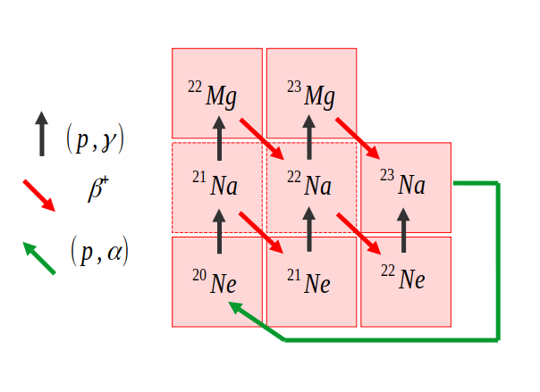
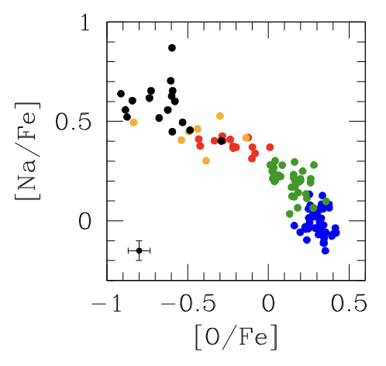
The Ne-Na cycle
Key astrophysical sites
Mg-Al cycle
RGB stars (Red Giant Branch)
AGB stars (Asymptotic Giant Branch)
Novae
Massive stars
²⁴Mg
puzzle of the Na-O anti-correlation in Globular Clusters
(AGB models predict both O and Na to be destroyed by nuclear processes while globular cluster observations show an anticorrelation)
Ne-Na elemental abundances
Mg and Al elemental abundances in the linked MgAl cycle
Notes:
11

Slide 12
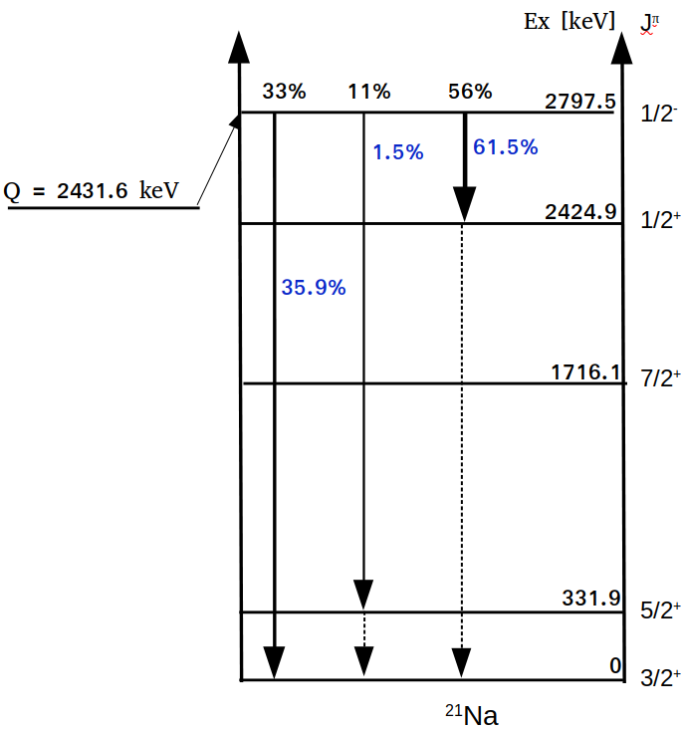
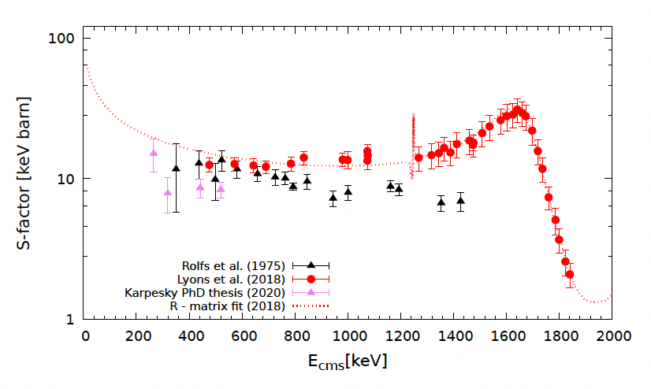
The ²⁰Ne(p,γ)²¹Na reaction
Q = 2431.6 keV
first and slowest reaction of the NeNa cycle
impacts the Ne-Na abundances
²⁴Mg
Only a few measurements available
No low energy measurements
Notes:
12

Slide 13
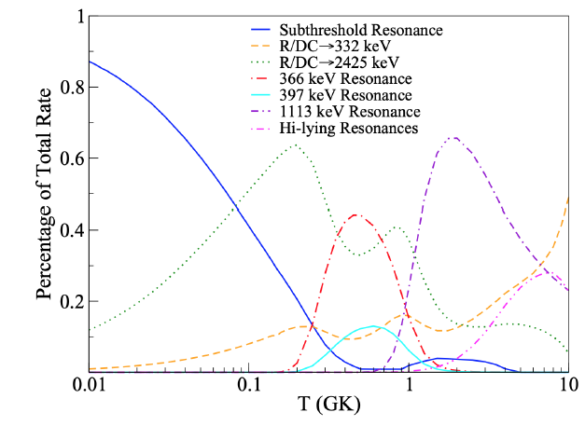
The ²⁰Ne(p,γ)²¹Na reaction
For T = 0.1 - 1 GK the TRR is dominated by the direct capture component and the Er = 386 keV resonance
LUNA GOALS
Study of the Ecm = 366 keV resonance
Direct capture below 400 keV
ωγ_{Rolfs}= 0.11 ± 0.02 meV (Rolfs et al. 1975)
ωγ_{Cooper}= 0.0722 ± 0.0068 meV (Cooper 2019, Ph.D thesis)
Notes:
13

Slide 14
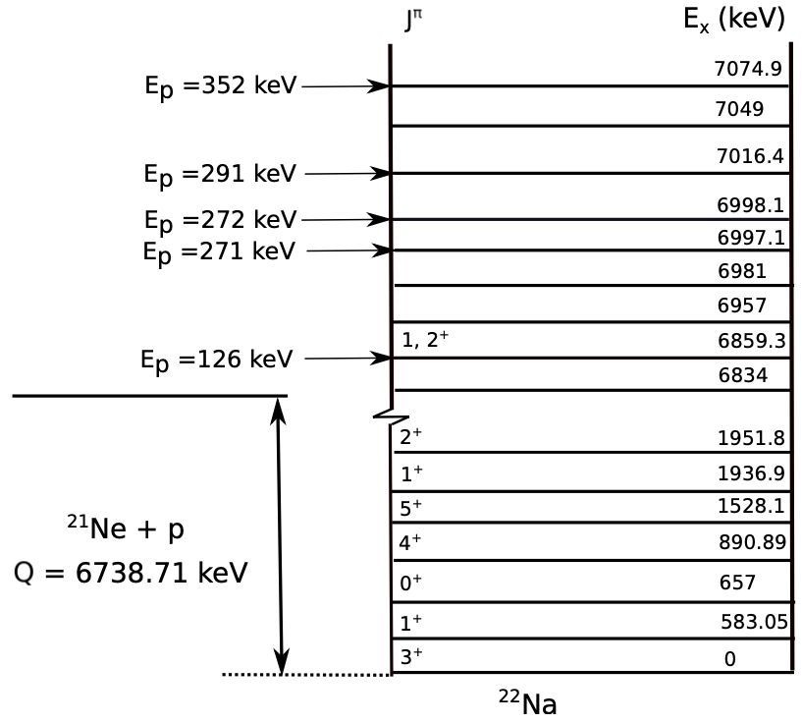
A. Caciolli
The ²¹Ne(p,γ)²²Na reaction
Q = 6738.7 keV
impacts on O-Ne novae and core-collapse supernovae through several resonances
²⁴Mg
Studied only by
J. Görres et al., (1982),
U.E.P. Berg et al., (1984)
H. Becker et al., (1992)
Notes:
14

Slide 15
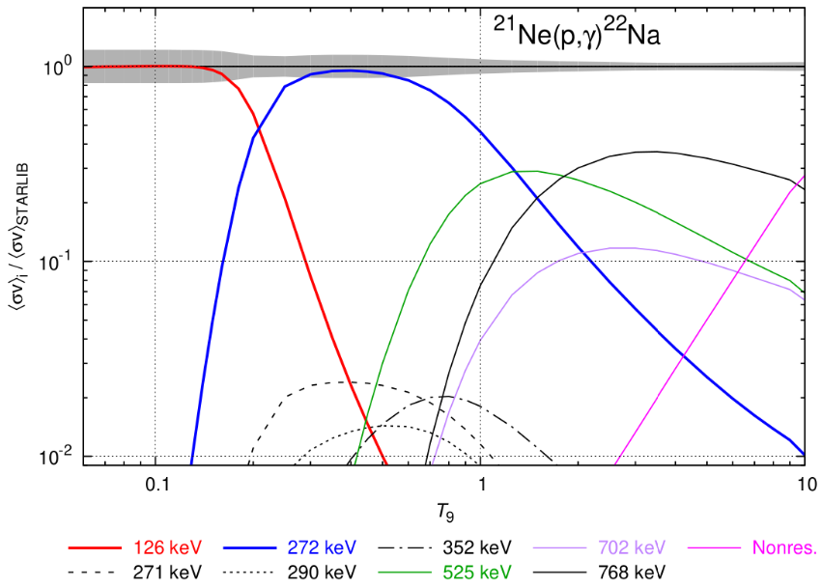
A. Caciolli
The ²¹Ne(p,γ)²²Na reaction
TRR completely dominated by the resonances
LUNA GOALS
Study of 5 different resonances:
Er= 126, 271, 272, 291, 352 keV
Notes:
15

Slide 16
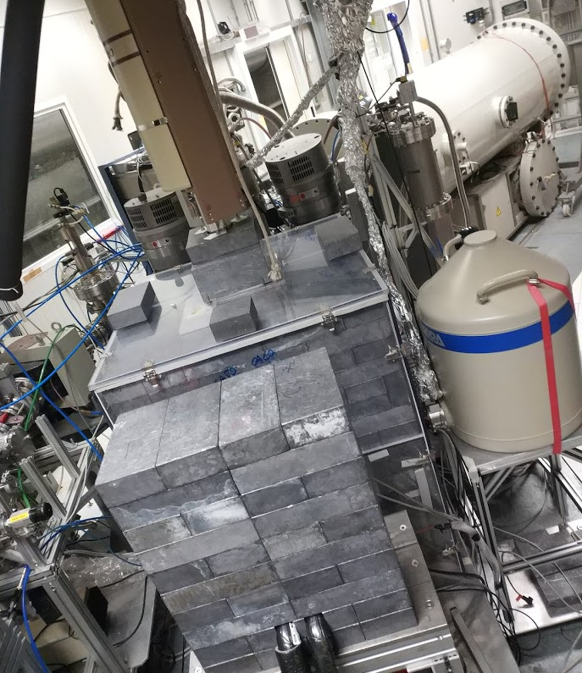
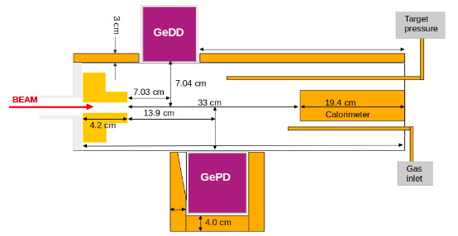
The experimental setup
Extended gas target with natural Ne (90.3% ²⁰Ne) or enriched ²¹Ne (59%) at p = 2 mbar
HPGe detecors:
GePd: relative efficiency 130%
GeDD: relative efficiency 90%
Lead shielding
Radon box
E. Masha
E. Masha
HPGe90%
Beam
HPGe130%
HPGe
90%
HPGe
90%
HPGe
130%
Notes:
16

Slide 17
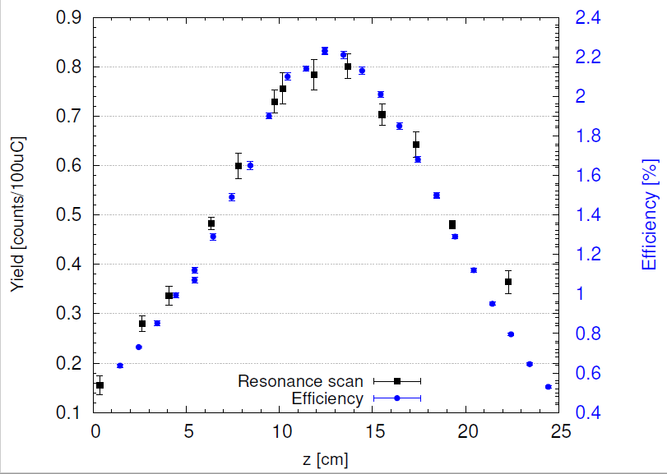
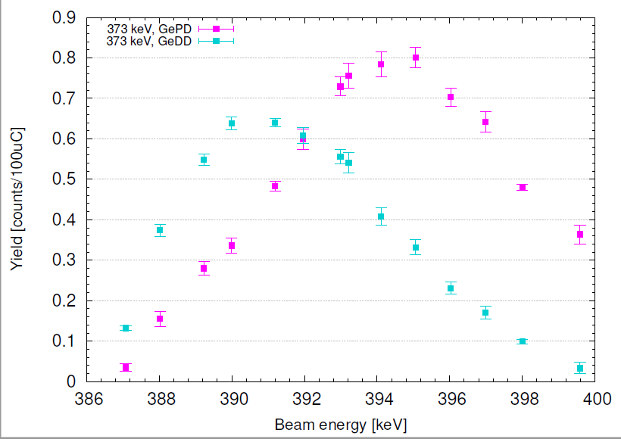
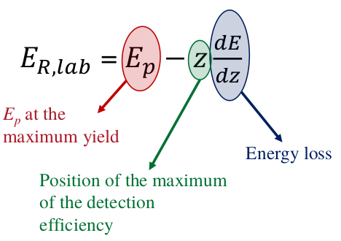
The resonance measurement technique (scan)
HPGe
90%
p = 2 mbar
E_{p} = 386 - 399 keV
Proton beam
Calorimeter
Varying the beam energy, the resonance is populated at different positions along the target chamber, where the detectors have different efficiency.
HPGe
130%
Rolfs et al. (1975) [keV] | LUNA (2023) [keV]
384±5 | 386.0±0.5
Notes:
17

Slide 18
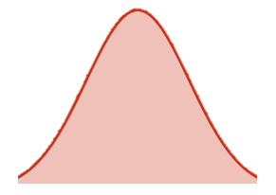
The resonance measurement technique (scan)
HPGe
90%
p = 2 mbar
E_{p} = 386 - 399 keV
Proton beam
Calorimeter
HPGe
130%
Varying the beam energy, the resonance is populated at different positions along the target chamber, where the detectors have different efficiency→
It is possible to determine the energy of the resonance
Rolfs et al. (1975) [keV] | LUNA (2023) [keV]
384±5 | 386.0±0.5
Notes:
18

Slide 19
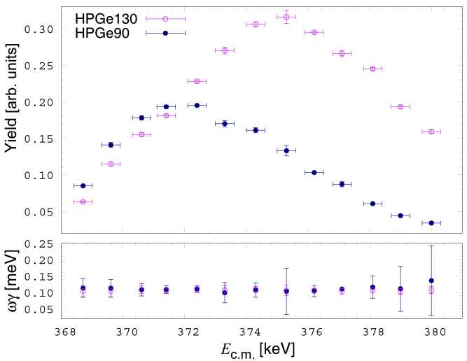
A. Caciolli
The 386 keV resonance strength and branching ratio
Transition [keV] | Rolfs et at. (1975) [%] | LUNA [%]
2425 →0 | 56±4 | 57.4±3.4
2798 →332 | 11±4 | 4.0±0.2
2798 →0 | 33±4 | 38.5±2.2
Experimental yield corrected for the combination of efficiency and beam straggling along the target chamber by using tuned GEANT4 simulations
Rolfs et al. (1975) [meV] | LUNA (2023) [meV]
0.11 ± 0.2 | 0.112 ± 0.002stat ± 0.005sys
Notes:
19

Slide 20
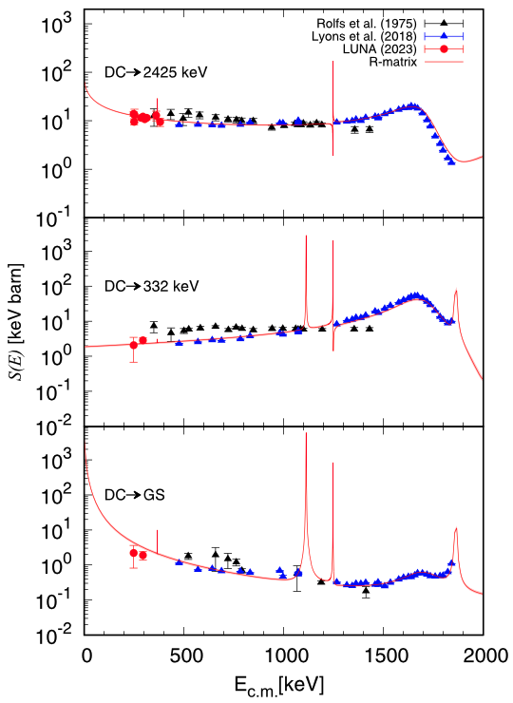
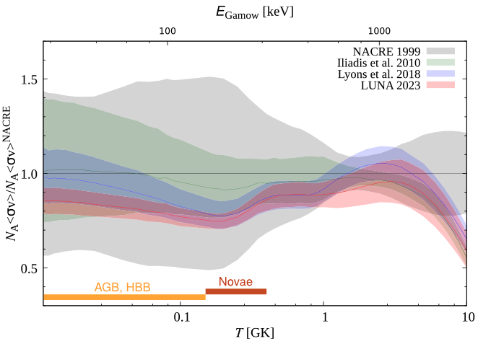
The ²⁰Ne(p,γ)²¹Na S-factor
Direct capture studied in the energy range : Ep = 260 keV – 400 keV
26% reduction of ²¹Ne surface abundance in hot bottom burning of AGB
30% reduction of ^{21,22}Ne in novae ejecta
23% reduction of ²²Na in novae ejecta
Masha et al.
PRC 108 (2023) L052801
Notes:
20

Slide 21
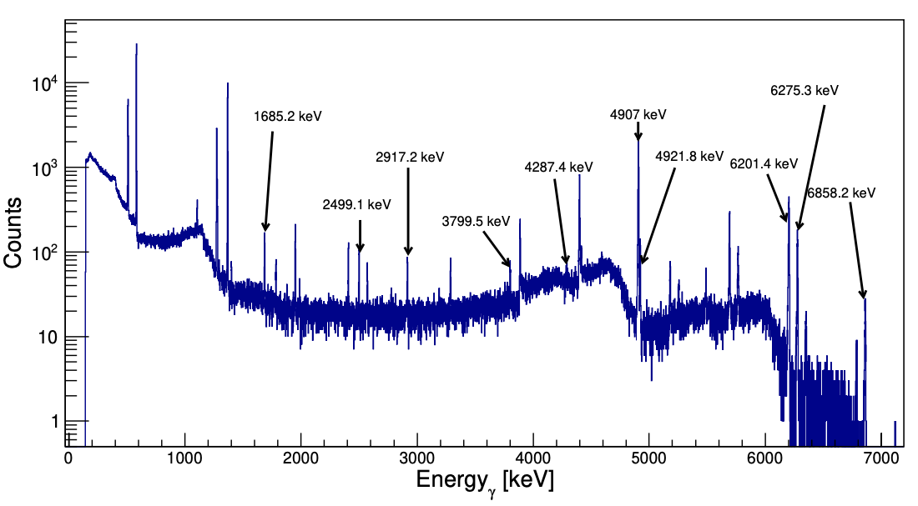
A. Caciolli
The ²¹Ne(p,γ)²²Na new transitions
HPGe spectrum at the 126 keV resonance
Many new transitions discovered for the 126 keV, 272 keV and 290 keV resonances
PRELIMINARY
Notes:
21

Slide 22
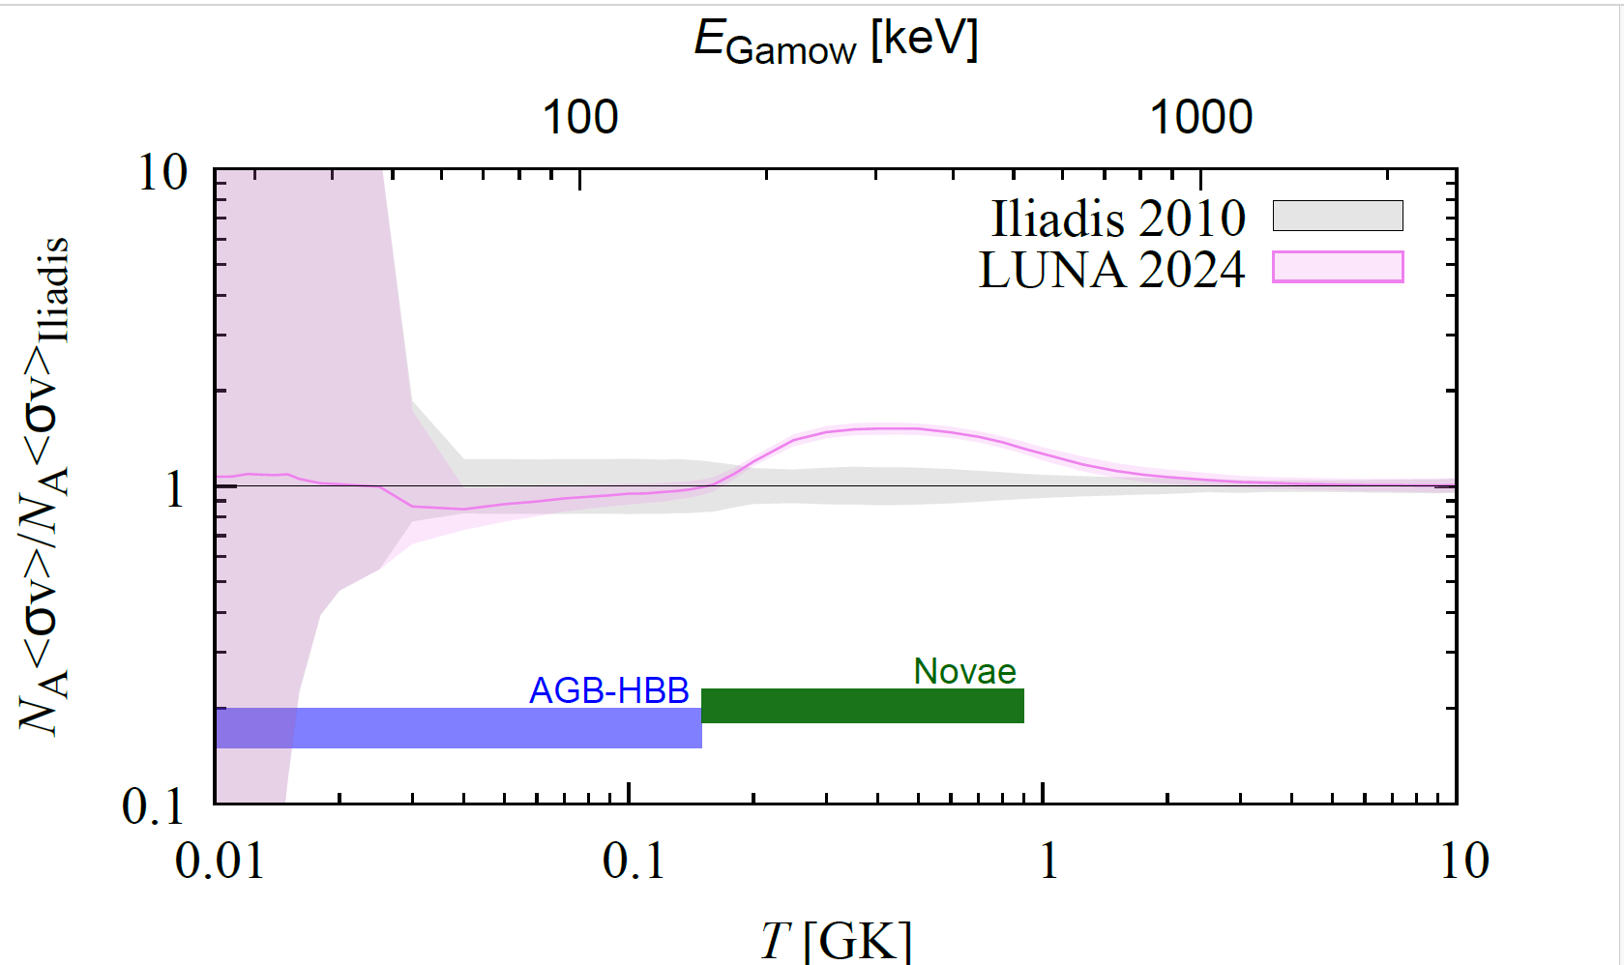
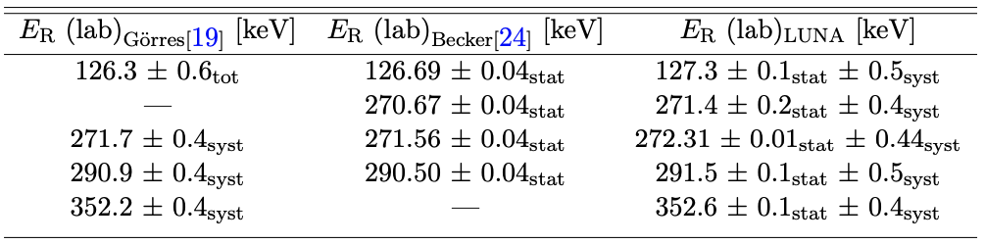
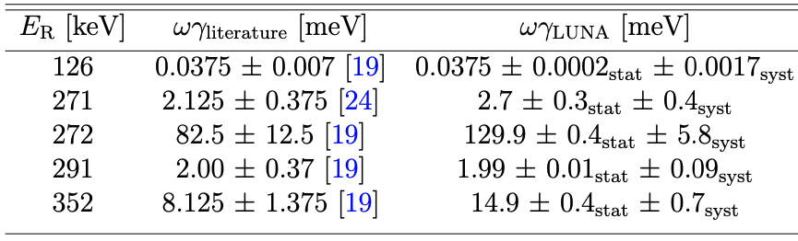
A. Caciolli
The ²¹Ne(p,γ)²²Na preliminary results
Measured resonance energies against literature
PRELIMINARY
PRELIMINARY
Measured resonance strengths against literature
PRELIMINARY
Enhancement in the ²¹Ne(p,γ)²²Na rate in the novae region. Reduced uncertainty
Impact on astrophysical scenarios under study
Notes:
22

Slide 23
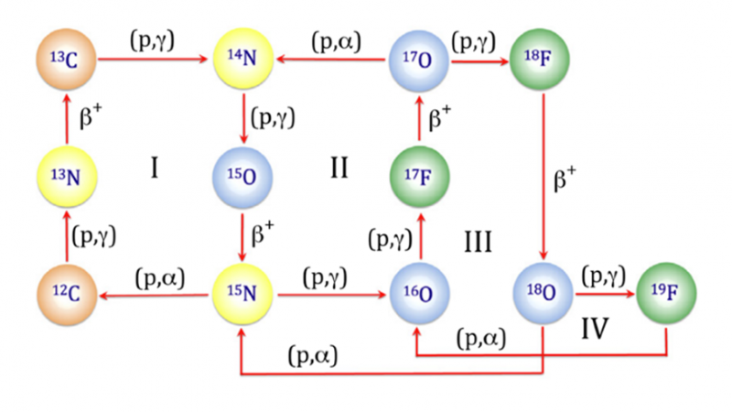

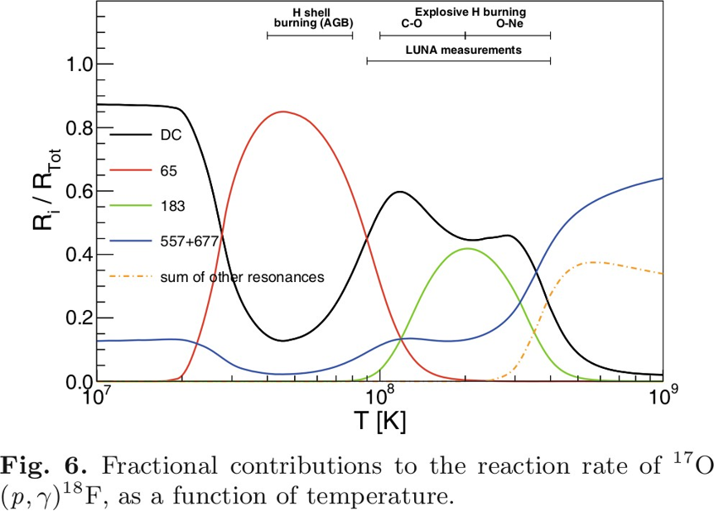
Astrophysical Motivation
The ¹⁷O(p,γ)¹⁸F reaction
Q= 5607 keV
Determine the oxygen isotopic ratio observed in giant stars and in stardust grains
The observed oxygen isotopic ratio is a useful tool to understand the interplay between nuclear burning and mixing processes in giant stars, as well as the origin of stardust grains
For 30 < T < 100 MK (35 < E_{G} < 140 keV) the resonance Ecm=65 keV (Ex = 5672 keV) dominates the reaction rate​
Only indirect measurements (THM, ¹⁴N+α channels, ¹⁷O(p,α)¹⁴N, ¹⁷O(³He, pγ)¹⁸F)
NN2024, Whistler (

Slide 24
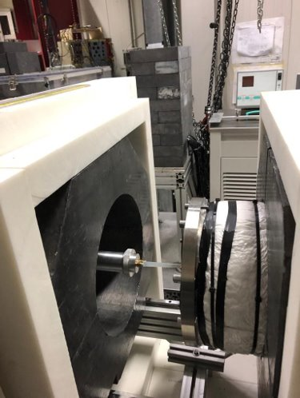
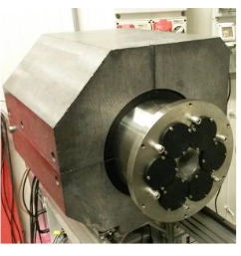
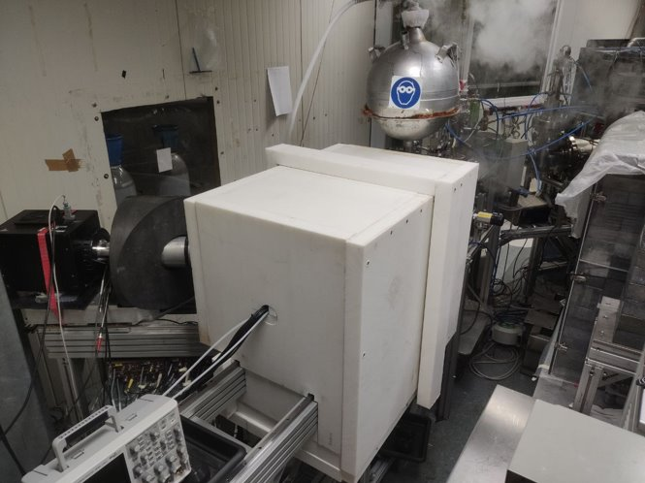
Astrophysical Motivation
Experimental setup
Ta₂O₅ target made by anodic oxidation with ¹⁷O (90%) enriched water.
3 layers shielding: BPE (5 cm)+ Pb (10 cm) + BPE (1 cm)-> reduction of the background by a factor ~5
Al chamber and target holder -> ~20% increase in efficiency w.r.t. previous brass and stainless steel setup
4π BGO Detector with 6 independent crystals.
TAS mode possible: coincident events in different channels are summed up offline to produce the addback spectrum
NN2024, Whistler (

Slide 25
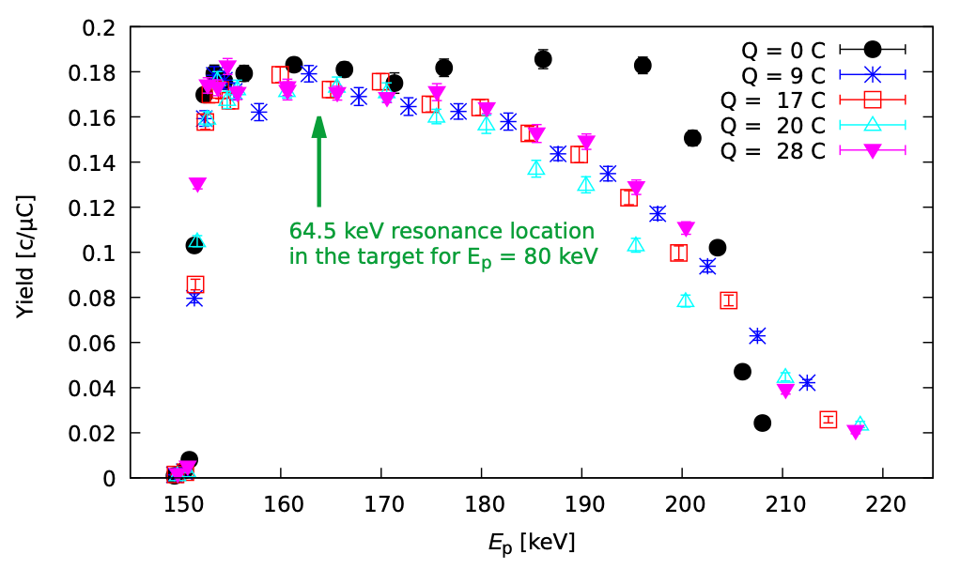

Let’s measure it!
The ¹⁷O(p,γ)¹⁸F reaction
The data taking covered 4 months
420 C accumulated on O-17 targets, 50 and 20 keV thick
Long runs performed at Ep = 80 keV
Targets monitored with periodic scan of the 151 keV resonance and run on top of the 193 keV resonance
300 C accumulated on Ultra Pure Water targets, same thickness but negligible O-17 content
To monitor the Beam Induced Background
NN2024, Whistler (Canada), August 18th - 23rd 2024

Slide 26
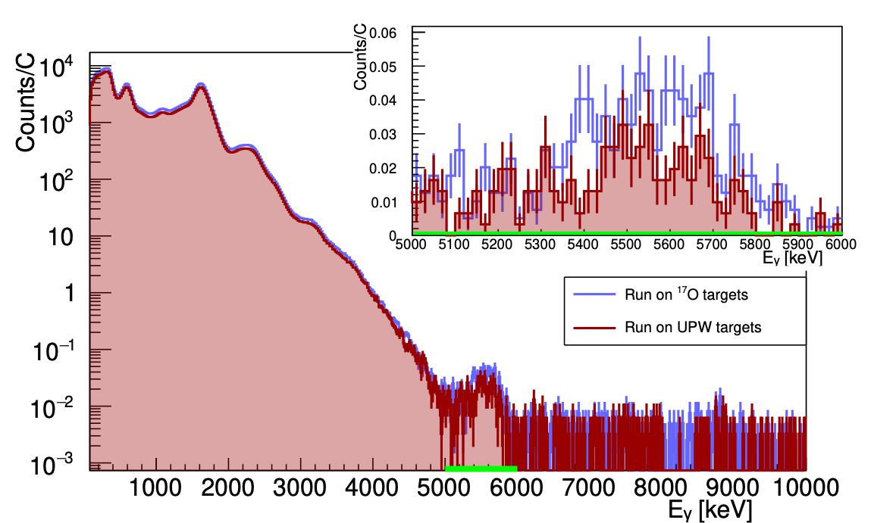
The Beam Induced Background Nightmare
The ¹⁷O(p,γ)¹⁸F reaction
BIB is due to contaminants in the oxide layer or in the backing that react with the beam
The scariest contaminants are those that populates the ROI, mimicking the signal of interest, and have much higher cross section than the reaction of interest
Ta is known for its H and D storage properties
p+D reaction has a Q = 5493.5 keV (only ~ 100 keV lower than the ¹⁷O(p,γ)¹⁸F reaction) and a cross section higher by many orders of magnitudes
With BGO poor resolution the ROI for ¹⁷O(p,γ)¹⁸F reaction is 5200-6200 keV
[Gesué R.M., PRL 133, 052701 (2024)]
No way to distinguish/resolve the p+D and the ¹⁷O(p,γ)¹⁸F sum peak
NN2024, Whistler (Canada), August 18th - 23rd 2024

Slide 27



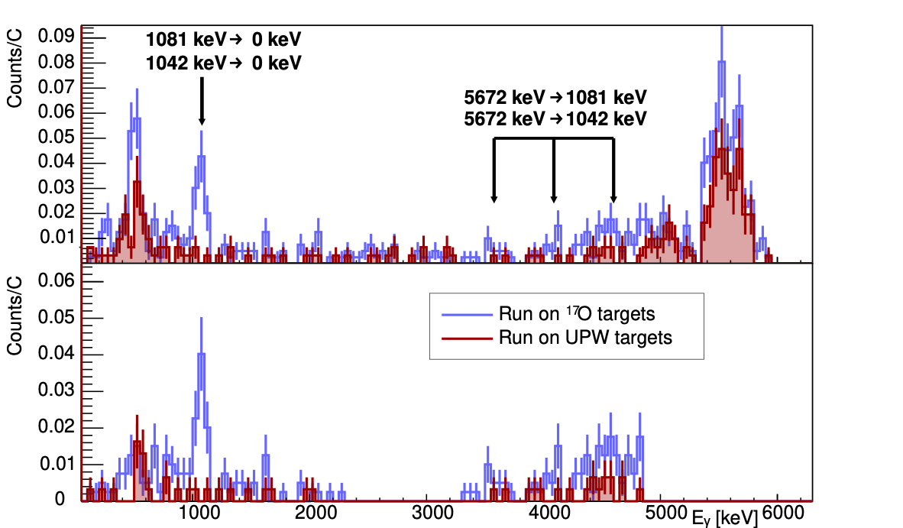
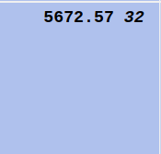
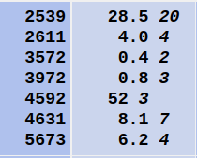
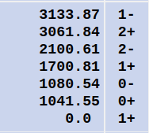
Never give up and be smart!
The ¹⁷O(p,γ)¹⁸F reaction
Even if the sum peak of signal and BIB is not distinguishable,
The signal gives rise to the following γ-rays
While the p+D reaction gives rise to single γ-rays of Eγ ~ 5560 keV
De-construct the sum peak:
Gate in the ROI and look at which γ-rays contributed to the sum peak
consider only coincident γ-rays corresponding to the ¹⁷O(p,γ)¹⁸F cascade
NN2024, Whistler (Canada), August 18th - 23rd 2024

Slide 28
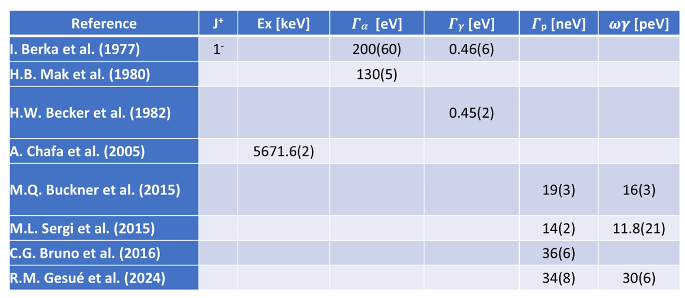
Astrophysical Motivation
The ¹⁷O(p,γ)¹⁸F results
Gesuè et al.
PRL 133 (2024) 052701
NN2024, Whistler (

Slide 29
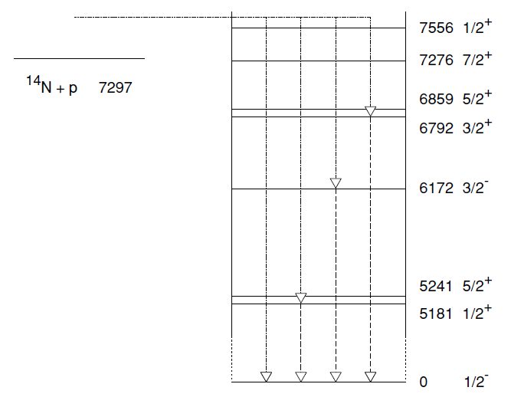
On going measurement: The ¹⁴N(p,γ)¹⁵O reaction
(p,γ)
¹⁴N(p,γ)¹⁵O is the slowest reaction of the CNO cycle
¹³C
¹⁴N
β⁺
(p,γ)
It determines the overall rate of the cycle
¹³N
¹⁵O
(p,γ)
β⁺
(p,α)
¹²C
¹⁵N
The reaction proceeds through capture to different excited states of ¹⁵O
Q= 7297 keV

Slide 30
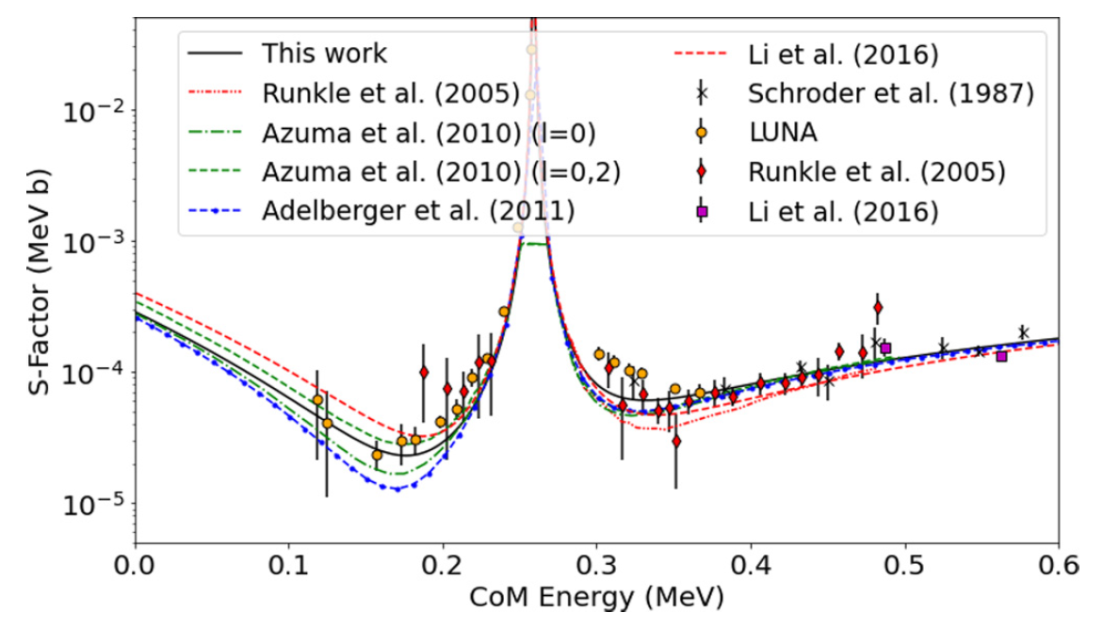
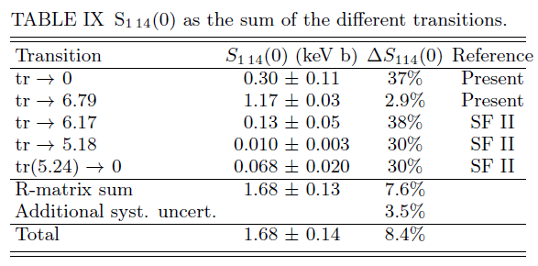
The ¹⁴N(p,γ)¹⁵O reaction: state of the art
Cross section never measured directly at solar energies (15 keV).
Astrophysicists rely on extrapolations that are still highly uncertain
Solar Fusion III arXiv:2405.06470v1 (2024)
Frentz et al. PRC 103, 045802 (2021)
GOAL: measure partial cross sections down to E_{cm} = 100 keV

Slide 31

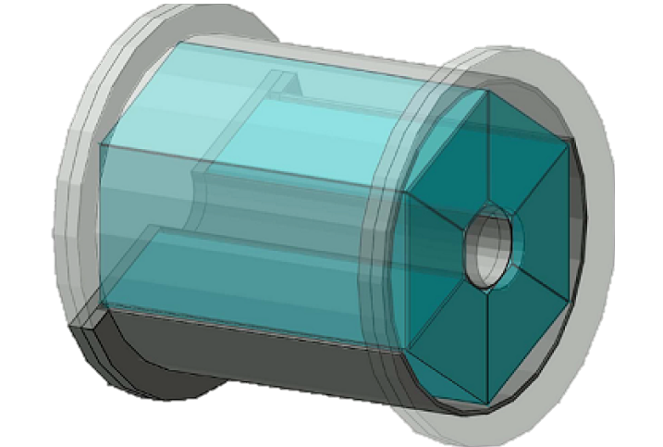
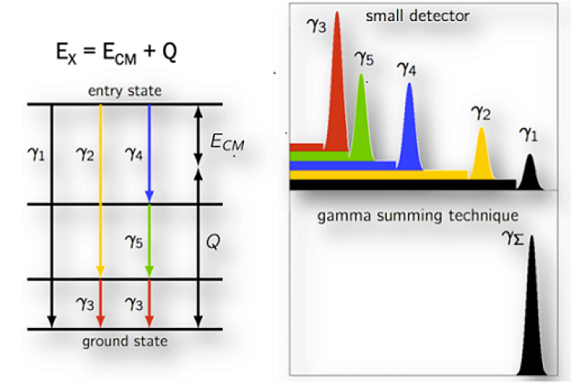
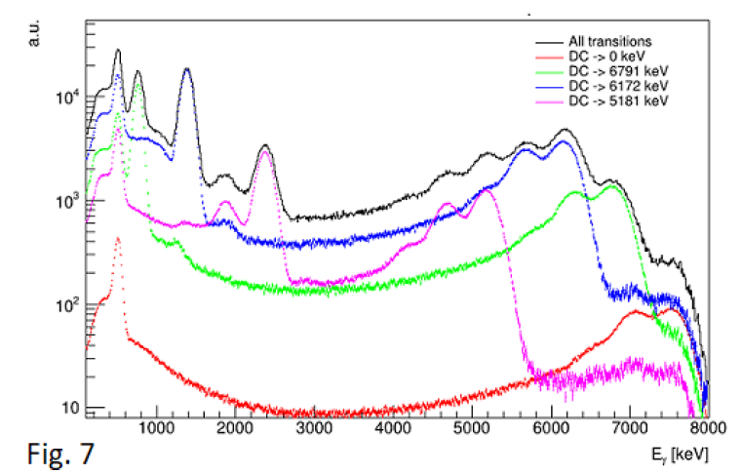
Experimental setup
TiN sputtered targets (thickness 70 – 140 nm) on Ta backing
4π-BGO detector (6 crystals) + lead shielding.
Data processed with the gamma-summing technique
SHIELDING
BEAM
4π BGO DETECTOR
Energy distribution of events contributing to the sum peak fitted with simulated spectra for each branching

Slide 32
Summary and perspectives
²⁰Ne(p,γ)²¹Na: 386 keV resonance (energy and strength) and direct capture (Ep= 260-400 keV)
Masha et al., PRC 108 (2023) L052801
²¹Ne(p, γ)²²Na: 5 resonances measured (energy and strength) tech paper accepted for publication, physical paper in preparation
¹⁷O(p, γ)¹⁸F: E = 65 keV resonance measured. Gesuè et al, PRL 133 (2024) 052701. Paper on astrophysical impact under final revision
¹⁶O(p, γ)¹⁷F: measurement completed (prompt gamma and activation), data analysis ongoing
¹⁴N(p, γ)¹⁵O: measurement just completed, data analysis ongoing
²³Na(p,α)²⁰Ne (eventually ²⁷Al(p,α)²⁴Mg): measurement ongoing. Presently the least known reaction in the NeNa cycle
¹⁹F(p,γ)²⁰Ne and ²⁴Mg(p,γ)²⁵Al planned for 2025
+ M. Aliotta talk + Additional program in preparation!

Slide 33
Luna Collaboration
Laboratori Nazionali del Gran Sasso, INFN, Italy/*GSSI, L'AQUILA, Italy T. Chillery, A. Compagnucci*, R. Gesuè*, F. Ferraro, M. Junker
Università degli Studi di Bari and INFN BARI, Italy G.F. Ciani, V. Paticchio, L. Schiavulli
Università degli Studi di Genova and INFN, GENOVA, Italy P. Corvisiero, P. Prati, M. Rossi, S. Zavatarelli
INFN Lecce, LECCE, Italy R. Perrino
Università degli Studi di Milano and INFN, MILANO, Italy R. Depalo, G. Gosta, A. Guglielmetti
Università degli Studi di Napoli ”Federico II” and INFN, NAPOLI, Italy A. Best, D. Dell’Aquila, A. Di Leva, G. Imbriani, D. Mercogliano, D. Rapagnani
Università degli Studi di Padova and INFN, PADOVA, Italy R. Biasissi, C. Broggini, A. Caciolli, R. Menegazzo, D. Piatti, J. Skowronski
INFN Roma, ROMA, Italy A. Formicola, C. Gustavino, M. Vagnoni
Laboratori Nazionali di Legnaro, Italy V. Rigato, M. Campostrini
Osservatorio Astronomico di Collurania, TERAMO and INFN LNGS, Italy O. Straniero
Università di Torino and INFN, TORINO, Italy F. Cavanna, P. Colombetti, G. Gervino, R. Sariyal
Konkoly Observatory, Hungarian Academy of Sciences, BUDAPEST, Hungary M. Lugaro
Institute of Nuclear Research (ATOMKI), DEBRECEN, Hungary L. Csedreki, Z. Elekes, Zs. Fülöp, Gy. Gyürky, T. Szücs
Helmholtz-Zentrum Dresden-Rossendorf, DRESDEN, Germany D. Bemmerer, A. Boeltzig, E. Masha
University of Edinburgh, EDINBURGH, United Kingdom M. Aliotta, L. Barbieri, R. Bonnel, C.G. Bruno, T. Davinson, J. Jones, D. Robb, J. Marsh,
Notes:
In 20 years he has established the THM as a world renowned approach in NA

Slide 34
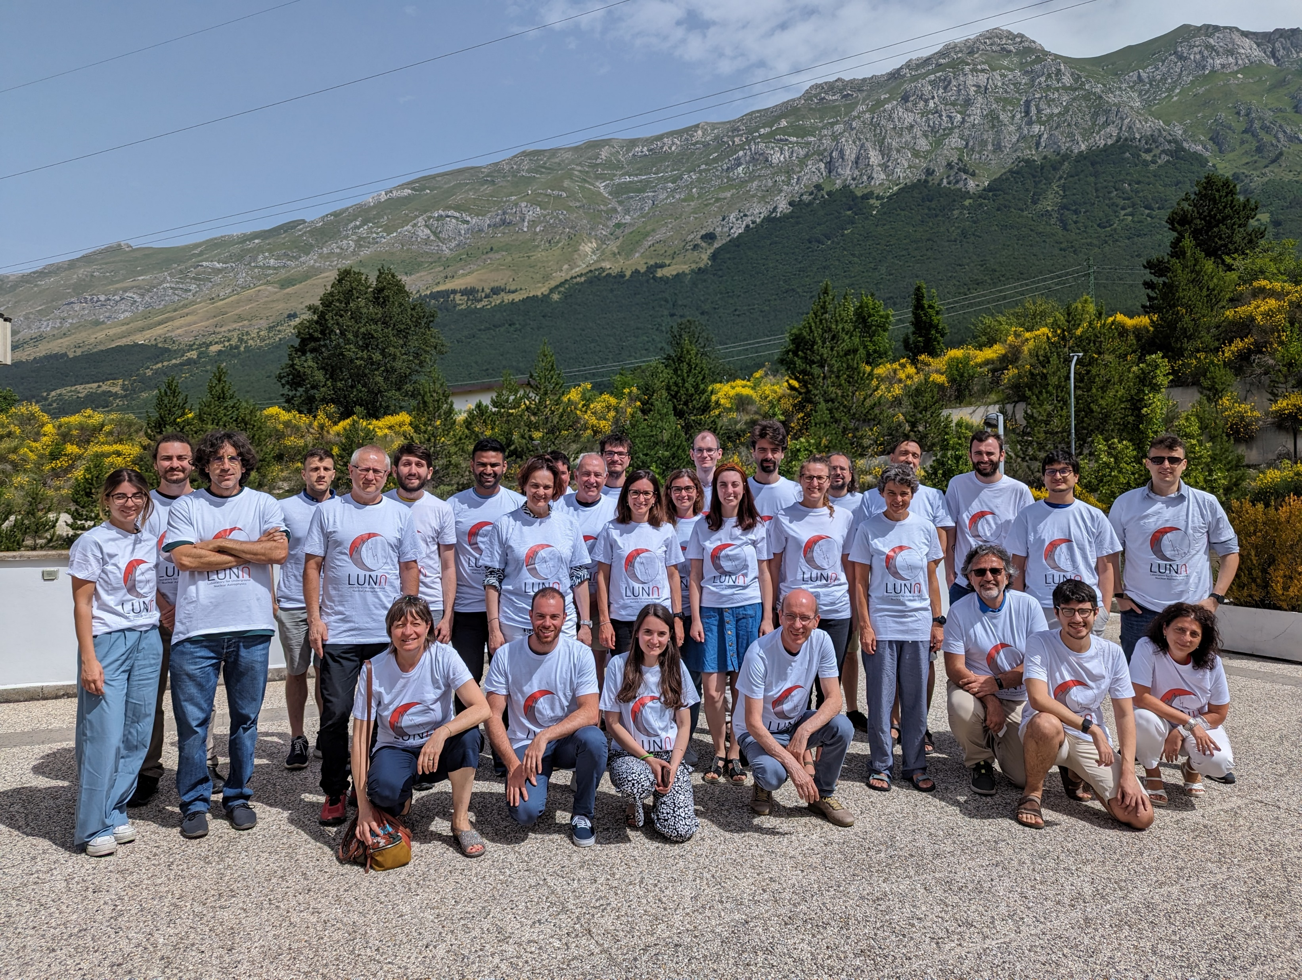
Gran Sasso, summer 2023- T-shirt

Slide 35
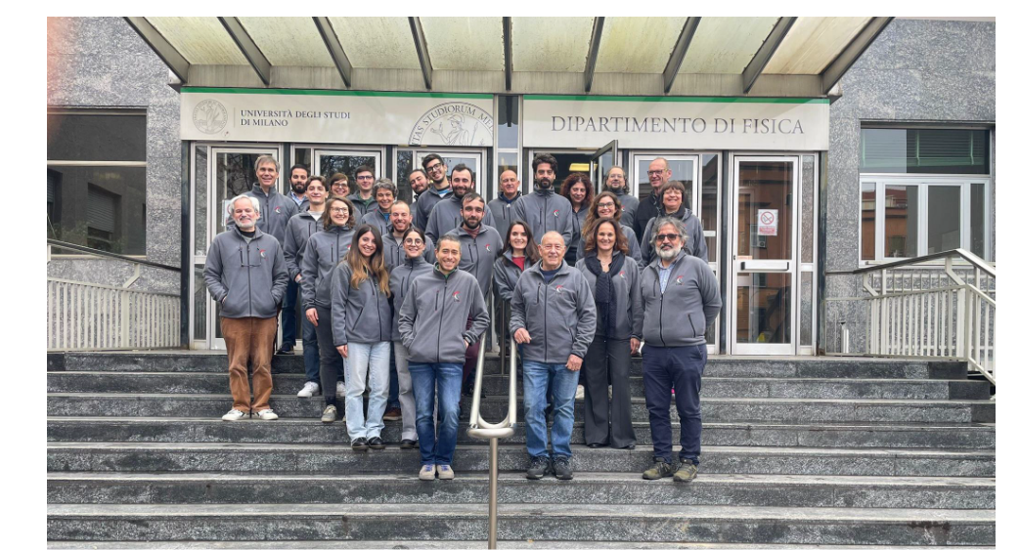
Milano, winter 2025- Sweatshirt

Slide 36
A. Caciolli
The ²⁰⁻²¹Ne(p,γ)²¹⁻²²Na reactions
HPGe
90%
Proton beam
Calorimeter
Pressure p = 2 mbar
E_{p} = 386 - 399 keV
HPGe
130%
Notes:
36

Slide 37
A. Caciolli
The ²⁰⁻²¹Ne(p,γ)²¹⁻²²Na reactions
HPGe
90%
E_{p} = 386 keV
Calorimeter
Pressure p = 2 mbar
E_{p} = 386 - 399 keV
HPGe
130%
Notes:
37

Slide 38
The ²⁰⁻²¹Ne(p,γ)²¹⁻²²Na reactions
HPGe
90%
E_{p} = 391 keV
Calorimeter
Pressure p = 2 mbar
E_{p} = 386 - 399 keV
HPGe
130%
Notes:
38

Slide 39
A. Caciolli
The ²⁰⁻²¹Ne(p,γ)²¹⁻²²Na reactions
HPGe
90%
E_{p} = 399 keV
Calorimeter
Pressure p = 2 mbar
E_{p} = 386 - 399 keV
HPGe
130%
Notes:
39

Slide 40
A. Caciolli
The ²⁰⁻²¹Ne(p,γ)²¹⁻²²Na reactions
HPGe
90%
E_{p} = 399 keV
Calorimeter
Pressure p = 2 mbar
E_{p} = 386 - 399 keV
HPGe
130%
Varying the beam energy, the resonance is populated at different positions along the target chamber, where the detectors have different efficiency.
Notes:
40

Slide 41
A. Caciolli
The ²⁰⁻²¹Ne(p,γ)²¹⁻²²Na reactions
Rolfs et al. (1975) [keV] | LUNA (2023) [keV]
384±5 | 386.0±0.5
Notes:
41

Slide 42
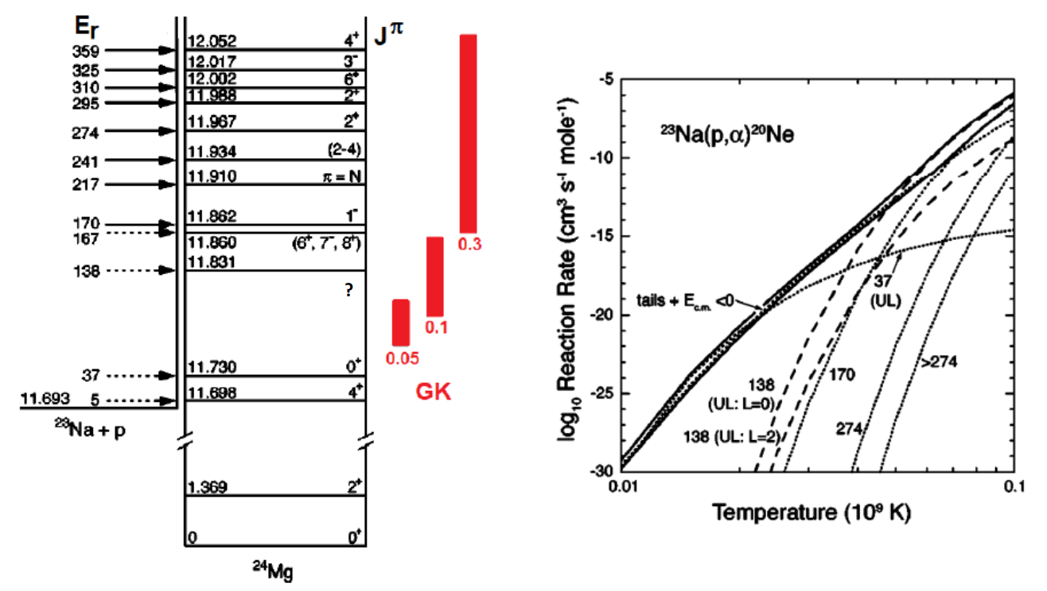
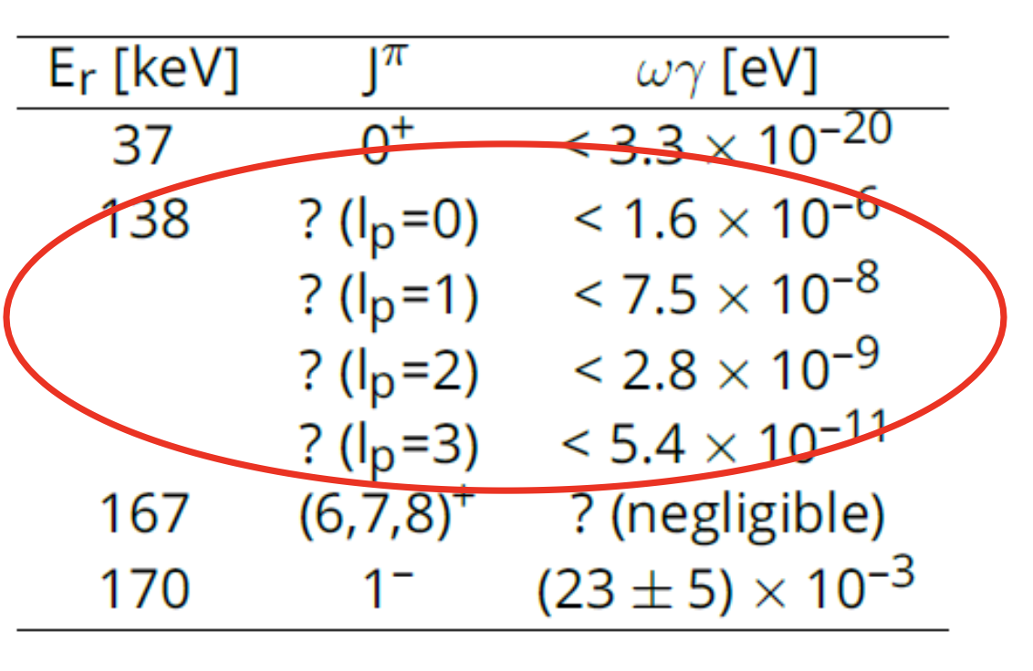

The ²³Na(p,α)²⁰Ne reaction: State of the art
Gamow window
In the AGB-relevant temperature range three resonances contribute to the reaction rate.
Hale et al. (2004)
Only tentative upper limits have been placed for the Er= 137 keV, depending on the value of the unknown proton momentum transfer I_{p}.
P.I: C. Bruno
Notes:
42

Slide 43


The ²³Na(p,α)²⁰Ne reaction: Experimental setup
24 HAMAMATSU
PHOTODIODES
Collimator
Cold trap
Beam
Interaction chamber
Wobblers
3 MSPADs (nTDs)
Notes:
43

Slide 44



The ²³Na(p,α)²⁰Ne reaction: First data taking
Targets
Main issue with sodium targets: All Na salts are hygroscopic
Sputtered target: Na_{x}Nb_{y}O_{z}
Produced: LNL, Italy
Low sensitivity to humidity
Good stability under irradiation
Evaporated target: Na₂WO₄
Produced: ATOMKI, Hungary
Known stoichiometry
Scan of 309 keV resonance in the (p,ɣ) channel
NO degradation up to 35 C.
Detection system
Resolution+ efficiency completed, first tests under analysis
Notes:
44

Slide 45


The ¹⁶O(p,γ)¹⁷F reaction
Based on outdated stopping powers
Relative, normalized to Tanner
Lack of low-energy data to constraint extrapolations
Notes:
In 20 years he has established the THM as a world renowned approach in NA

Slide 46


The ¹⁶O(p,γ)¹⁷F reaction: Experimental techniques
ACTIVATION (T_{1/2}(¹⁷F) = 64.49 s):
Performed in-situ using 4π, segmented BGO detector (high efficiency)
Not sensitive to gamma-ray angular distribution
  Need to discriminate background (i.e. from ¹²C(p,γ)¹³N and ¹⁴N(p,γ)¹⁵O)
PROMPT-GAMMA DETECTION:
  Allows to study individually captures to g.s. and 1st excited state
  Sensitive to angular distribution, needs multiple (shielded) detectors
Pb shielding
55°
HPGe
0° CeBr₃
beam
90° CeBr₃
Notes:
In 20 years he has established the THM as a world renowned approach in NA

Slide 47

The ¹⁶O(p,γ)¹⁷F reaction: preliminary results
Very preliminary results from first activation beam time
LUNA range
Notes:
In 20 years he has established the THM as a world renowned approach in NA

Slide 48



We made it!
The ¹⁷O(p,γ)¹⁸F reaction
3 layer shielding: BPE + Pb + BPE -> reduction of the background by a factor ~5
Al chamber and target holder -> ~20% increase in efficiency w.r.t. previous brass and stainless steel setup
[Skowronski J., J Phys. G 50, 045201 (2023)]
NN2024, Whistler (Canada), August 18th - 23rd 2024

Slide 49

¹⁹F(p,γ)²⁰Ne Astrophysical Motivations

Slide 50

²⁴Mg(p,γ)²⁵Al Astrophysical Motivations
Straniero et al. 2013 APJ 763
part of the MgAl cycle, it set the abundance of Mg and Al isotopes
  in Globular Cluster stars (among the oldest star in the Universe)
  in stardust grains formed around Asymptotic Giant Branch stars
activates during H burning for temperatures 30 MK < T < 60 MK

