Slide 1
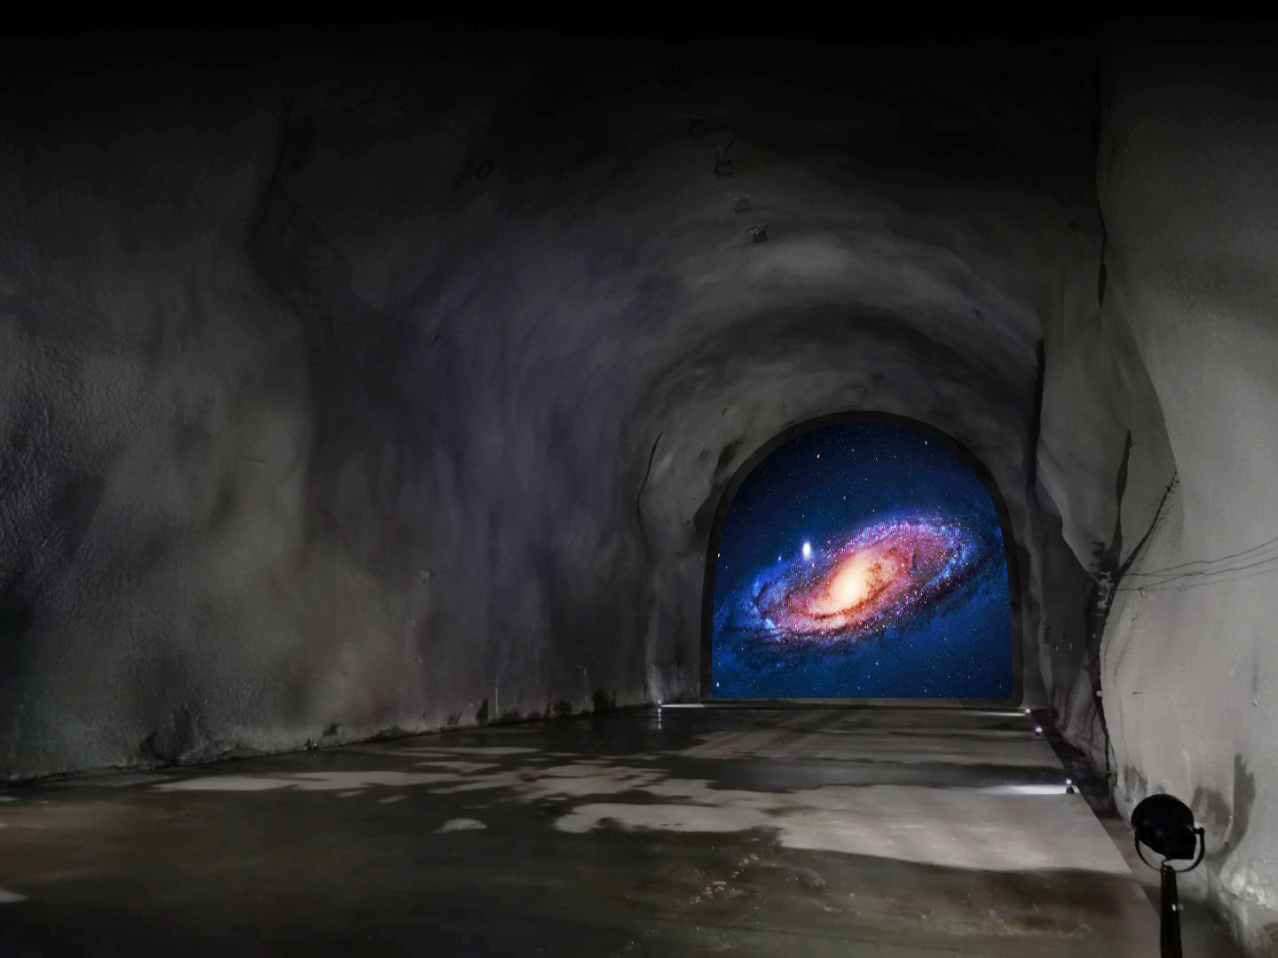
Mystery of Calcium production in the first generation stars
Jianjun HE
Institute of Modern Physics Fudan University
Feb. 19, 2025
Notes:
Good afternoon, everyone! I am Jianjun He from Fudan University, Shanghai, China. First of all, I would like to thank the organizers who invited me to this workshop. The title of my talk is the Mystery of Calcium production in the first generation stars.

Slide 2
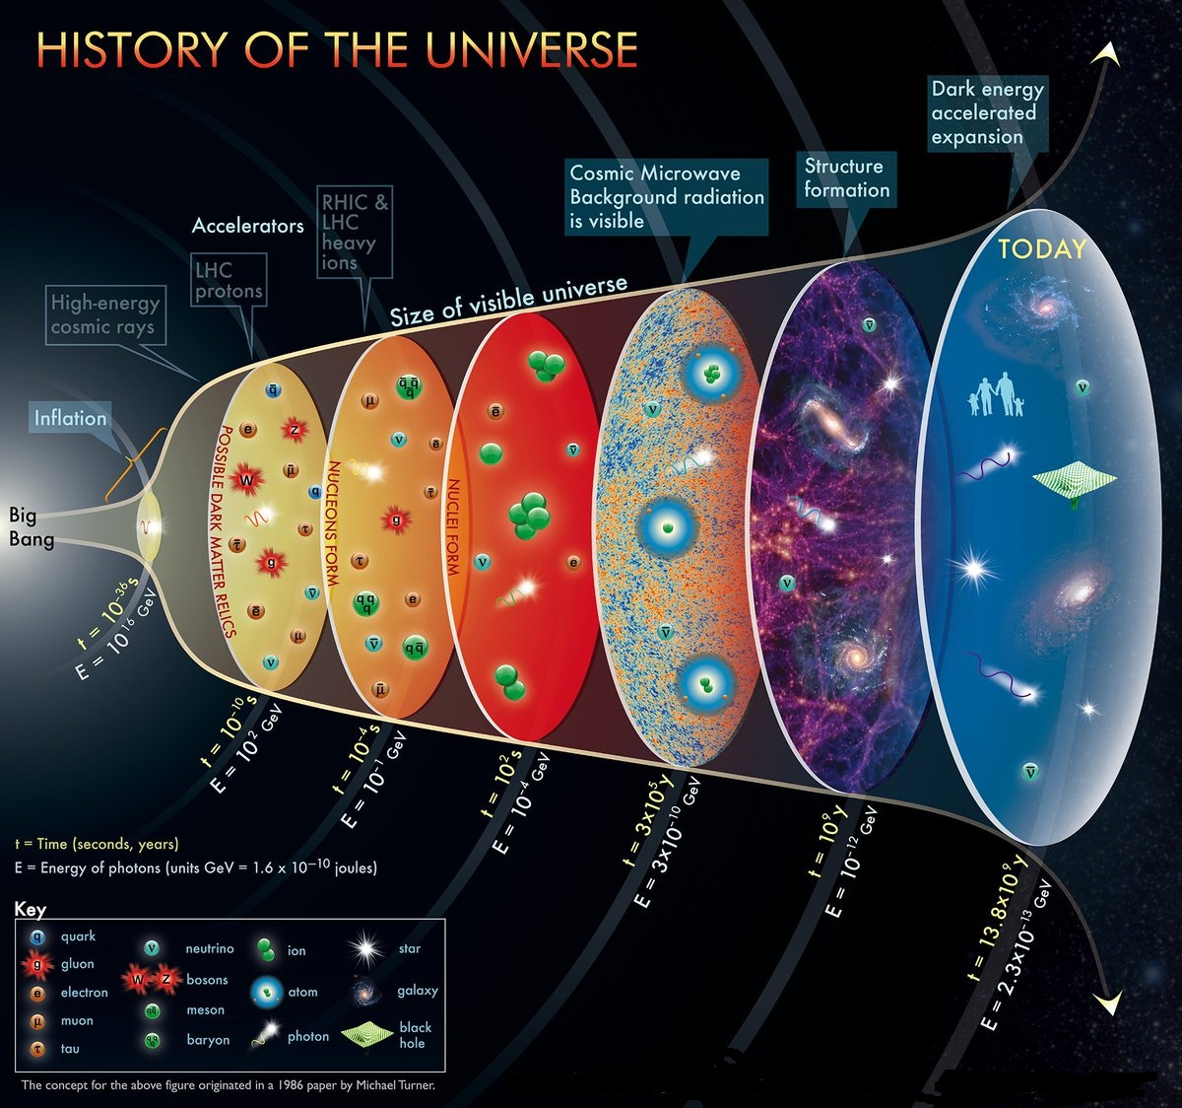
100 s
0.38 million yrs
150 million yrs
13.8 billion yrs
Notes:
The picture condenses the history of the universe. Our universe began with a Big Bang about 13.8 billion years ago. Afterwards, it expanded and cooled down quickly. After about 100 seconds, the temperature drops to about 1 billion Kelvin, starting the primordial nucleosynthesis of light elements; the first generation of stars in the universe formed about 150 million years, with temperature about 0.1 GK. This talk will focus on our recent studies about two key reactions involved in these first stars.

Slide 3
Today’s topic
The first generation stars (also called as the first stars, primordial stars,
or Pop III stars)
Notes:
Today, my topic is about the first generation stars, also called as the first stars, primordial stars, or Pop III stars.

Slide 4
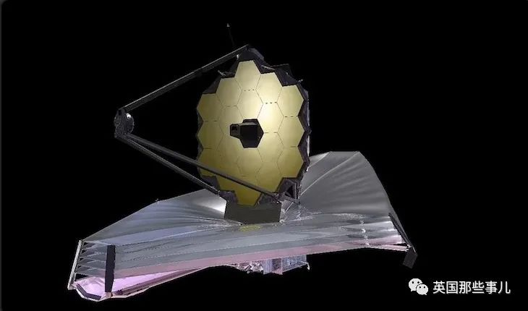
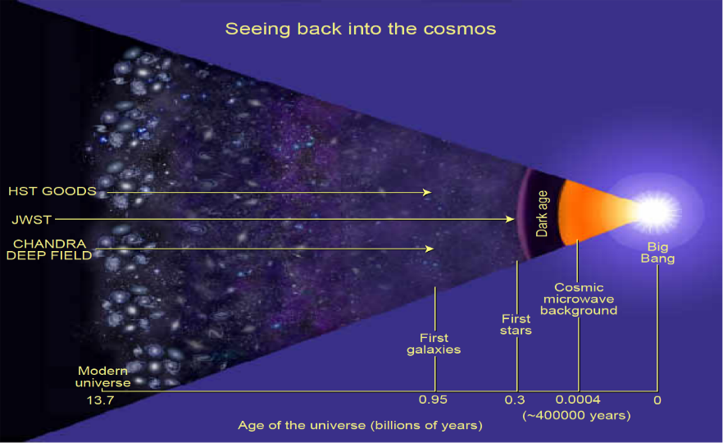
James Webb Space Telescope (JWST)
JWST: Directly observe the first stars, seeing back into the cosmos
According to the standard cosmology theory, during 380,000 to 150 million years after the Big Bang, there were no luminous objects during the so-called "Dark Age". After that, the first generation stars formed, and the first generation galaxies formed about 1 billion years later. One of the major scientific objectives of the Webb telescope is to study the "first rays of dawn" emitted by the first generation stars and galaxies in the universe.
Notes:
According to the standard cosmology theory, during 380,000 to 150 million years after the Big Bang, there were no luminous objects during the so-called "Dark Age". After that, the first generation stars formed, and the first generation galaxies formed about 1 billion years later. One of the major scientific objectives of the Webb telescope is to study the "first rays of dawn" emitted by the first generation stars and galaxies in the universe, seeing back into the cosmos.

Slide 5
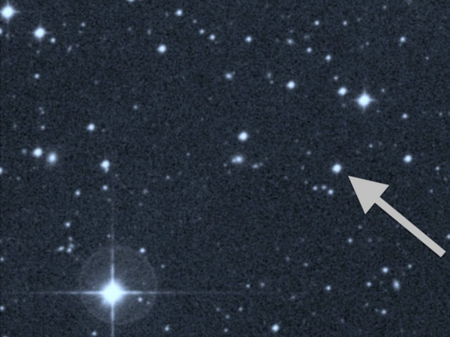
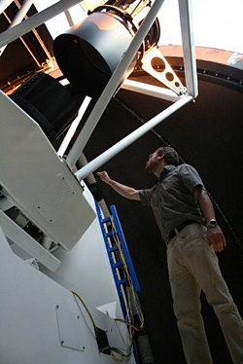
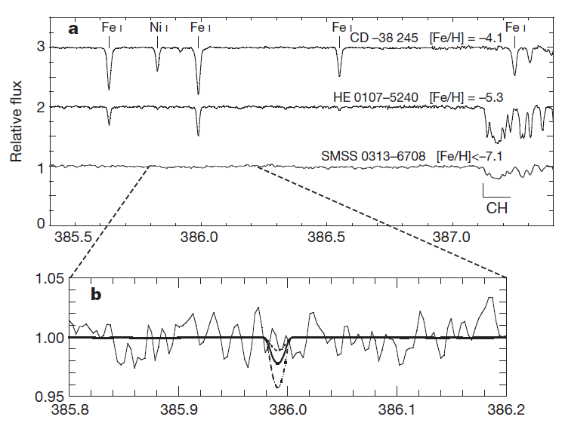
The oldest star in the universe
Oldest star: S.C. Keller et al., Nature 506(2014)463
SMSS0318-6708
~6000 light year from Earth, formed shortly after the Big Bang. It’s the oldest star yet found.
Extremely Metal Poor Stars (EMPs)
Siding Spring Observatory
Notes:
In 2014, ANU astronomers Keller et al. observed a red giant SMSS0318-6708, which is about 6000 light year from the Earth, formed shortly after the Big Bang. It’s claimed as the oldest star yet found by that time. It is really an Extremely Metal Poor star, in which the Iron was not observed, with an upper-limit abundance of -7.1 estimated.

Slide 6
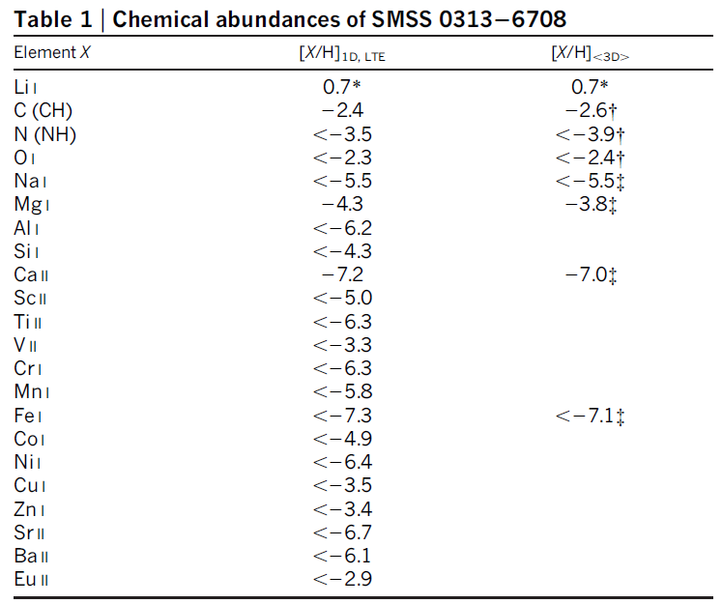
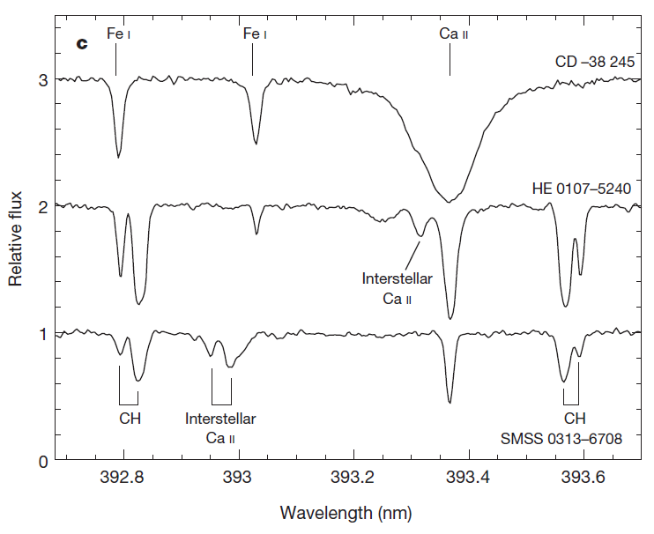
The oldest star in the universe
Ca abundance
Supernova burst of a 60 M⊙ first star
After explosion, the outer light elements being ejected and the inner heavy elements being fallen back onto the central black hole
Ca was thought to be produced by HCNO breakout reactions
Notes:
This is the chemical abundance table, where only Li, Mg and Ca were observed. It is thought this is a supernova burst of a 60 M⊙ first star. After explosion, the outer light elements being ejected and the inner heavy elements being fallen back onto the central black hole, and hence no Iron was observed. Here, Ca was thought to be produced by the HCNO breakout reactions

Slide 7
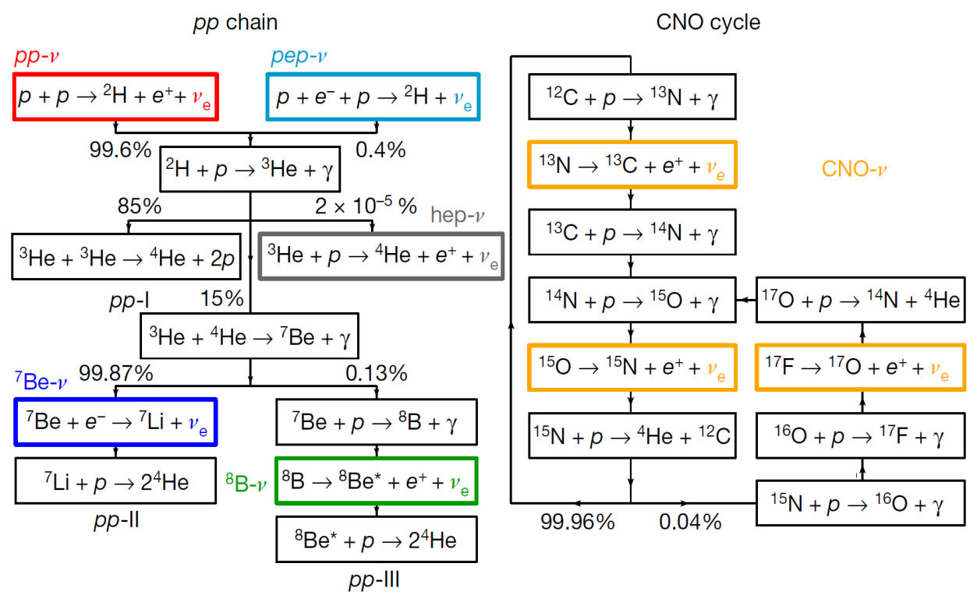
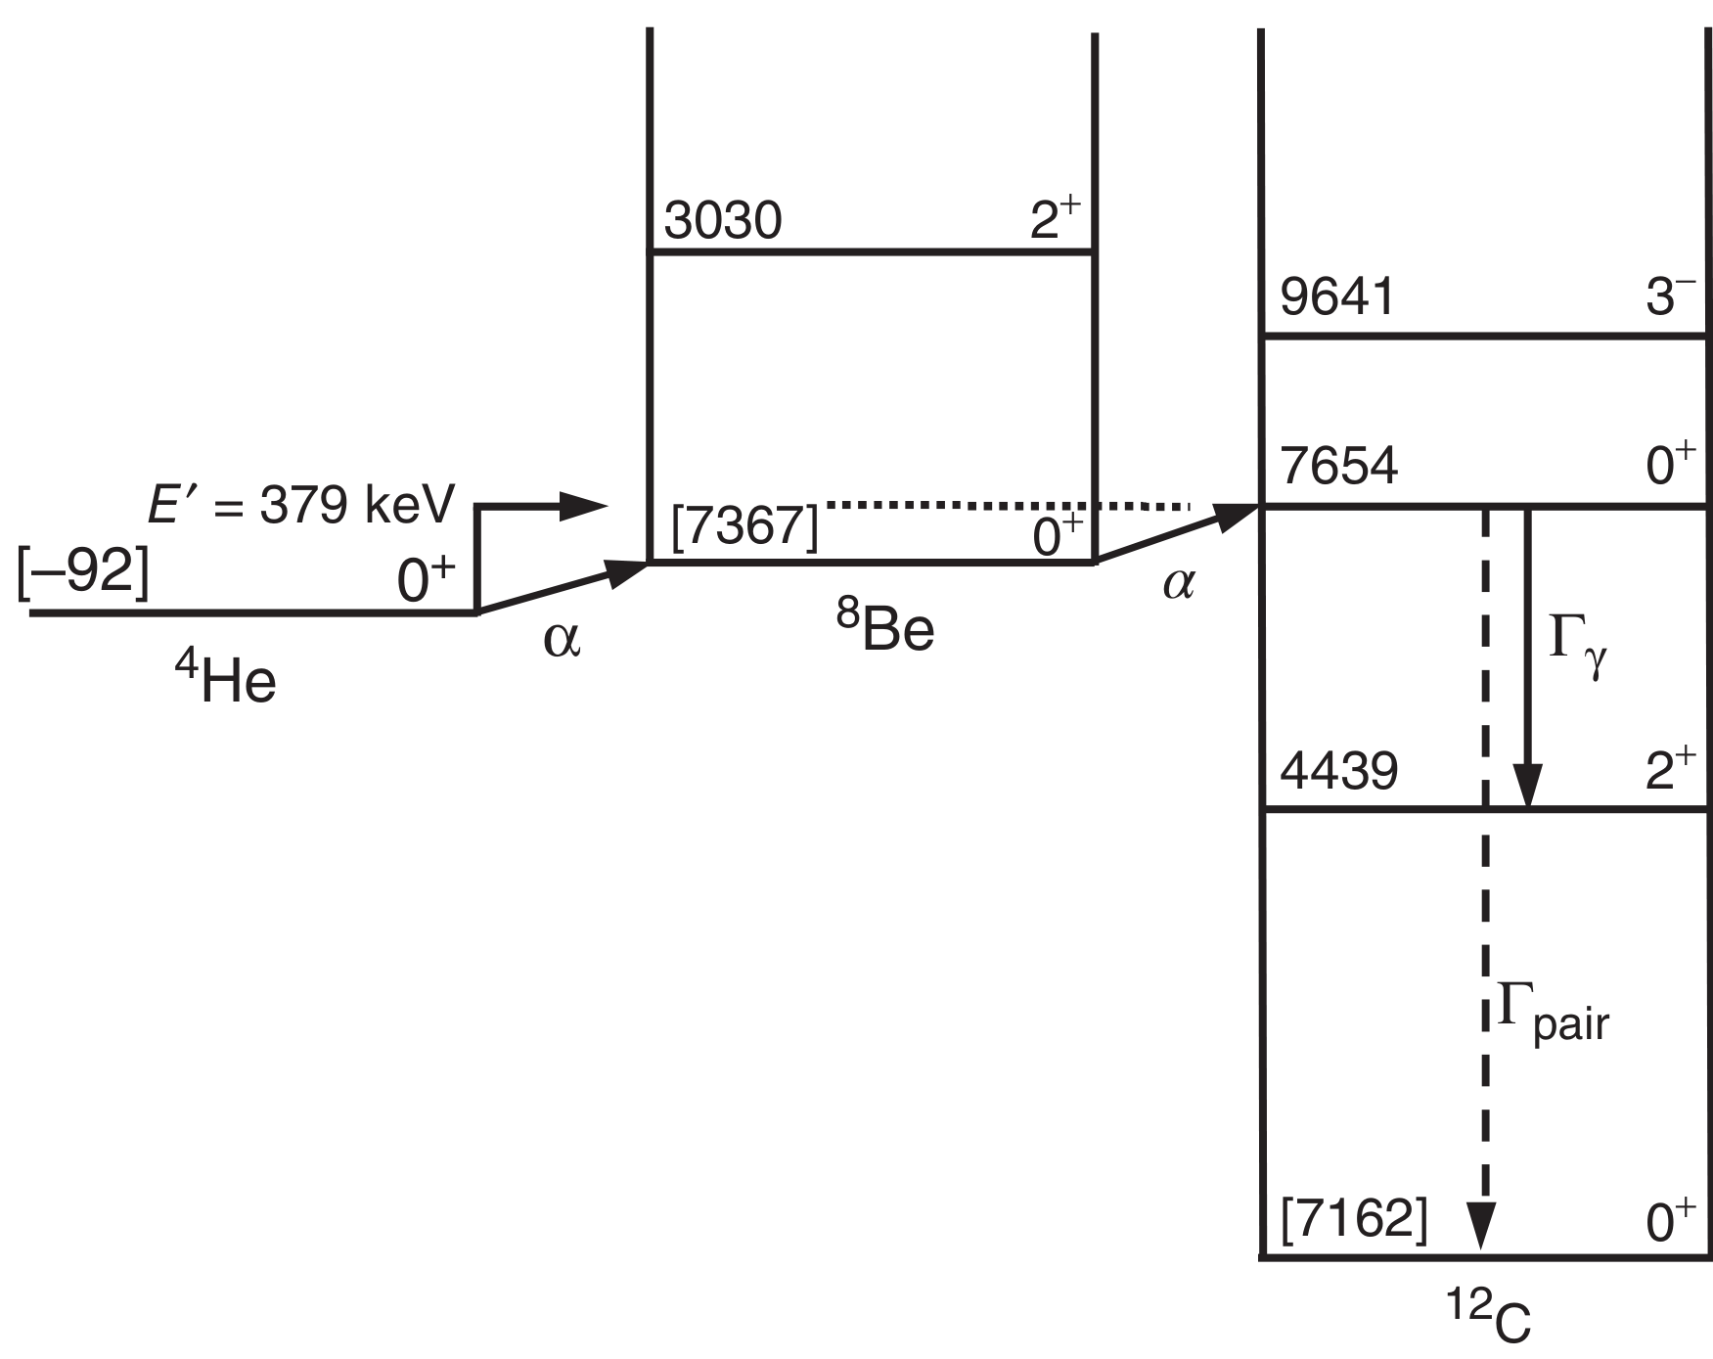
The oldest star in the universe
Nucleosynthesis process @First stars：
First stars begin their lives with primordial composition and begin hydrogen burning via pp chains and contract until central temperature is high enough (~0.1 GK) to ignite the 3α-process. This bridges the mass 5 and mass 8 gaps, such that a small amount of CNO catalyst is formed, X(¹²C) ~ 10⁻⁹, which can kickstart the CNO cycle.
3α-process
R.J. deBoer et al., Phys. Rev. C 103(2021)055815
Notes:
According to the stellar model, the First stars begin their lives with primordial composition and begin hydrogen burning via pp chains and contract until central temperature is high enough (~0.1 GK) to ignite the 3α-process. This bridges the mass 5 and mass 8 gaps, such that a small amount of CNO catalyst is formed, i.e., ¹²C abundance reach to about 10⁻⁹, which can kickstart the CNO cycle.

Slide 8
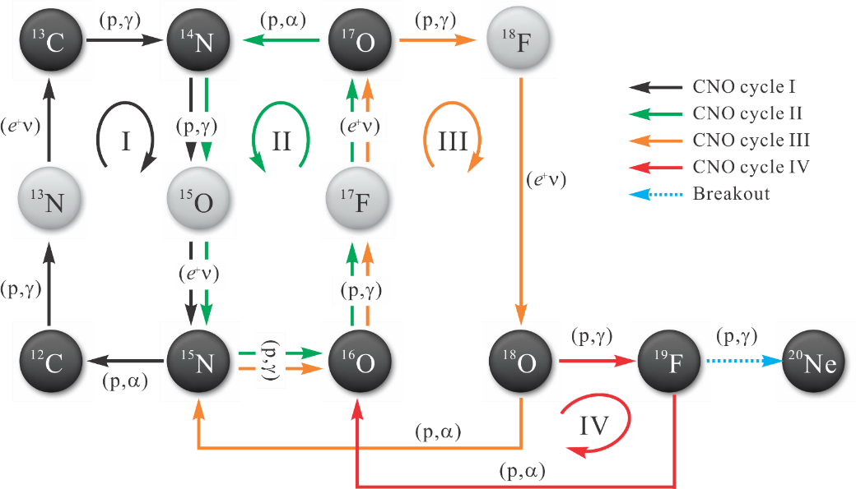
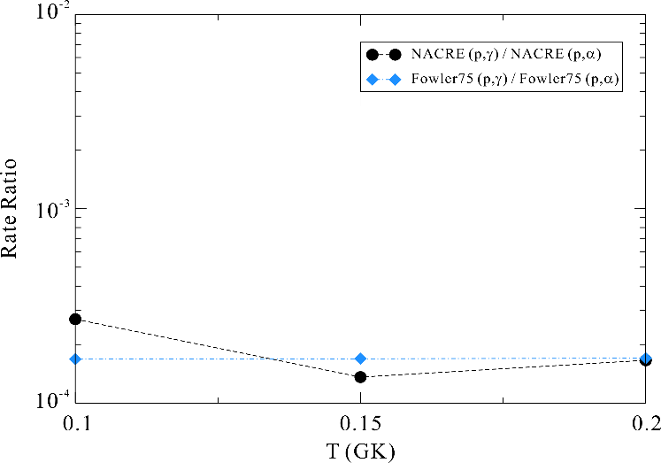
The oldest known star in the universe
Breakout from CNO cycle
Competition between
Breakout ¹⁹F(p,γ)²⁰Ne
& Recycling ¹⁹F(p,α)¹⁶O
3/10,000
Model calc.: If reaction rate ratio of (p,γ)/(p,α) could be enhanced by 7 times or more, then Ca problem can be solved! Two reactions need to be measured directly.
O. Clarkson, F. Herwig, Mon. Not. R. Astron. Soc. 500(2021)2685
R.J. deBoer et al., Phys. Rev. C 103(2021)055815
Notes:
This plot shows the classical four CNO cycles starting from 12C. There is a competition between the breakout 19F(p,g)20Ne reaction and recycling 19F(p,a)16O reaction. And their reaction rate ratio, about 3 in ten thousand, determines the breakout flux, and this breakout will ultimately lead to the production of Ca. But some astrophysicists thought that the Ca abundance observed in the first star can not be reproduced by the stellar models. According to their calculations, if this rate ratio could be enhanced by 7 times or more, then the Ca problem can be solved! Therefore, these two key reactions need to be measured directly at Gamow region.

Slide 9
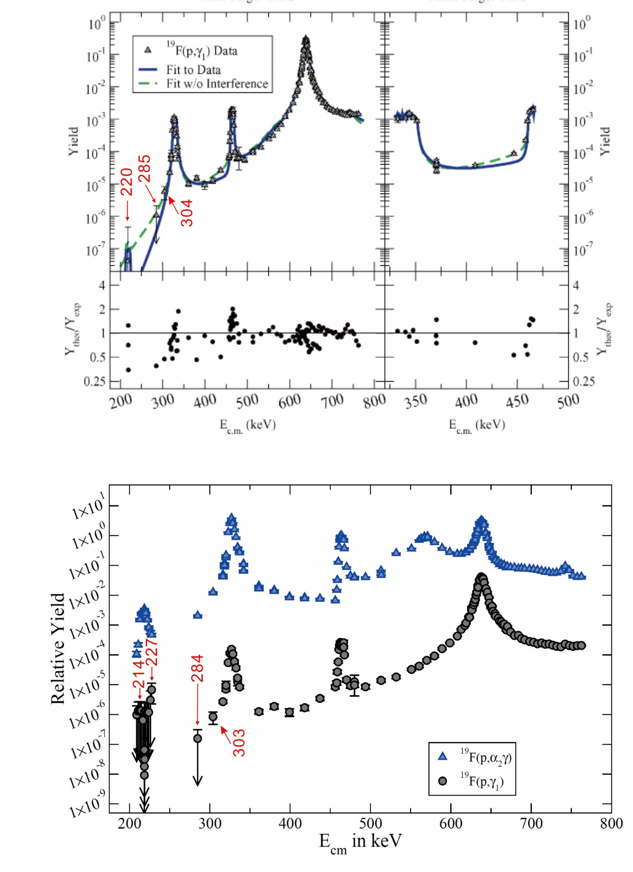
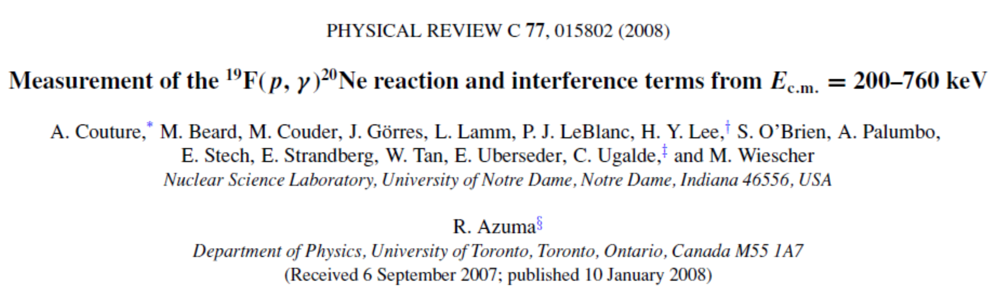
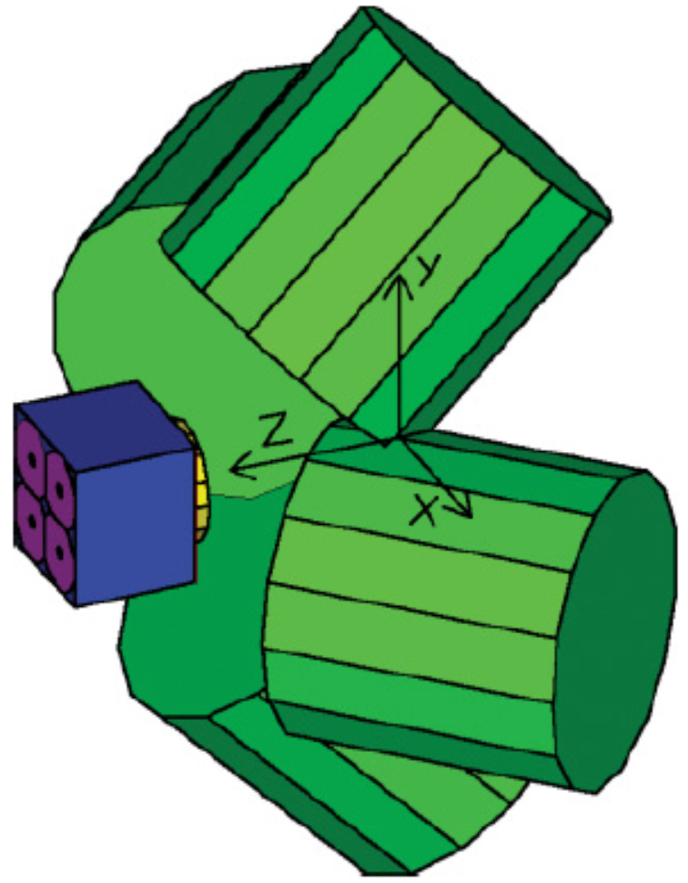
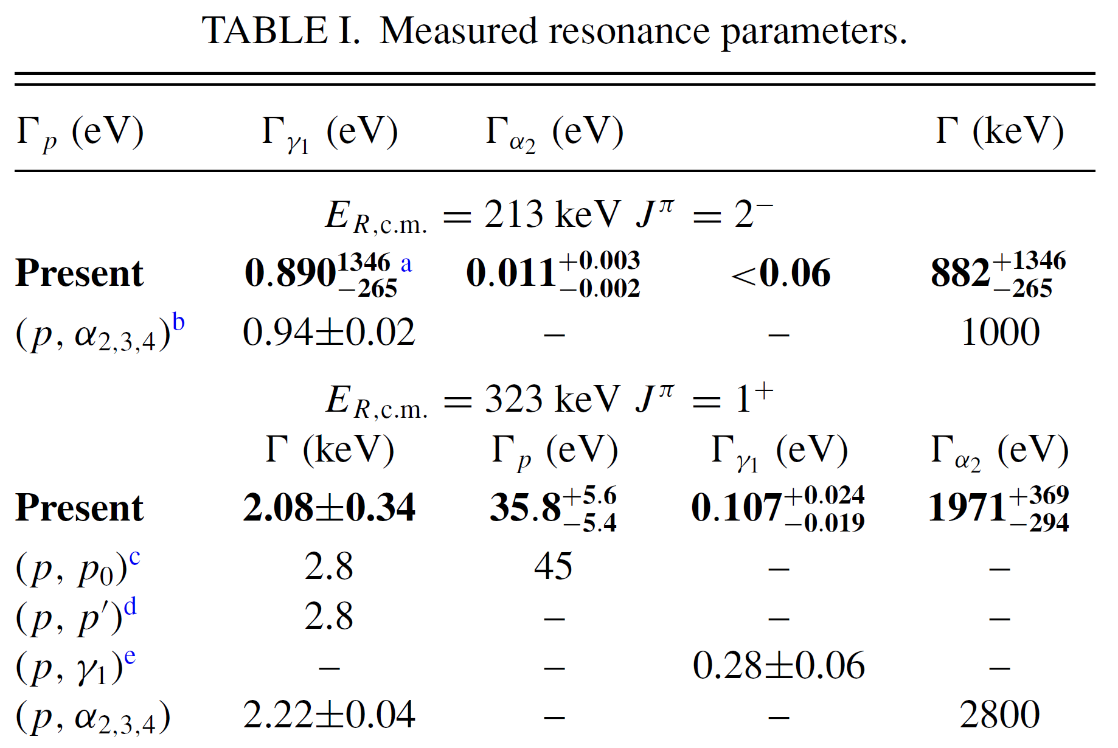
I. Status of ¹⁹F(p,γ)²⁰Ne reaction
@Notre Dame Univ.
Proton beam current: 20 uA
HPGe + NaI
A. Couture et al., Phys. Rev. C 77(2008)015802
Notes:
Let’s examine the research status of 19F(p,g) reaction first. In 2008, Notre Dame group made the direct measurement down to 200 keV energy region, with a proton beam current about 20 uA, by using the HPGe+NaI array at the above-ground lab. However, owing to their low beam intensity, they only gave some upper-limits below 285 keV. And they had to adopt a previously estimated upper-limit strength for the 213 keV resonance, which resonance was previously expected to be very important.

Slide 10
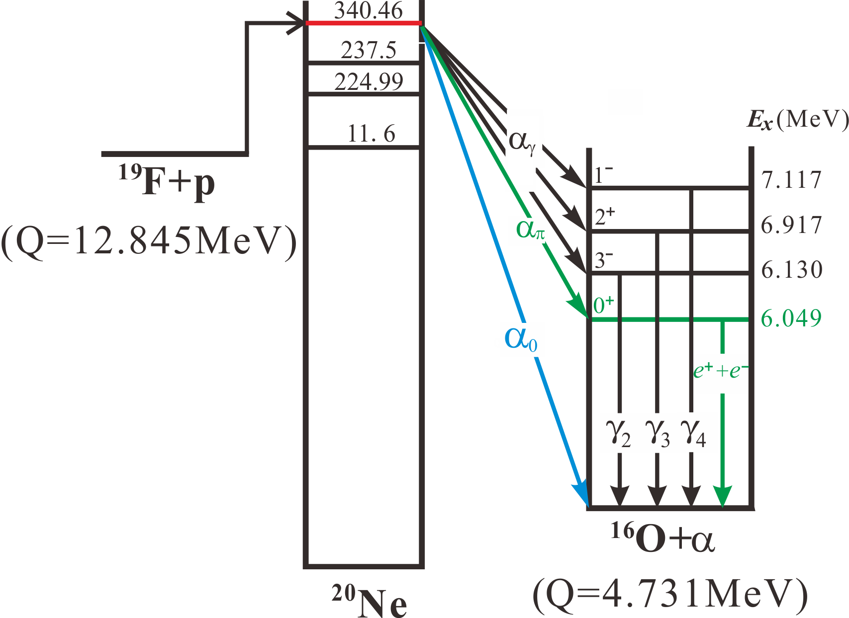
II. Status of ¹⁹F(p,α)¹⁶O reaction
Level scheme
Channel:
(p,α₀)
(p,α_{π})
(p,α_{γ})
J.J. He et al., Sci. China-Phys. Mech. Astron. 59 (2016) 652001
Notes:
As for the recycling 19F(p,a)16O reaction. Here, we show the level scheme. There are three types of channels, the so-called (p,a0), (p,api) and (p,ag) channels. The 19F captures protons forming a compound 20Ne, which may de-excite to the ground state of 16O by emitting an alpha particle, it is referred to as (p,a0) channel; if the compound goes to the first excited state in 16O, following the pair emission, it is referred to as (p,aπ) channel, the (p,ag) channel denotes those decays through gamma transitions, with energy about 6-7 MeV. By the previous knowledge, the (p,api) channel plays negligible role, while the (p,ag) and (p,a0) channels dominate the total reaction rate.

Slide 11
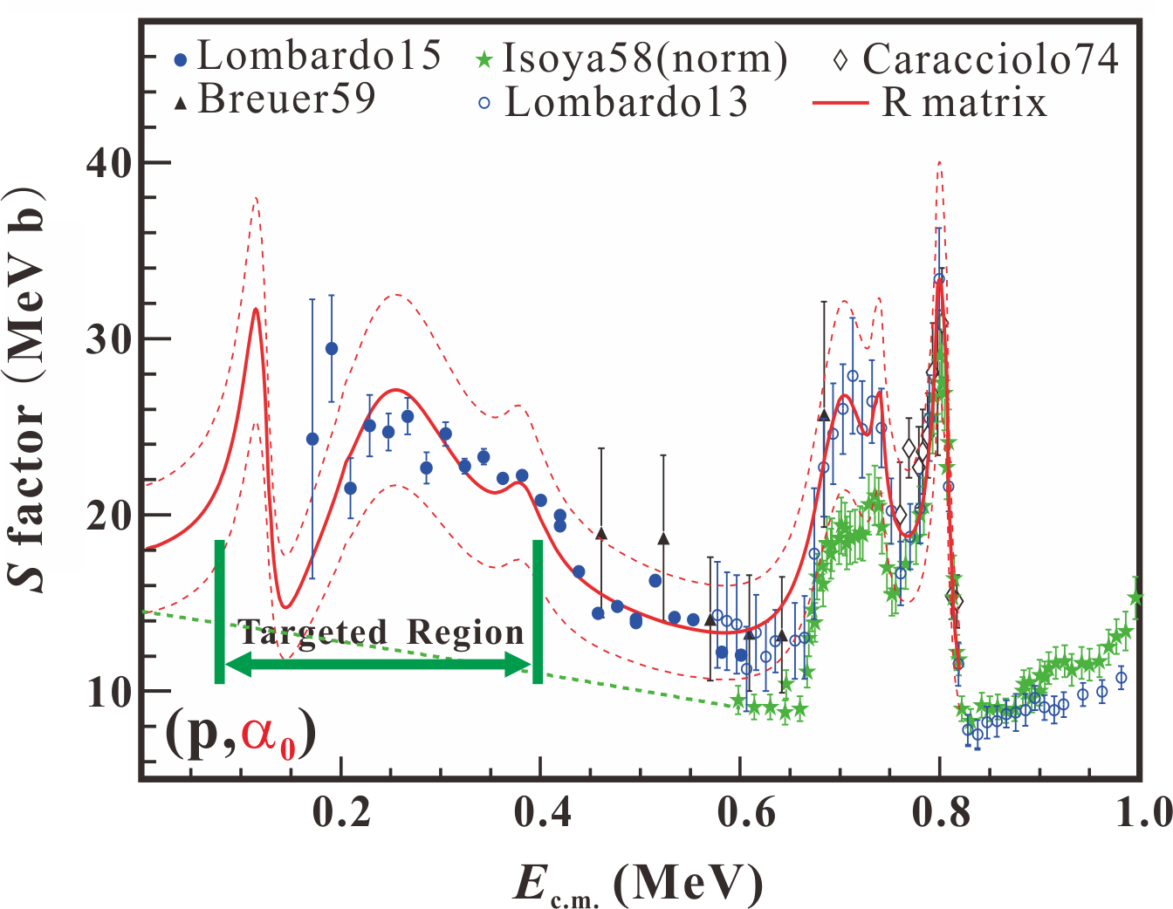
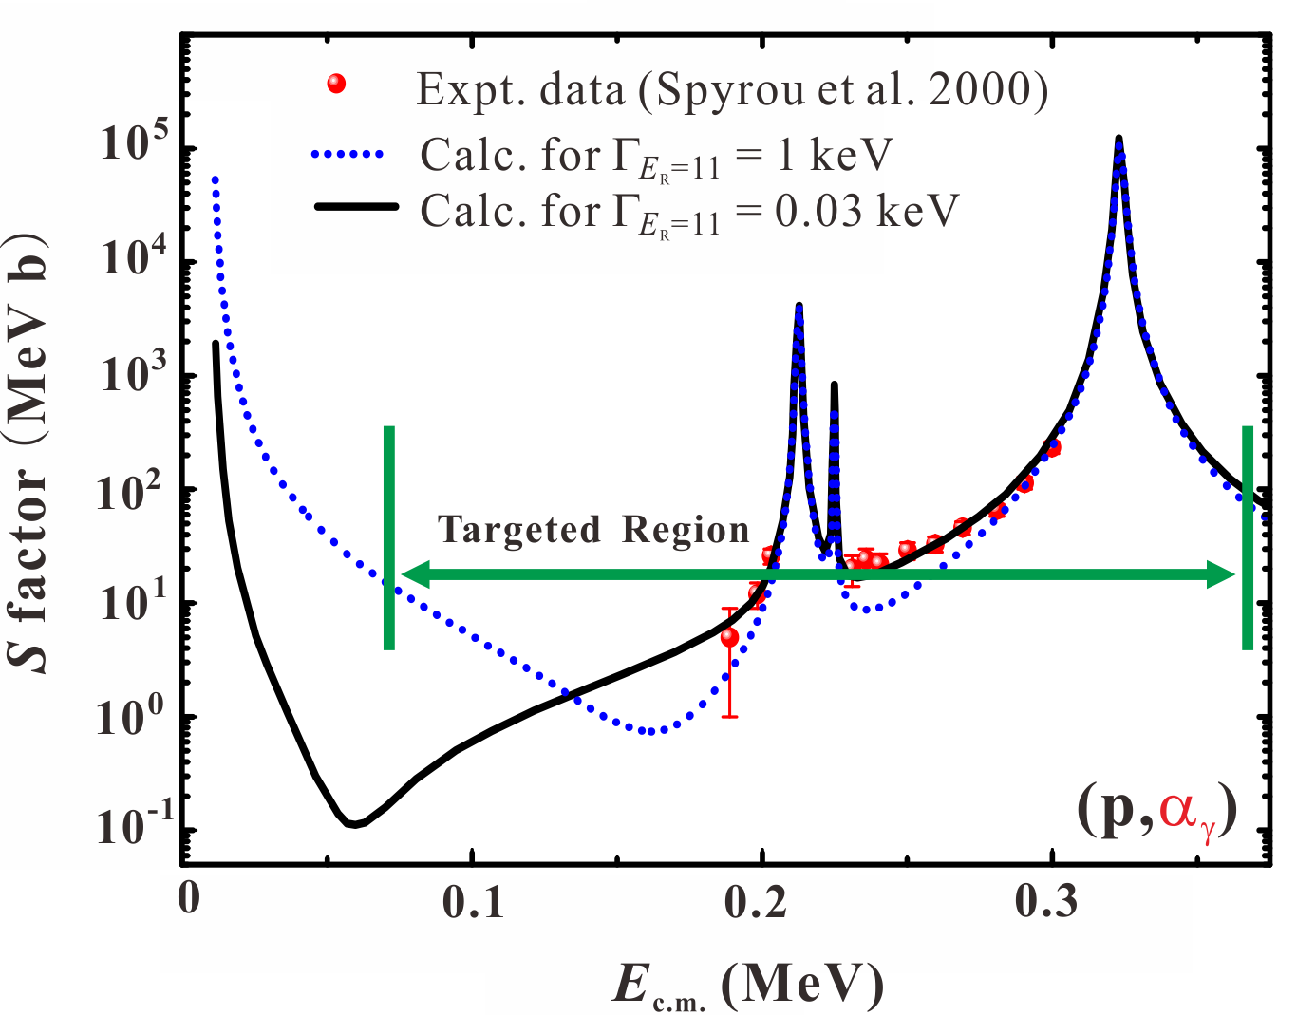
II. Status of ¹⁹F(p,α)¹⁶O reaction
Status & goal
Gamow window (70 ~ 350 keV)
No expt data in energy region of 70~200 keV (σ ~ 10⁻¹² b @70 keV), difficult to access in the above-ground lab.
J.J. He et al., Sci. China-Phys. Mech. Astron. 59 (2016) 652001
Notes:
As for First star environment, the Gamow window for this reaction locates around 70 to 350 keV. There are no experimental data in the energy region of 70-200 keV for both reaction channels (the cross section reduced down to about 10⁻¹² b at 70 keV, extremely small), which is quite challenge to access in the above-ground lab.

Slide 12
Challenge & Strategy
Low background
Intense beam
Strong target
High detection efficiency
Notes:
Since the cross section of these two reactions are extremely small at Gamow energy region, the direct measurement faces many challenges. Here, we need low background environment, intense beam, strong target and high detection efficiency.

Slide 13
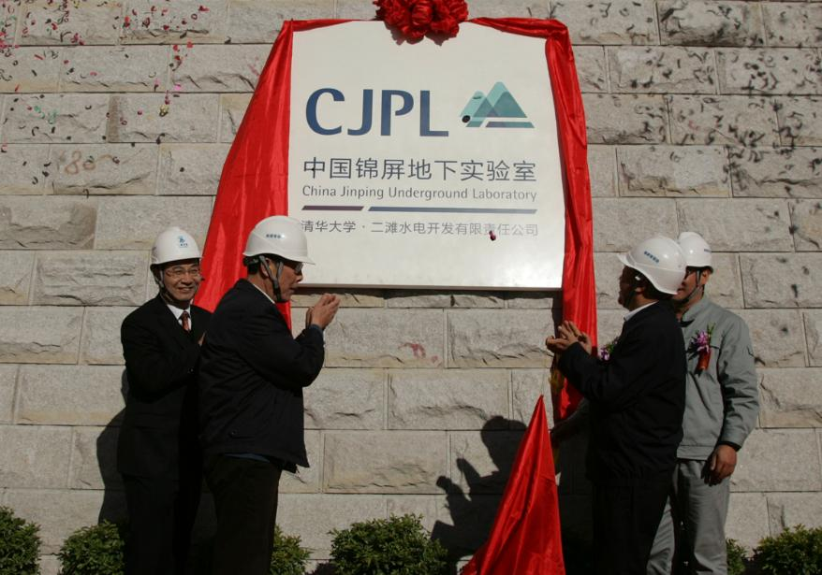

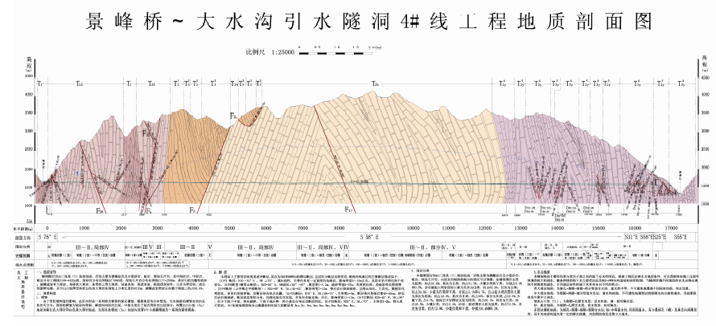
Kickoff on Dec. 12th, 2010
China Jinping Underground Lab(CJPL)
Beijing
Sichuan
~2400 m
~17 km
Notes:
The China Jinping Underground Lab (CJPL) was established in 2010. CJPL is located in a traffic tunnel of a hydropower station under Jinping Mountain in the southwest of China, and has about 2,400 m of vertical rock overburden.

Slide 14
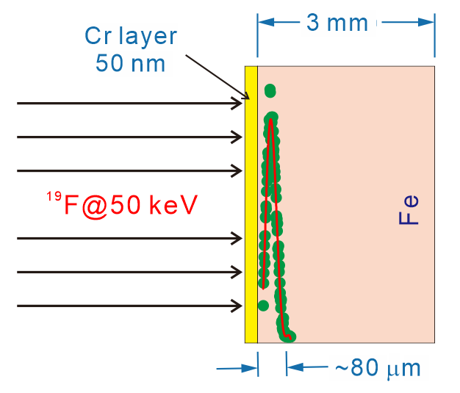
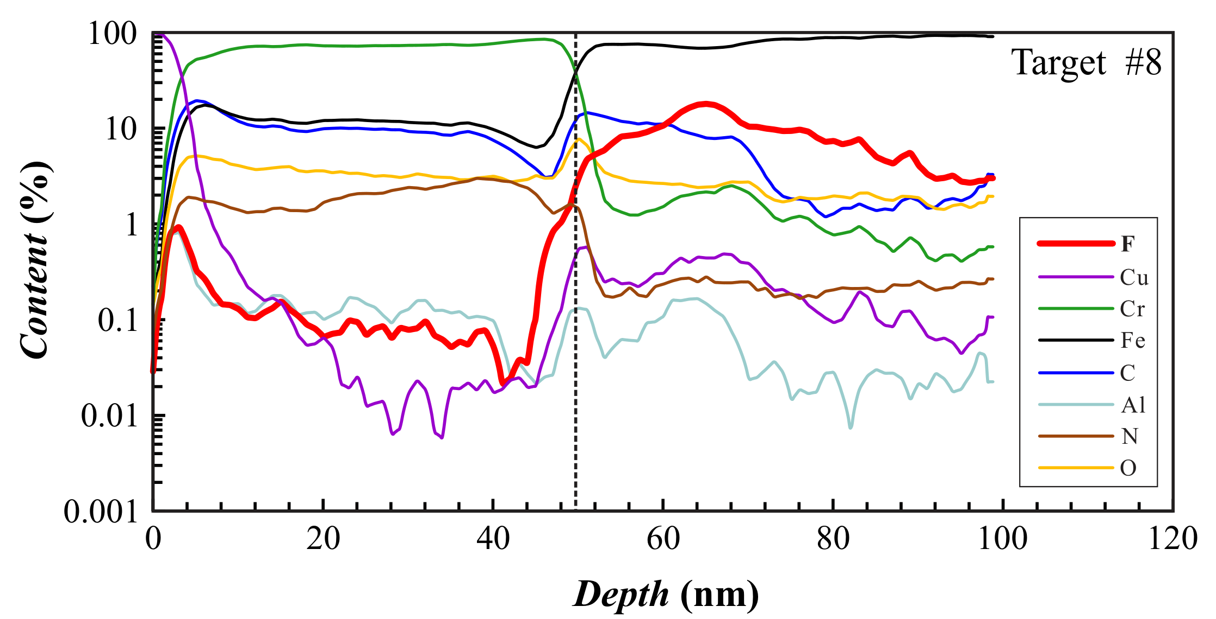
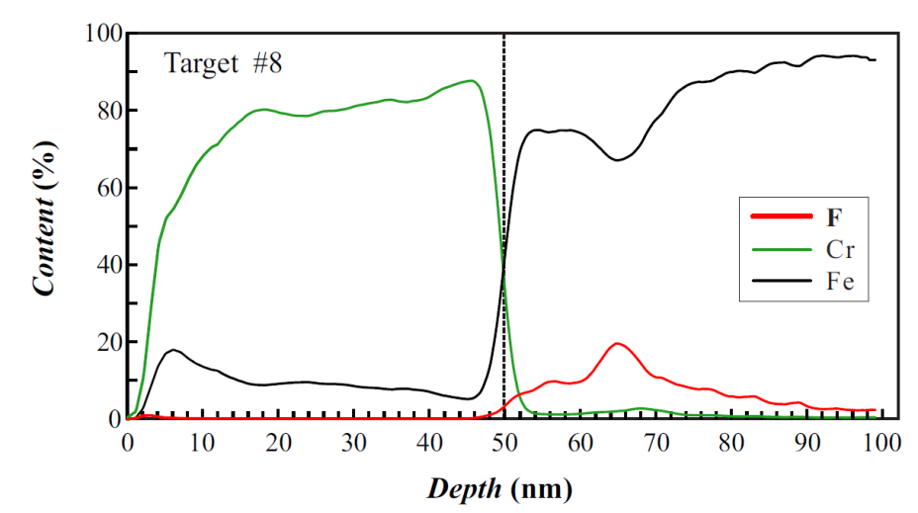
R&D stable ¹⁹F implanted targets
Atom Probe Tomography, APT
¹⁹F@40 keV
Implant Energy | 40 keV
Cr protective foil | 50 nm
Backing | Iron
Target loss | 7% per 300 Coul
L.Y. Zhang, S.W. Xu, J.J. He* et al., NIMB 438 (2019) 48
L.Y. Zhang, Y.J. Chen, J.J. He* et al., NIMB 496 (2021) 9
Notes:
As for intense beam, the target is a most critical issue. In the past 10 years, we have developed the 19F implanted targets and this is the optimized scheme. Firstly, implanting 19F ions into the pure Fe backing with an implantation energy of 40 keV, and then sputtering a 50-nm thick Cr layer to further prevent the fluorine material loss. The target loss is about 7% per 300 Coul. bombardment. Here we analyzed the chemical composition by the APT technique and got the F distribution in the target. Therefore, such implanted targets are strong enough against the intense beam bombardment at JUNA.

Slide 15
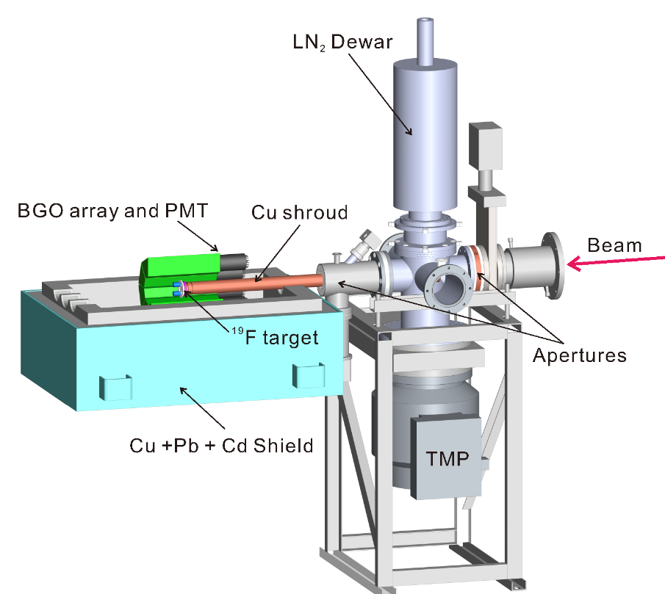
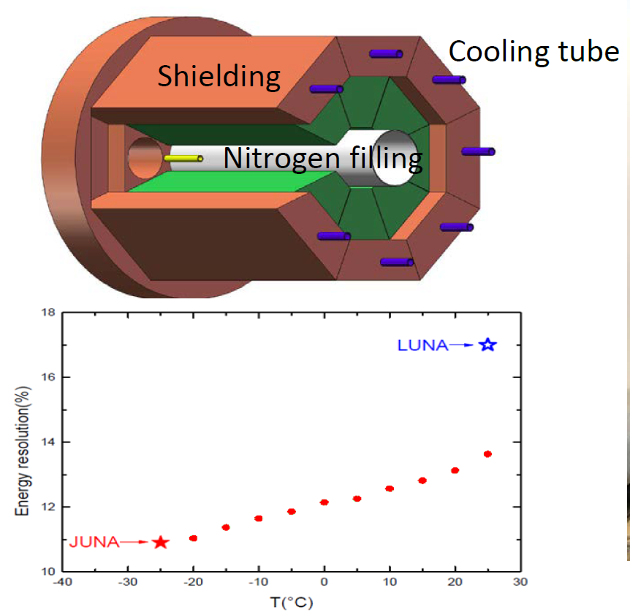
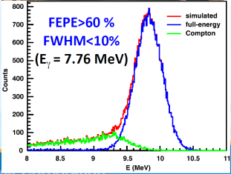
JUNA experiment campaign
Experimental setup
4π BGO γ-ray array
Beam current: ~1 mA
γ-ray @6130 keV
Resol.: ~6%, Effic.: ~60%
Notes:
This is the 3D drawing of the experimental setup. After passing through two apertures, the proton beam bombarded the water-cooled 19F target with beam current over 1 mA. The gamma rays were measured by a 4pi BGO array, which was heavily shielded by Copper, lead and Cd materials. As for the 6130-keV gamma ray, the BGO detector resolution is about 6% and efficiency about 60%.

Slide 16
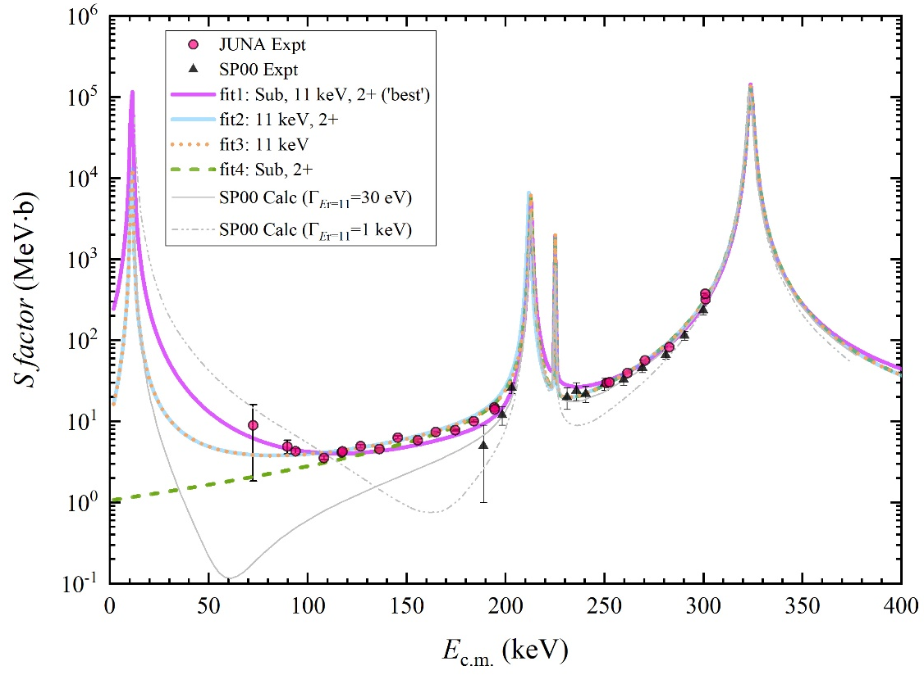
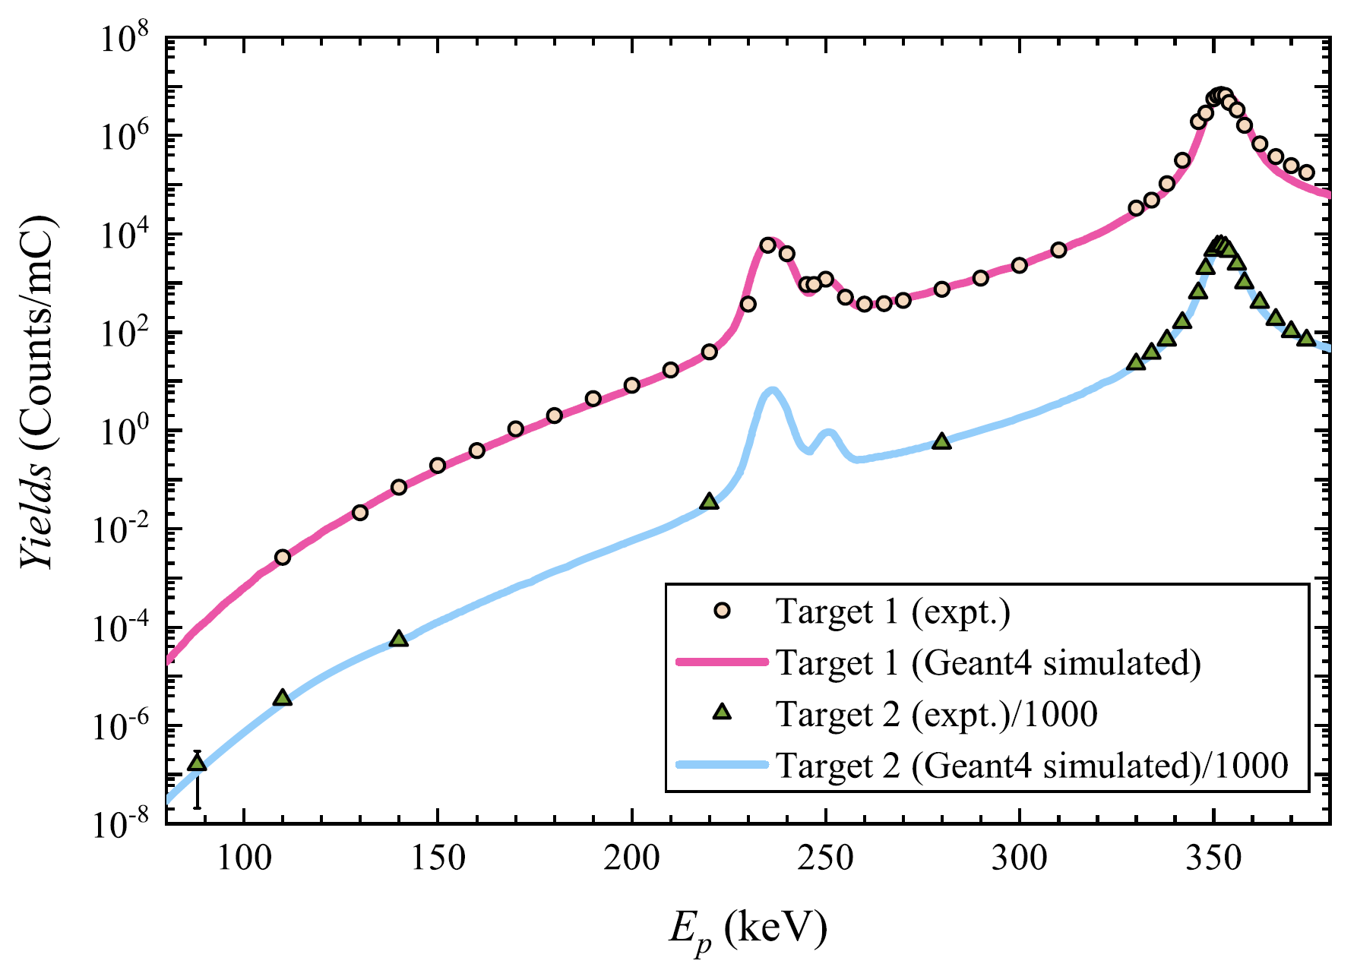
JUNA measurement of ¹⁹F(p,αγ)¹⁶O
Astrophysical S factor: S(E) = Eσ(E)exp(2πη)
By GEANT4 simulation
11-keV resonance
Sub-threshold state
Underlying α-cluster 2⁺ state
Reaction yield
(p,αγ)
213
323
0.1 ~ 0.5 GK
225
Lowest energy region achieved
Covering full AGB Gamow window
Differ significantly with predictions
R-matrix calc.: R.J. deBoer, M. Wiescher
Notes:
Here shows the astrophysical S-factors for the 19F(p,ag) reaction, which were derived based on the R-matrix fits and the Geant4 simulations. We show these new data in the off-resonance region. These two gray lines indicate the previous predictions, and it shows our JUNA data deviate from these predictions significantly. We show here three most probable R-matrix fits, where a 11-keV resonance, a sub-threshold state and an underlying alpha-cluster 2+ state seem required. Of course, if we can go down to even lower energy region, then a tighter constraint can be made. Anyway, the measured region is sufficient for calculating the reaction rate down to 0.1 GK, which fully covers the Gamow window of astrophysical interests. Here, James DeBoer and Michael Wiescher made the R-matrix calculations.

Slide 17
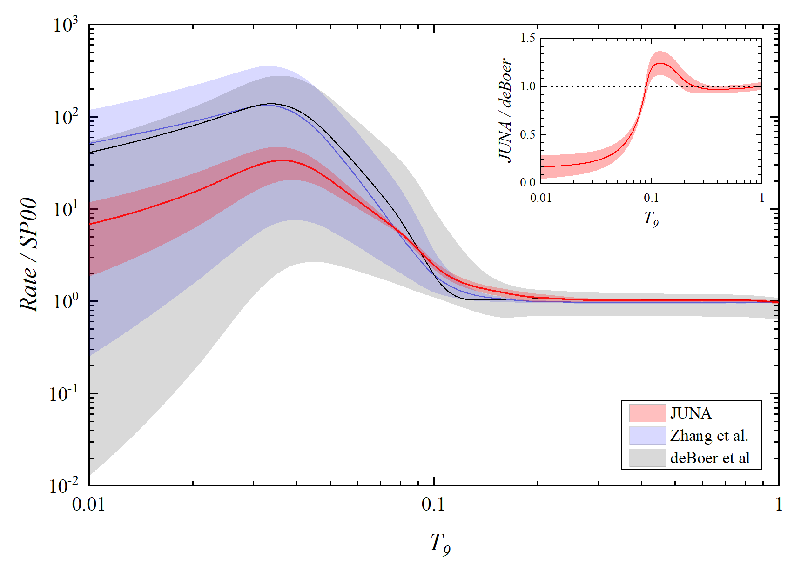
JUNA measurement of ¹⁹F(p,αγ)¹⁶O
Reaction rate
Our JUNA rate deviates significantly from the previous expectations by a factor of 0.2–1.3, and the associated uncertainties are reduced remarkably. At 0.1 GK, the uncertainty is reduced to about 10%.
L.Y. Zhang, J. Su, J.J. He*, R.J. DeBoer, M. Wiescher* …, W. P. Liu*, Phys. Rev. Lett. 127(2021)152702
Notes:
This plot shows the ratio of present rate relative to Spyrou et al.’s rate. The corresponding ratios for previous deBoer et al. and Zhang et al.’s rates are also shown for comparison. It shows that our JUNA rate deviates significantly from DeBoer’s one by a factor of 0.2 to 1.3, and importantly the uncertainties are reduced remarkably based on our solid experimental data, by several orders of magnitude. At 0.1 GK, the uncertainty is reduced down to about 10%.

Slide 18
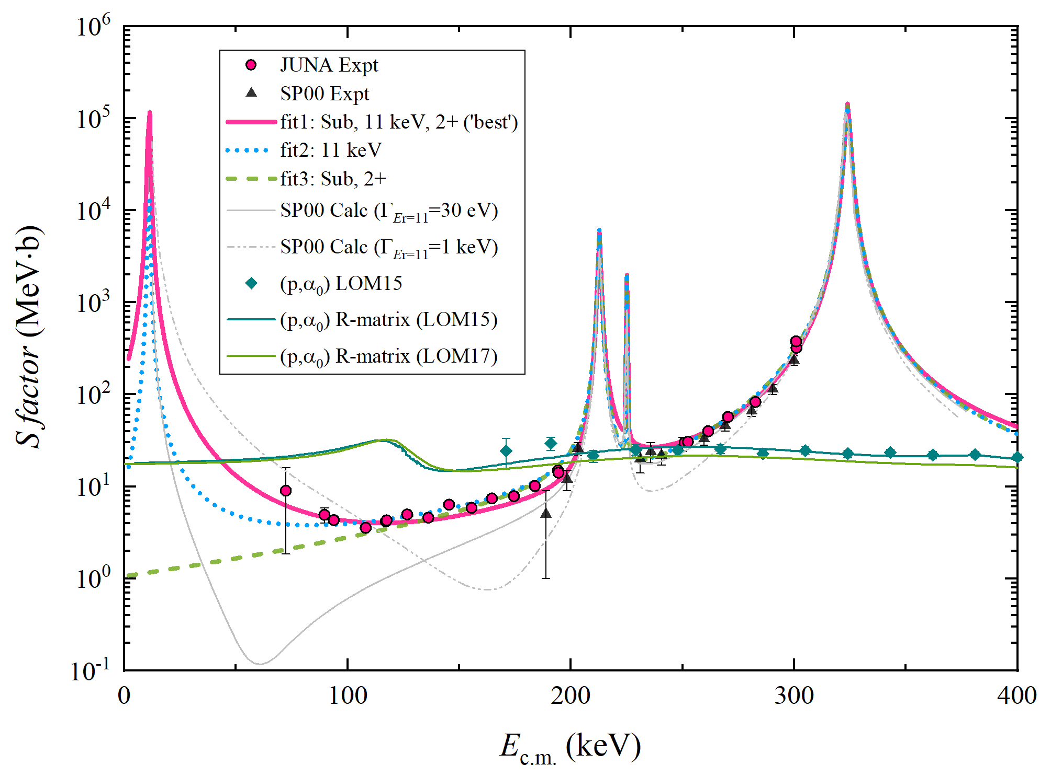
Role of (p,αγ) & (p,α₀) channels
Conclusion:
In the region of 50 ~ 200 keV, (p,α₀) dominates the total cross section and hence the rate (< 0.12 GK) !
L.Y. Zhang et al., Phys. Rev. C 106(2022)055803
Notes:
Here shows the present role of (p,ag) and (p,a0) channels below 400 keV. The (p,a0) data are indicated by these green data points and two theoretical R-matrix predictions. It shows that the (p,a0) channel dominates the total cross section in the energy region of 50~200 keV, and hence dominates the total rate below 0.12 GK. Therefore, the role of these two channels is clarified experimentally, and the (p,a0) channel needs future experimental studies.

Slide 19
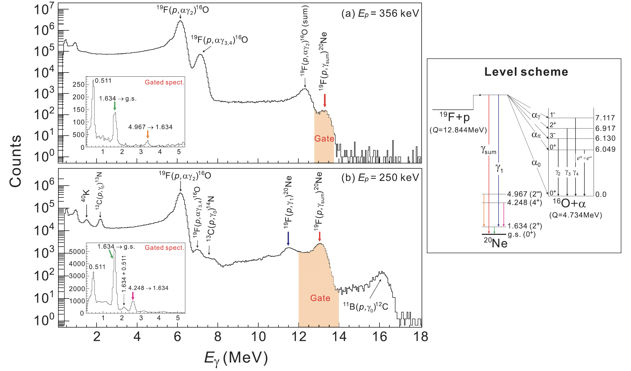
JUNA measurement of ¹⁹F(p,γ)²⁰Ne
Proton beam current: ~1 mA (JUNA)
Summed γ-ray spectra & coinc. spectra
Notes:
Now, I would like to introduce you the JUNA measurement of 19F(p,g)20Ne. The average proton beam current was about 1 mA, it is about 50 times higher than that at Notre Dame. The experiment shows that most of the gamma rays decaying to the first excited state of 20Ne, following by a 1.634 MeV gamma transition. This plot shows the summed g-ray spectra, by gating this summed peak around 13 MeV, we obtained the coincidence spectra as shown in the inset. Thus, we can determine the decay branching ratios.

Slide 20
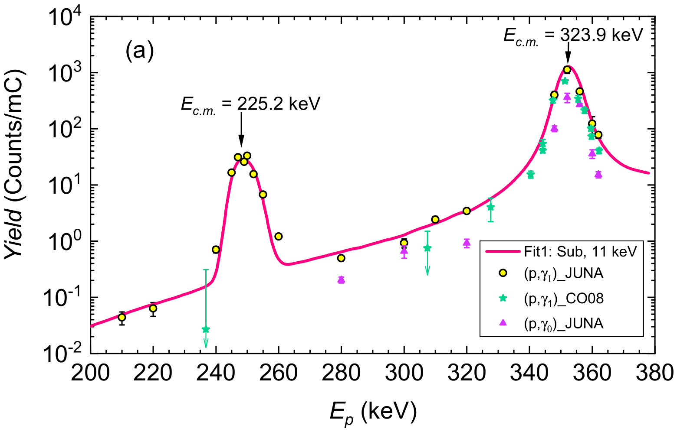
JUNA measurement of ¹⁹F(p,γ)²⁰Ne
A new resonance!
Measured down to the lowest energy of E_{c.m.}=186 keV
Observed a new resonance at 225 keV for the first time
Notes:
We measured this reaction down to the lowest energy of 186 keV in the center-of-mass system. Here shows the yield for the (p,g1) channel, the yellow one indicates the JUNA data, and the green one indicates that of Notre Dame, they agree very well in the overlapped region. It shows that a new resonance at 225 keV was observed for the first time, while Notre Dame only gave an upper limit around here.

Slide 21
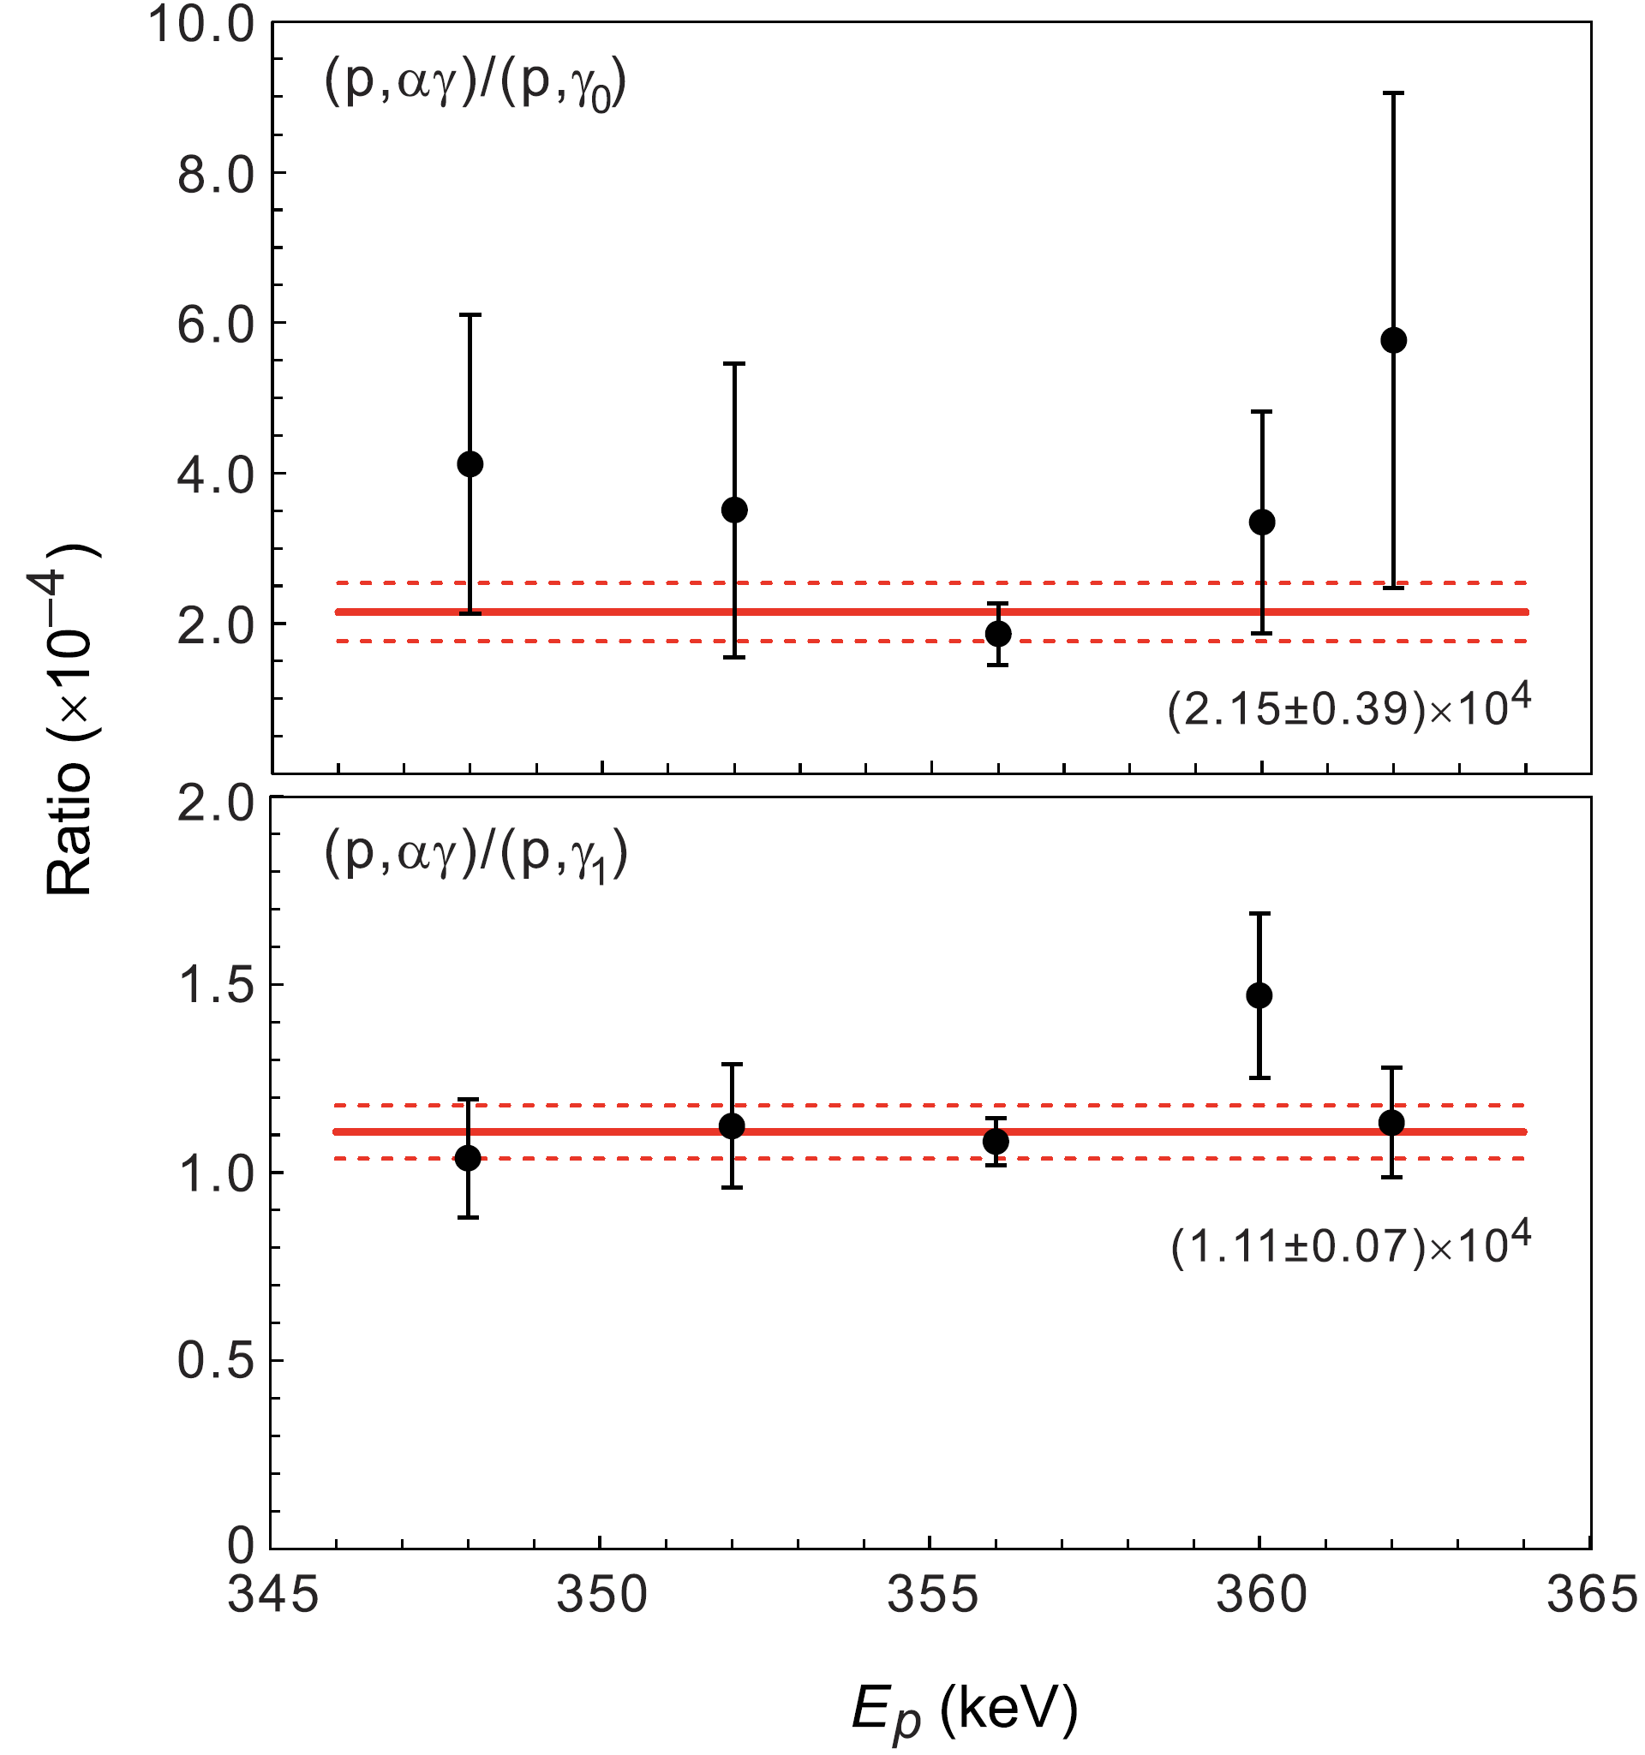
JUNA measurement of ¹⁹F(p,γ)²⁰Ne
Relative measurement to:
(p,αγ) strength of 323-keV resonance ωγ_{(p,αγ)} = 23.1±0.9 eV (3.9%)
(p,αγ)
213
323
225
323-keV resonance:
ωγ_{(p,γ1)}=2.09±0.21 meV; ωγ_{(p,γ0)}=1.07±0.21 meV
ωγ_{(p,γtot)}=3.16±0.33 meV
NACRE value: ωγ_{(p,γtot)}=5±3 meV
Notes:
In this work, we made the measurement relative to the (p,ag) strength of the well-known 323-keV resonance, having only 3.9% error.

Slide 22
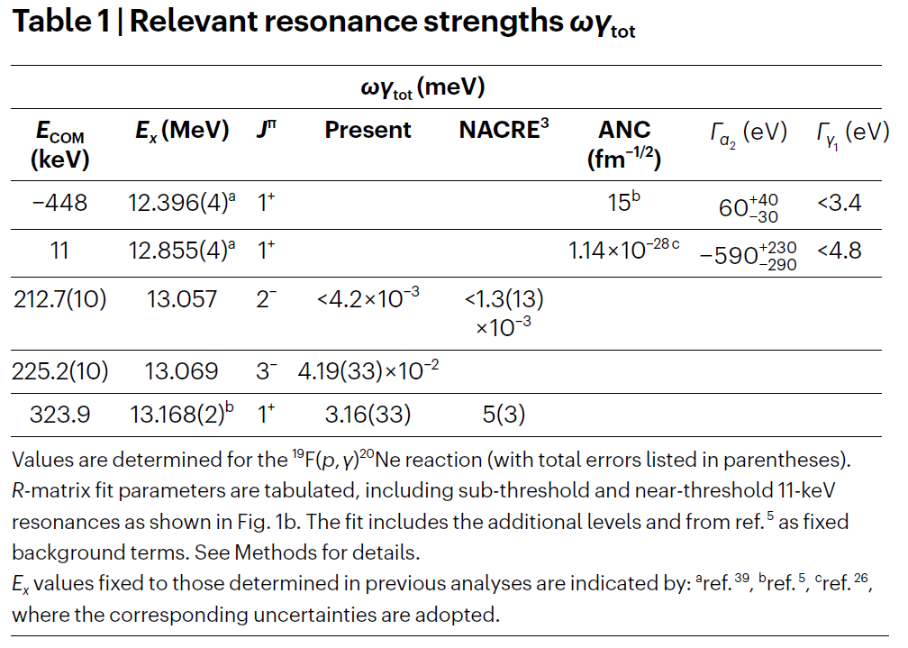
JUNA measurement of ¹⁹F(p,γ)²⁰Ne
Notes:
The relevant resonance strengths are listed in this Table. For 323 keV resonance, we got a strength with about 10% uncertainty, while the NACRE value has 60% uncertainty. The strength for the new 225-keV resonance is determined with an accuracy about 8%.

Slide 23
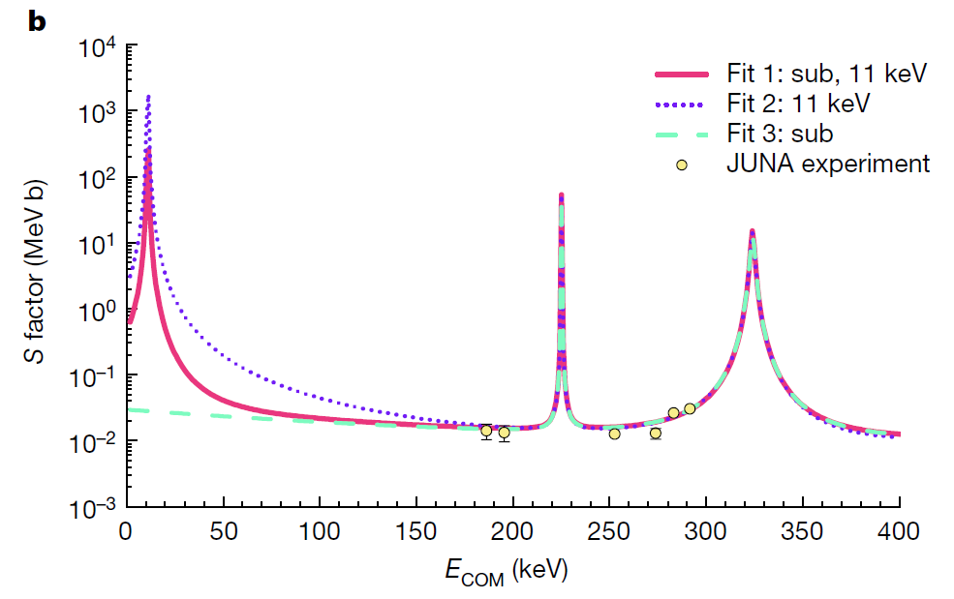
JUNA measurement of ¹⁹F(p,γ)²⁰Ne
Astrophysical S factor:
S(E) = Eσ(E)exp(2πη)
R-matrix calculations
DeBoer, Wiescher, Odell
S(E)
Gamow region of
First stars
Notes:
This plot shows the astrophysical S factors, which is based on the R-matrix fits to our JUNA data. This R-matrix fits were made by DeBoer, Wiescher and Odell. Several extrapolations towards low energy have been made by assuming different contributions of 11-keV resonance and the subthreshold resonance. In fact, the Gamow region of first stars is around 100 keV, and certainty the future measurement directly down to this region can strictly constrain the S factor as well as the reaction rate.

Slide 24
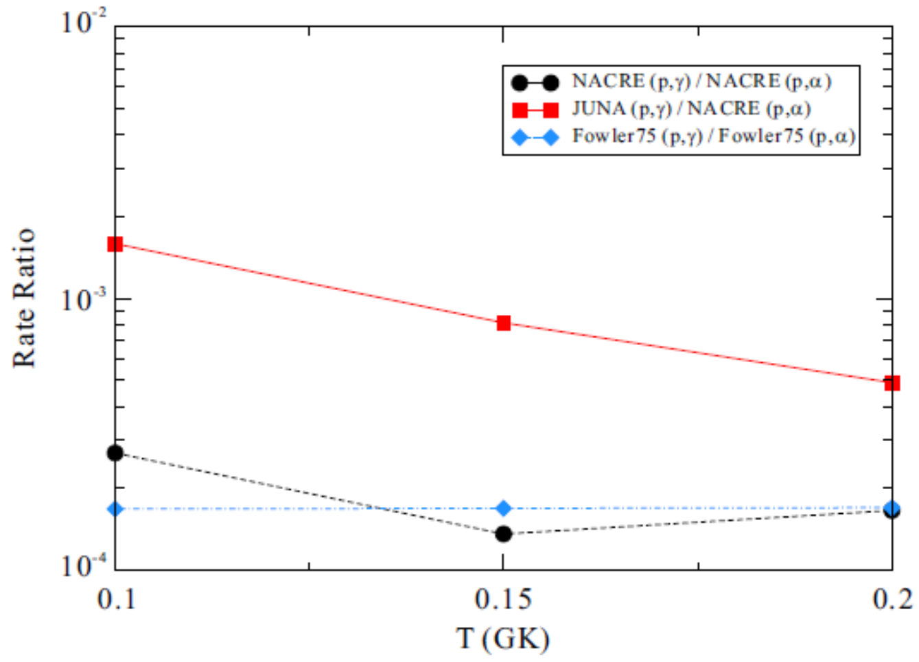
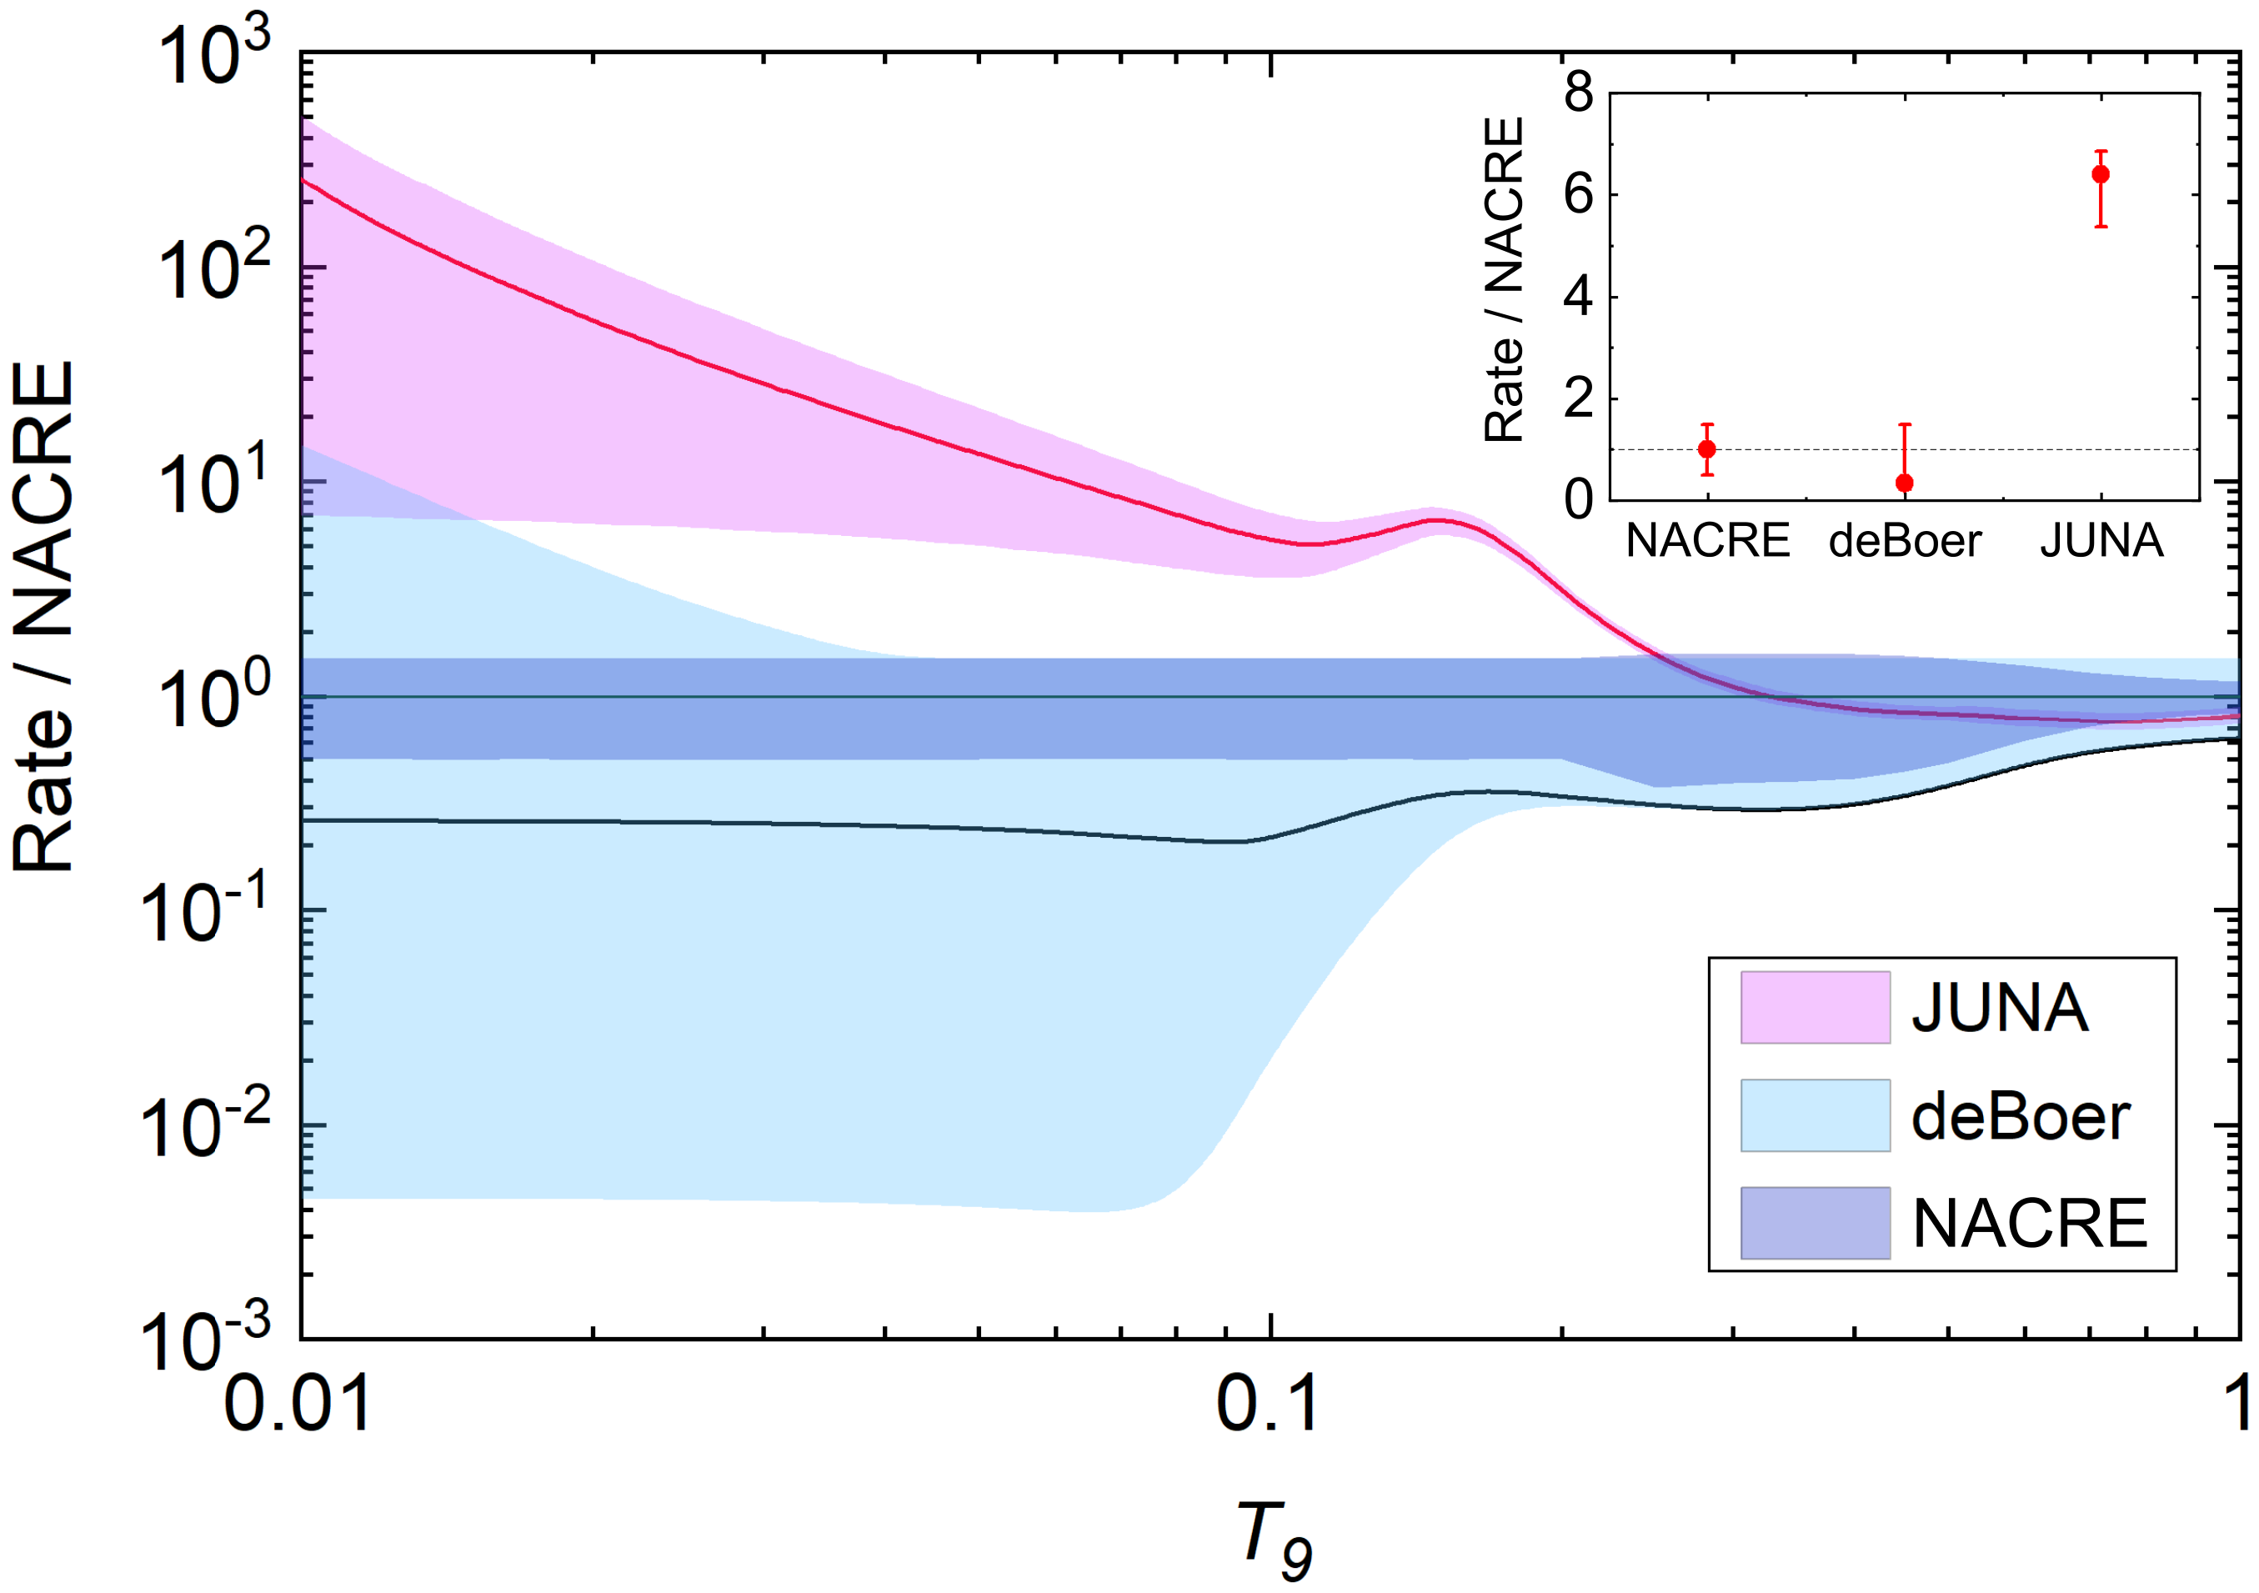

JUNA measurement of ¹⁹F(p,γ)²⁰Ne
New reaction rate:
7.4 times larger than previous estimation at 0.1 GK; 200 times larger around 0.01 GK
3 times more precise at 0.1 GK
Reaction rate ratio
¹⁹F(p,γ)²⁰Ne / ¹⁹F(p,α)¹⁶O
2/1,000
3/10,000
Notes:
Based on the JUNA data and R-matrix theory, we obtain a new reaction rate of 19F(p,g)20Ne. Here shows various rates relative to NACRE recommended one, where the color bands indicate the associate uncertainties. It shows our new rate is about 7 times larger than the previous recommendation at 0.1 GK of first star interest; and is about 200 times larger around 0.01 GK. In addition, the uncertainty of our rate is greatly reduced, and about 3 times more precise at 0.1 GK. This plot shows the rate ratio between these two reactions, and now the ratio is increased to about 2 in 1000, roughly 7 times enhancement.

Slide 25
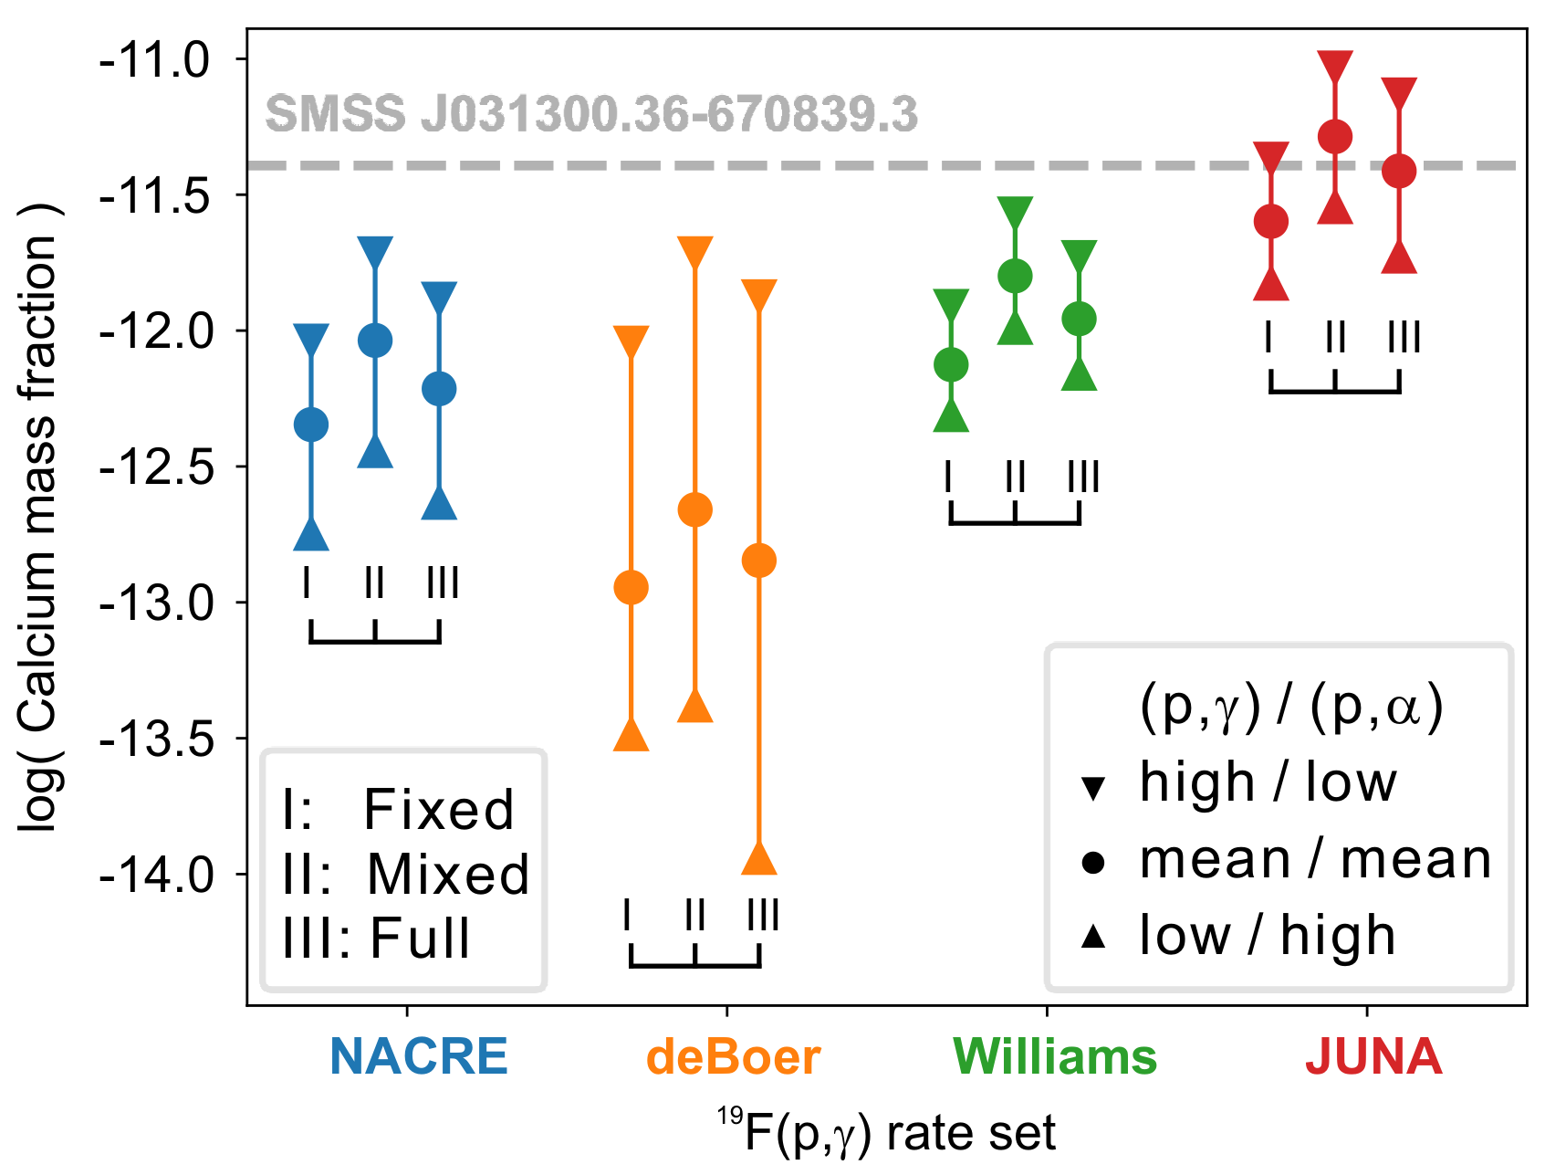
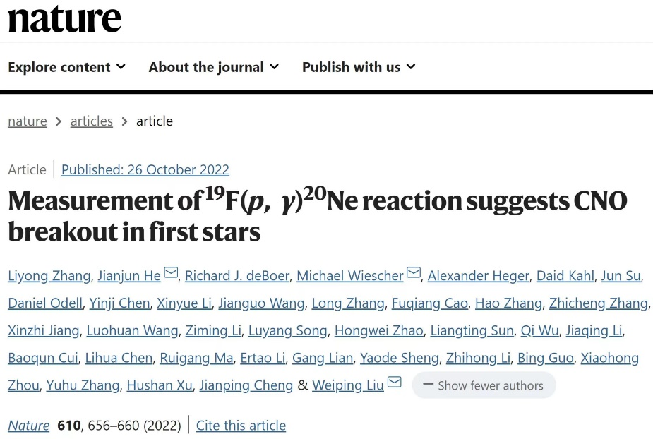
JUNA measurement of ¹⁹F(p,γ)²⁰Ne
Model calc. (A. Heger @Monash Univ.)
Astrophysical implications:
Reproduce the observed ⁴⁰Ca abundance, and verified the hypothesis that calcium comes from a key breakout reaction of CNO cycle, revealing the origin of calcium in the first stars.
Support the faint supernova model
L.Y. Zhang, J.J. He*, R.J. DeBoer, M. Wiescher* …, W. P. Liu*, Nature 610(2022)656
Notes:
With our JUNA data, our collaborator, Alex Heger made the stellar model calculations. It shows that the observed Ca abundance in the oldest star of SMSS J0313-6708 can be reproduced very well with JUNA data, while other data can not. This work successfully verified the hypothesis that calcium originates from a key breakout reaction of CNO cycle, revealing the origin of calcium in the first stars. The results strong support the faint supernova model of the first stars. The paper was published in nature in 2022.

Slide 26
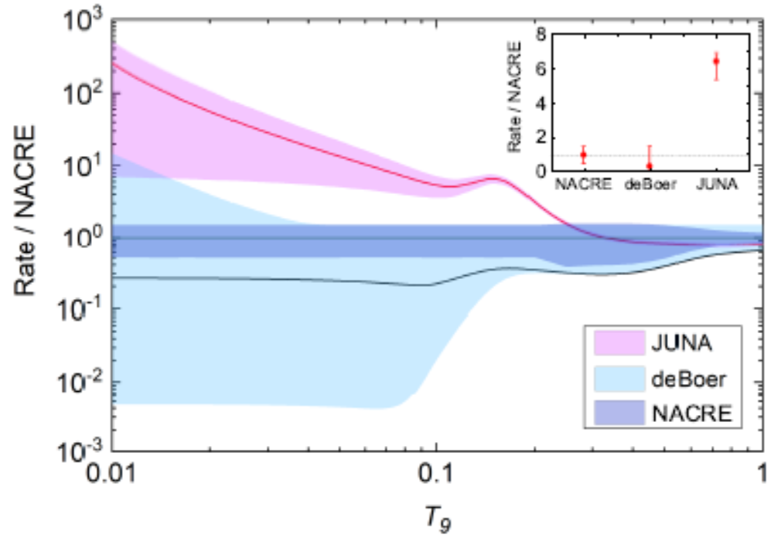
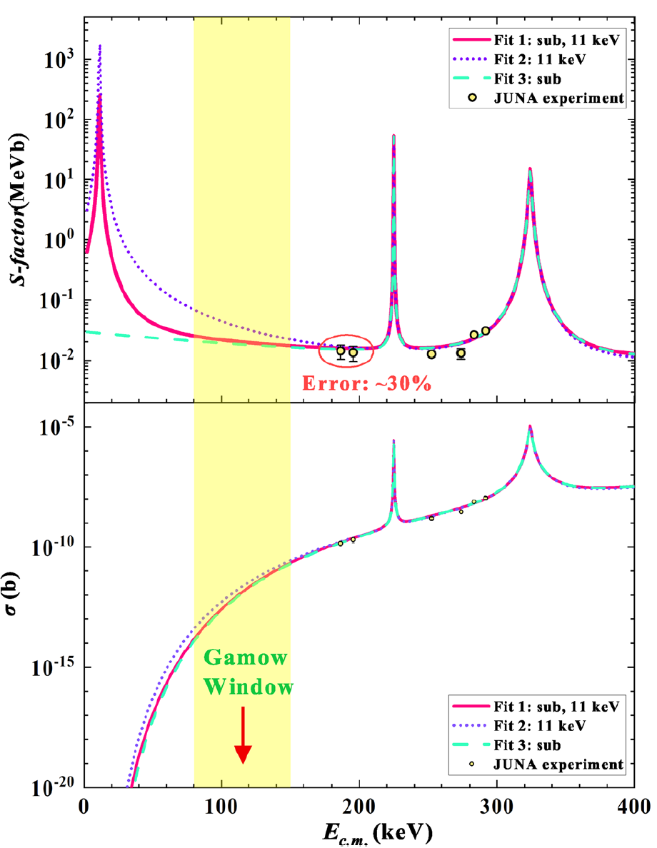
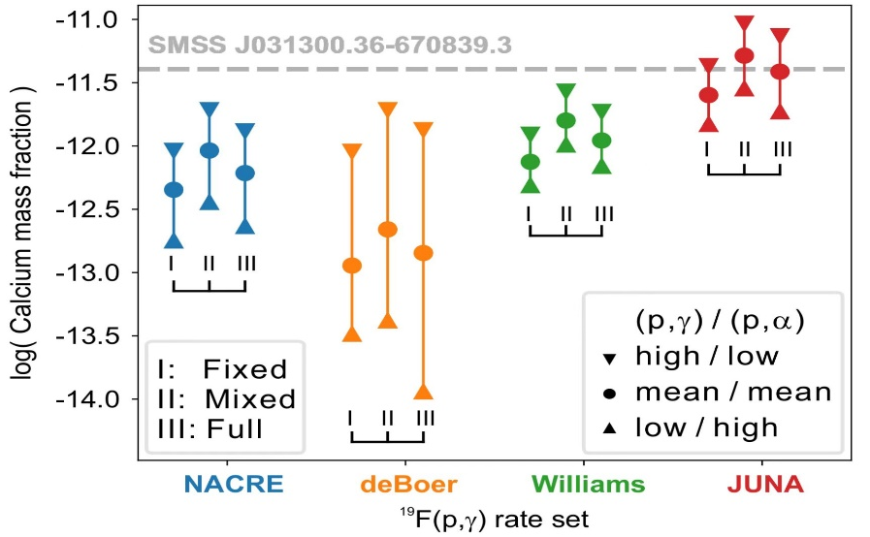
JUNA prospect for ¹⁹F(p,γ)²⁰Ne
JUNA will restart soon!
~ 50% @0.1 GK
factor of 2
Notes:
The current S factor error is still as large as about 30% here, and even about a factor of 2 in the Gamow region. As a results, the uncertainty remains about 50% in reaction rate around 0.1 GK and in the predicted Ca abundances. The JUNA will restart soon, as for the 19F(p,g) compaign, we will push the measurement directly down to the Gamow window, and try to reduced the above uncertainties significantly.

Slide 27
Conclusions
The ¹⁹F(p,αγ)¹⁶O cross section was directly measured down to ~70 keV, covering the full Gamow window of astrophysics interests. In the 50 ~ 200 keV region, (p,α₀) dominates the total rate below 0.12 GK, which needs future experimental studies.
The CNO breakout ¹⁹F(p,γ)²⁰Ne reaction was measured to the 186 keV point, and a new resonance was discovered at 225 keV. Our rate is ~7 times larger than NACRE one at 0.1 GK.
With new rate, the stellar model showed a strong breakthrough from the “warm” CNO cycle, which was never expected before. The mystery of Ca production in the first stars was revealed, and strongly supporting the faint supernova model of massive Pop III stars.
This result will have an important impact on future JWST abundance observations of the first stars in the early universe.
Notes:
Here are the conclusions for my talk. We measured the 19F(p,ag)16O cross section down to ~70 keV, covering the full Gamow window of astrophysics interests. In the 50 ~ 200 keV region, (p,a₀) dominates the total cross section and hence the rate below 0.12 GK! This (p,a₀) channel still needs future experimental investigations. The CNO breakout 19F(p,g)20Ne reaction was measured to the 186 keV point, and a new resonance was discovered at 225 keV. Our rate is about 7 times larger than NACRE recommended one at 0.1 GK. With our new rate, the mystery of Ca production in the first stars was revealed, and strongly supporting the faint supernova model of massive Pop III stars. This result might have an important impact on future JWST abundance observations of the first stars in the early universe.

Slide 28
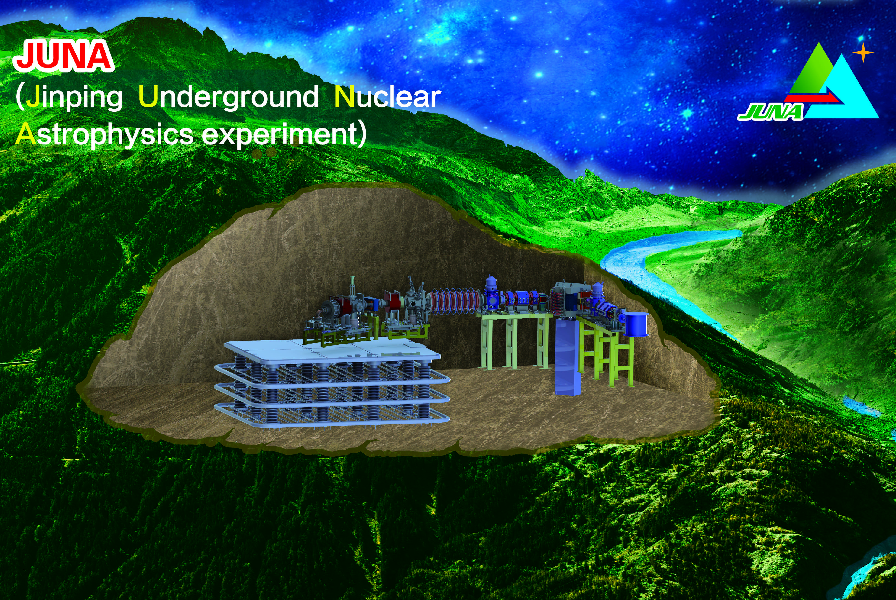
Thanks very much for your attention!
Notes:
OK, that’s all, thanks very much for your attention.

Slide 29
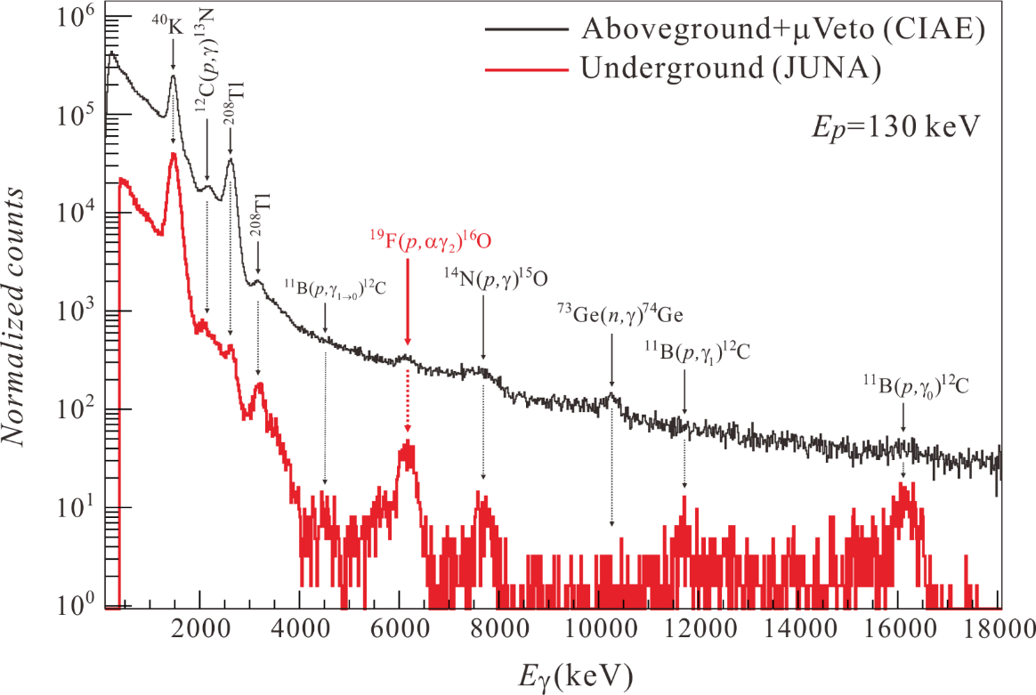
JUNA experiment campaign
Advantage of underground lab
Notes:
This plot shows the gamma-ray spectra of the 19F(p,a) experiment measured by a 4π BGO array at a proton energy of 130 keV. The aboveground (at CIAE) and underground (at JUNA) spectra are shown for comparison. We can see the interested 6130-keV peak clearly with very few background. It demonstrates clearly the great advantage of deep underground lab for the g-ray detection.

Slide 30
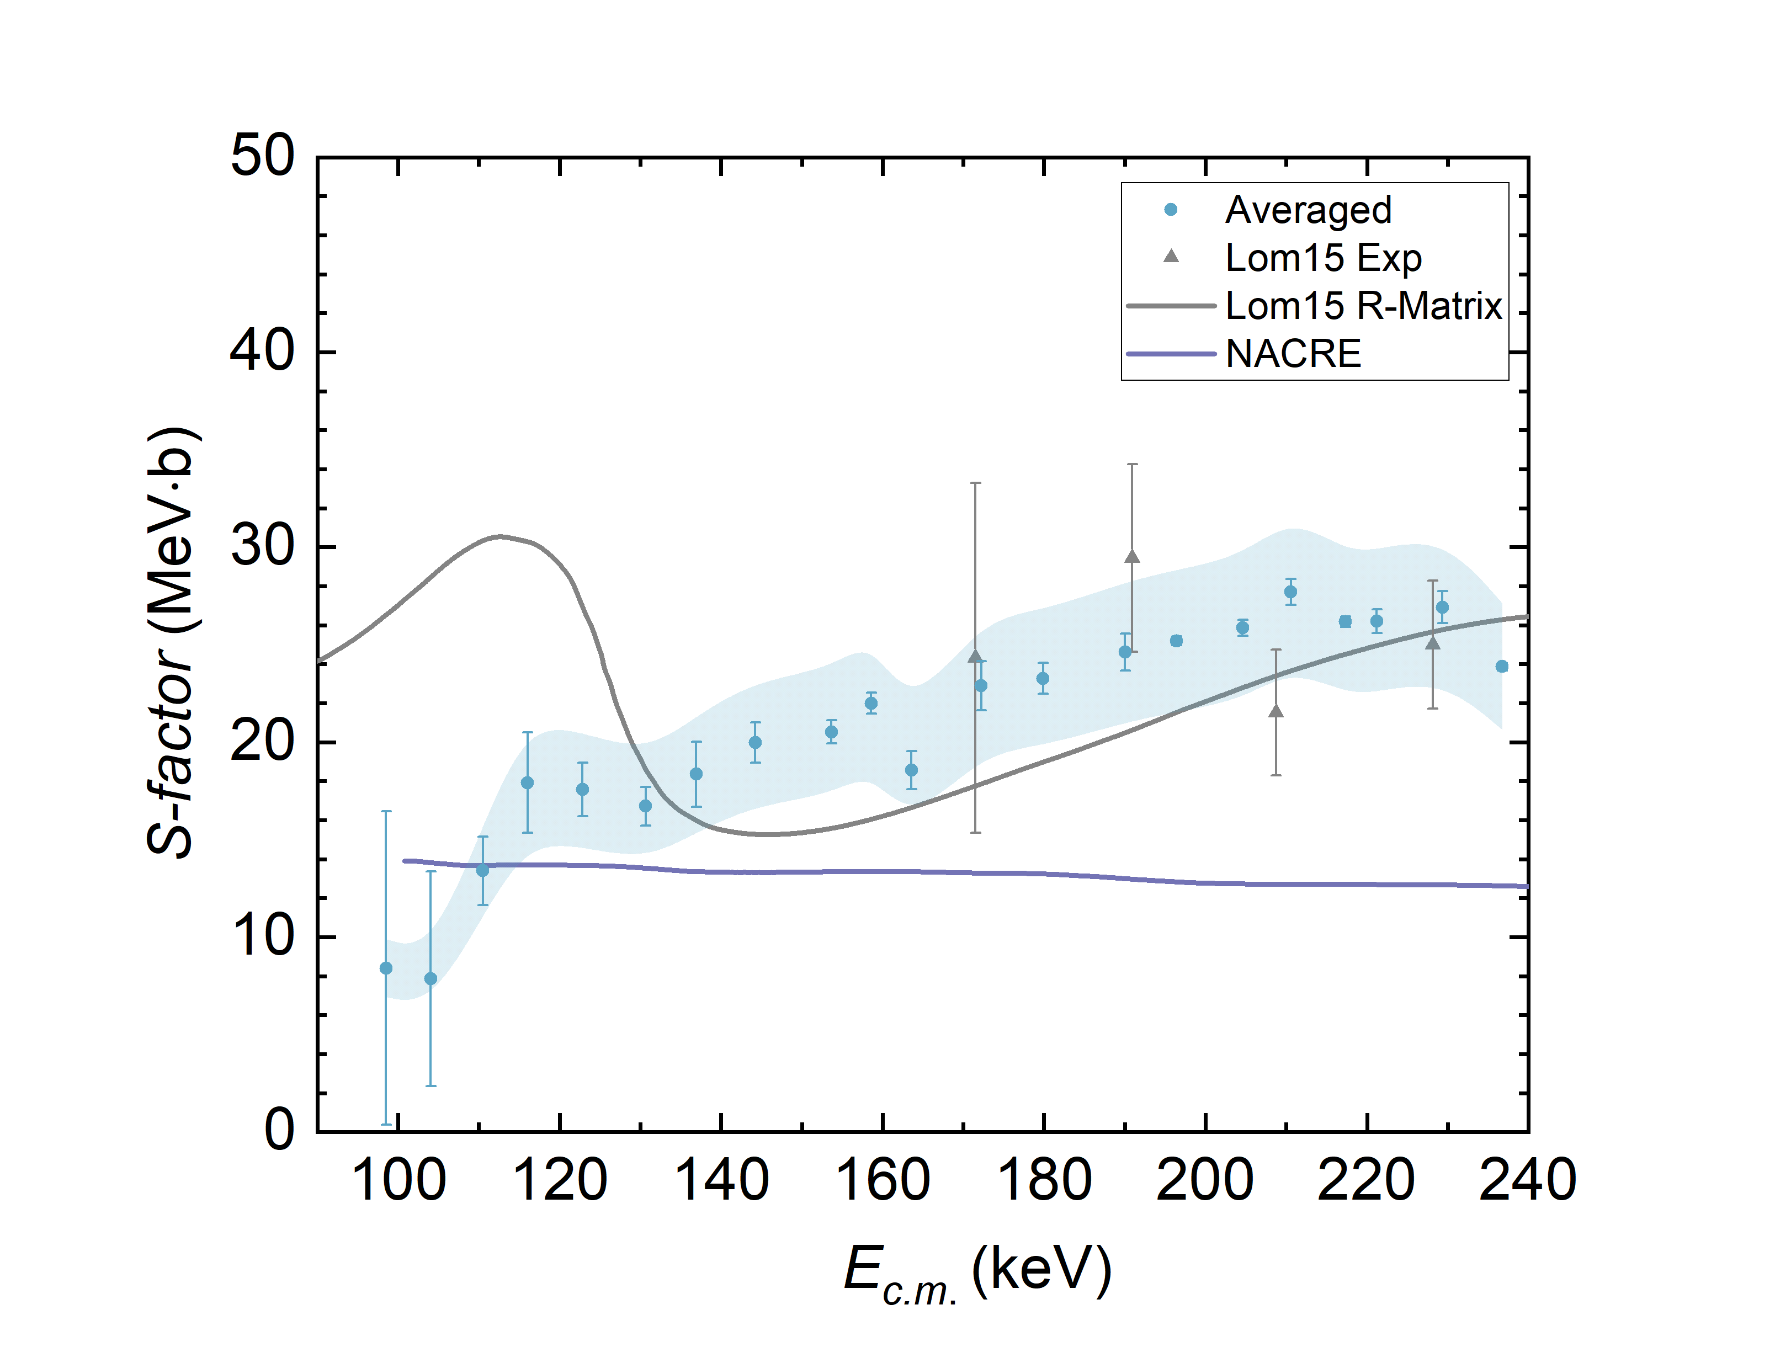
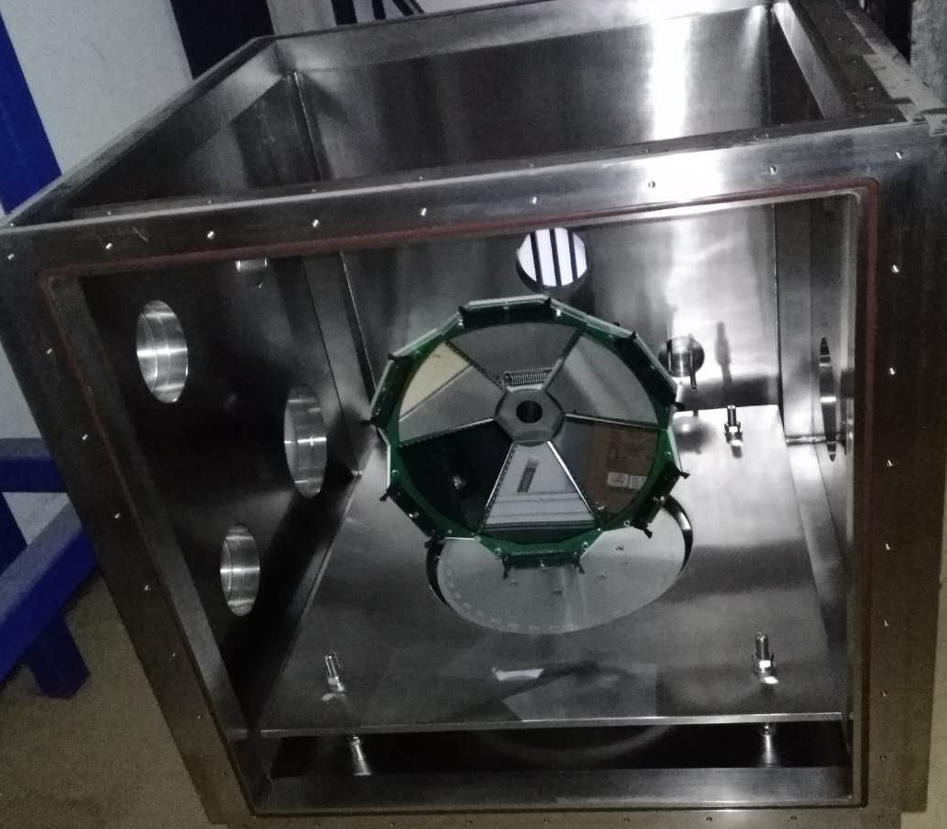
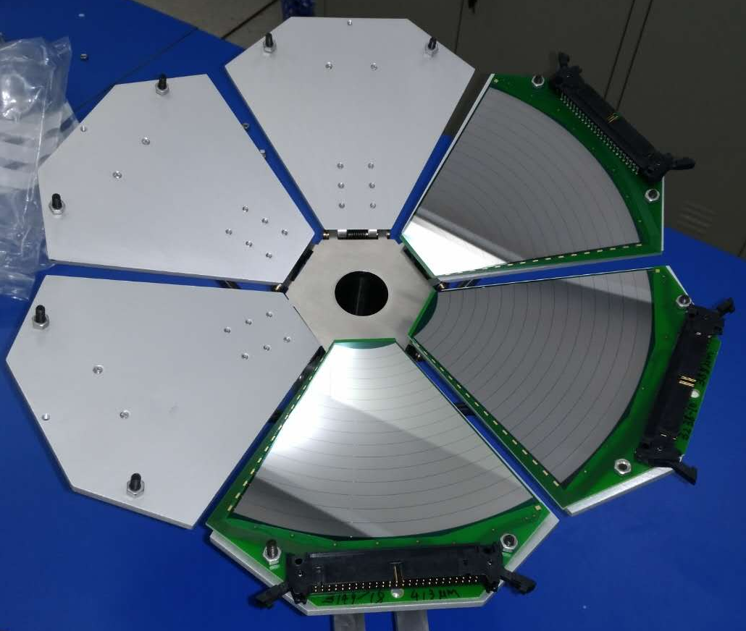
New aboveground ¹⁹F(p,α₀)¹⁶O expt
@Hefei, China
Si array
E_{R} = 113 keV
Preliminary
Around 100 keV region, no obvious resonance peak was observed! In progress…
Y.J. Chen et al., NIMA 1054 (2023) 168401
Notes:
In our original plan, we also expected to run this (p,a0) measurement at Jinping lab. But owing to the very limited machine time at this JUNA operation period, we have to make such measurement in an above-ground lab at Hefei, China. We used the Si array to measure the emitted alpha particles. These four data points are from the Lombardo’s direct measurement. We now extended this measurement down to around 100 keV region. This is the R-matrix curve based on the THM indirect measurement. It seems that no obvious resonance peak was observed at 113 keV. This is very interesting. Around 100 keV energy region, our data agree with the NACRE’s simple extrapolation. That means that around 0.1 GK, our reaction rate is about the same as that of NACRE’s recommendation. Now, the data analysis is still on going.

Slide 31
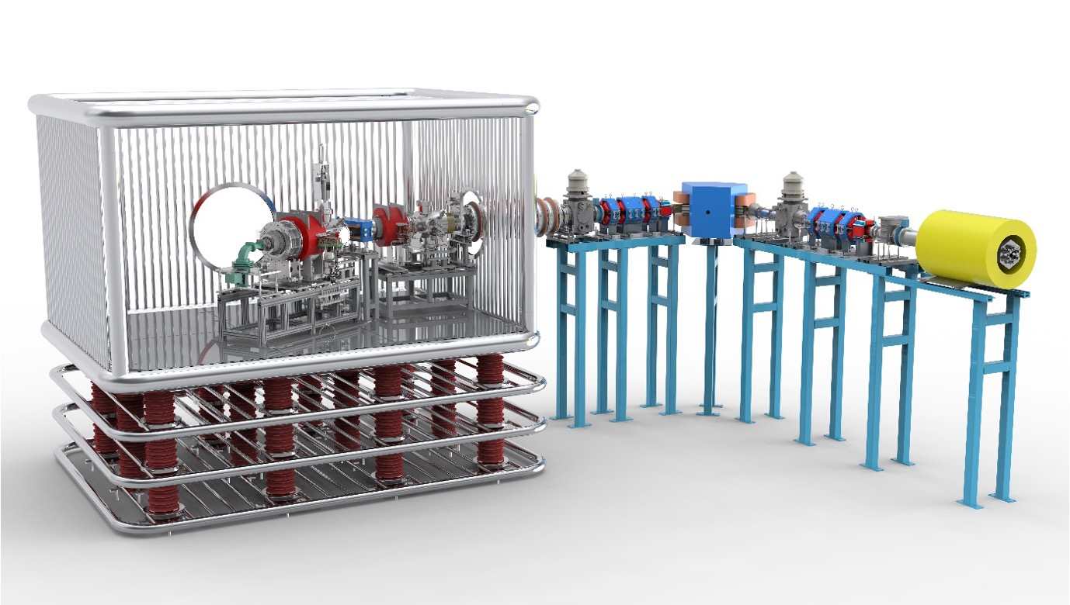
Facility comparison
JUNA I: 400 kV
Acceleration tube
HV platform
Beam analyze
ECR
Detector
 | Cosmic μ bkg ( cm⁻² s⁻¹ ) | Beam energy（keV） |  |  | Intensity（emA）
 |  | H⁺ | He⁺ | He²⁺ | H⁺ | He⁺ | He²⁺
LUNA | 2×10⁻⁸ | 50-400 | 50-400 | --- | 0.3~1 | 0.3~0.8 | ---
CASPAR | 4×10⁻⁹ | 100-1000 | 100-1000 | --- | 0.1 | 0.1 | ---
JUNA | 2×10⁻¹⁰ | 50-400 | 50-400 | 100-800 | 10 | 10 | 2
Q. Wu, L.T. Sun et al., NIMA 830(2016)214
Notes:
In JUNA phase one, a 400 kV high-voltage platform has been built. This table shows the comparison between LUNA, CASPAR and JUNA. Comparing to LUNA, we have 100 times lower cosmic u background, more than 10 times stronger beam intensity. Of course, we also have significant advantage than the CASPAR facility at certain aspects.

Slide 32



I. Status of ¹⁹F(p,γ)²⁰Ne reaction
Recent evaluation
The newly evaluated ¹⁹F(p,γ)²⁰Ne rate is ~4 times smaller than
that of NACRE value, which makes the Ca problem even worse!
R.J. deBoer et al., Phys. Rev. C 103(2021)055815
Notes:
Three years ago, Notre Dame DeBoer et al. made a complete evaluation of the available 19F(p,g) and (p,a) reaction datasets, and their newly evaluated 19F(p,g)20Ne rate is about 4 times smaller than that of NACRE recommended value, which makes the Ca problem even worse! Therefore, we need new measurement for this key breakout reaction at low energies.

Slide 33

JUNA measurement of ¹⁹F(p,αγ)¹⁶O
Typical γ-ray spectra (Contamination ¹¹B, ¹³C, ¹⁸O, D)
L.Y. Zhang, J. Su, J.J. He* et al., Phys. Rev. Lett. 127(2021)152702
L.Y. Zhang et al., Phys. Rev. C 106(2022)055803
Notes:
This is the typical g-ray spectra for six energy points. The main contaminants are from 11B, 13C, 18O and D. The first three do not affect the 19F, but below about 110 keV, the D background came in and became serious to the 6130-keV peak.

Slide 34

JUNA measurement of ¹⁹F(p,αγ)¹⁶O
Lowest energy achieved
Energy point: E_{c.m.} = 72.4 keV; Beam current: ~1 mA
Machine Time: 46.5 h; Challenge: deuteron contam.
Net counts: 30 ± 26 (80% err)
Notes:
The lowest energy point achieved in this work is around 72.4 keV. With beam current of about 1 mA and about 2 days machine time, we got this spectrum, because D contamination became dominant in the interested region, we got a net counts of 30+/-26 (with about 80% uncertainty). It almost represent a kind of JUNA limit. Of course, if we can reduce the D contribution and accumulate longer time, then the uncertainty can be reduced and the measurement can be moved downward to even lower energy in the future.

Slide 35



About ¹⁹F(p,α₀)¹⁶O
Catania group’s work
Trojan-Horse Method (THM)
²H(¹⁹F,α₀¹⁶O)n
E_{R} = 113 keV
M. La Cognata et al., Astrophys. J. 739 (2011) L54
M. La Cognata et al., Astrophys. J. 805 (2015) 128
Notes:
Now, I would like to talk about the 19F(p,a0) channel. In 2011, Italy Catania group studied this channel by the Trojan-Horse Method, and observed several resonance, especially one at 12.957 MeV, that is the 113 keV resonance. Later they made the R-matrix analysis and thought their (p,a0) rate is about a factor of 2 larger than the NACRE recommended one around 0.1 GK.

Slide 36

About ¹⁹F(p,α₀)¹⁶O
Lombardo et al.’s direct measurements
E_{R} = 113 keV
I. Lombardo et al., Phys. Lett. B 748 (2015) 178
I. Lombardo et al., J. Phys. G: Nucl. Part. Phys. 40 (2013) 125102
Notes:
Later, Lombardo et al. made the direct measurements of this reaction channel, down to about 200 keV. An R-matrix analysis was made together with this 113 keV resonance. But their uncertainties are still quite large.

Slide 37


2011
About ¹⁹F(p,α₀)¹⁶O
Trojan-Horse Method (THM)
Green: 2011
Red: 2017
E_{R} = 251 keV
2017
E_{R} = 113 keV
I. Indelicato et al., Astrophys. J. 845(2017)19
Notes:
In 2017, Catania group made the THM measurement again. Here is the comparison between 2011 and 2017 results. It is obvious that the later measurement had much better resolution. Here is the R-matrix comparison. Large differences appeared around 113 keV and 251 keV.

Slide 38

About ¹⁹F(p,α₀)¹⁶O
THM & Direct measurement
I. Indelicato et al., Astrophys. J. 845(2017)19
Notes:
Here shows the R-matrix calculation based on the 2017 THM data. The direct measurement is also shown for comparison. It seems they are consistent within the uncertainties.

Slide 39

JUNA measurement
Contribution of the 214-keV resonance（<10%）

Slide 40

JUNA measurement
Contribution of (p,γ₀) channel: (26.5±5.2)%
Y.J. Chen et al., Nucl. Sci. Tech. 35(2024) 143

Slide 41

The oldest star in the universe
Abundances of light nuclides @BBN ashes
A. Coc et al., Astrophys. J. 744(2012)158
Notes:
According to the BBN model calculations, the primordial abundances of light nuclides after Big-Bang are shown below. Except the dominant Hydrogen and Helium, there are a tiny amount of Lithium and other heavy elements. The primordial 12C abundance is only in a level between 10⁻¹⁵ to 10⁻¹⁴, extremely small amount.

Slide 42

First stars: Hydron burning
triple-α process produce ¹²C and CNO cycles started
Iliadis 2017
Notes:
42

Slide 43



Hydrogen or silicon burning?
Ca can be produced during hydrogen burning via proton capture reactions (no iron produced)
https://cococubed.com/images/astro101/massive_star_onion.png
Ca can also be produced in the Si shell, and ejected together with iron via supernova burst
Observe the elemental abundance of first stars
Notes:
43

Slide 44

Key reactions relevant to ¹⁹F
F production:
☐ ¹⁵N(α, γ)¹⁹F
☐ ¹⁴N(α, γ)¹⁸F
F destruction:
☑ ¹⁹F(p, α)¹⁶O
☐ ¹⁹F(α, p)²²Ne
☐ ¹⁹F(p, γ)²⁰Ne
☐ ¹⁹F(α, γ)²³Na
where,
☑: This JUNA work
☐: Future plan
Notes:
Here, I listed the key reactions relevant to 19F. According to the present knowledge, the following destruction and production reactions are important to the F abundance. As for the production reactions, these two (a,g) reactions still need to be studied at Gamow energy. For the destruction reactions, we have directly measured 19F(p,a)16O down to the Gamow window at JUNA, as a pilot study. Of course, other 3 reactions are also under consideration.

Slide 45

Fluorine overabundance in AGB stars
Lugaro et al. 2004
Standard AGB models cannot explain the observed F overabundance phenomenon. Nucleosynthesis model needs precise cross section data relevant to ¹⁹F production and destruction reactions.
M. Lugaro et al., ApJ 615 (2004) 934
Notes:
This plot shows the F abundances observed in various classes of AGB stars, relative to the Oxygen. It can be seen that most of the AGB stars exhibit the F-overabundance phenomenon, by about factors several tens up to a hundred. Currently, the standard AGB models cannot explain the observed overabundance phenomenon. Nucleosynthesis model needs precise cross section data relevant to ¹⁹F production and destruction reactions.

Slide 46

Direct measurement of break-out ¹⁹F(p,γ)²⁰Ne reaction at JUNA
Compared to the previous expected S factors
Notes:
核天体物理无论是在美国和欧洲核科学长期规划中，还是在中国学科发展战略上都占有重要地位。

Slide 47


Research status
Spyrou et al. 2000
Notes:
The research status for these three channels are shown. As for (p,a0) channel, the most recent data reached down to about 200 keV; as for the (p,ag) channel, the data down to also about 200 keV. As for (p,aπ) channel, the data down to about 500 keV, and here is the theoretical upper limit. Spyrou et al. calculated the reaction rates for these three channels, and the roles are shown here. We can see at lower temperature (below 0.1 GK), (p,a0) channel dominates, while the (p,ag) channel dominates the total rate at higher temperature region. Contribution from the (p,aπ) channel is negligible. However, their roles at low temperature region still need experimental verifications.

