Slide 1

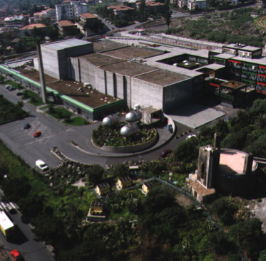
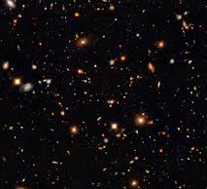





BBN and Indirect measurements: the neutron induced reactions
Rosario Gianluca Pizzone
Dipartimento di Fisica e Astronomia,
The University of Catania and
INFN – LNS Catania – Italy

Slide 2


Elephant Theory by Xiaodong:
in Catania, the LIOTRU, is with
High-Aiming trunk

Slide 3
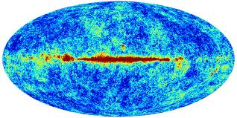

Primordial nucleosynthesis is one of the pillars of the current
Cosmological models.
Main evidences of Standard Big Bang scenario:
Galactic expansion (Hubble Law) from SN measurements,
Cosmic Microwave Background radiation probes the universe
at time around 3x10⁵ years after BB
Primordial nucleosynthesis probes the universe at around
1-20 minutes after Big Bang!!
The only in the radiation dominated era

Slide 4
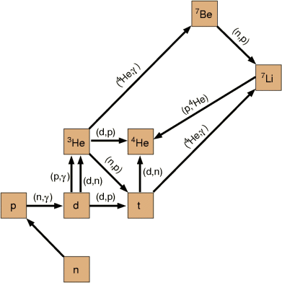
³He(n,p)³H is important for primordial nucleosynthesis and its study with THM is possible with
application to ³He(d,pt)p. The astrophysical range for this reaction is 0<Ecm<1 MeV.
The ³He beam energy required is 8.5 MeV.
This reaction is responsible of the inter-conversion of A=3 elements
(Pizzone et al 2014 APJ 2014)

Slide 5
Trojan Horse Method (outlook)
Quasi-Free mechanism
Basic idea:
It is possible to extract the astrophysically relevant two-body cross section σ
B + x → C + D
from quasi- free contribution
of an appropriate three-body reaction
A + B → C + D + S
Main application:
Charged particle bare nucleus cross section measurements at astrophysical energies
-The A nucleus present a strong cluster structure: A = x ⊕ S clusters
x
C
-The x cluster (participant) interacts with the nucleus B
B + x → C + D
B
D
A
S
x
-The S cluster acts as a spectator
(it doesn’ t take part to the reaction)
C
B
D

Slide 6


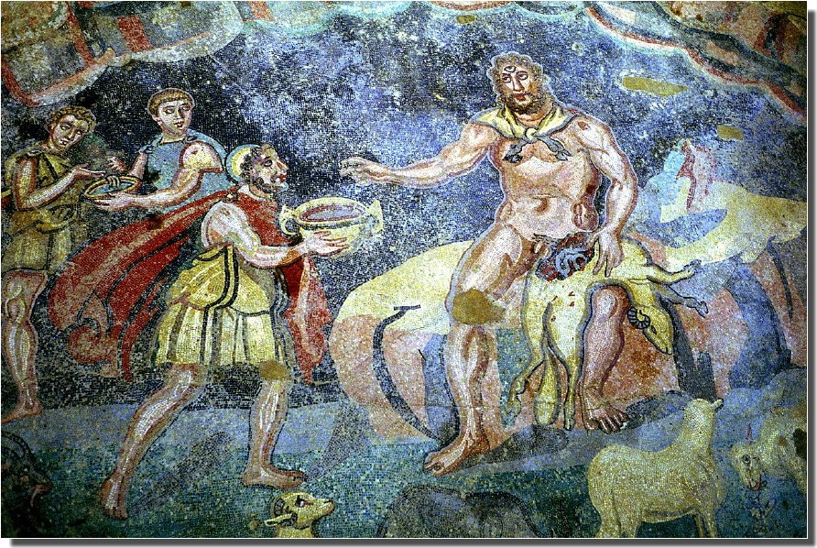
Ulysses TRIP

Slide 7
We can extract astrophysically relevant
two-body cross section σ
B + x → C + D
x
C
B
D
from quasi- free contribution of an appropriate three-body reaction
A + B → C + D + S
A
S
x
C
B
D
E_{A} > (E_{AB})_{Coulomb Barrier}

Slide 8

Quasi-Free mechanism Trojan Horse Method
The incoming energy E_{A} of the incident particle is larger than the Coulomb barrier energy (E_{AB})_{Coul. Bar.}
E_{A} > (E_{AB})_{Coulomb Barrier}
(This means that B and x have a non-negligible probability to be very close)
A
S
x
C
B
D
The nucleus A can be brought into nuclear field
of nucleus B and the cluster x induces the reaction
B + x → C + D
Coulomb effects and electron screening are negligible

Slide 9
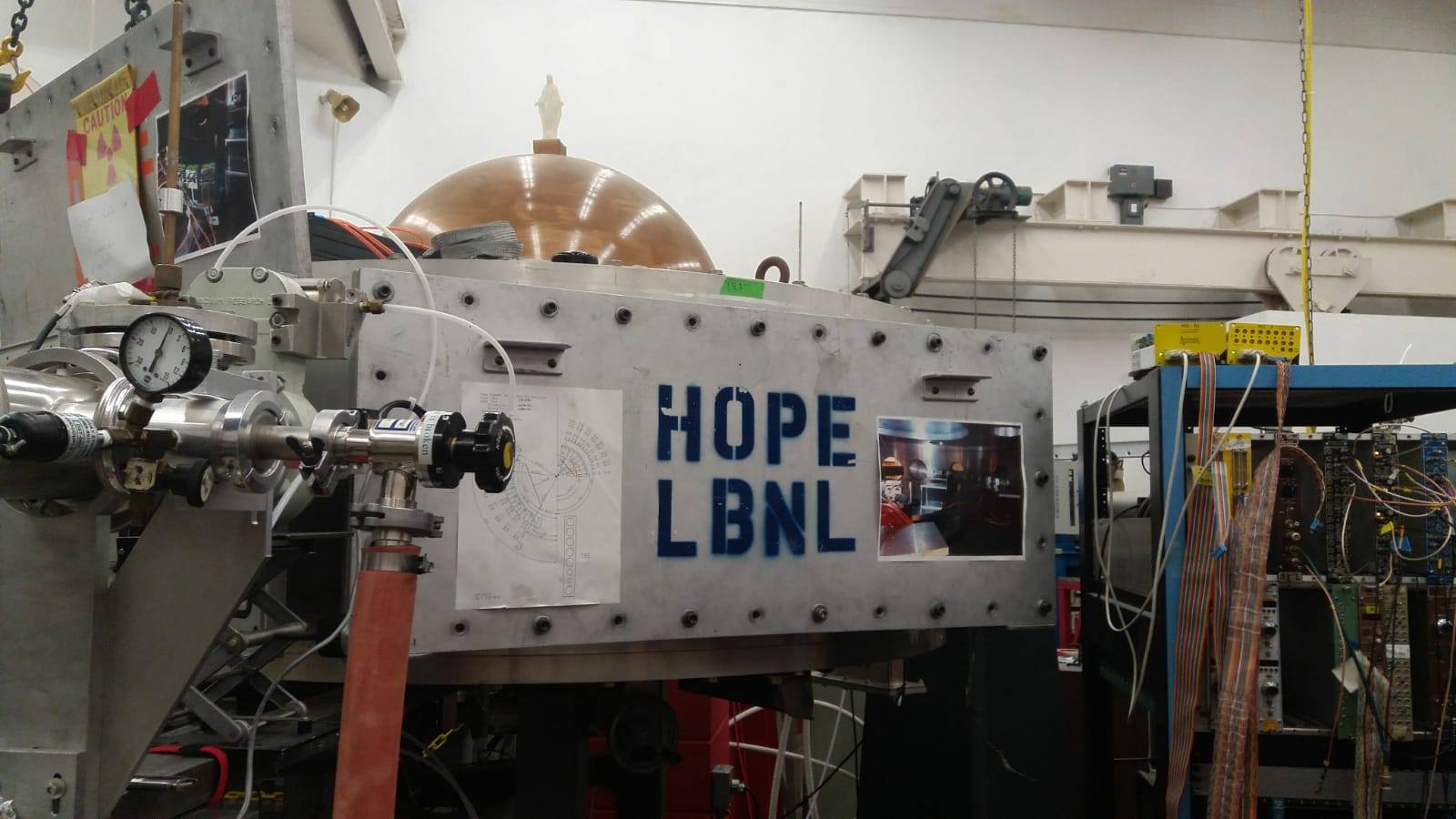
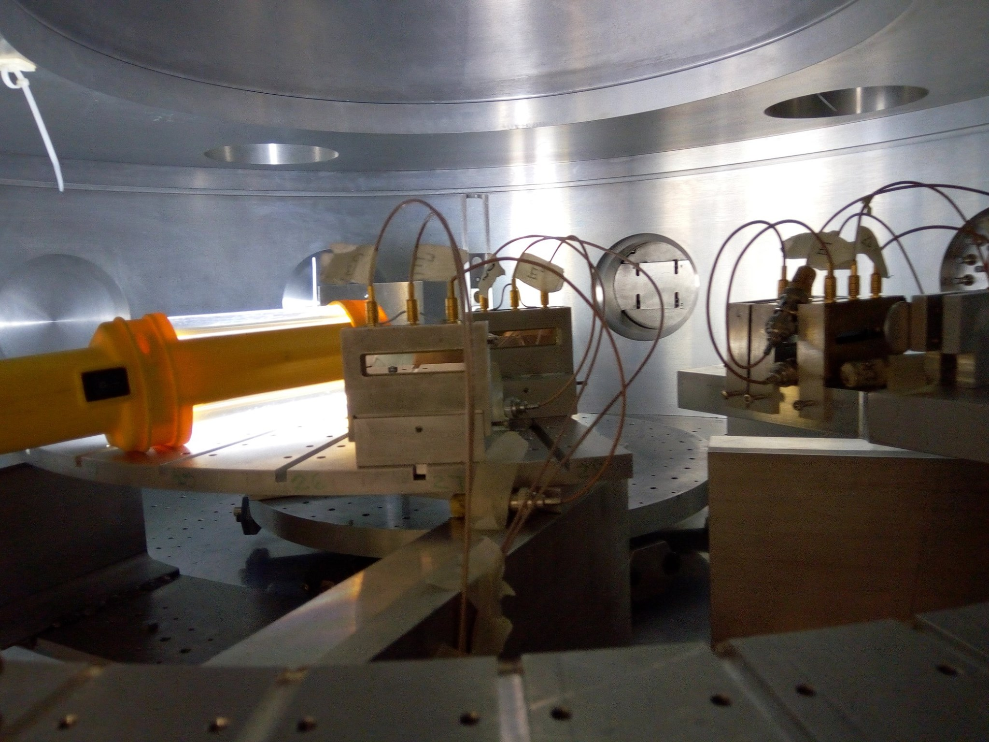
Required ³He E_{beam}=9 MeV very well focused and a large scattering chamber→ Notre Dame
³He+ d → p+t+p to study ³He+n→ p+ ³H
Quasi-free mechanism is dominant in the kinematic regions where spectator momentum
p_{spectator} is around zero.
θ_{p}= 10-24 or 26-40
θ_{t}= 6 - 15
Detection apparatus formed by De-E (silicon PSD detectors).

Slide 10
Identification of t and p is made by means of DE/E technique using 35 μm PSD as DE stage.
The bulk of the q.f. region falls within the black kinematic locus (ps<35 MeV/c). This corresponds to specific angular pairs (QF angles) where detectors are centered.
The reaction of interest can be identified and separated from the others after
Gating on proton and tritons as well as in the kinematic locus.

Slide 11
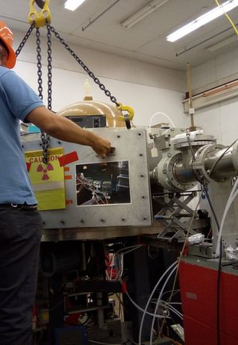
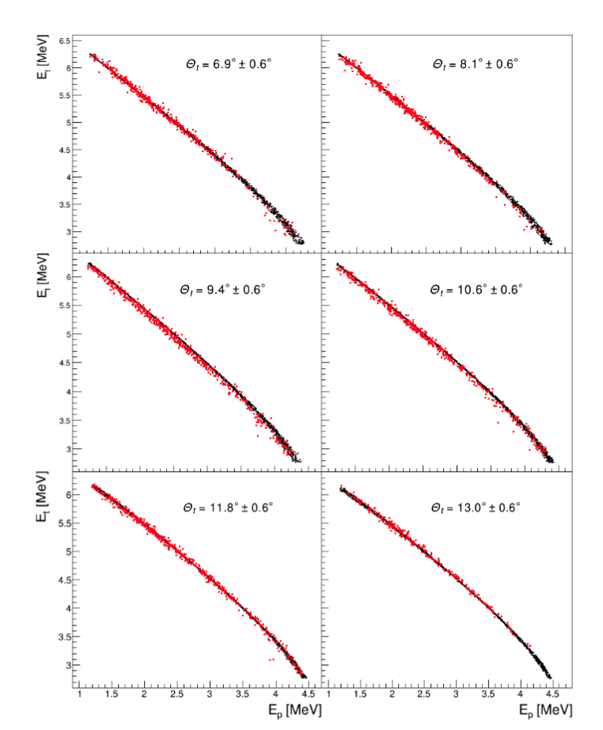
Separation of the 3-body process
Kinematc curves in agreement with simulation
Q-value spectrum tags the 3-body process

Slide 12
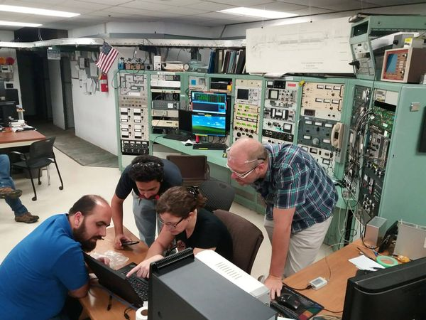
Data Analysis

Slide 13
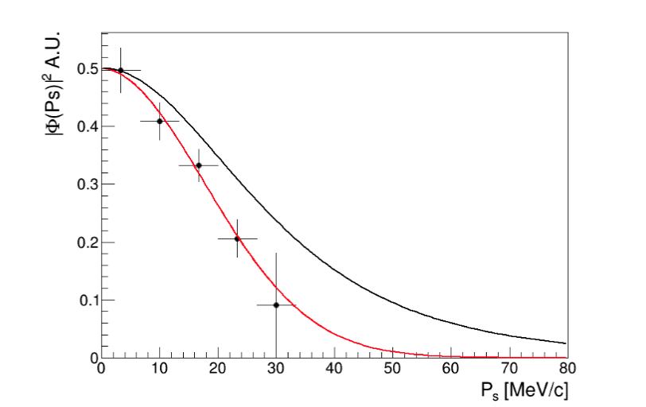
Quasi-free process separation 1
The spectator momentum distribution
Is a powerful tool to separate QF
Processes from others occurring in the target
With similar ejectiles (and different
Mechanism)
Narrower than expected theoretically?
Once p_{s}<25 MeV/c is selected the E_{cm} region 0<E_{cm}<1 MeV which is important for primordial
nucleosynthesis will be explored.

Slide 14
Quasi-free process separation 2
This is something already observed: at low transferred momenta the spectator momentum
Distribution is distorted and narrower. This holds for d, ³He, ⁶Li and ⁹Be.
A= projectile, B=c+C ejectiles
Pizzone RG et al. PRC 80 025807 (2009)

Slide 15
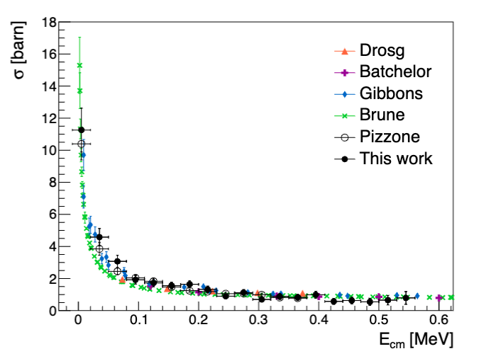
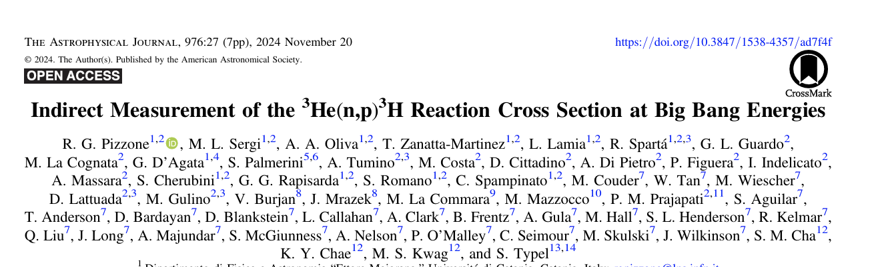
Cross section and comparison with direct data
After selection of QF data the binary cross section is extracted according to the formula
THM results are normalized in the high
Energy range (above 300 keV)
CONCLUSIONS & PERSPECTIVES
-It was possible to apply THM to the reaction of interest. Good comparison with direct data
-Measurement extended in the 0-400 keV energy range of interest for BBN
complete the analysis at higher energies E_{cm}>0.4 (complete analisys extends of 50% the energy range with respect to Pizzone et al. EPJA 2020.

Slide 16
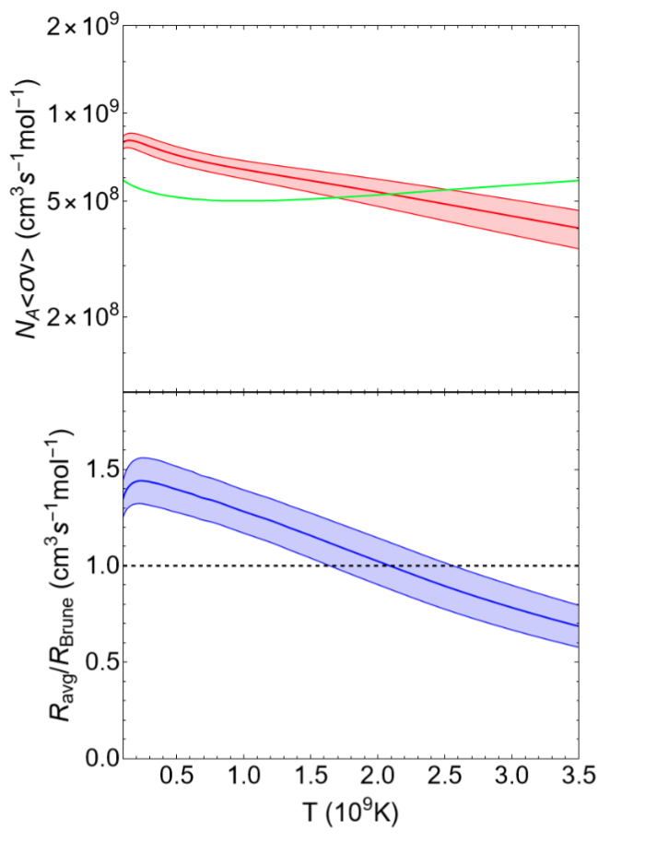
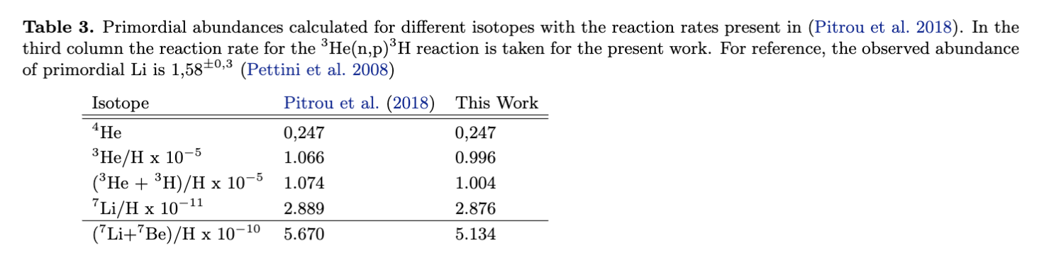
Reaction rate calculation
Reaction rate compared with Brune et al.
with relatively small changes;
Primordial abundances calculated by PRIMAT →
We are still far from primordial lithium problem solution
THM again is very useful for n-induced reaction →
Potential applications to n interactions with unstable beams
Which are crucial for many astrophysical scenarios e.g.
⁷Be+n, ²⁶Al+n etc

Slide 17
n-induced reactions & RIB’s in 2 steps: the ⁷Be(n,α)⁴He & (n,p) case
Simoultaneous measurement of:
⁷Be(n,p₀), ⁷Be(n,p₁) and ⁷Be(n,a)
Performed @ INFN-LNL &CNS RIKEN
Lamia et al. APJ 2017&2019 and
Hayakawa et al. APJ 2021

Slide 18
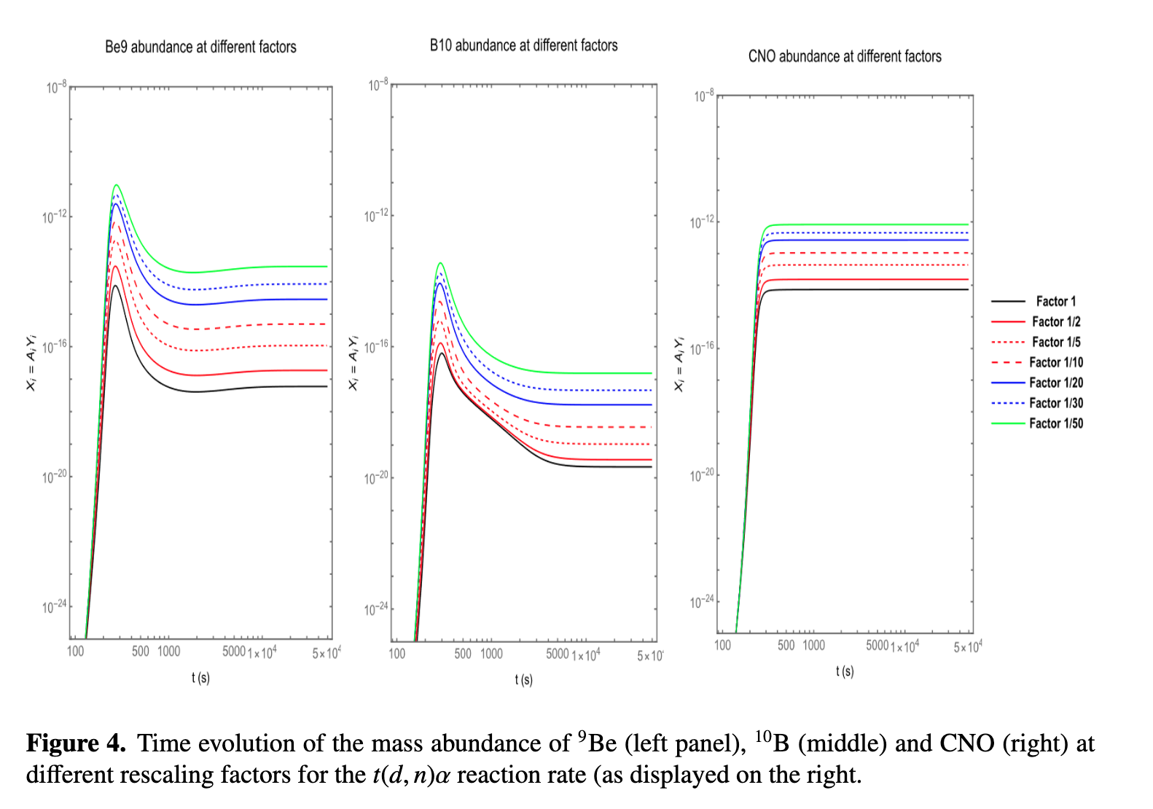
Possible studies of 3H+d → n,4He reaction with important impact
on primordial CNO abundances. Sensitivity study on A>9 isotopes in progress
Future THM Applications
Preliminary data

Slide 19















Thanks for your attention
The AsFin Group
@Catania A. Bonasera, S. Cherubini, A. Di Pietro, P. Figuera, G.L. Guardo, M. Gulino, M. La Cognata, L. Lamia, D. Lattuada, A.A. Oliva, R.G. Pizzone, G.G. Rapisarda, S. Romano, D. Santonocito, M.L. Sergi, R. Spartà, A. Tumino
@Perugia M. Busso, S. Palmerini, M. Limongi, A. Chieffi, M.C. Nucci @ Padova M. Mazzocco @Napoli M. La Commara
International Collaborations
  Notre Dame University USA: M. Wiescher, M. Couder
  Cyclotron Institute, Texas A&M, USA: R. Tribble, V. Goldberg
  Texas A&M Commerce USA: C. Bertulani
  Florida State University USA: I. Wiedenhofer
  C.N.S. Riken, Wako, Japan: S. Kubono, H. Yamaguchi, S. Hayakawa
  University of Taskent: B. Irgaziev,
  CIAE, Beijing, China: S. Zhou, C. Li, Q. Wen
  Nuclear Physics Institute, ASCR, Rez, Czech Rep.: V. Kroha, V. Burjan, J. Mrazek
  Nipne IFIN Bucharest: L. Trache
  ELI-NP Bucharest: C. Matei, D. Balabanski
  Atomki, Debrecen, Hungary: G. Kiss
  CSNSM, Orsay, France : A. Coc , F. Hammache, N. De Sereville
  University of Catalunya: J. Jose
  Rudjer Boskovic Institute Zagreb Croatia: N. Soic, M. Milin

Slide 20

Italian Nuclear Astrophysics
GROUPS meeting

Slide 23

Determination of primordial abundances
Primordial abundances :
  Observe a set of primitive objects born when the Universe was young
    ⁴He in H II (ionized H) regions of blue compact galaxies
    ³He in H II regions of our Galaxy
    D in remote cosmological clouds (i.e. at high redshift) on the line of sight of quasars
    ⁷Li at the surface of low metallicity stars in the halo of our Galaxy
  Extrapolate to zero metallicity : Fe/H, O/H, Si/H,…. → 0

Slide 24
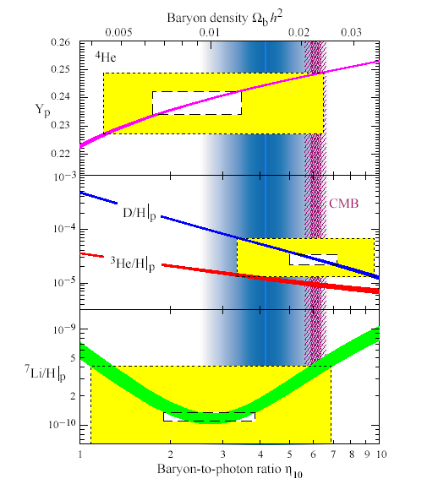
Before WMAP/Planck
From primordial abundances hints on the baryon-to-photon ratio and the baryon density.
Hints on eta from coupled measurements of D,Li and He primordial abundances (yellow boxes 2σ)
A wide range was found
3<η₁₀<7
After WMAP /Planck
From the CMB peaks information on the baryon density. This result is then compared to primordial abundances and agreement is found (except for Li).
A narrow range is found
5.9<η₁₀<6.9
Bare astrophysical S(E) factor must be known in the whole astrophysical range and then integrated numerically.

Slide 25
Why TH measurements?
The direct measurements at low-energies have been performed and discussed by several groups in last 50 years. Several reliable data sets are available but…
Only extrapolations have been performed in correspondence of the energy window relevant for astrophysics in many cases (even if low energy experimental data are available extrapolations are required due to the presence of electron screening, Assenbaum 1987);
Thus, the indirect THM approach has been adopted to measure the bare nucleus S(E)-factor

Slide 26
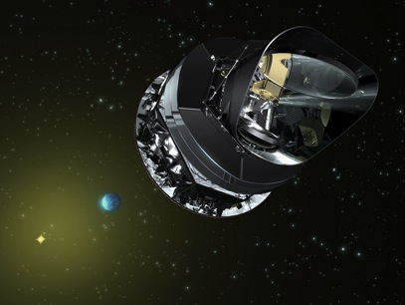
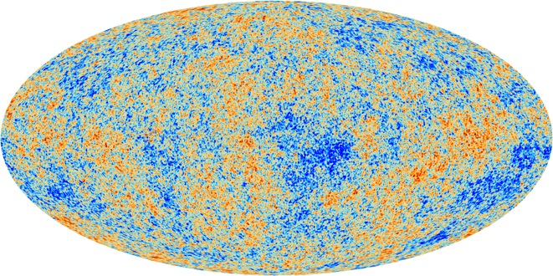
Anisotropies of the Cosmic Microwave Background
At t≈0.38 My, and T≈3000 K : recombination, the Universe becomes transparent (presently 2.725 K)
WMAP [Komatsu et al. 2011+….]
Planck [Ade+ 2013+]

Slide 27
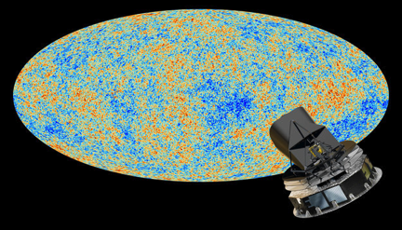
Observational status for Li
Different features can be extracted by studying the abundance.vs.metallicity scatter plot:
1)at lower metallicity, lithium abundances exhibit the so-called “Li-plateau” (Spite & Spite A&A, 1982) →Primordial Nucleosynthesis;
-4
-3
[Fe/H]
Primordial Lithium (Li/H) Observed ∼1-2*10-¹⁰ (Fields et al., ApJ, 2005)
Primordial Lithium (Li/H)WMAP ≈ 4.3*10⁻¹⁰
^{(Cyburt et al., PLB, 2005)}

Slide 28
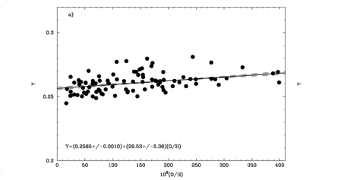
For the other baryometers…
Pettini et al. 2012
D from QSO absorbers,‘damped Lyman alpha systems’
WMAP value ≈ 2.55 x10⁻⁵
Obs. 2.82 (Pettini et al 2012)
⁴He in metal poor HII regions
WMAP value ≈ 0.2485
Obs. 0.2565 (Izotov et al.)
Pettini et al. 2012
Izotov et al. 2007

Slide 29
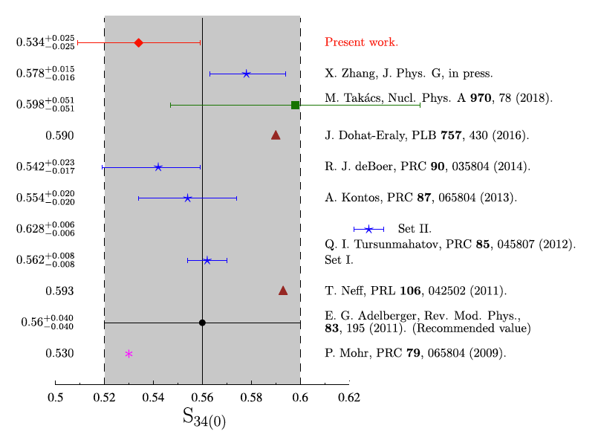

The ³He(α,γ)⁷Be S₃₄(0) using ANC
The post-form DWBA calculation contains:
s-wave ANC values for the d+p →³He and the d+α→⁶Li channels
Test of the dependence on the choice of the optical potentials
Test of the peripheral nature of the reaction
channels coupling effects (CCE)
Further improvements to be implemented:
Test one-step process in modelling the transfer
Test the coupling between ground and excited states of ⁶Li and ⁷Be
Perform full coupled-channel analysis to derive the ³He+⁴He and the p+⁶Li ANCs
Lower S₃₄(0) values favored, with a total uncertainty equal to 4.7%.
More than 50% of the error budget is due to the non-peripherality of the transfer process
³He(α,γ)⁷Be
Kiss et al.
PLB 807 (2020) 135606

Slide 30
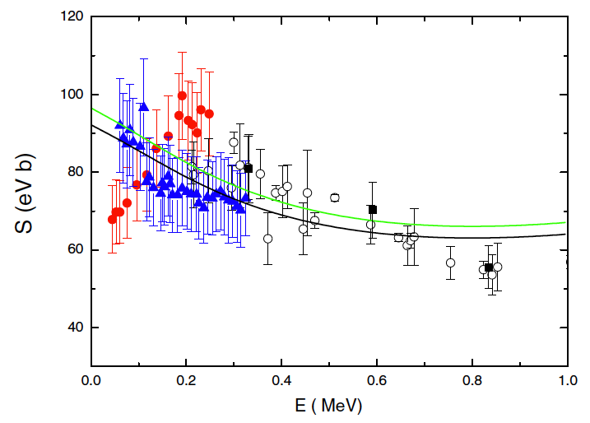

The ⁶Li(p,γ)⁷Be astrophysical factor
Two approaches:
the weighted means of the ANCs from the analysis of the ⁶Li(³He,d)7Be transfer were used to calculate the total astrophysical S factor for the ⁶Li(p,γ)⁷Be reaction using the modified two-body potential method [Igamov and R. Yarmukhamedov (2019)]. In the calculation M1 and E2 are neglected as their contribution is lower than 1% at these energies
the ANCs for the ⁶Li+p→ ⁷Be(g.s.) and ⁶Li+p→ 7Be(0.429 MeV) channels were derived from the experimental total astrophysical S factor and the branching ratios of Piatti et al. (2020) and then (after checking the actual agreement), we also calculated the astrophysical factor of the ⁶Li(p,γ)7Be reaction within the MTBPM
Green line: astrophysical S factor obtained by using the weighted average ANC values from the near-barrier proton transfer ⁶Li(³He,d)⁷Be reaction at E_{beam} = 3 and 5 MeV
Black line: astrophysical S factor obtained from the analysis of the ⁶Li(p,γ )⁷Be S-factor of Piatti et al. (2020)
Our result strongly disfavors the resonant trend claimed by He et al. (2014)
⁶Li(p,γ)⁷Be
Kiss et al.
PRC 104 (2021) 015807

Slide 31
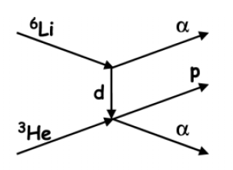


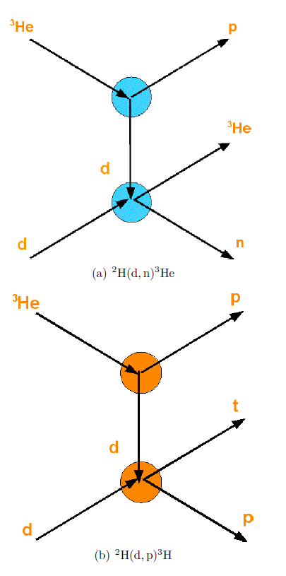
The ⁷Li(p,α)⁴He reaction rate
For the rate both direct
And THM data were taken
into account
Red: THM Data
Blue: Direct Data
- Azure R-Matrix fit
d
n
α
p
α
⁷Li
α
Lattuada M, RGP et al. 2001 APJ
d(d,n)³He ²H(³He,n³He)H
d(d,p)t ²H(³He,pt)H
Tumino et al. 2014 APJ

Slide 32
Available Measurements
Brune et al. PRC 1999
Most recent Brune et al. From p,n reaction on ³H

