Slide 1
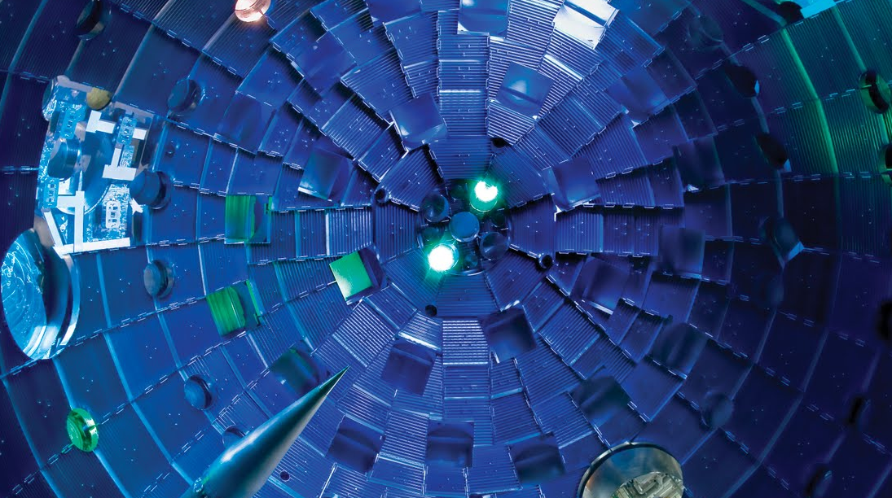

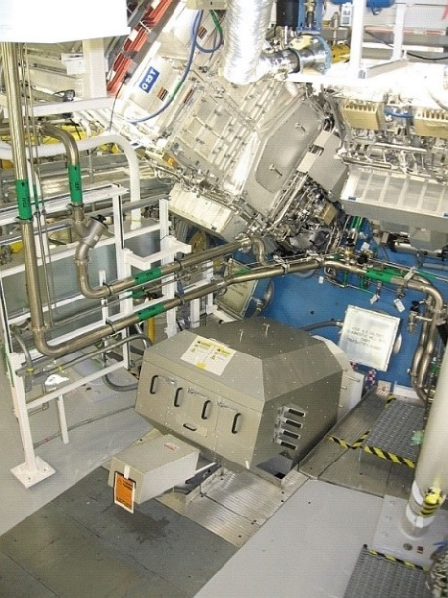
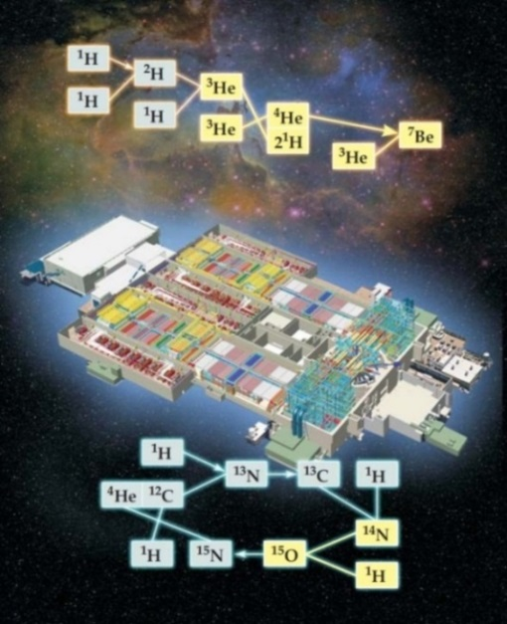
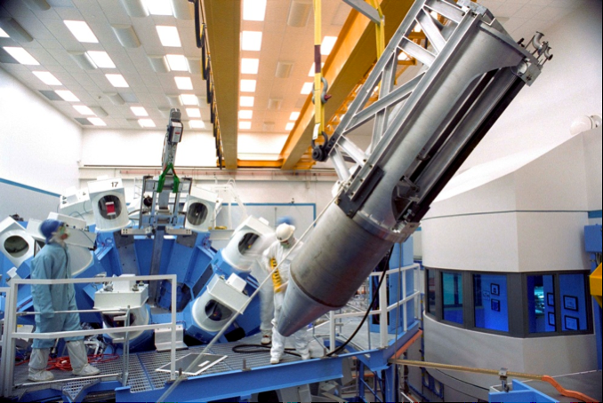
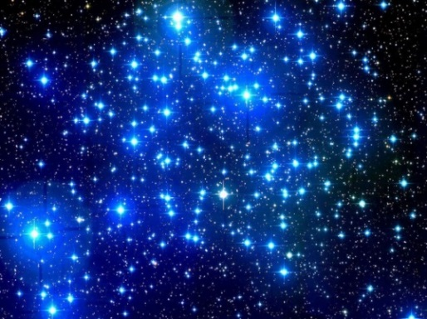
Using high energy density plasmas generated by
high-energy lasers for nuclear astrophysics experiments
NIF laser
Proton-proton chain
NIF
CNO cycle
OMEGA laser
Maria Gatu Johnson
Massachusetts Institute of Technology
KRINA workshop
Trento, Italy, Feb 19, 2025
Notes:
What I will talk about today is the use of High Energy Density Plasmas generated in Inertial Confinement Fusion implosions at the OMEGA and NIF laser facilities to probe nuclear reactions relevant to nuclear astrophysics. What we see here…

Slide 2
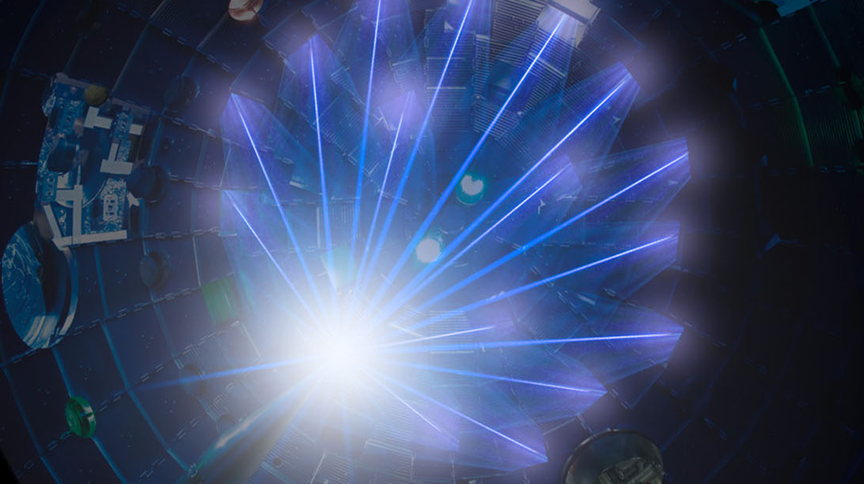
Using high energy density plasmas generated by
high-energy lasers for nuclear astrophysics experiments
NIF laser
Proton-proton chain
NIF
CNO cycle
OMEGA laser
Maria Gatu Johnson
Massachusetts Institute of Technology
KRINA workshop
Trento, Italy, Feb 19, 2025
Notes:
What I will talk about today is the use of High Energy Density Plasmas generated in Inertial Confinement Fusion implosions at the OMEGA and NIF laser facilities to probe nuclear reactions relevant to nuclear astrophysics. What we see here…

Slide 3










Collaborators
MIT
P. Adrian
S. Dannhoff
J. Frenje
T. Johnson
N. Kabadi
J. Kunimune
B. Lahmann
C. Li
C. Parker
J. Pearcy
R. Petrasso
F. Séguin
H. Sio
G.D. Sutcliffe
LLNL
D. Casey
A. Zylstra*
J. Jeet
C. Yeamans
J. Despotopulos
K. Kmak
S. Labb
M. Hohenberger
H. Whitley
D. Sayre
J. Caggiano
C. Cerjan
L. Ellison
E. Hartouni
R. Hatarik
M. Hohensee
D. Holunga
S. Khan
LLNL cont’
L. Masse
D. McNabb
A. Nikroo
J. Pino
B. Remington
H. Robey
M. Rubery
J. Sanchez
P. Springer
I. Thompson
B. Tipton
S. Quaglioini
Imperial College
B. Appelbe
A. Crilly
I. Garin-Fernandez
UR
C. Forrest
R.S. Craxton
E.M. Garcia
V. Glebov
R. Janezic
J. Knauer
P. McKenty
P.B. Radha
H. Rinderknecht
M. Rosenberg
T. Sangster
W. Seka
C. Stoeckl
LANL
G. Hale
M. Paris
H. Herrmann
Y. Kim
A. McEvoy
Z. Mohamed
M. Schmitt
AWE
W. Garbett
D. Pitman-Weymouth
Ohio Univ.
C.R. Brune
Indiana Univ.
A. Bacher
*Now at Pacific Fusion
Notes:
This is a large and growing collaboration – if you are interested in joining, please reach out to me afterwards

Slide 4
Summary
Exploration of Basic Nuclear Science and Nuclear Astrophysics using HED plasmas is a promising new field with much still to learn
High-Energy Density (HED) plasmas generated in laser-driven implosions provide a unique environment for studying stellar-relevant nuclear reactions:
  Plasma environment
  Hot and dense
  High neutron flux achievable
The NIF and OMEGA lasers are two primary facilities for executing experiments of this type
Experiments are made possible by enabling nuclear diagnostics
Initial results include spectral measurements of the reaction products from the T+T, ³He+³He, and T+³He six-nucleon systems, and S-factor measurements for T+³He-γ, p+D, p+T, and T+T
Ongoing efforts includes platform development for s-process-relevant (n,γ) cross section measurements and electron screening effect studies

Slide 5
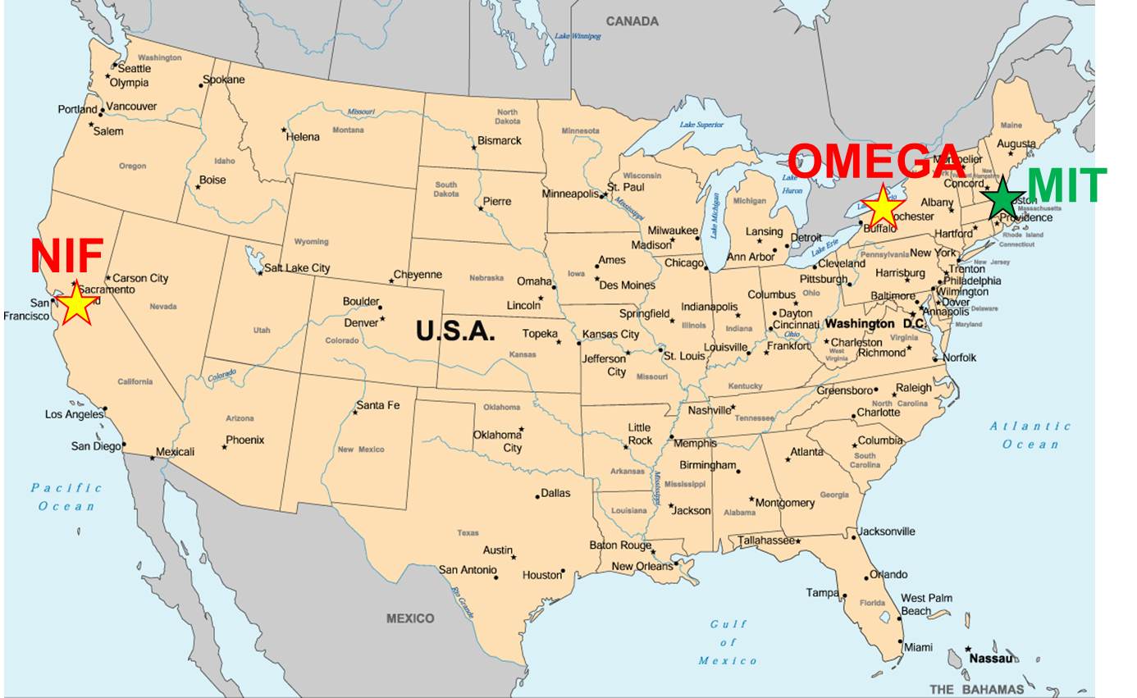
HED facilities
High energy density conditions are generated at laser facilities such as the OMEGA and National Ignition Facility (NIF) lasers
High energy density: extreme pressure (~1 Mbar - ~1000 Gbar)
~1 cm
Direct-drive implosion
Notes:
High energy density is about extreme pressure (~1 Mbar - ~1000 Gbar)
I will be talking a lot about OMEGA and NIF, and I wanted to put these facilities on the map to get everyone on the same page.

Slide 6
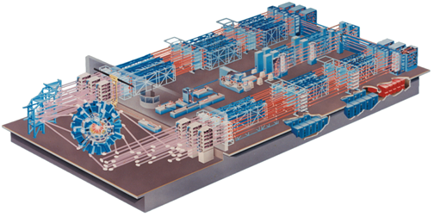
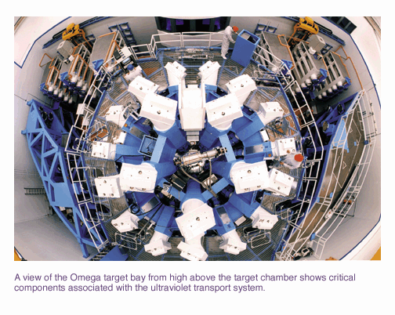
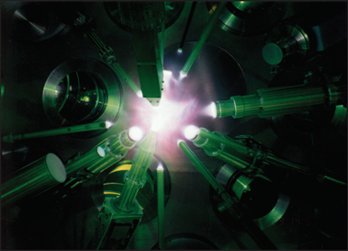
HED facilities
High energy density conditions are generated at laser facilities such as the OMEGA and National Ignition Facility (NIF) lasers
60 laser beams
30 kJ energy
Direct-drive implosion
Notes:
Very briefly…

Slide 7
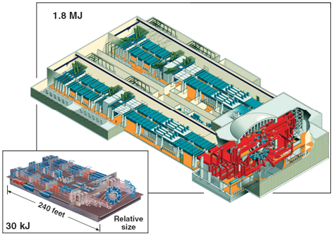
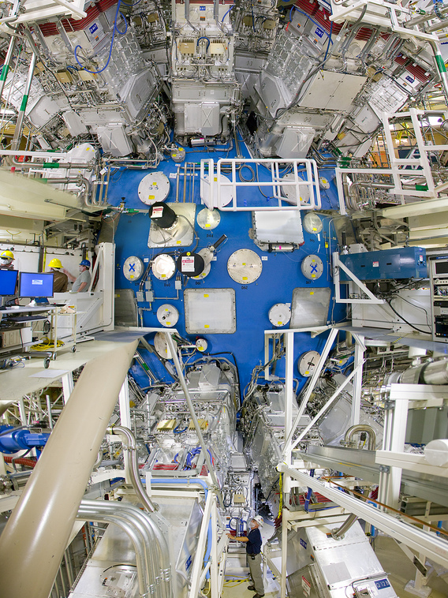
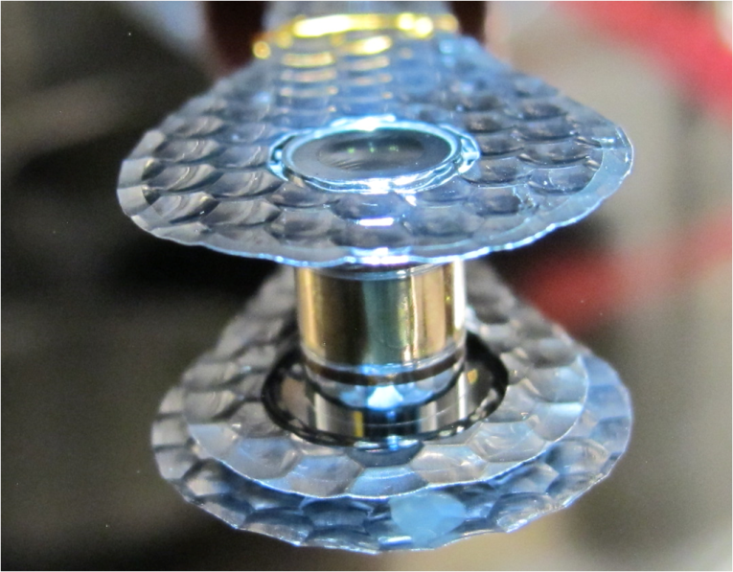
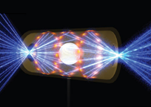
HED facilities
High energy density conditions are generated at laser facilities such as the OMEGA and National Ignition Facility (NIF) lasers
60 laser beams
30 kJ energy
192 laser beams
1.9 MJ energy
~1 cm
Direct-drive implosion

Slide 8
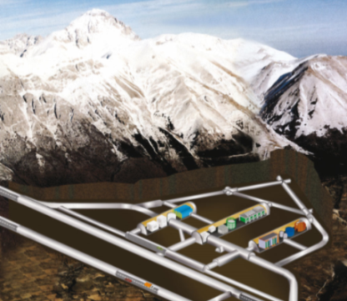
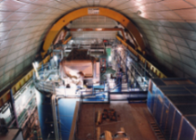
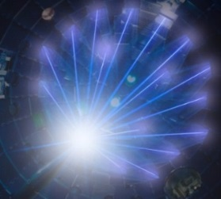
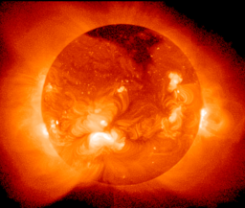
Motivation
In contrast to accelerators normally used for nuclear physics experiments, lasers create conditions similar to stellar cores
Accelerator experiments
Cold Target
Bound electron screening
Ions
Bound electrons
Monoenergetic ion
Dense and hot plasma
NIF
OMEGA
Debye screening
Sun
Thermally excited states
Thermal ions
Thermal electrons

Slide 9
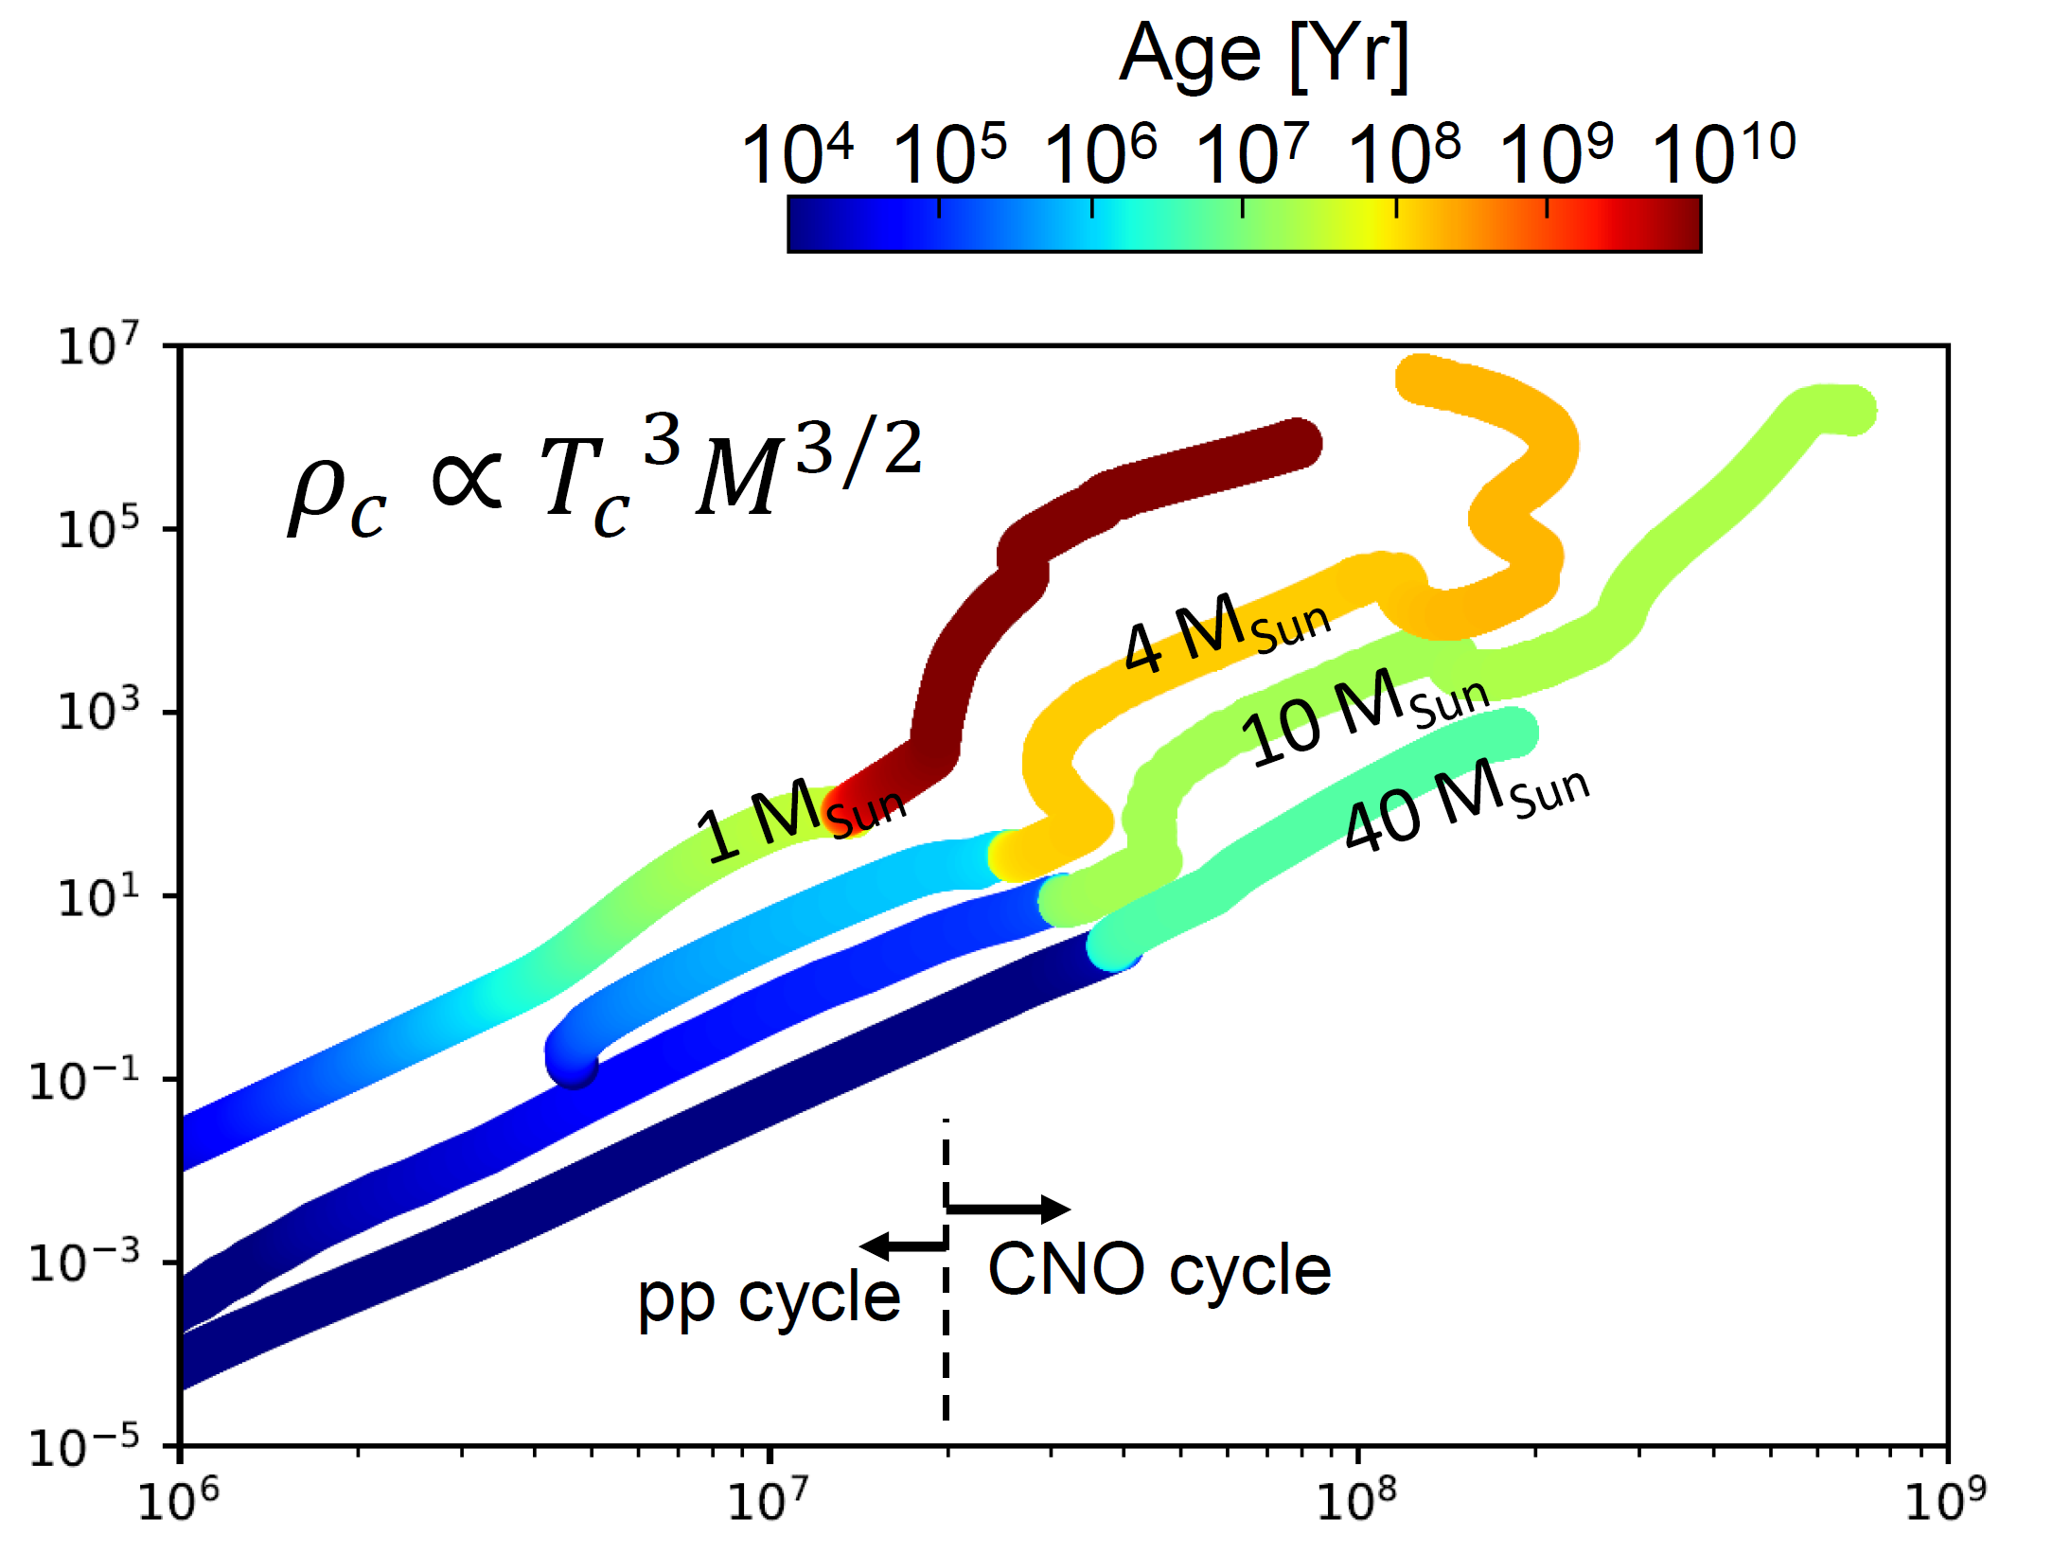
Motivation
Capsule implosions at the OMEGA and NIF lasers create HED-plasma conditions that are similar to the interior of a star
Stellar age [years]
Density [g/cc]
Temperature [K]
Stellar evolution simulations by Dave Dearborn (LLNL).

Slide 10
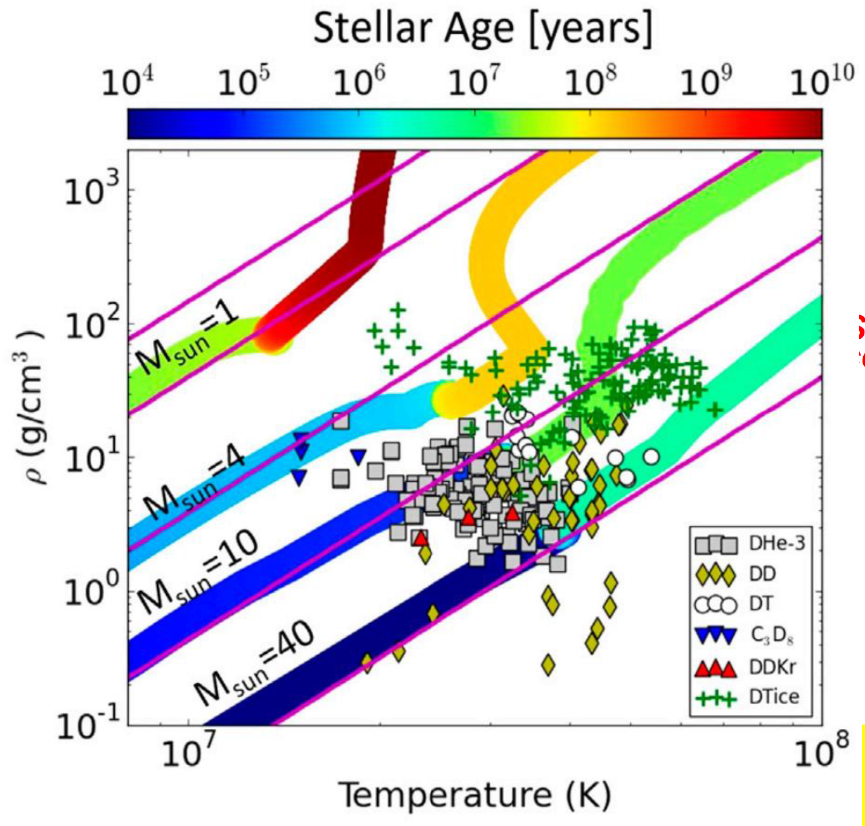
Motivation
Capsule implosions at the OMEGA and NIF lasers create HED-plasma conditions that are similar to the interior of a star
Stellar age [years]
Stellar age [years]
10⁸
1 MSun
10 MSun
10⁶
10⁴
40 MSun
Time
Density [g/cc]
Density [g/cc]
10²
NIF CH
NIF ignition
10⁰
OMEGA CH
Example NIF implosions
Time
10⁻²
10⁷
10⁸
10⁹
Temperature [K]
Temperature [K]
Stellar evolution simulations by Dave Dearborn (LLNL).

Slide 11


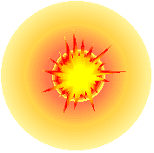
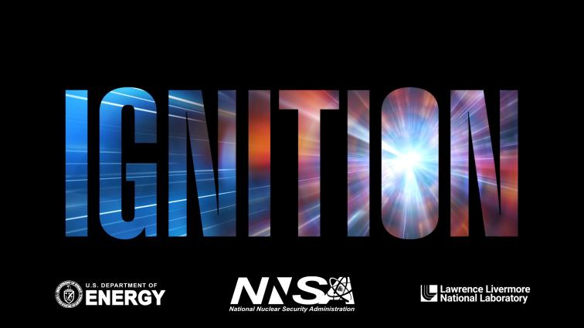
Motivation
Neutron fluxes achieved at the National Ignition Facility (NIF) are higher than anywhere else on earth by several orders of magnitude
Example:
4e17 neutrons/implosion¹
Burn duration <100 ps
→ 4e27 n/s
Burn region size ~100μm
→ ~10³⁰ n/s/cm² in capsule
Hohlraum radius ~3mm
~10²⁷ n/s/cm² on hohlraum wall
Such fluences are directly relevant for s- and/or r-process studies^{2,3}
capsule
10 µm fill-tube
¹H. Abu-Shawareb et al., Phys. Rev. Lett. 129, 071001 (2022); A. Zylstra et al., Nature 601, 542 (2022).
²S. LePape et al., Phys. Rev. Lett. 120, 245003 (2018)
³C. Cerjan et al., J. Phys. G: Nucl. Part. Phys. 45, 033003 (2018)
Notes:
This is an aspect of HED experiments that we will not really get into in the talk today, but I still wanted to mention it to illustrate the possibilities
This should be compared to core collapse supernovae neutron densities of 10^22 n/s/cm^2

Slide 12
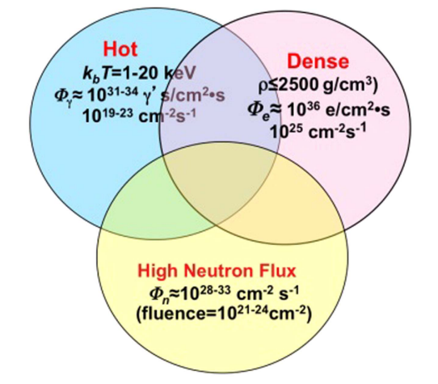
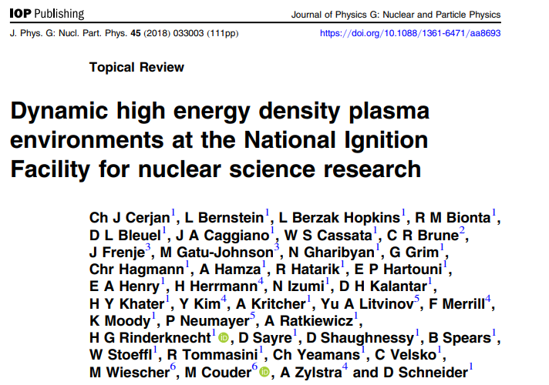
Motivation
At the NIF in particular, all these conditions come together in one experiment
Illustration from Cerjan et al.,
J. Phys. G: Nucl. Part. Phys. 45 (2018):

Slide 13
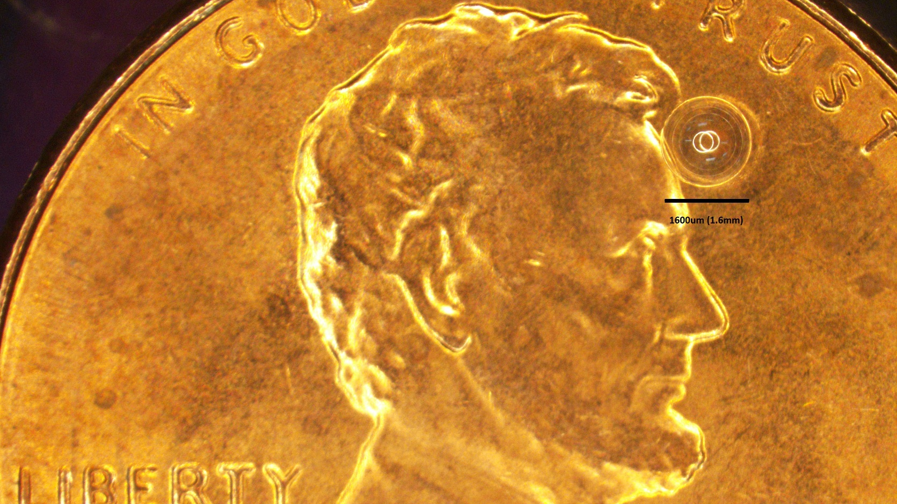
Background
Stellar-like conditions are reached by imploding capsules containing the relevant fuels
D+T
D+³He
Platform requirements depend on experiment type:
For charged reaction products: low areal density
For plasma effects: dopants in locations of interest
High enough yield to allow probing
Achievable plasma conditions determine astrophysical relevance
T+T
³He+³He
T+³He
D+D
p+D
Gatu Johnson et al., Phys. Plasmas 24, 041407 (2017)
Notes:
Challenge: Because of the dramatic reduction in reactivity towards lower temperature, it is much harder to produce sufficient yield at low temperature

Slide 14
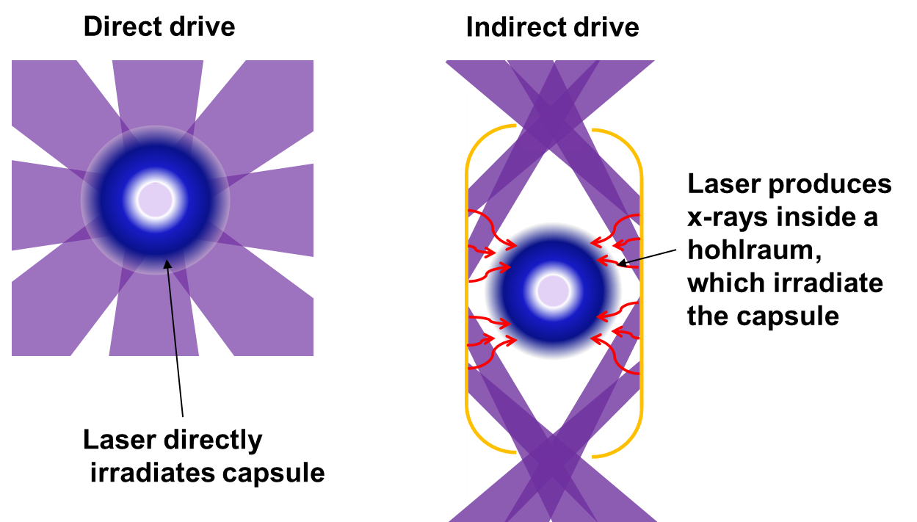
Background
There are two main ways of executing the implosions
Can achieve high temperature
Easier to get charged products out
Can achieve high compression
Know we can collect radioactive products
Options for sample placement

Slide 15
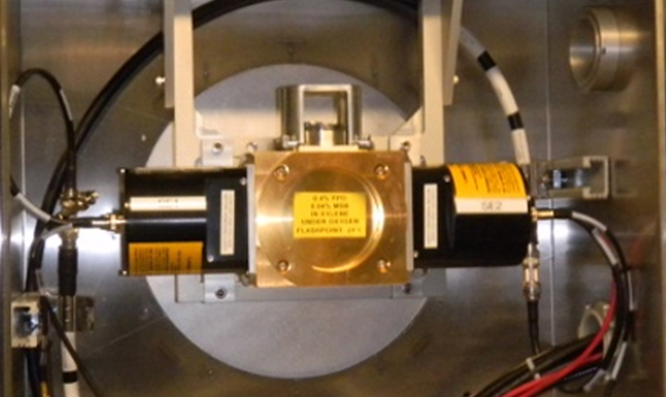
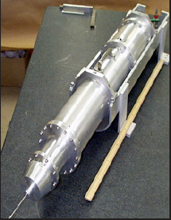
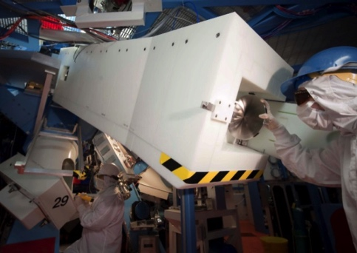
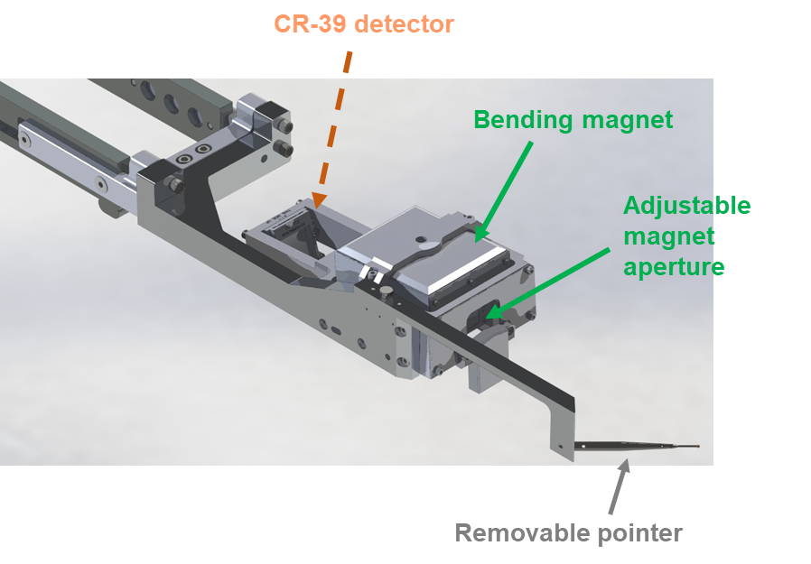
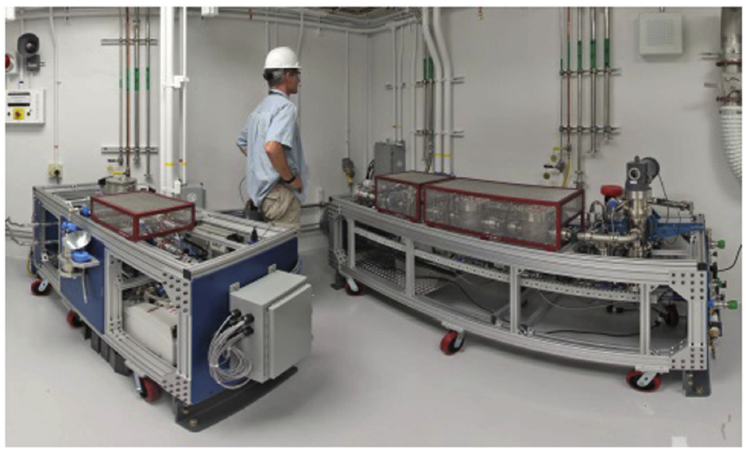

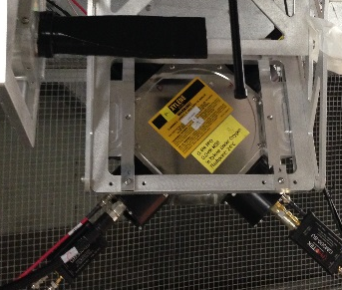
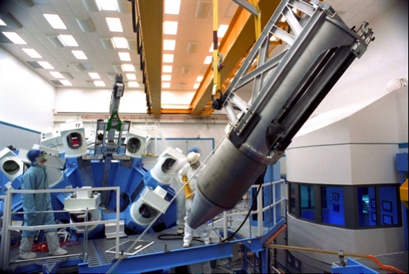
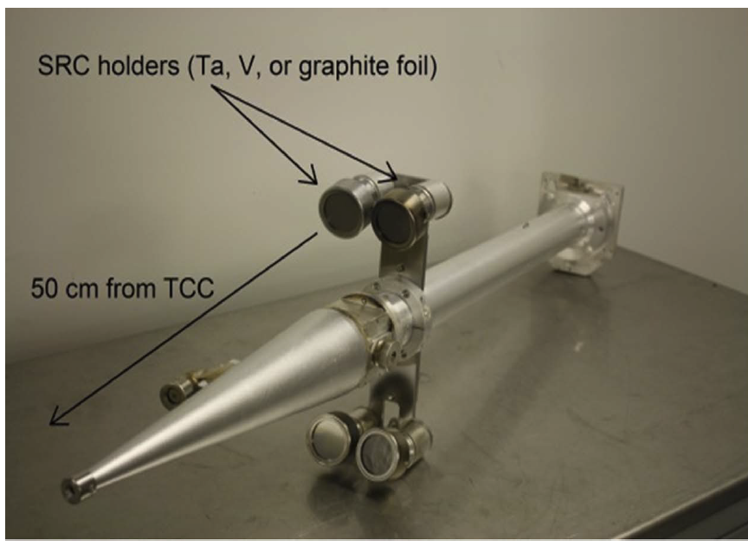
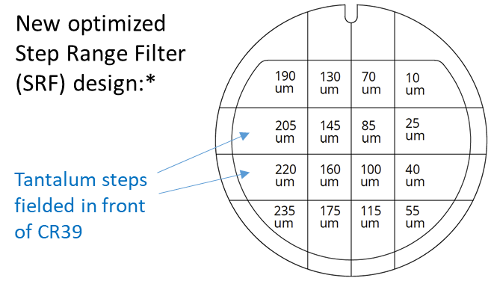
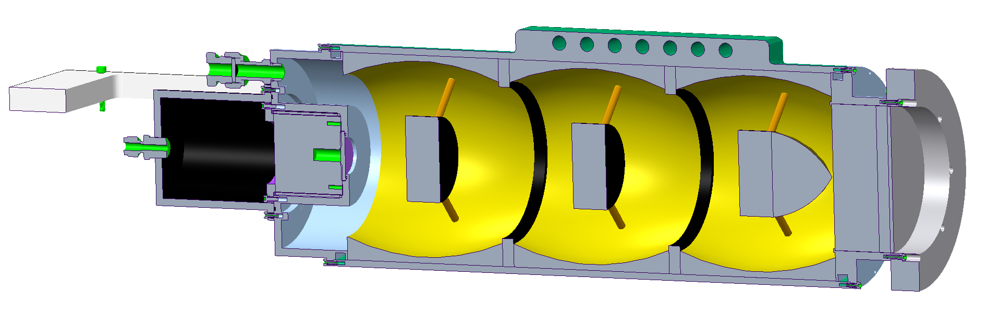
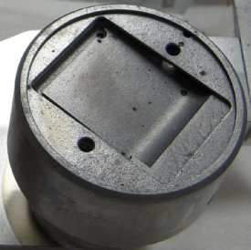
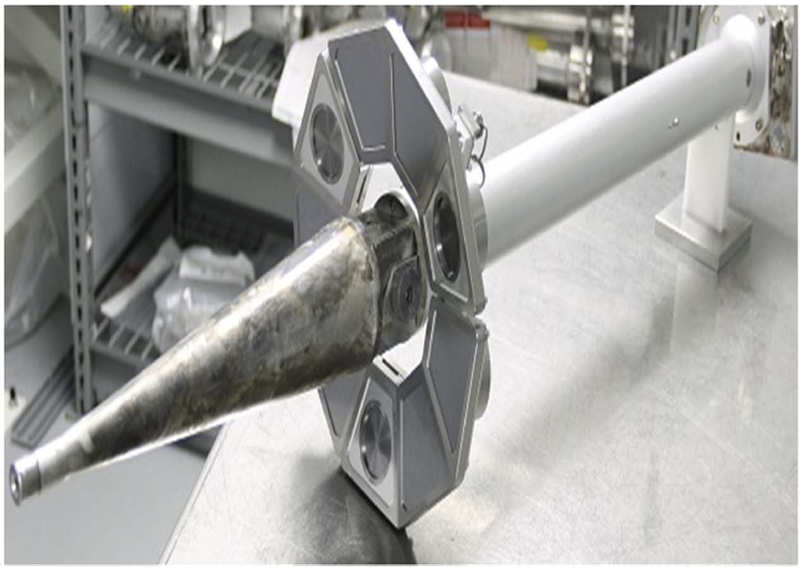
Existing and future nuclear diagnostics at the laser facilities enable
exploitation of these plasmas for study of nuclear astrophysics-relevant reactions
Diagnostics
Neutrons:
Gamma:
Low-Z ions:
Low-Z ions (new):
Radiochemistry:
nTOF¹
GCD³
MRS⁵
RAGS⁹
MagSpec
CPS⁶
SRC
SRF⁸
VCD⁴
nTOF²
Need capability to measure low-energy neutrons!
Need a gamma spectrometer!
5 cm
WRF⁷
¹Neutron time-of-flight spectrometer, Clancy et al., SPIE proceedings (2014)
²Neutron time-of-flight spectrometer, Forrest et al., RSI (2012, 2016)
³Gas Cherenkov Detector, Mack et al., NIM A (2013).
⁴Vacuum Cherenkov Detector, Jeet et al, submitted to RSI (2022)
⁵Magnetic Recoil Spectrometer, Frenje et al., RSI (2008)
⁶Charged Particle Spectrometer, Hicks, MIT PhD thesis (1999)
⁷Wedge-Range Filter proton spectrometer, Séguin et al., RSI (2003)
⁸Step Range Filter, Johnson et al., submitted to RSI (2022)
⁹Radiochemistry for gaseous samples, Shaughnessy et al., RSI (2012)
¹⁰Solid Radiochemistry Collectors, Shaughnessy et al., RSI (2014)
SRC

Slide 16
Summary
Exploration of Basic Nuclear Science and Nuclear Astrophysics using HED plasmas is a promising new field with much still to learn
High-Energy Density (HED) plasmas generated in laser-driven implosions provide a unique environment for studying stellar-relevant nuclear reactions:
  Plasma environment
  Hot and dense
  High neutron flux achievable
The NIF and OMEGA lasers are two primary facilities for executing experiments of this type
Experiments are made possible by enabling nuclear diagnostics
Initial results include spectral measurements of the reaction products from the T+T, ³He+³He, and T+³He six-nucleon systems, and S-factor measurements for T+³He-γ, p+D, p+T, and T+T
Ongoing efforts includes platform development for s-process-relevant (n,γ) cross section measurements and electron screening effect studies

Slide 17
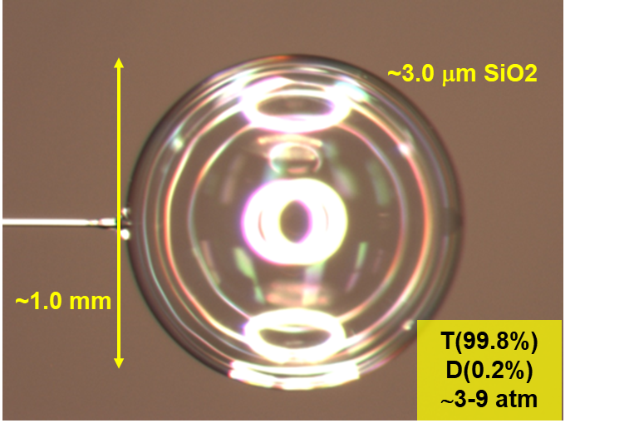
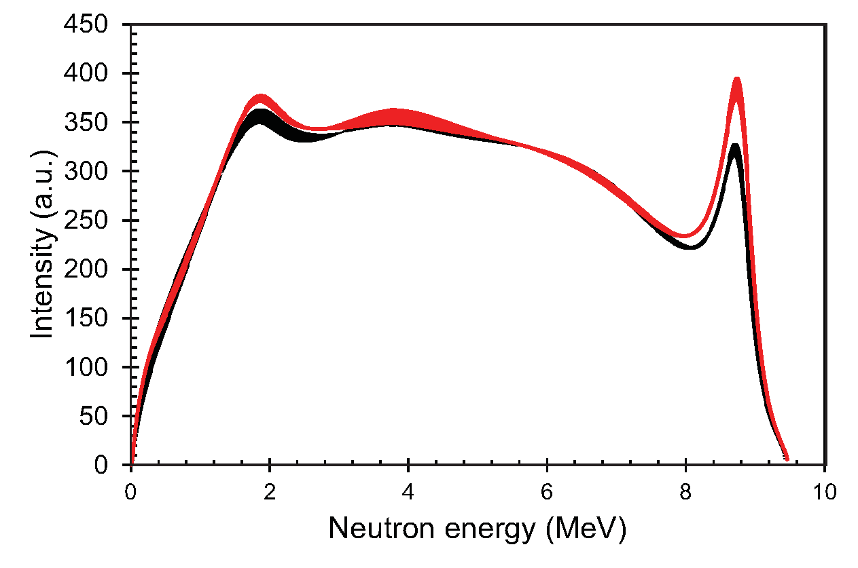
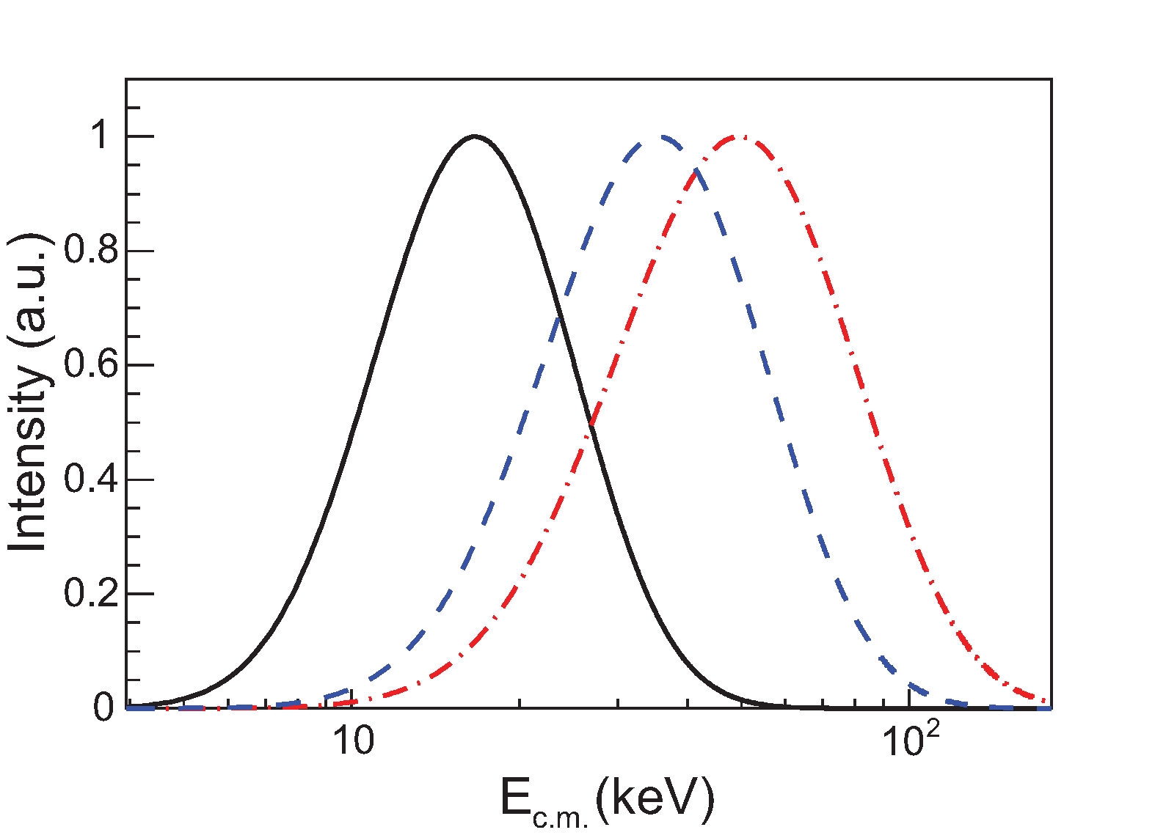
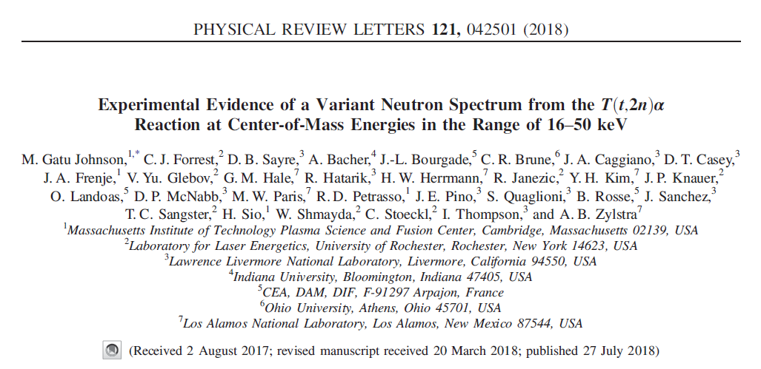
T+T reaction
ICF measurements of the T+T neutron spectrum suggests the reaction mechanism is c-m energy dependent
⁵He GS resonance
T + T → ??? → ⁴He + n + n
R-matrix fits to OMEGA data
⁵He + n
⁵He* + n
(nn)
E_{G}∼50 keV
E_{G}∼16 keV
9 atm fill
0.6 ns square laser pulse
All beams to TCC
9 atm fill
2 ns ramped laser pulse
defocused beams
3 atm fill
0.6 ns square laser pulse
All beams to TCC
Tion=4 keV
Tion=18 keV
nTOF
(Ref. 2)
Tion=11 keV
EG=16 keV
EG=50 keV
EG=36 keV
¹Gatu Johnson et al., Phys. Plasmas 24, 041407 (2017)
²Neutron time-of-flight spectrometer, Forrest et al., RSI (2012, 2016)
Notes:
R-matrix analysis assumes contributions from 0+ state (s-wave) only; p-wave may also contribute

Slide 18
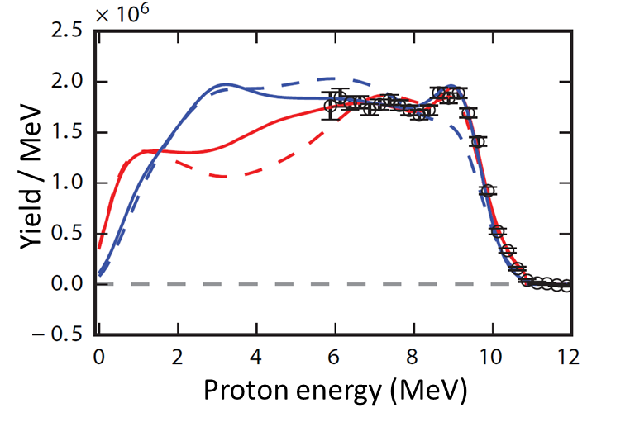
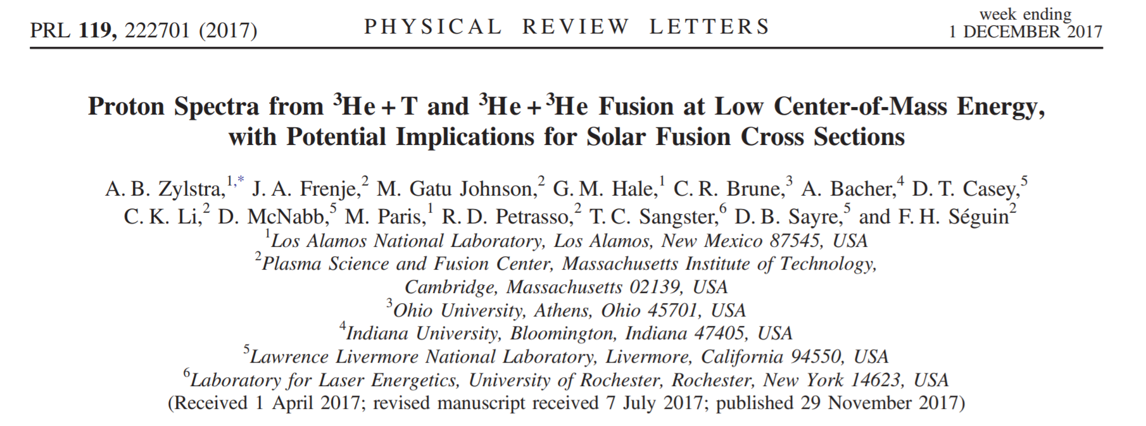
³He+³He, T+³He
Ongoing efforts are investigating whether a similar energy dependence may exist also for ³He+³He …
2-3 μm SiO2
³He+³He→α+p+p proton spectrum
OMEGA, EG=165 keV
20 atm
³He
Brune R-matrix
Hale R-matrix
5 cm
WRF
¹Zylstra et al., PRL (2017)
²Wedge-Range Filter proton spectrometer, Séguin et al., RSI (2003)
³Brune, Solar Fusion III workshop, 2022
Notes:
This data was collected at ~165 keV Gamow peak energy, but reactions happen at much lower energy in the sun

Slide 19
³He+³He, T+³He
Ongoing efforts are investigating whether a similar energy dependence may exist also for ³He+³He …
2-3 μm SiO2
³He+³He→α+p+p proton spectrum
OMEGA, EG=165 keV
Adelberger et al., Rev. Mod. Phys 83, 2011
20 atm
³He
Brune R-matrix
Bound electron screening
– cannot be avoided in accelerator measurements
Hale R-matrix
5 cm
WRF
ECM (MeV)
OMEGA ³He³He experiment (EG=165 keV)
Solar Gamow peak
NIF measurements
ICF-measured ³He+³He proton spectra can aid in interpretation of accelerator S-factor measurements³⁾
¹Zylstra et al., PRL (2017)
²Wedge-Range Filter proton spectrometer, Séguin et al., RSI (2003)
³Brune, Solar Fusion III workshop, 2022
Notes:
This data was collected at ~165 keV Gamow peak energy, but reactions happen at much lower energy in the sun

Slide 20
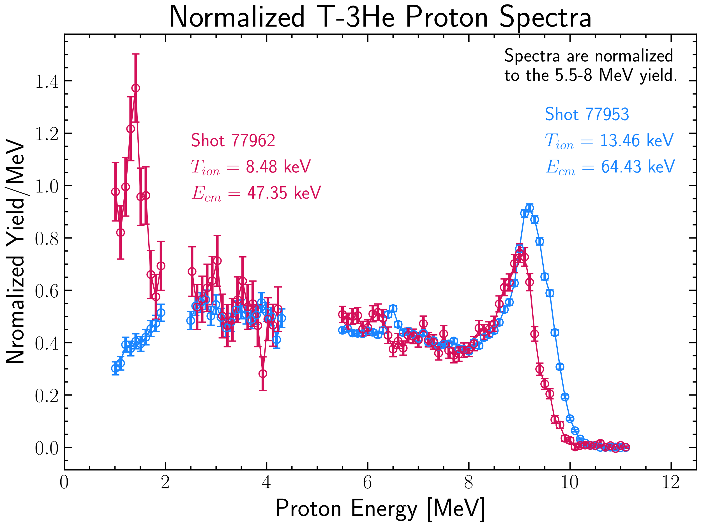
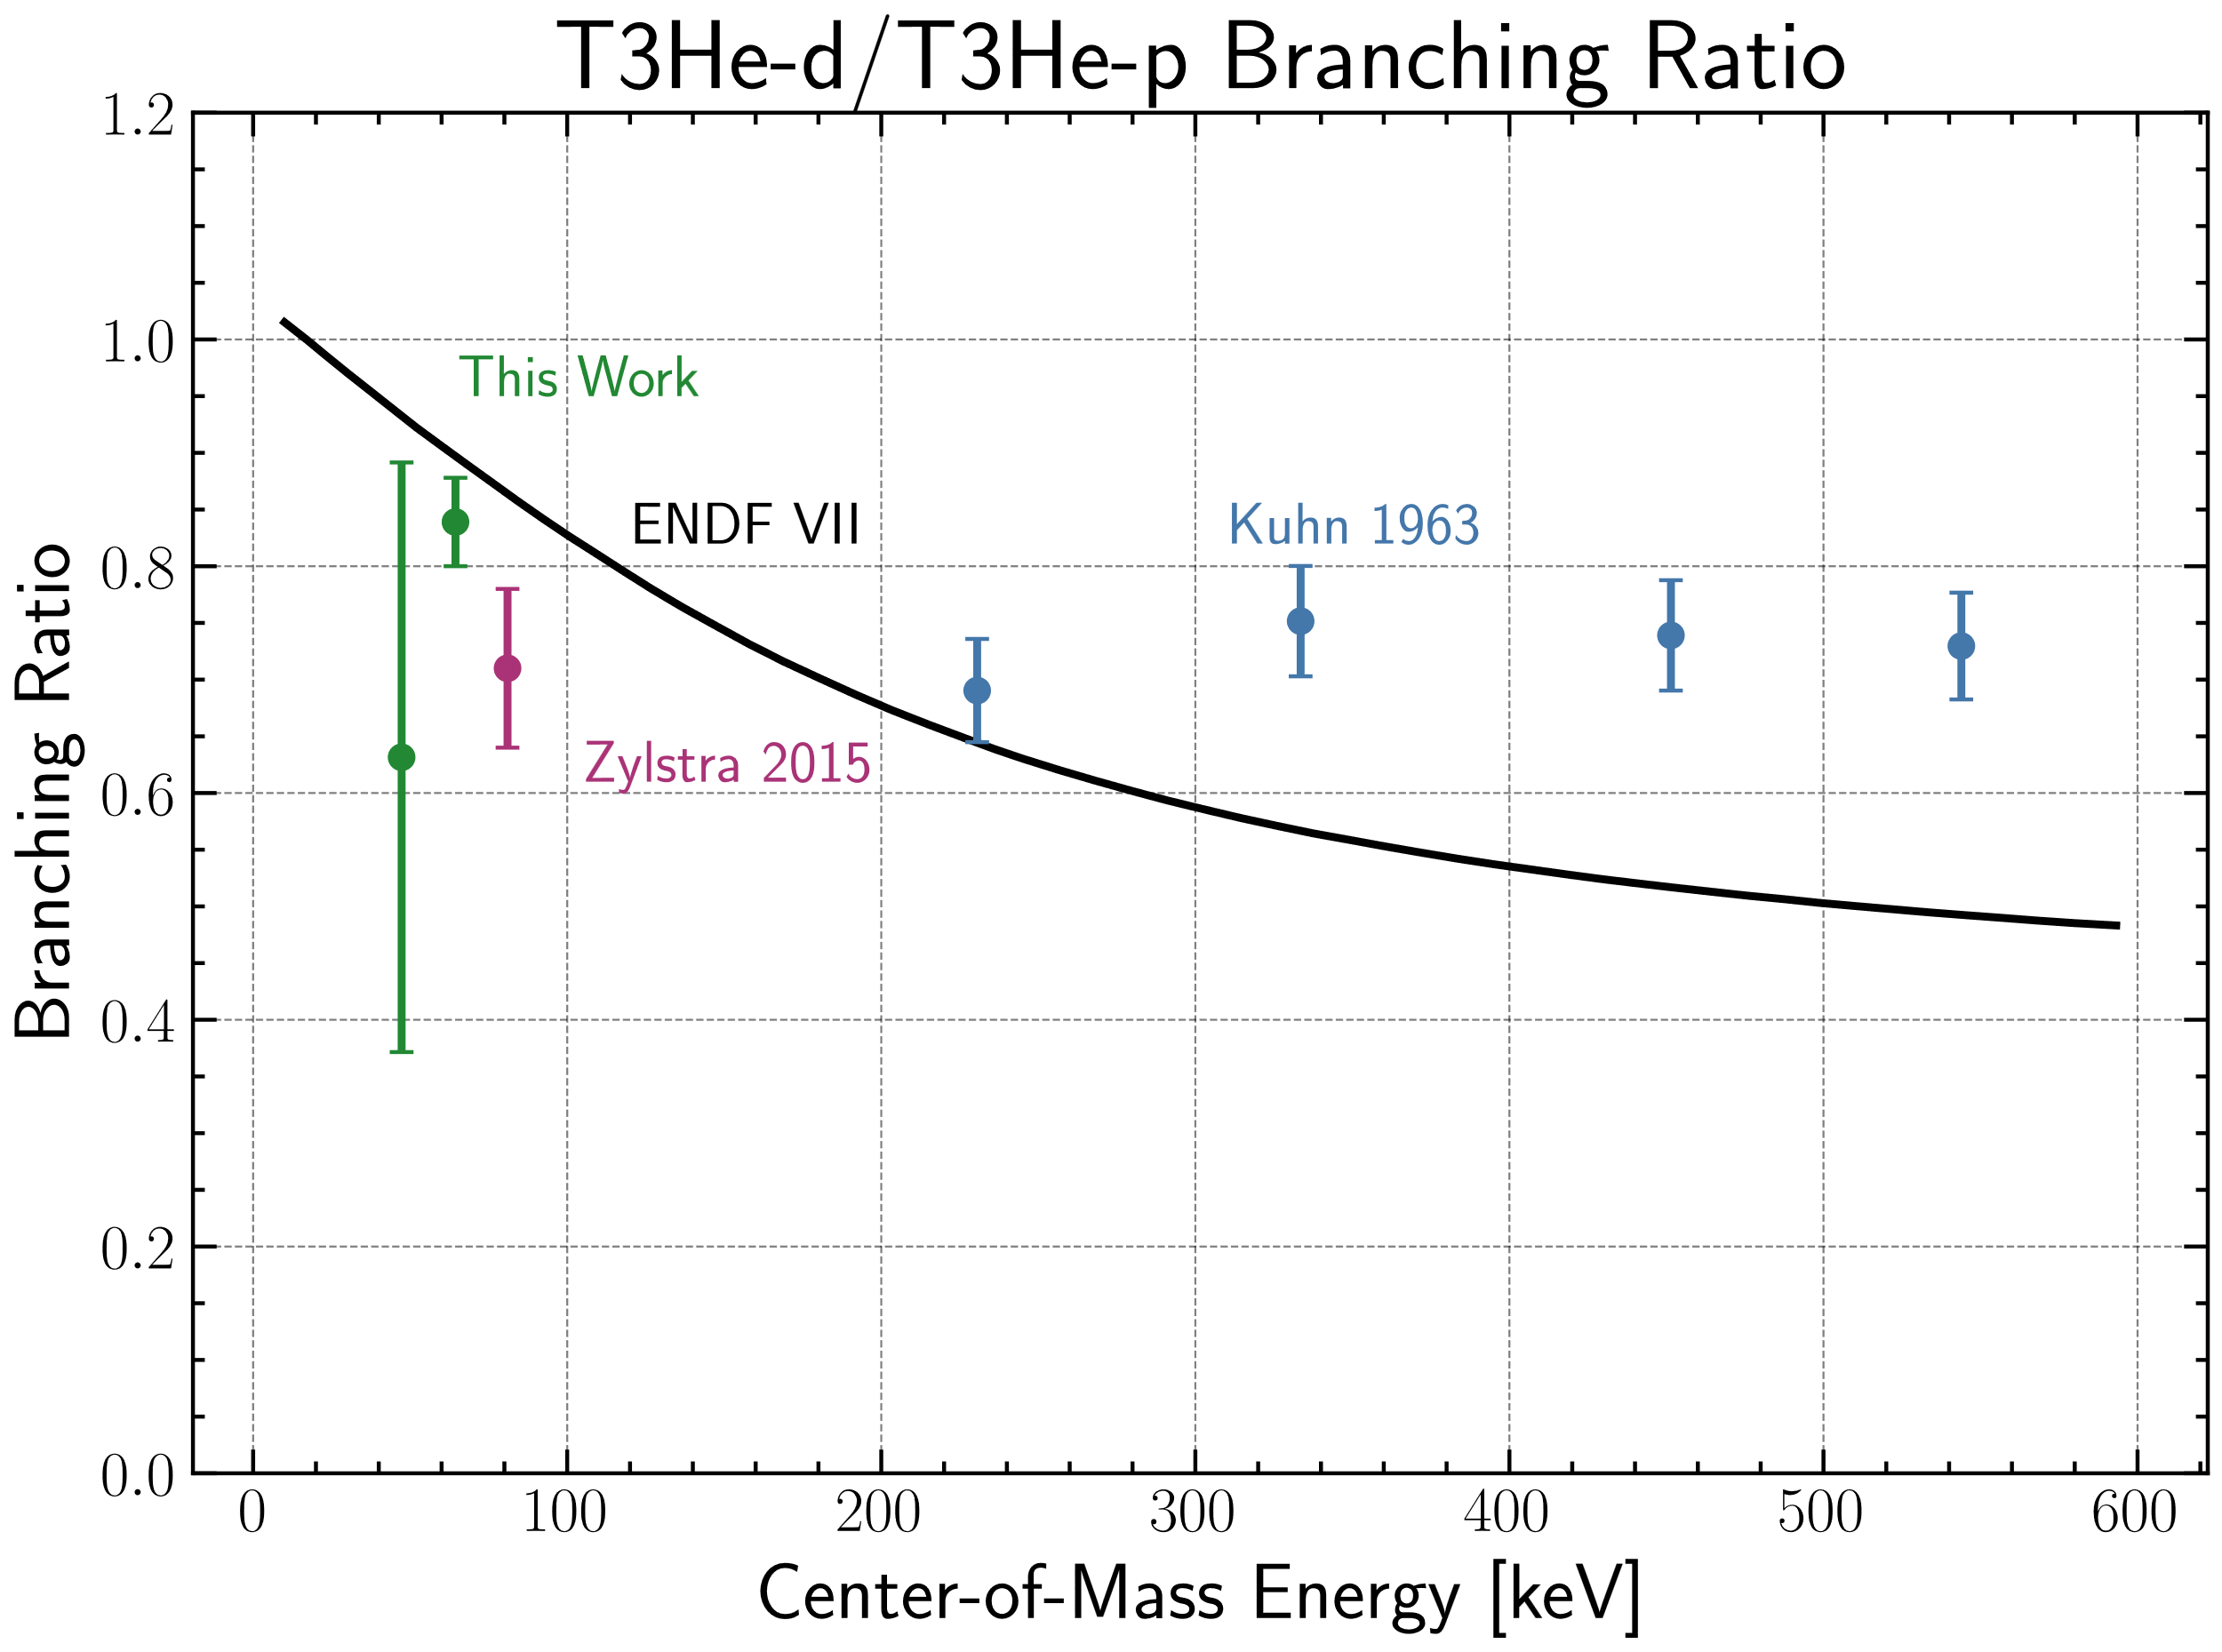
³He+³He, T+³He
Ongoing efforts are investigating whether a similar energy dependence may exist also for ³He+³He and T+³He
3 μm SiO2
T+³He→α+n+p proton spectrum
T+³He→α+d deuteron yield
OMEGA
20 atm
T³He
Not corrected for plasma effects
PRELIMINARY
Notes:
This data was collected at ~165 keV Gamow peak energy, but reactions happen at much lower energy in the sun

Slide 21
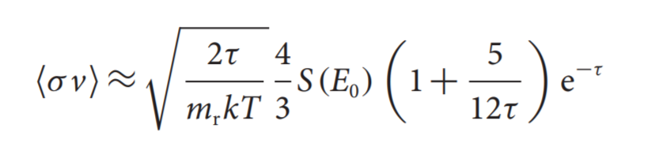
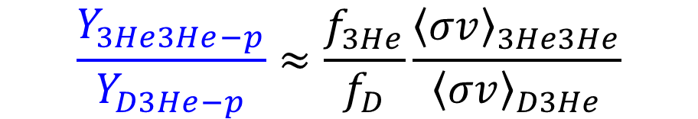
S-factor
Using this platform for S-factor measurements is challenging, as it requires accurate knowledge fuel composition and Tion
The ³He³He reactivity is determined based on the ³He³He-to-D³He yield ratio:
$$\frac{Y_{3He3He−p}}{Y_{D3He−p}}≈\frac{f_{3He}}{f_{D}}\frac{{\left\langle σv\right\rangle }_{3He3He}}{{\left\langle σv\right\rangle }_{D3He}}$$
Measure this
The S-factor is then calculated from the reactivity*:
*Casey et al., Nature Physics (2017)
Notes:
As an example, let’s look at how we would infer the S-factor for the 3He3He reaction

Slide 22
S-factor
Using this platform for S-factor measurements is challenging, as it requires accurate knowledge fuel composition and Tion
The ³He³He reactivity is determined based on the ³He³He-to-D³He yield ratio:
$$\frac{Y_{3He3He−p}}{Y_{D3He−p}}≈\frac{f_{3He}}{f_{D}}\frac{{\left\langle σv\right\rangle }_{3He3He}}{{\left\langle σv\right\rangle }_{D3He}}$$
Measure this
This must be accurately characterized
The S-factor is then calculated from the reactivity*:
*Casey et al., Nature Physics (2017)

Slide 23
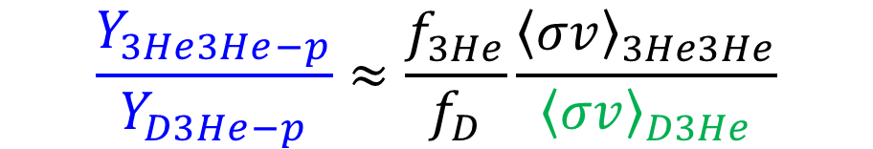
S-factor
Using this platform for S-factor measurements is challenging, as it requires accurate knowledge fuel composition and Tion
The ³He³He reactivity is determined based on the ³He³He-to-D³He yield ratio:
$$\frac{Y_{3He3He−p}}{Y_{D3He−p}}≈\frac{f_{3He}}{f_{D}}\frac{{\left\langle σv\right\rangle }_{3He3He}}{{\left\langle σv\right\rangle }_{D3He}}$$
Take this as known. Requires accurate knowledge of Tion:
Measure this
This must be accurately characterized
D+³He
T+T
³He+³He
T+³He
The S-factor is then calculated from the reactivity*:
D+D
p+D
*Casey et al., Nature Physics (2017)

Slide 24
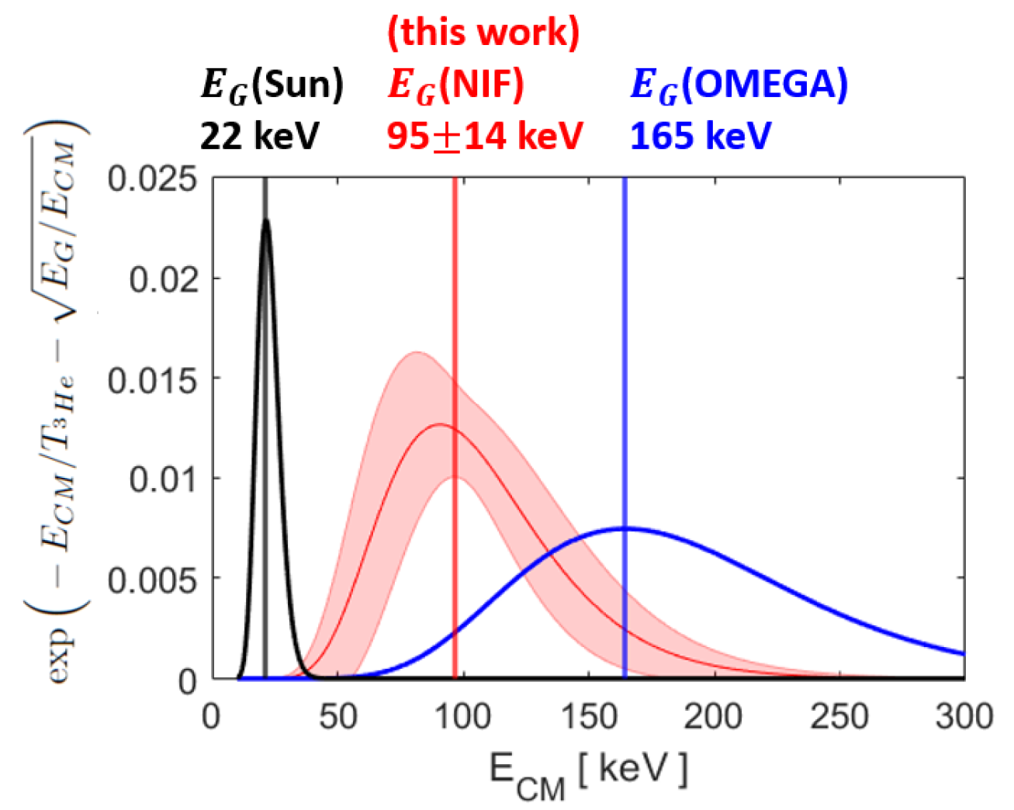

S-factor
Recent progress has been made in inferring Tion for ³He in implosions at the NIF
P.J. Adrian et al., Phys. Plasmas 2025

Slide 25


T+T S-factor
The ability to make S-factor measurements on this platform was demonstrated by measuring T+T relative to D+T on NIF
NIF SymCap
Casey et al., Nature Physics (2017)
nTOF

Slide 26

T+³He reaction
The S-factor for the T+³He-γ branch was measured relative to T+³He-d at OMEGA, ruling it out as a source for high ⁶Li levels in primordial material
2.5 μm SiO2
20 atm
T2/³He
T+³He γ-rays
(Ref. 1)
Gas Cherenkov Detector (GCD)
(Ref. 3)
(Ref. 2)
OMEGA
(EG = 80 keV)
(Ref. 5)
(Ref. 4)
Calculation by Gerry Hale (LANL)
EG (keV)
¹Blatt et al., Phys. Rev. (1968).
²Madsen et al., PRD (1990).
³Boyd et al., PRD (2010).
⁴Fukugita et al., PRD (1990).
⁵Mack et al., NIM A (2013).
Notes:
The rise towards low energy is due to a state just over the T3He threshold that was not previously included in the calculations

Slide 27



p+D reaction
The p+D S-factor was measured relative to the D+D S-factor in HED conditions, using plastic shell OMEGA implosions
New, higher pressure, reduced threshold Gas Cherenkov Detector (GCD)
²H(p,γ)³He (γ @ 5.5 MeV)

Slide 28


p+D reaction
A second OMEGA experiment subsequently extended the ²H(p,γ)³He study to span a broader range of CM energies
Work by Zaarah Mohamed
Z. Mohamed et al., Front. Phys. 10:944339. (2022); submitted to Phys. Rev. C (2022).
Notes:
From Zaarah: The error bars on the pD measurement are mainly due to statistics (low repetition of shots at different Tion due to the need to include shots for DD background + relatively low counting statistics on Cherenkov photons). These could be minimized with more shots and this is also why Alex's error bar is smaller (as all his shots were at a single Tion).

Slide 29

p+T reaction
Implosions at OMEGA with the enabling GCD detectors also provided the first ³H(p,γ)⁴He S-factor measurements in an HED setting
Work by Zaarah Mohamed
Z. Mohamed et al., Front. Phys. 10:944339. (2022); submitted to Phys. Rev. C (2022).
Notes:
Zaarah: The line from the accelerator data ("Canon (2002)") in the pT plots was from a fit that they did to their two data points along with higher energy accelerator data. It looks like my data agrees with their individual data points at low energies but not with their fit which includes the higher energy data from the literature.

Slide 30
Summary
Exploration of Basic Nuclear Science and Nuclear Astrophysics using HED plasmas is a promising new field with much still to learn
High-Energy Density (HED) plasmas generated in laser-driven implosions provide a unique environment for studying stellar-relevant nuclear reactions:
  Plasma environment
  Hot and dense
  High neutron flux achievable
The NIF and OMEGA lasers are two primary facilities for executing experiments of this type
Experiments are made possible by enabling nuclear diagnostics
Initial results include spectral measurements of the reaction products from the T+T, ³He+³He, and T+³He six-nucleon systems, and S-factor measurements for T+³He-γ, p+D, p+T, and T+T
Ongoing efforts includes platform development for s-process-relevant (n,γ) cross section measurements and electron screening effect studies

Slide 31




Excited states
B. Appelbe DS project
A NIF platform is being developed to study neutron capture cross sections on s-process branch point nuclei in plasma environment
Coat inner shell with ¹⁷¹Tm (~10¹⁵ atoms) and ⁸⁹Y (~10¹⁶ atoms)
Measure reaction products using solid radiochemistry
¹⁷¹Tm(n,γ)¹⁷²Tm
⁸⁹Y(n,γ)⁹⁰Y (monitor reaction)
3 mm diameter CH capsule
Polar DIM
(0,0)
4 collectors
D2 gas
Solid debris collection
250 um copper fill tube
Large collector
DIM 90-315
VADER collector
DIM 90-78
Vary plasma conditions to tune ¹⁷¹Tm ground state/1st excited state ratio
Large area solid radiochemistry collector, 1-5%
Collection of noble gas products
RadChem:
J. Despotopulos
Challenge: accurate knowledge of neutron spectrum
Radiochemical Analysis of Gaseous Species (RAGS)

Slide 32

Excited states
B. Appelbe DS project
A NIF platform is being developed to study neutron capture cross sections on s-process branch point nuclei in plasma environment
Coat inner shell with ¹⁷¹Tm (~10¹⁵ atoms) and ⁸⁹Y (~10¹⁶ atoms)
3 mm diameter CH capsule
D2 gas
250 um copper fill tube
Vary plasma conditions to tune ¹⁷¹Tm ground state/1st excited state ratio
Calculation by J. Escher
Calculation by Dr J Escher
Start at 2.5 MeV
Element of interest with significant ground/excited state cross section difference at 2.5 MeV?
Challenge: accurate knowledge of neutron spectrum

Slide 33

Screening
An ongoing NIF experiment is addressing the impact of bound electron screening
³He(d,p)⁴He
M. Aliotta et al, NP A (2001).
S. Engstler et al., Phys. Lett. B (1988).

Slide 34


Screening
An ongoing NIF experiment is addressing the impact of bound electron screening
Conclusion: if compression is too high, the protons cannot escape the shell!
M. Aliotta et al, NP A (2001).
S. Engstler et al., Phys. Lett. B (1988).

Slide 35


Screening
The first step is to measure the bare nuclear cross section, but longer term, we want to measure plasma screening user higher density plasmas
An experiment to probe plasma screening requires that
the effect is larger than the experimental yield uncertainty
  Higher charge Z
  Lower temperature kT
  Higher density n
  Lower Tion → lower yield
  Higher density → charged particles won’t escape
Proposed path forward: Increase Z to get high screening in a feasible experiment
  Design calculations under way to find the right regime
  Effort to minimize experimental uncertainties in progress
Simplest plasma screening model¹⁾:
→ larger screening effect:
$$\frac{σ_{screened}}{σ}≈e^{Z_{1} Z_{2}{ \tilde{z} Λ}_{0}}$$
$$Λ_{0}= {\left(4π\right)}^{1/2}{ e}^{3}{{ n}^{1/2}}/{{\left(kT\right)}^{3/2}}$$
We are working on designing an experiment where plasma screening effects will be directly measureable
¹Salpeter, E. E., Aust. J. Phys. 7, 373. (1954)

Slide 36



Screening
Design calculations suggest that this is achievable
- but not with the protons escaping
Λ0=10⁰
10⁻¹
Layered
implosions
Gas filled
implosions
(higher-Z)
10⁻²
10⁻³
Can we move here?
1 MSun
4 MSun
10 MSun
40 MSun
10⁻⁴
Density [g/cc]
10⁻⁵
Layered
implosions
Gas filled
implosions
10⁻⁶
10⁻⁷
Gas filled
implosions
Temperature [K]
$$\frac{σ_{screened}}{σ}≈e^{Z_{1} Z_{2}{ \tilde{z} Λ}_{0}}$$
Might require development of a new higher-efficiency gamma detector
D. Casey et al., Front. Phys. 10:1057603. (2023)
Notes:
Λ0 is the so called chargeless plasma parameter
One reason why plotting it this way is convenient because the star’s effective Z’s are changing through the burn but this takes that dimension out. We just have to remember that Zeff is not constant so screening increases with age as stars build up higher Z, and obviously higher Z reactions are screened more strongly.

Slide 37

Screening
An initial experimental test also looks promising
Layered
implosions
Can we move here?
Gas filled
implosions
$$\frac{σ_{screened}}{σ}≈e^{Z_{1} Z_{2}{ \tilde{z} Λ}_{0}}$$
Might require development of a new higher-efficiency gamma detector
D. Casey et al., Front. Phys. 10:1057603. (2023)
Notes:
Λ0 is the so called chargeless plasma parameter
One reason why plotting it this way is convenient because the star’s effective Z’s are changing through the burn but this takes that dimension out. We just have to remember that Zeff is not constant so screening increases with age as stars build up higher Z, and obviously higher Z reactions are screened more strongly.

Slide 38

Screening
First step – improved measurement of d+³He-γ/p branching ratio
OMEGA laser
Protons: CR-39-based charged particle detectors; well-known efficiency
γ: gas Cherenkov detectors (GCD); require calibration
Config 1: D-3He
Thin SiO₂ (Hoppe)
Wall = 3.0±0.2 um
OD = 1000±50 um
8.6 atm ³He + 4.3 atm D₂
TPS2
Puck material with well-known (p,γ) cross section?

Slide 39

Future
There is a rich set of opportunities to study nuclear reactions using HED plasmas at OMEGA and the NIF
Charged-particle induced reactions:
T(t,2n)⁴He (analogue to ³He(³He,2p)⁴He) [1]
T(³He,np)⁴He, T(³He,d) ⁴He, T(³He,γ)⁶Li (BBN) [2]
³He(³He,2p)⁴He (pp-I) [3]
D(p,γ)³He (Brown dwarfs, protostars) [4]
T(d,γ)⁵He [5]
⁴He(D,γ)⁶Li (BBN)
⁴He(T,γ)⁷Li (BBN)
⁴He(³He,γ)⁷Be (Solar)
⁶Li(p,α)³He (BBN)
⁷Li(p,α)⁴He (BBN)
⁷Be(p,γ)⁸B (Solar)
⁷Be(α,γ)¹¹C (BBN)
¹¹B(p,α)⁸Be (Basic nuclear)
¹⁵N(p,α)¹²C/ ¹⁵N(p,γ)¹⁶O (CNO)
¹⁰B(p,α)⁷Be [8]
¹²C(p,γ)¹³N [8]
¹⁴N(p,γ)¹⁵O [8]
Neutron-induced reactions:
n-d and n-T at 14 MeV [6]
D(n,2n) at 14 MeV [7]
T(n,2n) at 14 MeV
Various (n,γ) processes
Li(n,2n), Be(n,2n), other (n,2n) processes
double neutron capture (M. Paul)
Plasma effects:
Screening
s-process relevant reactions
NEET/NEEC (A. Ratkiewicz)
r-process relevant reactions
Proton-proton chain
Published
Ongoing
Proposed
Near future?
1: Casey et al., PRL 2012; Sayre et al., PRL 2013; Gatu Johnson et al., PRL 2018
2-4: Zylstra et al., PRL 2016; Zylstra et al., PRL 2017
5: Kim et al., PoP and PRC (2012)
6: Frenje et al., PRL 2011
7: Forrest et al., NIM A 2018
8: Wiescher et al., Front. Phys 2022
Proposed for NIF
CNO cycle
Notes:
Lessons learned from studies of these reactions together with new enabling diagnostics will be used to conduct HED experiments to probe other light-ion reactions in the future

Slide 40
Summary
Exploration of Basic Nuclear Science and Nuclear Astrophysics using HED plasmas is a promising new field with much still to learn
High-Energy Density (HED) plasmas generated in laser-driven implosions provide a unique environment for studying stellar-relevant nuclear reactions:
  Plasma environment
  Hot and dense
  High neutron flux achievable
The NIF and OMEGA lasers are two primary facilities for executing experiments of this type
Experiments are made possible by enabling nuclear diagnostics
Initial results include spectral measurements of the reaction products from the T+T, ³He+³He, and T+³He six-nucleon systems, and S-factor measurements for T+³He-γ, p+D, p+T, and T+T
Ongoing efforts includes platform development for s-process-relevant (n,γ) cross section measurements and electron screening effect studies

Slide 41


Future
A recent Frontiers in Physics “Research Topic” collects articles on ongoing work at this new frontier
https://www.frontiersin.org/research-topics/29357/using-high-energy-density-plasmas-for-nuclear-experiments-relevant-to-nuclear-astrophysics

Slide 42
Extra

Slide 43

S-factor
Constraining T_{ion} is key for S-factor analysis; for the NIF shots, DD-n T_{ion} is 9.3 keV,
D³He-p upper limit “T_{ion}” is 15.6 keV and recent analysis constrains ³He T_{ion} to 12.4±3.2 keV
The error bar in the inferred T_{ion} is not yet considered in this analysis
Using DD-n Tion
Using ³He Tion
Using D³He-p “Tion”

Slide 44



Short-pulse lasers
Short pulse lasers are another category of laser facilities potentially useful for nuclear astrophysics-relevant experiments
LaserNet (US/Canada)
Extreme Light Infrastructure
  ELI-Nuclear Physics (Romania)
ELI-NP

Slide 45




Short-pulse lasers
Short pulse lasers are another category of laser facilities potentially useful for nuclear astrophysics-relevant experiments
LaserNet (US/Canada)
Extreme Light Infrastructure
  ELI-Nuclear Physics (Romania)
ELI-NP

Slide 46

Challenges
There are challenges remaining in making this platform work for S-factor measurements with reactions involving ions other than hydrogen
Y. Xu et al., Nucl. Phys. A 918, 61 (2013)

Slide 47

Challenges
There are challenges remaining in making this platform work for S-factor measurements with reactions involving ions other than hydrogen
Temperature and density gradient effects?
Non-thermal effects?
Y. Xu et al., Nucl. Phys. A 918, 61 (2013)

Slide 48


Excited states
Calculations suggest life times for neutron-induced excited states relevant for probing successive neutron reactions in DT experiments at the NIF
Example: Persistence cross sections for excited states in ¹⁹⁷Au
After (n,n’) reactions:
After (n,2n) reactions:

Slide 49

T+T reaction
The energy dependence might be understood as due to increasing p-wave contributions at higher energy
R-matrix analysis assumes contributions from 0⁺ state (s-wave) only
Theoretical calculations* indicate that 0⁻ (p-wave) might contribute towards higher energy
For 0⁻, channels other the n+⁵He will be suppressed → more 0⁻ gives more n+⁵He
If this is the explanation, then it is likely that an energy dependence will exist also for ³He+³He
*K. Arai et al., Phys. Rev. C 74, 034305 (2006)

Slide 50



NIF
Measured proton spectra, differentially filtered x-ray penumbral imaging, and x-ray burn history are being used¹⁾ to constrain NIF implosion conditions
Average WRF Measurements for N200211-003 (19% D content)
750 Ti
600 Ti
400 Ti
500 Ti
¹⁾ P.J. Adrian, PhD thesis, MIT (2023); submitted to Phys. Plasmas (2024)

Slide 51








NIF
The penumbral x-ray images are used to constrain the hot-spot
volume (Vhs), and the SPIDER burn history data gives the burn duration (τ)
$$B$$
$$210 μm$$
(a) (b)
$$30\%$$
$$A$$
$$238 μm$$
Polar View
$$B$$
$$210 μm$$
(c) (d)
$$30\%$$
18 $μm$
CH Ablator
³He 10.2 atm
$$C$$
$$225 μm$$
Equator
View
¹⁾ P.J. Adrian, PhD thesis, MIT (2023)

Slide 52

NIF
The brightness (PSL) of each image is then used to constrain ne and Te given measurements of Vhs and τ
¹⁾ P.J. Adrian, PhD thesis, MIT (2023)

Slide 53


NIF
Finally, D³He Tion is inferred by using inferred ne and Te to calculate
ranging of the D³He protons and matching to the measured spectrum
Birth spectra Tion = 15.6 keV
Plasma Stopping + WRF inst. Response
WRF Data
¹⁾ P.J. Adrian, PhD thesis, MIT (2023)

