Slide 1

Direct Measurement of the Key Nuclear Reaction ¹⁹F(p, α₀)¹⁶O in AGB Stars
Yinji Chen, Fudan University
Jianjun He, Fudan University
Liyong Zhang, Beijing Normal University
Notes:
Good afternoon everyone, I am very happy to introduce some of our results here. My report is about xxx. My name is yinji chen, from Fudan University in Shanghai, China. Ok, Let’s begin my talk!

Slide 2

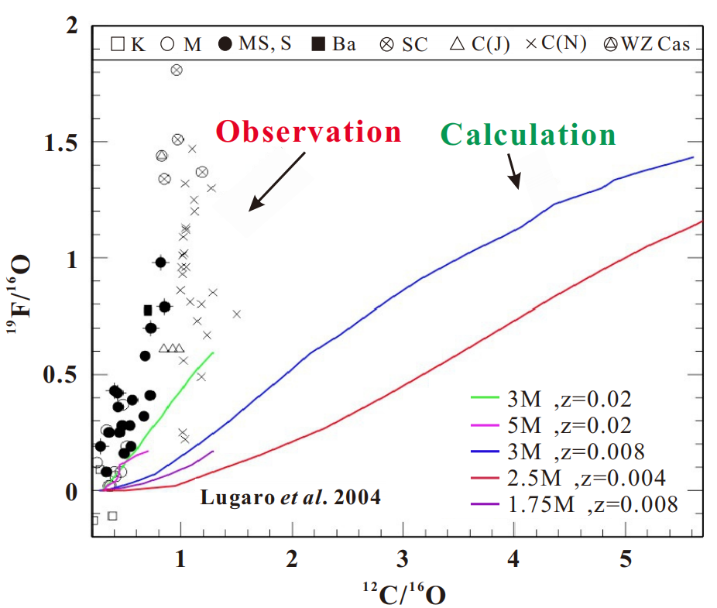

Fluorine overabundance in AGB stars
Fluorine is a key research object in the stellar nucleosynthesis
The standard stellar model is difficult to explain the Fluorine Overabundance
The nucleosynthesis model requires accurate ¹⁹F related nuclear reaction cross-section data
Maria Lugaro, et al., APJ 615 934 (2004)
1
Notes:
P1：众所周知氟元素是恒星核合成中的重点研究对象，但是我们只能在太阳系中观测到很少的氟。相反，如左图所示，人们观测到观测到氟超出了理论预测在AGB和RGB星中。但是标准恒星模型很难解释氟超丰。因此，我们需要测量并且提供与氟相关的核反应截面数据来提升核合成模型。
It is well known that the Fluorine is a key research object in the stellar nucleosynthesis, but we can only observe few fluorine in the solar system. On the contrary, as shown in the left picture, people have found the fluorine in AGB and RGB stars is much more than theory calculation. But the standard stellar model is difficult to explain the Fluorine Overabundance. So, we need to measure and provide accurate nuclear reaction cross-section data related to fluorine to improve the nucleosynthesis model.

Slide 3
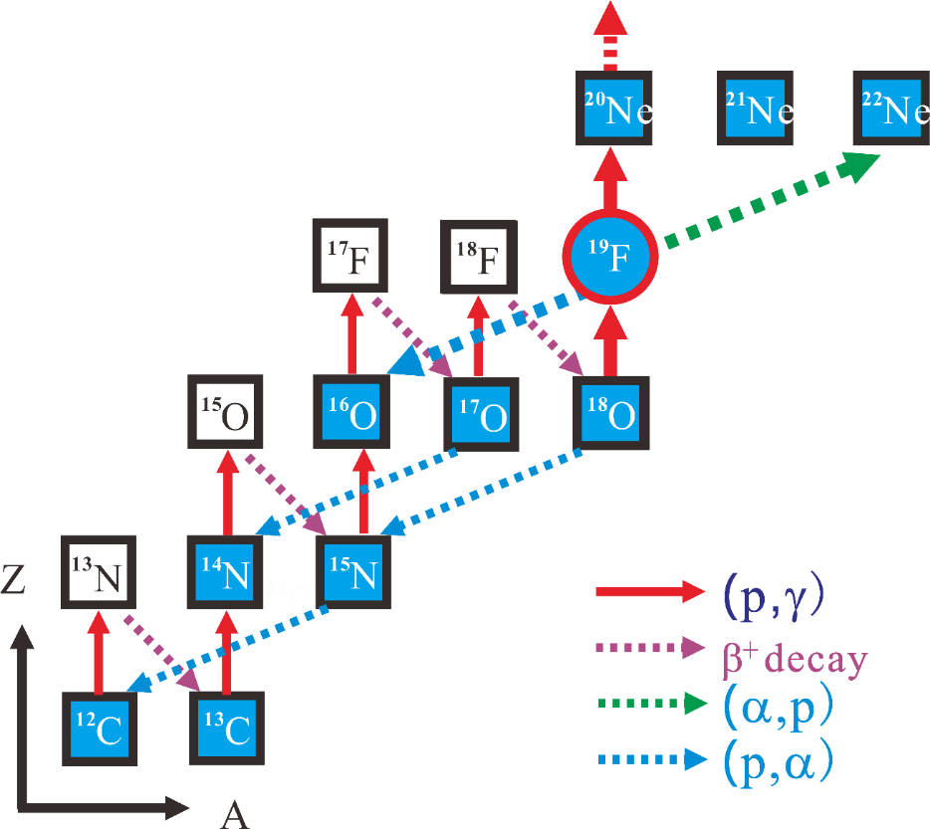
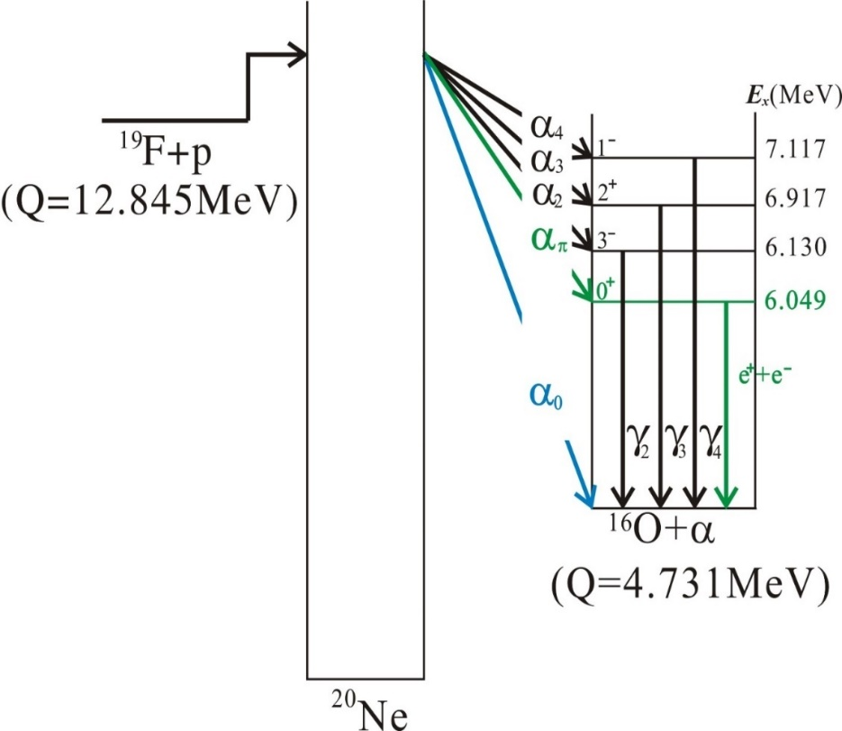
Nuclear reaction network related to 19F
Level scheme of the ¹⁹F + p system
Nuclear reaction network related to ¹⁹F
¹⁹F(p,α)¹⁶O + 8.11 MeV
channel:
(p,α₀)
(p,α_{π})
(p,α_{γ})
部分恒星演化核合成路径图
T < 0.15 GK, (p, α₀) contributes more;
T > 0.2 GK, (p, αγ) contributes more;
(p, απ) contributes < 10%, can be ignored
2
Notes:
P2：左边这张图展示了与氟相关的核反应网络，我们的测量主要关注一个破坏反应--19F(p,α)16O。右边这张图展示了这个反应的纲图。在这张图中，我们可以发现三个反应道：(p,aerfa-zero),αpi和αγ。在低温时，(p,aerfa-zero)道贡献更多，而在高温时，αγ道贡献更多。此外，αpi道被认为贡献小于10%，并且可以被忽略。我们的测量主要关注(p,aerfa0)道。
The left picture shows the Nuclear reaction network related to 19F, and our measurements mainly focus on a destruction reaction--19F(p, α)16O. The right picture shows the level scheme of this reaction. In this picture, we can find three reaction channels: (p, aerfa0), αpi, and αγ. At low temperatures, the (p, aerfa-zero) channel contributes more, but at high temperature, the αγ channel contributes more. Besides, the alpha-pi channel is considered to contribute less than 10% and can be ignored. Our measurement mainly focuses on the (p, aerfa-zero) channel.

Slide 4
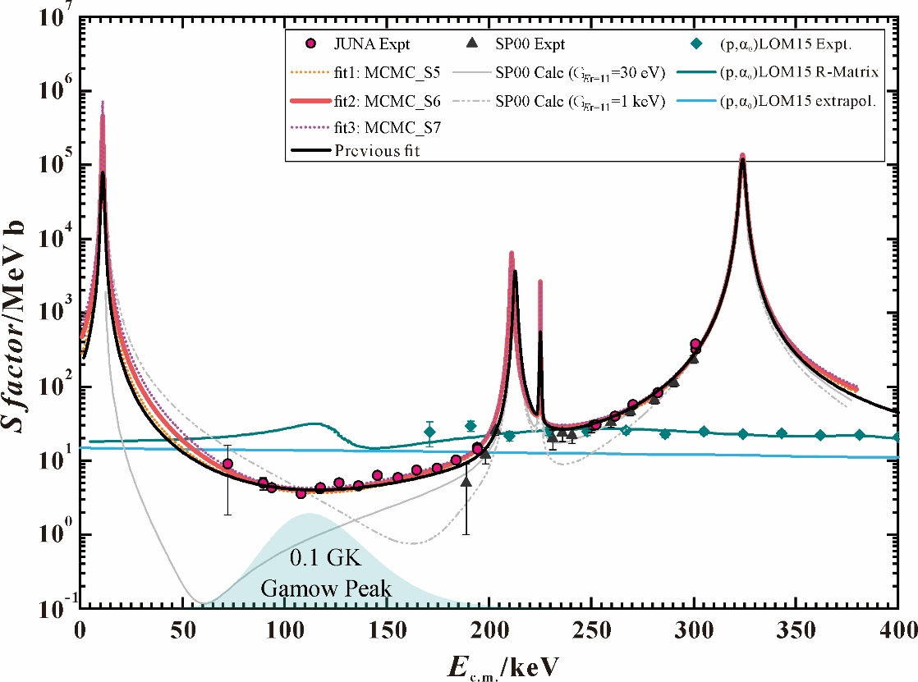
Importance of the (p, α₀) channel
within the energy range of 50 ~ 200 keV
(p,α0) channel contributes much more than (p,αγ) channel
within the temperature range of 0.03 ~ 0.12 GK
(p, α0) channel dominates the total (p, α) reaction rate
L.Y. Zhang, ..., Y. J. Chen et al., Phys. Rev. Lett. 127, 152702 (2021)
3
Notes:
P3：这张图比较了(p,α0)反应道和(p,αpi)反应道的S因子，其中红色的数据点展示了我们新的(p,αγ)道数据在JUNA测量的在中国四川，蓝线代表R矩阵计算的(p,α0)。我们可以发现，在50到200keV能量范围内，(p,α-aero)道贡献比(p,αγ)道多得多。这意味着在0.03到0.12GK温度范围内，(p,α-aero)道主导总的(p,α)反应率。
This picture compares the S factors of the (p, α-zero) channel and (p, αγ), and the red data points show our new results of (p, αγ) channel measured in JUNA 2021, and the blue line represent the (p,alpha-zero) channel. It’s a extrapolation of R-Matrix. We can find within the energy range of 50 to 200 keV, (p,α-zero) channel contributes much more than the (p,αγ) channel. It means within the temperature range of 0.03 to 0.12 GK, the (p, α-zero) channel dominates the total (p, α) reaction rate.

Slide 5
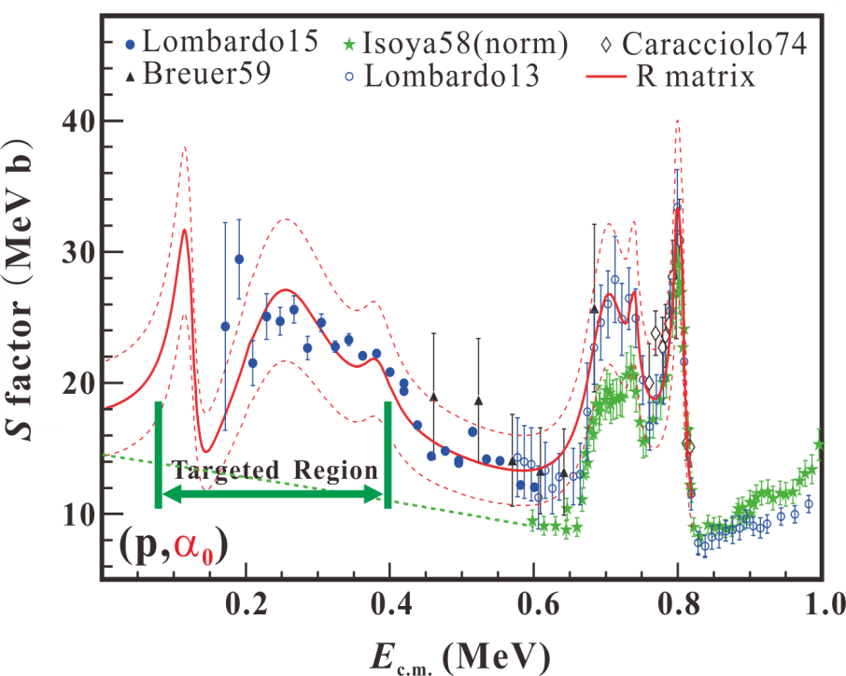
Data of the (p, α₀) channel
Gamow window ：70 ~ 350 keV
Previous data:
few experimental data below 200 keV
Goal of our new experiment：
energy range: 100 ~ 265 keV
total cross-section and angular distribution measurement
Platform：
HINEG at Hefei, China
4
Notes:
P4：这张图展示了(p,α-zero)道的实验数据和R矩阵结果。伽莫夫窗口是70到350keV, 用绿色箭头标识。但是只有很少的数据在伽莫夫窗口内，特别是在200keV以下。所以我们的新实验目标是在100到265keV能区内测量总截面和角分布。为了完成测量，我们选择了HINEG平台在中国合肥。
This picture shows the experimental data and R-matrix results of the (p, α-zero) channel. The Gamow window is 70 to 350 keV, labeled with green arrow。but only few data in the Gamow window, especially below 200 keV. So the goal of our new experiment is to measure the total cross-section and angular distribution in the energy range of 100 to 265 keV. To complete the measurement, we chose the HINEG platform at Hefei, China.

Slide 6

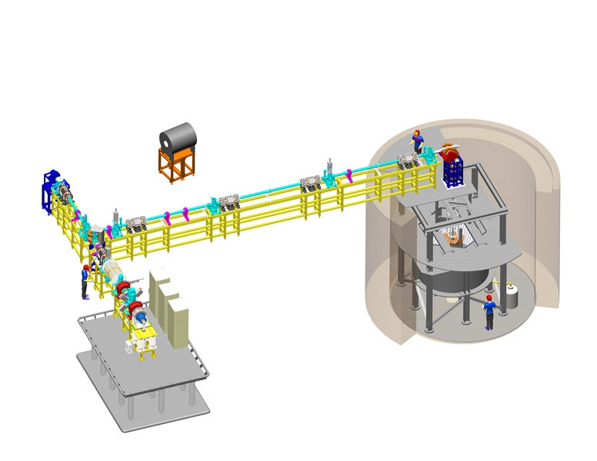
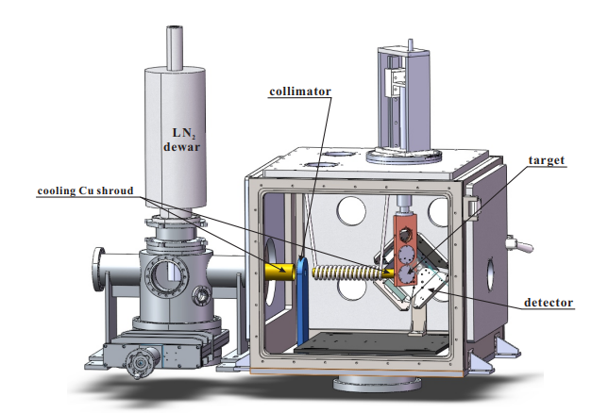
HINEG----Hefei Facility
new platform for nuclear astrophysics
Accelerating tube
shielded by PET
Ion source
(ECR)
Beam: H, D, He
High voltage：350kV
Beam intensity：target~2mA
Y. J. Chen, et al., NIMA 1054,168401(2023)
5
Notes:
P5：左边这张图展示了HINEG的加速器和束流线，它有两条束流线，这个加速器可以提供质子、氘和α束流，并且最大高压可以达到350kV，并且束流强度可以达到2mA。我们在九十度束流线上建立了一个新的用于核天体物理的实验终端。这个靶室用2mm的PET膜屏蔽，用液氮来提高真空度。我们已经在2023年发表了一篇文章来介绍这个平台的细节。The left picture shows the accelerator and beamline of the HINEG, it has two beamlines. This accelerator can provide proton, deuterium, and alpha beams, and the max high voltage is 350kV and the beam intensity can reach 2mA. We have established a new experimental platform for nuclear astrophysics at the 90 degree beamline. The target chamber is shielded by PET foil and we use liquid nitrogen to improve the vacuum。We have published a paper in 2023 to introduce the details of this platform.

Slide 7
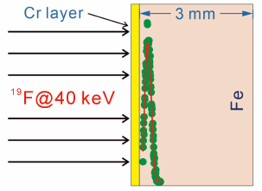
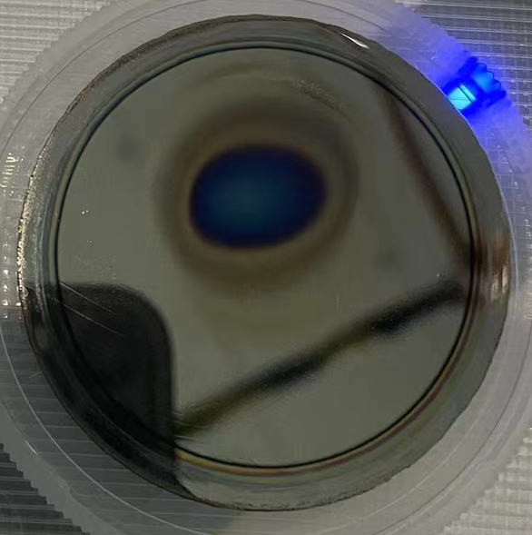
Target for experiment
Traditional evaporation targets can’t support long-term stable measurement with mA beam
Strong and durable fluorine-implanted targets
Backing: Fe 3mm
Implantation energy：40 keV
¹⁹F thickness: 10¹⁷/cm²
Protective layer: Chromium 50nm --reduce the ¹⁹F spatter loss effectively
¹⁹F loss: 4% per 200 Coulomb
Scanning beam:
The proton beam was undulated over an area about 3 cm in diameter by oscillating the magnetic field of the beam deflector.
L. Y. Zhang, Y. J. Chen, et al., NIMB 438 (2019) 48–53
6
Notes:
P6：然而传统蒸镀靶难以支持长期稳定的测量在mA束流下。因此，我们为实验开发了一个坚固耐用的氟注入靶。铁衬底厚度是3mm，注入能量是40keV，19F的密度是10^17/cm2。此外我们还提供了一个保护层在靶表面，它是50nm厚的铬，并且它可以有效减少19F的溅射损失。在我们的实验中，我们发现19F的损失为4%每200C。此外，我们还通过振荡束流偏转器的磁场来得到一个扫描的束流，质子束在一个3cm直径的区域内波动。我们也发表了一篇文章来介绍这个坚固的氟靶。
However, traditional evaporation targets can't support long-term stable measurement with mA beam. Therefore, we have developed a strong and durable fluorine-implanted target for the experiment. The iron backing is 3mm in thickness, the implantation energy is 40keV, and the density of fluorine is 10 to the 17th/cm2. Besides, we provide a protective layer on the target surface, it's a 50nm thick chromium and can effectively reduce the fluorine spatter loss. In our experiment, we found that the loss of fluorine is 4% per 200C. In addition, we oscillate the magnetic field of the beam deflector to get a scanning beam, and the proton beam was undulated over an area about 3 cm . We also published a paper to introduce this strong target.

Slide 8
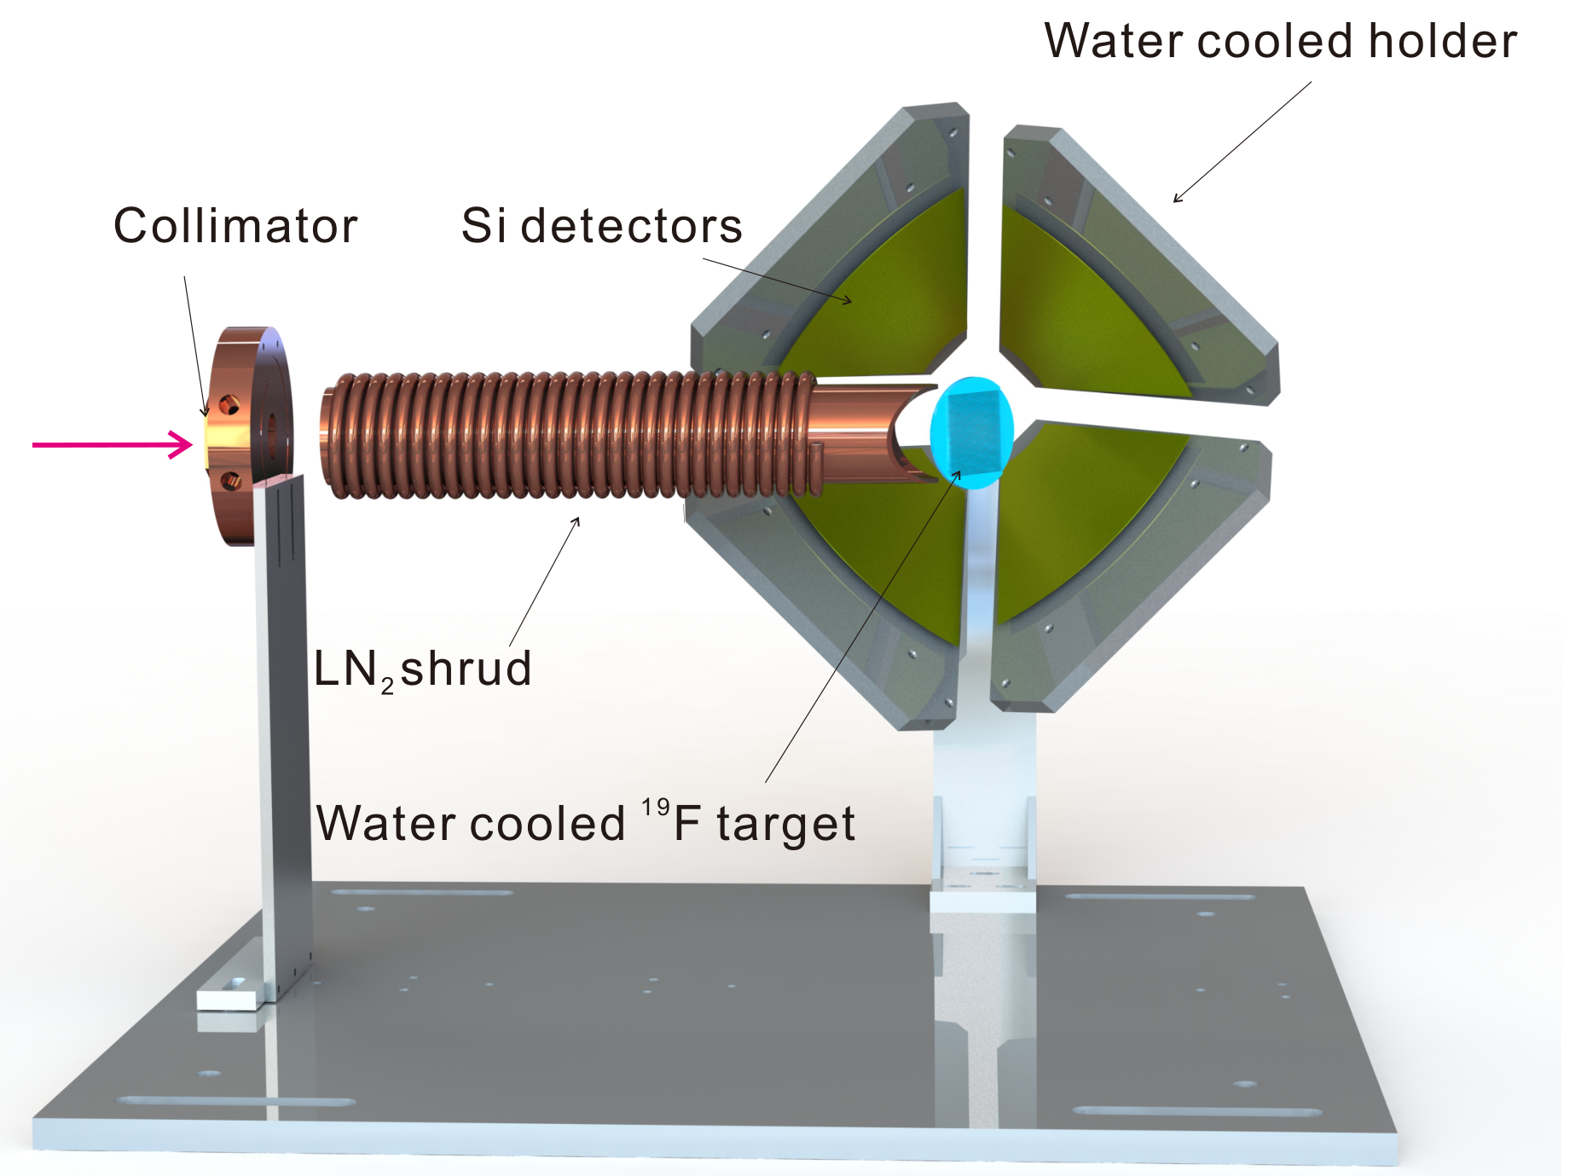
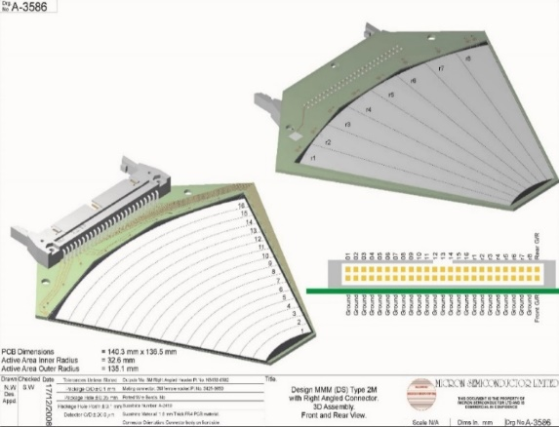
‘Lamp’-type silicon detector array
beam
MMM
TOP View
Inner R: 32.6 mm
Outer R: 135.1 mm
Si
target
Detection Angle range: 60°~ 120°
energy resolution: ~ 1%
Detector position is adjustable
The target surface is set as 45° relative to the beam direction.
Cover the surface with 9.5 μm Mylar foil
Calibrate the detector energy with
²³⁹Pu-²⁴¹Am α source
7
Notes:
P7：我们为这个测量准备了一个灯罩型硅探测器阵列。实验中我们在探测器表面覆盖了9.5um的mylar膜来阻挡散射的质子，并且用钚-镅源刻度了探测器能量。探测角度从60度到120度，能量分辨可以达到约1%。此外，探测器位置可以被改变，靶设置45度为了探测前角，就像这个图中红色线。
We have prepared a Lamp-type silicon detector array for this measurement. In the experiment, we covered the detector surface with a 9.5um mylar foil to shield the scattering protons, and calibrate the detector energy with a plutonium-americium two-component alpha source. The detection angle range is from 60 degrees to 120 degrees, and the energy resolution is about 1%. Besides, the detector position can be changed, and The target surface is set as 45° relative to the beam direction to detect the front angle, like the red lines in this picture.

Slide 9
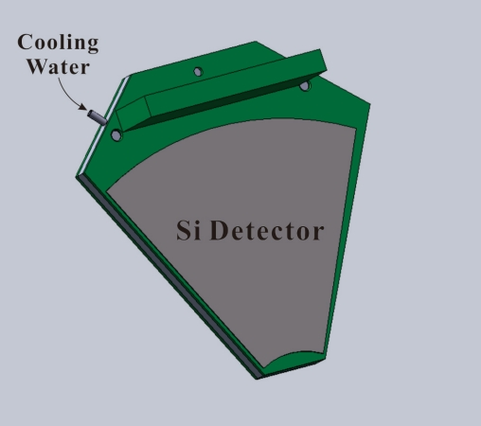
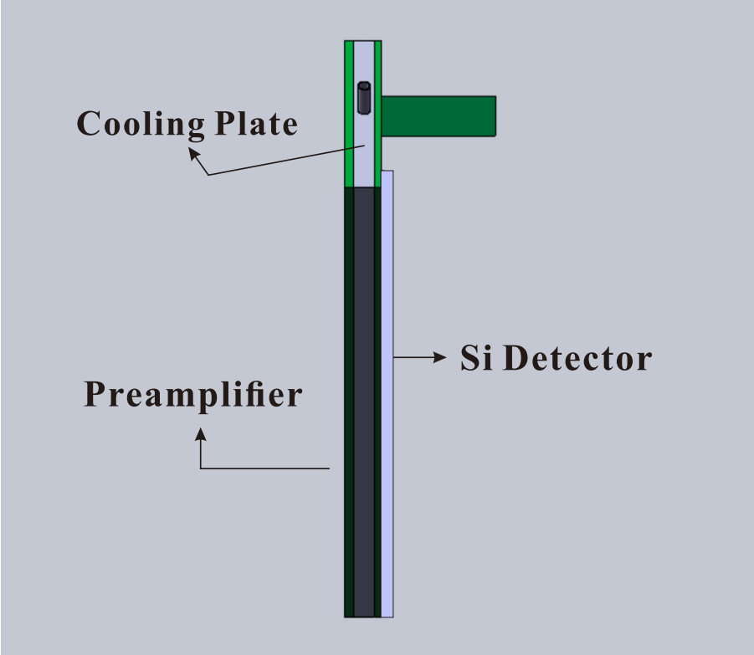
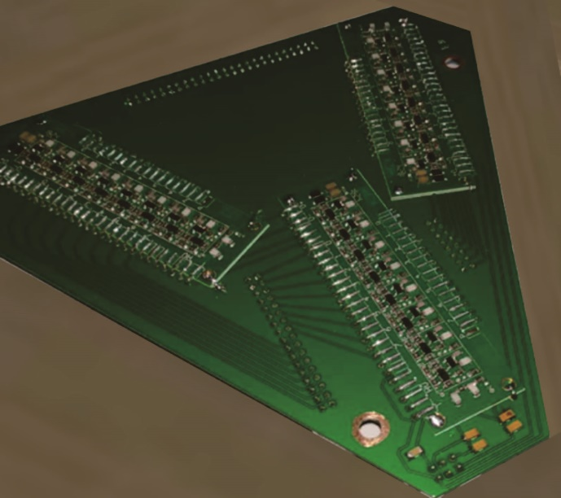
SPA type pre-amplifier:
developed by the China Institute of Atomic Energy (CIAE)
Front view
Side view
PCB of Pre-amplifier
Integrated design of the pre-amplifier and detector
Low noise：typical level ~ 2 mV Working temperature：~ 4 ℃
D. X. Wang, C. J. Lin et al., Nucl. Sci. Tech. 31 (2020) 48
Y. J. Chen, et al., NIMA 1054,168401(2023)
8
Notes:
P8：为这个探测器，我们准备了一个SPA型的前放，它是由中国原子能研究院开发的。我们制作了一个集成化的设计为这个前放和探测器，他有一个低噪声大约2mV，并且它的工作温度为4摄氏度。
For this detector, we have prepared a SPA type preamplifier, it's developed by the China Institute of Atomic Energy. We developed an integrated design of the preamplifier and detector, it has a low noise of about 2mV and working temperature is about 4 centigrade.

Slide 10
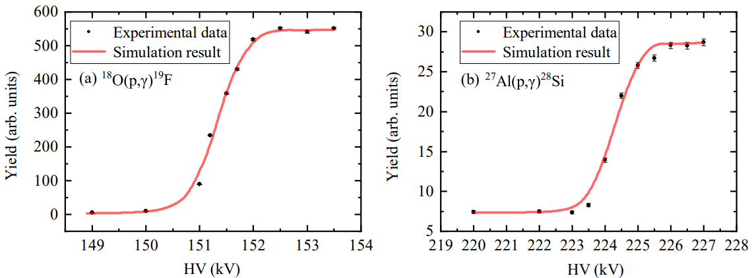
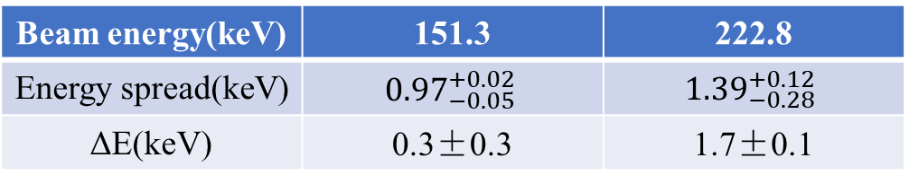
Beam energy calibration
Beam energy(keV) | 151.3 | 222.8
Energy spread(keV) | $${0.97}_{−0.05}^{+0.02}$$ | $${1.39}_{−0.28}^{+0.12}$$
ΔE(keV) | 0.3±0.3 | 1.7±0.1
The absolute beam energy and its spread can be determined by resonant reactions.
We calibrate the beam with the ¹⁸O(p, γ)¹⁹F and ²⁷Al(p, γ)²⁸Si reactions.
9
Notes:
P9：众所周知，绝对束流能量和展宽可以被共振反应决定。因此我们使用18O(𝑝, 𝛾)19F and 27Al(𝑝, 𝛾)28Si reactions刻度了质子束流，并且在表中总结了这些刻度的关键信息。
It is known that the absolute beam energy and its spread can be determined by resonant reactions.
We calibrated the proton beam with the 18O(𝑝, 𝛾)19F and 27Al(𝑝, 𝛾)28Si reactions and summarize the key information of these calibrations in the table.

Slide 11
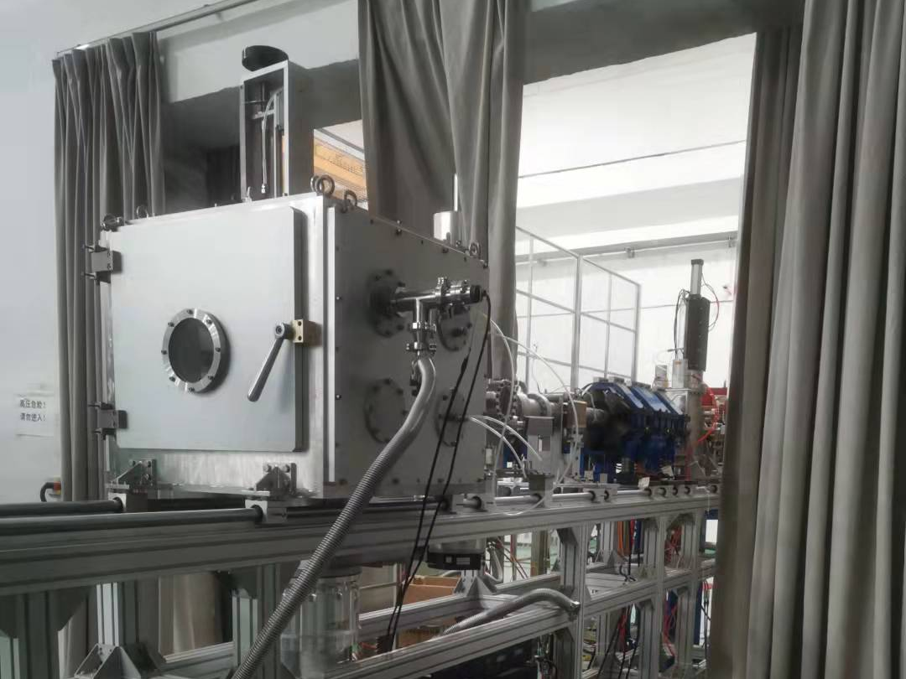
Measurement procedure
Directly measure the ¹⁹F(p, α₀)¹⁶O in E_{c.m.} = 98 ~ 237 keV.
Detect the α using a silicon detector array.
Scan the 213 keV resonance of the (p, αγ) channel per 50 C
to monitor the fluorine loss.
Total experiment time ~ 1 month.
10
Notes:
P10：总结一下，主要的测量程序是：在能量98-237keV范围内直接测量19F(p,α-aezo)反应，并且用硅探测器阵列探测α粒子。我们扫描(p,αγ)道的213keV共振每50C来监测氟损失。总的实验时间大约是一个月。
To summarize, the main measurement procedure is: directly measure the 19F (p, α - aezo) reaction in the energy range of 98-237keV, and detect the alpha particles using a silicon detector array. We scan the 213keV resonance of the α γ channel per 50C to monitor the fluorine loss. The total experiment time is about one month.

Slide 12
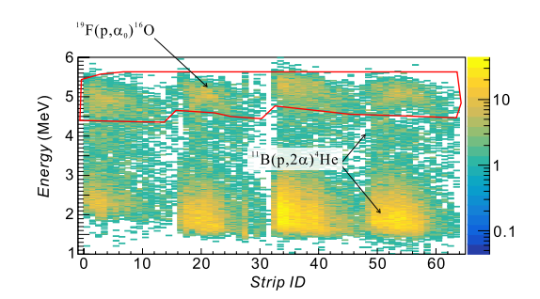
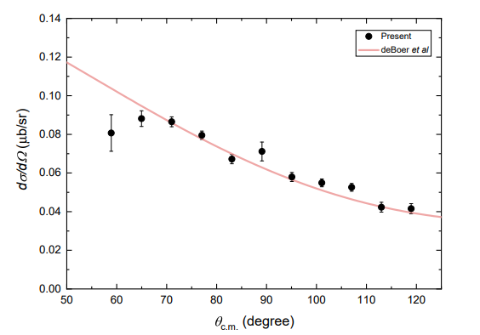
New results of angular distribution
E_{p} = 237 keV
The experimental results are consistent with previous R-Matrix analysis(deBoer et al.)
At 60°, some α particles are shielded by the target bracket, therefore the value is smaller
11
Notes:
P11：左边这张图展示了硅探测器的二维能谱，右边这张图是我们角分布的结果。我们可以发现，实验结果与过去的R矩阵分析一致。但是在60度，一些α粒子被靶支架屏蔽，因此这个值更小。
The left picture shows the two-dimensional energy spectrum of the silicon detector, and the right one shows our results of the angular distribution. We can find the experimental results are consistent with the previous R-matrix analysis. But at 60 degrees, some alpha particles are shielded by the target bracket, so this value is smaller.

Slide 13
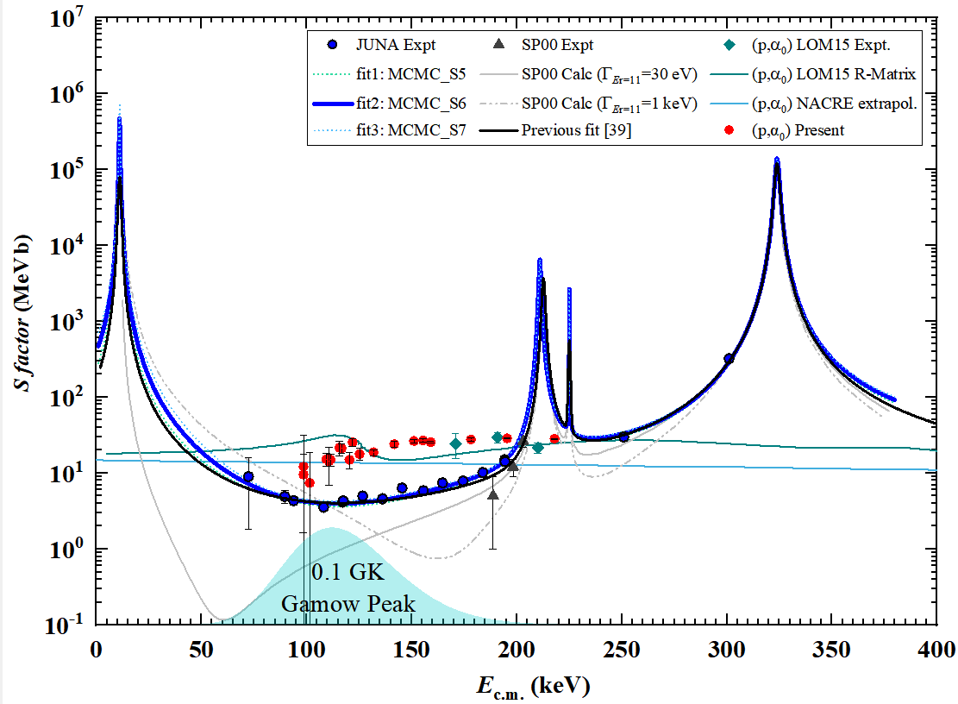
New S-factor of ¹⁹F(p, α₀)
In the energy range of 100 to 200 keV, the (p, α₀) channel is significantly higher than the (p, αγ) channel.
It's consistent with the conclusion of JUNA measurement(2021).
12
Notes:
P12：这张图展示了我们(p,α-zero) channel的最新S因子，用红点表示。蓝色点代表(p,αγ)道。容易发现，在100到200keV能区，(p,α-zero) channel贡献明显高于(p,αγ) channel，这与JUNA测量的结论是相符的。
This picture shows our new S factor of the (p, α-zero) channel, labeled by red dots. The blue dots represent the αγ channel. We can easily find in the energy range of 100 to 200 keV, the (p, α - zero) channel is significantly higher than the (p, αγ) channel, it's consistent with the conclusion of JUNA measurement.

Slide 14
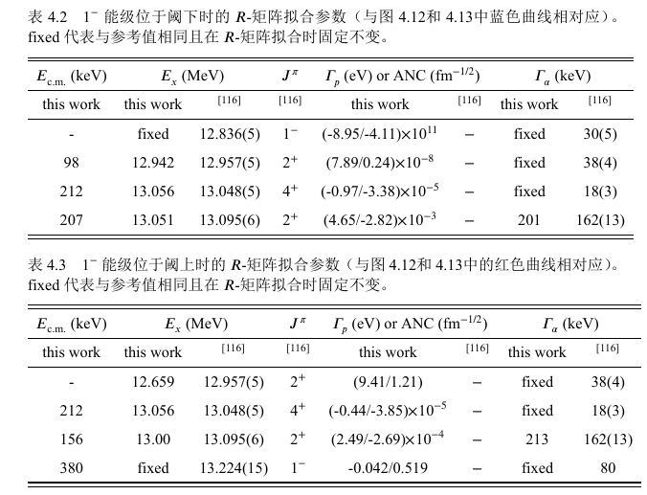
Results of R-Matrix analysis
A simplified R-Matrix analysis is performed just considering the new data,
and two general types of fits were found to most accurately describe the data
one using a 1- subthreshold state and the other one using an unbound resonance
13
Notes:
P13：很难将最新的数据加入到已有的全局R矩阵分析中，因此仅考虑本次测量的数据进行了简化的R矩阵分析，并且两个一般拟合被发现最精确描述数据。我们在表中列出了这两个拟合，主要的区别是：一个使用了阈下的1-能级，另一个是非束缚共振。
It's difficult to add the new data to the previous full R-Matrix analysis. Therefore a simplified R-Matrix analysis is performed just considering the new data, and two general types of fits were found to most accurately describe the data. we list the two fits in the table, and the main difference of this two fits is: one using a 1- subthreshold state and the other one using an unbound resonance.

Slide 15
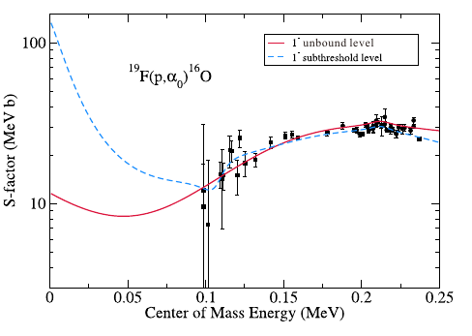
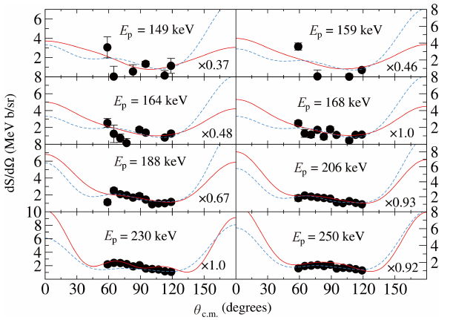
Results of R-Matrix analysis
Both fits can describe the experimental data well
but the trend below 0.1 MeV is quite different
Both fits can describe the angular distribution well
We need more accurate low-energy cross-section and angular distribution data
to constrain the R-Matrix analysis
14
Notes:
P14：在这张图中，红线和蓝线代表这两个拟合，黑点代表实验数据。这两个拟合都可以很好地描述实验数据，但是在0.1 MeV以下非常不同。并且两个拟合都能很好地描述角分布形状。因此我们需要更多、精度更高的低能数据，在更大角度范围内精确测量角分布来约束R-矩阵计算。
In this picture, the red and blue lines represent the two fits, and the black dots represent the experimental data. Both of the fit can describe the experimental data well, but but the trend below 0.1 MeV is quite different. And both fits can describe the angular distribution well. Therefore, we need more and higher accurate low-energy data to accurately measure the angular distribution over a larger angle range to constrain R-matrix calculations.

Slide 16
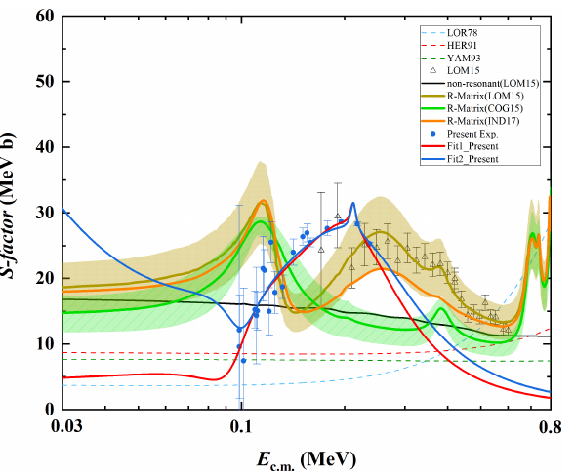
Compare with previous data
1. 130~230 keV, new data is significantly higher than the previous R-Matrix prediction.
2. No significant resonance was observed near Ec.m. = 113 keV.
3. E_{c.m.} < 100 keV, lack of low energy data constraints, show two different trend.
Future work:
Detailed full R-matrix calculations using previous data (different energy and channel).
More measurement at lower energy.
15
Notes:
P15：与过去的数据相比，我们可以发现几个重要的不同。首先，在能量范围130~230 keV内，新结果明显高于之前的R矩阵预测结果。第二，Ec.m. = 113 keV附近没有明显观察到共振。并且在能量小于100keV，由于缺少低能数据限制，R矩阵结果展现两个不同的趋势。所以在未来的工作中，我们计划了一个详细的全局R矩阵计算使用了过去的数据。并且我们计划了更低能量的测量。
Compare with previous data，we can find several important difference: Firstly, in the energy range of 130-230keV，the new data is significantly higher than the previous R-Matrix prediction. Secondly,no significant resonance was observed near Ec.m. = 113 keV. And below 100 keV, because of the lack of low energy data constraints, the R-Matrix results show two different trend. So in the future work, we plan a Detailed full R-matrix calculations using previous data and more measurement at lower energy.

Slide 17
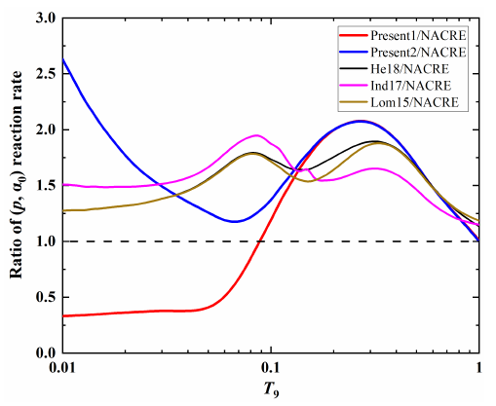
Reaction rate of ¹⁹F(p, α₀)
New data (98~237 keV) covered Gamow window of 0.15 GK.
Higher energy data by Lombardo et al. were added to the calculation.
1. T ≈ 0.11 ~ 0.4GK, new reaction rate is higher, the (p, α0) channel contributes more.
2. T < 0.1GK, the reaction rate is lower, likely due to the absence of the 113 keV resonance. The contribution of the (p, α0) reaction channel at low temperature may be lower than previously predicted.
3. T < 0.1GK, the reaction rates show different trends.
Continue to measure towards the low energy edge of the Gamow window (~70 keV) to better constrain the low temperature reaction rate and better understand the fluorine abundance in AGB stars.
16
Notes:
P16：这张图展示了我们的新反应率，并且列出了以前的结果作为比较。我们新的实验数据覆盖了0.15GK的Gamow窗口，并且将Lombardo的高能数据加入到反应率的计算中。我们可以发现：温度在0.11-0.4GK，新反应率更高，(p，αzero)道贡献更多；2.温度小于0.1GK，反应率更低，这可能是因为113keV的共振消失了。 (p, α0)反应道低温下的贡献比之前的理论预测要低。3.温度小于0.1GK时，两个反应率展现了不同的趋势。因此我们需要继续向Gamow窗口的低能边缘测量，来更好地限制低温反应率并且更好地理解AGB星中地氟丰度。
This picture shows our new reaction rate and lists previous results for comparison. Our new data covers the Gamow window of 0.15GK and Higher energy data by Lombardo et al. were added to the calculation. We can find at temperatures between 0.11-0.4GK, the new reaction rate is higher and the (p, α zero) channel contributes more; 2. When the temperature is below 0.1GK, the reaction rate is lower, , likely due to the absence of the 113 keV resonance.The contribution of the (p, α0) reaction channel at low temperature may be lower than previously predicted. 3.When the temperature is below 0.1GK, the red and blue reaction rates show different trends. Therefore, we need to Continue to measure towards the low energy edge of the Gamow window (~70 keV) to better constrain the low temperature reaction rate and better understand the fluorine abundance in AGB stars.

Slide 18
Future Plan
1.Improve the detector design to improve absolute detection efficiency(*10).
2.A new fluorine target with higher purity and less boron impurity (Zhang H. et al.) has been designed and tested to reduce the influence of boron impurity on the detection of ¹⁹F(p, α) channel.
A thinner Mylar foil has been prepared and a new foil bracket has been designed.
3. Increase the beam time and beam intensity to obtain more accurate data with lower statistical error and extend the measurement to lower energy.
17
Notes:
P17：在我们未来的计划中，1.我们优化了探测器地设计来提高绝对探测效率；2.设计制作了纯度更高、B杂质更少的氟靶，减少硼杂质对反应粒子探测的影响；设计 Mylar膜专用支架并选用更薄的膜，降低褶皱效应3.增加束流时间和束流强度，获得更多的统计数据，将测量向更低能点推进

Slide 19
Thank you all !

Slide 24
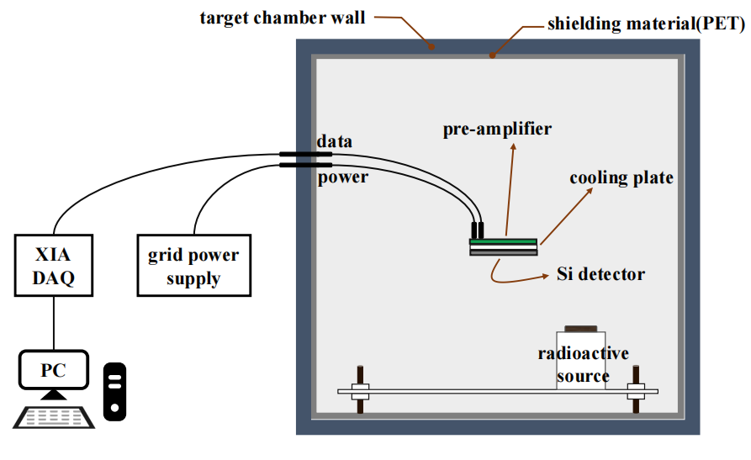
实验终端天然本底及屏蔽方案
天然本底影响很大
BNU与HINEG几乎相同的靶室
一个MMM型扇形面朝下
噪声信号幅度约为 ±5 mV
对比两种条件的屏蔽效果
(a)真空靶室通氮气
(b) PET膜覆盖靶室壁、水冷系统等
11
1
Notes:
考虑到极低截面测量时本底影响很大，我们也对靶室的带电粒子本底进行了仔细的研究，由于疫情封锁，我们当时没有办法在合肥做这个本底测量实验，因此在北师大半地下的实验室使用了一个与HINEG几乎完全一致的靶室和探测器，测量了天然本底水平。我们分别在两种条件下测量了天然本底，一种是真空靶室充满氮气，另一种情况是使用PET膜作为屏蔽材料覆盖靶室内壁和水冷系统等。

Slide 25
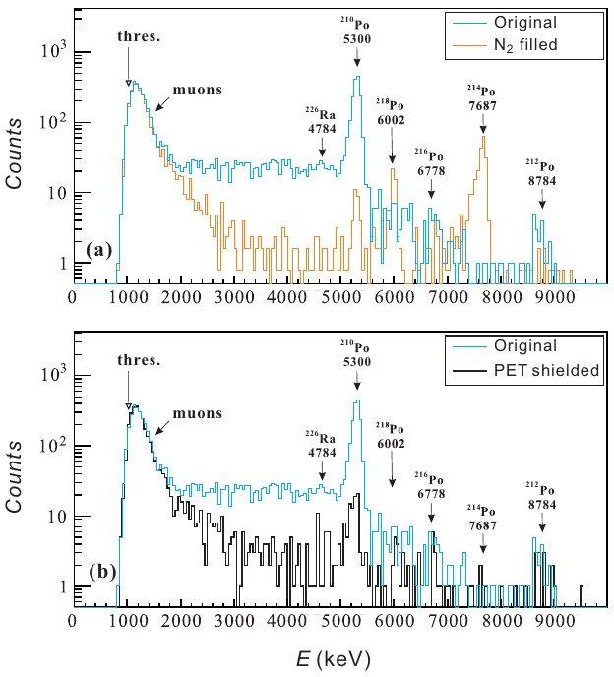
实验终端天然本底及屏蔽方案
（a）氮气屏蔽：真空通入氮气并维持1 atm
验证本底的主要来源是靶室壁
（b）PET屏蔽：0.2 mm 除了探测器全覆盖
两种屏蔽下分别测量天然本底80 h
PET膜是效果很好的屏蔽方案
Y. J. Chen, et al., NIMA 1054,168401(2023)
12
Notes:
我们首先向真空靶室中冲入氮气并维持一个大气压测量了80h的天然本底，目的是验证本底的主要来源是靶室壁或者是外部的其他具有放射性的材料。然后使用0.2mm厚的PET膜覆盖了靶室内除了探测器的所有表面，包括靶室内壁、探测器支架等，也测量了80h天然本底情况。左边这张图就是这两种屏蔽的效果展示，可以看出PET膜是效果很好的屏蔽方案，他可以极大地降低我们感兴趣能区内的本底水平。

Slide 26
details of energy calibration
参考NIMA描述：
A 1.8 mm thick pure 27Al target and a 2 μm thick magnetron sputtered Ti18O 𝑥 isotope target were used for the 27Al(𝑝, 𝛾)28Si and 18O(𝑝, 𝛾)19F reaction measurements, respectively. For the two well-known resonances located at 𝐸 𝑝 = 222.8 keV [7,8] and 𝐸𝑝 = 151.3 keV [7,9], these two targets can be regarded as infinitely thick. A 6 × 6 × 12 cm BGO detector was placed behind the target to measure the 𝛾 rays. The typical 𝛾-ray spectra of the two capture reactions are shown in Fig. 1.
The integral region is filled in red, and the gray regions indicates the background.
To obtain precise yield curves, the beam energy was changed by adjusting the ACC voltage (𝑉ACC) in a step size of 200∼500 eV around the resonance energy (see Fig. 2). The data were well reproduced by the Geant4 [10] simulation by adjusting parameters such as the target composition, beam energy shift (𝛥𝐸shift) and spread (𝛥𝐸b). The simulation shows that for the proton beams at 151.3 and 222.8 keV, the
corresponding energy spreads are 𝛥𝐸b = 0.97+0.02 -0.05 and 1.39+0.12 -0.28 keV, while the energy shifts are 𝛥𝐸shift = (0.3 ± 0.3) and (1.7 ± 0.1) keV,
respectively [4]. These values are comparable with other similar accelerators [11,12]. It demonstrates that the platform in Hefei Facility satisfies well the requirements of nuclear astrophysics studies. In the near future, we will calibrate the beam energy in more detail with the
12C(𝑝, 𝛾)13N non-resonant reaction.

Slide 27
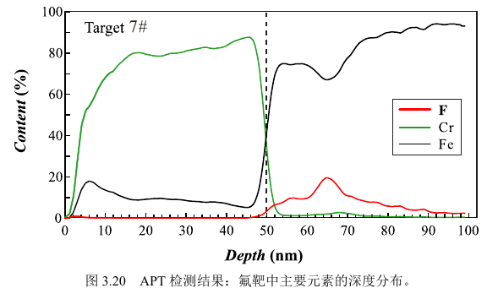
APT分析
APT：三维原子探针层析技术
深度分辨 ~ 0.2 nm 定量分析不同元素的原子个数
使用FIB制备针尖样品
样品：7#靶 累计辐照质子束流109 C
7# 靶注入能量40 keV
布拉格峰位置在110 nm处
实验靶中的¹⁹F会集中65 nm处
靶核粒子随束流轰击向靶表面移动
Cr
Fe
17
Notes:
我们还使用刚才稳定性测试实验中的7号靶做了APT分析来研究靶核粒子的深度分布。APT的全称是三维原子探针层析技术，它可以分析不同深度上不同元素的原子数目。它的深度分辨可以达到0.2nm，也就是2A，这个深度分辨已经非常好了，并且可以将原子数目精确到个。左下这张图展示了APT给出的深度分布结果，只列出了我们关心的F、Fe、Cr的深度分布。由于制靶时是在铁衬底表面覆盖了50 nm的Cr膜，因此深度50nm处对应的就是Cr层和Fe层的交界。从结果可以看出，辐照后的实验靶中，F集中在65nm的深度附近，但是根据它的注入能量，按理说大部分氟应该在110nm深度附近。这种差异实际上指出：注入的氟会随束流轰击向靶表面移动。

Slide 28
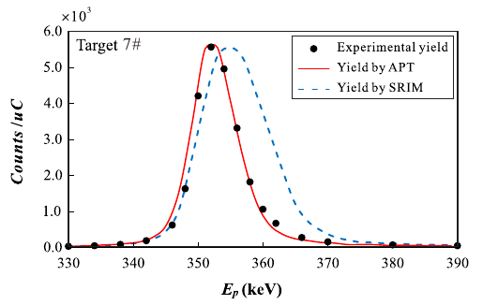
APT分析：Geant4验证APT深度分布可靠性
长时间高强度质子束轰击后，靶中¹⁹F集中在Fe衬表面附近的薄层中->指导Geant4模拟
可能来自束流辐照时的粒子扩散效应
18
Notes:
我们使用APT给出的深度分布，可以在Geant4中很好地重建产额曲线，如右图的红色实现所示，这实际上验证了APT分析的可靠性。作为对比，我们还使用了SRIM模拟的深度分布数据，但是它重建出的产额曲线也就是蓝色虚线，比真实的产额曲线相差很多。因此我们可以得出结论，在经过长达上百库伦的质子束轰击后，靶中注入的氟会集中在铁衬表面附近的薄层中，这个结论实际上指导了我们后期的Geant4模拟。

Slide 29
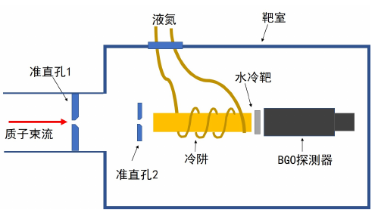
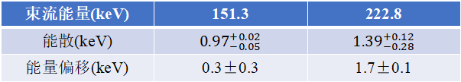
束流能量刻度1
束流能量刻度实验设置
束流能量(keV) | 151.3 | 222.8
能散(keV) | $${0.97}_{−0.05}^{+0.02}$$ | $${1.39}_{−0.28}^{+0.12}$$
能量偏移(keV) | 0.3±0.3 | 1.7±0.1
束流能量刻度结果
19
Notes:
在正式实验开始前，我们还对加速器的束流能量分别进行了两次刻度。首先利用18O(p,g)的151keV共振和27Al(p,g)的223keV共振刻度了束流能量，刻度的结果展示在左下角这个表格中，可以看出不管是能量偏移还是能散都完全可以满足我们的实验需求。

Slide 30
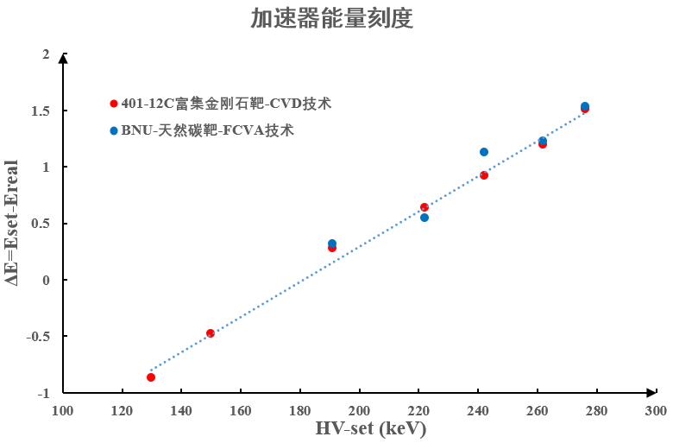
束流能量刻度2
¹²C(p, γ)非共振能区刻度束流
高纯锗探测器
测量能区内ΔE < 1 keV
满足直接测量需求
20
Notes:
之后，又使用高纯锗探测器利用12C(p,g)非共振能区的数据连续性刻度了束流能量，可以看到，在本次实验测量的目标内区内，能量偏移都在1keV以内，也完全满足我们的测量需求。

Slide 31
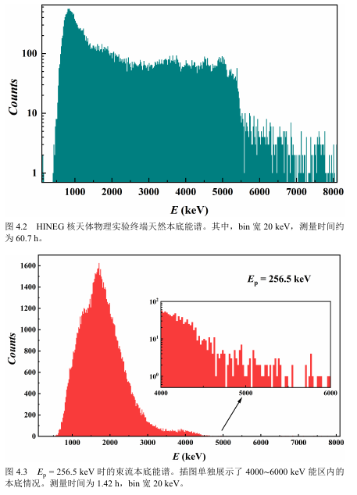
数据处理1：天然本底和束流本底
硅探测器天然本底能谱
时间归一扣除
硅探测器束流本底能谱
束流积分归一扣除
22
Notes:
接下来简要介绍数据处理的几个关键内容。首先是测量了终端的天然本底和束流本底能谱，本底需要在计算反应产额时分别根据时间或者束流积分进行归一后扣除。

Slide 32
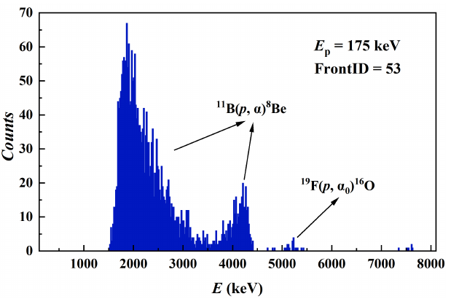
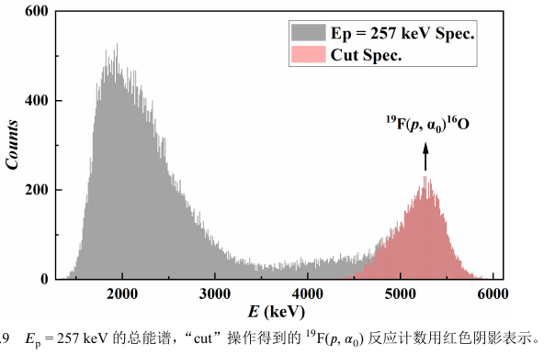

数据处理2：能谱分析计算反应产额
每个Run有64个正面硅条能谱
23
Notes:
然后我们分析了反应能谱。我们的探测器正面一共有64个硅条，左图展示了其中一个硅条的能谱，能谱上主要存在三类α粒子，左边这两个较高的是11B(p,a)产生的α粒子，最右侧这个较低的是我们要测量的19F(p,a0)反应产生的α粒子。我们通过分析能谱并扣除本底可以得到19F(p,a0)反应的产额。右图是质子能量为257keV时的总谱，红色阴影是我们分析能谱筛选出的19F(p,a0)产生的α。获取到这部分计数后我们就可以计算出反应产额。本次实验用靶在数据处理时可以按照非共振薄靶进行处理，因此要计算反应截面，除了反应产额我们还需要知道对应的靶核粒子数和入射质子的有效能量。

Slide 33
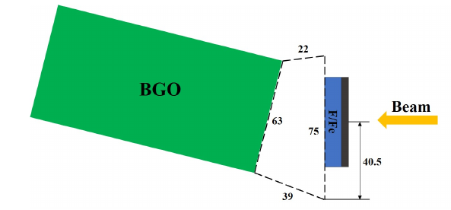
数据处理3：靶核损失修正并导出入射质子有效能量
定期扫描¹⁹F(p, αγ)¹⁶O 213 keV共振产额曲线监测靶核损失并通过Geant4导出靶核数n与E_{eff}
Scan1
……………......
靶核数n1
Run1
……
Run2
……
根据库仑数线性内插
Run3
……
Run4
……
Geant4调整Cr层厚度、F/Fe层厚度、F/Fe比重现产额曲线
已知共振强度、角分布、探测效率
导出靶核数、Cr膜厚度、有效能量E_{eff}
Scan2
……………......
靶核数n2
实验靶在经过累计204 C质子轰击后，靶核损失约为4%
24
Notes:
这两个物理量我们可以通过Geant4模拟共振产额曲线得到。具体是怎么做的呢？我们在实验中每隔50C会扫描一次19F(p,ag)反应在213keV的共振产额曲线，目的是为了监测靶核损失，同时也可以通过这部分数据导出靶核数与有效能量。基本思路是在Geant4中模拟这个19F(p,ag)反应，将靶、束流、探测器等都按照真实情况在Geant4中建模，然后将Cr膜厚度，含氟铁层的厚度以及Fe、F比例作为可以调整的变量来重现共产额曲线，结合已知的共振强度、角分布和探测效率，我们就可以导出当前扫描轮次的靶核数和有效能量。看右边这张图，我们通过刚刚这个方法得到了两次扫描轮次的靶核数后，也就是Scan1和Scan2的靶核数，对于这两次扫描间进行了19F(p,a0)的测量，我们认为靶核损失与靶上电荷积分呈线性相关，由此建立了靶核粒子数与靶上电荷积分的关系。因此在计算不同run的反应截面时，需要根据当前靶上累计辐照的束流积分推导出对应的靶核粒子数，才能进行反应截面与天体物理S因子的计算。

