Slide 1
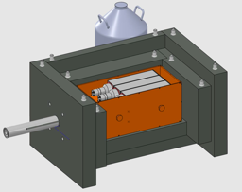
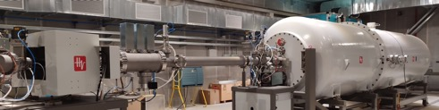
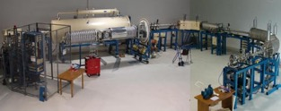


LUNA projects at Bellotti Ion Beam Facility, focusing on the status of 12C+12C measurement
Trento 18-02-2025
Gianluca Imbriani
Physics Department of University of Naples Federico II,
Italian National Institute of Nuclear Physics (INFN)

Slide 2
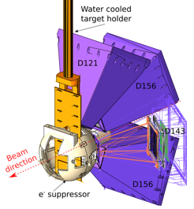

LUNA projects at Bellotti Ion Beam Facility, focusing on the status of 12C+12C measurement…. And I add also Gastly experiment at CIRCE
Trento 18-02-2025
Gianluca Imbriani
Physics Department of University of Naples Federico II,
Italian National Institute of Nuclear Physics (INFN)

Slide 3
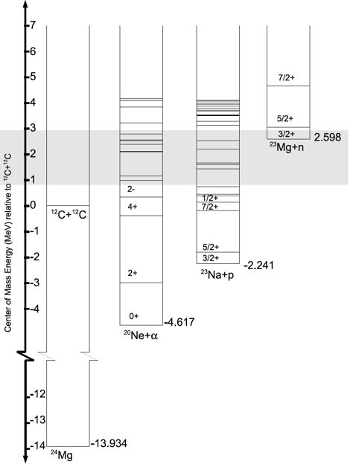
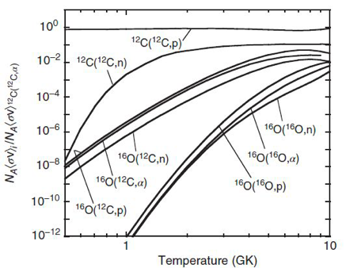
The ¹²C+¹²C reactions
¹²C+¹²C→ ²⁰Ne + a Q = 4.62 MeV
¹²C+¹²C→ ²³Na + p Q = 2.24 MeV
¹²C+¹²C→ ²⁴Mg + γ Q = 13.93 MeV
¹²C+¹²C→ ²³Mg + n Q = -2.62 MeV
Iliadis, C., Nuclear Physics of Stars, Wiley, 2015

Slide 4
The ¹²C+¹²C reactions
¹²C+¹²C→ ²⁰Ne + a Q = 4.62 MeV
γ-rays and α particles energies for excited states for ¹²C(¹²C, α)²⁰Ne (Q = 4.617 MeV)
E_{X} (MeV) | J^{p} | Main γ transitions (MeV) |  | ID | E_{α−max} (MeV) (E^{CM} = 2 MeV)
0.0 | 0⁺ |  |  | α₀ | 8.6
1.63 | 2⁺ | 1.63 → 0 1.63 |  | α₁ | 6.8
4.24 | 4⁺ | 4.24 → 1.63 2.61 |  | α₂ | 3.9
4.96 | 2⁻ | 4.96 → 1.63 3.33 |  | α₃ | 3.1
5.62 | 3⁻ | 5.62 → 1.63 3.98 |  | α₄ | 2.2
5.78 | 1⁻ | 5.78 → 1.63 4.15 | 5.78 → 0 5.78 | α₅ | 2.0

Slide 5
The ¹²C+¹²C reactions
¹²C+¹²C→ ²³Na + p Q = 2.24 MeV
γ-rays and p particles energies for excited states for ¹²C(¹²C, p)²³Na (Q = 2.241 MeV)
E_{X} (MeV) | J^{p} | Main γ transitions (MeV) |  | ID | E_{p-max} (MeV) (E^{CM} = 2 MeV)
0.0 | 3/2⁺ |  |  | p₀ | 5.3
0.44 | 5/2⁺ | 0.44 → 0 0.44 |  | p₁ | 4.8
2.07 | 7/2⁺ | 2.07 → 0.44 1.63 (91%) | 2.07 → 0 2.07 (9%) | p₂ | 3
2.39 | 1/2⁺ | 2.39 → 0.44 1.95 | 2.39 → 0 2.39 | p₃ | 2.6
2.64 | 1/2⁻ | 2.64 → 0 2.64 |  | p₄ | 2.3
2.70 | 9/2⁺ | 2.70 → 2.07 0.62 | 2.70 → 0.44 2.26 | p₅ | 2.3
2.98 | 3/2⁺ | 2.98 → 0.44 2.54 | 2.98 → 0 2.98 | p₆ | 1.9

Slide 6
The ¹²C+¹²C study via γ detection
¹²C+¹²C→ ²⁰Ne + α Q = 4.62 MeV
γ-rays and α particles energies for excited states for ¹²C(¹²C, α)²⁰Ne (Q = 4.617 MeV)
E_{X} (MeV) | J^{p} | Main γ transitions (MeV) |  | ID | E_{α−max} (MeV) (E^{CM} = 2 MeV)
0.0 | 0⁺ |  |  | α₀ | 8.6
1.63 | 2⁺ | 1.63 → 0 1.63 |  | α₁ | 6.8
E_{γ}=0.44 MeV
¹²C+¹²C→ ²³Na + p Q = 2.24 MeV
E_{γ}=1.63 MeV
γ-rays and p particles energies for excited states for ¹²C(¹²C, p)²³Na (Q = 2.241 MeV)
E_{X} (MeV) | J^{p} | Main g transitions (MeV) |  | ID | E_{p-max} (MeV) (E^{CM} = 2 MeV)
0.0 | 3/2⁺ |  |  | p₀ | 5.3
0.44 | 5/2⁺ | 0.44 → 0 0.44 |  | p₁ | 4.8

Slide 7
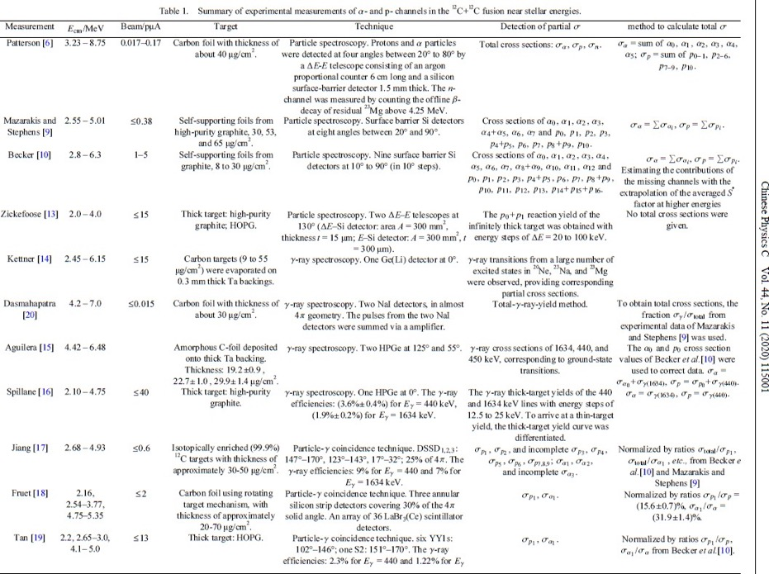
Summary table (as of 2020)

Slide 8
TARGETS
Summary table (as of 2020)

Slide 9
Technique
Summary table (as of 2020)

Slide 10
Total or
partial σ
Summary table (as of 2020)

Slide 11

Total or
partial σ
Summary table (as of 2020)

Slide 12
Minimum
energy
Summary table (as of 2020)

Slide 13
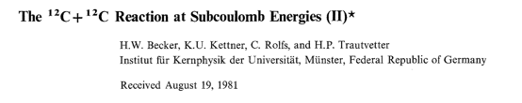

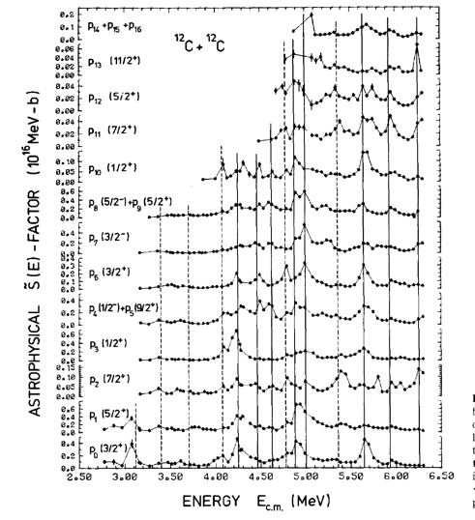
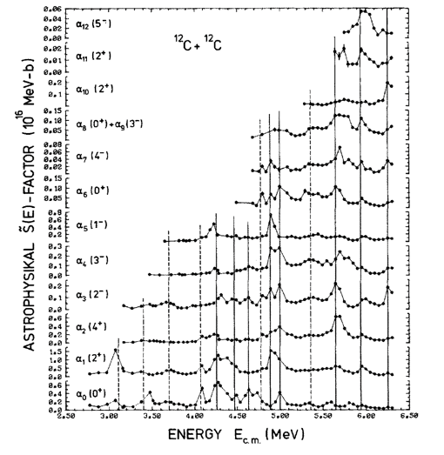
The Becker experiment

Slide 14
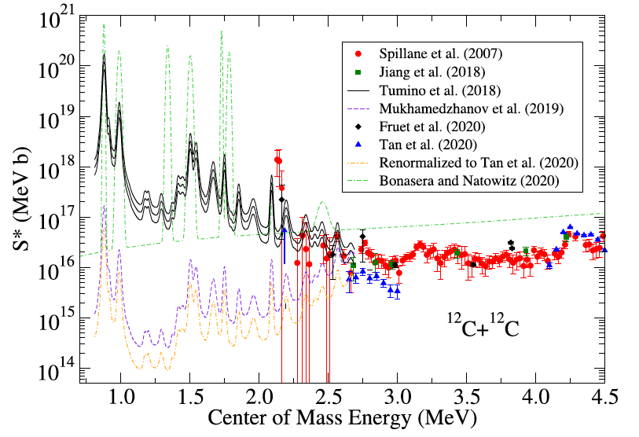
The ¹²C+¹²C state of the art
Several datasets and models
Direct measurements above 2.1 MeV (large scattering, large uncertainties)
Only indirect measurements below 2.1 MeV (problems with normalization and other discrepancies)
Very large uncertainty below 2.5 MeV
Presence of several states at low energies
Gamow peak

Slide 15
The ¹²C+¹²C state of the art
Several datasets and models
Direct measurements above 2.1 MeV (large scattering, large uncertainties)
Only indirect measurements below 2.1 MeV (problems with normalization and other discrepancies)
Very large uncertainty below 2.5 MeV
Presence of several states at low energies

Slide 16


Summary table (as of 2020)
Morales-Gallegos et al., Eur. Phys. J. A (2024)
E_{cm}=2.51-4.36 MeV
I_{beam}=10-50 μA
Target: 1 mm thick HOPG (99.99% pure) at high T Technique: charged particle spectroscopy with ΔE-E PID (ionization chamber + silicon strip detector)
Detection of partial σ: p₀, …, p₆, α₀, α₁

Slide 17
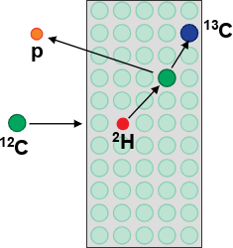
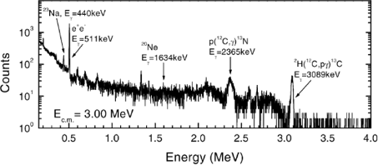
¹²C+¹²C background issues
Photon detection
²H(¹²C,pγ)¹³C
¹H(¹²C,γ)¹³N
Particle detection
²H(¹²C,¹²C)²H + ²H(¹²C,pγ)¹³C
(E_{γ}=3.09 MeV) (E_{γ}=2.36 MeV)
12_{C+}12_{C}
Beam-Induced Background Full energy peak
Beam Induced Background (BIB) due to ¹H and ²H in the target was a strong limitation in previous measurements based on particle detection
BIB affects mostly the measurements based on particle detection, as in photon detection measurements it only causes a moderate Compton background

Slide 18
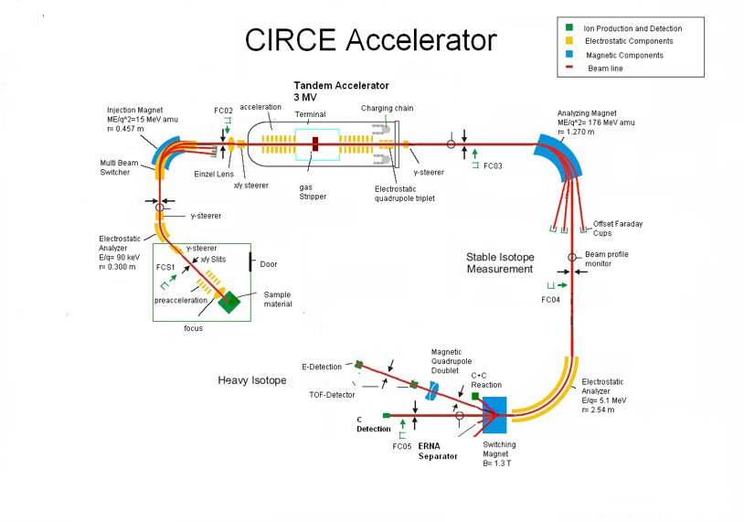
¹²C+¹²C @CIRCE laboratory first experiment: p detection
PHYSICAL REVIEW C 97, 065806 (2018)
J. Zickefoose, A. Di Leva, F. Strieder, L. Gialanella, G. Imbriani,
N. De Cesare, C. Rolfs, J. Schweitzer, T. Spillane, O. Straniero, and F. Terrasi

Slide 19
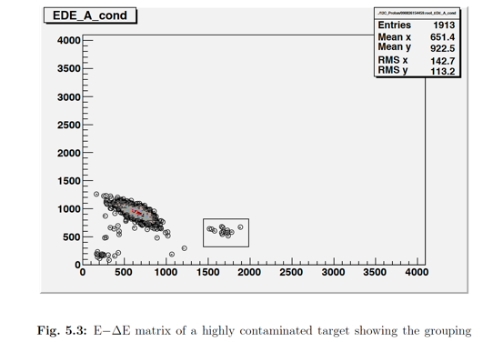
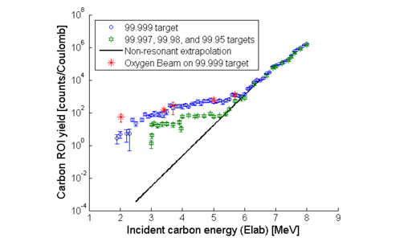
¹²C+¹²C @CIRCE laboratory first experiment: p detection

Slide 20
¹²C+¹²C @CIRCE laboratory first experiment: p detection
E = 2.6 MeV
PHYSICAL REVIEW C 97, 065806 (2018)
J. Zickefoose, A. Di Leva, F. Strieder, L. Gialanella, G. Imbriani,
N. De Cesare, C. Rolfs, J. Schweitzer, T. Spillane, O. Straniero, and F. Terrasi

Slide 21
¹²C+¹²C @CIRCE laboratory first experiment: p detection
PHYSICAL REVIEW C 97, 065806 (2018)
J. Zickefoose, A. Di Leva, F. Strieder, L. Gialanella, G. Imbriani,
N. De Cesare, C. Rolfs, J. Schweitzer, T. Spillane, O. Straniero, and F. Terrasi

Slide 22
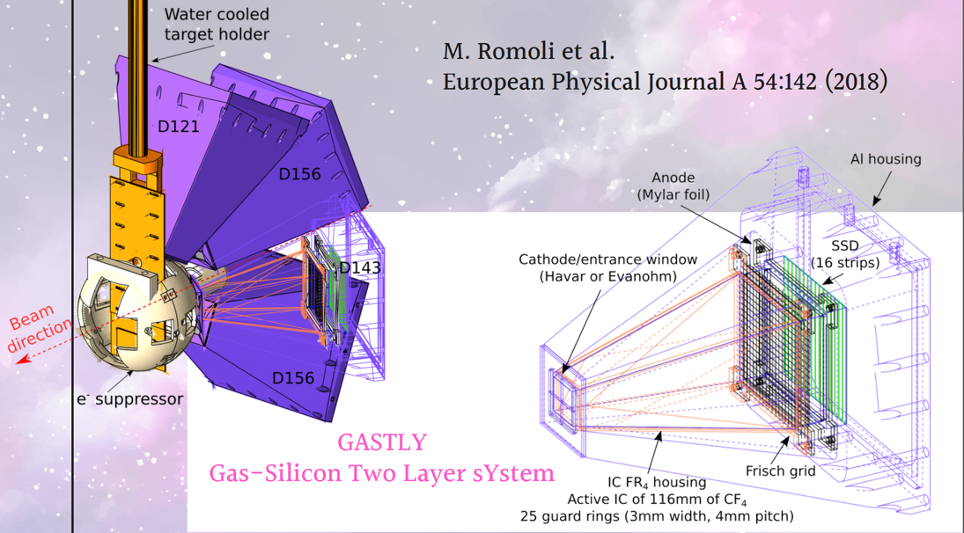
¹²C+¹²C @CIRCE laboratory second experiment:
double stage detector

Slide 23
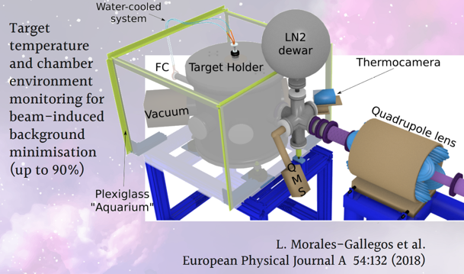
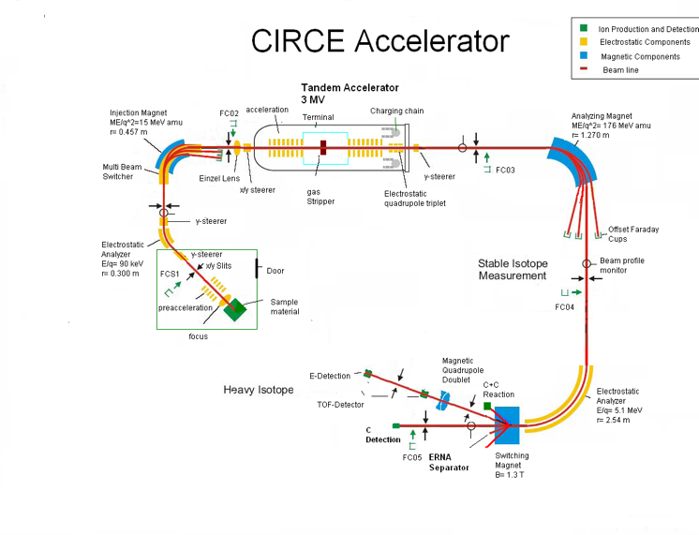
¹²C+¹²C @CIRCE laboratory second experiment:
double stage detector

Slide 24
¹²C+¹²C @CIRCE laboratory second experiment:
double stage detector
GASTLY detectors
GAs-Silicon Two-Layer sYstem
L. Morales-Gallegos et al.
Eropean Phisical Journal A 58:65 (2022)
Elab = 8.6 MeV
Detector at 121°

Slide 25
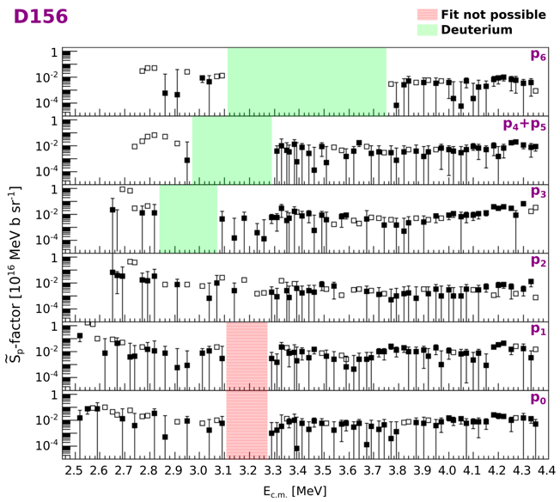
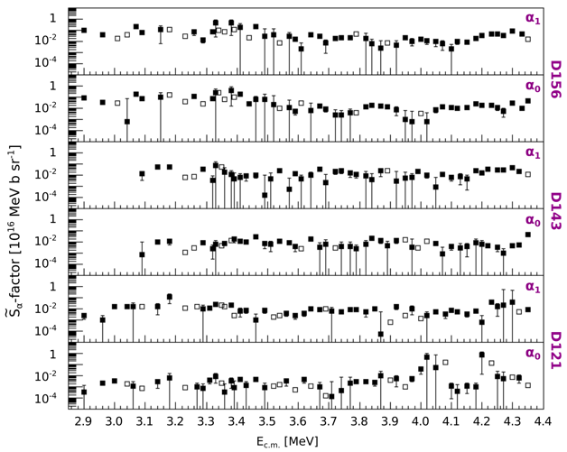
¹²C+¹²C @CIRCE laboratory second experiment:
results

Slide 26

The ¹²C+¹²C NEW state of the art

Slide 27
The ¹²C+¹²C NEW state of the art

Slide 28
The ¹²C+¹²C study via γ detection
¹²C+¹²C→ ²⁰Ne + α Q = 4.62 MeV
γ-rays and α particles energies for excited states for ¹²C(¹²C, α)²⁰Ne (Q = 4.617 MeV)
E_{X} (MeV) | J^{p} | Main γ transitions (MeV) |  | ID | E_{α−max} (MeV) (E^{CM} = 2 MeV)
0.0 | 0⁺ |  |  | α₀ | 8.6
1.63 | 2⁺ | 1.63 → 0 1.63 |  | α₁ | 6.8
E_{γ}=0.44 MeV
¹²C+¹²C→ ²³Na + p Q = 2.24 MeV
E_{γ}=1.63 MeV
g-rays and p particles energies for excited states for ¹²C(¹²C, p)²³Na (Q = 2.241 MeV)
E_{X} (MeV) | J^{p} | Main g transitions (MeV) |  | ID | E_{p-max} (MeV) (E^{CM} = 2 MeV)
0.0 | 3/2⁺ |  |  | p₀ | 5.3
0.44 | 5/2⁺ | 0.44 → 0 0.44 |  | p₁ | 4.8

Slide 29
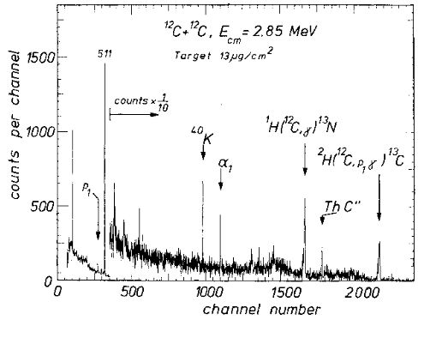
Measuring ¹²C+¹²C in laboratory: γ-rays detection
Spillane et al., PRL 98, 122501 (2007)
Kettner

Slide 30
Measuring ¹²C+¹²C in laboratory: γ-rays detection
Spillane et al., PRL 98, 122501 (2007)
Figures from Spillane’s PhD thesis Spillane
initial heating of the target by means of the beam itself: desorption of H and ²H is sufficient for the measurement based on photon detection

Slide 31
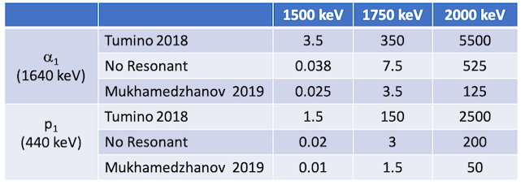
The ¹²C+¹²C expected count rate
Reaction per day with 200 μA
¹²C(¹²C, p)²³Na
^{Spillane lowest data}

Slide 32
The ¹²C+¹²C expected count rate
Reaction per day with 200 μA
¹²C(¹²C, p)²³Na
^{Spillane lowest data}

Slide 33
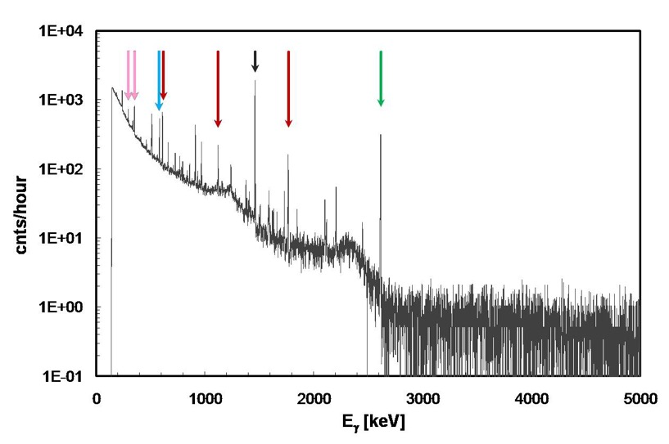
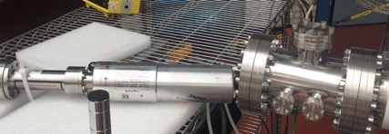
γ-ray natural background
Environmental radioactivity (γ-rays of low energy):
  natural radioactive series ²²⁶Ra, ²¹⁴Bi, ²¹⁴Pb (from ²³⁸U) and ²²⁴Ra, ²⁰⁸Tl, ²¹²Pb (from ²³²Th);
  radon (²²²Rn - ²²⁰Rn) a short-lived radioactive gas (from ²³⁸U and ²³²Th respectively);
  long-lived natural radionuclides such as ⁴⁰K, ⁸⁷Rb, ¹¹⁵In, ¹³³La, ¹⁴²Ce, etc.
Cosmic rays (γ-rays of high energy).
²⁰⁸Tl
⁴⁰K
²¹⁴Pb
²¹⁴Bi
²¹⁴Bi
²³²Th
Background
γ-ray spectrum
Cosmic rays

Slide 34
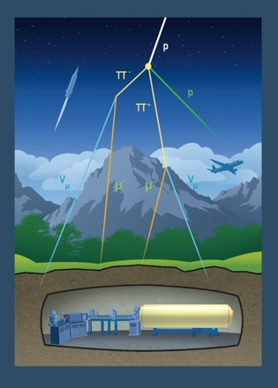
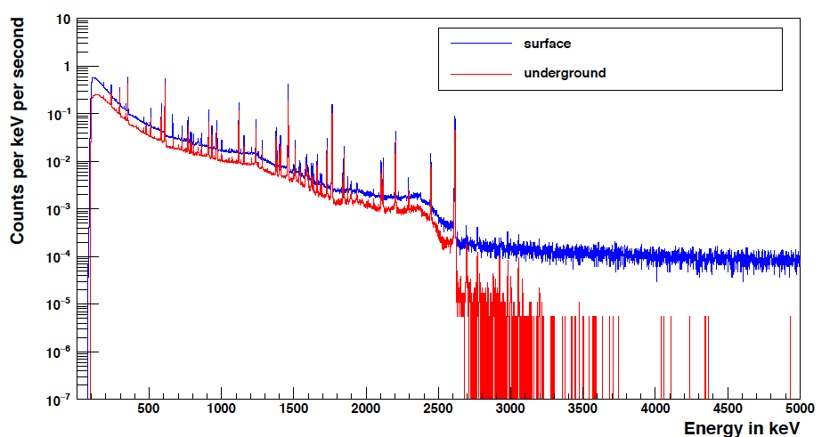
Why going underground: γ-background
Gran Sasso shielding: 3800 m w.e.
E>3.5MeV Counts/keV/hours
0.33
0.00024
cosmic rays
Environmental radioactivity
Radiation | LNGS/out
muons neutrons | 10⁻⁶ 10⁻³
Therefore, the advantage of an underground environment is evident for high Q-value reactions such as ¹⁴N(p,γ)¹⁵O, ¹⁵N(p,γ)¹⁶O, ¹⁷O(p,γ)¹⁸F, ²⁵Mg(p,γ)²⁶Al......

Slide 35
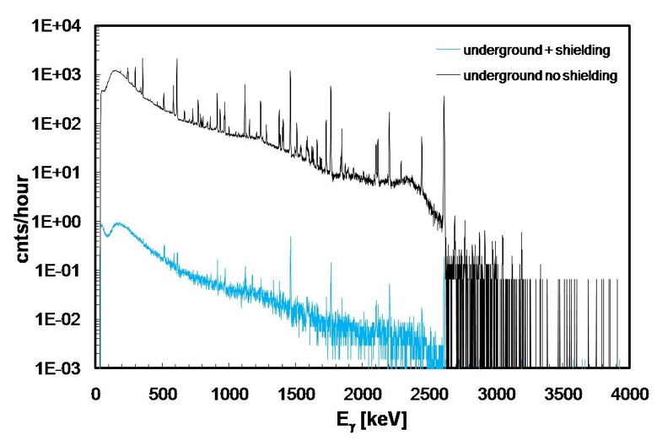
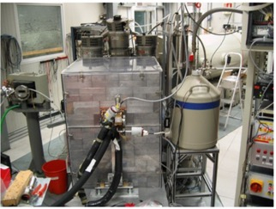
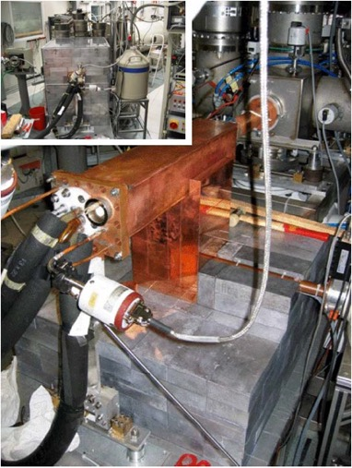
Why going underground: γ-background
Eur. Phys. J. A 39(2009)
3 orders of
magnitude!!!!
25 cm of lead + radon box

Slide 36
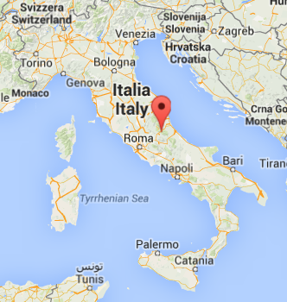
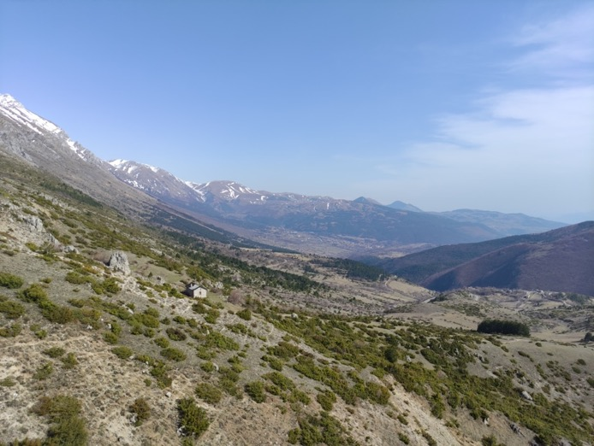
LNGS laboratory
Laboratori Nazionali del Gran Sasso
Notes:
In 20 years he has established the THM as a world renowned approach in NA

Slide 37
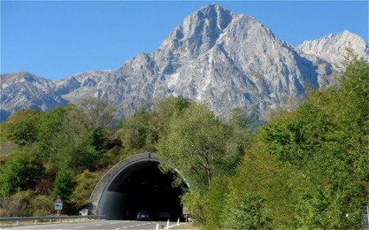
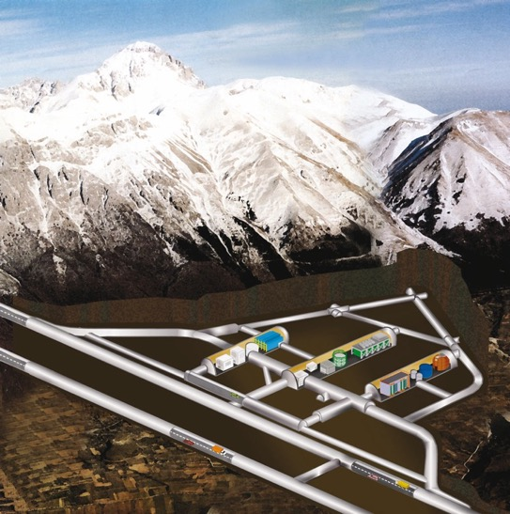
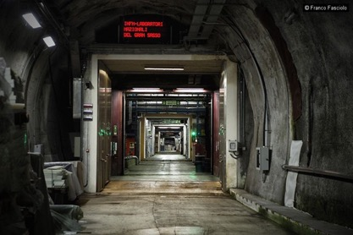
LNGS laboratory
Cosmic ray attenuation: μ → 10⁻⁶
n → 10⁻³
~ 1400 m
(3800 m.w.e.)
Notes:
In 20 years he has established the THM as a world renowned approach in NA

Slide 38
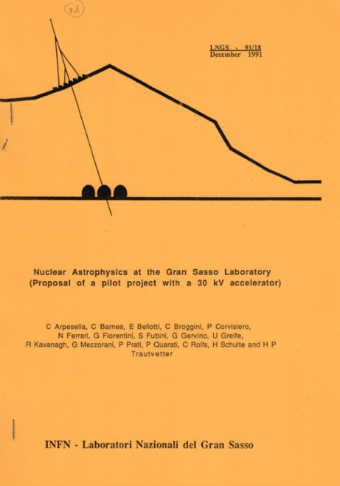

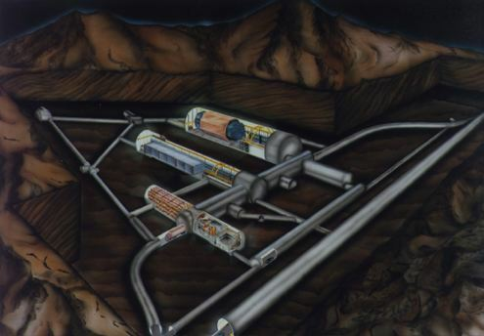
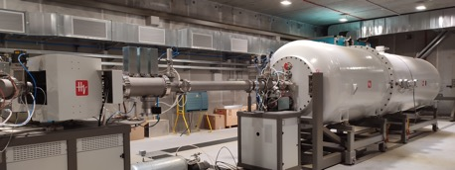
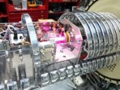
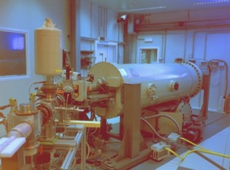
LUNA: a long story of discoveries
LNGS
LUNA-MV – 2022/
LUNA-50 kV
– 1992/00
LUNA-400 kV
– 2000/

Slide 39
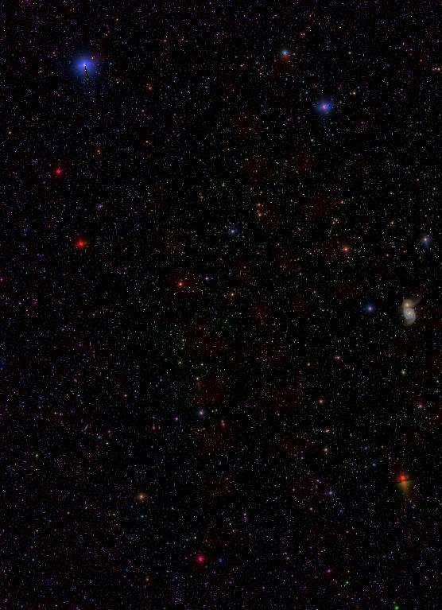
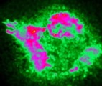

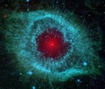
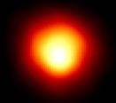

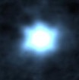
Nuclear Burning in Stars
10
⇒ ⁵⁶Fe Neon, Oxygen, Silicon
Burning
2 ¹²C ⇒ ²⁴Mg Carbon Burning
3 ⁴He ⇒ ¹²C + 8MeV Helium Burning
4 ¹H ⇒ ⁴He + 26MeV Hydrogen Burning
Si-ignition
O-ignition
Ne-ignition
9
C-ignition
log (T_{c})
LUNA MV
He-ignition
8
H-ignition
7
0
2
4
4
6
8
10
log (ρ_{c})

Slide 40
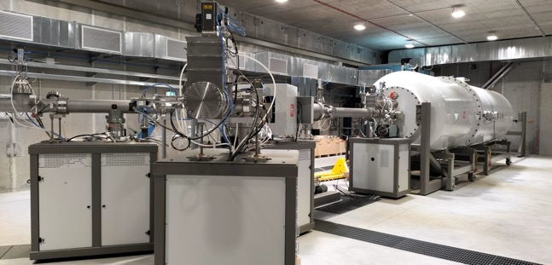

Bellotti Ion Beam Facility
LNGS
Inline Cockcroft Walton accelerator TERMINAL VOLTAGE: 0.2 – 3.5 MV
Beam energy reproducibility: 0.01% TV or 50V
Beam energy stability: 0.001% TV / h
Beam current stability: < 5% / h
H⁺ beam: 500 - 1000 µA
He⁺ beam: 300 - 500 µA
C⁺ beam: 100 - 150 µA
C⁺⁺ beam: 50 pµA

Slide 41
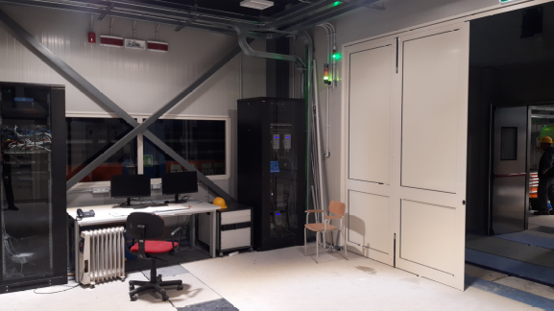
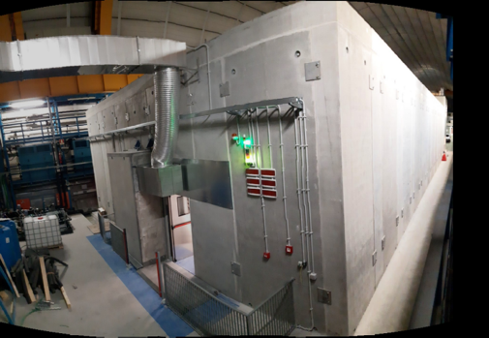
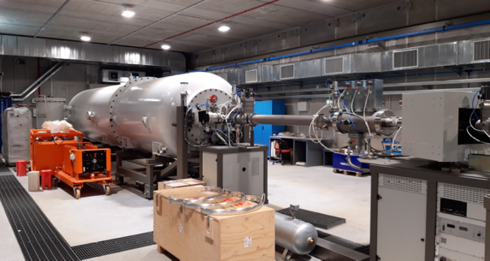
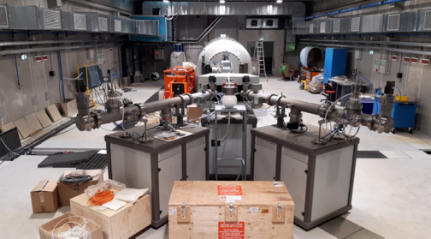
Bellotti Ion Beam Facility

Slide 42

Avalaible beams:
H, He, C⁺ and C⁺⁺
Competitors:
JUNA, China -> 400 kV machine, available beams: H, He⁺ and He⁺⁺;
CASPAR, USA -> 1 MV machine, available beams: H and He⁺
LNGS is still the unique place where to find an underground carbon beam!

Slide 43
First LUNA MV scientific proposal
CNO Hydrogen burning, Age of Globular Clusters and C production in AGB:
¹⁴N(p,γ)¹⁵O also for final scientific commissioning the MV accelerator
First experiment, data acquisition finished
C burning:
¹²C+¹²C fusion Pillar processes
detections of both particles and γ−rays
γ-experiment ready to start by spring of 2025
Main neutron source:
²²Ne(α,n)²⁵Mg
Data taking already started

Slide 44


The ¹²C+¹²C setup at LUNA-MV
25 cm thick lead shielding, under production;
An 150% HPGe;
16 NaI detector as further active shielding/anti-Compton;
Work ongoin on targets characterization in collaboration with LNL

Slide 45

The ¹²C+¹²C setup at LUNA-MV
25 cm thick lead shielding, under production;
An 150% HPGe;
16 NaI detector as further active shielding/anti-Compton;
Work ongoin on targets characterization in collaboration with LNL

Slide 46

Status of ¹²C+¹²C project: HPGePD2

Slide 47


Underground shielding
Spillane et al. PRL 2009
More than 4 OoM less background compared with Spillane et al.
Massive shielding very effective underground:
we will detect the structures below E_{cm} = 2.5 MeV and presence of hindrance !!!!

Slide 48


Measuring ¹²C+¹²C in laboratory: γ-rays detection @LNGS
Reaction per day with 200 μA

Slide 49


Measuring ¹²C+¹²C in laboratory: γ-rays detection @LNGS
Reaction per day with 200 μA

Slide 50
Measuring ¹²C+¹²C in laboratory: γ-rays detection @LNGS
Reaction per day with 200 μA

Slide 51



Status of ¹²C+¹²C project: NaI Prototype

Slide 52



Status of ¹²C+¹²C project: NaI Prototype

Slide 53
Status of ¹²C+¹²C project: NaI final design
NaI
NaI
SiPM
SiPM
Beam
HPGe
detector
HPGe
base
NaI
NaI
SiPM
SiPM
Front view
Lateral view

Slide 54

Expected setup efficiency and sensitivity
10

Slide 55
Expected setup efficiency and sensitivity
10

Slide 56



Status of ¹²C+¹²C project: target tests @LNGS
1 mm thick AXF or ZDF graphite by Entegris POCO

Slide 57

Status of ¹²C+¹²C project: status of the beam line
Beamtime will start in a couple of months

Slide 58

LUNA collaboration
Laboratori Nazionali del Gran Sasso, INFN, ASSERGI, Italy/*GSSI, L'AQUILA, Italy
T. Chillery, A. Compagnucci, F. Ferraro, R. Gesué, and M. Junker
Università degli Studi di Bari and INFN, BARI, Italy
G.F. Ciani V. Paticchio, L. Schiavulli
Università degli Studi di Genova and INFN, GENOVA, Italy
P. Corvisiero, P. Prati, S. Zavatarelli
Università degli Studi di Milano and INFN, MILANO, Italy
R. Depalo, A. Guglielmetti,
Università degli Studi di Napoli ”Federico II” and INFN, NAPOLI, Italy
C. Annana, A. Best, A. Di Leva, G. Imbriani, D. Mercogliano, D. Rapagnani
Università degli Studi di Padova and INFN, PADOVA, Italy
C. Broggini, A. Caciolli, P. Marigo, R. Menegazzo, D. Piatti, J. Skowronski, K. Stöckel
INFN Roma, ROMA, Italy
C. Gustavino, A. Formicola
Osservatorio Astronomico di Collurania, TERAMO and INFN LNGS, Italy
O. Straniero
Università di Torino and INFN, TORINO, Italy
F. Cavanna, G. Gervino, P. Colombetti
Konkoly Observatory, Hungarian Academy of Sciences, BUDAPEST, Hungary
M. Lugaro
Institute of Nuclear Research (ATOMKI), DEBRECEN, Hungary
L. Csedreki, Z. Elekes, Zs. Fülöp, Gy. Gyürky, T. Szücs
Helmholtz-Zentrum Dresden-Rossendorf, DRESDEN, Germany
A. Boeltzig, D. Bemmerer, E. Masha,, M. Takács
University of Edinburgh, EDINBURGH, United Kingdom
M. Aliotta, L. Barbieri, C.G. Bruno, T. Chillery, T. Davinson

