Slide 1
Feasibility study of α scattering on ${}_{}^{24}{Mg}$ in the energy range of astrophysical interest
ECT* KRINA2025 Workshop
Federica Ercolano
University of Naples "Federico II"
INFN-Naples Division

Slide 2
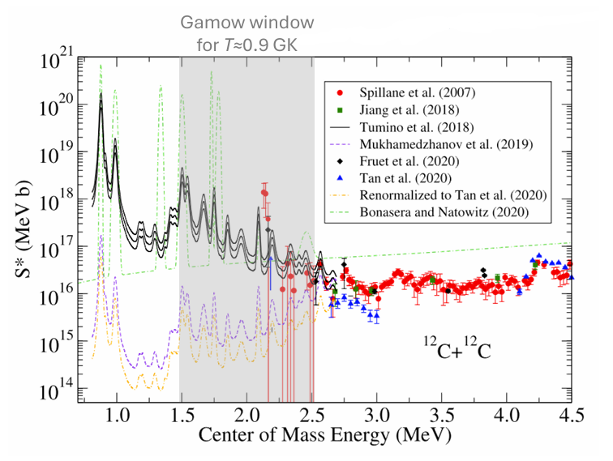
${}_{}^{12}C+{}_{}^{12}{C }$: experimental studies
The ${}_{}^{12}C+{}_{}^{12}C$ fusion reaction is a trigger and driving force of the carbon burning in massive stars.
Several datasets and models;
Direct measurements above 2.1 MeV (large scattering, large uncertainties);
Only indirect measurements below 2.1 MeV.
Very large uncertainty below 2.5 MeV
Courtesy of Federico Ferraro, INFN - LNGS

Slide 3
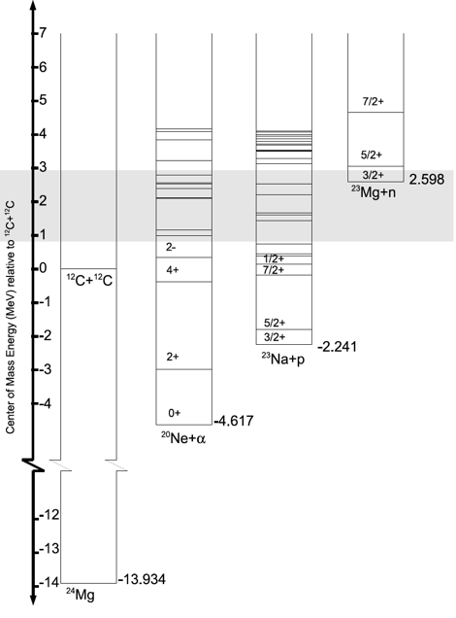
${}_{}^{12}C+{}_{}^{12}{C }$ fusion reaction
The description of deep sub-barrier resonances is challenging and demanding;
The primary reaction channels involve the rearrangement of many nucleons and the strong channel coupling;
Nuclear models usually adopt phenomenological potentials to mimic such complex reaction dynamics.
Plausible description of the resonances in the ${}_{}^{12}C+{}_{}^{12}C$ system by a full-microscopic nuclear model;
Experimental method to confirm the theoretical predictions.
T. Yasutaka and M. Kimura, PLB 823 (2021)

Slide 4
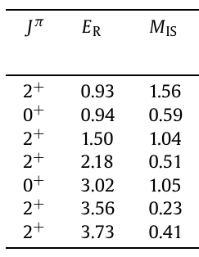
${}_{}^{12}C+{}_{}^{12}{C }$: fusion reaction rate from a microscopic nuclear model
T. Yasutaka and M. Kimura, Physics Letters B 823 (2021)
Antisymmetrized molecular dynamics (AMD) to investigate the (cluster-like) resonances in the energy region of $E_{x}=14\text{−}17 MeV$ in ${}_{}^{24}{Mg}$;
Calculated resonance energies in MeV and isoscalar transition matrix elements in Weisskopf unit.
Calculated and observed modified astrophysical S∗-factors.

Slide 5
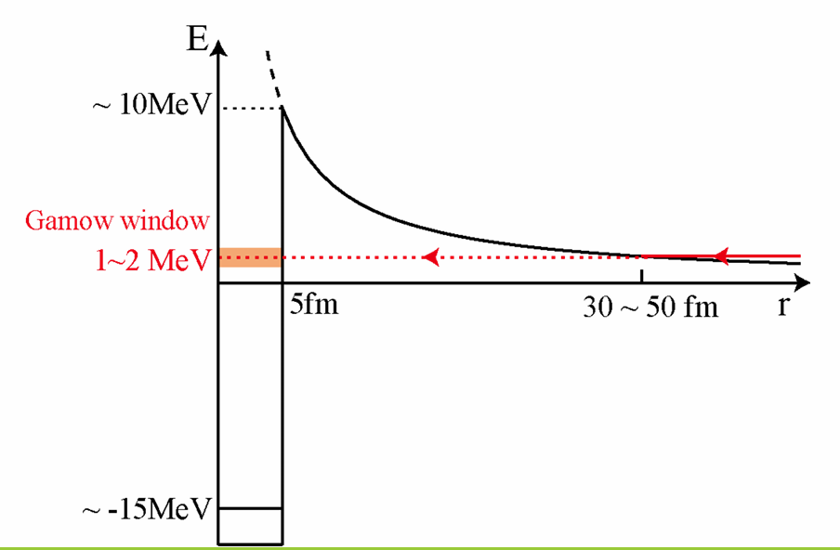
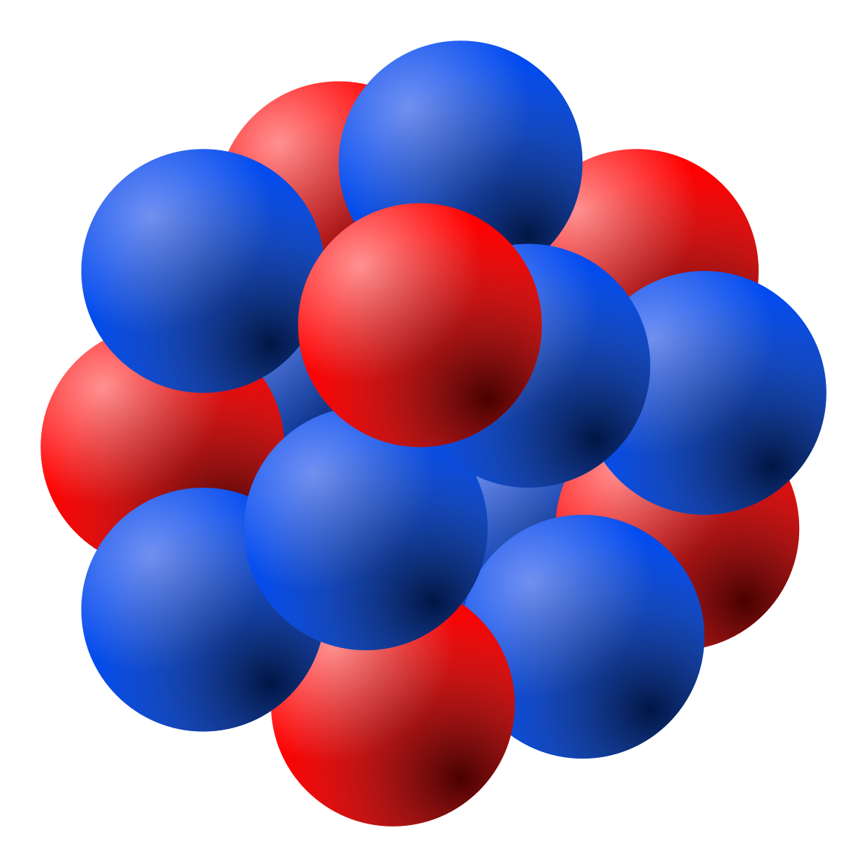
${}_{}^{12}C+{}_{}^{12}{C }$: monopole transition as novel probe for resonances
T. Yasutaka and M. Kimura, Physics Letters B 823 (2021)
Electric monopole (quadrupole) transitions from g.s. to states (resonances) with cluster configuration are considerably enhanced.
The mechanism was explained by
A. Yamada et al., PTP120, 1139 (2008).
$${}_{}^{12}C$$
$${}_{}^{12}C$$
The most promising and feasible reaction may be the α-inelastic scattering on ${}_{}^{24}{Mg}$.
$${}_{}^{24}{Mg}\left(α,α^{′}\right){}_{}^{24}{{Mg}^{∗}}$$
α
$${}_{}^{24}{Mg}$$
g.s.

Slide 6
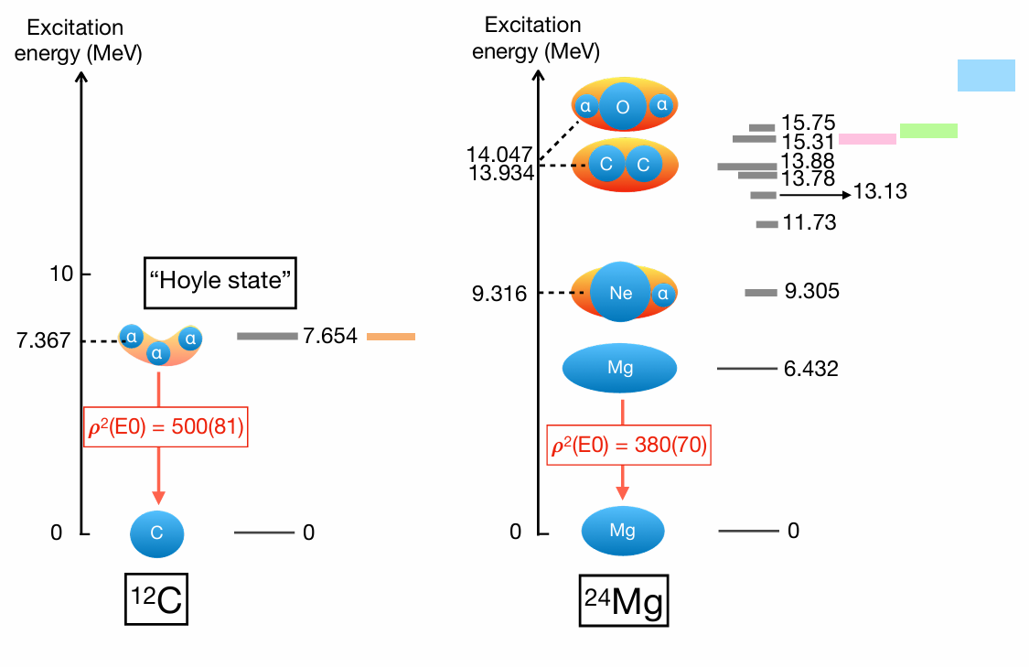
${}_{}^{12}C+{}_{}^{12}{C }$: monopole transition as novel probe for resonances
P. Adsley et al., Physical Review Letters 129.10 (2022)
type 1a supernovae ( $T_{9}$ = 1.8)
massive stars ($T_{9}$ = 0.6)
superbursts ($T_{9}$ = 0.4)
Possible analogy between the Hoyle-state in ${}_{}^{12}C$ as the driver of 3α fusion and candidate C+C cluster states in ${}_{}^{24}{Mg}$ as drivers of ${}_{}^{12}C$+ ${}_{}^{12}C$ fusion.
Energetics are crucial in driving the system towards a particular cluster configuration → Ikeda diagrams (1968) → clusters are expected to emerge close or slightly below the cluster separation energy.

Slide 7
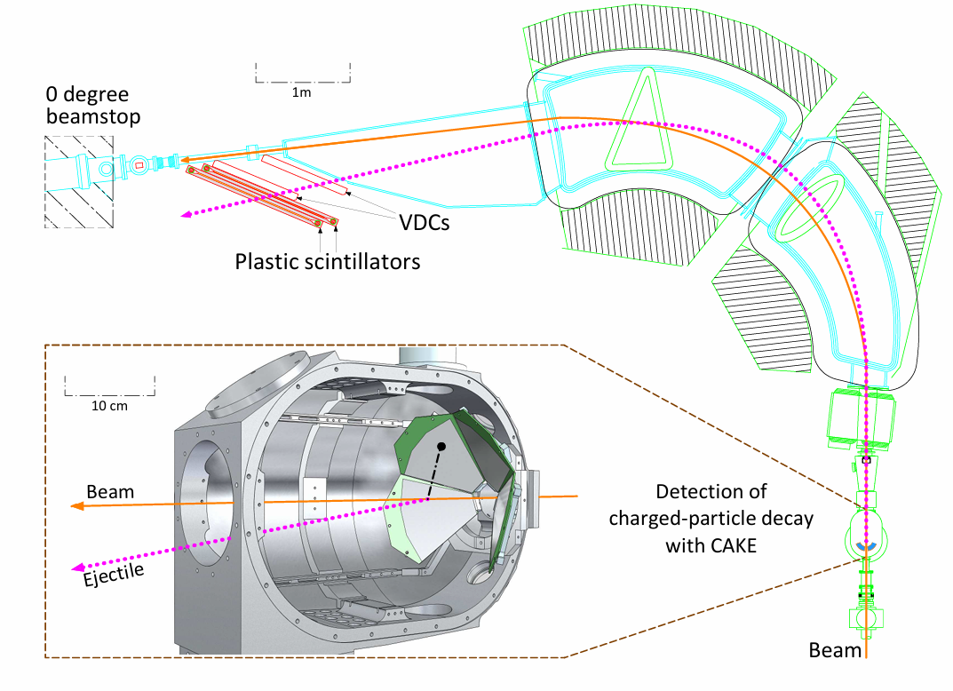
${}_{}^{12}C+{}_{}^{12}{C }$: Extending the Hoyle-State Paradigm to${}_{}^{12}C+{}_{}^{12}C$ fusion
P. Adsley et al., Physical Review Letters 129.10 (2022)
200-MeV beam of α particles;
enriched ${}_{}^{24}{Mg}$ foil;
K600 Q2D magnetic spectrometer;
Inelastically scattered α particles detected at the focal plane of the K600;
Coincidence Array for K600 Experiments (CAKE) of double-sided silicon strip detectors.
Set-up used in the experiment at iThemba LABS, Cape Town.

Slide 8
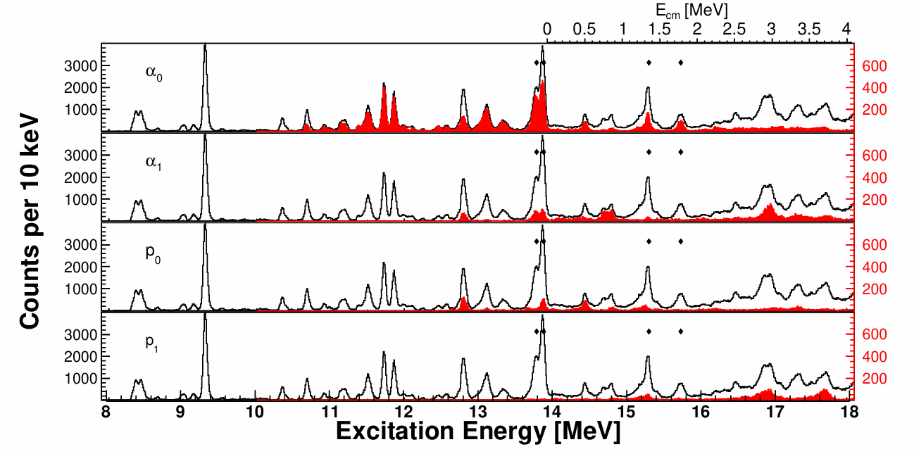
${}_{}^{12}C+{}_{}^{12}{C }$: Extending the Hoyle-State Paradigm to${}_{}^{12}C+{}_{}^{12}C$ fusion
P. Adsley et al., Physical Review Letters 129.10 (2022)
The four $J^{π}=0^{+}$ states of importance in the present work (marked with black diamonds) are:
$E_{x}=13.78, 13.88, 15.31, 15.75 MeV;$
Despite comprehensive data on resonance scattering measurements of α particles from ${}_{}^{20}{Ne}$, there is no evidence for population of these four $J^{π}=0^{+}$ states.
Excitation-energy spectra for states excited in the ${}_{}^{24}{Mg}\left(α,α^{′}\right){}_{}^{24}{{Mg}^{∗}}$ reaction at 0-degree. Superimposed are the coincidence data for different breakup channels.

Slide 9
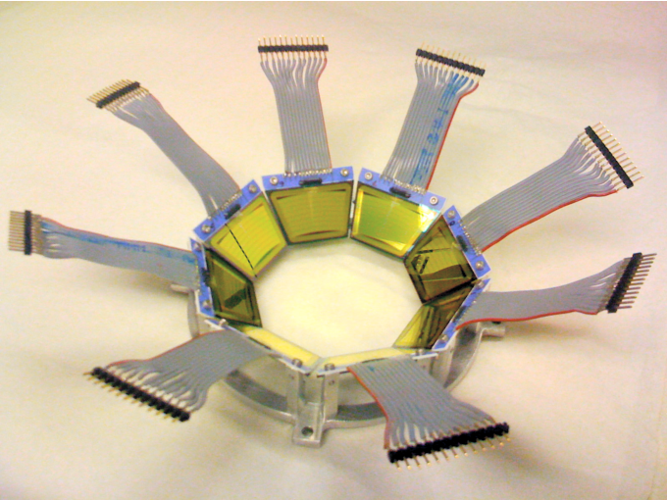
α scattering on ${}_{}^{24}{Mg}$ at Oslo Cyclotron Laboratory (OCL)
30-MeV beam of α particles;
SiRi particle-telescope system: 8 trapezoidal ΔE-E silicon detectors. Thin ΔE front detector segmented into 8 annular strips$(θ_{LAB}=40°−54°)$.
Oslo SCintillator ARray (OSCAR): 30 ${LaBr}_{3}(Ce)$ scintillating crystals coupled to photomultiplier tubes.
M. Guttormsen et al. / Nuclear Instruments and Methods in Physics Research A 648 (2011).
F. Zeiser et al. / Nuclear Inst. and Methods in Physics Research, A 985 (2021).

Slide 10
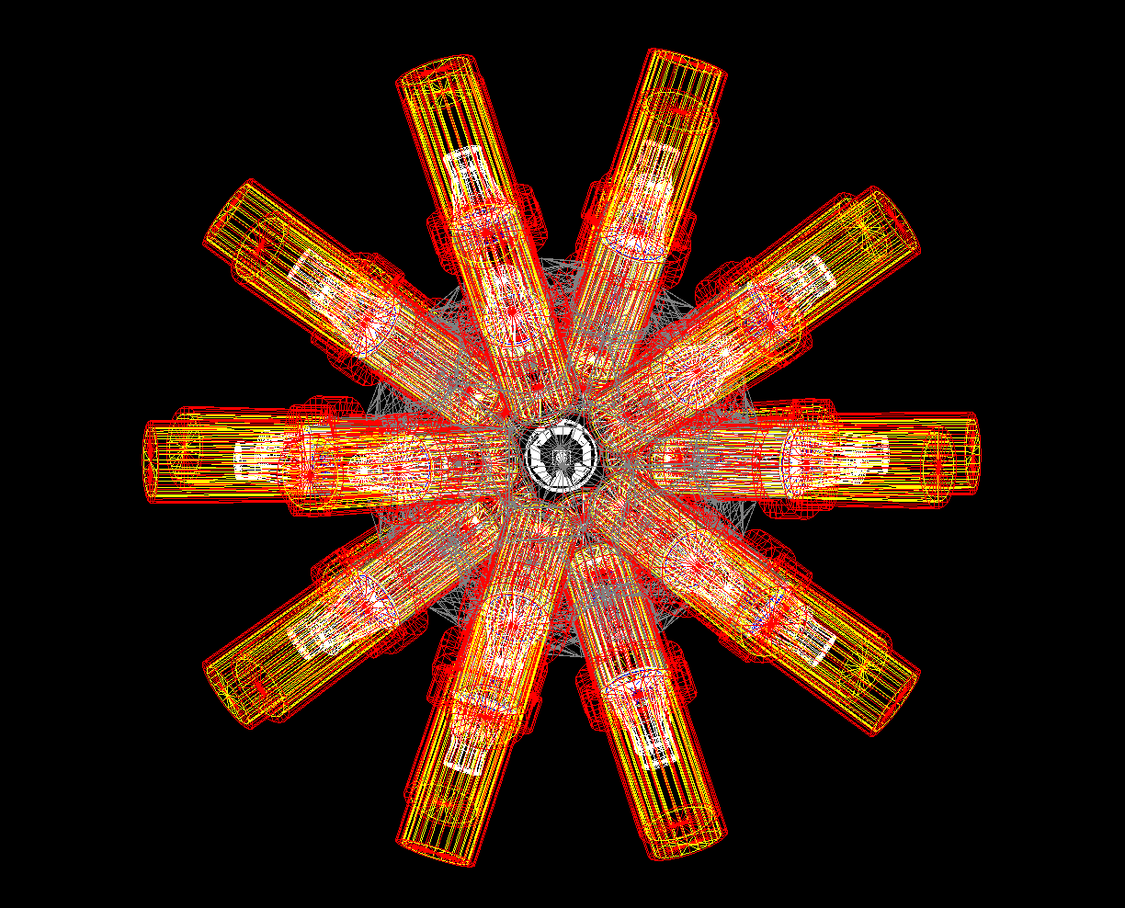
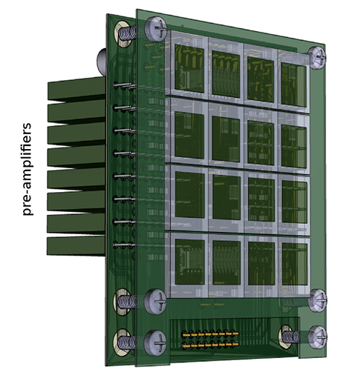
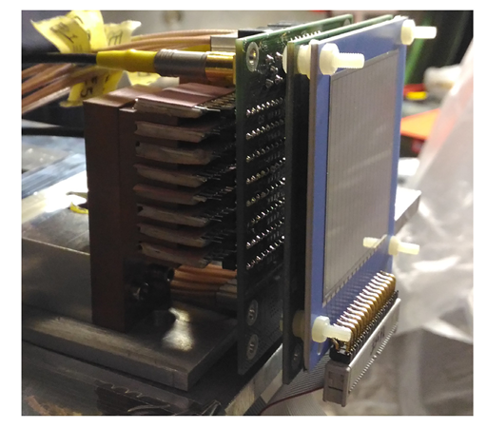
α scattering on ${}_{}^{24}{Mg}$ at Oslo Cyclotron Laboratory (OCL)
OSCAR (hOdoscope of Silicons for Correlations and Analysis of Reactions)
OCL set-up geometry implementation in Geant4.
D. Dell’Aquila et al. Nuclear Inst. and Methods in Physics Research, A 877 (2018).

Slide 11
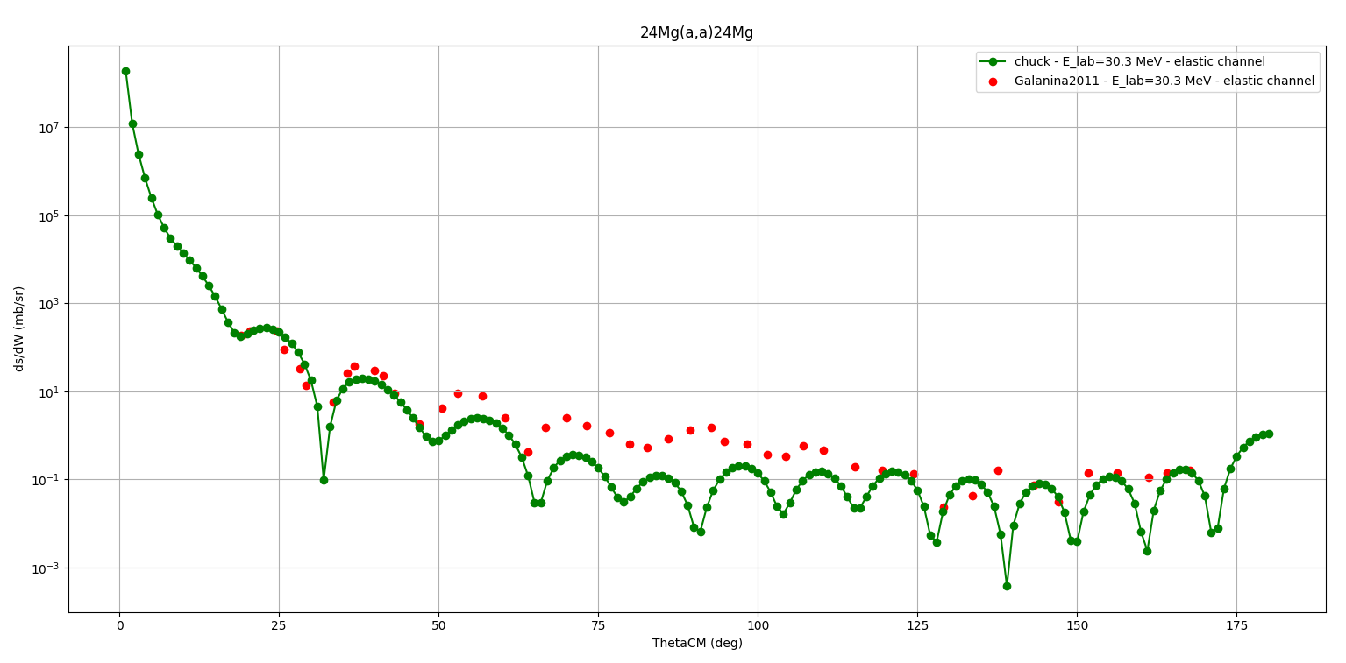
Feasibility study - CHUCK3 calculations
${}_{}^{24}{Mg(α,α^{′}){}_{}^{24}{Mg}}$
at $E_{α}$ = 30.3 MeV;
3 states in ${}_{}^{24}{Mg }$:
- $0^{+}$ (g.s.);
- $2^{+}$ at 1.368 MeV;
- $0^{+}$ at 15 MeV;
OMP from Galanina, L. I., et al. Bulletin of the Russian Academy of Sciences: Physics 75 (2011).
Differential cross-section of the ${}_{}^{24}{Mg(α,α^{′}){}_{}^{24}{Mg}}$reaction with the formation of a final nucleus in the ground state. Experimental data from Galanina et al. in red. CHUCK3 output in green.

Slide 12
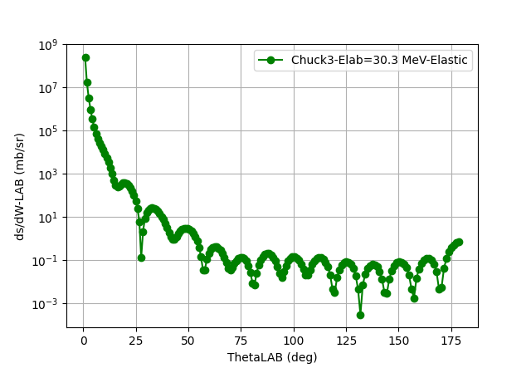
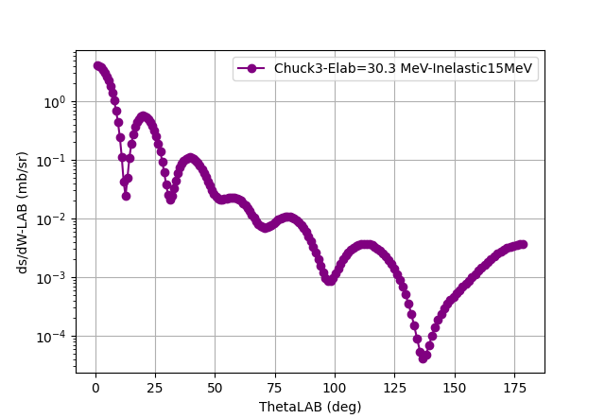
Feasibility study - CHUCK3 calculations
Differential cross-section of the ${}_{}^{24}{Mg(α,α^{′}){}_{}^{24}{Mg}}$reaction with the formation of a final nucleus in the ground state calculated with CHUCK3.
Differential cross-section of the ${}_{}^{24}{Mg(α,α^{′}){}_{}^{24}{Mg}}$reaction with the formation of a final nucleus in the $0^{+}$ state at
15 MeV calculated with CHUCK3.

Slide 13
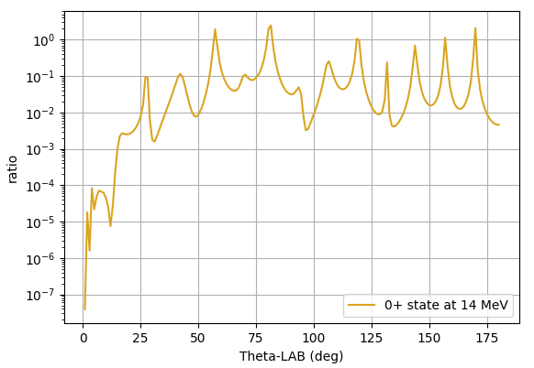
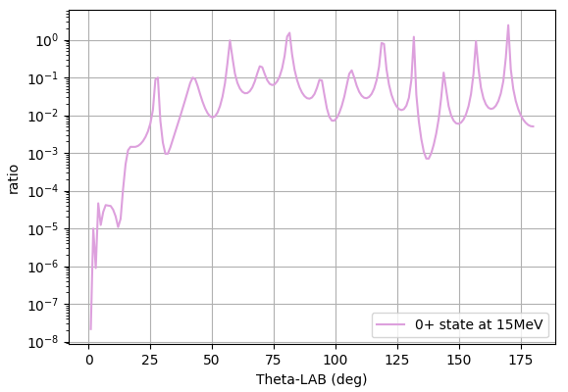
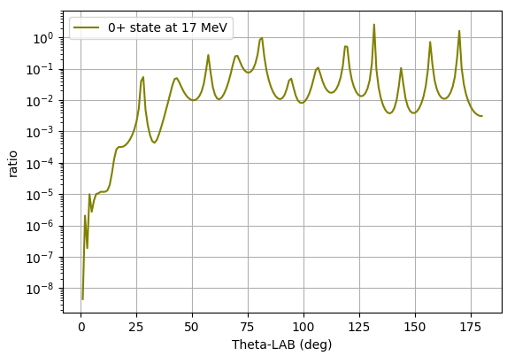
Feasibility study - CHUCK3 calculations
Differential cross-section ratio between inelastic and elastic channels.

Slide 14
Thank you for the attention

