Slide 1
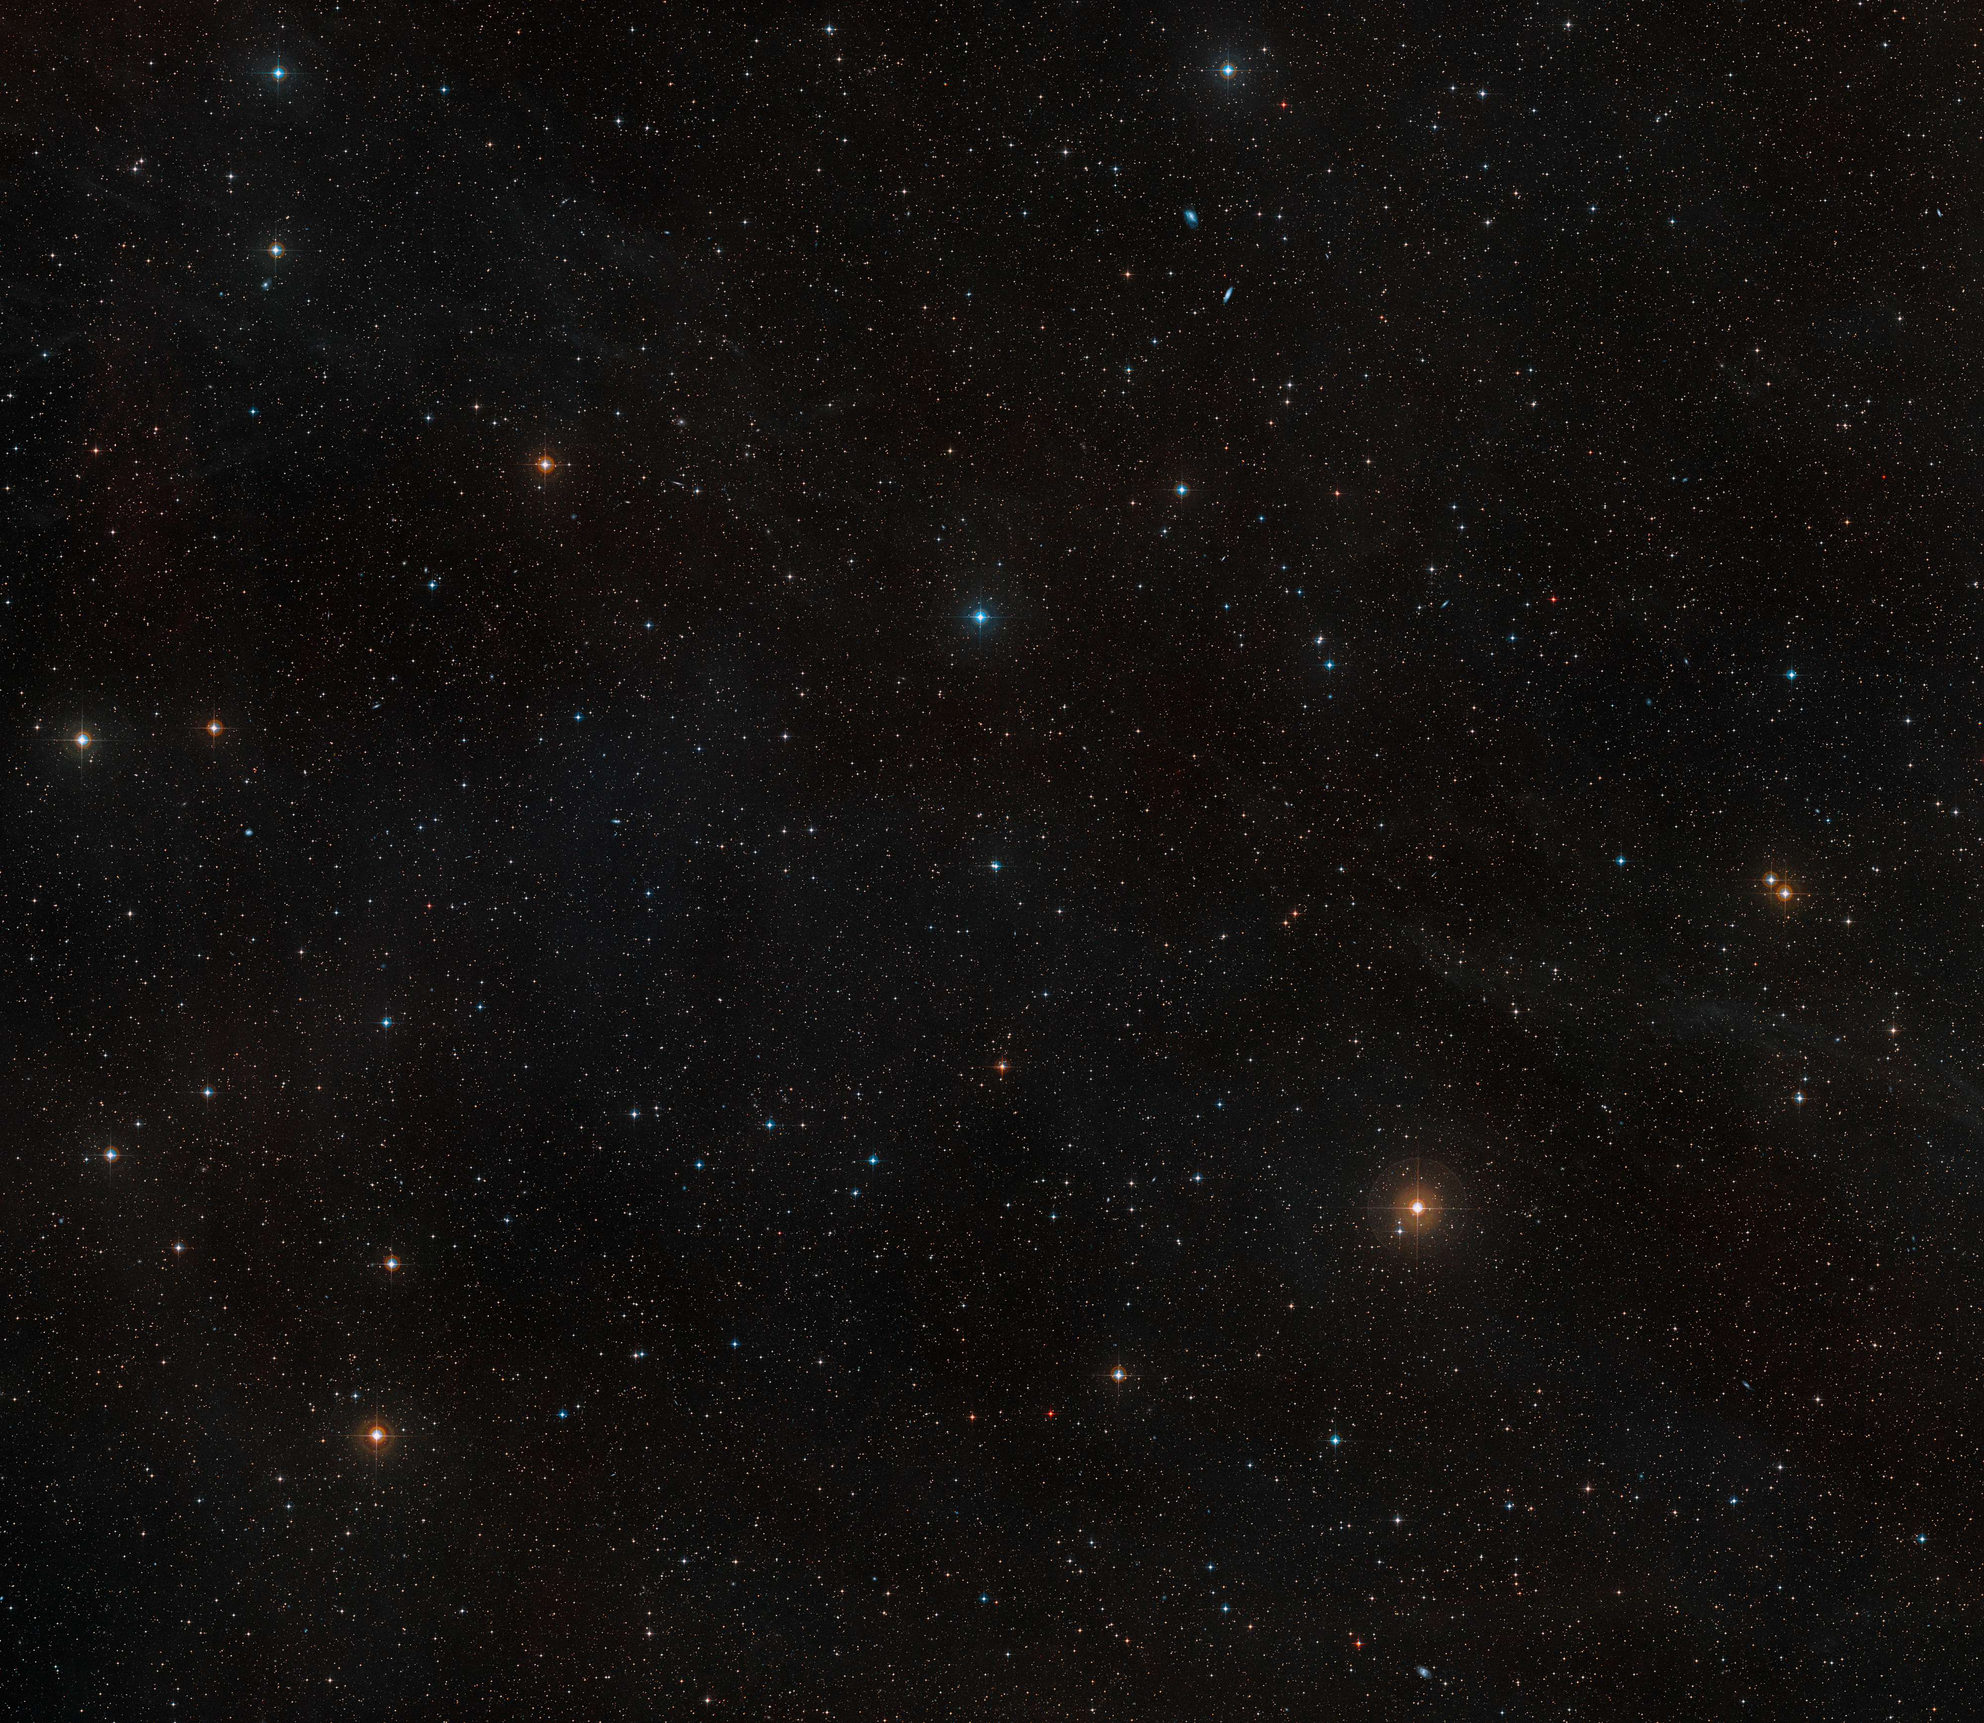


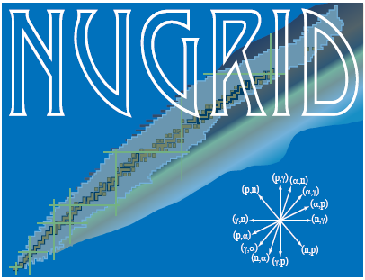


The Role of Carbon-Oxygen Shell Interactions in the Nucleosynthesis and Final Fate of Massive Stars
Key Reaction In Nuclear Astrophysics
Trento, February 18, 2025
Lorenzo Roberti, Konkoly Observatory, HUN-REN CSFK, Budapest, Hungary
(soon joining the INFN – Laboratori Nazionali del Sud, Catania, Italy!)
Main collaborators:
Marco Pignatari, Konkoly Observatory, HUN-REN CSFK Maria Lugaro, Konkoly Observatory, HUN-REN CSFK
Marco Limongi, INAF – OAR Alessandro Chieffi, INAF – IAPS

Slide 2

Carbon-oxygen shell mergers in massive stars
Ingestion of some C (and Ne) in the O burning shell during late stages of the evolution;
Formation of an extended (both in mass and radius) mixed convective zone;
Peculiar nucleosynthesis and impact on the explodability;
Intrinsically 3D occurrence: studied by hydro simulations (e.g., Andrassy+20, Rizzuti+24);
Found in several 1D stellar models with M_{ini}$≤$25 M$⊙$ (e.g., Rauscher+02, Ritter+18, Roberti+24).

Slide 3
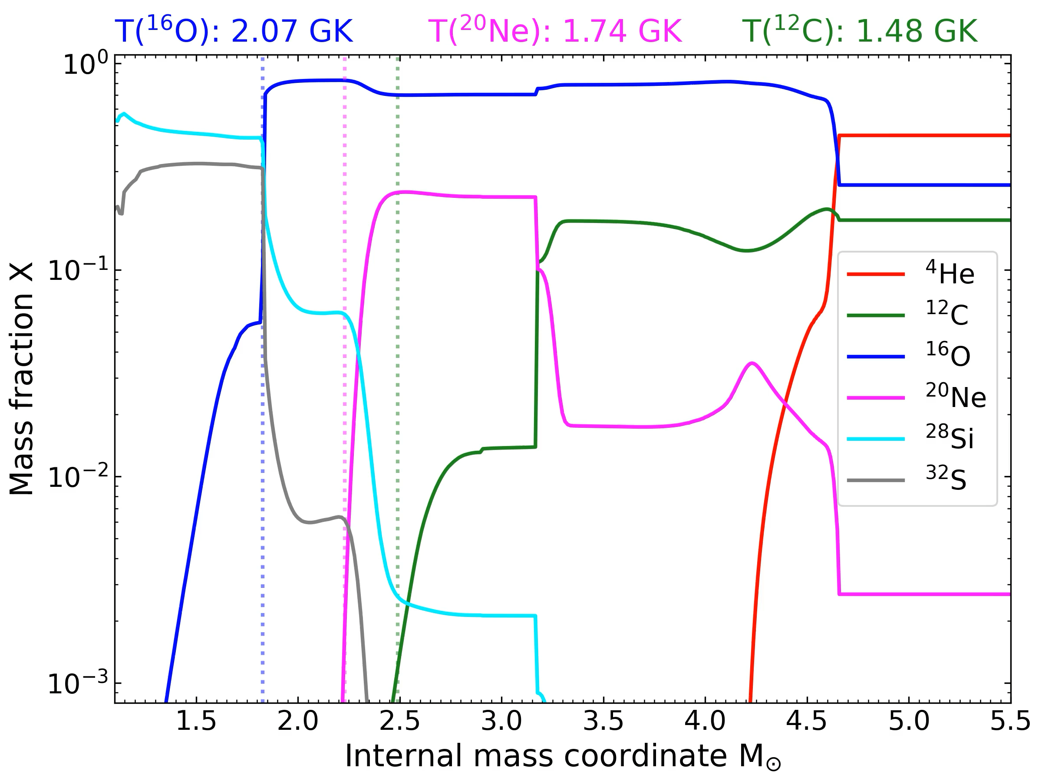
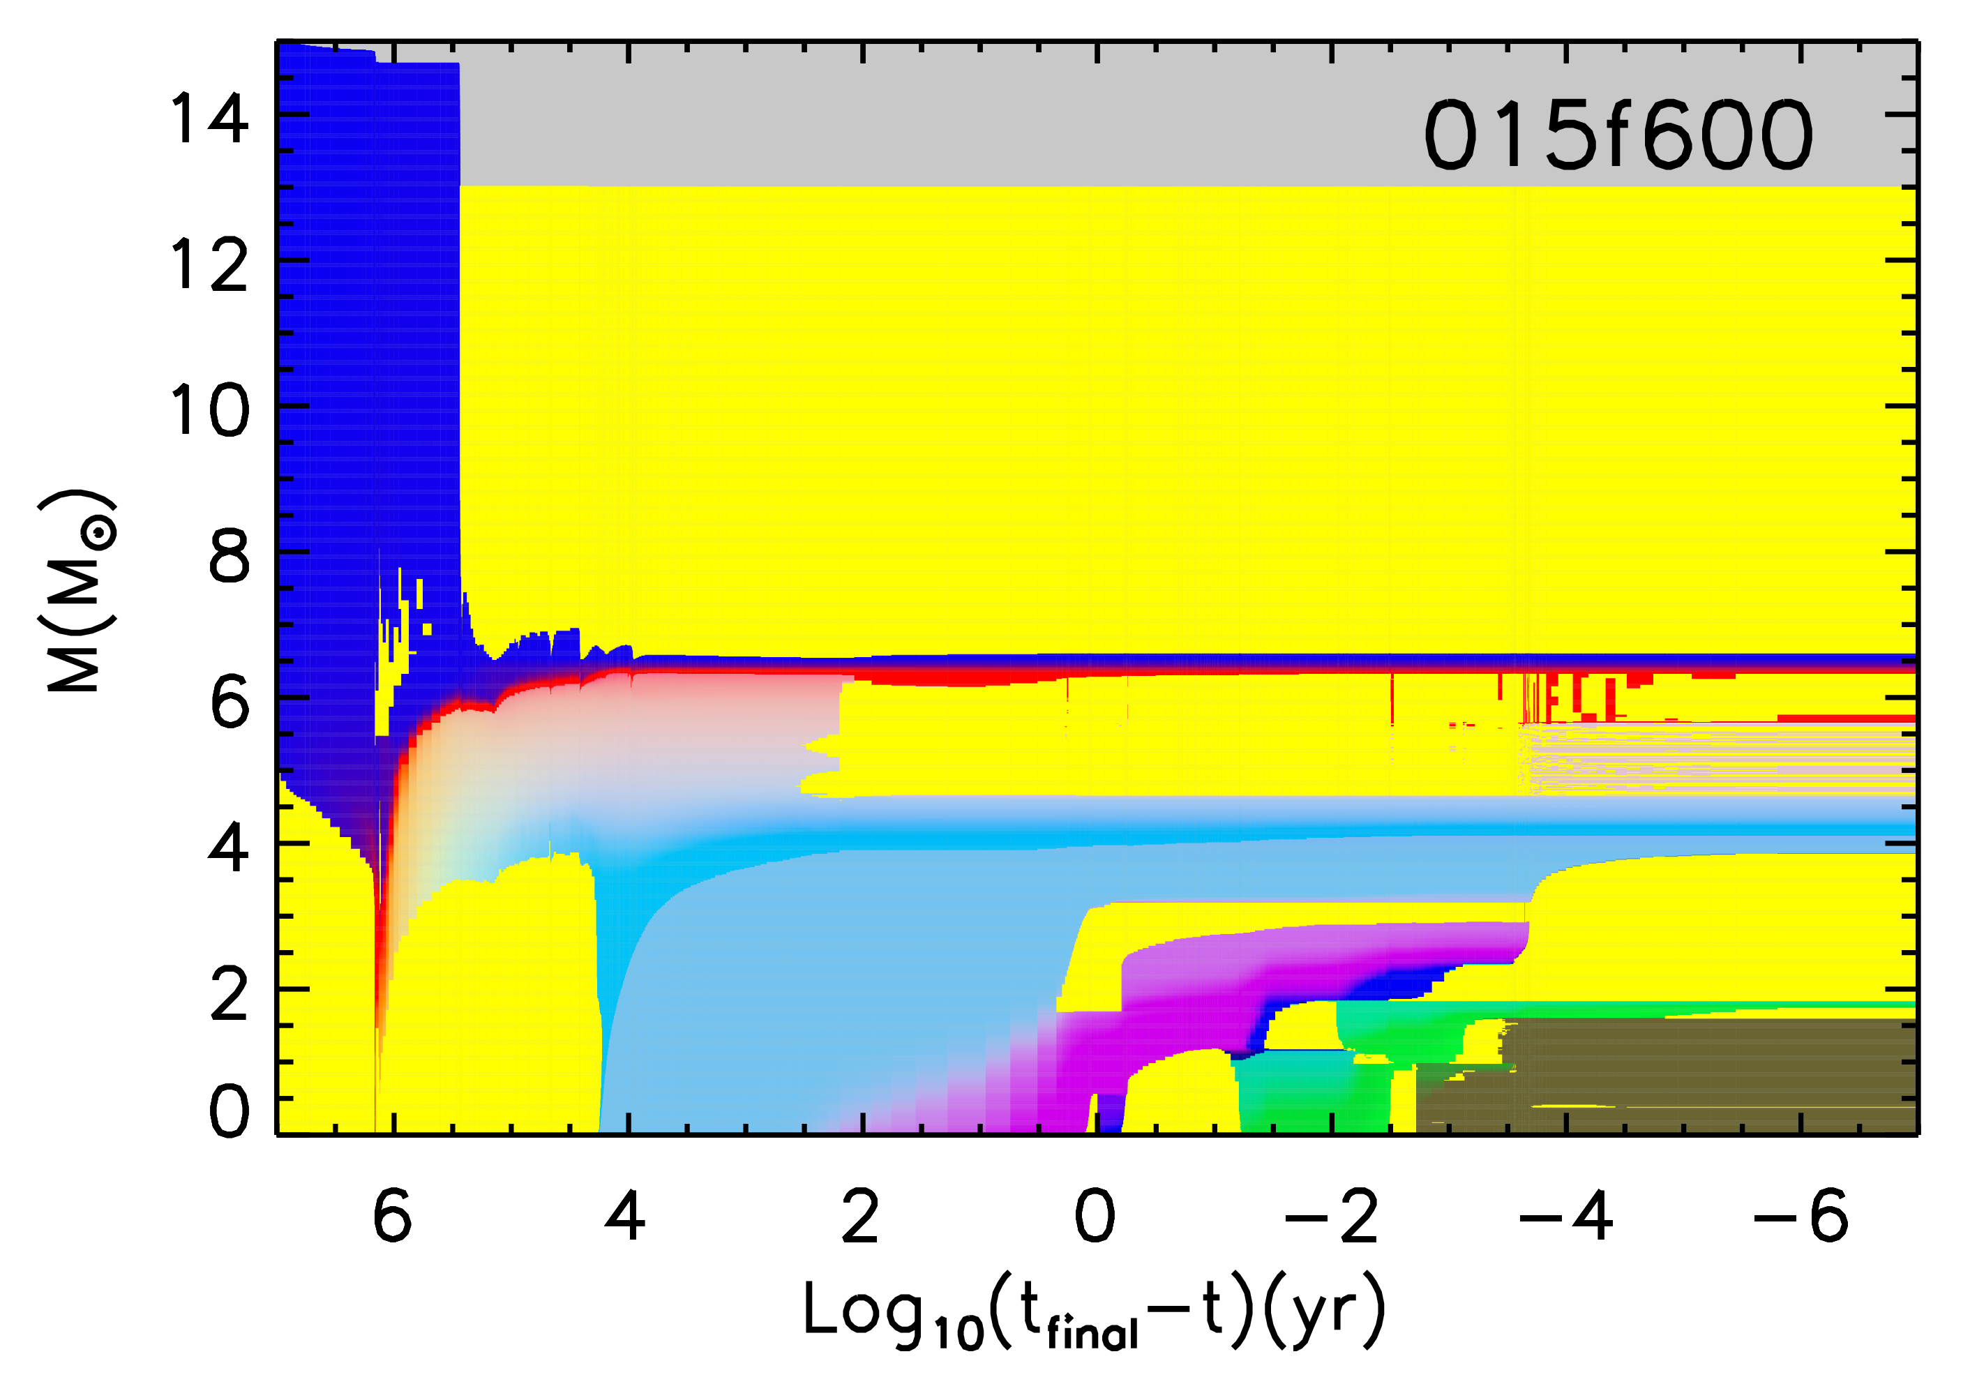
Carbon-oxygen shell mergers in massive stars
H
Convective envelope
He
Conv. shell
Conv. core
C/O
O/Ne
C-O merger
Si
Fe
(See M. Limongi’s presentation)

Slide 4
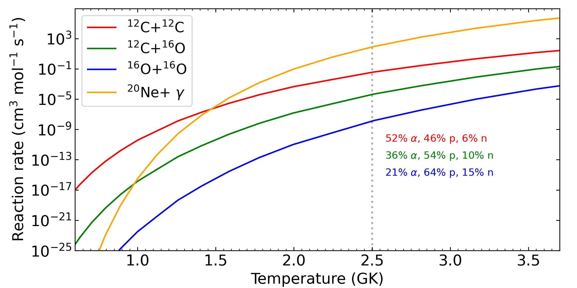
Nuclear reactions during a C-O merger

Slide 5
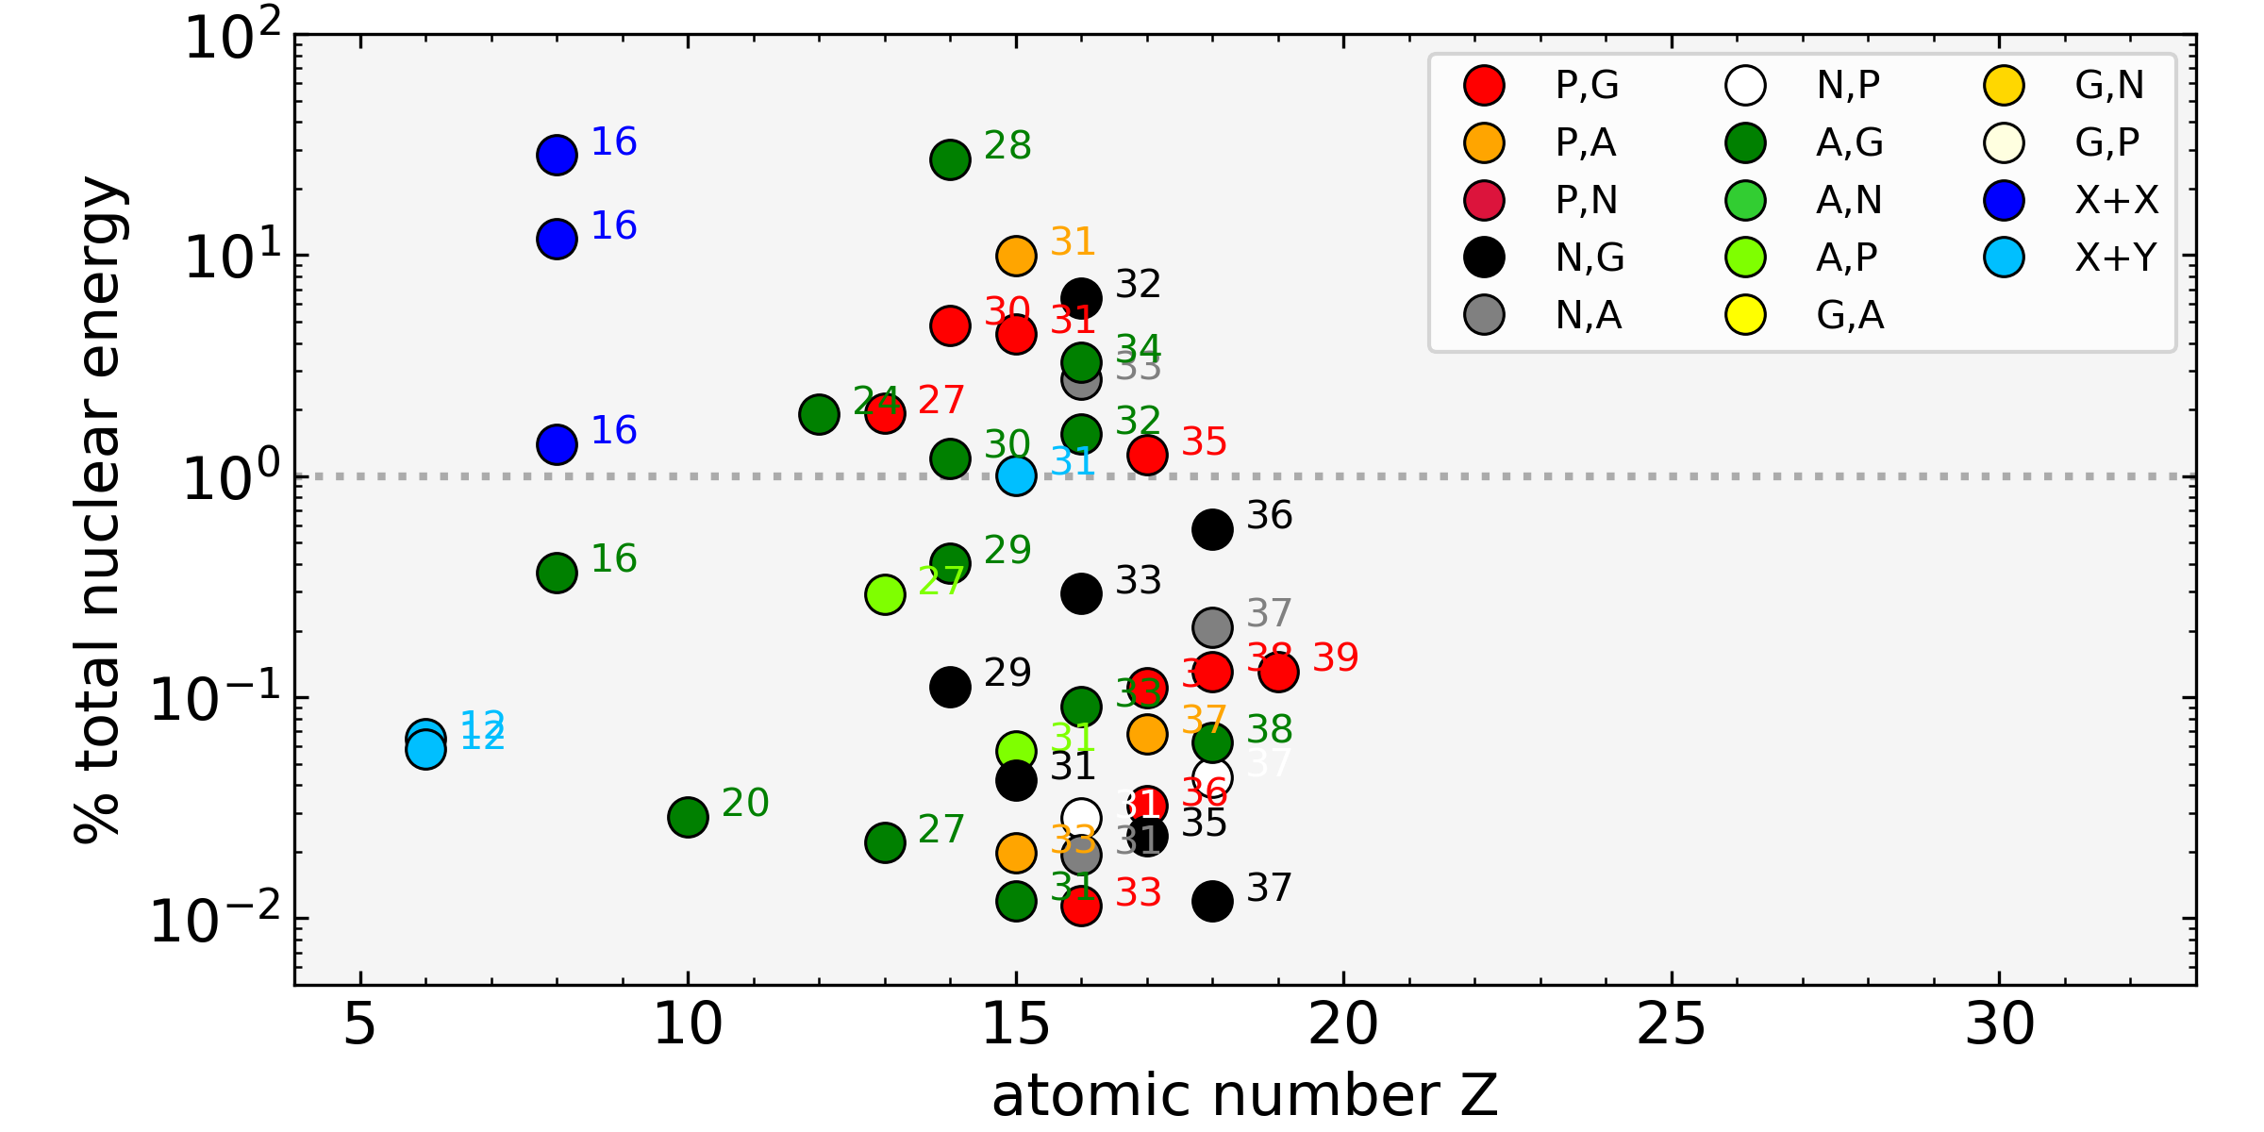
Nuclear reactions during a C-O merger
^{O shell burning}

Slide 6
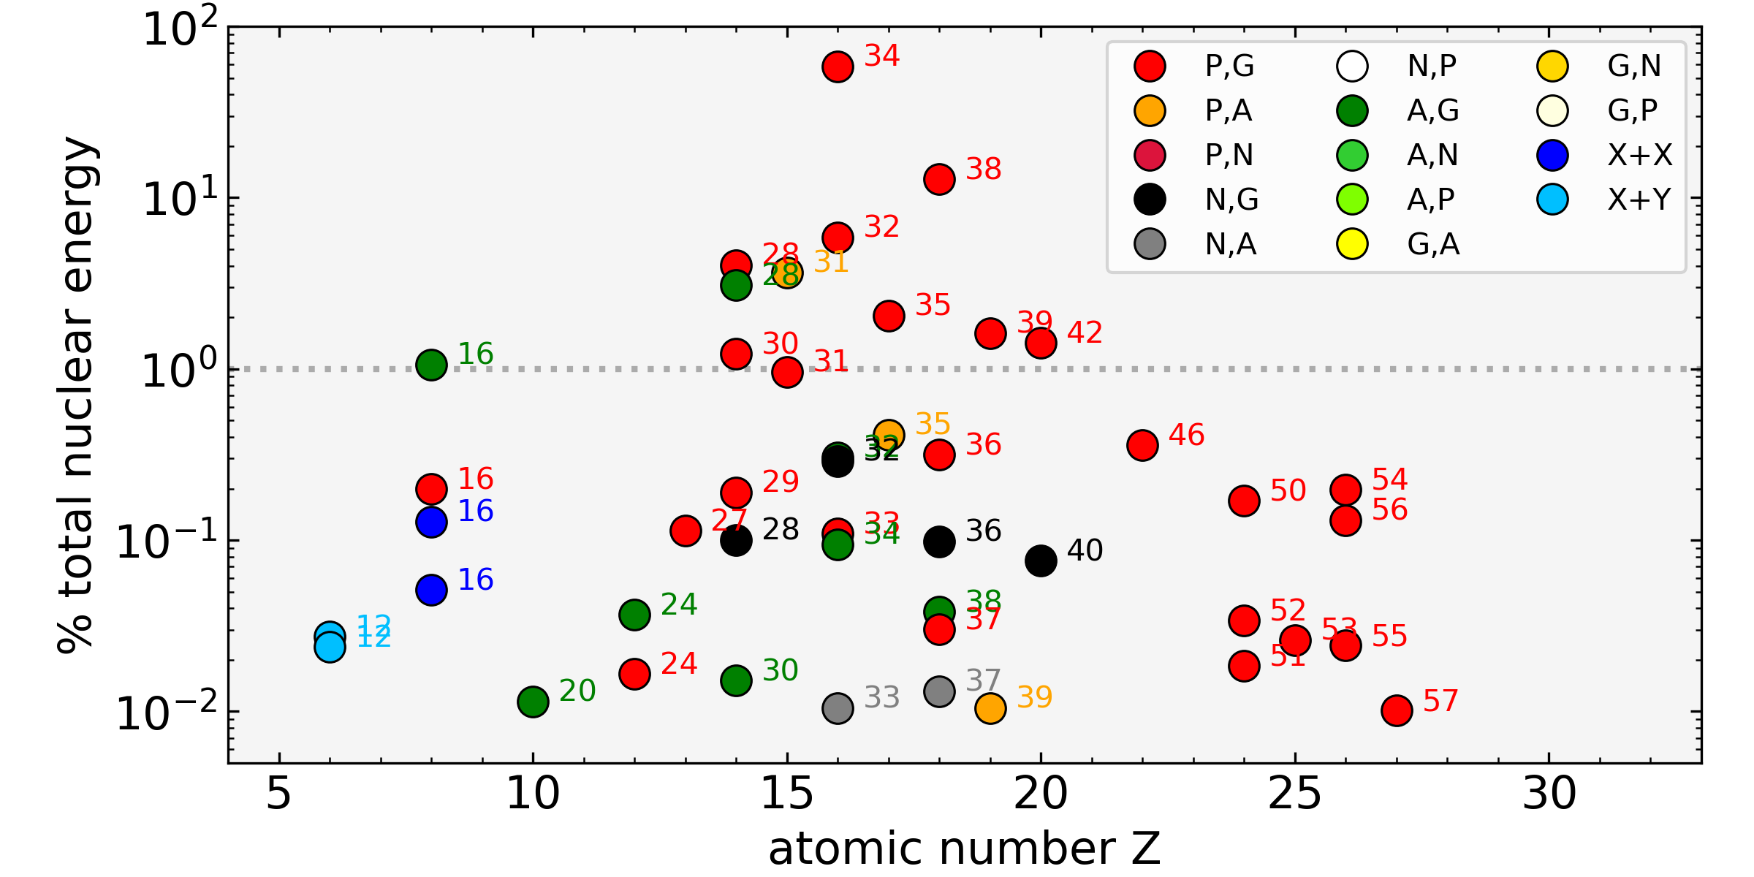
Nuclear reactions during a C-O merger
^{C-O shell merger}

Slide 7
Nucleosynthesis in a C-O shell merger
Enhanced O-burning products and production of odd-Z elements (P, Cl, K, Sc);
Efficient photodisintegration of heavy elements: production of the weak s-process and 𝜸-process nuclei.

Slide 8
Nucleosynthesis: odd-Z element production

Slide 9
Nucleosynthesis: odd-Z element production
Odd-Z elements and O-burning products

Slide 10
Nucleosynthesis: odd-Z element production

Slide 11

Nucleosynthesis: odd-Z element production
$$Tshock∝R^{−3/4}$$

Slide 12
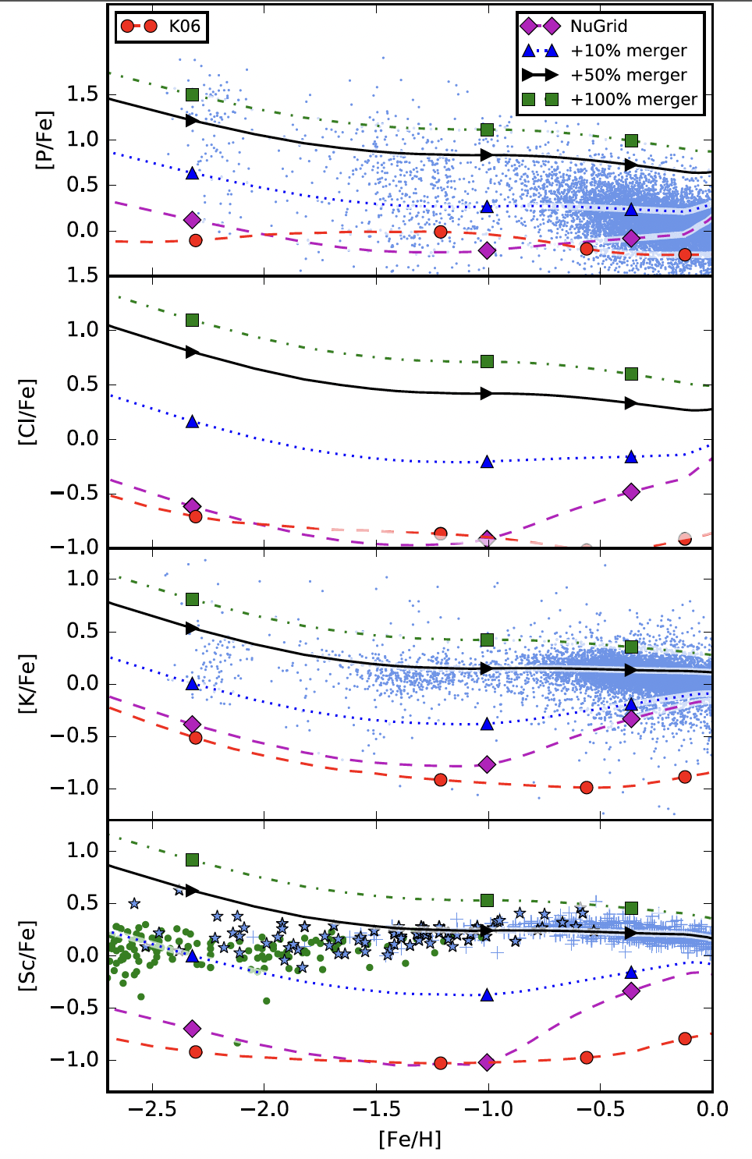
Nucleosynthesis: odd-Z element production
Ritter et al., 2018, MNRAS 474, L1

Slide 13
Nucleosynthesis: odd-Z element production
Roberti et al., in preparation

Slide 14
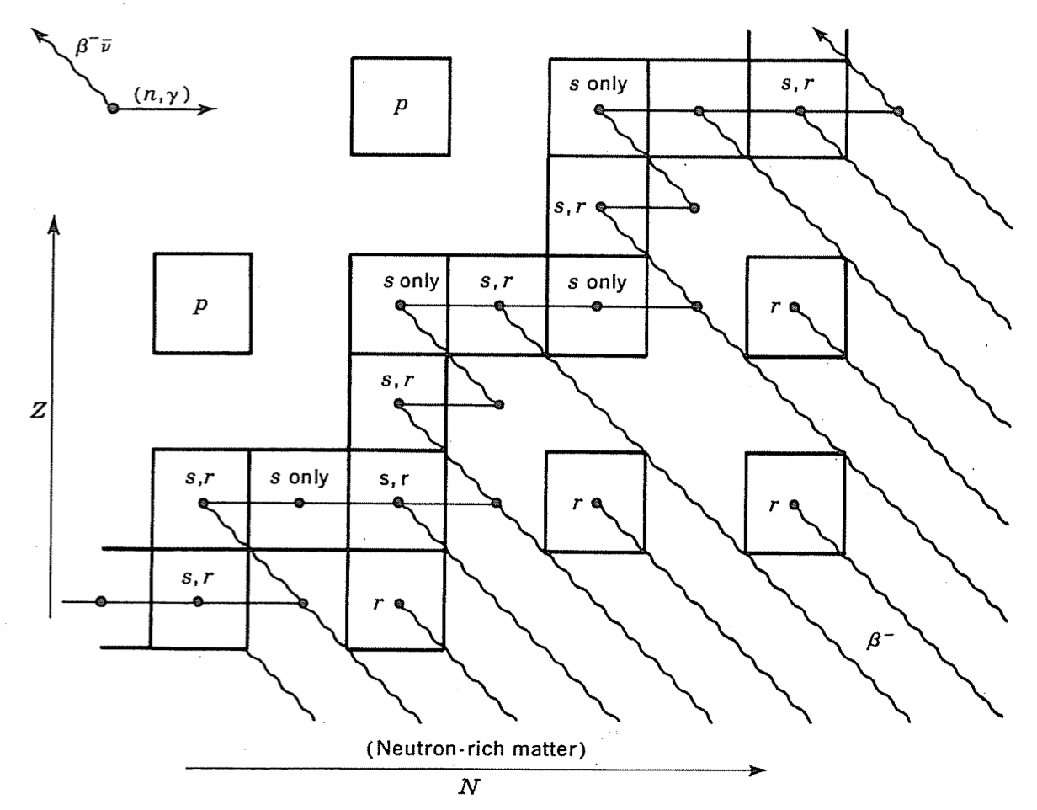


Nucleosynthesis: the $γ$-process
The γ-process: a sequence of photodisintegrations (γ,n), (γ,p), and (γ,$α$) in O/Ne rich layers in CCSN explosions from massive star progenitors (e.g., Woosley & Howard, 1978; Rayet et al., 1995);
Production of p-nuclei: 35 neutron-deficient isotopes of elements heavier than Fe;
Underproduction of typical γ-process yields from massive stars (factor of $\sim$2-4) compared to the solar system abundances. Larger underproduction of ^{92,94}Mo and ^{96,98}Ru yields ($\sim 1$ order of magnitude).
Clayton, D.D. (1968) Principles of Stellar Evolution and Nucleosynthesis. University of Chicago Press, Chicago.

Slide 15
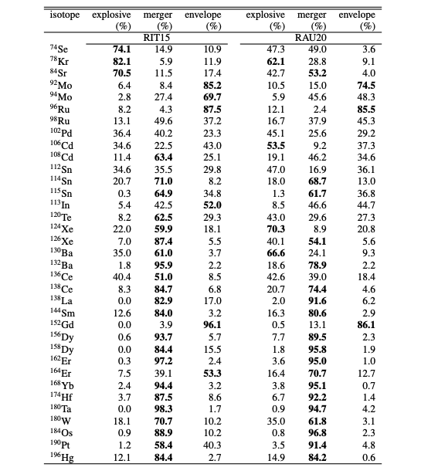
Nucleosynthesis: the $γ$-process

Slide 16
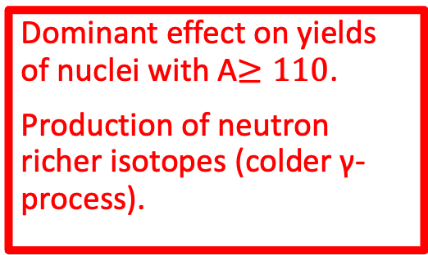
Nucleosynthesis: the $γ$-process
Dominant effect on yields of nuclei with A$≥110$.
Production of neutron richer isotopes (colder γ-process).

Slide 17
Nucleosynthesis: the $γ$-process
Increasing explosion energy
Roberti et al., 2024, A&A, 686, L8

Slide 18
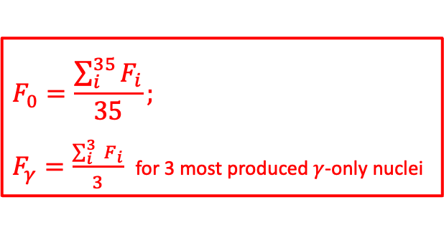
Nucleosynthesis: the $γ$-process
$$F_{0}=\frac{\sum_{i}^{35}{F_{i}}}{35};$$
$F_{γ}=\frac{\sum_{i}^{3 }{F_{i}}}{3}$ for 3 most produced $γ$-only nuclei
Increasing explosion energy
Roberti et al., 2024, A&A, 686, L8

Slide 19
Nucleosynthesis: the $γ$-process
C-O merger
Increasing explosion energy
Roberti et al., 2024, A&A, 686, L8

Slide 20
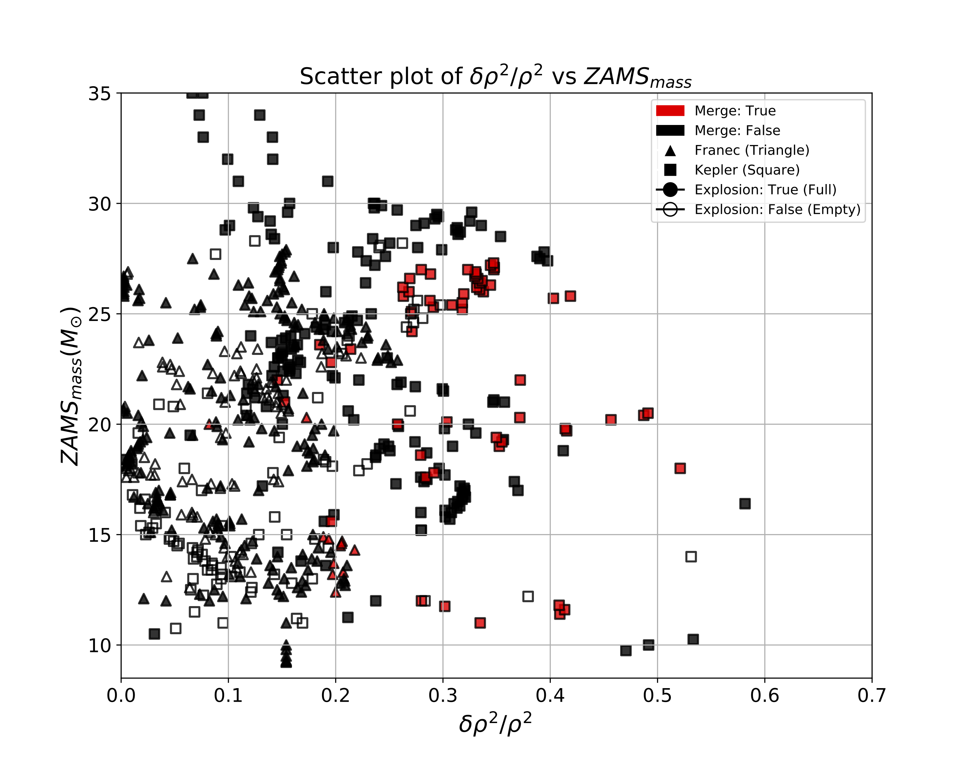

Do stars with a C-O merger explode?
Large $δρ/ρ$ at the Si/O interface help the CCSN explosion (Wang+22; Boccioli+23).
Massive stars with C-O shell mergers naturally meet this condition (Marco Loddo’s master thesis – PRELIMINARY RESULTS).

Slide 21
Summary and conclusions
Carbon-oxygen (C-O) shell mergers in massive stars have a crucial impact on the explosion and on the ejecta composition of CCSNe;
Indications from 3D modeling seem to confirm their existence;
Large density jump at the Si/O interface because of the extended mixed convective region: easier explosion? In progress, stay tuned!
Production site for odd-Z elements, p-nuclei, weak s-process component;
Questions: frequency? Trend with mass/metallicity/rotation? Nuclear physics?
THANK YOU!

Slide 22
Summary and conclusions
Carbon-oxygen (C-O) shell mergers in massive stars have a crucial impact on the explosion and on the ejecta composition of CCSNe;
Indications from 3D modeling seem to confirm their existence;
Large density jump at the Si/O interface because of the extended mixed convective region: easier explosion? In progress, stay tuned!
Production site for odd-Z elements, p-nuclei, weak s-process component;
Questions: frequency? Trend with mass/metallicity/rotation? Nuclear physics?
THANK YOU!

Slide 23

Carbon-oxygen shell mergers in massive stars
Low ${}_{}^{12}C$ left by He burning may favor C-O shell mergers, by decreasing the entropy barrier at the shell interface (Roberti+24).
Roberti et al., 2024, ApJS, 270, 28

Slide 24
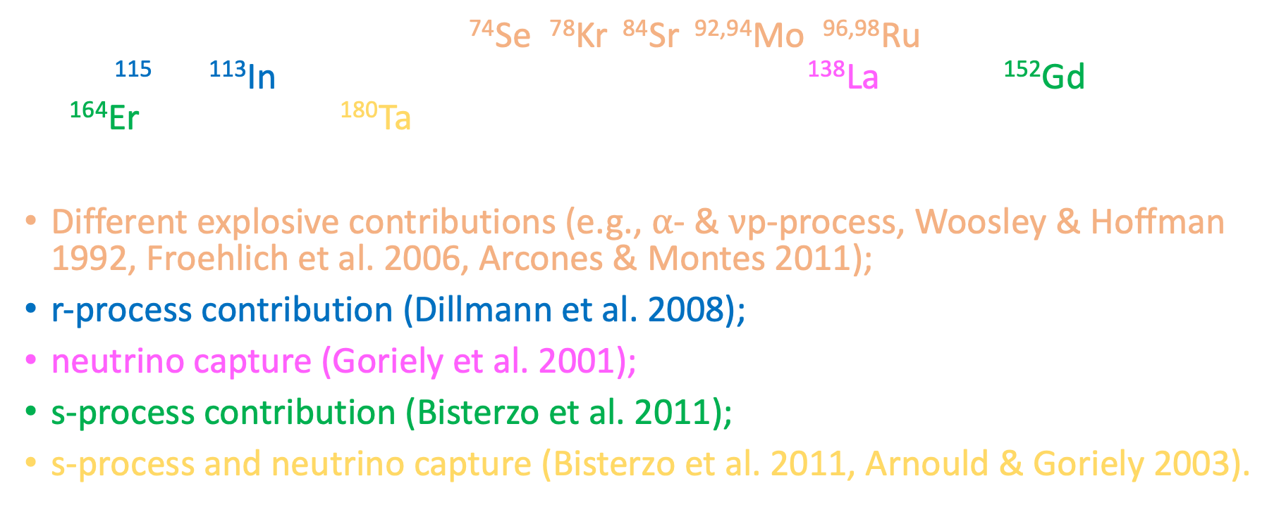
Nucleosynthesis: the $γ$-process
35 stable proton-rich nuclei: ⁷⁴Se, ⁷⁸Kr, ⁸⁴Sr, ^{92,94}Mo, ^{96,98}Ru, ¹⁰²Pd, ^{106,108}Cd, ^{112,114,115}Sn, ¹¹³In, ¹²⁰Te, ^{124,126}Xe, ^{130,132}Ba, ^{136,138}Ce, ¹³⁸La, ¹⁴⁴Sm, ¹⁵²Gd, ^{156,158}Dy, ^{162,164}Er, ¹⁶⁸Yb, ¹⁷⁴Hf, ¹⁸⁰Ta, ¹⁸⁰W, ¹⁸⁴Os, ¹⁹⁰Pt and ¹⁹⁶Hg.
Different explosive contributions (e.g., $α$- & $ν$p-process, Woosley & Hoffman 1992, Froehlich et al. 2006, Arcones & Montes 2011);
r-process contribution (Dillmann et al. 2008);
neutrino capture (Goriely et al. 2001);
s-process contribution (Bisterzo et al. 2011);
s-process and neutrino capture (Bisterzo et al. 2011, Arnould & Goriely 2003).

