Slide 1


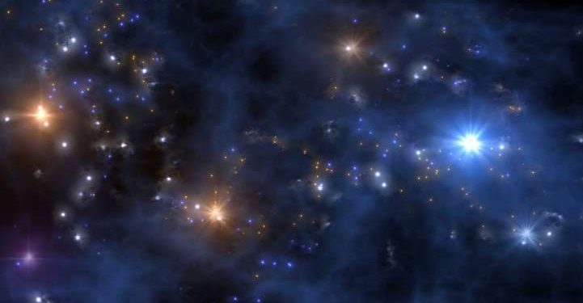

NUclear CLustering Effects in Astrophysical Reactions
NUCLEAR
Nucleosynthesis in First Stars and Other Puzzles
Marialuisa Aliotta – University of Edinburgh, UK

Slide 2

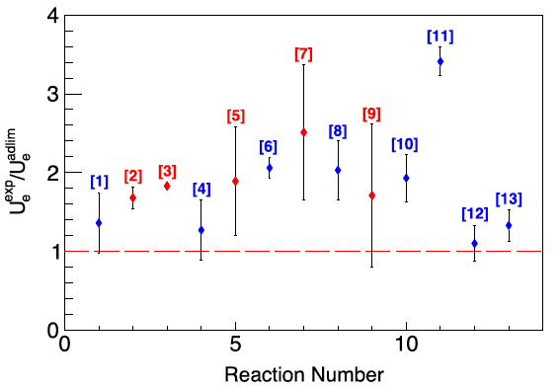
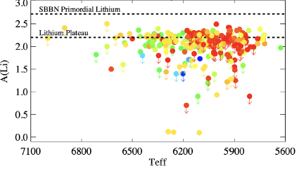
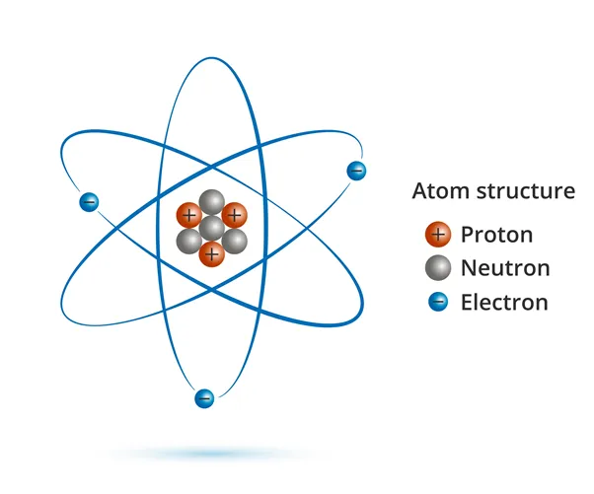
Long-Standing Questions in Nuclear Astrophysics
Q1. Cosmological Lithium Problem
Q2. Nucleosynthesis in First Stars
Q3. Electron Screening Puzzle
[log10]
Matteucci+ MNRAS (2021)
Spitaleri+ PLB (2016)
[K]
factor of 3 discrepancy between observed and predicted Li abundance
made of pristine H and He
very massive → need CNO nuclei
discrepancy between experiment and theory remains unexplained
Standard Model of Particle Physics
+ Cosmology
Chemical Evolution of Early Universe
+ Astronomical Observations (JWST)
Reactions in Plasmas
Fusion-driven Energy Generation

Slide 3

Long-Standing Questions in Nuclear Astrophysics
Q1. Cosmological Lithium Problem
Q2. Nucleosynthesis in First Stars
Q3. Electron Screening Puzzle
[log10]
Matteucci+ MNRAS (2021)
Spitaleri+ PLB (2016)
[K]
factor of 3 discrepancy between observed and predicted Li abundance
made of pristine H and He
very massive → need CNO nuclei
discrepancy between experiment and theory remains unexplained
key idea:
Nuclear Clustering
key to unlock all three puzzles

Slide 4
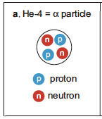


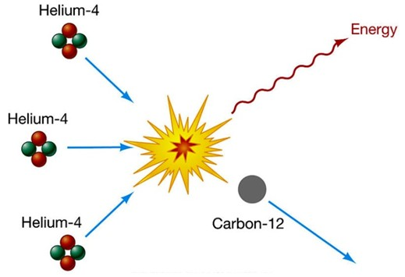
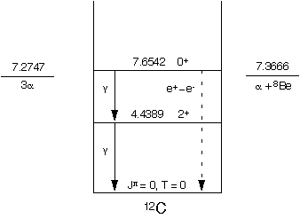


Nuclear Clustering
⁶Li
¹⁰B
nuclear clustering may greatly enhance fusion probabilities
at low (i.e. astrophysical) energies
very stable configurations
→ building blocks for other nuclei
α ⊕ d
α ⊕ d ⊕ α
triple alpha process
electron screening puzzle
Hoyle state
≠
+
+
~10⁷ times faster
lower Coulomb barrier → enhanced fusion

Slide 5
The Cosmological Lithium Problem(s)

Slide 6
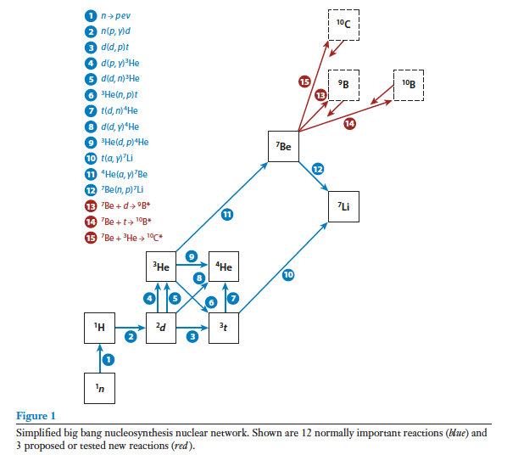
M. Aliotta
Big Bang Nucleosynthesis
Primordial Nucleosynthesis (BBN) and Primordial Abundances
3 minutes after Big Bang
adapted from Fields (2011) ARNPS©
Notes:
BBN very successful theory – only one free parameter: baryonic matter density. Very precise predictions
Precise observations of primordial abundances also possible
agreement between predicted and observed abundances generally good → success story for BBN and NA

Slide 7
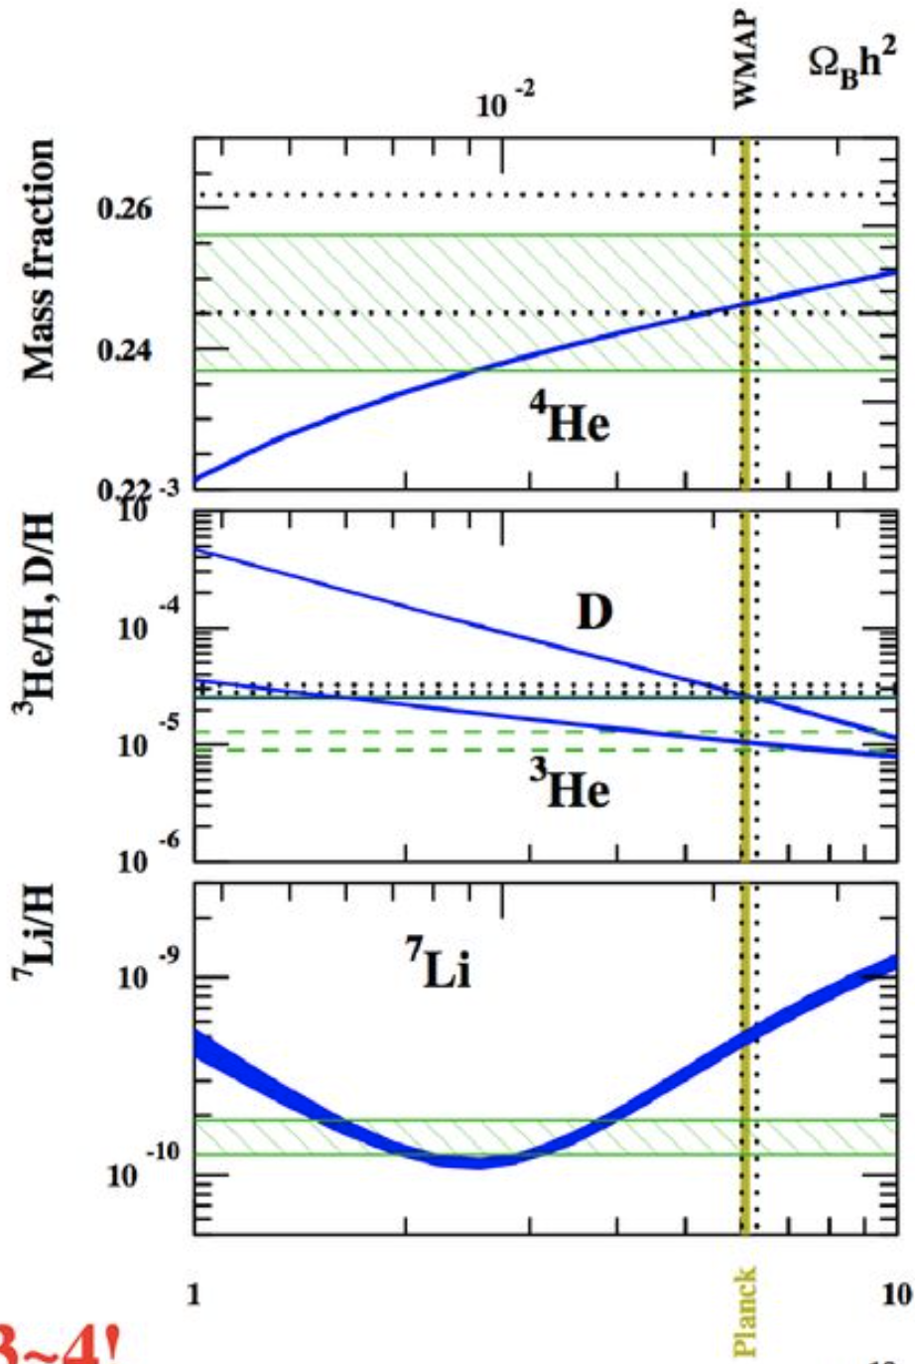
M Aliotta
The Cosmic Lithium Problem: Possible Solutions
D, ³He and ⁴He: good agreement
Li: overestimated by factor 3!
Astrophysics:
incorrect interpretation of astronomical observation?
depletion mechanisms in stars?
Nuclear physics:
wrong or incomplete nuclear reaction rates?
other key reactions controlling ⁷Li yield?
Non-standard model:
current theories incorrect or incomplete?

Slide 8
Nucleosynthesis in First Stars

Slide 9
M Aliotta
Nucleosynthesis in First Stars
Identikit of First Stars
formed 200-400 million years after Big Bang
very massive (up to 100-1000 M)
made of primordial H and He
no CNO to sustain star against gravity
How did first stars evolve?
burn He via 3α?
form CNO nuclei?
die as CCSN, pair production SN, or BHs?

Slide 10
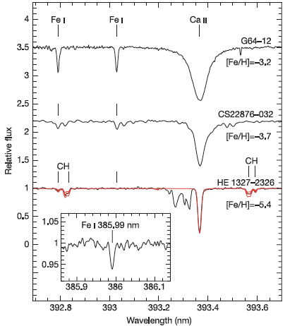
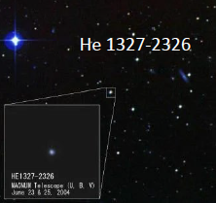
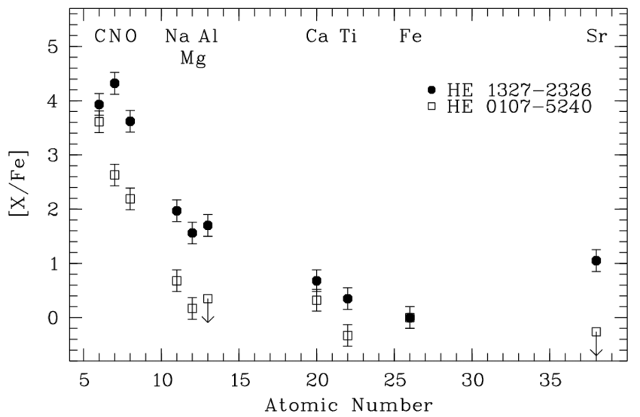
M Aliotta
First Stars and Their Imprints
First stars are difficult to observe today…
HE 1327-2326:
one of the most metal poor stars observed
[Fe/H]= -5.4 (1/250000 of solar Fe value)
cococube.com
Frebel et al. Nature 434, 871–873 (2005)
Where do CNO, Ca and Sr come from?
… but their imprints remain visible
in the composition of second-generation stars

Slide 11
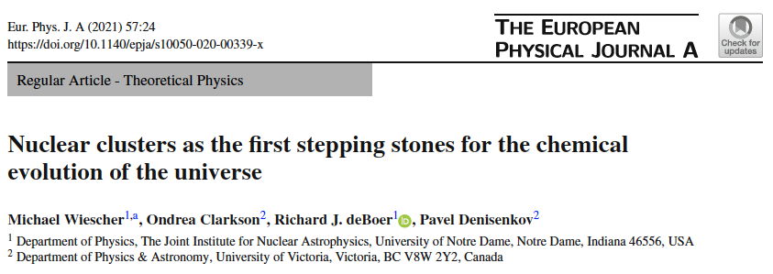

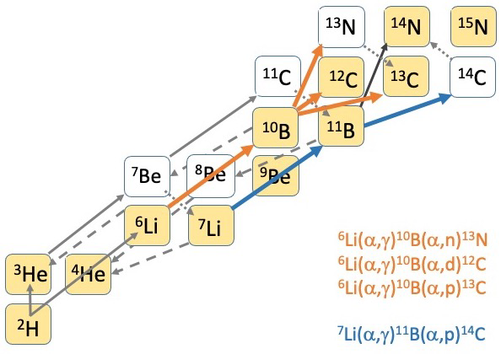

M Aliotta
Nuclear Clustering: A Possible Solution?
⁴He(d,γ)⁶Li(α,γ)¹⁰B(α,d)¹²C
¹⁰B(α,p)¹³C
¹⁰B(α,n)¹³N
deuterons as catalyst isotope
possible neutron source
Z
³He(α,γ)⁷Be(e,γ)⁷Li(α,γ)¹¹B(a,p)¹⁴C
¹¹B(α,n)¹⁴N possible neutron source
NOTE: 3α process forms C but completely by-passes Li;
instead, proposed reaction sequences would also
alter Li abundances → solution to CLiP?
N
requirement: strong enhancement of (α,γ) reaction rates

Slide 12
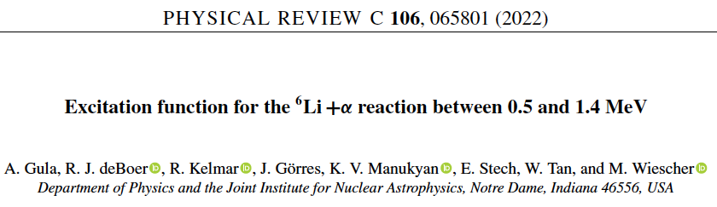

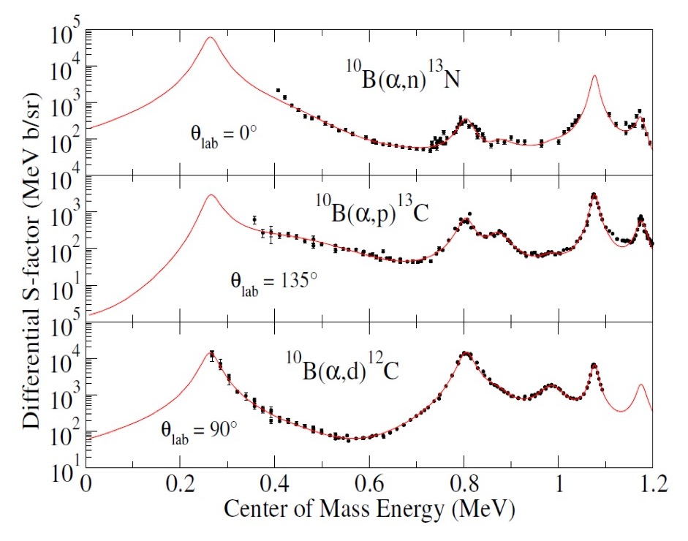
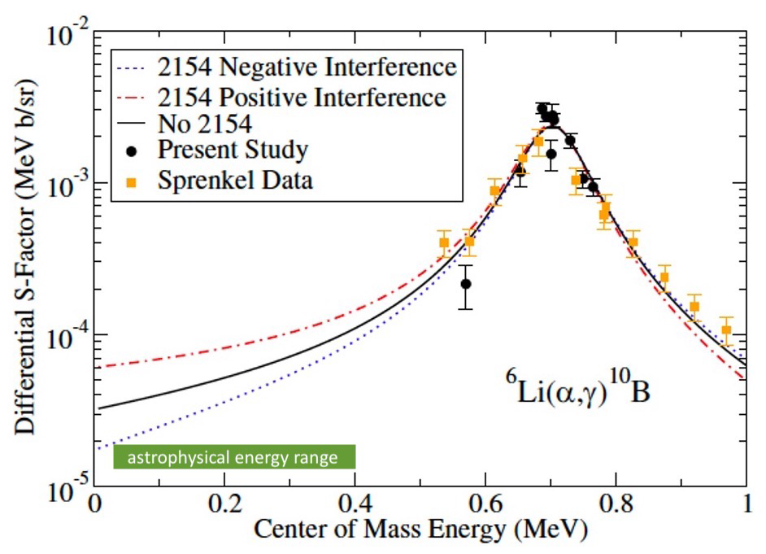
M Aliotta
Current Status
proposed reactions involve strong cluster configurations
tantalizing new evidence for broad cluster resonances
d + α → ⁶Li + α → ¹⁰B + α → ¹⁴N
α ⊕ d α ⊕ d ⊕ α ¹²C ⊕ d
no data
at relevant energies
new measurements UNDERGROUND needed

Slide 13
Skype meeting | 17 July 2014
Electron Screening

Slide 14
M Aliotta
Electron Screening
text
σ (E) = exp(-2πη) S(E)
S_{screen}(E)
f_{lab}(E) =
~ exp(πηU_{e}/E)
S_{bare}(E)
assumption:
2πη ~ Z₁Z₂(μ/E)^{½}
bare nuclei
S(E)
E_{c}
screened S(E)
bare
fit to measured
low-energy data
Coulomb potential
∝ U_{e}
screened
E + U_{e}
high-energy data
extrapolation
E
bare S(E)
0
R_{n}
R_{atomic}
R
0
E
in the lab and in stellar plasmas
interaction affected by electrons
experimental U_{e} values in excess of theoretical limit !
SCREENING POTENTIAL U_{e}
corrections typically negligible, except at ultra-low energies
ELECTRON SCREENING PUZZLE

Slide 15
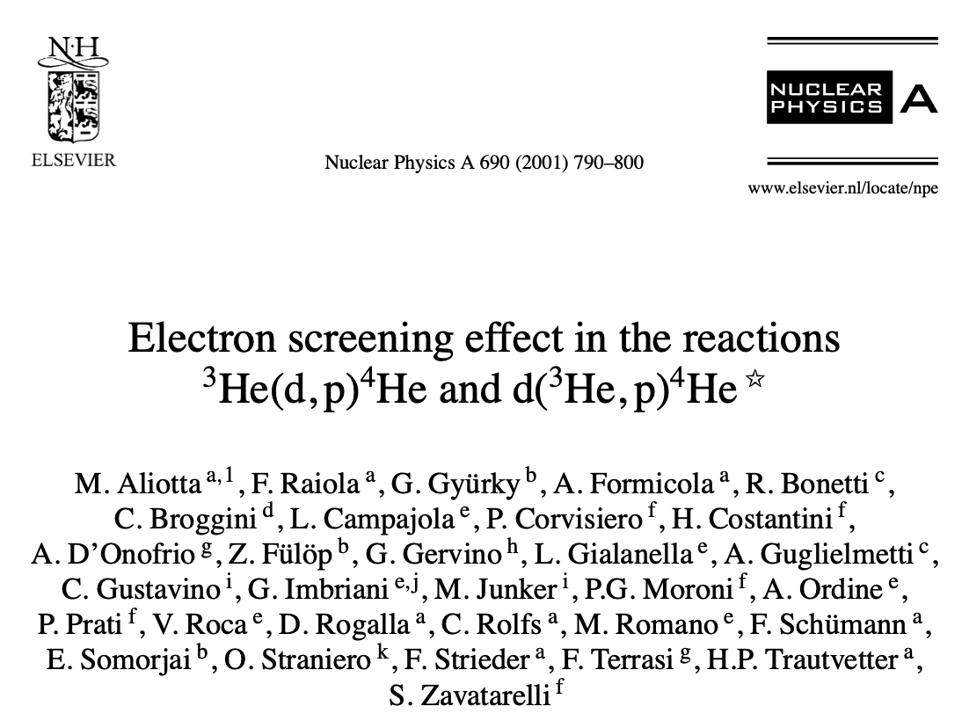
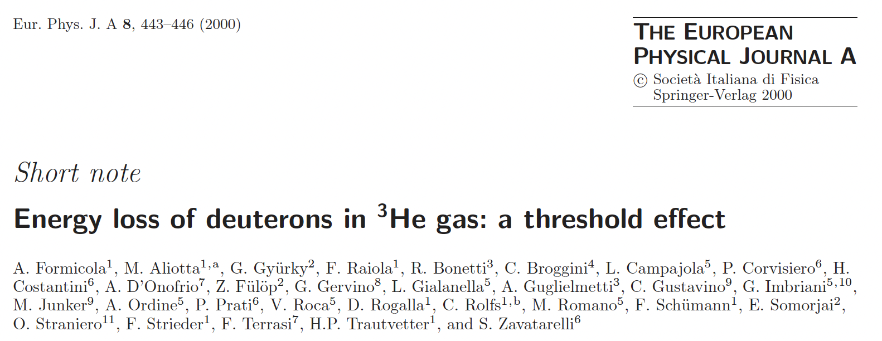
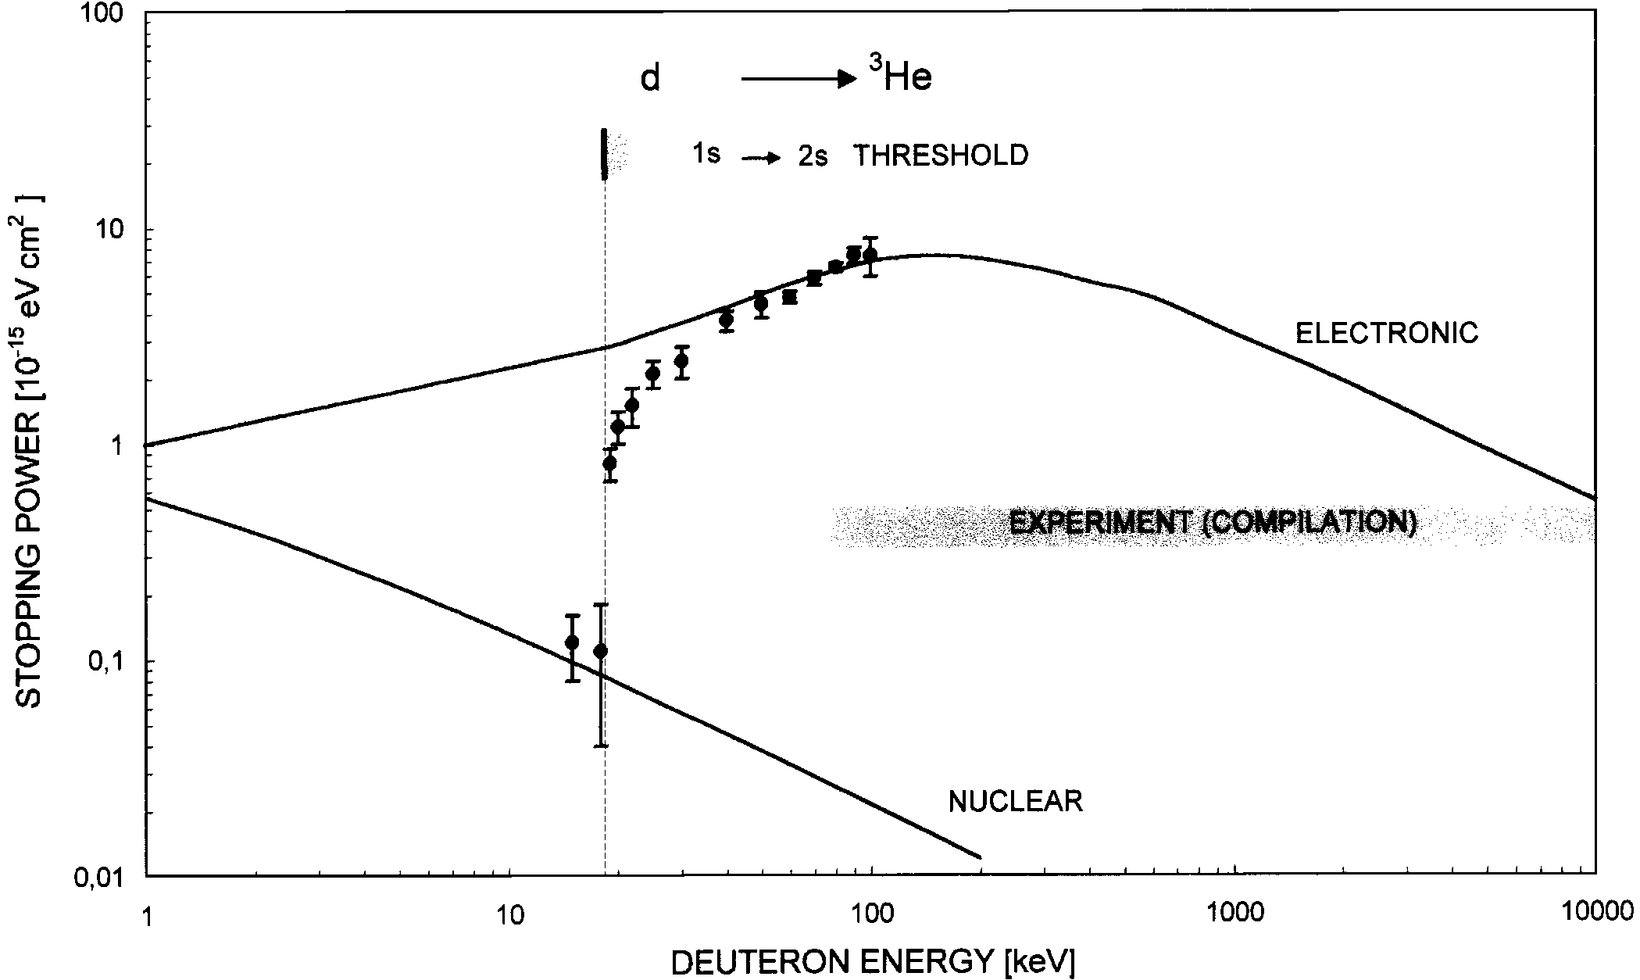
M Aliotta
Electron Screening
text
³He(d,p)⁴He
U_{e} = 219±7 eV
U_{e}^{theo} = 120 eV

Slide 16
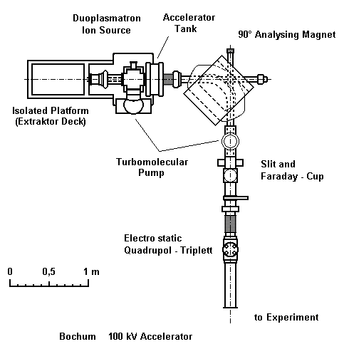
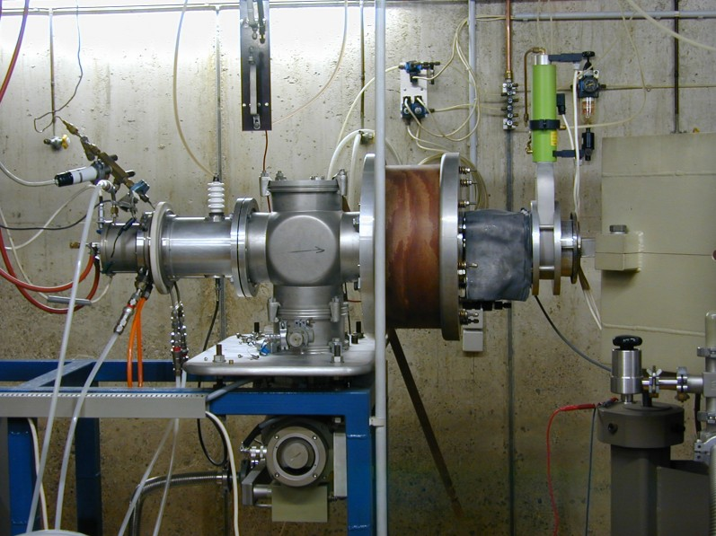
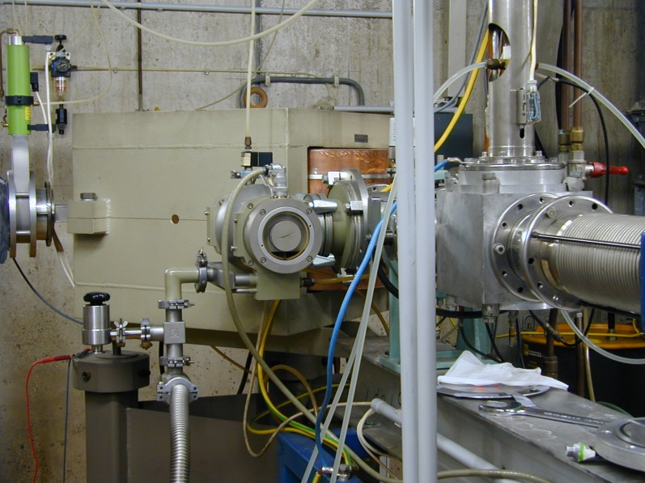
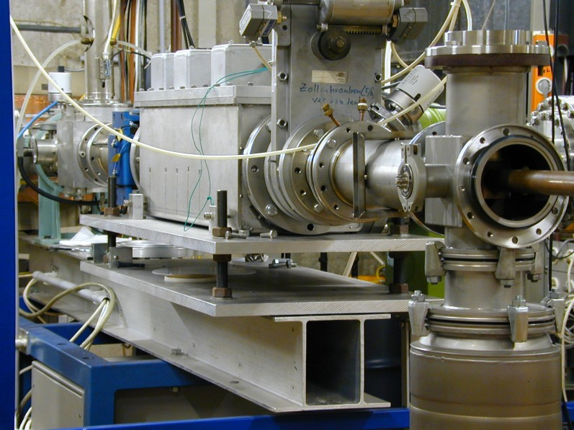
M Aliotta
Electron Screening Studies at RUB
text
100 kV accelerator – Ruhr-Universität Bochum
Ni foil
LN₂-cooled
Si
systematic study of
d(d,p)t reaction
on various hosts
Cu pipe
-200 V
M_{x}D
target
D⁺ ion beam
Si
x/y wobbling
units
θ = 130°
turbo pump
aperture
8 mm f
P = 2x10⁻⁸ mbar

Slide 17
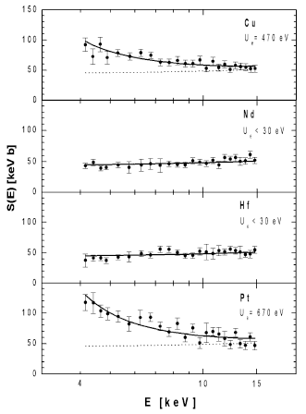
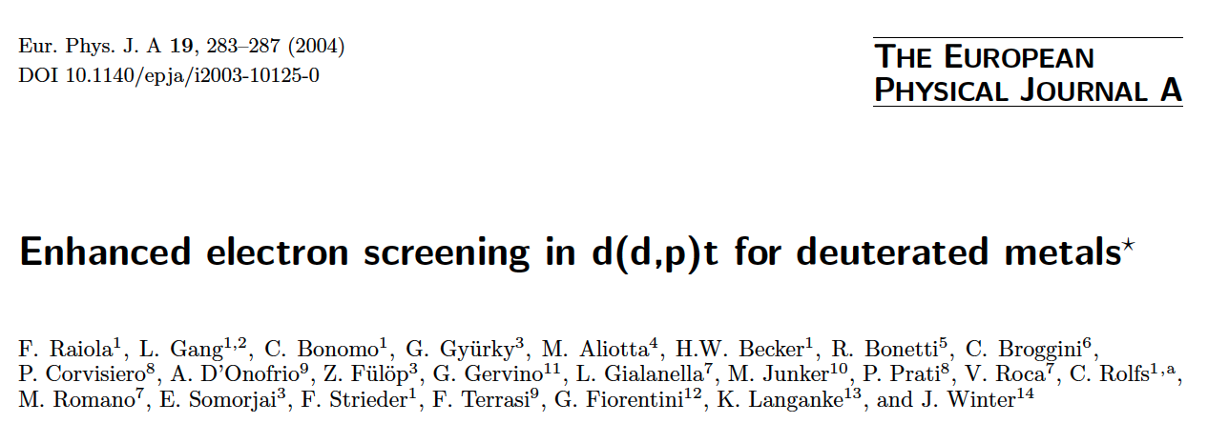
M Aliotta
Electron Screening: Anomalous U_{e} Behaviour for d(d,p)t Reactions in Metals
text
Electron screening in d(d,p)t reaction
Cu
U_{e} = 470 eV
factor ~ 20 higher
Nd
U_{e} < 30 eV
comparable to gas target case
Hf
U_{e} < 30 eV
compared to screening in gas D₂ target (U_{e} ≅ 30 eV)
anomalous enhancements observed for
some materials but not for others
WHY?
comparable to gas target case
Pt
U_{e} = 670 eV
factor ~ 25 higher

Slide 18
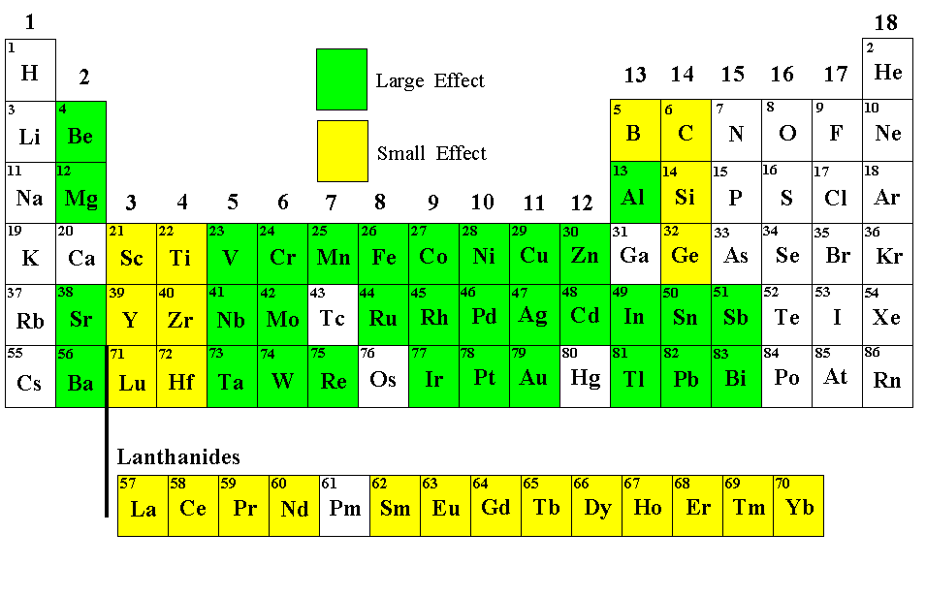
M Aliotta
Electron Screening
text
Results overview
55 samples
in total
F. Raiola et al.: Eur. Phys. J A19 (2004) 283
Key Results:
elements in same group show similar U_{e} values
    large effect ~ 300 eV
    small effect ~ 30 eV
exceptions: group 13 (B = metalloid) and group 14 (C, Si, Ge = semiconductors)
possible explanation based on Debye model (applied to electrons in metal) qualitative agreement

Slide 19
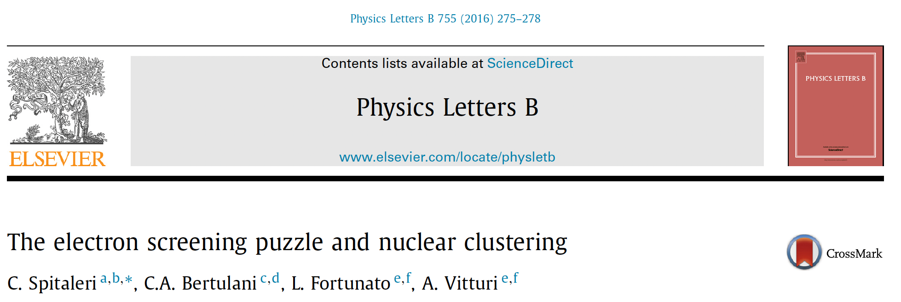
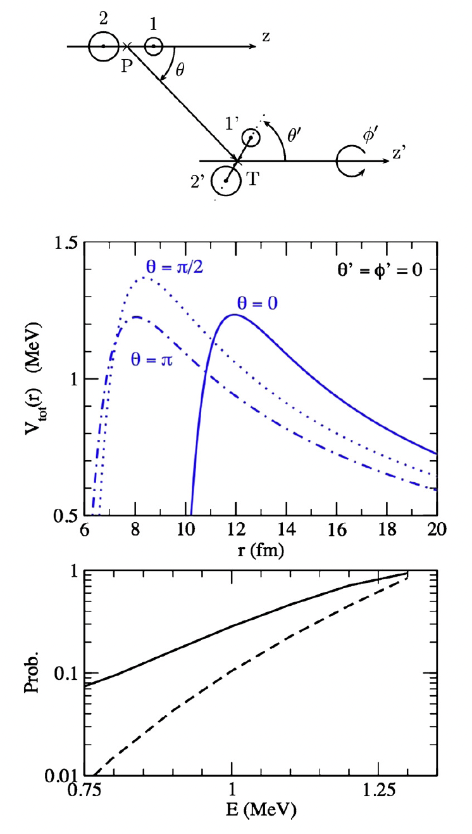
M Aliotta
Electron Screening and Nuclear Clustering
text
Results overview
di-cluster orientation
modified Coulomb barrier
enhanced fusion probability
can nuclear clustering provide additional ‘screening’?

Slide 20
Strategic Approach: Synergic Exploitation of Critical Expertise
Experimental Program:
α-induced reactions on Li and B isotopes
optimise information transfer across boundaries
for accelerated progress with widest impact
Theoretical Program
Computational Program

Slide 21


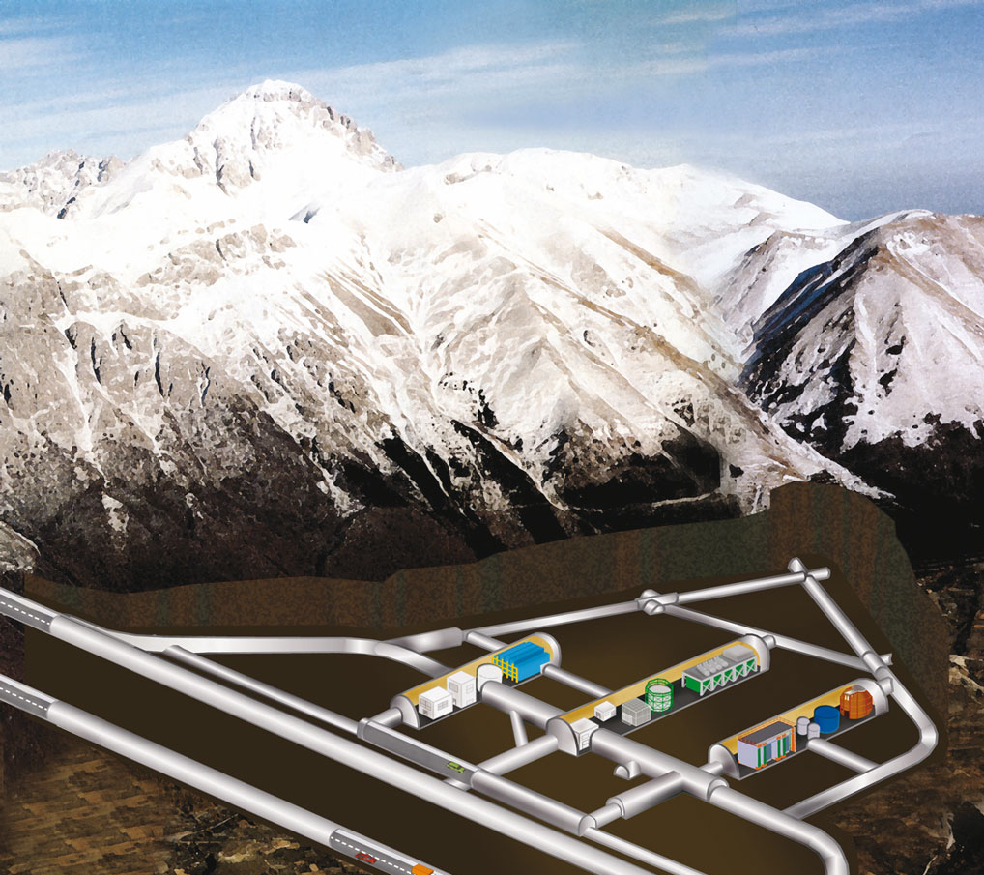
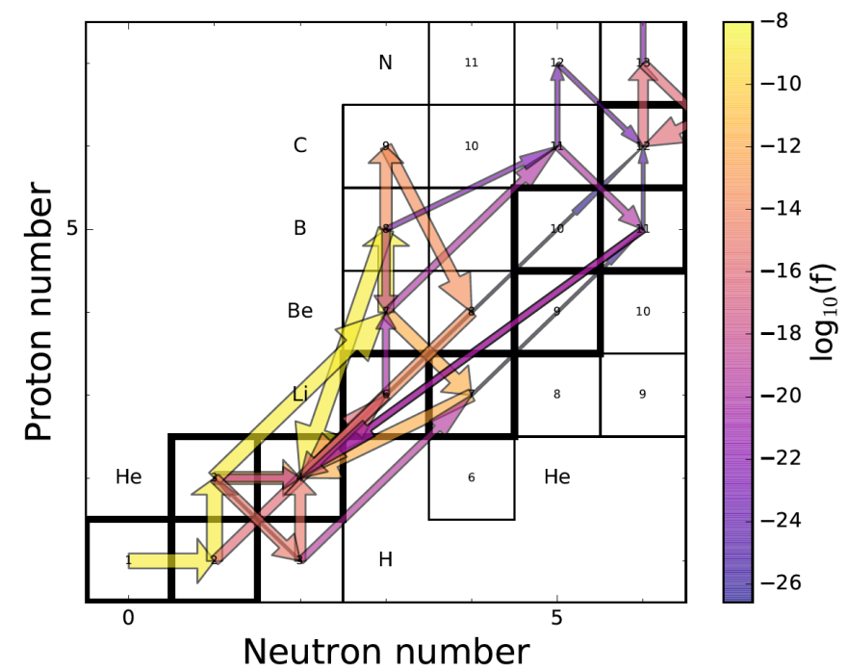

Work Programme and Outcomes
Theoretical Programme
WP2a: PDRA2
cluster structures at low energies
impact on astrophysical reactions
& electron screening
Experimental Programme
WP1: PI, PDRA1, PhD1,PhD2
Laboratory for Underground Nuclear Astrophysics
α+Li and α+B reactions (Q1-Q3)
ultra-low background @LUNA
lowest-energy data (world best)
Computational Programme
WP3: PI, PDRA3
stellar models for first stars (MESA)
nucleosynthesis networks (NuGRID)
impact on Q1 and Q2
G Hupin
M Pignatari
RJ deBoer
WP2b: PI, PDRA2
improved R-matrix capabilities
robust reaction rates

Slide 22
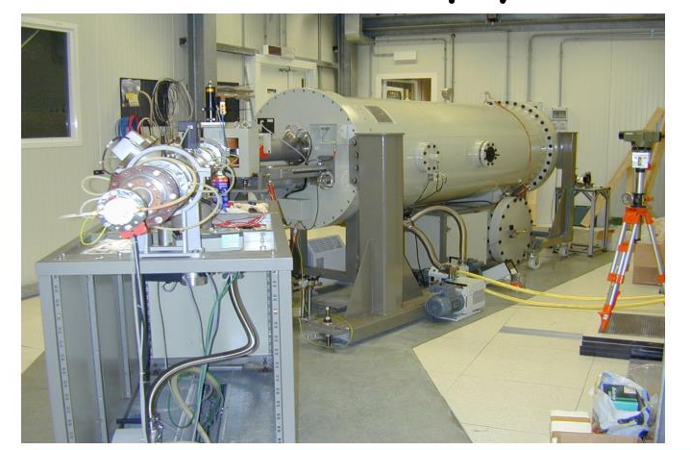
¹⁰B + α Reaction Studies at LUNA 400kV

Slide 23

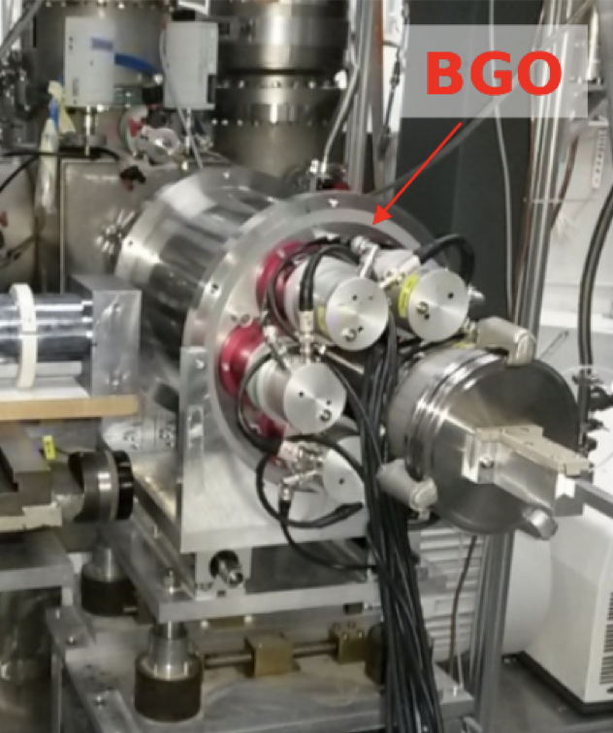
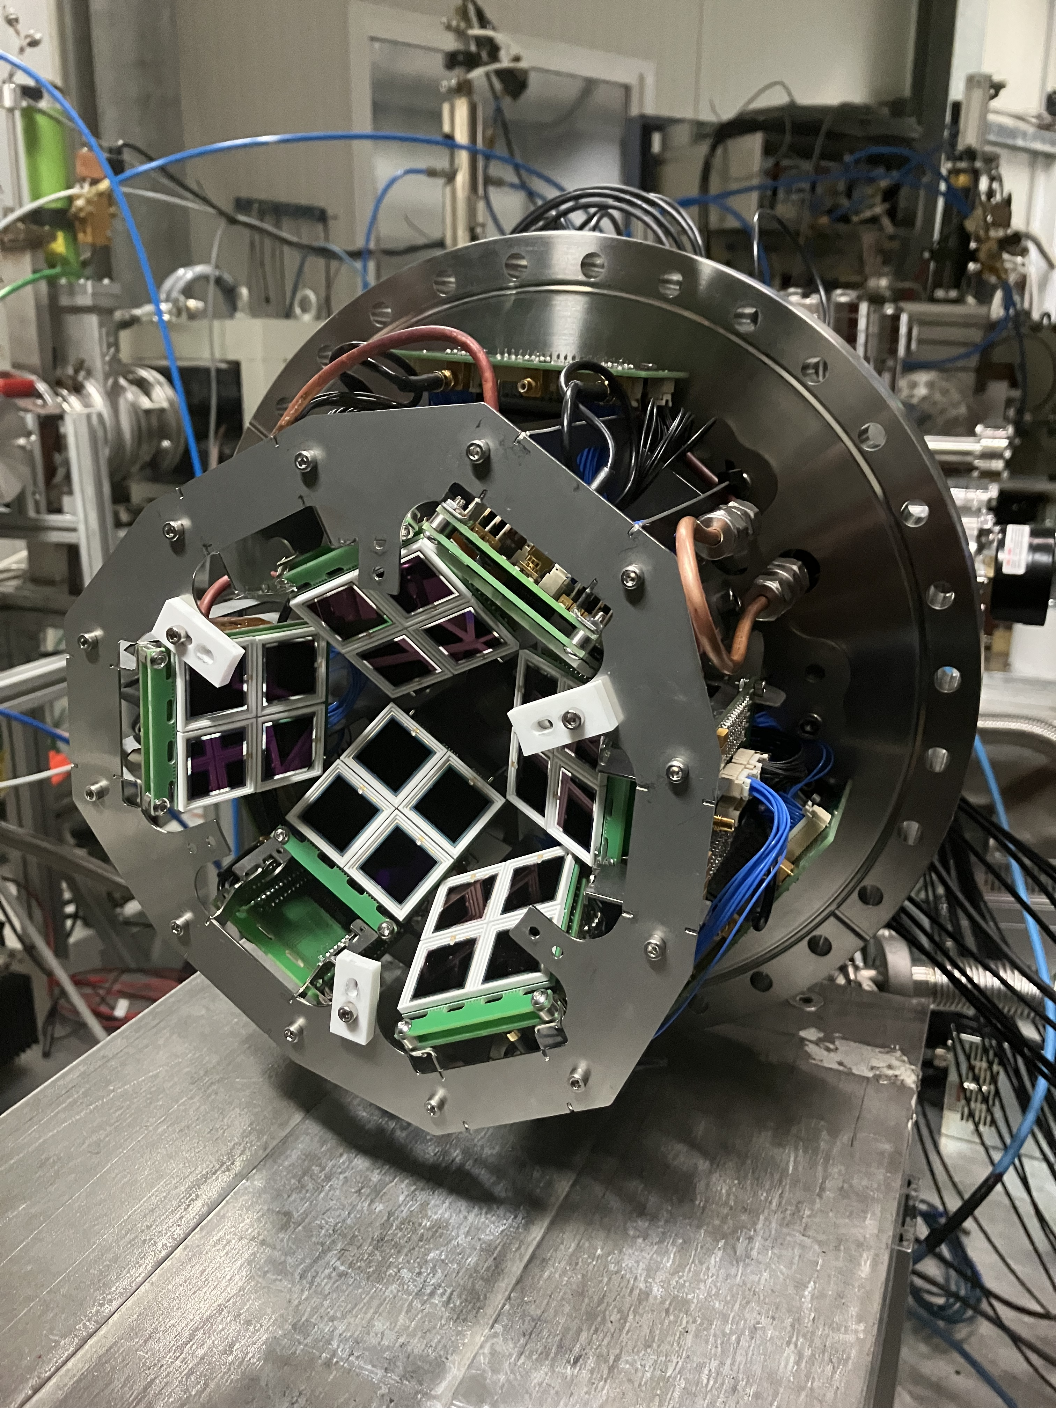

M Aliotta
Upcoming measurements at LUNA
¹⁰B(α,d)¹²C
¹⁰B(α,p)¹³C
¹⁰B(α,n)¹³N activation measurement:
detect 511 keV annihilation γ rays following β⁺ decay of ¹³N (t _{½} ~ 10 mins) in opposite crystals
charged particle detection
silicon detector array
²³Na(p,α)²⁰Ne
ELDAR ERC – Bruno (UoE)
segmented BGO detector
Rhys Bonnell, PhD
Jamie Jones, PhD

Slide 24
¹⁰B Target Production & Characterization
Target production by:
evaporation of enriched ¹⁰B on Ta backings @ Notre Dame
  target thicknesses: 5 – 30 μg/cm²
  target durability tests ongoing at ND
previous studies [Gula+ 2023] indicate 15% after 1-2C α-beam, but no data at low energies
implantation (exploring options at Rossendorf)

Slide 25
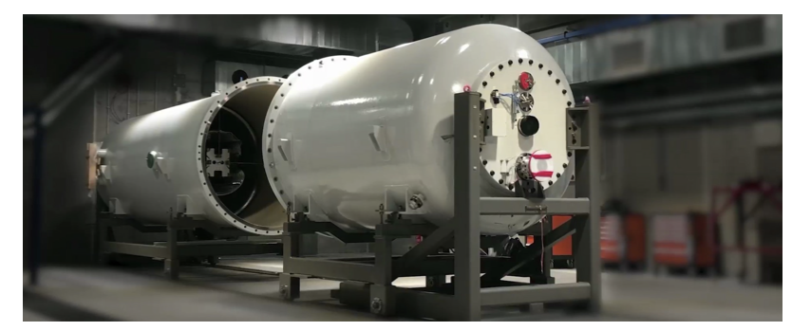
^{6,7}Li + α Reaction Studies at Bellotti Facility
He
⁴He⁺ (TV: 0.3 – 0.5 MV): 300 μA
3.5 MV accelerator
⁴He⁺ (TV: 0.5 – 3.5 MV): 500 μA

Slide 26
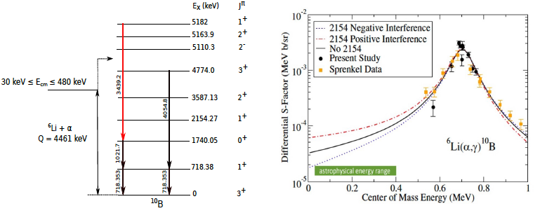
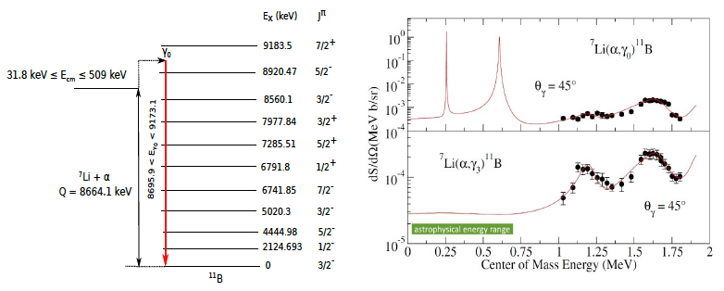
^{6,7}Li(α,γ) reactions: prompt γ-ray measurements
prompt γ-ray detection with either
HPGe detectors or the BGO detector
push measurements
to lowest accessible energies

Slide 27




Grant Start Date: 2 December 2024
https://www.erc-nuclear.uk
Just recruited: 1 PhD student (December), 1 PDRA Exp (February), 1 PDRA Theo (June-July)

Slide 28

M Aliotta

