Slide 1


Key Reactions in Nuclear Astrophysics, Trento, 12-17 February 2025
An Overview of the ¹⁹F(p,α) reaction at the intersection of nuclear structure and astrophysics
University of Naples "Federico II" & INFN-Naples
Daniele Dell’Aquila^{1,2}
¹Dipartimento di Fisica "Ettore Pancini", University of Naples "Federico II", Naples, Italy
²INFN-Sezione di Napoli, Naples, Italy
daniele.dellaquila@unina.it
Daniele Dell’Aquila (daniele.dellaquila@unina.it) – February, 20th 2025

Slide 2
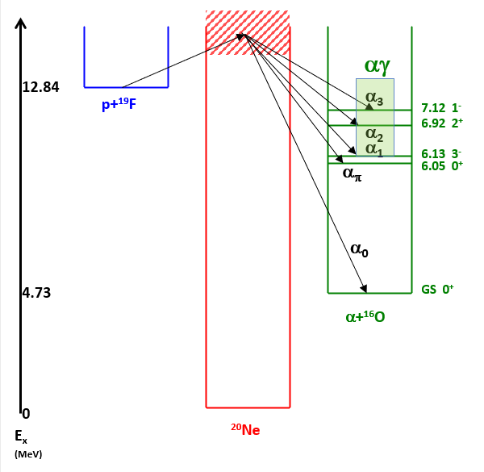


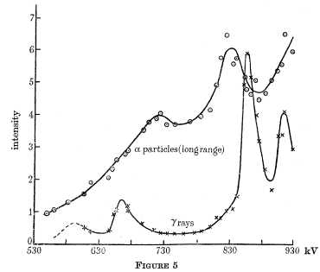
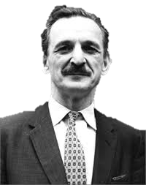
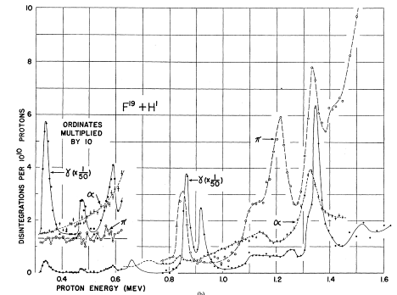
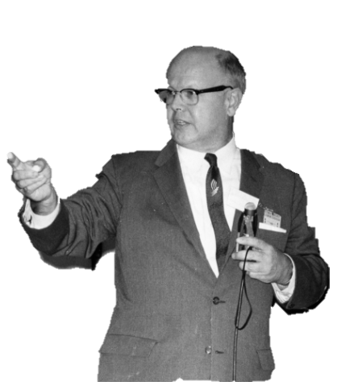
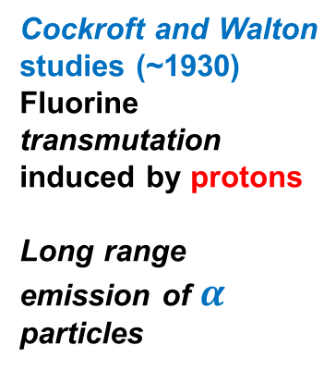
¹⁹F(p,α)¹⁶O: history of the reaction
Cockroft and Walton studies (~1930)
Fluorine transmutation induced by protons
Long range emission of $α$ particles
W. Burcham
University of Naples "Federico II" & INFN-Naples
S. Devons
Astrophysical and nuclear structure goals
²⁰Ne cluster states highlighted by ¹⁹F(p,α₀) and ¹⁹F(p,α_{π}) reactions at sub-barrier energies
(Arima, Gillet, Ginocchio PRL 1970)
²⁰Ne spectroscopy ambiguities
at E_{x} ~ S_{p} (12.844 MeV)
(Tilley et al, NPA 1999)
Low energy S(E) are of astrophysical interest
(CNO cycle and fluorine nucleosynthesis in AGB stars)
W. Fowler
Daniele Dell’Aquila (daniele.dellaquila@unina.it) – February, 20th 2025

Slide 3
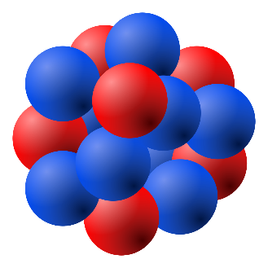










¹⁹F(p,α)¹⁶O: nuclear structure challenges
Ex. ¹⁶O
15.7 MeV
Single particle separation energy is several MeV larger than that of an α particle.
7.2 MeV
University of Naples "Federico II" & INFN-Naples
Strong interactions inside a quartet
Weak interactions
between quartets
BREAKING
$$0f1p$$
$$z$$
$$0d1s$$
$$y$$
Some excited states can be seen as the excitation of quartets from one shell to another
$$0p$$
$$x$$
$$0s$$
(Arima, Gillet, Ginocchio PRL 1970)
²⁰Ne 5.1 MeV $= [220]$
Daniele Dell’Aquila (daniele.dellaquila@unina.it) – February, 20th 2025

Slide 4

¹⁹F(p,α)¹⁶O: astrophysical relevance
“We find [Ca/H] values of −7.92, −7.72, and −8.91 for the final models of our 80Mled, 60Mledf-l, and 15Mled simulations, respectively. Therefore, the observed Ca abundance is between ∼0.8 and nearly 2 dex larger than
the largest amount of Ca made by hydrostatic H burning in these models.
If the branching ratio for 19F(p, γ )/19F(p, α) were a factor of ≈10 higher, this would help relieve the tension. In our PPN simulation using the maximum shell temperature from the 80Mled model,
increasing the 19F(p, α) rate by a factor of 10 results in an increase in the Ca abundance of 1 dex.”
O. Clarkson, F. Herwig, Convective H–He interactions in massive population III stellar evolution Models, MNRAS 500, 2685–2703 (2021)
¹⁹F(p,α)¹⁶O
¹⁹F(p,γ)²⁰Ne
University of Naples "Federico II" & INFN-Naples
towards Ne, Mg, Ca
¹⁹F(p,α) and ¹⁹F(p,γ) → key to describe CNO cycle loss in first generation (pop III) stars → path to calcium production through breakout from the “warm“ CNO (see talk from J. He).
R.J. deBoer et al., Phys. Rev. C 103 (2021) 055815
L.Y. Zhang et al., Phys. Rev. Lett. 127 (2021) 152702
L.Y. Zhang et al., Nature 610 (2022) 656
Daniele Dell’Aquila (daniele.dellaquila@unina.it) – February, 20th 2025

Slide 5
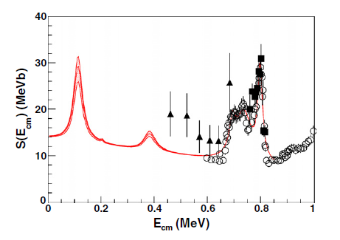
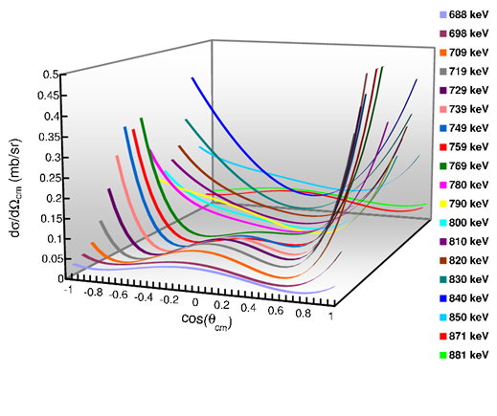
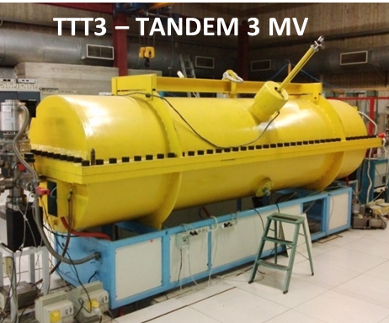
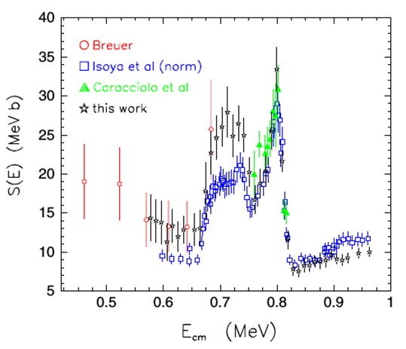
¹⁹F(p,α)¹⁶O: former data
M. La Cognata et al., Astr. J. Lett. 2011
TH Method
University of Naples "Federico II" & INFN-Naples
NACRE compilation (2000)
I. Lombardo, D. Dell’Aquila, L. Campajola, E. Rosato, G. Spadaccini and M. Vigilante, J. Phys. G 40 (2013) 125102
Daniele Dell’Aquila (daniele.dellaquila@unina.it) – February, 20th 2025

Slide 6
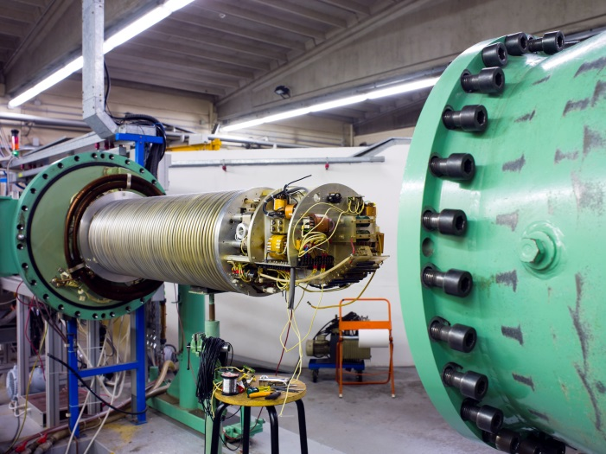
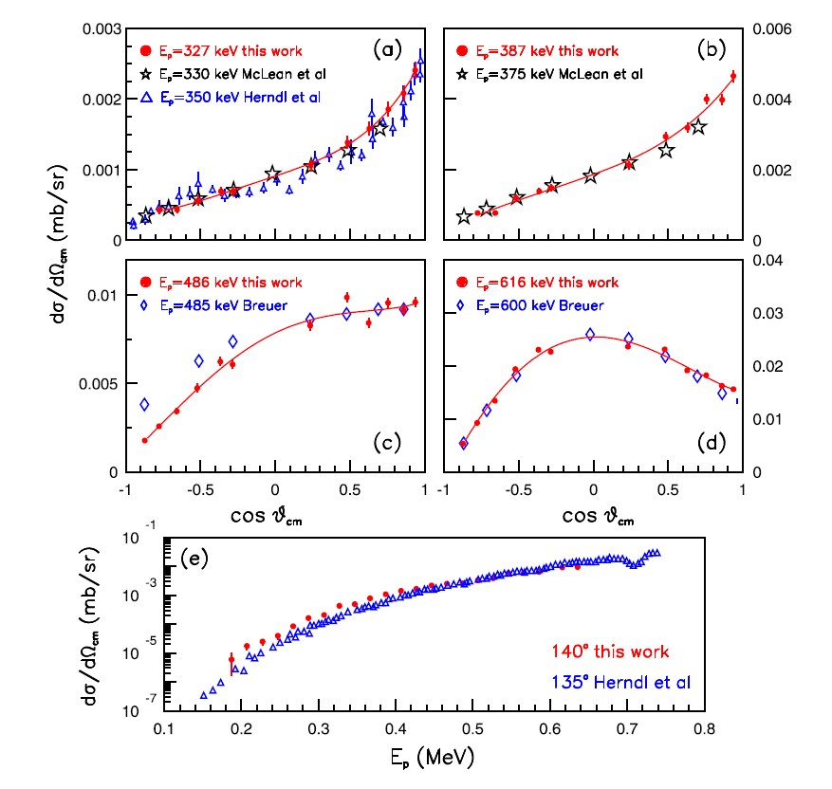
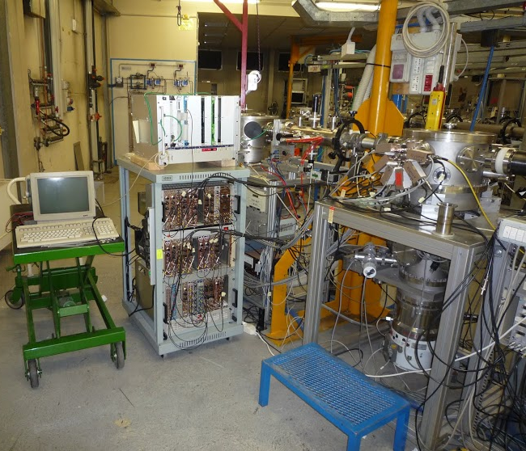
¹⁹F(p,α)¹⁶O: our direct experiment
Down to the “astrophysical” energy region (0.2 – 0.6 MeV) → the INFN – LNL experiment at the AN-2000 accelerator
AN-2000 (INFN-LNL)
University of Naples "Federico II" & INFN-Naples
Daniele Dell’Aquila (daniele.dellaquila@unina.it) – February, 20th 2025

Slide 7
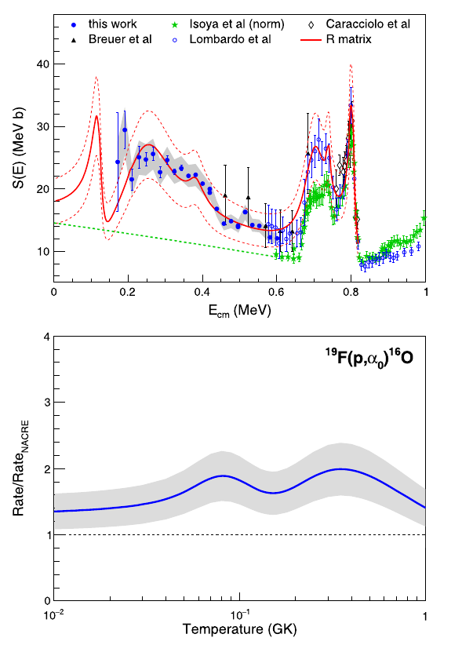
¹⁹F(p,α)¹⁶O: our direct experiment
I. Lombardo, D. Dell’Aquila, A. Di Leva, I. Indelicato, M. La Cognata, M. La Commara, A. Ordine, V. Rigato, M. Romoli, E. Rosato, G. Spadaccini, C. Spitaleri, A. Tumino and M. Vigilante, Phys. Lett. B 748 (2015) 178.
S(E) factor at low energies → broad state at 13.095 MeV → interference with the 12.957 MeV state (E_{cm}=0.113 TH method).
RR 1.5 – 2 times larger than the previous NACRE non-resonant extrapolation
NACRE
University of Naples "Federico II" & INFN-Naples
E_{cm} | Γ_{tot} (keV) | J^{π}
0.801 | 22 | 0⁺
0.783 | 25 | 1⁻
0.733 | 9 | 2⁺
0.700 | 54 | 2⁺
0.380 | 40 | 3⁻
0.251 | 162 | 2⁺
0.113 | 38 | 2⁺
Large α cluster structure →
Daniele Dell’Aquila (daniele.dellaquila@unina.it) – February, 20th 2025

Slide 8
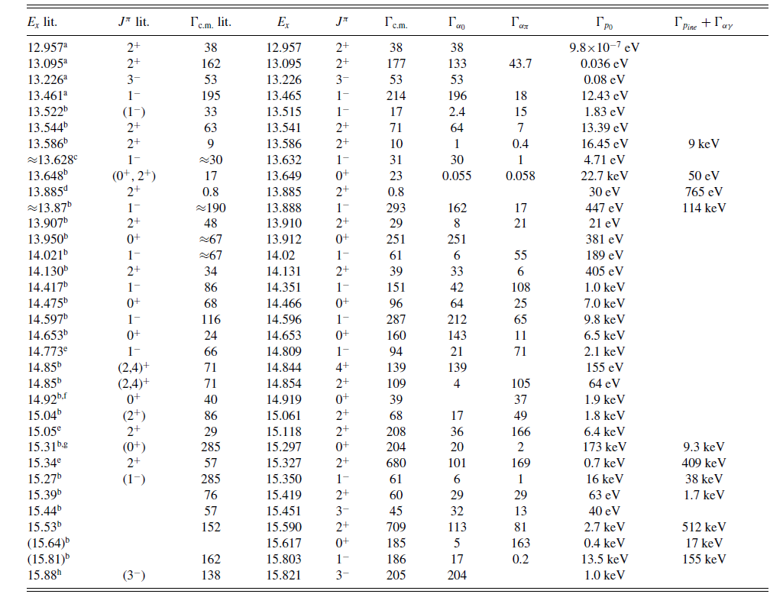
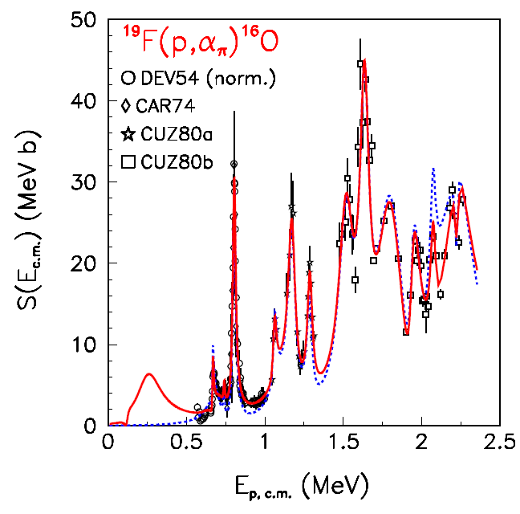
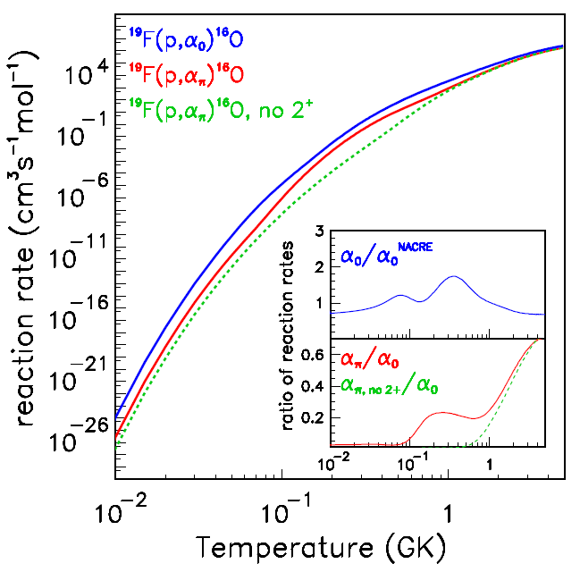
¹⁹F(p,α)¹⁶O: successive S-factor evaluations
Further re-evaluations involved a comprehensive dataset of (p,α), (p,α_{π}), and (p,p) data
(see J. He et al., Chin. Phys. C 42 (2018) 015001 and I. Lombardo et al., Phys. Rev. C 100 (2019) 044307) → role of the α-cluster state at E_{cm}=0.251 MeV to the (p,α_{π}) reaction → a complete R-matrix re-evaluation included 35 ²⁰Ne compound nucleus states in about 3 MeV!
University of Naples "Federico II" & INFN-Naples
Daniele Dell’Aquila (daniele.dellaquila@unina.it) – February, 20th 2025

Slide 9
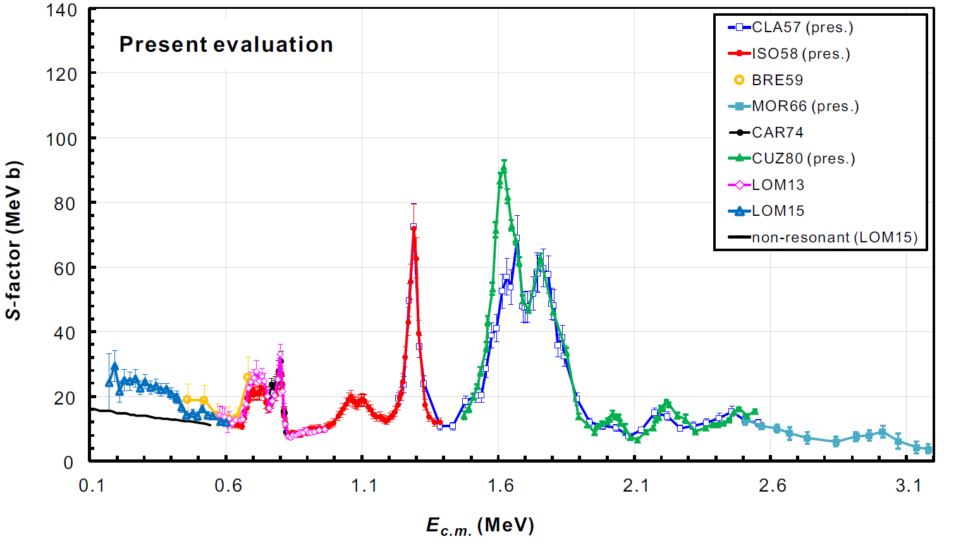


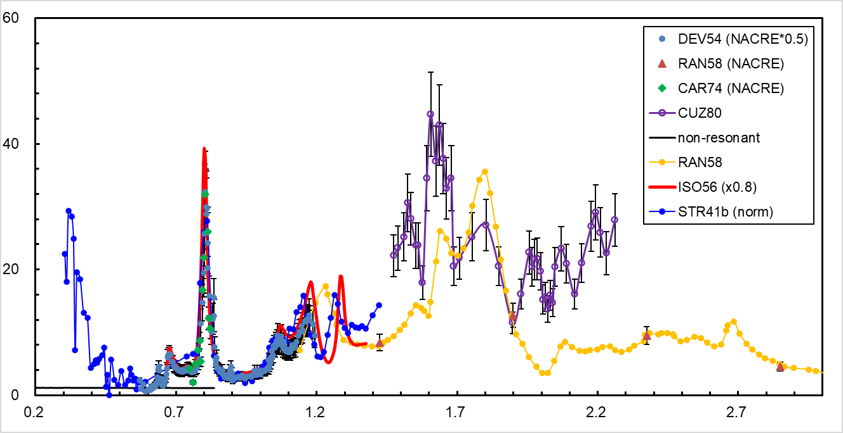
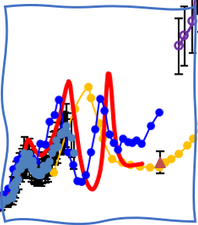


What next? A new experiment at higher energies
$$19F\left(p,α_{0}\right)16O_{gs}$$
1.5x Disagreement between data sets for the α₀ channel at E_{c.m.} ~ 1.6 MeV
…even after careful normalization*
University of Naples "Federico II" & INFN-Naples
$$19F\left(p,α_{π}\right)16O_{6.05}$$
General lack of data for the
α_{π} channel at E_{c.m.} ~ 1.3 MeV
See J.J. He et al., Chin. Phys. C (2018)
Daniele Dell’Aquila (daniele.dellaquila@unina.it) – February, 20th 2025

Slide 10
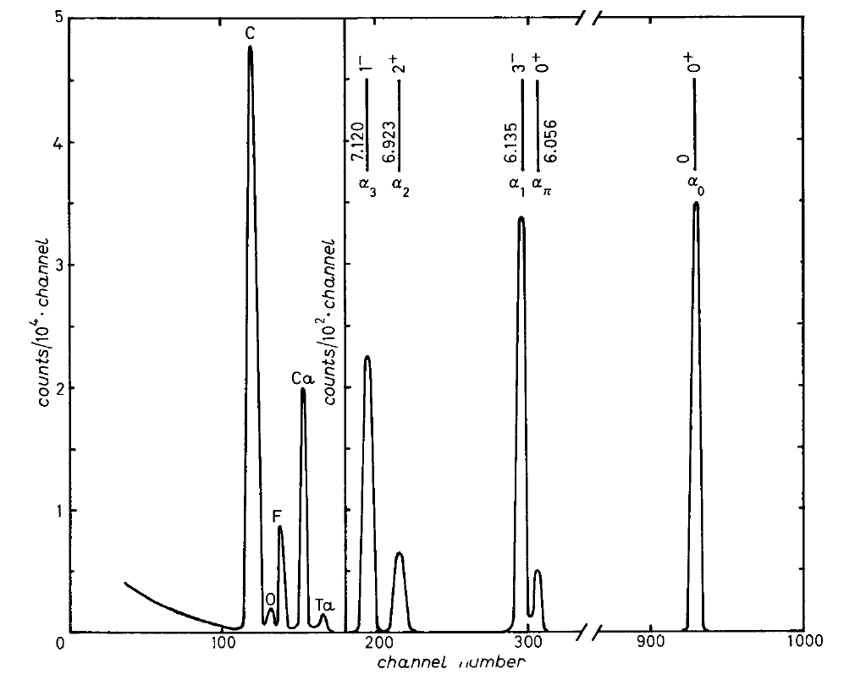
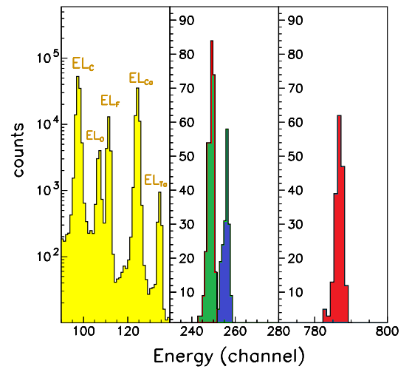

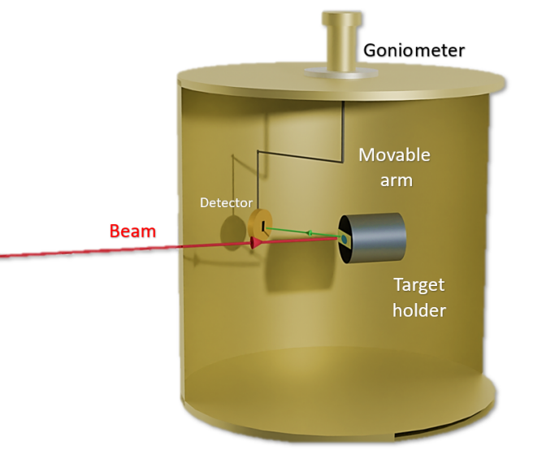



What next? A new experiment at higher energies
$$α_{1}$$
$$α_{0}$$
$$α_{π}$$
University of Naples "Federico II" & INFN-Naples
An improvement is achieved with respect to the previous state-of-the-art experiment (Caracciolo et al., Nuovo Cimento (1974)
Excellent α_{π} vs α₁ separation:
1.3 times better than before
Daniele Dell’Aquila (daniele.dellaquila@unina.it) – February, 20th 2025

Slide 11

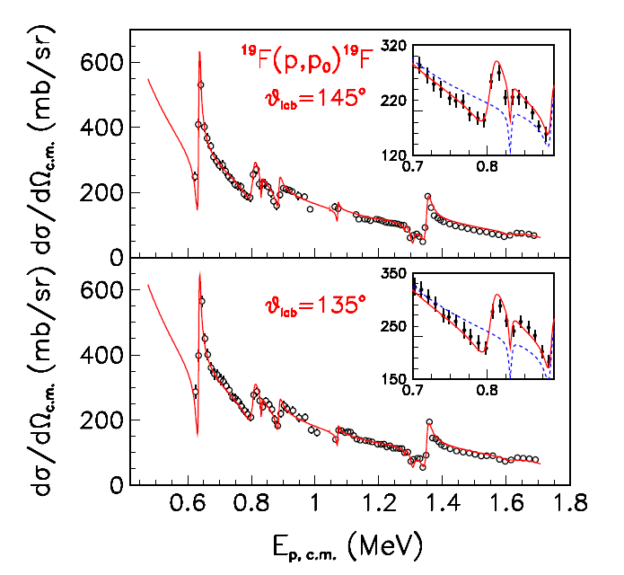
What next? A new experiment at higher energies
Fluorine stoichiometry in the CaF₂ target could vary under bombardment!
→ Measured data have been normalized, for every run, to the p+¹⁹F elastic cross section
Proton beam
CaF₂ Target
University of Naples "Federico II" & INFN-Naples
Obtained elastic cross sections verified with benchmarked data (at 135º and 145º)
Elastic σ extrapolated via R-Matrix calculations at other angles,
(resonance parameters from Lombardo et al. PRC 100 (2019))
→ Benchmark at 153º
data from Knox & Harmon (1989)
Maximum non-statistical uncertainty:10%
Daniele Dell’Aquila (daniele.dellaquila@unina.it) – February, 20th 2025

Slide 12
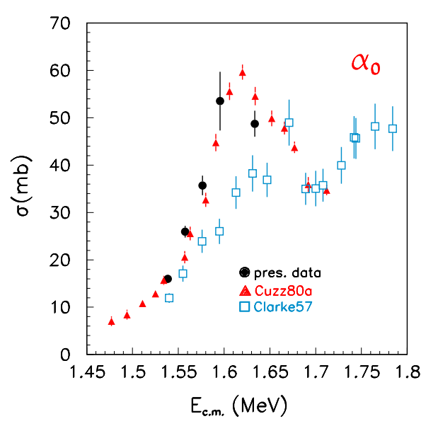





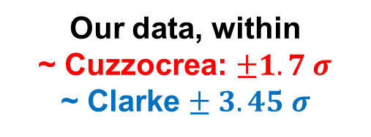
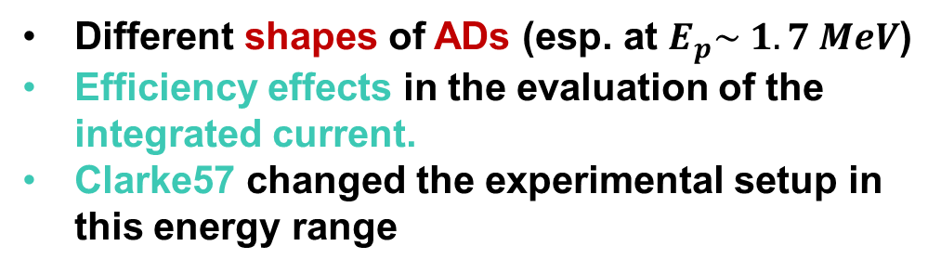
What next? A new experiment at higher energies
$α0$ channel $σ$
Our data, within
~ Cuzzocrea: $±1.7 σ$
~ Clarke $± 3.45 σ$
University of Naples "Federico II" & INFN-Naples
A clearer agreement with Cuzzocrea (1980) is shown
Possible origin of the discrepancies
Different shapes of ADs (esp. at $E_{p}\sim 1.7 MeV$)
Efficiency effects in the evaluation of the integrated current.
Clarke57 changed the experimental setup in this energy range
Daniele Dell’Aquila (daniele.dellaquila@unina.it) – February, 20th 2025

Slide 13
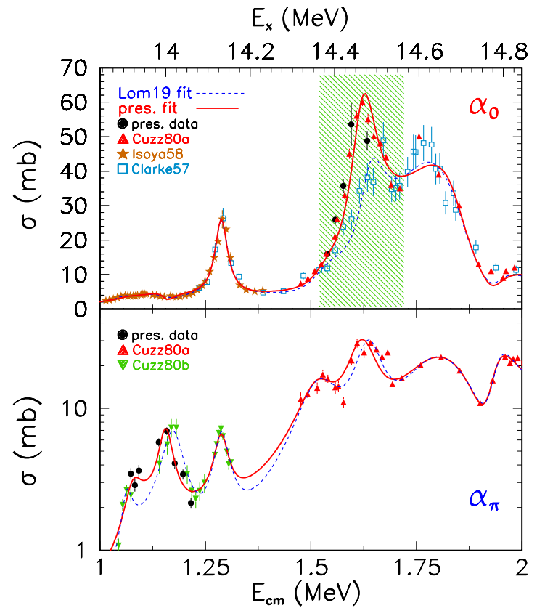

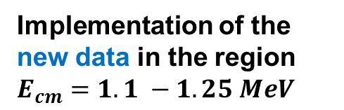
Clusters in nuclei
Comprehensive R-matrix fits to our results with a broad database of literature data, for the α₀ and the α_{π} channels.
Change in shape
and amplitude
Data from Clarke (1957) have been excluded from the fit in this area.
University of Naples "Federico II" & INFN-Naples
Implementation of the new data in the region
$E_{cm}=1.1 −1.25 MeV$
Small energy shift
Both the present and the old (Lombardo 2019) fits are shown.
Daniele Dell’Aquila (daniele.dellaquila@unina.it) – February, 20th 2025

Slide 14
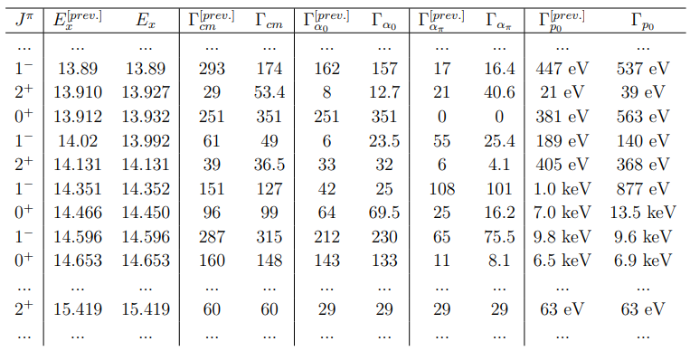
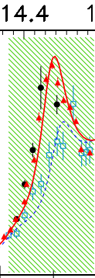


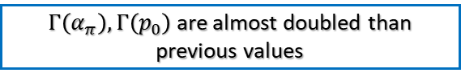
What next? A new experiment at higher energies
All values ($J^{π}, E_{x}, Γ$) are in good agreement with the previous ones
University of Naples "Federico II" & INFN-Naples
Improved description of the ~14.45 MeV 0⁺ state
→ We potentially rule out the quartet model hypothesis.
$Γ\left(α_{π}\right), Γ\left(p_{0}\right)$ are almost doubled than previous values
$Γ\left(α_{0}\right)$is ~40% larger than previous value
The $\frac{Γ\left(α_{π}\right)}{Γ\left(α_{0}\right)}$ ratio is now closer to 1
Daniele Dell’Aquila (daniele.dellaquila@unina.it) – February, 20th 2025

Slide 15
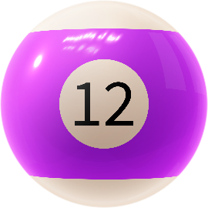



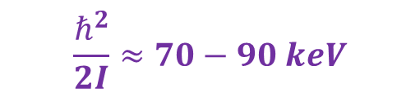


What next? A new experiment at higher energies
$14.92 MeV \left(0^{+}\right)$ state → $γ_{α_{π}}^{2}>γ_{α_{0}}^{2},γ_{p_{0}}^{2}$ → good candidate for as the [211] quartet band head…
Rough estimate of the Inertia Moment
$$\frac{ℏ^{2}}{2I}≈70−90 keV$$
A possible 2⁺ rotation of this state should thus be located at energies between
University of Naples "Federico II" & INFN-Naples
$$E_{x}≈15.3−15.4 MeV$$
$$E_{x}≈15.3−15.4 MeV$$
$$γ_{α_{π}}^{2}>γ_{α_{0}}^{2} (10>2.7 keV)$$
A promising
candidate!
$$γ_{α_{π}}^{2}, { γ}_{α_{0}}^{2}≫γ_{p_{0}}^{2}$$
Daniele Dell’Aquila (daniele.dellaquila@unina.it) – February, 20th 2025

Slide 16
Conclusions and Perspectives
The ¹⁹F(p,α) reaction is a powerful tool to probe the structure of the compound ²⁰Ne nucleus at E_{x}>12.84 MeV → possible key role of quartet states in ²⁰Ne;
In the astrophysical domain → together with the ¹⁹F(p,γ) reaction it is crucial to describe CNO-cycle loss in pop III stars → towards Ne, Mg, Ca;
The ¹⁹F(p,α₀) reaction has been investigated with direct and indirect experiments down to astrophysical energies. Our direct data in the E_{cm}=0.2-0.6 MeV energy region indicates a resonant behaviour of the cross section due to the appearance of clustering phenomena (also shown by indirect experiments with the Trojan Horse Method). More recently → agreement with G.L. Guardo et al., EPJ A (2023) at E_{cm}=0.4-0.9 MeV;
Recent re-evaluations of cross section data point out discrepancies at higher energies for the ¹⁹F(p,α₀) and ¹⁹F(p,α_{π}) reactions → a new experiment suggests the occurrence of clustering and rotational symmetries in ²⁰Ne;
In the future → ¹⁹F(p,⁸Be) could be key to definitely probe the cluster properties of ²⁰Ne excited states at E_{x}>12.84 MeV.
University of Naples "Federico II" & INFN-Naples
Daniele Dell’Aquila (daniele.dellaquila@unina.it) – February, 20th 2025

Slide 17
Thank you for your attention
University of Naples "Federico II" & INFN-Naples
Daniele Dell’Aquila (daniele.dellaquila@unina.it) – February, 20th 2025

Slide 18
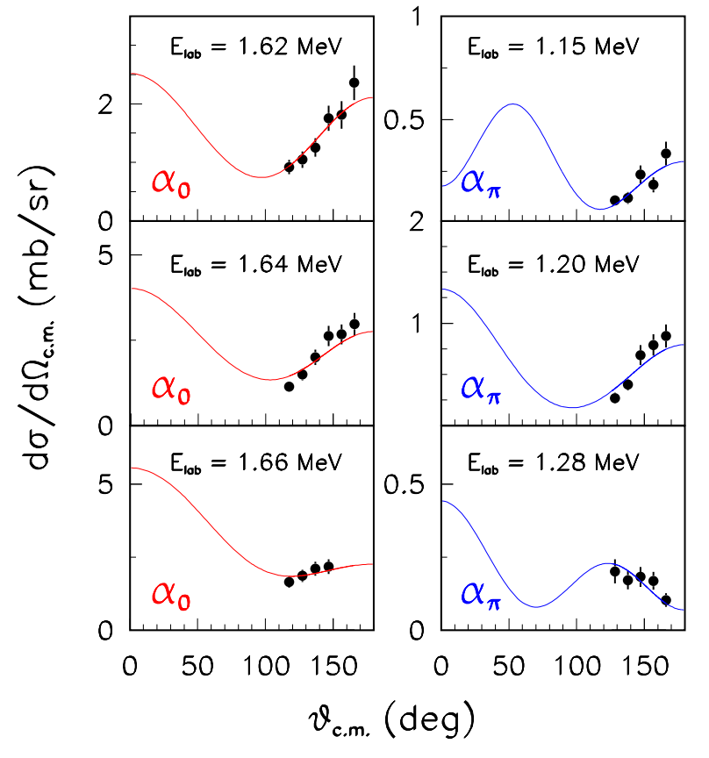




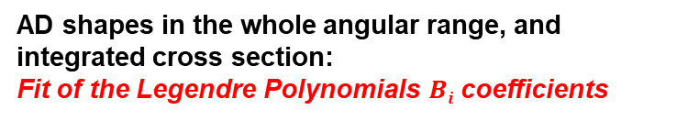
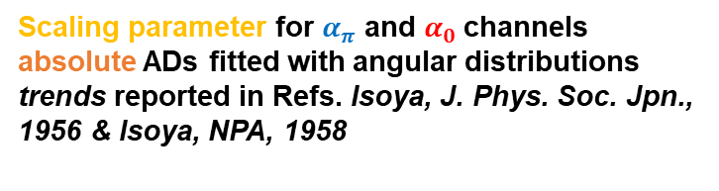
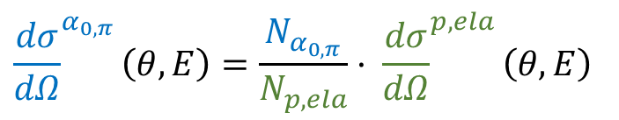
What next? A new experiment at higher energies
$$α_{1}$$
Elastic, α₀ and α_{π} peak areas →
multi-gaussian fits with polynomial background
Differential cross sections of α₀ and α_{π} channels: ratio with
fluorine elastic peak area
$$α_{0}$$
$$α_{π}$$
$${\frac{dσ}{dΩ}}^{α_{0,π}}\left(θ,E\right)=\frac{N_{α_{0,π}}}{N_{p,ela}}· {\frac{dσ}{dΩ}}^{p, ela}\left(θ,E\right)$$
University of Naples "Federico II" & INFN-Naples
AD shapes in the whole angular range, and integrated cross section:
Fit of the Legendre Polynomials $Bi$coefficients
$$σ\left(E\right)=A\left(E\right)⋅4πB_{0}\left(E\right)$$
Scaling parameter for $α_{π}$ and $α_{0}$channels absolute ADs fitted with angular distributions trends reported in Refs. Isoya, J. Phys. Soc. Jpn., 1956 & Isoya, NPA, 1958
Daniele Dell’Aquila (daniele.dellaquila@unina.it) – February, 20th 2025

Slide 19
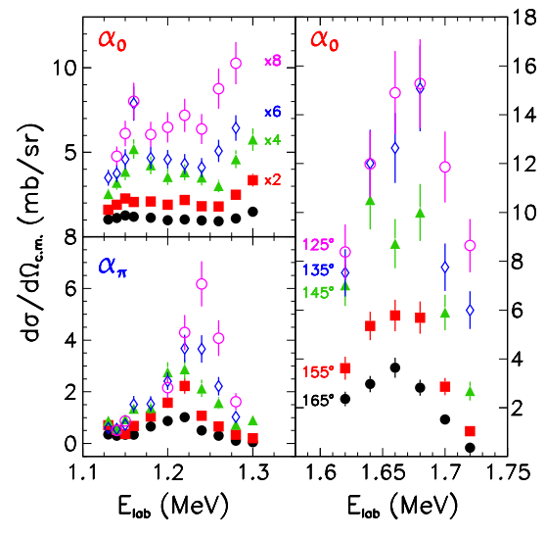
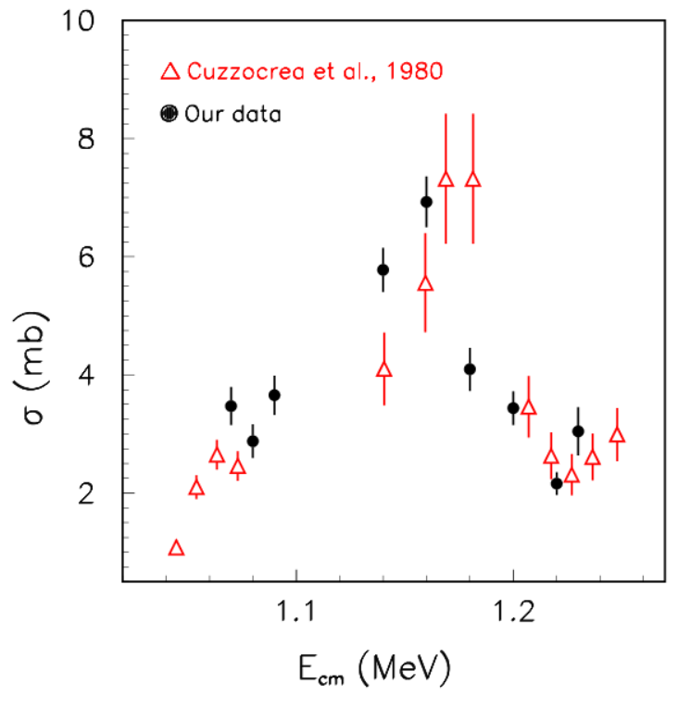

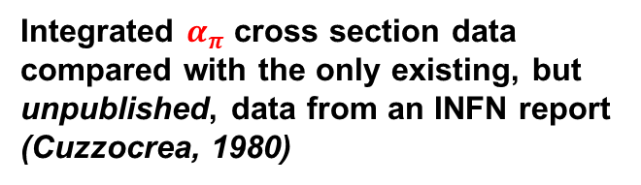
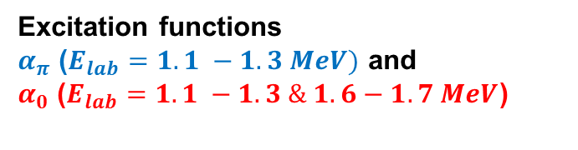
What next? A new experiment at higher energies
Excitation functions
$α_{π}$ ($E_{lab}=1.1 −1.3 MeV)$ and
$α_{0}$ ($E_{lab}=1.1 −1.3 \& 1.6−1.7 MeV$)
EFs at different angles scaled for clarity purposes
University of Naples "Federico II" & INFN-Naples
$α_{π}$ channel $σ$
Integrated $α_{π}$ cross section data compared with the only existing, but unpublished, data from an INFN report (Cuzzocrea, 1980)
Daniele Dell’Aquila (daniele.dellaquila@unina.it) – February, 20th 2025

Slide 20



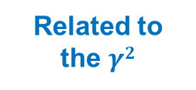



What next? A new experiment at higher energies
Real Identity?
[1] Band-head of the [211] quartet band?
[2] Just a state with [220] structure?
[3] An iso-analogue of the 4.32, T = 1, 0⁺ state in ²⁰F?
De Rosa (1978)
Cuzzocrea (1980)
Ouichaoui (1985)
University of Naples "Federico II" & INFN-Naples
Related to the $γ2$
Small $\frac{Γ_{p0}}{Γ} BR$
A better candidate:
In this case,
$$γ_{α_{π}}^{2} \sim { γ}_{α_{0}}^{2}$$
$$14.92 MeV \left(0^{+}\right)$$
Not suitable for Hp [3]
$$γ_{α_{π}}^{2}>γ_{α_{0}}^{2},γ_{p_{0}}^{2}$$
Typical of a quartet state!
Not suitable for a quartet state (Hp [1] and partly [2])
Daniele Dell’Aquila (daniele.dellaquila@unina.it) – February, 20th 2025

Slide 21
















¹⁹F(p,α)¹⁶O: astrophysical relevance
¹⁹F(p,α₀) and ¹⁹F(p,α_{π}) at sub-barrier energies → quartet states in ²⁰Ne → Ambiguities in ²⁰Ne spectroscopy above the S_{p} (12.844 MeV) (D.R. Tilley et al., Nucl. Phys. 1998)
S(E) factor low energy extrapolation → astrophysical interest → CNOF cycles,
fluorine nucleosynthesys → ambiguities in direct data
$$(p,γ)$$
$$(p,α)$$
$$(p,γ)$$
¹³C
¹⁴N
¹⁷O
¹⁸F
$$(β^{+},ν)$$
$$(p,γ)$$
$$(β^{+},ν)$$
University of Naples "Federico II" & INFN-Naples
¹³N
¹⁵O
¹⁷F
$$(β^{+},ν)$$
$$(p,γ)$$
$$(β^{+},ν)$$
$$(p,γ)$$
¹²C
¹⁵N
¹⁸O
$$(p,γ)$$
$$(p,γ)$$
¹⁶O
¹⁹F
$$(p,α)$$
$$(p,γ)$$
NeNa
cycle
$$(p,α)$$
CNO-F
cycles
$$(p,α)$$
Daniele Dell’Aquila (daniele.dellaquila@unina.it) – February, 20th 2025

