Slide 1
Direct Measurements with Radioactive Beams for Heavy Element Nucleosynthesis
Matthew Williams
STFC Ernest Rutherford Fellow

Slide 2
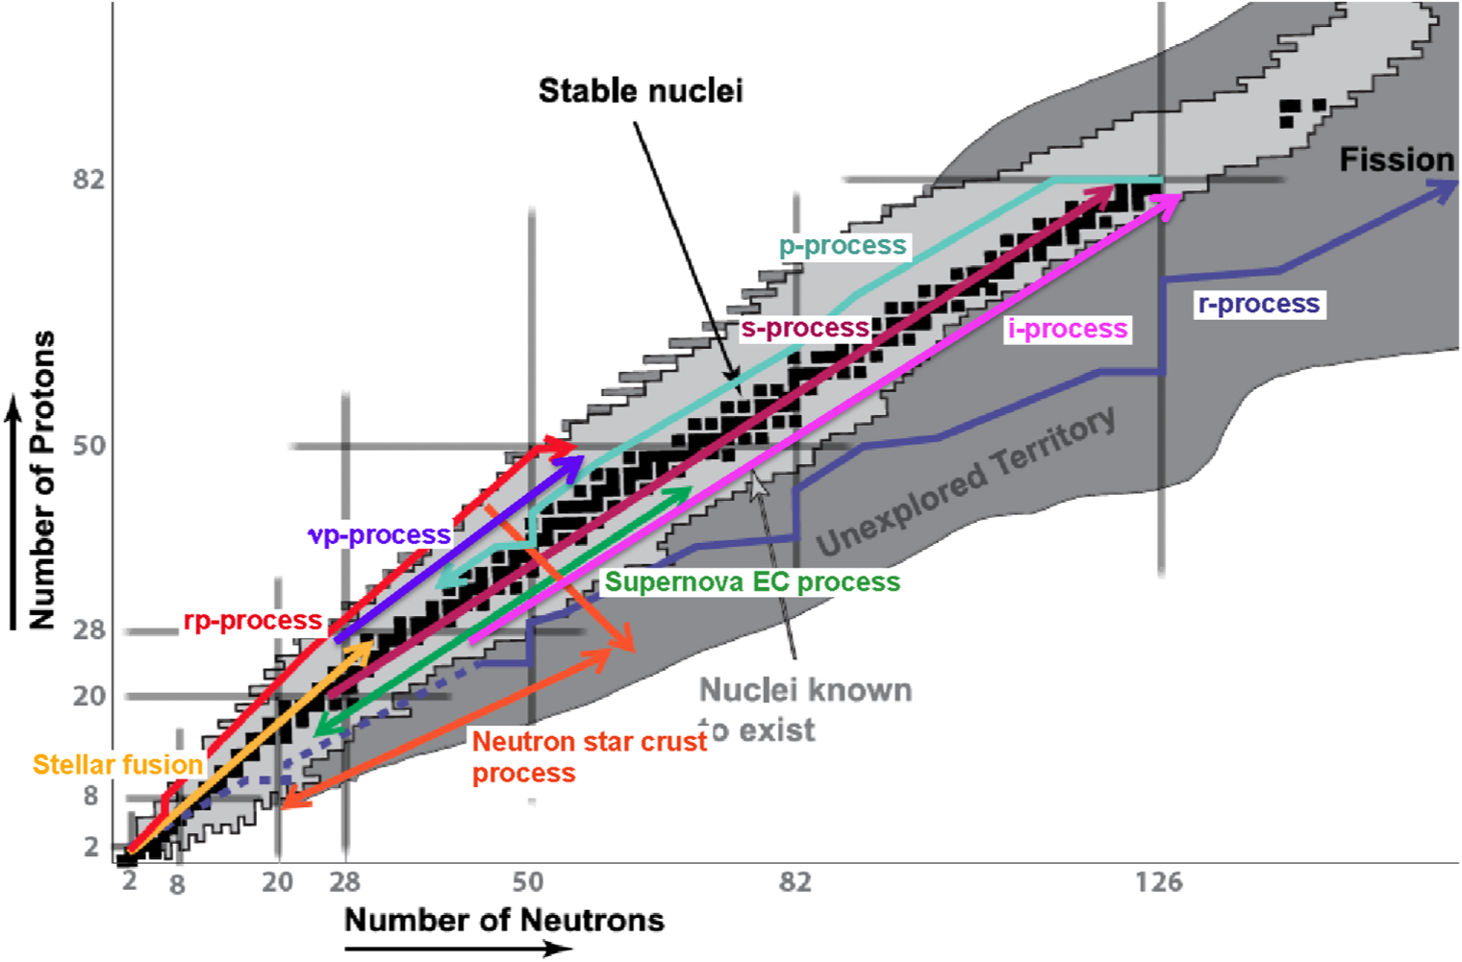
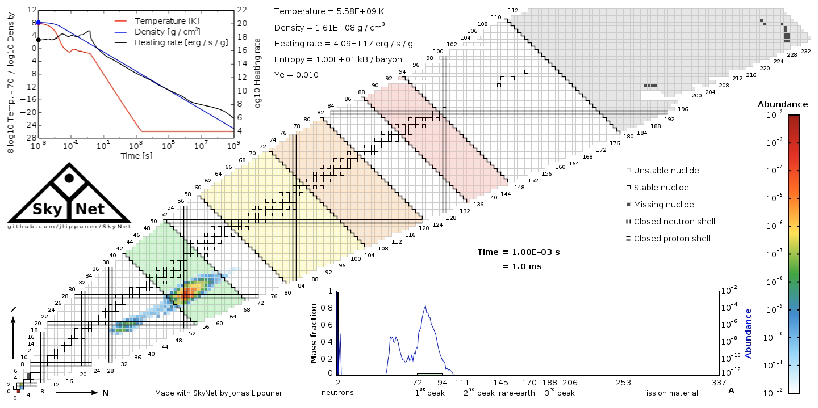
Heavy Element Production
Site(s) of the r-process not well-understood.
Contribution of neutron star mergers.
Can the r-process happen in supernovae?
Several unique processes have been identified as contributing to the production of elements beyond the iron peak.
Radioactive nuclei are known to play an important role in many of these processes: e.g. r-, p- and i-processes.
Still unclear where the conditions required to drive these processes are achieved in nature… nuclear physics information is often lacking.

Slide 3
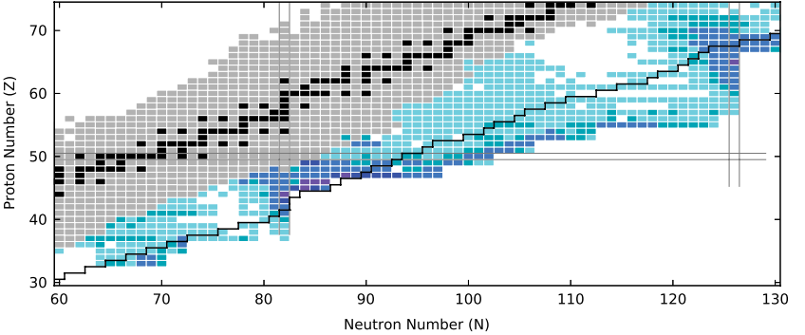
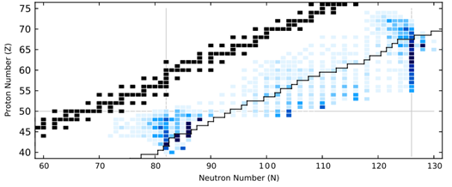
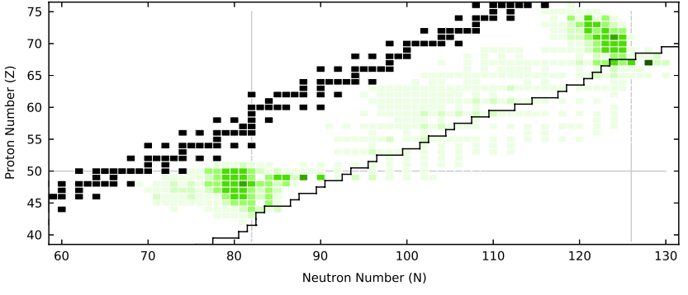


Required Nuclear Physics Information
Nucleosynthesis models primarily require three quantities: masses, half-lives, and reaction rates.
Can test the sensitivity of final abundances to varying nuclear properties
Masses
$β$-decay Half-lives
$(n,γ)$ reaction rates
Example: r-process scenario resulting from a neutron star merger model [1] (darker shade = important)
Importance of sensitivity studies:
Tell us what to measure in which nuclei out of the thousands that take place in nucleosynthesis.
Can assess the impact of a measurement before and after it has been performed.
[1] M.R. Mumpower et al., Progress in Particle and Nuclear Physics 86 (2016) 86–126

Slide 4

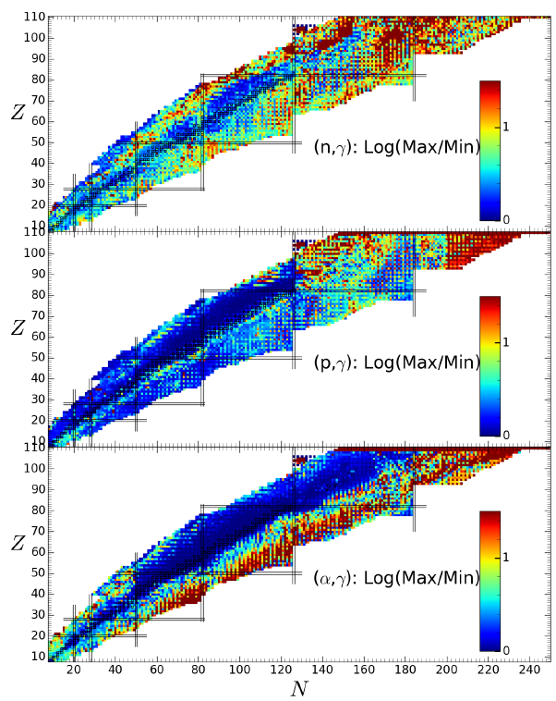
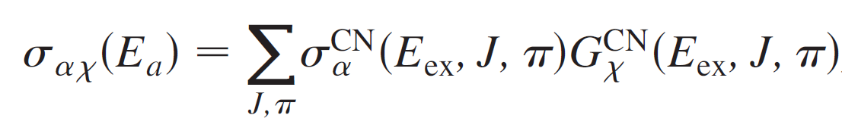
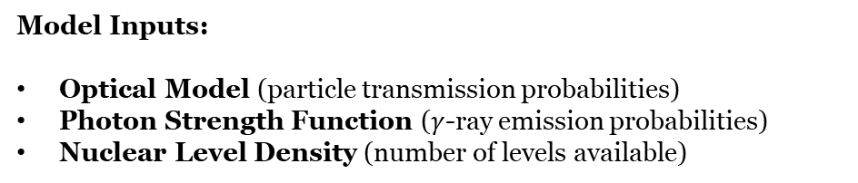
Statistical Model
In heavier nuclei the threshold is often at located in an excitation range where many levels overlap
Hauser-Feshback Model:
Compound Nuclear (CN) Formation cross-section
CN Decay branching ratio
Treat formation and decay as independent processes and represent parameters as averaged properties across many states.
Model Inputs:
Optical Model (particle transmission probabilities)
Photon Strength Function ($γ$-ray emission probabilities)
Nuclear Level Density (number of levels available)
Can perform sensitivity studies on nuclear reaction rates by varying models or parameters within models.
Then feed back to reaction rate limits to nucleosynthesis sensitivity studies. (caution needed here)
Wiedeking M, Goriely S. Phil. Trans. R. Soc. A 382: 20230125 (2024)

Slide 5
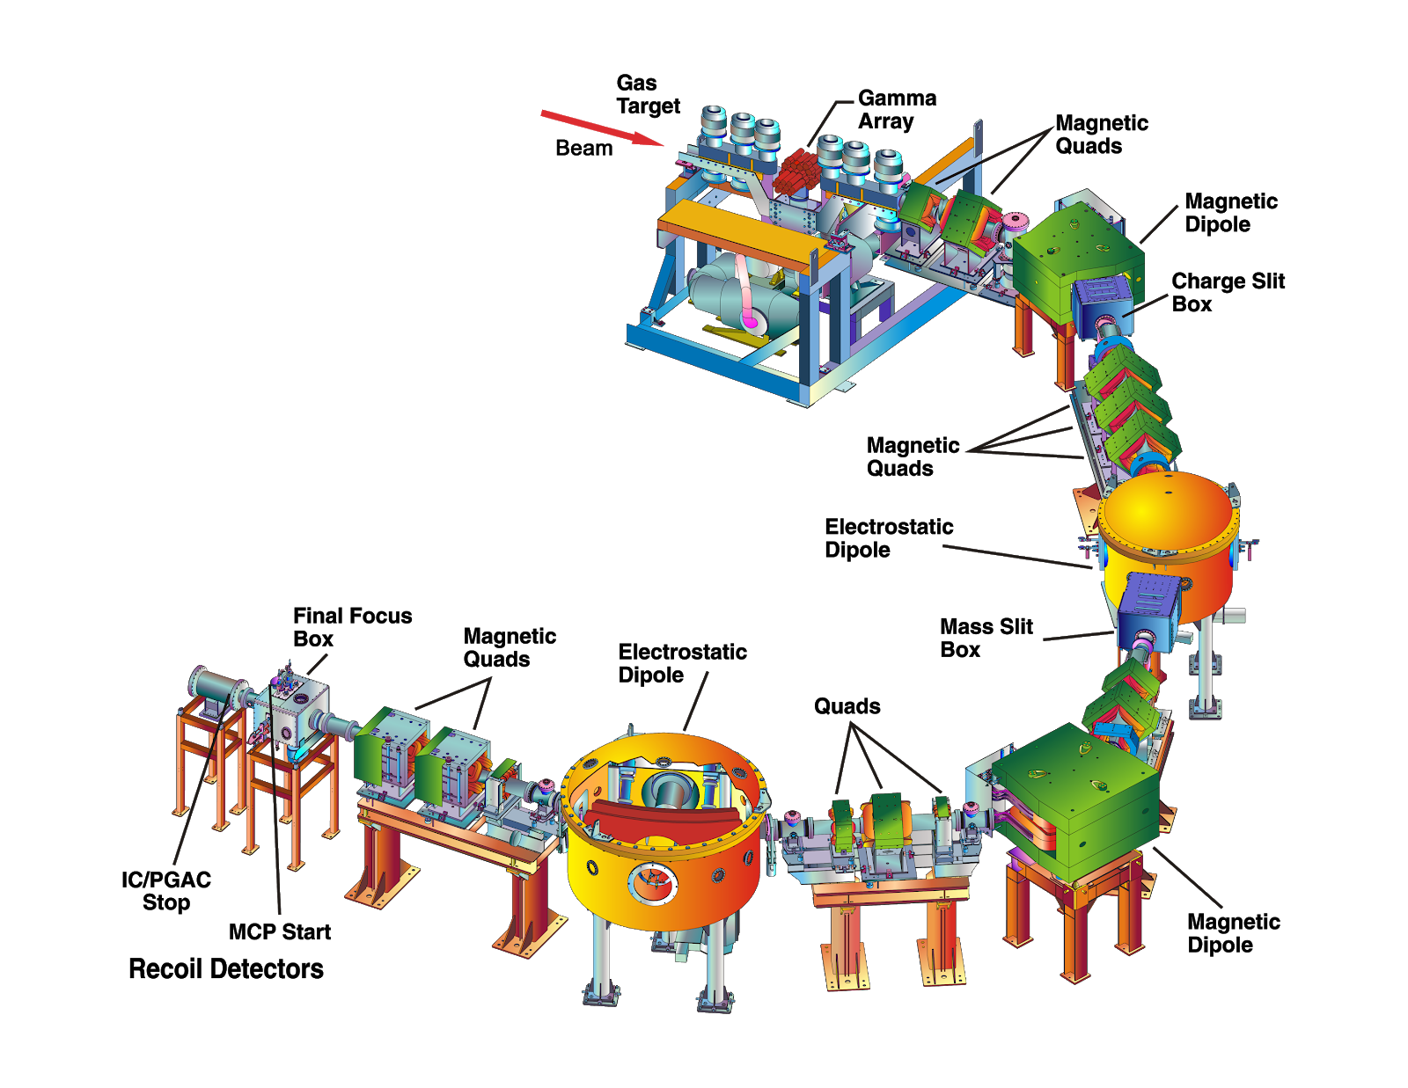
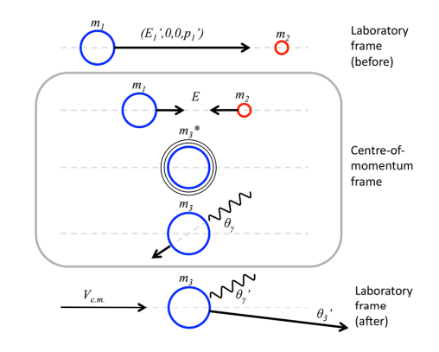

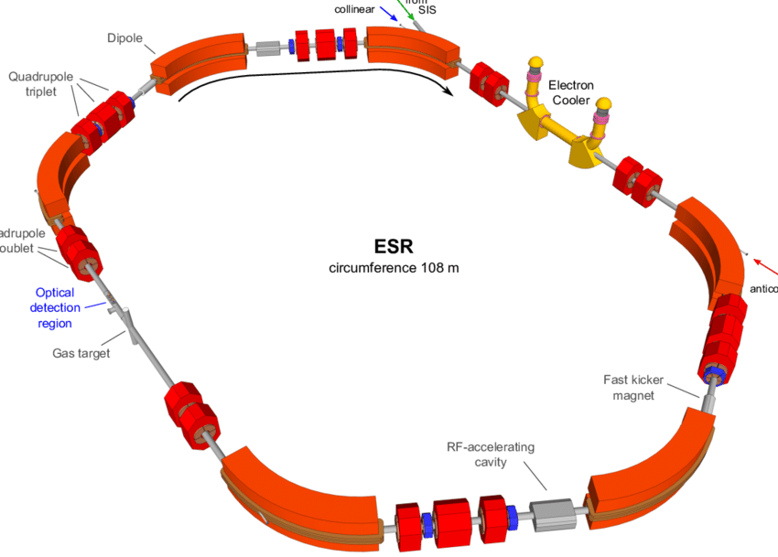
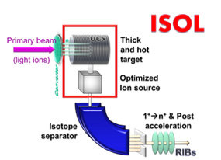
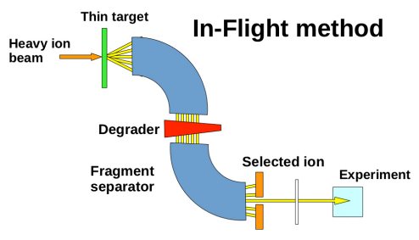
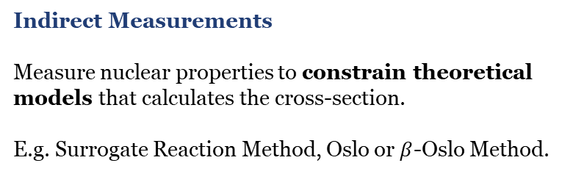
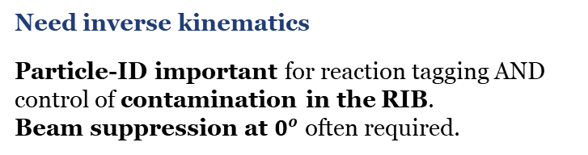
Nuclear Experiments
Need inverse kinematics
Particle-ID important for reaction tagging AND control of contamination in the RIB.
Beam suppression at $0^{o}$ often required.
Direct Measurements
Measure the same reaction as occurs in the star ideally at the relevant energies (Gamow Window).
Not always practical!
Indirect Measurements
Measure nuclear properties to constrain theoretical models that calculates the cross-section.
E.g. Surrogate Reaction Method, Oslo or $β$-Oslo Method.
Fragmentation energies too high:
Need to either cool beam (GSI) or stop and extract (ReA@FRIB)
RIB Beam Production Methods
What about other ISOL facilities (e.g. ISOLDE)?
No recoil mass separator or storage ring.
Beam structure makes heavy-ion PID difficult (instantaneous rate from beam bunching).
Storage
Ring
4
5
Direct measurements with radioactive beams A>56:
1
2
And in the Gamow window:

Slide 6
Reaction Studies for the Weak r-process

Slide 7
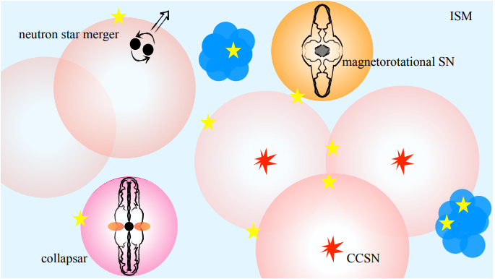
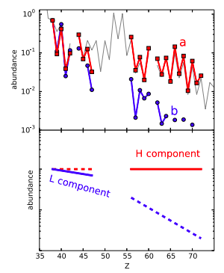
Observations from Metal-Poor Stars
Stars preserve heavy element signatures of the ISM in which they formed (ignoring s-process enhancement in binaries). For metal poor stars perhaps only one or few rare r-process events contributed.
Standard r-process
Other process?
Many metal-poor stars show abundances that deviate from the “main” r-process pattern.
Not yet clear what other process produce this pattern let alone which sites are responsible
K. Farouqi et al. A&A 663, A70 (2022)
C. J. Hansen, F. Montes, and A. Arcones, ApJ 797, 123 (2014).

Slide 8
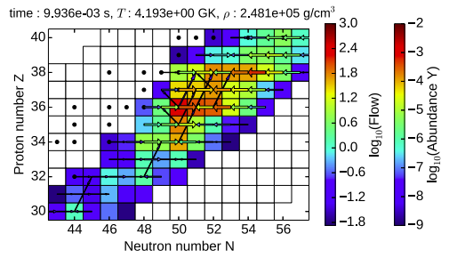
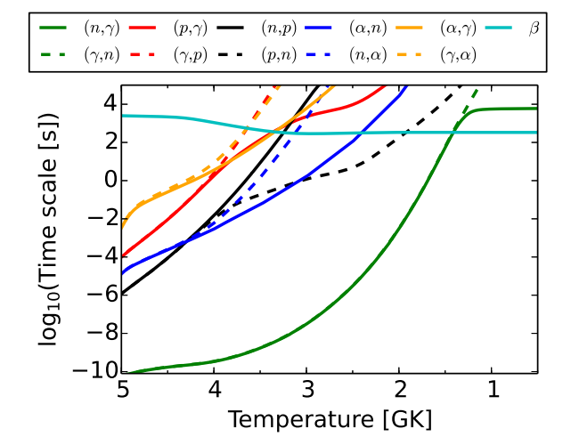
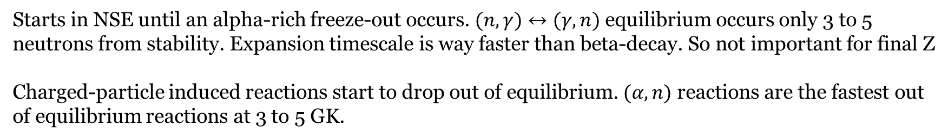
The weak r-process
Characterised by moderately neutron-rich conditions: $0.4<Y_{e}<0.49$
Candidate site in neutrino-driven winds of supernovae but may also occur in parts of NSM ejecta.
Starts in NSE until an alpha-rich freeze-out occurs. $(n,γ)↔(γ,n)$ equilibrium occurs only 3 to 5 neutrons from stability. Expansion timescale is way faster than beta-decay. So not important for final Z
Charged-particle induced reactions start to drop out of equilibrium. $(α,n)$ reactions are the fastest out of equilibrium reactions at 3 to 5 GK.
J. Bliss et al., J. Phys. G: Nucl. Part. Phys. 44 (2017) 054003

Slide 9
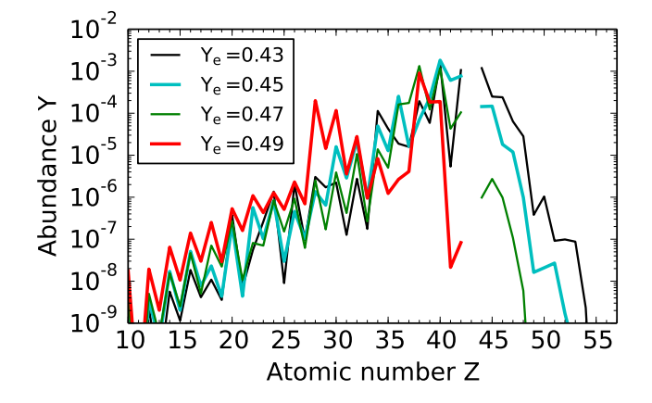
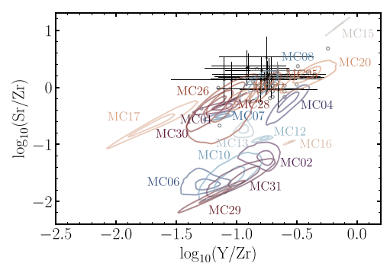
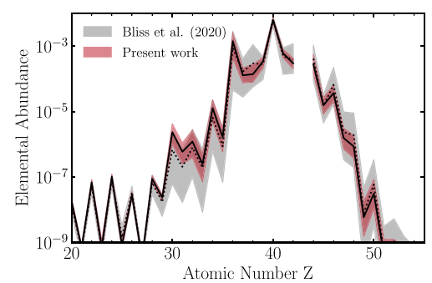
Uncertain conditions and uncertain reaction rates
The initial conditions of the wind heavily impact final abundances.
Varying nuclear reactions within uncertainties also changes abundances
Effect on abundances is of similar order to observational uncertainties. By constraining the nuclear reactions, observations can be used to find the matching conditions.
J. Bliss et al., J. Phys. G: Nucl. Part. Phys. 44 (2017) 054003
A. Psaltis, et al., ApJ, 935:27 11, (2022)

Slide 10
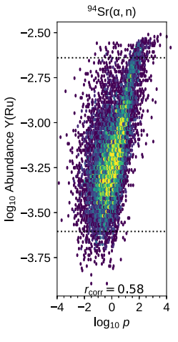
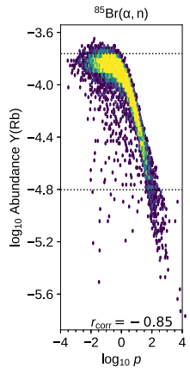
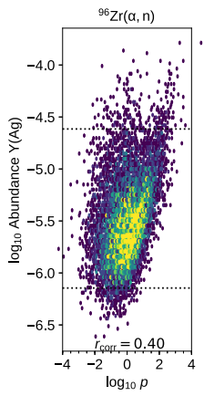
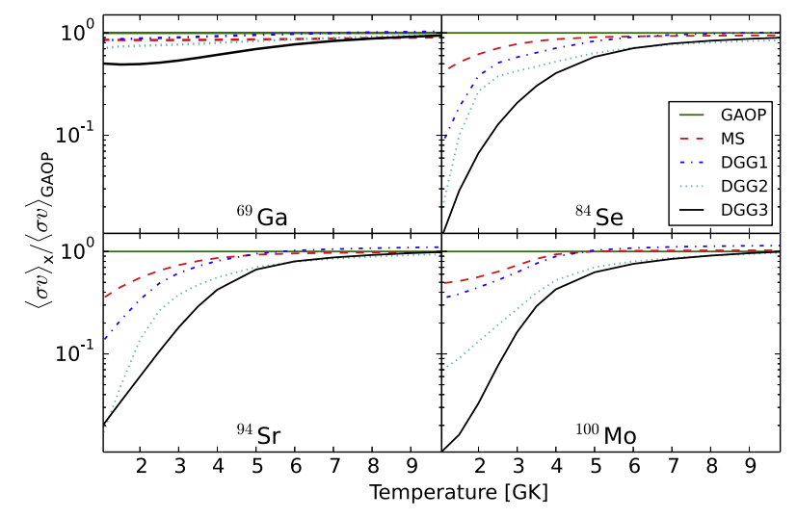
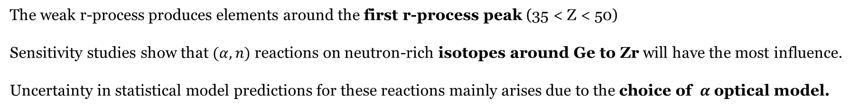
Important Reactions for the Weak r-process
The weak r-process produces elements around the first r-process peak (35 < Z < 50)
Sensitivity studies show that $(α,n)$ reactions on neutron-rich isotopes around Ge to Zr will have the most influence.
Uncertainty in statistical model predictions for these reactions mainly arises due to the choice of $α$optical model.
J. Bliss et al., Phys. Rev. C 101, 055807 (2020).
J. Bliss et al., J. Phys. G: Nucl. Part. Phys. 44 (2017) 054003

Slide 11
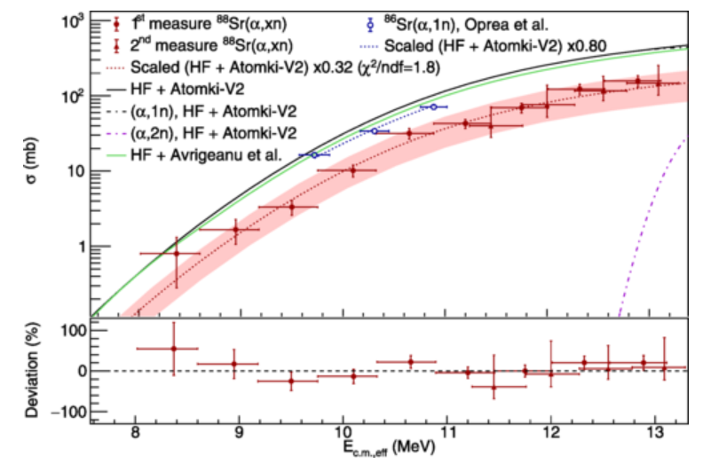
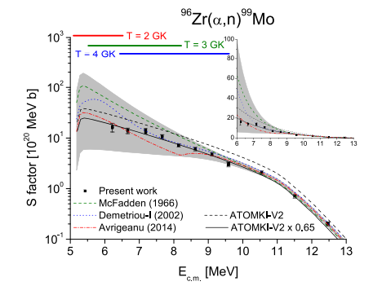
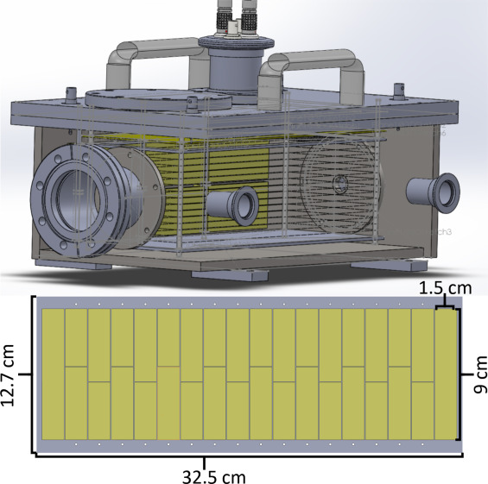
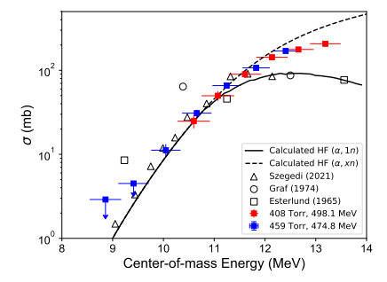
Recent Experimental Efforts
Significant experimental work on $(α,n)$ reactions have been pursued by the ATOMKI group (not just motivated by the weak r-process) to test and refine the $α$ optical model.
Most work at ATOMKI follows the activation technique after bombardment of targets with alpha beams.
Experiments in inverse kinematics have also been carried out instead using inverse kinematics. MUSIC ion chamber can identify total $(α,xn)$ reactions.
No radioactive beam experiments yet published!
G. G. Kiss et al., ApJ 908 202 (2021)
C. Fougeres, et al., Phys. Rev. C 109, 065805 (2024)
W-J. Ong, et al., Phys. Rev. C 105, 055803

Slide 12



TRIUMF: Canada’s national particle accelerator centre
University of British Columbia
TRIUMF

Slide 13
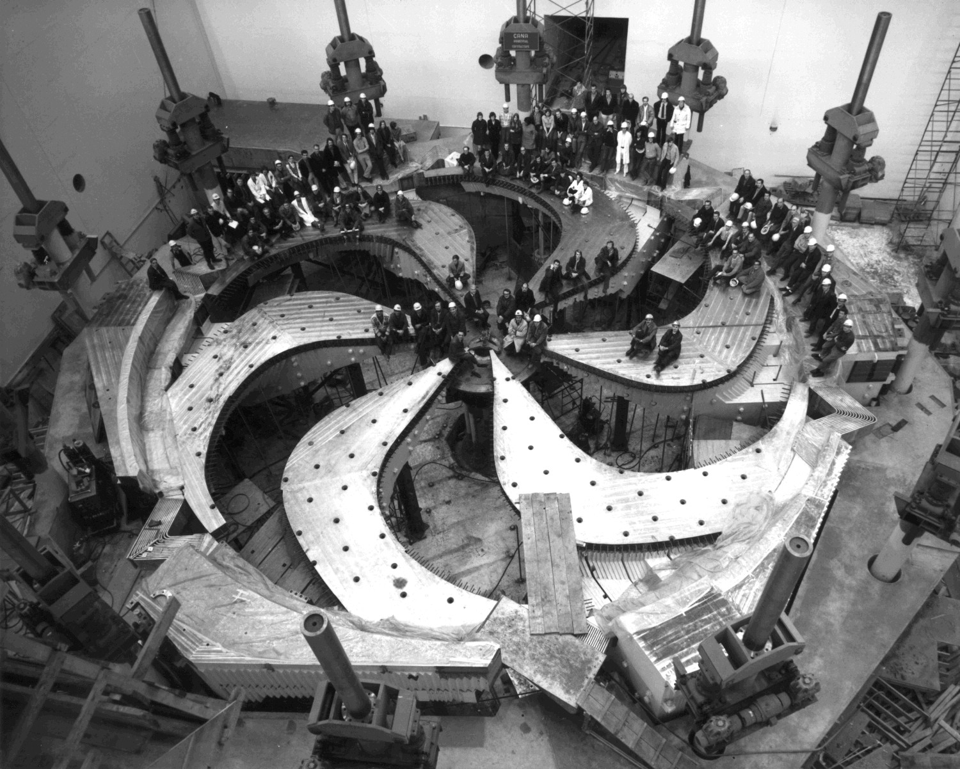
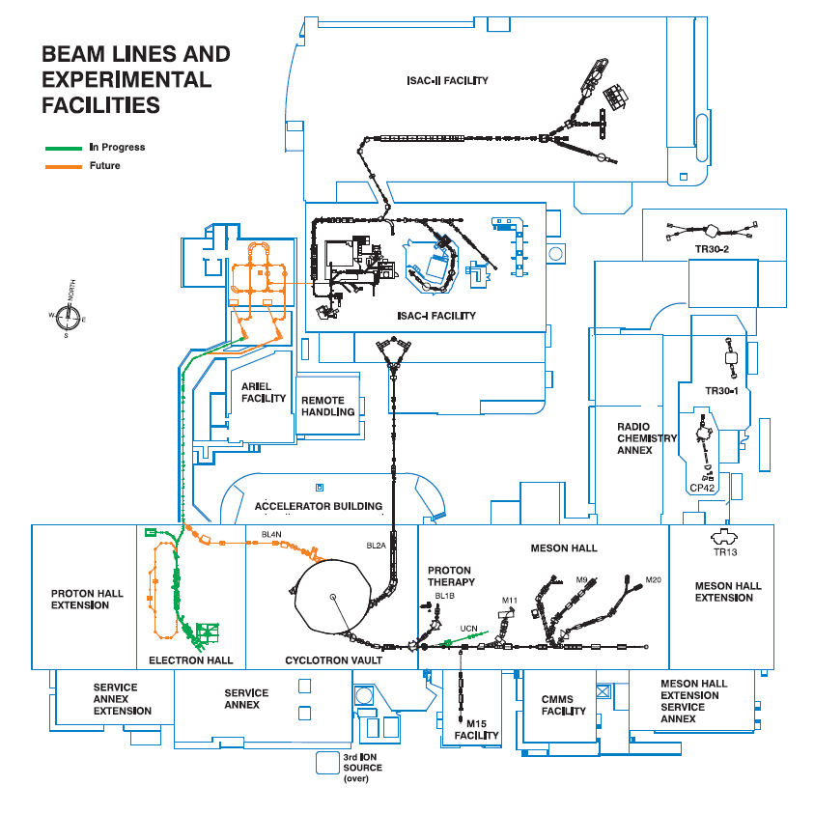
Largest cyclotron in the world
Main cyclotron accelerates H- ions to 500 MeV and ejected by stripping.

Slide 14
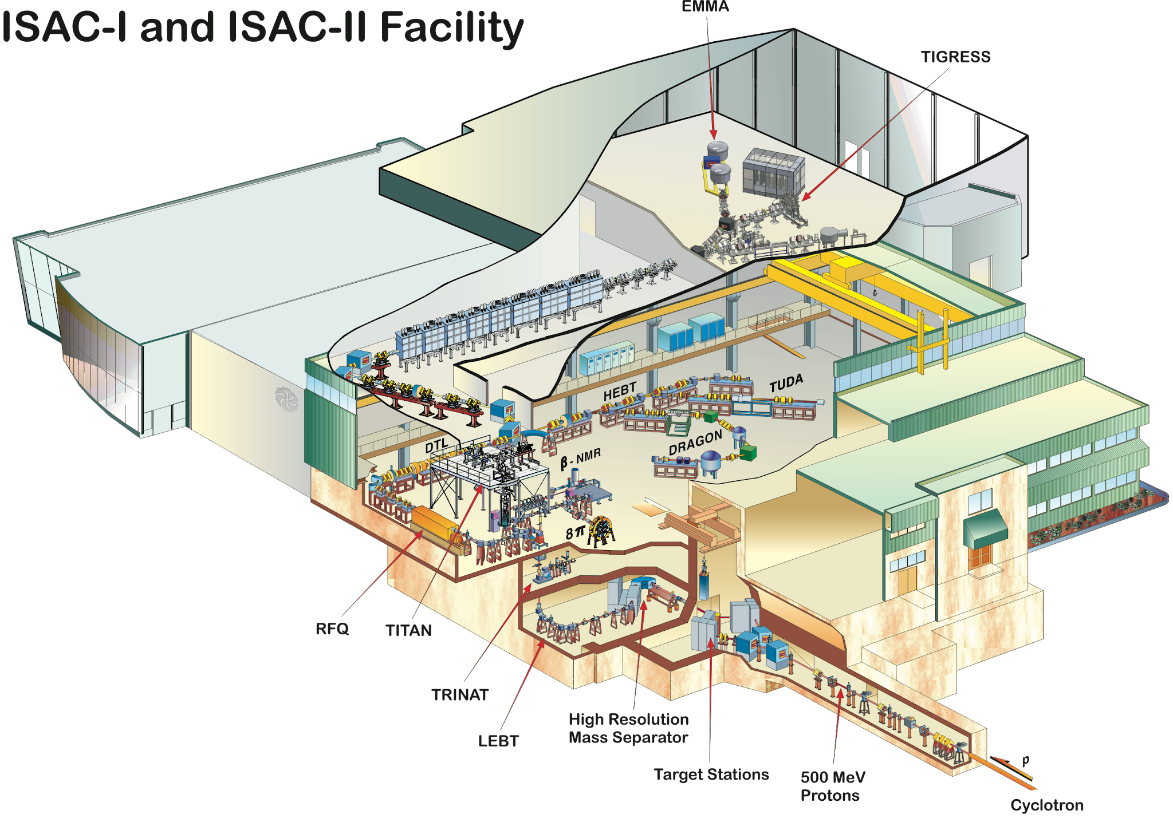
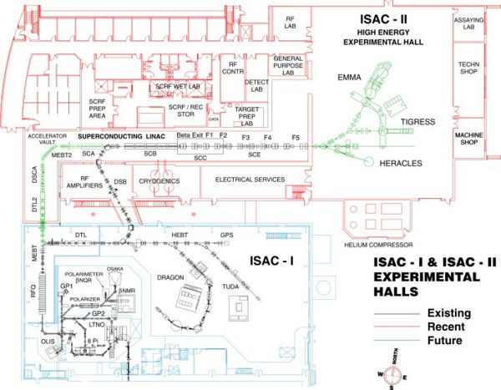
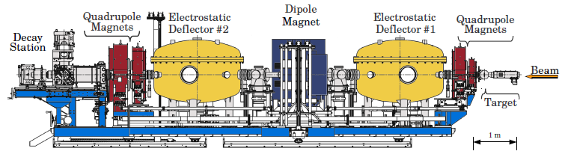
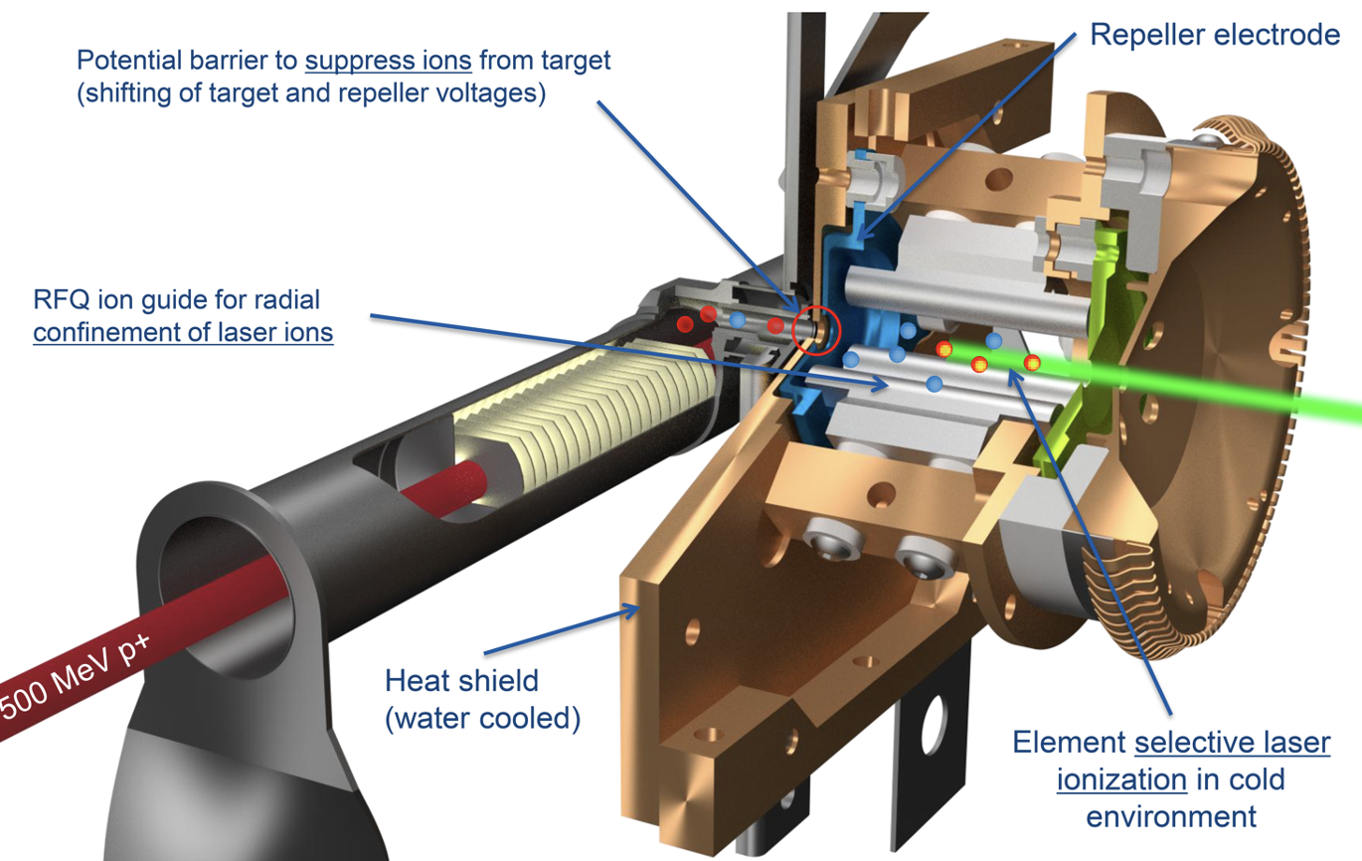
The Isotope Separator and Accelerator (ISAC) Facility

Slide 15
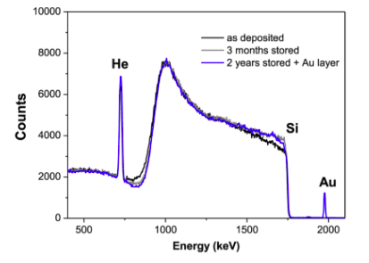
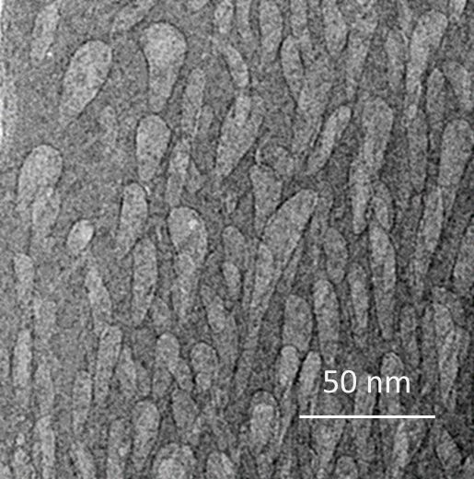
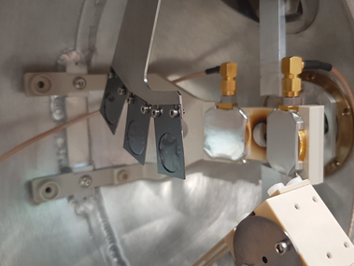
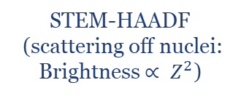
New Target Material
Using a radioactive beam means we need to use helium (a noble gas) as a target.
Gas Targets: Require windows and/or large pumping infrastructure. Limits space for detectors. Not compact.
He-implanted Metallic Foils: Low number density, not very uniform, known to lose He-content quickly with beam exposure.
Novel Si:He Nanomaterial Targets:
Silicon thin-films grown via sputtering technique using helium as the processing gas. Helium collects in nanoscale pores that permeate the whole target. We found that using a thin aluminium backing foil improved mechanical stability.
High helium content up-to 7 x 10¹⁸ atoms/cm²
Uniform target content.
Retains He content while in storage.
STEM-HAADF
(scattering off nuclei: Brightness $∝ Z^{2}$)
Characterised by proton elastic backscattering
Traditional TEM
V. Godinho, et al., ACS Omega 2016, 1, 1229−1238
Asuncion Fernandez, Private Communication

Slide 16
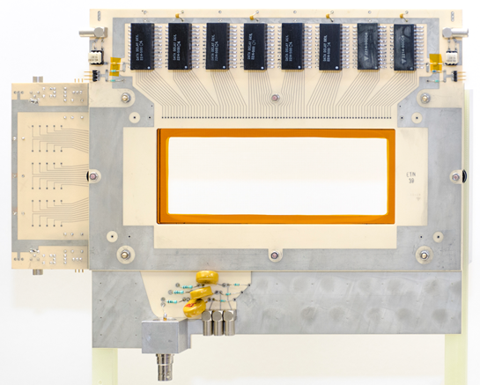
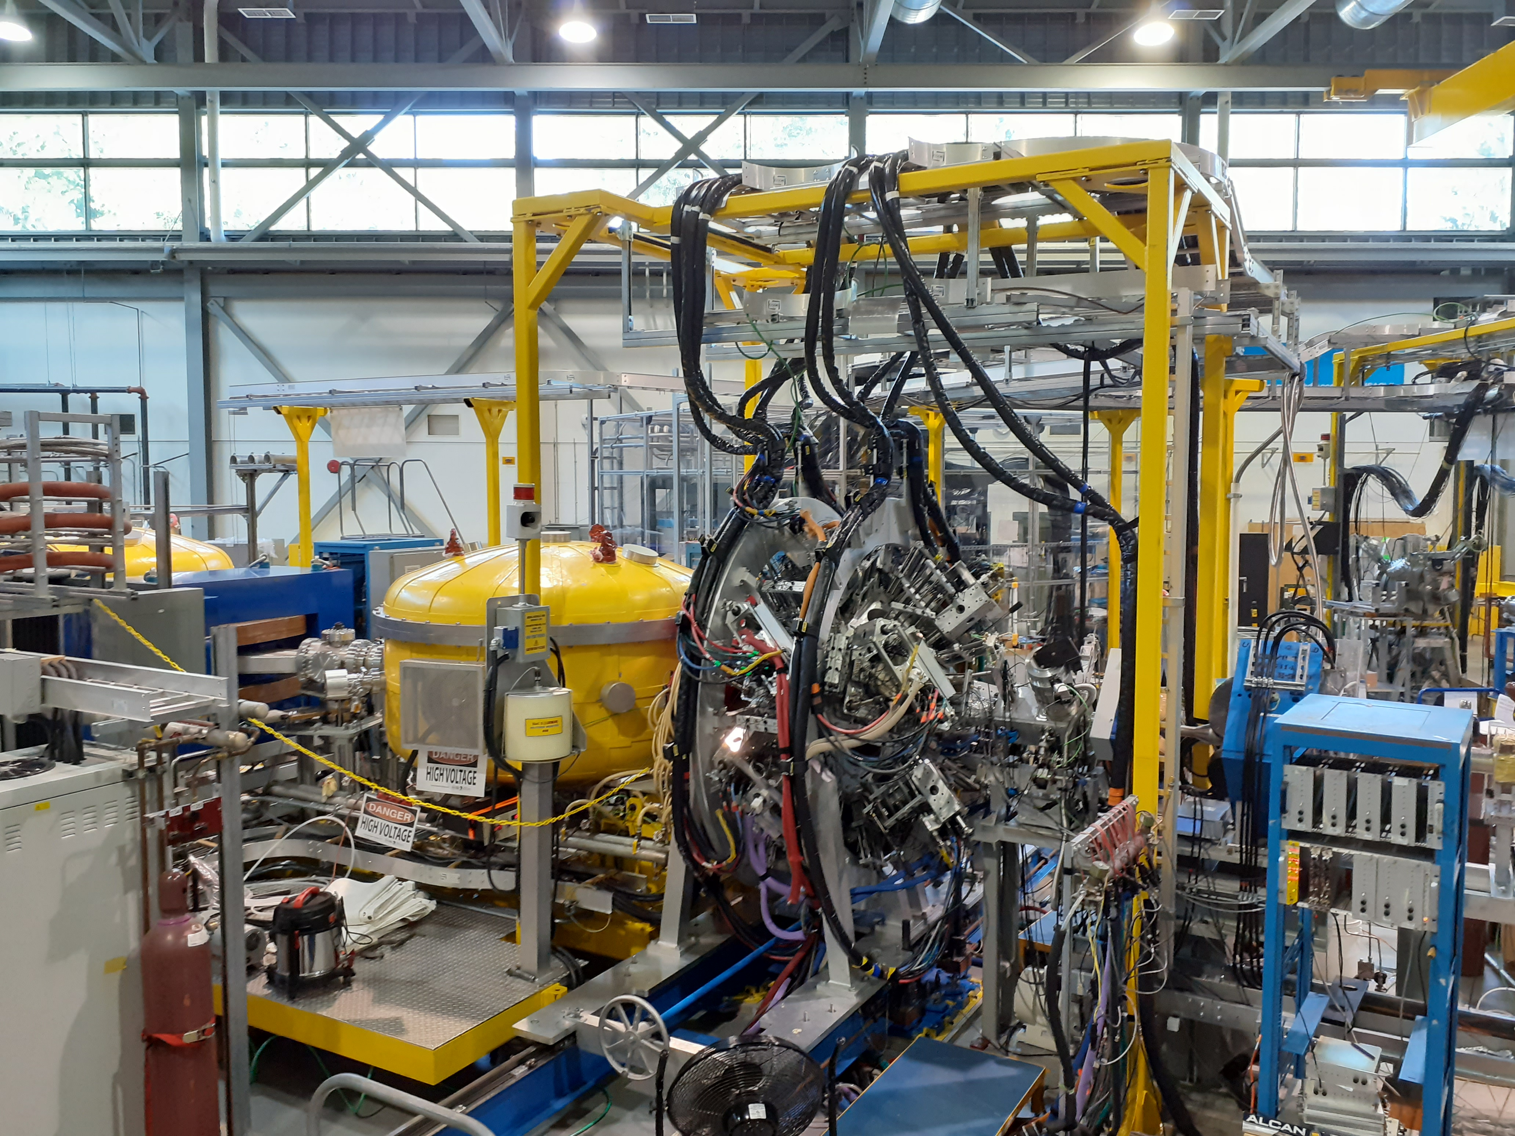
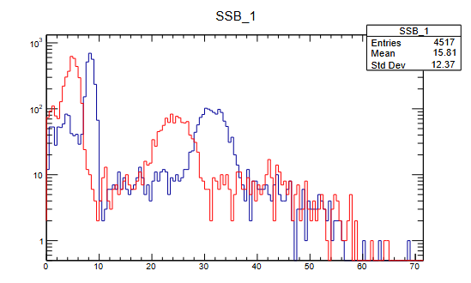
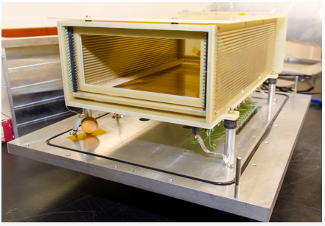
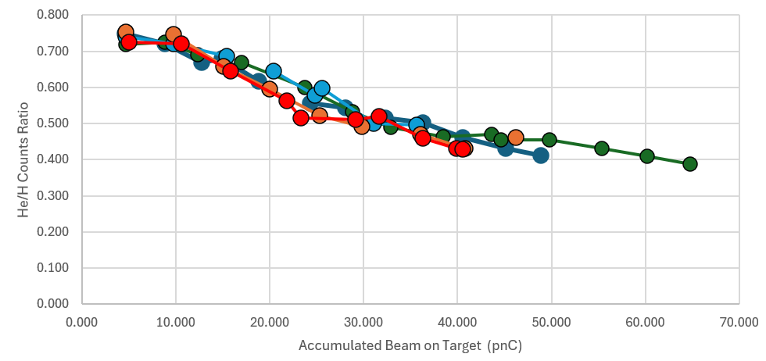

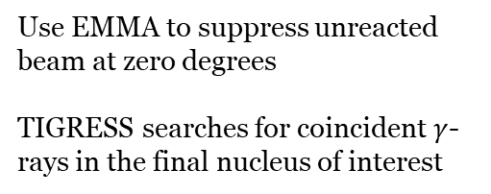
The EMMA+TIGRESS Set-up
PGAC
Use EMMA to suppress unreacted beam at zero degrees
TIGRESS searches for coincident $γ$-rays in the final nucleus of interest
Ion Chamber
Helium in each SSB
Ion-implanted Silicon
Monitor target content by detecting scattered helium with two SSB detectors at 20 degrees.
Helium content decreased with accumulated charge. But returned to same value when illuminating a fresh spot.
Indicates uniform content – as expected!
B. Davids, M. Williams, et al., NIMA 930 (2019) 191–195
G. Hackman, C. Svensson. Hyperfine Interact (2014) 225:241–251

Slide 17
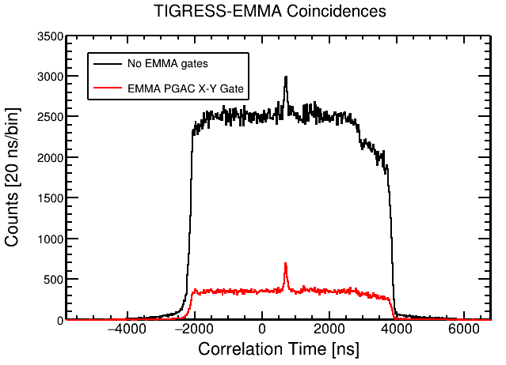
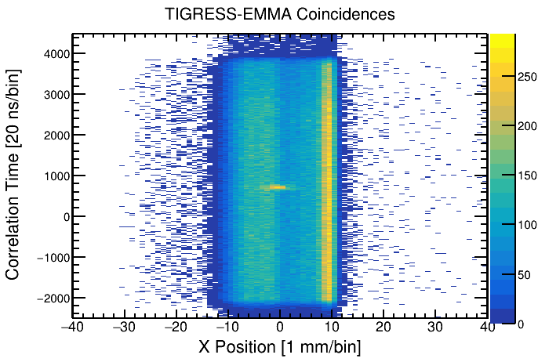

Test Measurement of ⁸⁶Kr(α,n)⁸⁹Sr
Measured the ⁸⁶Kr(α,n)⁸⁹Sr reaction at two energies: 10.4 and 8.3 MeV in centre of mass.
Correspond to the centre of the (classical) Gamow window at ~5 GK and ~4 GK.
TIGRESS-EMMA ToF peak clearly seen. Signal to background improved by gating on central X-position.
Several prominent γ-rays in ⁸⁹Sr are observed, from which partial cross-sections can be easily extracted.
M. Williams, et al., Physical Review Letters (Accepted)

Slide 18


Study of ⁹⁴Sr(α,n)⁹⁷Zr using EMMA+TIGRESS
Higher background in RIB due to random coincidence with decays from scattered beam deposited in target chamber. Doppler-shifted stopped lines then obscure many ⁹⁷Zr transitions.
Nonetheless, able to see the 407-keV transition in ⁹⁷Zr. Allows partial cross-section measurement
M. Williams, et al., Physical Review Letters (Accepted)

Slide 19



First measurement of a weak r-process reaction with radioactive beam.
⁸⁶Kr(α,n) & ⁹⁴Sr(α,n) – ~60 % of default TALYS
Both ⁸⁶Kr(α,n) and ⁹⁴Sr(α,n) are lower than prediction assuming default TALYS v2.0
⁹⁴Sr(α,n) rate is a factor 5 to 10 lower than REACLIB at weak r-process temperatures.
This will reduce the abundance of ruthenium, which has been identified as a key marker for the weak r-process.
First measurement of a weak r-process reaction with RIB and demonstration of Si:He targets
Opens-up more possibilities for the future!
M. Williams et al., Physical Review Letters (Accepted)
J. Bliss et al., Phys. Rev. C 101, 055807 (2020).

Slide 20



What next? Neutron Detectors & ARIEL (Advanced Rare Isotope Laboratory)
New Organic Glass Scintillators coupled to PMTs or SiPMs can be used to create a simple, low-cost array to tag neutrons.
ARIEL peak production rates in neutron-rich region of interest for weak r-process (from photofission of Uranium)

Slide 21



Direct Measurements with radioactive beams at FRIB
Astrophysical Energies in ReA3 Hall
FRIB beams are stopped in a gas catcher, extracted, charge-bred, and then reaccelerated through a superconducting linac.
Maximum extraction intensity is on the low-end for direct measurements (<10⁷) – especially for radiative capture. Efficiency worse for low Z
In the future there will be a solid stopper and ion source that will allow higher intensities to be reached.

Slide 22



SECAR Facility
JENSA Gas-Jet
Extended Gas Target

Slide 23






p-process studies with SECAR
~30 stable isotopes cannot be produced by neutron capture processes.
Light p-nuclei sensitive to $(p,γ)$ rates on radioactive nuclei.
Only one measurement of a $(p,γ)$ on a radioactive nucleus involved in the p-process.
Measured using EMMA+TIGRESS
Efficiency very low and EMMA not ideal separator for beam suppression
Observed abundances from pre-solar grains
First approved direct measurement with RIB at SECAR to measure light p-process reactions
G. Lotay, S. Gillespie, M. Williams, et al., Phys. Rev. Lett. 127, 112701
M. Williams, et al., Phys. Rev. C 107, 035803 (2023).
E23054 FRIB PAC2 PI: M. Williams

Slide 24
Summary
Direct measurements with radioactive beams heavier than iron are scarce. We are just at the beginning of the road…
Pioneering first measurements of weak r-process and p-process reactions with radioactive beams just in the last few years.
New facilities (ARIEL, FRIB, SECAR, Storage rings) and equipment (Nanomaterial Targets, New neutron detectors) will help us on this journey.
Follow-ups and further studies are planned that will provide required nuclear data for understanding the weak r-process and p-process.

Slide 25





When direct measurements are not possible… Introducing the FAUST Project
£3.4 M project funded by STFC to build a silicon array backed by CsI for use with fast beams at FRIB and the GRETA tracking array.
Led by University of Surrey (PI: Prof. Gavin Lotay). Partner Institutes: University of York and Daresbury Lab
Registration for first FAUST science workshop OPEN
https://indico.stfc.ac.uk/event/1423/overview
April 14th to 15th 2025
Institute of Physics in London

Slide 26















Slide 27



Astrophysical impact of ⁸³Rb$(p,γ)$⁸⁴Sr measurement
Impact investigated for both Type II and Type Ia supernovae explosions
Lower ⁸³Rb$(p,γ)$⁸⁴Sr cross-section leads to less efficient destruction of the ⁸⁴Sr p-nucleus in supernovae, raising its production factor.
The total uncertainty in ⁸⁴Sr production is reduced by a factor of 2 from previous sensitivity study.
Uncertainties represent the combined effect of all reaction rates variations – not just ⁸³Rb$(p,γ)$⁸⁴Sr.
Abundance enhancement not sufficient to explain enhanced ⁸⁴Sr seen in Allende Meteorite but could relieve tension – full GCE simulations required!
15 $M_{⊙}$ CCSNe = +30 %
25 $M_{⊙}$ CCSNe = +12 %
Type 1a SNe = +32 %
M. Williams, et al., Phys. Rev. C 107, 035803 (2023).
Astrophysical modeling by N. Nishimura

Slide 28


The Statistical Model
Simplified form of Hauser-Feshback model:
Compound Nuclear (CN) Formation cross-section
CN Decay branching ratio
Optical Model:
Volume
Surface
Spin-Orbit
Coulomb
Can’t solve the many-body Schrodinger equation for reactions involving heavy nuclei.
Need to simplify the problem by treating the nucleus as a series of potentials. (Often Woods Saxon shaped)
Many free parameters are constrained by fits to scattering data on stable nuclei

Slide 29





Required Nuclear Physics Information
Understanding the origin of the elements requires many nuclear physics inputs (masses, half-lives, cross-sections)
Can test nucleosynthesis sensitivity to changes in nuclear properties.
$±0.5$ MeV variation results in order of magnitude impact on isobaric abundances.
Mass models diverge by several MeV beyond measured nuclei.
r-process sensitivity to nuclear masses
Divergence in models away from stability
Many important nuclei will remain inaccessible even with new facilities
Novel methods using AI/ML tools are being deployed to improve extrapolation from stability.
M.R. Mumpower et al., Physical Review C 92, 035807 (2015)
M.R. Mumpower et al., Progress in Particle and Nuclear Physics 86 (2016) 86–126
E. Yϋksel, Soydaner, & Bahtiyar. Physical Review C 109, 064322 (2024)

