Slide 1
Nucleon's gravitational form factors and how we are going to measure them
Feng Yuan
Lawrence Berkeley National Laboratory

Slide 2
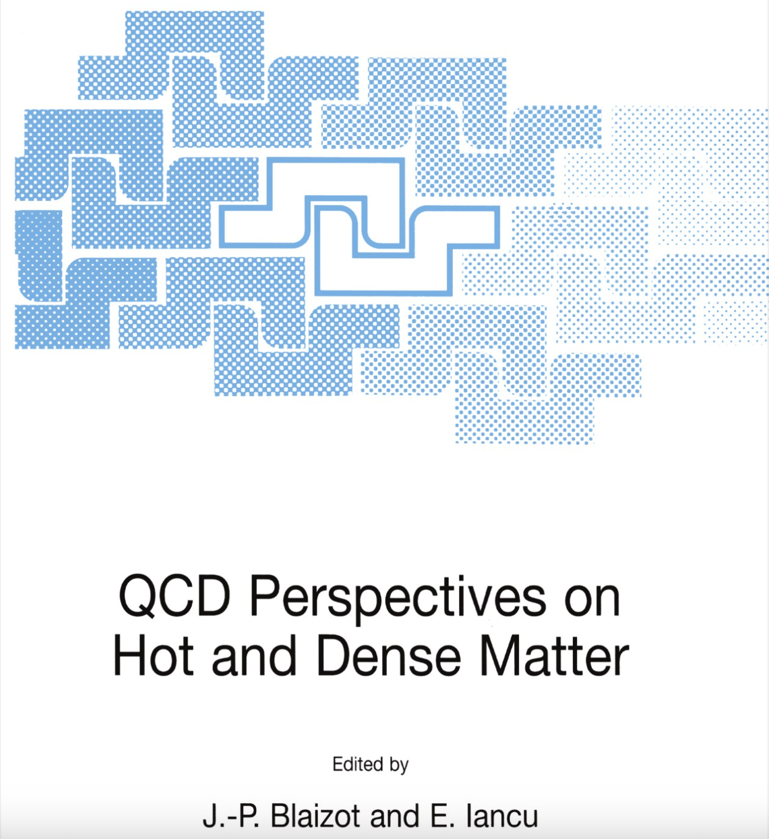


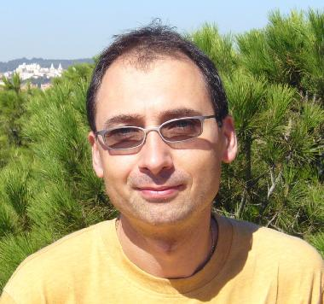
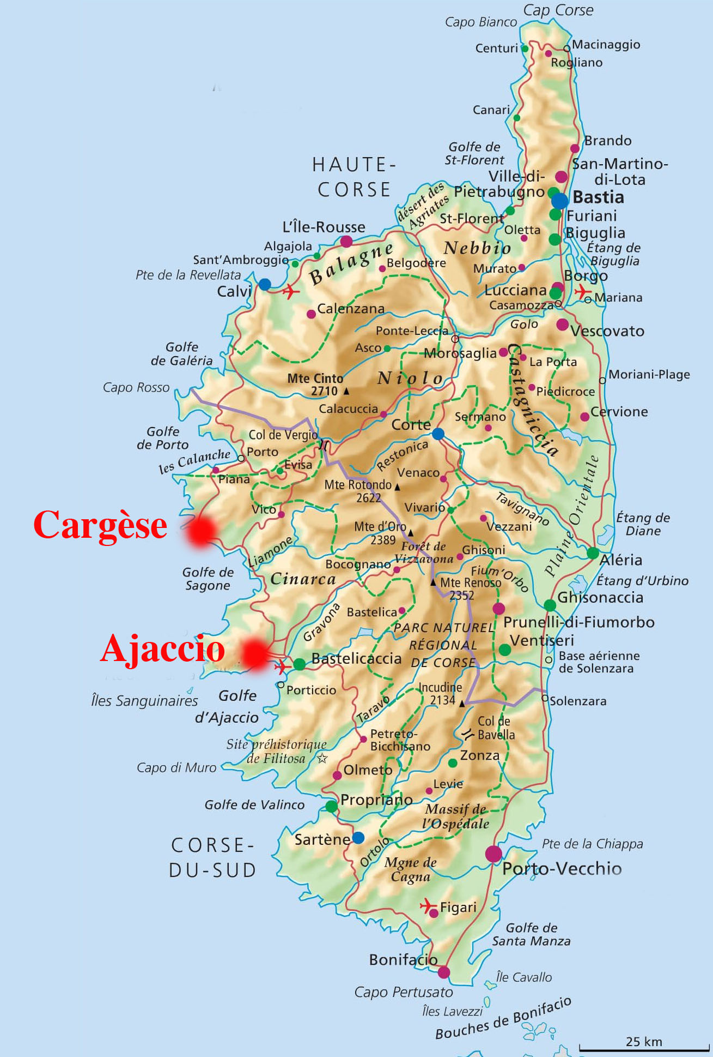
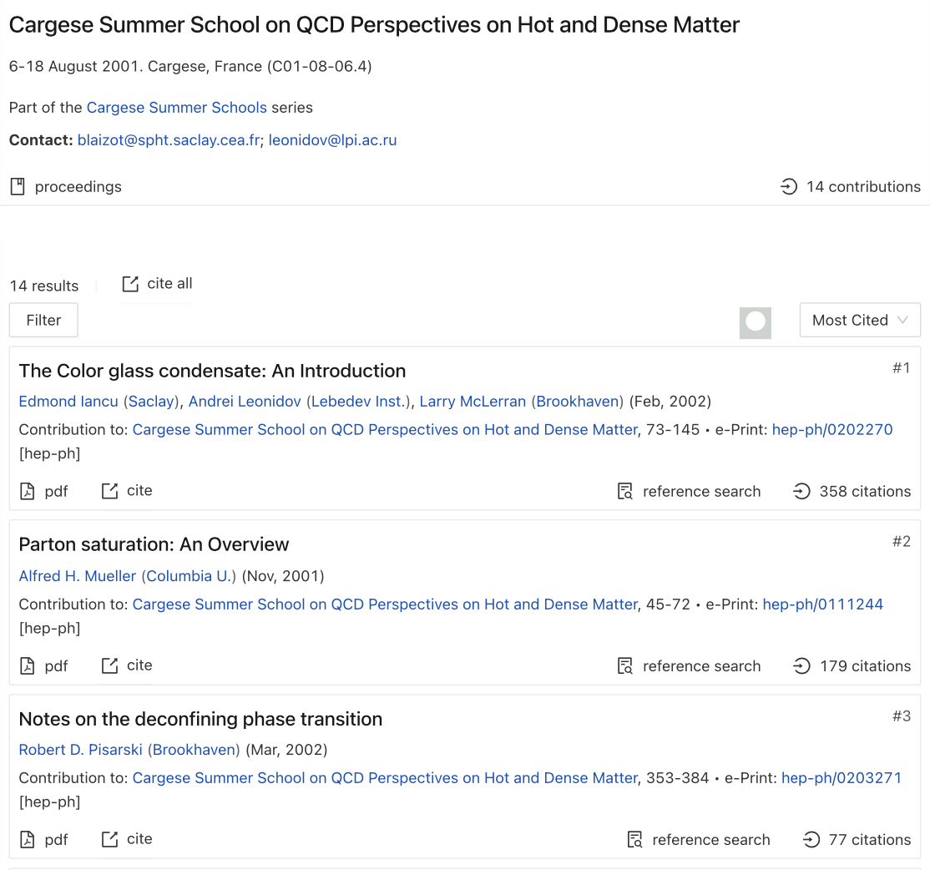
Cargese Summer School
6-18 August 2001

Slide 3
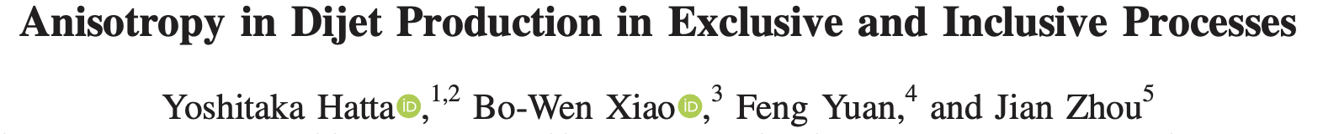
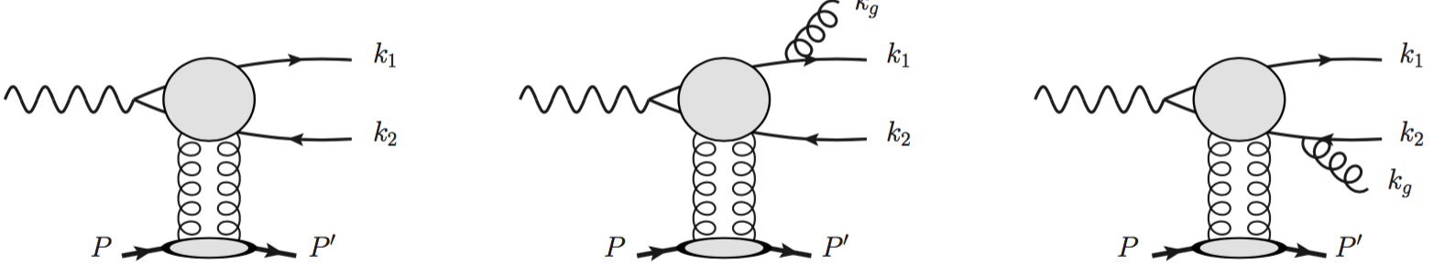
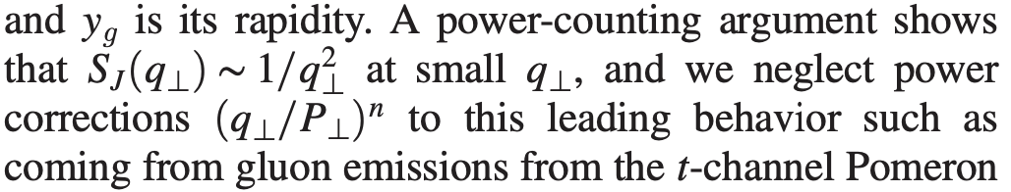
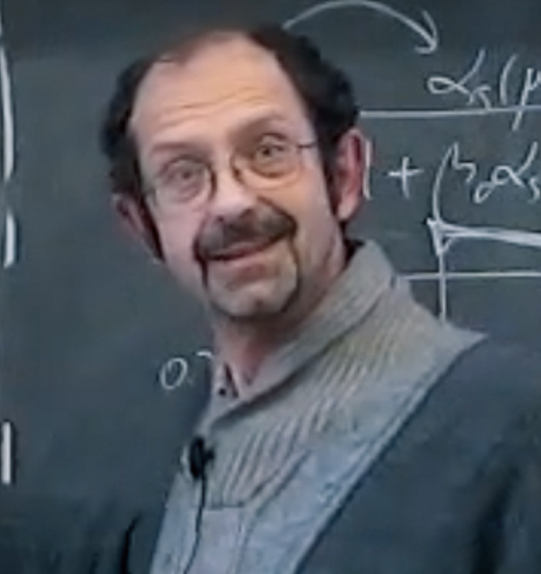
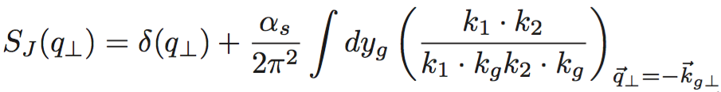
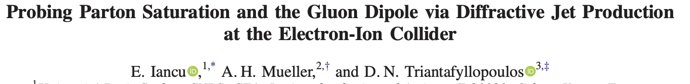
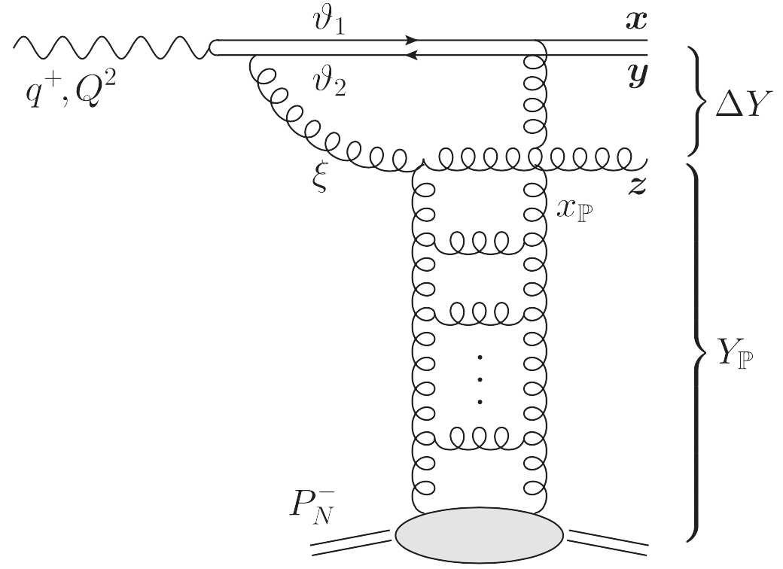
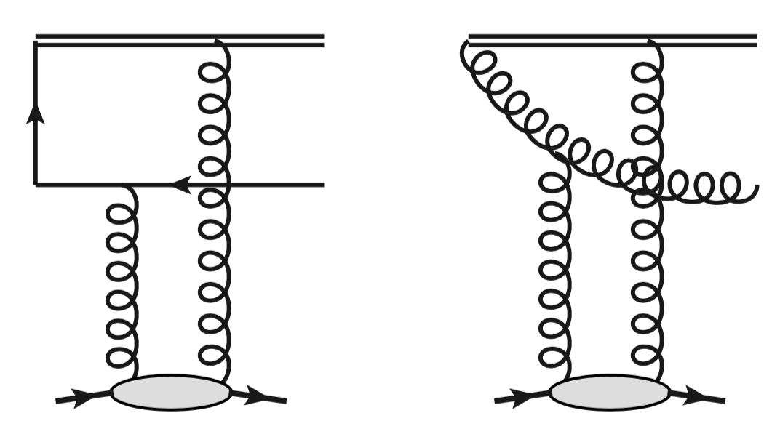
PRL2021
Catani-Grazzini-Sargsyan 2017
PRL2022
Dionysios’ talk
Thursday
Hatta-Xiao-Yuan, 2205.08060, Hatta-Yuan, 2403.19609;

Slide 4
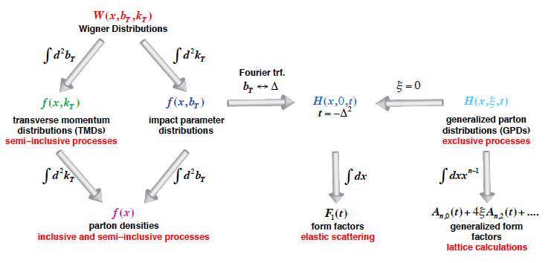
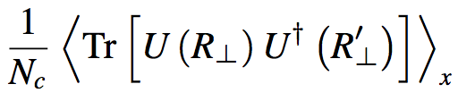
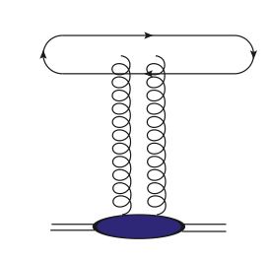
Nucleon/nucleus Tomography and
QCD landscape at small-x
Small-x
Hatta-Xiao-Yuan,1601.01585
earlier: Mueller, NPB 1999

Slide 5
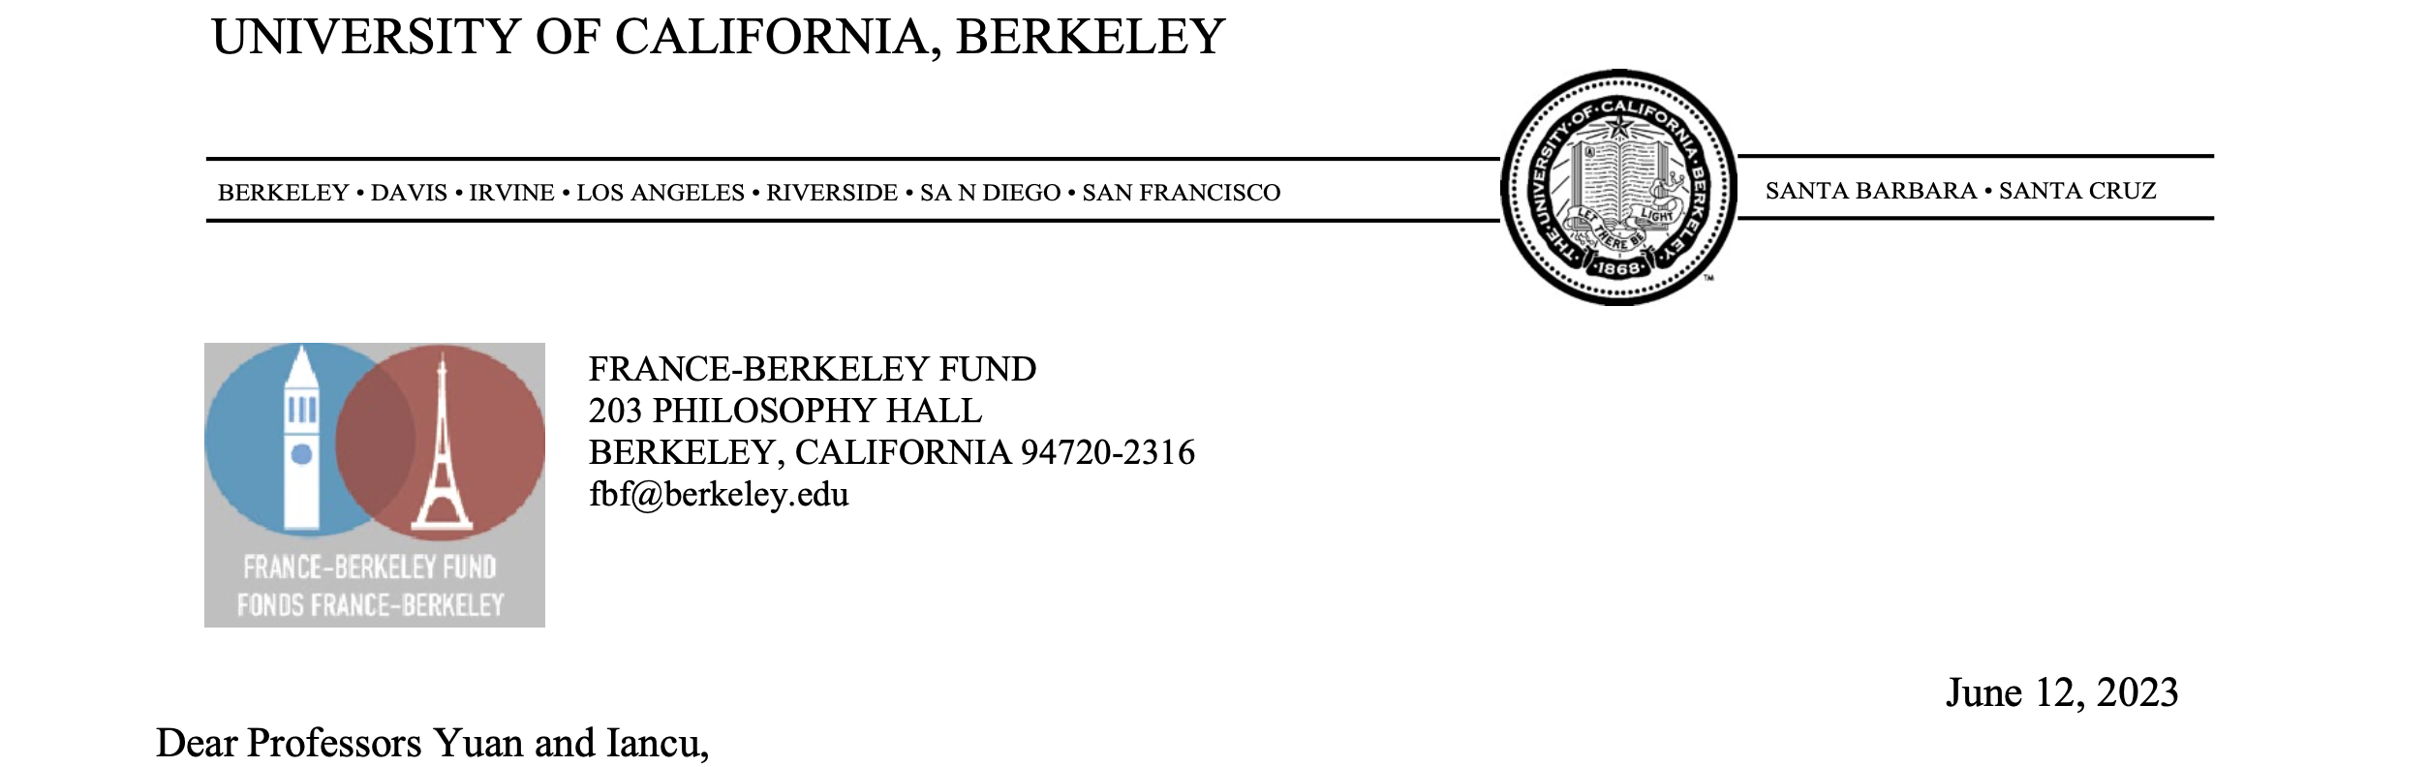
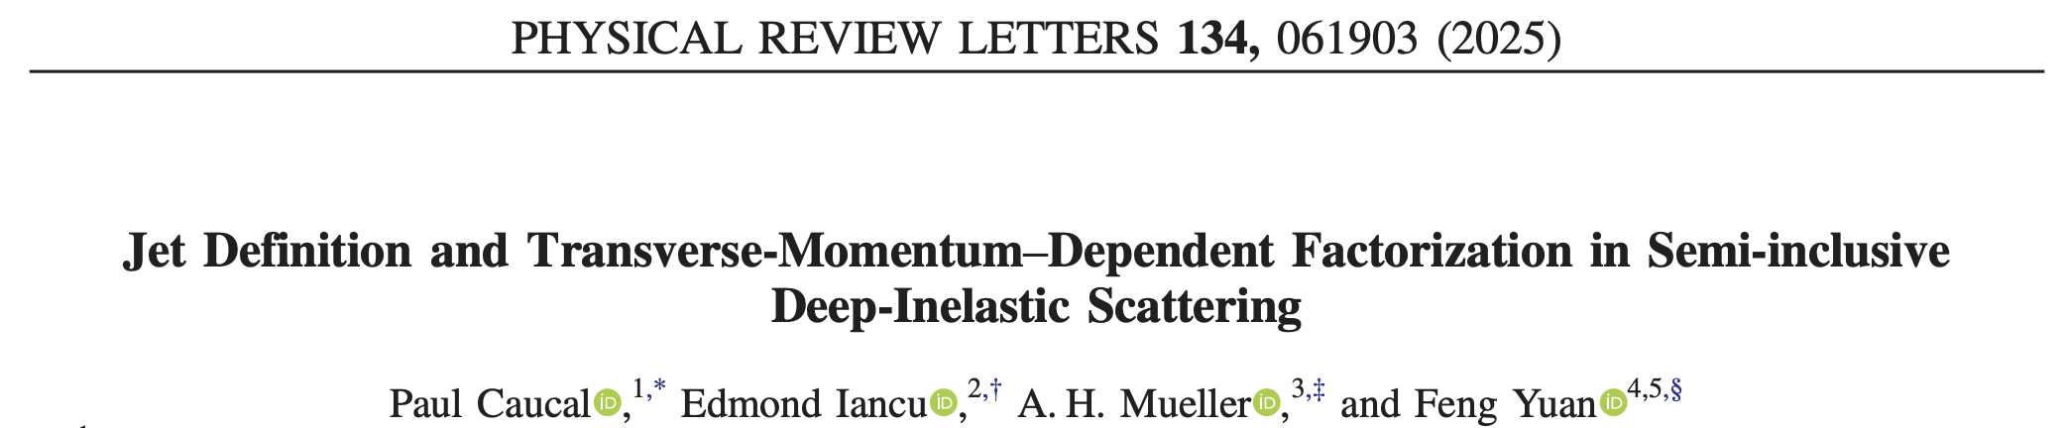

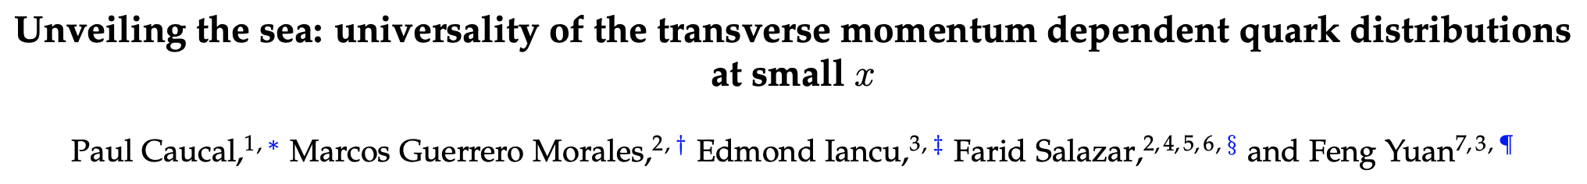
+….

Slide 6
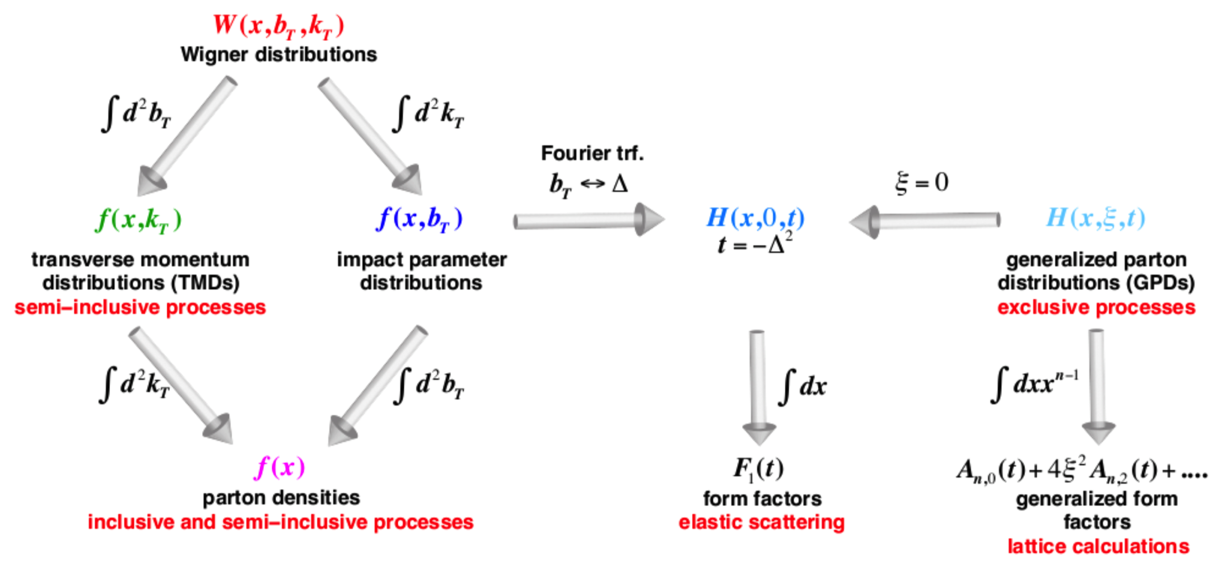
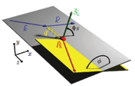
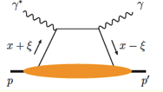
Gravitational Form Factors: important aspect of tomography
Wigner distributions (Belitsky, Ji, Yuan)
5D
3D
1D

Slide 7
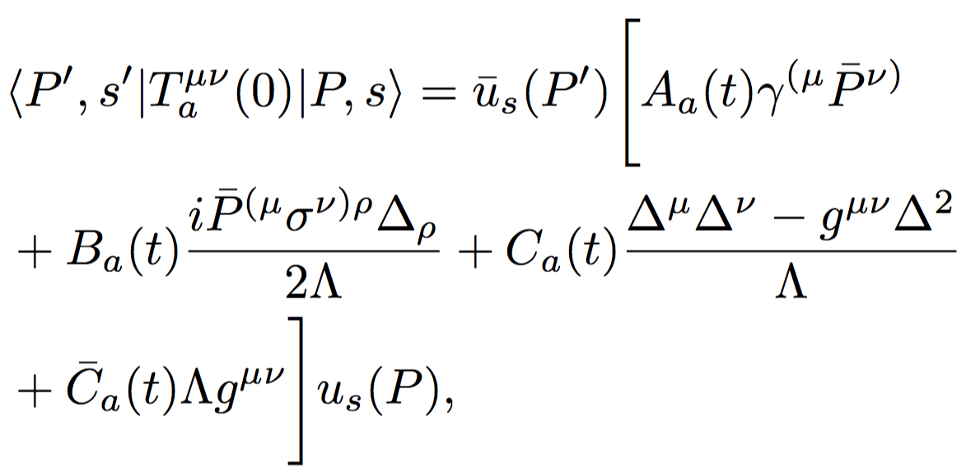
What do we learn
My view: one aspect of the parton tomography in hadrons, because they are part of GPDs
  Proton spin sum rule is derived from these form factors
C-form factors
  Pressure, shear force: Polyakov-Schweitzer 2018
  Momentum-current gravitation multipoles: Ji et al., 2021, 2025
Reconstruct the proton mass
  Ji 1996; Ji 2021; Ji-Liu 2021
  Hatta-Rajan-Tanaka 2018;
  Metz-Pasquini-Rodini 2020

Slide 8
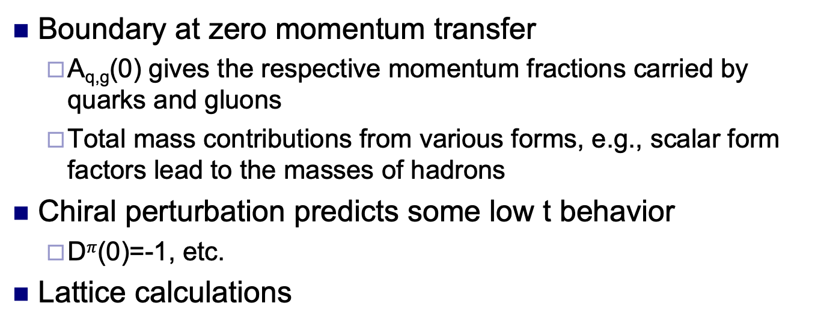
What do we know about GFFs
Boundary at zero momentum transfer
  A_{q,g}(0) gives the respective momentum fractions carried by quarks and gluons
  Total mass contributions from various forms, e.g., scalar form factors lead to the masses of hadrons
Chiral perturbation predicts some low t behavior
  D$π$(0)=-1, etc.
Lattice calculations

Slide 9
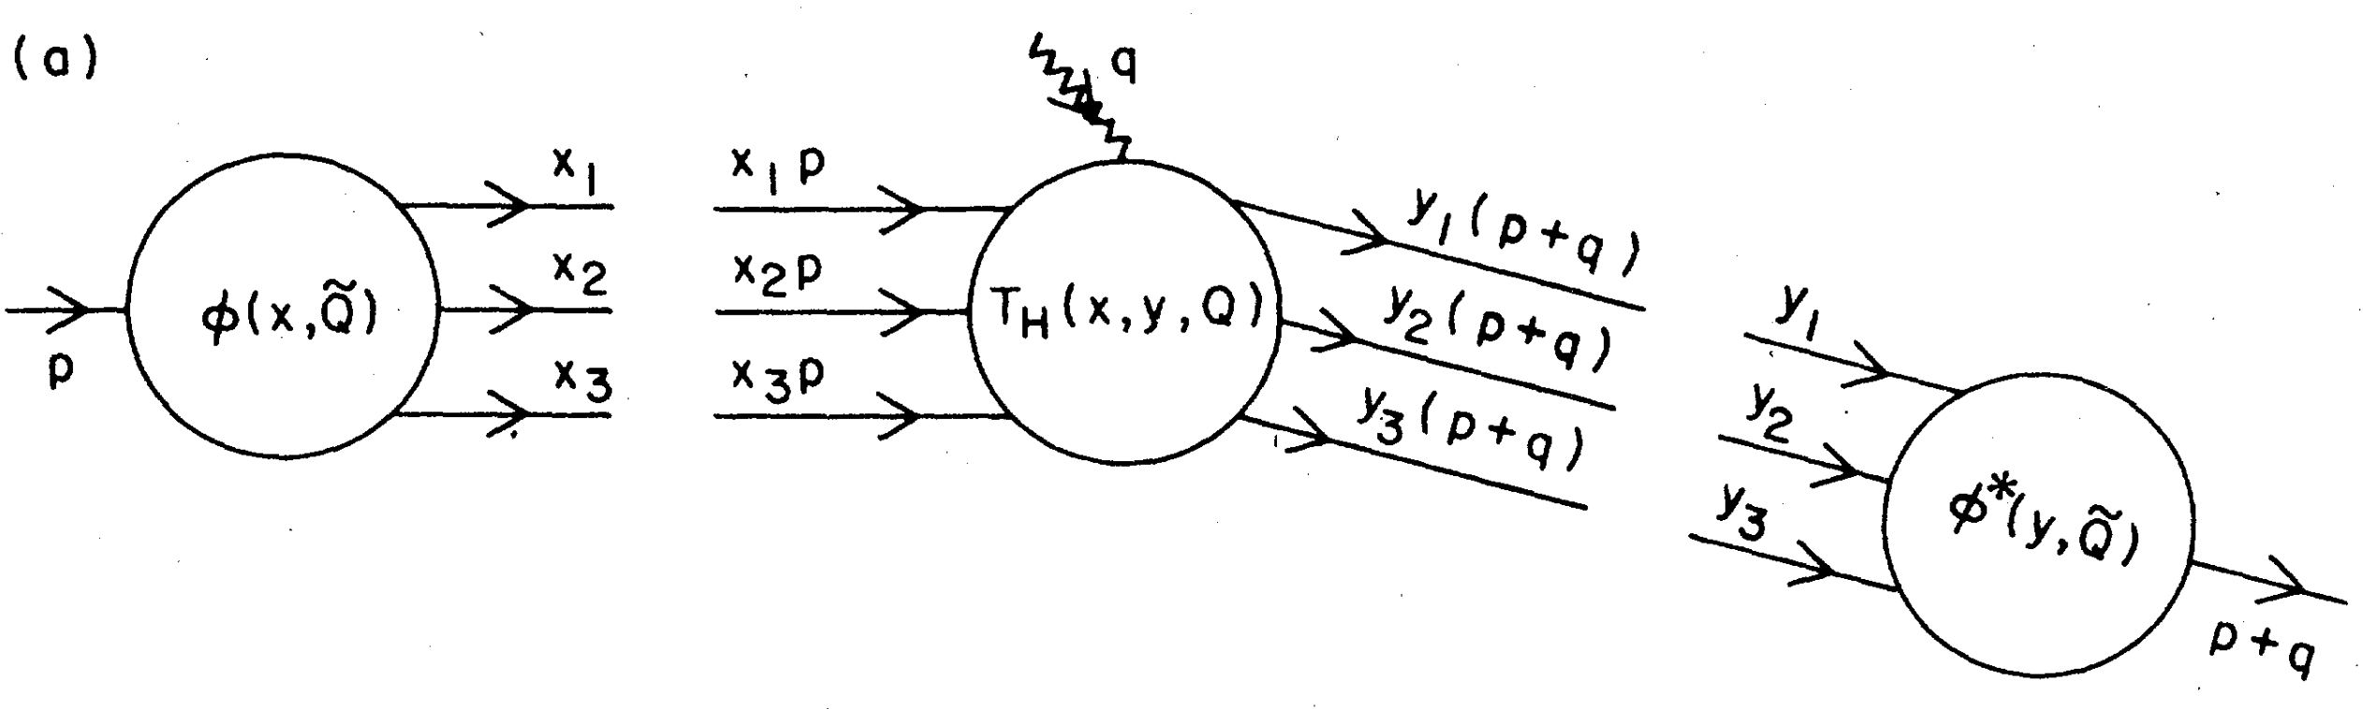
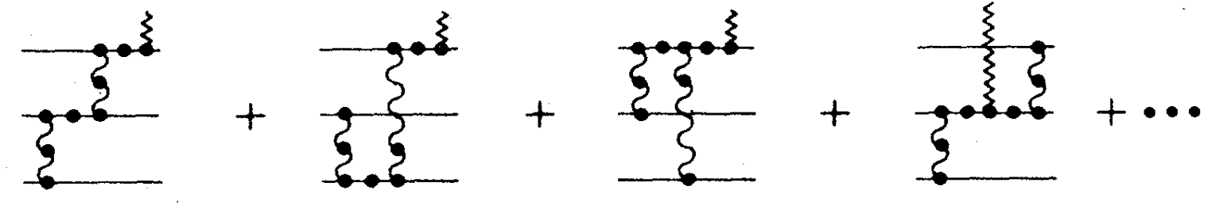
Perturbatively, one can compute the form factors at large momentum transfer
Lepage-Brodsky 1980
Efremov-Radyushkin 1980
Nucleon wave
function
Nucleon wave
function

Slide 10
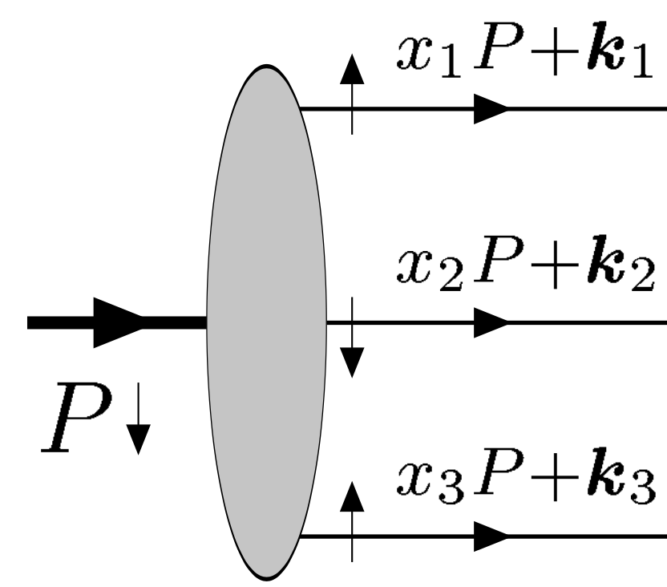
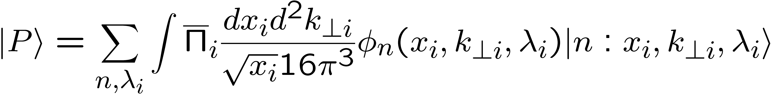
Light-cone Wave Functions
Lepage-Brodsky 1980
They are building blocks for the hadron structure
Fock state of n-partons: momentum fractions, transverse momenta, helicities
Can be used to calculate the form factors, GPDs, and hard exclusive scattering amplitudes

Slide 11
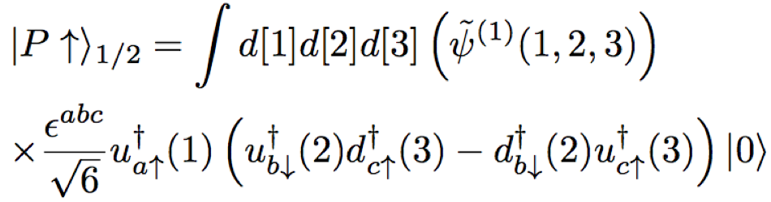
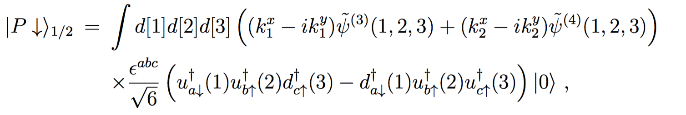
Nucleon’s 3-quarks WF
Ji, Ma, Yuan, 2002
According to the general structure, six independent light-cone wave functions for three quarks component:
L_{z}=0
|L_{z}|=1

Slide 12
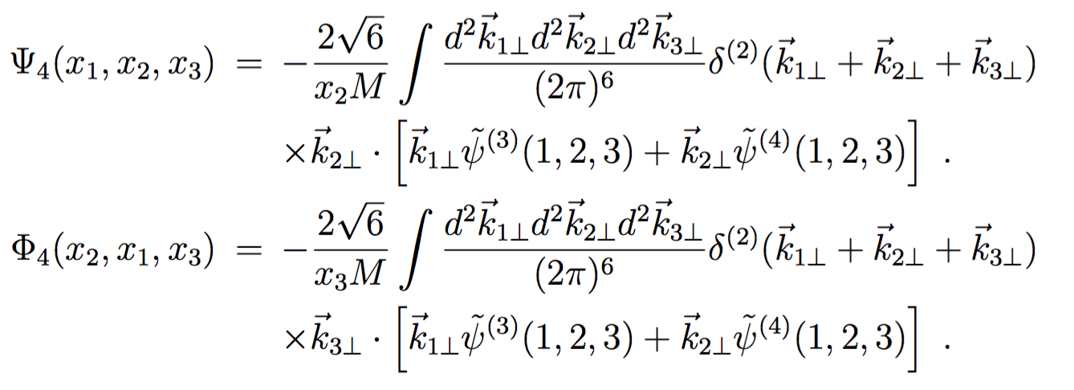
Distribution amplitudes
Integrate out the transverse momentum
  Twist-three (leading-twist)
  Twist-four (Braun-Fries-Mahnke-Stein 2000)

Slide 13
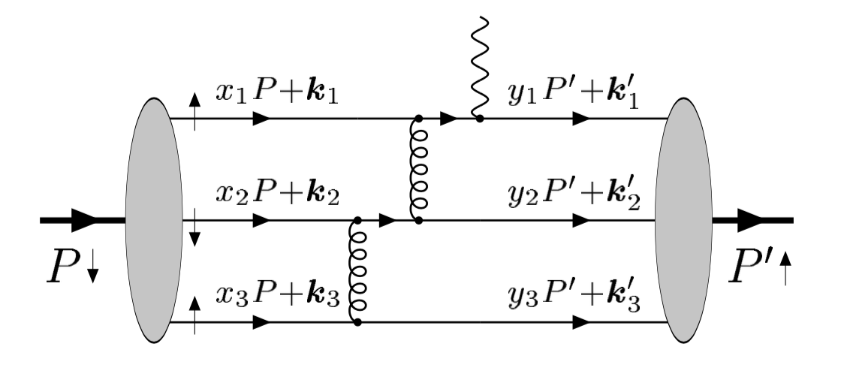
Form factor calculations
Compute the partonic scattering
amplitudes, convert to hadron’s
Leading-twist: direct integration of
k_{t}, higher-twist: need k_{t}-expansion
Two gluon exchanges are needed to generate large momentum transfer
Helicity-non-flip has power behavior, F₁~1/t^2
Helicity-flip amplitude has power behavior, F₂~1/t^3
Brodsky-Lepage 1981 for F₁
Belitsky-Ji-Yuan 2002 for F₂

Slide 14
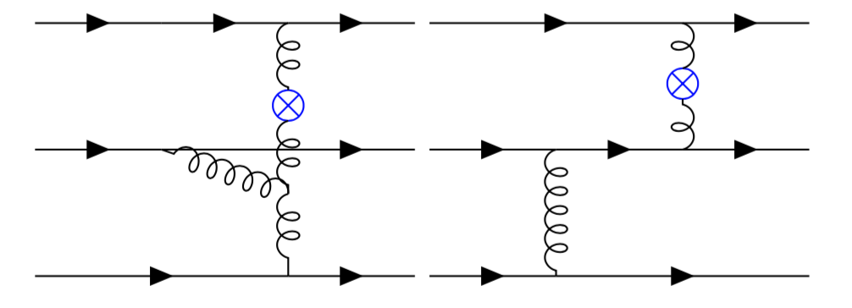
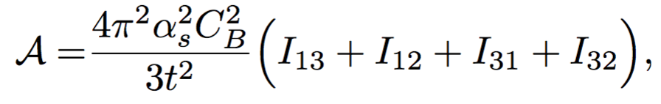
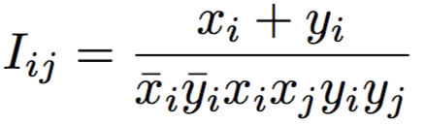
Gravitational FFs
No contribution from three-gluon vertex diagram
A_{g}~1/t^2
B_{g}, C_{g} scale as 1/t^3,Cbar_{g} scales as 1/t^2
Tong-Ma-Yuan, 2103.12047
2203.13493

Slide 15
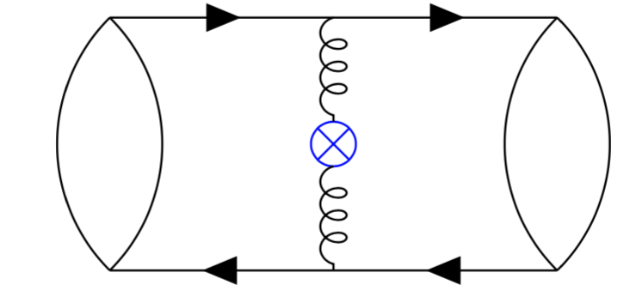
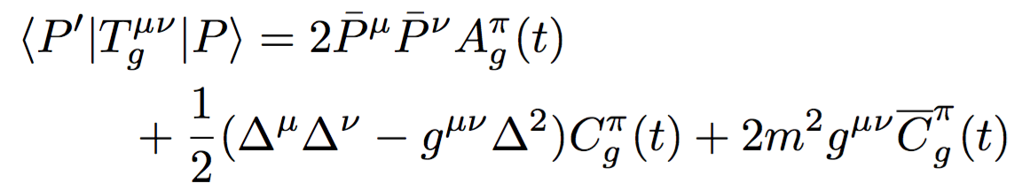
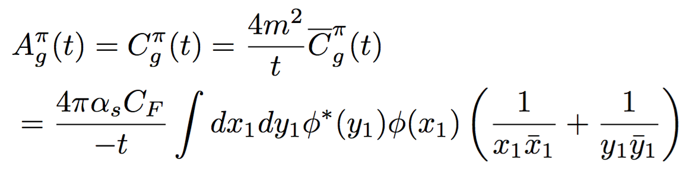
Gravitational form factors for Pions:
No much difference, only some surprises
Pion case
  A_{g}=C_{g}!!
  Cbar cancels between quarks and gluons
    Quark part from GPD quark at large-t (Hoodbhoy-Ji-Yuan 2003)
Tong-Ma-Yuan, 2103.12047;
earlier work: Tanaka, PRD 2018
May introduce difficulty in the
interpretation, since integral over
t is not convergent
Polyakov-Schweitzer 2018
Freese-Miller 2021

Slide 16
Implication: Mass distribution of hadrons
(F² term)

Slide 17
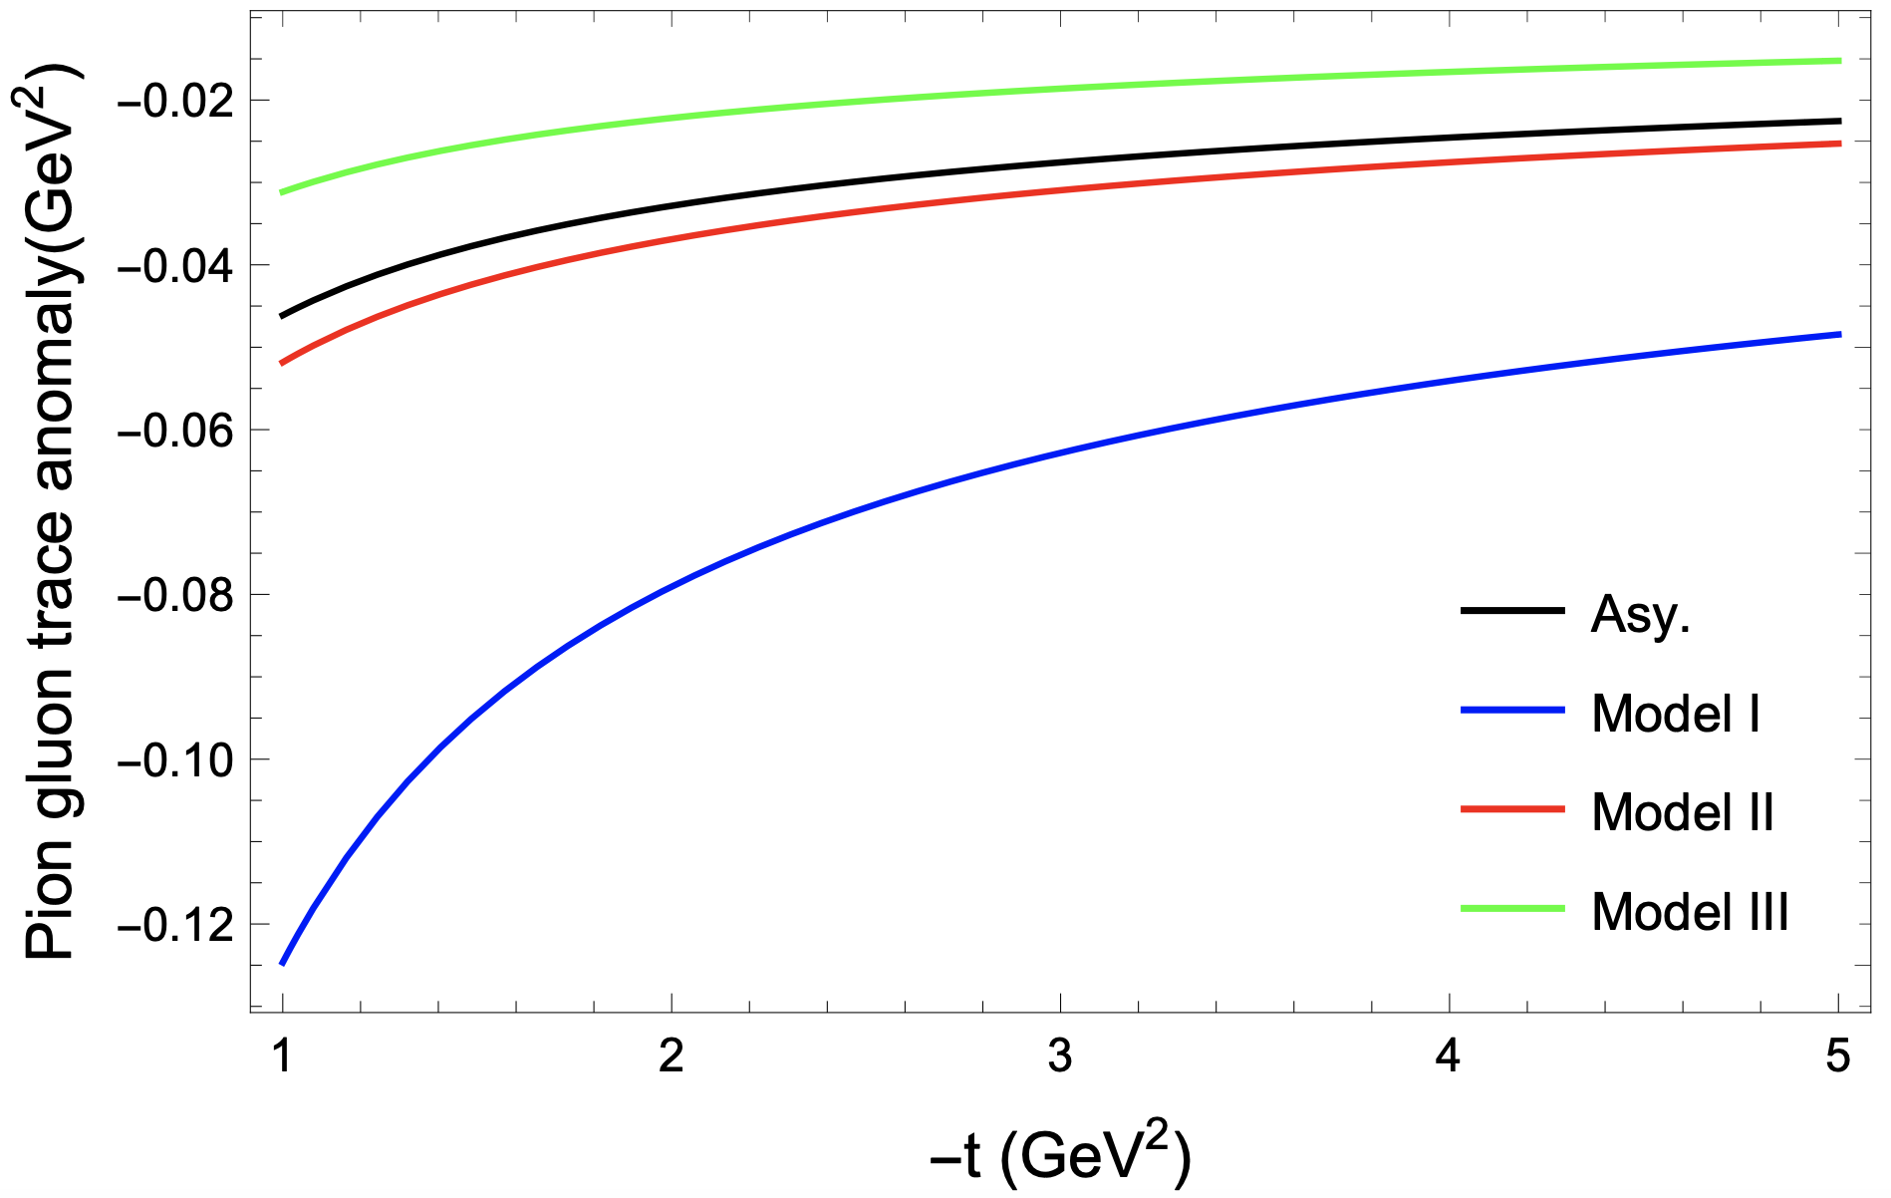
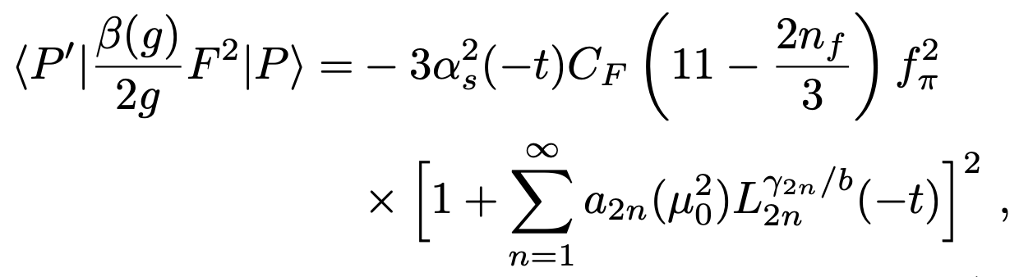
Scalar form factor of Pion
In the perturbative region:
See also: X. Gao et al, 2206.04084

Slide 18
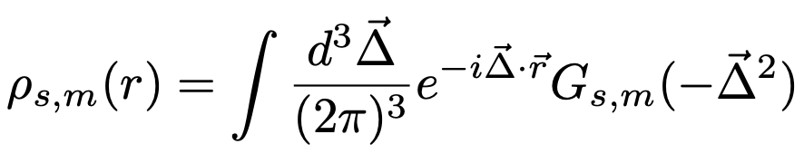

Parameterization at low-t from lattice calculations:
$$r2ρs(r)$$
Form factor
Pert. region
Changes sign around 0.4fm
See also, lattice simulation:
He et al, 2101.04942

Slide 19
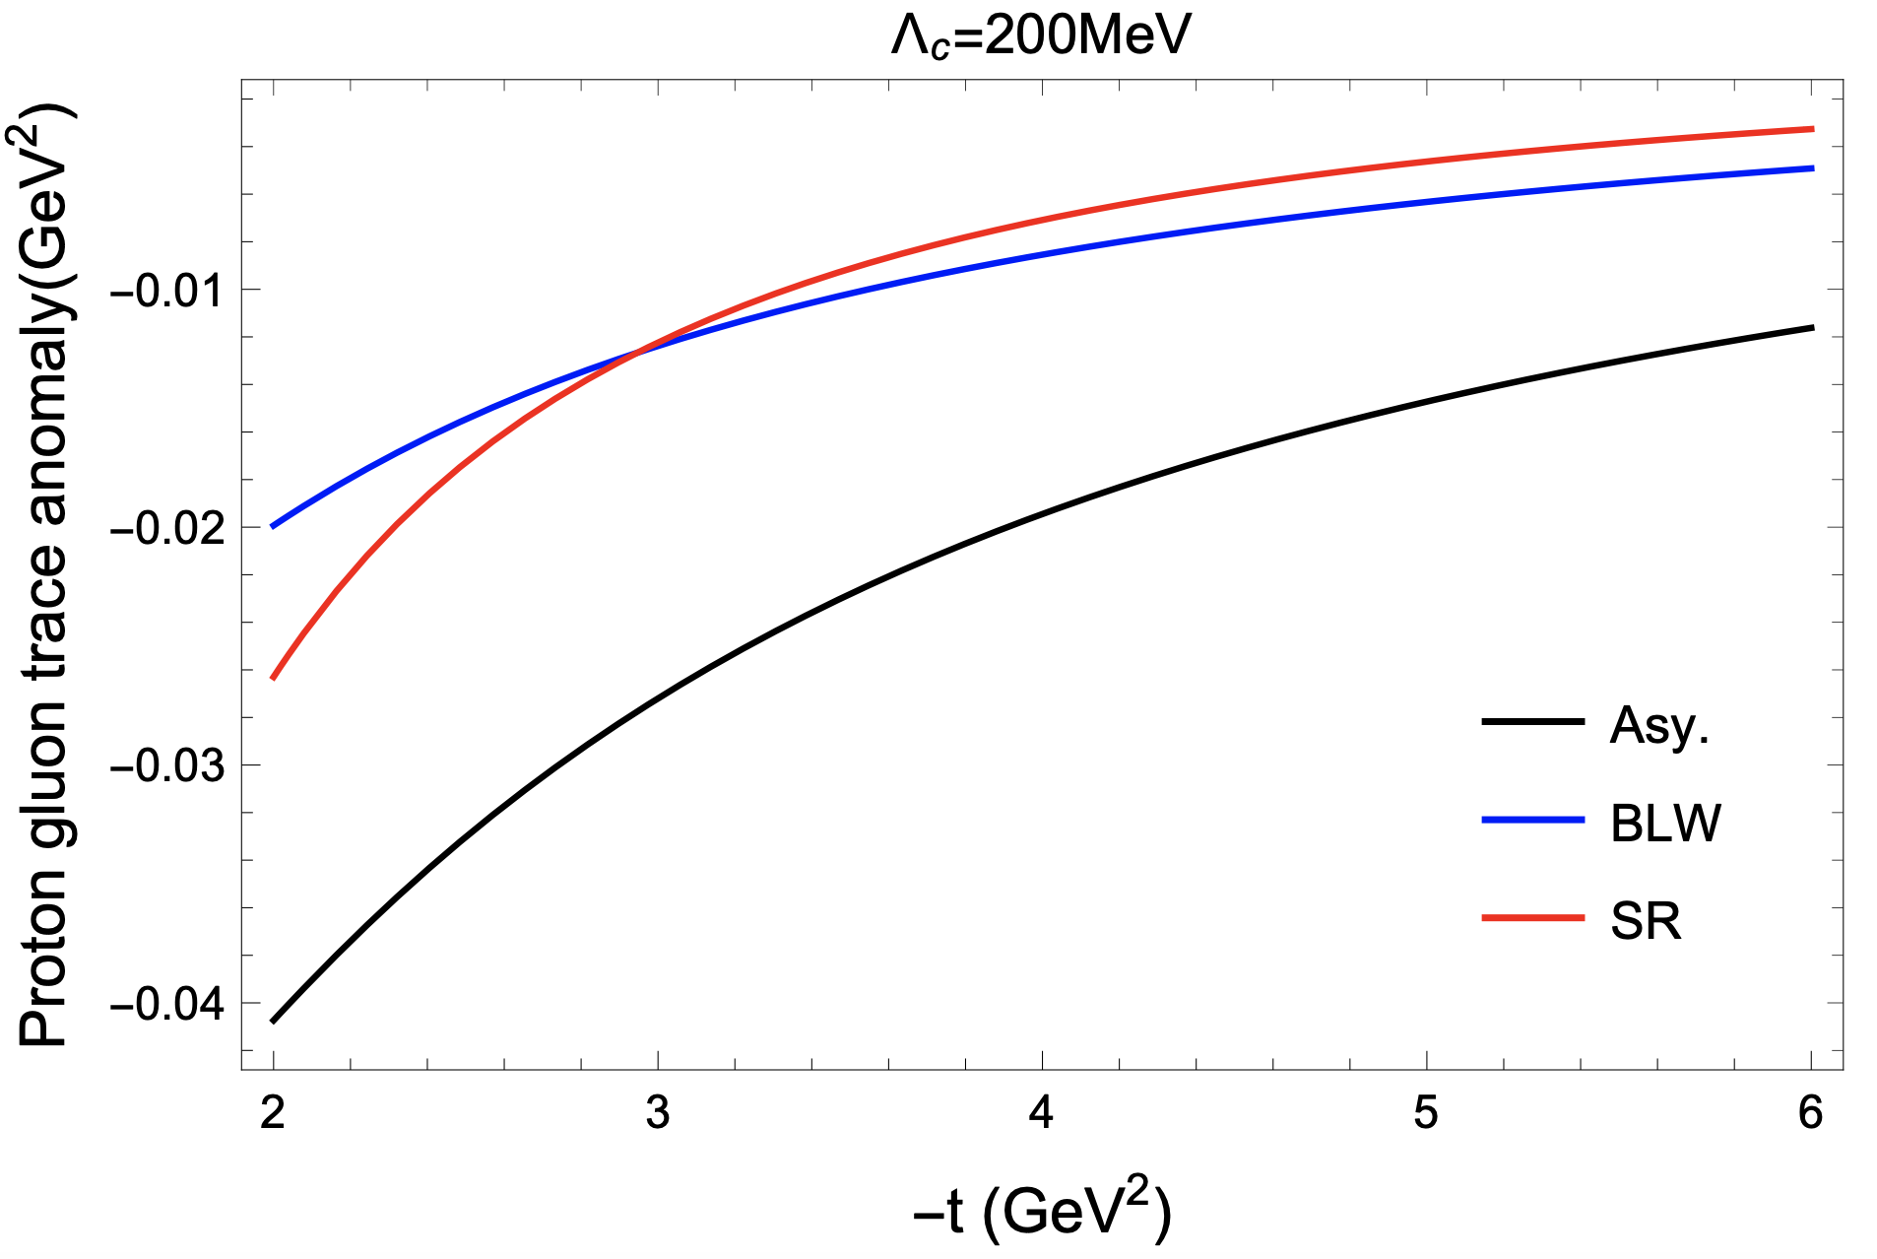
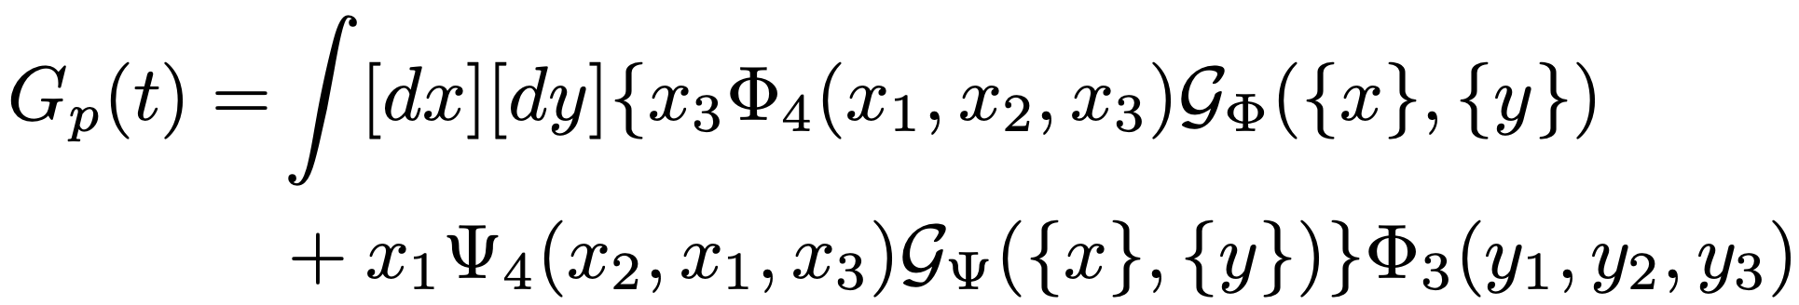
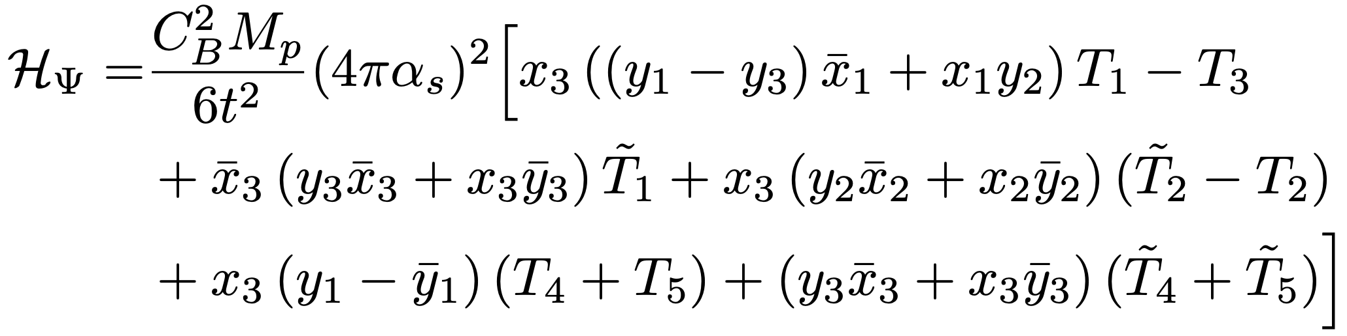
Scalar form factor of Nucleon
In the perturbative region:

Slide 20

Parameterization at low-t from lattice calculations
$$ρs(r)$$
Pert. region

Slide 21
Only if we have strong gravity, ☺
Photon
Graviton
EM current
Energy-Momentum
current
Kobzarev-Okun 1992;
Pagels 1966; Ji 1997

Slide 22
How to measure the GFFs: through DPDs
Wigner distributions (Belitsky, Ji, Yuan)
5D
3D
1D

Slide 23
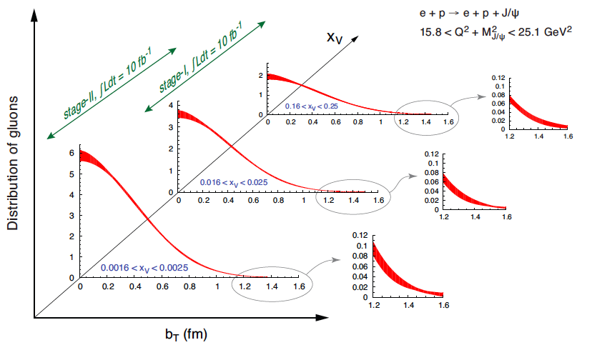
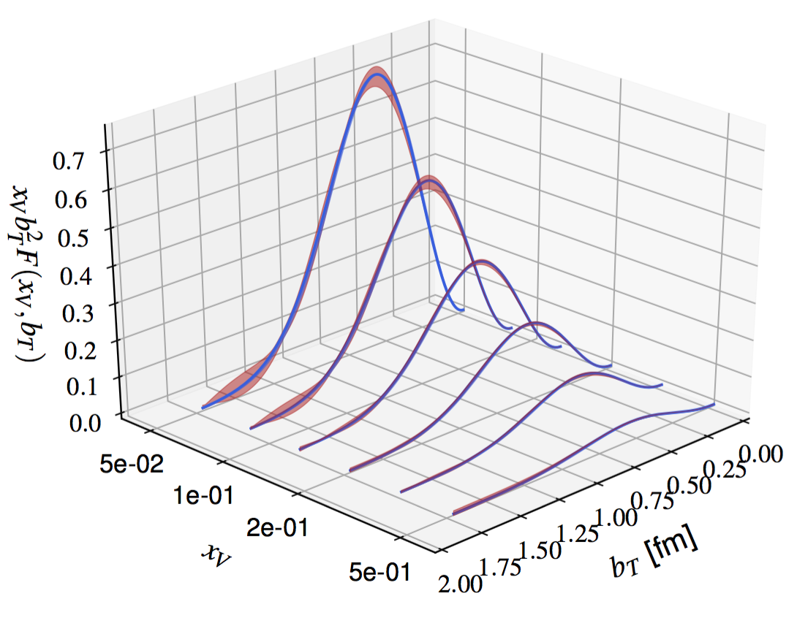
Alternatively: small-x and large-x
EIC-White paper, arXiv:1212.1701
Joosten, Meziani, 1802.02616

Slide 24
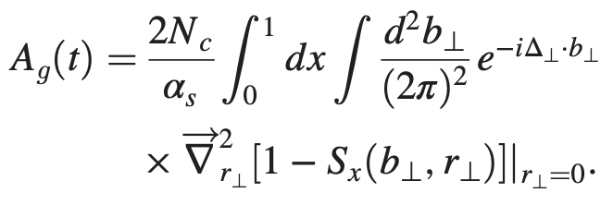
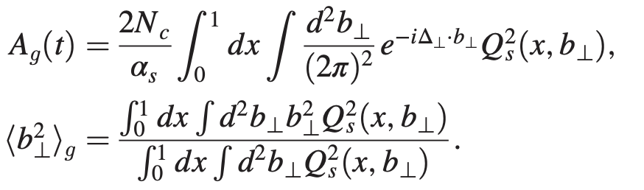


CGC Calculations at small-x
Taking $ξ=0$, with impact parameter dependence→ t-dependence
HERA data imply:
Hagiwara-Tong-Xiao, 2401.12840

Slide 25
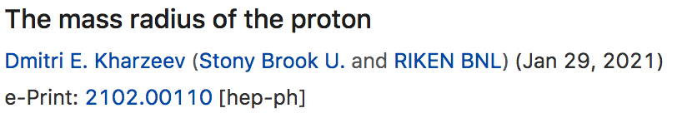
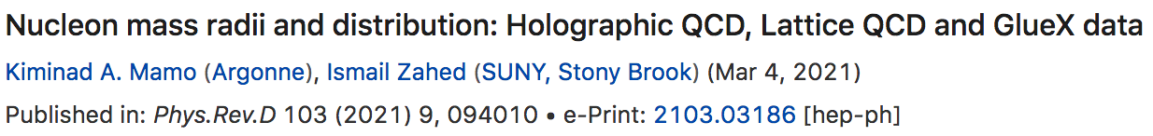


Large-x: Near threshold: the proton mass distribution/mass radius is one of focuses
The analysis depends on models
  Vector meson dominance model
  Holographic model

Slide 26



Kharzeev’s Proposal
Kharzeev, 1996, 2021
Kharzeev et al., 1999
Vector meson dominance: photon transition to heavy quarkonium
The amplitude proportional to heavy quarkonium-nucleon interaction
  Applying OPE, lowest order gluonic operator contributes
    Peskin 1979; Luke-Manohar-Savage 1992; Kharzeev 1996; Wang-Yuan 2001

Slide 27

Rutherford scattering with heavy quarkonium
Graviton
X
The QCD dynamics involved in the on-shell photon (massless) transition to a massive heavy quarkonium does not allow a simple interpretation

Slide 28









Near-threshold J/$ψ$ photo-production to probe GPDs
CFF
GPD
GPD
GFF
Y. Guo et. al. Phys. Rev. D 103 9, 096010
Earlier references in GPD formalism:
Hoodbhoy 1996;
Koempel-Kroll-Metz-Zhou 2012 and references therein
We can then extract the GFFs from the gCFFs, utilizing the large skewness kinematics in the near-threshold region in the heavy quark limit.

Slide 29


Taylor expansion of the hard coefficient
Only the leading term corresponds to the gluonic gravitational form factors
Boussarie-Hatta 2020;
Hatta-Strikman 2021;
Guo-Ji-Liu 2021;

Slide 30






Systematics of large-$ξ$ expansion
Model
Radyushkin 1999
Guo-Ji-Yuan, PRD109.014014 (2024)

Slide 31





Next-leading order
Guo-Yuan-Zhao, 2501.10532
References for NLO GPD calculations:
Ivanov-Schafer-Szymanowski-Krasnikov,
hep-ph/0401131;
Chen-Qiao, 1903.00171.
Flett-Gracey-Jones-Teubner, 2105.07657

Slide 32


Combined fit to the exp. and lattice
Bayesian Inferring Nucleon's Gravitation Form Factors via
Near-threshold J/ψ Photoproduction, Guo-Yuan-Zhao, 2501.10532
With ξ > 0.5 data
Guo et. al. Phys. Rev. D 108, 034003 (2023)
Lattice: Pefkou et. al. Phys. Rev. D 105, 054509 (2022), Phys. Rev. Lett. 132, 251904 (2024)

Slide 33


DVCS and other hard exclusive processes
Quark GPDs and GFFs
Hatta-Schoenleber, 2502.12061

Slide 34
Conclusion and Looking forward
Small-x and large-x provide complementary constraints on the gluonic gravitational form factors
With high precision data from current and near-future experiments at Jlab and EIC, we need to improve the theory precision
  Carry out higher order perturbative QCD corrections (NLO+NNLO+..)
  Implement unbiased analysis: extending to wider kinematics; including more processes in the fit (DVCS, other mesons)

Slide 35

Happy Birthday, Edmond!

Slide 36


Nucleon gravitational form factors
DVCS exp.
Lattice
Burkert, Elouadrhiri, Girod,
Nature 2018
Shanahan, Detmold, PRL 2019

Slide 37






Finite size of nucleon
(charge radius)
Rutherford scattering with electron
Hofstadter
Extended target
RevModPhys.28.214

Slide 38


Proton charge radius and form factors
PRad: Xiong et al, Nature 575 (2019) 147
Christy et al., PRL 2022

