Slide 1

Revealing the Mass
At the Heart of Matter
Craig Roberts

Slide 2
Collaborators: 2015-Present
Students, Postdocs, Profs.
Daniele Binosi (ECT*)
Stan Brodsky (SLAC);
Volker Burkert (Jlab)
Lei Chang (Nankai U. ) ;
Xiao-Yun Chen (Jinling Inst. Tech., Nanjing)
Bruno El-Bennich (São Paulo);
Tanja Horn (Catholic U. America)
Yu-Xin Liu (PKU);
Joannis Papavassiliou (U.Valencia)
M. Ali Paracha (NUST, Islamabad)
Jia-Lun Ping (Nanjing Normal U.)
Si-xue QIN (Chongqing U.);
Jose Rodriguez Quintero (U. Huelva) ;
Sebastian Schmidt (IAS-FZJ & JARA);
Peter Tandy (KSU);
Shaolong Wan (USTC) ;
Qing-Wu Wang (SICHUAN U)
Pei-Lin Yin (NJUPT)
Hong-Shi Zong (Nanjing U)
Ya LU (Nanjing U.)
Zhao-Qian YAO (Nanjing U.)
Yin-Zhen XU (Nanjing U.)
Chen CHEN (UNESP - São Paulo, USTC & IIT);
Muyang CHEN (NKU, PKU)
Zhu-Fang CUI (Nanjing U.) ;
J. Javier COBOS-MARTINEZ (U Michoácan);
Minghui DING (ANL, Nankai U.) ;
Fei GAO (Valencia, Peking U.) ;
L. Xiomara GUTIÉRREZ-GUERRERO (MCTP)
Bo-Lin LI (Nanjing U.)
Cédric MEZRAG (INFN-Roma) ;
Khépani RAYA (U. Huelva, U Michoácan);
Eduardo ROJAS (Antioquia U.)
Jorge SEGOVIA (IFAE&BIST, Barcelona);
Chao SHI (ANL, Nanjing U.)
Shu-Sheng XU (Nanjing U.)
Adnan Bashir (U Michoácan);

Slide 3
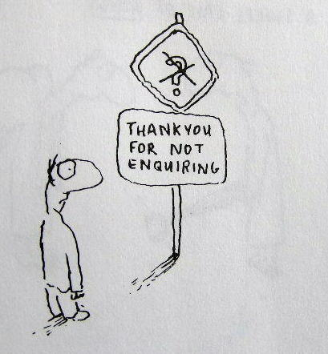
Enigma of Mass

Slide 4
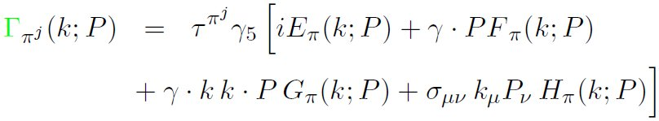

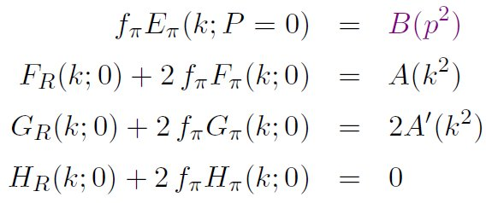
Pion’s Goldberger
-Treiman relation
Maris, Roberts and Tandy
nucl-th/9707003, Phys.Lett. B420 (1998) 267-273
Pion’s Bethe-Salpeter amplitude
Solution of the Bethe-Salpeter equation
Dressed-quark propagator
Axial-vector Ward-Takahashi identity entails
B(k²)
Owing to DCSB
& Exact in
Chiral QCD
Miracle: two body problem solved, almost completely, once solution of one body problem is known

Slide 5
The most fundamental expression of Goldstone’s Theorem and DCSB
Rudimentary version of this relation is apparent in Nambu’s Nobel Prize work
Model independent
Gauge independent
Scheme independent
f_{π} E_{π}(p²) = B(p²)

Slide 6
Pion exists if, and only if, mass is dynamically generated
Rudimentary version of this relation is apparent in Nambu’s Nobel Prize work
Model independent
Gauge independent
Scheme independent
f_{π} E_{π}(p²)⇔ B(p²)

Slide 7

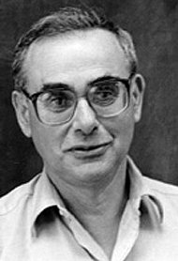
Enigma of mass
f_{π} E_{π}(p²) = B(p²)
This algebraic identity is why QCD’s pion is massless in the chiral limit
The quark level Goldberger-Treiman relation shows that DCSB has a very deep and far reaching impact on physics within the strong interaction sector of the Standard Model; viz.,
  Goldstone's theorem is fundamentally an expression of equivalence between the one-body problem and the two-body problem in the pseudoscalar channel.
This emphasises that Goldstone's theorem has a pointwise expression in QCD
Hence, pion properties are an almost direct measure of
the dressed-quark mass function.
Thus, enigmatically, the properties of the massless pion
are the cleanest expression of the mechanism that is
responsible for almost all the visible mass in the universe.

Slide 8
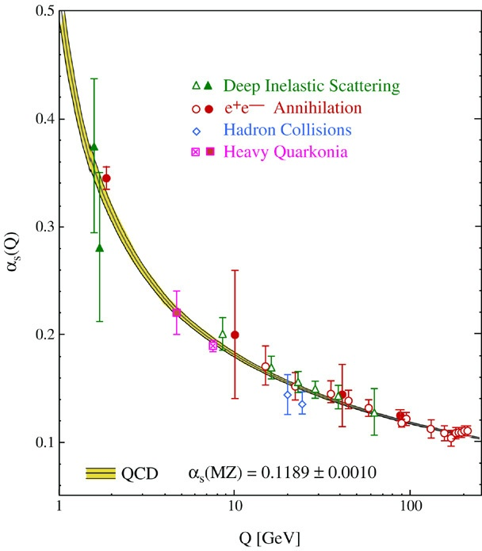
QCD’s Running Coupling
⇐
What’s happening
out here?!

Slide 9
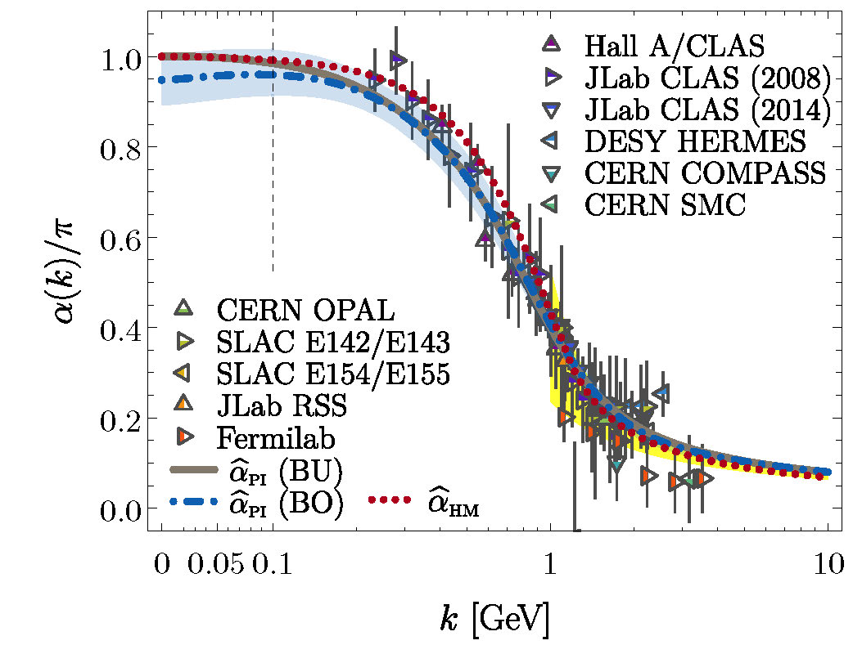
Process-independent effective-charge in QCD
Process independent strong running coupling
Binosi, Mezrag, Papavassiliou, Roberts, Rodriguez-Quintero
arXiv:1612.04835 [nucl-th], Phys. Rev. D 96 (2017) 054026/1-7
Modern continuum & lattice methods for analysing gauge sector enable
“Gell-Mann – Low”
  running charge to be defined in QCD
Combined continuum and lattice analysis of QCD’s gauge sector yields a parameter-free prediction
N.B. Qualitative change in α̂_{PI}(k) at k ≈ ½ m_{p}
=gluon mass-scale

Slide 10

QCD Effective Charge
Process independent strong running coupling
Binosi, Mezrag, Papavassiliou, Roberts, Rodriguez-Quintero
arXiv:1612.04835 [nucl-th], Phys. Rev. D 96 (2017) 054026/1-7
The QCD Running Coupling,
A. Deur, S. J. Brodsky and G. F. de Teramond,
Prog. Part. Nucl. Phys. 90 (2016) 1-74
Near precise agreement between process-independent α̂_{PI} and α_{g1}
and α̂_{PI} ≈ α_{HM}
Perturbative domain:
difference = (1/20) α_{M̅S̅}²
Parameter-free prediction:
  curve completely determined by results obtained for gluon & ghost two-point functions using continuum and lattice-regularised QCD.
Data = process dependent effective charge:
α_{g1}, defined via Bjorken Sum Rule

Slide 11
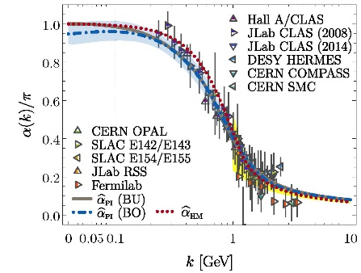
QCD Effective Charge
α̂_{PI} is a new type of effective charge
  direct analogue of the Gell-Mann–Low effective coupling in QED, i.e. completely determined by the gauge-boson two-point function.
α̂_{PI} is
  process-independent
  appears in every one of QCD’s dynamical equations of motion
  known to unify a vast array of observables
α̂_{PI} possesses an infrared-stable fixed-point
  Nonperturbative analysis demonstrating absence of a Landau pole in QCD
QCD is IR finite, owing to dynamical generation of gluon mass-scale, which also serves to eliminate the Gribov ambiguity
Asymptotic freedom ⇒ QCD is well-defined at UV momenta
QCD is therefore unique amongst known 4D quantum field theories
  Potentially, defined & internally consistent at all momenta

Slide 12
QCD Effective Charge
α̂_{PI} is a new type of effective charge
  direct analogue of the Gell-Mann–Low effective coupling in QED, i.e. completely determined by the gauge-boson two-point function.
α̂_{PI} is
  process-independent
  appears in every one of QCD’s dynamical equations of motion
  known to unify a vast array of observables
α̂_{PI} possesses an infrared-stable fixed-point
  Nonperturbative analysis demonstrating absence of a Landau pole in QCD
QCD is IR finite, owing to dynamical generation of gluon mass-scale, which also serves to eliminate the Gribov ambiguity
Asymptotic freedom ⇒ QCD is well-defined at UV momenta
QCD is therefore unique amongst known 4D quantum field theories
  Potentially, defined & internally consistent at all momenta
Conceivably, therefore,
QCD can serve as a basis
for theories that take physics
beyond the Standard Model

Slide 13

Observing Mass

Slide 14
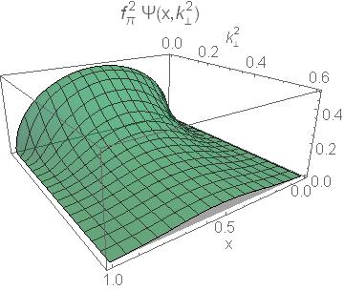
Pion’s Wave Function

Slide 15
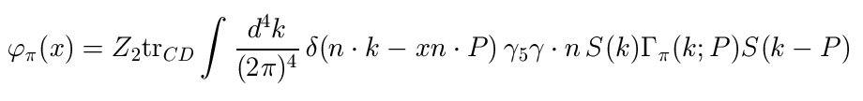
Pion’s valence-quark
Distribution Amplitude
Imaging dynamical chiral symmetry breaking: pion wave function on the light front, Lei Chang, et al., arXiv:1301.0324 [nucl-th], Phys. Rev. Lett. 110 (2013) 132001 (2013) [5 pages].
Methods have been developed that enable direct computation of the pion’s light-front wave function
φ_{π}(x) = twist-two parton distribution amplitude = projection of the pion’s Poincaré-covariant wave-function onto the light-front
Results have been obtained with the DCSB-improved DSE kernel, which unifies matter & gauge sectors
  ϕ_{π}(x) ∝ x^{α} (1-x)^{α}, with α≈0.5

Slide 16
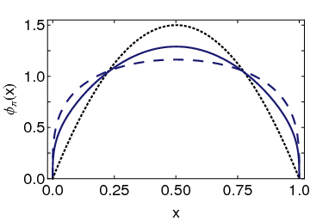
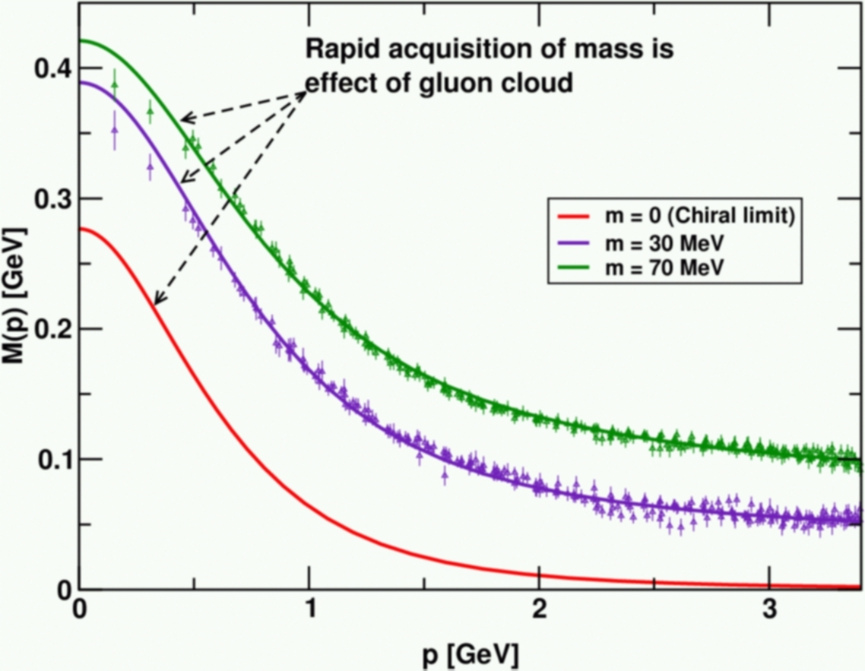
Pion’s valence-quark
Distribution Amplitude
Imaging dynamical chiral symmetry breaking: pion wave function on the light front, Lei Chang, et al., arXiv:1301.0324 [nucl-th], Phys. Rev. Lett. 110 (2013) 132001 (2013) [5 pages].
Prediction:
marked broadening of φ_{π}(x), which owes to DCSB
Conformal QCD
DB
RL
Real-world PDAs are squat and fat
A theory that produces M(p)=constant
also produces φ(x)=constant

Slide 17
Pion Elastic Electromagnetic Form Factor
VMD
These techniques, based on perturbation theory integral representations
  Enable evaluation of F_{π}(Q²) to arbitrarily large Q².
Predict existing JLab data
Identify domain whereupon scaling and QCD scaling violations observable:
Q² > 8 GeV²
EIC projections
JLab12
Realistic PDA
Conformal limit PDA
Predictions can be tested at
  JLab12
  EIC

Slide 18
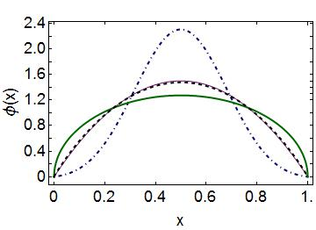
Emergent Mass vs. Higgs Mechanism
Parton distribution amplitudes of S-wave heavy-quarkonia
Minghui Ding, Fei Gao, Lei Chang, Yu-Xin Liu and Craig D. Roberts
arXiv:1511.04943 [nucl-th], Phys. Lett. B 753 (2016) pp. 330-335
When does Higgs mechanism begin to influence mass generation?
limit m_{quark}→ ∞
φ(x) → δ(x-½)
limit m_{quark} → 0
φ(x) ∼ (8/π) [x(1-x)]^{½}
Transition boundary lies just above m_{strange}
Comparison between distributions of light-quarks and those involving strange-quarks is good place to seek signals for strong-mass generation
conformal
c+c_{bar}: Higgs
(weak mass)
s+s_{bar}:
on the border
q+q_{bar}: Emergent
(strong mass)

Slide 19
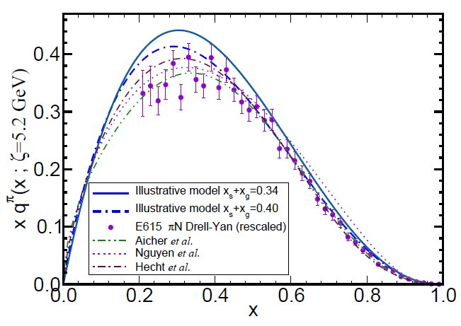
π & K Valence-quark Distribution Functions

Slide 20
π & K PDFs
Extant data on π & K PDFs (mesonic Drell-Yan) is old: 1980-1989
New data would be welcome:
  persistent doubts about the Bjorken-x ≃1 behaviour of the pion’s valence-quark PDF
  single modest-quality measurement of u^{K}(x)/u^{π}(x) cannot be considered definitive.
Approved experiment, using tagged DIS at JLab 12, should contribute to a resolution of pion question
  Similar techniques also serve for the kaon.
Future:
  new mesonic Drell-Yan measurements at modern facilities could yield valuable information on π and K PDFs (COMPASS),
  as could two-jet experiments at the large hadron collider;
  EIC would be capable of providing access to π and K PDFs through measurements of forward nucleon structure functions.
Gribov-Lipatov reciprocity (crossing symmetry) entails connection between PDFs and fragmentation functions on z ≃ 1 (z ≥ 0.75)
    D_{H/q}(z) ≈ z q^{H}(z)
  Reliable information on meson fragmentation functions is critical if the worldwide programme aimed at determining TMDs is to be successful

Slide 21

Valence-quark PDFs within mesons
Basic features of the pion valence-quark distribution function,
Lei Chang, Cédric Mezrag, et al.,
arXiv:1406:5450 [nucl-th], Phys. Lett. B 737 (2014)pp. 23–29
Valence-quark distribution functions in the kaon and pion,
Chen Chen, Lei Chang et al.
arXiv:1602.01502 [nucl-th], Phys. Rev. D93 (2016) 074021/1-11
Compute PDFs from imaginary part of virtual-photon – pion forward Compton scattering amplitude:
    γ π → γ π
Handbag diagram is insufficient. Doesn’t even preserve global symmetries. Exists a class of leading-twist corrections that remedies this defect ⇒
  Similar expressions for u_{V}^{K}(x), s_{V}^{K}(x)
Projection onto light-front
Partial derivative wrt relative momentum
Measurable quantities
Directly related to
dynamically generated quark masses
& bound-state wave functions

Slide 22


Valence-quark PDFs within mesons
Basic features of the pion valence-quark distribution function,
Lei Chang, Cédric Mezrag, et al.,
arXiv:1406:5450 [nucl-th], Phys. Lett. B 737 (2014)pp. 23–29
Valence-quark distribution functions in the kaon and pion,
Chen Chen, Lei Chang et al.
arXiv:1602.01502 [nucl-th], Phys. Rev. D93 (2016) 074021/1-11
Formulae guarantee that valence-quark PDFs satisfy, independent of any and all structural details:
Algebraic proof that at an hadronic scale ζ ≈ 0.5 GeV
    q_{V}^{M}(x ≃ 1) ∝ (1-x)^{2n}
  in any theory with (1/k²)^{n} vector-boson exchange interaction

Slide 23
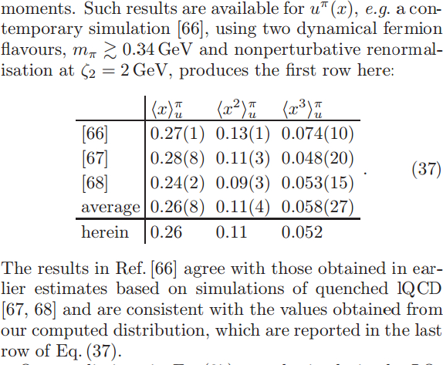
Pion:
DSE comparison with lQCD moments
lQCD studies agree with each other, within errors
[66]: Brommel et al. (2007)
  [67]: Best et al. (1997)
  [68]: Detmold et al. (2003)
DSE and lQCD agree, within errors; and DSE at level of 4% with lQCD-average
On light-front, just 52% of the pion’s momentum is carried by valence-quarks at ζ₂ = 2GeV, down from 65% at ζ_{H}= 0.51GeV

Slide 24
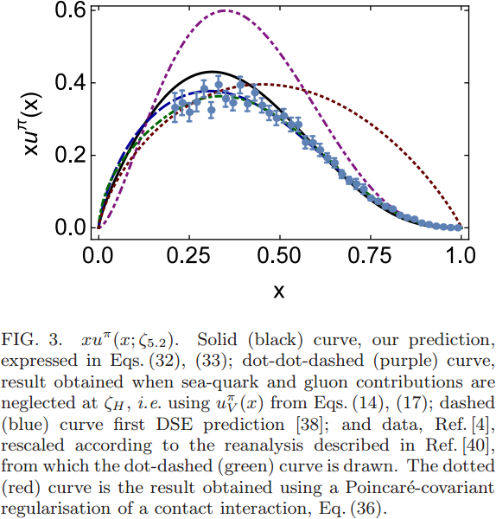
Pion PDF
DSE
2000 2016
Purple dot-dot-dash = prediction at ζ_{H}
Data = modern reappraisal of E615: NLO analysis plus soft-gluon resummation (ASV)
Solid black curve, prediction evolved to ζ=5.2GeV, the scale associated with the experiments
Blue dashed curve = first DSE prediction, in 2000 (ζ=5.2GeV)
Dotted red curve = result obtained with momentum-independent gluon exchange (contact interaction, ζ=5.2GeV)
CI: (1-x)^{1.0±0.1}
ζ=5.2GeV
QCD demands it
& phenomenology should respect that
DSE: (1-x)^{3.0±0.1}

Slide 25
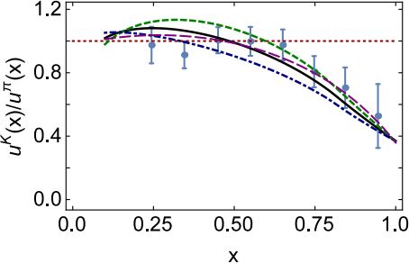

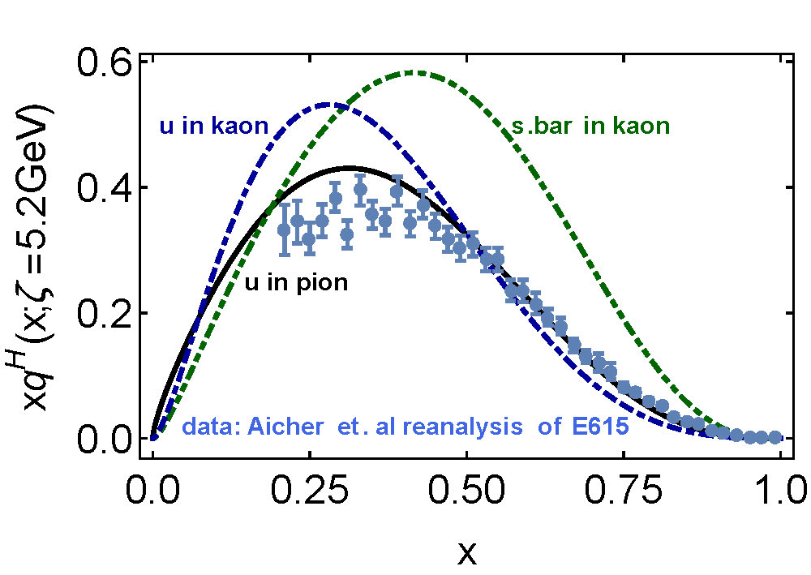
Kaon’s gluon content
0%
10%
〈x〉_{g}^{K}(ζ_{H}) = 0.05 ± 0.05
  ⇒ Valence quarks carry
  95% of kaon’s
  momentum at ζ_{H}
DGLAP-evolved to ζ₂
  Valence-quarks carry ⅔ of kaon’s light-front momentum
  Cf. Only ½ for the pion

Slide 26

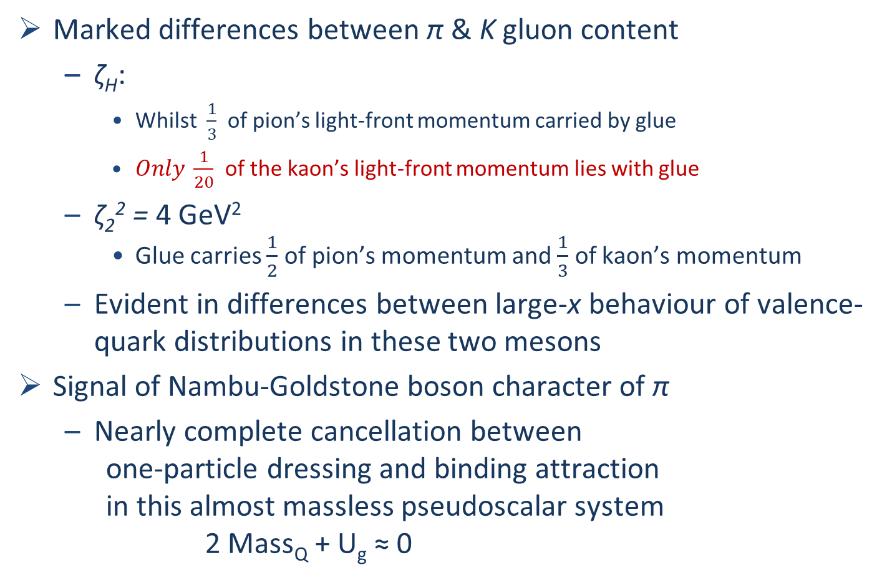
π & K PDFs
Valence-quark distribution functions in the kaon and pion,
Chen Chen, Lei Chang et al.
arXiv:1602.01502 [nucl-th], Phys. Rev. D93 (2016) 074021/1-11
Marked differences between π & K gluon content
  ζ_{H}:
    Whilst $\frac{1}{3}$ of pion’s light-front momentum carried by glue
    $Only \frac{1}{20}$ of the kaon’s light-front momentum lies with glue
  ζ₂² = 4 GeV²
    Glue carries $\frac{1}{2}$ of pion’s momentum and $\frac{1}{3}$ of kaon’s momentum
  Evident in differences between large-x behaviour of valence-quark distributions in these two mesons
Signal of Nambu-Goldstone boson character of π
  Nearly complete cancellation between
    one-particle dressing and binding attraction
    in this almost massless pseudoscalar system
    2 Mass_{Q} + U_{g} ≈ 0

Slide 27
π & K PDFs
Valence-quark distribution functions in the kaon and pion,
Chen Chen, Lei Chang et al.
arXiv:1602.01502 [nucl-th], Phys. Rev. D93 (2016) 074021/1-11
Existing textbook description of Goldstone’s theorem via pointlike modes is simplistic

Slide 28

π & K PDFs
Valence-quark distribution functions in the kaon and pion,
Chen Chen, Lei Chang et al.
arXiv:1602.01502 [nucl-th], Phys. Rev. D93 (2016) 074021/1-11
The appearance of Nambu-Goldstone modes in the Standard Model is far more interesting
  Nambu-Goldstone modes are nonpointlike!
  Intimately connected with origin of mass!
  Possibly/Probably(?) inseparable from expression of confinement!
Difference between gluon content of π & K is measurable … using well-designed EIC
Write a definitive new chapter in future textbooks on the Standard Model

Slide 29
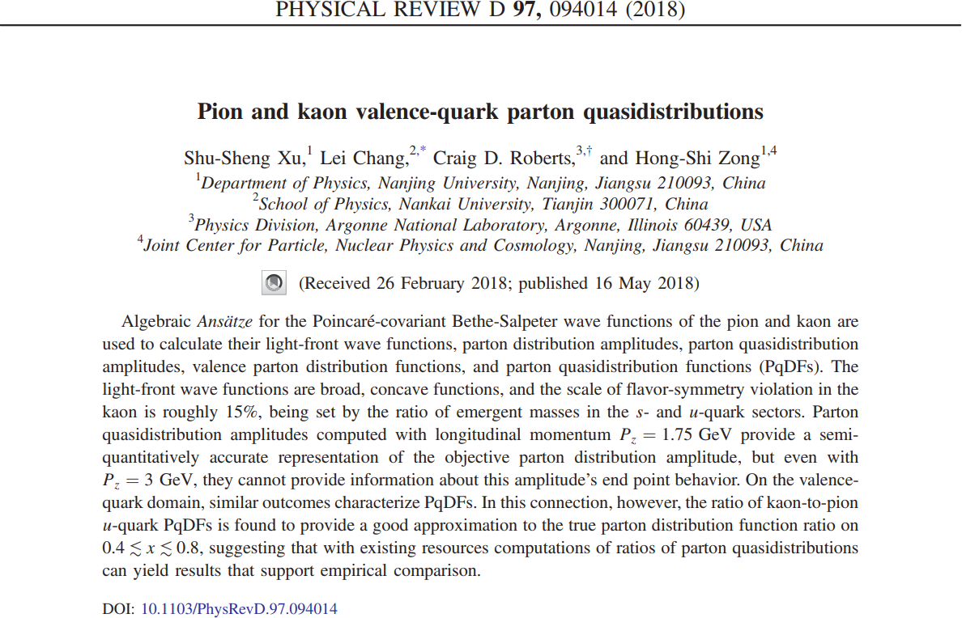

Slide 30
lQCD and Parton Distributions
lQCD provides ab initio approach to strong QCD
However, a given PDF is defined as an expectation value of some bilocal operator evaluated along a light-like line
  Cannot be evaluated using the methods of lQCD.
lQCD only provides access to Mellin moments of the PDF
No problem … if every moment is computable because a probability distribution is completely determined once all moments are known.
However, discretised spacetime does not possess the full rotational symmetries of the Euclidean continuum.
  Hence, only the lowest three non-trivial moments can readily be calculated
  They are insufficient to support a model-independent reconstruction of the PDF.
Paths are being pursued to circumvent this problem Liu:1993cv, Ji:2013dva, Radyushkin:2016hsy, Chambers:2017dov, Bali:2018spj
.

Slide 31
Large P_{z} Approach
Focus on [Ji:2013dva, Radyushkin:2016hsy]:
  large P_{z} (longitudinal-momentum) approach to the lQCD computation of parton distributions
Use continuum methods in quantum field theory to address some questions:
  Maximum value of P_{z} is bounded in any lQCD simulation … what is the lowest value of P_{z}^{max} for which the quasidistribution provides a realistic sketch of the true distribution?
  Given a P_{z}^{max} quasidistribution, is it possible to extract reliable information about the true distribution?
Primary element = Meson Bethe-Salpeter Wave Function
S(k) = dressed-quark propagator, Γ(k,P) = Bethe-Salpeter amplitude

Slide 32




LFWFs ⇔ quasi-PDAs
Pseudoscalar meson's leading-twist two-dressed-parton light-front wave function (LFWF):
  ∫dk∥ = (1/π)∫ dk₃ dk₄,
  δ_{n}^{x}(k_{K})= δ (n⋅ k - x n⋅P_{K})
  n²=0, n⋅P_{K} = -m_K
Twist-two PDA follows immediately:
Twist-two dressed-parton quasi-DA (PqDA) is simply obtained via the replacement n = (1,0,0,i) → ñ = (0,0,1,0):
Algebra →

Slide 33
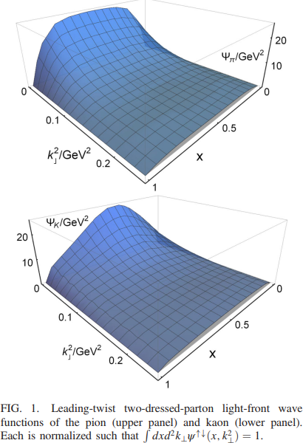
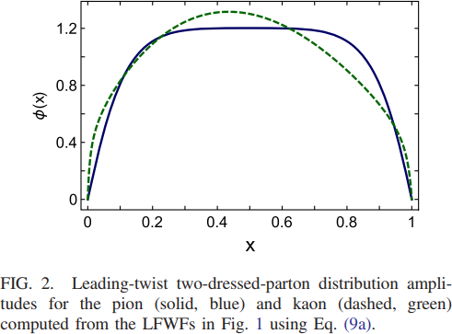
Algebraic Ansätze for Bethe-Salpeter Amplitudes
Adapt the algebraic models used for π & K PDF calculation
True PDAs

Slide 34
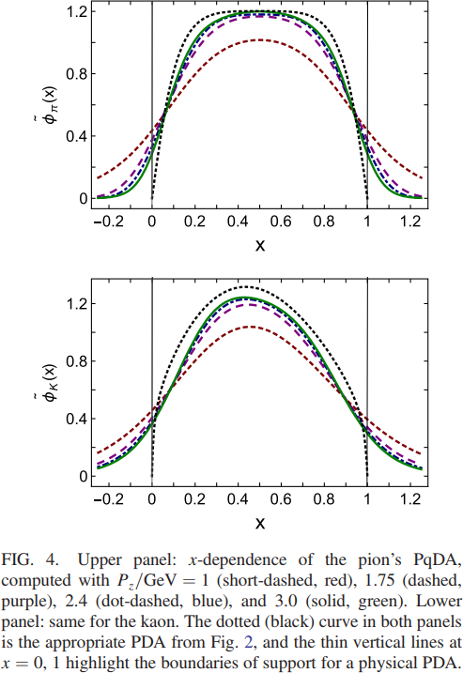
Parton Quasidistribution Amplitudes
Pion (upper panel)
  P_{z}=1.0 GeV does not closely resemble φ(x)
    L₁-difference between the two curves is 42%
  Step to P_{z}=1.75 GeV brings big improvement
    φ̃(x) provides qualitatively sound approximation to φ(x)
    L₁-difference = 18%
    Can reasonably conclude that the target PDA is a broad, concave function.
  But further increments in P_{z} do not bring much improvement.
    E.g. P_{z}=3.0 GeV
      L₁-difference = 10%
      Reflection of fact that once the perturbative domain is entered, evolution in QCD is logarithmic.
Green 3.0
Blue 2.4
Purple 1.75
Red 1 GeV

Slide 35
Parton Quasidistribution Amplitudes
Pion (upper panel)
  Notable: pointwise forms of φ̃(x) leak significantly from the domain 0<x<1.
  This prevents determination of target PDAs endpoint behaviour, even with P_{z}=3 GeV.
  Endpoint behaviour is crucial because it fixes magnitude of leading-order, leading-twist perturbative QCD results for numerous observables
    Sets benchmark against which existing and foreseen experiments aimed at testing solid QCD predictions must be compared
  To reach P_{z} ≈ 3 GeV in a lQCD simulation, need roughly 48 spatial sites and a=0.06 fm.
Green 3.0
Blue 2.4
Purple 1.75
Red 1 GeV

Slide 36
Parton Quasidistribution Amplitudes
Kaon (lower panel)
  Much the same as the pion
  New feature is “skewing”, i.e. shift of peak away from x=½:
    Reliably located with P_{z}=1.75 GeV.
  P_{z}=3.0 GeV:
    L₁-difference = 20%
    L₁-difference = 10% would require
    P_{z}≈ 20 GeV.
Green 3.0
Blue 2.4
Purple 1.75
Red 1 GeV

Slide 37
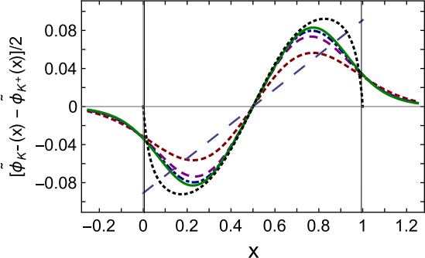
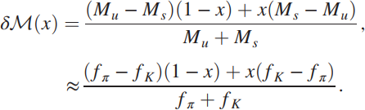
PqDA SU(3)-flavour breaking Amplitudes
Kaon
  particle-antiparticle difference
  Using Pz ≥ 1.75 GeV, obtain fair pointwise description of the true difference on x ∈ [0.3,0.7]
  But, again, the behaviour on large domains near the endpoints is poorly represented
  Comparison with δM(x)
    highlights that scale of flavour-symmetry breaking in kaon distribution amplitudes measures differences between emergent masses of s- and u-quarks
Green 3.0
Blue 2.4
Purple 1.75
Red 1 GeV
    Analogue produced using Higgs-generated current-masses is an order-of-magnitude too large at the PqDAs' extrema.

Slide 38
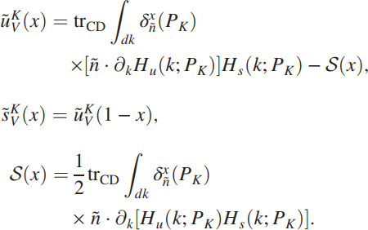
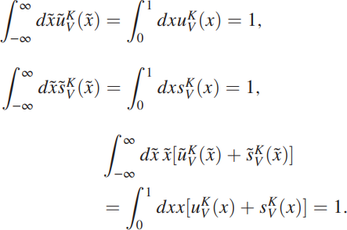
Parton Quasi-distribution Functions
Similar analysis leads to expressions for quasidistribution functions
True valence-quark quasidistributions

Slide 39
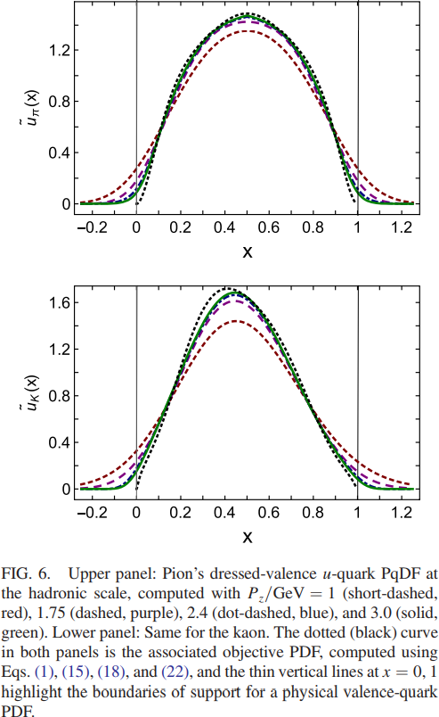
Parton Quasidistribution Functions
Pion (upper panel)
  valence-quark PqDF is typically a better approximation to the objective result than a PqDA at any given value of P_{z}.
  L₁-differences:
    19% (P_{z}=1 GeV),
    9% (P_{z}=1.75 GeV),
    5% (P_{z}=2.4 GeV),
    4% (P_{z}=3 GeV).
  Even with P_{z}=1 GeV, the pion's valence-quark PqDF delivers a qualitatively sound approximation to the true result
  Step to Pz=1.75 GeV brings noticeable improvement
  But, as with the PqDAs, improvement is slow on P_{z} > 1.75 GeV.
Green 3.0
Blue 2.4
Purple 1.75
Red 1 GeV

Slide 40

Parton Quasidistribution Functions
Also similar:
  pointwise behaviour of the valence-quark PqDFs in neighbourhood of the endpoints
  PqDFs leak significantly from the domain 0<x<1
Important
  One of the earliest predictions of the QCD parton model, augmented by features of perturbative QCD (pQCD)
  γ>0 is an anomalous dimension
Verification is an important milestone on the path toward confirmation of QCD as the theory of strong interactions
Green 3.0
Blue 2.4
Purple 1.75
Red 1 GeV

Slide 41
Pion’s Valence-Quark
Distribution Function
Owing to the validity of factorisation in QCD,
q^{π}(x) is directly measurable in πN Drell-Yan experiments
E615 @ FNAL (Conway:1989fs): leading-order analysis of πN Drell-Yan
q^{π}(x) ∼ (1-x)¹
Apparent disagreement with QCD.
Nevertheless (often) used to produce “modern” PDF fits

Slide 42
E615 Controversy
q^{π}(x) ∼ (1-x)¹
Numerous “explanations”
Nambu – Jona-Lasinio model, translationally invariant regularisaion
q^{π}(x) ∼ (1-x)⁰,
which becomes ≈1 after evolving from a low resolution scale
NJL models with a hard cutoff & also some duality arguments:
q^{π}(x) ∼ (1-x)¹
Relativistic constituent quark models:
q^{π}(x) ∼ (1-x)^{0…2}
depending on the form
of model wave function
Instanton-based models
q^{π}(x) ∼ (1-x)^{1…2}
Any power you might like in models possessing no connection with QCD.
What can be learnt from this?
Is QCD threatened?

Slide 43
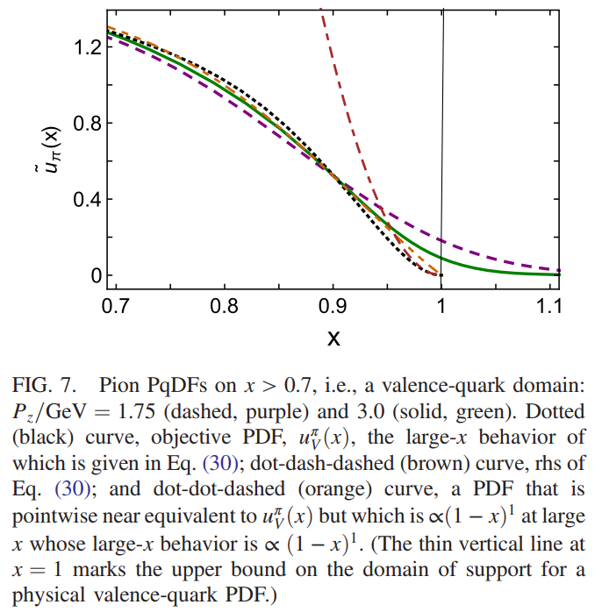
Parton Quasidistribution Functions
Obviously: quantitatively reliable lQCD results bearing upon
  would be very valuable.
But ∃ significant challenges
On a valence-quark x-domain
  true large-x behaviour:
    u_{π}(x) ≈ 113 (1-x)²
  cf. another curve
    Visually almost indistinguishable
      L₁-difference on 0<x<1 = 2%
    But ∝ (1-x)¹ at large x
Evidently, even P_{z}=3 GeV PqDF is unable to distinguish between these two distinctively different results.
u_{π}(x) ≈ 113 (1-x)²
Fake PDF
Purple 1.75 GeV
Green 3.0
Real PDF
x>0.9 is required before (1-x)²
is manifest in pion's valence-quark PDF

Slide 44
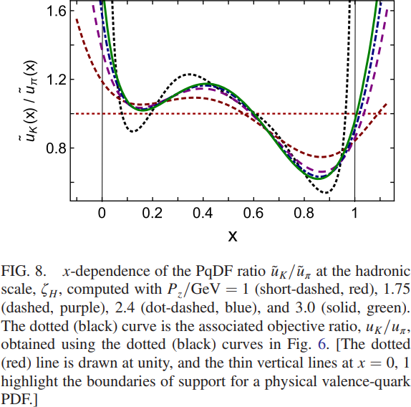
K/π valence-quark quasidistribution functions
u_{V}^{K}(x)/u_{V}^{π}(x) serves as sensitive probe of difference between gluon distributions in π & K
This difference can reveal much about emergence of mass in Standard Model
Experimental data [Badier:1980jq]
  One measurement is insufficient for complete confidence
Can PqDFs contribute?
  On P_{z} ≥ 1.75 GeV
    Ratio of PqDFs is quantitatively a good approximation to the objective ratio on 0.4 < x < 0.8
This domain ∼covers that upon which empirical data is available.
lQCD simulations could potentially provide sound
prediction for this ratio before next generation
experiments are completed

Slide 45
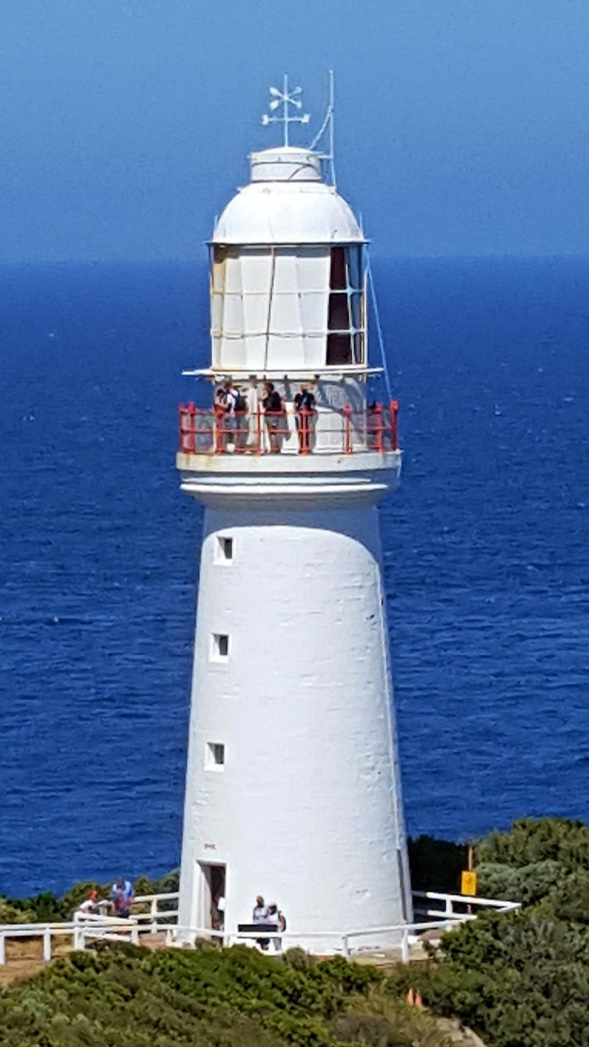
Summary

Slide 46
Summary
Hadron LFWFs are
  broad, concave functions
  with power-law k⊥²-decay
LFWFs provide direct access parton distributions and quasidistributions
PqDAs
  Qualitatively reliable on P_{z} ≥ 1.75 GeV
  Cannot provide information about the true PDA's endpoint behaviour
PqDFs
  At any given P_{z} , a PqDF delivers a better representation of the associated PDF than does a PqDA of the objective PDA
  ũ_{V}^{K}(x)/ ũ_{V}^{π}(x)
    Provides a good approximation to true ratio on 0.4 < x < 0.8
    Contemporary lQCD can potentially deliver a reasonable prediction for this ratio before next generation experiments are completed

Slide 47
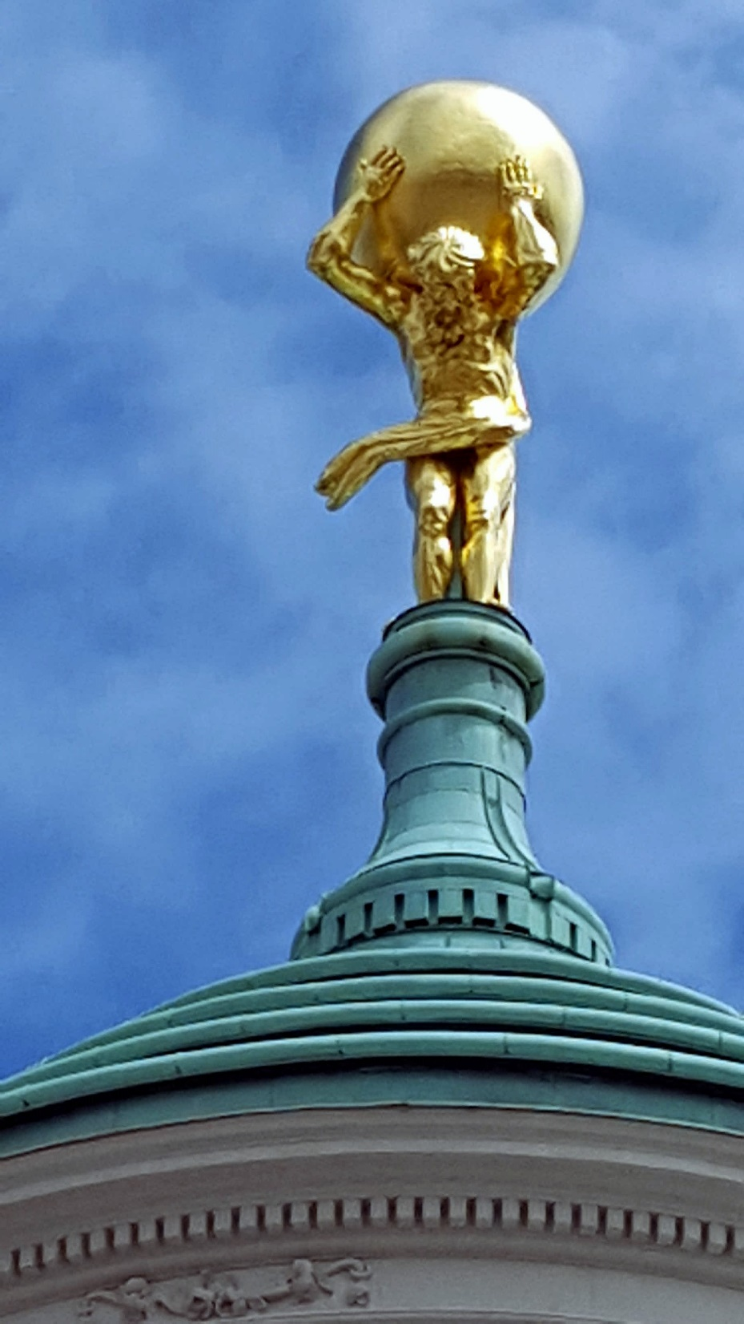
Epilogue

Slide 48
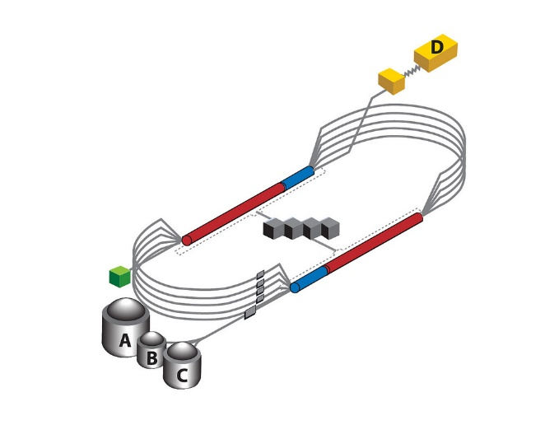

Epilogue
Challenge: Explain and Understand
the Origin and Distribution of the Vast Bulk of Visible Mass
Current Paradigm: Quantum Chromodynamics
QCD is plausibly a mathematically well-defined quantum field theory,
The only one we’ve ever produced
  Consequently, it is a worthwhile paradigm for developing Beyond-SM theories
Challenge is to reveal the content of strong-QCD
Tough Problem
Progress and Insights
being delivered by amalgam of
  Experiment
  Phenomenology
  Theory
Must continue into eras of

Slide 49

Thankyou

