Slide 1

INCL in Geant4
(INCL = IntraNuclear Cascade of Liège)
Jean-Christophe David
23 October 2024 – ECT* - Trento

Slide 2
Next ν-oscillation experiments → ν energy more precise than ever!
→ What nuclear reaction models can do?
→ Which models?
→ Role of Geant4?
The beginning of an answer (…I hope)
from a non-expert neutrino physicist
Geant4 - INCL…

Slide 3
Plan
Generalities on nuclear interactions around MeV-GeV (with light projectiles)
Geant4 (which models)
INCL Neutrino
INCL in (some) details
Geant4 - INCL…

Slide 4
MeV-GeV Interactions
4 main interaction domains can be considered where the projectile see
the nucleus
the hadrons
the partons
Geant4 - INCL…

Slide 5
MeV-GeV Interactions
4 main interaction domains can be considered where the projectile see
the hadrons
Two possibilities or ways of simulating this domain:
  two phases: precompound + INC
  INC alone
depends on the INC « ingredients »
Geant4 - INCL…

Slide 6
MeV-GeV Interactions
Modeling
Numerous nucleons interacting → Schrödinger equation → assumptions needed BUU/VUU equation (transport equation with a collision term)
1 + 2 → 3 + 4
f_{i}: density distributions
σν₁₂: collision term
U: potential
Monte-Carlo method
2 ways
BUU – QMD models
Potential calculated
(Heavy ion collisions)
Slow
(NOT convenient in particle transport code)
INC models
Potential = constant
(Light particle projectile)
Fast
(convenient in particle transport code)
Examples
of
differences
Geant4 - INCL…

Slide 7
MeV-GeV Interactions
Modeling
Numerous nucleons interacting → Schrödinger equation → assumptions needed BUU/VUU equation (transport equation with a collision term)
1 + 2 → 3 + 4
f_{i}: density distributions
σν₁₂: collision term
U: potential
Monte-Carlo method
2 ways
BUU – QMD models
Potential calculated
(Heavy ion collisions)
Slow
(NOT convenient in particle transport code)
INC models
Potential = constant
(Light particle projectile)
Fast
(convenient in particle transport code)
Examples
of
differences
Geant4 - INCL…

Slide 8
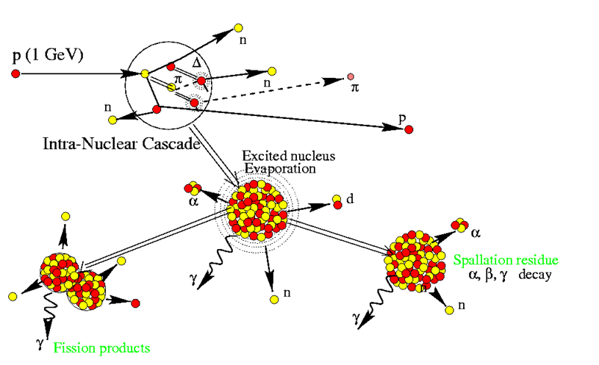
MeV-GeV Interactions
INC + (preequilibrium) + De-excitation
INC
sometimes
precompound
(preequilibrium)
Deexcitation
Geant4 - INCL…

Slide 9
MeV-GeV Interactions
INC + (preequilibrium) + De-excitation
INCL
ABLA
Geant4 - INCL…

Slide 10
Geant4
Three INC models
 | Bertini (BERT) | Binary light Ion Cascade (BIC) | INCL (INCLXX)
projectile | 𝑝, 𝑛, 𝜋⁺, 𝜋⁻, 𝐾⁺, 𝐾−, 𝐾_{𝐿}, 𝐾_{𝑆}, Λ, Σ⁺, Σ⁻, Σ⁰, Ξ⁻, Ξ⁰, Ω⁻ | n, p, nucleus | 𝑝, 𝑛, 𝜋⁺, 𝜋⁻,( 𝜋⁰, 𝐾⁺, 𝐾⁻, 𝐾⁰, Λ, Σ⁺, Σ⁻, Σ⁰,) pbar
Energy | 0 – 6 GeV | 0 – 6 GeV | 0 – 20 GeV
Precompound | Its own | The one from Geant4 | No
De-excitation | Its own | The one from Geant4 | ABLA (Geant4’s also)
Often used within Physics Lists (examples)
  FTFP_BERT_HP (BIC used for nucleus-nucleus interaction)
  FTFP_INCLXX_HP
  QGSP_BIC_HP (BERT used for π, K, strange hadrons)
  …
Geant4 - INCL…

Slide 11
Geant4
None of them deal with the neutrino! However...
Three INC models
 | Bertini (BERT) | Binary light Ion Cascade (BIC) | INCL (INCLXX)
projectile | 𝑝, 𝑛, 𝜋⁺, 𝜋⁻, 𝐾⁺, 𝐾−, 𝐾_{𝐿}, 𝐾_{𝑆}, Λ, Σ⁺, Σ⁻, Σ⁰, Ξ⁻, Ξ⁰, Ω⁻ | n, p, nucleus | 𝑝, 𝑛, 𝜋⁺, 𝜋⁻,( 𝜋⁰, 𝐾⁺, 𝐾⁻, 𝐾⁰, Λ, Σ⁺, Σ⁻, Σ⁰,) pbar
Energy | 0 – 6 GeV | 0 – 6 GeV | 0 – 20 GeV
Precompound | Its own | The one from Geant4 | No
De-excitation | Its own | The one from Geant4 | ABLA (Geant4’s also)
Often used within Physics Lists (examples)
  FTFP_BERT_HP (BIC used for nucleus-nucleus interaction)
  FTFP_INCLXX_HP
  QGSP_BIC_HP (BERT used for π, K, strange hadrons)
  …
But
see talk of V. Grichine
Geant4 - INCL…

Slide 12
INCL and the Neutrinos
Increasing precision of the experiments
Better/refined results in ν-Nucleus interactions
Need to use models known to treat well Final State Interaction (FSI)
see A. Ershova talk
The recent history of « INCL and neutrinos »
 | 2019 | 2020-2023 | 2024 | 2024 | 2024
Who | GENIE | A. Ershova (Thesis CEA) | Antoine L.T. (Internship CEA) | GENIE | NEUT
Link/Goal | Contact | ν-oscillation exp. INCL to treat FSI | CCQE in INCL | New contact | Contact
Work | Implementing INCL | NuWro ν-N INCL FSI | It works. Some points to be understood | Implementation OK? Used within Geant4 | Implementing INCL
…Bertini also
in GENIE
Discussions to get a common interface to use INCL for neutrino physics
Geant4 - INCL…

Slide 13
INCL
Basic principles
Four (common) main hypotheses
  Numerous scatterings → Interferences cancel out
  Good enough definition of position and momentum → Classical trajectories
  scattered wave → asymptotic value before next collision → Classical treatment of scattering
  time of interaction << time between collisions → Binary collision
Main ingredients
  Nucleus = nucleons with position-momentum (correlated) and potential
  Cascade
    Next collision (driven by cross sections)
    Final products (driven by cross sections, but not only)
    Pauli Blocking
    Ad-hoc models (ex.: cluster production)
  …Competing with reflection/emission (border) and decays (Δ, Σ⁰, ω)
  Stopping time (based on the thermalization of the remnant nucleus)
Geant4 - INCL…

Slide 14








INCL
Chronology of development
Produced particles
n
p
π
Cluster A $≤$ 4
Cluster A $≤$ 8
η
ω
K
Λ
Σ
10-20 GeV
2009-2011
2014
2-3 GeV
2017-2018
2023
2024…
2016
2002
2004
2013
2014
~150 MeV
2003 (npπ) 2013 (A $≤$4)
Tens of MeV
n
p
π
Cluster A $≤$ 18
K
Λ
Σ
$$\overline{p}$$
$$\overline{n}$$
Anticluster
$(\overline{d}$, …)
Projectile particles
Cluster A $≤$ 4
ν
Geant4 - INCL…

Slide 15
INCL
Applications
To study interaction mechanisms Stand-alone version X exp. data
  particle spectra
  residual production (A, Z, (Z,A) distributions, versus energy)
  cluster production
Implementation in Transport codes
  MCNPX INCL4.2 - Fortran
  PHITS INCL4.6 - Fortran
  Geant4 Latest versions – C++
Macroscopic applications
  Neutron sources
  ADS
  Facility design
  Hadrontherapy
  Meteorites (also std-alone version…)
Geant4 - INCL…

Slide 16
INCL
Benchmarks
External users Which models? What’s the reliability?
Specific benchmarks (application oriented)
Much rarer General benchmarks (all ref. in J.-C. David, Eur. Phys. J. A (2015) 51: 68)
              NEA 90’s
              IAEA 2008-2010
But, how to analyse the benchmark?
    Plots Shapes Developers
    Figure of merits Right values Users
The main question: Are we able to know the error and uncertainties of our calculations?
It could be…
Geant4 - INCL…

Slide 17
INCL
Errors – Uncertainties
Optimization
A project (NuRBS: Nuclear Reaction model improvement with Bayesian Statistics)
has been funded (2024->2027) – CEA & Bern U. (and IAEA+Coruña U.)
Goals:
      Building tools for biasing and parameter optimisation
      Applying them to INCL and ABLA for several cases
Geant4 - INCL…

Slide 18
Conclusions
INCL’s interest in neutrinos
    Recognized model in its field (FSI)
    Available in Geant4
    Still maintained
    … and improved
    Uncertainties under study
Interface for multi-input use (ex.: ν-nucleon vertex) Discussions (manpower…)
Geant4 - INCL…

Slide 19
Thanks
for your attention!
Geant4 - INCL…

Slide 20
BACKUP
Geant4 - INCL…

Slide 21




Bias (Error) estimate
    bayesian theorem
    information = exp. data
Method
    y1 = bias
    y2 = exp. data – calculations
    (ρ = probability distribution)
    each distribution = gaussian
    We obtain the new distribution for (bias knowing exp. data)
    where K_{ab} have to be estimated
        form?
        Hyperparameters from marginal likelihood maximization
Geant4 - INCL…

Slide 22
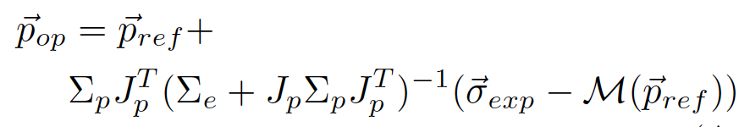
GLS = Generalized Least Square
Parameter optimisation
GLS
GLS gives the new values of the parameters and related covariance matrices
reference
link between
parameter and
model
weight of the information
information
Calculation (M) is supposed to be linear…
Not the case for models like INCL, but
1- almost linear close to the value (of the parameter)
2- process by iterations
Hypothesis reasonable to get the optimized value, BUT not for determining the uncertainties!
To estimate uncertainties, we use however a similar method where we broke the linear hypothesis during the process.

