Slide 1

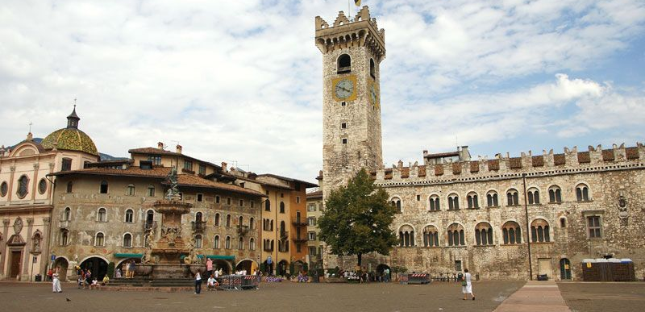


Neutrino Interaction Measurements with Hydrocarbon-Based Detectors
Kevin McFarland
University of Rochester
FBK ECT*, Trento
21 October 2024

Slide 2
“Help from CH-land”?
I love amusing and broad titles as much as anyone.
This one is particularly so.

Slide 3
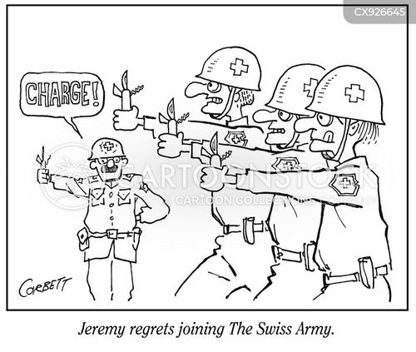
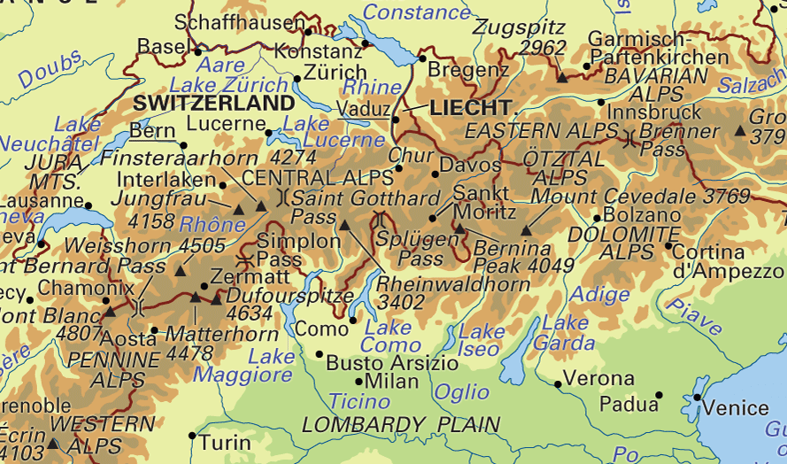
“Help from CH-land”?
I love amusing and broad titles as much as anyone.
This one is particularly so.
  Is the Swiss army invading?

Slide 4

“Help from CH-land”?
I love amusing and broad titles as much as anyone.
This one is particularly so.
  Is the Swiss army invading?
  Did I take a wrong turn over the Atlantic and end up in CHicagoland?
(yes, foodie me is aware this is a fictional sign, but it reminds me so much of real Chicago…)

Slide 5


“Help from CH-land”?
I love amusing and broad titles as much as anyone.
This one is particularly so.
  Is the Swiss army invading?
  Did I take a wrong turn over the Atlantic and end up in CHicagoland?
  Is the chemical industry of the 1960s coming to save us?

Slide 6

“Help from CH-land”?
I love amusing and broad titles as much as anyone.
This one is particularly so.
  Is the Swiss army invading?
  Did I take a wrong turn over the Atlantic and end up in CHicagoland?
  Is the chemical industry of the 1960s coming to save us?
  Long-last Beatles album subtitle?
🎵 Help! We need some plastic.
Help! Not just any plastic. 🎶

Slide 7
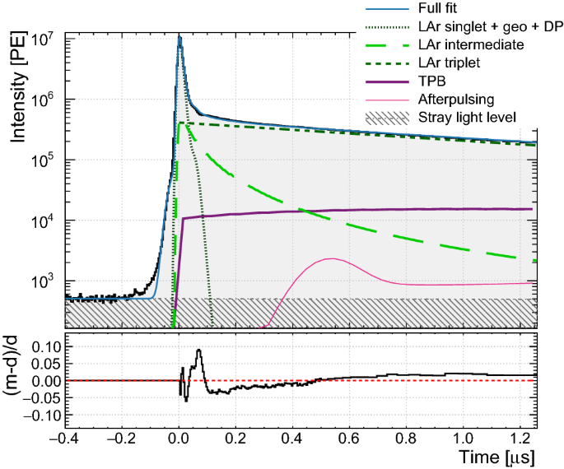
Thoughts about What The Title Might Mean
Experiments arguably have bifurcated between two different detector technologies for neutrino interactions.
Why liquid argon (not my remit)?
  Though slow to read out (even for a large portion
  of the scintillation light!), liquid argon charge imaging
  resolution is better than a ton-scale scintillator detector.
It follows that there must be some other advantage(s)
for plastic scintillator detectors since we keep building them.
(I assume the organizers will now rush me off the stage if I have it wrong, but if not, you’ll see the rest of my slides.)
e.g., DEAP-360 light model, Eur. Phys. J. C 80, 303 (2020)

Slide 8
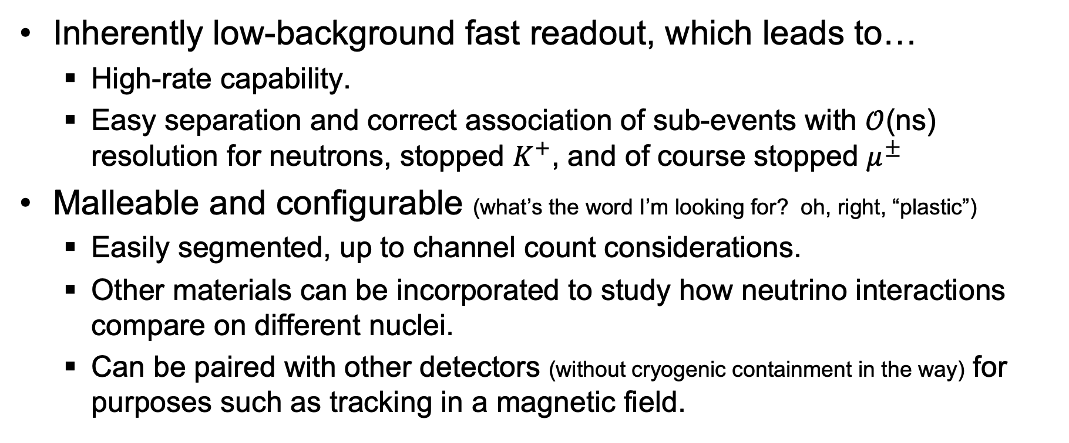
Signature Advantages of CH-Scintillator
Inherently low-background fast readout, which leads to…
  High-rate capability.
  Easy separation and correct association of sub-events with $𝒪$(ns) resolution for neutrons, stopped $K^{+}$, and of course stopped $μ^{±}$
Malleable and configurable (what’s the word I’m looking for? oh, right, “plastic”)
  Easily segmented, up to channel count considerations.
  Other materials can be incorporated to study how neutrino interactions compare on different nuclei.
  Can be paired with other detectors (without cryogenic containment in the way) for purposes such as tracking in a magnetic field.

Slide 9
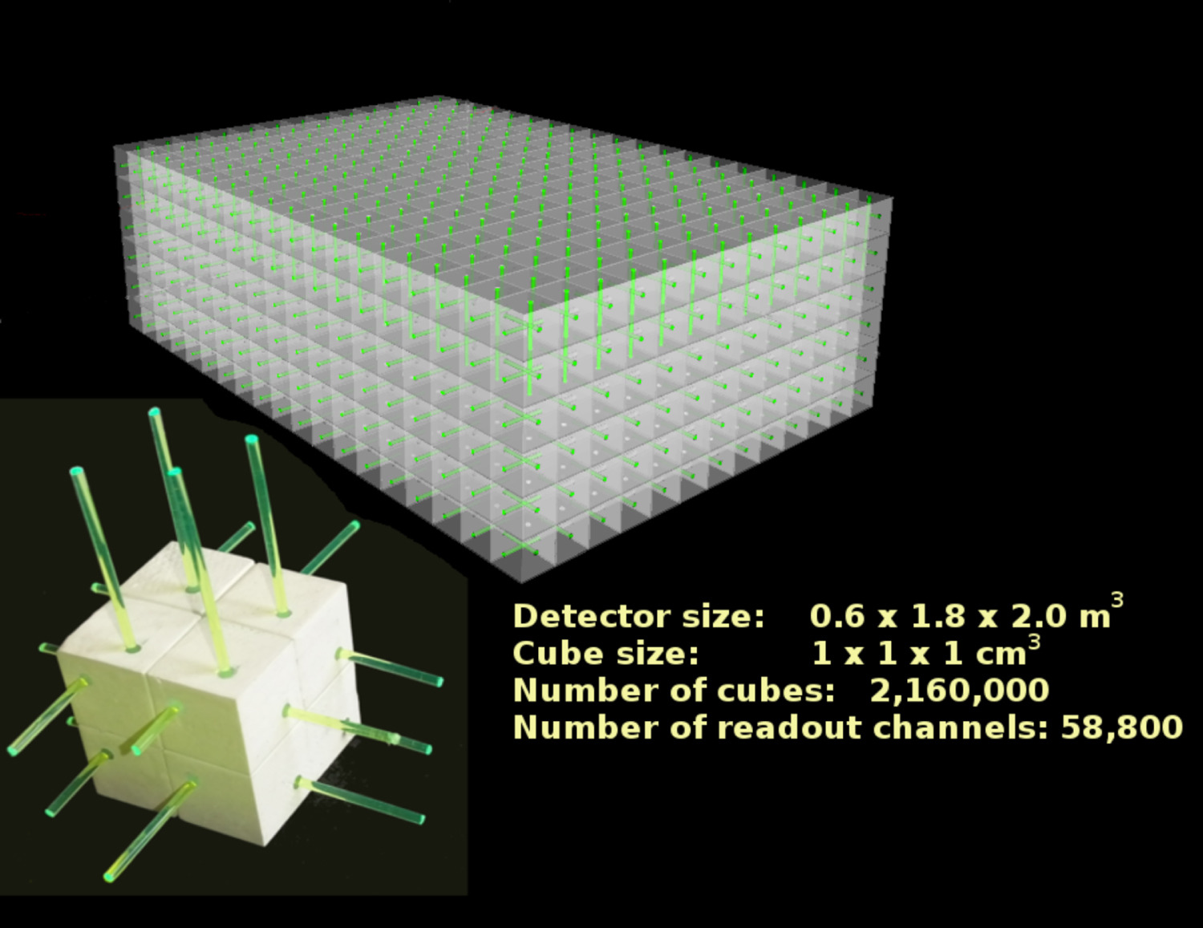
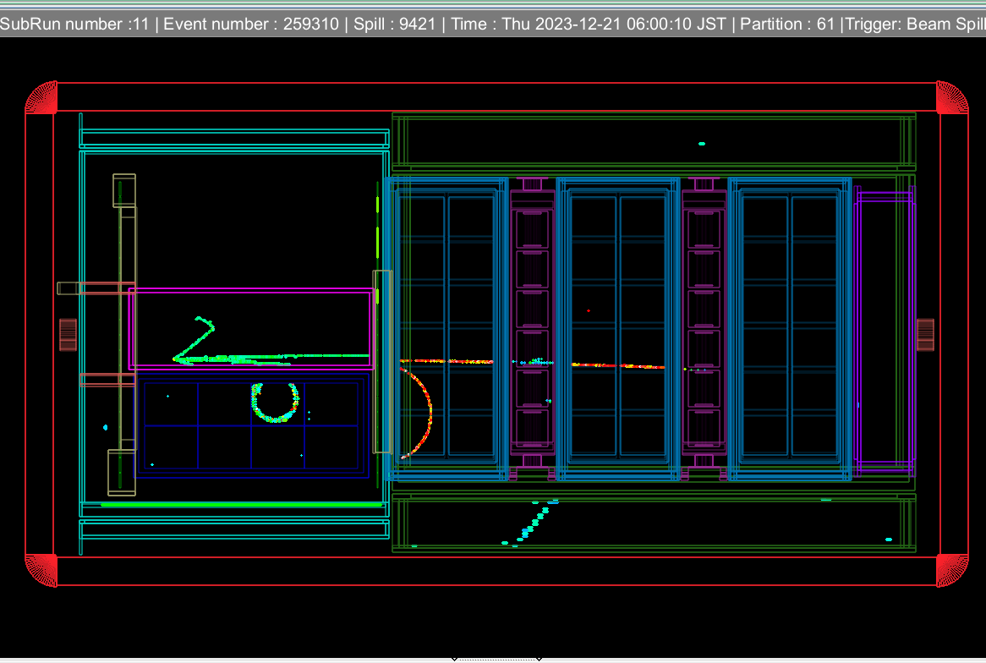
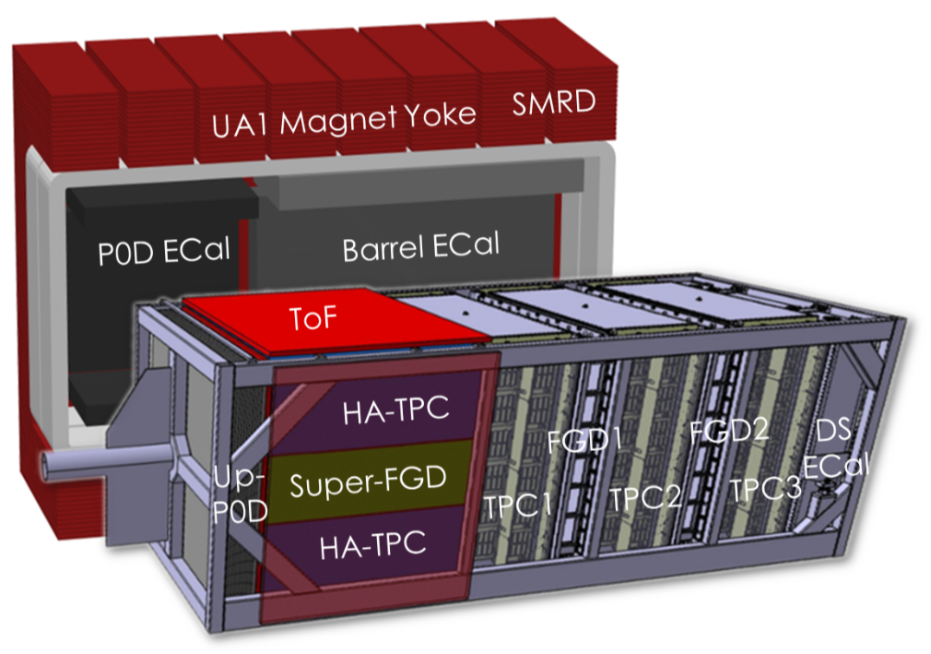
An Illustration of Both Principles
T2K ND280 (upgraded) detector for T2K/HK configurable, fast CH scintillator.
The SuperFGD 3D pixelated scintillator is interspersed with gaseous tracking in a magnetic field for charge ID and high resolution dE/dx PID.
The SuperFGD also has excellent neutron capability, including time-of-flight momentum reconstruction (more later).
(Pictures assembled by C. Giganti.)
Notes:
An revolutionary realization of an old technique is 3D segmented scintillator tat the T2K SuperFGD. It is cm^3 segments, read out by a 3D array of fibers. A highlight of this detector are its low thresholds with excellent segmentation, great timing, and therefore an ability to reconstruct neutrons down to ~10 MeV kinetic energies.

Slide 10

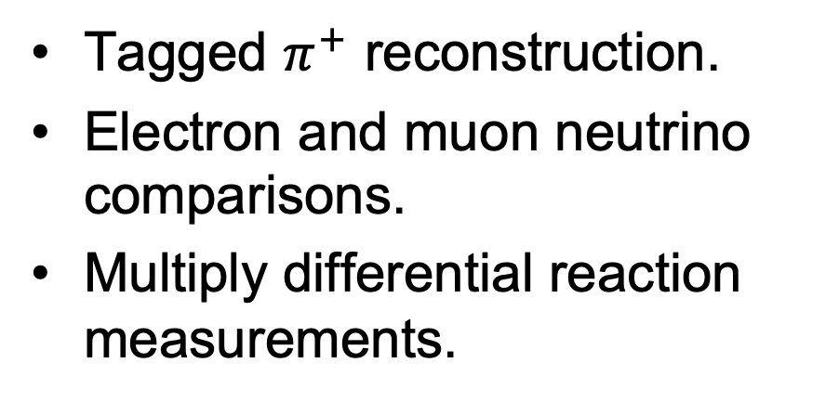
Topics for this CH review
Now how much would I pay?
CONFIGURABLE!
FAST!
Tagged $π^{+}$ reconstruction.
Electron and muon neutrino comparisons.
Multiply differential reaction measurements.
Neutron reconstruction
Comparisons among nuclei.
  and free protons too!
Maybe the organizers also expected this, but most of my examples will be related to work I know best from MINERvA or T2K. Sorry if this unintentionally leaves your work out..

Slide 11
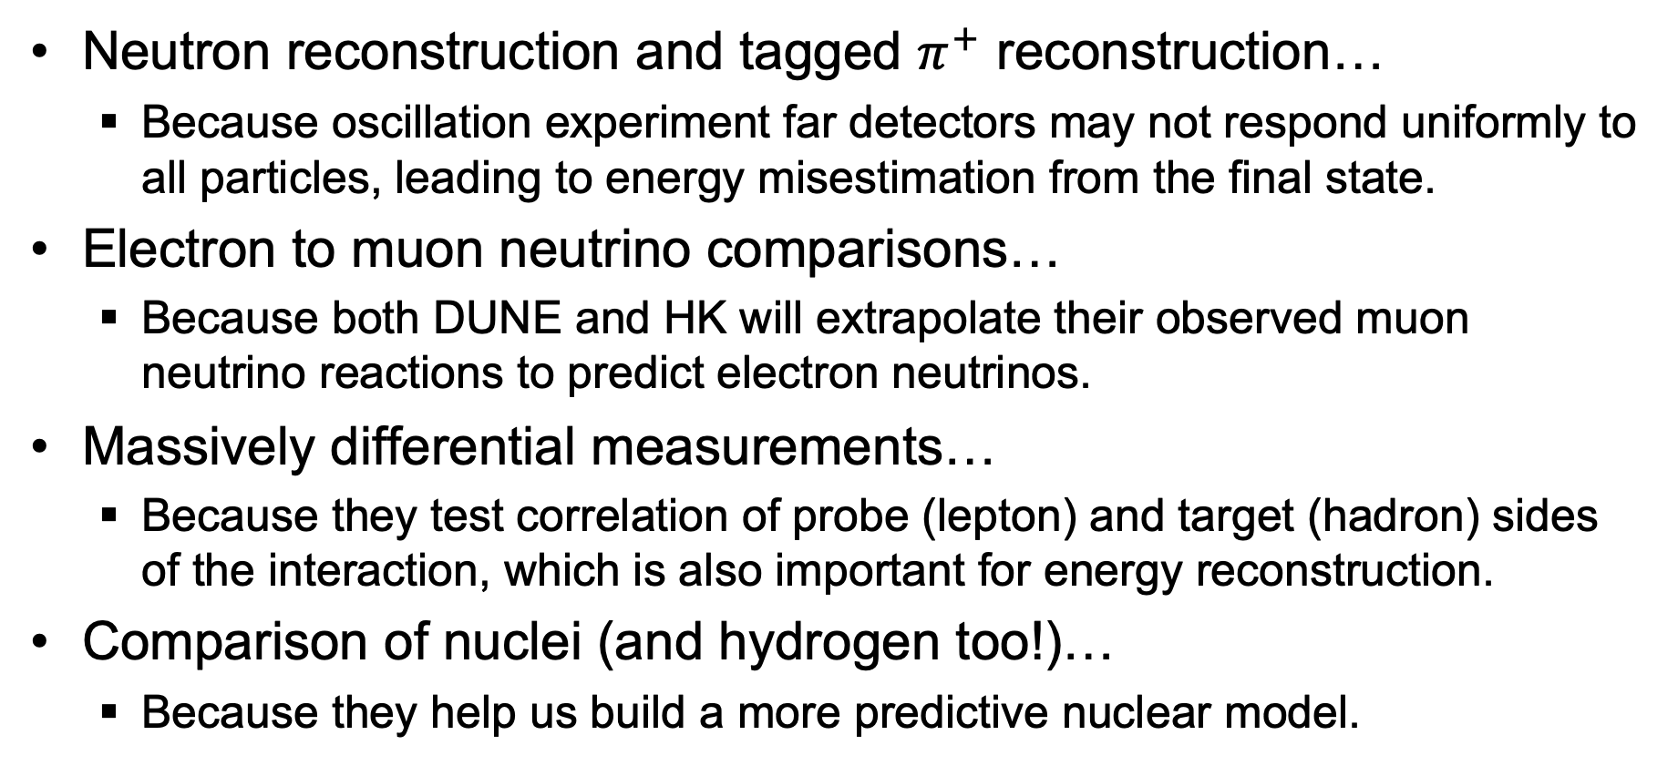
And why those matter for DUNE and HK
Neutron reconstruction and tagged $π^{+}$ reconstruction…
  Because oscillation experiment far detectors may not respond uniformly to all particles, leading to energy misestimation from the final state.
Electron to muon neutrino comparisons…
  Because both DUNE and HK will extrapolate their observed muon neutrino reactions to predict electron neutrinos.
Massively differential measurements…
  Because they test correlation of probe (lepton) and target (hadron) sides of the interaction, which is also important for energy reconstruction.
Comparison of nuclei (and hydrogen too!)…
  Because they help us build a more predictive nuclear model.

Slide 12
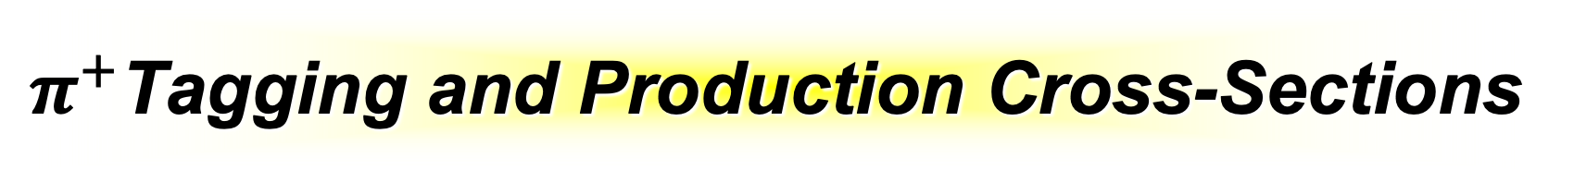
$π^{+}$Tagging and Production Cross-Sections
(important for calorimetry and event selection in oscillation experiments)
Notes:
I may spell flavor without a “u”, but “u” absolutely care about interactions for different neutrino flavors. There are two very distinct problems, mu->tau comparison and mu->e comparison. I’ll stick to the first in this talk.

Slide 13
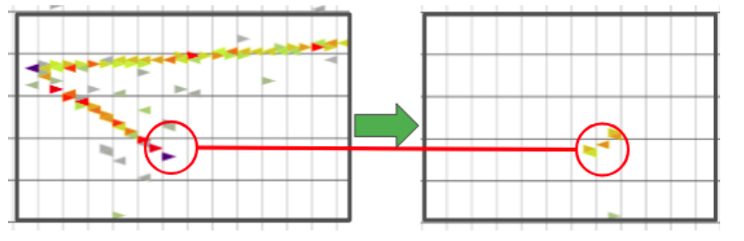
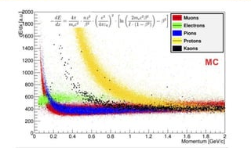
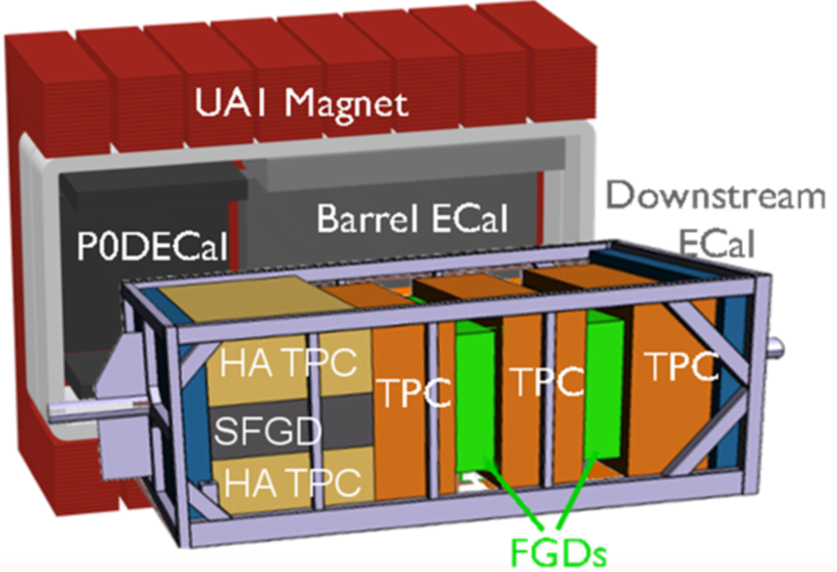
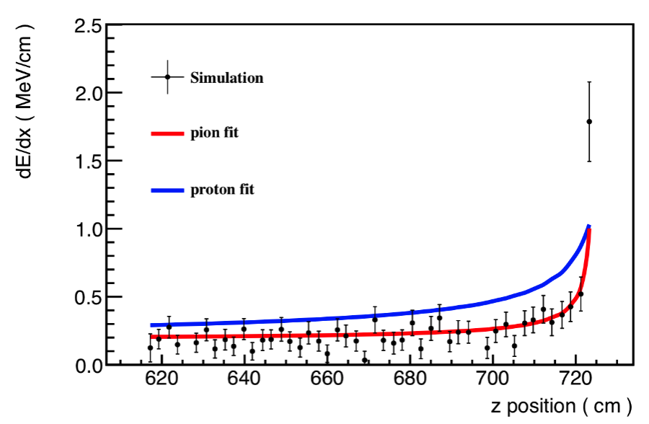


How do we identify $π^{+}$ in CH?
Broadly speaking, we can identify the Michel electrons from $π^{+}→μ^{+}→e^{+}$, or from energy loss dE/dx along a track.
T2K’s dE/dx is particularly outstanding…gaseous TPC tracking!
MINERvA’s techniques
dE/dx (MeV/mm)

Slide 14
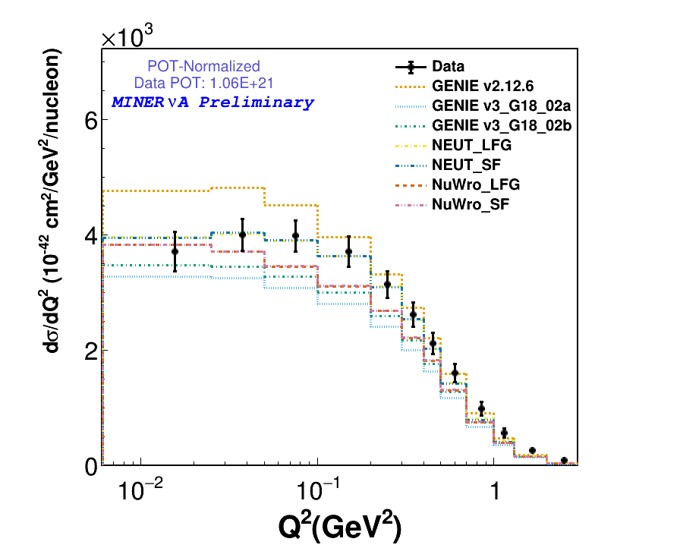
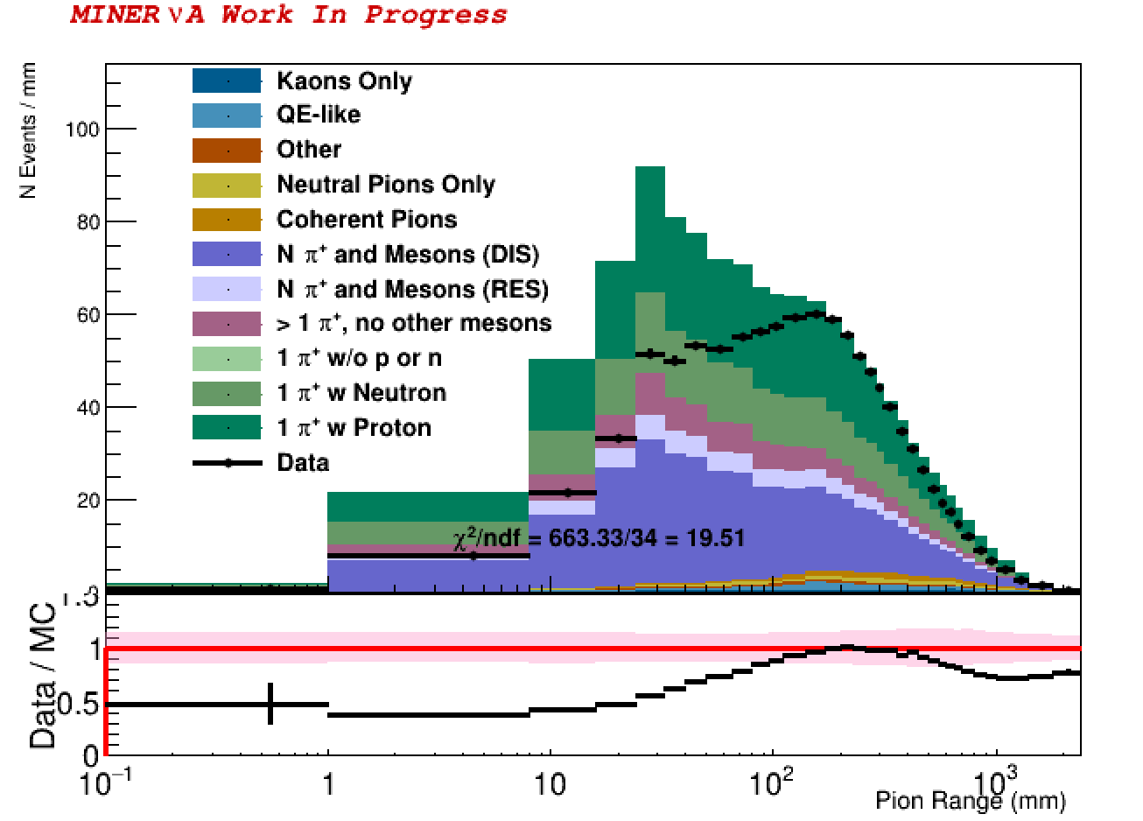
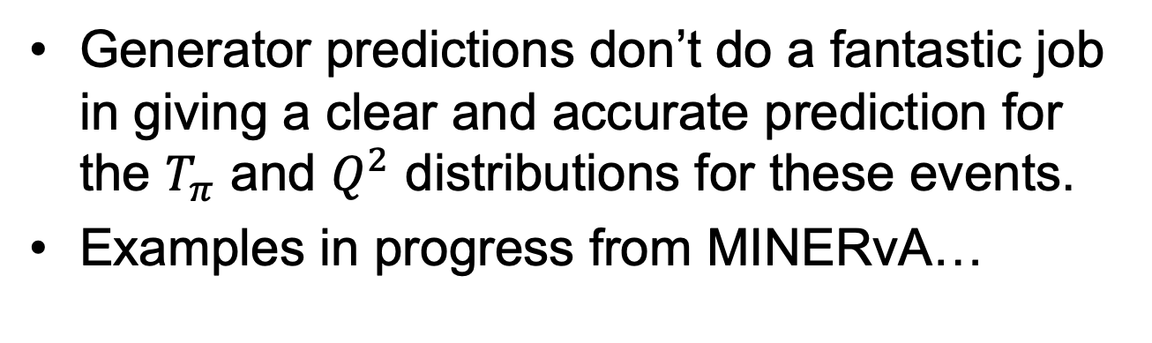

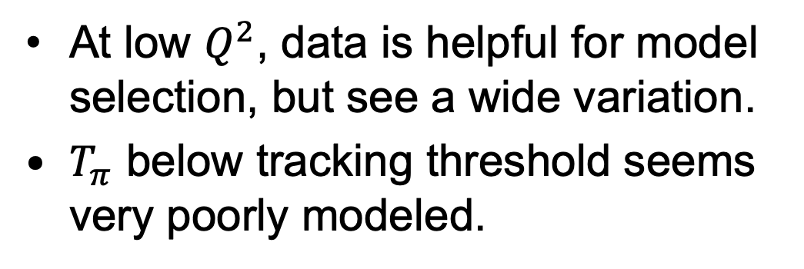
A few $π^{+}$ Results...
Generator predictions don’t do a fantastic job in giving a clear and accurate prediction for the $T_{π}$ and $Q^{2}$ distributions for these events.
Examples in progress from MINERvA…
MINERvA Preliminary, Harris NuINT24
At low $Q^{2}$, data is helpful for model selection, but see a wide variation.
$T_{π}$ below tracking threshold seems very poorly modeled.

Slide 15
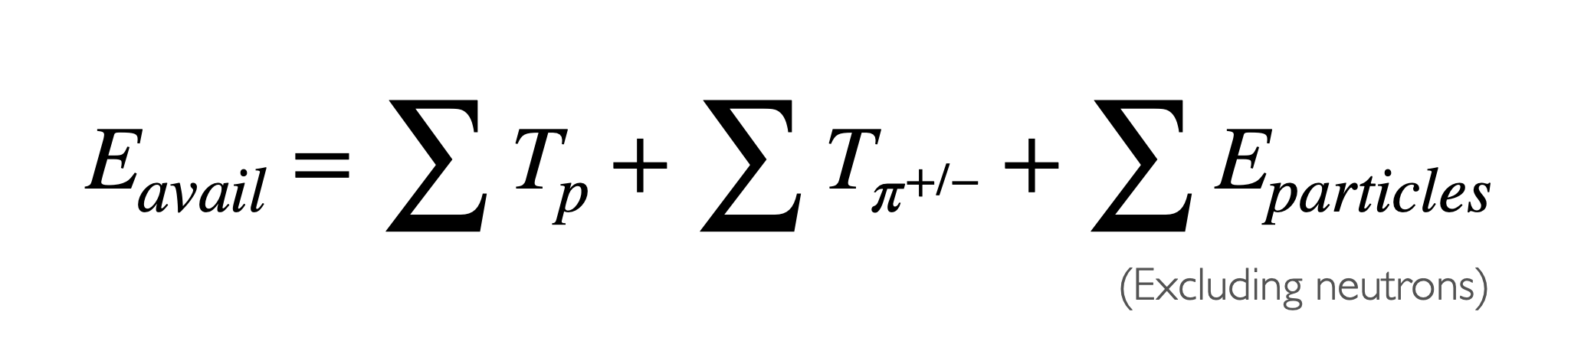
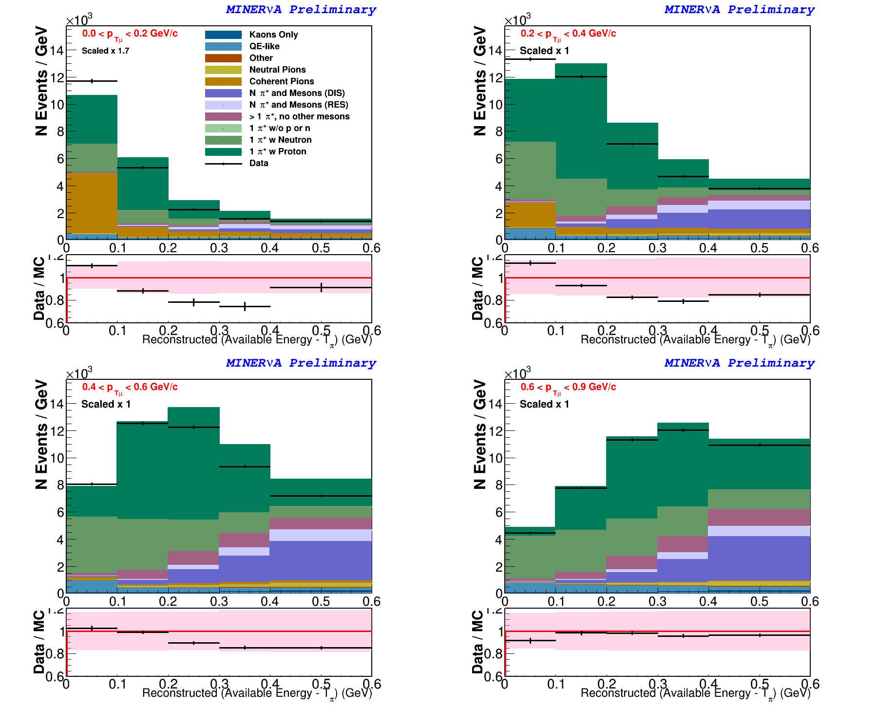
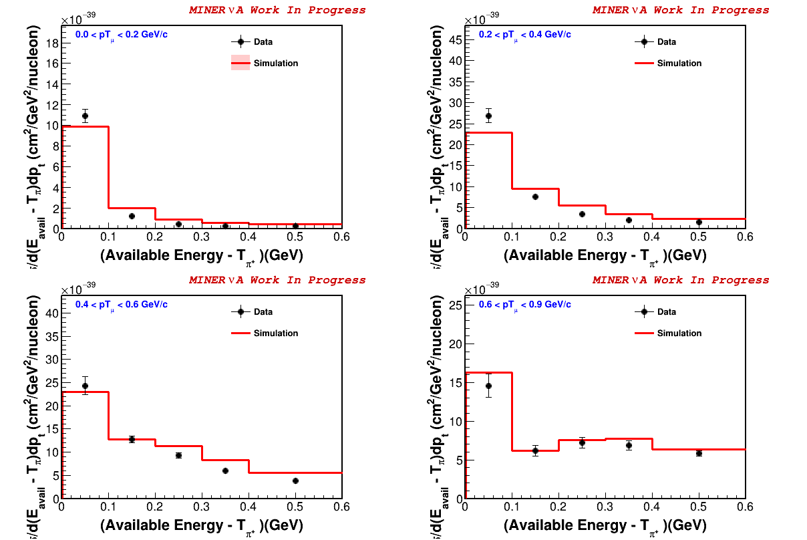
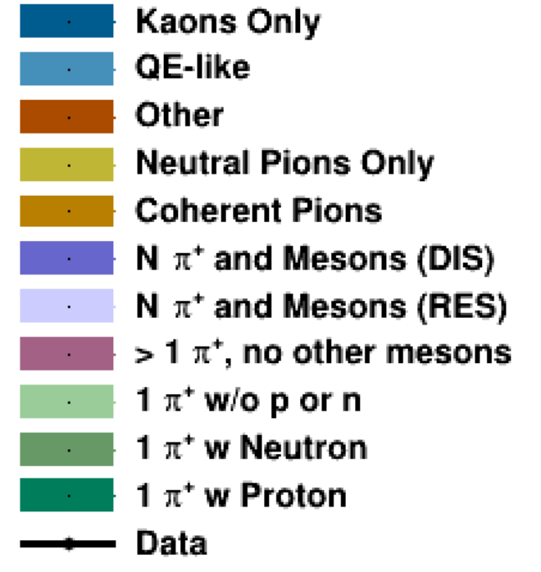
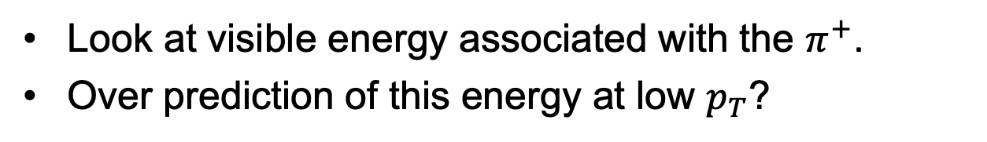

One last MINERvA $π^{+}$ result in progress…
Look at visible energy associated with the $π^{+}$.
Over prediction of this energy at low $p_{T}$?
events, to cross-section
MINERvA Preliminary, Harris NuINT24

Slide 16
Electron and Muon Flavors
(in American English, it’s not only irony to note that there is no “u” in “flavor”)
Notes:
I may spell flavor without a “u”, but “u” absolutely care about interactions for different neutrino flavors. There are two very distinct problems, mu->tau comparison and mu->e comparison. I’ll stick to the first in this talk.

Slide 17
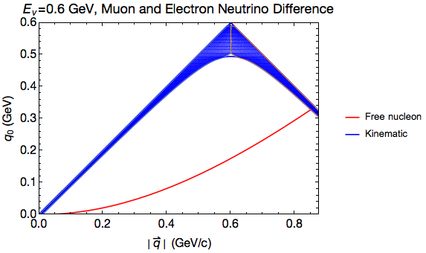
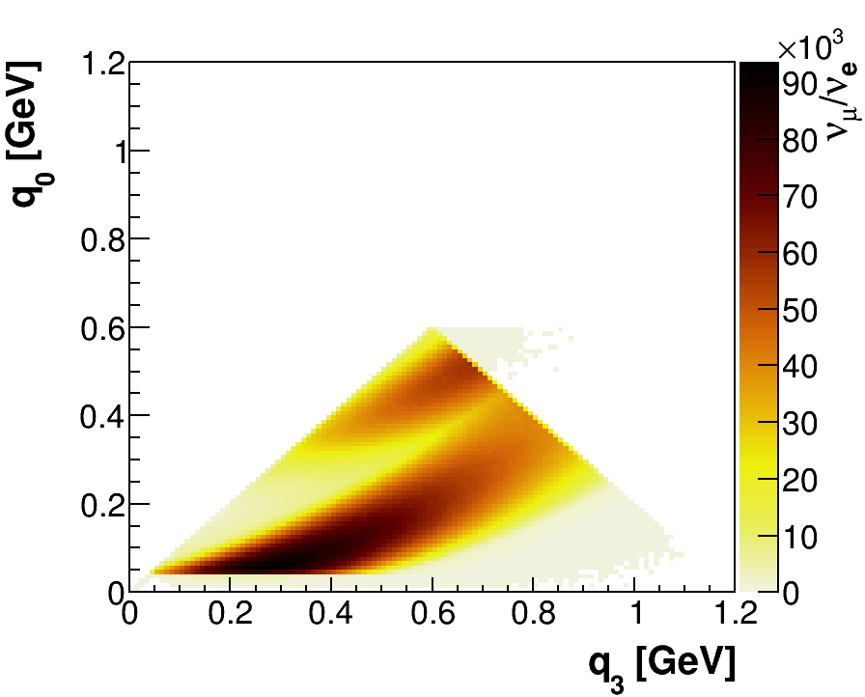
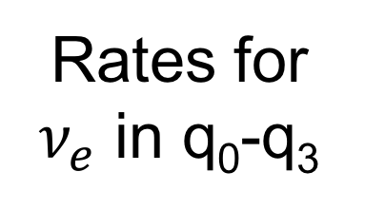

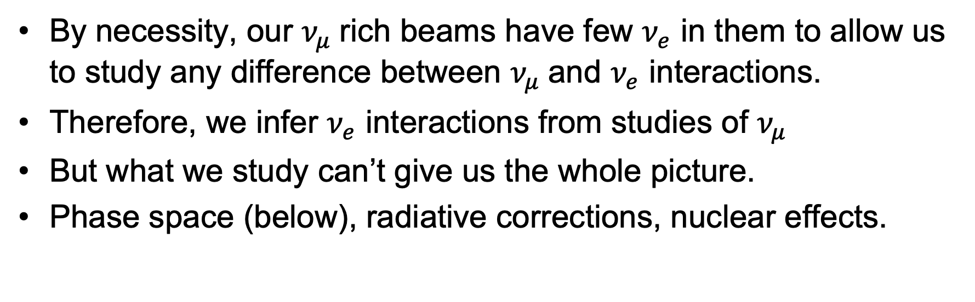
The $ν_{e}$ Problem
By necessity, our $ν_{μ}$rich beams have few $ν_{e}$ in them to allow us to study any difference between $ν_{μ}$and $ν_{e}$ interactions.
Therefore, we infer $ν_{e}$ interactions from studies of $ν_{μ}$
But what we study can’t give us the whole picture.
Phase space (below), radiative corrections, nuclear effects.
Missing reaction space due to muon mass
this is Q²~0
Radiative corrections:
O. Tomalak et al.,
Nature Commun. 13 (2022) 1, 5286 and Phys.Rev.D 106 (2022) 9, 093006
Nuclear effects:
T. Dieminger et al.,
Phys.Rev.D 108 (2023) L031301
energy transfer
3-momentum transfer
Notes:
Why might nu_e and n_mu cross-sections be different? Well, two problems with predicting one from the other is that there is phrase space in energy-momentum transfer not available to muon neutrinos because of the heavy final state muon. But there are also nuclear effects (due to the phase space) and radiative correctinos which are different for the two. We have some theoretical understanding, improved recently by Sasha Tomalak and collaborators

Slide 18
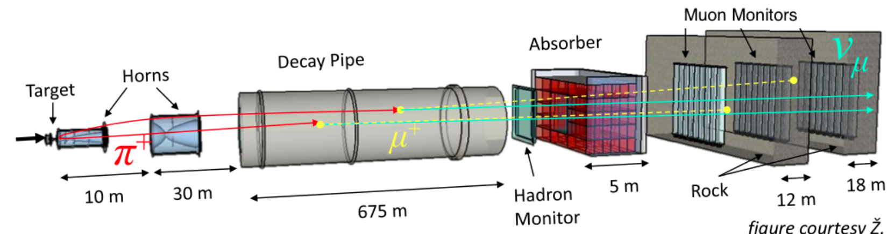
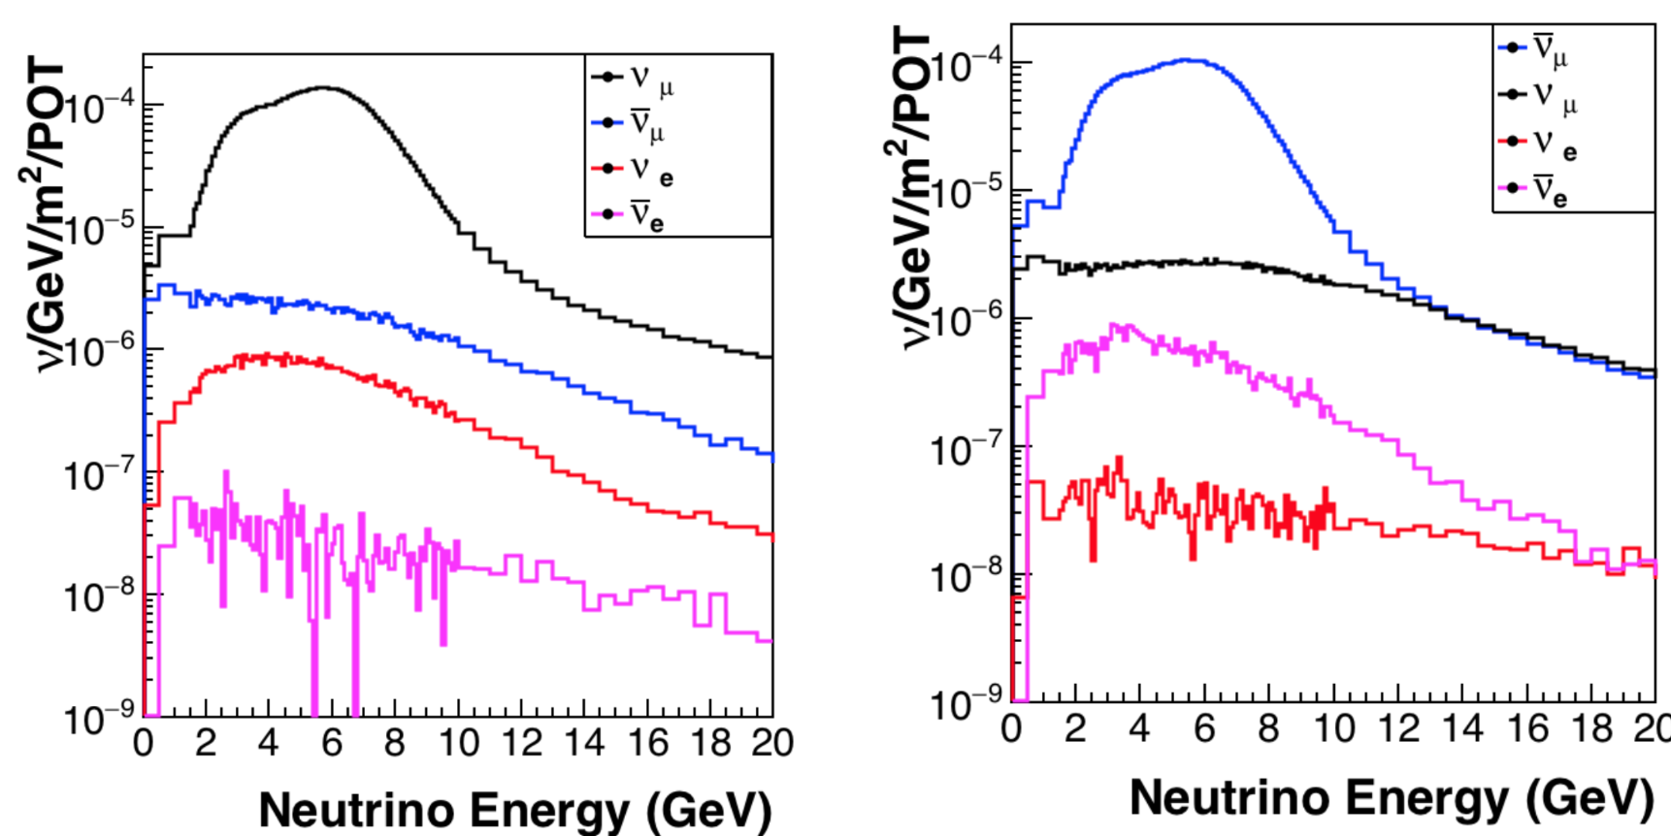
MINERvA: Electron Neutrino Flux
NuMI Beams @ MINERvA
NuMI is a “conventional” neutrino beam, with most neutrinos produced from focused pions.
Pions decay mostly to muons, but weak decays involving electrons come from daughter muons or kaons.
~1% contribution of the beam.
FHC
RHC
Notes:
There is a current benchmark for this from MINERvA, noted by Margherita, just using the “1%” electron neutrinos in the beam

Slide 19
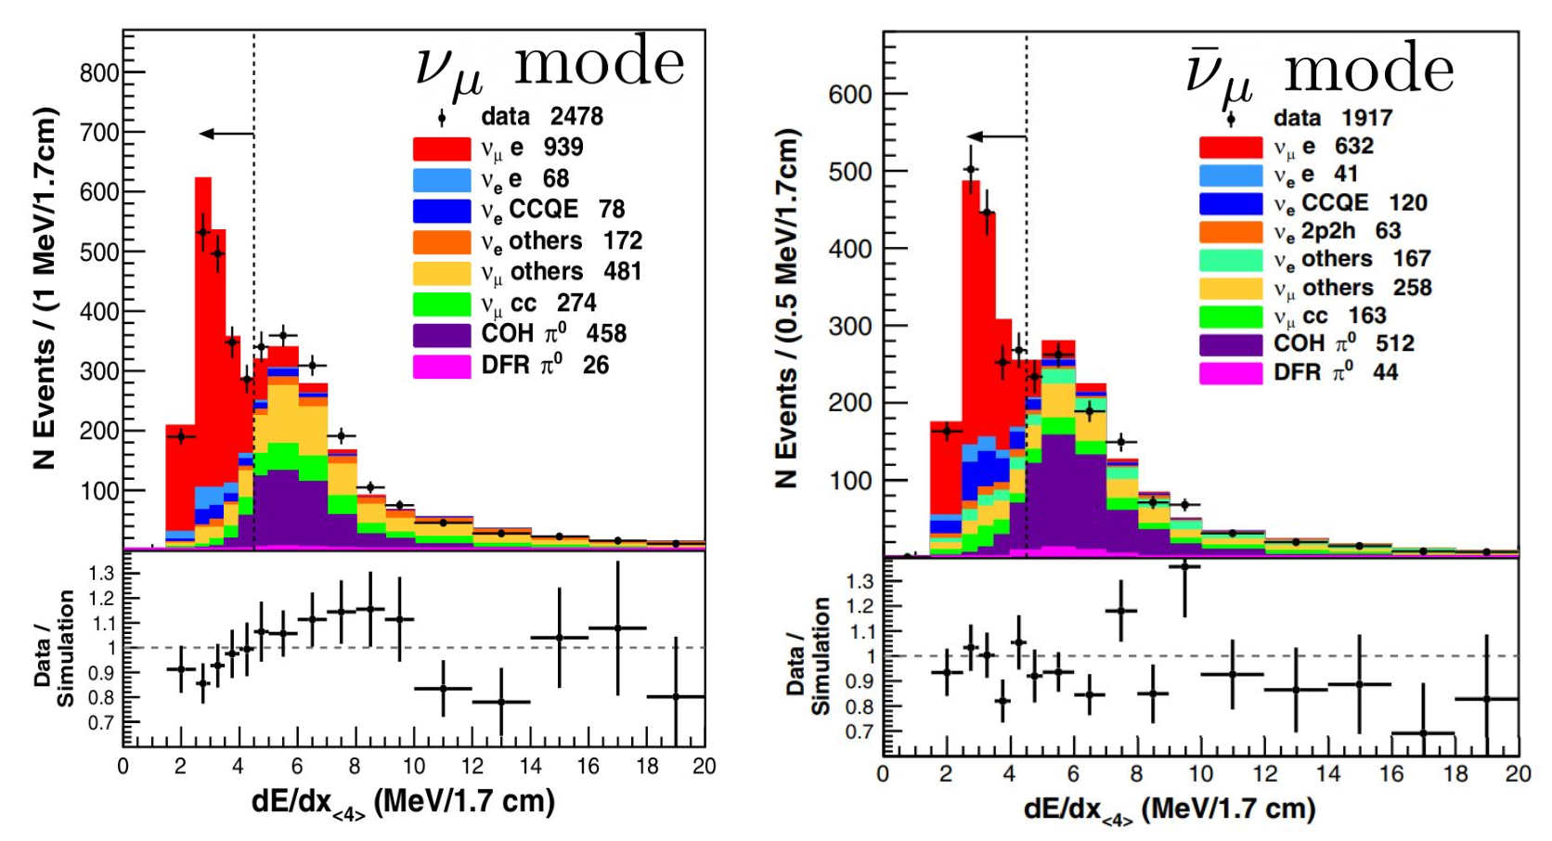
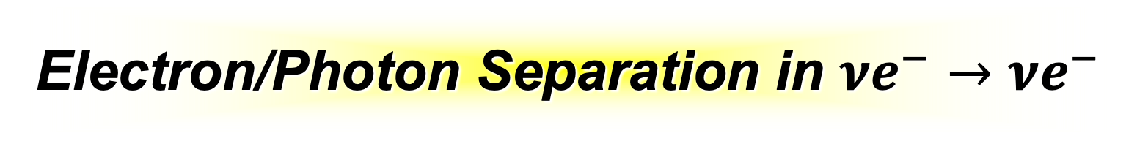
Electron/Photon Separation in $νe^{−}→νe^{−}$
Background from production neutral pions is manageable with dE/dx in scintillator, even with an electron energy threshold of 800 MeV.
In Liquid argon TPCs, separation by dE/dx is surprisingly(?) similar.
MINERvA, Phys.Rev.D 107
(2023) 1, 012001

Slide 20
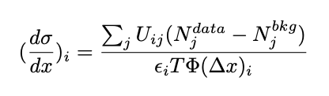
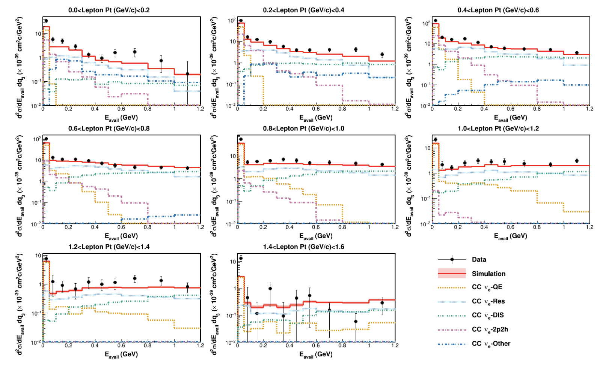

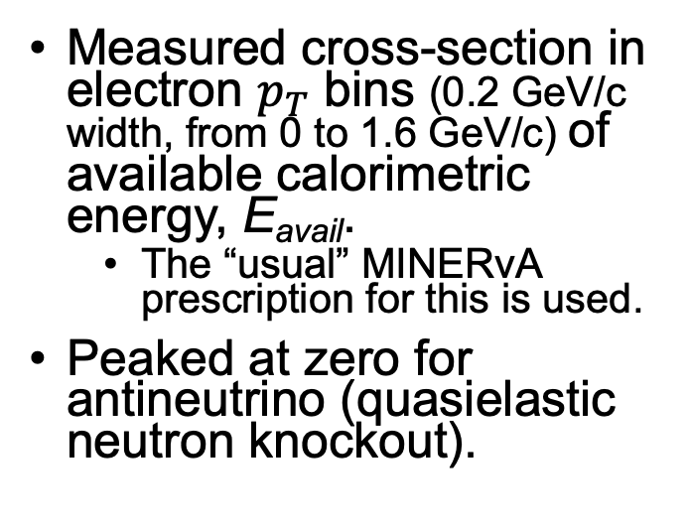
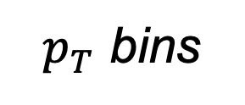
Antineutrino Cross Section
After background subtractions, unfolding, flux and targets calculation…
$p_{T}$ bins
Measured cross-section in electron $p_{T}$ bins (0.2 GeV/c width, from 0 to 1.6 GeV/c) of available calorimetric energy, E_{avail}.
  The “usual” MINERvA prescription for this is used.
Peaked at zero for antineutrino (quasielastic neutron knockout).
MINERvA, Phys.Rev.D 109 (2024) 9, 092008
Eavail ≡ (Proton and π± KE)
+ (E of other particles except neutrons)
$E_{avail}$ (GeV)

Slide 21
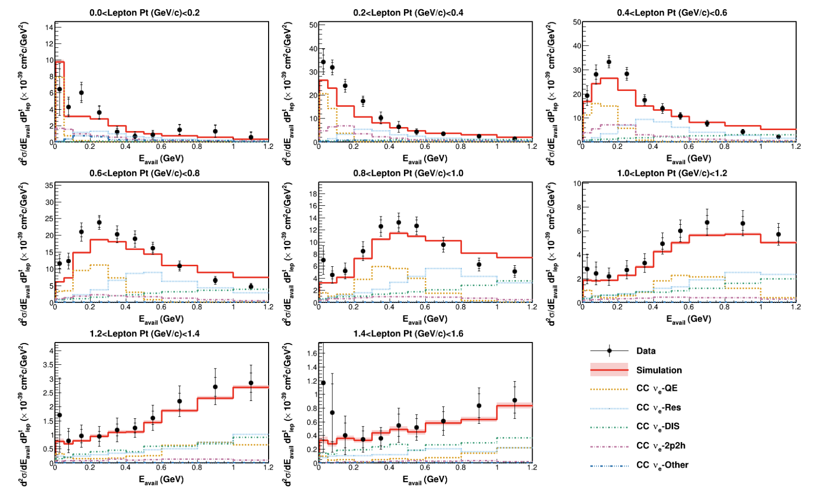
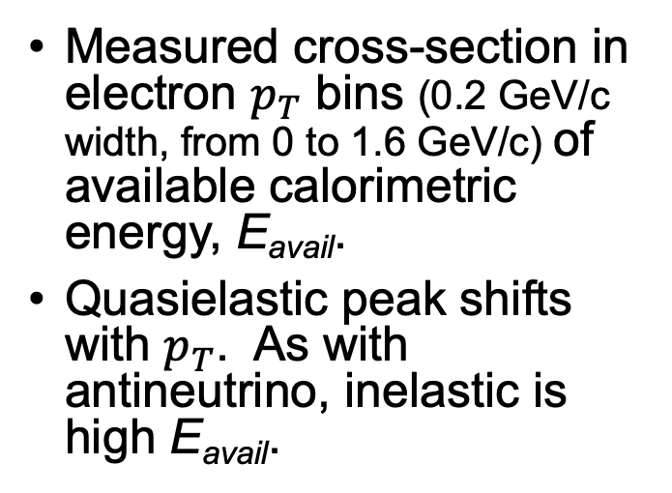
Neutrino Cross Section
After background subtractions, unfolding, flux and targets calculation…
$p_{T}$ bins
Measured cross-section in electron $p_{T}$ bins (0.2 GeV/c width, from 0 to 1.6 GeV/c) of available calorimetric energy, E_{avail}.
Quasielastic peak shifts with $p_{T}$. As with antineutrino, inelastic is high E_{avail}.
MINERvA, Phys.Rev.D 109 (2024) 9, 092008
Eavail ≡ (Proton and π± KE)
+ (E of other particles except neutrons)
$E_{avail}$ (GeV)

Slide 22
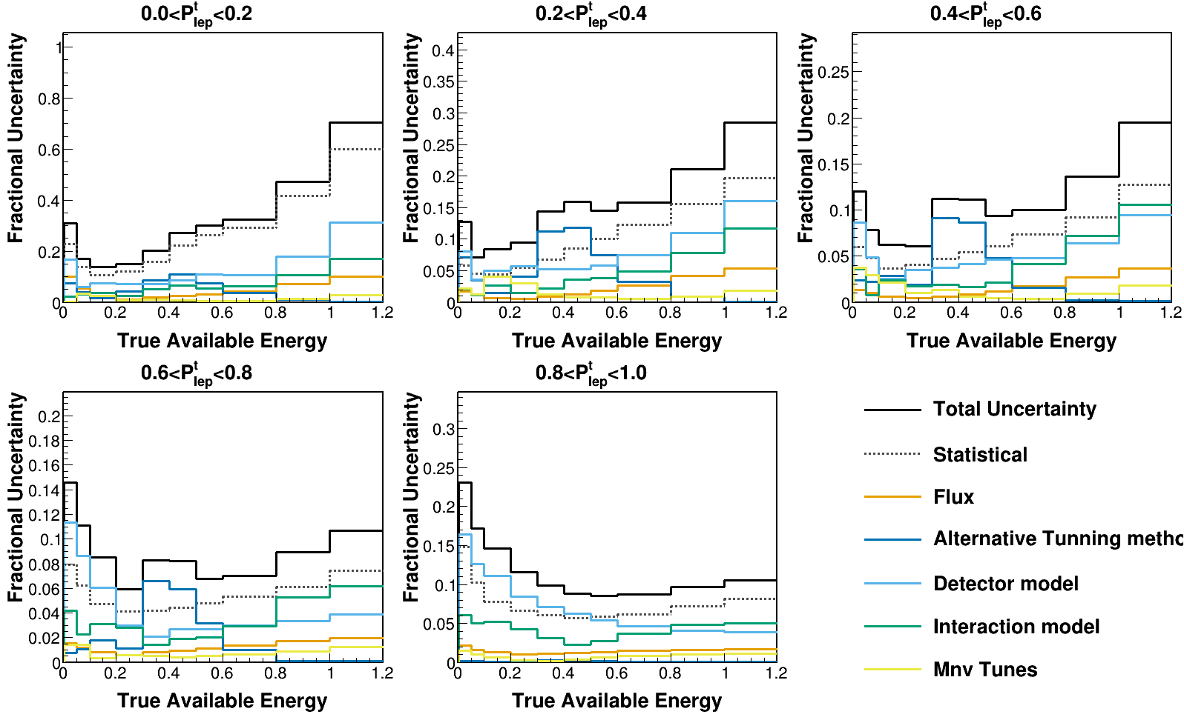

MINERvA: Uncertainties on 𝜈_{e} /𝜈_{𝜇}
𝜈_{e} /𝜈_{𝜇}
These are preliminary, and so far only for neutrinos.
Systematic uncertainties are ~subdominant, at least in any given bin.
Detector model (muon energy scale) becomes significant. But flux and interaction models are small uncertainties.

Slide 23

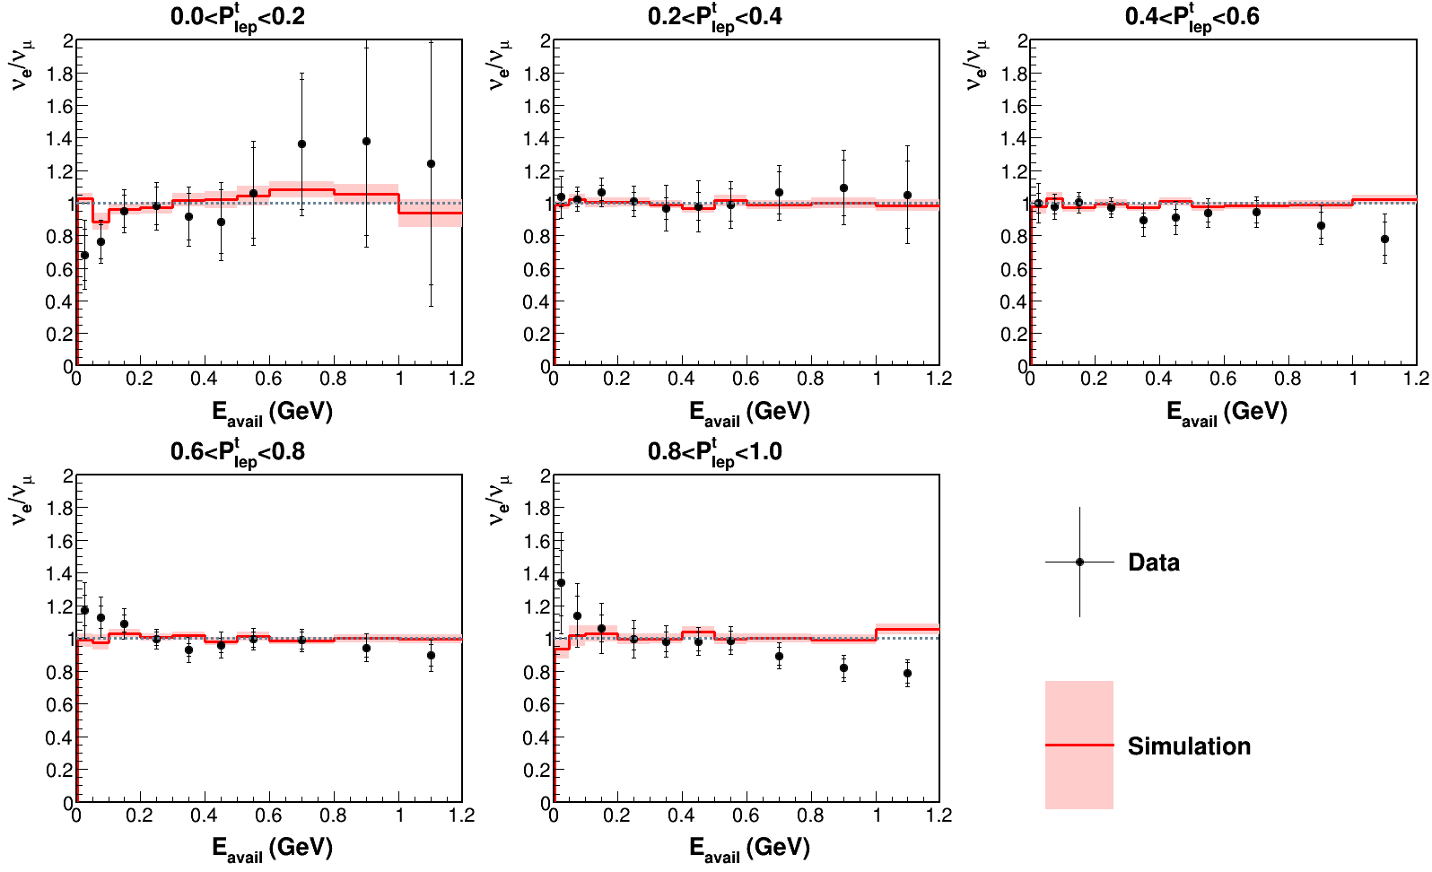
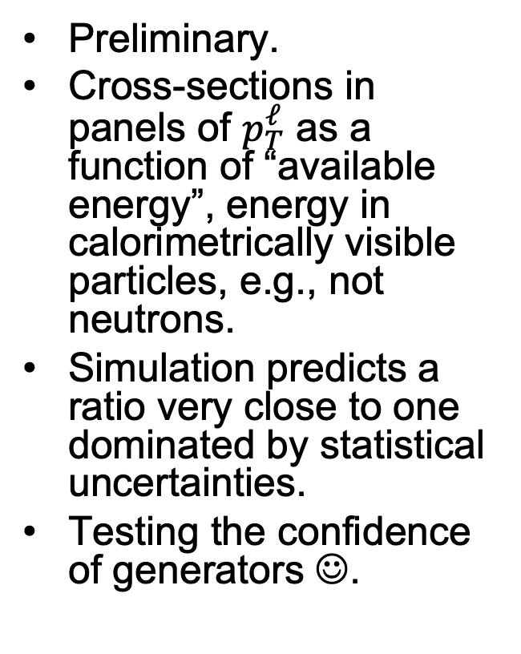
MINERvA 𝜈_{e} /𝜈_{𝜇} Ratios
𝜈_{e} /𝜈_{𝜇}
Preliminary.
Cross-sections in panels of $p_{T}^{ℓ}$ as a function of “available energy”, energy in calorimetrically visible particles, e.g., not neutrons.
Simulation predicts a ratio very close to one dominated by statistical uncertainties.
Testing the confidence of generators ☺.
MINERvA Preliminary, McFarland NuINT24
Notes:
Margherita referenced the result, but here is the preliminary version of the ratio to muon neutrinos. These are cross-section ratios, with the muon neutrinos corrected for flux, in panels of pT as a function of visible calorimetric energy

Slide 24
Flavor (or color?) commentary
I’ve given one (MINERvA) example, but T2K, MicroBooNE, and NOvA (in order of increasing statistics) are active early explorers.
The MINERvA inclusive measurement has ~10% uncertainties in many bins across a wide range of recoil and transverse momenta, with systematic uncertainties ~few% in the high statistics bins.
  We need to do better than that by factors of two or three in order to interpret oscillation experiments with experimental confirmation of flavor dependence of cross-sections.
With very high statistics from future beams, supplemented by far off-axis samples (enriched in 𝜈_{e}) from SBN (ICARUS) and MicroBooNE, we can make a go at this. Still very difficult.

Slide 25
Multiply Differential Measurements
(if need to use both the lepton and recoil to learn about neutrino energy, don’t we need to know how they are correlated?)
Notes:
Nuclear dependence is a thing… or is it?

Slide 26

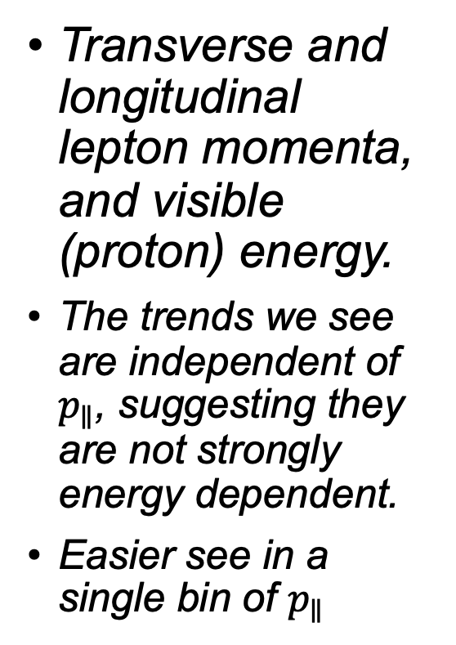
MINERvA “3D” CC0$π$ $ΣT_{p}$, $p_{T}$, $p_{∥}$
Transverse and longitudinal lepton momenta, and visible (proton) energy.
The trends we see are independent of $p_{∥}$, suggesting they are not strongly energy dependent.
Easier see in a single bin of $p_{∥}$
D. Ruterbories et al. Phys.Rev.Lett. 129 (2022) 2, 021803

Slide 27
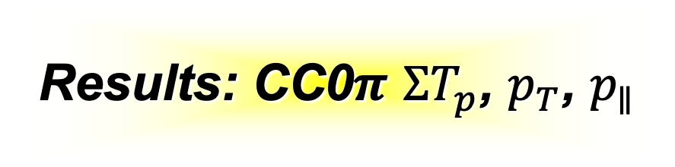
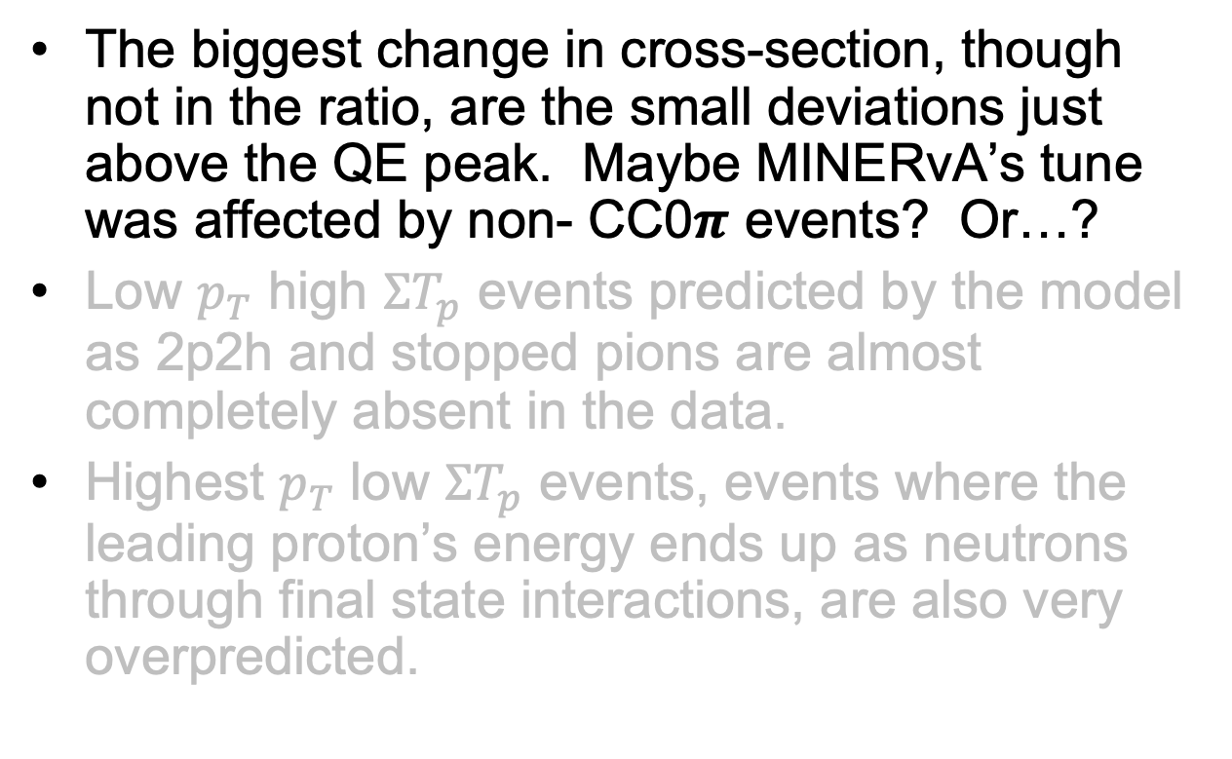
Results: CC0$π$ $ΣT_{p}$, $p_{T}$, $p_{∥}$
D. Ruterbories et al. Phys.Rev.Lett. 129 (2022) 2, 021803
The biggest change in cross-section, though not in the ratio, are the small deviations just above the QE peak. Maybe MINERvA’s tune was affected by non- CC0$π$ events? Or…?
Low $p_{T}$ high $ΣT_{p}$ events predicted by the model as 2p2h and stopped pions are almost completely absent in the data.
Highest $p_{T}$ low $ΣT_{p}$ events, events where the leading proton’s energy ends up as neutrons through final state interactions, are also very overpredicted.
Notes:
would have been better to put in some highlights… this slide and the next three

Slide 28
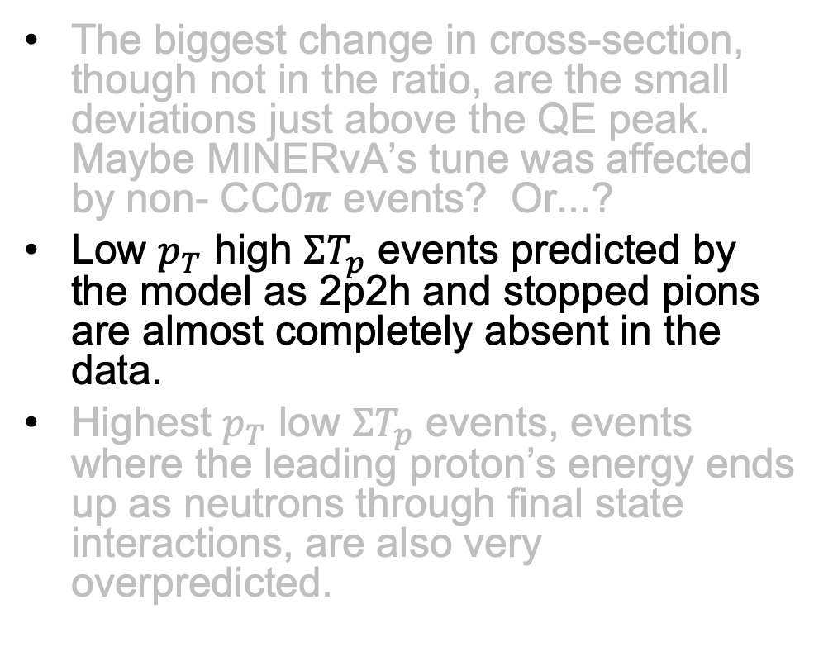
Results: CC0$π$ $ΣT_{p}$, $p_{T}$, $p_{∥}$
The biggest change in cross-section, though not in the ratio, are the small deviations just above the QE peak. Maybe MINERvA’s tune was affected by non- CC0$π$ events? Or...?
Low $p_{T}$ high $ΣT_{p}$ events predicted by the model as 2p2h and stopped pions are almost completely absent in the data.
Highest $p_{T}$ low $ΣT_{p}$ events, events where the leading proton’s energy ends up as neutrons through final state interactions, are also very overpredicted.
D. Ruterbories et al. Phys.Rev.Lett. 129 (2022) 2, 021803

Slide 29
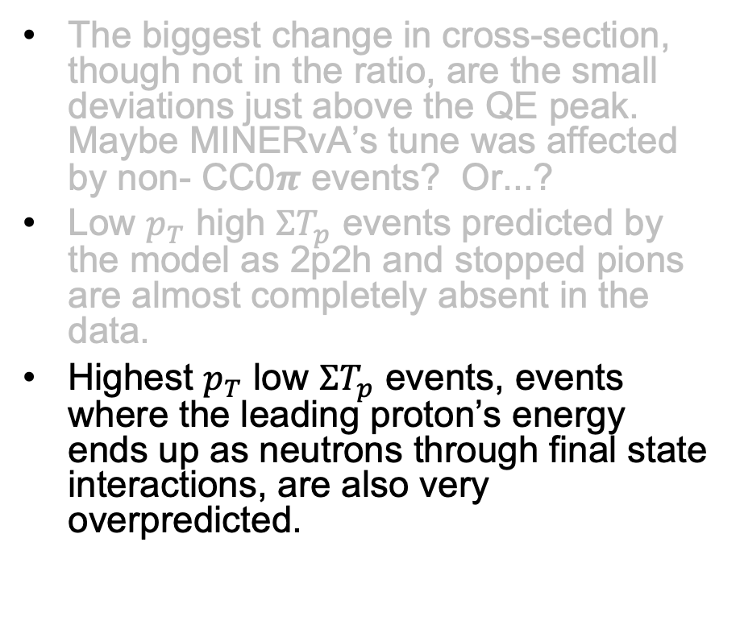
Results: CC0$π$ $ΣT_{p}$, $p_{T}$, $p_{∥}$
The biggest change in cross-section, though not in the ratio, are the small deviations just above the QE peak. Maybe MINERvA’s tune was affected by non- CC0$π$ events? Or...?
Low $p_{T}$ high $ΣT_{p}$ events predicted by the model as 2p2h and stopped pions are almost completely absent in the data.
Highest $p_{T}$ low $ΣT_{p}$ events, events where the leading proton’s energy ends up as neutrons through final state interactions, are also very overpredicted.
D. Ruterbories et al. Phys.Rev.Lett. 129 (2022) 2, 021803

Slide 30
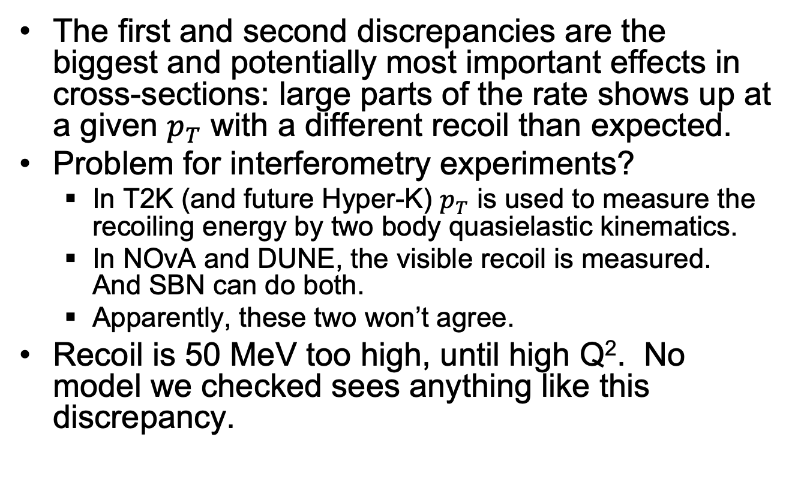
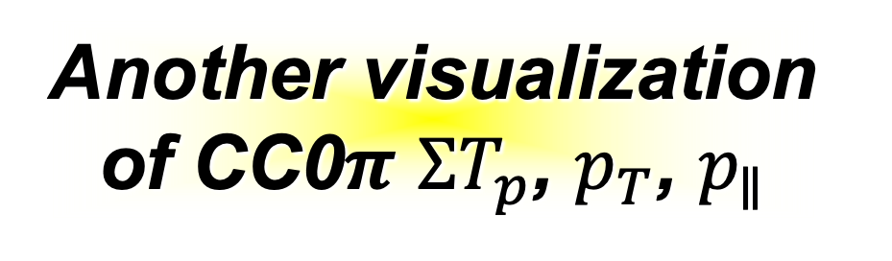
Another visualization of CC0$π$ $ΣT_{p}$, $p_{T}$, $p_{∥}$
D. Ruterbories et al. Phys.Rev.Lett. 129 (2022) 2, 021803
The first and second discrepancies are the biggest and potentially most important effects in cross-sections: large parts of the rate shows up at a given $p_{T}$ with a different recoil than expected.
Problem for interferometry experiments?
  In T2K (and future Hyper-K) $p_{T}$ is used to measure the recoiling energy by two body quasielastic kinematics.
  In NOvA and DUNE, the visible recoil is measured. And SBN can do both.
  Apparently, these two won’t agree.
Recoil is 50 MeV too high, until high Q². No model we checked sees anything like this discrepancy.

Slide 31
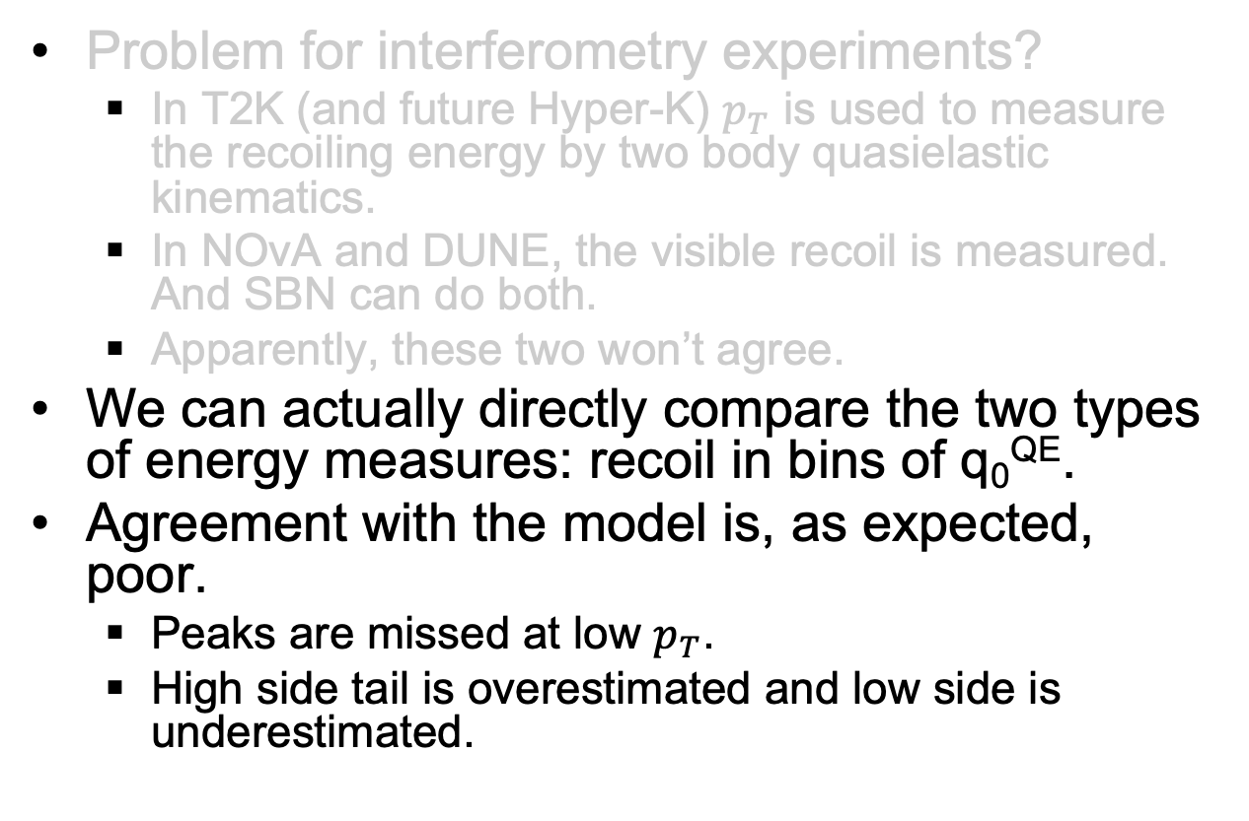

Another visualization of CC0$π$ $ΣT_{p}$, $p_{T}$, $p_{∥}$
D. Ruterbories et al. Phys.Rev.Lett. 129 (2022) 2, 021803
Problem for interferometry experiments?
  In T2K (and future Hyper-K) $p_{T}$ is used to measure the recoiling energy by two body quasielastic kinematics.
  In NOvA and DUNE, the visible recoil is measured. And SBN can do both.
  Apparently, these two won’t agree.
We can actually directly compare the two types of energy measures: recoil in bins of q₀^{QE}.
Agreement with the model is, as expected, poor.
  Peaks are missed at low $p_{T}$.
  High side tail is overestimated and low side is underestimated.

Slide 32




Transverse variables, full MINERvA CC0$π$ statistics
Transverse momentum imbalance in reaction plane is sensitive to Fermi motion and (bias) from removal energy.
Expect momentum dependence.
all processes
Summary of optical potential from electron scattering
A. Bodek and T. Cai, Eur. Phys. J. C. (2019) 79: 293
MINERvA Preliminary, Ruterbories NuINT24

Slide 33

Transverse variables, full MINERvA CC0$π$ statistics
in reaction plane, sensitive to Fermi motion and (bias) from removal energy
quasielastic, after other processes subtracted
Summary of optical potential from electron scattering
A. Bodek and T. Cai, Eur. Phys. J. C. (2019) 79: 293
MINERvA Preliminary, Ruterbories NuINT24

Slide 34
Different Nuclei
(and how different are they for our purposes?)
Notes:
Nuclear dependence is a thing… or is it?

Slide 35



Is a nucleus a nucleus a nucleus?
Details of nuclei, such as energies and momenta of individual nucleons within the nucleus, vary.
But we are beginning to see some consistencies in how models describe different nuclei equally well (or equally poorly).
MINERvA CH/C/H₂O/Fe/Pb
T2K CH/H₂O
Notes:
Actually, we have some evidence from data the Margherita interpreted as showing the ability to downselect pion final state interaction models – which is is – as showing that another nuclear effect (a large correction to the Q2 shape estimated in scattering on nuclei actually appears universal from carbon to iron to lead. This is an example of growing confidence that we are building in our nuclear models to predict scaling from one nucleus to another.

Slide 36
CH Detector and Passive Targets
Experiments with passive interspersed targets use a vertex and background subtraction technique.
Can control the backgrounds,
at least in part, by reconstructing
scintillator events adjacent in
detector to the passive target.

Slide 37


T2K CC0π CH vs H₂O
T2K compares CC0π cross-sections on its CH vs H₂O.
  Labeled “O” and “C” since there is no neutrino CC0π cross-section on hydrogen.
Measurements directly check lepton kinematic differences since in the same beam.
  Consistent with model within uncertainties.
  Same beam is very important for reducing uncertainties!
T2K, Phys.Rev.D 101 (2020) 11, 112004

Slide 38



MINERvA CC0π {C, H₂O, Fe, Pb}/CH
MINERvA’s targets allow for comparison across a wide range of A.
  Not particularly high statistics for most C and H₂O results (so not enough to subtract out CH-H to get hydrogen, for example), but good statistics for Fe and Pb.
  Reasonable consistency, if varied the fraction of non-quasielastic events?
Ratios to CH
MINERvA, Phys.Rev.Lett. 130 (2023) 16, 161801

Slide 39





MINERvA CC0π {C, H₂O, Fe, Pb}/CH
Also ratios for transverse kinematic imbalances.
Perhaps same issue with non-quasielastic contribution differing?
Ratios to CH
$$δα_{T}$$
MINERvA, publication in process,
J. Kleykamp FNAL W&C

Slide 40




MINERvA CC0π {C, H₂O, Fe, Pb}/CH
Also ratios for transverse kinematic imbalances.
Perhaps same issue with non-quasielastic contribution differing?
Ratios to CH
$$δp_{T}$$
MINERvA, publication in process,
J. Kleykamp FNAL W&C

Slide 41



MINERvA CCπ⁺ {C, H₂O, Fe, Pb}/CH
Result is generally that we see similar shapes in $T_{π}$ and $p_{T}^{μ}$ ($Q^{2}≈{\left(p_{T}^{μ}\right)}^{2}\left(1+\frac{ν}{E_{μ}}\right)$).
However the overall result rate is different, for some models of π⁺ FSI.
MINERvA, Phys.Rev.Lett. 131 (2023) 1, 1

Slide 42
Neutrons, Nucleons and Nuclei
(rapid recent development)

Slide 43



Neutron reconstruction
MINERvA has, and SuperFGD will reconstruct neutrons through their quasielastic knockout of protons from nuclei, e.g., ¹²C(n,np)¹¹B
  SuperFGD has lower threshold
  three-dimensional reconstruction
  AND time-of-flight momentum.
Phys. Rev. D101 (2020) 9, 092003
Nature, 614, 48-53
Giganti, T2K
Notes:
The technique in scintillator (or Ar for that matter) is detection of protons quasielastically knocked out. MINERvA showed this technique could work in scintillator strips with poor timing, but T2K SuperFGD has much lower thresholds with its native 3D reconstruction and adds TOF capabilities allowing for energy measurement as well, at least at the lower energies.

Slide 44

Why Neutron Reconstruction Matters
Neutron measurement techniques developed in recent years, through detector and analysis technologies, are having its time.
  I will emphasize isolation of hydrogen on ${\overline{ν}}_{μ}p→μ^{+}n$.
  But this also has applications for understanding of energy lost to nuclei in interactions because of very low detection thresholds, neutrino and antineutrino separation, etc.
Efficiency of reconstruction is significantly less than unity, requires capable (often smaller) detectors, so the highest intensity neutrino beams will also be important for this work.

Slide 45



Neutron and Axial Form Factor
MINERvA used neutron reconstruction and ability to isolate events on hydrogen (only with direction!) to measure $F_{A}\left(Q^{2}\right)$ with useful precision ${0.06<Q}^{2}≲2$ GeV².
SuperFGD will have two handles, direction and energy, to isolate hydrogen scattering.
Nature, 614, 48-53
Phys. Rev. D 101, 092003 (2020),
(figure assembled by L. Munteanu)
Notes:
We have seen first phsycs with this. MINERvA used direction to kinematically isolate CC elastic scattering on hydrogen to measure the axial form factor. But the T2K SuperFGD with energy also and lower thresholds should do far better. Example of trasnverse kinematic balance separation where there can be S/N exceeding 1:1 (MINERvA is more like 1:3)

Slide 46


DUNE-ND “Solid Hydrogen” from CH_{n}
The DUNE SAND near detector plans CH₂ and C foils interspersed with low density tracker.
This adds a third handle to direction and energy constraints, for separating hydrogen interactions by subtraction.
Significant potential to dramatically reduce backgrounds and systematics in a high statistics measurement.
  Caveat: the estimate at right isn’t a projection from DUNE (third-party authors), and IMHO it uses a deeply flawed metric. (But “it’s got a beat, and you can dance to it.”)
one realization of the SAND low-density tracker
Phys.Rev.D 109 (2024) 5, L051301
Notes:
This seems to motivate more measurements on free nucleons. And important player will be DUNE-ND. Recall that the SAND detector has a low density tracker with CH2 and C foils, so can infer H from subtraction. This adds another handle to reduce systematic uncertainties, and the high statistics in the DUNE beam should allow an enormous improvement.

Slide 47



Nucleons vs Nuclei
By contrast, we are struggling to understand cross-sections on free nucleons as a base for calculating cross-sections on nucleons.
In $F_{A}\left(Q^{2}\right)$, there are significant
tensions between the deuterium
bubble chamber legacy data, and
either the MINERvA hydrogen or
lattice QCD calculations.
Why? It’s possible that nuclear
model assumptions in the analysis
of the deuterium data played a role.
More from Aaron and Minoo on Thursday.
Aaron Meyer, NuINT 2024
Notes:
But when it comes to free nucleon form factors, we are in more chaos. Aaron Meyer’s work at NuINT showed that there are serious problems with the deuterium bubble chamber data because of its internal inconsistency and incompatibility with the hydrogen measurement form MINERvA and with LQCD. Maybe the data was messed up by nuclear effects assumed in the analysis?

Slide 48

Nucleon and Nuclei commentary
We’ve made progress in our nuclear models, informed by electron scattering, theory, and data from neutrinos and hadron scattering.
While there is growing evidence that these models
may be helping us to understand nuclear effects,
there is also growing evidence that the input of
free nucleon predictions is not serving us well.
Experiments that can measure or theory that can
calculate free-nucleon interactions, will become
increasingly important.
  This suggests a continuing role for scintillator, but maybe
  also a future need for free nucleon (hydrogen) detectors.
Understanding
Data on nuclei
Nuclear Model
Data on nucleons

Slide 49
Closing Thoughts

Slide 50


H and C and Ar… Can’t we just all be friends?
As Callum mentioned in passing, SAND (DUNE Phase One on-axis Near Detector) plans to include CH₂ and C, for separation of H and C, and Ar targets to compare interactions on different nuclei.
Notes:
DUNE’s ND also has an on-axis magnetized low density tracker detector with CH2 and C foil targets with a LAr target. Low thresholds, good charge and PID, and the ability to directly compare rates on different targets.

Slide 51


Brave Brew World?
Ar targets inside a CH detector reminded me of the enthusiasm of true believers.
New Starbucks Opens In Rest Room Of Existing Starbucks
CAMBRIDGE, MA—Starbucks, the nation’s largest coffee-shop chain, continued its rapid expansion Tuesday, opening its newest location in the men’s room of an existing Starbucks.
“Coffee lovers just can’t stand being far from their favorite Starbucks gourmet blends,” said Chris Tuttle, Starbucks vice-president of franchising. “Now, people can enjoy a delicious Frappuccino or espresso just about any time they please, even while defecating.”
The new men’s-room-based Starbucks, the coffee giant’s 1,531st U.S. location, will be open to both men and women when not “in use.” In addition to offering specialty coffees from around the world, it will serve freshly baked pastries, Italian pannini sandwiches and soups, as well as the rest room’s usual selection of toilet paper and soap…
According to Starbucks CEO Howard Schultz, the new location represents the beginning of a long-term expansion plan… At some point a ‘Starbucks Express’ window will eventually open in the walk-in closet of the men’s room Starbucks.”
“Drink our coffee,” Schultz said. “Drink it.”
Notes:
The Onion is a long-running satirically United States news publication. Now that social media and search engines have destroyed US journalism (by stealing their content), and have sent the United States hurdling headlong towards authoritarianism (is this being recorded?), the Onion has recently changed its distribution strategy to emphasize its print edition. Perhaps a meta-ironic move, or perhaps not.

Slide 52
Brave Brew World?
Ar targets inside a CH detector reminded me of the enthusiasm of true believers.
New Starbucks Opens In Rest Room Of Existing Starbucks
CAMBRIDGE, MA—Starbucks, the nation’s largest coffee-shop chain, continued its rapid expansion Tuesday, opening its newest location in the men’s room of an existing Starbucks.
“Coffee lovers just can’t stand being far from their favorite Starbucks gourmet blends,” said Chris Tuttle, Starbucks vice-president of franchising. “Now, people can enjoy a delicious Frappuccino or espresso just about any time they please, even while defecating.”
The new men’s-room-based Starbucks, the coffee giant’s 1,531st U.S. location, will be open to both men and women when not “in use.” In addition to offering specialty coffees from around the world, it will serve freshly baked pastries, Italian pannini sandwiches and soups, as well as the rest room’s usual selection of toilet paper and soap…
According to Starbucks CEO Howard Schultz, the new location represents the beginning of a long-term expansion plan… At some point a ‘Starbucks Express’ window will eventually open in the walk-in closet of the men’s room Starbucks.”
“Drink our coffee,” Schultz said. “Drink it.”

Slide 53
Brave Brew World?
Ar targets inside a CH detector reminded me of the enthusiasm of true believers.
New Starbucks Opens In Rest Room Of Existing Starbucks
CAMBRIDGE, MA—Starbucks, the nation’s largest coffee-shop chain, continued its rapid expansion Tuesday, opening its newest location in the men’s room of an existing Starbucks.
“Coffee lovers just can’t stand being far from their favorite Starbucks gourmet blends,” said Chris Tuttle, Starbucks vice-president of franchising. “Now, people can enjoy a delicious Frappuccino or espresso just about any time they please, even while defecating.”
The new men’s-room-based Starbucks, the coffee giant’s 1,531st U.S. location, will be open to both men and women when not “in use.” In addition to offering specialty coffees from around the world, it will serve freshly baked pastries, Italian pannini sandwiches and soups, as well as the rest room’s usual selection of toilet paper and soap…
According to Starbucks CEO Howard Schultz, the new location represents the beginning of a long-term expansion plan… At some point a ‘Starbucks Express’ window will eventually open in the walk-in closet of the men’s room Starbucks.”
“Drink our coffee,” Schultz said. “Drink it.”

Slide 54
“Measure Neutrino Interactions”, Schultz said. “Measure Them.”
Although Starbucks CEO Howard Schultz and I may not agree about the importance and function of labor unions, we both agree that measuring neutrino interactions in CH is very important.
There are key capabilities of CH detectors that are hard to duplicate in LAr TPCs, even if resolution is generally worse.
  Configurability of plastic detectors to add alternate targets.
  Fast timing enables high rates and aggressive use of sub-event relative timing for neutrons and weakly decaying mesons.
  Cases where improved ionization resolution isn’t necessarily a big advantage, such as electron identification.
Expect CH to continue to have impact on models, even for DUNE.

Slide 55
Backup

Slide 56
More on MINERvA’s Electron Neutrinos

Slide 57





Characterization of Backgrounds
Discriminant is $dE/dx$ at start of the shower.
Missing diffractive $π$⁰ production on scattering from hydrogen! (Coherent $π$⁰ production from carbon is the dark blue.)
  Also, both diffractive and coherent $π$⁰ production are badly underestimated by the Rein model and Rein-Sehgal and Berger-Sehgal models at high energies, respectively.
There is also significant contamination of electrons to high $dE/dx$ (early showering) and photons to low $dE/dx$ (very asymmetric pair production).
Divide high $dE/dx$ region into diffractive-like (recoiling proton at vertex), coherent-like, and incoherent-like to characterize backgrounds.
$$e^{±}$$
$π$⁰

Slide 58







Characterization of
Backgrounds
RHC…
Diffractive-like
Tune primarily in electron $p_{T}$ for each process separately.
RHC (antineutrino dominant) has much less incoherent $π$⁰ production, so use the RHC results in FHC (neutrino dominant) beam for coherent and $π$⁰ production from carbon is the dark blue.)
(Sideband tune has tensions in FHC beam not observed in RHC. Add an extra systematic uncertainty to cover this in FHC.)
Pre-Tune
Coherent-like
…Sidebands
Incoherent-like

Slide 59


Signal Region after Background Tunes
After tuning the backgrounds, compare signal region.
As expected, backgrounds much larger in FHC (incoherent processes).
Signal FHC
Signal RHC

Slide 60


Discussion and Uncertainties
Reference model is GENIE 2.12.6 with MINERvA tunes. (And yes, Andy Furmanski, a correction for the FSI bug…)
Most useful in comparison to muon neutrinos, BUT this tune largely predicts the MINERvA muon neutrino measurements.
Statistics dominated, mostly, with significant interaction model uncertainties at mid-$p_{T}$.
Flux uncertainties ~5%.
Anti-neutrino uncertainties

Slide 61


Uncertainties in FHC
Statistics dominated, mostly, with significant interaction model uncertainties at mid-$p_{T}$.
FHC has the background tuning uncertainty, due to imperfect sidebands agreement very visible at low $p_{T}$.
Flux uncertainties ~4%.
Neutrino uncertainties

Slide 62

More on MINERvA’s $π^{+}$ Results

Slide 63


New 1π⁺ Result Uncertainties
Cross Sections versus Q²

Slide 64


CC≥1π Cross Section Uncertainties vs. Available Energy-T_{π} and p_{tμ}
Fractional Uncertainties larger for this quantity
Still there are contributions from several sources, no clear source dominates

Slide 65


MINERvA CCπ⁺ {CH, Fe, Pb}
Result is generally that we see similar shapes in $T_{π}$ and $p_{T}^{μ}$ ($Q^{2}≈{\left(p_{T}^{μ}\right)}^{2}\left(1+\frac{ν}{E_{μ}}\right)$).
However the overall result rate is different, for some models of π⁺ FSI.
MINERvA, Phys.Rev.Lett. 131 (2023) 1, 1

