Slide 1
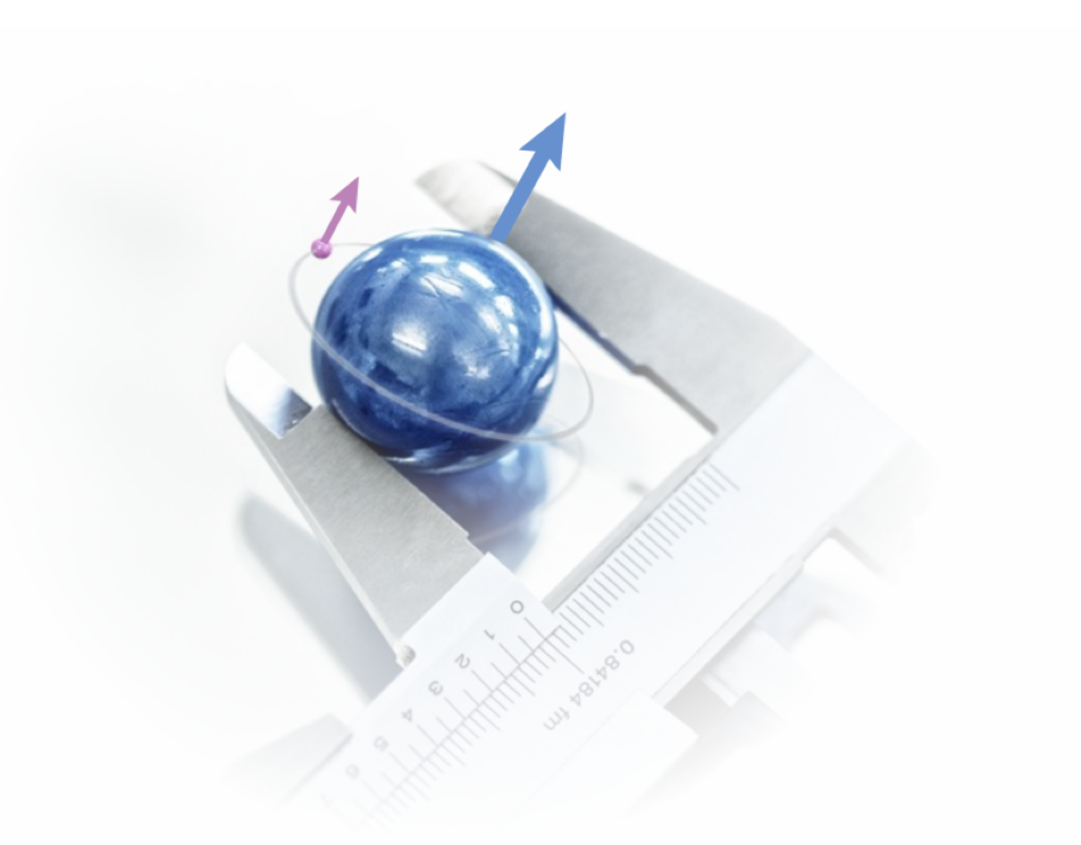




Laser spectroscopy of the ground state hyperfine splitting in muonic H
KAMPAI 2024 Trento
Elmer Gründeman
On behalf of the CREMA collaboration
Notes:
On behalf of CREMA collaboration. We are interested in precision measurements of simple atomic systems. Bound state of 2 particles. This way we can compare measurements with very accurate predictions and test the underlying theory. A good example is hydrogen:

Slide 2
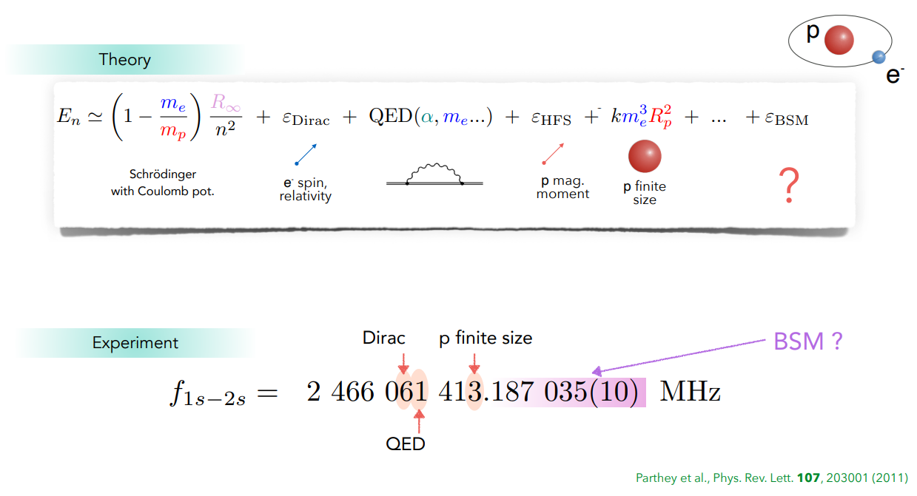
Simple atomic systems
Notes:
Very accurate measurement. But also calculable. You have to take into account relativity, QED corrections, hyperfine interactions and even nuclear size effects. You can see on which digits these effect enter. More exotic BSM effects could influence further digits. A problem though is that the theory needs input constants, which have to be determined experimentally. Their uncertainty stands in the way of more precise tests of BSM physics in such systems

Slide 3
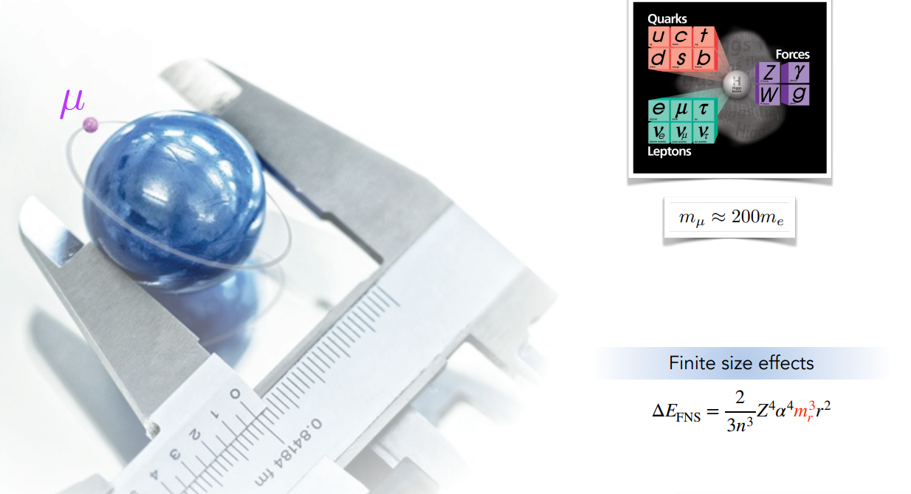

Muonic atom experiments
$$m_{rμ}≈185 m_{re}$$

Slide 4
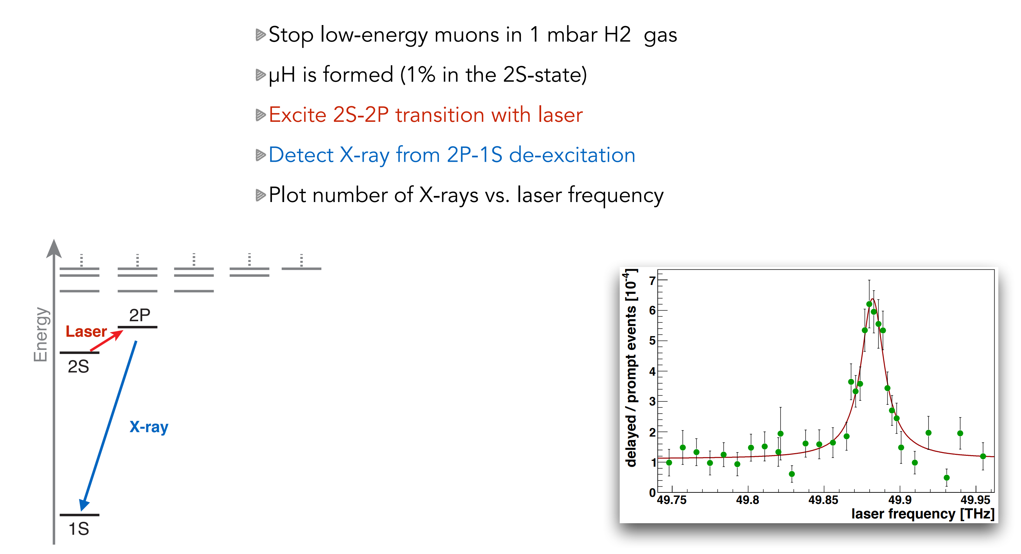
Muonic atom experiments (2010)
2010 measurements
Notes:
1 GHz in hydrogen, close to 50 THz in muonic hydrogen. 6 um can be excited with a laser!
Factor 50,000 of energy

Slide 5
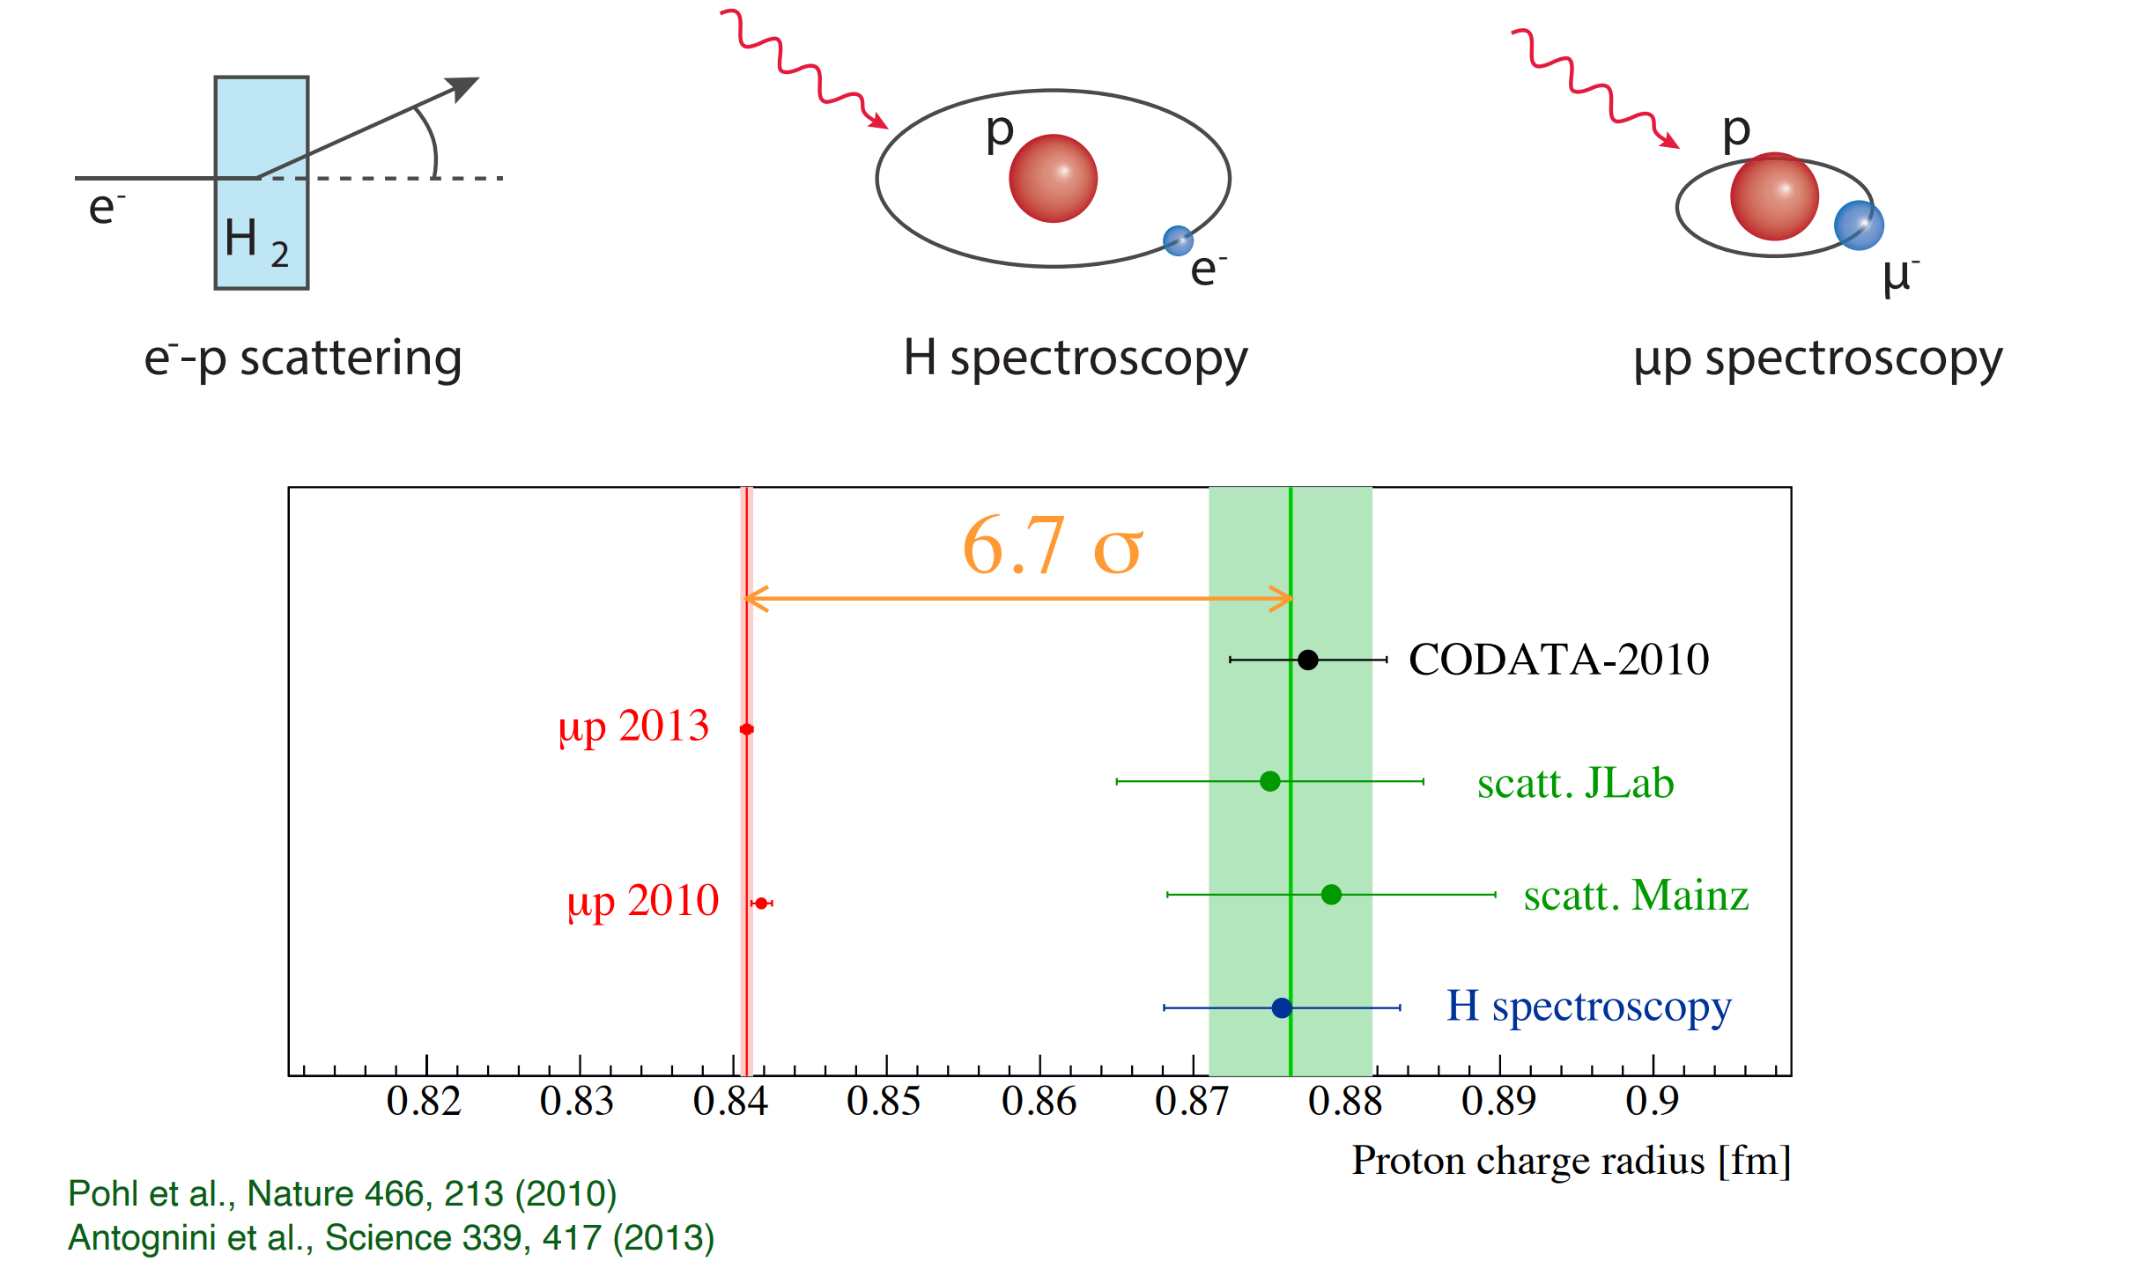
The proton radius puzzle?
2013 situation
Notes:
Seemingly showed a difference between mouns and electrons?

Slide 6
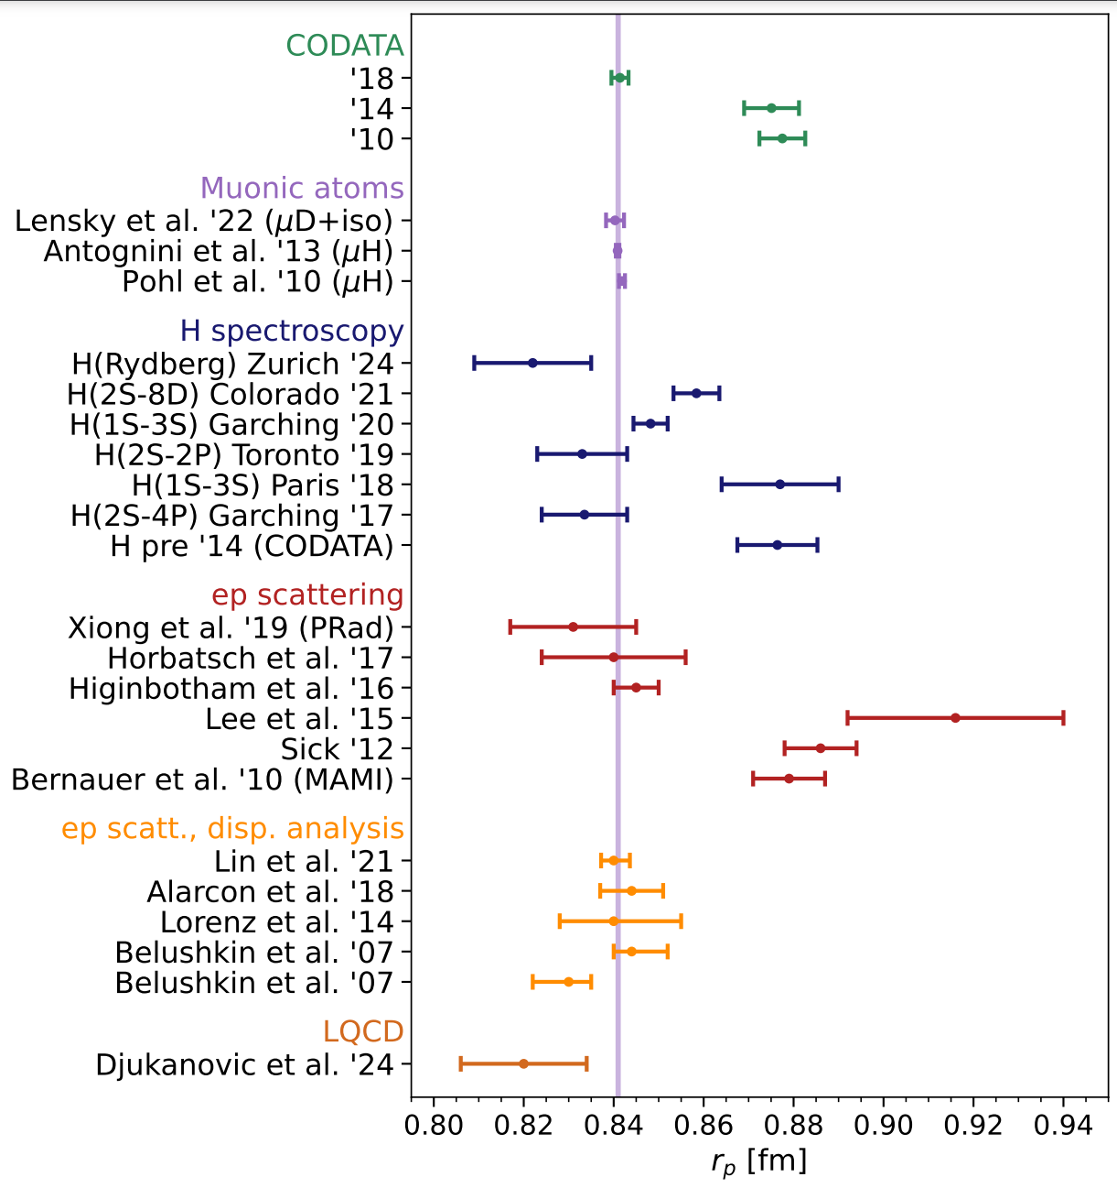
Current situation
Notes:
Nowadays, most likely some measurement mistakes in e-p scattering and H spectroscopy
Shows the value of performing many different measurements!!!!
Also some lattice QCD calculations

Slide 7
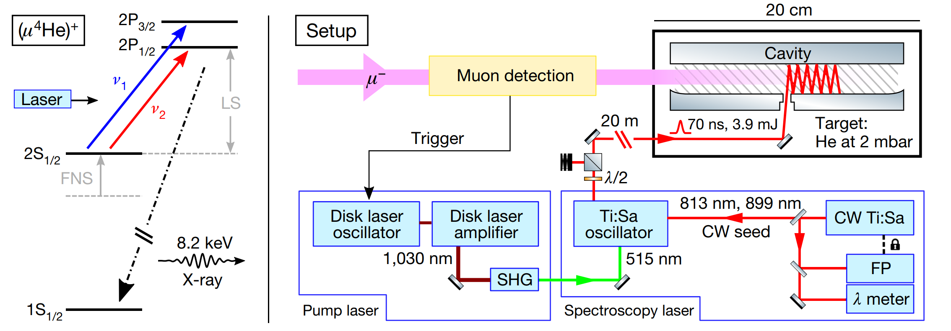
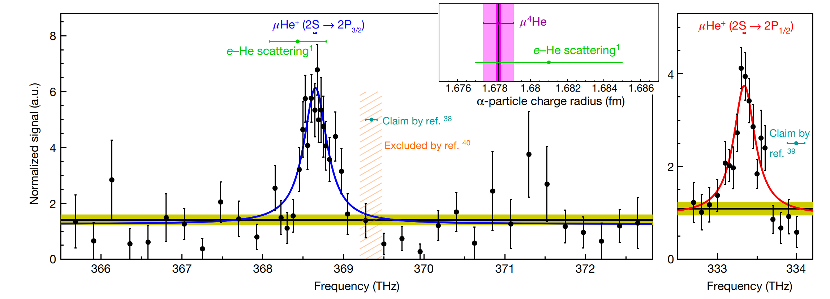
Muonic helium spectroscopy
Krauth, Julian J., et al. Nature 589.7843 (2021): 527-531.

Slide 8
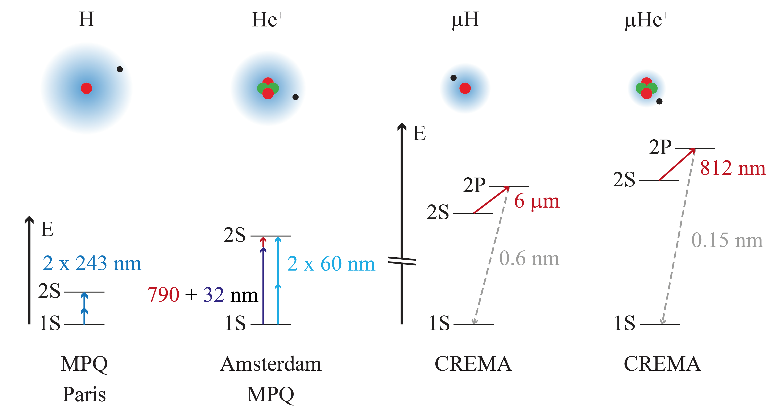
Comparison with electronic He
Results expected
in the next years!
C. Parthey, et al.
PRL 107 203001 (2011)
Pohl, Randolf, et al.
Nature 466, 213-216 (2010)
J.J. Krauth et al.
Nature 589, 527–531 (2021)
Gründeman, Elmer L., et al. arXiv preprint arXiv:2308.13271 (2023)
Moreno, Jorge, et al. The European Physical Journal D 77.4 (2023): 67

Slide 9
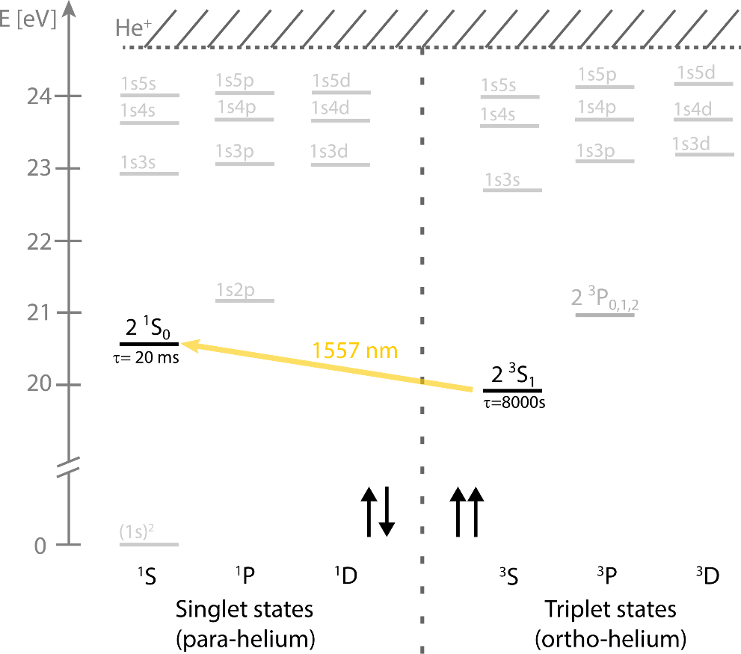
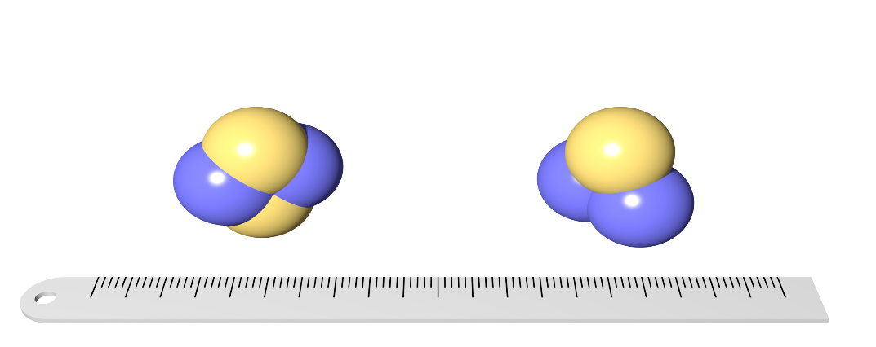
Neutral Helium
No (direct) charge radii extraction currently possible
Nuclear charge radius difference can be extracted through the isotope shift
310 nm
260 nm
1083 nm
Clausen, G., et al. Physical Review Letters 127.9 (2021): 093001.
Clausen, G., et al. Physical Review Letters 131.10 (2023): 103001.
Notes:
Fill in wavelength

Slide 10
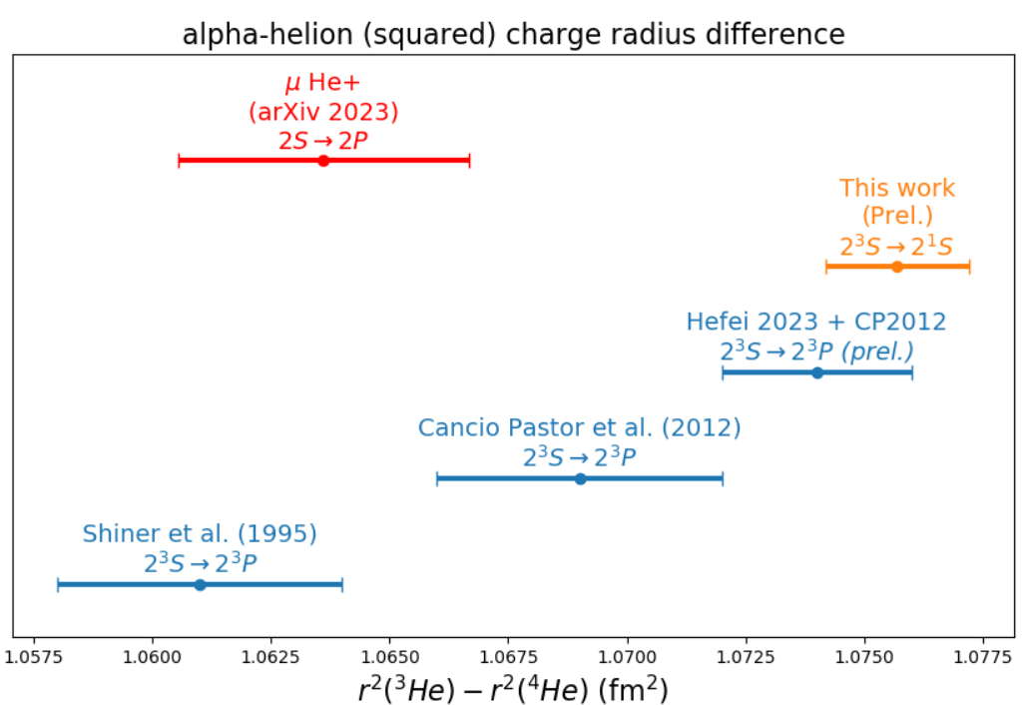
Current situation
Possible issues with
quantum interference!
van der Werf, Y., et al., arXiv:2306.02333 (2023)
Schuhmann, K., et al., arXiv:2305.11679 (2023)
Shiner, D., et al., Phys. Rev. Lett. 74, 3553 (1995).
Cancio Pastor, P., et al., Phys. Rev. Lett. 108, 143001 (2012)
Zheng, X., et al., Phys. Rev. Lett. 119, 263002 (2017)
Marsman, A., et al., Review A 89.4 (2014): 043403.
Notes:
With better measurements, either in He or He+ we can test the nuclear polarizability calculations

Slide 11
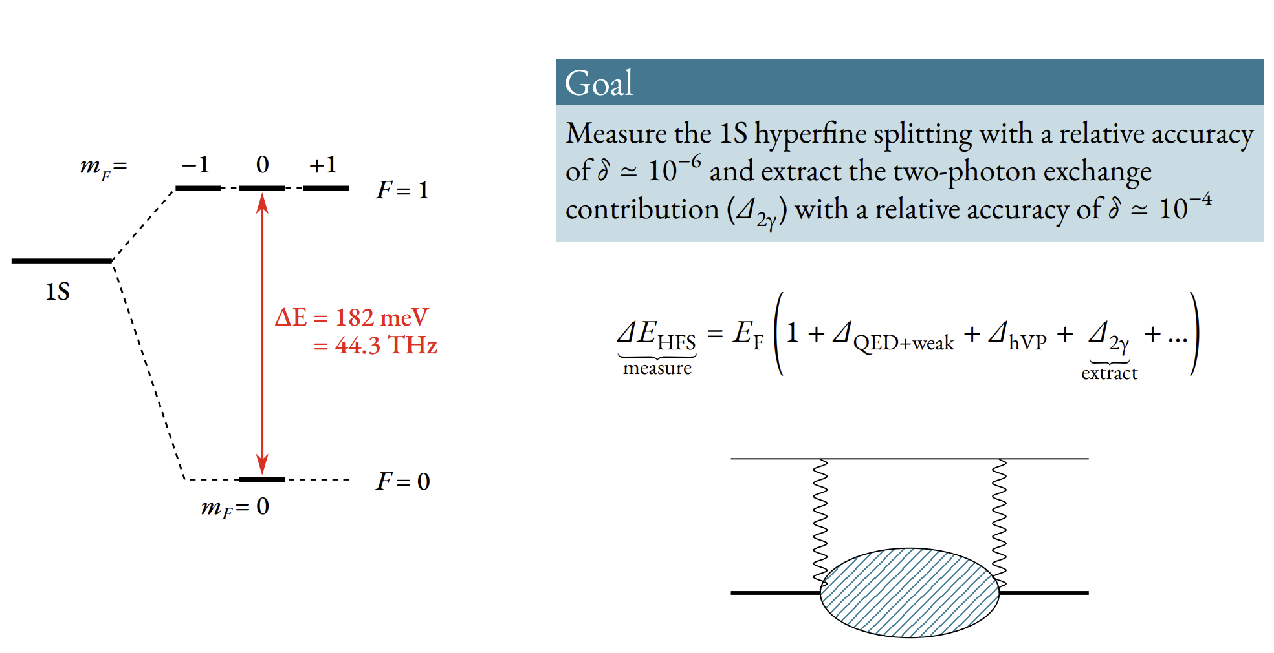
Ground state hyperfine splitting
Notes:
Limiting term is 2 photon exchange

Slide 12
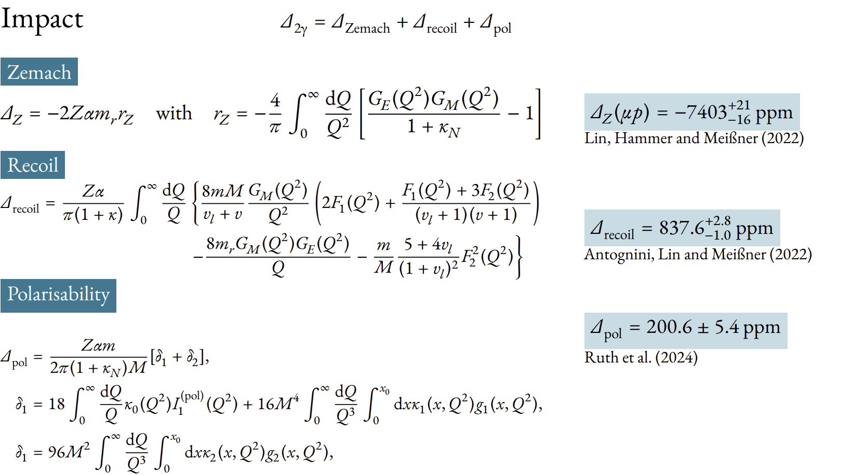
Ground state hyperfine splitting
Notes:
Limiting is the Zemach radius, which is a convolution of the charge and magnetic radius. Electric and magnetic form factors from e-p scattering
Recoil term depends on proton form factors F1 and F2
Polarisability terms g1 and g2 from proton structure functions -> e-p scattering

Slide 13
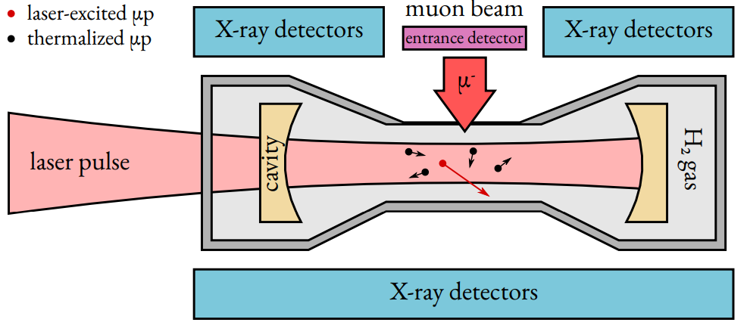
HFS measurement principle
Stop muon in H₂ gas target
(22 K, 0.5 bar and 1 mm thickness)
Formed μp atom de-excites and
thermalizes to H₂ temperature
Laser pulse excites transition:
μp_{(F=0)} + γ → μp_{(F=1)}
Collisional de-excitation:
μp_{(F=1)} + H₂ → μp_{(F=0)} + H₂ + E_{kin}
μp atom diffuses in H₂ gas reaching
Au-coated target walls
Formed μAu* de-excites promptly
producing several MeV X-rays
Detected X-rays are plotted against
laser frequency to obtain the
resonance

Slide 14
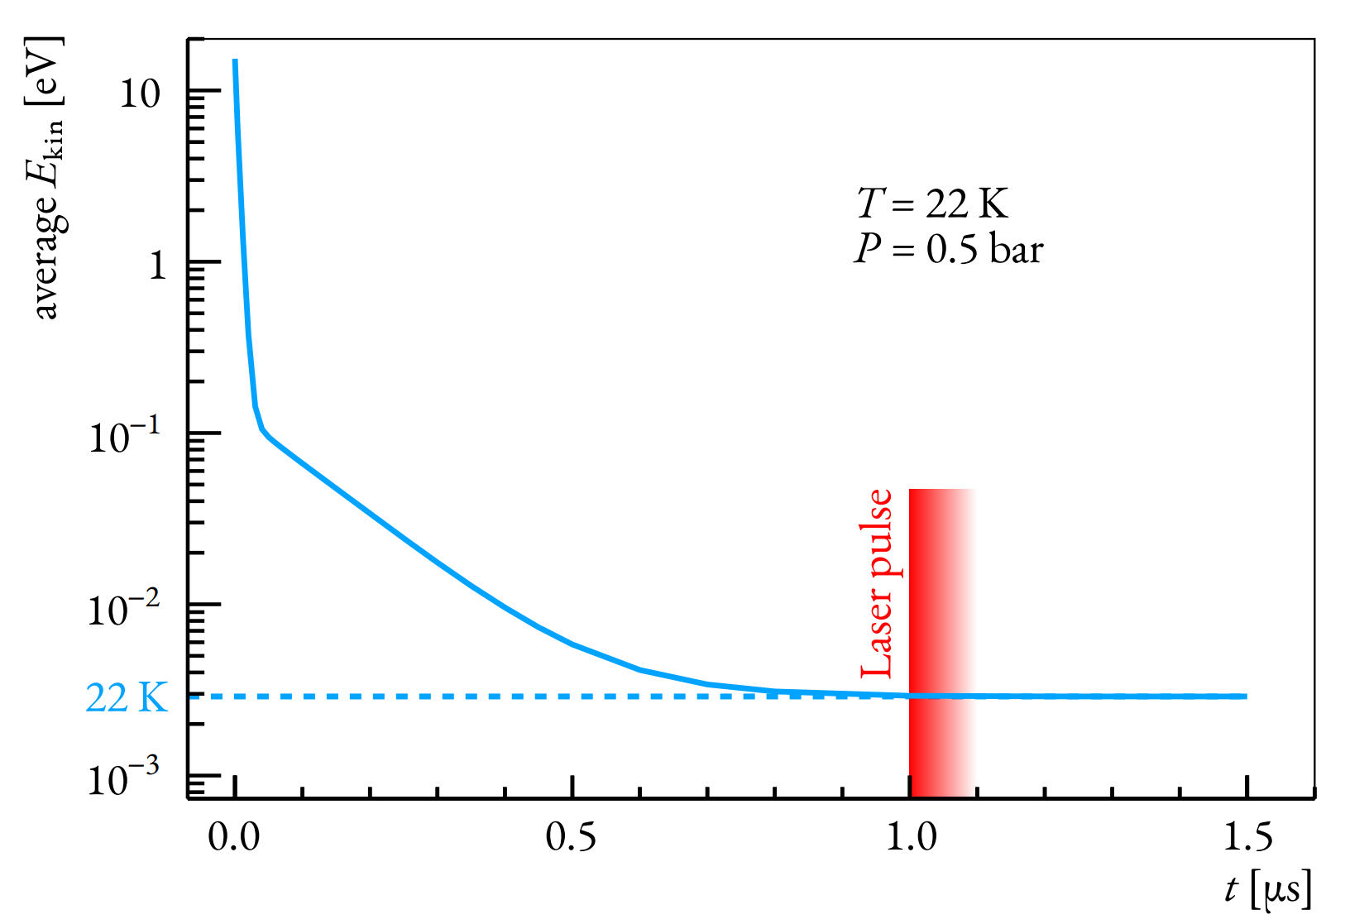
HFS measurement principle
Stop muon in H₂ gas target
(22 K, 0.5 bar and 1 mm thickness)
Formed μp atom de-excites and
thermalizes to H₂ temperature
Laser pulse excites transition:
μp_{(F=0)} + γ → μp_{(F=1)}
Collisional de-excitation:
μp_{(F=1)} + H₂ → μp_{(F=0)} + H₂ + E_{kin}
μp atom diffuses in H₂ gas reaching
Au-coated target walls
Formed μAu* de-excites promptly
producing several MeV X-rays
Detected X-rays are plotted against
laser frequency to obtain the
resonance

Slide 15
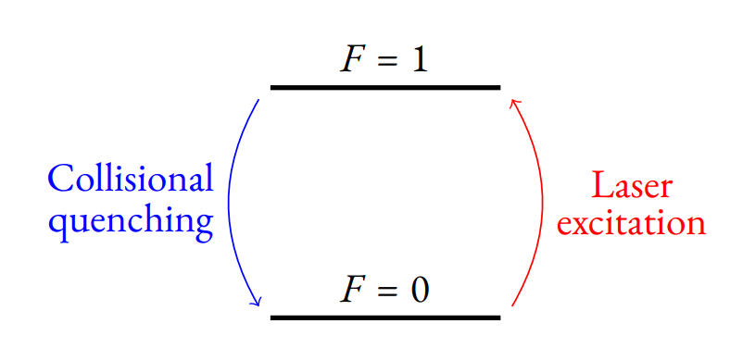
HFS measurement principle
Stop muon in H₂ gas target
(22 K, 0.5 bar and 1 mm thickness)
Formed μp atom de-excites and
thermalizes to H₂ temperature
Laser pulse excites transition:
μp_{(F=0)} + γ → μp_{(F=1)}
Collisional de-excitation:
μp_{(F=1)} + H₂ → μp_{(F=0)} + H₂ + E_{kin}
μp atom diffuses in H₂ gas reaching
Au-coated target walls
Formed μAu* de-excites promptly
producing several MeV X-rays
Detected X-rays are plotted against
laser frequency to obtain the
resonance

Slide 16
HFS measurement principle
Stop muon in H₂ gas target
(22 K, 0.5 bar and 1 mm thickness)
Formed μp atom de-excites and
thermalizes to H₂ temperature
Laser pulse excites transition:
μp_{(F=0)} + γ → μp_{(F=1)}
Collisional de-excitation:
μp_{(F=1)} + H₂ → μp_{(F=0)} + H₂ + E_{kin}
μp atom diffuses in H₂ gas reaching
Au-coated target walls
Formed μAu* de-excites promptly
producing several MeV X-rays
Detected X-rays are plotted against
laser frequency to obtain the
resonance

Slide 17
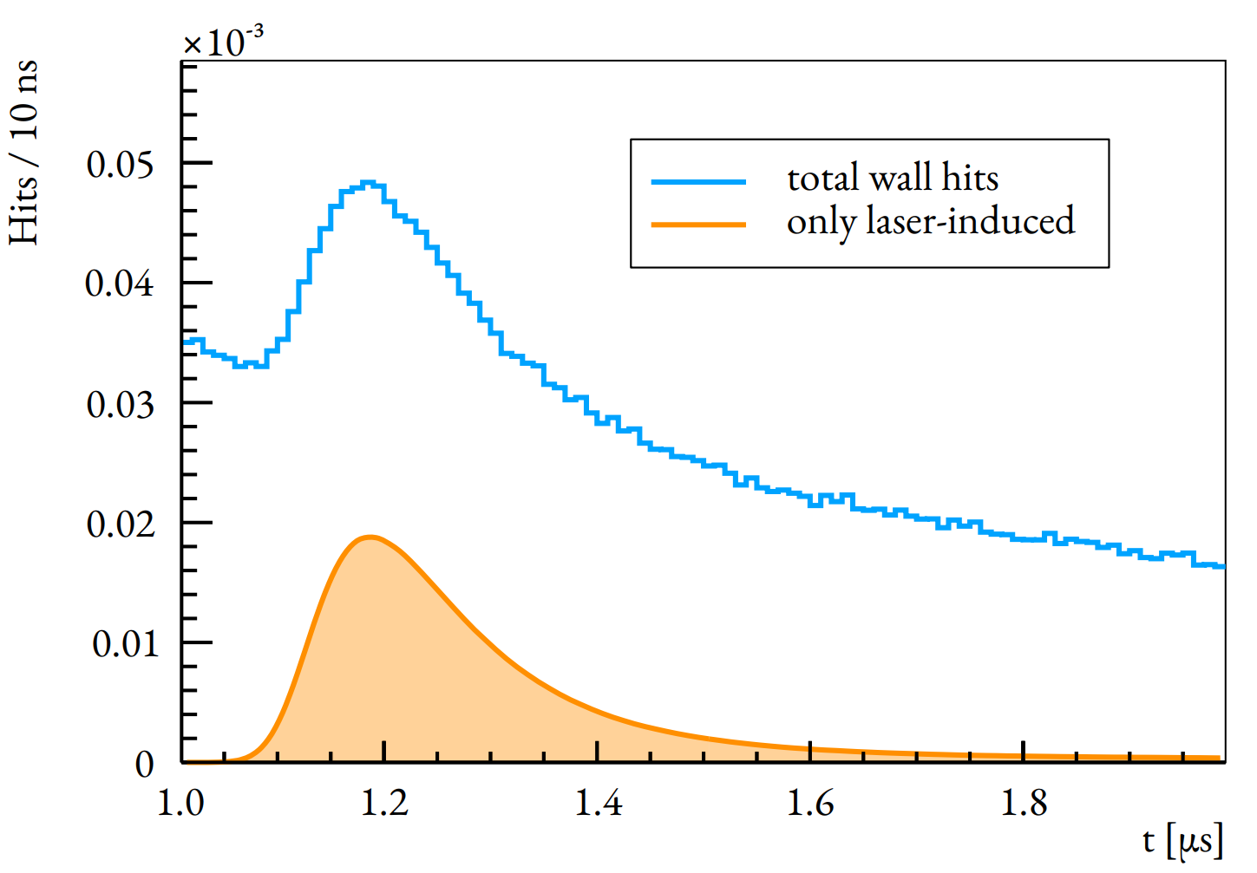
HFS measurement principle
Stop muon in H₂ gas target
(22 K, 0.5 bar and 1 mm thickness)
Formed μp atom de-excites and
thermalizes to H₂ temperature
Laser pulse excites transition:
μp_{(F=0)} + γ → μp_{(F=1)}
Collisional de-excitation:
μp_{(F=1)} + H₂ → μp_{(F=0)} + H₂ + E_{kin}
μp atom diffuses in H₂ gas reaching
Au-coated target walls
Formed μAu* de-excites promptly
producing several MeV X-rays
Detected X-rays are plotted against
laser frequency to obtain the
resonance

Slide 18
HFS measurement principle
Stop muon in H₂ gas target
(22 K, 0.5 bar and 1 mm thickness)
Formed μp atom de-excites and
thermalizes to H₂ temperature
Laser pulse excites transition:
μp_{(F=0)} + γ → μp_{(F=1)}
Collisional de-excitation:
μp_{(F=1)} + H₂ → μp_{(F=0)} + H₂ + E_{kin}
μp atom diffuses in H₂ gas reaching
Au-coated target walls
Formed μAu* de-excites promptly
producing several MeV X-rays
Detected X-rays are plotted against
laser frequency to obtain the
resonance

Slide 19
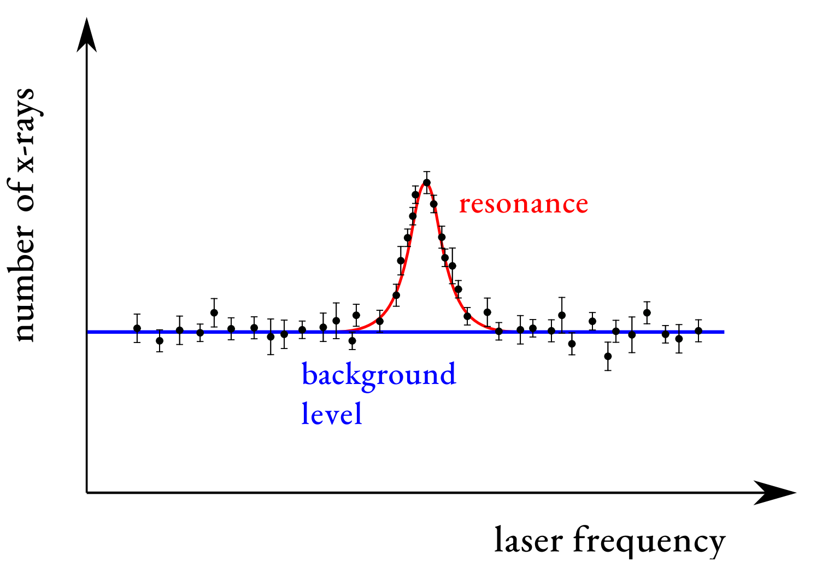
HFS measurement principle
Stop muon in H₂ gas target
(22 K, 0.5 bar and 1 mm thickness)
Formed μp atom de-excites and
thermalizes to H₂ temperature
Laser pulse excites transition:
μp_{(F=0)} + γ → μp_{(F=1)}
Collisional de-excitation:
μp_{(F=1)} + H₂ → μp_{(F=0)} + H₂ + E_{kin}
μp atom diffuses in H₂ gas reaching
Au-coated target walls
Formed μAu* de-excites promptly
producing several MeV X-rays
Detected X-rays are plotted against
laser frequency to obtain the
resonance

Slide 20
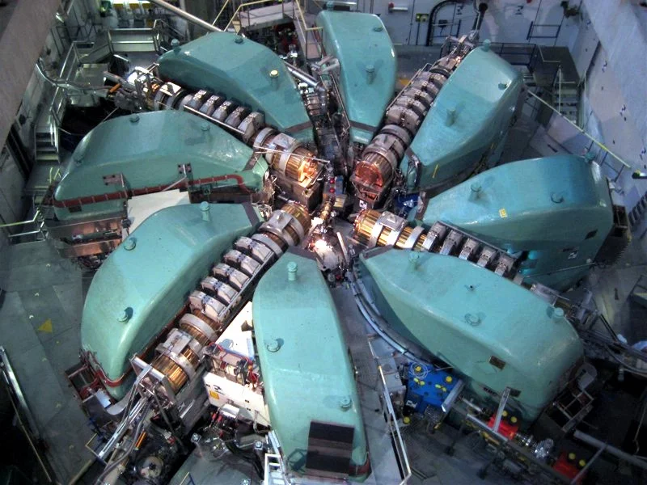

Paul Scherrer Institute (PSI)
High intensity proton accelerator (HIPA)
590 MeV proton beam 2.2 mA
πΕ5 beam line: 500 μ⁻/s @ 11 MeV/c
Continuous beam

Slide 21
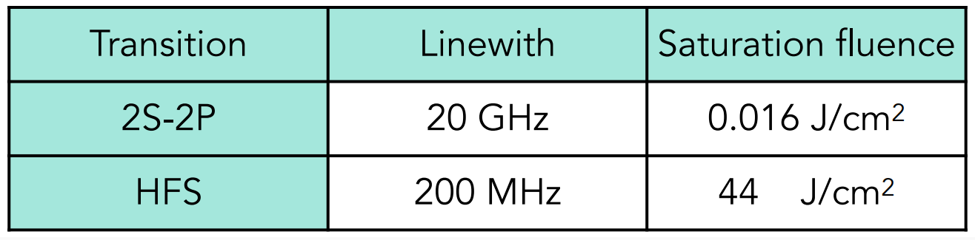
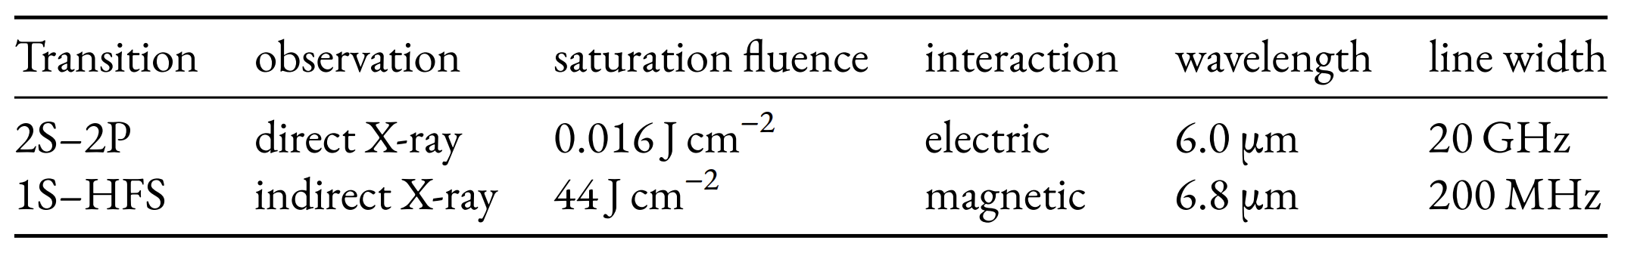
Requirements laser system
Challenges | Requirement
Muon decays in 2.2 μs | Fast response time of 1 μs
Muon arrives randomly | Stochastic trigger – Fire when Muon Arrives
Weak M1 transition | 5mJ, 50 ns pulse at 6.8 μm, enhancement cavity
Precision and Stability Required | <100 MHz Linewidth of Laser, > 6 weeks of continuous operation
Background | Scintillators to veto false events

Slide 22
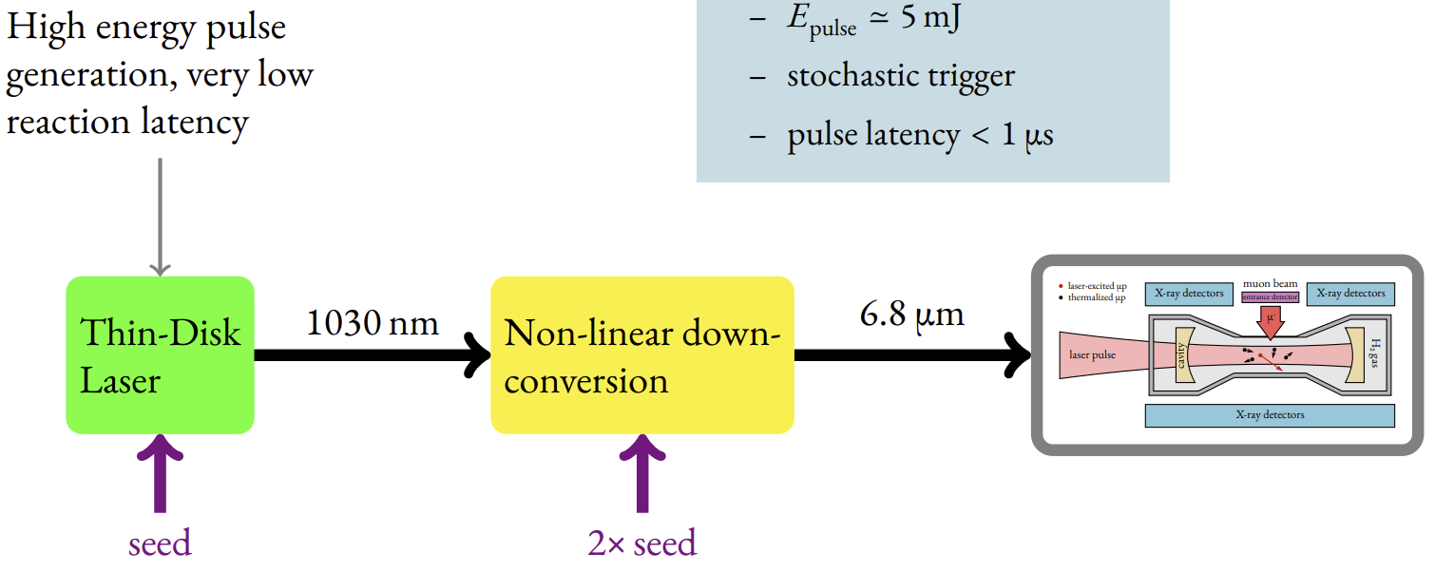
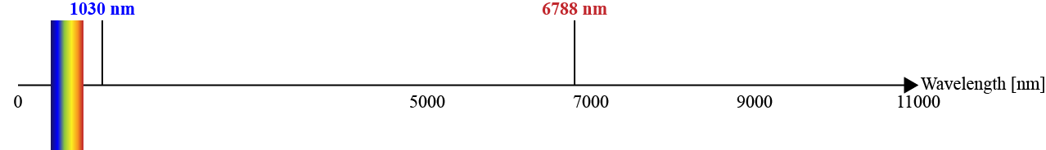
Laser scheme
300 mJ
5 mJ

Slide 23
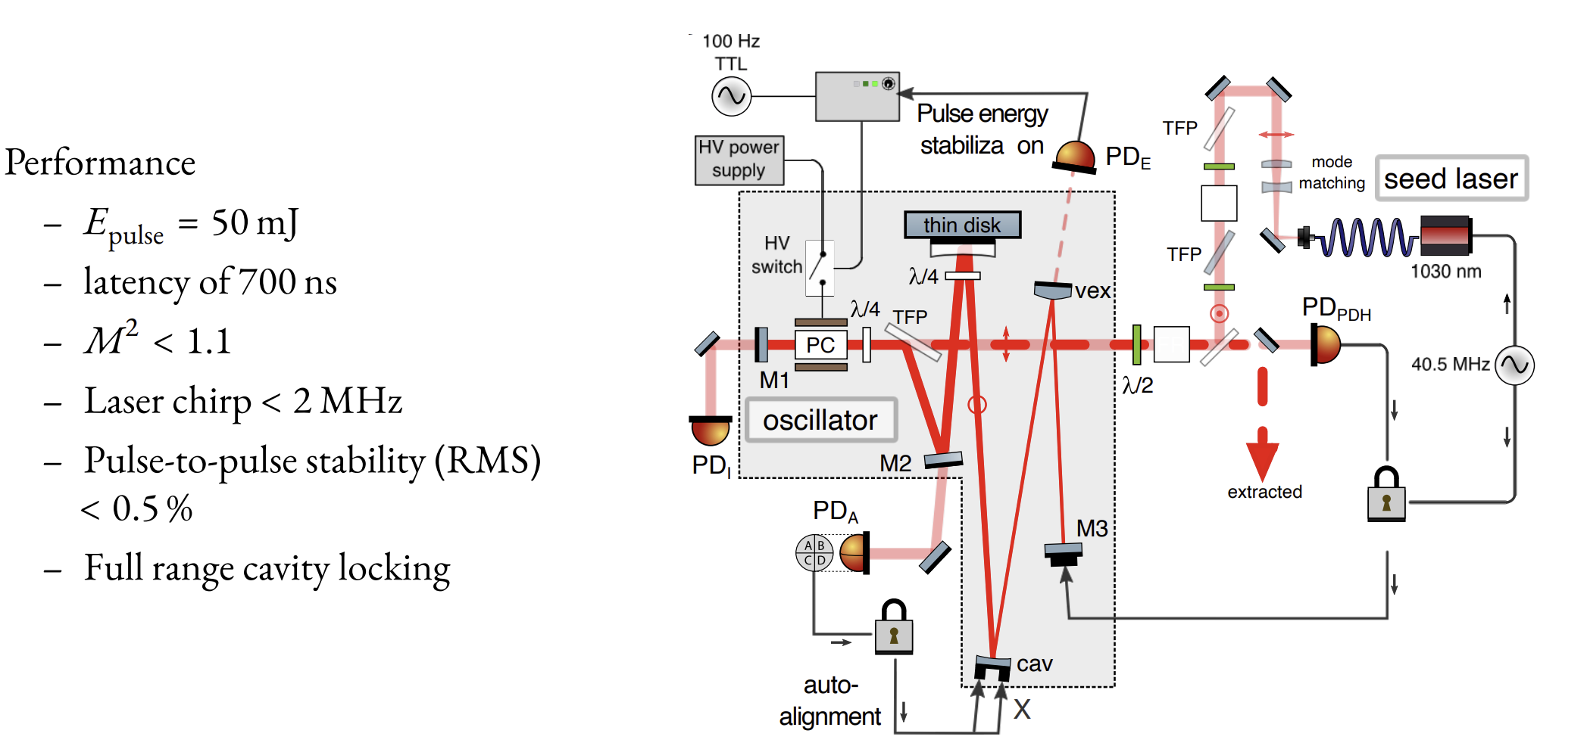
Thin disk oscillator
Zeyen, Manuel, et al. Optics Express 31.18 (2023): 29558-29572.

Slide 24
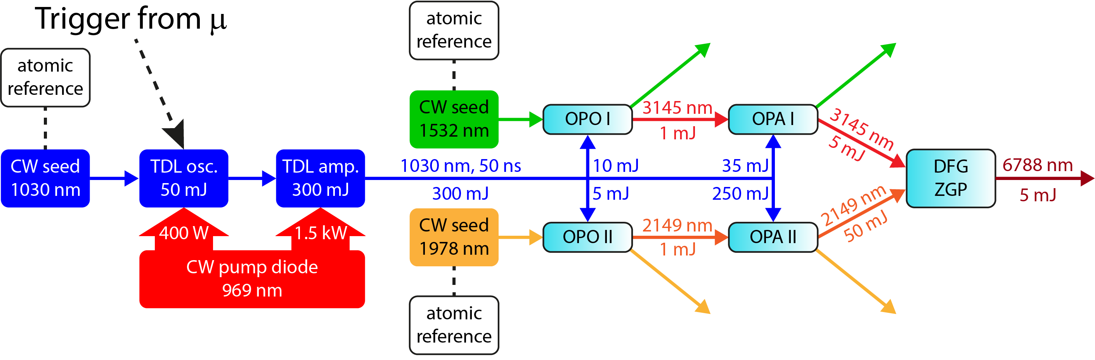
Thin disk amplifier

Slide 25
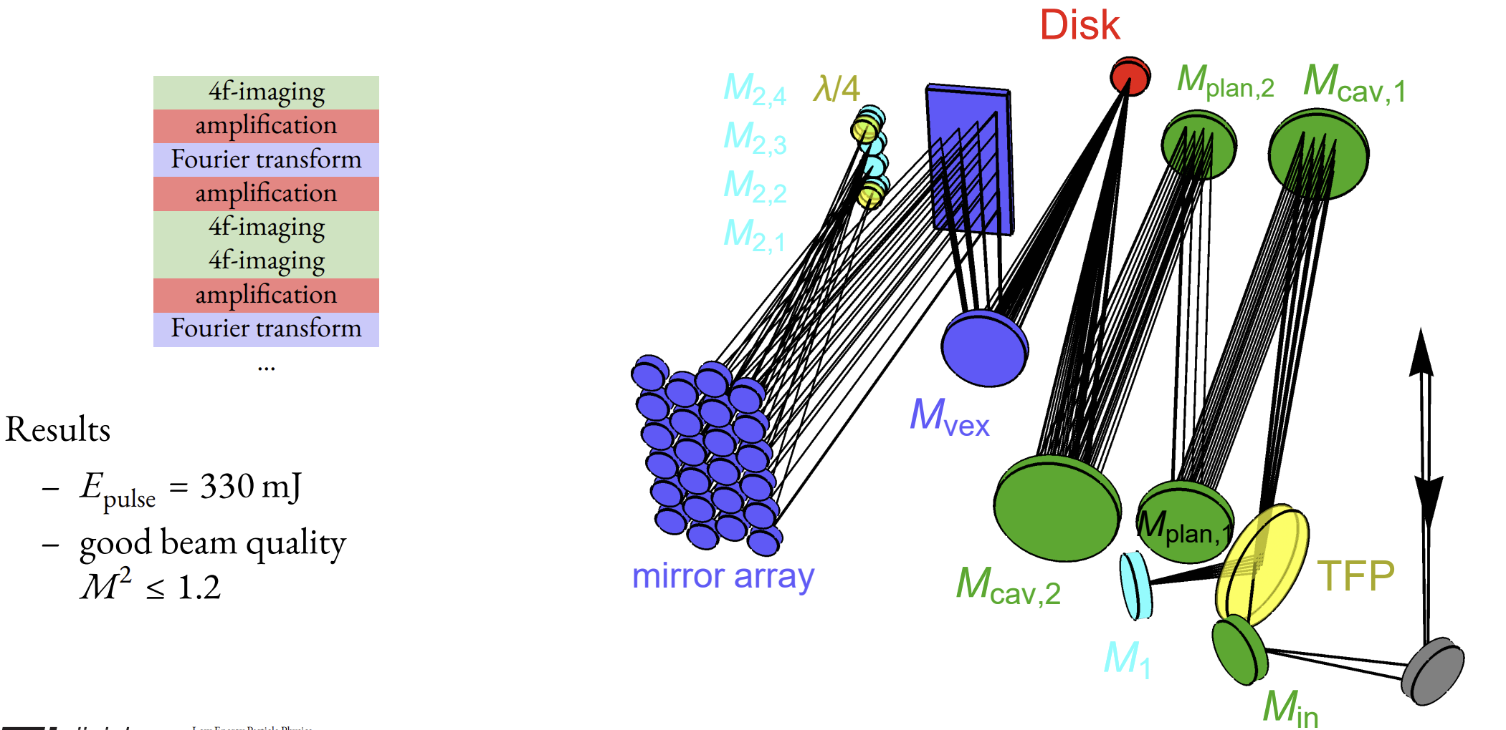
Thin disk amplifier
Zeyen, Manuel, et al. Optics Express 32.2 (2024): 1218-1230.

Slide 26
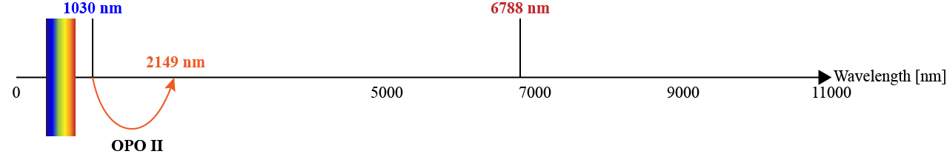
Nonlinear downconversion

Slide 27
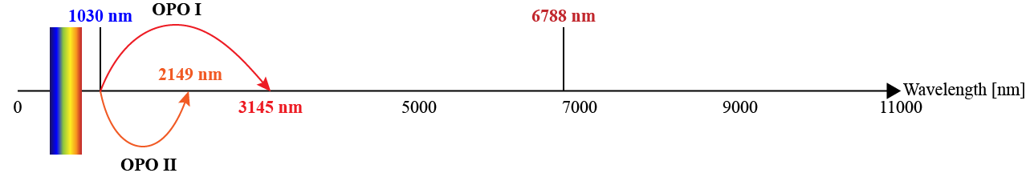
Nonlinear downconversion

Slide 28
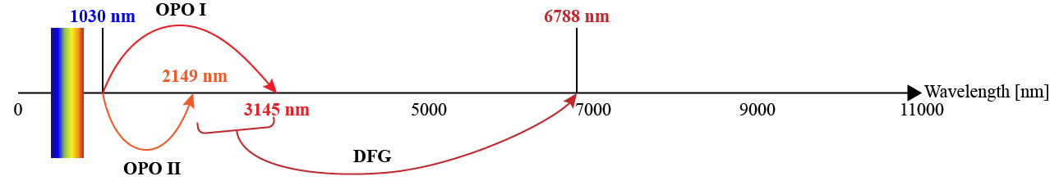
Difference frequency generation (DFG)

Slide 29
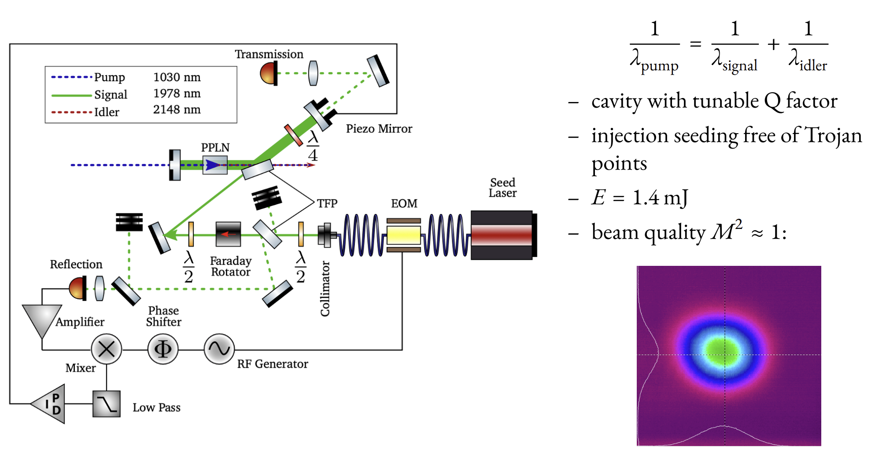
2148 nm OPO
ω_{p} = ω_{s} + ω_{i}

Slide 30
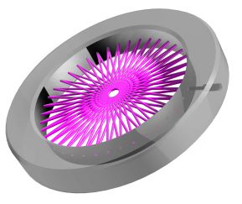
Enhancement cavity

Slide 31
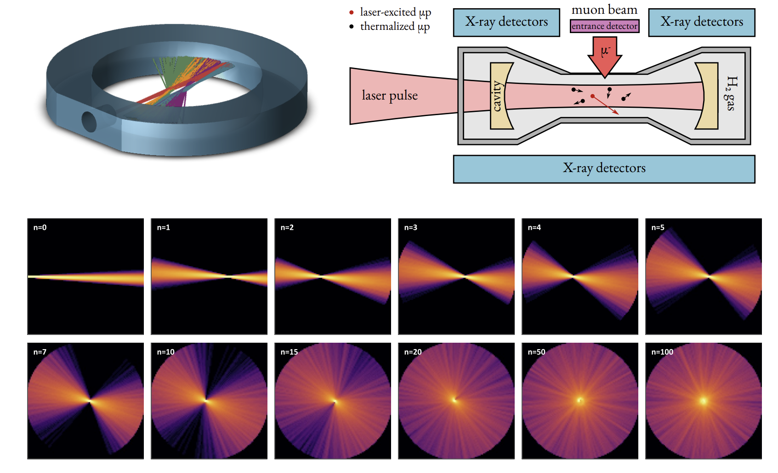
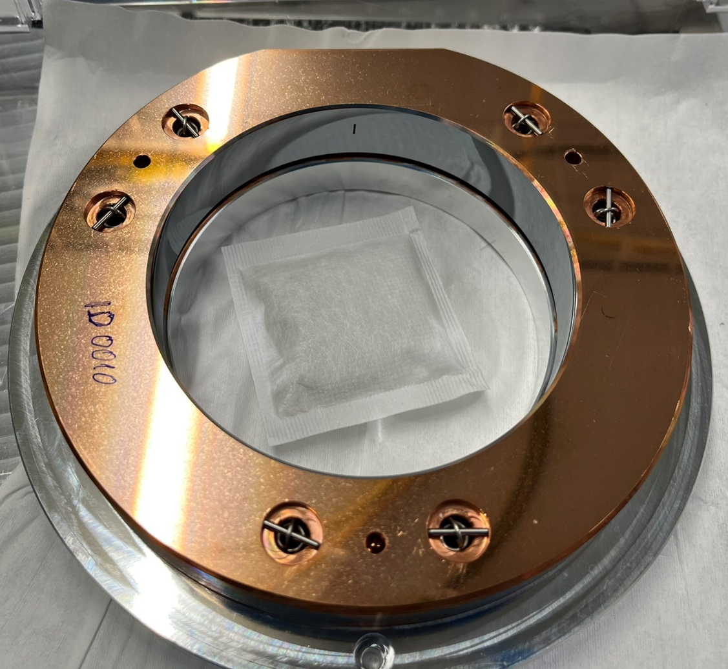
Multipass cell
M. Marszalek, “Radiant fluence from ray tracing in optical multipass systems”, Applied optics (2024)

Slide 32
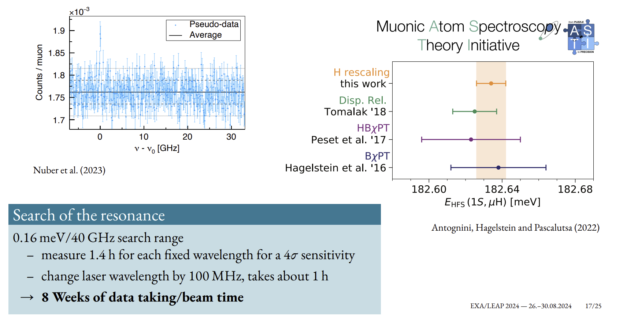
Search of the resonance
Notes:
Mention MUASTI

Slide 33
Status laser system
Coming weeks!

Slide 34
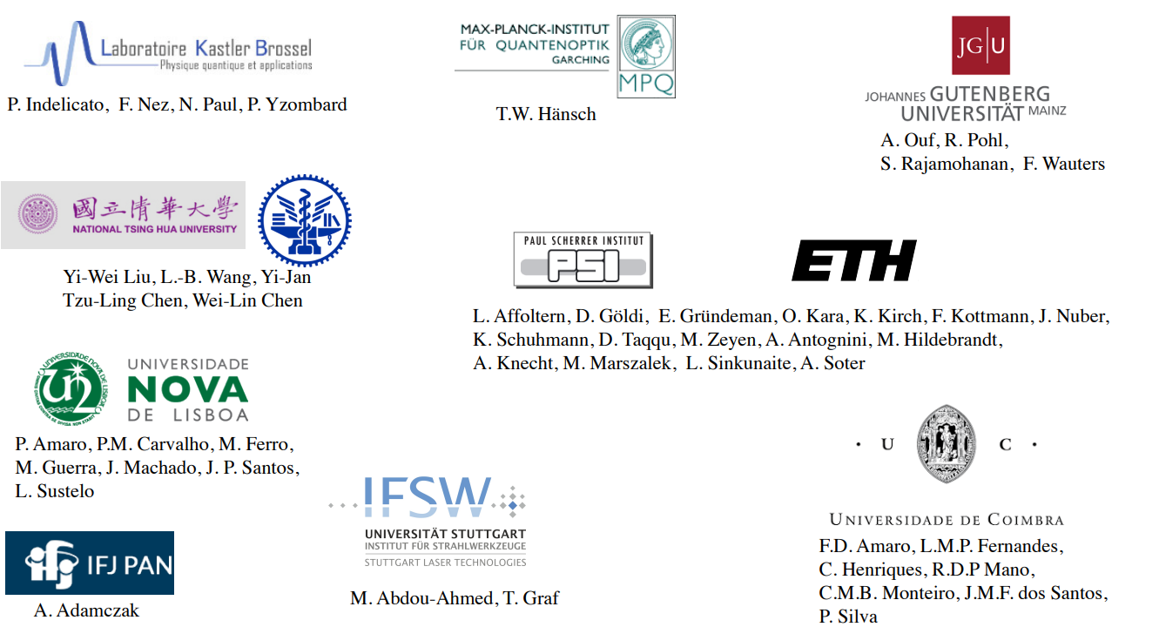
CREMA collaboration

Slide 35
Questions:
Our life could be (very much) made easier by:
More accurate theory prediction
Better MIR crystals allowing for direct downconversion
Cheaper MIR detectors (photodiodes, cameras)
Possibly in the future: Ground state hyperfine splitting μHe-3 @ ~900 nm

Slide 36
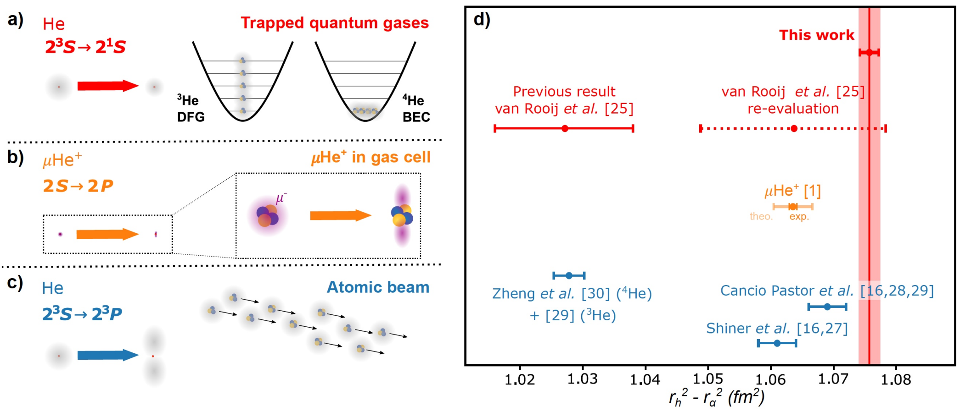
Current situation
AC-Stark
Quantum
Interference?
Velocity selection
[0] van der Werf, Y., et al., arXiv:2306.02333 (2023)
[1] Schuhmann, K., et al., arXiv:2305.11679 (2023)
[16] Pachucki, K., et al., Phys. Rev. A 95, 062510 (2017)
[25] Van Rooij, R., et al., Science 333.6039 (2011): 196-198
[27] Shiner, D., et al., Phys. Rev. Lett. 74, 3553 (1995).
[28] Cancio Pastor, P., et al., Phys. Rev. Lett. 92, 023001 (2004)
[29] Cancio Pastor, P., et al., Phys. Rev. Lett. 108, 143001 (2012)
[30] Zheng, X., et al., Phys. Rev. Lett. 119, 263002 (2017)
Notes:
Sonia update muonic helium

Slide 37
Optical parametric oscillator (OPO)
Pulsed pump (ω_{p})
PPLN crystal
CW signal (ω_{s})
Pulsed idler (ω_{p} - ω_{s})
Signal and pump frequencies are locked to an atomic reference
Frequency generated idler is fixed through ω_{i} = (ω_{p} - ω_{s})
OPO can be very efficient (up to 50% pump depletion)

Slide 38
Optical parametric amplifier (OPA)
Signal pulse (ω_{p} – ω_{i} 1978 nm)
Pump pulse (ω_{p} 1030 nm)
PPKTP crystal
Seed idler pulse (ω_{i} 2140 nm)
Amplified idler pulse (ω_{i})
High energy pump photon is split into two lower energy photons (signal and idler)
Seed idler is amplified in the process
Again 50% pump depletion can be achieved

Slide 39
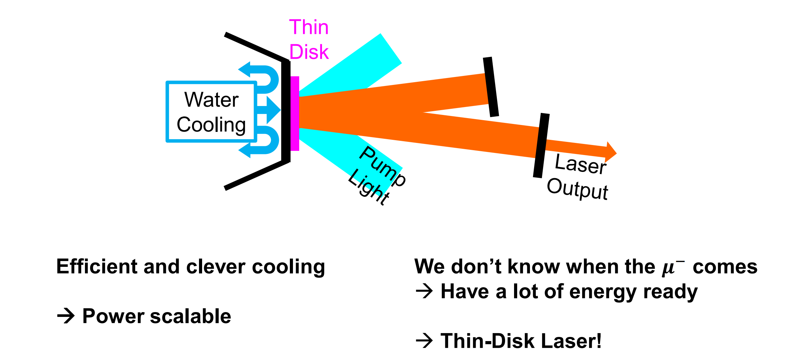
Laser scheme
969 nm
1030 nm

Slide 40
Difference frequency generation (DFG)
Signal pulse (ω_{s} 3145 nm)
ZGP crystal
Pump pulse (ω_{p} 2140 nm)
Idler pulse (ω_{i} = ω_{p} – ω_{s}) 6788 nm
High energy pump photon is split into two lower energy photons (signal and idler)
Again 50% pump depletion can be achieved

Slide 41
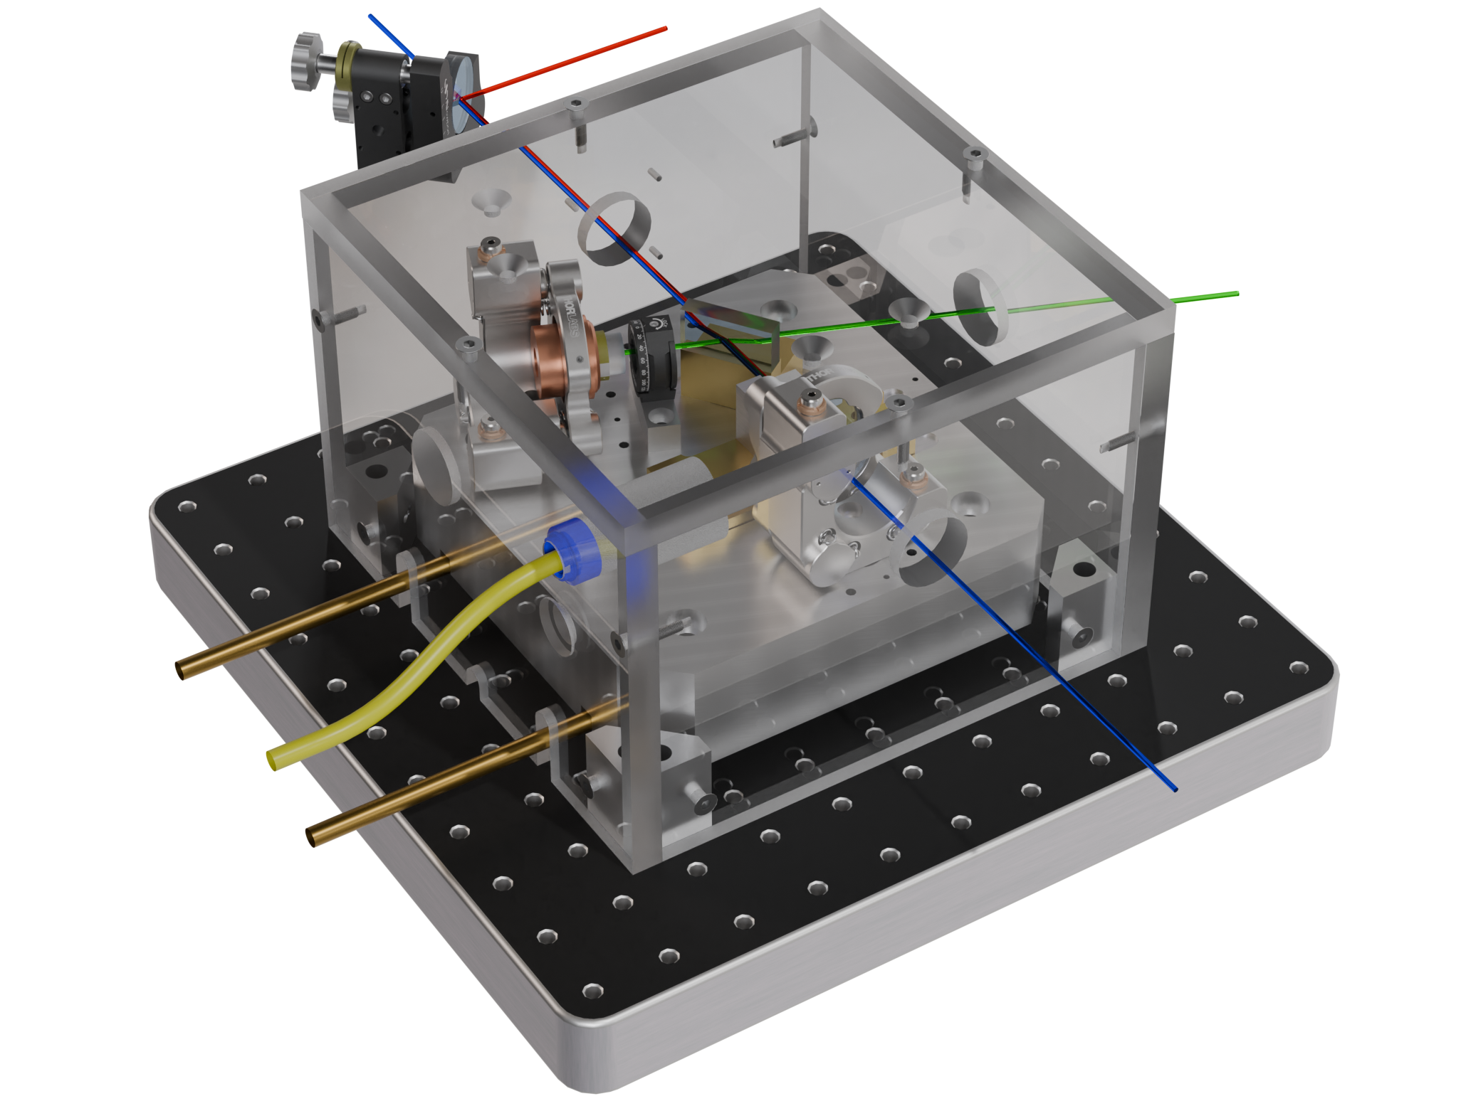
Leftover 1030 nm “pump”
2149 nm “idler” pulse
PPLN crystal
Dichroic mirror
1978 nm “signal”
Cooling water in
N₂ flushing
Cooling water out
1030 nm “pump” pulse

Slide 42
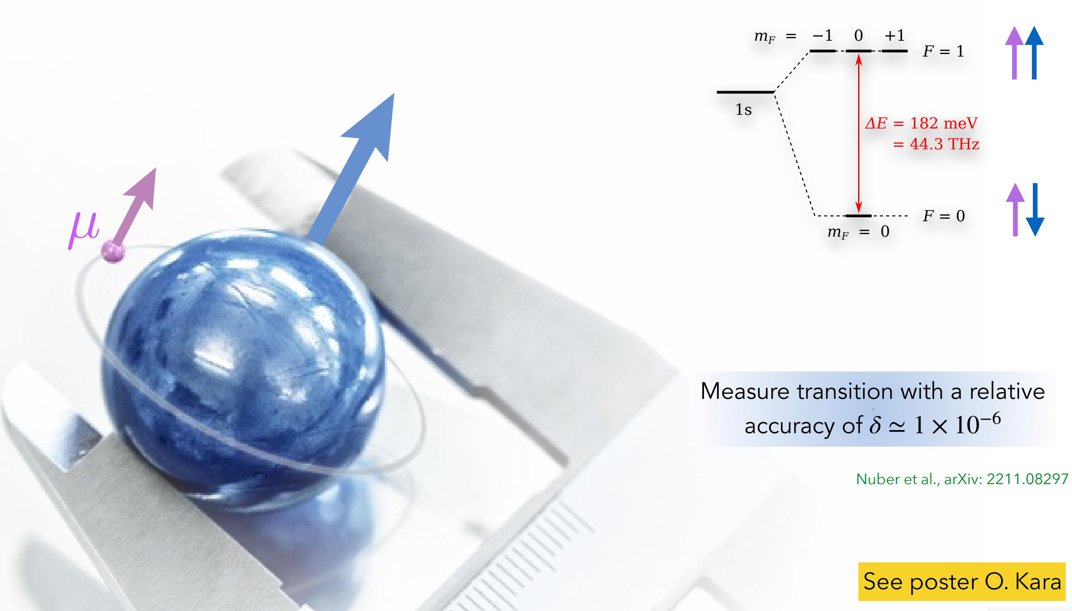
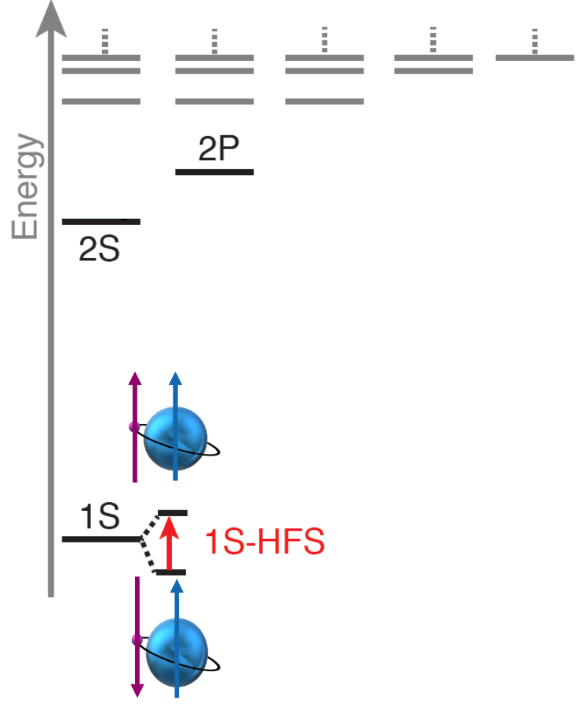
Ground state hyperfine splitting
6.8 μm
Lamb shift

Slide 43
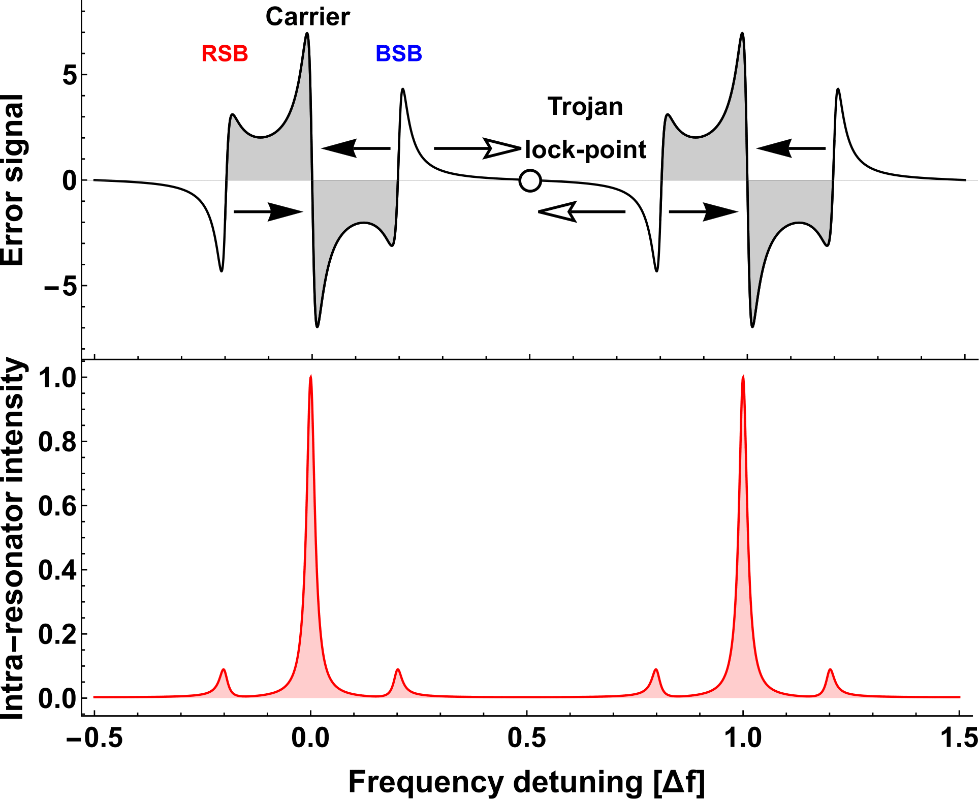
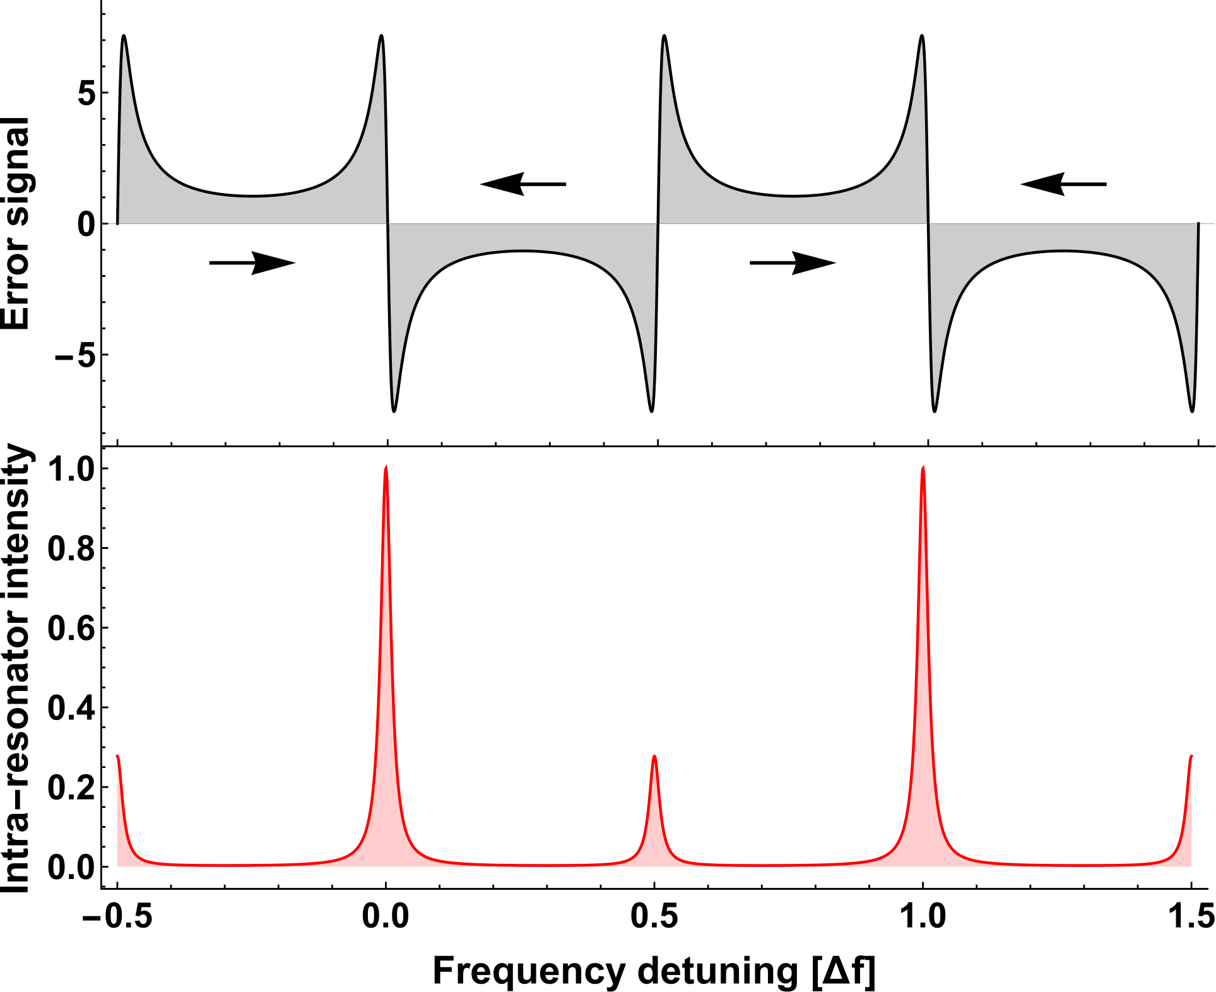

Slide 44
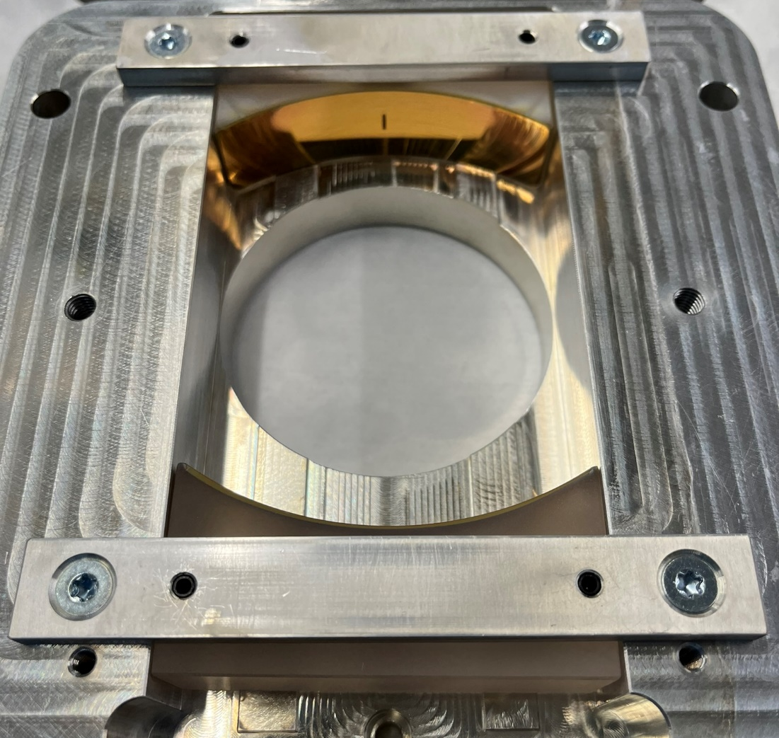
Multipass cell, 2 designs
Coated by the Fraunhofer institute.
Evaluation currently ongoing
Very high quality coatings readily available.
But: high loss from aperature, and very critical relative alignment

Slide 45
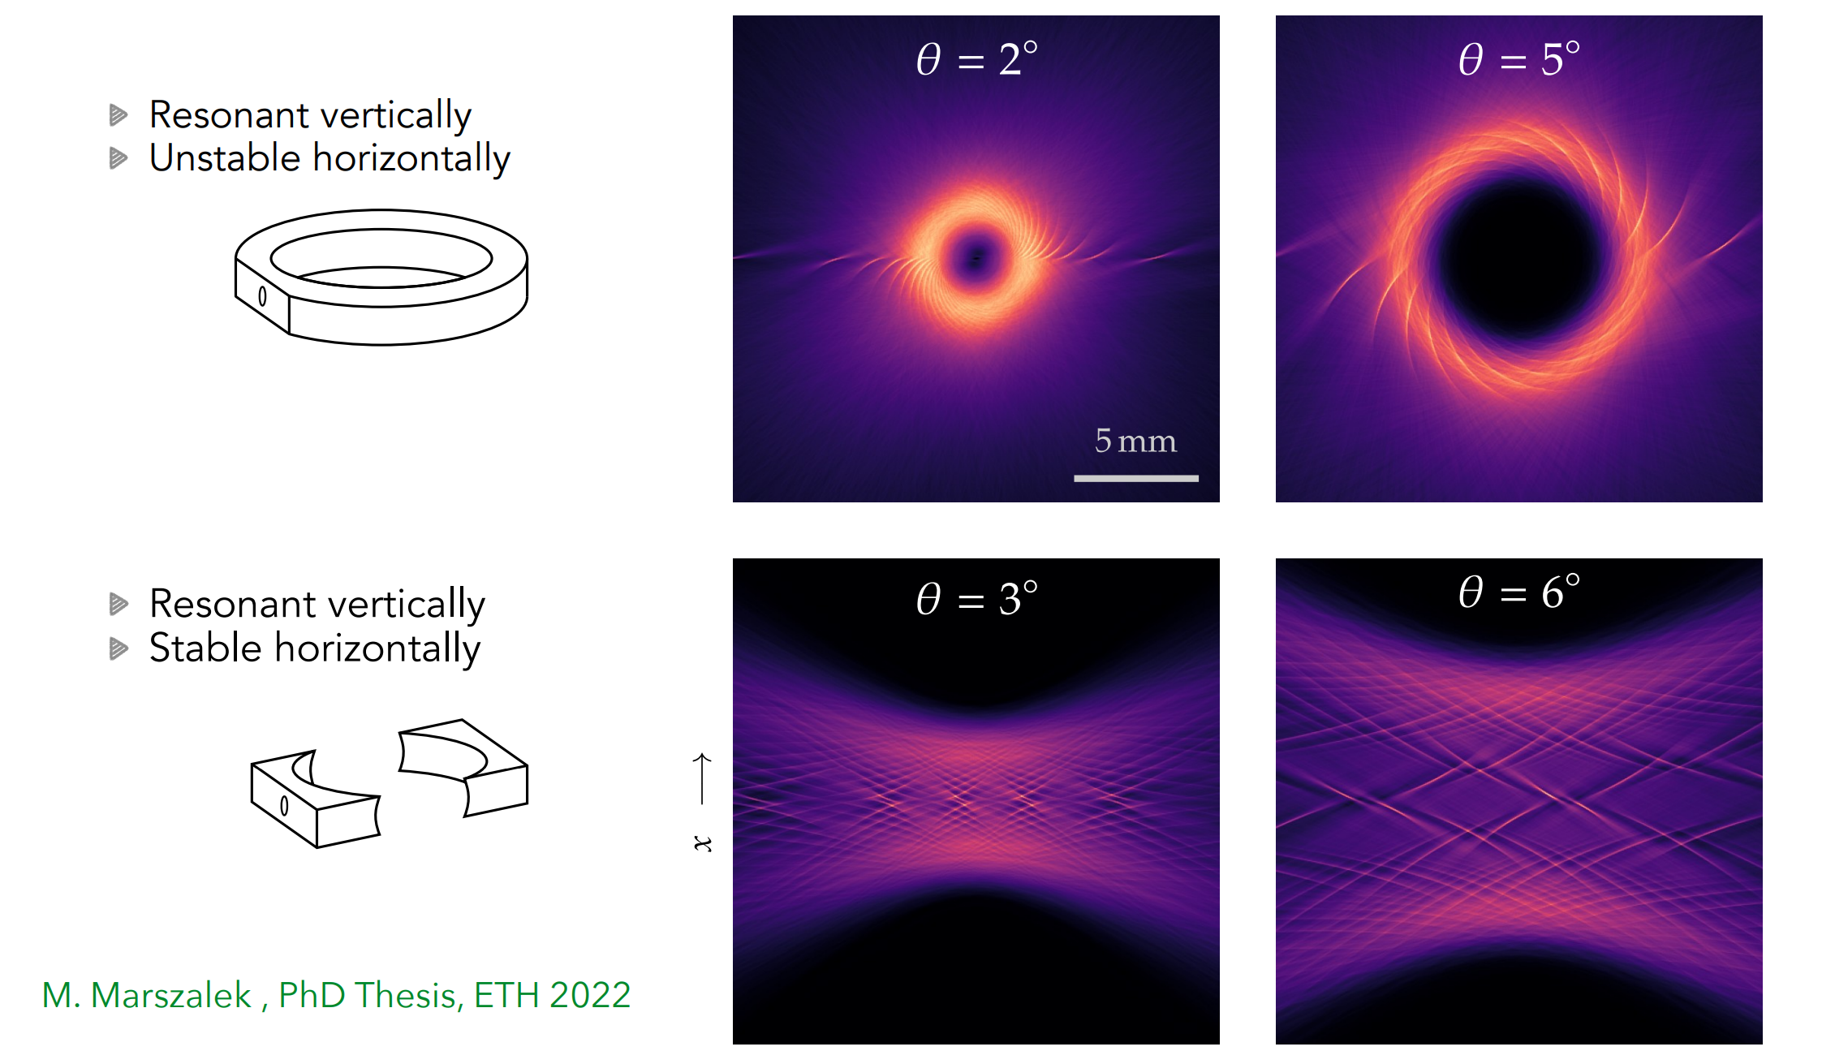
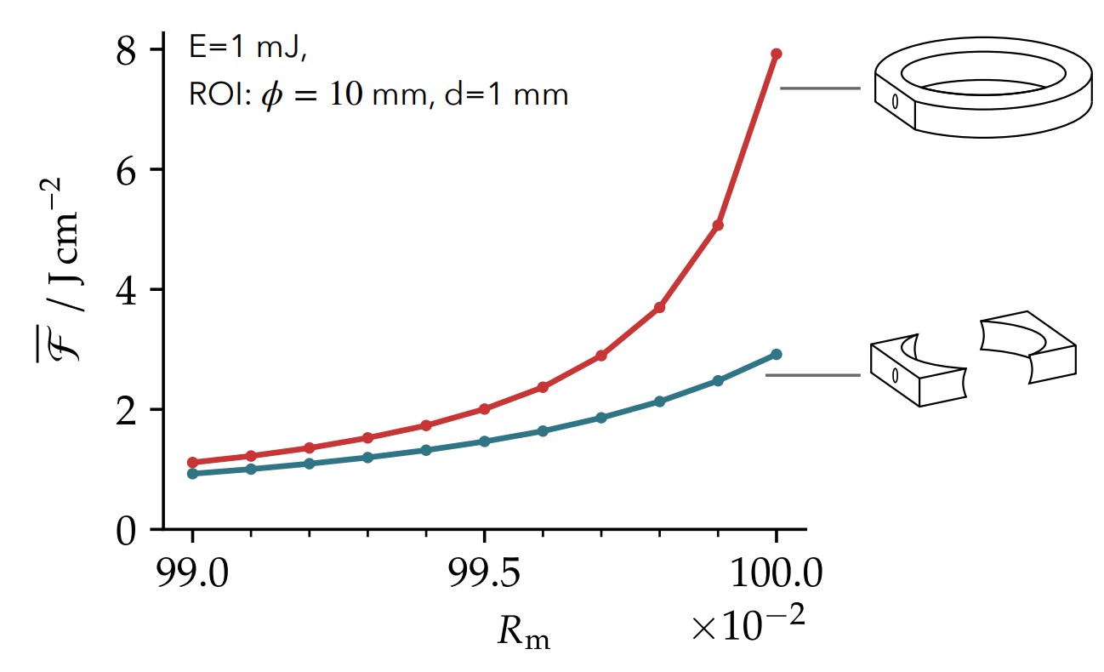
Multipass cell, 2 designs
Toroidal design presents a coating challenge!

