Slide 1

KAMPAI - Kaonic, Antiprotonic, Muonic, Pionic and “onia” exotic Atoms:
Interchanging knowledge and recent results
Kaonic Atom Properties and Cascade Models:
Exploring Strong Interactions through First-Principles Calculations and Monte Carlo simulations
Simone Manti on behalf of the SIDDHARTA-2 collaboration
Jul 30–4, 2024, ECT* , Trento
Notes:
Title 24
Text 20

Slide 2
Outline
Studying Strong Interaction with Kaonic Atom
Kaonic Atom Properties From First Principles
Cascade Models for Fluorescence Yields Calculations
Studying Strong Interaction with Kaonic Atom
Kaonic Atom Properties From First Principles
Cascade Models for Fluorescence Yields Calculations

Slide 3
Why Kaonic Atoms?
Fundamental physics New Physics
The modern era of light kaonic atom experiments
Rev.Mod.Phys. 91 (2019) 2, 025006
Part. and Nuclear physics QCD @ low-energy limit Chiral symmetry, Lattice
Kaonic Atoms to Investigate Global Symmetry
Breaking Symmetry 12 (2020) 4, 547
Kaonic Atoms Kaon-Nuclei Interactions (scattering and nuclear interactions)
Astrophysics EOS Neutron Stars
The equation of state of dense matter: Stiff, soft, or both?
Astron.Nachr. 340 (2019) 1-3, 189
Dark Matter studies
On self-gravitating strange dark matter halos around galaxies
Phys.Rev.D 102 (2020) 8, 083015

Slide 4
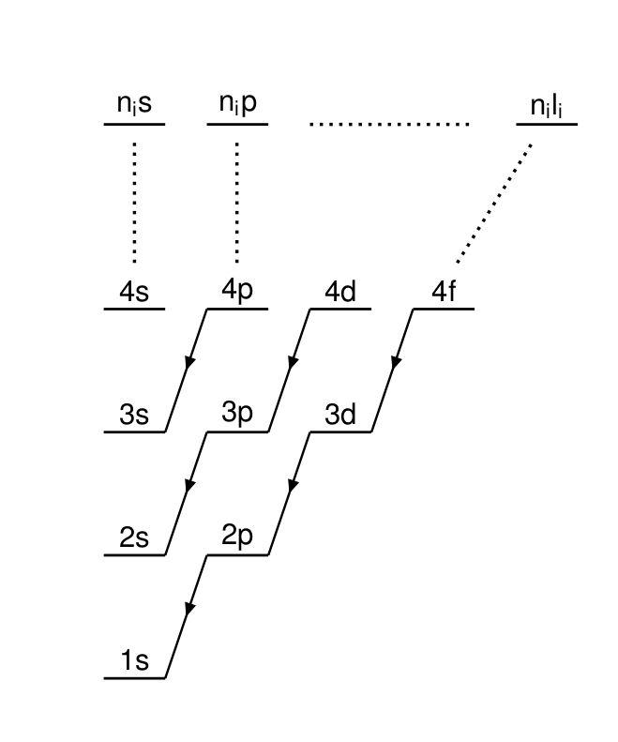
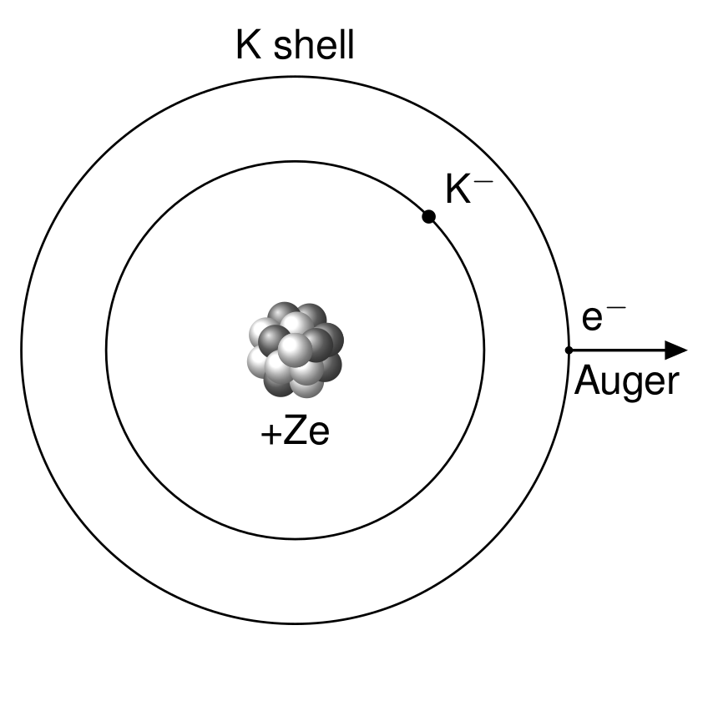
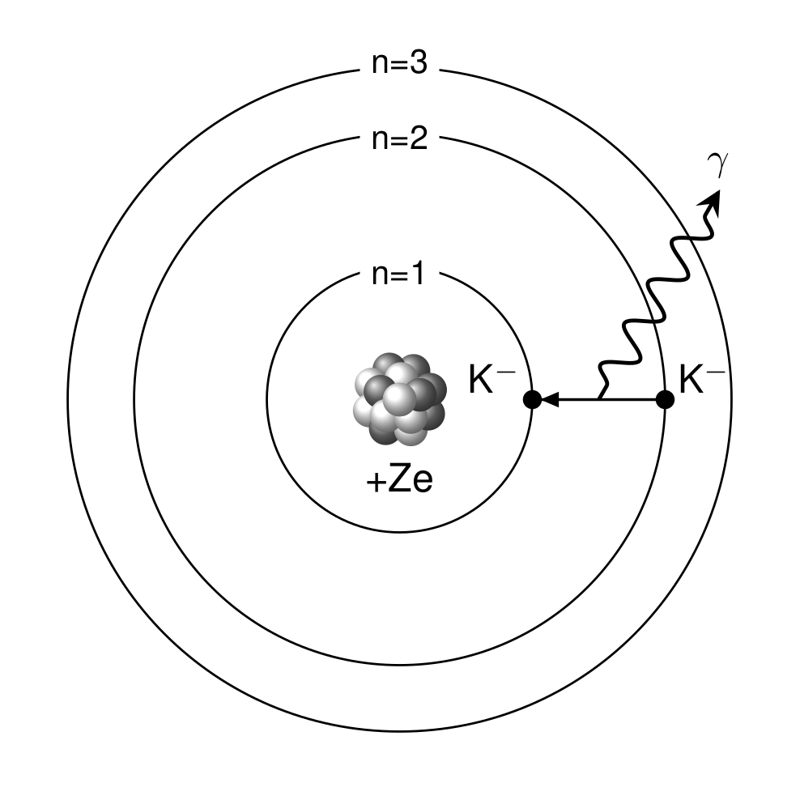

Formation of a Kaonic Atom

Slide 5
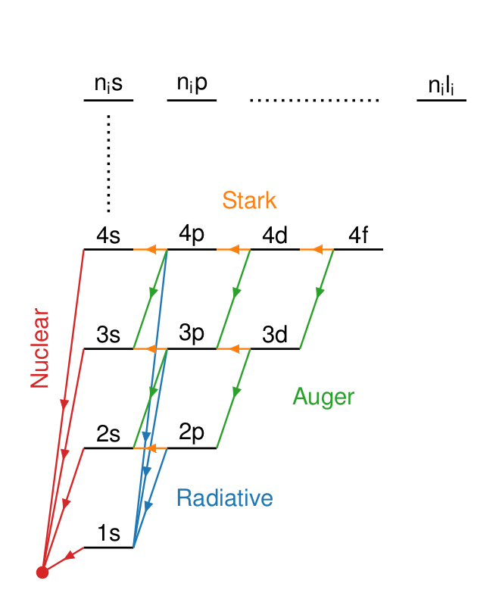
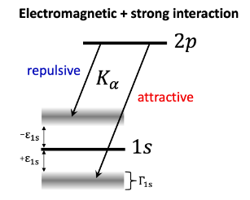

Emitted X-rays are influenced by the Strong Interaction
Deser-Trueman formula

Slide 6
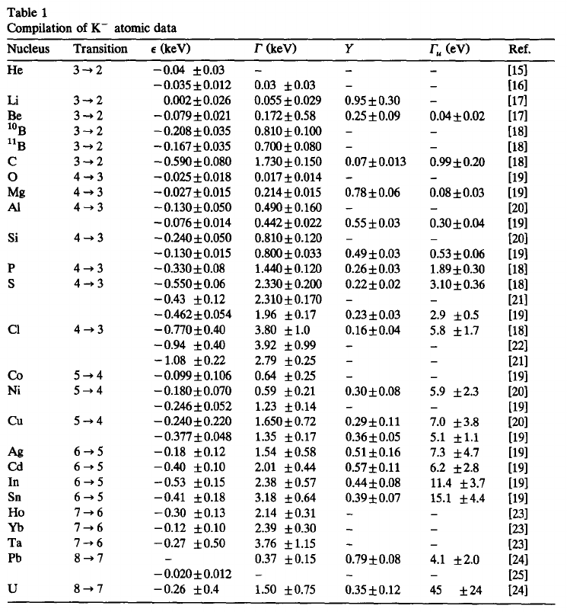
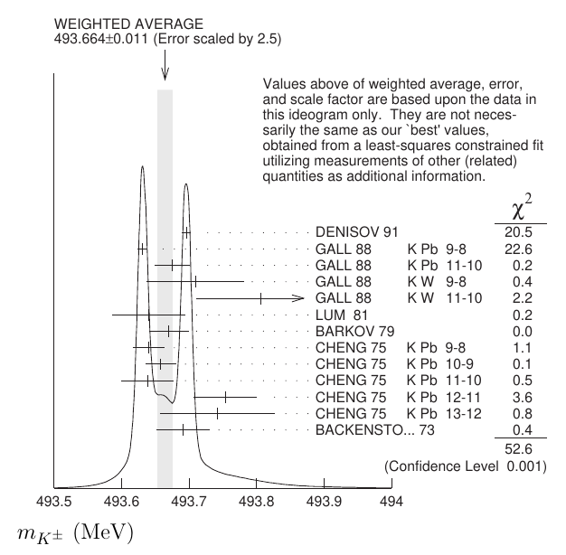
Emitted X-rays are influenced by the Strong Interaction
Friedman, E., A. Gal, and C. J. Batty. "Density-dependent K− nuclear optical potentials from kaonic atoms." Nuclear Physics A 579.3-4 (1994): 518-538.
Óbertová, Jaroslava, E. Friedman, and J. Mareš. "First application of a microscopic K− NN absorption model in calculations of kaonic atoms." Physical Review C 106.6 (2022): 065201.

Slide 7
Outline
Studying Strong Interaction with Kaonic Atom
Kaonic Atom Properties From First Principles
Cascade Models for Fluorescence Yields Calculations
Studying Strong Interaction with Kaonic Atom
Kaonic Atom Properties From First Principles
Cascade Models for Fluorescence Yields Calculations

Slide 8
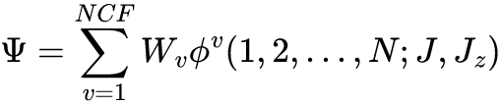

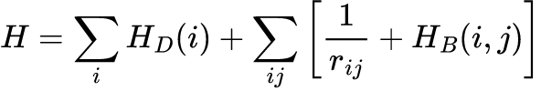
The MultiConfigurational Dirac-Fock code (MCDF)
Written by Indelicato and Desclaux [Desclaux 9 (1975) 31-45]
Solve the Multiconfiguration Dirac-Fock equations (with all orbitals relaxed) including
various contributions self-consistently (Coulomb, Breit, vacuum polarization).
Include, besides electrons, several exotic particles, including bosons
Correct the total energy for QED contributions.
Compute:
  Total energy of a given state either at the single configuration
or multiconfiguration level
  Radiative transition probabilities
  Auger transition probabilities
  Stark effect
  Photoionization cross sections

Slide 9
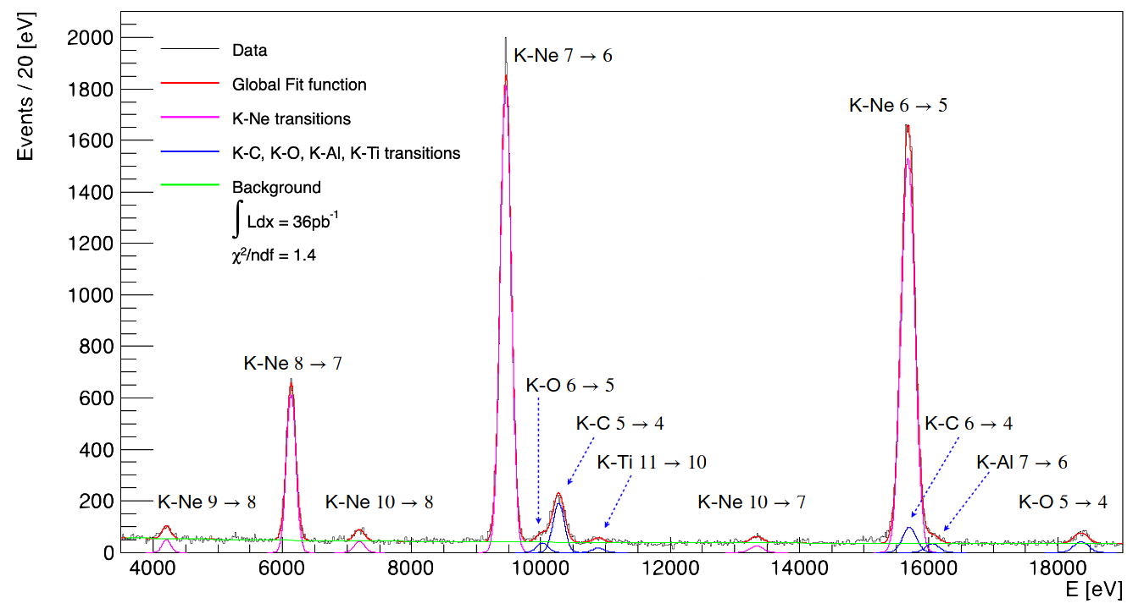
Putting Bounds on Kaon Mass with Kaonic Neon

Slide 10
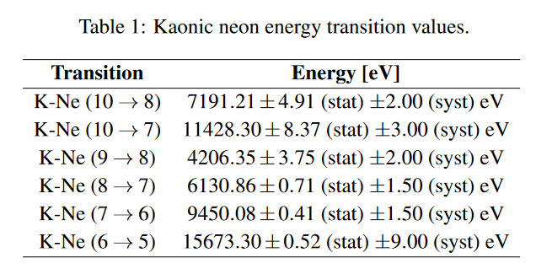
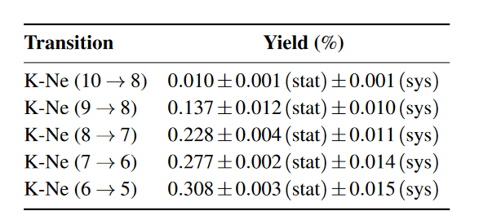
Putting Bounds on Kaon Mass with Kaonic Neon

Slide 11
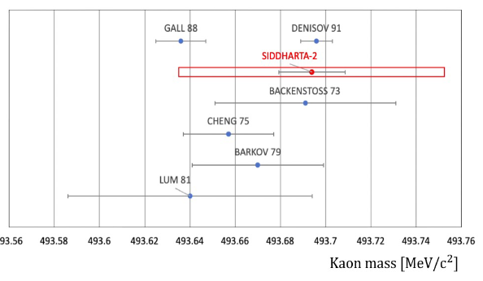
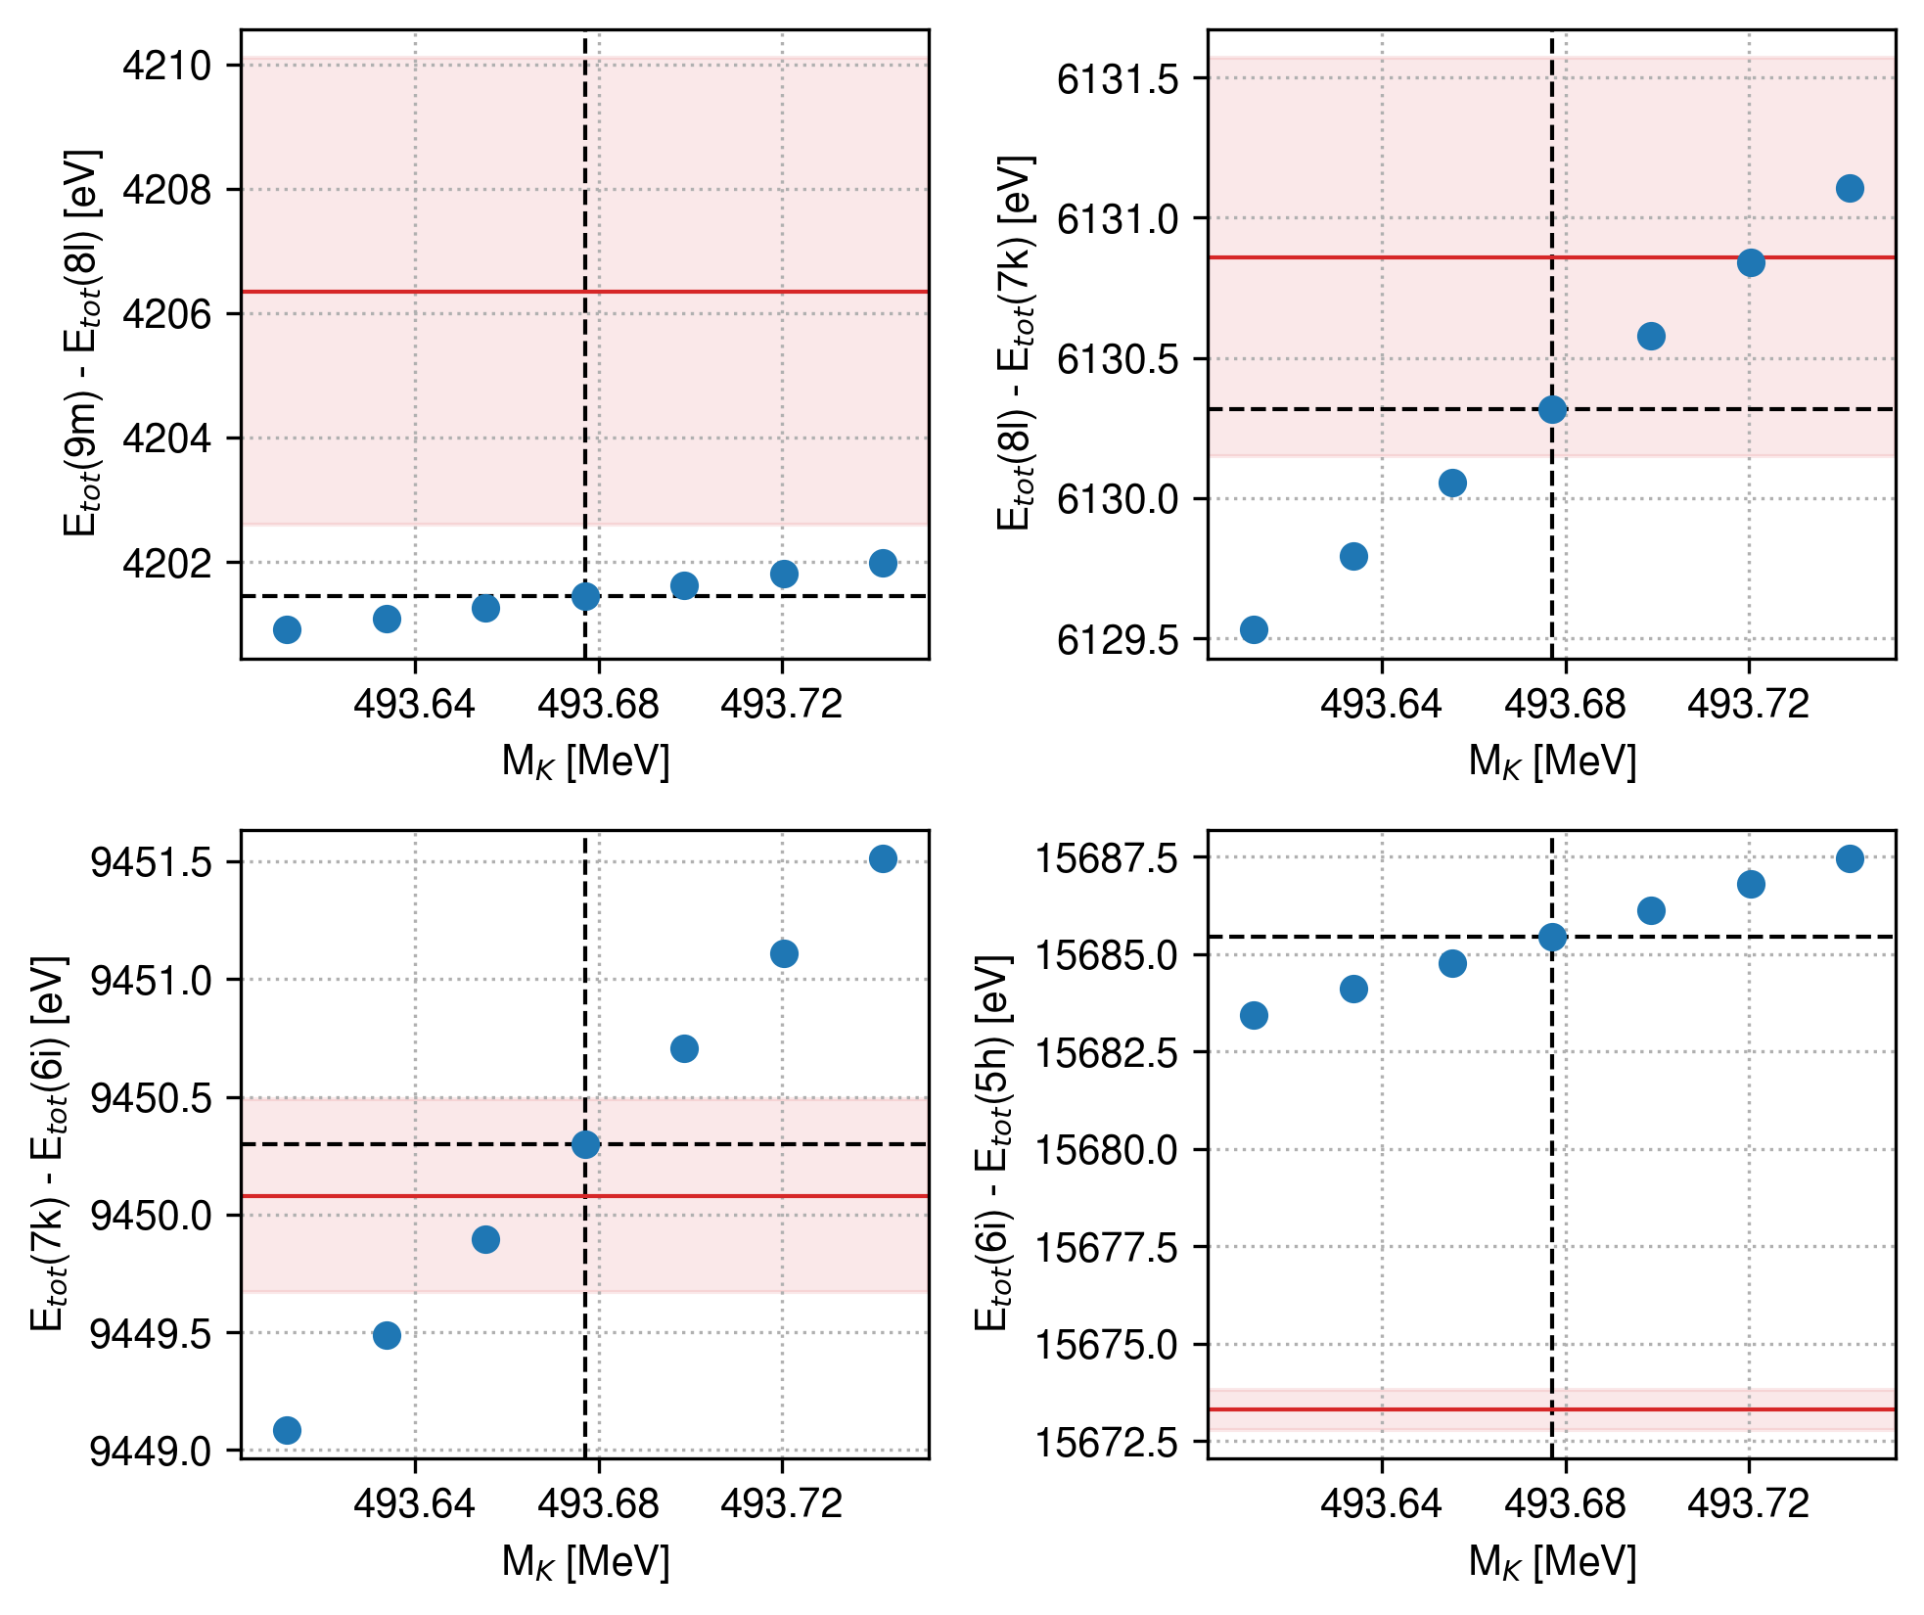
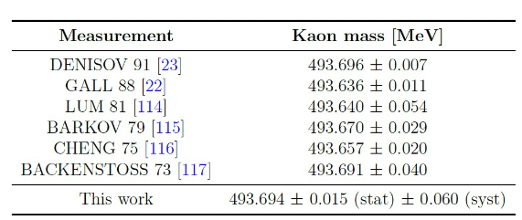
Putting Bounds on Kaon Mass with Kaonic Neon

Slide 12
Outline
Studying Strong Interaction with Kaonic Atom
Kaonic Atom Properties From First Principles
Cascade Models for Fluorescence Yields Calculations
Studying Strong Interaction with Kaonic Atom
Kaonic Atom Properties From First Principles
Cascade Models for Fluorescence Yields Calculations

Slide 13
Model the cascade of the Kaonic Atom with a Monte Carlo
1962 - M. Leon and H. A. Bethe, Phys. Rev. 127, 636
1980 - E. Borie and M. Leon, Phys. Rev. A 21, 1460
1989 - G. Reifenröther, E. Klempt, Nucl. Phys. A, 503, 3–4
1997 - T. P. Terada and R. S. Hayano, Phys. Rev. C 55, 73
2002 - Jensen T., Markushin V., Eur. Phys. J. D 21, 271–283
???

Slide 14
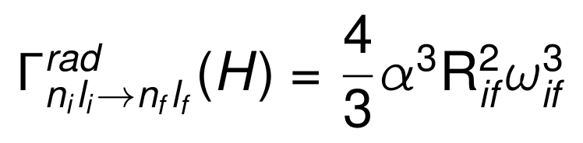
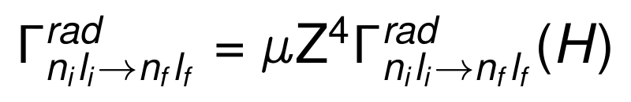
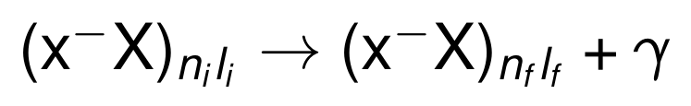
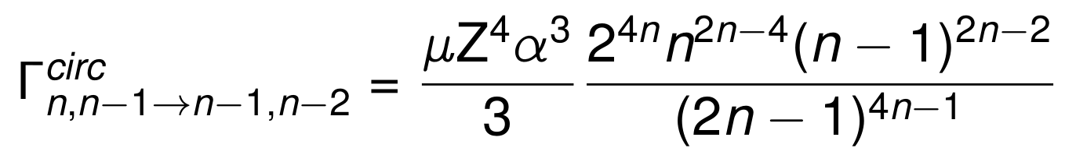
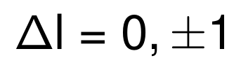
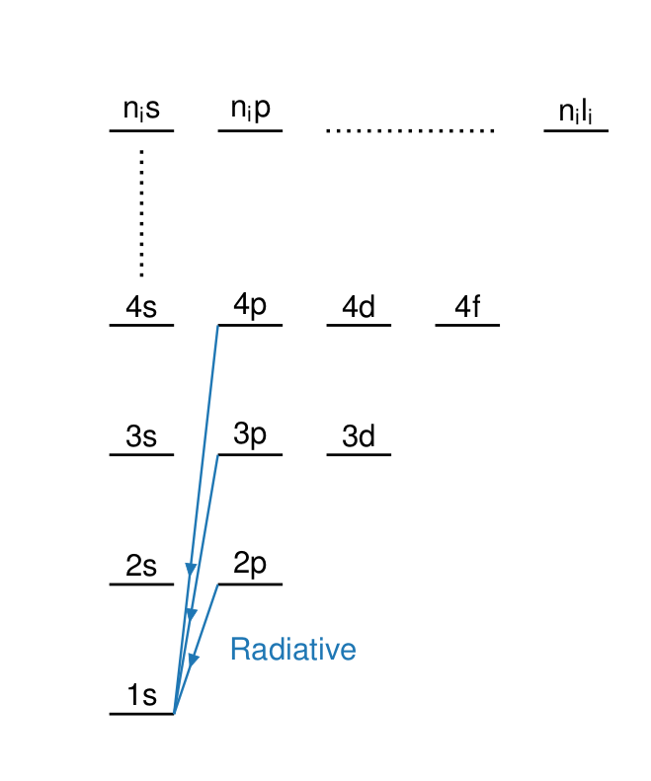
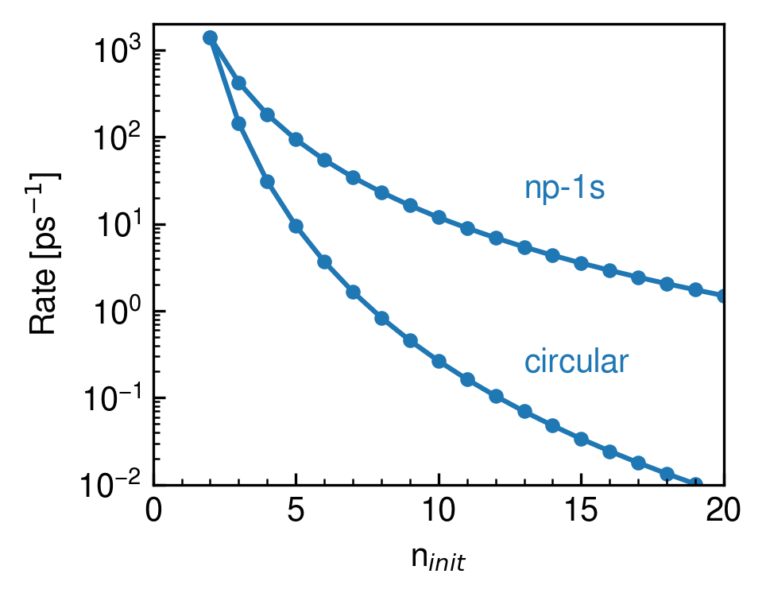
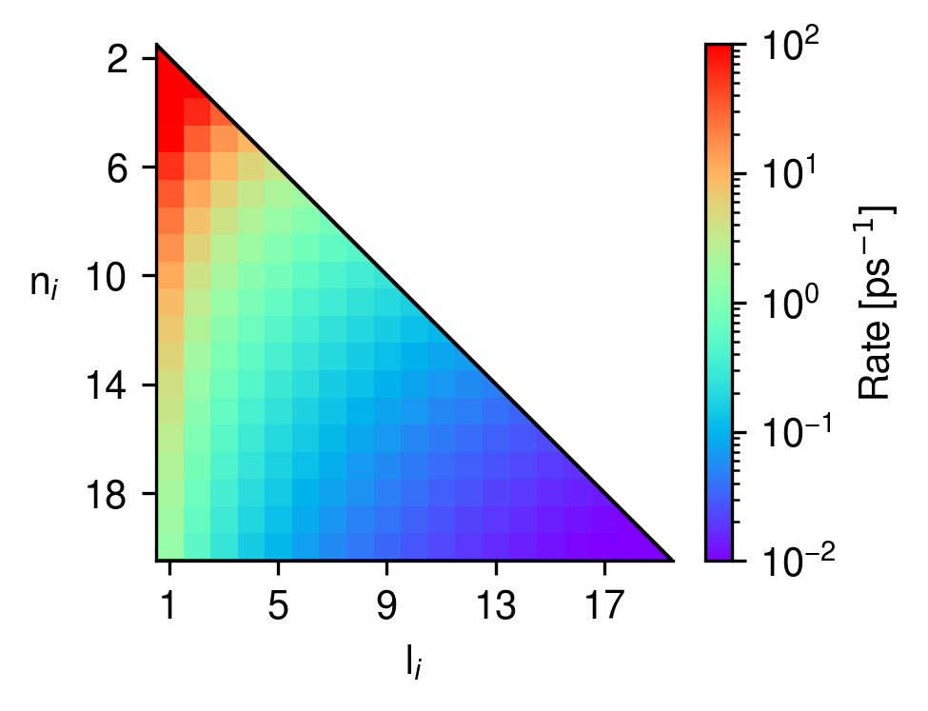
Building the Cascade: Radiative Rate

Slide 15
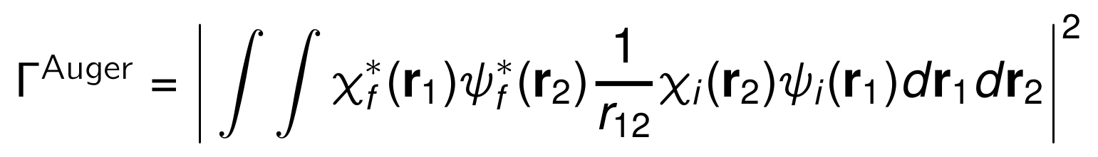
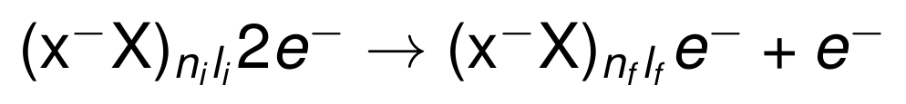
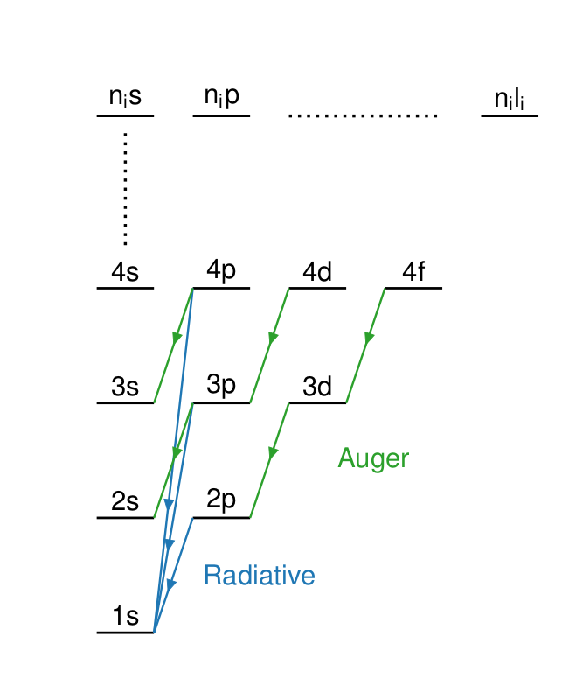
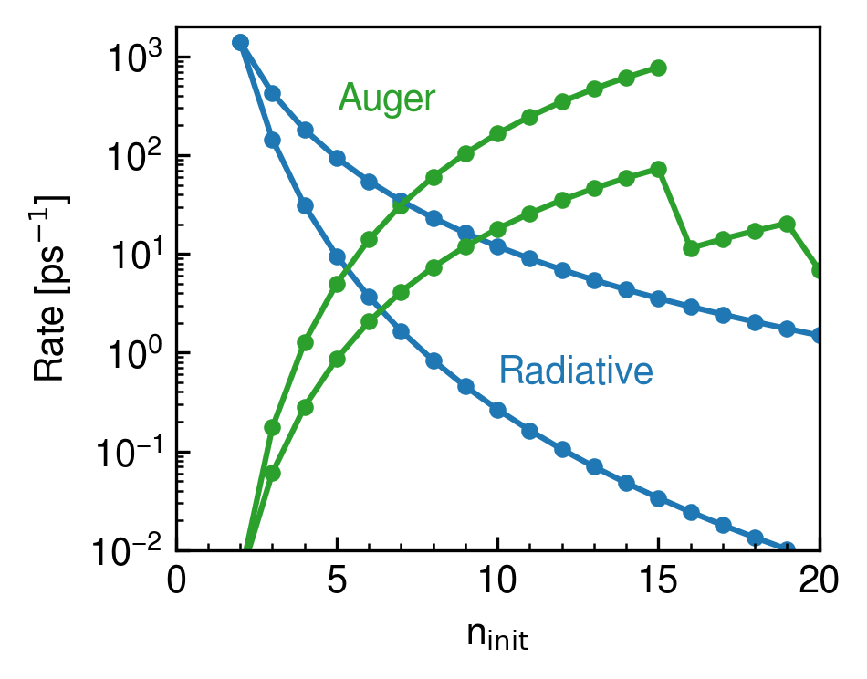
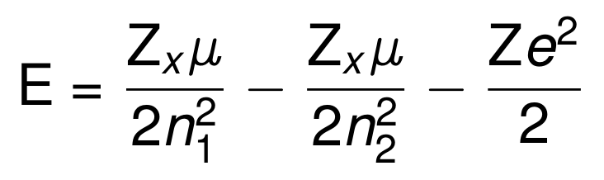
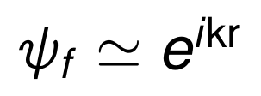
Building the Cascade: Auger Effect
G. R. Burbidge and A. H. de Borde, Phys. Rev. 89, 189 -1953

Slide 16
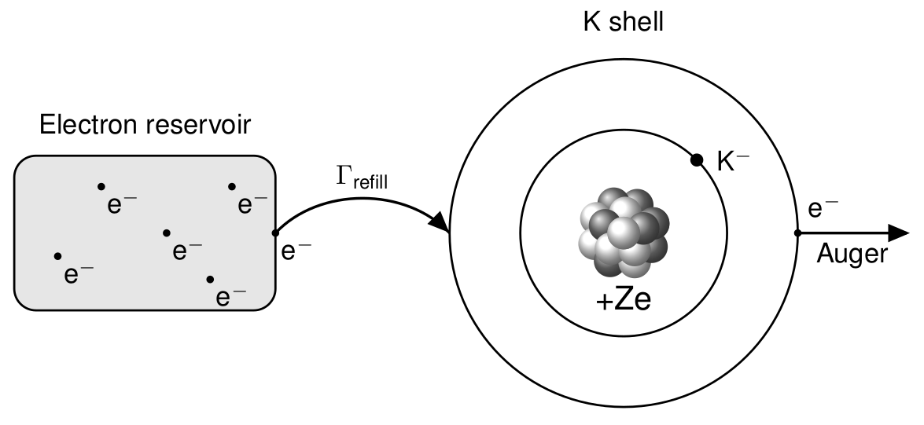
Building the Cascade: Density Dependence

Slide 17
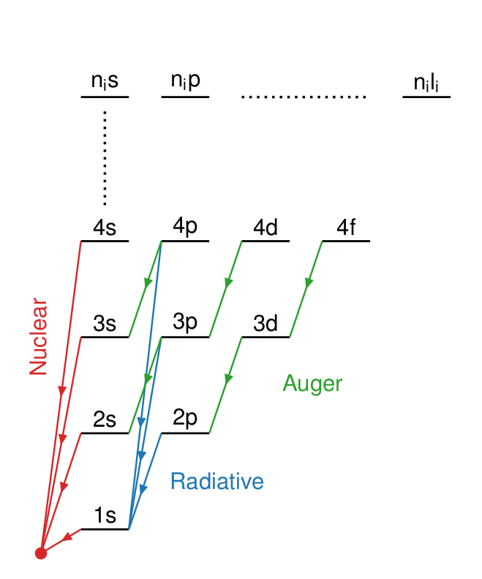
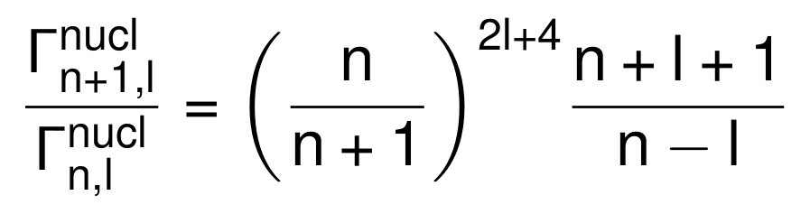
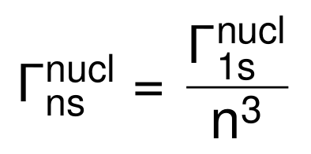
Building the Cascade: Nuclear Absorption
Z | Г_{1s} | Г_{2p} | Г_{3d} | Г_{4f}
- | [keV] | [keV] | [eV] | [meV]
C | 100 | 1.7 | 1 | 0.1-10
N | 100 | 2.7 | 3.5 | 0.1-10
C.J. Batty, Nuclear
Physics A, 372, 3, - 1981
C.J. Batty, Nuclear Physics A, 372, 3, - 1981

Slide 18
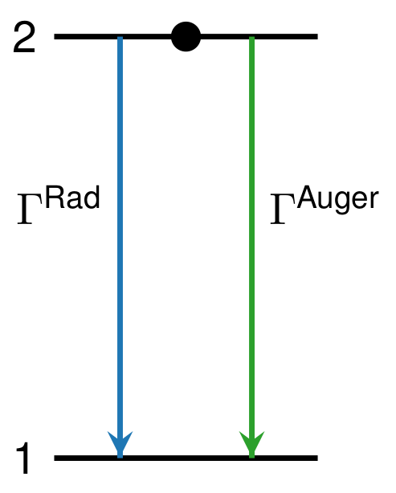
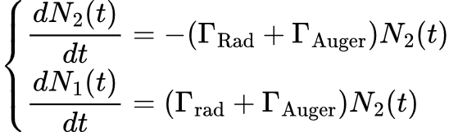


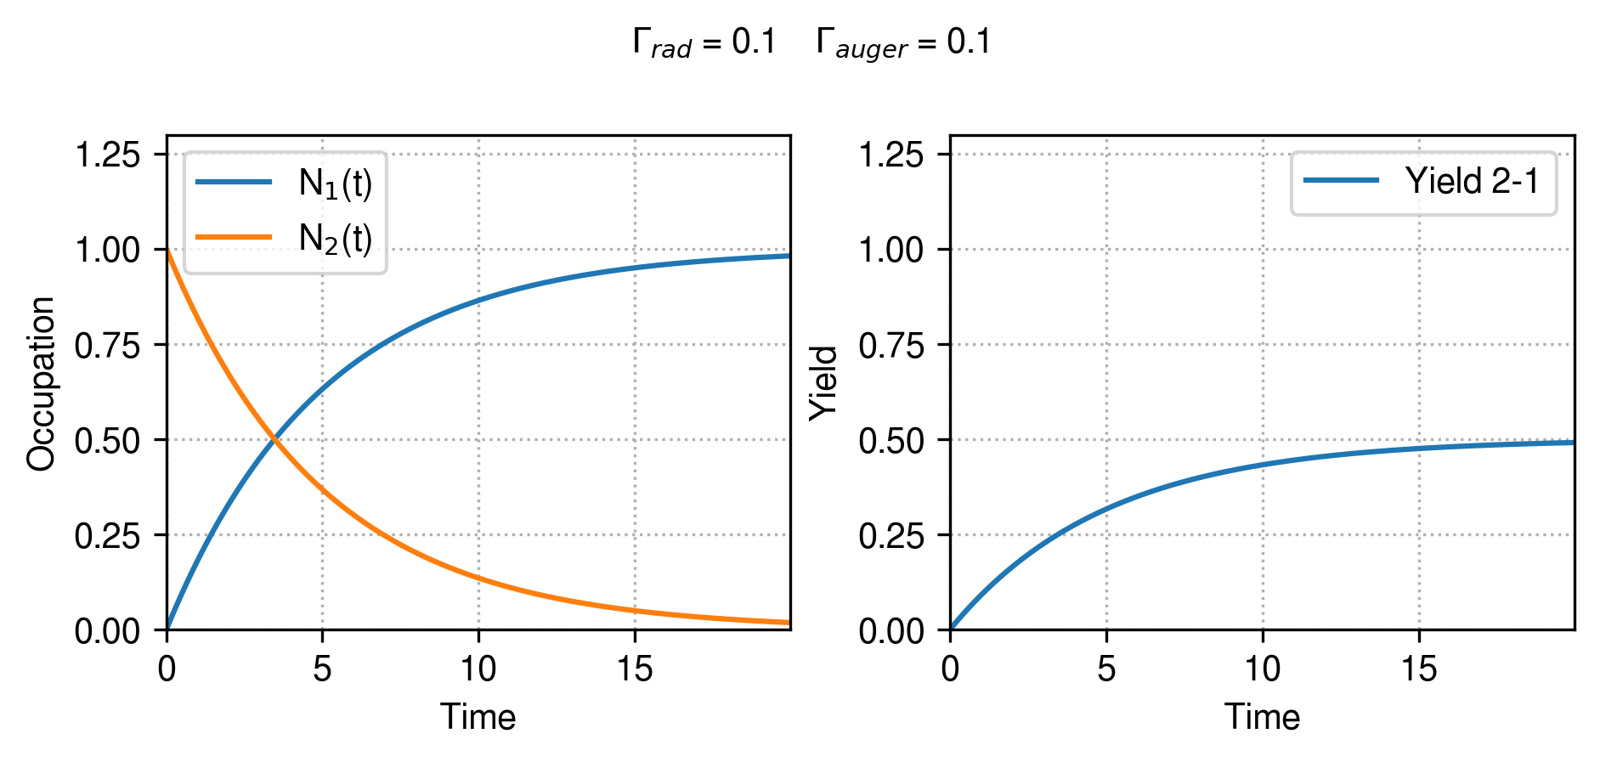
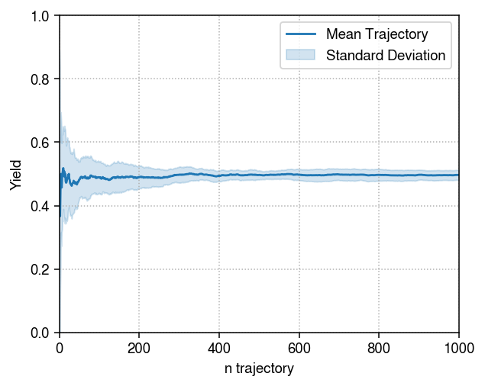
Building the Cascade: Two-Level Systems

Slide 19
Cascade for Kaonic Neon

Slide 20
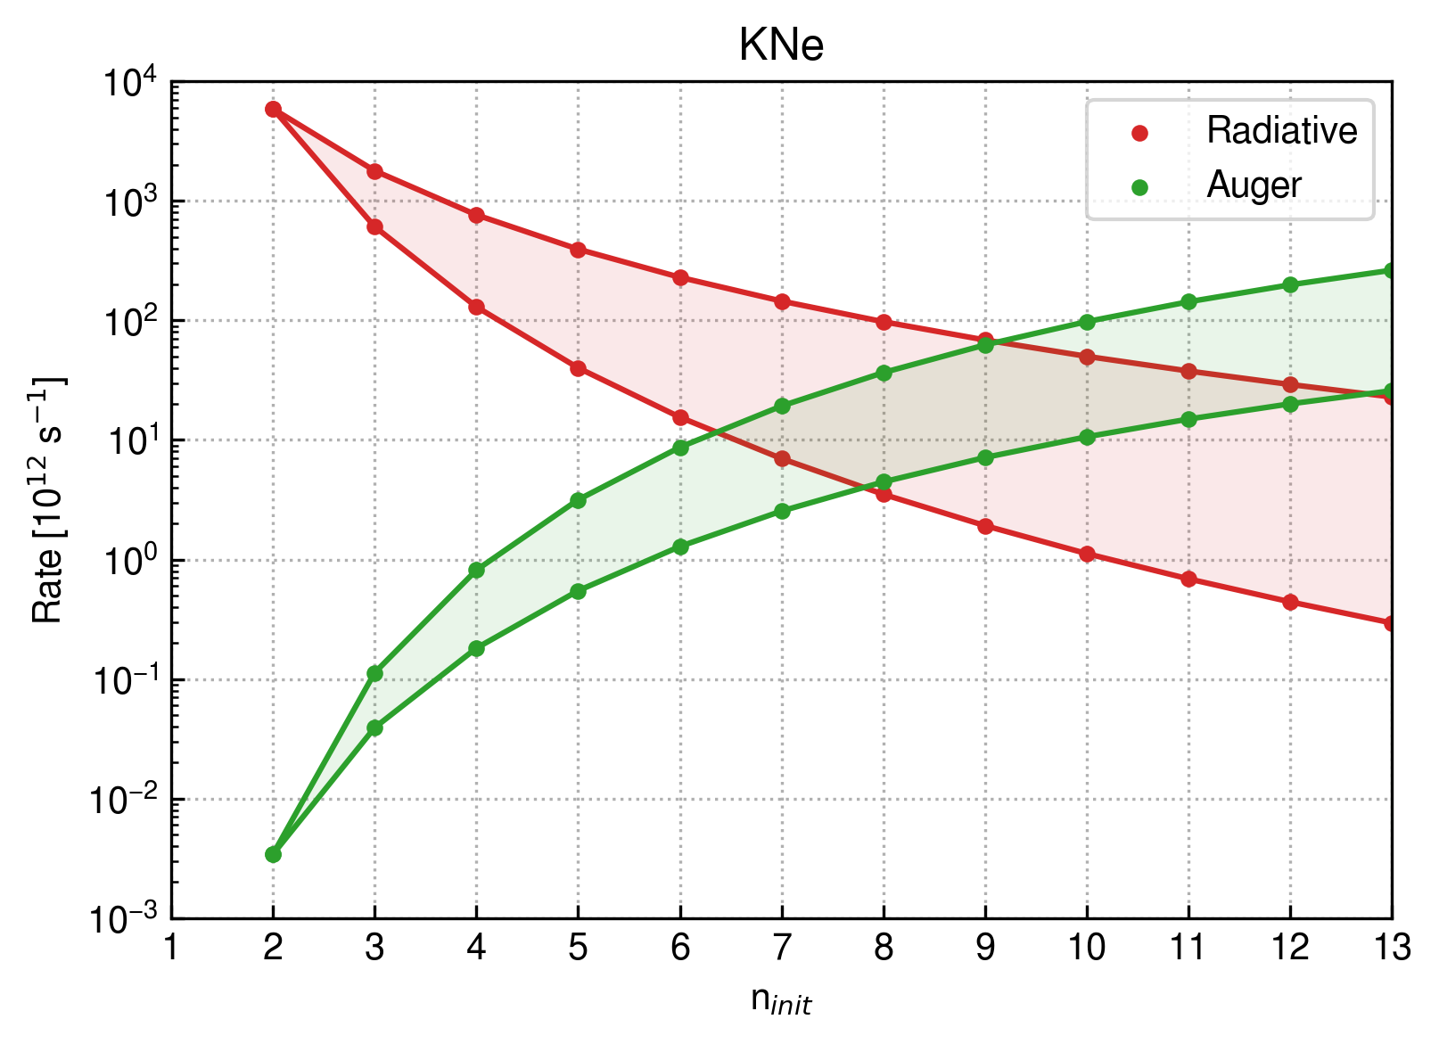
Cascade for Kaonic Neon: Radiative and Auger
Radiative Rate suppressed for n>9
Lower np-1s-transition
Upper circular-transition

Slide 21
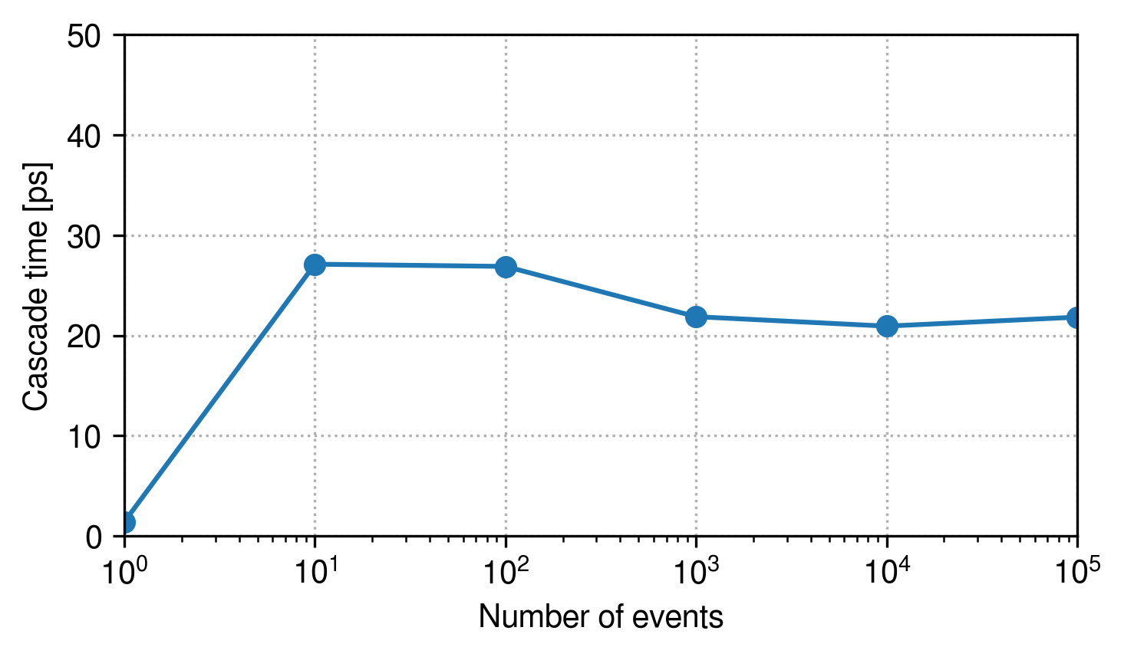
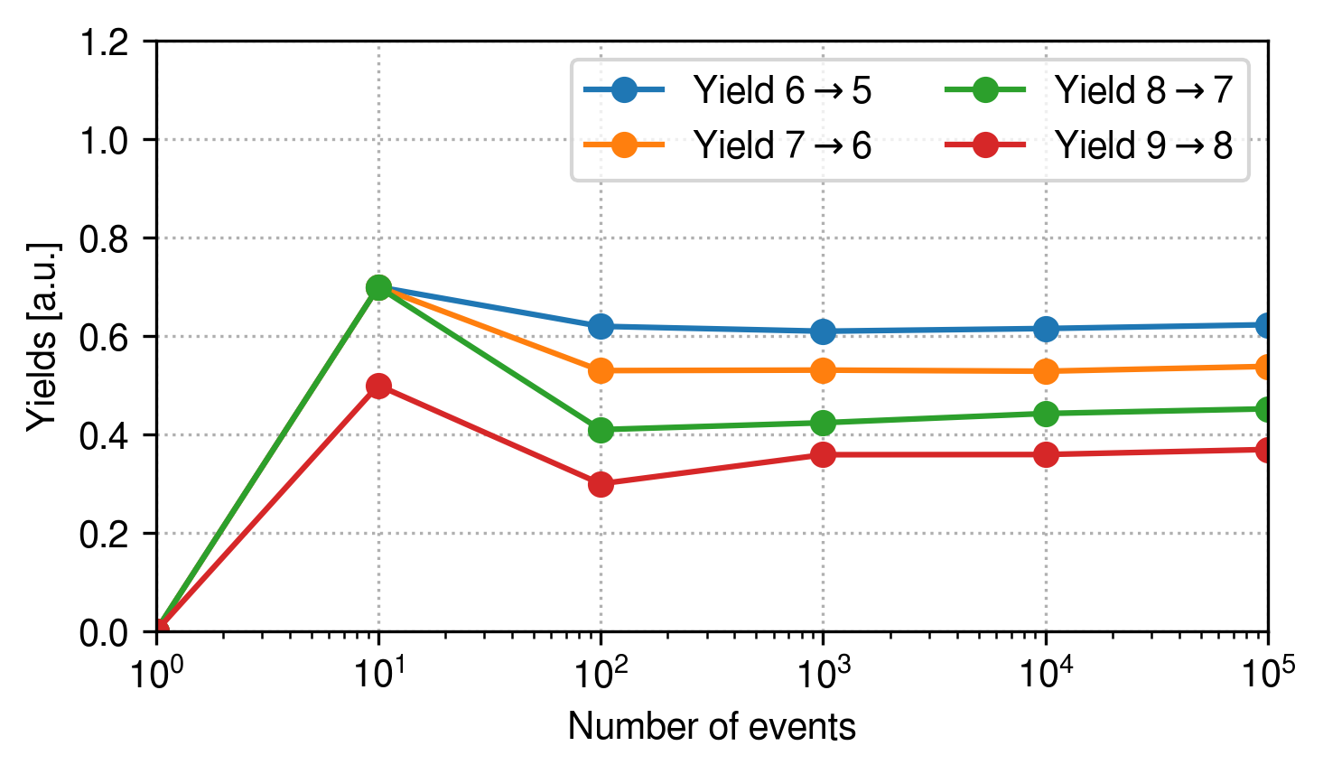
Converging the cascade to compare with experimental yields

Slide 22
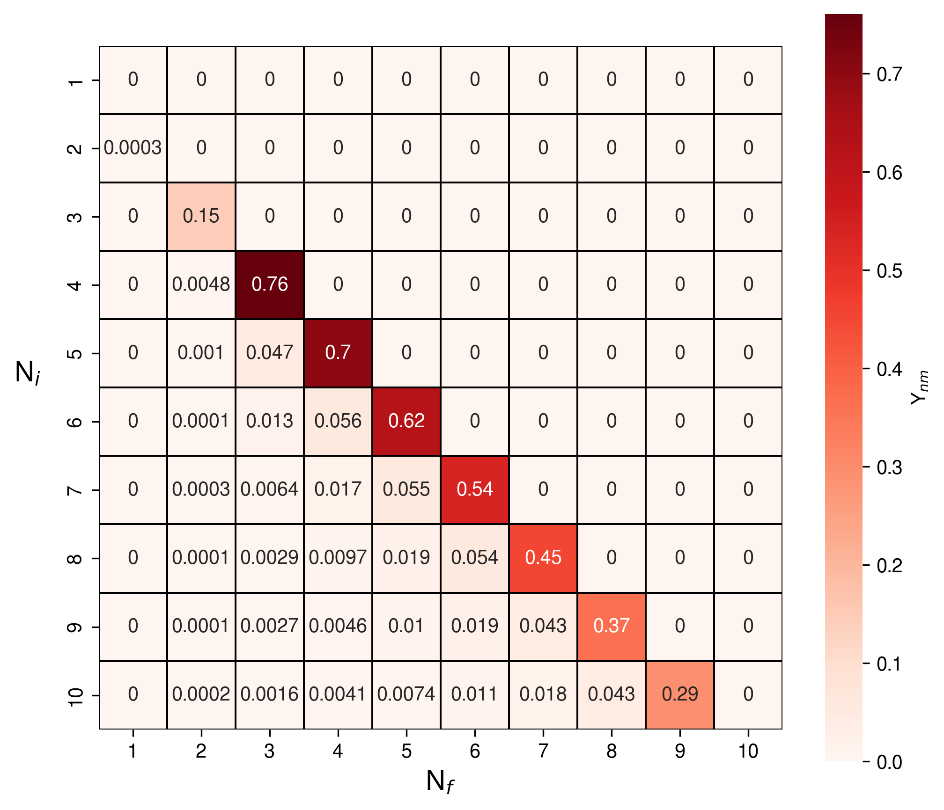
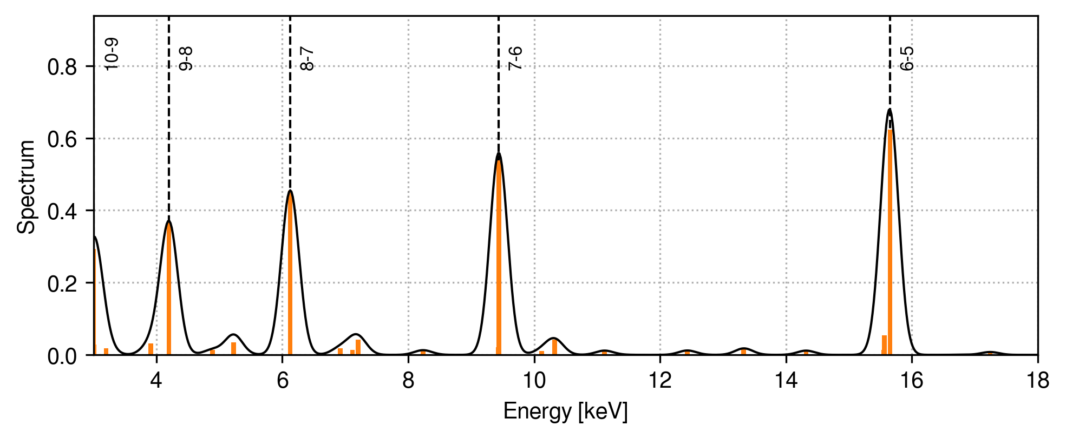
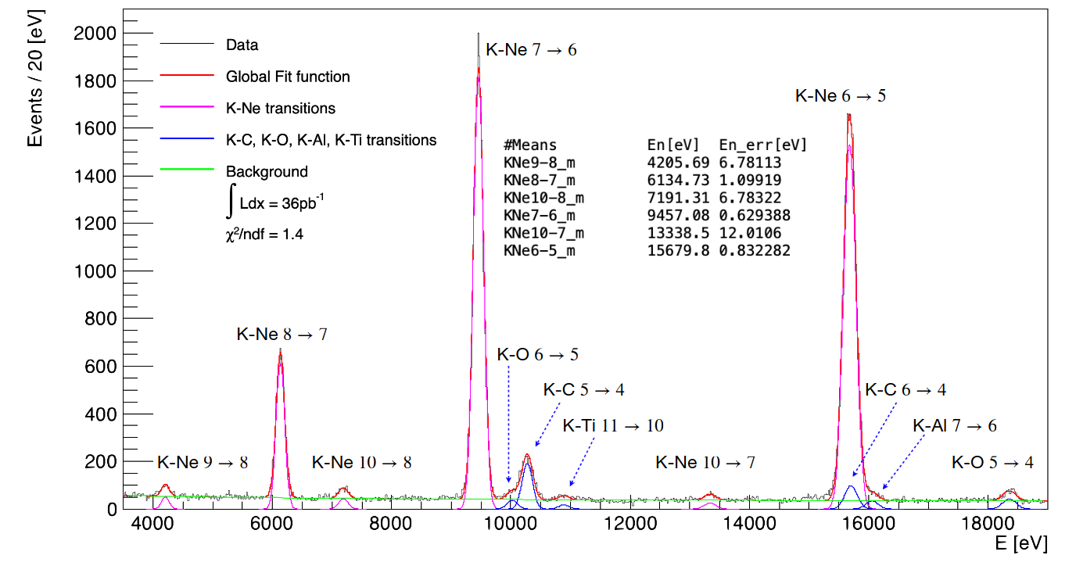
Cascade for Kaonic Neon: Yields and Spectrum
Comparison after including self-absorption and detector’s efficiency

Slide 23
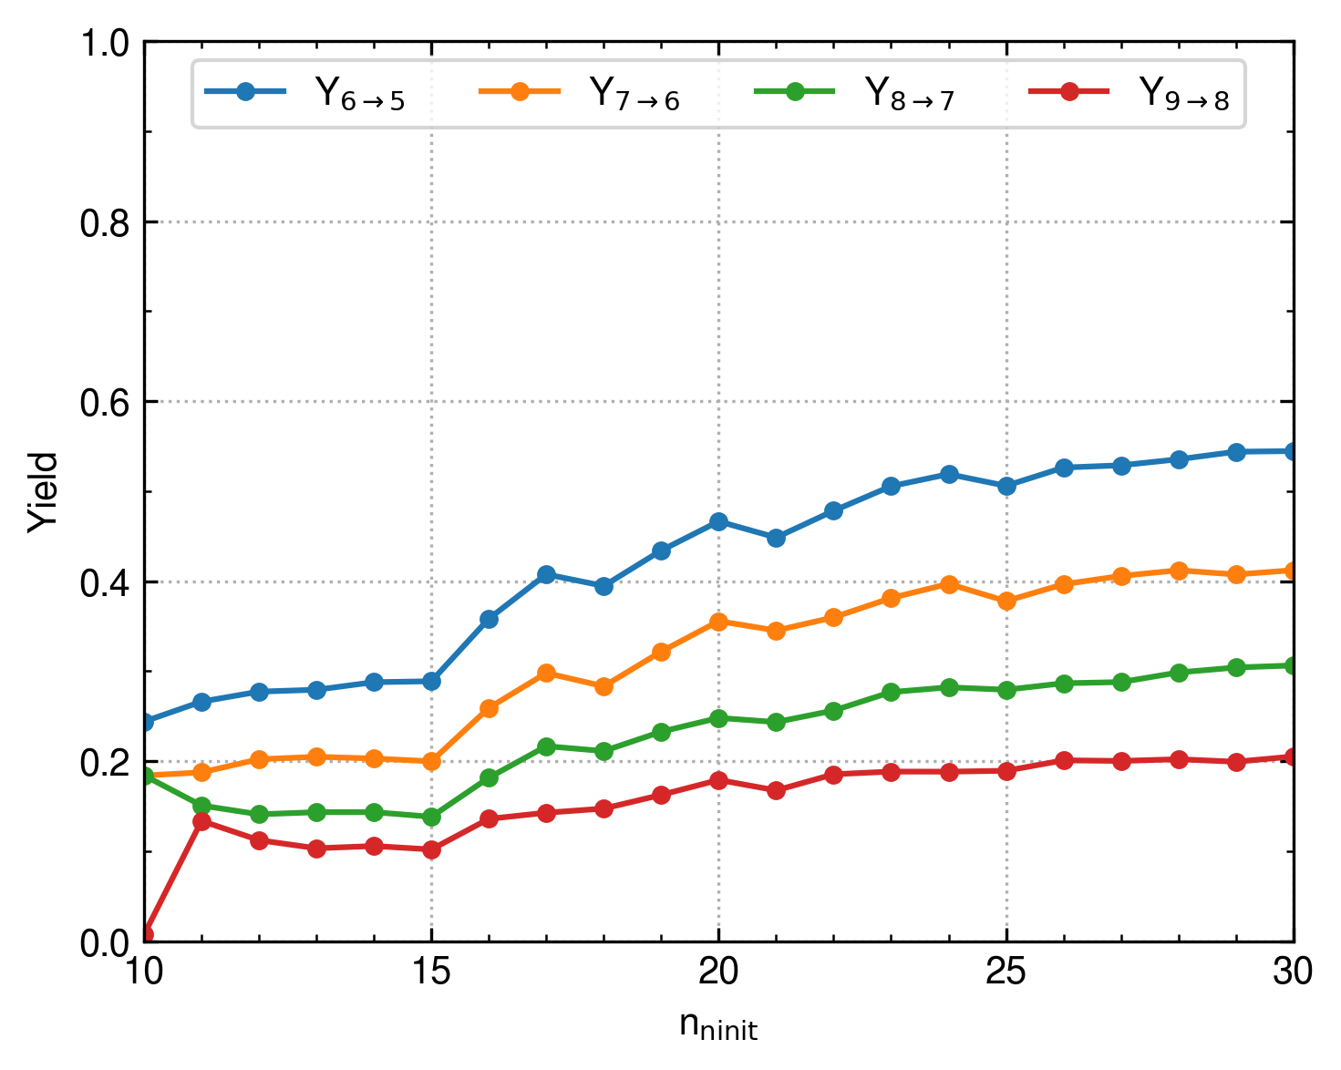
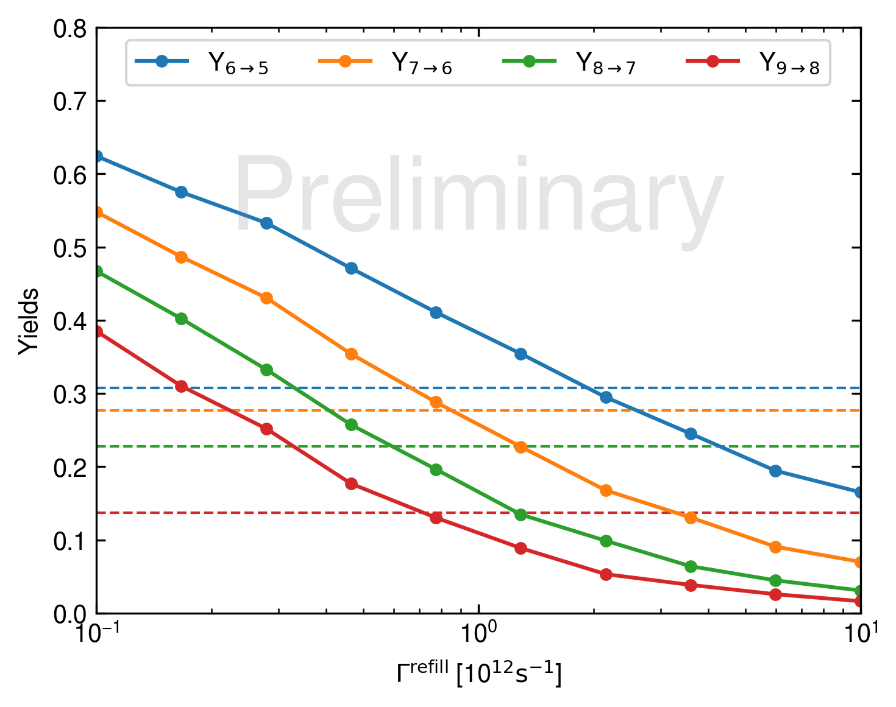
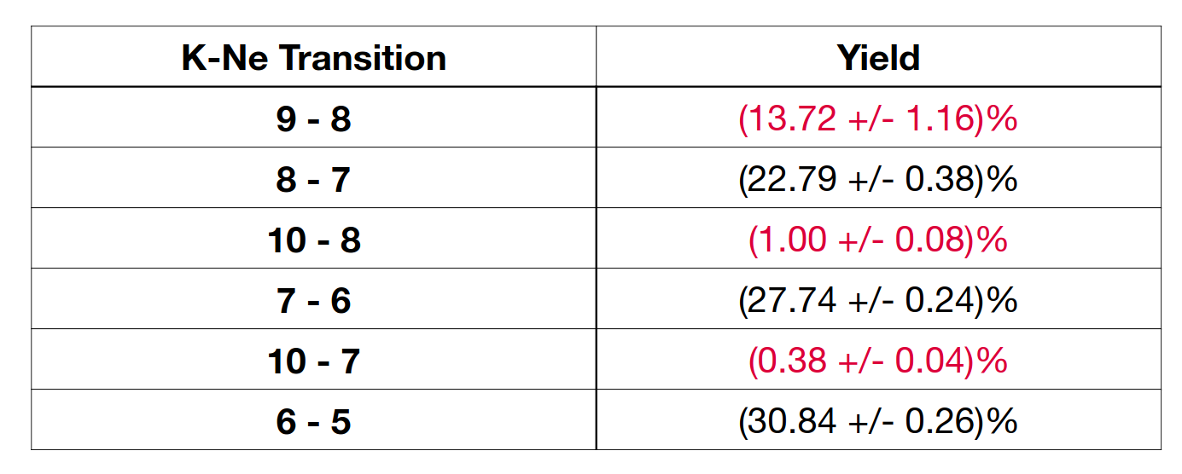
Cascade for Kaonic Neon: Connection with the Experiment

Slide 24
Conclusion
Studying Strong Interaction with Kaonic Atom
Kaonic Atom Properties From First Principles
Cascade Models for Fluorescence Yields Calculations
Thank for your attention!

