Slide 1

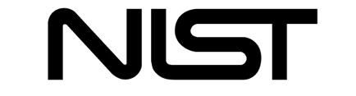
Microcalorimeter Sensors for the Study of Exotic Atoms
Joel Ullom
Chief, Quantum Sensors Division, NIST
Lecturer, Department of Physics, University of Colorado
joel.ullom@nist.gov
Oct 1, 2024
Notes:
Hi everyone, I’m Max from nist, and today I’m going to talk about a kinetic inductance travelling wave amplifier that we have been developing, that presents interesting characteristics. In fact we pump it in a 3WM fashion and that way we obtain promising noise performances that I will show.
Here are some pictures of this KIT, at different scales.

Slide 2
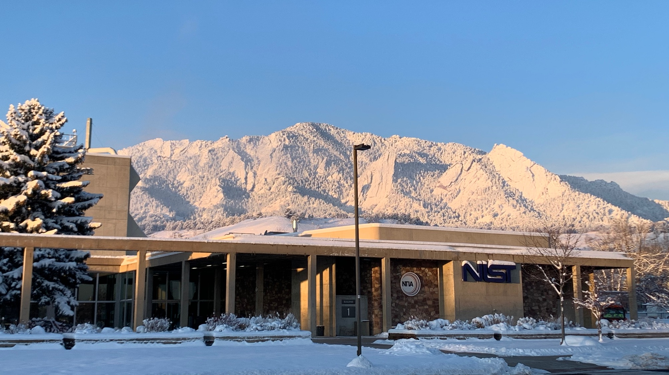
NIST = National Institute of Standards and Technology, branches in Boulder Colorado and Gaithersburg Maryland
US National Metrology Institute, part of Department of Commerce. Analogous to NPL or PTB.
The Quantum Sensors Division develops measurement technology for x-ray astrophysics, studies of the cosmic microwave background, synchrotron science, nuclear materials accounting, quantum information science, …
1
2

Slide 3
HEATES Collaboration
CU Boulder
K Morgan
D Becker
J Fowler
J Gard
J Nobles
J Weber
RIKEN
T Azuma
T Isobe
T Saito
NIST QSD
D Bennett
WB Doriese
J Imrek
JAB Mates
GC O’Neil
N Ortiz
DR Schmidt
DS Swetz
JN Ullom
Chubu University
S Okada
Y Toyama
LKB CNRS
N Paul
P Indelicato
G Baptista
Q Senetaire
LPNHE/IN2P3
N Garroum
JAEA
T Hashimoto
Technion-Israel Institute
of Technology
B Ohayon
Rikkyo University
S Yamada
Tokyo Metropolitan University
T Okamura
IHEP
D Yan
2

Slide 4
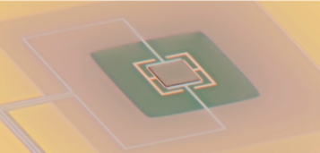
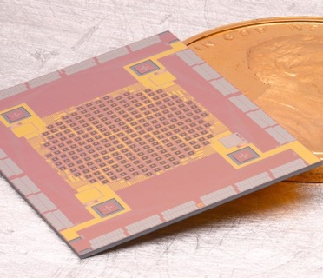
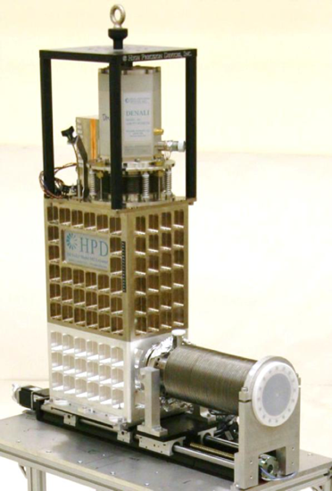
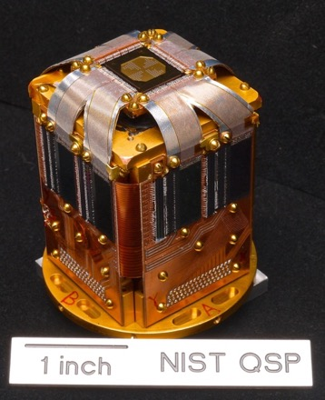
Superconducting microcalorimeters
a complete instrument including a 50 mK refrigerator
thin-film sensor
packaged array and superconducting readout circuitry
pixelated array of sensors
300 um
1 m
3

Slide 5
Superconducting microcalorimeters
a complete instrument including a 50 mK refrigerator
thin-film sensor
packaged array and superconducting readout circuitry
pixelated array of sensors
300 um
1 m
10 keV sensor: ~0.1 mm², 1000 sensors = 100 mm² located 30 mm from source
100 keV sensor: ~1 mm², 1000 sensors = 1000 mm² located 30 mm from source
3

Slide 6
What is a microcalorimeter?
universal thermal sensor
E
measure this
microcalorimeter: a device that measures deposited energy via a temperature change
4

Slide 7
Why millikelvin temperatures?
universal thermal sensor
E
measure this
Temperatures near 0.1 K suppress noise, enabling precise energy and power measurements
Johnson noise: V_{N} = (4 k_{b} T R)^{1/2} V/√Hz
4

Slide 8
Why millikelvin temperatures?
universal thermal sensor
E
measure this
P_{N}
Temperatures near 0.1 K suppress noise, enabling precise energy and power measurements
Johnson noise: V_{N} = (4 k_{b} T R)^{1/2} V/√Hz
Phonon noise: P_{N} = (4 k_{b} T² G) ^{1/2} W/√Hz
4

Slide 9
Why millikelvin temperatures?
universal thermal sensor
E
measure this
P_{N}
Temperatures near 0.1 K suppress noise, enabling precise energy and power measurements
Phonon noise: P_{N} = (4 k_{b} T² G) ^{1/2} W/√Hz
If power entering and leaving the sensor fluctuates, then the energy in the sensor fluctuates
4

Slide 10


Why millikelvin temperatures?
universal thermal sensor
E
measure this
P_{N}
credit: W. Fullagar, Australian National University
Temperatures near 0.1 K suppress noise, enabling precise energy and power measurements
Phonon noise: P_{N} = (4 k_{b} T² G) ^{1/2} W/√Hz
If power entering and leaving the sensor fluctuates, then the energy in the sensor fluctuates:
ΔE = (2 k_{b} T² C)^{1/2} J
4

Slide 11
Why millikelvin temperatures?
universal thermal sensor
E
consider a 6 keV x-ray: E = 1 fJ
consider a sensor consisting of a 250 x 250 x 0.25 μm³ film of gold at 0.1 K C = 0.1 pJ/K ΔE = 1.0 eV
how does this compare to other x-ray detectors? for silicon sensor, ΔE = 125 eV
measure this
P_{N}
Temperatures near 0.1 K suppress noise, enabling precise energy and power measurements
Phonon noise: P_{N} = (4 k_{b} T² G) ^{1/2} W/√Hz
If power entering and leaving the sensor fluctuates, then the energy in the sensor fluctuates:
ΔE = (2 k_{b} T² C)^{1/2} J
4

Slide 12
Transition-Edge Sensor (TES) thermometer
superconducting film as thermometer
0.06
resistance (Ω)
TES thermometer
working point
0.00
95.8
96
96.2
temperature (mK)
fractional change in resistance is >> fractional change in temperature
α = (T/R)(dR/dT) = (.1 K / 6e-3 Ω) (6e-2 Ω / 1e-4 K) = 10⁴ !
5

Slide 13
Transition-Edge Sensor (TES) thermometer
superconductor as thermometer
0.06
resistance (Ω)
0.00
95.8
96
96.2
temperature (mK)
TES is voltage-biased using a current source and a parallel shunting resistor R_{sh}
The TES is placed is series with a SQUID ammeter that measures its current
SQUID = Superconducting Quantum Interference Device, a thin-film circuit that transduces current or magnetic flux to voltage
6

Slide 14
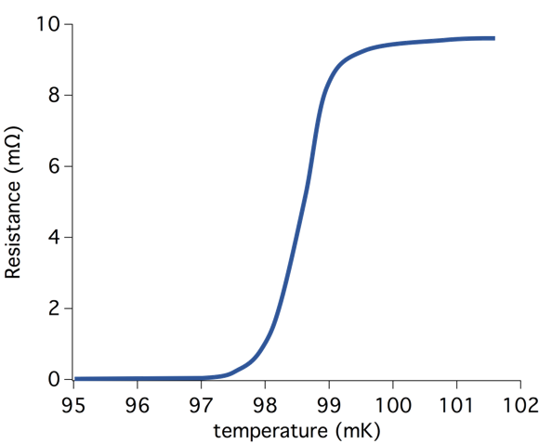
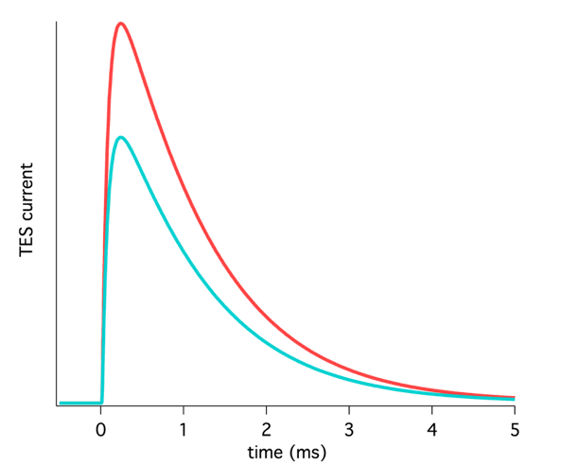
TES response to deposited energy
(-1) * TES current
deposited energy causes TES temperature and resistance to increase
a resistance increase under voltage bias causes current and power to decrease (Irwin, APL 1995)
then, the TES cools back to its quiescent state
the height (and area) of the current pulse reveal the deposited energy
7

Slide 15
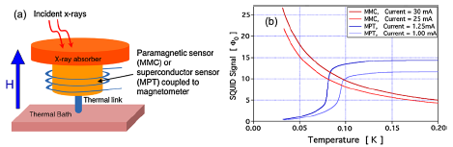
Magnetic MicroCalorimeter (MMC)
MMCs are also microcalorimeters that transduce energy to temperature
Temperature sensing mechanism different from TES: change in paramagnetic or diamagnetic response
MMC response also sensed with SQUID
Loredana Gastaldo will speak about MMCs on Friday
8

Slide 16
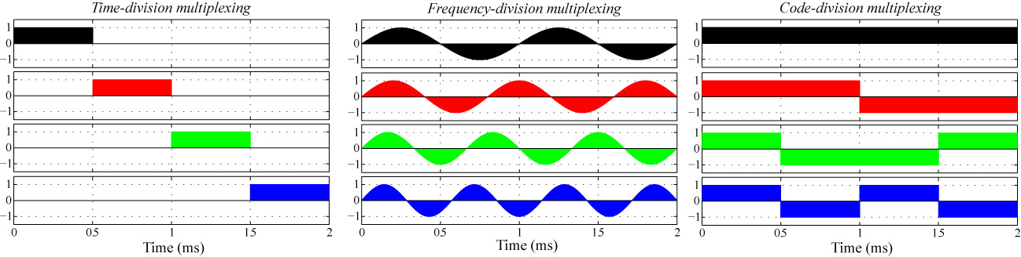
Multiplexed TES readout
electrical connections between 300 K and 100 mK are mechanically complex and produce a thermal load
in an array with 100s or 1000s of sensors, it is impractical to have a dedicated amplifier chain for each sensor
instead, sensors are multiplexed: sensor signals are encoded with an orthogonal basis set, combined, amplified, passed to 300 K, and then demodulated
there are several possible multiplexing schemes:
sensor 1
sensor 2
sensor 3
sensor 4
Frequency-division multiplexing at GHz frequencies = state-of-the-art
9

Slide 17
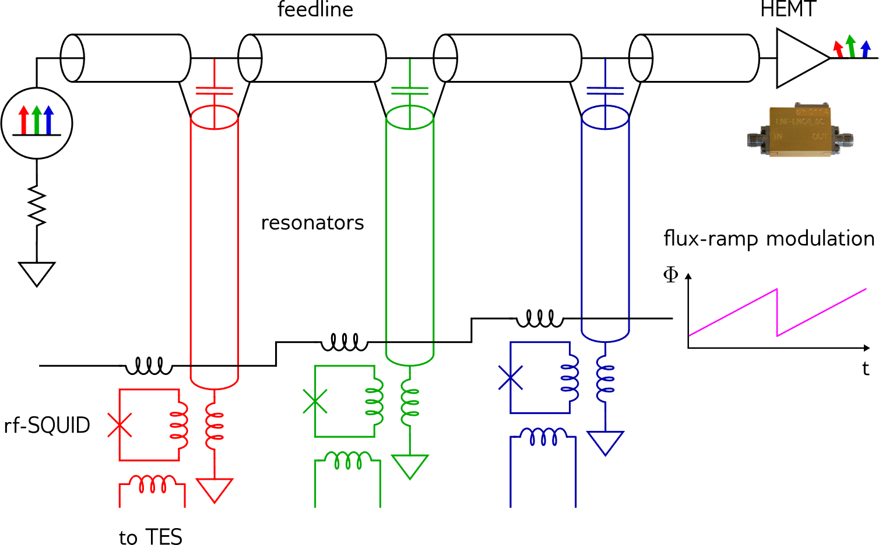
Microwave SQUID multiplexing
Frequency-specific microresonators coupled to a common feedline and amplifier
An RF-SQUID embedded in each resonator. Each TES sensor coupled to an RF-SQUID
Several GHz of bandwidth per amplifier channel, 100s to 1000s of sensors per amplifier
microwave resonators terminated in variable inductor (RF-SQUID), which is coupled to TES detector
change in detector resistance
  → change in current
  → change in termination inductance
  → change in resonant frequency
  → change in transmitted amplitude and phase
sensor signals encoded as phase shift in response to linearizing flux ramp
Irwin and Lehnert, Applied Physics Letters 85, 2107 (2004)
10

Slide 18
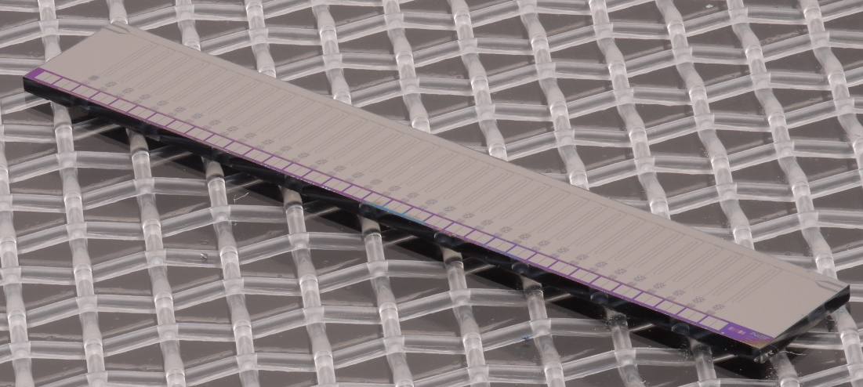
Actual multiplexer
Tens of microwave resonators coupled to common feedline
Frequencies between 4 and 8 GHz
Resonator widths between 100 kHz and ~10 MHz
feedline in
28 mm
TES signals enter here
feedline out
11

Slide 19
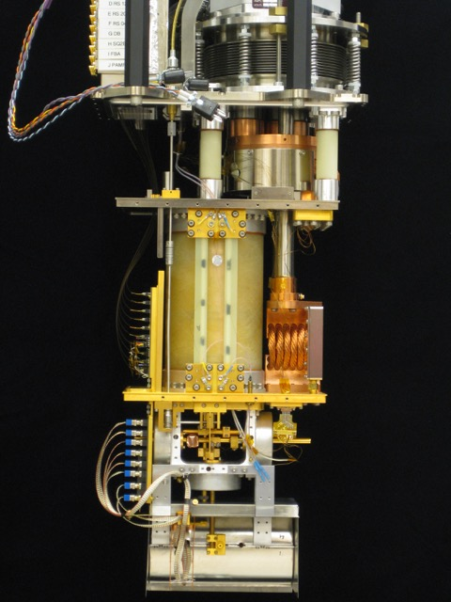
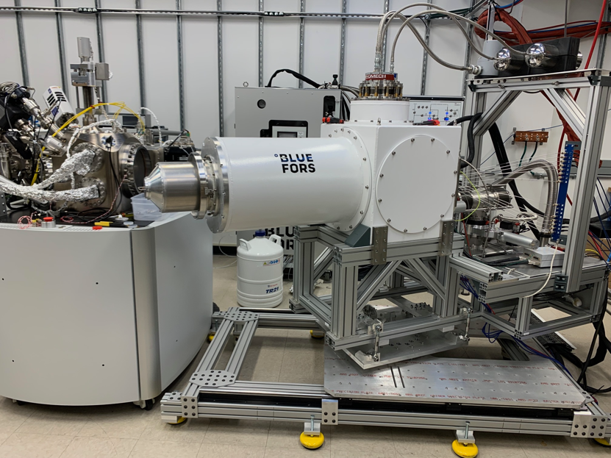
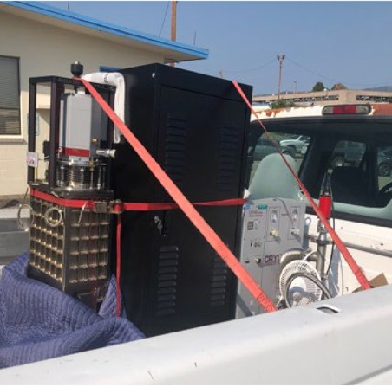
Modern cryogenics: no liquid cryogens
commercial adiabatic demagnetization refrigerator (NIST-designed)
commercial dilution refrigerator (right) on custom stand to mate with electron microscope (left)
1 m
DR has abundant cooling power for large sensor arrays
modest cooling power but easily brought to photon sources
12

Slide 20
Why microcalorimeters and exotic atoms?
Requirements
measurements of exotic atoms require sub-eV energy uncertainties
signal photon fluxes are very low
sources are spatially extended
some background radiation present
broadband response sometimes needed
13

Slide 21
Why microcalorimeters and exotic atoms?
Requirements
measurements of exotic atoms require sub-eV energy uncertainties
signal photon fluxes are very low
sources are spatially extended
some background radiation present
broadband response sometimes needed
energy dispersive (Si, Ge, …)
TES
arrays
collection efficiency
wavelength dispersive
(crystals, gratings)
A Solution – Microcalorimeter Arrays
high collection efficiency combined with excellent resolving power
energy-dispersive, so broadband response and resolving power is unchanged by extended sources
more radiation resistant than semiconductors (with caveats)
resolving power
 | 1,000 TESs, 6 keV | Xtal, 6 keV | 1,000 TESs, 100keV | Xtal, 100 keV
resolving power (E/ΔE) | 2-4✕10³ | around 10⁴ | 2-4✕10³ (could get better) | 1.3✕10³
collecting efficiency (ηdΩ/4π) | 2✕10⁻² | 1.6✕10⁻⁴ | 10⁻² | 8✕10⁻⁸
13
For ESRF ID26, courtesy of P. Glätzel
See Paul, PRL 2021 and Beyer J Phys B 2015

Slide 22
Capsule history of HEATES program
Started in 2014
8 beamtimes to study exotic atoms, 1 at PSI, 7 at JPARC
9th beamtime in 2025
Now using 2nd generation TES instrument
 | Experiment | Title | Beam type | Start date | End date | Location | Beamline | TES type
1 | - | pionic C | pion | 10/27/14 | 11/5/14 | PSI | πM1 | 10-keV TES
2 | J-PARC E62 | beam commissioning | kaon | 6/24/16 | 6/30/16 | J-PARC | Hadron K1.8BR | 10-keV TES
3 | J-PARC E62 | kaonic He | kaon | 6/2/18 | 6/30/18 | J-PARC | Hadron K1.8BR | 10-keV TES
4 | 2019A0083 | muonic Ne (w/o x-ray tube) | muon | 4/19/19 | 4/23/19 | J-PARC | MLF muon D2 | 10-keV TES
5 | 2019MS01 | muonic Ne & Fe | muon | 1/14/20 | 1/20/20 | J-PARC | MLF muon D2 | 10-keV TES
6 | 2019MS01 | muonic D2 (ddμ* w/gas target) & Ar | muon | 3/9/22 | 3/19/22 | J-PARC | MLF muon D2 | 10-keV TES
7 | 2019MS01 | muonic molecule ddμ* w/solid target | muon | 2/5/23 | 2/11/23 | J-PARC | MLF muon D2 | 5-keV TES
8 | 2023B0036 | muonic Ar & Si | muon | 2/6/24 | 2/16/24 | J-PARC | MLF muon D2 | 50-keV & 100-keV TES
9 | 2024B0329 | muonic Ar & Si (next beamtime) | muon | 2025 |  | J-PARC | MLF muon H1 | 50-keV & 100-keV TES
Courtesy of Shinji Okada
14

Slide 23
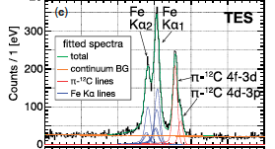
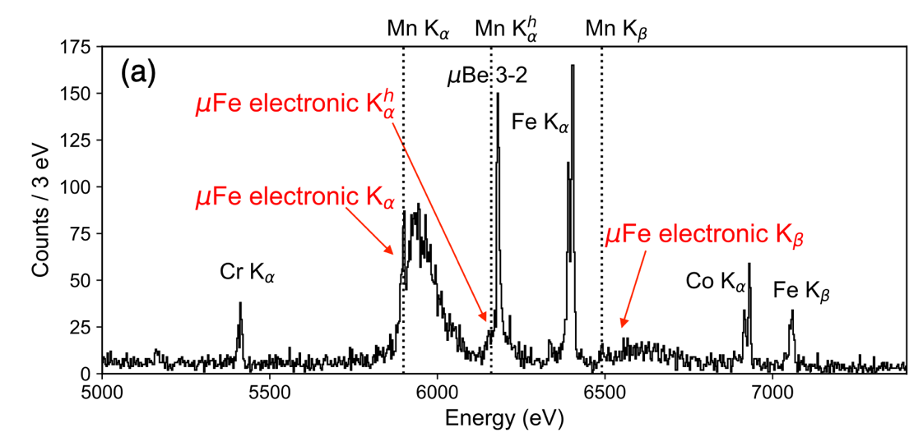
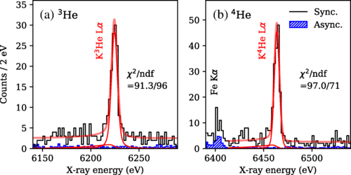
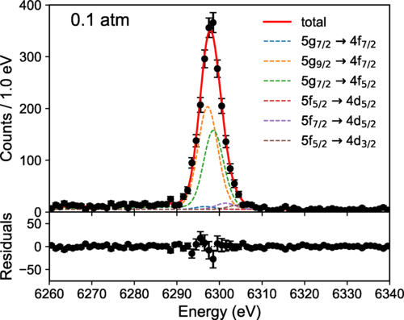
Highlights
First use of superconducting microcals for hadronic atom spectroscopy.
Measured emission spectrum of pionic C
Okada et al., PTEP 2016, 9, (2016)
Deexcitation dynamics of muonic Fe
Okumura et al., PRL 127 (2021)
First measurement of
QED vacuum polarization contribution to
5g_{9/2} → 4f_{7/2} transition of muonic Ne
Okamura et al., PRL 130 (2023)
Strong-interaction effects in kaonic He
Hashimoto et al., PRL 128 (2022)
15

Slide 24
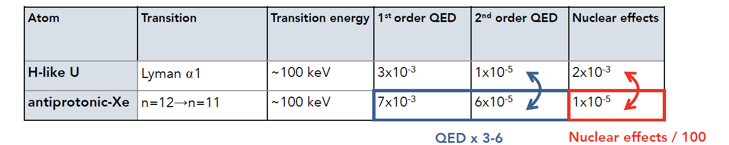
Future work – PAX
Goal:
study Quantum Electrodynamics (QED) in strong field limit
exotic atoms provide larger electric fields and smaller nuclear effects than HCIs
new project PAX led by N. Paul and P. Indelicato: study antiprotonic atoms at CERN ELENA facility
Initial demonstration:
96 pixels, 50 – 200 keV
small, portable 2-stage ADR cryostat
Pilot experiment at CERN in summer 2025
Full instrument
4x 96-pixel arrays
3He-backed 1-stage ADR
delivery to CERN in 2027
16

Slide 25
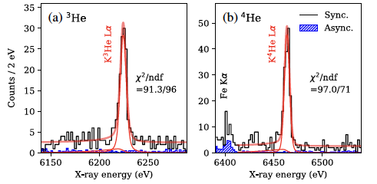
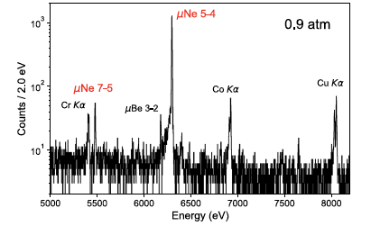
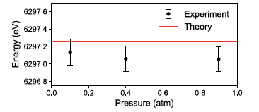
Absolute energy calibration important
Many exotic atom experiments require an absolute energy measurement to test theoretical predictions
spectroscopy of kaonic helium (Hashimoto, 2022)
spectroscopy of muonic neon (Okumura, 2023)
“Our results exclude the large shifts and widths predicted by a coupled-channel calculation and are compatible with the optical-model-based calculations.”
5g_{9/2} → 4f_{7/2}
17

Slide 26
Absolute energy calibration
Many exotic atom experiments require an absolute energy measurement to test theoretical predictions
Microcalorimeters are nonlinear so calibration is an important task
nonlinear sensor response curve
For TESs
Electrical units (arb)
I(t) = V_{b}/(R_{o} + ΔR(t)) where R ≡ R(I,T), a surface whose shape does not have a simple form known from theory
For MMCs
shape of response curve is better described by theory but not so well as to preclude calibration
Energy
18

Slide 27
Absolute energy calibration
Many exotic atom experiments require an absolute energy measurement to test theoretical predictions
Microcalorimeters are nonlinear so calibration is an important task
Calibrating microcalorimeters requires narrow spectral features at known energies
nonlinear sensor response curve
For TESs
Electrical units (arb)
I(t) = V_{b}/(R_{o} + ΔR(t)) where R ≡ R(I,T), a surface whose shape does not have a simple form known from theory
Use cubic smoothing spline to describe curve
For MMCs
shape of response curve is better described by theory but not so well as to preclude calibration
Use natural functional form to describe curve (probably)
Energy
18

Slide 28
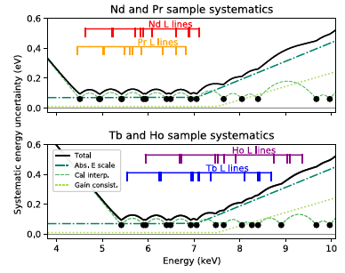
Examples of absolute energy determination
exotic atom experiments:
  energy of 6400 eV Fe Kα feature determined with .04 eV uncertainty: 6 ppm (Tatsuno, JLTP 2016)
  energy of 6425 eV πC features determined with 0.1 eV uncertainty: 16 ppm (Okada, PTEP 2016)
measurements of elemental fundamental parameters:
  lanthanide features between 4500 and 7000 eV determined with ~ 0.1 eV uncertainty: 14-22 ppm (Fowler, Metrologia 2021)
measurements of nuclear material:
  energy of 59540 eV ²⁴¹Am gamma-ray determined with 0.4 eV uncertainty: 7 ppm (Kim, JLTP 2020)
several demonstrations of ~10 ppm absolute energy uncertainty
  from Fowler, Metrologia 2021
19

Slide 29
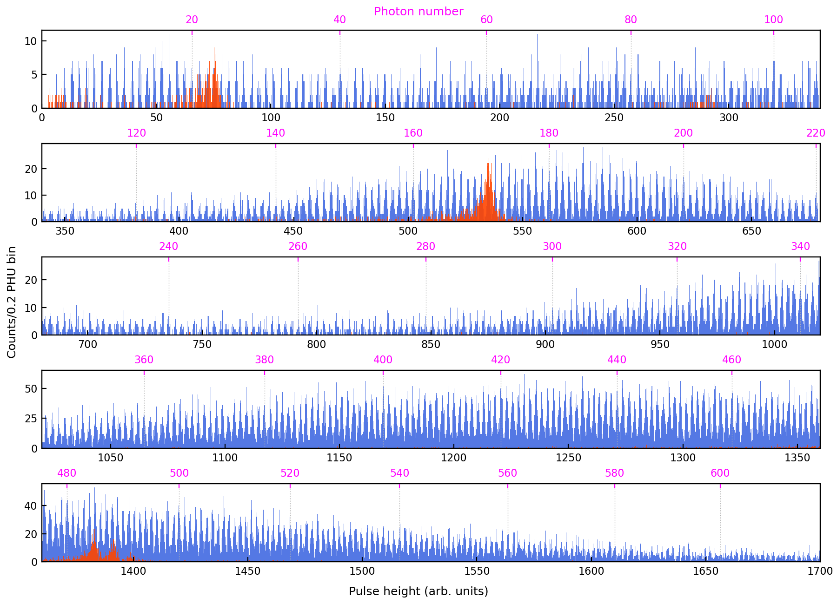
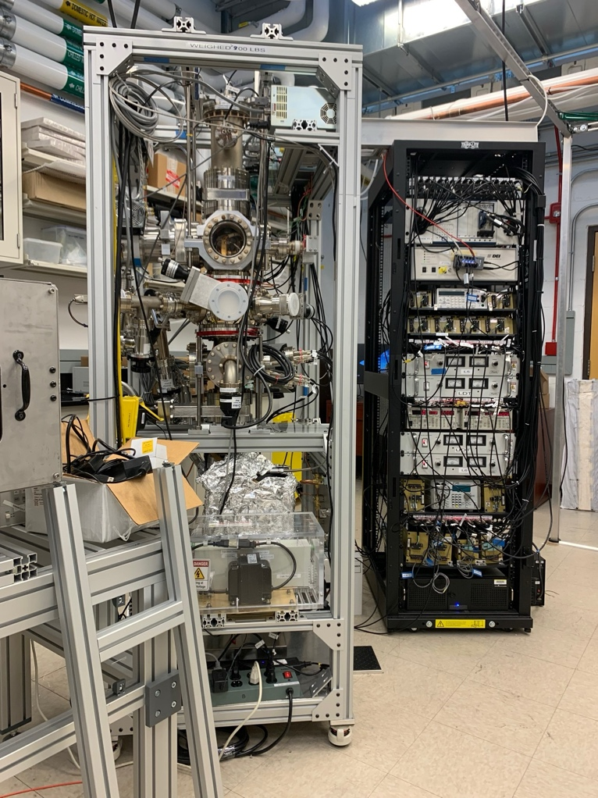
Availability of calibration features critical
At low energies (<3 keV), few good elemental calibrators because of broad and chemistry-dependent line shapes
  Alternative #1: laser-based calibration promising (challenges remain for arrays)
  Alternative #2: HCIs as calibrators (no data yet)
X-ray spectrum overlayed with response to 400 nm laser pulses
compact HCI source
Al L
O K
Credit:
Avirup Roy Wisconsin/NIST
mini-ebit at NIST Boulder (built by J. Tan)
Al Kα
20

Slide 30
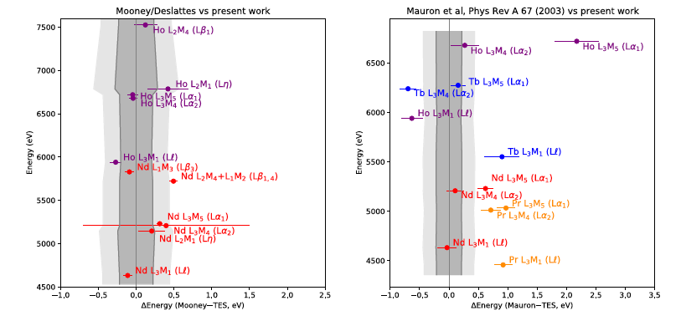
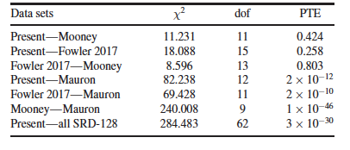
Availability of calibration features critical
At intermediate energies (~3-10 keV), some excellent elemental calibrators but proceed with caution …
Fowler (Metrologia 2021) used 3d transition metals as calibrators to determine absolute energies of lanthanide L lines
Fowler lanthanide results were statistically consistent with ‘best’ previous measurements (Mooney)
Fowler lanthanide results were statistically inconsistent with some specific previous measurements (Mauron) and with the aggregate of previous measurements (Deslattes, Rev Mod Phys 2003 - SRD128)
Uncertainties likely underestimated in some past work
21

Slide 31
Calibration at higher energies may be harder
At intermediate energies (~3-10 keV), 3d transition metals = excellent calibrators: ~1 ppm uncertainties, 500 eV separation
But, calibration features worse at higher energies …
Recommended γ-ray calibrators from Helmer and van der Leun, NIM A 2000
~10 ppm uncertainties
sparse regions
Energy Uncertainty (ppm)
Energy (keV)
22

Slide 32
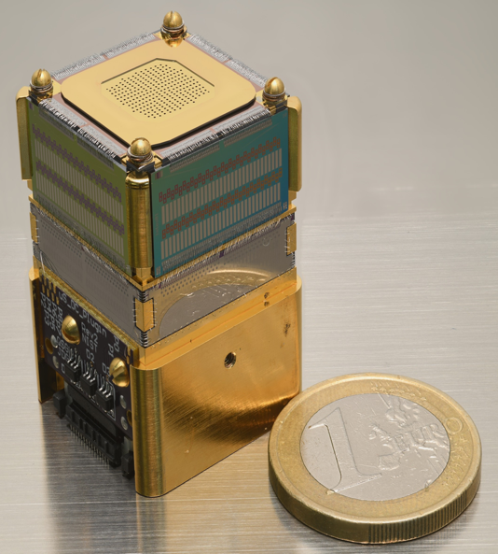
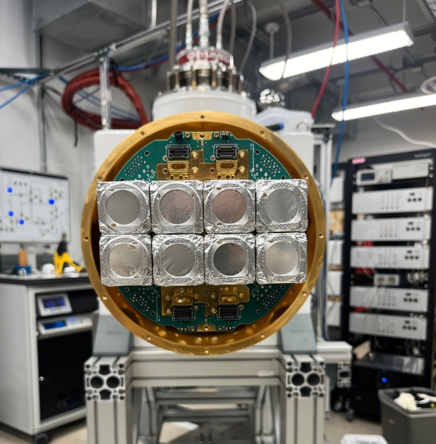
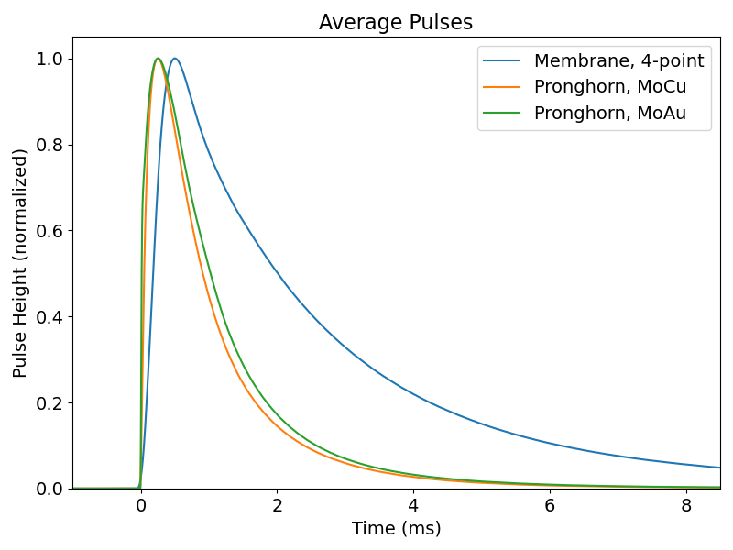
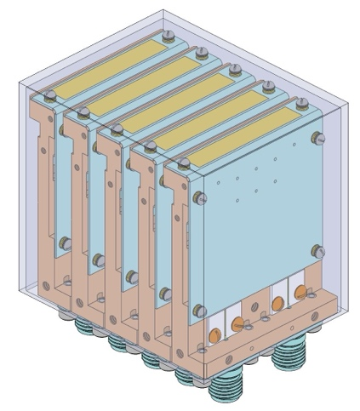
Trends in microcalorimeter technology
more sensors
faster sensors
current 100 keV devices
new
denser packaging and 10,000 TES spectrometer
microsnout module: 250 10 keV TESs or 100 100 keV TESs
spectrometer with 2,000 live TESs and capacity for 3,000
better robustness to radiation possible
better understanding of R(I,T) surface
added thermal mass
on-chip active energy removal
anticoincidence detectors
promising work to describe TESs using time-dependent Ginzburg-Landau theory
could this lead to better calibrations? maybe, but not guaranteed
23

Slide 33
Possible discussion topics
What sensor developments would be most beneficial to this community?
Ideas for calibration schemes that can work up to 300 keV?
  laser-driven x-ray source with indium target: multiple In Kα photons per pixel per pulse?
  any working, well-calibrated xtal spectrometers?
  … ?
Are there other exotic atom experiments that could benefit from microcalorimeters?
joel.ullom@nist.gov
24
33

Slide 34
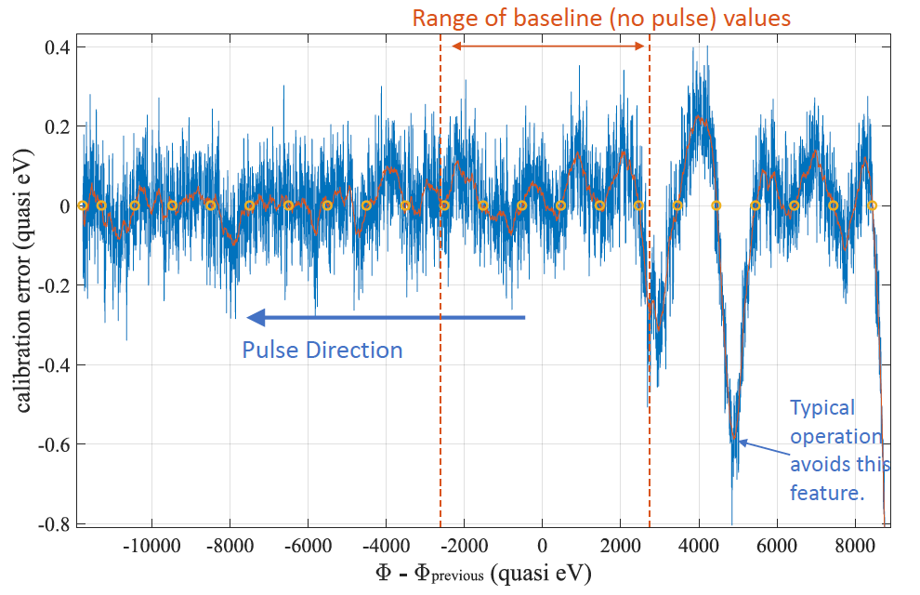
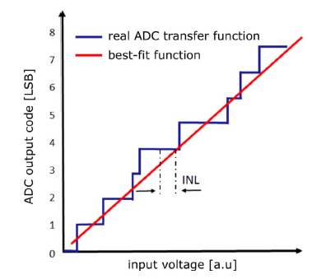
Other sources of non-linearity
There can be other sources of non-linearity besides the sensors:
  The digitizers
  The details of the readout
Pixel-level systematic errors can be averaged away using measurements from many pixels
Calculated non-linearity in earlier TDM readout
Cartoon of ADC non-linearity
gain-scale errors of ~0.1 eV in certain spectral regions
Is there an analog in modern umux readout? TBD
From Dolde, NIM A 2017

Slide 35
Relevant calibration details
experiment | <E> (eV) | ΔE (eV, ppm) | calibrator spacing (eV, % of <E>) | notes
Tatsuno | 6400 | 0.04, 6 | 1000, 16 | stats and systematics each ~.03 eV, TESs
Okada | 6425 | 0.1, 16 | 1000, 16 | systematics ~.05 eV, TESs
Fowler | 4500-7000 | 0.1, 14-22 | 500, 7-11 | TESs
Kim | 59540 | 0.4, 7 | 2000, 3 | systematics ~0.3 eV, MMCs
Tatsuno, Okada, and Fowler results similar: same energy range, similar absolute energy uncertainty
Kim at 10x higher energy, energy uncertainty expressed as ppm 2x better than T, O, & F, but maybe that’s explained by calibration features being (fractionally) twice as dense

