Slide 1
In Memoriam
Johann “Hannes” Zmeskal
Eberhard Widmann
Stefan Meyer Institute, Vienna
With contributions from Johann Marton@EXA/LEAP2024
ECT* KAMPAI Workshop
Trento, 30 Sep 2024

Slide 2
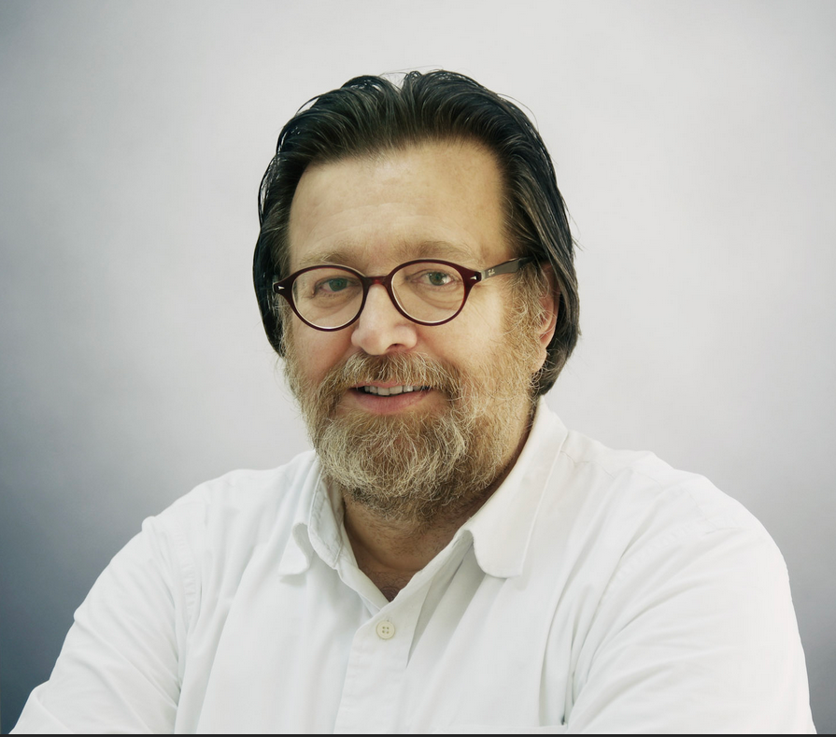
Johann (Hannes) Zmeskal May 13, 1955 – July 23, 2024
Scientific career
Working place(s)
Teaching
Coordinator of the SMI workshop (mechanical and electronic), head of the group Advanced Instrumentation at SMI
Scientific interest
  Main focus: experimental physics (detectors, cryogenics, UHV, …)
  Muon Catalized Fusion 𝜇CF
  (Pionic and) kaonic atoms
  Kaonic nuclear bould states
  PANDA
  ASACUSA

Slide 3
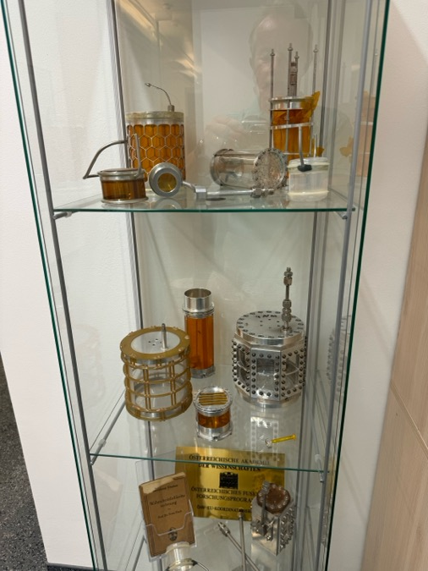
Curriculum vitae Hannes Zmeskal
1955 born in Vienna
Study at University Vienna
Dr. phil. 1986
Habilitation 2009
1979 – 1986 researcher at “Kuratorium für das SIN-Projekt”
1986-… permant position at Institute for Medium Energy Physics (IMEP), then SMI
1997-2005 Member of the DEAR Executive Board
2002-2006 Member of the Program Advisory Committee RIKEN/RAL/Japan
Since 2006 Technical Director of SIDDHARTA
Co-Spokesperson of SIDDHARTA2
2004– 2008 Responsible for SMI activities in PANDA-Internal targets, SIDDHARTA in EU project Hadron Physics
2009-2014 Spokesperson in research activity jointGEM in EU project HadronPhysics2
Spokesperson in research activity WP26 project in EU project Strong 2020
2015 Spokesperson of E57 experiment at J-PARC/Japan
PI in several research projects in STRONG2020 and projects of the Austrian Science Fund (FWF)

Slide 4
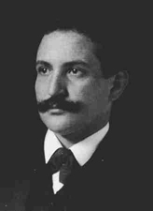
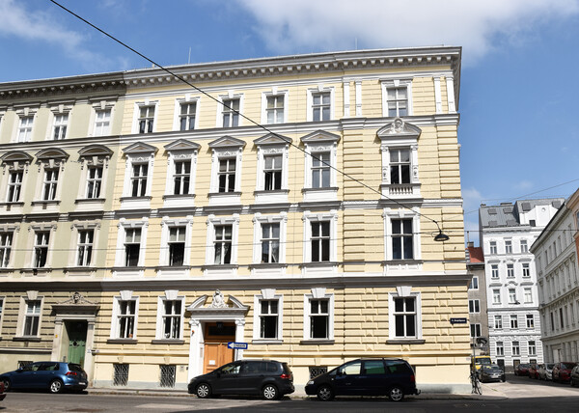
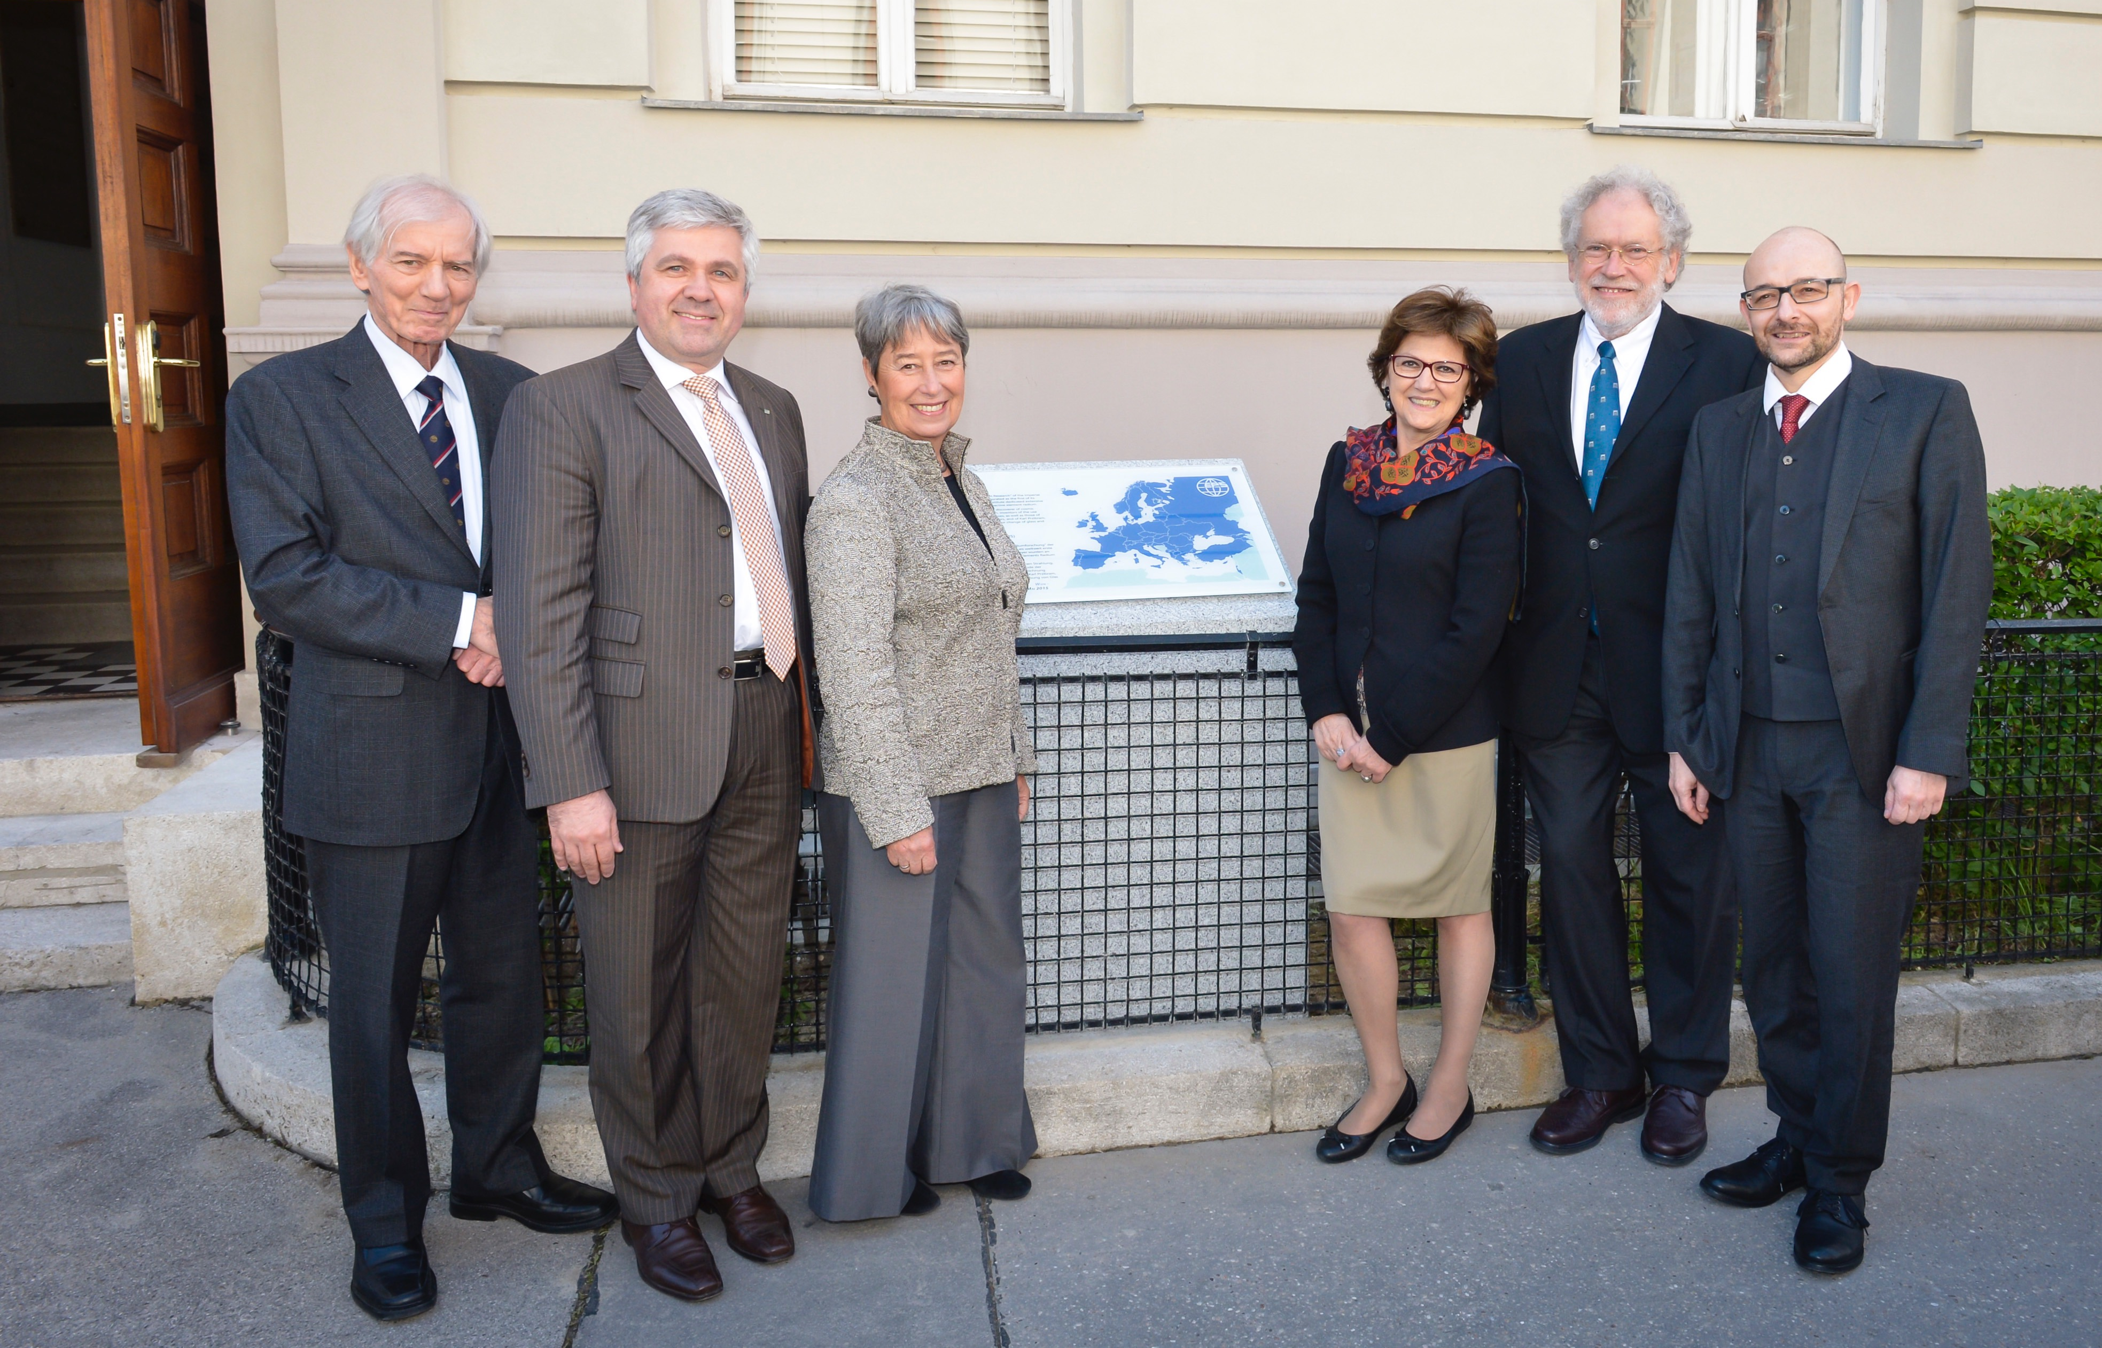
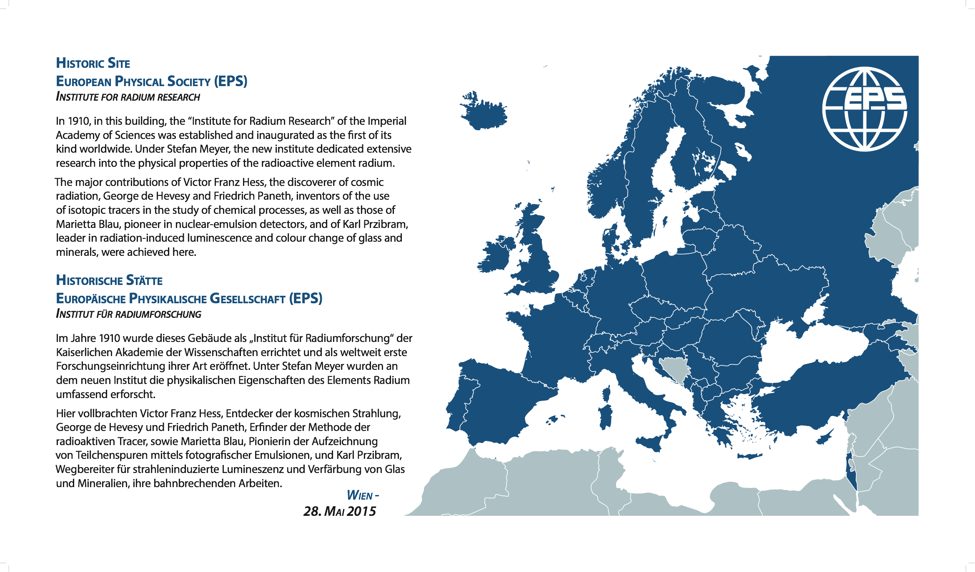
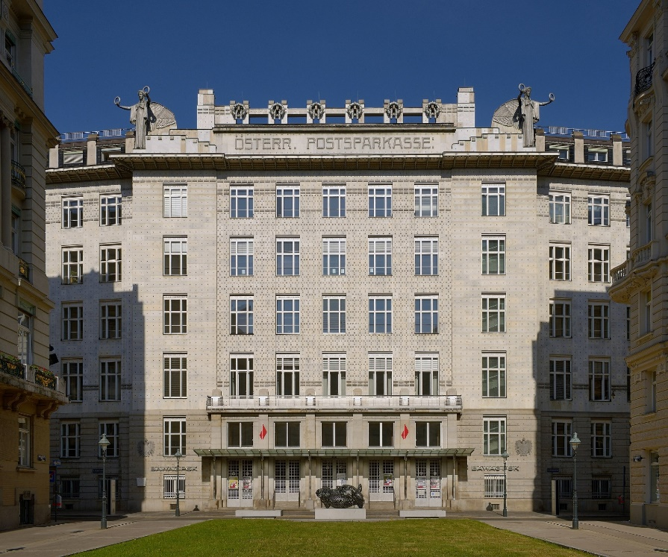
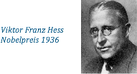

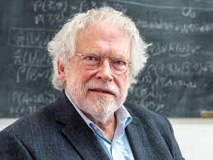


Historical note
1910 „Institut für Radiumforschung“
  Boltzmanngasse 3
  Stefan Meyer was first director
  Nobel prizes
    V. Hess (physics): cosmic rays
    G.v. Hevesy (chemistry): tracer method
    A. Zeilinger, IQOQI (physics): quantum physics
1987 Renamed to „Institute for Medium Energy Physics“
2004: Institute renamed to “Stefan Meyer Institute for Subatomic Physics”
2024: Symposium 20 years
2021 $→$ Kegelgasse
Boltzmanngasse 3
2023 $→$ PSK
Stefan Meyer
A. Zeilinger
Nobelpreis 2022

Slide 5
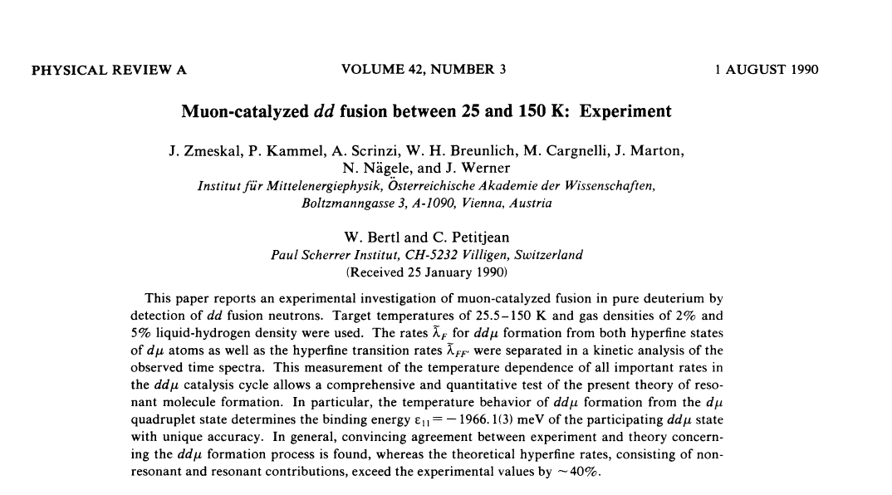
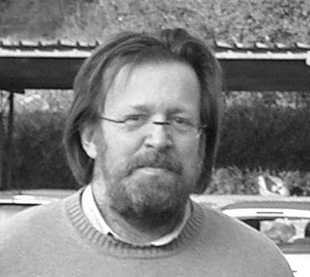
PhD Thesis on muon-catalyzed fusion, University Vienna 1986
published in PRA

Slide 6
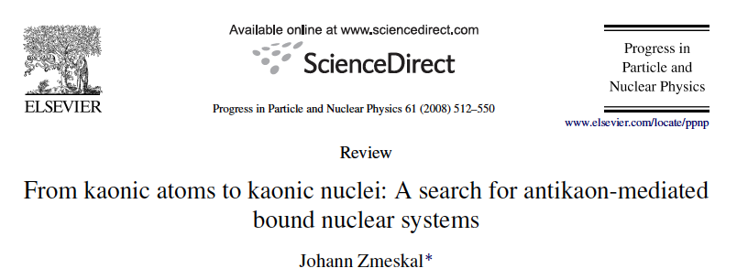
Habilitation about kaonic atoms and nuclei (2009)

Slide 7
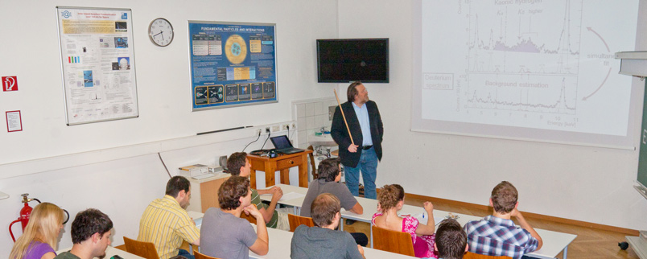
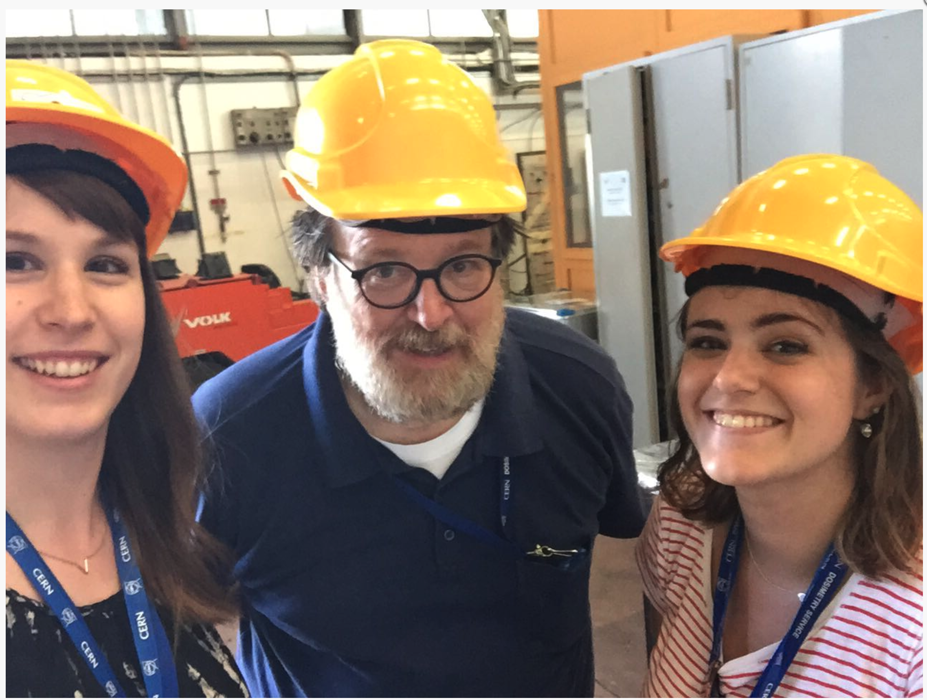
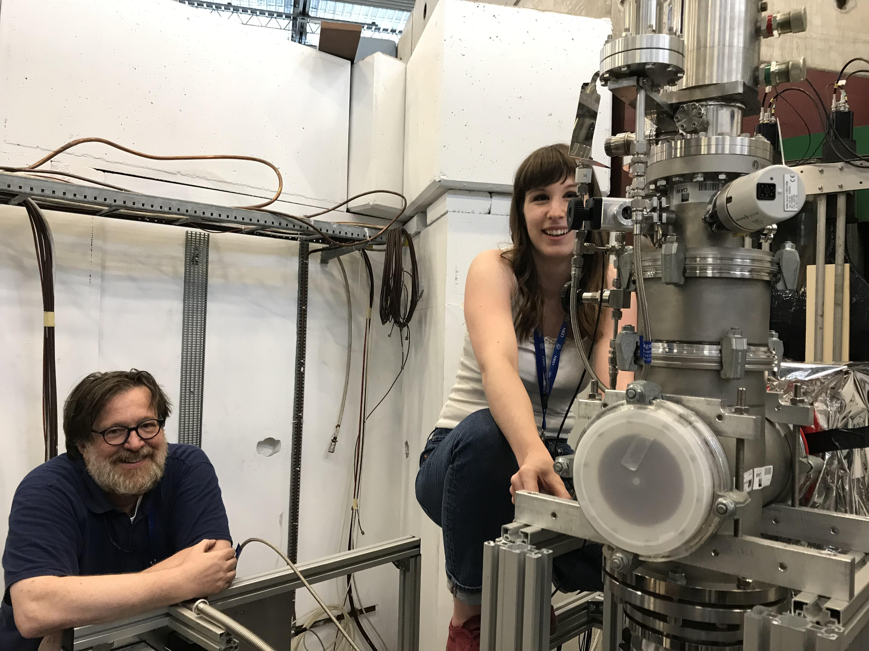
Teaching
Habilitation at Vienna University
Regular special lectures on detectors for nuclear and particle physics
  Incl. lab demonstrations
Very successful, attracted many Master and consecutively PhD students
  17 Master students
  3 PhD students

Slide 8
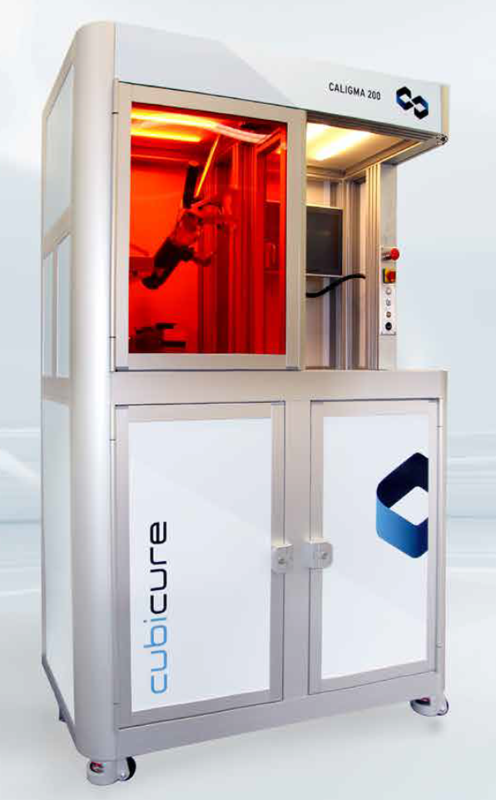
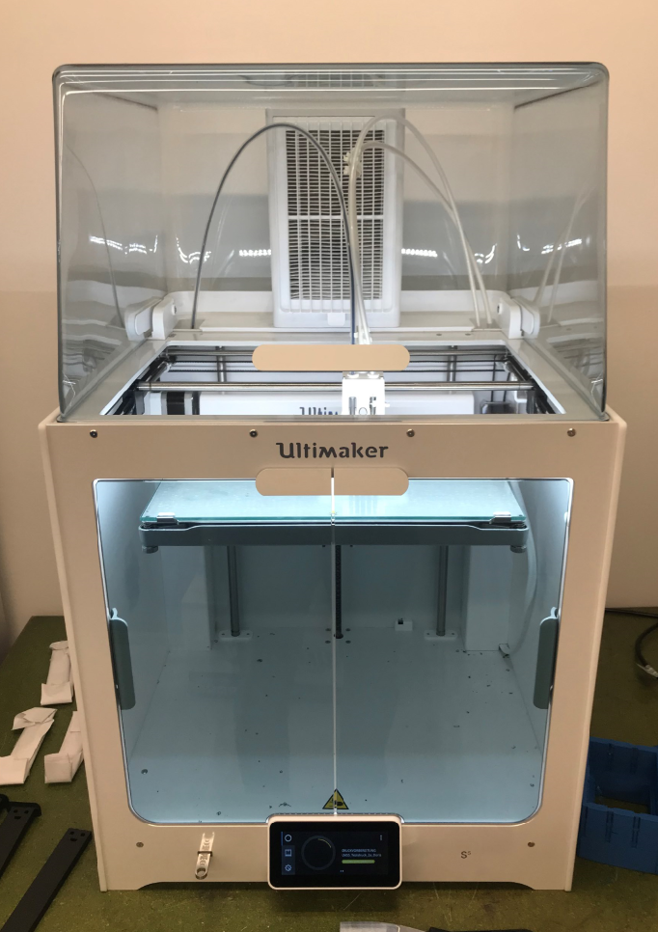
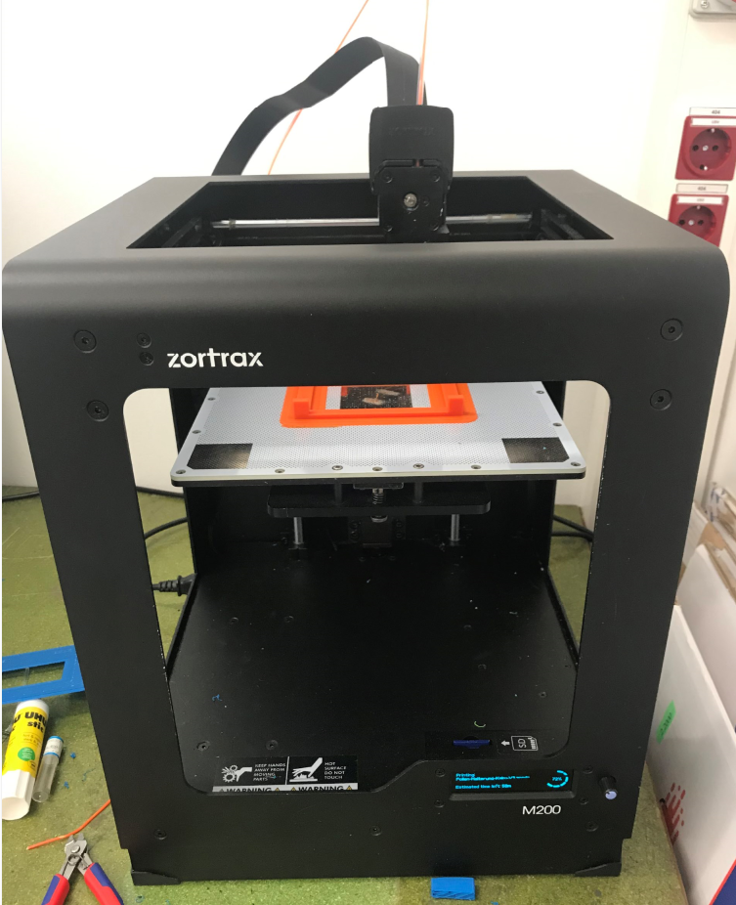
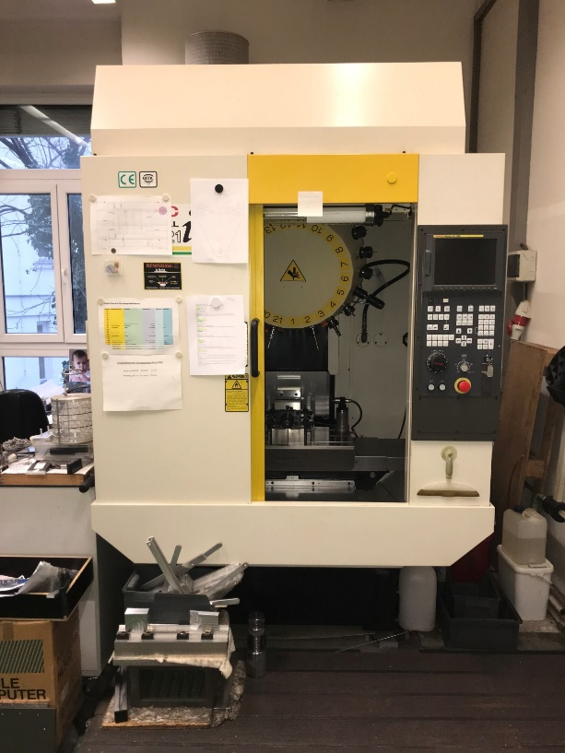
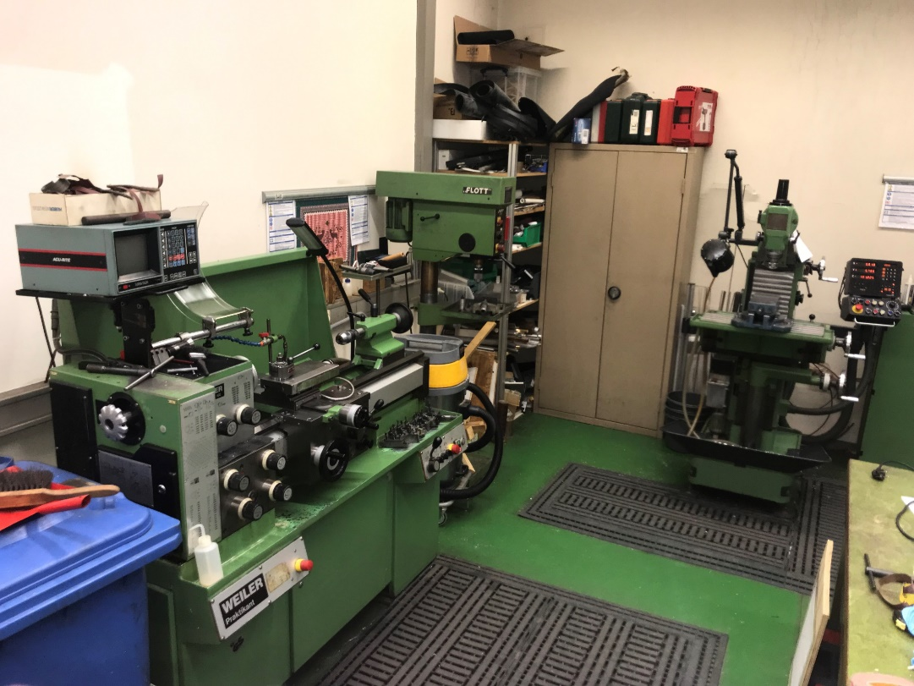
Advanced instrumentation
Mechanical workshop
Additive manufacturing
CNC mill
lathe
drill
mill
IQOQI equipment
SMI equipment

Slide 9
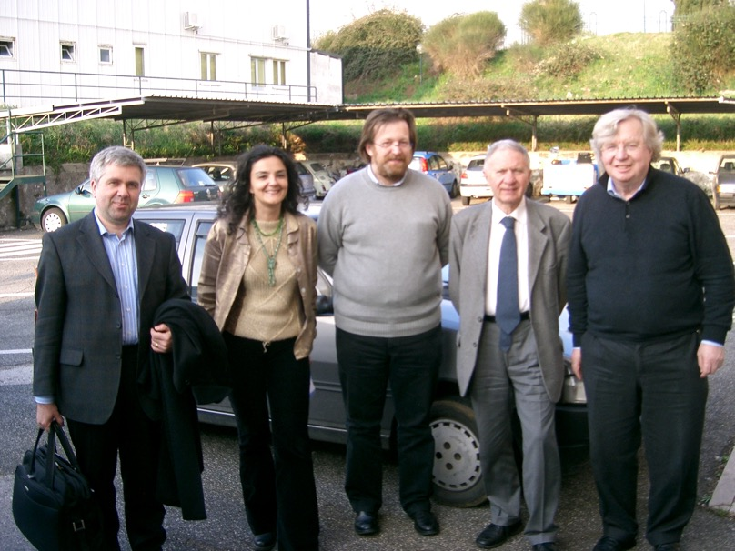
Start of collaboration with Hannes from 2004

Slide 10
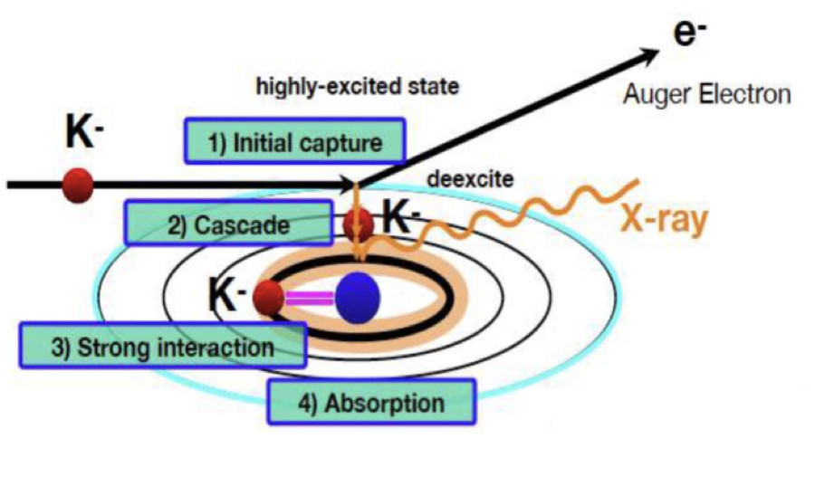
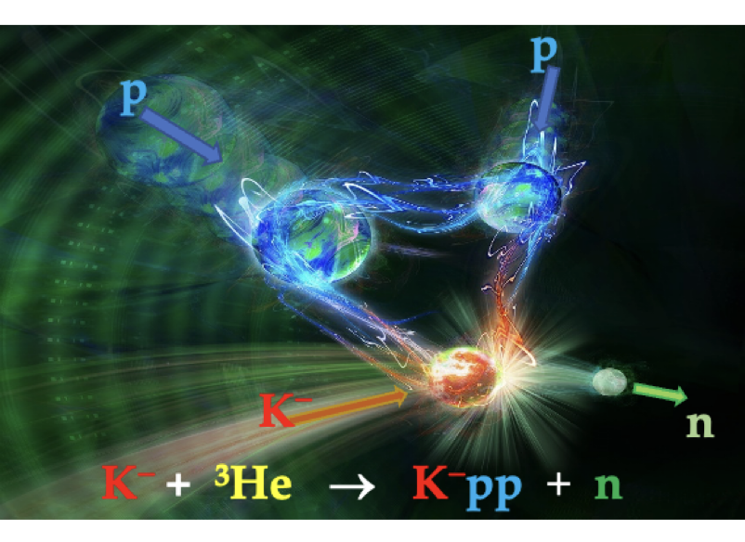
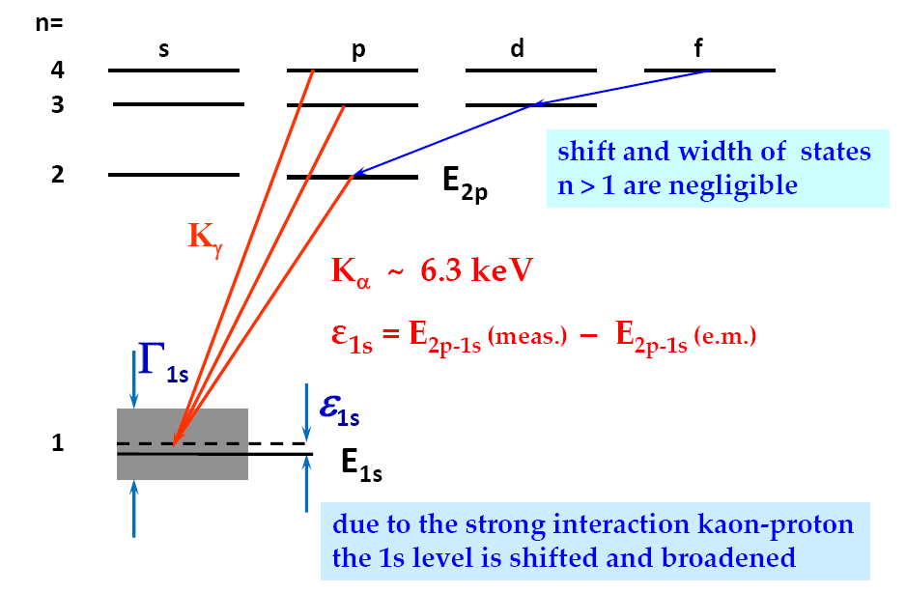
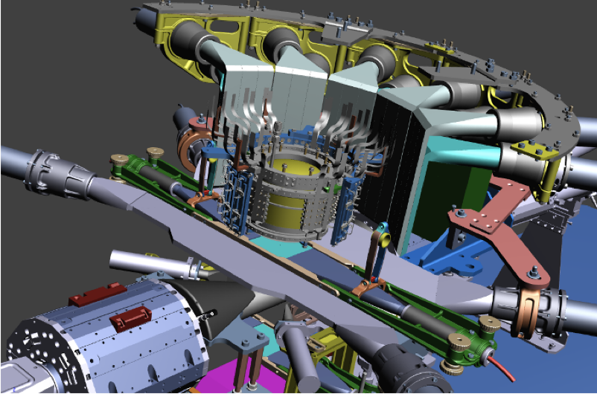
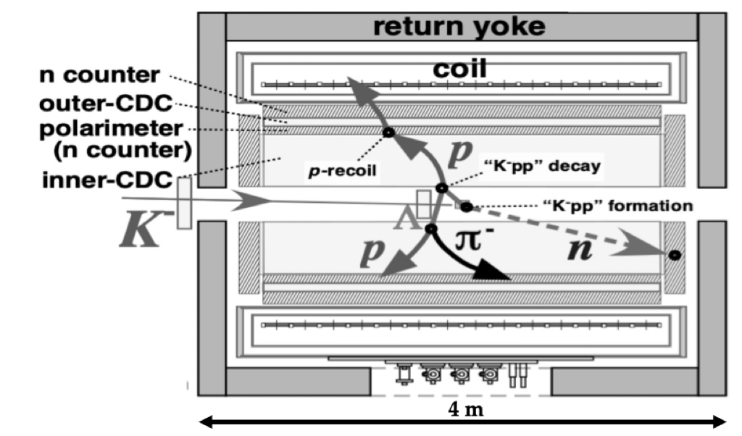
Exotic kaonic bound states: strong interaction at low E
Kaonic atom: X-ray spectroscopy
Kaonic nuclear bound states

Slide 11
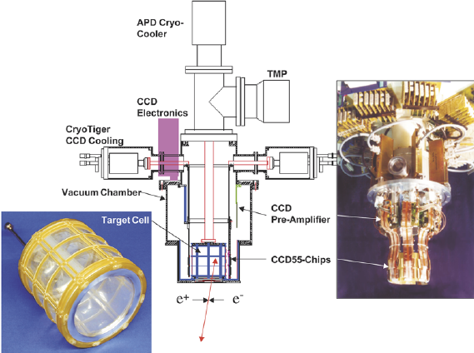
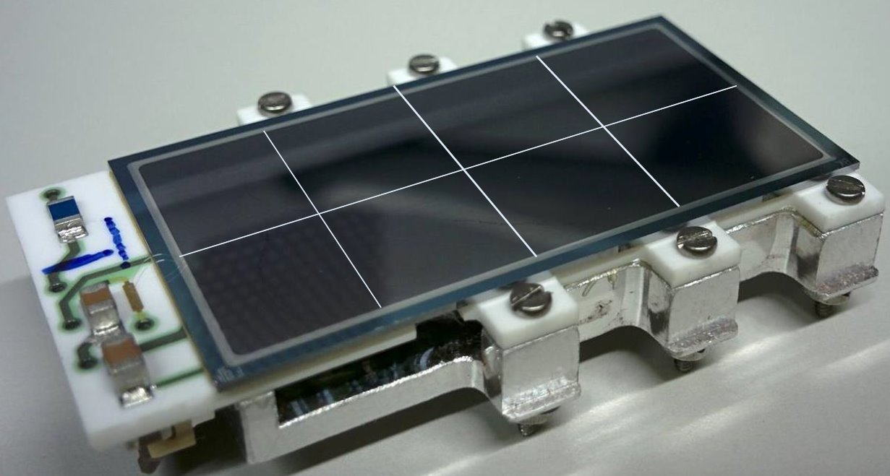
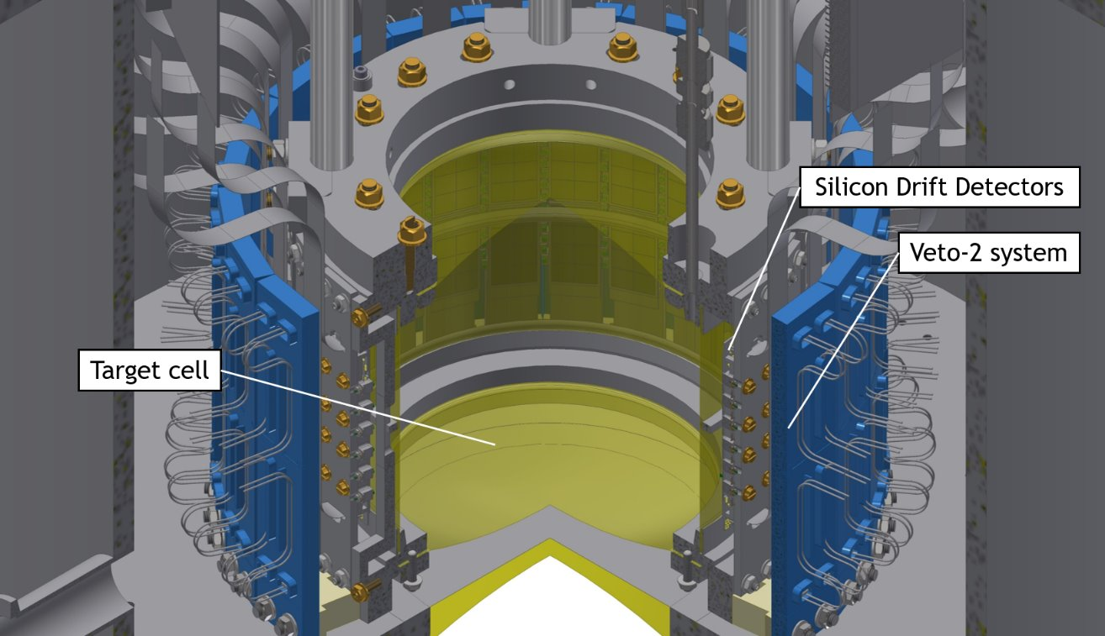
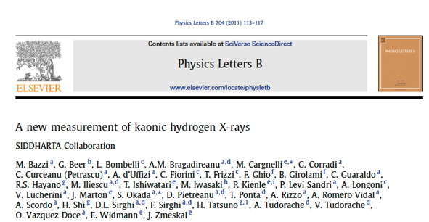
X-ray spectrososcopy of kaonic atoms
DEAR: CCD
SIDDHARTA: SDD
Guaraldo, C. et al. (2004). First results on kaonic hydrogen from the DEAR experiment.
European Physical Journal A. 19. 185-188. 10.1140/epjad/s2004-03-031-y.
Together with Carlo Guaraldo
and Catalina Curceanu

Slide 12
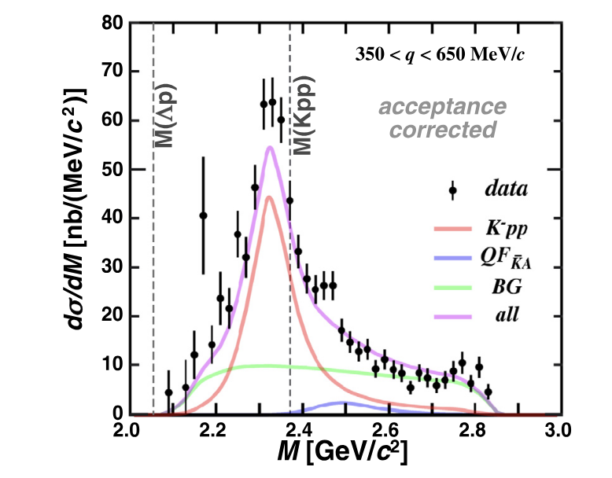
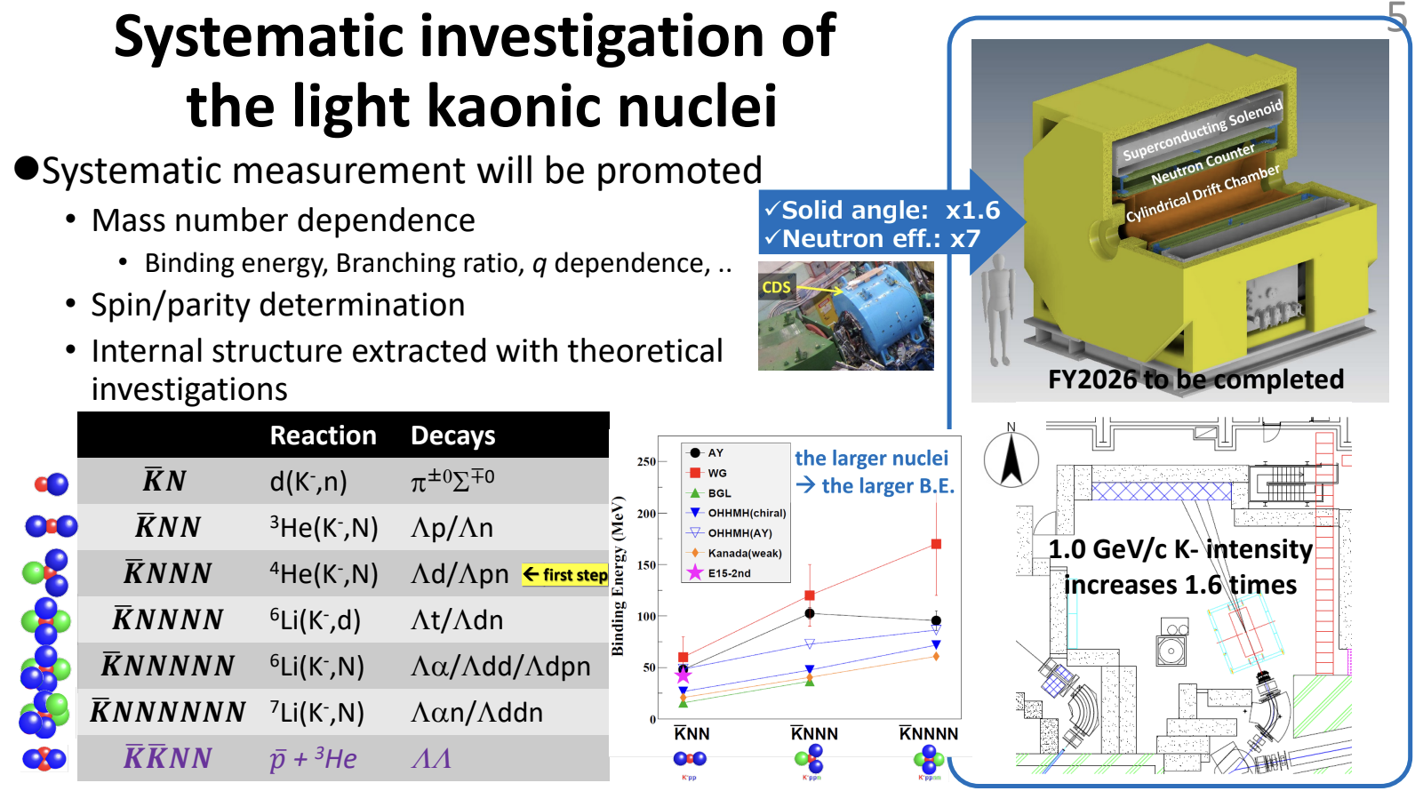
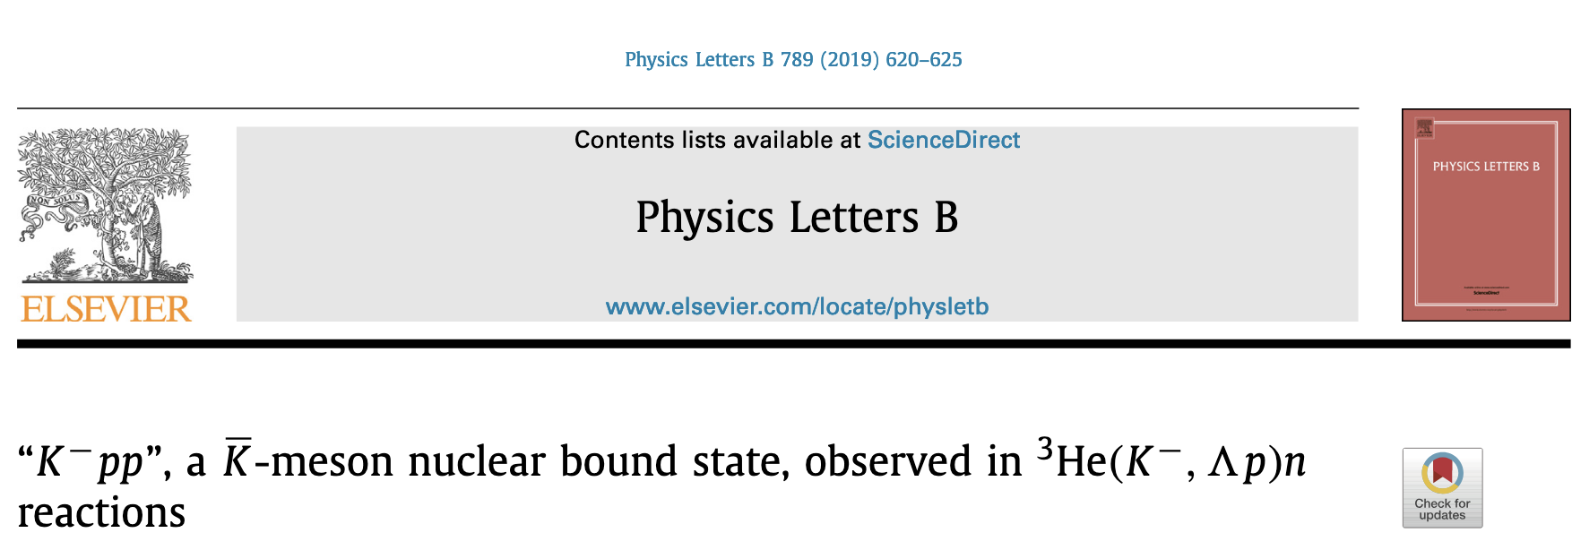
E15, E57, E80 @ J-PARC

Slide 13

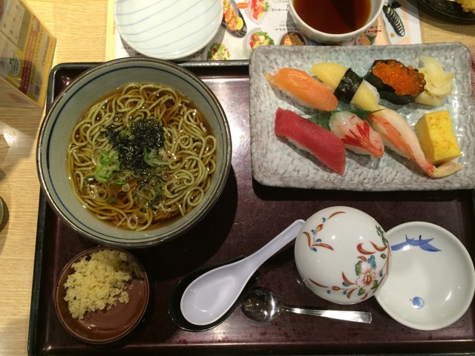
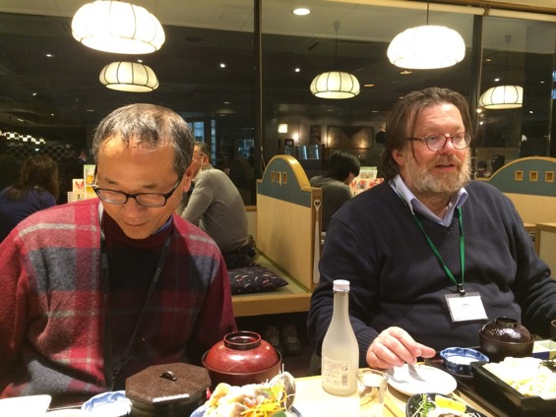
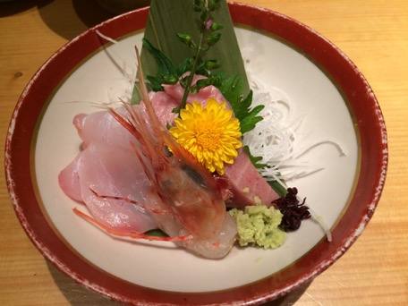
Hannes liked Japan, its culture and sushi

Slide 14



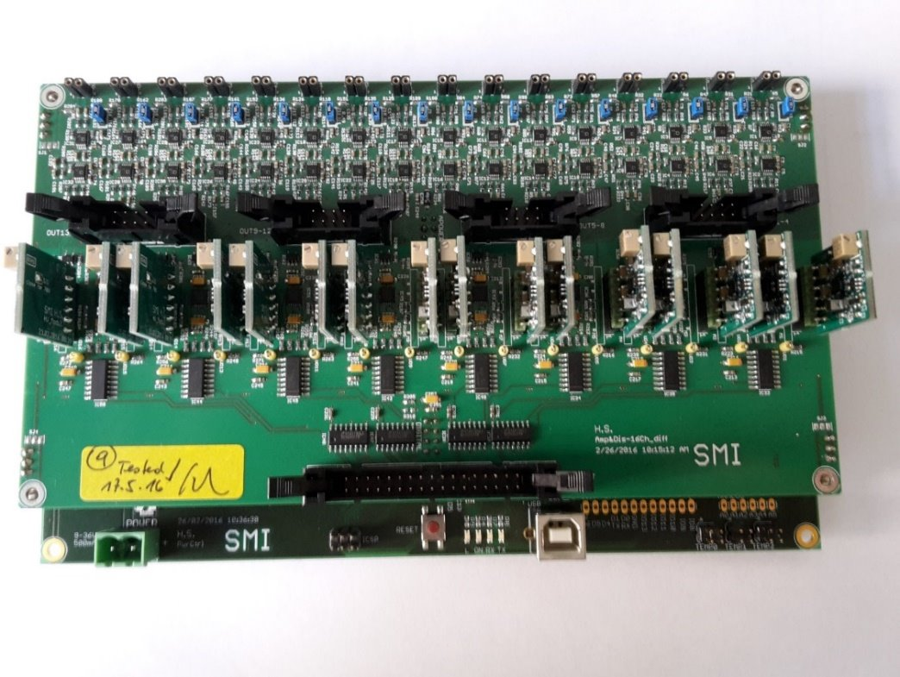
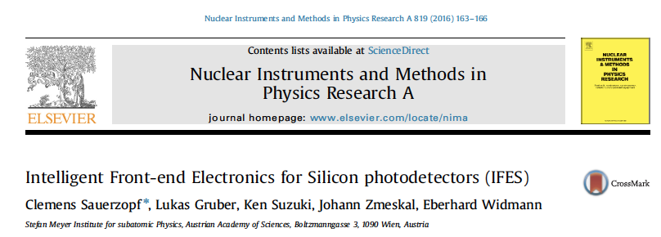
SiPM development: PANDA, ASACUSA

Slide 15
PANDA@FAIR
Barrel TOF detector:
  Time resolution < 100 ps
  TDR written at SMI, approved
  Construction funding pending
Assembly start Q3/2021
Comissioning w/beams Q4 2023

Slide 16
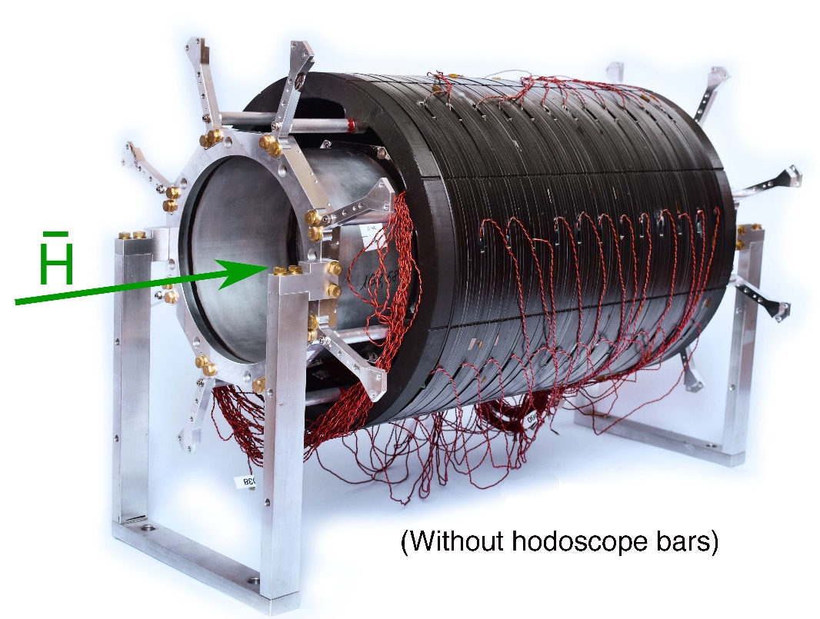
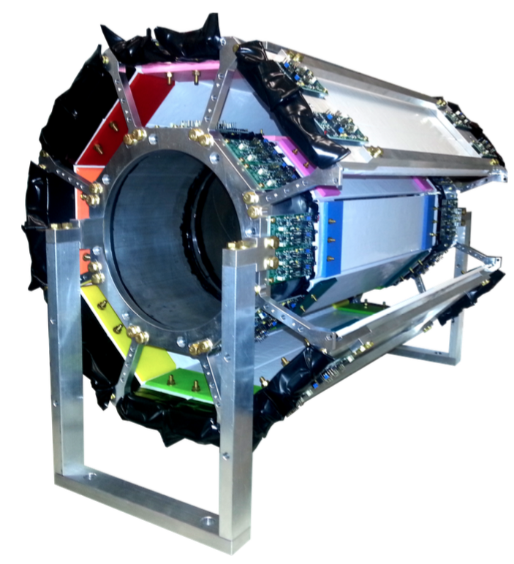
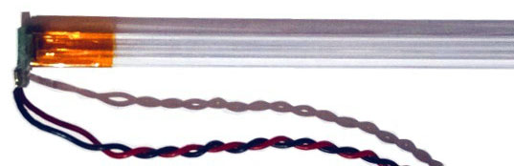
ASACUSA antihydrogen detector: Hodoscope
Achieved suppression
using machine learing techniques
in analysis
cosmics rejection eff.
ε_{c} = 0.9836 ± 0.0031
Antiproton detecion eff.
ε_{p} = 0.8000 ± 0.0111,
false positive rate
f_{fp} = 0.0077 ± 0.0015 Hz.
Fibre bundle 2x2 of 1x1 mm2 fibres
2 layers
7.7 mm geometrical resolution in z at r=0

Slide 17
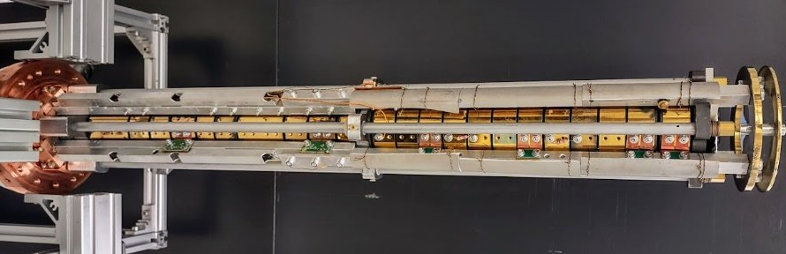
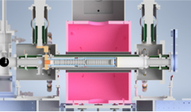

ASACUSA Cusp trap cold bore
Reduction of trap electrode temperature by factor 3
Reduction of plasma temperature by
factor > 10
Increase of antihydrogen production rate by OM

Slide 18
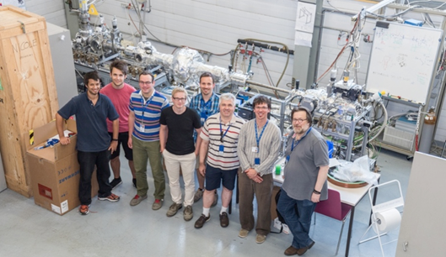
ASACUSA hydrogen beam apparatus

Slide 19
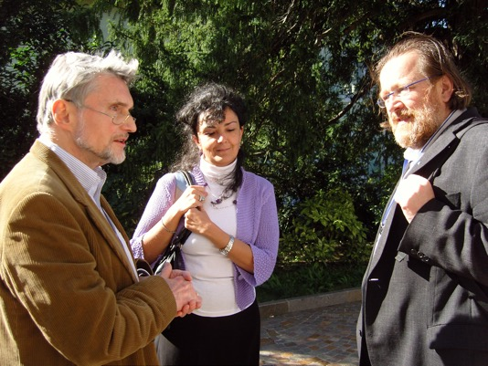
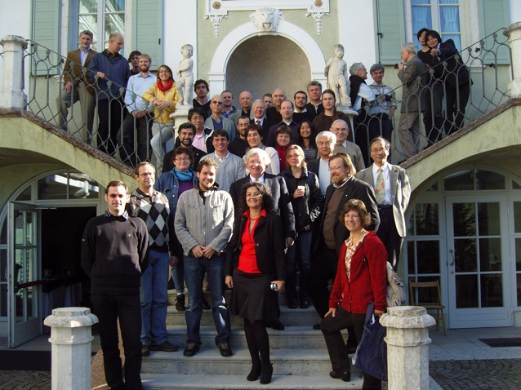
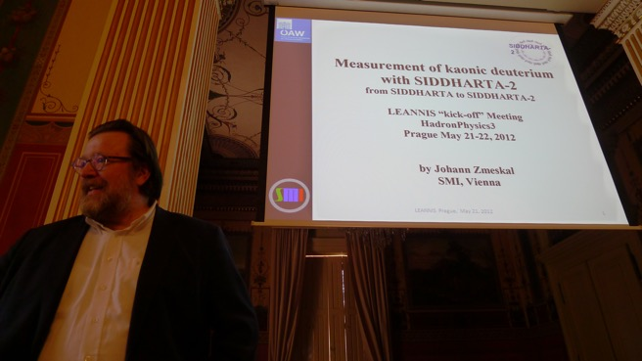
Conferences & Workshops

Slide 20
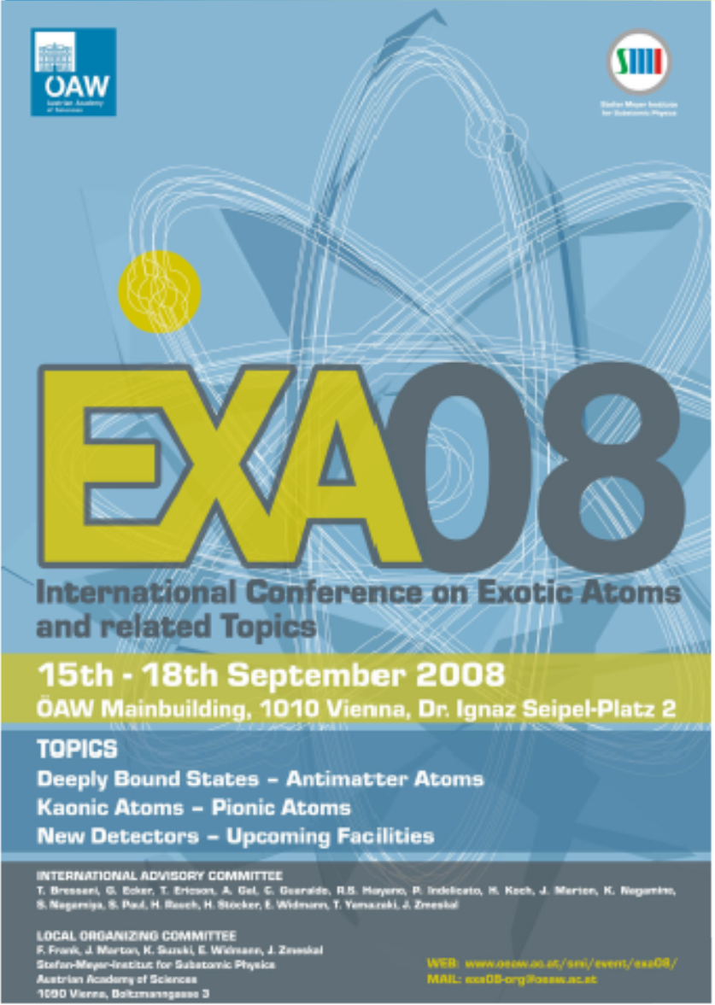
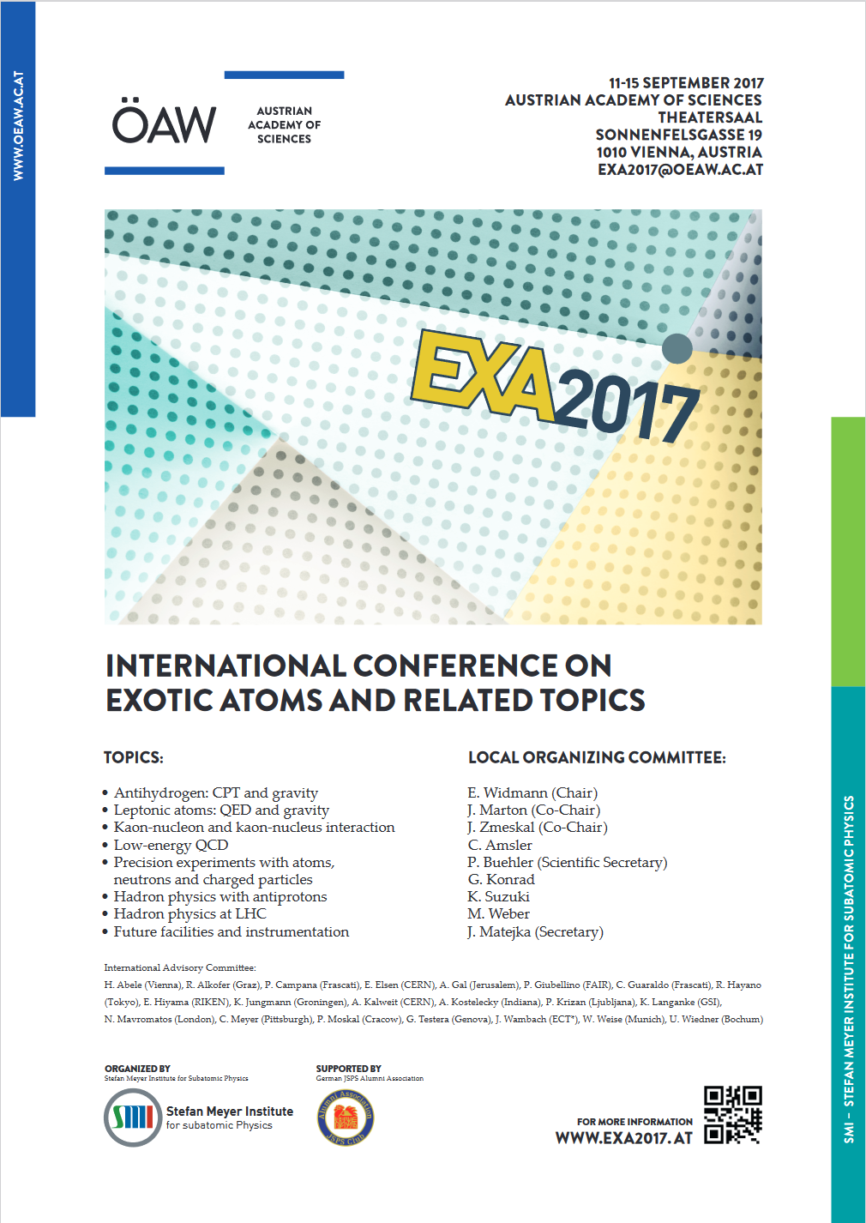
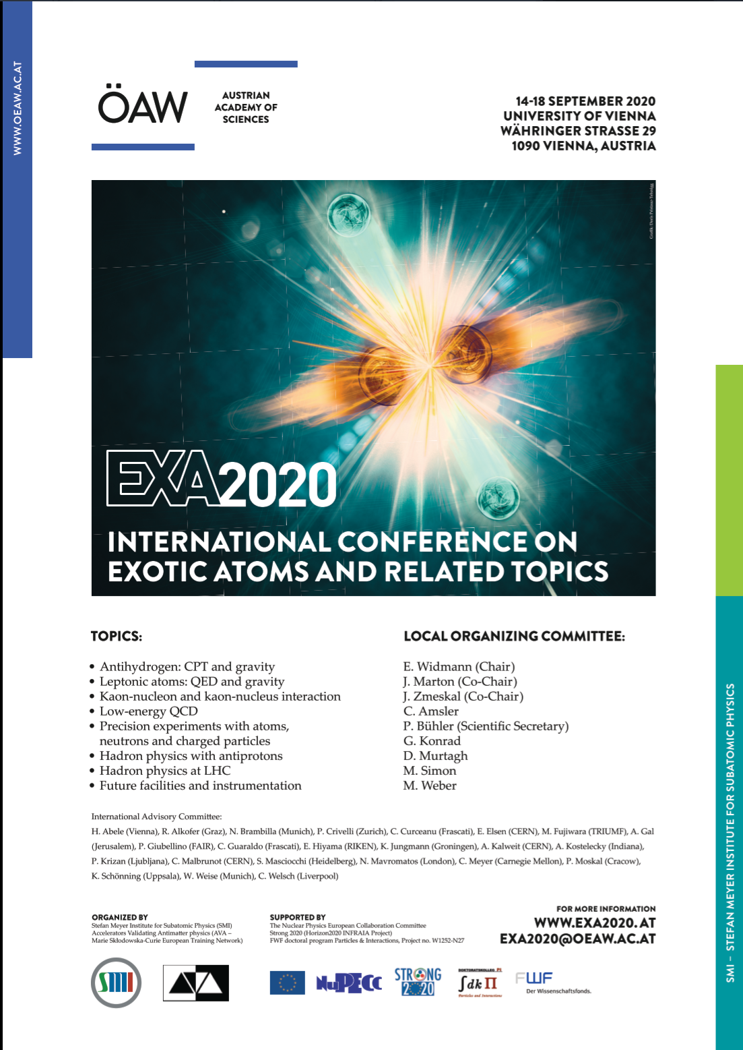

EXA series since 2002
2021 (online)

Slide 21


Rest in peace
Online condolence book https://www.viternity.org/de/gedenkseiten/detail/dr-johann-zmeskal-1955-05-13-bis-2024-07-23-9156.html#kondolenzuch
Obituary in next NPN w/ Catalina, Masa

