Slide 1
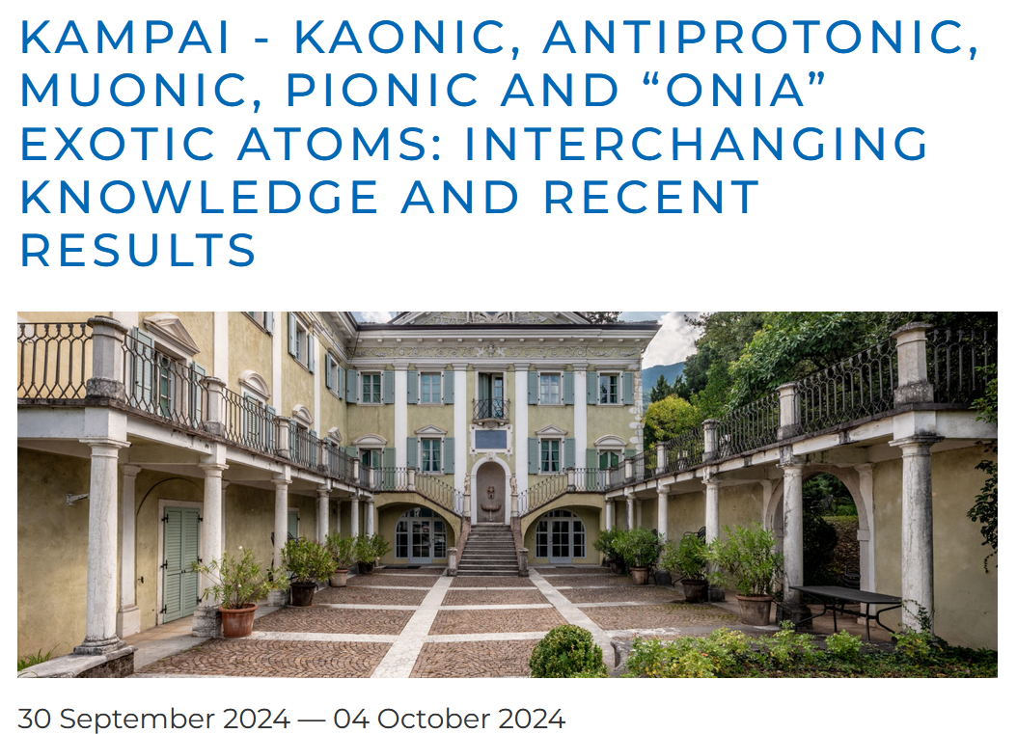

Slide 2
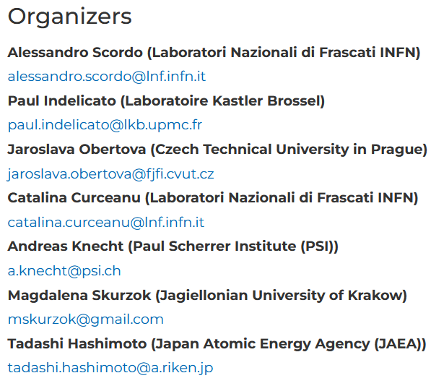
Special thanks

Slide 3
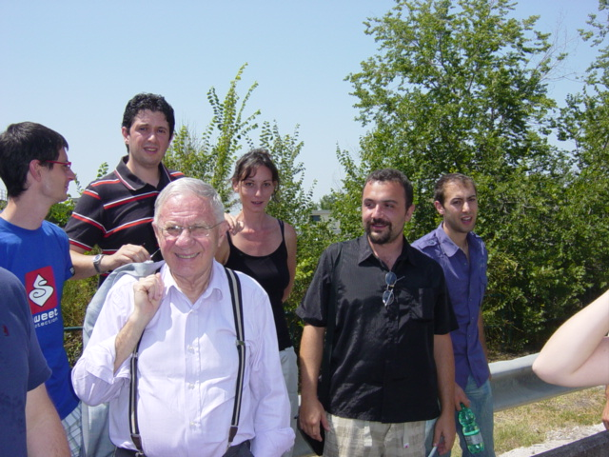
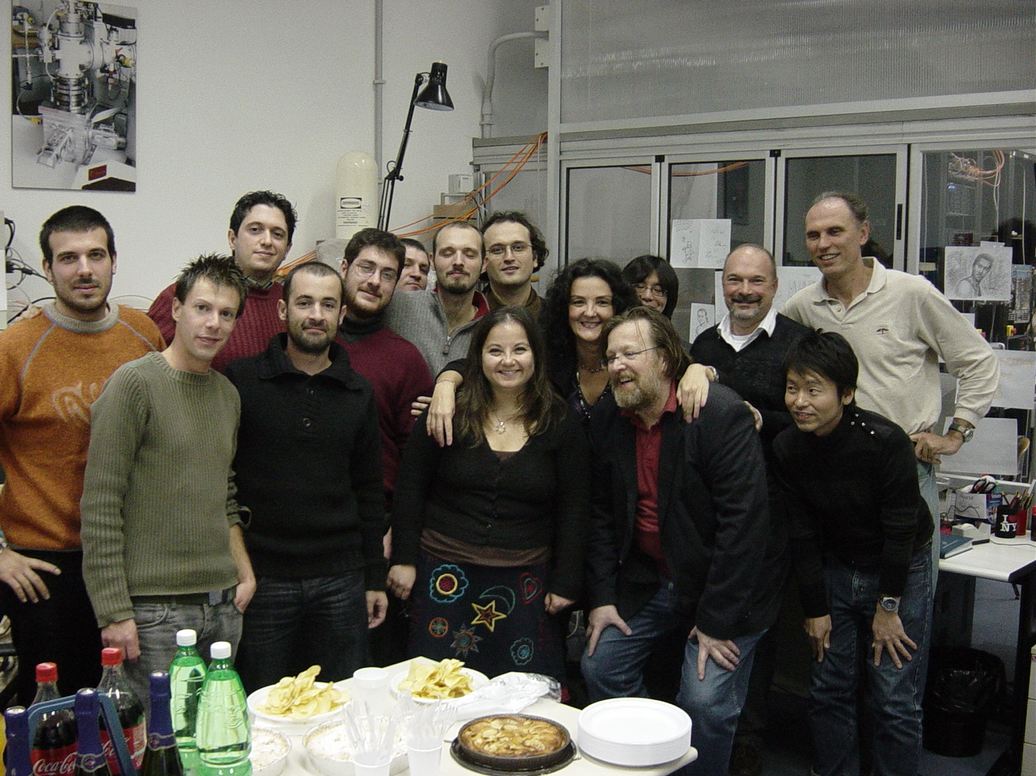
To the memory of Carlo Guaraldo and J. Zmeskal

Slide 4
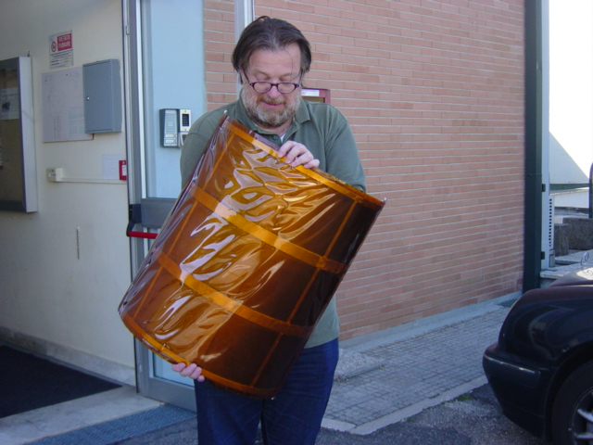
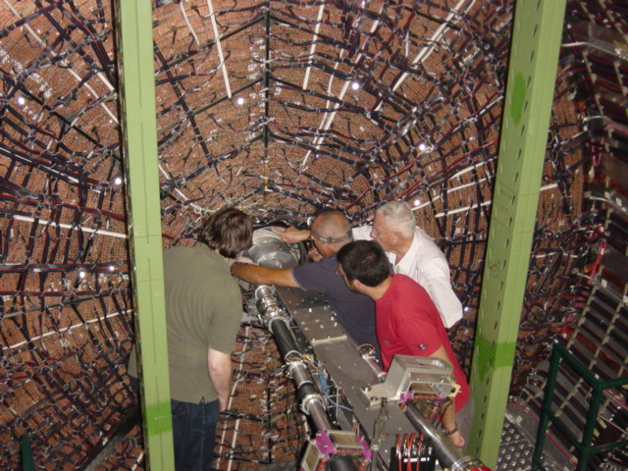
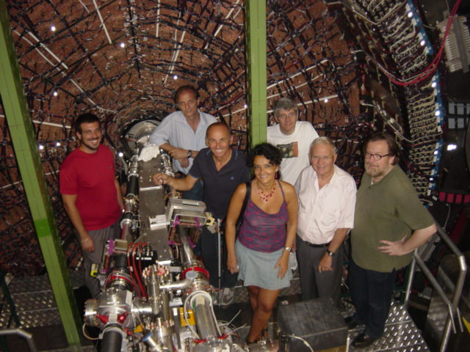
To the memory of Carlo Guaraldo and J. Zmeskal
“In memory of Carlo Guaraldo and Johannes Zmeskal” – C. Curceanu, 30/09 @ 10:30
“In memory of Johannes Zmeskal” – E. Widmann, 30/09 @ 14:00

Slide 5
Participants,
sessions and talks
Participants
30 Participants from 12 countries
8 women and 22 males (to be improved…)
10 under 40 years old (also to be improved…)
Schedule
30’ (25’+5’) talks
2 Discussion sessions per day
3 Full days of workshop (Mon, Wed, Thu)
2 Half-days (Tue, Fri)
1 Free afternoon (Tuesday 01/10)
Sessions
Muonic atoms – 6 talks
Positronium and related physics – 3 talks
Detectors – 2 talks
Kaonic atoms – 7 talks
Multidisciplinary – 7 talks

Slide 6
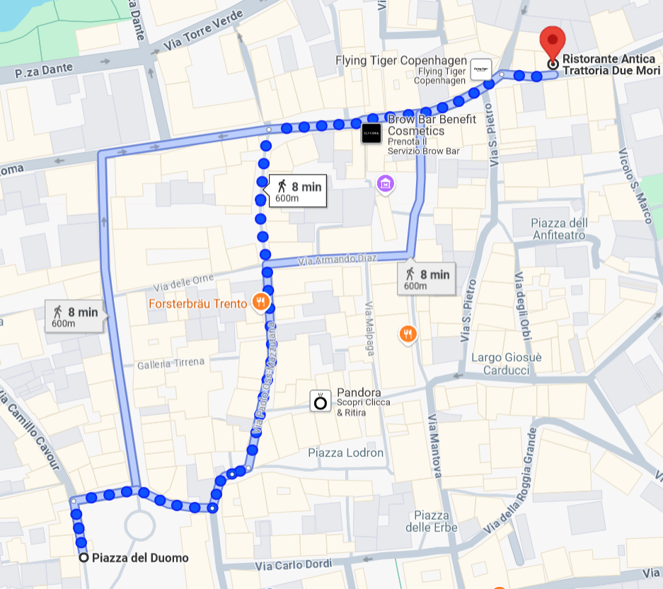
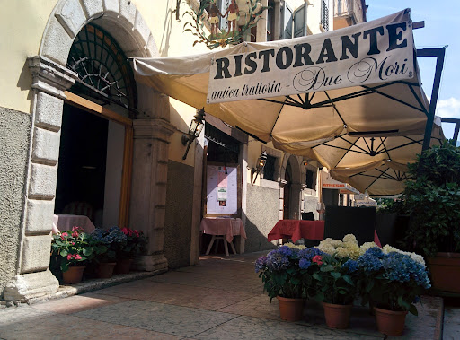
Social Dinner
Tuesday 01/10 – 20:00
Ristorante “Antica trattoria Due Mori”
Via S. Marco, 11, 38122 Trento TN

Slide 7
Info & Logistics
1 ) Please, remember to sign EVERY DAY the 2 papers (presence and lunch) at the registration desk
2) Coffee break and lunches will be served in the other building in front of the main entrance
3) Please, upload your slides on the Indico server, directly from the timetable, the day before your presentation
4) We kindly ask you to include in your presentations a final slide with some important highlights or open questions and problems to contribute to the Discussion sessions

Slide 8
ENRICH COST Action
European Network for research and innovation in Radiation-based applications to address Increasing societal CHallenges
Main Scope:
Build a broader and multidisciplinary community that exchanges information and expertise, covering fundamental physics, nuclear physics, astrophysics, medical physics, agrifood, and material science.
WG1: Management and Coordination
WG2: Technological Advancement
WG3: Software Advancement
WG4: Electronics and DAQ
WG5: Multidisciplinary and Societal Applications
WG6: Integration and Interchange
WG7: Mentoring, Training and Dissemination

Slide 9
ENRICH COST Action
European Network for research and innovation in Radiation-based applications to address Increasing societal CHallenges
COST Actions provide financial support for:
- Meetings (e.g., Management Committee meetings, Working Group meetings);
- Training Schools;
- Mobility of Researchers and Innovators (Short-Term Scientific;
- Missions – STSMs; Virtual Mobility - VM);
- Presentations at conferences organised by third parties;
- Dissemination and Communication Products;
Deadline to join as a secondary proponent: 15/10/2024
Contact: Alessandro.Scordo@lnf.infn.it

Slide 10
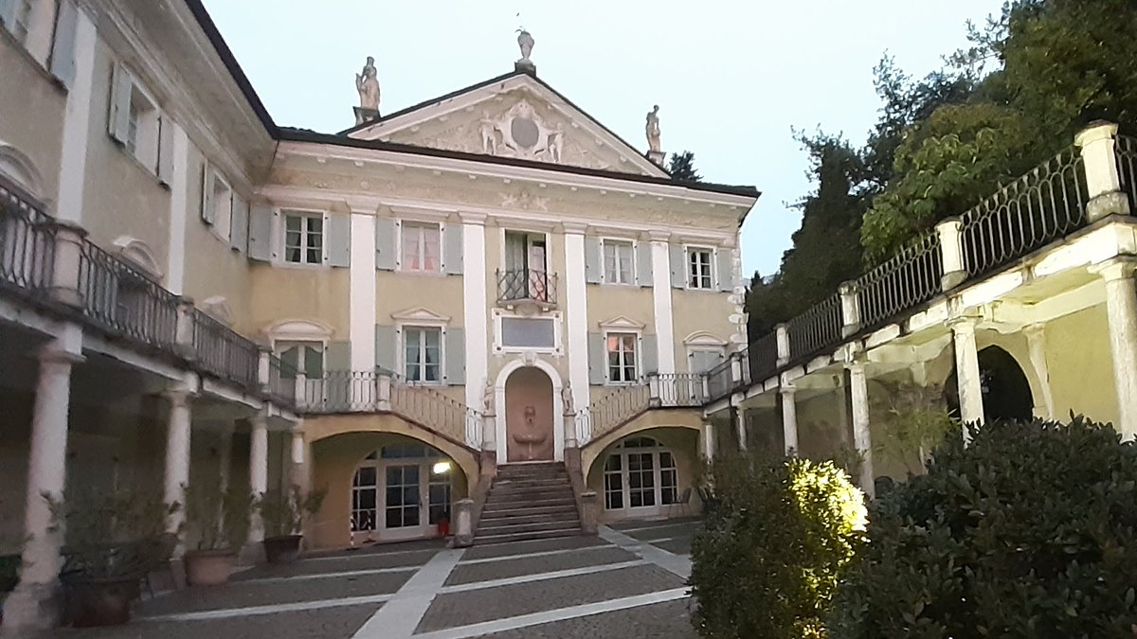
Enjoy the KAMPAI workshop

