Slide 1
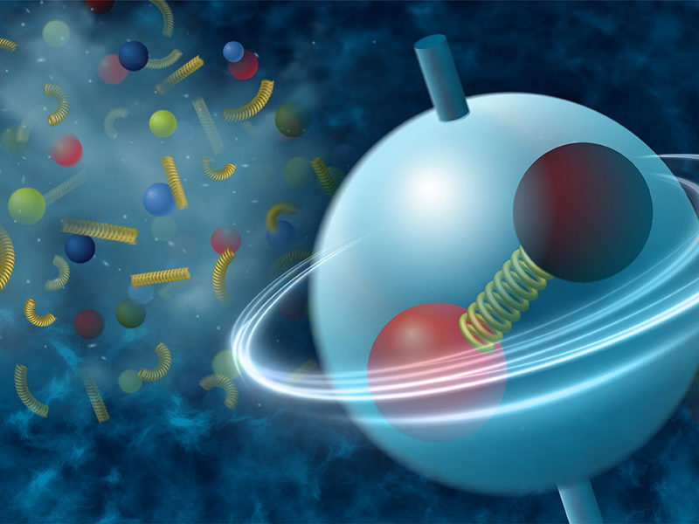




Spin Alignment
- Experimental Overview
Aihong Tang

Slide 2
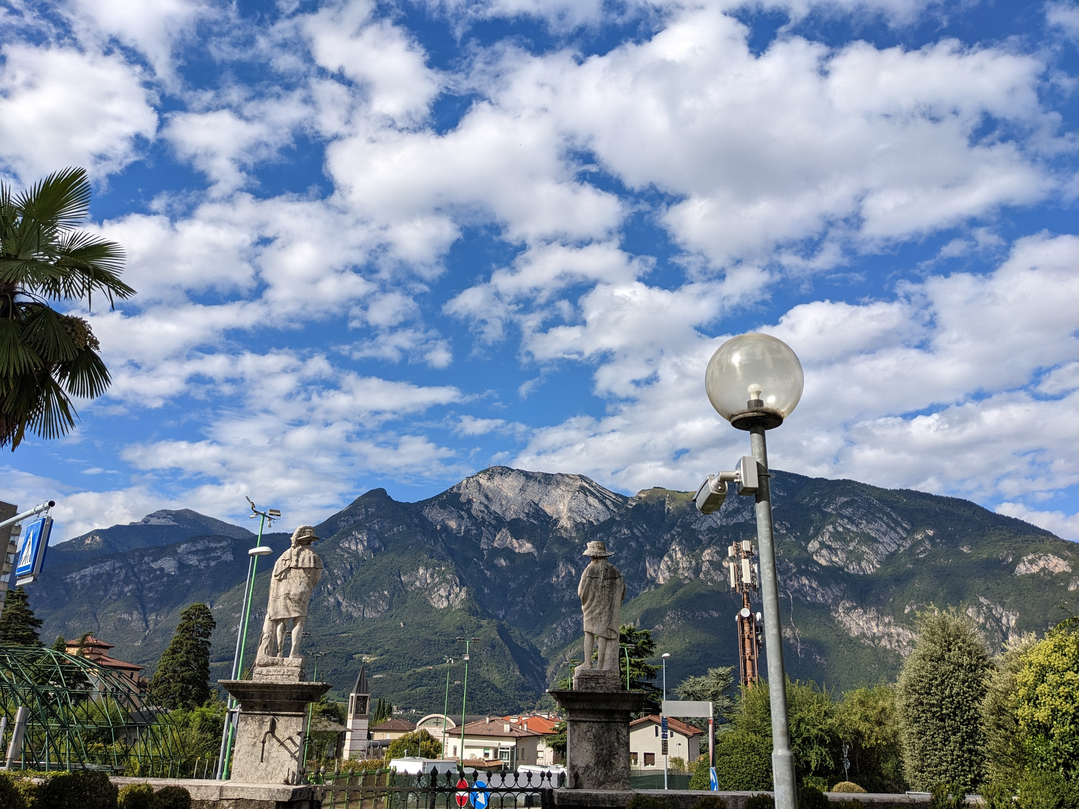

Slide 3
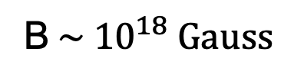

Strongly Interacting Matter under Rotation
B$\sim {10}^{18} Gauss$
$$L \sim {10}^{3}−{10}^{7}ℏ$$

Slide 4
Strongly Interacting Matter under Rotation

Slide 5
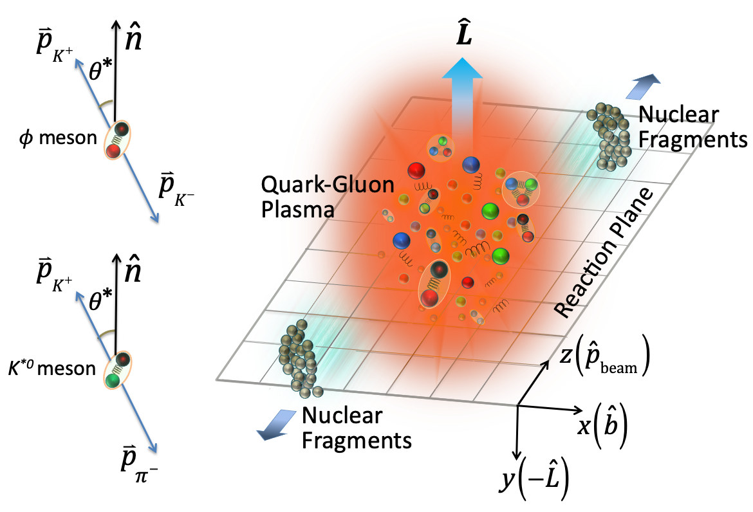
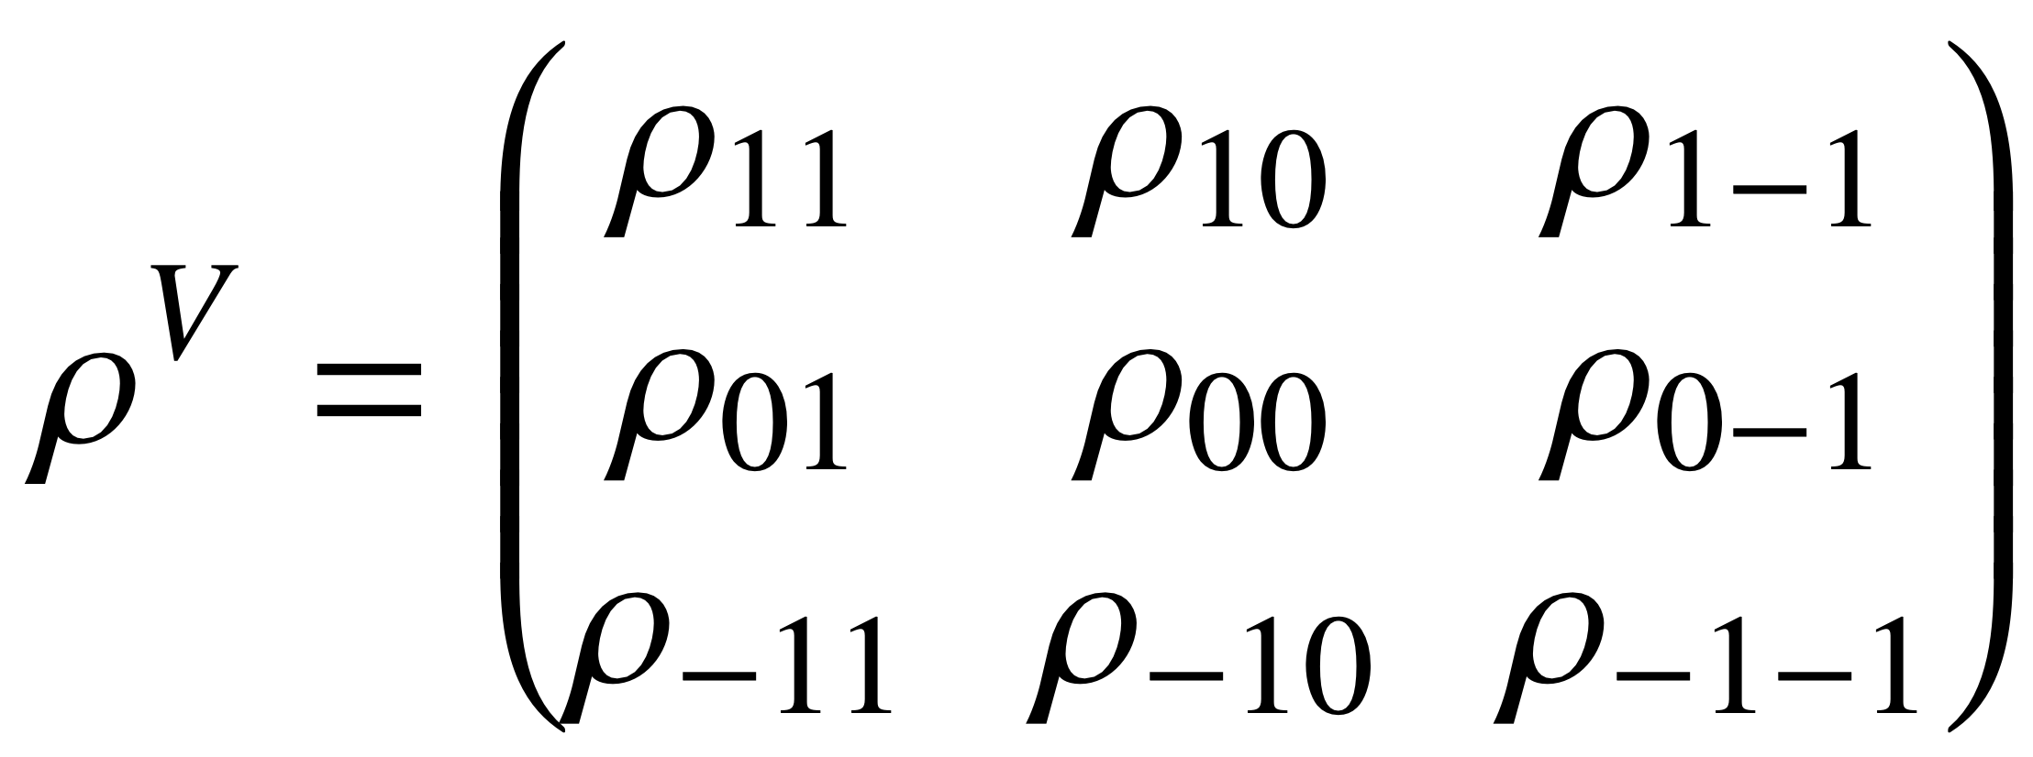
Global Spin Alignment
The spin state of a vector meson can be described by a 3x3 spin density matrix.
The diagonal element ρ00 corresponds to the probability of finding a vector meson
in spin state 0 out of 3 possible spin states of -1, 0 and 1.
A deviation of ρ00 from 1/3 would indicate
a non-zero spin alignment.
5

Slide 6
Global Spin Alignment
The spin state of a vector meson can be described by a 3x3 spin density matrix.
The diagonal element ρ00 corresponds to the probability of finding a vector meson
in spin state 0 out of 3 possible spin states of -1, 0 and 1.
A deviation of ρ00 from 1/3 would indicate
a non-zero spin alignment.
No local cancelation when integrating over phase space as opposed to spin-1/2 particles.
Access to spin-orbital force S•(Eϕ x P), a term which is canceled in Λ polarization.
Some mesons, like ϕ, are expected to originate predominantly from primordial production ➔ less decay contributions if compared to hyperons, more sensitive to early dynamics.
6

Slide 7

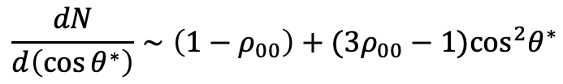



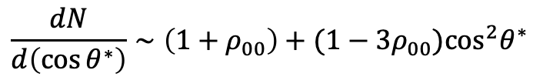
Global Spin Alignment
The spin state of a vector meson can be described by a 3x3 spin density matrix.
The diagonal element ρ00 corresponds to the probability of finding a vector meson
in spin state 0 out of 3 possible spin states of -1, 0 and 1.
A deviation of ρ00 from 1/3 would indicate
a non-zero spin alignment.
Strong p-wave decay
Dilepton decay
$φ$ $(s\overline{s})$ ➝ k⁺+ k⁻
$J/ψ(c\overline{c})→μ^{+}+$ $μ^{−}$
k^{*0} $(d\overline{s})$ ➝ k⁺+ $π$⁻
$J/ψ(c\overline{c})→e^{+}+$ $e^{−}$
$$\frac{dN}{d\left(\cos{θ^{∗}}\right)}∼\left(1−ρ_{00}\right)+(3ρ_{00}−1)\cos^{2}θ^{∗}$$
$$\frac{dN}{d\left(\cos{θ^{∗}}\right)}∼\left(1+ρ_{00}\right)+(1−3ρ_{00})\cos^{2}θ^{∗}$$
7

Slide 8
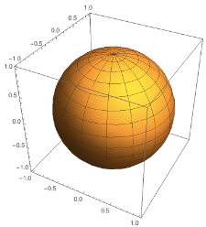
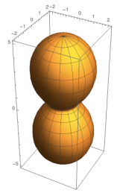

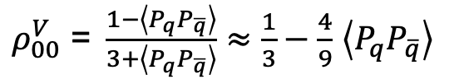
Global Spin Alignment
The spin state of a vector meson can be described by a 3x3 spin density matrix.
The diagonal element ρ00 corresponds to the probability of finding a vector meson
in spin state 0 out of 3 possible spin states of -1, 0 and 1.
A deviation of ρ00 from 1/3 would indicate
a non-zero spin alignment.
Strong p-wave decay
$φ$ $(s\overline{s})$ ➝ k⁺+ k⁻
k^{*0} $(d\overline{s})$ ➝ k⁺+ $π$⁻
$$\frac{dN}{d\left(\cos{θ^{∗}}\right)}∼\left(1−ρ_{00}\right)+(3ρ_{00}−1)\cos^{2}θ^{∗}$$
From quark combination :
$ρ_{00}^{V}\text{ = }\frac{1−\left\langle P_{q}P_{\overline{q}}\right\rangle }{3+\left\langle P_{q}P_{\overline{q}}\right\rangle }≈\frac{1}{3}−\frac{4}{9}$ $\left\langle P_{q}P_{\overline{q}}\right\rangle$

Slide 9
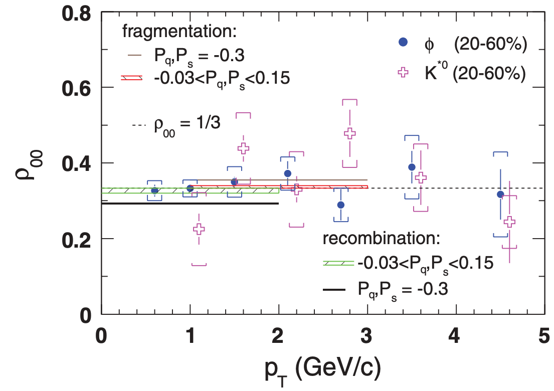
Global Spin Alignment
Strong p-wave decay
$φ$ $(s\overline{s})$ ➝ k⁺+ k⁻
STAR, PRC 77 061902 (2008)
k^{*0} $(d\overline{s})$ ➝ k⁺+ $π$⁻
$$\frac{dN}{d\left(\cos{θ^{∗}}\right)}∼\left(1−ρ_{00}\right)+(3ρ_{00}−1)\cos^{2}θ^{∗}$$
From quark combination :
$ρ_{00}^{V}\text{ = }\frac{1−\left\langle P_{q}P_{\overline{q}}\right\rangle }{3+\left\langle P_{q}P_{\overline{q}}\right\rangle }≈\frac{1}{3}−\frac{4}{9}$ $\left\langle P_{q}P_{\overline{q}}\right\rangle$

Slide 10
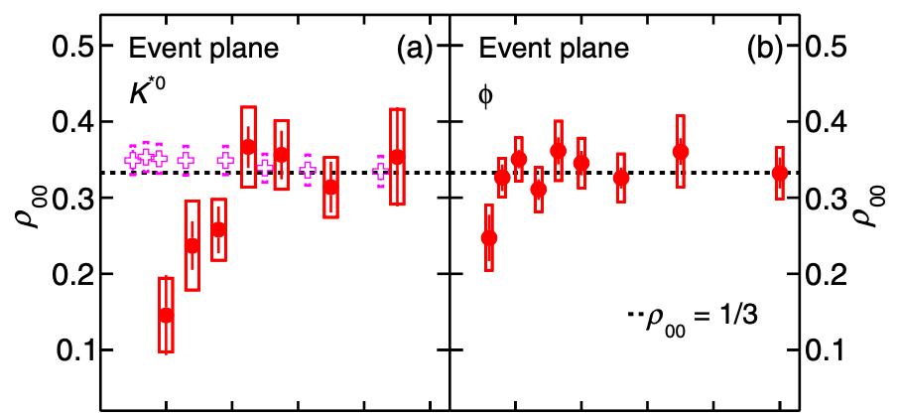
Global Spin Alignment
Strong p-wave decay
$φ$ $(s\overline{s})$ ➝ k⁺+ k⁻
ALICE, PRL 125 012301 (2020)
k^{*0} $(d\overline{s})$ ➝ k⁺+ $π$⁻
$$\frac{dN}{d\left(\cos{θ^{∗}}\right)}∼\left(1−ρ_{00}\right)+(3ρ_{00}−1)\cos^{2}θ^{∗}$$
From quark combination :
$ρ_{00}^{V}\text{ = }\frac{1−\left\langle P_{q}P_{\overline{q}}\right\rangle }{3+\left\langle P_{q}P_{\overline{q}}\right\rangle }≈\frac{1}{3}−\frac{4}{9}$ $\left\langle P_{q}P_{\overline{q}}\right\rangle$

Slide 11
Global Spin Alignment
Strong p-wave decay
$φ$ $(s\overline{s})$ ➝ k⁺+ k⁻
k^{*0} $(d\overline{s})$ ➝ k⁺+ $π$⁻
STAR, Nature 614 244 (2023)
$$\frac{dN}{d\left(\cos{θ^{∗}}\right)}∼\left(1−ρ_{00}\right)+(3ρ_{00}−1)\cos^{2}θ^{∗}$$
From quark combination :
$ρ_{00}^{V}\text{ = }\frac{1−\left\langle P_{q}P_{\overline{q}}\right\rangle }{3+\left\langle P_{q}P_{\overline{q}}\right\rangle }≈\frac{1}{3}−\frac{4}{9}$ $\left\langle P_{q}P_{\overline{q}}\right\rangle$

Slide 12
Global Spin Alignment : STAR Results
[1]. Liang et., al., Phys. Lett. B 629, (2005);
Yang et., al., Phys. Rev. C 97, 034917 (2018);
Xia et., al., Phys. Lett. B 817, 136325 (2021);
Beccattini et., al., Phys. Rev. C 88, 034905 (2013)
[2]. Sheng et., al., Phys. Rev. D 101, 096005 (2020);
Yang et., al., Phys. Rev. C 97, 034917 (2018)
[3]. Liang et., al., Phys. Lett. B 629, (2005)
[4]. Xia et., al., Phys. Lett. B 817, 136325 (2021);
Gao, Phys. Rev. D 104, 076016 (2021)
[5]. Muller et., al., Phys. Rev. D 105, L011901 (2022)
[6]. Sheng et., al., Phys. Rev. D 101, 096005 (2020);
Phys. Rev. D 102, 056013 (2020); Phys Rev. Lett. 131
042304 (2023); Phys. Rev. D 109, 036004 (2024)
[7] A. Kumar, B. Muller and D.-L Yang, PRD 108 016020
(2023)
[8] Sheng, Pu and Wang, Phys. Rev. C 108 054902 (2023)
[9] Sheng et., al., arXiv:2403.07522
[10] Lv et. al., Phys. Rev. D 109, 114003 (2024)
STAR, Nature 614 244 (2023)
ϕ exhibits surprisingly large global spin alignment while K* displays little.

Slide 13


The Large ρ00 Surprise
$ρ_{00}≈\frac{1}{3}+C_{Λ}+C_{ε}+C_{E}+C_{F}$ $+C_{L}+C_{A}$ $+C_{φ}+C_{g}$
Physics Mechanisms | (ρ₀₀)
c_{Λ}: Quark coalescence vorticity & magnetic field^{[1]} | < 1/3 (Negative ~ 10⁻⁵)
c_{ε}: E-comp. of Vorticity tensor^{[1]} | < 1/3 (Negative ~ 10⁻⁴)
c_{E}: Electric field^{[2]} | > 1/3 (Positive ~ 10⁻⁵)
c_{F}: Fragmentation^{[3]} | > or, < 1/3 (~ 10⁻⁵)
c_{L}: Local spin alignments^{[4]} | < 1/3
c_{A}: Turbulent color field^{[5]} | < 1/3
c_{ϕ}: Vector meson strong force field^{[6]} | > 1/3 (Can accommodate large positive signal)
c_{g}: Glasma fields + effective potential^{[7]} | could be significant
}
STAR, Nature 614 244 (2023)
strong force
$C_{φ}$=$\frac{G_{s}^{(y)}}{27m_{s}^{2}T_{eff}^{2}},$
$$G_{s}^{(y)}=g_{φ}^{2}\left[3\left\langle B_{φ,y}^{2}\right\rangle −\frac{{\left\langle P^{2}\right\rangle }_{φ}}{m_{s}^{2}}\left\langle E_{φ,z}^{2}+E_{φ,x}^{2}\right\rangle \right]$$
ϕ exhibits surprisingly large global spin alignment while K* displays little.

Slide 14
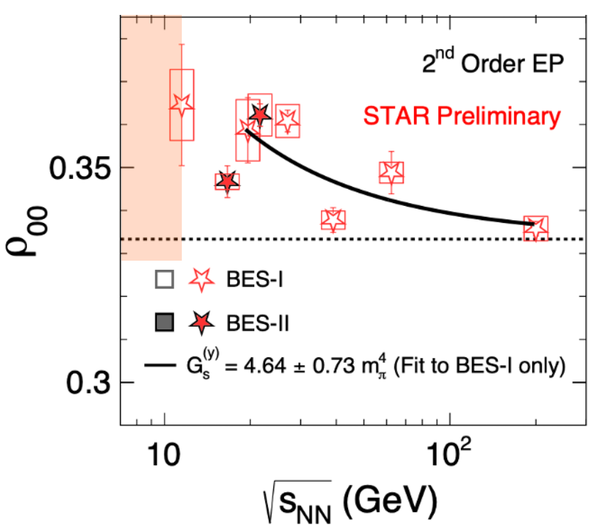

The Large ρ00 Surprise
$ρ_{00}≈\frac{1}{3}+C_{Λ}+C_{ε}+C_{E}+C_{F}$ $+C_{L}+C_{A}$ $+C_{φ}+C_{g}$
Physics Mechanisms | (ρ₀₀)
c_{Λ}: Quark coalescence vorticity & magnetic field^{[1]} | < 1/3 (Negative ~ 10⁻⁵)
c_{ε}: E-comp. of Vorticity tensor^{[1]} | < 1/3 (Negative ~ 10⁻⁴)
c_{E}: Electric field^{[2]} | > 1/3 (Positive ~ 10⁻⁵)
c_{F}: Fragmentation^{[3]} | > or, < 1/3 (~ 10⁻⁵)
c_{L}: Local spin alignments^{[4]} | < 1/3
c_{A}: Turbulent color field^{[5]} | < 1/3
c_{ϕ}: Vector meson strong force field^{[6]} | > 1/3 (Can accommodate large positive signal)
c_{g}: Glasma fields + effective potential^{[7]} | could be significant
Large ϕ global spin alignment corroborated with BES-II data.
}
strong force
ϕ exhibits surprisingly large global spin alignment while K* displays little.

Slide 15
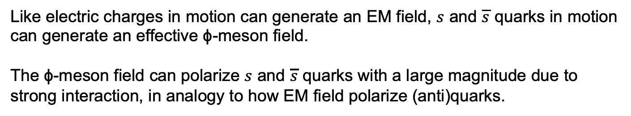
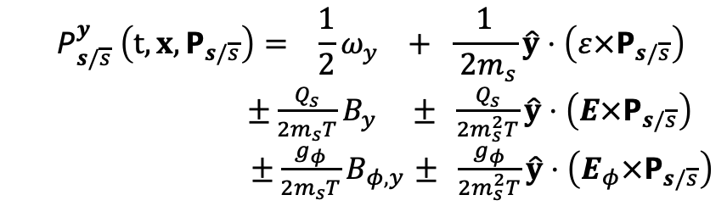
The Large ρ00 Surprise
$ρ_{00}≈\frac{1}{3}+C_{Λ}+C_{ε}+C_{E}+C_{F}$ $+C_{L}+C_{A}$ $+C_{φ}+C_{g}$
Like electric charges in motion can generate an EM field, $s$ and $\overline{s}$ quarks in motion
can generate an effective ϕ-meson field.
The ϕ-meson field can polarize $s$ and $\overline{s}$ quarks with a large magnitude due to
strong interaction, in analogy to how EM field polarize (anti)quarks.
$$P_{s/\overline{s}}^{y} \left(t,x,P_{s/\overline{s}}\right)= \frac{1}{2}ω_{y} + \frac{1}{ 2m_{s}}\hat{y}⋅\left(ε×P_{s/\overline{s}}\right)$$
$±\frac{Q_{s}}{2m_{s}T}B_{y}$ $± \frac{Q_{s}}{2m_{s}^{2}T}\hat{y}⋅\left(E×P_{s/\overline{s}}\right)$
$±\frac{g_{φ}}{2m_{s}T}B_{φ,y}$ $± \frac{g_{φ}}{2m_{s}^{2}T}\hat{y}⋅\left(Ε_{φ}×P_{s/\overline{s}}\right)$
⟸ vorticity
⟸ EM field
⟸ strong force field
Quark version of the spin-orbit
force. Not accessible via PΛ.
“magnetic” components
“electric” components
Sheng et., al., Phys. Rev. D 101, 096005 (2020)
The first time the strong force field is experimentally supported as a key mechanism that leads to global spin alignment.

Slide 16
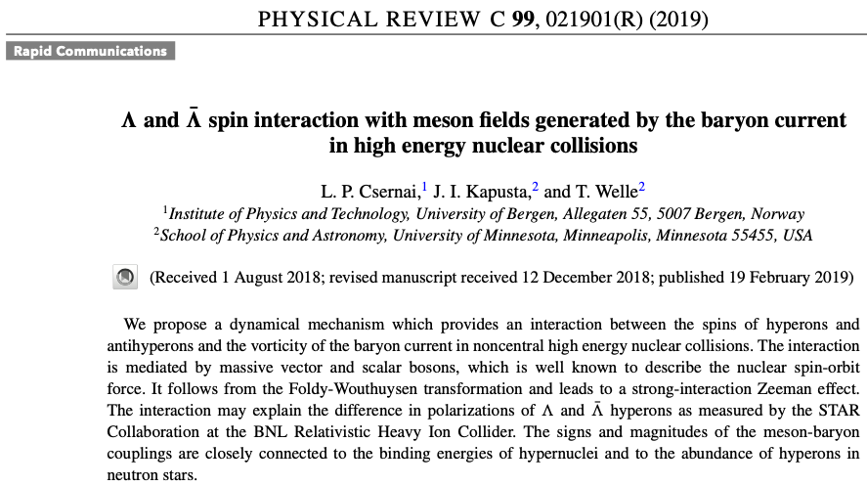
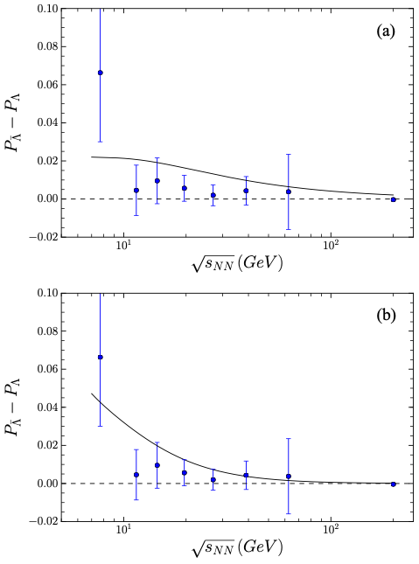

ϕ-meson Vector Field
Similar idea to explain $P_{Λ}− P_{\overline{Λ}}$

Slide 17
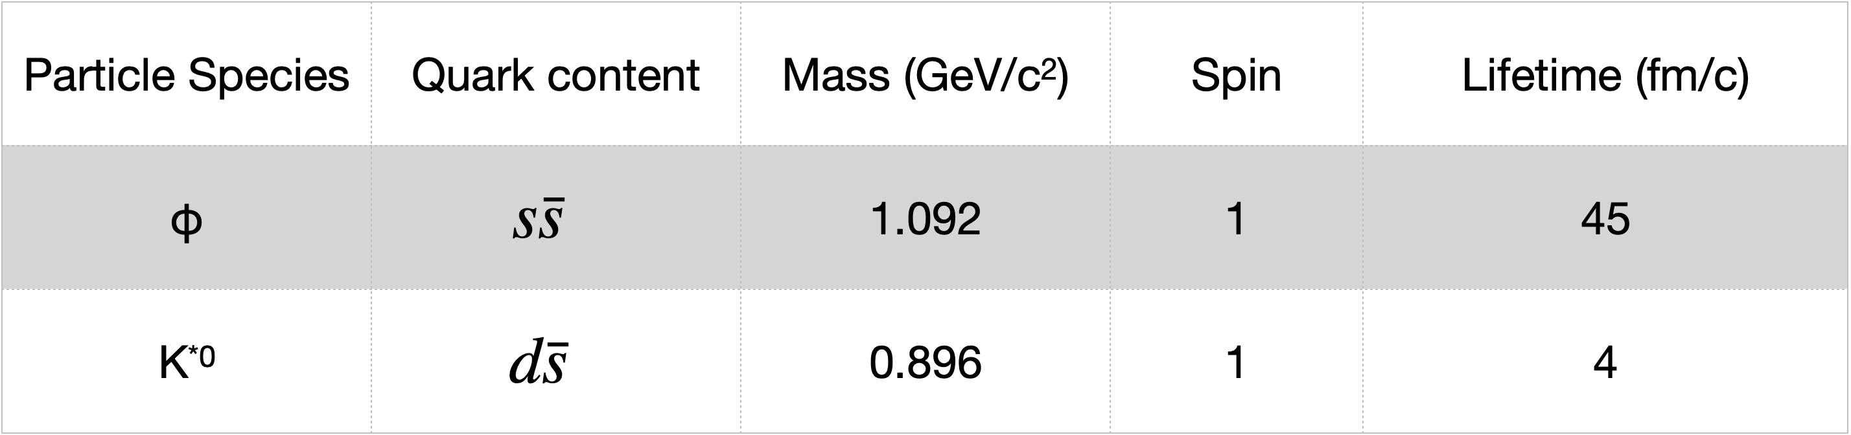
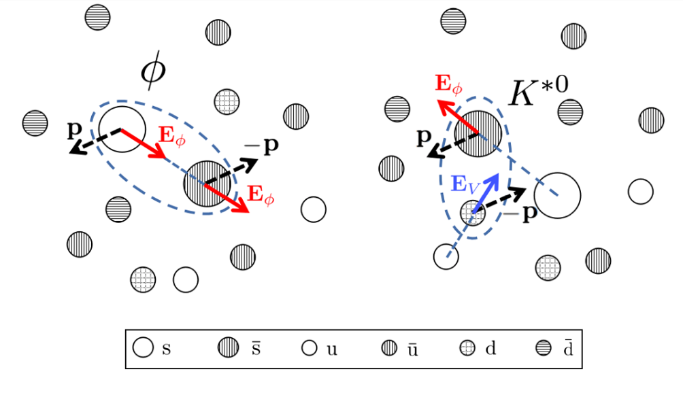
What About K*⁰ meson ?
Sheng et., al., Phys. Rev. D 102, 056013 (2020)
Little field correlation for K^{*0}, causing $\left\langle P_{\overline{q}}P_{q}\right\rangle$ to diminish.

Slide 18
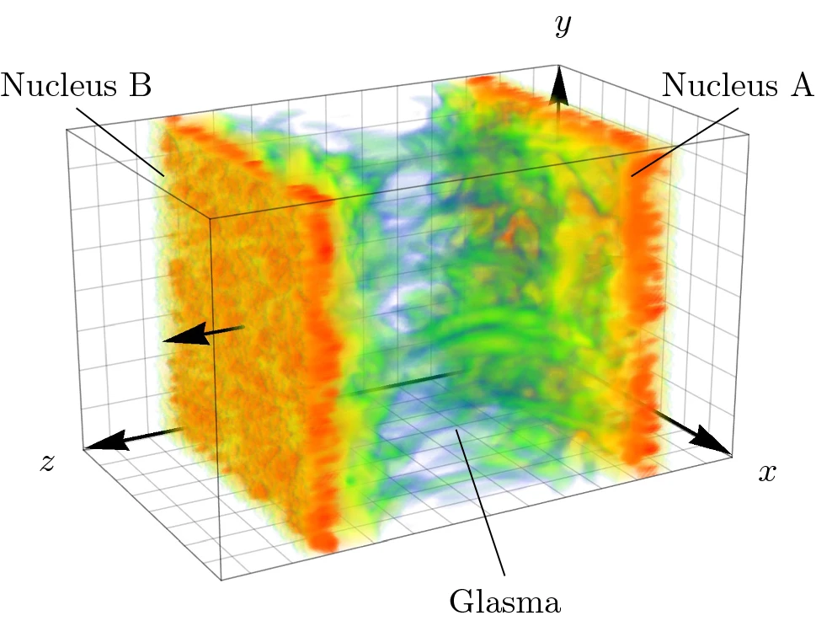
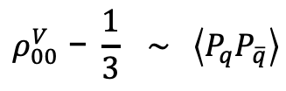
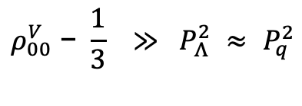

Fluctuation Matters
What do we learn ?
$$ρ_{00}^{V}\text{ −} \frac{1}{3} ≫ P_{Λ}^{2} ≈ P_{q}^{2}$$
$$ρ_{00}^{V}\text{ − }\frac{1}{3} \sim \left\langle P_{q}P_{\overline{q}}\right\rangle$$
$\left\langle P_{q}P_{\overline{q}}\right\rangle$ $≠$ $\left\langle P_{q}\right\rangle$ $\left\langle P_{\overline{q}}\right\rangle$
STAR, Nature 614 244 (2023)
Global spin alignment measures local field fluctuations, while hyperon polarization measures the mean.
What does it predict on the rapidity dependence ?
A. Ipp and D. Muller. EPA 56 243 (2020)

Slide 19
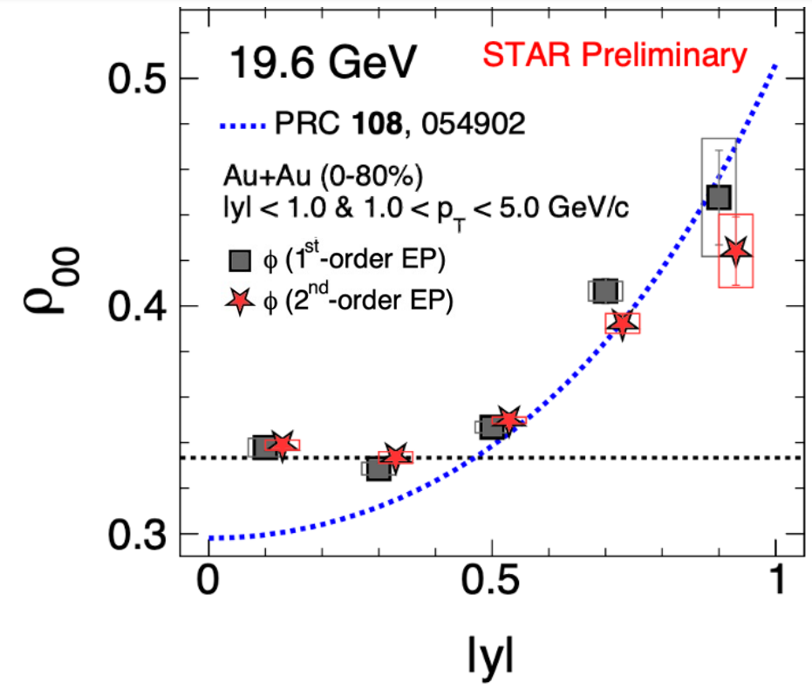
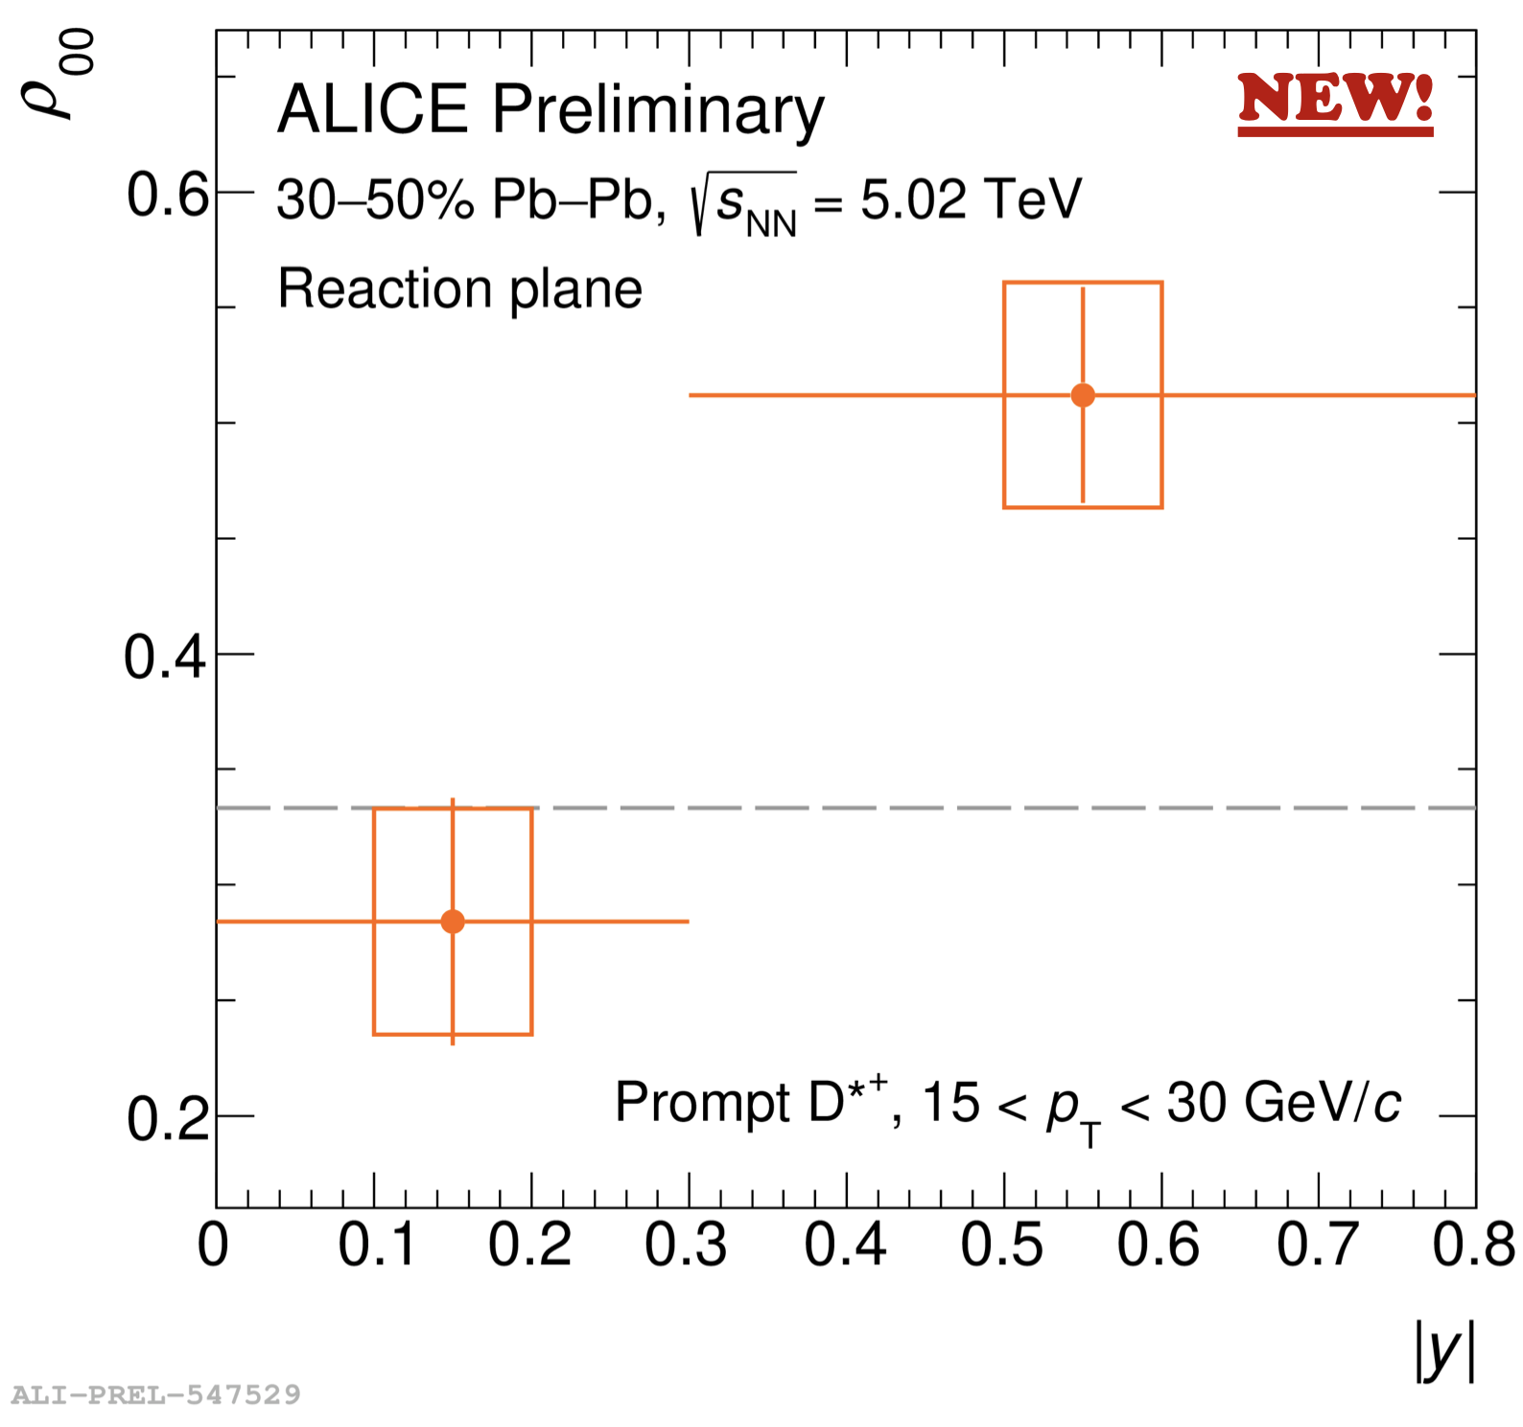

The Rapidity Dependence
D^{*+} $(c\overline{d})$➝ D⁰ + 𝜋⁺
↳ k⁻ + 𝜋⁺
G. Wilks for STAR, SQM 2024
Theory curve : X.L. Sheng, et al., PRC 108 054902 (2023)
L. Micheletti for ALICE, QM2023
Strong rapidity dependence at both RHIC and LHC.
Trend consistent with prediction invoking strong force field.

Slide 20
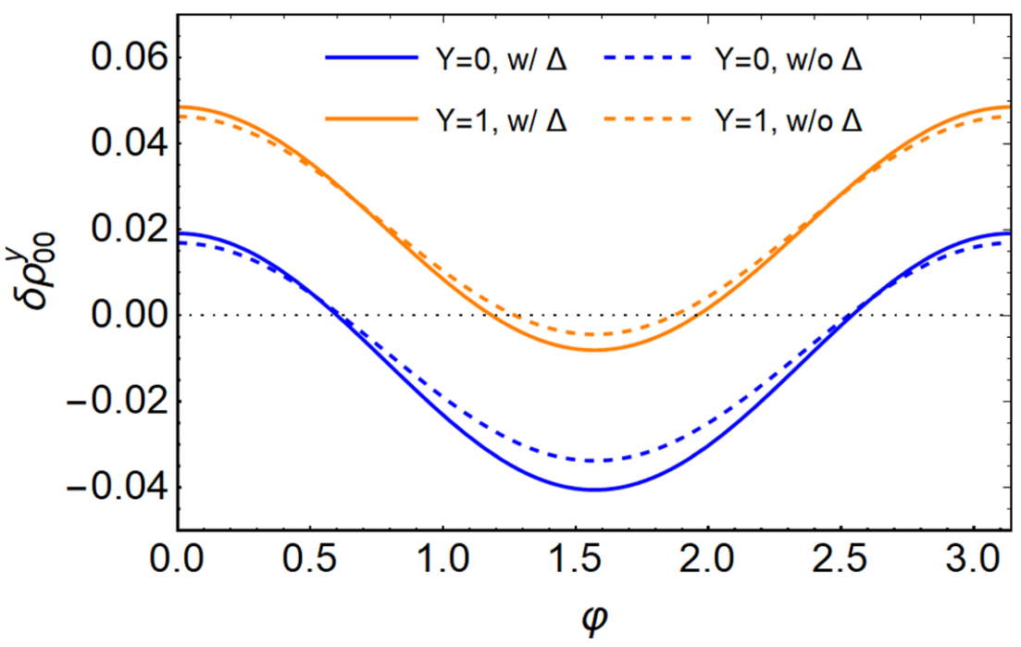
The Rapidity Dependence
Relative motion to bulk induce asymmetry of fluctuation in rest frame (more severe at forward rapidity), leading to ρ^{z}00 < 1/3.
ρ^{z}00 < 1/3 ⇒ ρ^{x}00 = ρ^{y}00 > 1/3
G. Wilks for STAR, SQM 2024
Theory curve : X.L. Sheng, et al., PRC 108 054902 (2023)
X.L. Sheng, S. Pu and Q. Wang, PRC 108 054902 (2023)
Strong rapidity dependence at both RHIC and LHC.
Trend consistent with prediction invoking strong force field.

Slide 21
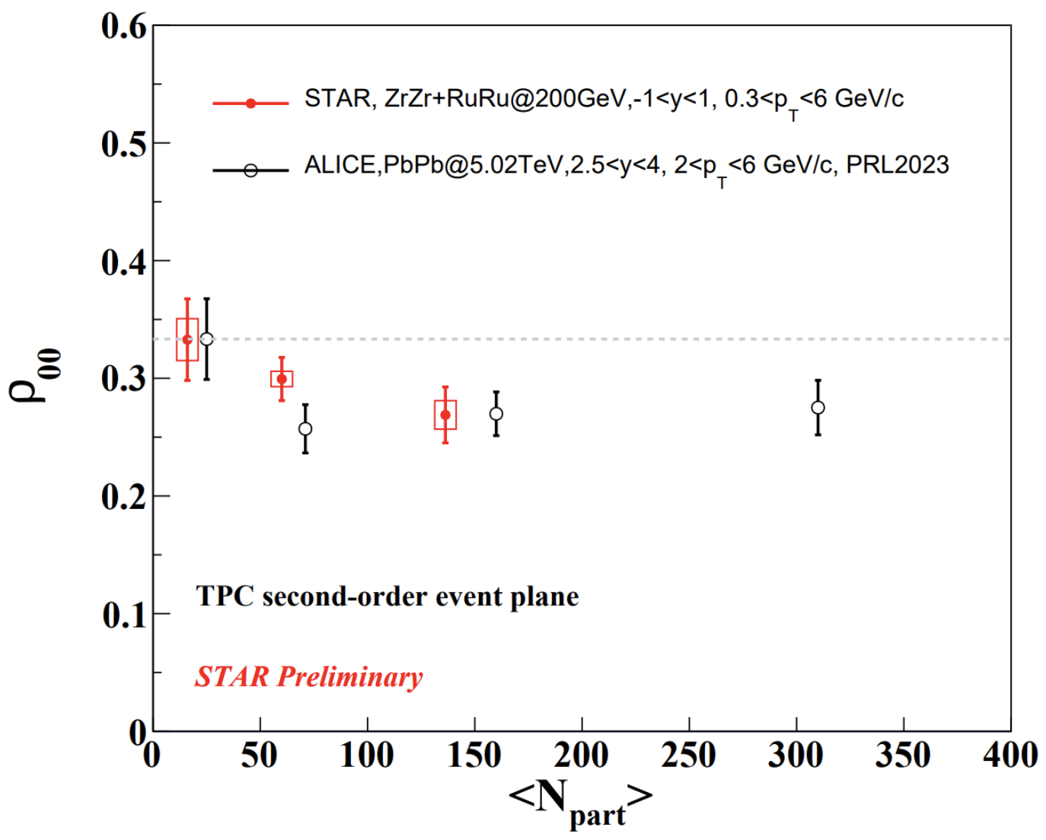
What about J/ψ ?
Naïve expectation from fluctuating strong force field : ρ00 > 1/3 at midrapidity
D. Shen for STAR, SPIN 2023
X. Bai for ALICE, SPIN 2023
Forward J/ψ ρ00 at LHC and midrapidity J/ψ ρ00 < 1/3 at RHIC, both < 1/3.
How do we understand J/ψ ρ00 ?

Slide 22
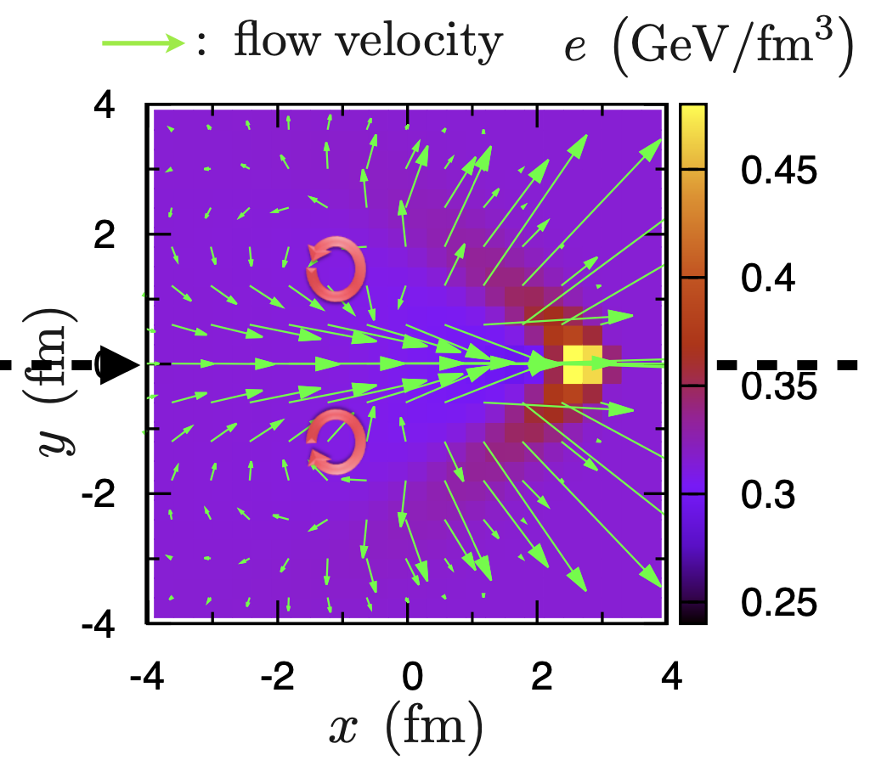
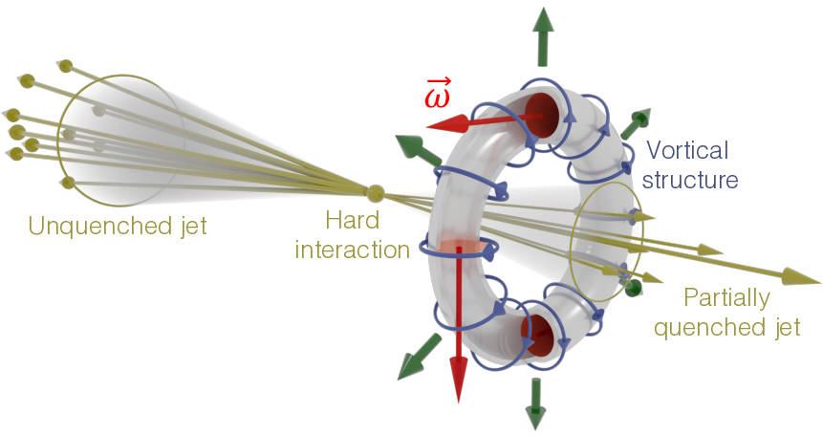
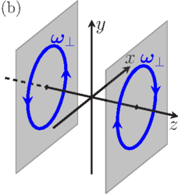
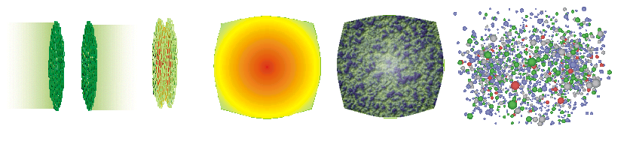
Any Hint on Vortical Structure ?
B. Bets, M. Gyulassy and G. Torrieri, PRC 76 044901 (2007)
Y. Tachibana and T. Hirano, NPA 904 1023c (2013)
W.M. Serenone et al, PLB 820 136500 (2021)
Xia et. al., PRC 98 024905 (2018)
Xia et. al., Phys. Lett. B 817 136325 (2021)
Local ring and toroidal vorticity : unique fluid structures

Slide 23
Centrality Dependence
ρ00
STAR, Nature 614 244 (2023)
Xia et. al., PRC 98 024905 (2018)
Xia et. al., Phys. Lett. B 817 136325 (2021)
Local ring vorticity from fluid nature in the system ?

Slide 24
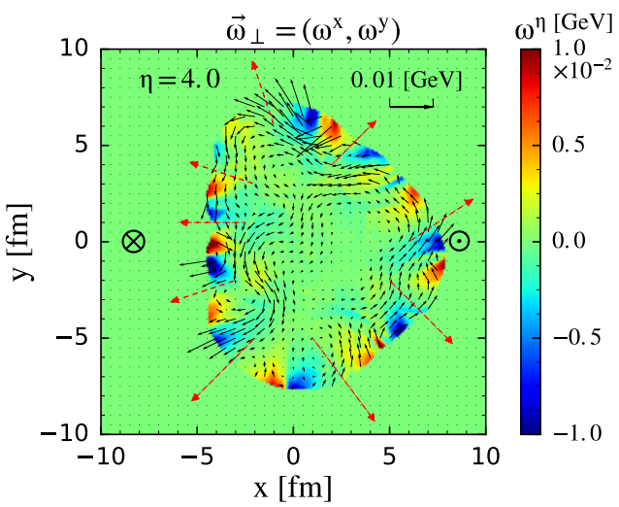
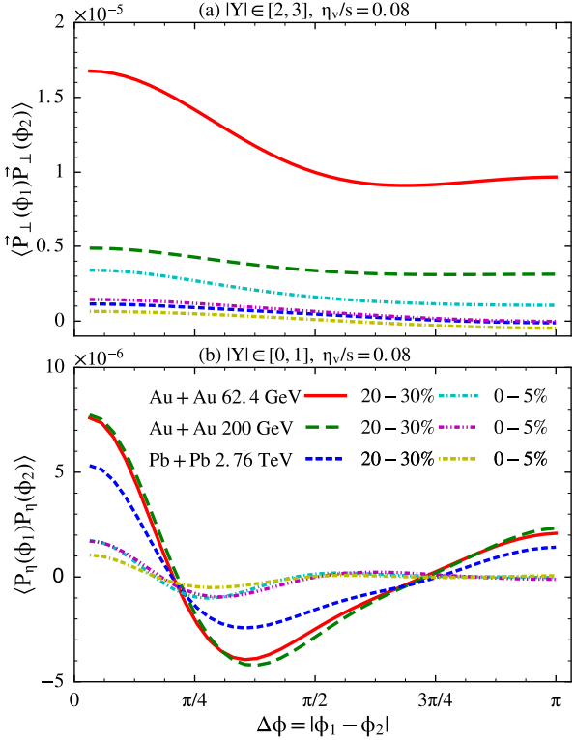
Spin-Spin Correlation : Vortical Structure
Vortical structure induced spin-spin correlation
Pang et.al., PRL 117 192301 (2016)

Slide 25
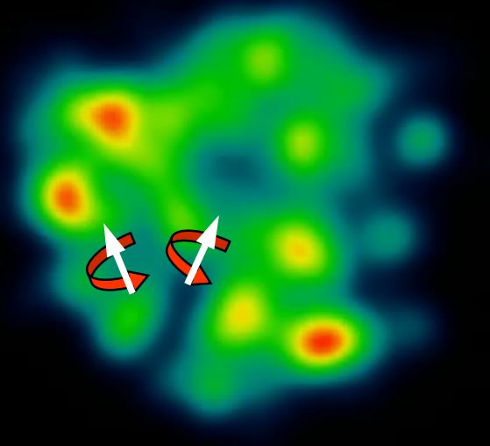



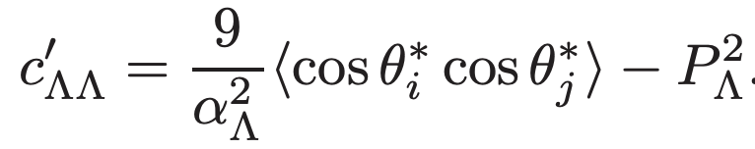

Spin-Spin Correlation : Strong Force
Spin correlation function :
: fraction of particle pair
in the spin state | m1m2 ⟩
In heavy ion collisions with finite global polarization,
It can be shown that
In practice with the consideration of EP resolution
Strong force induced hyperon spin correlation
Lv et. al., Phys. Rev. D 109, 114003 (2024)
Lyuboshitz and Lyuboshitz, Phys. Of Atomic Nuclei, 273 805 (2010)
Chen et. al., Phys.Rev. D 95, 034009 (2016)
Lv et. al., Phys. Rev. D 109, 114003 (2024)
Chen, Goldstein, Jaffe and JI, NPB 445 380 (1995)
Zhang and Wei, arXiv:2301.04096
Shen, Chen and Tang, arXiv:2407.21291
New clue to strong interaction.

Slide 26
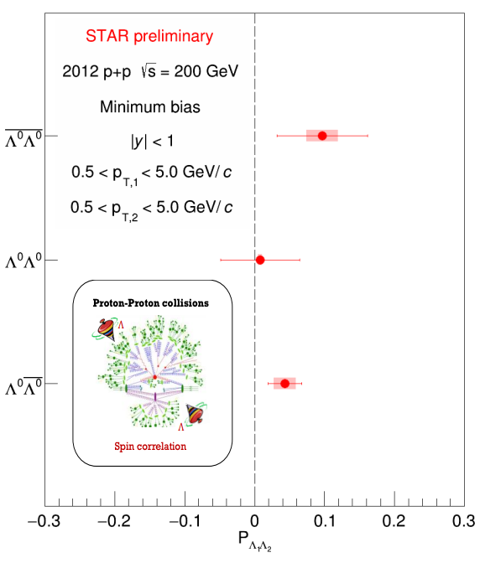

Spin-Spin Correlation in pp
Correlation induced by
parton spin correlation and/or entanglement ?
fragmentation and hadronization ?
Within uncertainty no signal is seen when integrated over phase space.
Desirable to study it differentially.
Jan Vanek for STAR, DIS 2024

Slide 27
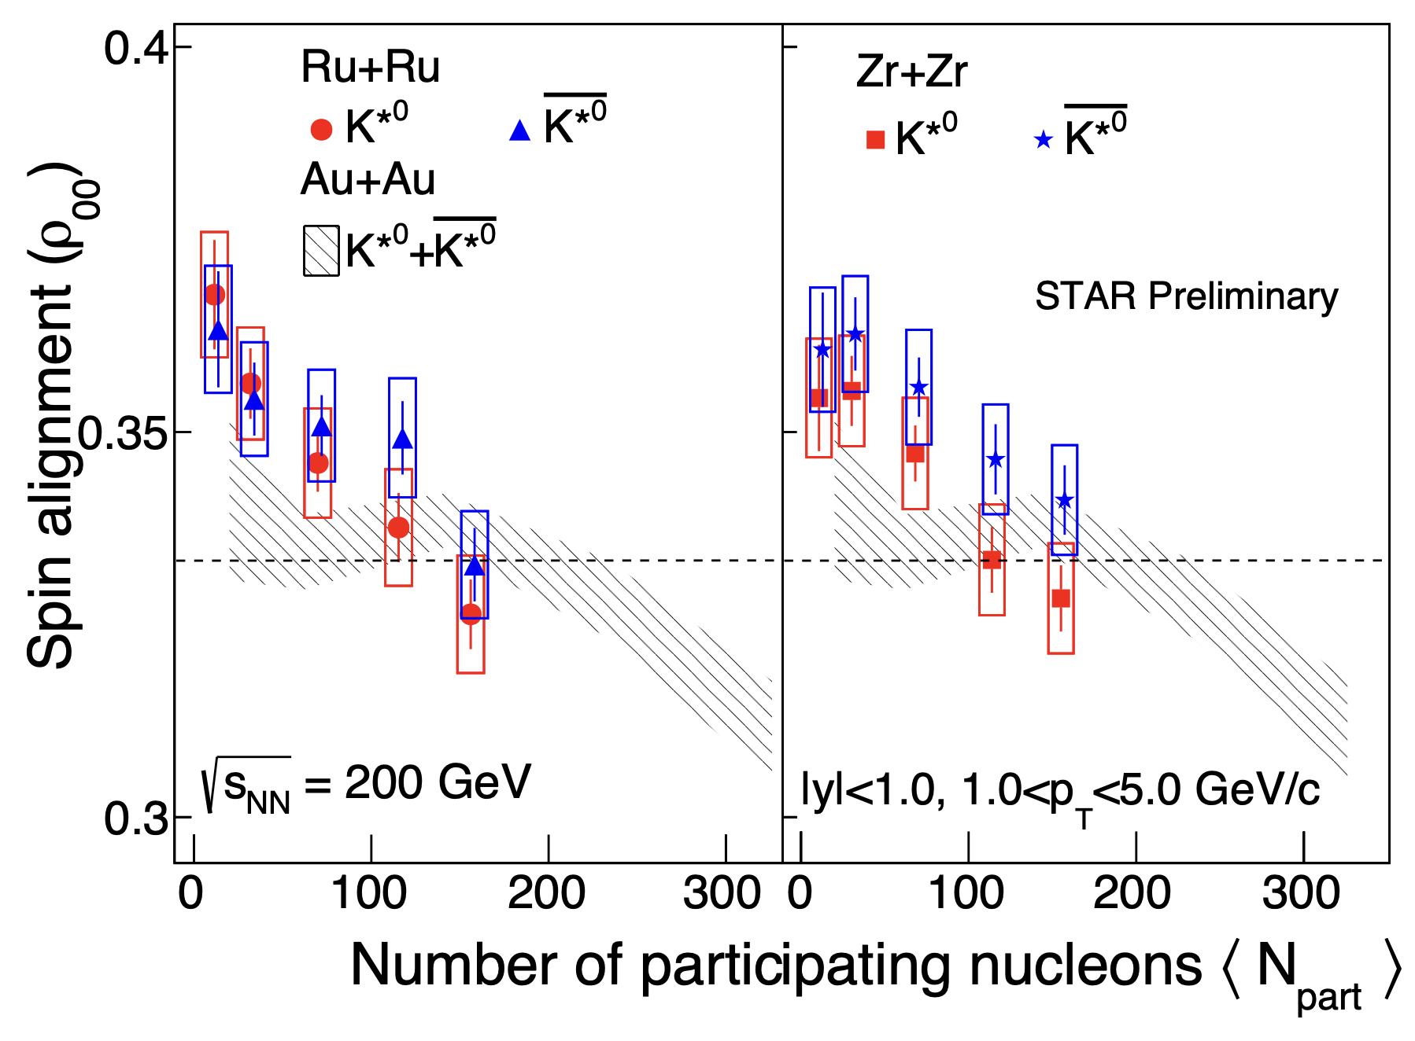

K^{*0} in Isobar
k^{*0} $(d\overline{s})$ ➝ k⁺+ $π$⁻
STAR, QM 2022
K^{*0} ρ00 > 1/3 at small Npart in isobar.
comparable to AuAu at similar Npart

Slide 28
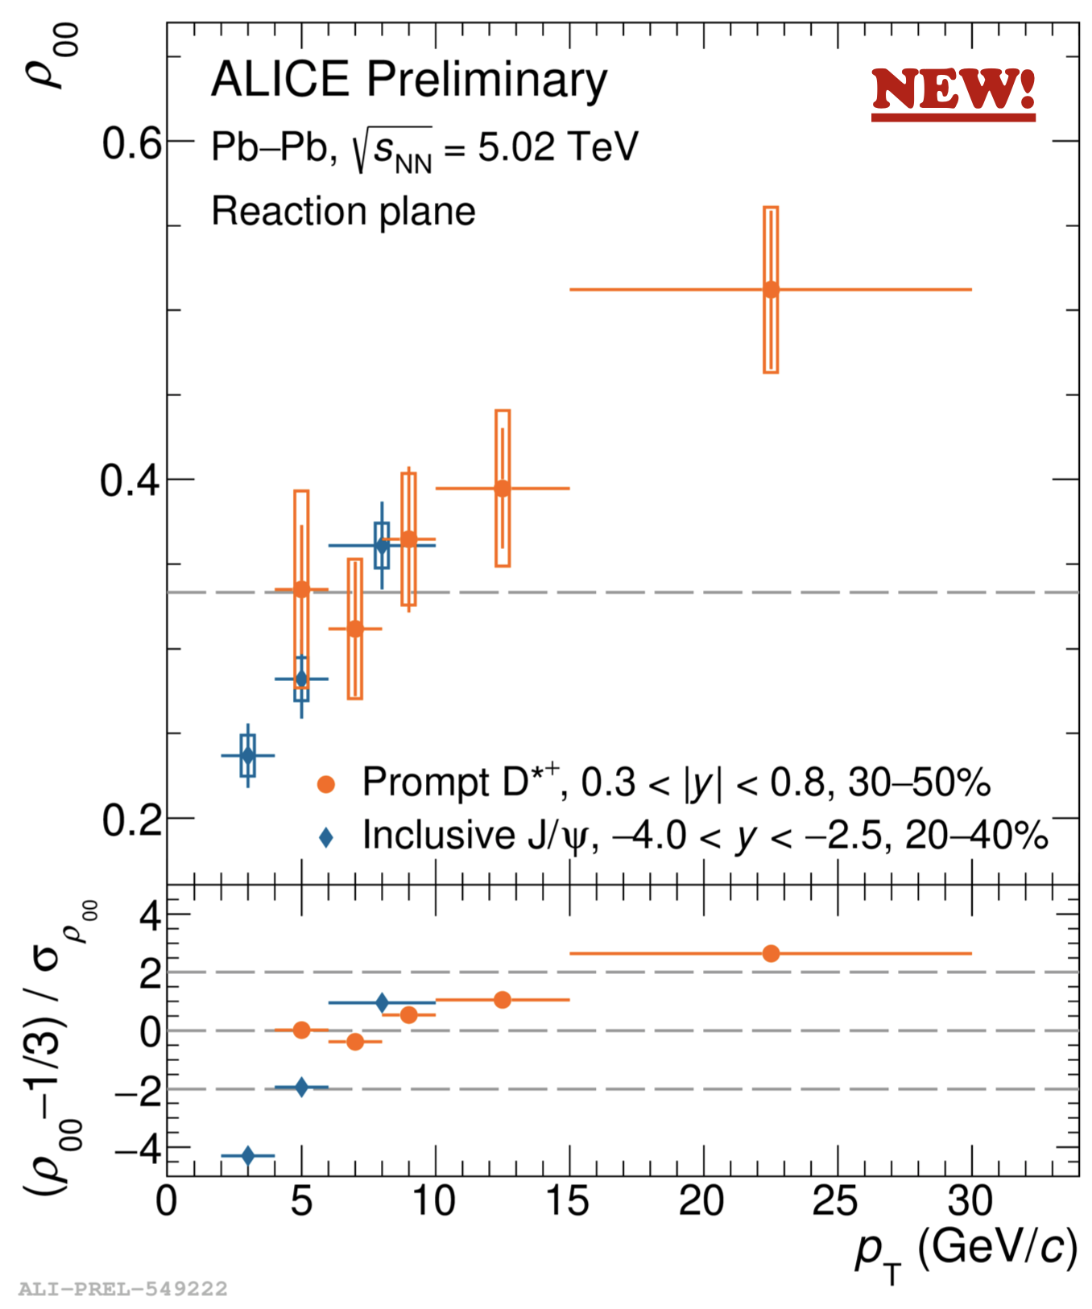
D^{*+} ρ00
D^{*+} $(c\overline{d})$➝ D⁰ + 𝜋⁺
↳ k⁻ + 𝜋⁺
Expectation :
from Recombination : < 1/3
from Fragmentation : > 1/3
Observation :
Low pt < 1/3
High pt > 1/3
--- Qualitatively agree with expectation that recombination is relevant at low while fragmentation is relevant at high pt.
However, quantitative agreement could be very challenging.
X. Bai for ALICE, SPIN2023

Slide 29
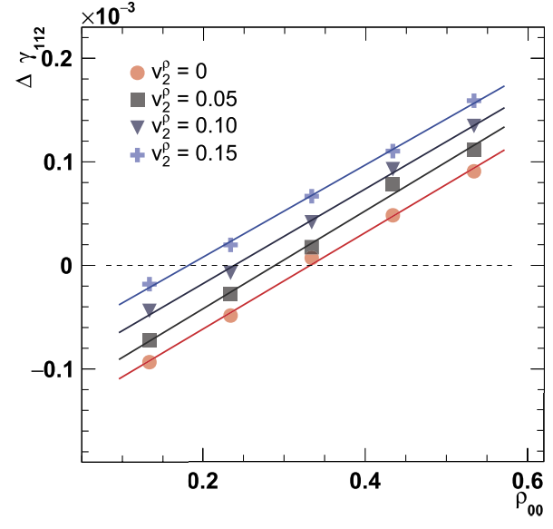
ρ00 and CME
A. Tang, Chin Phys. C 44 054101 (2020)
D. Shen et al., PLB 839 137777 (2023)
ρ00 being larger(smaller) than 1/3 means positive(negative) contribution to CME
observables
How to properly account for ρ-meson ρ00 in CME analyses ?

Slide 30
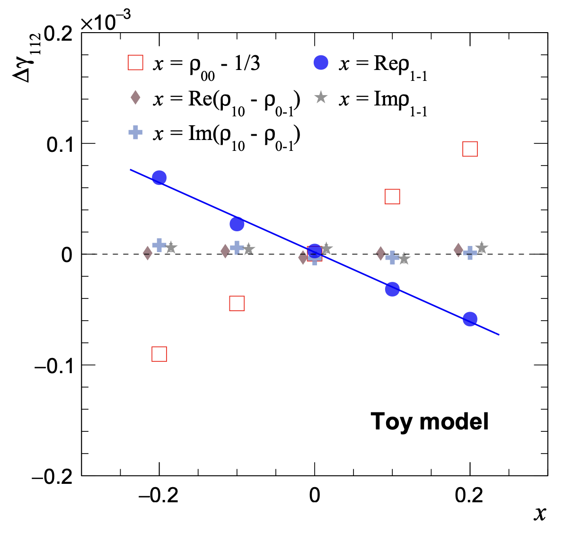
ρ1-1 and CME
Z. Wang et al., arXiv:2409.04675
ρ1-1 affects Δγ in opposite way to ρ00
How to properly account for ρ-meson ρ00 in CME analyses ?

Slide 31
Spin is aligned, let’s add some magnetism to the mix …

Slide 32
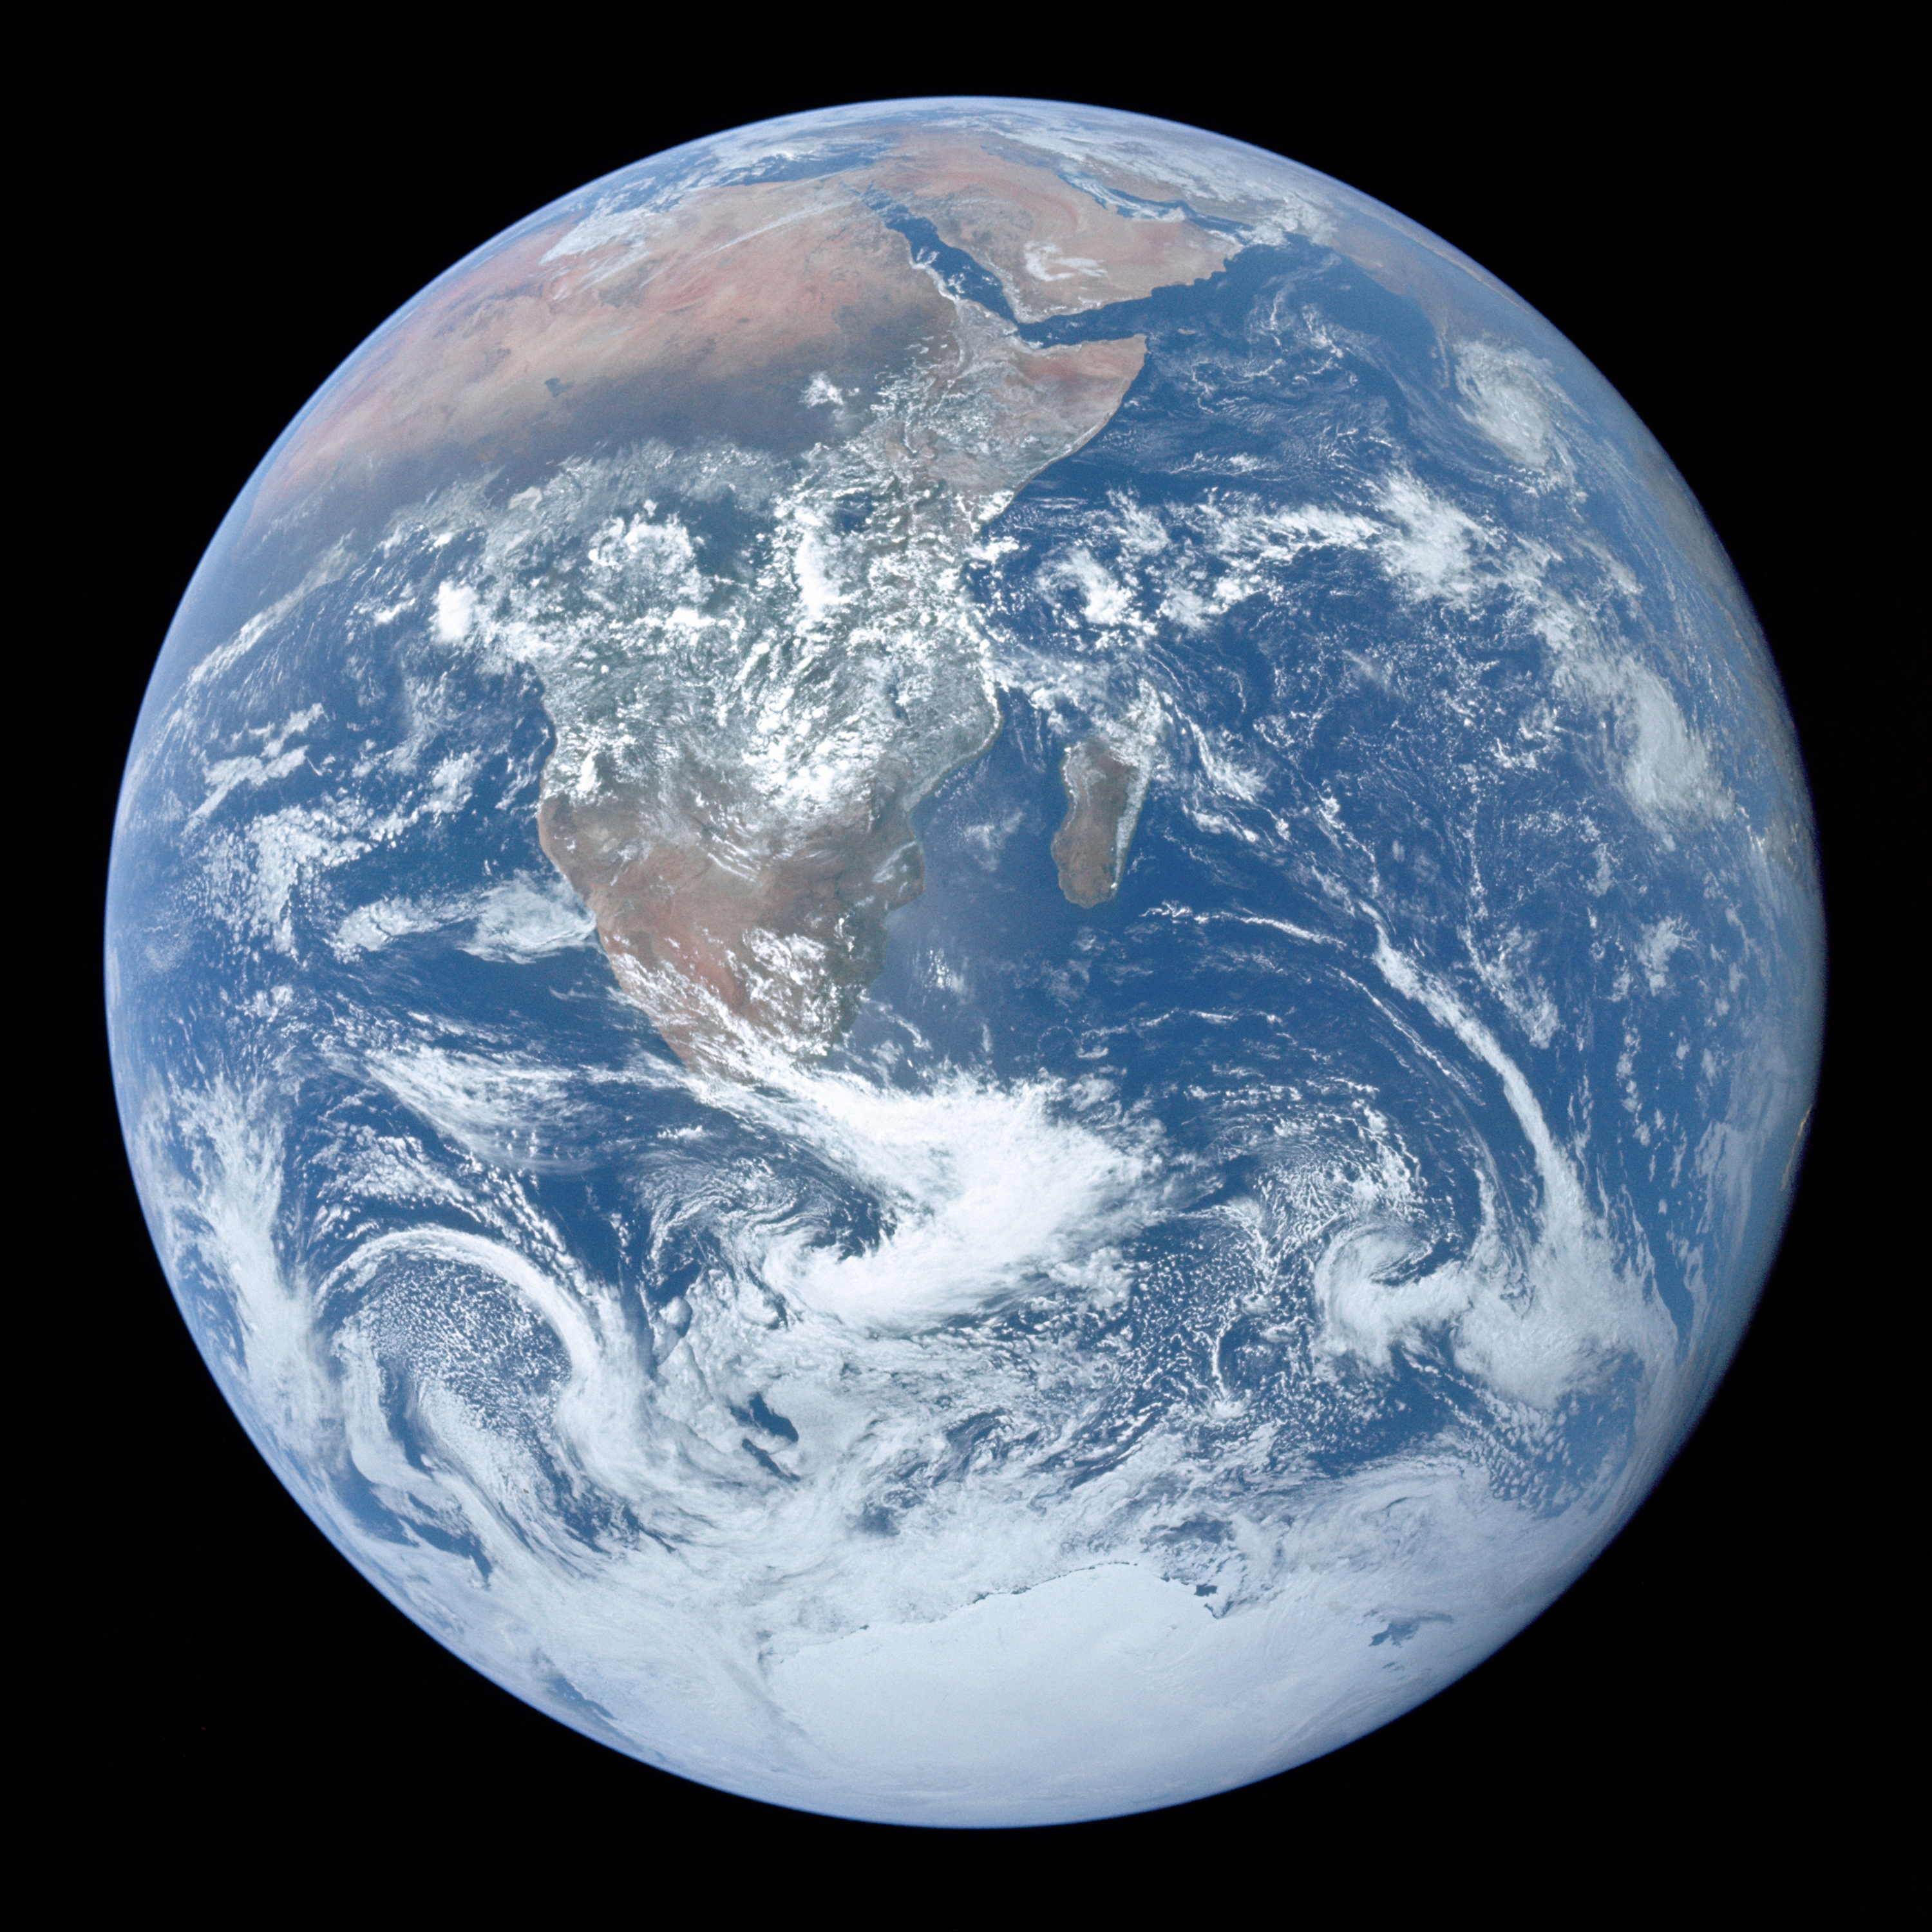
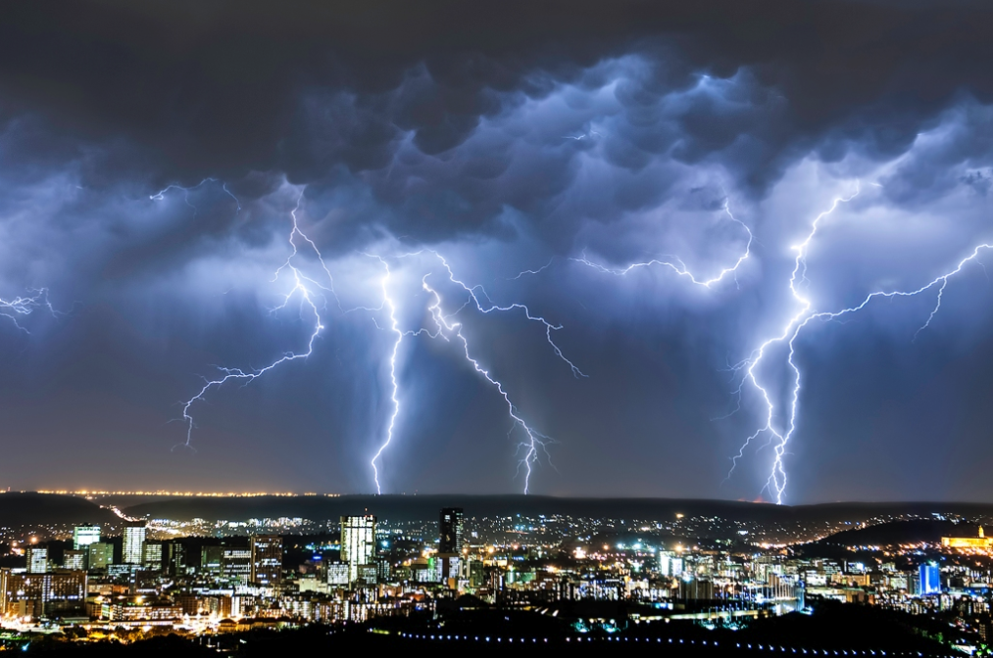
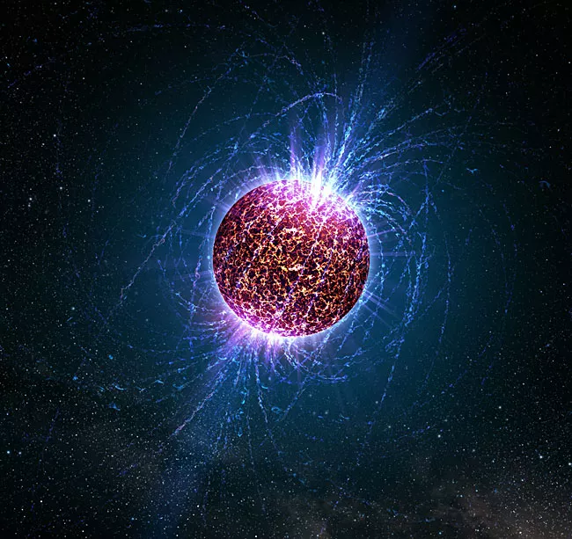
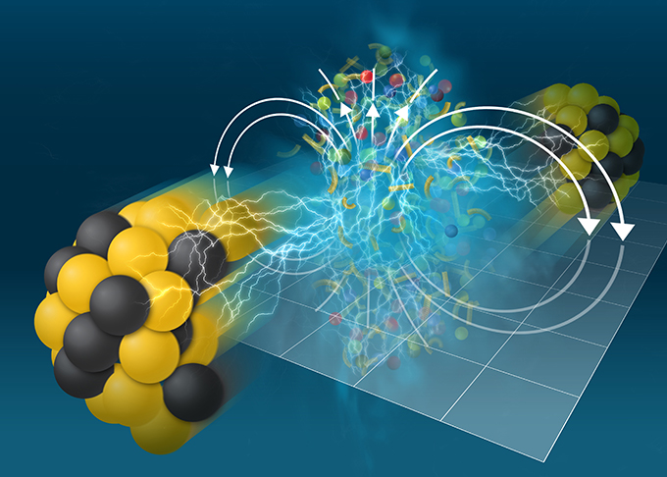
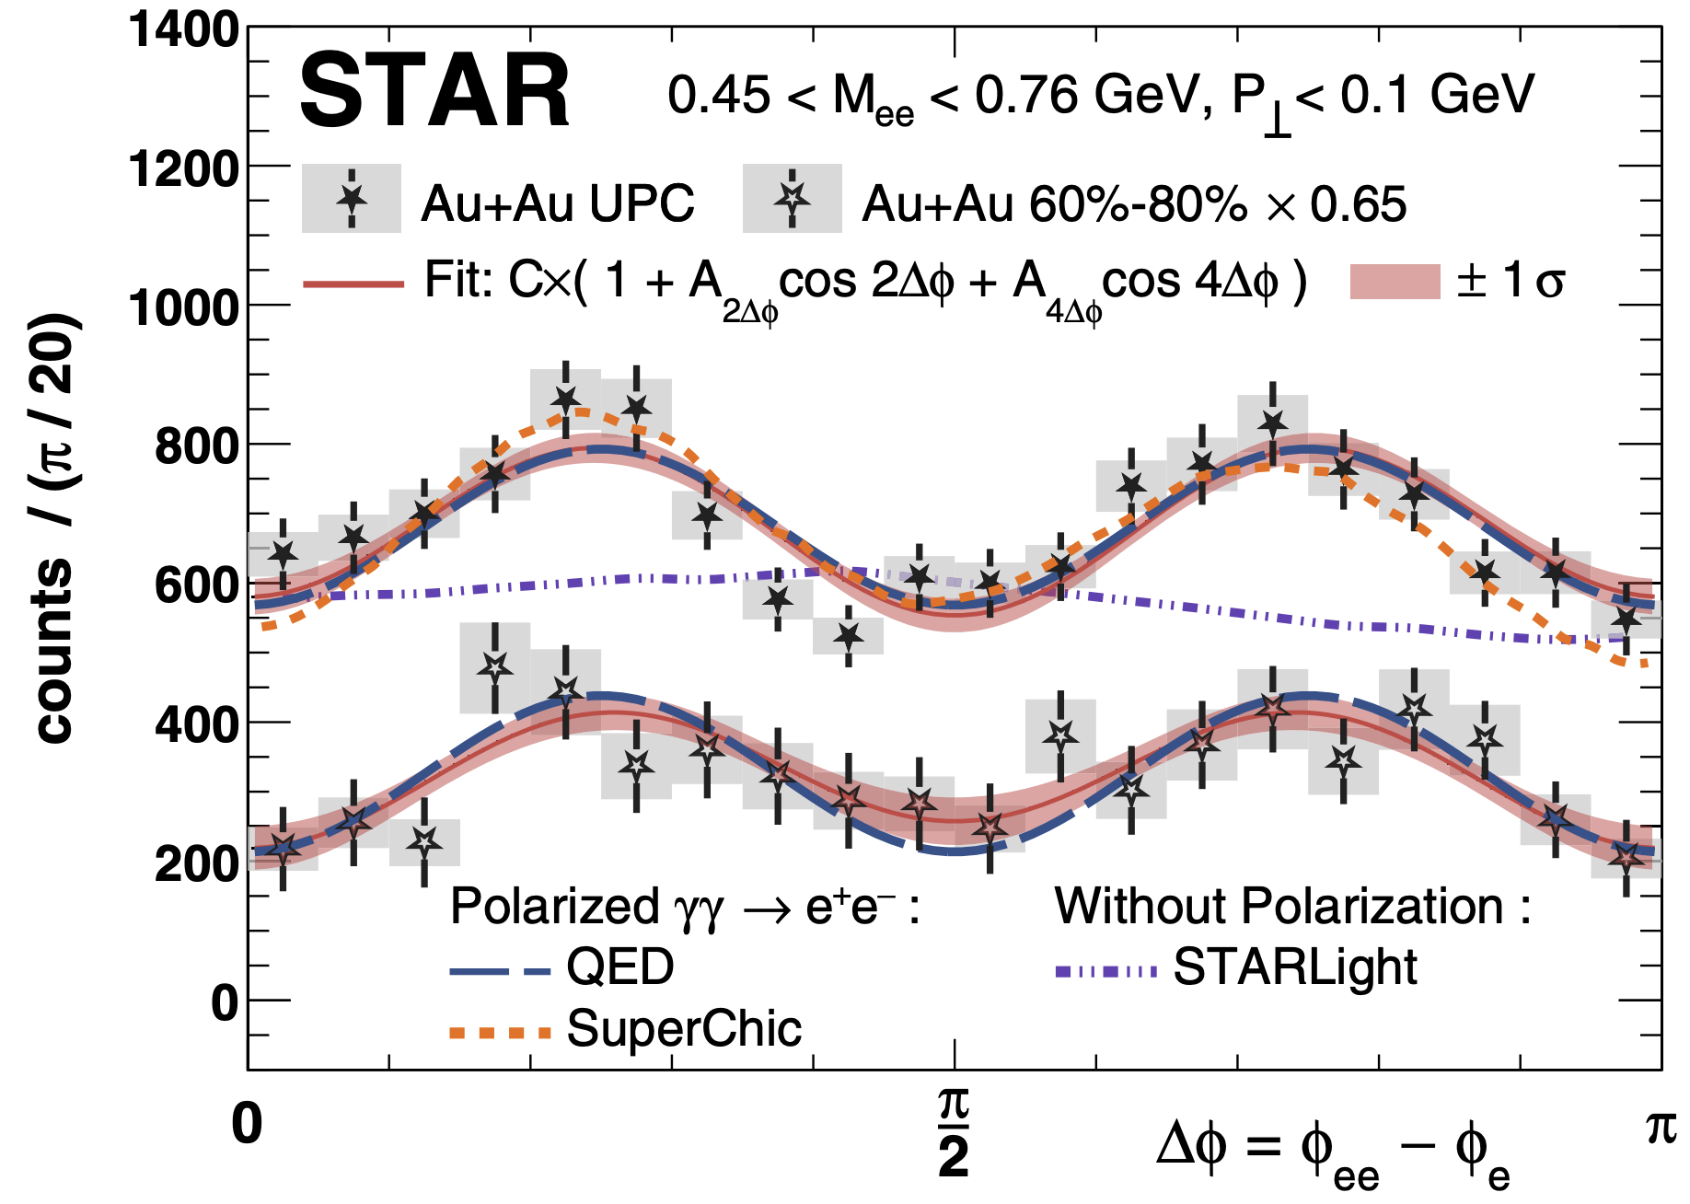
The Strongest EM Field, But Do We “See” It ?
Earth
~ 0.5 Gauss
Lightning
~ 10³ - 10⁴ Gauss
Neutron Star (Magnetar)
~ 10¹⁴ Gauss
Heavy ion collisions
~ 10¹⁸ Gauss
?
STAR, PRL 127, 052302 (2021)
Vacuum birefringence
vacuum + strong B
Gürsoy, Kharzeev & Rajagopal, Phys. Rev. C 89, 054905 (2014) …
Despite wide expectation of its existence, its imprint in QGP has been elusive.

Slide 33
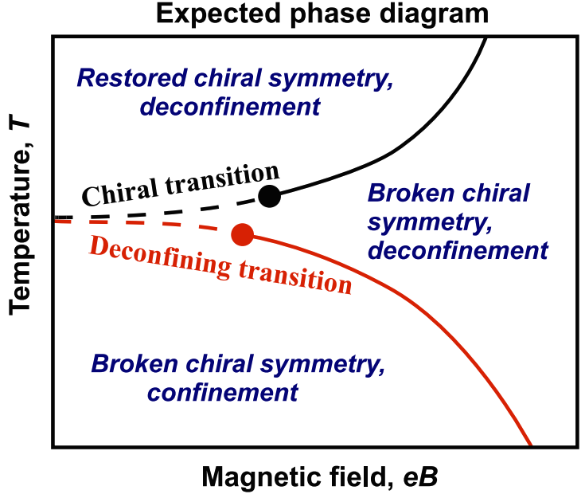
EM Field and Phase Diagram
Mizher, Chernodub and Fraga, PRD 82 105016 (2010)
E. Fraga and A. Mizher, PRD 78 025016 (2008)
Rich structure of QCD phase diagram under strong EM field.

Slide 34
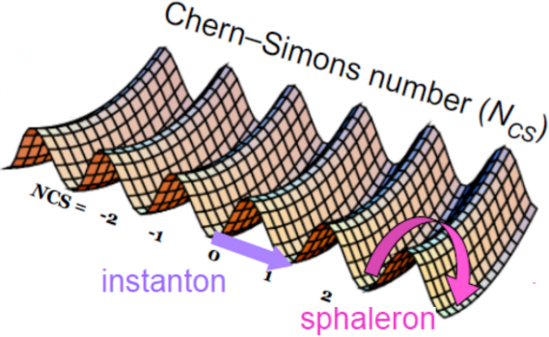
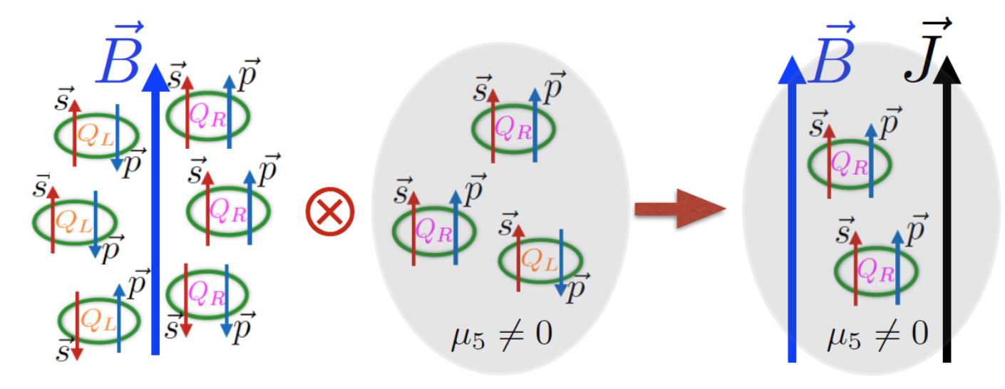
EM Field and CME
QCD vacuum topology (finite μ5)
Chiral Magnetic Effect
_
_
Chiral Magnetic Effect with strong magnetic field.
+
+
Chiral Separation Along B

Slide 35
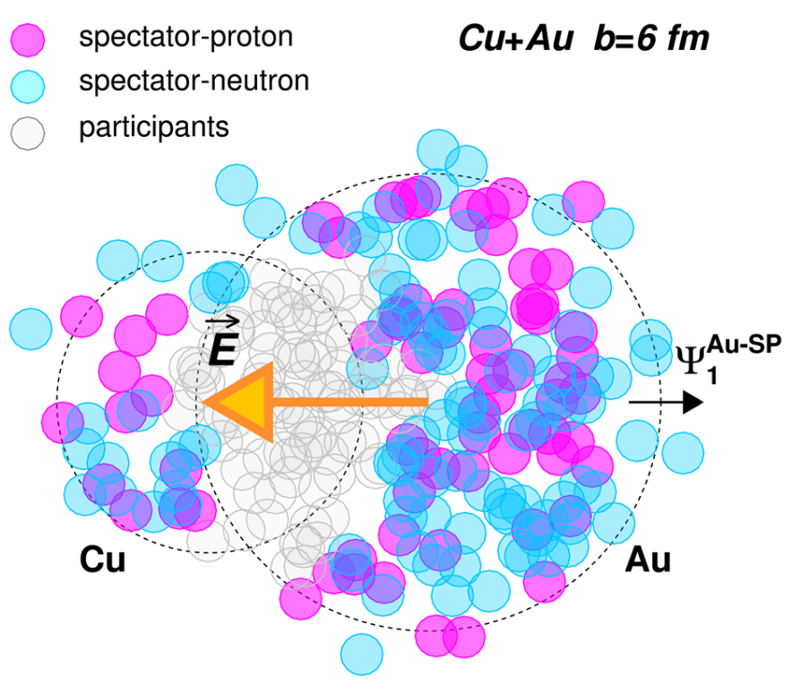
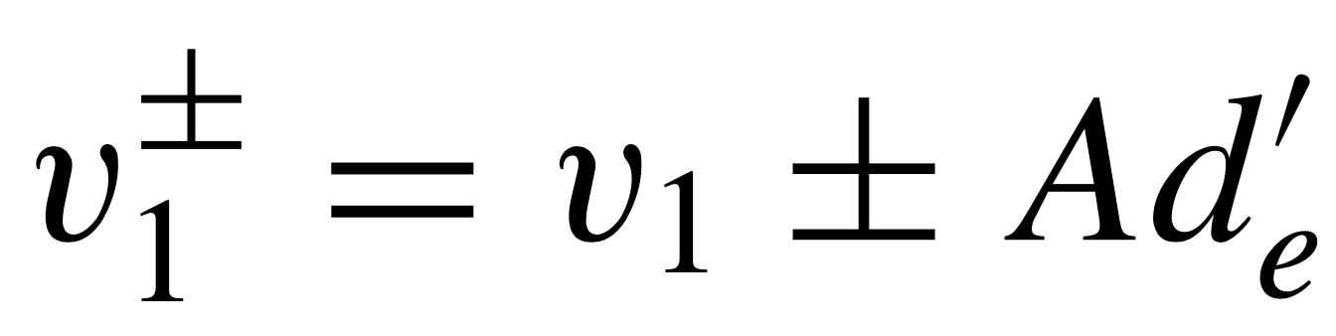
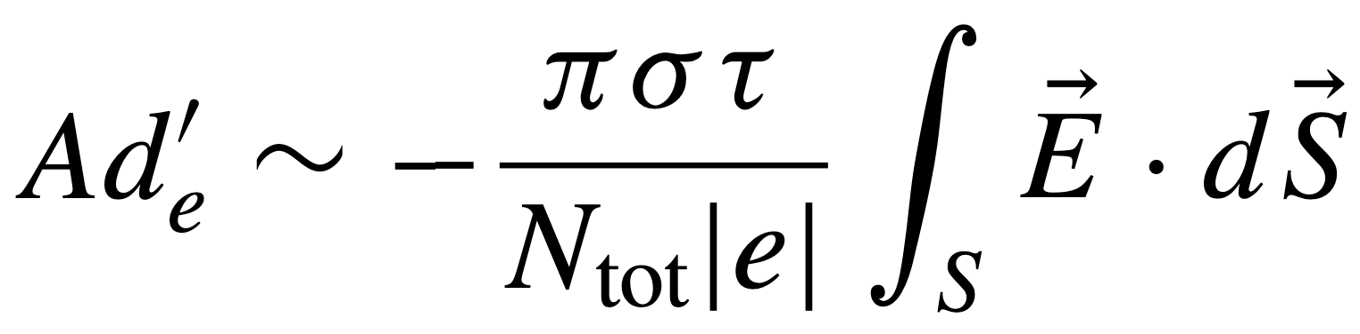
Probe E Field in Cu + Au Collisions
Asymmetric collisions (Cu+Au) create in-plane E fields.
Charge-dependence of v1
Hirono, Hongo and Hirano, Phys. Rev. C 90, 021903 (2014)
…
Study electric conductivity of medium via Cu+Au collisions

Slide 36

Evidence of the Coulomb Field
Qualitatively agrees with expectation from strong E field
10 times smaller than PHSD which uses a lower value of σ. Probably due to that (anti)quarks not all created when EF is strong ( < 1 fm).
STAR, PRL 118 012301 (2017)
Study electric conductivity of medium via Cu+Au collisions

Slide 37

Λ and anti-Λ Polarization
PRC 98 014910 (2018)
PRC 98 014910 (2018)
Challenging to see the B effect at later stage

Slide 38


Λ and anti-Λ Polarization
$$P_{\overline{Λ}}−P_{Λ}=−2\frac{μ_{Λ}B}{T}$$
STAR, PRC 108 014910 (2023)
Challenging to see the B effect at later stage

Slide 39


EM field : Hall, Faraday and Coulomb Effect
Hall effect (Lorentz force) and Faraday + Coulomb effect compete each other.
Hall effect is more relevant for heavy quarks at early stage.
Calculations indicate Faraday + Coulomb effect dominate over Hall effect for light hadrons.
Faraday induction and
Coulomb effect
Hall effect
$$⦿ \vec{B}$$
Gursoy, Kharzeev and Rajagopal, PRC 89 054905 (2014)
S.K. Das et al., PLB 768 260 (2017)
Umut Gursoy, et al., PRC 98 055201 (2018)
K. Nakamura et. al., PRC 107 034912 (2023)
K. Nakamura et. Al., PRC 107 014901 (2023)

Slide 40

Transported Quarks
Dunlop, Lisa and Sorensen, PRC 84 044914 (2011)
Guo, Liu and Tang, PRC 86 044901 (2012)
Nayak, Shi, Xu and Lin, PRC 100 054903 (2019)
P. Bozek, PRC 106 L061901 (2022)
Transported quarks carry information from incident nucleons, causing v1 splitting.

Slide 41










Interplay between Effects
d(v1⁺-v1⁻)/dy : Hall ⇧ transported quark ⇧ Faraday ⇩ Coulomb ⇩
(Heavy quarks)
(Light quarks)
Faraday + Coulomb > Hall
For proton and kaon
Transported quark effect :
$$p :uud$$
v1 slope difference between protons and antiprotons:
sign change as a function of centrality.
Similar pattern expected for kaons.
No sign change expected for pions.
$$\overline{p} :\overline{u}\overline{u}\overline{d}$$
$$v_{1}^{p} >{ v}_{1}^{\overline{p}} at η>0$$
$$K^{+}:u\overline{s}$$
$$v_{1}^{K^{+}}>v_{1}^{K^{−}} at η>0$$
$$K^{−}:\overline{u}s$$
$$π^{+}:u\overline{d}$$
$$v_{1}^{π^{+}}<v_{1}^{π^{−}} at η>0$$
$$π^{−}:\overline{u}d$$
(#d > #u, Au neutron rich)

Slide 42
Sign Change in Δ(dv1/dy)
STAR, PRX 14 011028 (2024)
Sign change in Δ(dv1/dy) occurs for both protons and kaons.
The magnitudes follow the expected ordering between protons and kaons.
Pion results are either consistent with zero or negative, as expected.
The electric conductivity of QGP used in iEBY-VISHNU+EM model lies within a plausible interval.
(σ=0.023 fm⁻¹)
Strong evidence in favor of EM field at work in QGP

Slide 43
Summary
The study of global spin properties in extreme conditions has opened new promising research directions. Recent findings also highlight the significant role of magnetic fields at RHIC, deepening our understanding of spin dynamics.
As is typical in emerging fields, numerous unanswered questions beckon, offering fertile ground for future investigation and inquiry.

Slide 44
Backup Slides

Slide 45


v1 Splitting of D Mesons
ALICE, PRL 125 022301 (2020)
Large v1 and large v1 splitting
STAR, PRL 123 162301 (2019)
Consistent with Hall effect dominating for heavy quarks.

Slide 46

EM Field and Phase Diagram
M Elia, L. Maio, F. Sanfilippo and A. Stanzione, PRD 105 034511 (2022)
QCD phase diagram under strong EM field.

