Slide 1






Spin transport in condensed matter from a quantum kinetic perspective
Thierry Valet
ECT* Workshop – Trento 09/18/2024

Slide 2


acknowledgements
General Theory
Roberto Raimondi
Dipartimento di Matematica e Fisica, Università Roma Tre, Italy
Application to SOT theory
Libor Vojacek, Mairbek Chshiev
SPINTEC, Université Grenoble Alpes, CEA, CNRS, Grenoble INP, France
Jing Li
Université Grenoble Alpes, CEA, LETI, France
Sergey Nikolaev
Osaka university, Graduate school of engineering science, Osaka, Japan
Application to orbitronics
Henri Jaffrès, Vincent Cros, Armando Pezo
Laboratoire Albert Fert, CNRS, Thales,
Université Paris Saclay, France
Many important and useful discussions with
A. Fert (CNRS/LAF), X. Waintal (UGA/PHELIQS),
F. Piéchon (UPS/CNRS/LPS)
Financial support

Slide 3
OUTLINE
Solid state spintronics and beyond - Motivations
Non relativistic electron QKT in solids - General formalism
Linear response in presence of weak and dilute disorder
Interplay of quantum geometry and disorder e.g. for intrinsic Spin-Orbit Torque (SOT)
Importance of gradient induced quantum coherences e.g. for orbital accumulation
Conclusion and perspectives
ECT* Workshop – T. Valet - September 2024
NR Electron QKT in Solids – 3

Slide 4

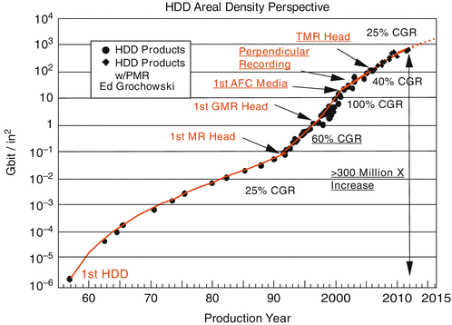

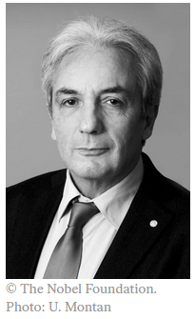
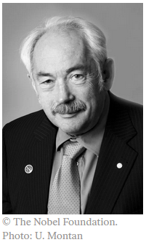
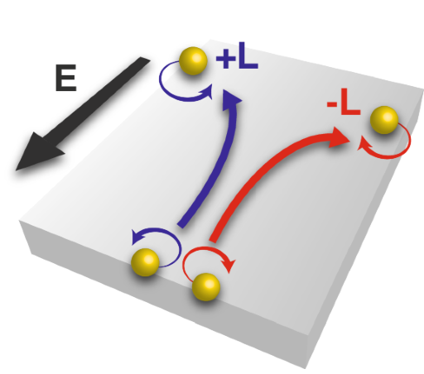
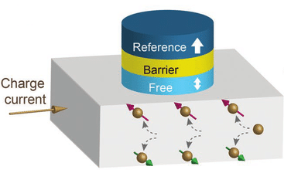
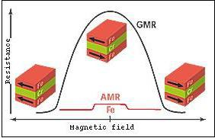
SOLID STATE SPINTRONICS AND BEYOND
Hard Disk Drives – GMR, TMR…
Albert Fert (1938-) Peter Grünberg (1939-2018)
Non volatile solid state memories – MRAM, STT, SOT…Orbitronics

Slide 5
Motivations
1
We are entering the “end of roadmap” / “more than Moore” era, while there is a rapidly expanding universe of “quantum materials”. Understanding the dynamics, and taking advantage of, additional internal degrees of freedom (DOFs) such as spin and orbital character of charge carriers is of both fundamental and practical interest. These internal DOFs are inescapably quantum in nature.
2
Despite the general downscaling (in size) and upscaling (in frequencies), a broad range of newly explored effects and contemplated new devices will continue to “live” in the semiclassical realm as far as the external DOFs of the charge carriers i.e., position and momentum, and the “probing” external perturbations i.e., EM fields, elastic stresses, etc, are concerned.
3
Due to the mesoscopic size of many experimental devices of interest, a full quantum modeling is still often out of reach. Kinetic theory is the ideal approach to keep the treatment of the internal DOFs fully quantum, while filtering out the external coherences…however:
  We need systematicaly derived kinetic equations as a controlled approximation of out-of-equilibrium quantum field theory in a multiband context in presence of external perturbations, in all generality and with manifest gauge invariance,
  The interplay between quantum geometry and disorder effects needs to be captured.

Slide 6
Non relativisitic electron qkt in solids general formalism
ECT* Workshop – T. Valet - September 2024
NR Electron QKT in Solids – 6

Slide 7

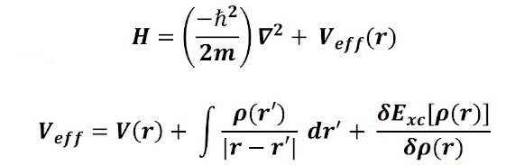
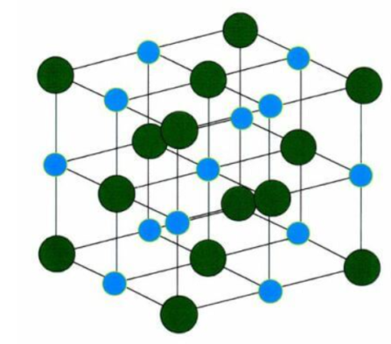
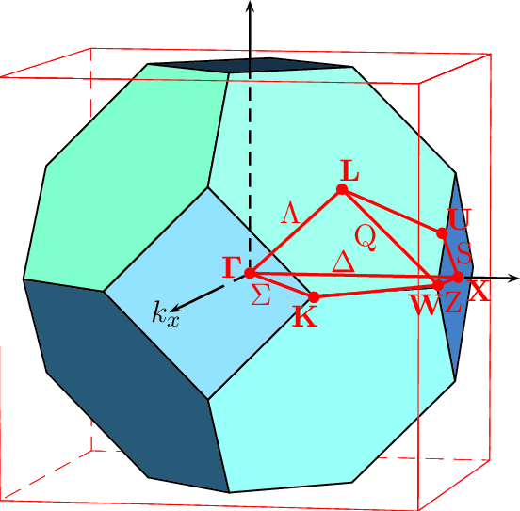
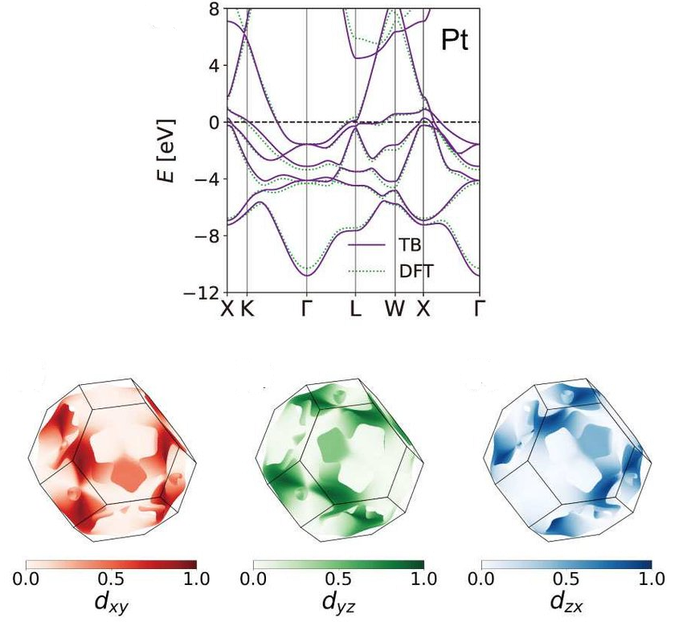
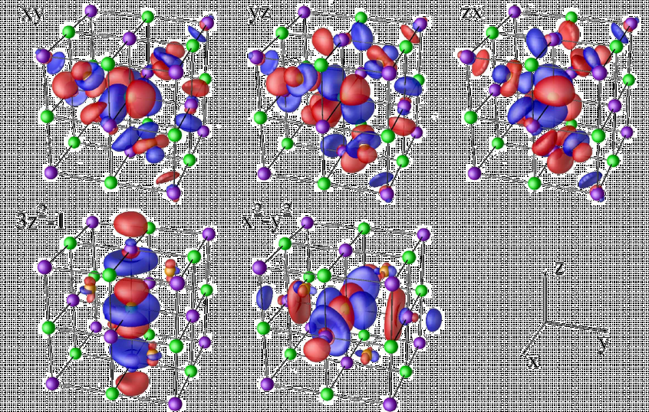
Electrons in solids as a gas of Non (or weakly) relativistic and weakly interacting quasiparticles near the fermi surface
Wannier tight-binding (TB)
Hamiltonian matrix
acting in the Hilbert space of dimension N spanned by the chosen AO basis
dependent on the crystal canonical pseudo-momentum k
Fermi liquid theory, Khon-Sham theory…
Non interacting quasi-particles in a periodic self-consistent potential
Periodic atomic structure
Complex quantum geometry in periodic momentum space
(low energy approximation)
DFT- Wannier atomic orbital (AO) basis
e.g. VASP + Wannier90

Slide 8
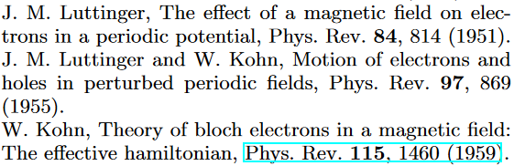
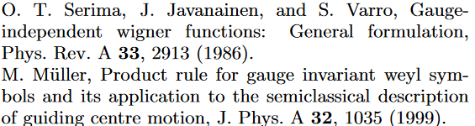





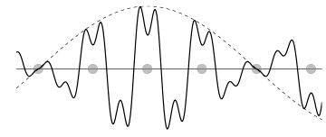

Minimaly coupled envelope WF hamiltonian
Infinite & periodic
crystal
Smoothly disturbed
crystal under
smooth EM field excitation
U(1) gauge invariant
Weyl quantization
“smooth”
perturbation
eg., time and space
dependent texture,
elastic deformation, etc.
minimal
coupling
DFT-Wannier TB
energy matrix
kinetic pseudo-momentum
U(1) gauge invariant
Wigner transform
EM gauge covariant
derivative
Schrödinger equations for the N-component envelope wave functions
e.g. 3s(↑,↓), 3p_{(x,y,z)}(↑,↓), 3d_{(xy,xz,yz,x2-y2,3z2-1)} (↑,↓), 3s(↑,↓) → N=20

Slide 9
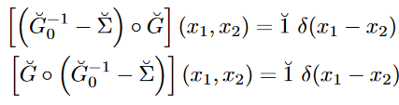

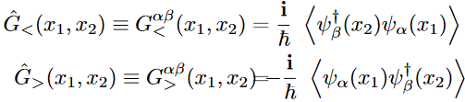

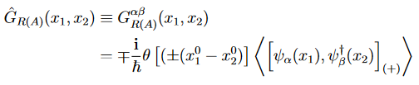




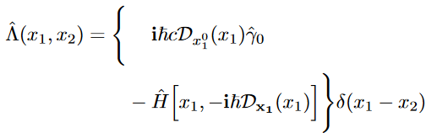



Non relativistic Schwinger-keldysh theory
promoted to field operator
in the Heisenberg picture
L&R Dyson’s equations in differential form
One particle 2-points real time Green’s functions
identity
“Lagrangian”
self-energy
Keldysh“space”
Lagrangian kernel for the N-component Schrödinger field

Slide 10
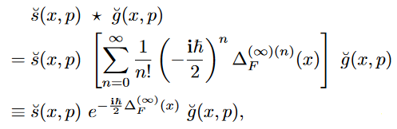

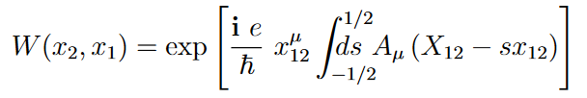


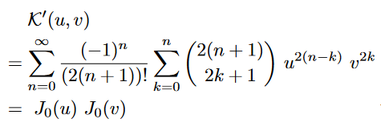
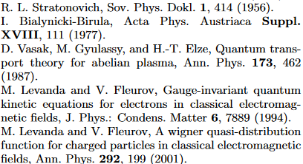
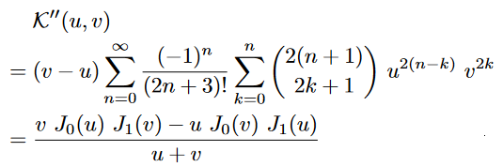


GAUGE invariant keldysh theory in phase space (1)
U(1) Gauge invariant Wigner transformation
U(1) gauge link aka Wilson loop
U(1) Gauge invariant Moyal product aka “star” product
Y. Hidaka, S. Pu, Q. Wang, D.-L. Yang,
Foundations and applications of quantum kinetic theory,
Prog. Part. Nucl. Phys.,127, 103989 (2022)
T. Valet (2020), unpublished

Slide 11








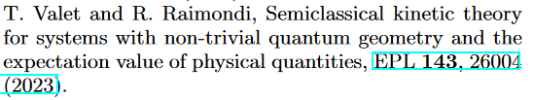
GAUGE invariant keldysh theory in phase space (2)
(WT L-R Dyson equations)
Quantum Kinetic Equation
(WT L+R Dyson equations)
Constraint Equation
“Lagrangian” function
spectral function
“linewidth”
T. Valet and R. Raimondi, Quantum kinetic theory of the linear response for weakly disordered multiband systems, in preparation, (2024).

Slide 12






Quantum geometric decomposition
Projectors
(unique) quantum geometric decomposition
Manifest SU(N) gauge invariance
(w_{n}=1)
: vector of the traceless Hermitian generators of the su(N) algebra, e.g. generalized Gell-Mann matrices
This parallels the decomposition over the generators of the Clifford algebra in relativistic kinetic theory

Slide 13











Clean limit(1) – semiclassical expansion
(QKE)
(CE)
“gradient” expansion of the star product
gauge invariant Poisson bracket
gauge invariant derivative
Leading order quantum corrections
Domain of validity
adiabicity conditions !
Quasiparticle kinetics
<

Slide 14
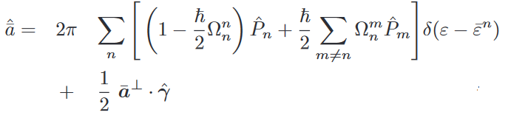



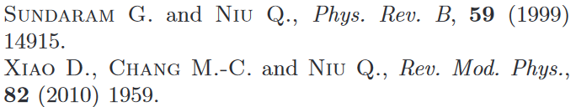









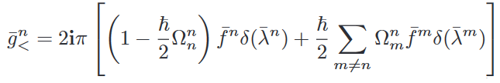
Clean limit(2) – quantum geometric corrections to the spectral structure and on shell condition(non degenerate case)
spectral function
correction to the quasiparticle energies
(e.g. orbital magnetic moment)
:
generalized Berry curvature in extended phase space
(EM tensor as a deformation parameter of the quantum geometry)
spectral weight transfers (NOT DOS correction)
Special case : BC in momentum space only
modified on-shell condition

Slide 15





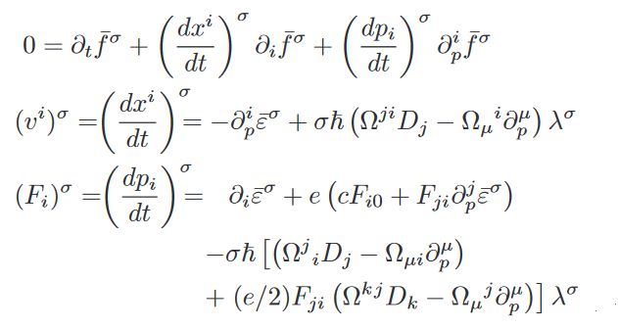
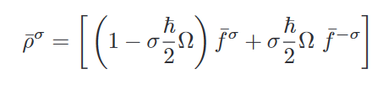
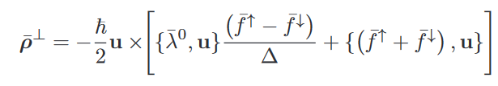
Clean limit(3) – Vlasov equation with leading order quantum corrections and interband quantum coherences (N=2 – non degenerate case)
Intraband transport of quasiparticles
Interband quantum coherences
slave DOFs

Slide 16

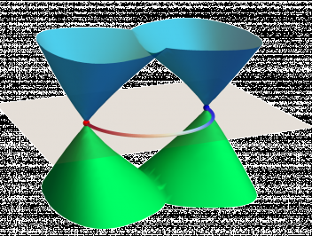
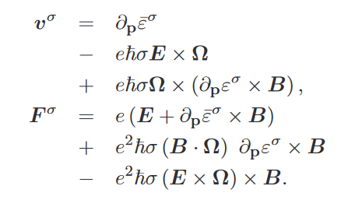

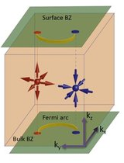
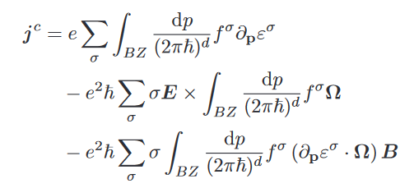
Clean limit(4) – Triangle anomaly, AHE, CME…
Special case
BC in momentum space only
Weyl semimetals
Triangle anomaly
Intrinsic AHE
CME

Slide 17
Linear response in presence of weak and dilute disorder
ECT* Workshop – T. Valet - September 2024
NR Electron QKT in Solids – 17

Slide 18
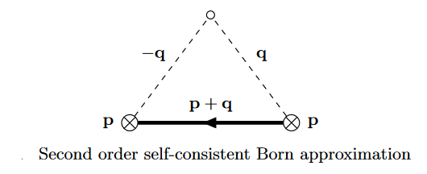


Weak and dilute static disorder
Can be easily extended: T matrix, SOC scattering…
Weak and dilute regime – vanishing disorder broadening

Slide 19


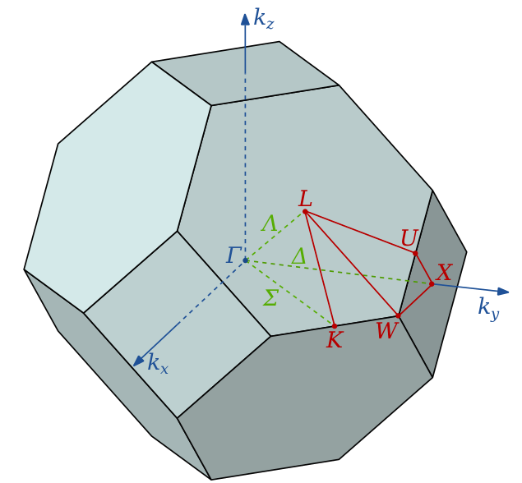
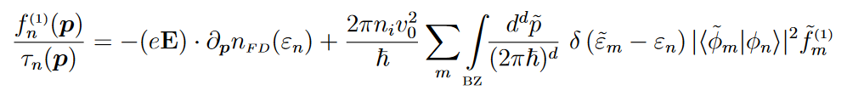

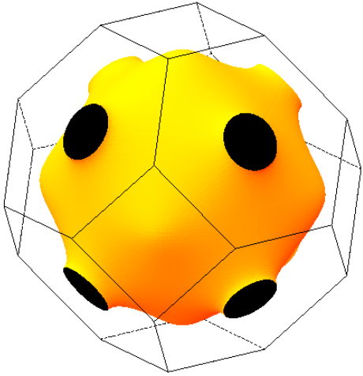


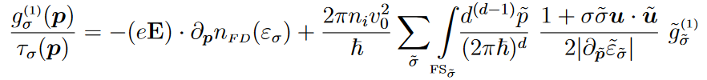

Intraband response
Quasi-uniform and quasi-static electric field
No magnetic field
Hamiltonian matrix dependent only on momentum
Nondegenerate bands almost everywhere in the BZ
intraband response
Linear Boltzmann equation
advection
driving term
quantum geometry
(Quasi) static and uniform case
relaxation time approximation
relaxation time
in-scattering
2-bands case - Bloch vector
T = 0

Slide 20

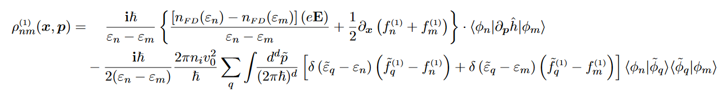

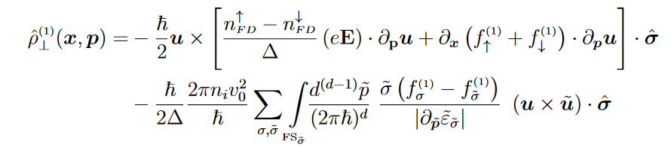

Interband response
Quasi-uniform and constant electric field
No magnetic field
Hamiltonian matrix dependent only on momentum
Nondegenerate bands almost everywhere
interband response
The quantum coherences between bands are slave variables
1
2
3
1
The “standard” intrinsic response
2
New !!! Gradient induced coherence !
3
New !!! Leading disorder correction !
2-bands case – T= 0
T. Valet and R. Raimondi, Quantum kinetic theory of the linear response for weakly disordered multiband systems, in preparation, (2024).

Slide 21
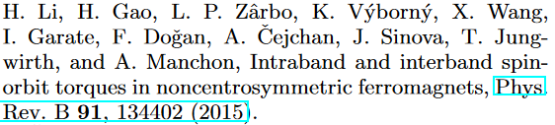
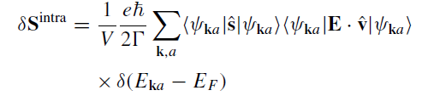
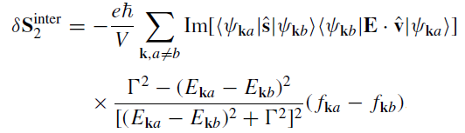
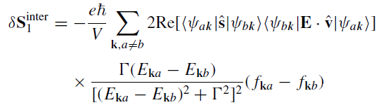

Relation to kubo-streda
1
The Kubo formula is of course formally exact in all generality !
2
But, more often than not, it is the Kubo-Streda formula at the
constant broadening level of approximation which is used in practice !
Incomplete ! No vertex correction !
Only equivalent to the BE solution at
the isotropic RTA level !
Correct, but only in the clean limit !
Wrong !!! No vertex correction !
3
For an infinite crystal, under the influence of a uniform and constant electric field, and in the weak
disorder limit, our kinetic formalism is exactly equivalent to the Kubo linear response theory
with vertex corrections included at the ladder diagrams level ! But often much “easier” in practice …
4
Under “mild” spatial inhomogeneities, our kinetic formalism capture the leading gradient corrections
without the need of real space quantum transport calculations !

Slide 22
Quantum geometry and disorder interplay e.G. SOT in vdw ferromagnets
ECT* Workshop – T. Valet - September 2024
NR Electron QKT in Solids – 22

Slide 23
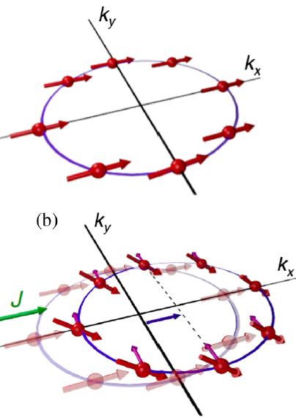


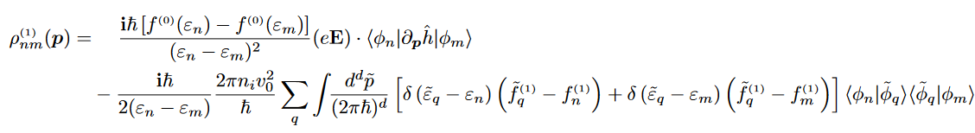
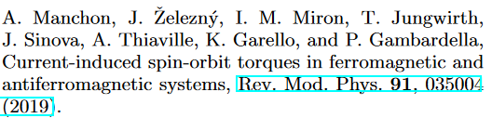
QKT of Spin-orbit torque
LLG equation
Helmann-Feynman theorem
broken TR and I
T. Valet, S. Nikolaev, J. Li, L. Vojacek, R. Raimondi and M. Chshiev, Importance of disorder in the spin-orbit torque, in preparation, (2024).

Slide 24
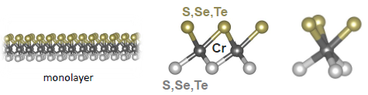
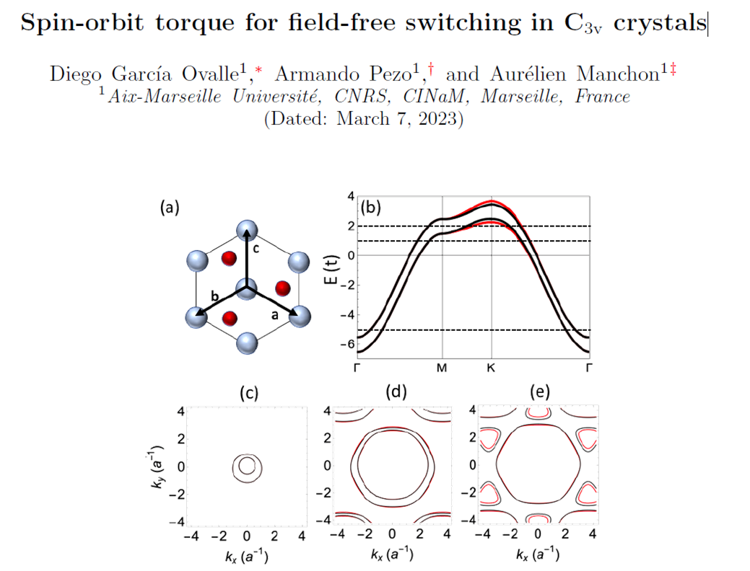


Torque in c3v vdW ferromagnet
Ferromagnetic order in 2D vdW system
SOT switching has been observed
Trigonal/hexagonal symmetry -> new SOT
Potential for field free switching

Slide 25











Model Hamiltonian
t = 1 eV
J_{e} = 0.5 eV
t_{R} = 0.1 eV
t_{R3} = 0.05 eV
The unit cell in real space is spanned by the basis vectors {a,-b}
Casting of the Hamiltonian in “canonical” form
a x b*
Γ
a x a*

Slide 26




Numerical solution of the Boltzmann equation
M
E
T. Valet, S. Nikolaev, J. Li, L. Vojacek, R. Raimondi and M. Chshiev, Importance of disorder in the spin-orbit torque, in preparation, (2024).

Slide 27




Intraband contribution to the torque
h_{x} : black
h_{y}: blue
h_{z} : red
E_{F} = -5 eV
From Ovalle(2023)
T. Valet, S. Nikolaev, J. Li, L. Vojacek, R. Raimondi and M. Chshiev, Importance of disorder in the spin-orbit torque, in preparation, (2024).
E_{F} = 2 eV
Profound modification of the intraband SOT by the vertex corrections beyond RTA !

Slide 28




Interband contributions to the torque
While there is agreement on the “purely intrinsic” contribution, we observe a complete suppression of the intrinsic “normal” Rashba torque by the leading disorder correction !
E_{F} = -5 eV
hx : black
hy: blue
hz : red
T. Valet, S. Nikolaev, J. Li, L. Vojacek, R. Raimondi and M. Chshiev, Importance of disorder in the spin-orbit torque, in preparation, (2024).
From Ovalle(2023)
E_{F} = 2 eV
We also observe a significant quantitative impact of a proper accounting of disorder effects on the sought after “3m” torque !

Slide 29
Gradient induced quantum coherences E.G. edge orbital accumulation
ECT* Workshop – T. Valet - September 2024
NR Electron QKT in Solids – 29

Slide 30



Considered experiments
l_{O} = 6.6 ± 0.6 nm

Slide 31








Minimal model hamiltonian
Archetypal R-T orbital texture
For positive chemical potential, only the electron band crosses the Fermi level near the Gamma point.
: OAM operator

Slide 32










“hydrodynamic” (approximate) solution to the be

Slide 33

EDGE OrbitaL accumulation (1)
k_{y}
: OAM operator
E
k_{x}
W

Slide 34


Edge Orbital accumulation (2)
Orbital accumulation found at the edge !
Its source is the quantum coherence induced by the charge current gradient !
The spatial dependence follows what you expect from a diffusion equation, but what diffuses is linear momentum !
T. Valet and R. Raimondi, Quantum kinetic theory of orbital accumulation, in preparation (2024)
See also:
A. Shitade and G. Tatara, Phys. Rev. B 105, L201202 (2022)
M. Rang and P. Kelly, arxiv:2403.06827
J. Voss, I.A. Ado and M. Titov, arxiv:2405.11979

Slide 35

Conclusions and perspectives
1
We are developing a general NR kinetic formalism which :
  Is derived as a controlled approximation of Keldysh theory in the weak static disorder limit, in all generality for a N band low energy Hamiltonian matrix,
  Is exactly equivalent to Kubo formula in the linear response regime and weak disorder limit, with full account for vertex corrections at the ladder diagram level…but can also easily capture gradient effects !
2
There are multiple obvious correspondences with relativistic quantum kinetic theory as developed in the HE physics community. We are eager to explore the opportunity for collaborations (non linear regime with scattering and general EM field, degeneracy…)
3
At the numerical level, we are also engaged in the development of a new generation of (generalized) Boltzmann equation solvers
From http://www.phys.ufl.edu/fermisurface

Slide 36

THANK YOU !
Thierry Valet
ECT* Workshop – T. Valet - September 2024
NR Electron QKT in Solids – 36

