Slide 1
Anisotropic linear waves and breakdown of the momentum expansion in spin magnetohydrodynamics
Zhe Fang, KH, Jin Hu (Fuzhou), To appear in PRD [2402.18601]; [2409.07096]
Cf. KH, X.-G. Huang, M. Hongo, 2207.12794 for a review.
Koichi Hattori
Zhejiang Univ.
Spin and Quantum Features of QCD Plasma, Sep. 16-20, 2024

Slide 2


Table of contents
B
1. The first-order magnetohydrodynamics (MHD)
Formulation
Solutions for linearized MHD with full anisotropy
→ Critical angle where the momentum exp. breaks down
2. The first-order spin MHD
Formulation
Solutions linearized spin MHD

Slide 3
Formulating relativistic MHD
KH, Hirono, Yee, Yin (2017)
KH, Hongo, Huang (2022) for a review
Hongo, KH (2020) for a QFT approach

Slide 4
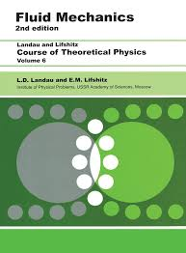
Derivation of constitutive equations
Statistical description of underlying theory
Weak coupling
Strong coupling
Kinetic theory
Operator method (QFT)
Zubarev, Becattini, Hayata-Hidaka-Noumi-Hongo,
Hongo-KH (for MHD), Hongo-Huang-Stephanov-Yee (for spin)
Grad, Israel-Stewart,
Frankfurt group
Dynamics of averaged charges
(Course graining)
Thermodynamics
Constraints on constitutive eqs. from the 2nd law aka the “entropy-current analysis”
Hydrodynamics

Slide 5
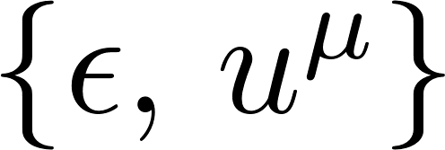
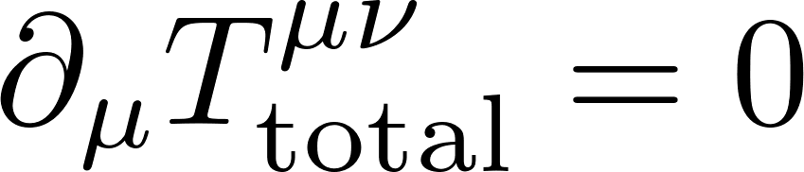

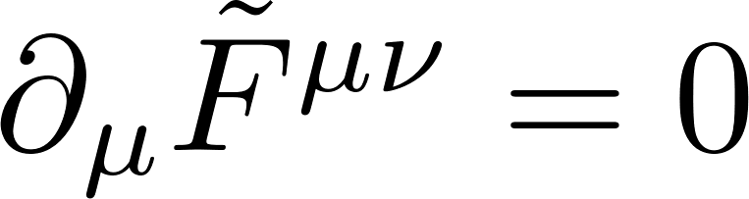
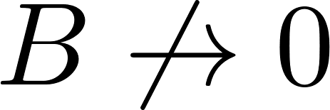
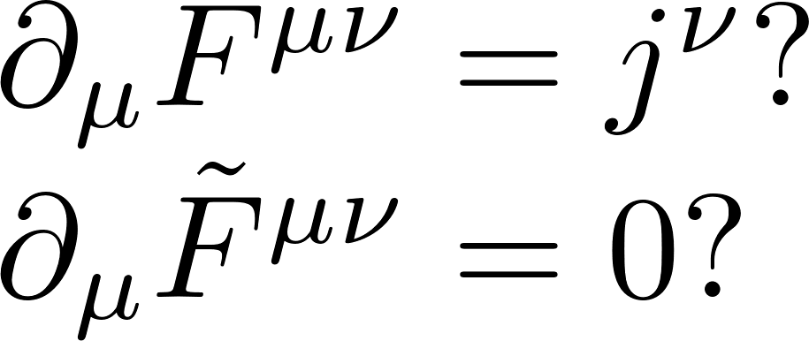
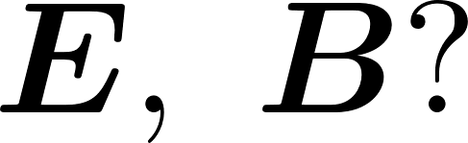

Dynamics of conserved charges
Hydrodynamic variables
Conservation laws
{Total energy density, fluid flow velocity}
Electromagnetism
A static charge distribution does not screen the B-field.
(No “magnetic Coulomb field” without a magnetic monopole).
Conservation of magnetic flux.
Electromagnetism
E-field is screened by a static charge distribution, i.e., the Debye screening effect.
+
-
E(u, B) and j(u, B) are induced at off-equilibrium

Slide 6
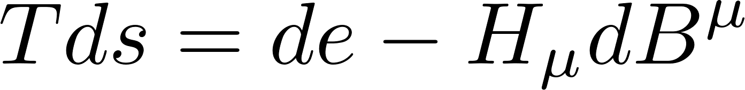
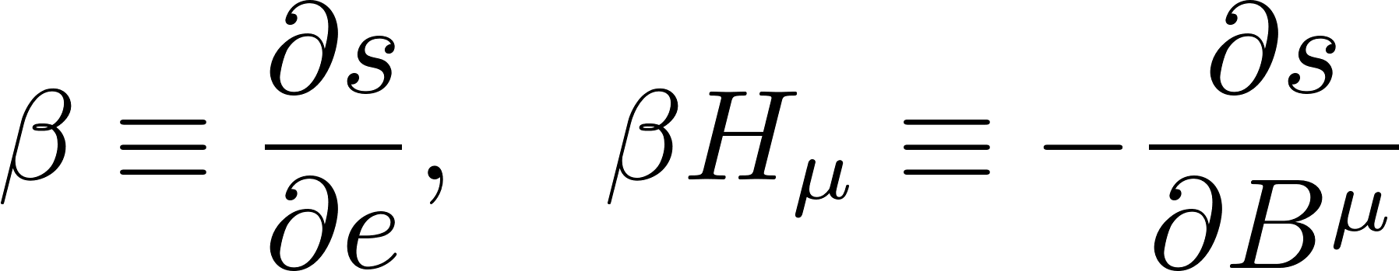
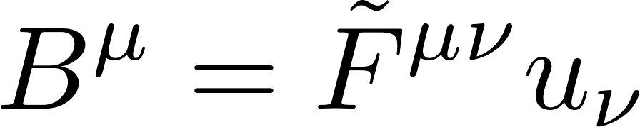
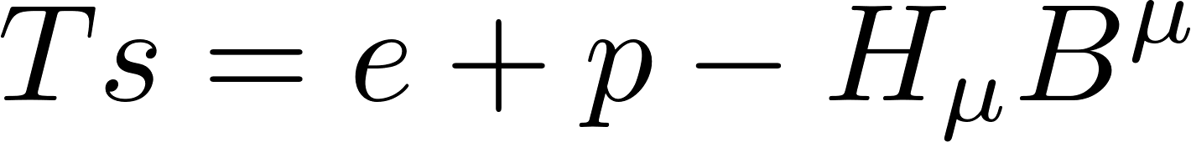
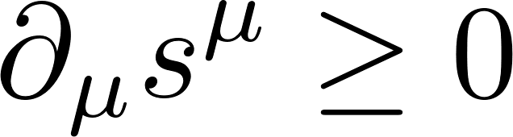
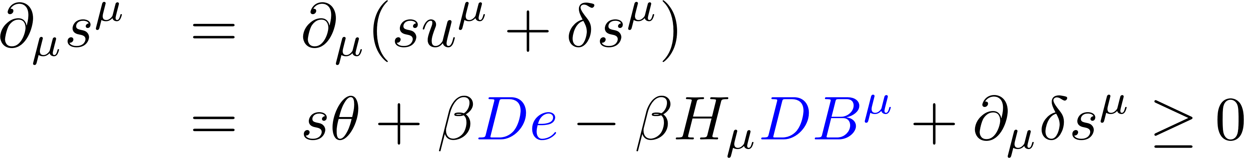
Thermodynamics
1st law
Energy density Magnetic flux
Thermodynamic conjugates (Lagrange multipliers)
Temperature Magnetic field
2nd law
Connection to the equations of motion.
→ Constraints on the constitutive eqs.

Slide 7
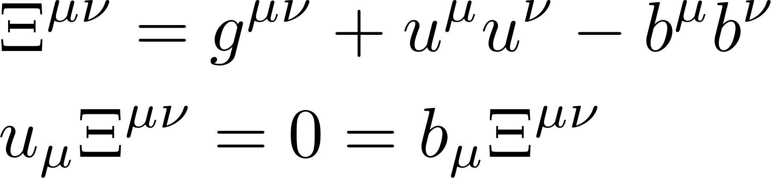
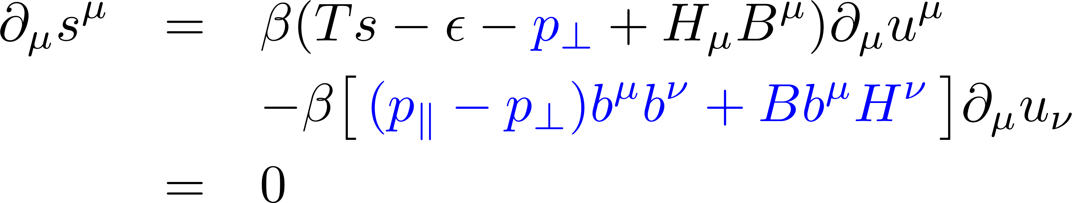

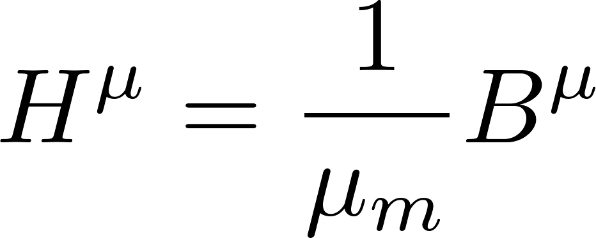
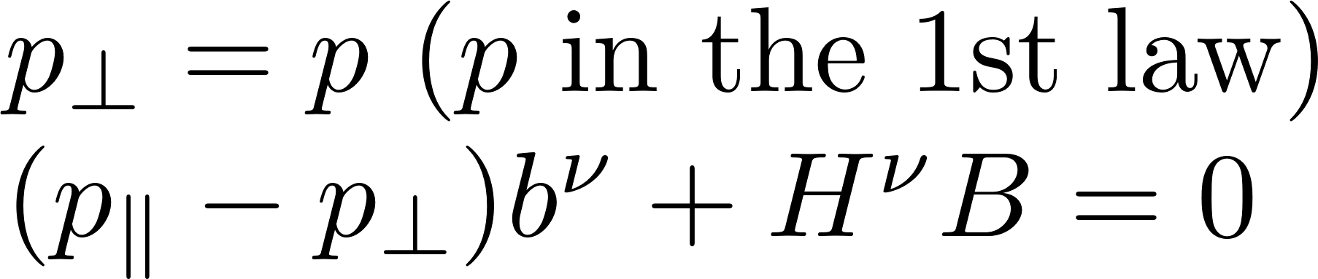

Leading-order constitutive eq.
Available symmetric tensor

Slide 8
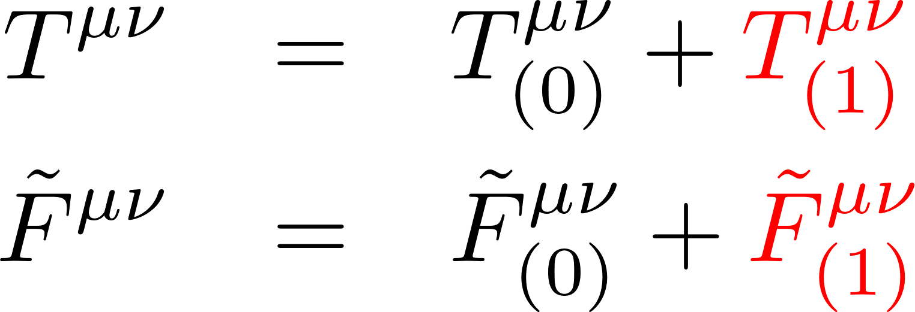
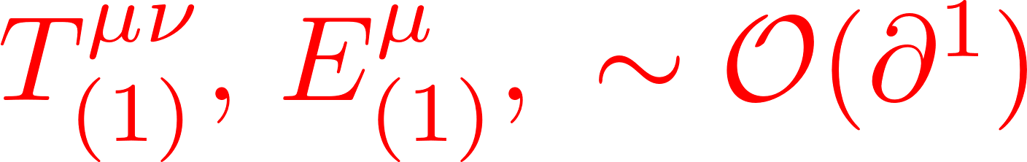
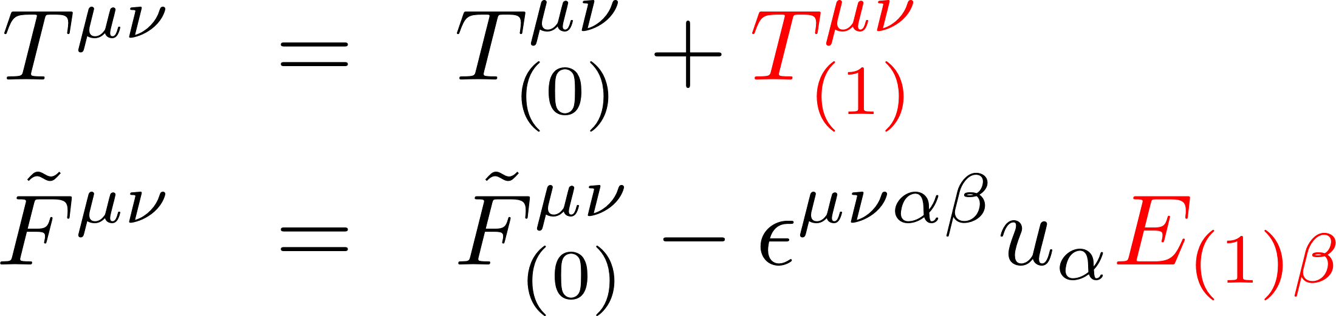
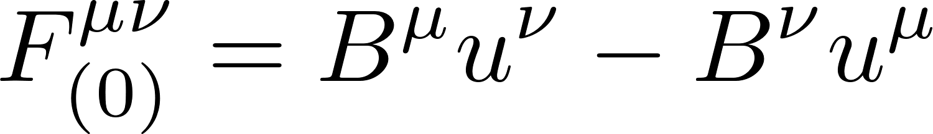
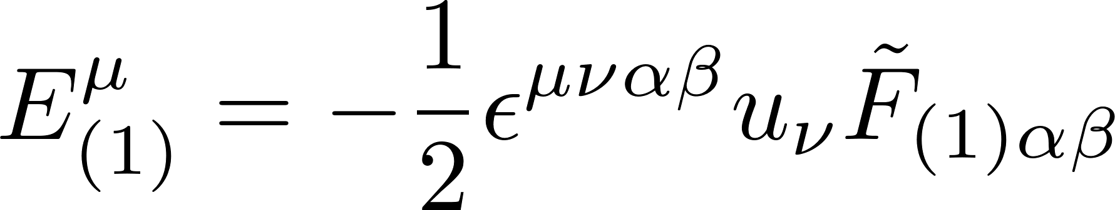
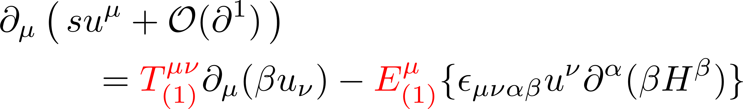
First-order constitutive eqs
Computing the entropy current,
Each term should take a semi-positive value.

Slide 9
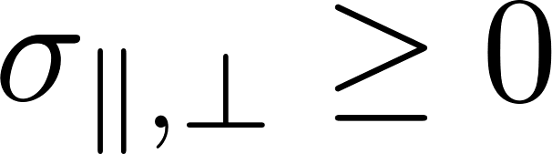
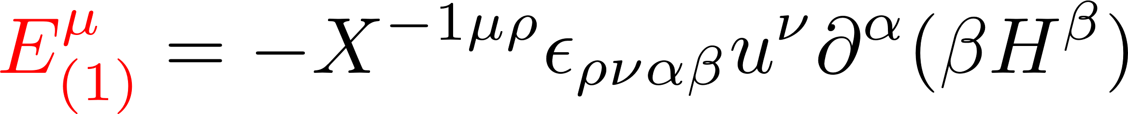
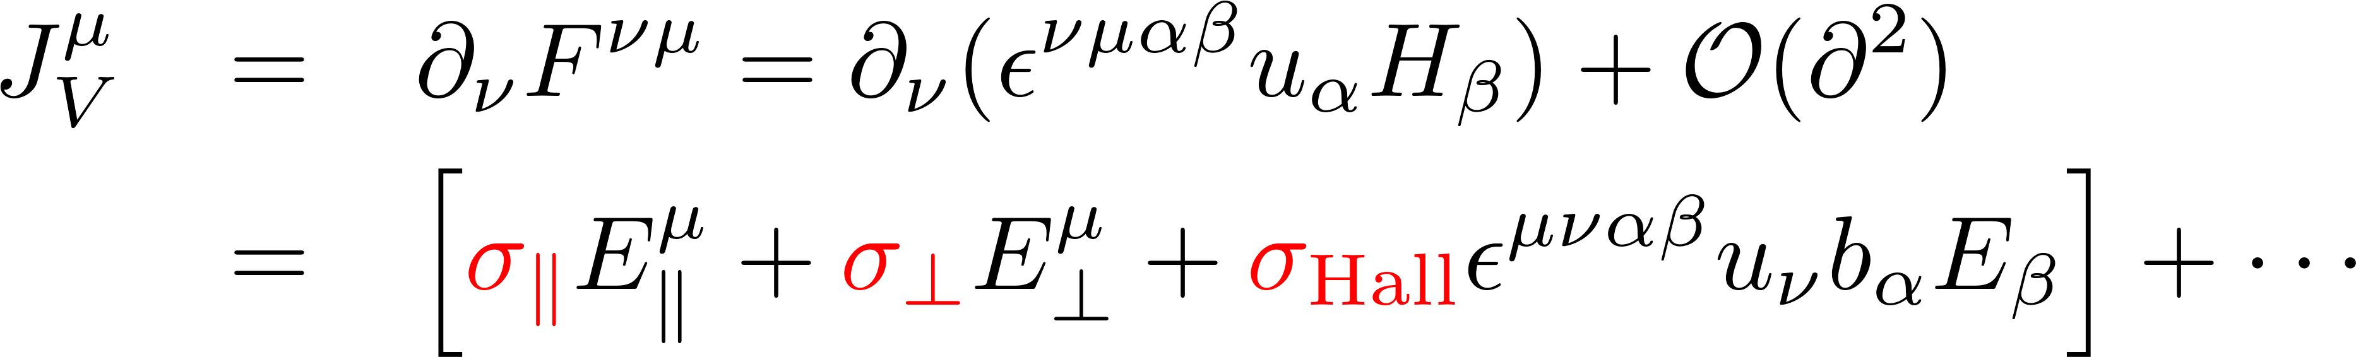
Induced electric fields and currents
Therefore, we get a “constitutive eq.” of the E-field:
KH, Hirono, Yee, Yin
The relation to the current is given by the Maxwell eq:

Slide 10
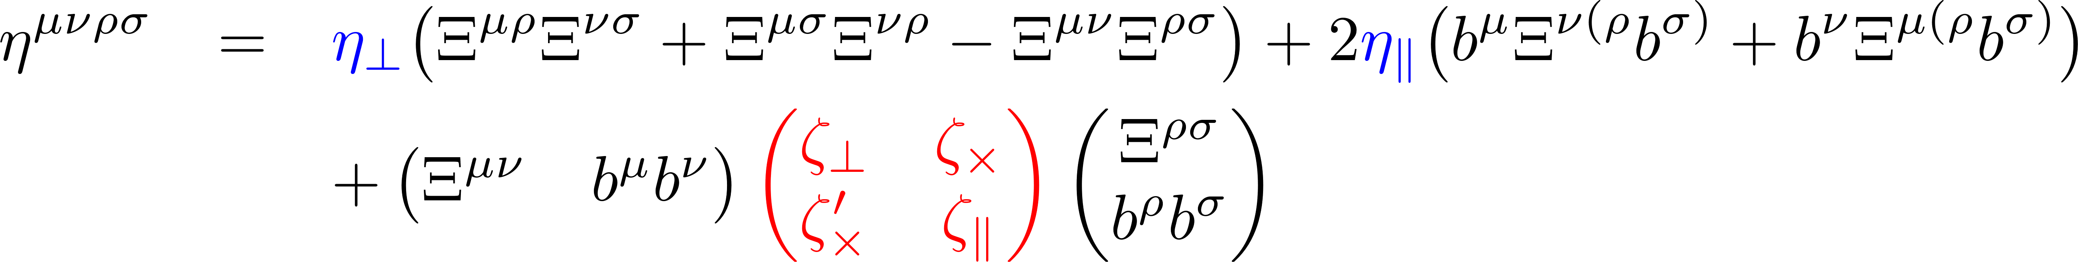
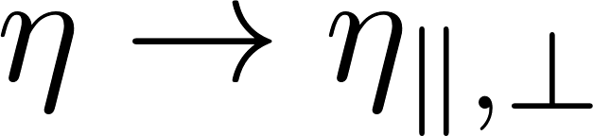
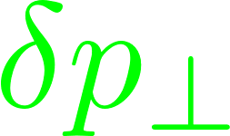

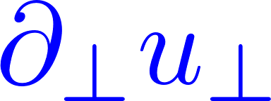
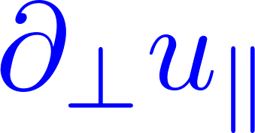
Anisotropic viscosities
2 shear viscosities
3 bulk viscosities
Splitting of shear viscosity
Splitting + a cross bulk viscosity
B
B

Slide 11
MHD from the global symmetries of QED
We argued that E is screened in the equilibrium, but B is not.
MHD = fluid dynamics + magnetic flux
Q1: Can we understand MHD from any symmetry
of the underlying microscopic theory?
Q2: How is MHD derived from a microscopic theory?
Grozdanov et al.
Hongo, KH
Fluxes as conserved currents
Gaiotto et al.
1-form symmetry
Conventional (0-form) symmetry
Conservation of 1D objects
through a surface
Conservation of point-like
charges in a box
“MHD from QED” a talk at “Spin and Hydrodynamics in Relativistic Nuclear Collisions”
(ECT* online, Oct. 5 – 16, 2020)

Slide 12
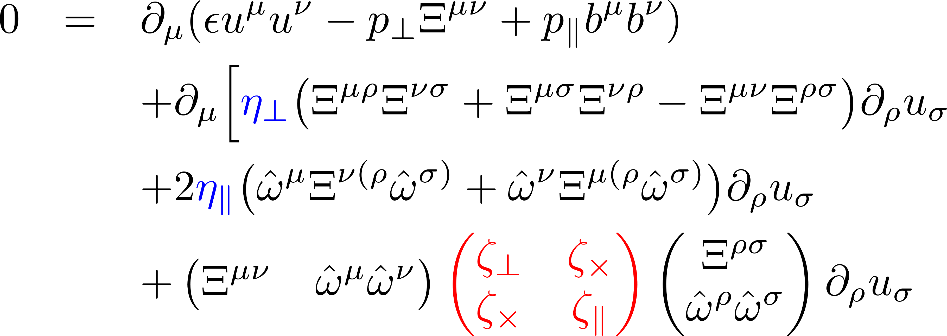
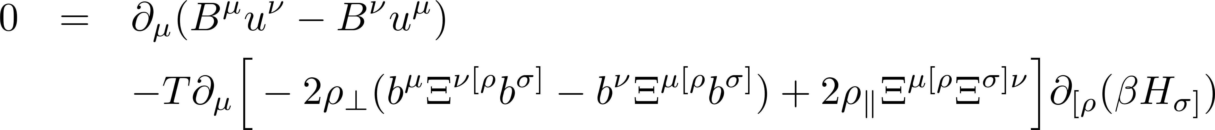
Solving the MHD equations

Slide 13
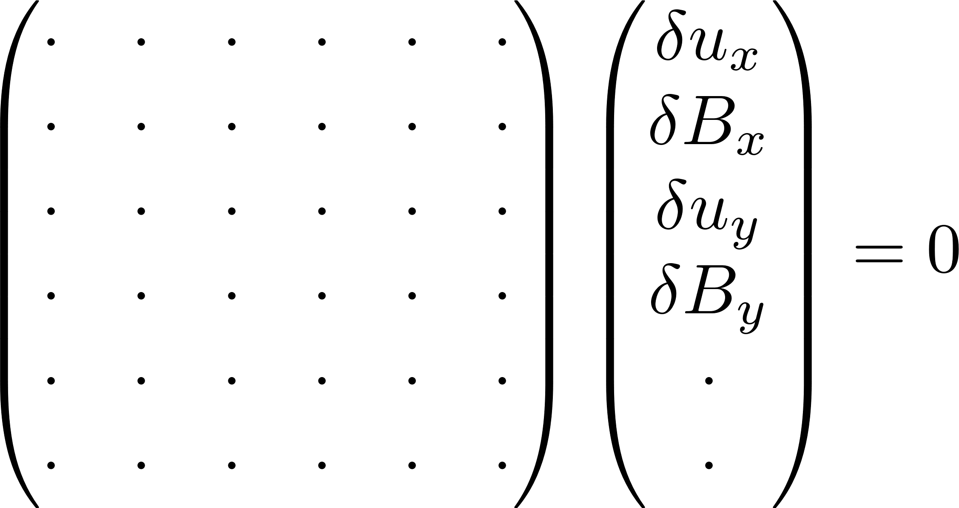
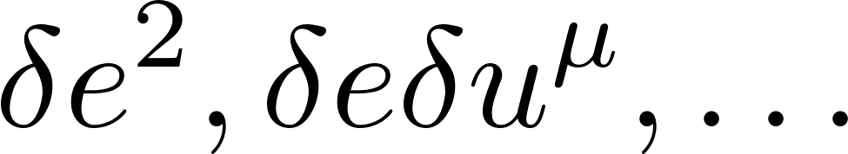
Linear waves with full anisotropy
Linear regime
Nonlinear regime
Linearized equation in a matrix form
Secular equation (det = 0)
Can we diagonalize large matrices with broken spatial symmetries?
We found an analytic algorithm for solution search.
Works for an arbitrary angle. (Solutions only at special angle were known for MHD)
Can be applied to general sets of hydrodynamic equations.
It turns out that the momentum expansion breaks down at a critical angle.
Energy density (1)
Flow velocity (3)
Magnetic field (2)
+
Spin (3)
Resistivities (2)
Viscosities (5)
+
Rotational viscosities (3)
Complete solutions for the first-order MHD were not known.
What can we see with the analytic solutions?

Slide 14
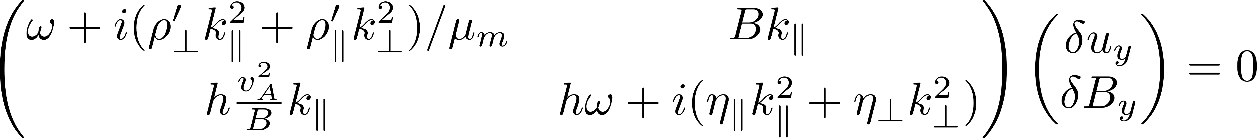

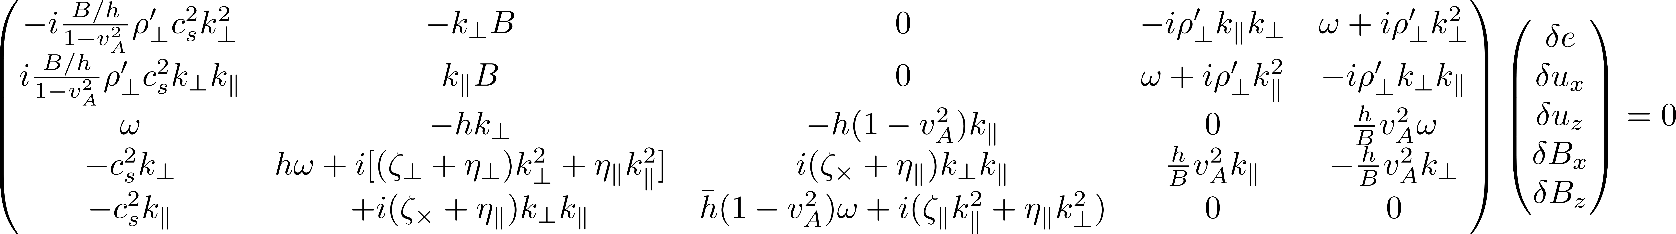
Linearized equations with full anisotropy
2×2 → Alfven waves (transverse)
Linear regime
Nonlinear regime
5×5 → Magneto-sonic waves (longitudinal)
We found an analytic algorithm for solution search.
Works for an arbitrary angle. (Solutions only at special angle were known for MHD)
Can be applied to general sets of hydrodynamic equations.
It turns out that the momentum expansion breaks down at a critical angle.
Large matrices with broken spatial symmetries.
Energy density (1)
Flow velocity (3)
Magnetic field (2)
Spin (3) included later
Resistivities (2)
Viscosities (5)
Rotational viscosities (3) included later

Slide 15
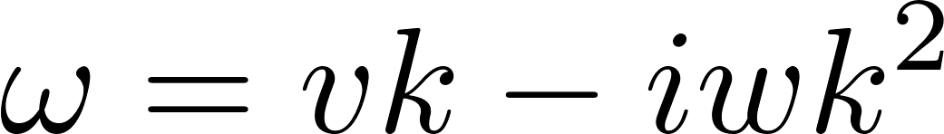
B
We developed a simple analytic algorithm that
Works for an arbitrary angle.
(Solutions were only known at θ = 0, π/2.)
Works on an order-by-order basis in k.
Can be applied to general sets of hydrodynamic equations and higher-order in k.
The phase velocities are subluminal and the dissipative transport coefficients provide damping effects.
It turns out that the momentum expansion breaks down at a critical angle.
Bonus: The analytic solutions tell us that
All the phase velocities are subluminal.
All the imaginary parts act as damping effects
in the fluid rest frame.
However, the small k expansion breaks down for MHD.
0 ≦ v ≦ 1
Im[w] ≧ 0

Slide 16
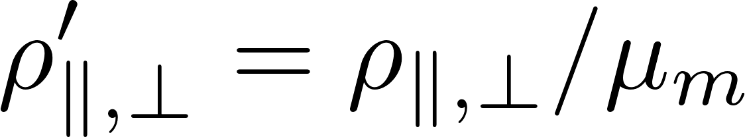
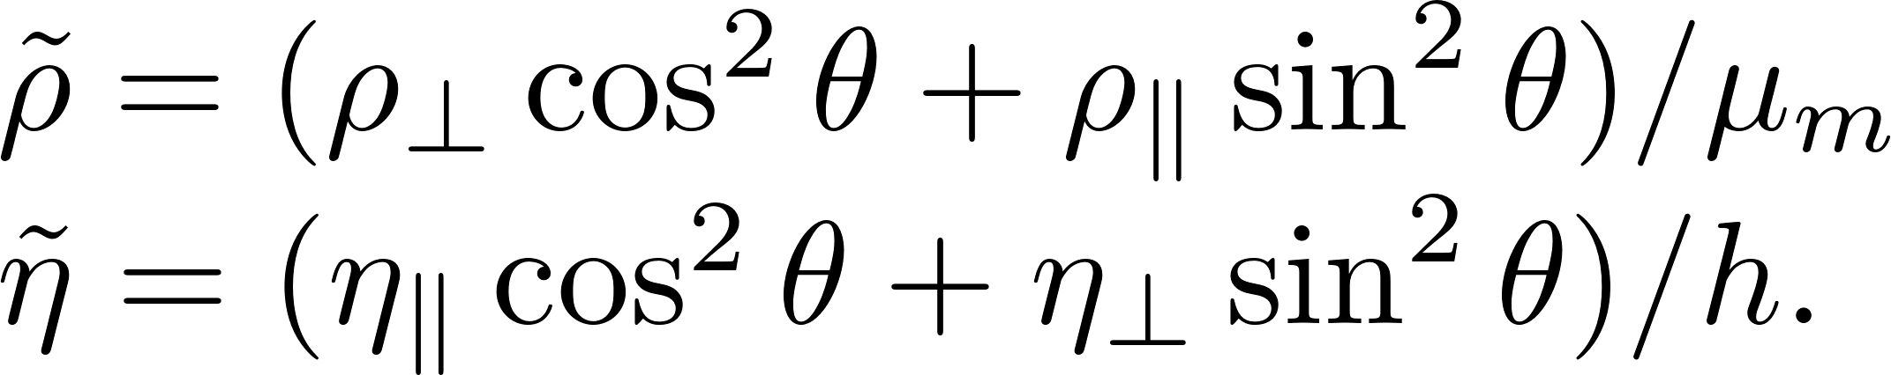
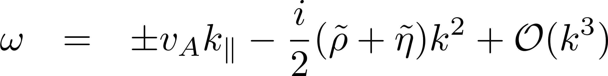
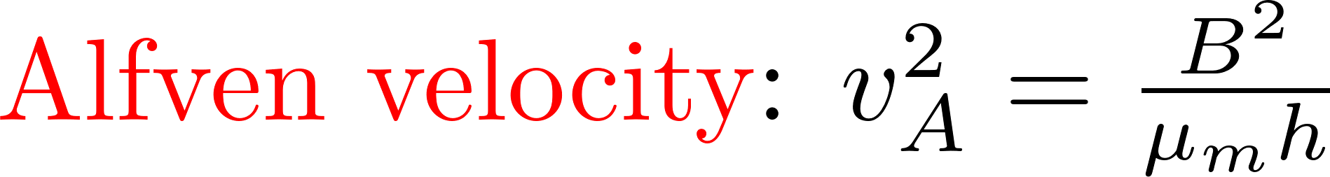
Alfven waves (Transverse waves)
2×2
Secular equation for the 2×2 matrix
Dispersion relations for the Alfven waves

Slide 17
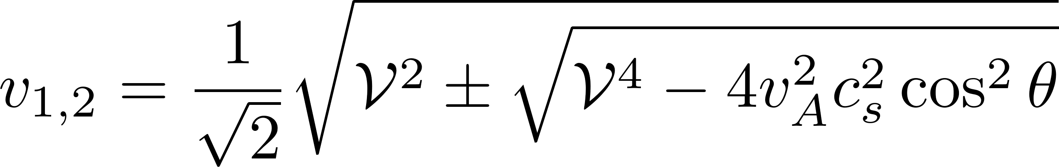
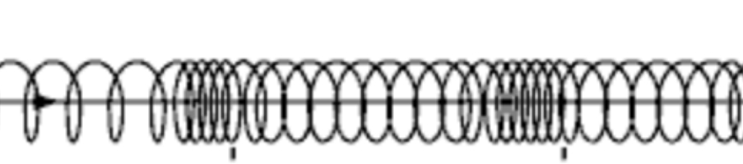
Solutions for the 4 × 4 matrix:
Ideal-order solutions (well known)
Magneto-sonic waves (Longitudinal waves)
Secular equation w/o dissipative corrections (the lowest order in k)
Quadratic eq. for ω²
Modifications of the sound velocity due to the magnetic pressure.
Fast and slow magneto-sonic waves

Slide 18
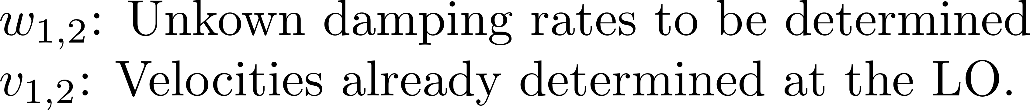
Damping magneto-sonic waves
- Solutions have not been known in the literature
0th order solutions:
Pairs of waves propagating in opposite directions
1st order dissipative corrections:
Pairs of waves damping at the same rate
(w/o parity breaking effects)
The same magnitudes of
velocities and damping rates
Ansatz for the four solutions

Slide 19
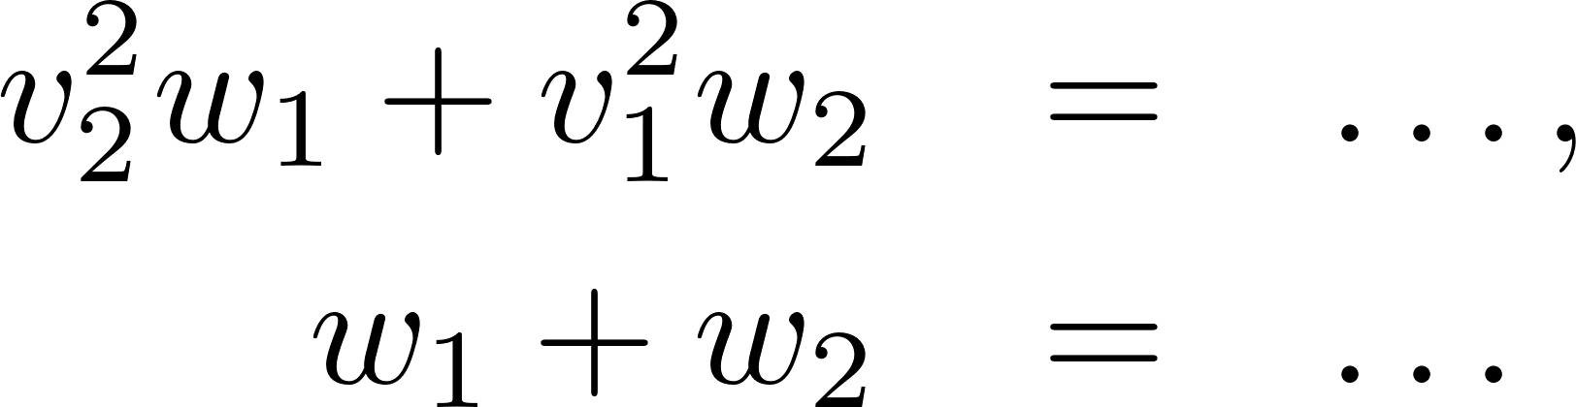
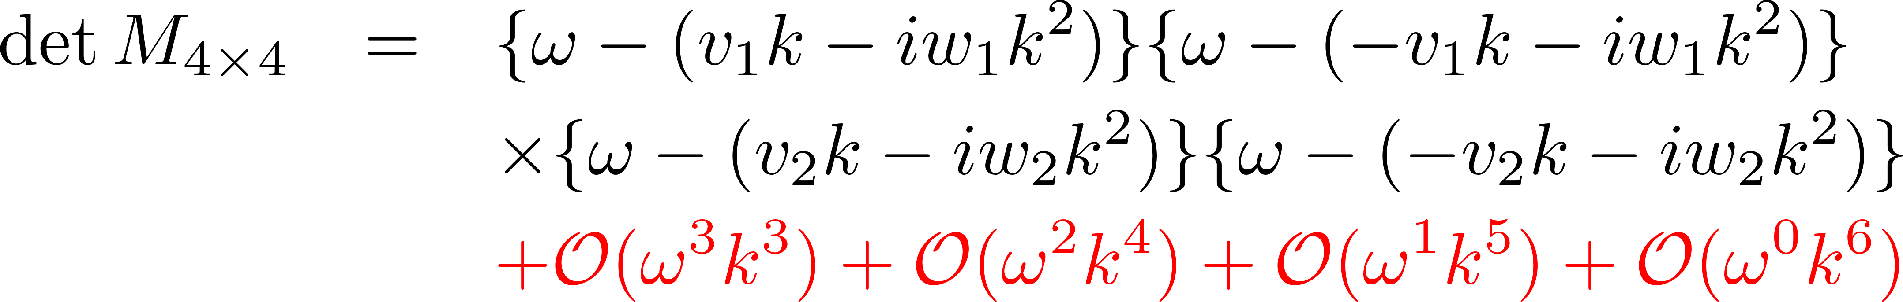
Sweeping trashes away
The goal is to get the solutions up to k² order.
(Higher orders are uncertain in the first-order hydro.)
→ Leading to simple eqs. for unknowns
Determinant should be factorized with ansatz
The goal is to get the solutions up to k² order.
(Higher orders are uncertain in the first-order hydro.)
Determinants include irrelevant higher-order terms that should be thrown away appropriately.
One should remove irrelevant terms first and then compute like in EFT!
Uncertainties in ω and k are correlated with each other.
Greatly simplified if irrelevant higher orders are identified and thrown away appropriately at this stage (like in EFTs).

Slide 20
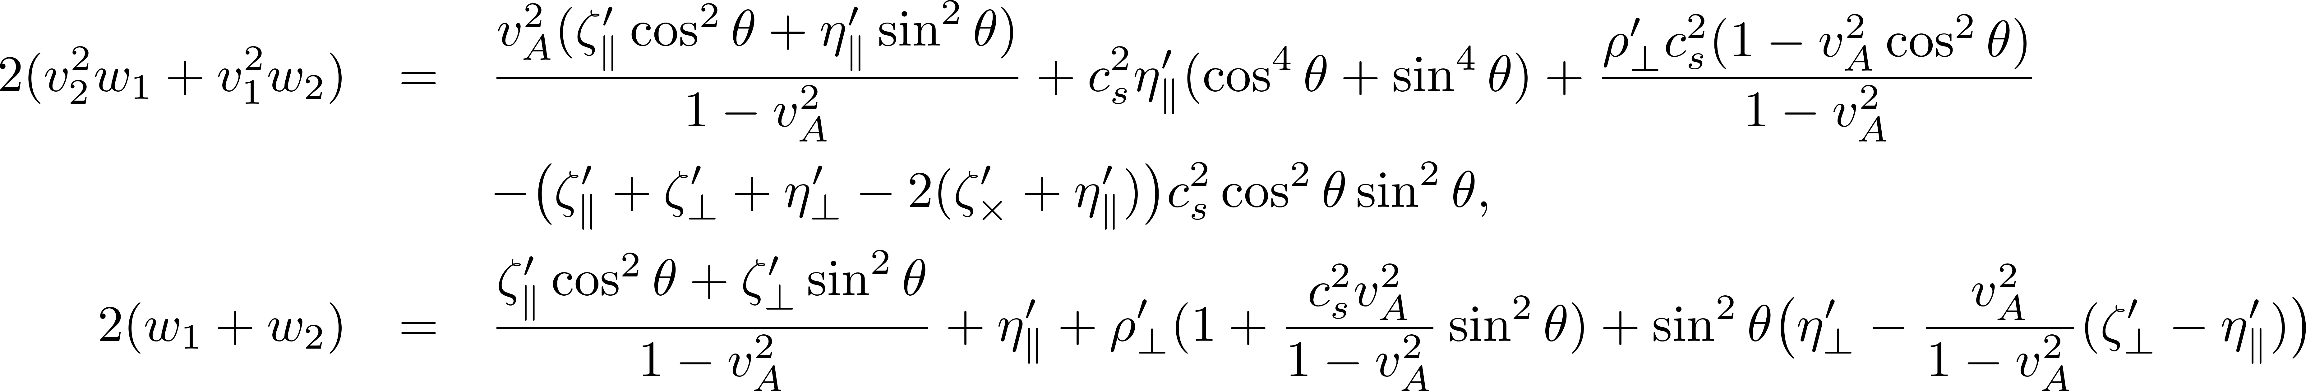
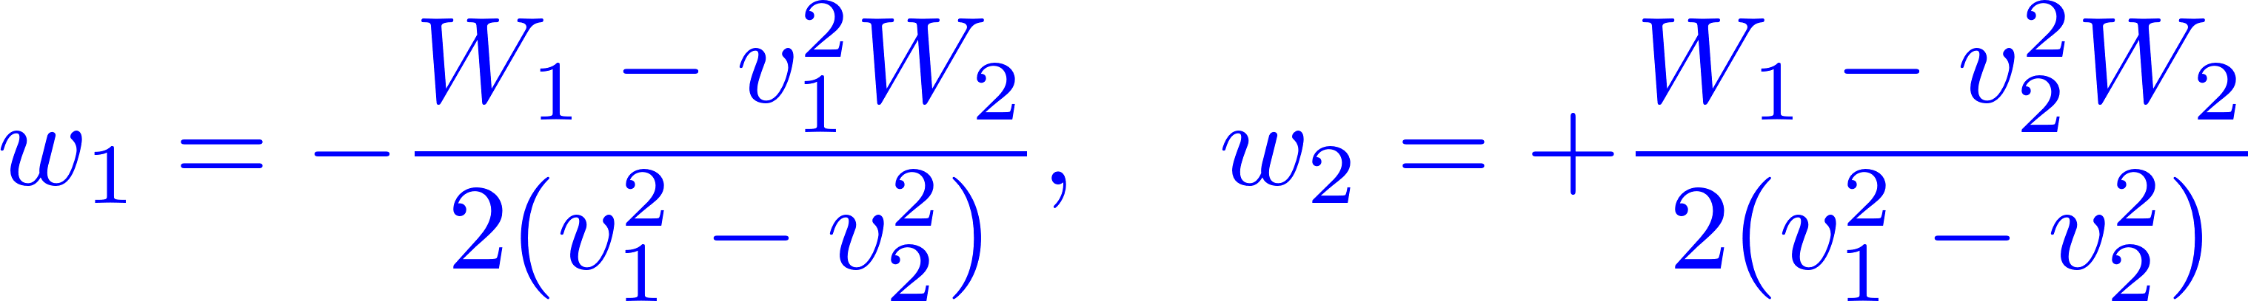
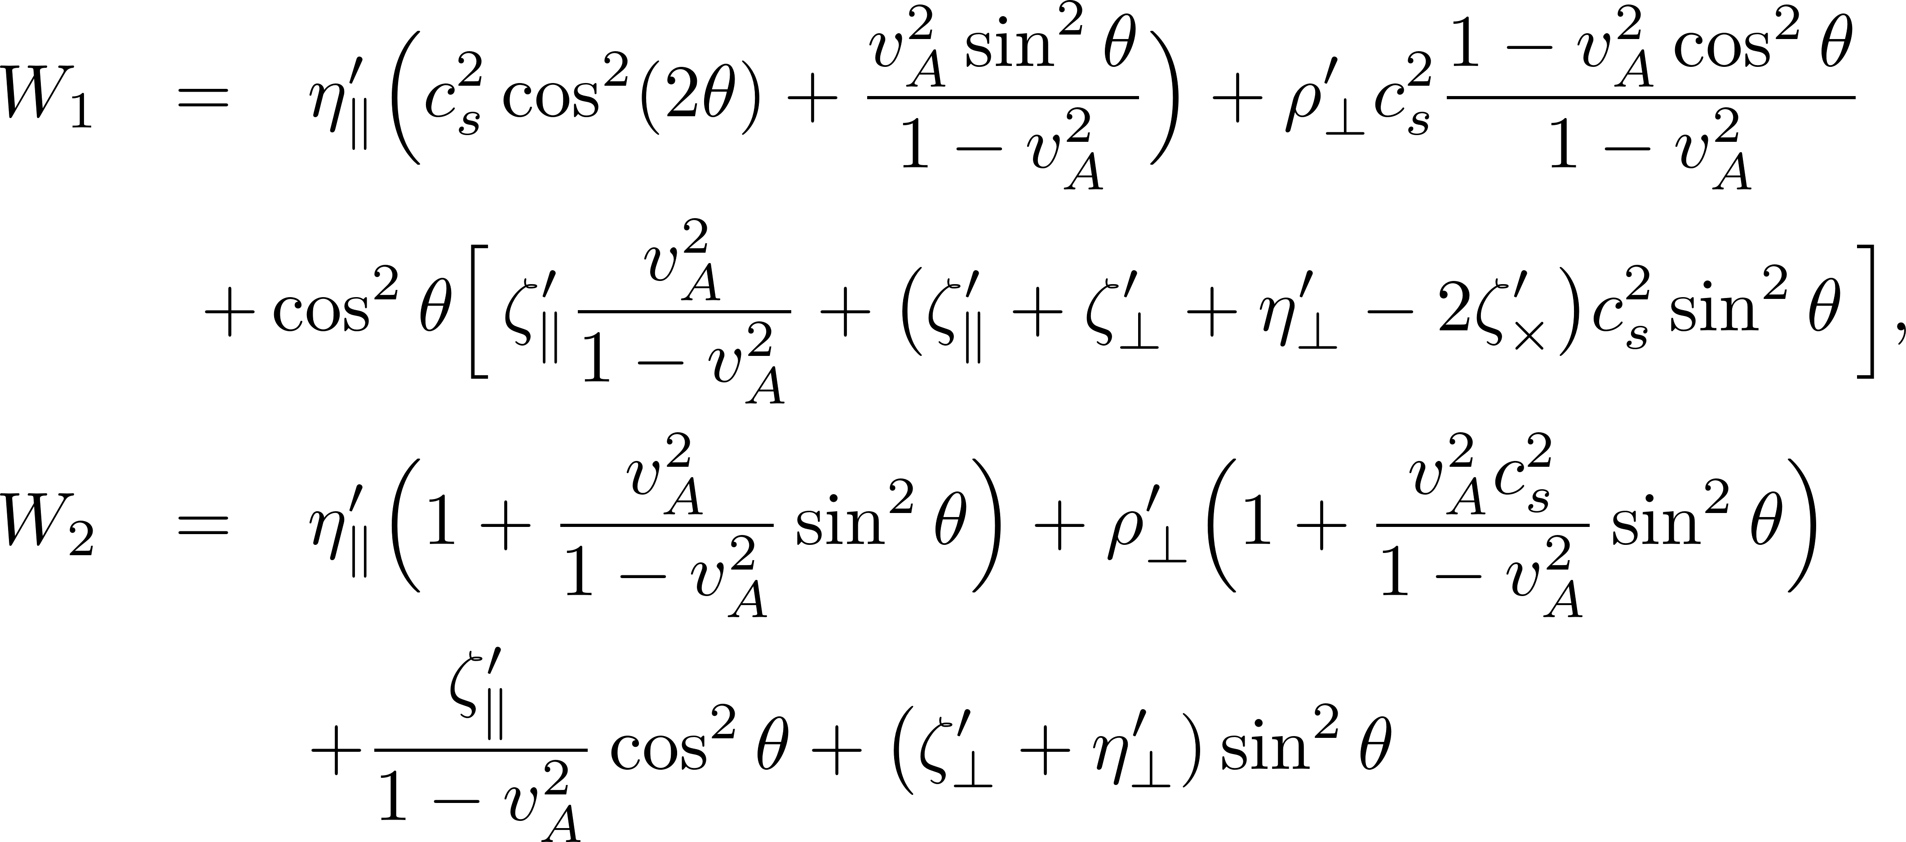
Analytic solutions: Damping rates
All solutions are always damping in the fluid rest frame
(stable around the equilibrium)
All the phase velocities are subluminal.
All the imaginary parts act as damping effects in the fluid rest frame.
This is, however, not sufficient to ensure causality
and stability in arbitrary Lorentz frame (see a back-up slide).

Slide 21
Breakdown of the small k expansion in anisotropic systems

Slide 22




Non-commutative limits
B
Demonstration with the simplest case: The Alfven mode (w/o spin)
Distinct diffusive modes
A pair of diffusive modes
Higher k terms blow up with 1/cosθ
This breakdown is potentially a general issue for anisotropic systems.

Slide 23



Critical angle and an alternative expansion
Phase velocities
Diffusion rates
Purely diffusive near the transverse direction.
Split of the diffusion rates
Cosine function serves as another small parameter.

Slide 24





Critical angle in the magneto-sonic waves
Distinct diffusive modes

Slide 25


Slide 26
Formulation of spin magnetohydrodynamics
with the entropy-current analysis
Zhe Fang, KH, Jin Hu

Slide 27





Conservation laws
Translational symmetry
Rotational symmetry
1-form symmetry
(Magnetic flux conservation)
Orbital AM
Spin
Spin-orbit coupling for relativistic constituents
→ Spin “non-conservation” equation
No symmetry protecting spin conservation.

Slide 28





Explicit, but weak, symmetry breaking
→ Small energy gap
Quasi-hydrodynamic modes
Cf. Hydro+ (Stephanov-Yin) for a long-lived mode due to the critical slowing down.
(kinetic relaxation time) ≲ 1/gap << (spacetime scale of our interest)
Momentum transfer rate
(randomization of momentum)
Transfer rate of quasi-conserved charge

Slide 29














Constitutive equations to the first order
(in a parity-even environment)
Available tensors
・ “Landau frame”
・ First-order corrections
・ Totally anti-symmetric spin tensor
(motivated by Dirac fermions)
Extended first law
Shear
Torque
Bulk
Energy density Spin density Magnetic flux
Spin potential

Slide 30



Number of dof
Constraint equation (no temporal derivative)
Both # of dof and EoM are reduced by 3.
Throwing away the redundancy

Slide 31


Divergence of the entropy current
Equations of motion
Leading order (ideal fluid)
- Should be vanishing
NLO in derivative
- Should be semi-positive

Slide 32


First-order corrections
Symmetric part
(Shear)
Anti-symmetric part
(Torque, vorticity)
Induced EM field
The entropy production stops when the spin potential equals the thermal vorticity.
Semi-positivity is insured by bilinear forms
Becattini
Viscous tensors
Resistivity tensor

Slide 33

Rotational viscosities (Anti-symmetric part)
“No-slip condition” with
the rotational fluid motion
Torque
KH, Masaru Hongo, Xu-Guang Huang,
Mamoru Matsuo, Hidetoshi Taya, 1901.06615

Slide 34


Shear-Torque conversion
Onsager’s reciprocal relations from time-reversal symmetry

Slide 35





Short summary
Spin MHD is formulated based on
Energy-momentum conservation
Spin (non-)conservation
Magnetic flux conservation
New transport coefficients
2 rotational viscosities
1 cross viscosity
in addition to
5 shear and bulk viscosities
2 resistivity
Inequalities for semi-positivity

Slide 36
Solving linearized spin MHD

Slide 37












Linearized spin MHD

Slide 38




Alfven modes with spin mixing
From the 4×4 matrix,
Alfven modes
Spin modes
Spins are not conserved → Gapped modes at k = 0.
All solutions are always damping (stable around the equilibrium)

Slide 39



Magneto-sonic modes with spin mixing
From the 5×5 matrix,
Sonic modes
Spin modes
Always damping (stable around the equilibrium)

Slide 40




Critical angles in spin MHD
Alfven-like modes
Sonic-like modes

Slide 41

Summary
We formulated spin MHD with new transport coefficients.
We developed an analytic algorithm for solutions search on an order-by-order basis in derivative.
We pointed out the breakdown of a small k expansion in anisotropic systems.
Three bulk, Two shear
Two dissipative
Outlook
Applications to the Israel-Stewart extensions
Extension to a finite baryon density for low-energy collisions.
-- Spin polarization induced by a magnetic field.
One dissipative
Two dissipative
+
-
Cancelled in neutral fluid

Slide 42
Back-up slides

Slide 43







Causality and artificial instability
Stability against perturbation on an equilibrium state
Stability (expectation)
Artificial instability despites dissipation, depending on Lorentz frames
Hiscock & Lindblom (1983-1987)
Dissipative currents are acausal.
Systems need finite time to develop dissipative currents.
Chronicle order can be different for spatially separated observers.
✘ Stability becomes an observer-dependent concept.
Causality is necessary for stability.
→ Israel-Stewart theory, etc.
Gavassino (2022)

Slide 44
MHD from the global symmetries of QED
We argued that E is screened in the equilibrium, but B is not.
MHD = fluid dynamics + magnetic flux
Q1: Can we understand MHD from any symmetry
of the underlying microscopic theory?
Q2: How is MHD derived from a microscopic theory?
Grozdanov et al.
Hongo, KH
Fluxes as conserved currents
Gaiotto et al.
1-form symmetry
Conventional (0-form) symmetry
Conservation of 1D objects
through a surface
Conservation of point-like
charges in a box
“MHD from QED” a talk at “Spin and Hydrodynamics in Relativistic Nuclear Collisions”
(ECT* online, Oct. 5 – 16, 2020)

