Slide 1
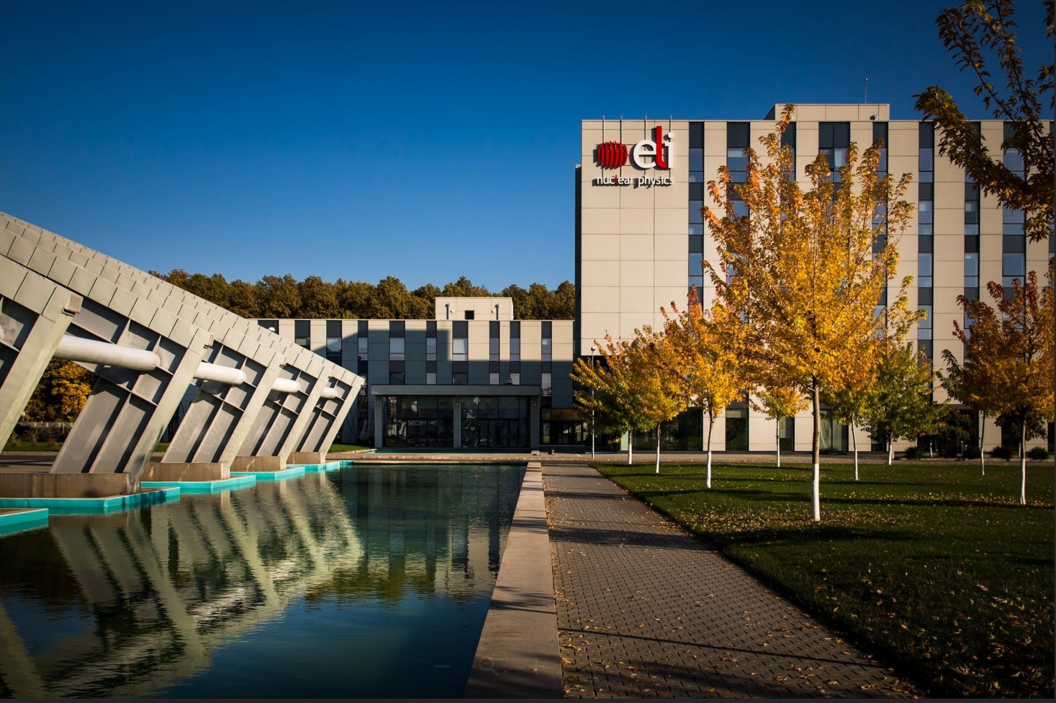
On feasibility of the laboratory r-process studies
with a laser-driven neutron source
Un-feasibility of the laboratory r-process studies
with a laser-driven neutron source
Photo by Paolo Tomassini.
Vojtěch Horný
Extreme Light Infrastructure – Nuclear Physics
3th July 2024
My co-authors
Julien Fuchs, Sophia N. Chen, Laurent Gremillet, Xavier Davoine
New opportunities and challenges in nuclear physics with high power lasers, Trento.

Slide 2
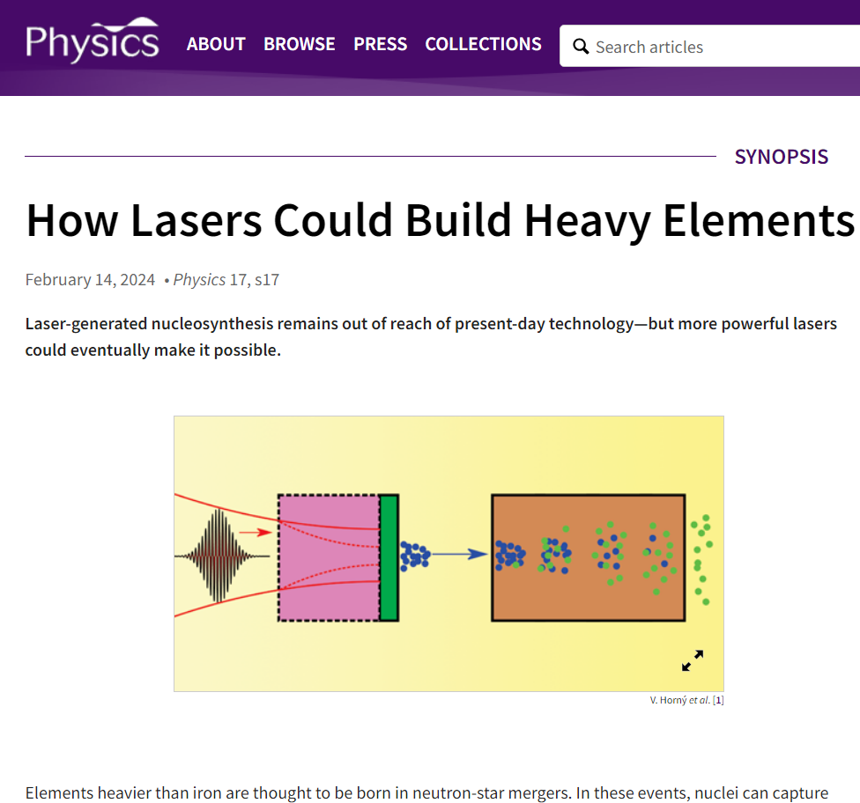
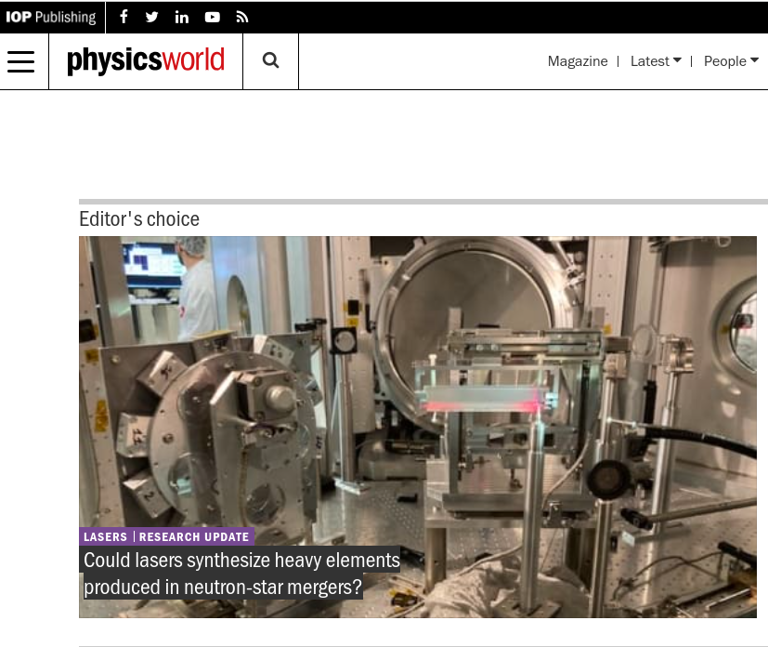
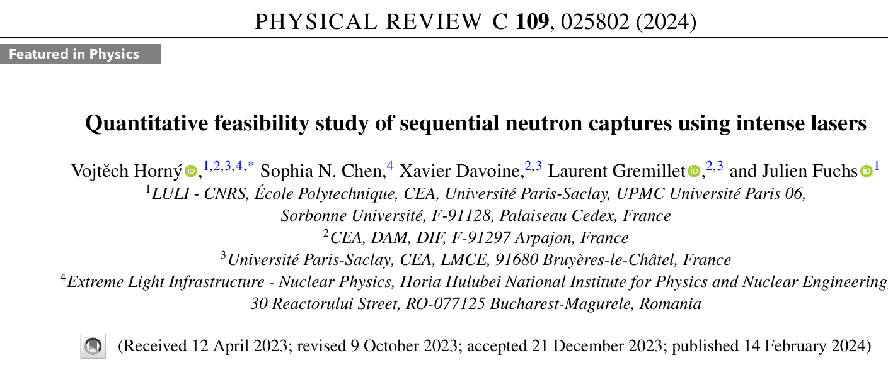
Contents
  What is r-process?
  Contemporary neutron sources
  Laser-driven neutron source
    Considered nuclear reactions
    Experimental state-of-the-art
  Anticipated progress with a new generation of the high-power laser systems
  Model of the final neutron-rich isotope abundance
  Discussion and conclusion

Slide 3
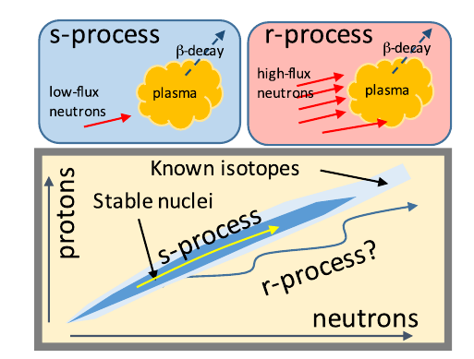
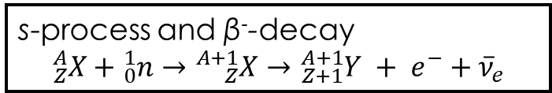
s-process and astrophysical r-process
  Rapid neutron capture:
  capture of two or more neutrons on the seed nucleus within the lifetime of the intermediate product.
  Origin of half of the atomic nuclei heavier than iron, and of the heavier isotopes of heavy elements.
  Occurs in neutron star mergers, probably not during core-collapse of supernovae as though till LIGO.
  Astrophysical conditions: extreme neutron density of >10²⁰ cm⁻³, temperature of ~keV.
  On Earth observed by the thermonuclear explosion.
s-process and β⁻-decay
$${}_{Z}^{A}X+{}_{0}^{1}n→{}_{Z}^{A+1}X→{}_{Z+1}^{A+1}Y + e^{−}+{\overline{ν}}_{e}$$
s-process works only up to ²⁰⁹Bi, because ²¹⁰Po undergoes α-decay
²¹⁰Po → ²⁰⁶Pb + ⁴α

Slide 4
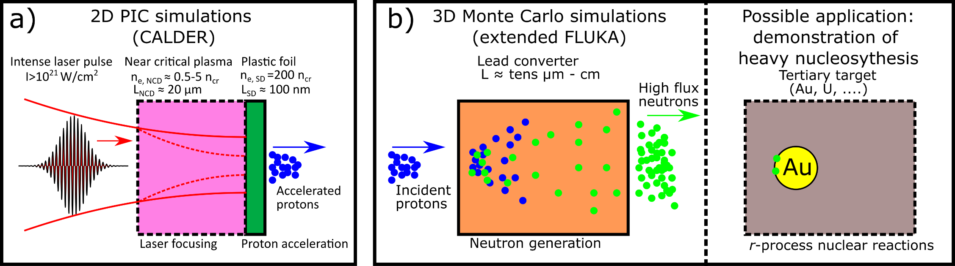
Idea of laboratory r-process study
  Ion acceleration: TNSA, RPA, shock acceleration
  Conversion in the neutron converter: Be(d,n), Li(p,n) fusion reactions, spallation on heavy nuclei
  Neutron capture on an appropriate nucleus: e.g. ¹⁹⁷Au+2n -> ¹⁹⁹Au within the lifetime of intermediate product of ¹⁹⁸Au
  Measurement of decay of final product ¹⁹⁹Au

Slide 5
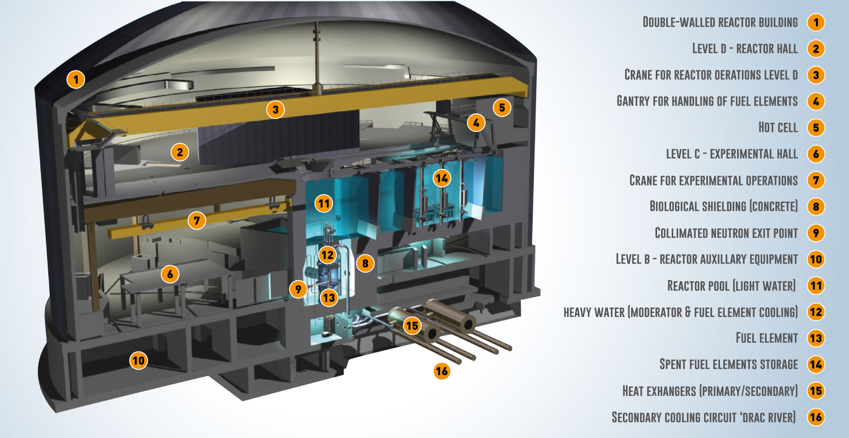
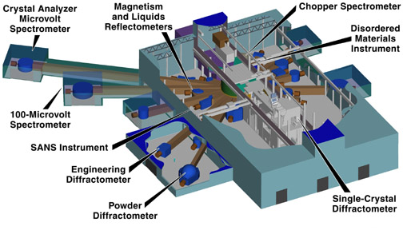
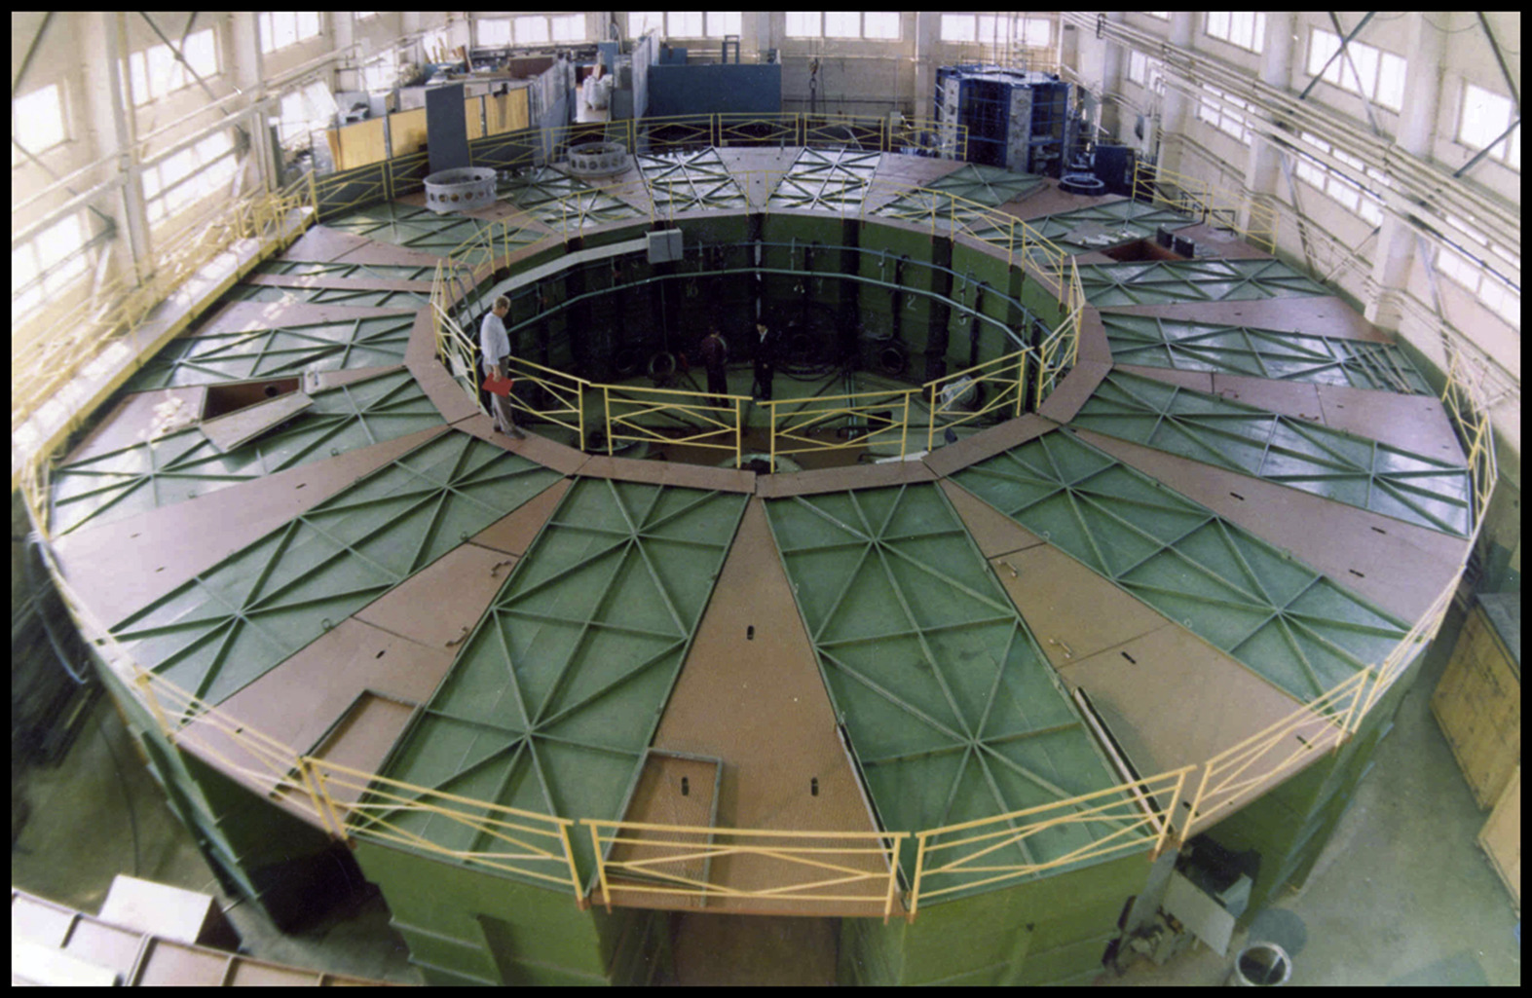
Contemporary neutron sources
Facility | Peak neutron flux [n cm⁻² s⁻¹] | Average neutron flux [n cm⁻² s⁻¹] | Neutron bunch duration | Repetition rate | Spectrum
Institut Laue–Langevin (reactor) | 10¹⁵ | 10¹⁵ | continuous | continuous | thermalised
Spallation Neutron source (accelerator) | 10¹⁶ | 10¹² | 1 μs | 60 Hz | thermalised
National Ignition Facility (fusion devoted laser) | 10²⁶ | 10¹⁰ | 100 ps | once a day | MeVs
GIT-12 (Z-pinch) | 10¹⁸ | 10⁶ | 10 ns | once a day | MeVs
Current lasers | 10¹⁸ | 10⁶ | 1 ns | once per hour | broad
Cikhardt, J., et al. Physics of Plasmas 27.7 (2020): 072705.

Slide 6
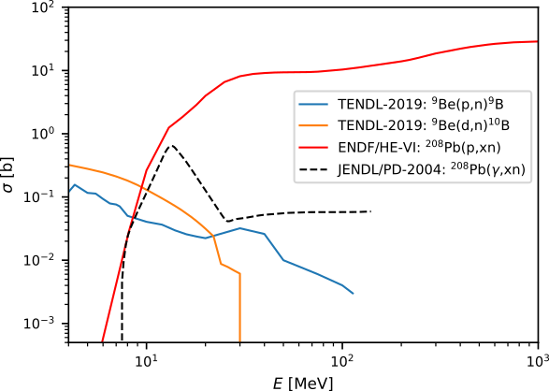
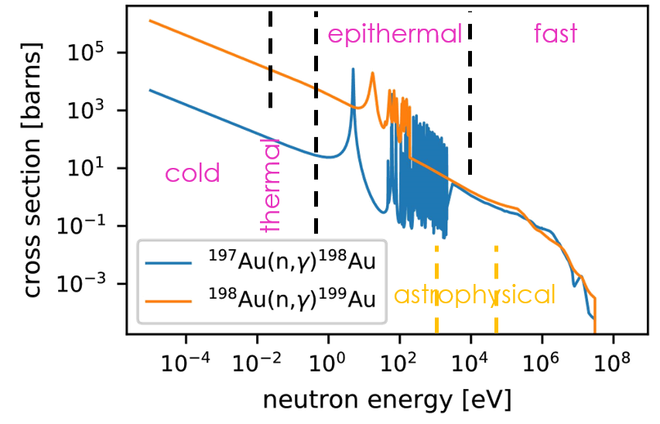
Neutron generation and capture cross-sections
Conversion from ions to neutrons
Neutron capture
Source: TENDL-2019 database
Generation of neutrons
  Fusion reaction on light nuclei (keV-MeV).
  Spallation on heavy nuclei (MeVs)
  Photonuclear reactions from bremsstrahlung or synchrotron radiation (keV-MeV).
  Nuclear fission (MeV)
Uncertainities
  Lacking data especially A+1 isotopes → TALYS modelling.
  In astrophysics, increased cross-section
    stellar enhancement factor

Slide 7
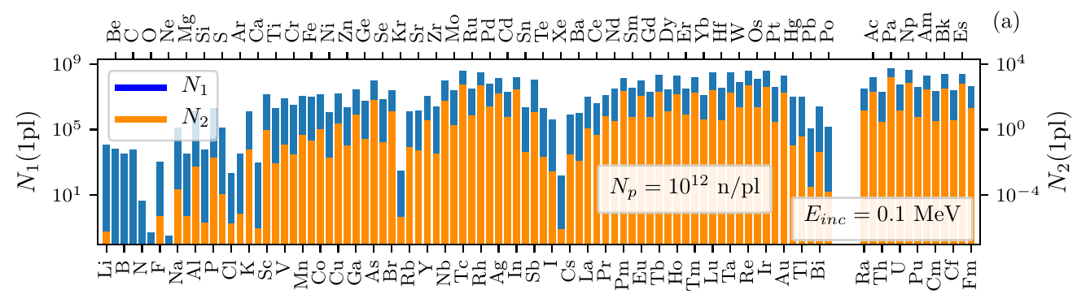
r-process with LDNS: recent literature
P. Hill & Y. Wu, PRC, 103, 014602 (2021)
N = 10¹² neutrons per pulse
Gaussian energy spectrum
  100 keV – 5 MeV
  10% relative width
Uniform flux through S = 25 μm²
Converter thickness L=100 μm
Neutron areal density of
N/S = 4×10¹⁸ n.cm⁻²
Assuming duration of τ =1 ns, the flux is
N/Sτ = 4×10²⁷ n.cm⁻²s⁻¹
After one shot, cca 600 ¹⁹⁹Au nuclei predicted.

Slide 8
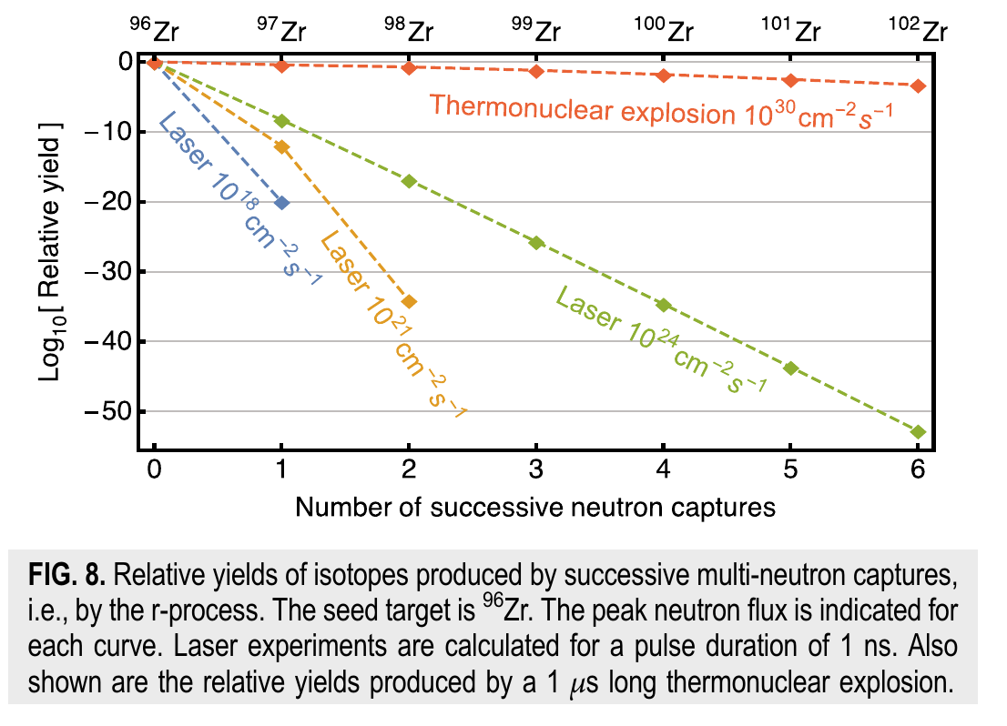
r-process with LDNS: recent literature
S. N. Chen et al., MRE, 4.5, 054402, 2019.
Neutron capture on ⁹⁶Zr
Estimation of neutron
In their estimation, it is assumed constant σ=1b (corresponds to ≈ 0.3 keV, for fast neutrons it is order of magnitude lower)
Abundance of respective neutron-rich isotopes calculated.
Taking similar parameters as previously and a correct cross section.
  L = 100 μm
  S = 25 μm²
  N = 10¹² neutrons per pulse
10⁻⁴ ⁹⁸Zr isotopes per shot is predicted.
10⁵ neutron-rich isotopes in needed for measurement.

Slide 9


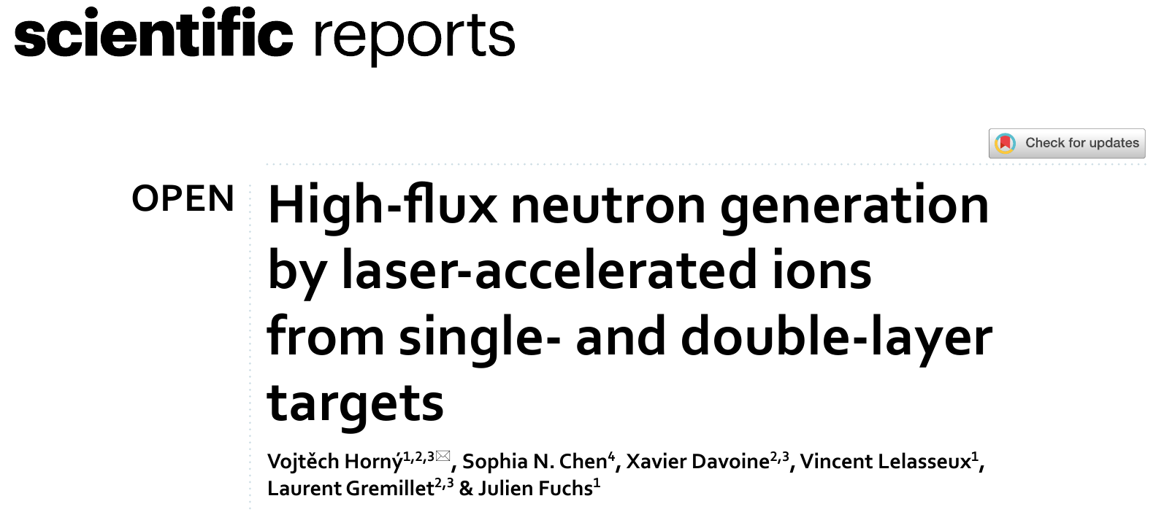
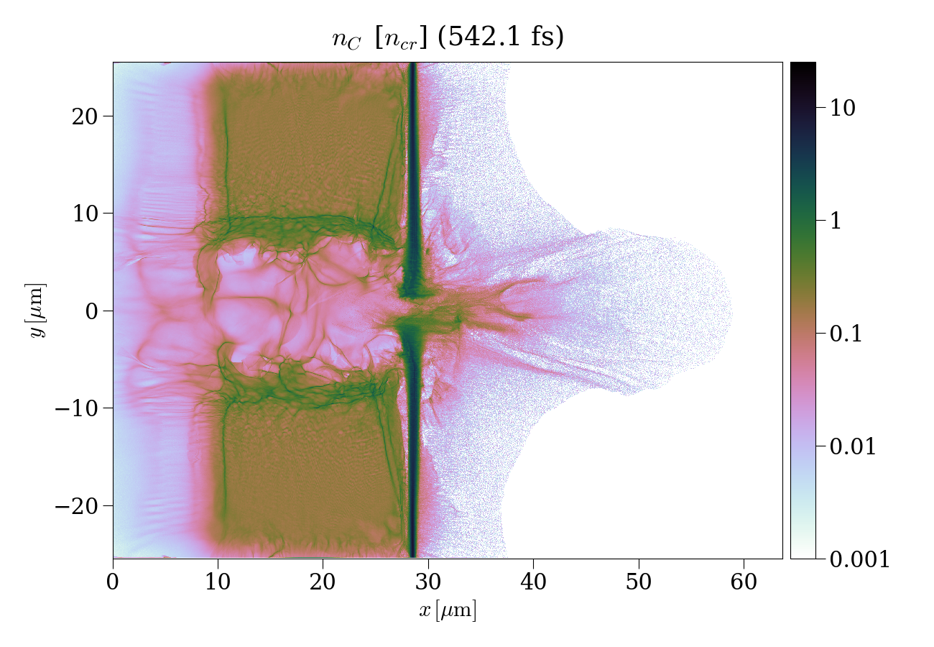
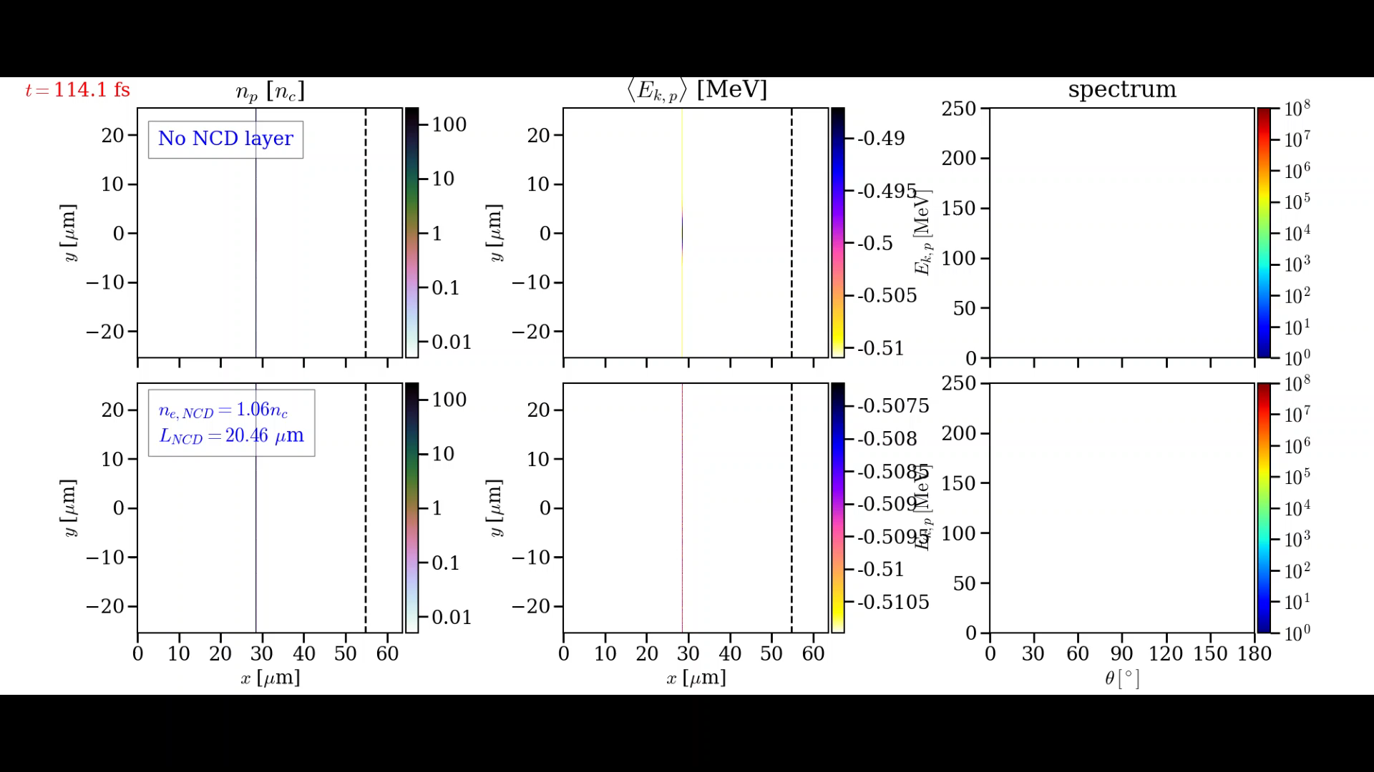
Realistic proton source: an optimized double-layer target for 1 PW Apollon
Plasma: n_{e,SD} = 200 n_{cr,} n_{e,NCD} = 1.06 n_{cr}
L_{NCD} = 25 µm, L_{SD} = 115 nm
Laser: D₀ = 5 μm, a₀ = 30.6, τ = 20 fs
Tight laser self-focusing in near-critical plasma significantly enhances the proton acceleration.
n_{cr} =1.72×10²¹ cm⁻³ for a Ti-sapphire laser.
n_{p} [n_{cr}]
<E_{p}> [MeV]
Angular energy distribution

Slide 10
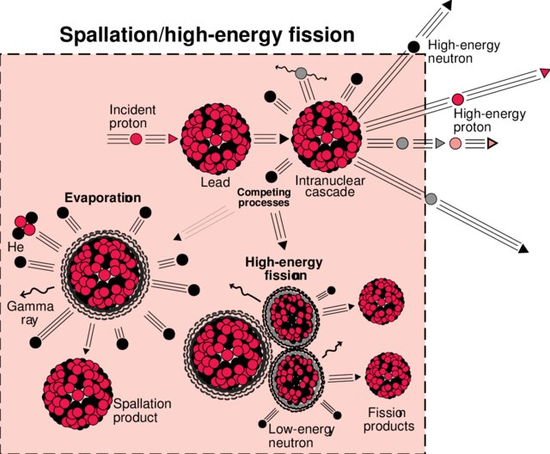
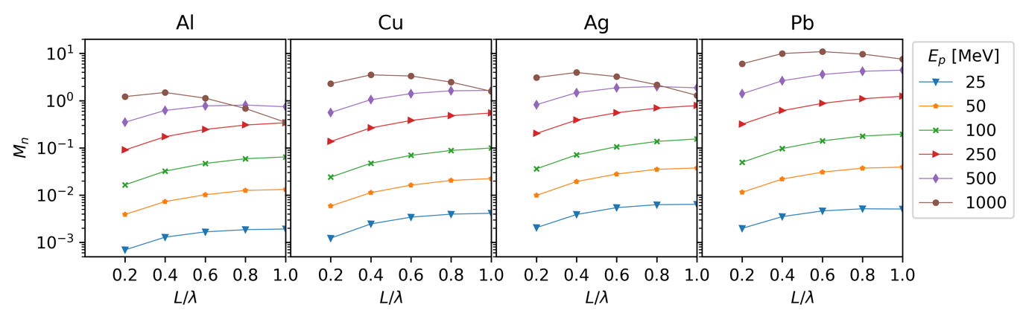
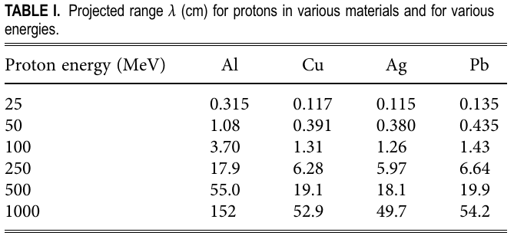
Spallation
A nuclear reaction in which the high-energy level of incident particles causes the nucleus to eject more than three particles, thus changing both its mass number and its atomic number.
cylinder
r = 50 cm
Martinez, B., et al. Numerical investigation of spallation neutrons generated from petawatt-scale laser-driven proton beams. Matter and Radiation at Extremes, 2022, 7.2: 024401.
Kelley, K. C., Gadolinium-148 and Other Spallation Production CrossSection Measurements for Accelerator Target Facilities, Dissertation, Georgia Institute of Technology, 2004.

Slide 11
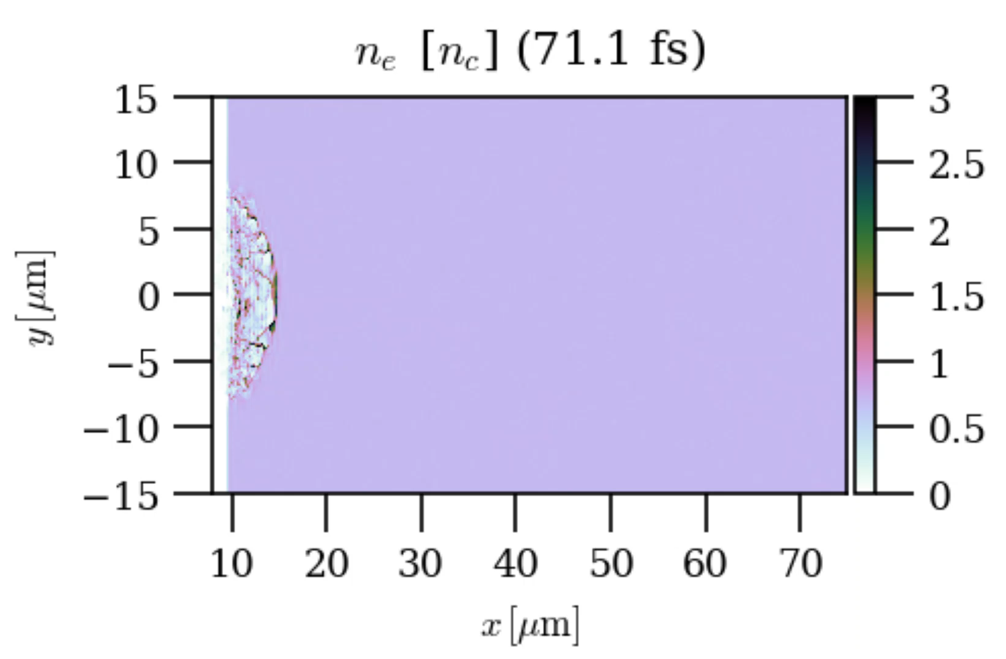
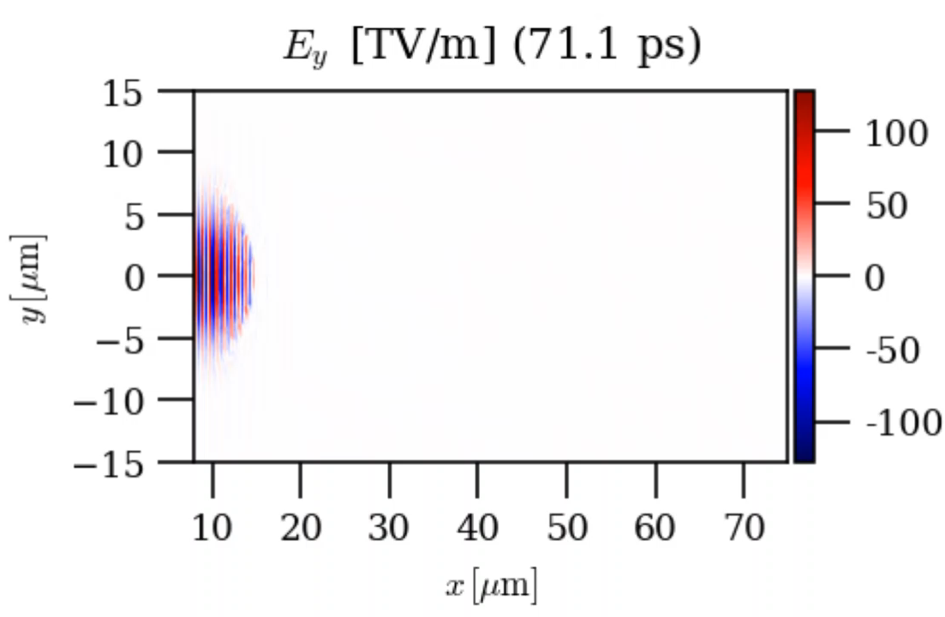
Light intensification in NCD layer
2D PIC CALDER simulation of laser propagation in an uniform plasma with n_{e}=0.74 n_{cr}.
Initial maximum intensity is 2×10²¹ W/cm².
After 25.2 µm of propagation in the NCD plasma, the laser reaches a
maximum intensity of 7.4×10²¹ W/cm², within a spot size of D = 1.33 µm.

Slide 12
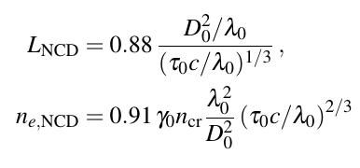


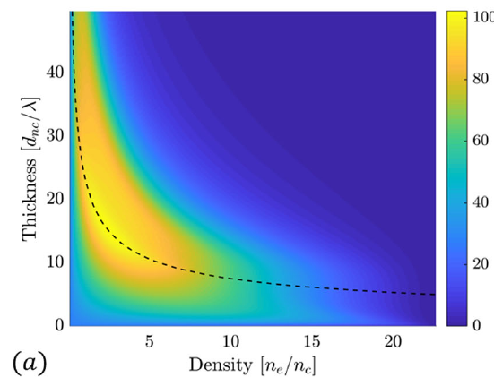

Light intensification in NCD layer
Thin lens approximation predicts optimal focusing for Apollon 1 PW:
  n_{e}=1.93 n_{cr}
  D=0.73 µm
  L = 14.1 µm
Pazzaglia, A., Fedeli, L., Formenti, A., Maffini, A., & Passoni, M. (2020). A theoretical model of laser-driven ion acceleration from near-critical double-layer targets. Communications Physics, 3(1), 1-13.

Slide 13
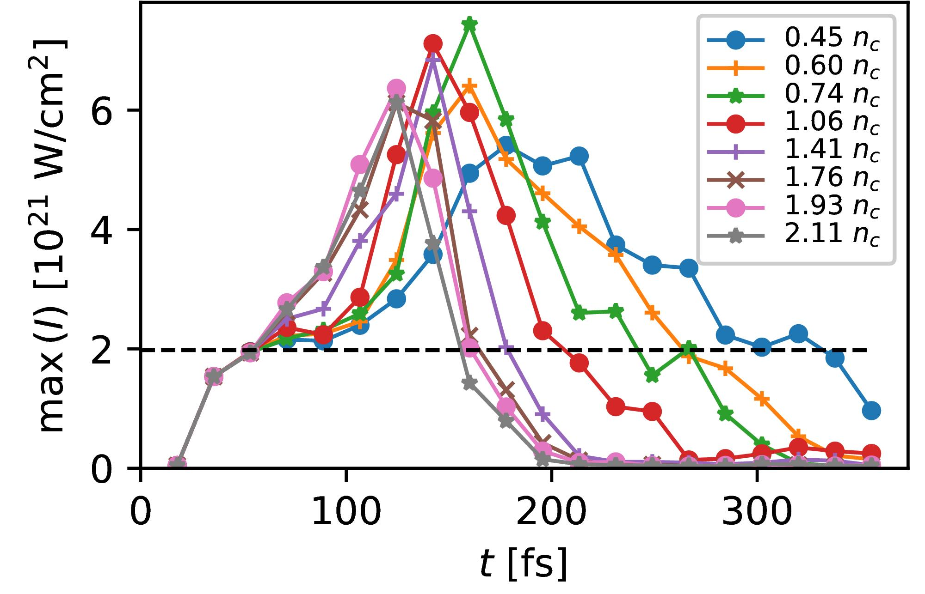
Light intensification in NCD layer
Maximum intensification is around factor of three for NCD densities in range (0.60, 2.11) n_{cr}.
Optimum achieved for lower density of 0.74 n_{cr}.

Slide 14
Light intensification in NCD layer
Maximum intensification is around factor of three for NCD densities in range (0.60,2.11) n_{cr}.
Optimum achieved for lower density of 0.74 n_{cr}.
Best focusing agrees with model.
The smallest laser spot does not necessarily lead to the highest intensity.
Pazzaglia, A., Fedeli, L., Formenti, A., Maffini, A., & Passoni, M. (2020). A theoretical model of laser-driven ion acceleration from near-critical double-layer targets. Communications Physics, 3(1), 1-13.
Notes:
Looses energy on the way.

Slide 15
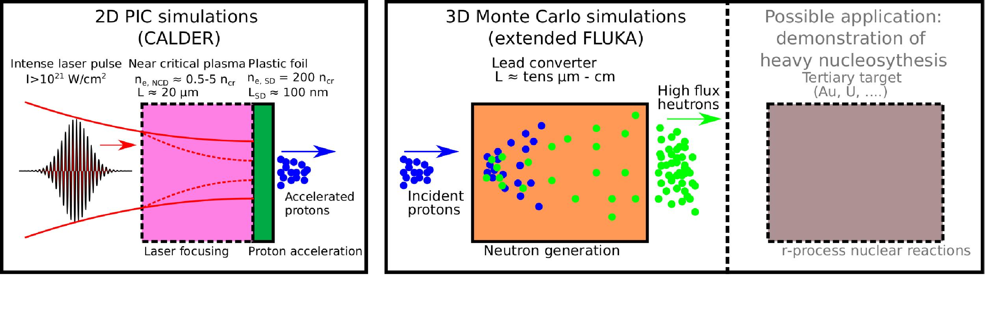

Ultraintense-laser-based neutron generation
High-energy protons from single-/double-layer targets driven by 1 PW Apollon laser
E = 22 J
$a_{0,d}=30.6$
$λ_{0}=0.8$ μm
$D_{0}=5$ μm (FWHM of intensity)
$τ=20$ fs (FWHM of intensity)
nm-thick solid CH foil target, n_{e}=200 n_{cr}
μm-thick near-critical plasma layer + nm-thick solid CH foil target, n_{e}=200 n_{cr}
Apollon or ELI NP systems operate once per minute - it is rather a nuclear security concern.
In fact, similar systems could be capable of running at 10 Hz.
Notes:
NCD layer advantage: reduces the damage caused by prepulses.

Slide 16
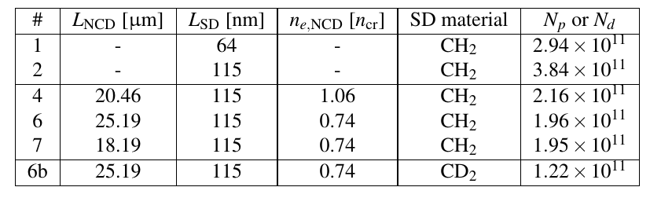
PIC simulations of proton acceleration
Brantov L
Other parameters are the same:
Plasma: n_{e,SD} = 200 n_{cr}
Laser: D₀ = 5 μm, a₀ = 30.6, τ = 20 fs
Last column shows total number of accelerated protons or deuterons with energy above 1 MeV.
Notes:
6: optimum case in terms of locusing

Slide 17
Proton acceleration with a single- and double-layer targets
Case #2
Case #6
Tight laser self-focusing in near-critical plasma leads to significantly faster protons but with reduced number and larger angular divergence!

Slide 18
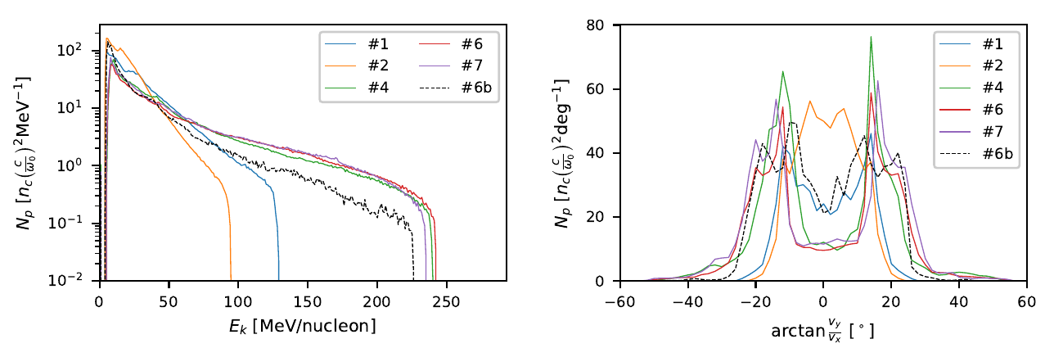
Ion acceleration with a single- and double-layer targets
NCD layer greatly enhances the final ion energy.
NCD decreases the total ion number and worsens the divergence.

Slide 19
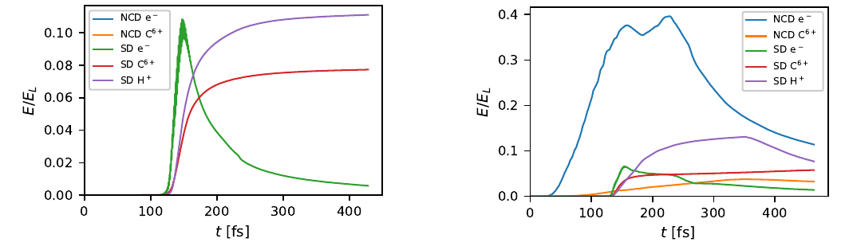
Laser energy conversion to particles
Optimum near-critical plasma (NCP) can absorb over 40% of laser energy
Fast electrons from NCP enhance proton acceleration from solid foil
10 − 12 % laser energy conversion into protons
#2
#6

Slide 20
Ultraintense-laser-based neutron generation
High-energy protons from single-/double-layer targets driven by 1 PW Apollon laser
E = 22 J
$a_{0,d}=30.6$
$λ_{0}=0.8$ μm
$D_{0}=5$ μm (FWHM of intensity)
$τ=20$ fs (FWHM of intensity)
nm-thick solid CH foil target, n_{e}=200 n_{cr}
μm-thick near-critical plasma layer + nm-thick solid CH foil target, n_{e}=200 n_{cr}
Apollon or ELI NP systems operate once per minute - it is rather a nuclear security concern.
In fact, similar systems could be capable of running at 10 Hz.
Notes:
NCD layer advantage: reduces the damage caused by prepulses.

Slide 21
Monte Carlo simulation with FLUKA
Extensions of the FLUKA code
Loading of the primary particles from CALDER produced input
  Transformation from 2D to 3D assuming the cylindrical symmetry
  Each position (x,y) and momentum (p_{x},p_{y}) rotated by a random azimuthal angle
  Particle weight divided by the radial distance from the axis
Implementation of the routine for the tracking of the particle flux temporal profile
  Temporal profile considered both at the primary particles and all secondaries.
Simulation parameters
Always at least 3.6×10⁸ primary particles used.
Convergence tests conducted up to 3.6×10¹⁰ primaries.
Converter is a cylinder of r = 3 cm.
Further studies on the effect of the laser accelerated electrons and generated x-rays
their contribution to the final neutron yield is negligible.
Kudos to Bertrand Martinez (now Technico Lisboa) for his contribution to the implementation of those routines.

Slide 22
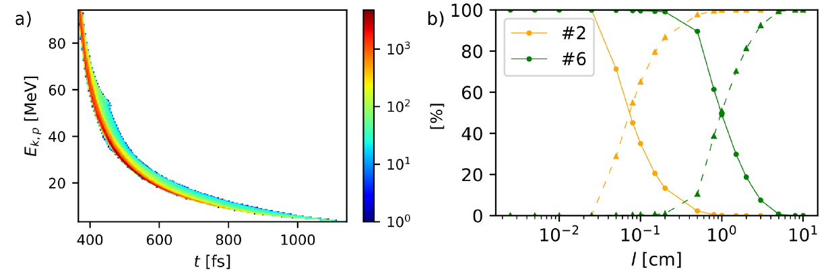
Proton transport through Pb converter
Incident proton spectrogram #2
Monte Carlo simulation
Transported
Absorbed
Thin converters: l ≤ 250 μm (#2) or 2 mm (#6), ≤ 1% of incident energy deposited
Thick converters: l > 0.5 mm (#2) or 5 cm (#6), all incident energy deposited

Slide 23
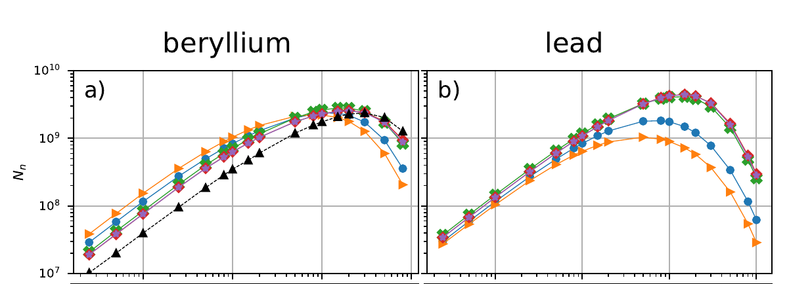
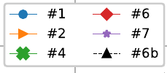
Neutron source features
Total neutron number emitted from the rear side of the converter (i.e. in 2π sr)
Highest neutron production already in primary double layer target and lead converter.
Only a weak dependence on the exact parameters of the front NCD layer.

Slide 24
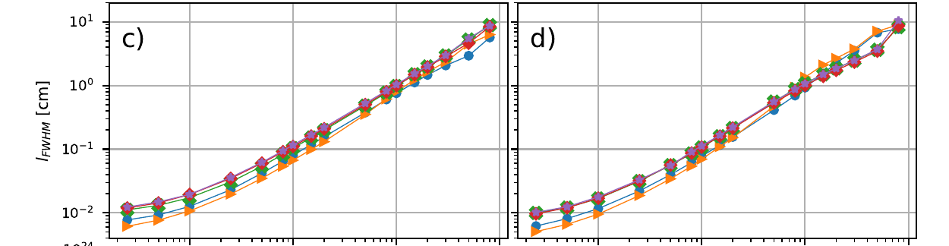
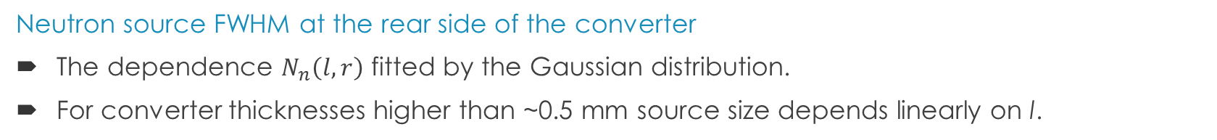
Neutron source features
Neutron source FWHM at the rear side of the converter
The dependence $N_{n}\left(l,r\right)$ fitted by the Gaussian distribution.
For converter thicknesses higher than ~0.5 mm source size depends linearly on l.

Slide 25
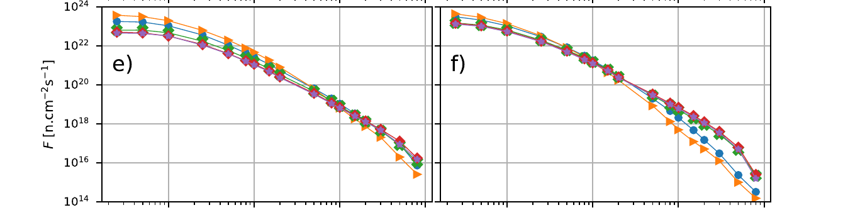

Neutron source features
The highest immediate neutron flux
Single layer proton acceleration targets in combination with thin converters can provide immediate flux above 10²³ neutrons cm⁻²s⁻¹.
The strong dependence on the source size surpasses the relatively low neutron number.
Notes:
For such thin converters, their thickness l is lower than the proton mean free path. The protons do, in this case, experience at most one inelastic collision. On this reason, the highest peak neutron flux is
achieved for the proton acceleration configuration #2 having a thicker single-layer target and a 25 μm thick lead converter. It is a counter-intuitive result, as Figure 4a shows that this proton acceleration configuration corresponds to the generation of the lowest proton energies of all considered cases. The better performance in lead is due to its significantly higher neutron multiplicity, especially for the protons above ≳ 8 MeV.

Slide 26
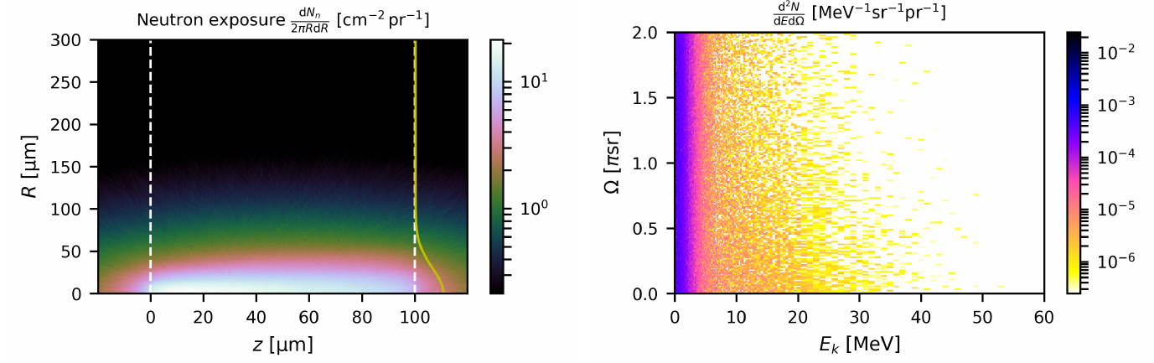
Neutron fluence and energy-angle spectra
Proton acceleration #2 + 100 μm thick Pb converter
1.54 × 10⁸ neutrons emitted per shot
Transverse neutron source size ∼ 95 μm
Maximum immediate neutron flux ∼ 1.41 × 10²³ n cm⁻² s⁻¹
Maximum integrated neutron flux ∼ 1.27 × 10⁶ n sr⁻¹

Slide 27
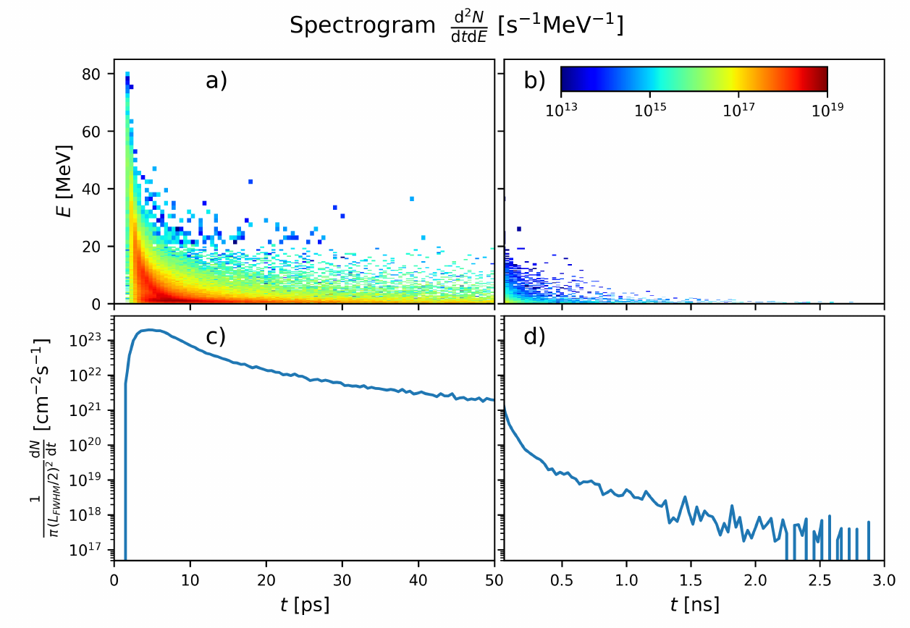
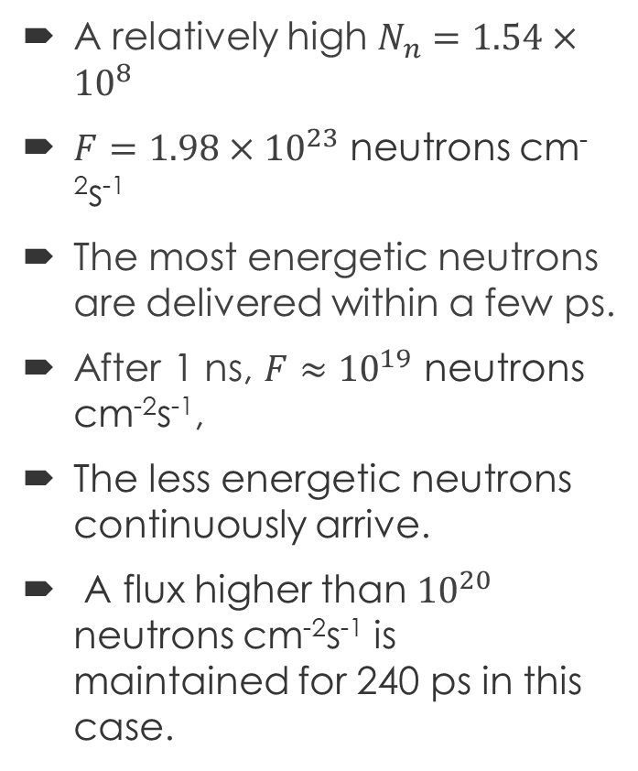
Neutron source features
A relatively high $N_{n}=1.54×{10}^{8}$
$F=1.98×{10}^{23}$ neutrons cm⁻²s⁻¹
The most energetic neutrons are delivered within a few ps.
After 1 ns, $F≈{10}^{19}$ neutrons cm⁻²s⁻¹,
The less energetic neutrons continuously arrive.
A flux higher than ${10}^{20}$ neutrons cm⁻²s⁻¹ is maintained for 240 ps in this case.
Notes:
For such thin converters, their thickness l is lower than the proton mean free path. The protons do, in this case, experience at most one inelastic collision. On this reason, the highest peak neutron flux is
achieved for the proton acceleration configuration #2 having a thicker single-layer target and a 25 μm thick lead converter. It is a counter-intuitive result, as Figure 4a shows that this proton acceleration configuration corresponds to the generation of the lowest proton energies of all considered cases. The better performance in lead is due to its significantly higher neutron multiplicity, especially for the protons above ≳ 8 MeV.

Slide 28
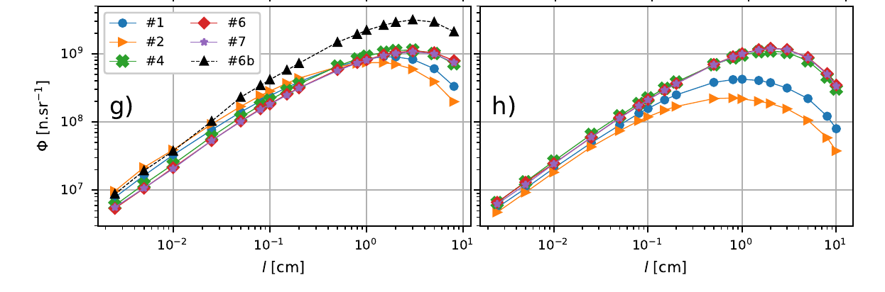
Neutron source features
The neutron flux at the axis: the quantity important for applications
In 1 PW regime, neutron generation is still slightly better for accelerated deuterons and a Be converter.
The strong forward directionality of the nucleons released by the deuteron break-up.

Slide 29
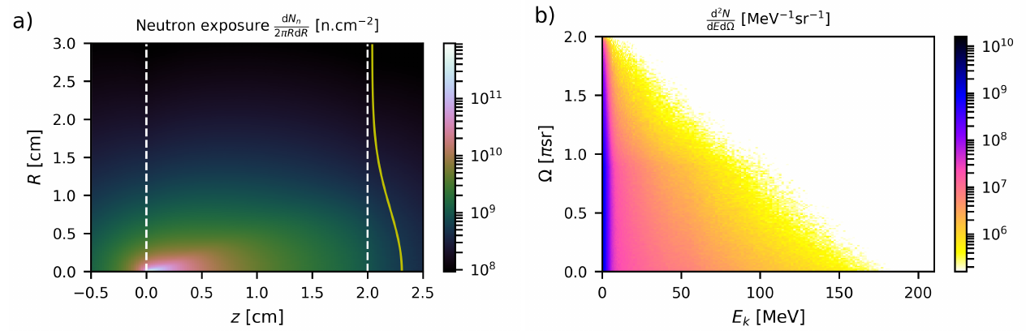
Neutron fluence and energy-angle spectra
Proton acceleration #6 + 2 cm thick Pb converter
4.25 × 10⁹ neutrons emitted per shot
Transverse neutron source size ∼ 1.74 cm
Maximum immediate neutron flux ∼ 1.27 × 10¹⁸ n cm⁻² s⁻¹
Maximum integrated neutron flux ∼ 8.40 × 10⁷ n sr⁻¹

Slide 30
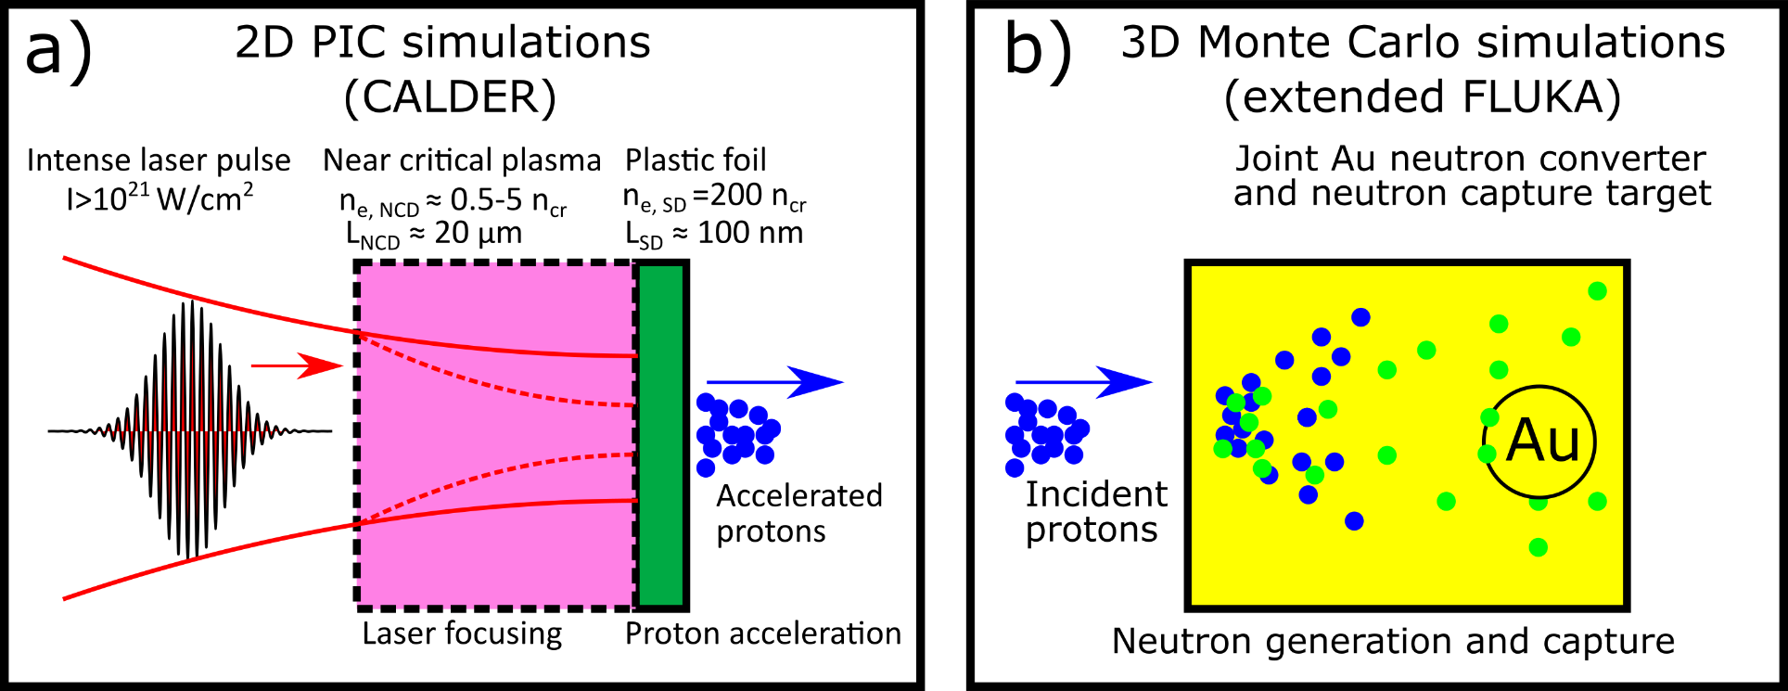
Simplified scheme for neutron capture
High Z material can be used for both neutron generation and capture with >20 MeV protons from advanced acceleration schemes.

Slide 31
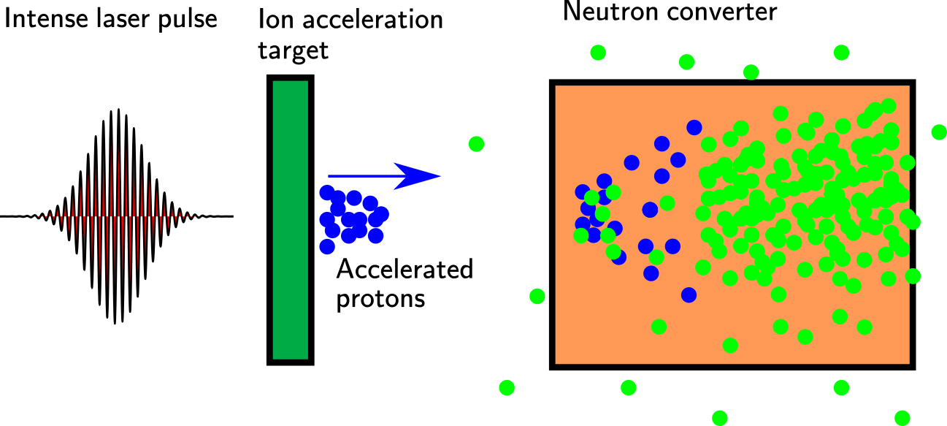
Laser-driven neutron source
~μm
~cm
State-of-the-art results achieved at PHELIX@GSI, TRIDENT@LANL or LFEX@ILE Osaka.
 | E [J] | τ[fs] | f |  | F [N/sr] | F/E[N/sr/J] | fF [N/sr/s]
Roth, et al. PRL (2013) | 80 | 600 | once per hour | CD₂+Be | 4.40×10⁹ | 5.50×10⁷ | 1.22×10⁶
Kleinschmidt et al., Phys. Plasmas (2018) | 150 | 500 | once per 90 minutes | CD₂+Be | 1.42×10¹⁰ | 9.47×10⁷ | 2.63×10⁶
Huang et al., APL (2022) –theoretical suggestion | 282 | 1000 | once per hour | CD2+Be | 1.70×10¹¹ | 6.03×10⁸ | 4.72×10⁷
Günther et al., Nat Com. (2022) | 20 | 700 | once per hour | CHO+Au | 4.93×10⁹ | 2.47×10⁸ | 1.37×10⁶
Mirfayzi et al., SciRep (2020) | 300 | 1200 | once per hour | CD₂+Be+PET+H | 8×10⁵ cold
Horný et al., SciRep (2022) | 22 | 20 | once per minute | CH₂+Pb | 1.2×10⁹ | 5.5×10⁷ | 2.0×10⁷

Slide 32
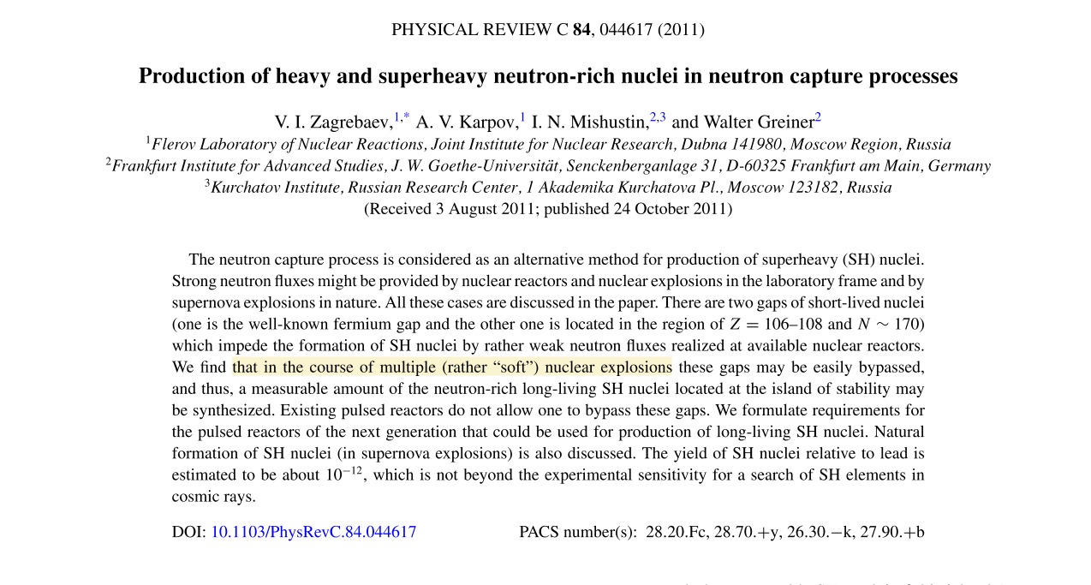
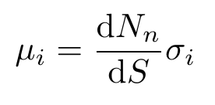
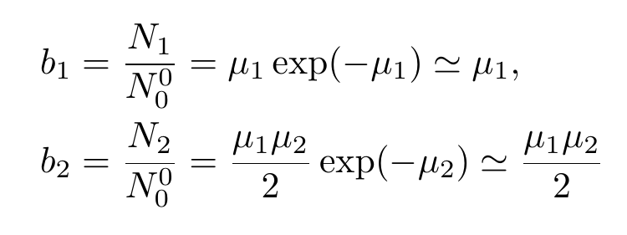
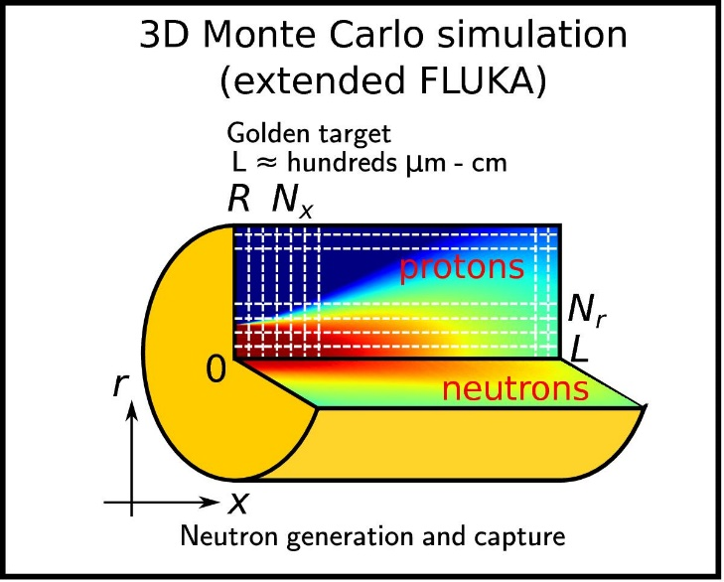

Neutron-rich isotopes abundance model
neutron areal density
neutron capture cross-section
Based on Zagrebaev, V. I., et al. PRC 84.4 (2011): 044617.
Abundance of (A+i)-th isotope
Generalisation: radially and energy dependent flux
Number of (A+2) isotope nuclei scales with
  Square of the neutron areal density → spatially small sources
  Square of the neutron capture cross-section → slower than epithermal neutrons
can be taken e.g. from FLUKA simulation

Slide 33
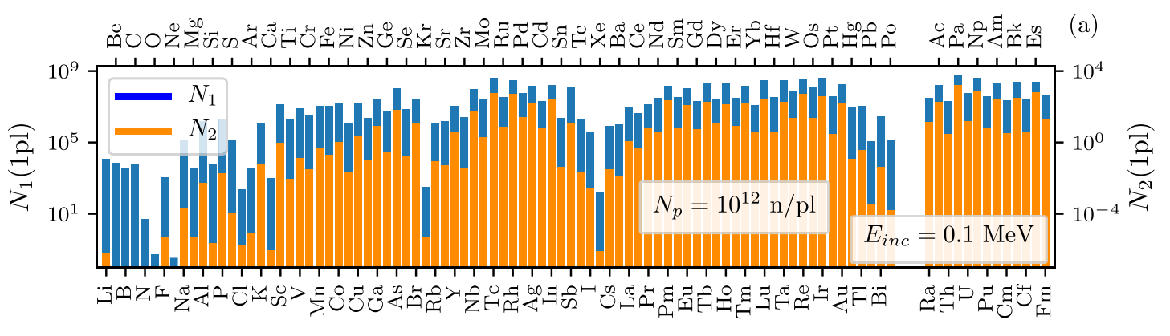
Neutron-rich isotopes calculation
Calibration: Hill & Wu parameters
100 keV neutrons
N_{n} = 1.0e12
No divergence!
S = 25 um²
Au converter, l = 100 um
The yield is
N₁ = 3.0×10⁸
N₂ = 615
It agrees.
Implementation details:
Written Python
Neutron cross sections from TENDL-2019 library.

Slide 34
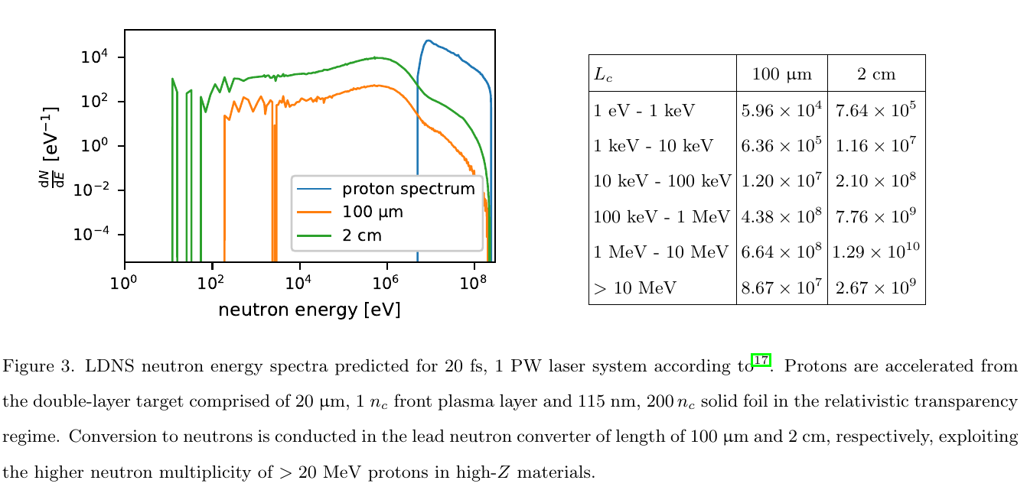
Laser-driven neutron source
Optimised proton and neutron spectra predicted for Apollon@1 PW
Neutron source size is comparable to converter length!
Horný, V. et al. (2022). High-flux neutron generation by laser-accelerated ions from single- and double-layer targets. Scientific Reports, 12, 19767.

Slide 35
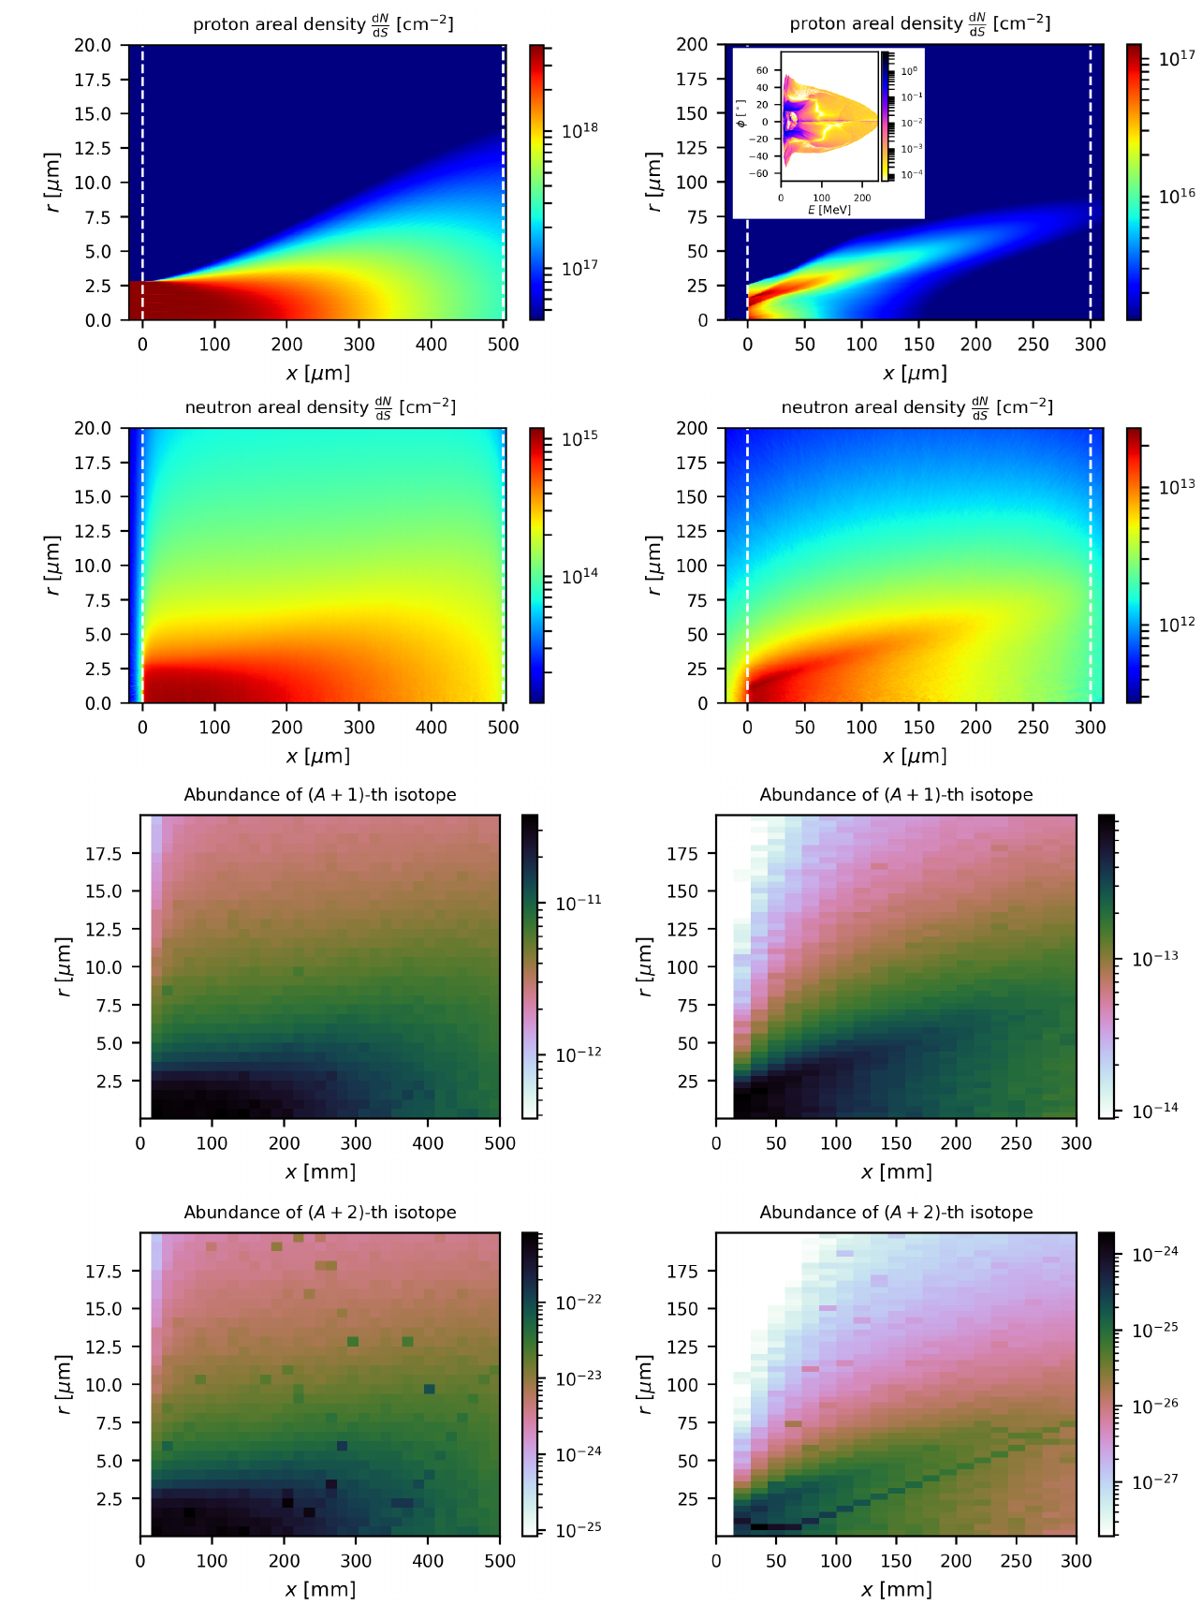
Proton transport and neutron generation
10¹² collimated monochromatic
protons at E = 100 MeV
Optimised 1 PW
double layer case

Slide 36
Neutron-rich isotopes generation
10¹² collimated monochromatic
protons at E = 100 MeV
Optimised 1 PW
double layer case
Generated isotopes
10¹² protons of E = 100 MeV
N₁ = 1.8×10⁵
N₂ = 7.3×10⁻⁷
Double layer primary target
N₁ = 4.7×10⁵
N₂ = 8.8×10⁻⁸
Orders of magnitude lower than with idealized neutron source from literature.

Slide 37




Neutron-rich isotopes calculation
Scholar case: spallation of 1 GeV protons in a golden bulk
Neutron spectrum
Proton beam area, S = 25 um²
N_{p} = 1.0×10¹³
Au converter, L = 8 cm
N₁ = 9.5×10¹²
N₂ = 4.6
protons

Slide 38

Neutron-rich isotopes calculation
Mirfayzi, S. R., et al., Scientific Reports 2020 10(1), 1–8.
Standard LDNS
TNSA with 300 J,
1.2 ps system and
5 μm C₂D₄ target.
Be converter
Fast neutron flux
1×10⁹ n/sr.
Two stage moderation
PET pre-moderator attached to converter
Cryogenic H₂ moderator
Golden plate
Let us assume
100 Hz, 8 hours operation
Cold neutrons , E_{c} = 20 meV
1×10⁷ cold neutrons per shot
total integrated flux at the moderator surface: 1×10¹² n/cm²
Suggested tertiary target
1 mm thick golden plate, A = 10 cm²
Neutron-rich isotope production
N₁ = 6.5×10¹² ,N₂ = 9.1×10⁴

Slide 39



Discussion
Advertisement
Horný, V., & Veisz, L. (2021). Generation of single attosecond relativistic electron bunch from intense laser interaction with a nanosphere. Plasma Physics and Controlled Fusion, 63(12), 125025.
What was ignored?
Decay of (A+1)-isotopes.
  ¹⁹⁸Au half-life is 2.7 days.
Fact that ¹⁹⁹Au decay is hardly observable.
Potential improving effect
  (A+1)-isotopes are for up to 1 ns in excited state
  neutron capture cross-section might be higher
Chen, Q., Mašlárová, D., Wang, J., Li, S. X., Horný, V. & Umstadter D. (2022). Transient relativistic plasma grating to tailor high-power laser fields, wakefield plasma waves, and electron injection. Physical Review Letters, 128, 164801.
Conclusion
Recent literature overestimate the potential of the laboratory studies of astrophysical r-process.
Generation of neutron-rich (≥A+2) isotopes at laser systems in principle possible, but makes no sense.
Horný, V., Krůs, M., Yan, W. & Fülöp, T. (2020). Attosecond betatron radiation pulse train. Scientific Reports 10, 15074.
Dr Vojtěch Horný vojtech.horny@eli-np.ro https://ft.nephy.chalmers.se/~vojtech

Slide 40







Application of neutrons
Mor, I. et al. Reconstruction of material elemental composition using fast neutron resonance radiography. Phys. Procedia
69, 304–313 (2015).
  A very distinctive characteristics compared to ions, electrons or x-rays, making them unique tools to investigate or modify the properties of materials.
Moreau, J. F., et al. "The Dating of a Sixteenth Century Settlement in the Vicinity of Quebec City (Canada) by Means of Elemental Analysis of Glass Beads Through Thermal and Fast Neutron Activation Analyses." Proceedings of the 37th International Symposium on Archaeometry, 13th-16th May 2008, Siena, Italy. Springer, Berlin, Heidelberg, 2011.
Lapinaite, A., Carlomagno, T., and Gabel F. Small-angle neutron scattering of RNA–protein complexes. RNA Spectroscopy. Humana, New York, NY, 2020. 165-188.
Noguere, G. et al. Non-destructive analysis of materials by neutron resonance transmission. NIMA. 575, 476–488 (2007).
Tajima, T., Necas, A., Mourou, G., Gales, S. & Leroy, M. Spent nuclear fuel incineration by fusion-driven liquid transmutator operated in real time by laser. Fusion Sci. Technol. 77, 251–265 (2021).
Fast neutron therapy utilizes high energy neutrons typically between 50 and 70 MeV to treat cancer.
Method: Gray, L. & Read, J. Treatment of cancer by fast neutrons. Nature 152, 53–54 (1943).
Sowerby, B.D. (2007). CRP Report: Fast Neutron and Gamma-Ray Interrogation of Air Cargo Containers.

