Slide 1

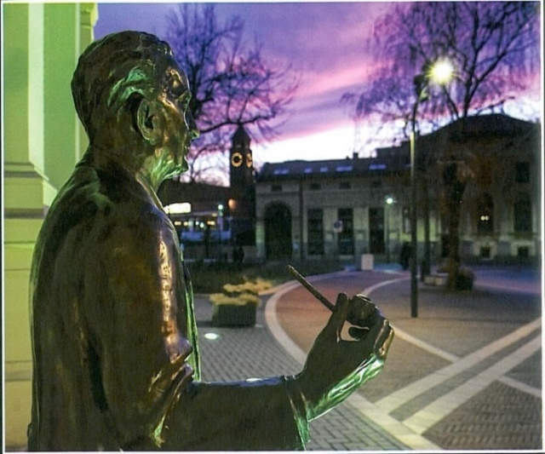
Fast neutron production with kHz repetition rate, few-cycle lasers
Károly Osvay
New opportunities and challenges in nuclear physics with high power lasers
Trento, 1st July, 2024

Slide 2
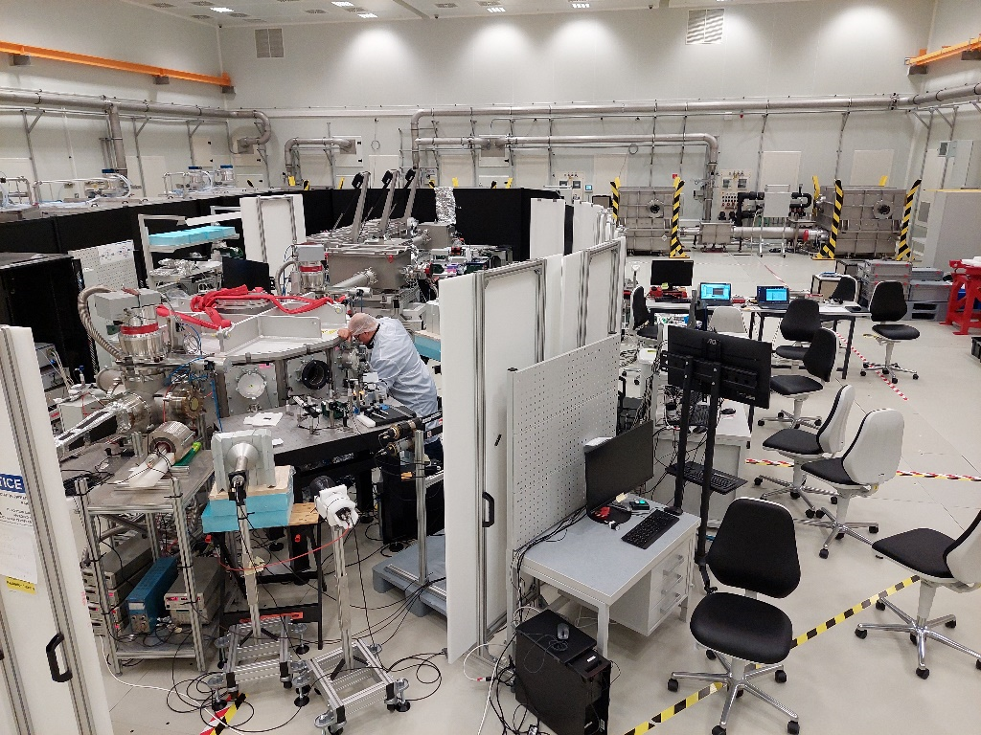

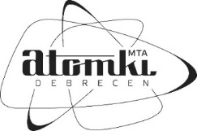



E. Buzás, M. Füle, T. Gilinger, M. Karnok, A.P. Kovács, B. Nagy,
P. Varmazyar
A. Börzsönyi, J. Csontos, A. Farkas, K. Hideghéthy, T. Luca, A. Mohácsi,
R. Nagymihály, R. Polanek, T. Somoskői, L. Schrettner, G. Szabó
R.E. Szabó, L. Tóth, Sz. Tóth
B. Biró, I. Csedreki, Z. Elekes, Z. Halasz, A. Fenyvesi, Zs. Fülöp,
Z. Korkulu, I. Kuti, L. Stuhl
S. Figul, G. Marowski
Hungarian Government: ITM 1096/2019. (III.8.)
National Research, Development and Innovation Office
NKFIH-877-2/2020, NKFIH-476-4/2021, NKFIH-476-16/2021
Multiscan 3D H2020 project: 101020100

Slide 3
Outline
Motivation
Laser-based neutron sources
Neutron generation at 10 Hz
Neutron generation at 1kHz – PRELIMINARY!
Applications

Slide 4
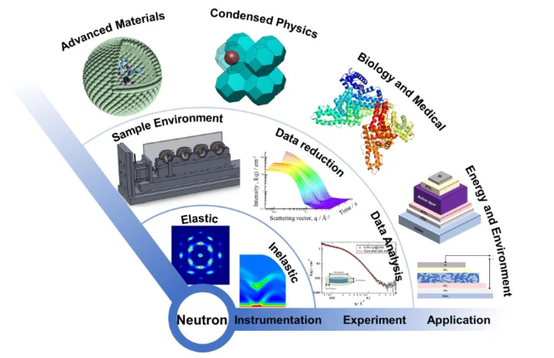
A room for laser-based neutron sources
Demand for neutron sources is rapidly increasing
– by academy, industry, and health care

Slide 5
A room for laser-based neutron sources
Demand for neutron sources is rapidly increasing
– by academy, industry, and health care
The number of neutron facilities sources is decreasing
reactors are aging, and closing down.
big sources are delayed.
Many emerging applications call for neutron sources with
a yield of 10⁸ n/s - 10¹¹ n/s;
relaxed safety and security (compared to reactors);
compact, efficient;
reliable.
Specialities of a laser-based neutron source
neutrons are generated in ultrashort bunches;
the ”machine” (laser) and the ”source” can be separated;
the laser is not a nuclear device.

Slide 6
Laser-based neutron sources
PW class lasers – current situation
Highest efficiency experiment
PhotoFusion
Accelerate ion (proton, deuterium)
Make fusion: Be(p,n), Li(p,n), D(d,n) (T)d,n)
69×10⁷ n/J
2×10⁶ n/s
Günther et al., Nat. Com.13, (2022) 170
Photonuclear
Accelerate electrons
Brehmstralung and high Z converter: (γ,n)
2.9×10⁷ n/J
~ 10⁵ n/s
Average power of such lasers is ~1W
Predicted efficiency
Laser spallation
Accelerate proton
Make fusion: Be(p,n), Li(p,n), D(d,n) (T)d,n)
~8×10¹⁰ n/J
~1300×10⁶ n/s
~1% laser->neutron
Martinez et al., MatRadExt 7 (2022) 024401

Slide 7

Neutron needs and lasers
– energy conservation
Demand: 10¹⁰ n/s, >1 MeV/n
Average power of the neutrons: 1.6 mW (1.6 mJ /s)
Laser needs
0.01% conversion from laser to neutron: 160 W laser
0.001% conversion from laser to neutron: 1.6 kW laser

Slide 8
State of the art reprated PW-class lasers
(all with Ti:S power amps)
Laser | Peak [PW] | Repetition rate [Hz] | Average power [W] | Pulse duration [fs]
Bella (LBNL) | 1 | 1 | 40 | <40
CLPU | 1 | 1 | 30 | 30
CALA | 2.5 | 1 | 70 | 27
ELI-BL | 1 | 10 (3.3) | 300 (42) | 28
ELI-ALPS | 2 | 10 (2.5) | 340 (25) | <20
ELI-NP | 1 | 1 | 30 | <23
 | 10 | 1/60 | <4 | <23
ZEUS | 3 | 1/60 | <1.3 | 20
CoReLS | 3 | 0.1 | 6.3 | 20

Slide 9

Strategies ”en large”
for a laser driven particle (neutron) source
NLTL approach
Start from ”ideal”, ”Dirac”-pulse
Investigate interactions and optimise yields
High repetition rate target development
Purpose designed laser
Increase pulse energy
Use T(P)W lasers from single shot mode
Contrast issues
Increase laser repetition rate
Target development
Both paths would lead to a laser accelerator based particle source…
… with differences especially in early stage
Laser-fusion
(single shot events)
Tokamak
(”continous” operation)

Slide 10
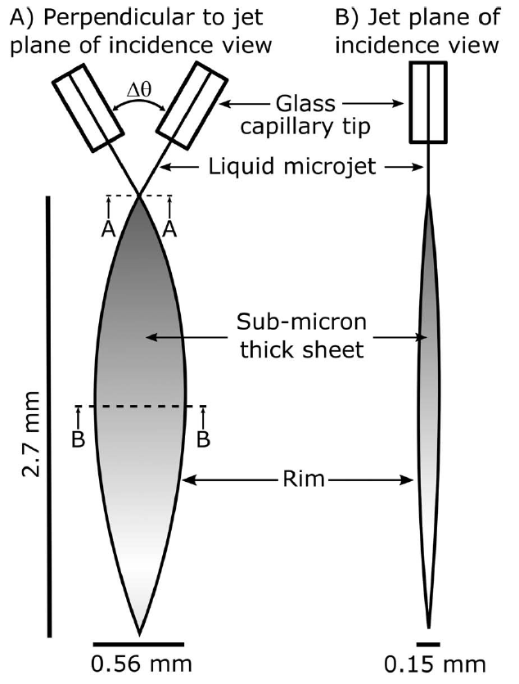
Common challange
High Repetition Rate Targets
Most promising candidates so far
Tape target
Liquid jet
PRAB 20, 041301 (2017)
Cryo H (D) ribbon
HPLSE 7, e50 (2019)
PHYS. REV. X 6, 041030 (2016)

Slide 11
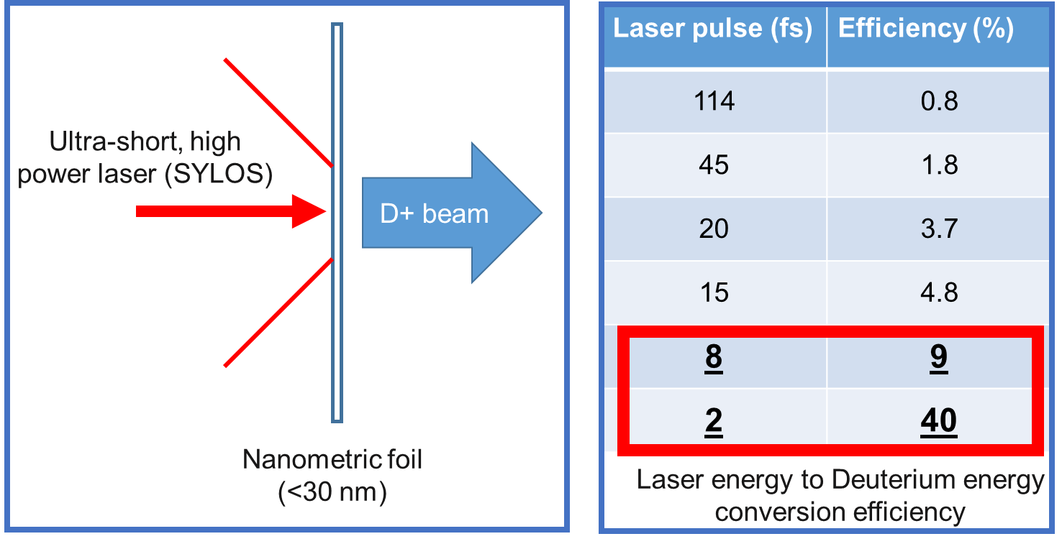
Challange - few-cycle laser pulse
Coherent Acceleration of Ion by Laser (CAIL)
(thin target, single- (few-) cycle laser pulse)
a₀ ~ σ
Early 1D simulations

Slide 12
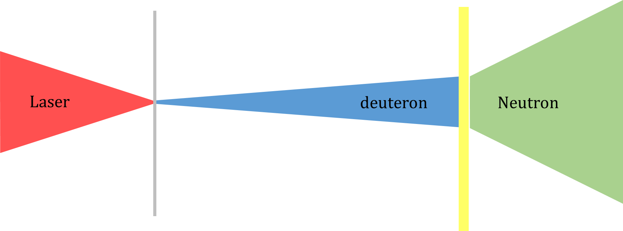
Scheme of the interactions
D⁺ acceleration
d(D,n)3He fusion
1 Hz (burst) mode, rotating wheel target
Deuteron acceleration from foils and neutron generation
Single shot, few-cycle, single cycle pulses
Study of ion acceleration on ultrathin foils
Osvay et al., EPJ Plus, in print
10 Hz continous mode ultrathin liquid leaf target system
Deuteron acceleration from liquid leaf and neutron generation
Singh et al., Sci. Rep. 12 (2022) 8100
Varmazyar et al., Rev.Sci.Instr. 93 (2022) 073301
Ter-Avetisyan et al., PPCF 65 (2023) 085012
Toth et al., Opt. Lett. 48 (2023) 57
Hadjikyriacou et al., in prep.
Lecz, Varmazyar et al, in prep.
Füle et al, HPLSE in print
Osvay et al, in prep.

Slide 13
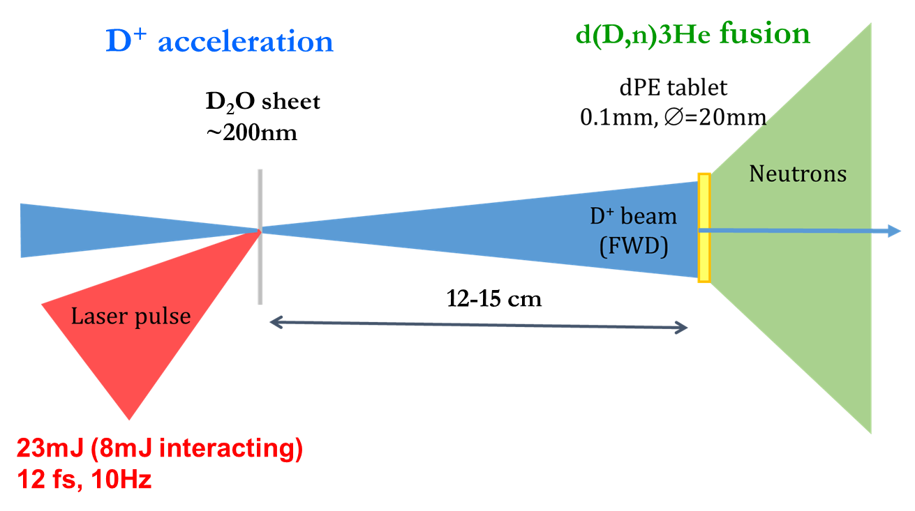
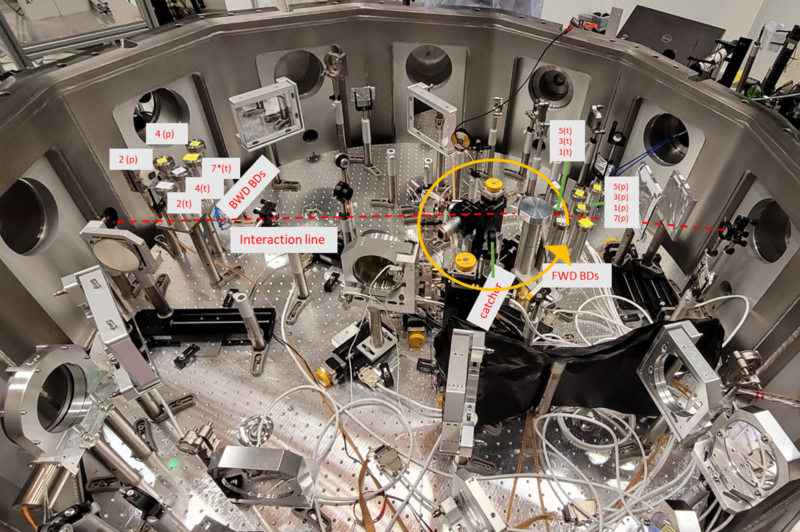
Ion Acceleration and Neutron Generation with Few-Cycle Lasers

Slide 14
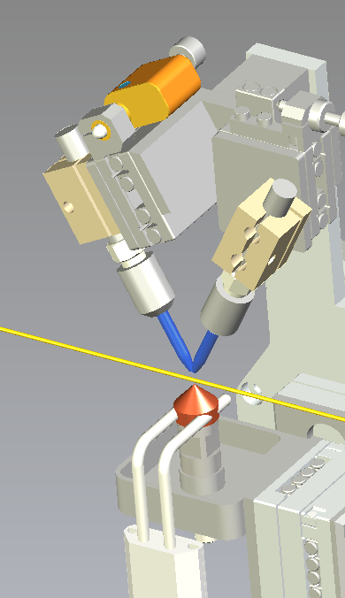
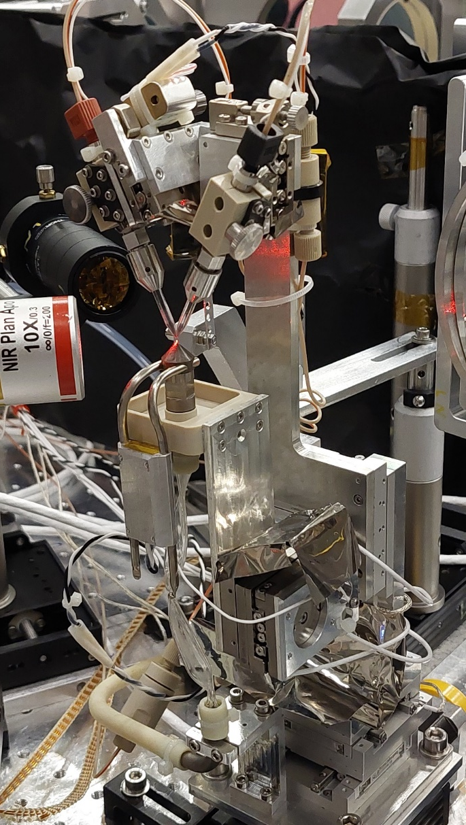
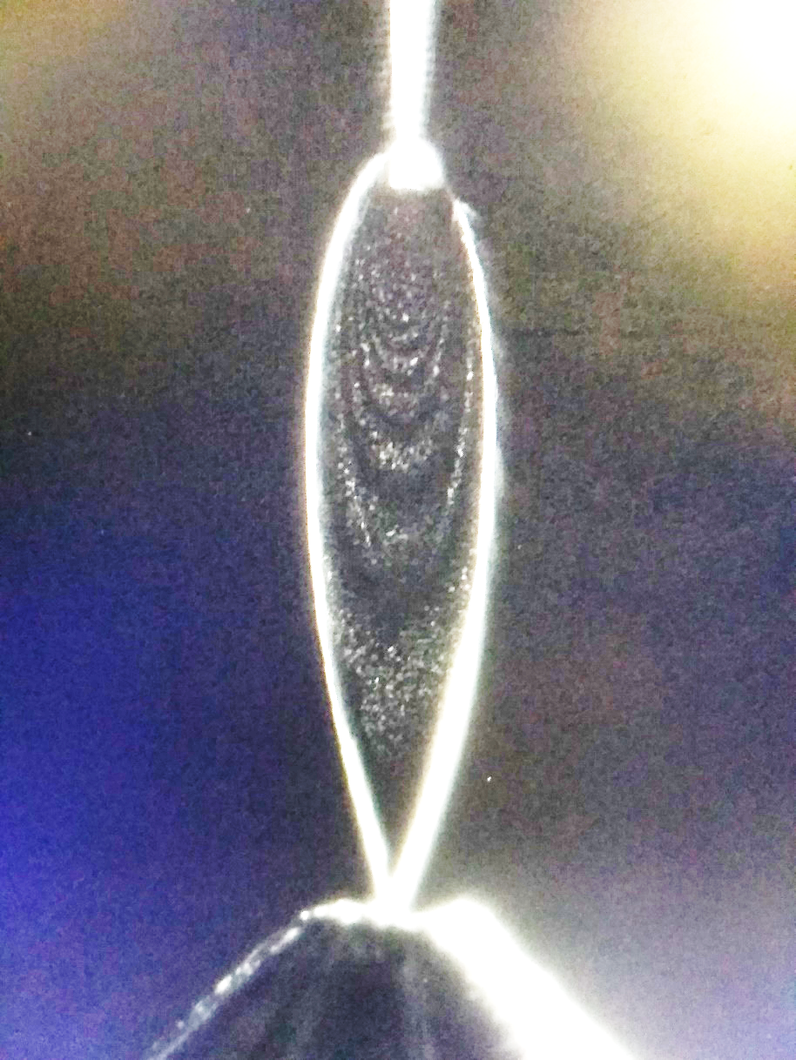
Development of a sub-200nm
liquid leaf target
Two liquid jets collide from two glass nozzles
Pulsation damping system for stability
Recirculation system for continous operation
Cold finger for 10⁻⁴ mbar vacuum
Thickness measurement in situ, in air and in vacuum
Füle et al, HPLSE (2024) in print

Slide 15
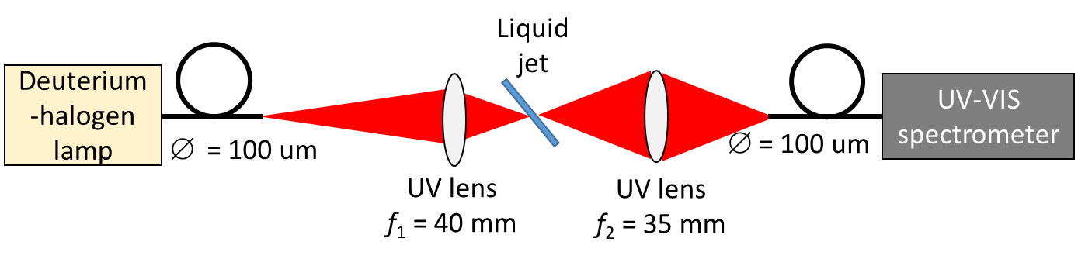
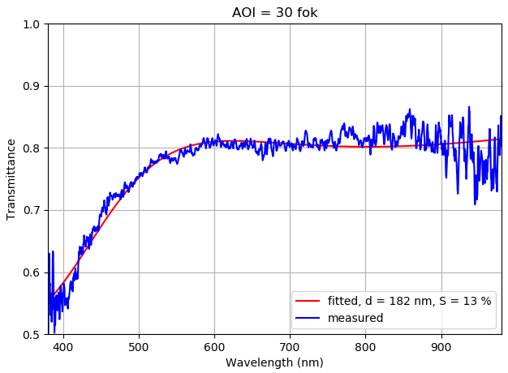
Thickness measurement
Thickness measurement with white light spectral interferometry
Vacuum compatible (with fibers):
- light spot diameter on the target: 50 μm.
- modulation of the spectral transmittance due to the interference between the transmitted beam and the beams arising from the reflection on the front and back surfaces of the layer.
The resolution is:
~180 nm (PTFE foil)
With extension to UV → ~100nm

Slide 16
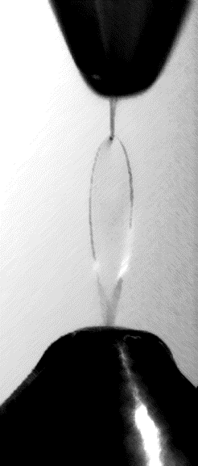
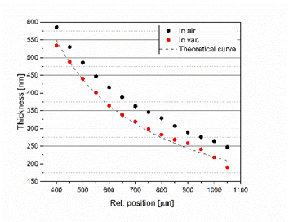
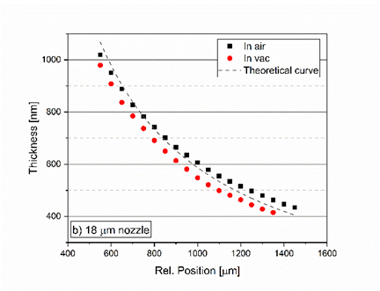
Thickness variation and tuning in situ
in air and in vacuum
∅: 11 μm
∅: 18 μm
Thickness of the liquid sheet
Varies along the flat surface;
Depends on the size of microjets;
Thinner in vacuum
Vacuum: <10⁻⁴ mbar
Füle et al., HPLSE (2024), in print

Slide 17
Thickness mapping
The thinnest and optically good quality part of the liquid leaf is around its tip.

Slide 18
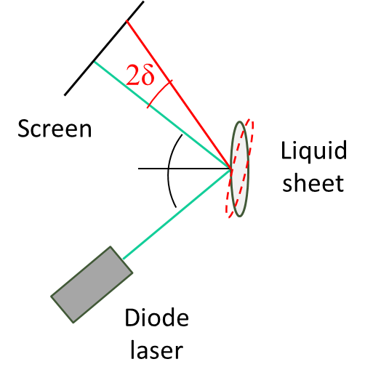
Mechanical stability
Angular position in vacuum
by human intelligence correction
Resonant stability
by MicroEpsilon ILD2300-20
Füle et al., HPLSE (2024), in print

Slide 19
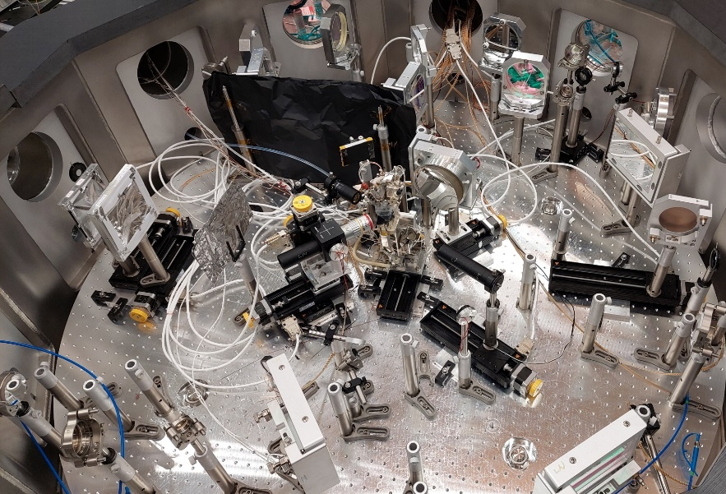
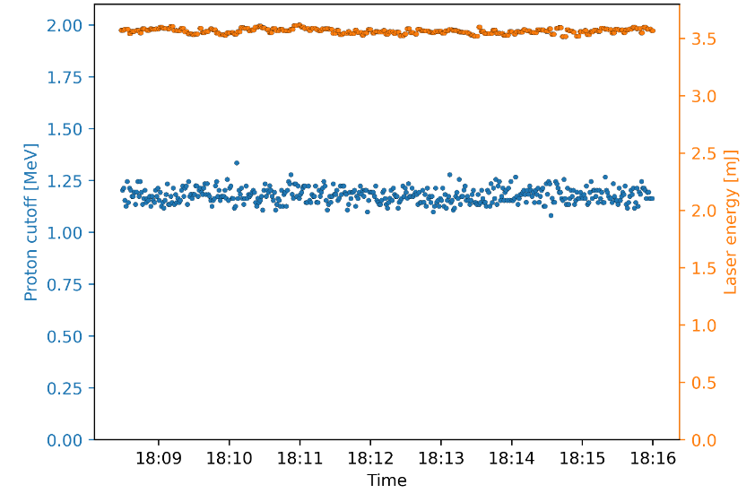
First test - proton acceleration
Leaf thickness: ~200nm
Laser ”interaction” energy
3.56 mJ ± 0.02 mJ
Proton cut-off energy:
1.19 MeV± 0.04 MeV
Proton energy stability <3.5%

Slide 20
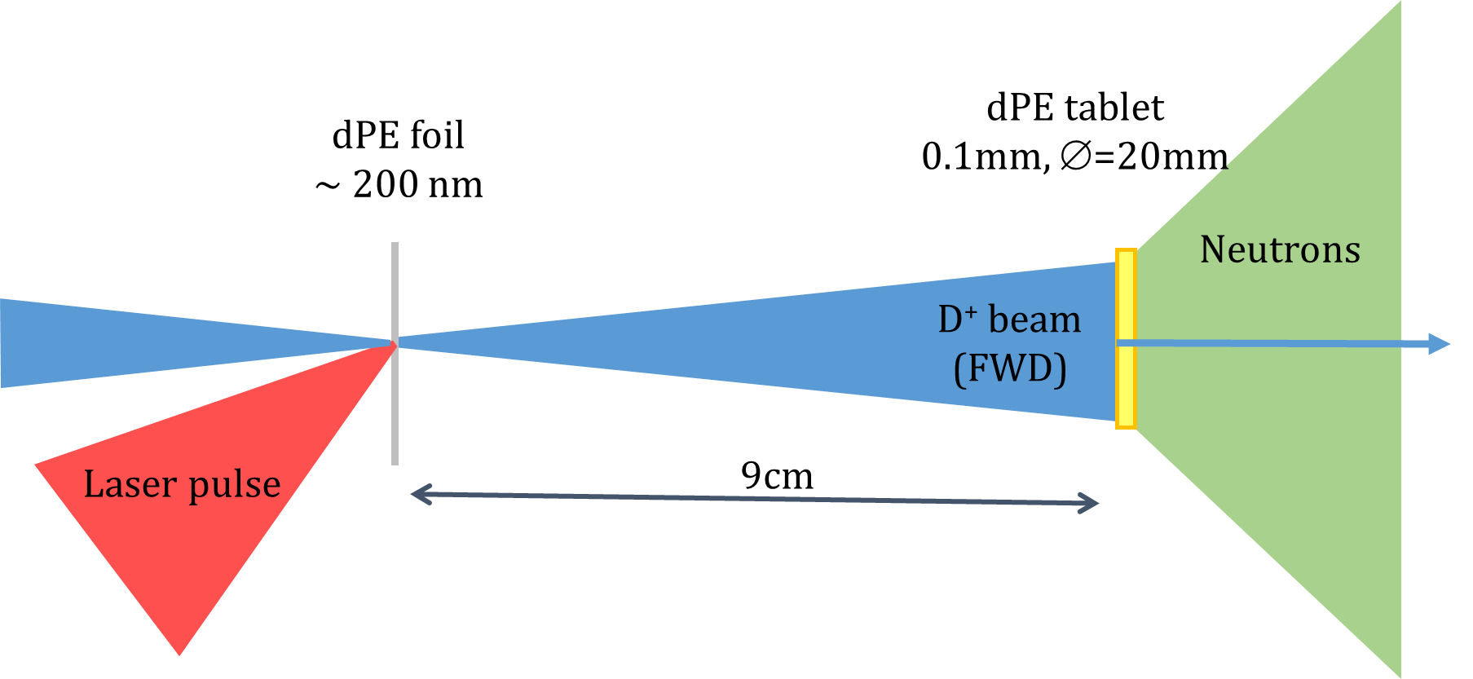
Neutron generation at 10Hz
D⁺ acceleration
d(D,n)3He fusion
D₂O sheet
~200nm
12-15 cm
23mJ (8mJ interacting)
12 fs, 10Hz

Slide 21
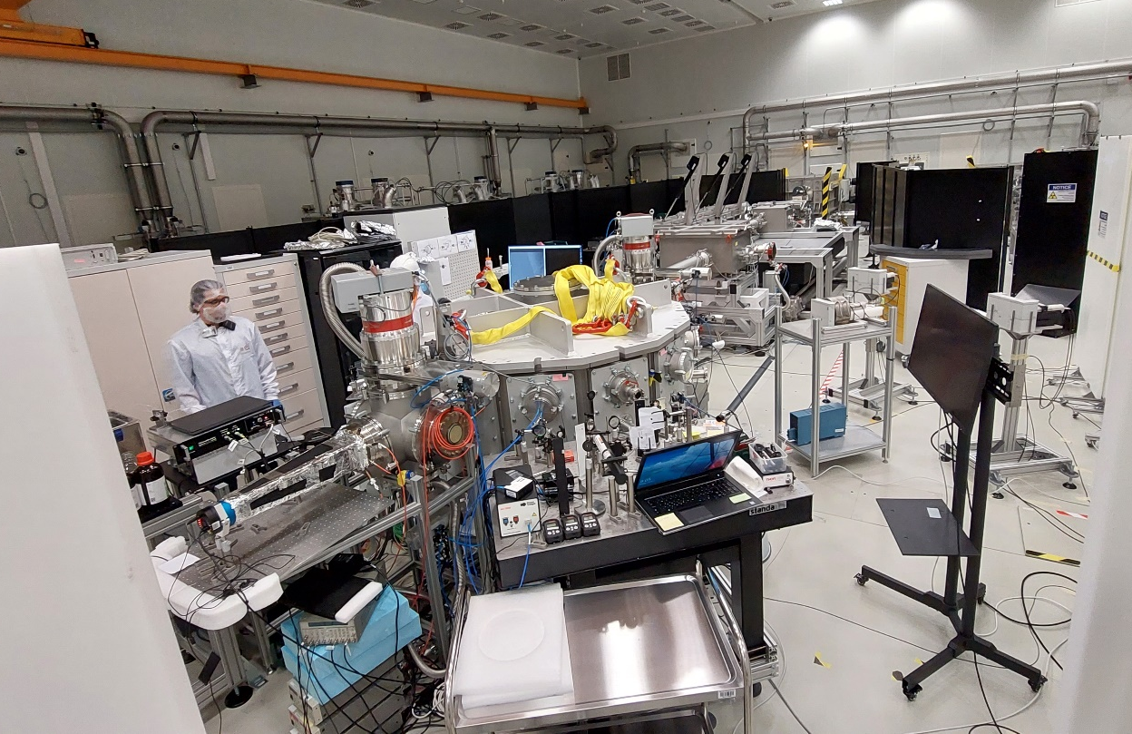
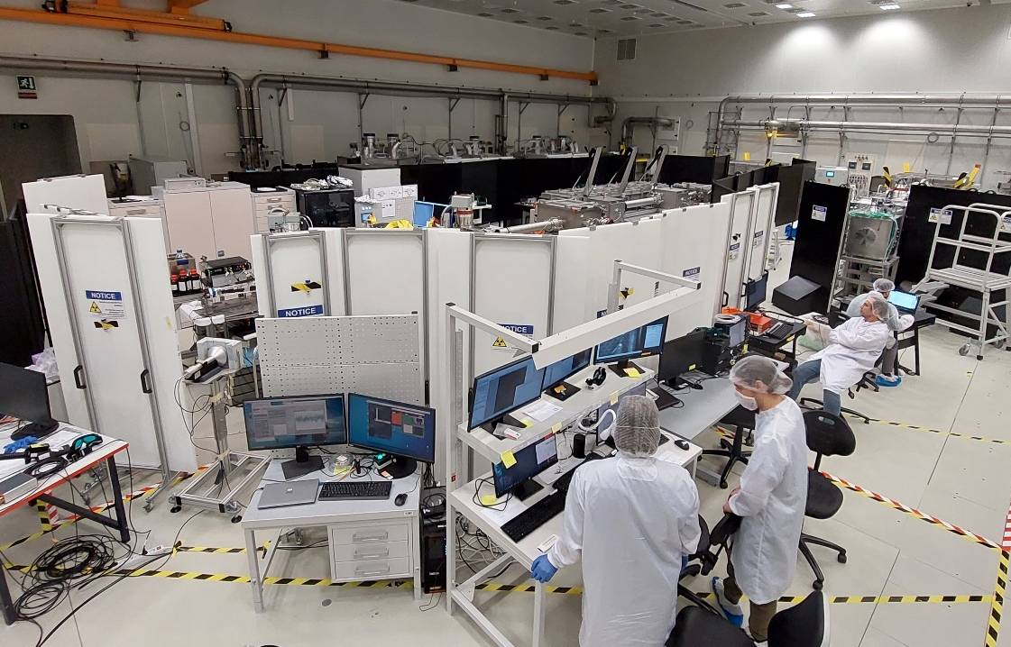
The Light Energy Ion Acceleration (LEIA) First University beamline in ELI-ERIC (ALPS)

Slide 22
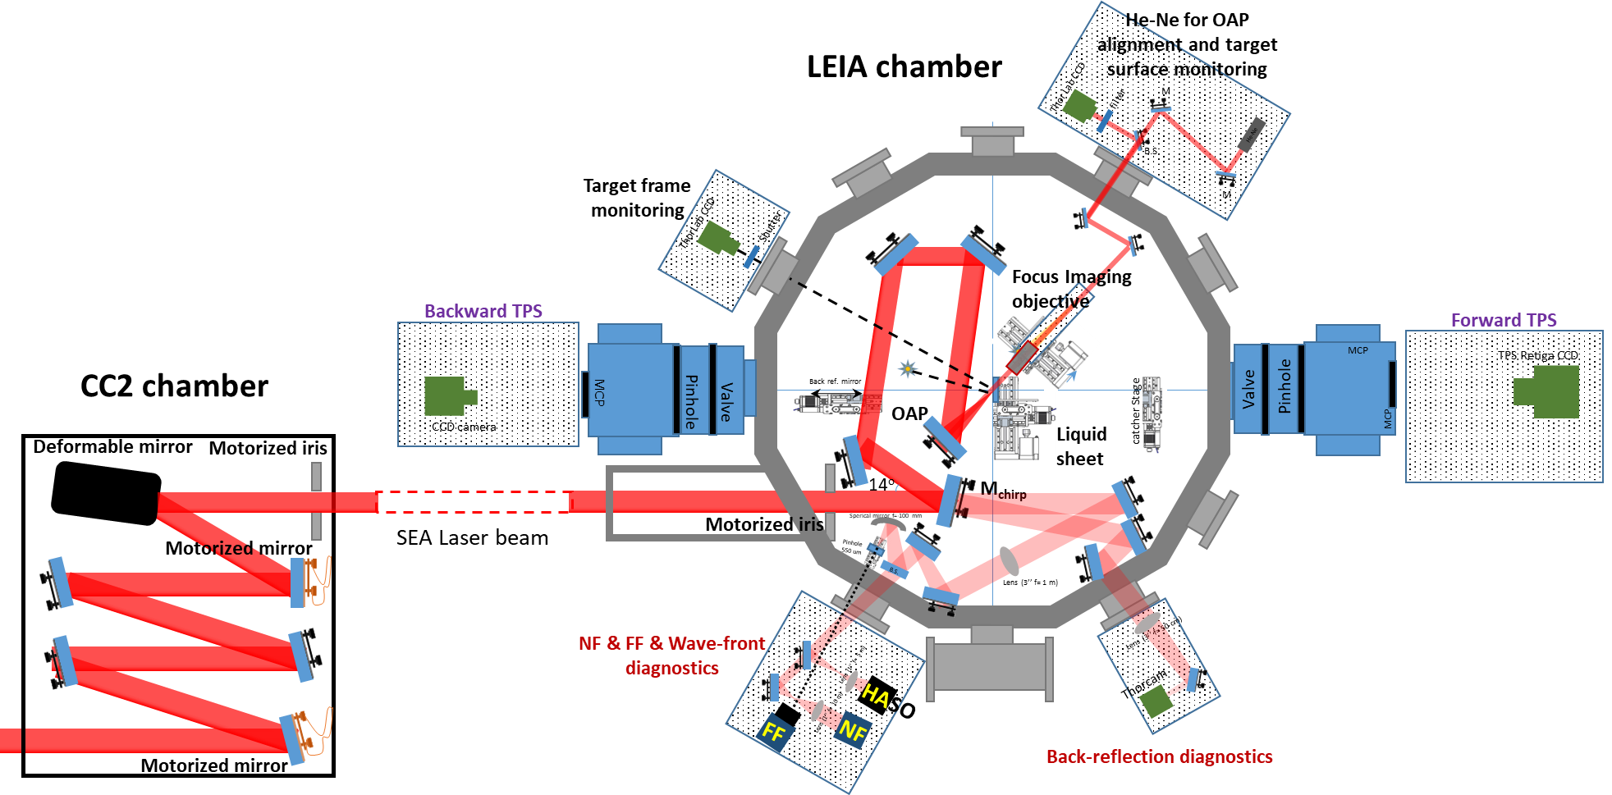
Ion acceleration at 10 Hz repetition rate
from D₂O liquid target

Slide 23

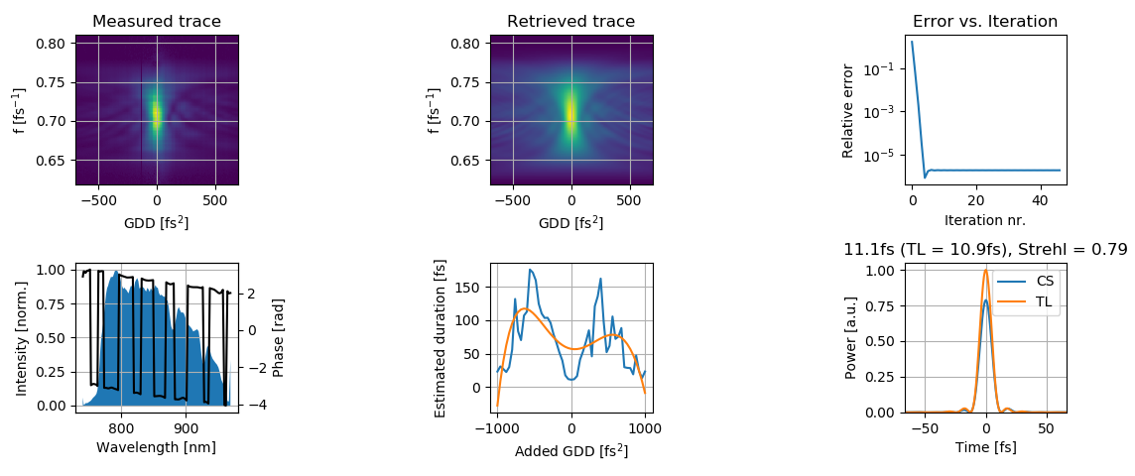
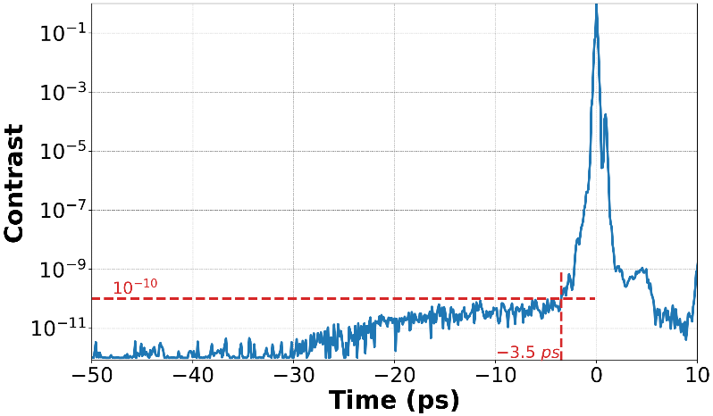
LASER
SEA laser (10Hz, OPCPA) of ELI-ALPS parameters on target
Pulse energy: ~23 mJ
(measured for each shot)
Laser pulse duration: 12.3 fs
Measured in vacuum, after OAP,
with disp scan
Focal spot FWHM: 3.2×3.8 µm²
Peak intensity in focus: 4×10¹⁸ W/cm² (a₀~1)
Temporal contrast
Toth, et al., Photonics 2, 045003 (2020)

Slide 24
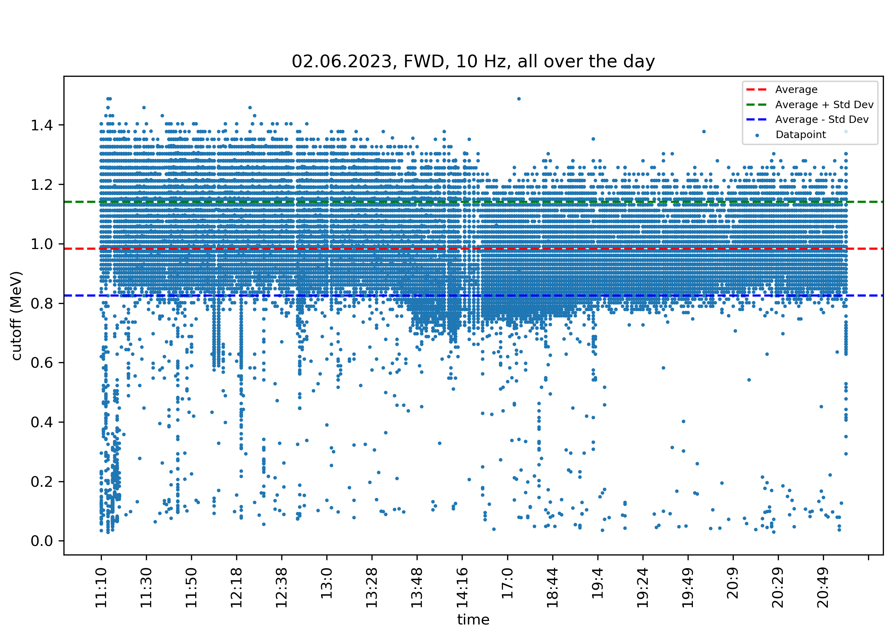
Deuterion acceleration at 10 Hz repetition rate
One of the four days
On 2nd June, number of shots: 73422
cut-off for the day: 0.98±0.16 (MeV)
cut-off morning: 1.02±0.17 (MeV)
cut-off afternoon: 0.96±0.11 (MeV)

Slide 25

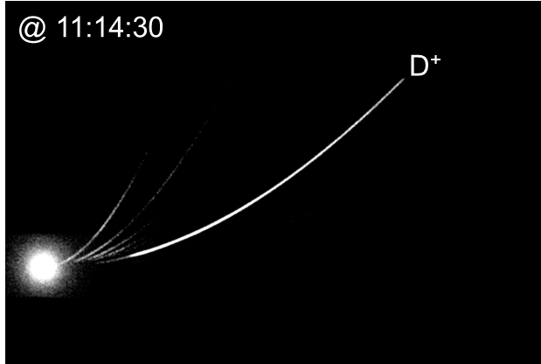
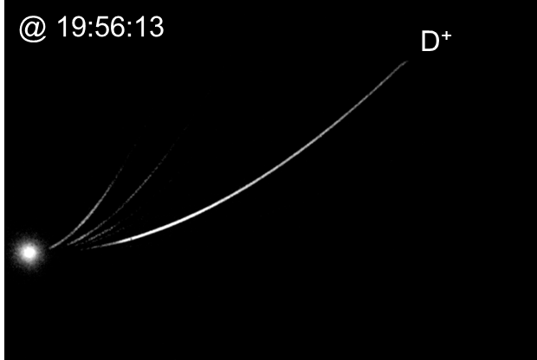
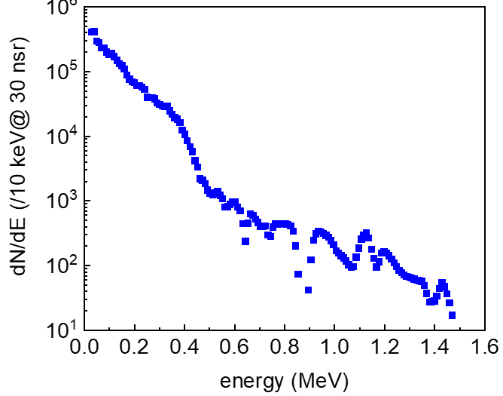
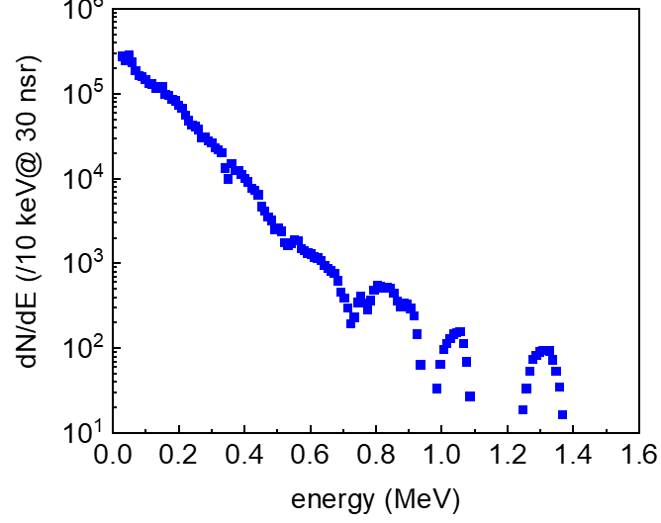
Deuterion acceleration at 10 Hz repetition rate
Spectral stability

Slide 26
DIAGNOSTICS – neutron
Three independent systems
Outside the chamber
Plastic scintillators: LILITH M, XL systems
Liquid scintillator: PHRS system
Inside the chamber
Bubble Neutron Detector Spectrometer
Plastic scintillators
Time-of-Flight detection

Slide 27
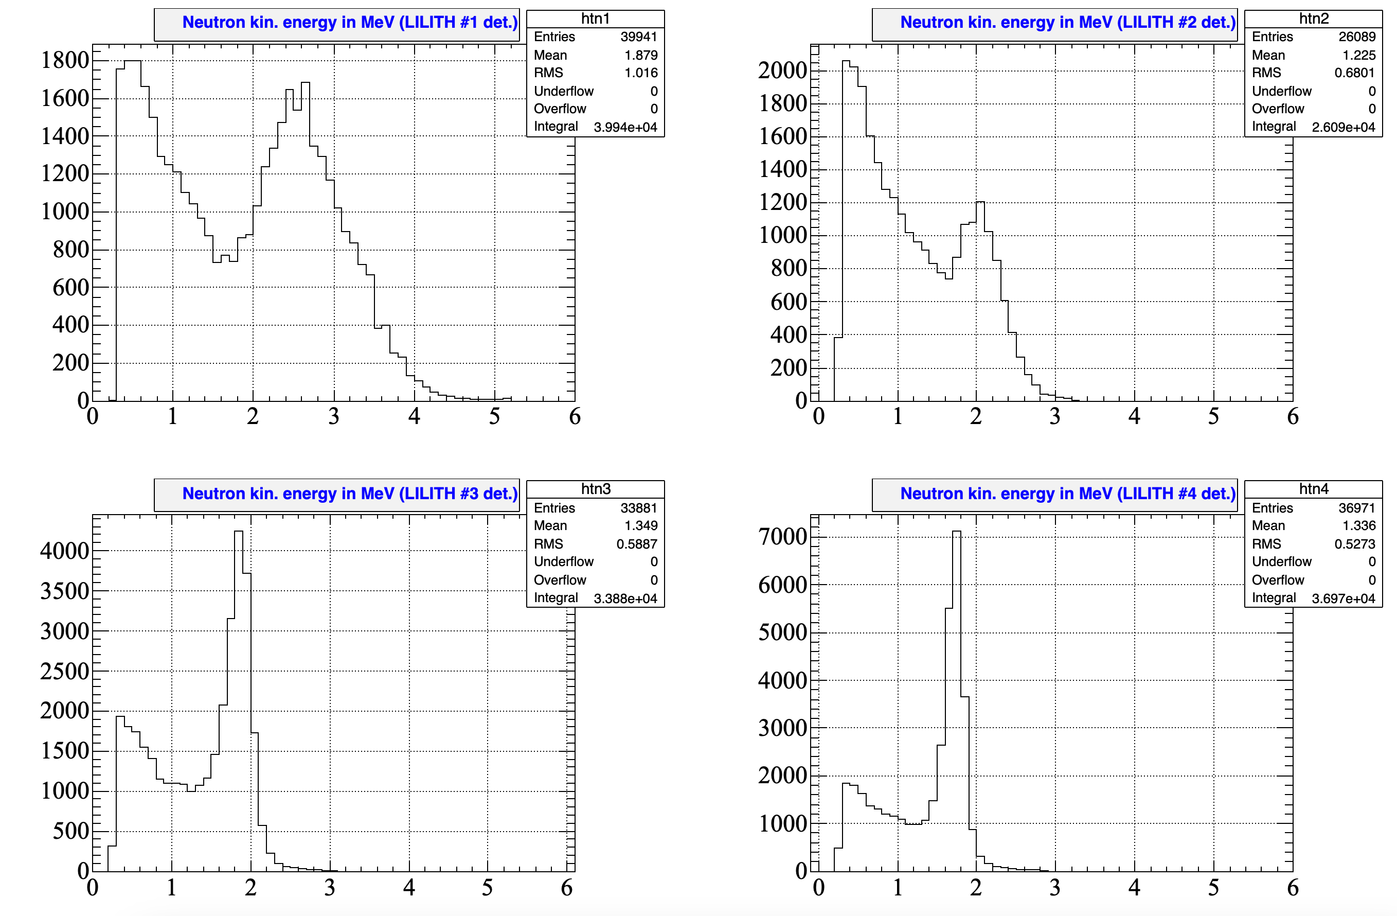
Neutron measurements
LILITH system, neutron spectra
1
2
4
3
2
3
4
1

Slide 28
Neutron measurements
Pulse Height Response System (PHRS)

Slide 29
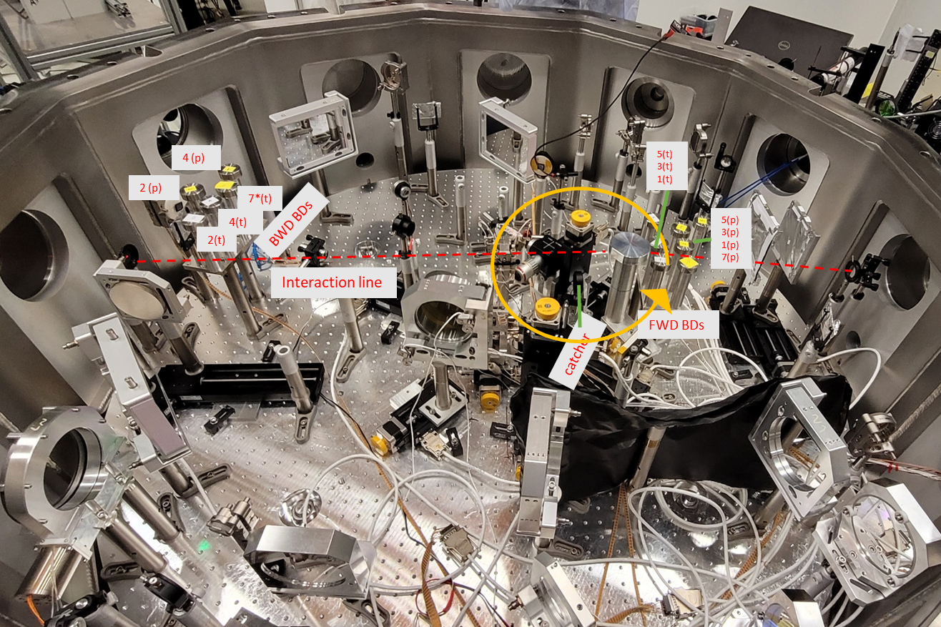
Neutron measurements
Bubble neutron detector spectrometer
FWD, BWD

Slide 30
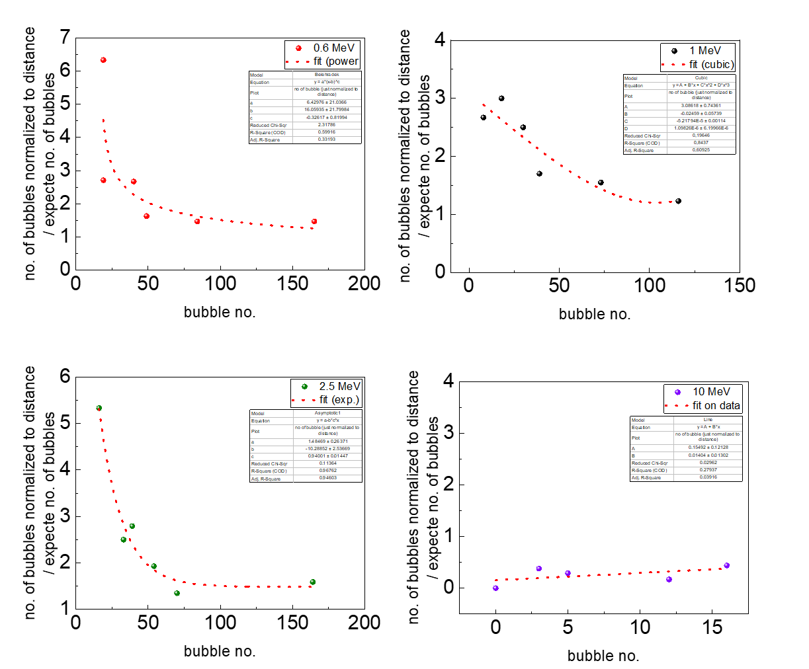
Neutron measurements
Calibration of BNDS for low number of bubbles with a Pu-Be source
At low counts, the bubble detectors (<10MeV) overestimate the real neutron numbers!

Slide 31
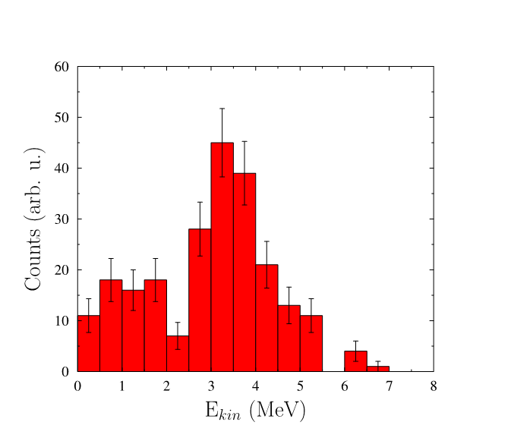
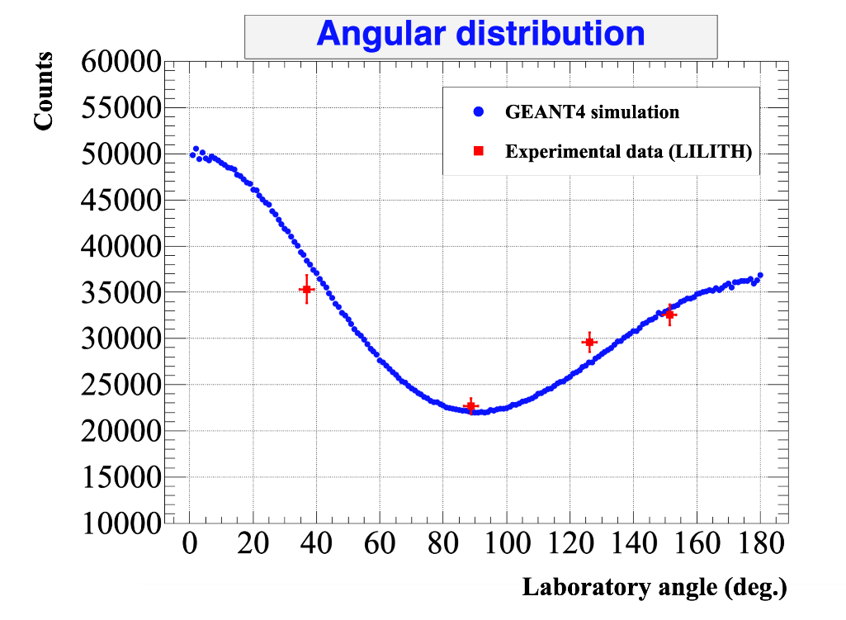
Neutron yield
LILITH, vs angle
FWD Neutron spectrum
Laser energy on the target: 23mJ
Laser energy within FWHM focal spot: 8mJ
~1.5×10⁵ n/s

Slide 32
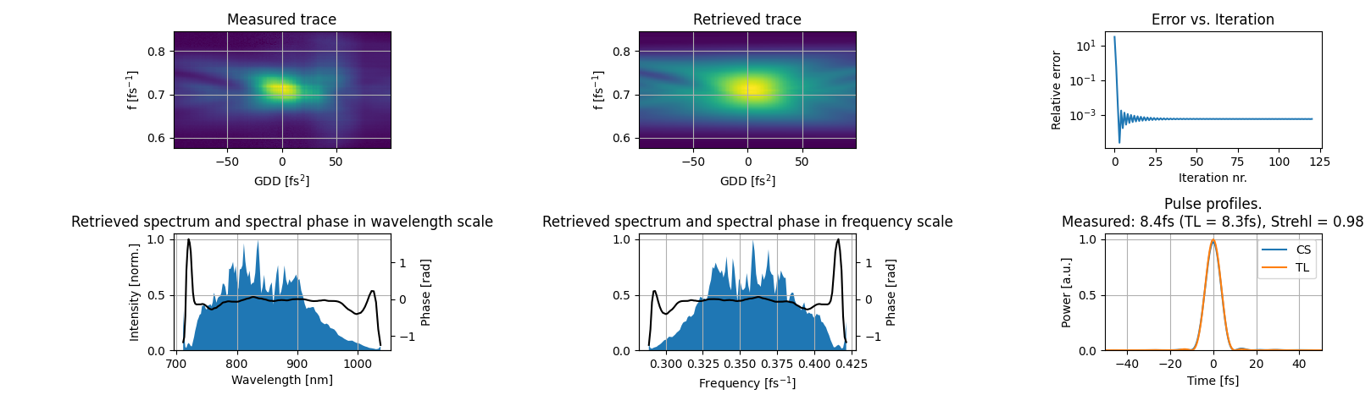
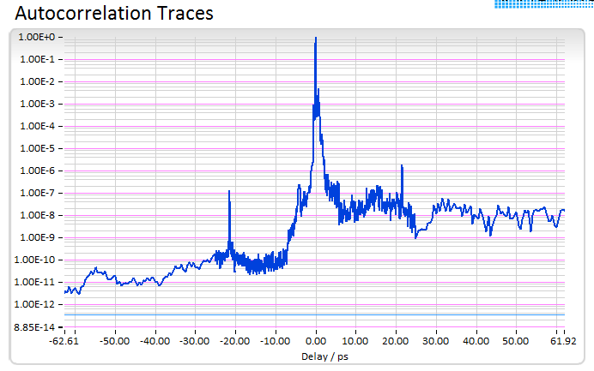
LASER
S3 laser (1 kHz, OPCPA) of ELI-ALPS parameters on target
Pulse energy: ~90 mJ
(average measurement of
10k shot)
Laser pulse duration: 8.4 fs
(measured in vacuum, after OAP, with disp scan)
Central wavelength: 826nm
Focal spot FWHM: 2.9×2.6 µm²
Peak intensity in focus: 1×10¹⁹ W/cm² (a₀~2.2)
Temporal contrast
*peak at +-22ps is estimated to be post-pulse from the variable density filter in the diagnostics arm, not in the main output

Slide 33
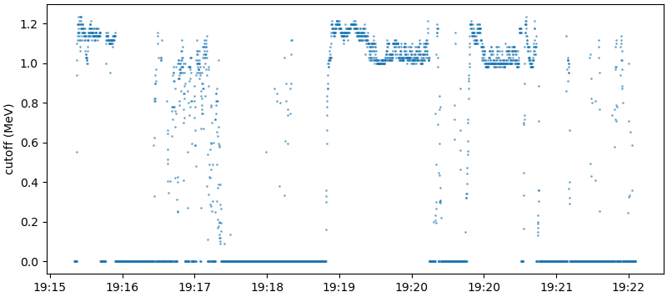
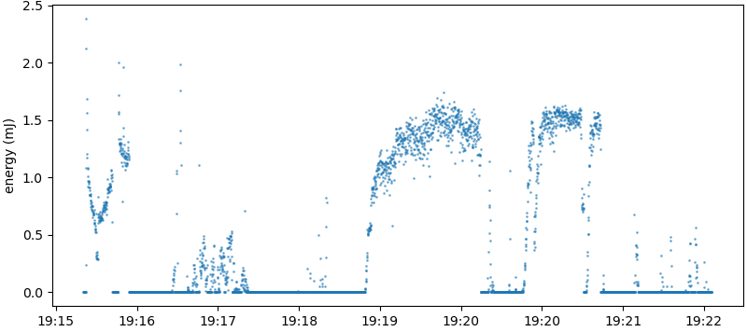
Deuterion acceleration at 1 kHz repetition rate
100 mJ (20mJ ”interacting”) energy on target
Cut-off energy of deuterons
Preliminary, confidential
Energy of deuteron pulses
Liquid jet instabilities;
Optimisation with contrast and focusing
Reneweable catcher
… all to be solved in the next months

Slide 34
Neutron generation at 1kHz
Neutrons measured with bubble detectors – AVERAGE numbers!
Preliminary, confidential
Average neutron per shot on Dec 20th:
~ 17×10³ n/shot

Slide 35
”Seven seconds of grace”
neutron detection for 100 shots
ToF measurement of the generated neutrons
Preliminary, confidential
Peak neutron per shot (average of 100) :
70×10³ n/shot

Slide 36
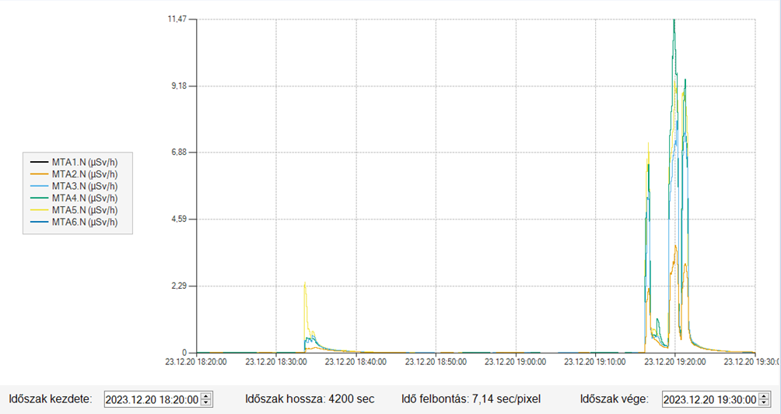
YET considerable dose was delivered in 6 min with 1kHz laser-based fast neutrons
Neutron radiation measured by the neutron detectors within the MTA area
(~9m from the neutron source)
Peak: 11.5 μSv/h
Preliminary, confidential
Average neutron per shot:
~ 16×10³ n/shot
Peak neutron per shot:
~ 300×10³ n/shot
Peak neutron yield / sec:
~ 3×10⁸ n/s

Slide 37
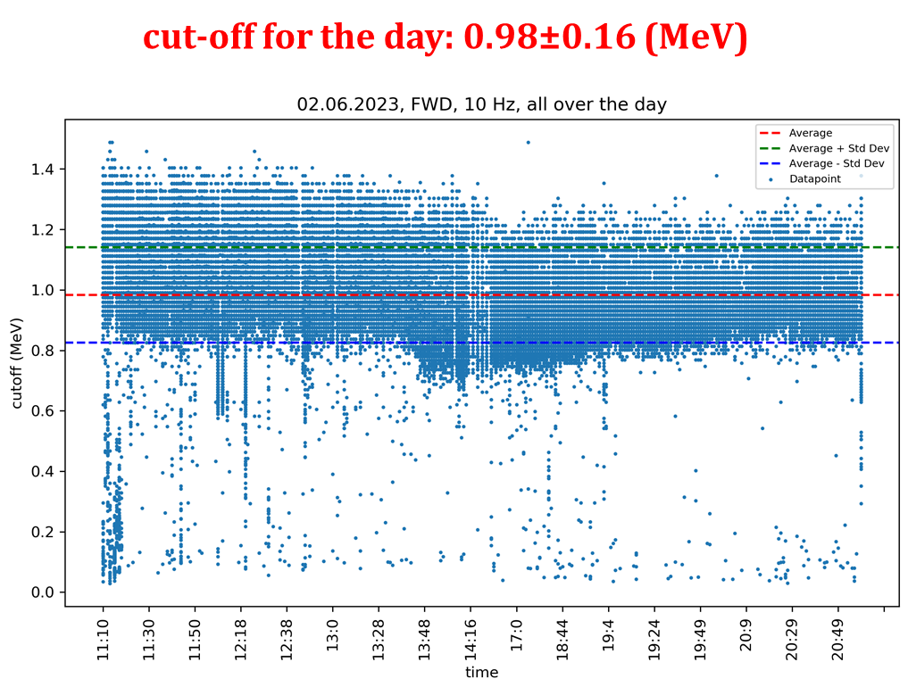
State of the art neutron generation at 10 Hz repetition rate (~6 hours)
Deuteron acceleration from liquid
- at 10 Hz, SEA laser
- at 230mW (80mW) average power
- 200nm D₂O leaf + 0.1mm C₂D₄
Neutron generation
- 200nm D₂O leaf + 0.1mm C₂D₄
- fusion neutron spectra peaks ~3 MeV
~1.5×10⁵ n/s
Peak yield detected 2023/24 at 1kHz :
- at 100W (?20W?) average power
~10⁸ n/s

Slide 38
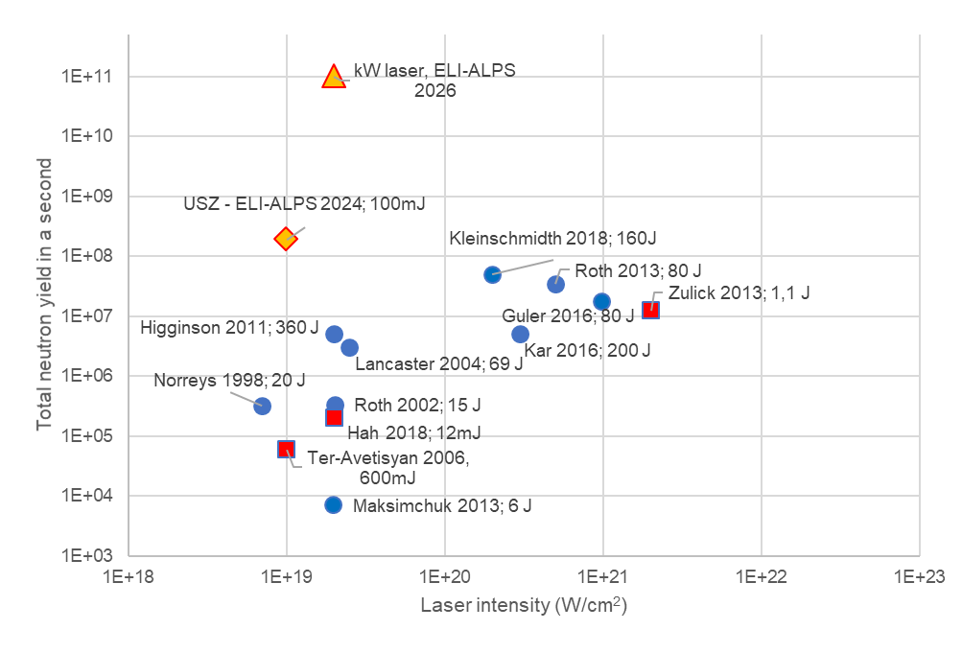
Laser-based neutron sources
for applications
Most recent result from us
Applications: where reliable statistics are needed.

Slide 39

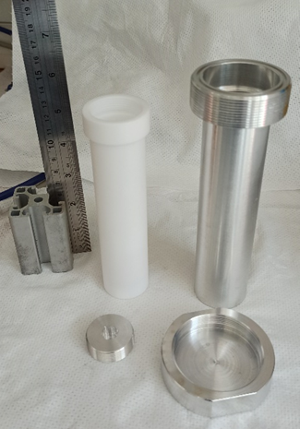
Possible (ongoing) applications of
laser-generated high reprate neutrons
Radiation damage research (space science, fusion reactors, etc.)
Nuclear physics
Radiation safety
Isotope production
Home land security
A H2020 project
Experiment in December ’23 - January ’24
with Hideghethy’s groups in ELI-ALPS
and Oncology Clinics of Uni Szeged
Radiobiology

Slide 40
Development of a compact,
laser-based multiple source (X-ray, electron, neutron)
stage for cargo inspection

Slide 41
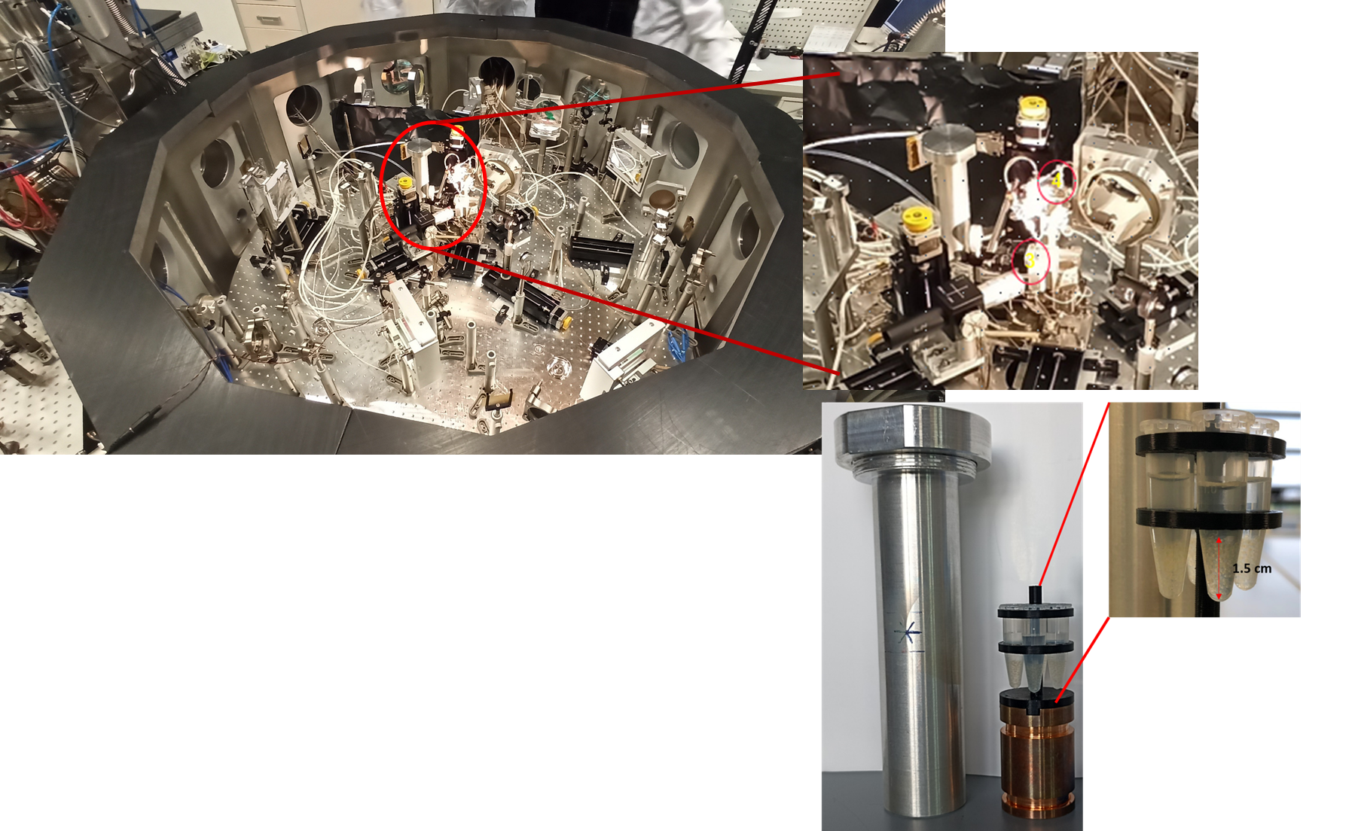
First radiobiology experiment with
laser-generated neutrons
Experimental chamber…
…. Zebrafish embryos in
a vacuum tight container

Slide 42
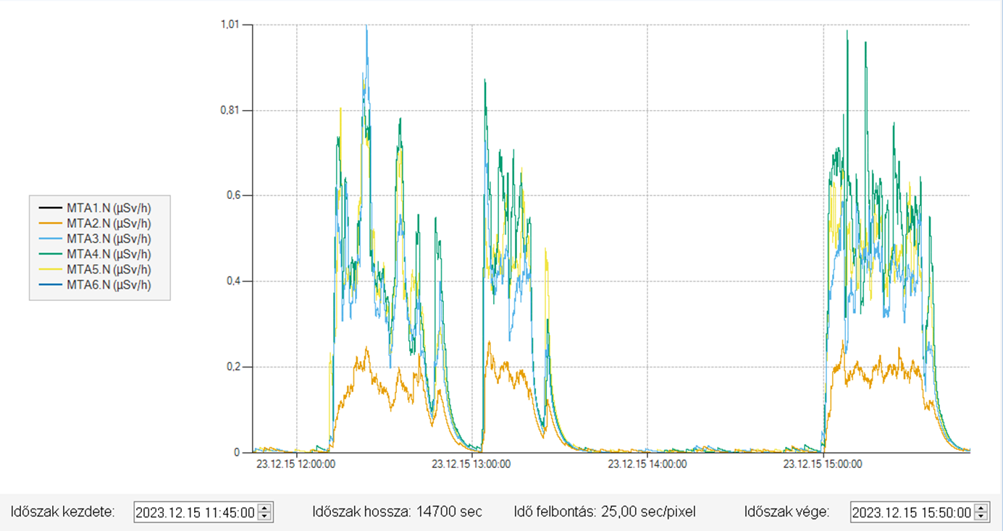
First radiobiology experiment with
laser-generated neutrons
1kHz repetition rate, laser pulse energy on target: 50mJ
Irradiation time: ~100 min
Neutron radiation measured by the neutron detectors within the MTA area
(~9m from the neutron source)

Slide 43
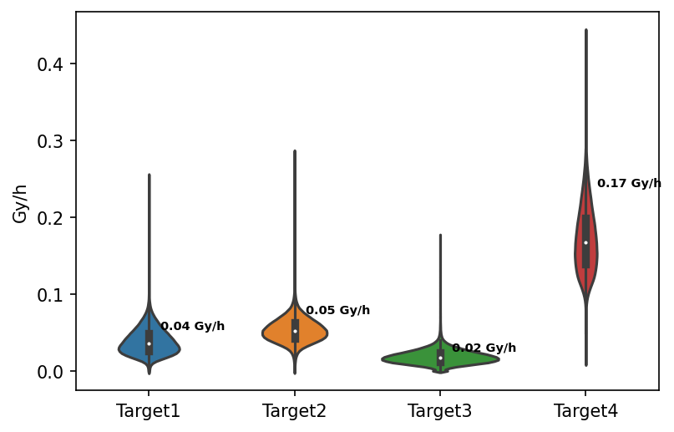
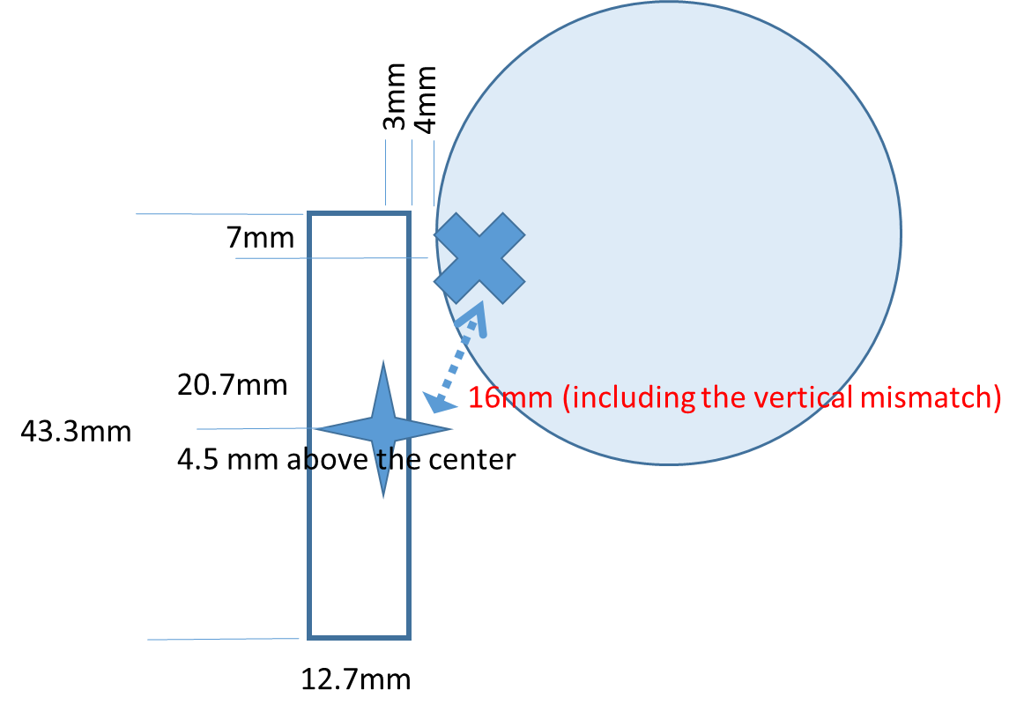
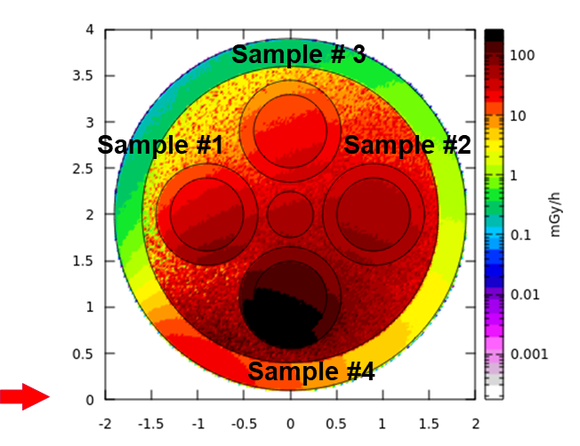
First radiobiology experiment with
laser-generated neutrons
MC-calculated neutron dose on the samples
Largest delivered dose (#4) :
0.27Gy

Slide 44

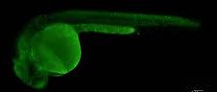


First radiobiology experiment with
laser-generated neutrons
Apoptotic cell density

Slide 45
Towards Nuclear Reaction Studies

Slide 46
Towards Nuclear Reaction Studies
State-of-the-art technology:
  Proton beam:
    Wide energy range
    Cut off energy around 1MeV
  Neutron beam
    Quasi mono energetic around 3MeV
Beam intensity:
  High/shot, low/s
  kHz repetition rate and beyond
  Flash-like beam
Astro physics cases:
  rp-process
    2p induced reactions
    Low E protons
  R-process
    High n-flux
    High energies
Detection technology:
  In-beam vs activation (EMP/flash effects)
  AMS

Slide 47
Towards a neutron source for
sub-critical nuclear reactors
Sub-critical 100MW_{th} reactor, k>0.99 10¹⁶ n/s, >1 MeV/n
Average power of the neutrons: 1.6 kW (1.6 kJ /s)
Laser needs
0.1% conversion from laser to neutron: 1.6 MW laser
0.01% conversion from laser to neutron: 16 MW laser
Current industrial-grade laser technology (Trumpf): ~10kW laser
Number of lasers needed: 10… 100

Slide 48




The first AD research reactor - MYRRHA
Large infrastructure
600 MeV – 1.5 GeV Proton Accelerators
  Large undertaking in of itself
Very Localized
To be operational mid 2030’s
Large, industrially not stable neutron source

Slide 49
Can laser ion acceleration do it better
(than a linac)?
Reliability
- >99% availability vs. 85%
- chance of one laser is broken within a year is < 10⁻⁷
Trouble-free operation of a laser (months): 2 10
Number of laser systems: 100 10
Novel reactor architecture
Multiple sources – isotropical burn
Fast feedback and control - AI
Smaller footprint (real estate)
J. Tanner et al., PhD Thesis, UCI

Slide 50

(Partition and) Transmutation of spent nuclear fuel
Radiation time reduction:
1 000x
Volume reduction: 100x

Slide 51

Further outlook - the big(est) shot
A (laser-)accelerator driven Thorium (molten salt)
(sub-critical) reactor!
First promoter was and initial experiments done by E.Teller.
Recently, Nobel leaurates as C. Rubbia and G. Mourou
by C.Rubbia

