Slide 1
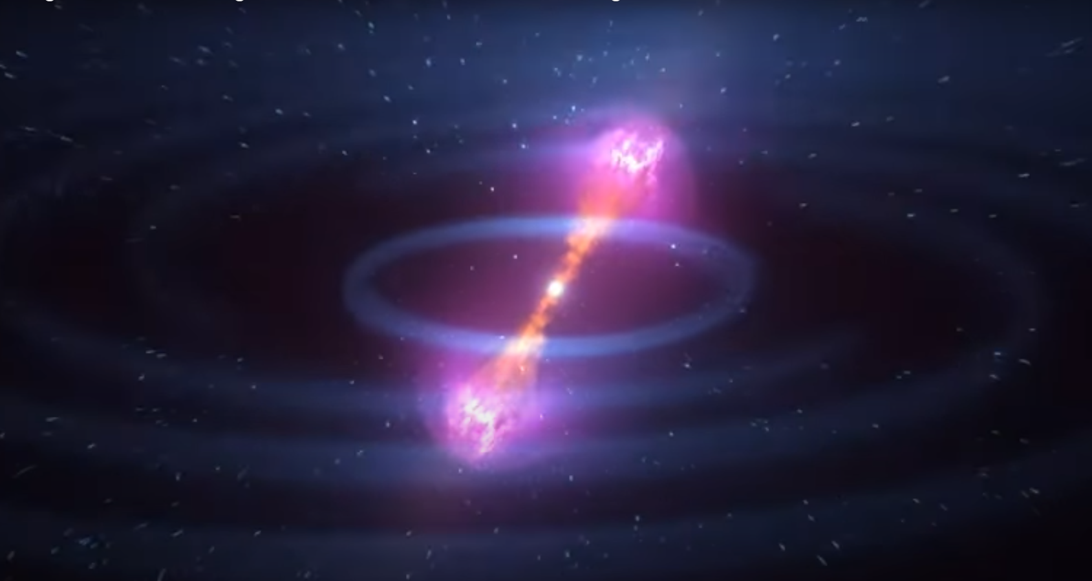
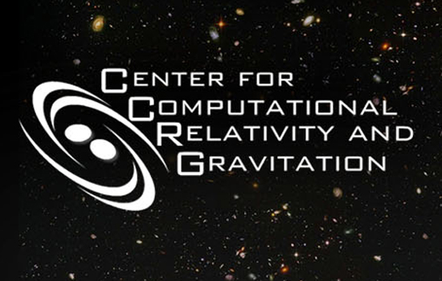




Kilonova dependence on ejecta morphology and composition
(+ nucleosynthesis dependence on nuclear input)
Atul Kedia
Postdoc @ NCSU
ECT* - Trento, italy
illustration: NASA Goddard

Slide 2
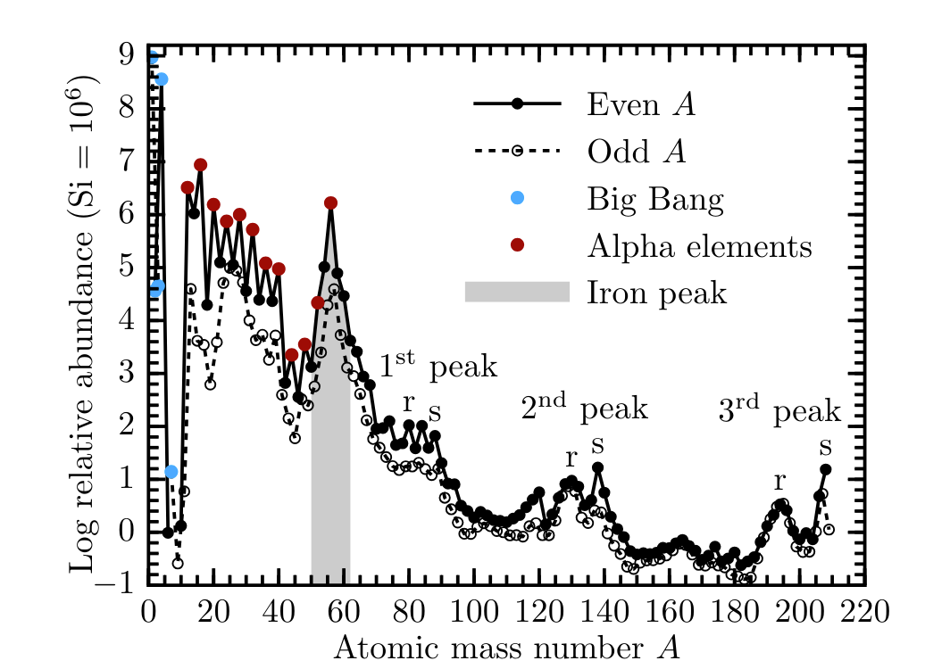
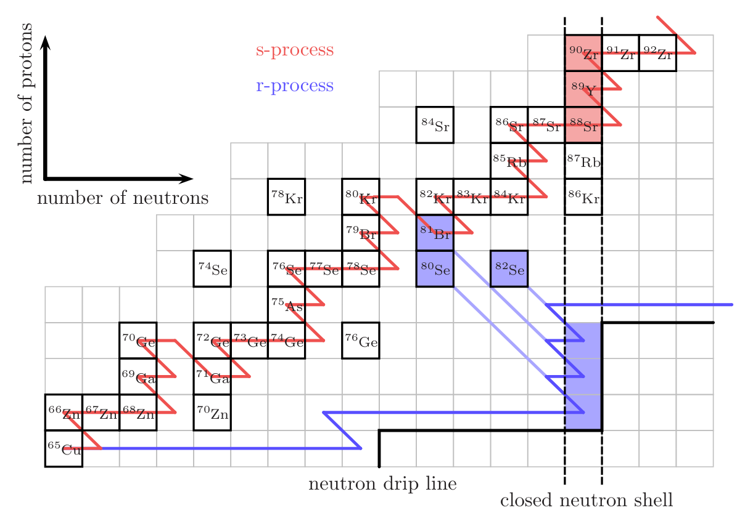
Solar chemical composition
and r-process
Lippuner (2018)

Slide 3
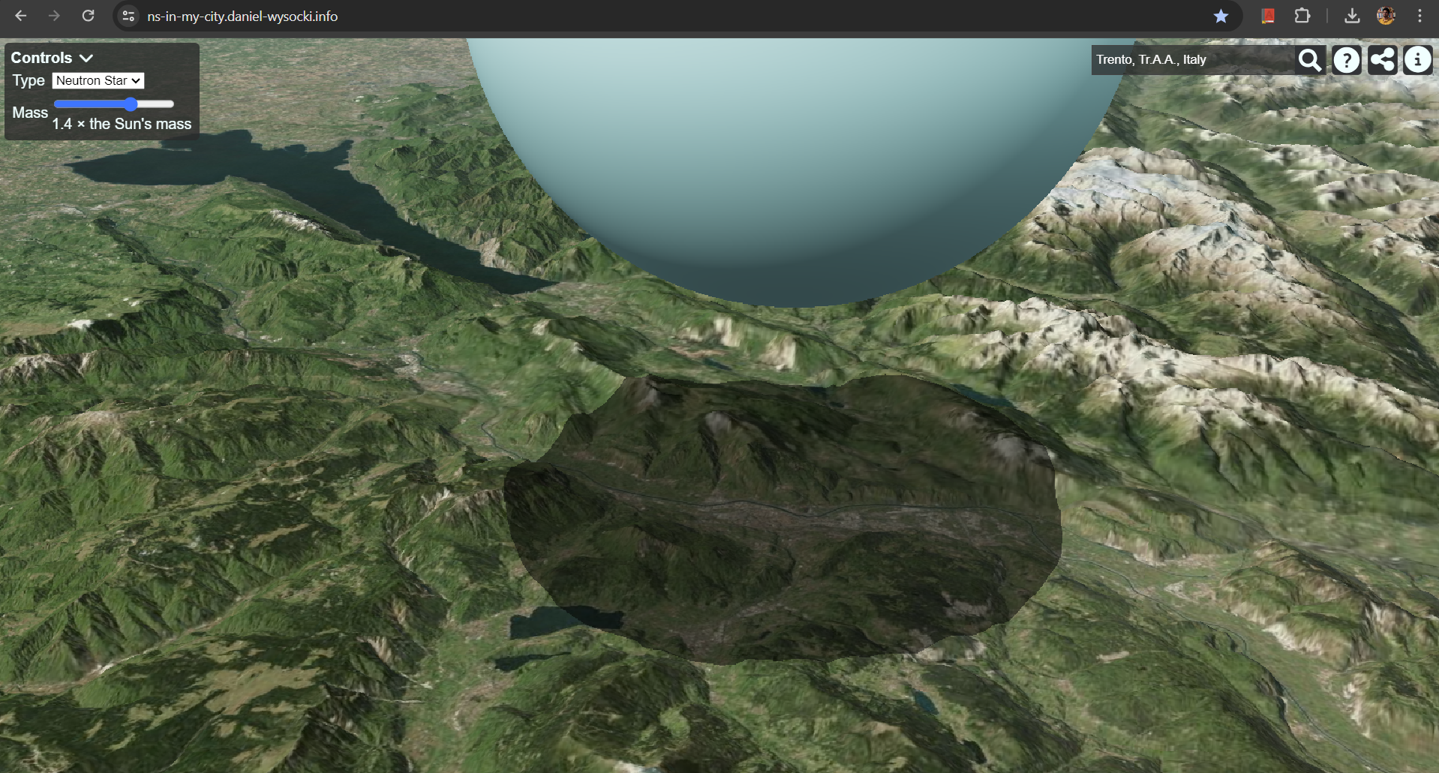

NS over Trento
Mass ~1-2 $M_{⊙}$
Radius ~ 9-13 km
$ρ$ ~ ${10}^{14}g/cm^{3}$
Mass ~1-2 $M_{⊙}$
Radius ~ 9-13 km
$ρ$ ~ ${10}^{14}g/cm^{3}$
Website by RIT alum Dan Wysocki
Website by RIT alum Dan Wysocki
Atul Kedia – NCSU

Slide 4
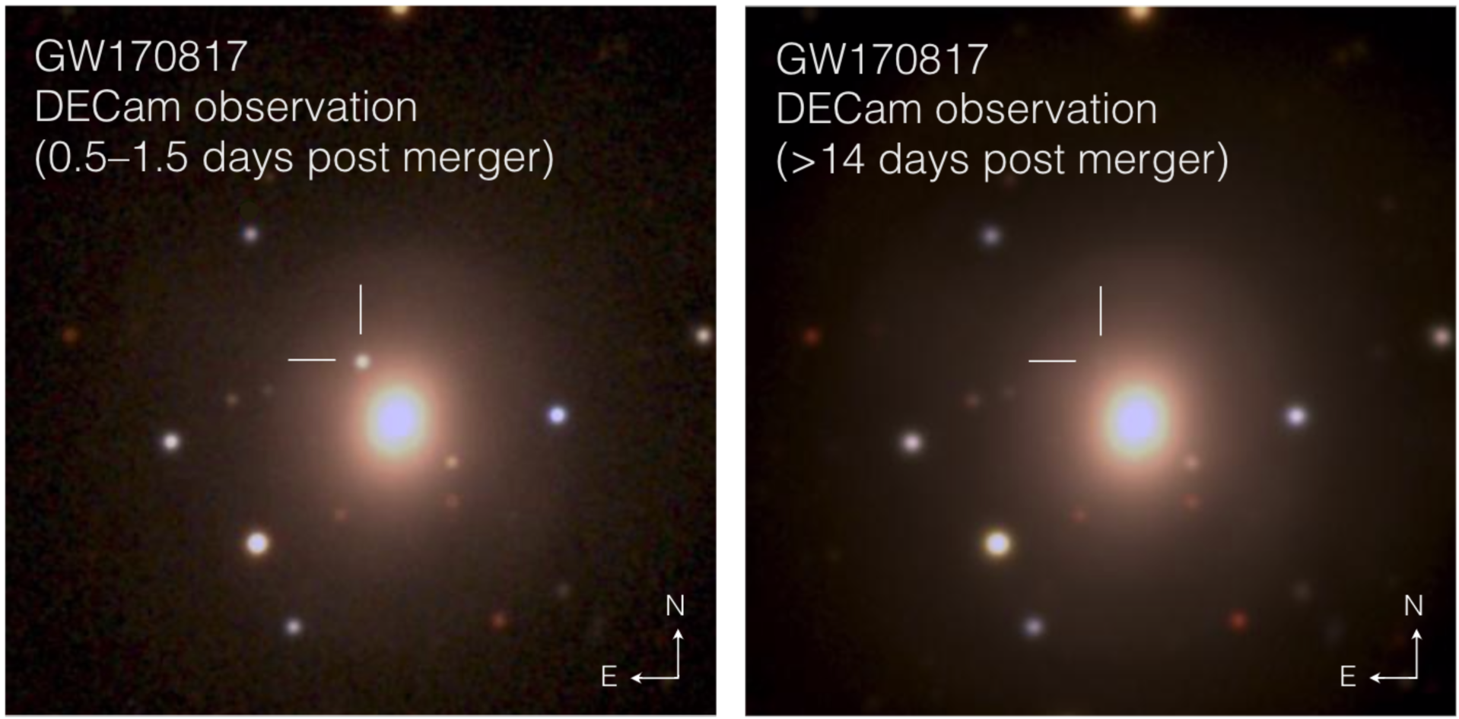
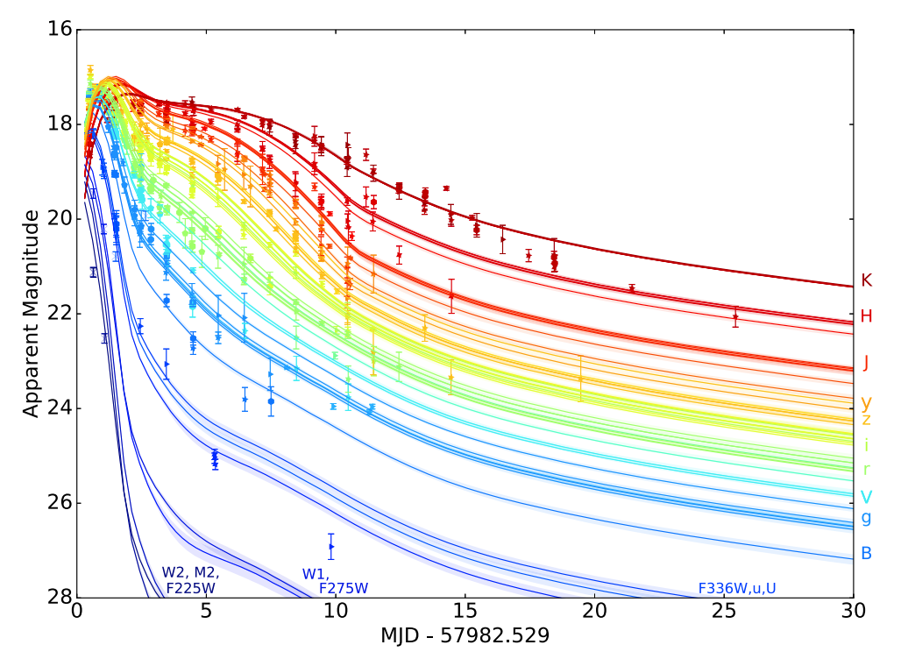
AT2017gfo / GW170817
sGRB ~ 2s
NGC 4993;
d ~ 40 Mpc
Villar et al ApJL 2017
Abbott et al PRL 2017 , LIGO+Virgo
Atul Kedia – NCSU

Slide 5
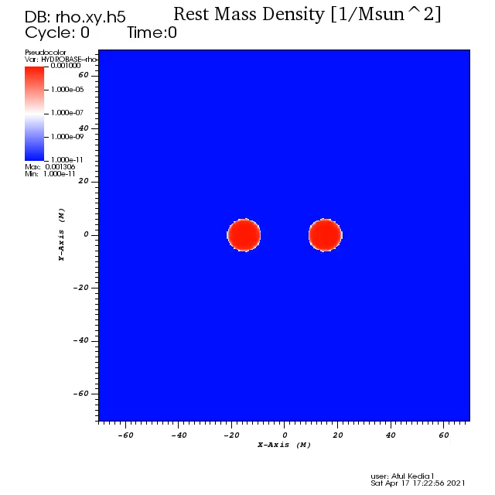

AT2017gfo / GW170817
sGRB ~ 2s
Top-Down view
Edge-on view
Abbott et al PRL 2017 , LIGO+Virgo
AK et al., PRD (2022)
Atul Kedia – NCSU

Slide 6
Important physics influencing or influenced by the GW/Kilonova emission
This talk
Equation of state
(merger dynamics)
Bovard+17, Radice+18, Nedora+21, Coughlin+18, Dietrich+20, Kedia+22,24
Ejecta dynamics –
mass distribution, velocity distribution
Breschi+21, Bulla+19,23, Heinzel+21, Kawaguchi+20,21, Kedia+23
Nucleosynthesis (r-process)
Composition –
neutrino, masses, reaction rates
(superheavies, island of stability? Mumpower+18, Lund+23,24, Holmbeck+23, Zhu+18)
Thermalization efficiencies alpha, beta, fission fragments, gamma rays –
Barnes+16,21
Atomic Opacity –
Fontes+ 15, 20, 23, Tanaka+20, Bulla+23
My interests

Slide 7
Multi-Messenger Inference
Radiative transfer
simulations
BNS merger modelling (Numerical relativity)
Kilonova modelling
Nucleosynthesizing ejecta material
Fig.: Raaijmakers et al, ApJ (2021) ; modified here
Atul Kedia – NCSU

Slide 8
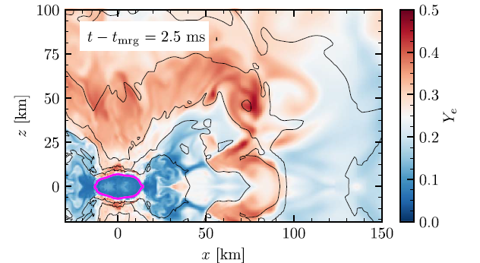
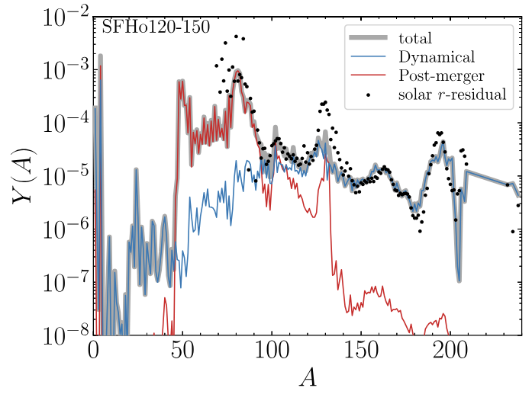

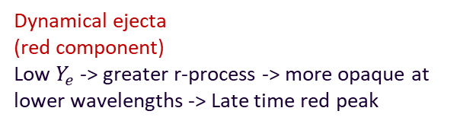

Ejecta components corresponding to the kilonova spectrum
High $Y_{e}$ component
$$Ye=\frac{p}{p+n}$$
Dynamical ejecta
(red component)
Low $Y_{e}$ -> greater r-process -> more opaque at lower wavelengths -> Late time red peak
Radice et al ApJ (2018)
Fujibayashi et al, ApJ (2023)
Atul Kedia – NCSU

Slide 9
Ejecta components corresponding to the kilonova spectrum
Wind ejecta (blue component)
Dynamical ejecta
(red component)
Low $Y_{e}$ -> greater r-process -> more opaque at lower wavelengths -> Late time red peak
Atul Kedia – NCSU

Slide 10
EM v GW ejecta tension
Ejecta properties (Kilonova approach) != Ejecta properties (GW approach)
Kilonova approach
← Assuming(Torus, Peanut morphology )
GW approach
Atul Kedia – NCSU

Slide 11
EM v GW ejecta tension
Ejecta mass (Kilonova approach)
!= Ejecta mass (GW approach)
Kilonova approach
← Assuming(Torus, Peanut morphology )
GW approach
Also see Siegel+19, Kawaguchi+18, Nedora+21, Radice+20, Korobkin+21
GW fits from Coughlin+19, Kruger and Foucart 20, Dietrich+20, Nedora+21
Atul Kedia – NCSU

Slide 12
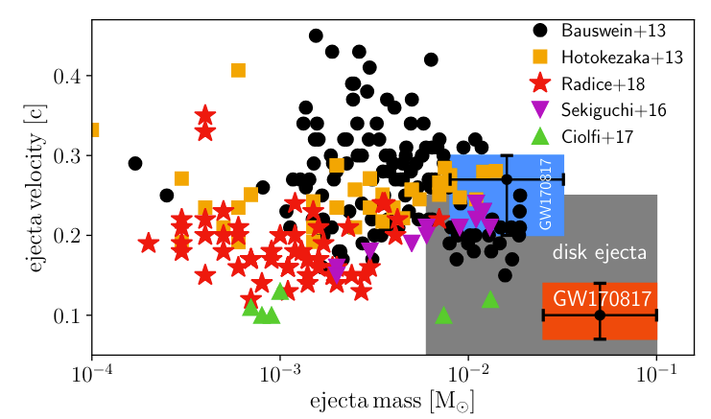
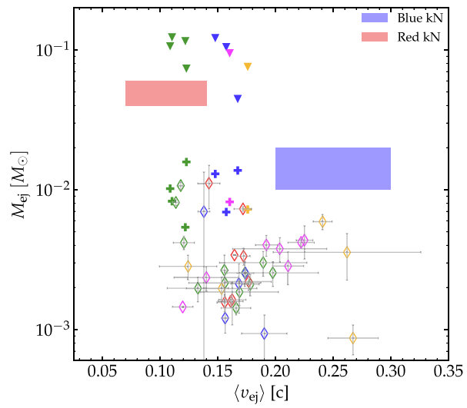
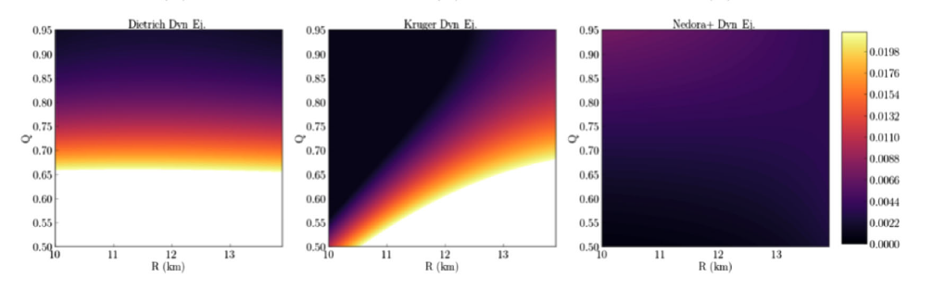
EM v GW ejecta tension
Siegel EPJA (2019)
Nedora et al ApJ (2021)
Henkel, PRD (2023)
Atul Kedia – NCSU

Slide 13
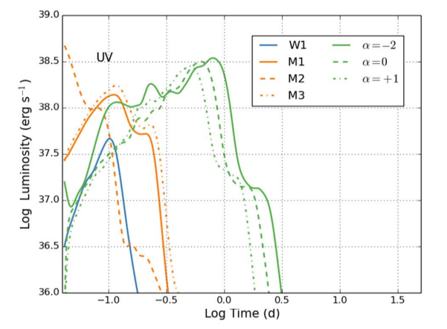
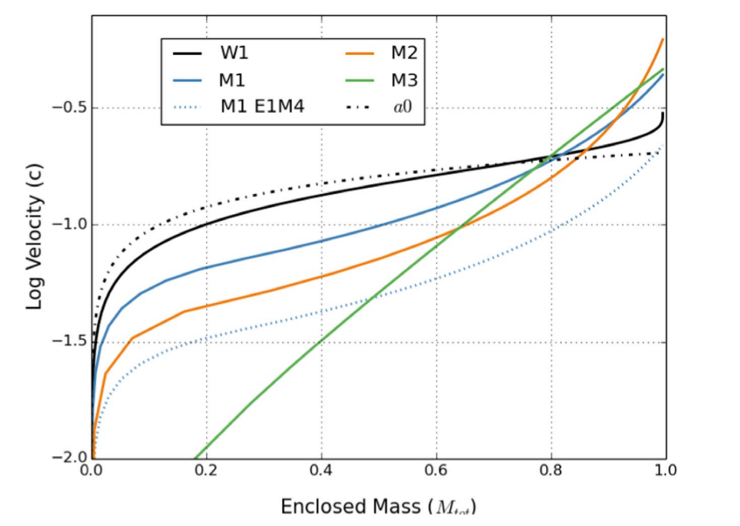
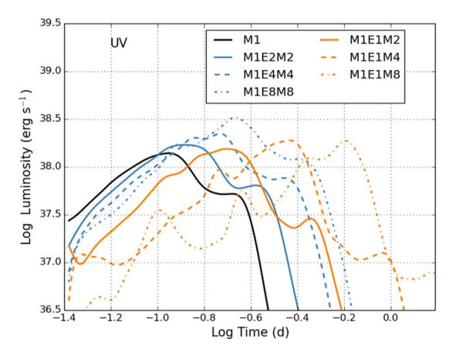
Impact of velocity
Fryer, .., AK et al, ApJ, (2024) ; similar conclusions by Tak et al, ApJ (2023)
Atul Kedia – NCSU

Slide 14
Ejecta masses and velocities
Darker shade signifies more mass ;
longer arrows indicate faster moving ejecta
Atul Kedia – NCSU

Slide 15
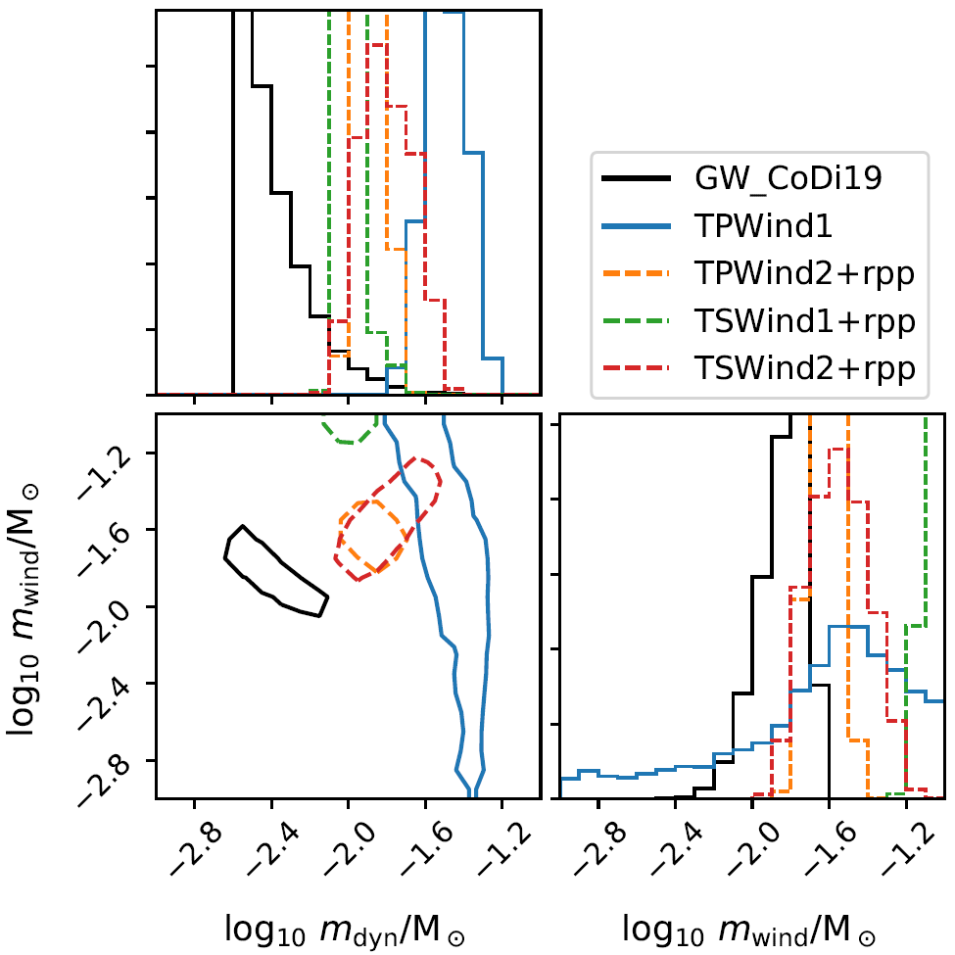
EM v GW ejecta parameter estimation
Different morphologies predict different amount of ejecta masses and velocities
Models with high electron fraction wind ejecta (TSwind2 and TPwind2) are significantly closer to GW estimate
AK et al, Phys. Rev. Research 5, 013168 (2023); similar results in Peng et al. (2024)
Atul Kedia – NCSU

Slide 16
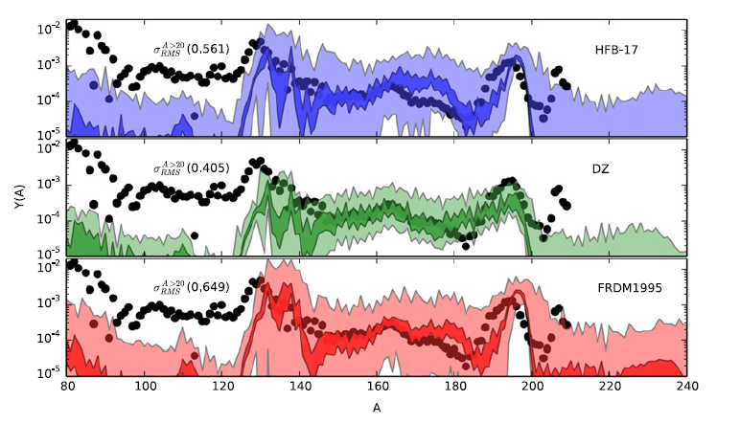
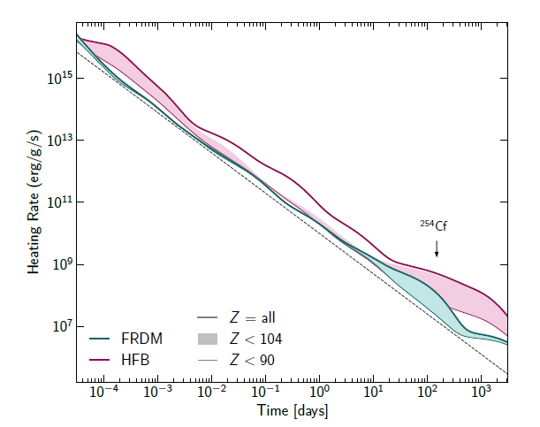
Mumpower +, PPNP (2016)
Different abundance patterns for different mass models
Uncertainties in abundance prediction due to mass model errors
=> Differences in the Kilonova signal
Holmbeck+ (2023)

Slide 17
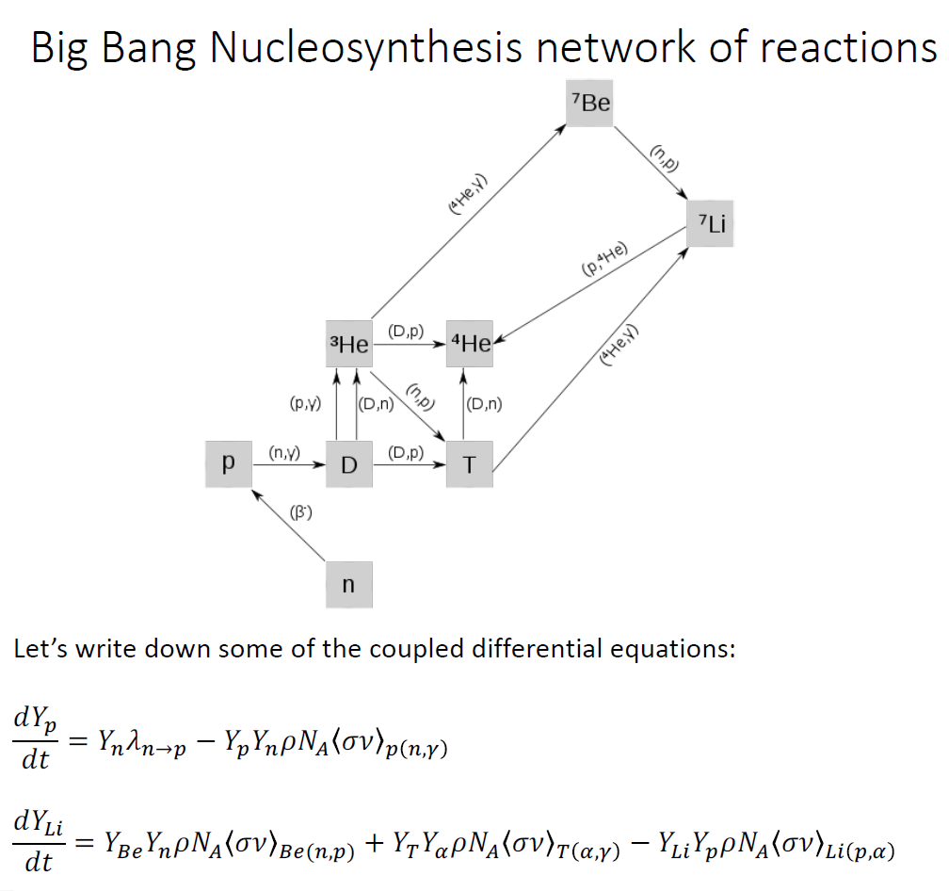
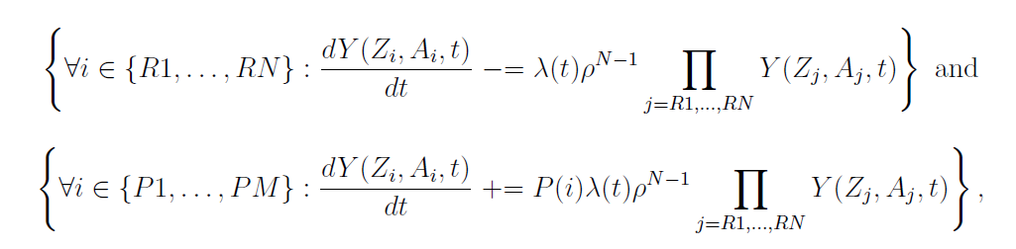
PRISM
Portable Routines for Integrated nucleoSynthesis Modeling (Sprouse & Mumpower)
Purpose – Reaction network code for astrophysical abundance yield calculation
Execution – for (Z_{R1},A_{R1}) +...+ (Z_{RN},A_{RN}) → (Z_{P1},A_{P1}) +...+ (Z_{PM},A_{PM})
Solves for Y(Z_{i},A_{i},t) from
(P(i) = probability for
each isotope formation)
Inputs –
Nuclear data – for reactions rates(OMP, Gamma strength function, level densities), decays probabilities. (alpha decay, beta decay, neutron capture, fission rates.)
Astrophysical data – Tracer particle - Initial abundance, Evolution of the packet in time, temperature, density

Slide 18
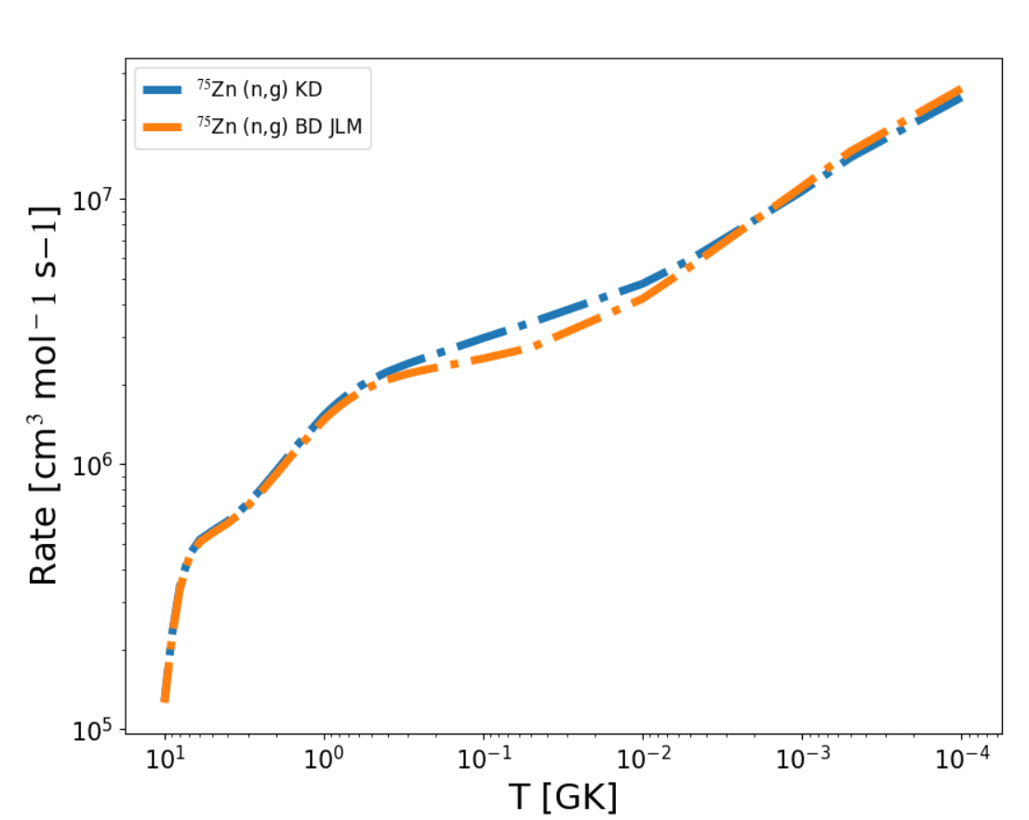
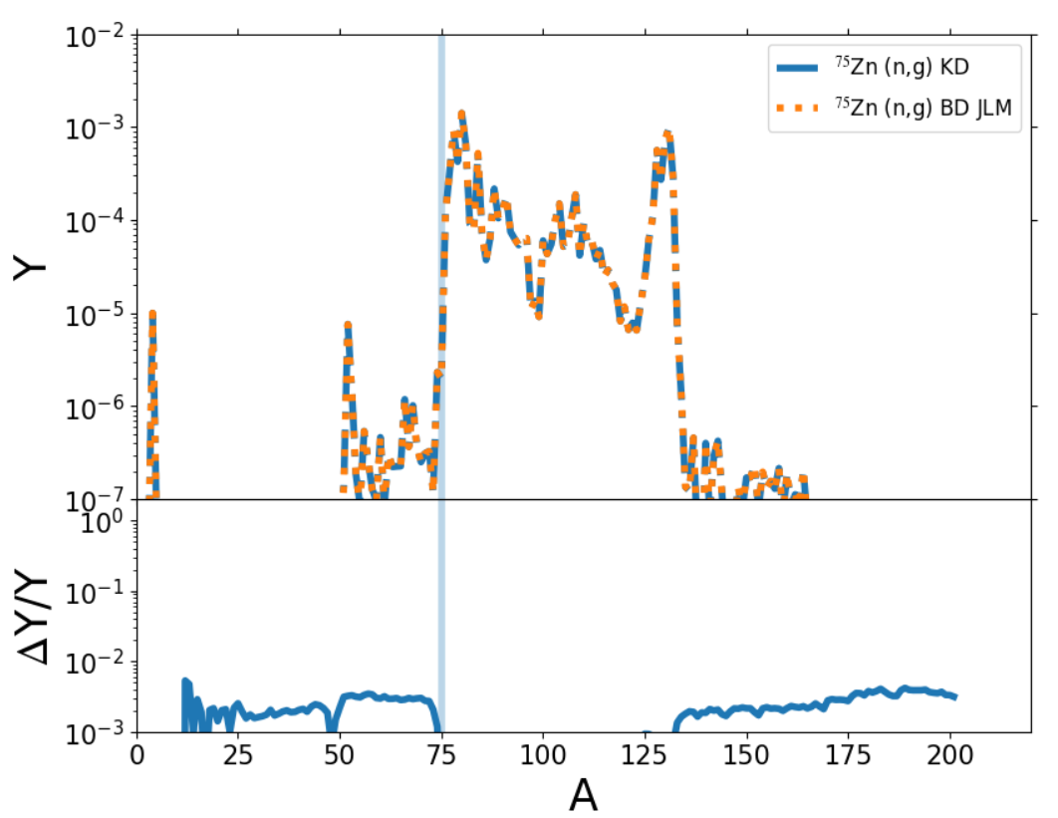
Effect of optical potential
Alert! Preliminary!

Slide 19
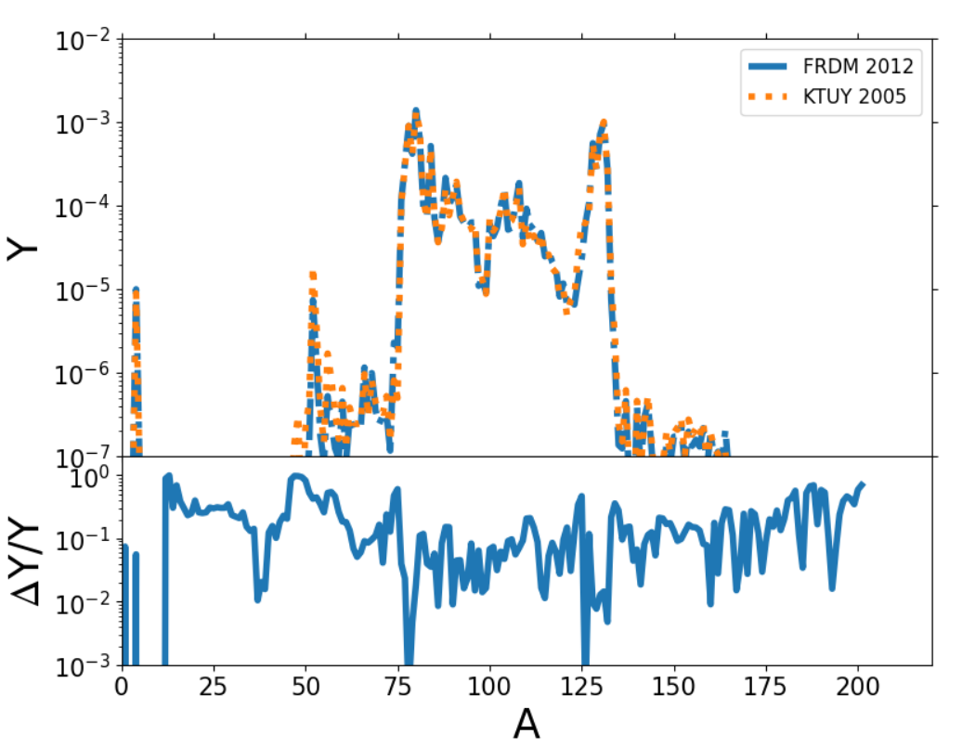
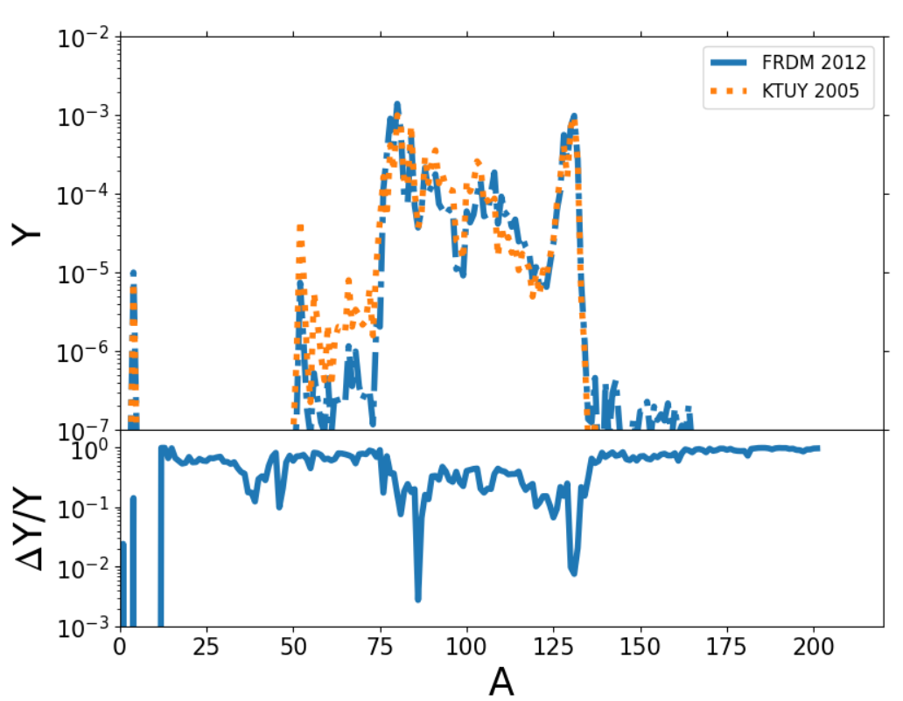
Mass model dependence
Alert! Preliminary!

Slide 20
Summary
  Neutron star merger GW or EM (kilonova) observations can inform the amount of r-process enhanced material is ejected into the interstellar medium
  Tension between the inferred ejecta implies we have an incomplete kilonova/GW model.
  Kilonovae can reveal the ejecta properties and in turn inform us about r-process nucleosynthesis
  Nuclear reaction rates (Optical potential, level densities, gamma strength function) can influence the abundances and kilonova signal substantially and hence galactic chemical evolution.
Atul Kedia – NCSU

