Slide 1




ODDERON EXCHANGE
OBSERVATION AND PROPERTIES
T. Csörgő^{1,2} , T. Novák², R. Pasechnik ³, A. Ster ¹ and I. Szanyi ^{1,4}
¹ Wigner RCP, Budapest, Hungary
² MATE KRC, Gyöngyös, Hungary
³ University of Lund, Lund, Sweden
⁴ Eötvös University, Budapest, Hungary
Intro to Odderon exchange
Model independent results:
Significance at least 6.26 σ
Model dependent results:
Significance at least 7.08 σ
New results at 8 TeV
1: H(x) scaling
2: ReBB Model vs ATLAS and TOTEM
3: Extended Pomeranchuk theorem
Universe 2024, 10(6),264; https://doi.org/10.3390/universe10060264 | arXiv:2405.06733 [hep-ph]

Slide 2
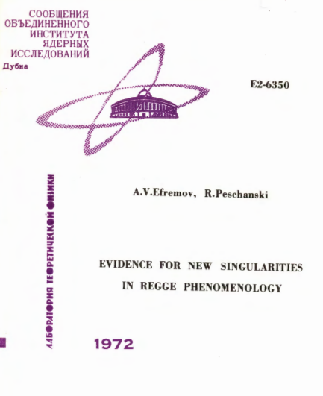
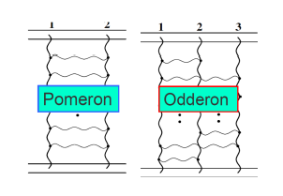
Odderon: 48 years old scientific puzzle
Odderon: L. Lukaszuk, B. Nicolescu,
Lett. Nuovo Cim. 8, 405 (1973)
Received: 31 July 1973
Odderon is an odd component of elastic scattering:
Changes sign for crossing
2
Odderon name coined: D. Joynson, E. Leader, B. Nicolescu, C. Lopez, Nuovo Cim. 30A, 345 (1975) - Well established in QCD by now !
Honorable mention: A. V. Efremov, R. Peschanski, JINR-E2-6350 (1972)

Slide 3
Odderon: elusive experimentally
Odderon search at ISR: indication but no conclusive result
Breakstone et al, Phys. Rev. Lett. 54, 2180 (1985): CL = 99.9 %
Indication of Odderon
CL = 99.9 %,
Significance: 3.35 σ
Terminology for this talk:
Agreement if statistical significance is < 3 σ
Indication of signal if 3 σ ≤ significance < 5 σ
Evidence or observation of signal if 5 σ ≤ significance
Discovery of signal if 5 σ ≤ significance for the first time.
Accepted discovery if Clay Mathematical Institute (CMI) criteria satisfied.
Miscovery if CMI criteria for Millenium Prize Problems are not satisfied.
3

Slide 4
Odderon: well established in QCD
Odderon proposed in Regge phenomenology:
L. Lukaszuk, B. Nicolescu, Lett. Nuovo Cim. 8, 405 (1973)
Three Gluon Integral Equation and Odd c Singlet Regge Singularities in QCD
J. Kwiecinski, M. Praszalowicz, Phys.Lett.B 94 (1980) 413-416
A new Odderon intercept from QCD:
R. A. Janik, J. Wosiek, Phys. Rev. Lett. 82 (1999) 1092
Odderon in QCD:
J. Bartels, L.N. Lipatov, G. P. Vacca: Phys. Lett. B (2000) 178
Odderon in QCD with running coupling:
J. Bartels, C. Contreras, G. P. Vacca, JHEP 04 (2020) 183
For an excellent theory intro/review, see Yu. Kovchegov’s
CTEQ Webinar, April 28, 2021
http://youtu.be/yHBO3zcB3V4
4

Slide 5
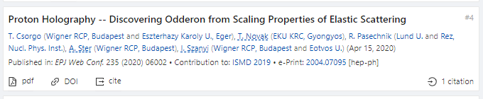
Odderon: first observation with > 5 σ
EPJ Web of Conf. (2020) 235: 06005
https://doi.org/10.1051/epjconf/202023506002
First publication of an at least 5.0 σ (6.26 σ) odderon effect:
May 11, 2020,
EPJ Web of Conf. 235 (2020) 06002
in an anonymously refereed / peer reviewed conference proceedigs.
(Proc. ISMD 2019, Santa Fe, USA)
5

Slide 6

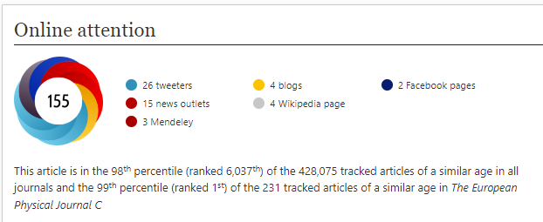
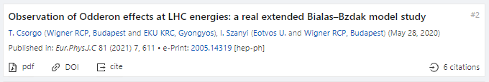
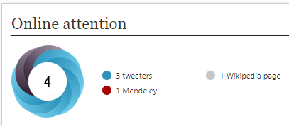
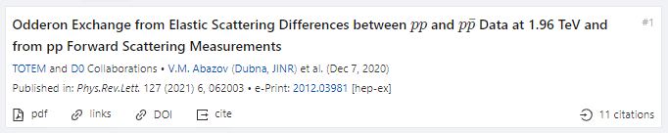
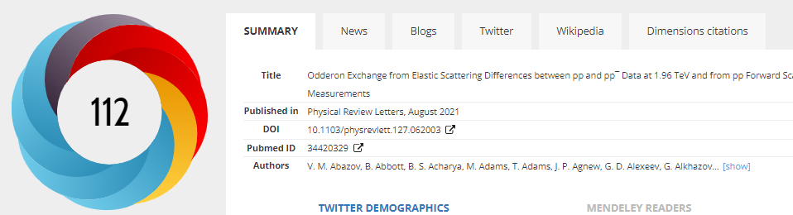
First journal publications, Odderon > 5 σ
Hungarian-Swedish team:
Eur. Phys. J. C (2021) 81: 180, Published: 23 February 2021
https://doi.org/10.1140/epjc/s10052-021-08867-6
Hungarian team, model of Polish origin:
Eur. Phys. J. C (2021) 81:611 , Published: 13 July 2021
https://doi.org/10.1140/epjc/s10052-021-09381-5
6
D0 and TOTEM Collaborations:
Phys. Rev. Lett. 127 (2021) 6, 062003, Published: 4 August 2021
https://doi.org/10.1103/PhysRevLett.127.062003

Slide 7
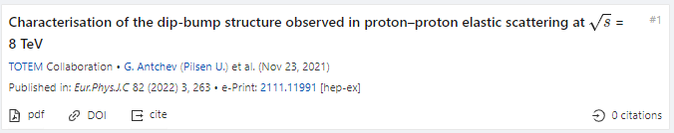
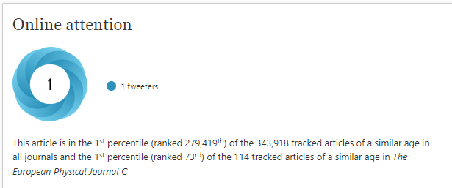
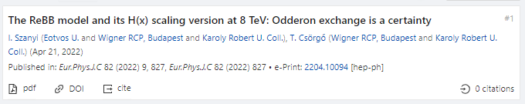
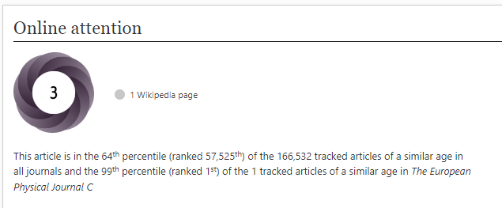
2022 observations of Odderon with > 5 σ
TOTEM Collaboration:
8 TeV: EPJ C (2022) 82, 263 (2022).Published: March 26, 2022
https://doi.org/10.1140/epjc/s10052-022-10065-x
Publishes final data for D0-TOTEM PRL published in 2021
Hungarian team, model of Polish origin:
New TOTEM 8 TeV data vs ReBB model predictions:
EPJ C 82 (2022) 9, 827. Published: Sept 19, 2022
In the ReBB model, Odderon exchange is a certainty
Presented at Zimányi’22 by I. Szanyi
What about model independent results?
7

Slide 8
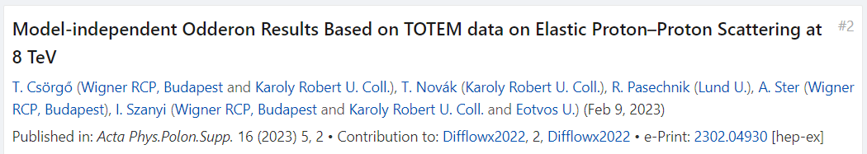
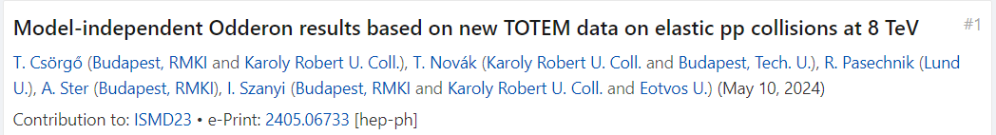
2023-24: new O observations with > 5 σ
Hungarian – Swedish team, new TOTEM data at 8 TeV:
Model-independent H(x) scaling method
Proc. Diffraction and Low-x 2022 by T. Csörgő
8 TeV data confirm and strengthen the Odderon signal
Hungarian – Swedish team, scaling method:
New TOTEM 8 TeV data vs H(x) scaling:
MDPI Universe (2024) 10(6), 264;
Full description, detailed peer reviewed paper
Universe 2024, 10(6),264; https://doi.org/10.3390/universe10060264 | arXiv:2405.06733 [hep-ph]
What about domain of validity, model independently?
-- stay tuned… coming soon
8

Slide 9

Hungarian-Swedish team, Odderon > 6.26 σ
Eur. Phys. J. C (2021) 81: 180, published February 2021
https://doi.org/10.1140/epjc/s10052-021-08867-6
H(x) = 1/(B σ_{el}) dσ/dt vs x = - B t
B ≡ B₀(s) from now on
x = - B t = - B₀(s) t
9
S: Model independent Odderon significance ≥ 6.26 σ
C1: All D0 and TOTEM published data at 1.96, 2.76 and 7.0 TeV
C2: domain of validity is still determined model dependently.

Slide 10
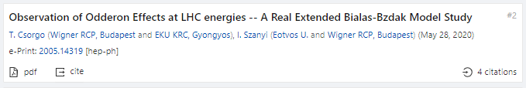
Hungarian team, Polish model, Odderon > 7.08 σ
Eur. Phys. J. C (2021) 81:611, published July 2021
https://doi.org/10.1140/epjc/s10052-021-09381-5
1.96 TeV
2.76 TeV
7 TeV
With new 8 TeV data:
Model dependent certainty
Eur. Phys. J. C (2022) 82, 827, published September 2022
https://doi.org/10.1140/epjc/s10052-022-10770-7
S: Model dependent Odderon significance ≥ 7.08 σ
C1: All D0 and TOTEM published data at 1.96, 2.76, and 7.0 TeV
C2: domain of validity extended to both pp and pbarp
But limited to 0.37 ≤ −t ≤ 1.2 GeV² and 0.546 ≤ sqrt(s) ≤ 7 → 8 TeV
10
Model dependent, Real Extended Bialas-Bzdak theory results,
Odderon significance ≥ 7.08 σ, from 1.96 and 2.76 TeV data only

Slide 11
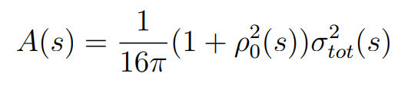
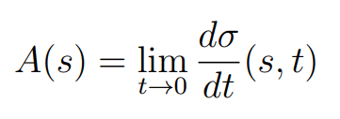
Formalism: elastic scattering
11
Basic problem: dσ/dt measures an amplitude, modulus squared.
If Odderon exists: signals in elastic scattering at t = 0 and at –t > 0.

Slide 12
Formalism in b space
12
Impact parameter or b space:
elastic scattering interferes with propagation w/o collisions: Genuine quantum physics.
Complex opacity function Ω(s,b) (eikonal, from unitarity)
0 ≤ P(s,b) ≤ 1 : inelastic scattering has a probabilistic interpretation

Slide 13
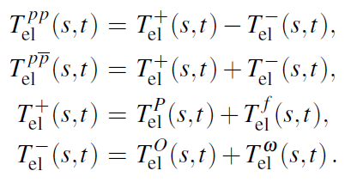
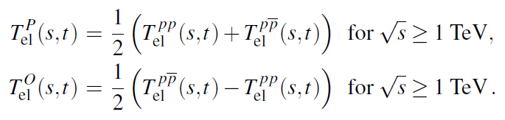
Looking for Crossing-Odd(eron) effects
Three simple consequences:
13
Odderon differential cross-section from pp and ppbar collisions, Reggeized Philips-Barger:
A. Ster, L. Jenkovszky, T. Cs., arxiv:1501.03860, Phys.Rev.D 91 (2015) 7, 074018

Slide 14
Odderon search: a possible strategy
Known trivial s-dependences in
σ_{tot}(s), σ_{el}(s), B(s), ρ(s)
Try to scale this out
Data collapsing (scaling)
Look for scaling violations
In the TeV energy range:
Odderon is equivalent with
a crossing-odd component
Look for violations of C-symmetry
14

Slide 15



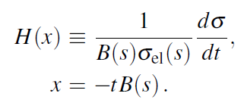
Scaling in the diffractive cone region
Advantages:
1) H(x) ~ exp(-x) in the diffractive cone
2) Start from a place that you know
3) Measurable both for pp and pbarp
15

Slide 16
Test of the H(x) scaling at ISR
16
H(x) = exp(-x) in the cone
Works better than expected, even in the bump/tail region!

Slide 17
Derivation of H(x) scaling for all x
Advantages:
H(x) ≠ exp(-x) arbitrary positive def. in the dip-bump region
Measurable both for pp and p-antip. Normalized as H(0) = 1.
17

Slide 18
Test of the H(x) scaling at 7 vs 2.76 TeV
Valid between 2.76 and 7 TeV, even with stat errors only,
H(x) scaling valid even in the bump/tail region!
Between 8 and 13 TeV, scaling limited to the cone, but
scaling violated beyond stat+syst errors in dip/dump/tail region!
18

Slide 19
NEW RESULTS 1
H(x) SCALING, USING 8 TeV

Slide 20
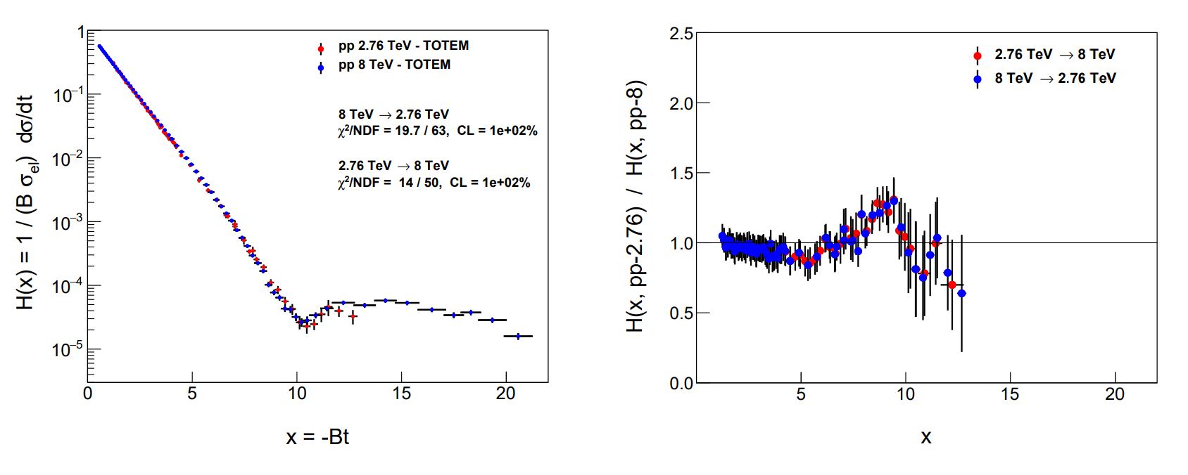
e-Print:
2405.06733 [hep-ph]
Test of H(x) scaling: 8 vs 2.76 TeV
e-Print:
2405.06733 [hep-ph]
20
Between 2.76 and 8 TeV, H(x) scaling observed!
Hungarian-Swedish team, e-Print: 2405.06733 [hep-ph],
MDPI Universe 2024, 10(6), 264

Slide 21
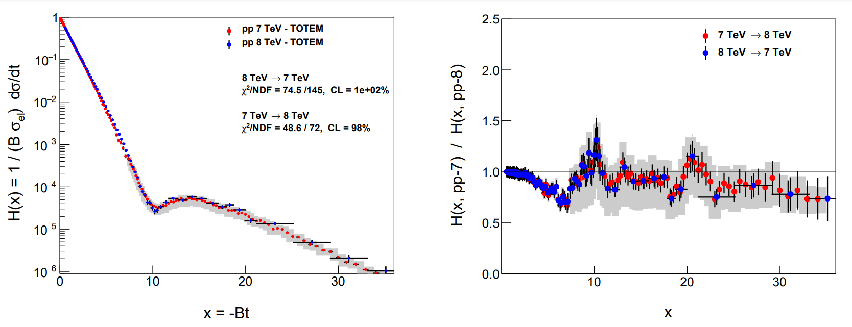
e-Print:
2405.06733 [hep-ph]
Test of H(x) scaling: 8 vs 7 TeV TOTEM
e-Print:
2405.06733 [hep-ph]
21
Between 7 and 8 TeV, H(x) scaling observed, but …
Hungarian-Swedish team, e-Print: 2405.06733 [hep-ph],
MDPI Universe 2024, 10(6), 264

Slide 22
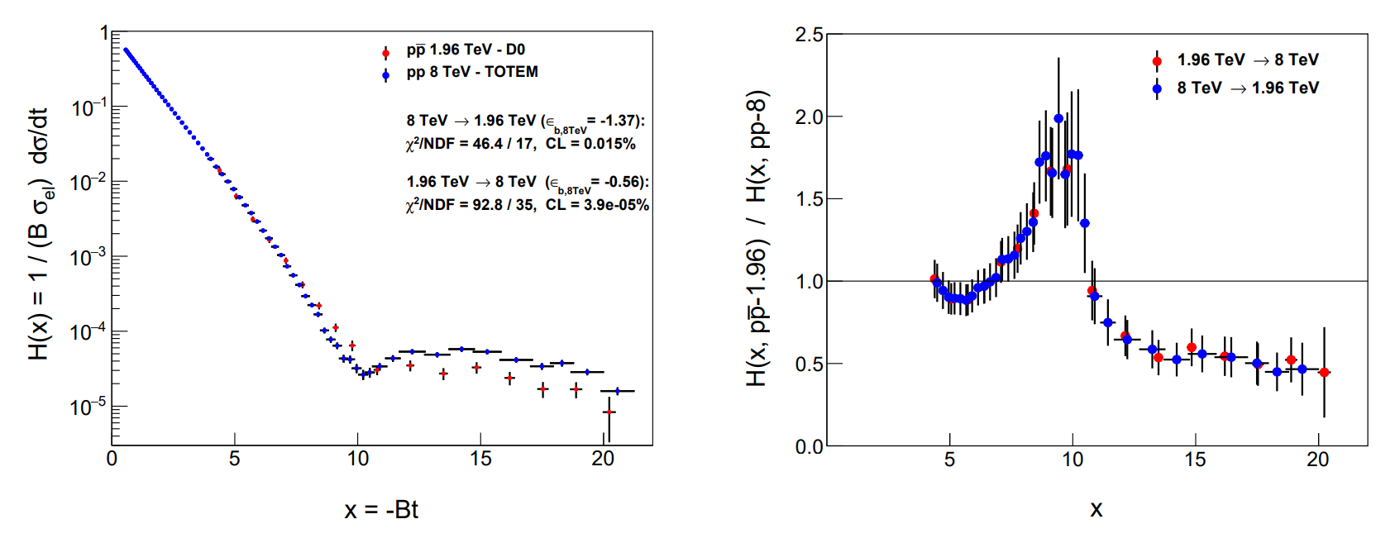
e-Print:
2405.06733 [hep-ph]
Odderon of H(x) scaling: 8 vs 1.96 TeV
e-Print:
2405.06733 [hep-ph]
Between 1.96 and 8 TeV, H(x|s,pp) and H(x|s,pbarp) are clearly different, with 3 < 3.79 < 5 σ
Hungarian-Swedish team, e-Print: 2405.06733 [hep-ph],
MDPI Universe 2024, 10(6), 264
22

Slide 23
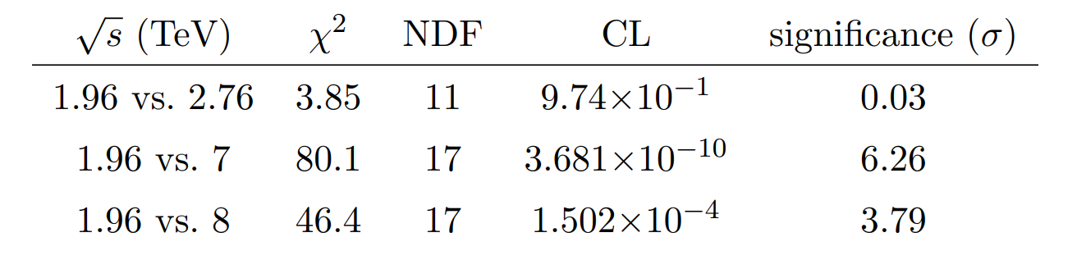
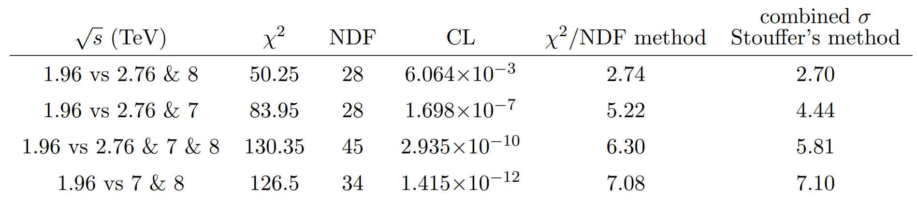
e-Print:
2405.06733 [hep-ph]
Odderon significances from H(x) scaling
e-Print:
2405.06733 [hep-ph]
If 1.96, 2.76, 7 and 8 TeV data are combined, H(x) significances on all data results in 5 < 5.8 σ
If 1.96, 7 and 8 TeV data are combined, at least 7.08 σ.
Hungarian-Swedish team, e-Print: 2405.06733 [hep-ph],
MDPI Universe 2024, 10(6), 264
23

Slide 24
NEW RESULTS 2
Low-t extension of ReBB
7 and 8 TeV pp
(cross-check, without Levy)

Slide 25
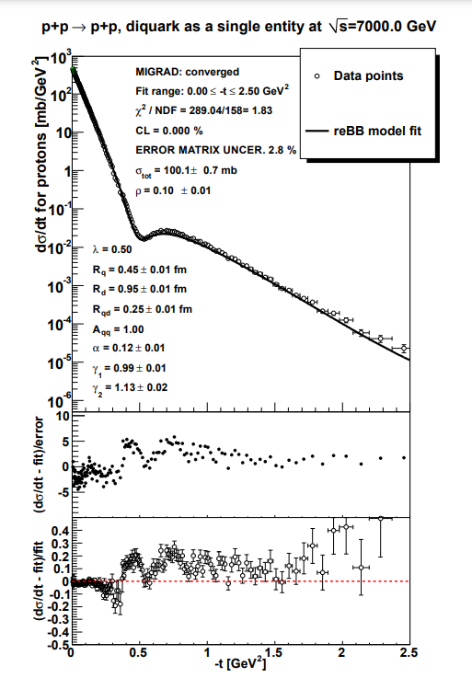
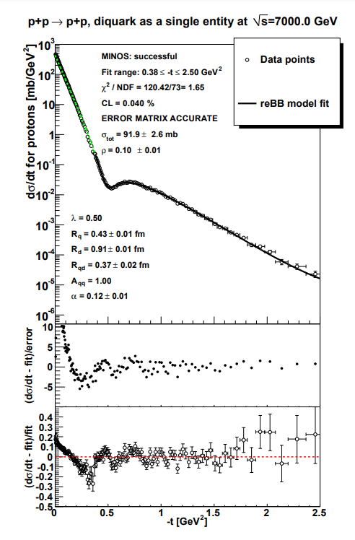
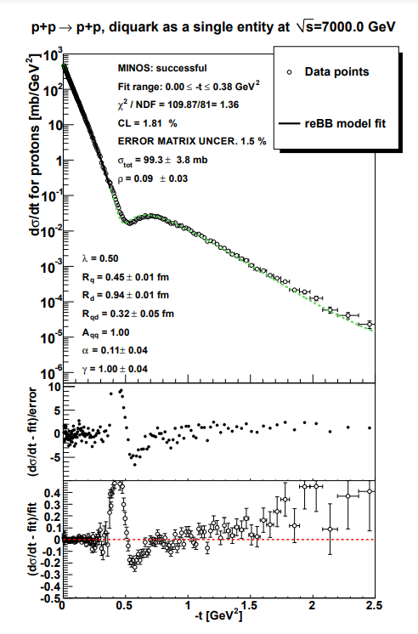
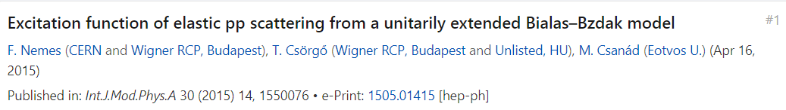
Statement of the problem, with old chi2
25
TOTEM low-t vs TOTEM-large-t fit acceptable at 7 TeV, but
The two datasets could not be ReBB fitted without PHENIX chi2 definition !

Slide 26
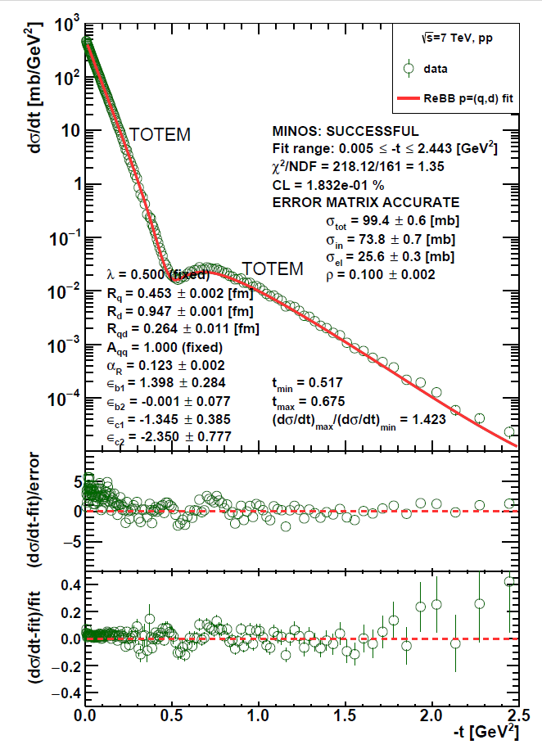
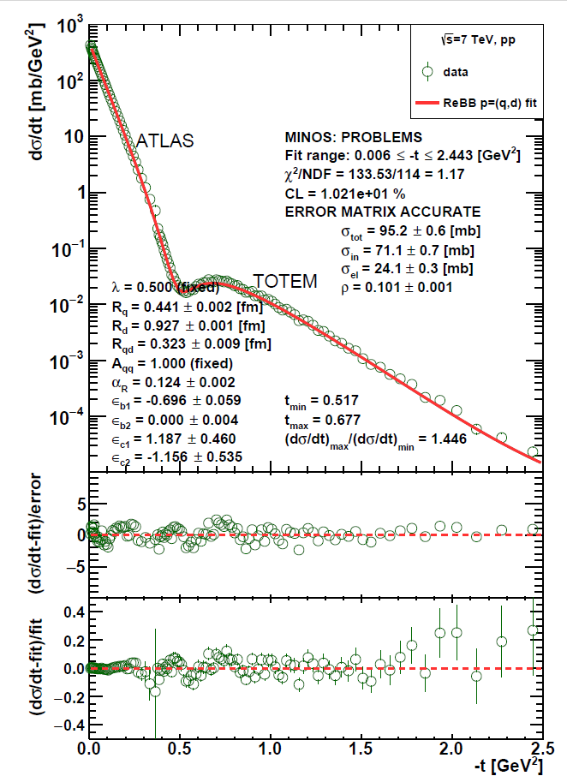
ReBB model extension to low –t, 7 TeV
26
TOTEM low-t vs TOTEM-large-t fit acceptable at 7 TeV, using PHENIX chi2 definition, but ...
ATLAS low-t vs TOTEM-large-t fit successful at 7 TeV !

Slide 27
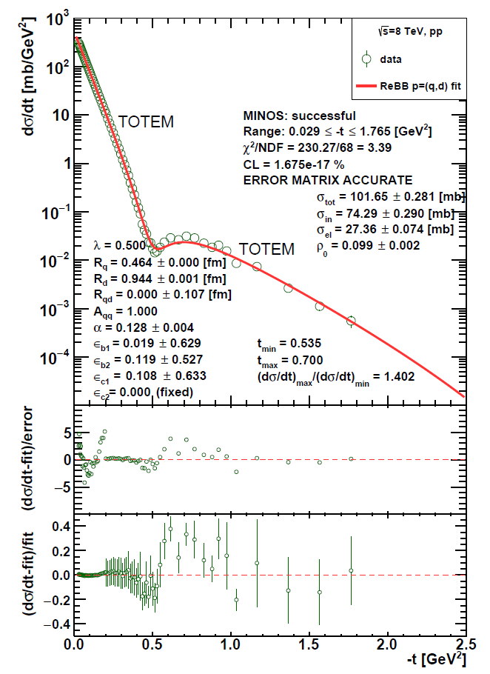
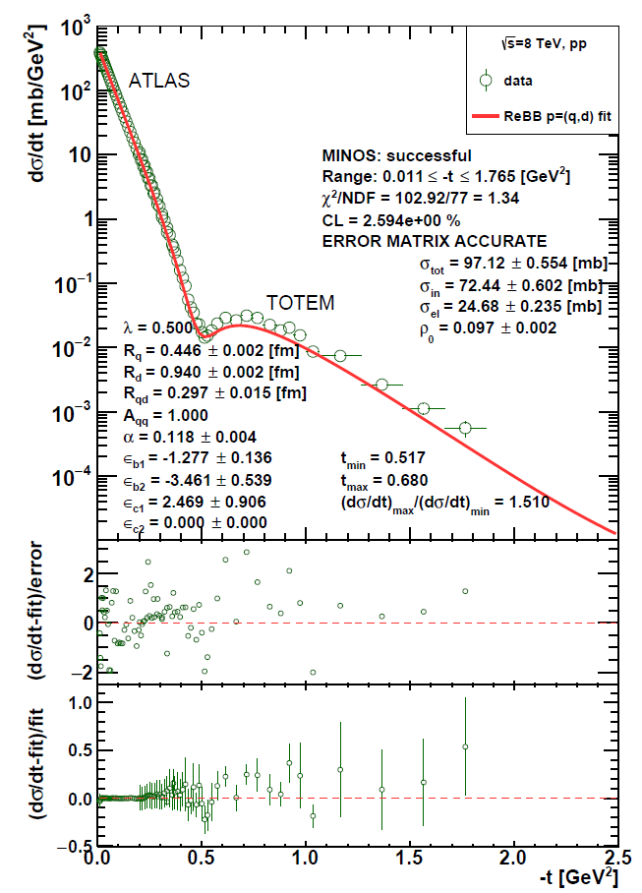
ReBB model extension to low –t, 8 TeV
27
TOTEM low-t vs TOTEM-large-t fit FAILS at 8 TeV, but ...
ATLAS low-t vs TOTEM-large-t fit SUCCESSFUL at 8 TeV !

Slide 28
NEW RESULTS 3
Simple Levy fits at small –t
(For details, see talk of I. Szanyi)

Slide 29
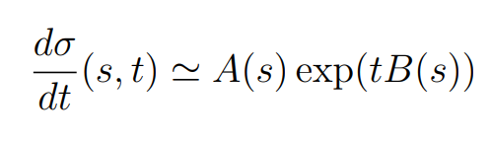
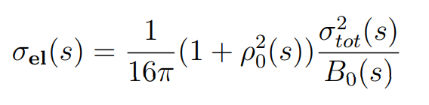
Review: Elastic scattering at small -t
29
If Odderon exists: signals possible both at t = 0 and at –t > 0.
Where the significance of the signal is coming from?

Slide 30
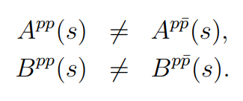

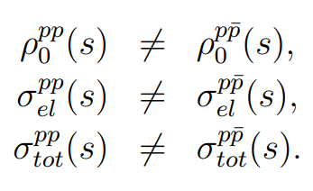
Odderon Search at small -t
valid for
Some simple consequences at small –t, Gaussian sources:
If any of
is statistically significant
30

Slide 31
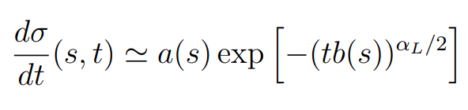
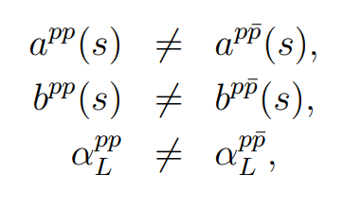

Odderon Search at small -t
valid for
Some simple consequences at small –t, Levy sources:
If any of
is statistically significant
31

Slide 32
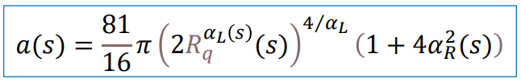


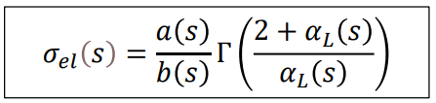

Levy generalized Bialas-Bzdak Model
Simple results at small -t:
From data fits: R_{q}, R_{d}, R_{qd}, α_{L} is same in pp and pbarb
But!
32

Slide 33
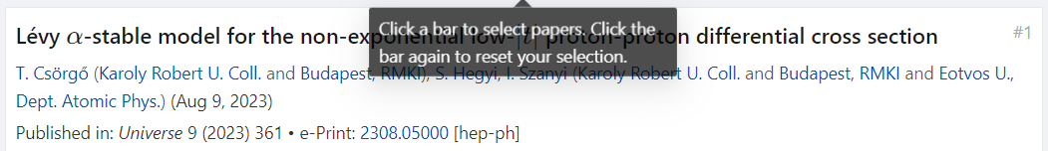
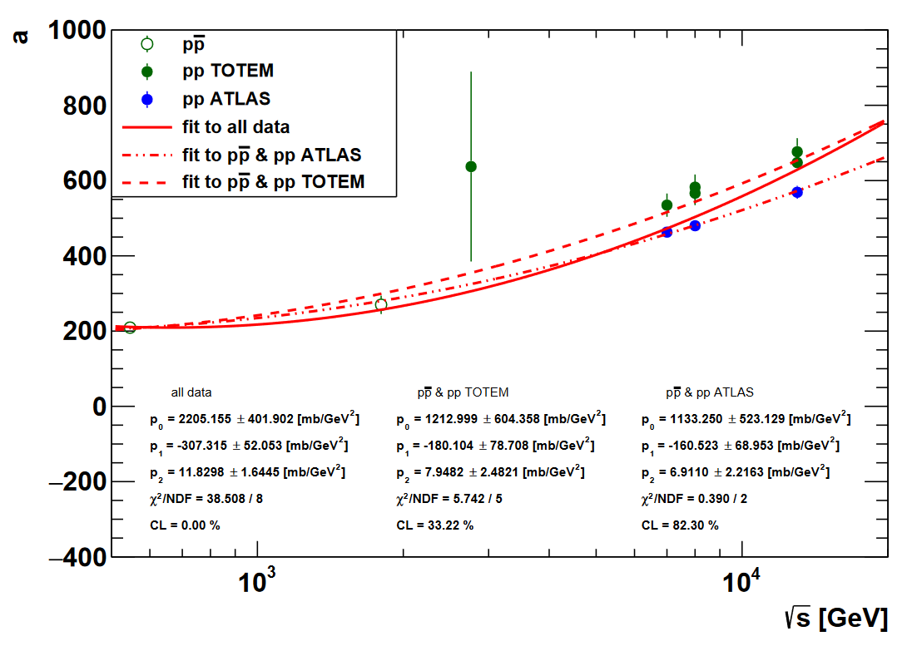

Slide 34
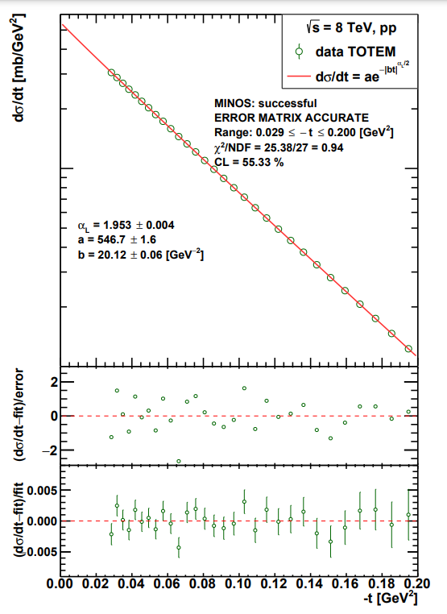
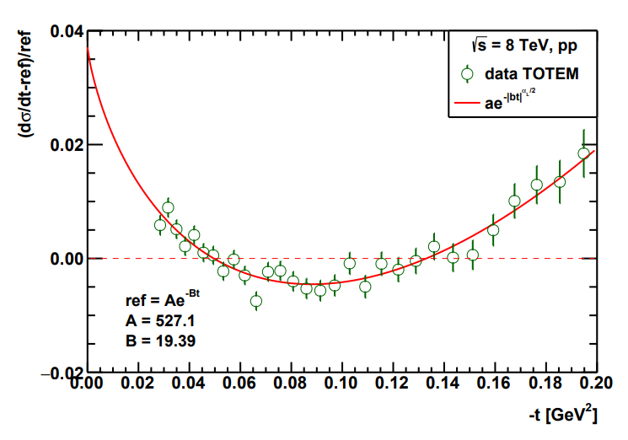
From Glauber’s theory, p=(q,d)
Good quality fits at 8 TeV and also
at every low –t dataset for pp, pbarp

Slide 35
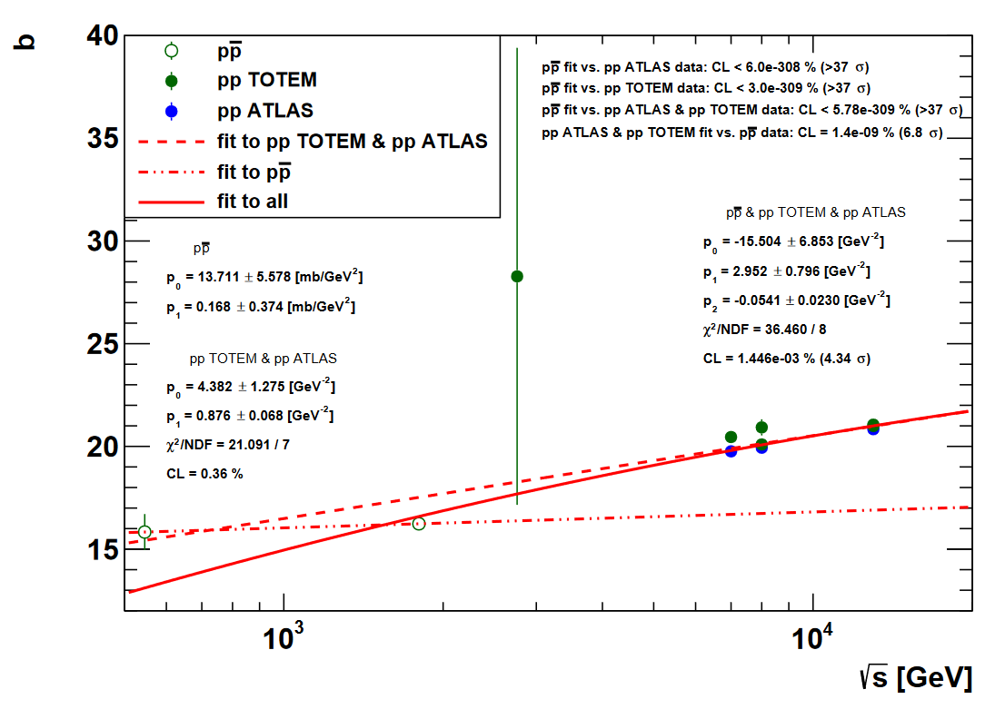

Slide 36
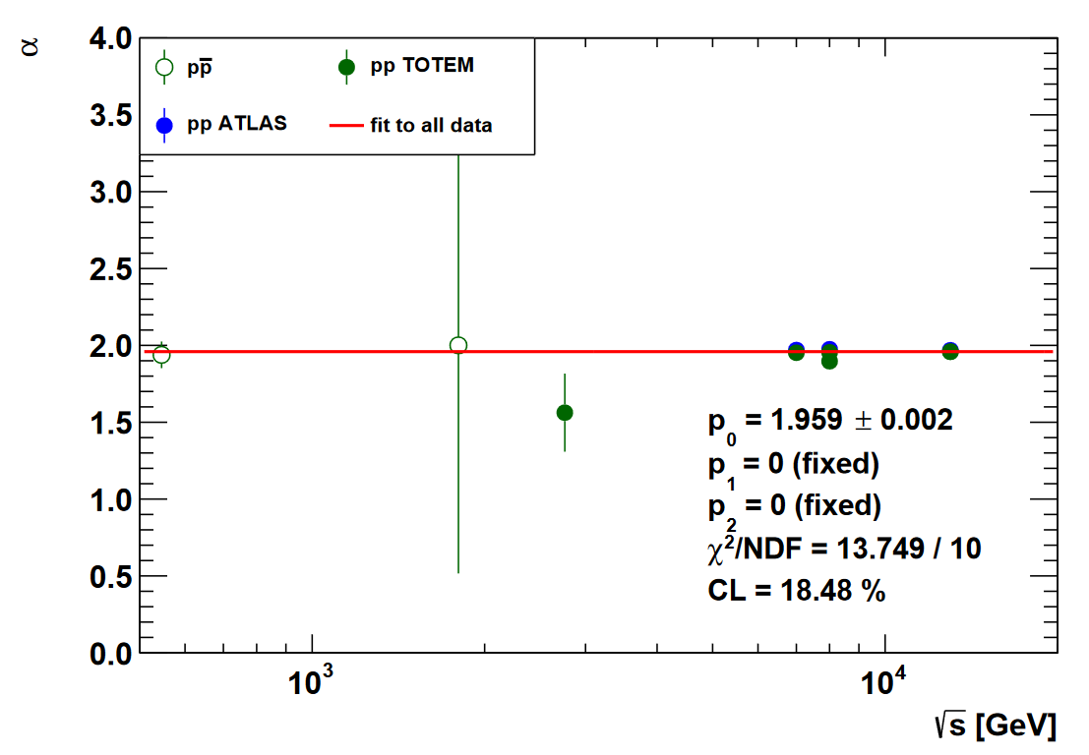

Slide 37
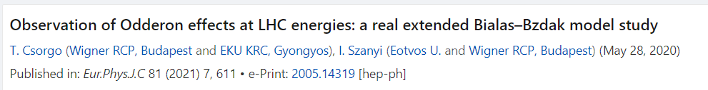
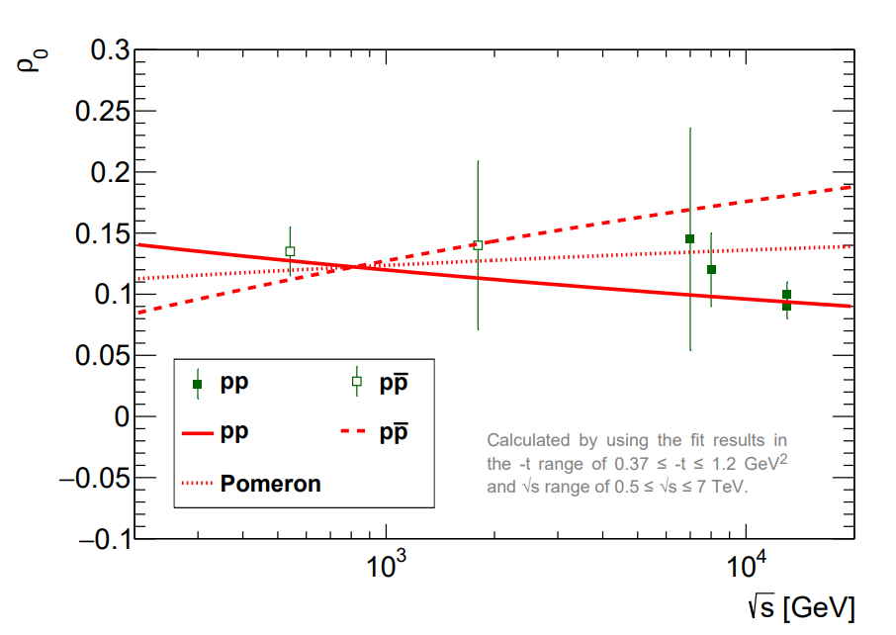
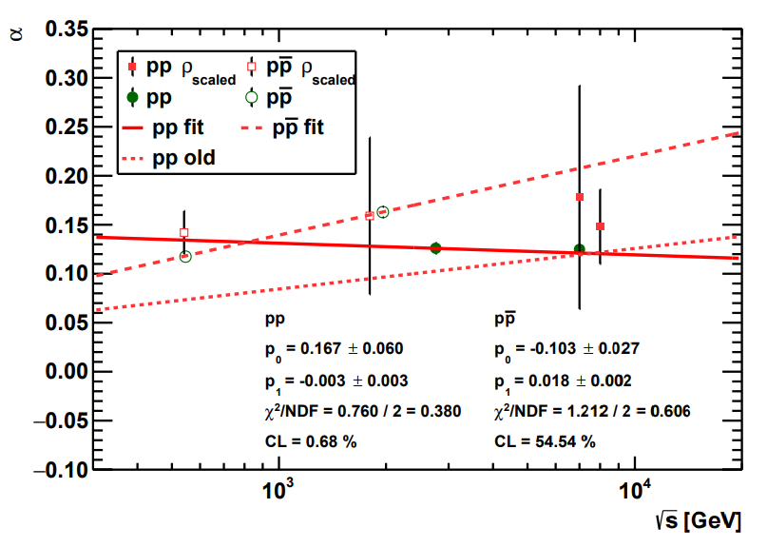
ρ₀ from fits to data
From data fits: R_{q}, R_{d}, R_{qd} is the same, but
α ∼ ρ (opacity) is not the same in pp and pbarb
37

Slide 38


Levy + Bialas-Bzdak at small t
Easy to fit model, with dramatic consequences
Strong form of Pomeranchuk theorem,
with small signals of odderon exchange in
optical point, ρ and elastic cross-section! Tests are needed…

Slide 39
Summary and conclusions
New 8 TeV TOTEM data strenghten
Odderon signal using H(x) scaling method
New 8 TeV TOTEM data strenghten
Odderon signal using ReBB model
ReBB fit range can be extended to low –t at 8 TeV, if ATLAS data are used
instead of TOTEM low –t data
Levy generalization of ReBB model in progress to fit TOTEM+TOTEM data at 8 TeV
Levy ReBB suggest a strong form of the Pomeranchuk theorem

Slide 40
THANK YOU !

Slide 41
QUESTIONS?

Slide 42
H(x) rebin: linear interpolations in x
Need for a comparison of different data sets
measured at different values of x:
Linear interpolation to the same x = -t B
Errors: both vertical AND horizontal, type A, B, C
type A: point-to-point fluctuating error
type B: point-to-point 100 % correlated error
type C: point independent overall correlated error
42

Slide 43

Model independent results since ISMD’19
43
T. Cs, R. Pasechnik, T. Novák, A. Ster, I. Szanyi, Eur. Phys. J. C (2021) 81: 180
https://doi.org/10.1140/epjc/s10052-021-08867-6 , 1912.11968 [hep-ph]

Slide 44

Model independent results since ISMD’19
arXiv:2004.07318v2
Model independent Odderon significance 6.26 σ
11 pages, 2 figures, synthesis of data analysis and theory results
But: domain of validity is still determined model dependently.
44

Slide 45
Model independent results since ISMD’19
45
arXiv:2004.07318v2
Model independent Odderon significance 6.26 σ
11 pages, 2 figures , synthesis of data analysis and theory results
New result presented in this talk: domain of validity model independently

Slide 46
Model dependent evidence for Odderon
46
82 pages, 31 figures, model dependent theory results,
Odderon significance ≥ 7.08 σ, see e-Print: 2005.14319 [hep-ph]

Slide 47
Model independent result
H(x|pp)
s-independent:
2.76 – 7(8) TeV
H(x|pp, 7 TeV)
≠
H(x|pantip,
1.96 TeV)
Odderon,
IF scaling holds
in pp down to
1.96 TeV
6.26 σ
Odderon effect
47
Energy range: tested both model independently and with modelling.
Modelling is useful, but model independent tests more important!

Slide 48
Asymmetry parameter for C-violation
A(x|pbarp,s₁|pp,s₂)
does NOT vanish
for a C-symmetry violation AND
A(x|pp,s₁|pp,s₂)
vanishes if
H(x) scaling valid
48
Energy range: HAS to be tested carefully

Slide 49
Main result of A
A(x|pp,s₁|pp,s₂) ~ 0
vanishes if
H(x) scaling valid
A(x|pbarp,s₁|pp,s₂) ≠ 0
does NOT vanish
if Odderon term is present
49
Scaling violations: under theoretical control:
Model calculations by solid line, see e-Print: 2005.14319 [hep-ph]

Slide 50
OBSERVATION OF ODDERON
2020 → 2O2O
7 TeV data shifted
by ε_{B7,TeV} to minimize χ²
Type A errors are shown only
Both swing and dip regions important!

Slide 51
SLIDING WINDOW for 5 σ
Model independent results:
only datapoints,
without s-dependent extrapolations !
Where is the signal of Odderon from?
All possible sliding windows,
where the significance is at least 5 σ

Slide 52

Is H(x,s) = H(x) at 1.96 TeV?
MODEL INDEPENDENTLY: YES!
In the background of the Odderon signal,
defined as x ≤ 7.0 in union with x > 13.5
H(x|pp,7 TeV) ~ H(x|pbarp, 1.96 TeV)
Agreement within a significance of 2.39 σ
New MODEL INDEPENDENT result
52

Slide 53
Is H(x,s) = H(x) at 1.96 TeV?
S IGNAL
MODEL DEPENDENTLY: Yes
1.96 TeV
Highest energy where p+antip data are available
H(x) scaling limit:
in the Bialas-Bzdak model
Fits pbarp data up to largest -t
(red line, dashed line: pp)
Pull plots:
(data-fit)/error
(data-fit)/fit
t_{max}(1.96 TeV, pp) > 1.2 GeV²
→ x_{max}(1.96 TeV, pp) > 20
53

Slide 54
Safely above the 5 σ threshold
Role of the H(x) scaling violations
Do they decrease the signal or not?
H(x) scaling: allows to project pp data ONLY
Scaling violations decrease significance at 1.96 TeV
BUT
Also allow to evaluate pbarp data at 2.76 TeV
Trade-off effect!
Odderon significance increases
from 6.26 to 7.08 σ .

Slide 55

Predictions for pp and pbarp dσ/dt @ 510 GeV
Model dependent Odderon signal @510 GeV: pp above pbarp !

Slide 56

Ratio of pbarp to pp cross-sections @ 510 GeV
Model dependent Odderon signal @510 GeV: no peak, but a hole
Scaling violations: dominant @510 GeV
Model dependent Odderon signal: pbarp dσ/dt ~ 25 % below pp !!

Slide 57

Asymmetry parameter @ 510 GeV
Model dependent Odderon signal @510 GeV: no peak, but a hole
Scaling violations: dominant @510 GeV
Model dependent Odderon signal: A ~ - 15 % @ -t ~ 0.85 GeV²

Slide 58
Summary: At least 6.26 σ Odderon
An at least 6.26 σ Odderon effect
A discovery level, model independent Odderon effect at TeV scale.
Published: Eur. Phys. J. C 81, 180 (2021). https://doi.org/10.1140/epjc/s10052-021-08867-6
Domain of validity of H(x) scaling: full x =-tB range of D0 at 1.96 TeV.
Published result confirmed with NEW, model INDEPENDENT result !
Model dependent results, using the ReBB model
Significance ≥ 7.08 σ , see e-Print: 2005.14319 [hep-ph]
58

Slide 59


Mandelstam variables
p₁,p₂: four-momenta
before elastic scattering
p₃,p₄: four-momenta
after elastic scattering
s: square of the cms energy
t: square of four-momentum transfer
59

Slide 60
Odderon and QCD in Laymen’s Terms
p₁
p₃
g₁
g₂
g₃
O = (g₁, g₂, g₃)
p₂
p₄
Pomeron (2+4+…) gluon in pp:
(RGB)+(RGB) → (GRB)+(GRB)
Odderon (3+5+… gluon) in pp:
(RGB)+(RGB) → (GBR)+(BRG)
Well established in QCD
60

Slide 61
Odderon and elastic collisions
p₁
p₃
g₁
g₂
g₃
O = (g₁, g₂, g₃)
p₂
p₄
Odderon exchange: both pp and pp
(RGB)+(RBG) → (BRG)+(BGR)
Changes sign for crossing
p₁
p₃
g₃
g₁
g₂
O = (g₁, g₂, g₃)
p₂
p₄
61

Slide 62
SLIDING WINDOWS
7 TeV data shifted
by ε_{B7,TeV} to minimize χ²
Type A errors are shown only
Both swing and dip regions important!
2020 → 2O2O

Slide 63
CLOSING DOORS
7 TeV data shifted
by ε_{B7,TeV} to minimize χ²
Type A errors are shown only
Both swing and dip regions important!
2020 → 2O2O

Slide 64

RESULTS FOR CLOSING DOORS
Two sliding doors of size n and size m:
(n,m): Leaving out the first n and last m D0 point
New MODEL INDEPENT RESULT
Odderon signal at least 6.33 σ

Slide 65
D0/TOTEM FIRMS UP OUR RESULTS
If we study dσ/dt and limit our analysis to the same range as
D0/TOTEM:
Significance reduces to
5.01 σ effect,
due to leaving out 9 D0 points
If we add D0’s 14.4 % overall correlated error to fluctuating errors,
for all D0 data:
Our published value is 3.27 σ
If we conservatively optimize coefficient ε_{B,7TeV}
of point-to-point correlated errors: 2.79 σ
Significance of D0/TOTEM for dσ/dt: 3.4 σ

Slide 66

Recent results from D0/TOTEM
including our contributions
Submitted to PRL in December 2020.
Uses 13, 8, 7 and 2.76 TeV TOTEM data,
limited in -t to the dip-bump structure.

Slide 67
APPENDIX: D0/TOTEM Fig. 2 OK
Our cross-test of Fig. 2 of arxiv:2012.03981:
Fits ISR and LHC data with separate lines
p₁^{LHC} = 0.034 ± 0.050
Consistent with 0 → fix it to 0!
R(pp) = 1.77 ± 0.01 @ 1.96 TeV
→ Reggeon effects negiligble @ 1.96 TeV, OK.
Fig. 2 of arxiv:2012.03981:
Fits ISR and LHC data with same curve
R(pp) = 1.77 ± 0.01 @ 1.96 TeV
Reggeon effects from ISR? Test this!

Slide 68
APPENDIX: D0/TOTEM FIG. 3 OK
Our cross-test of
Fig. 3 of arxiv:2012.03981:
Fits to max(s) and min(s) neglect
the constraint of Fig. 2:
R(s|pp) = max(s|pp)/min(s|pp)
measured to be 1.77 ±0.01 !
What about constrained fits?
Only two out of three quantities can be fitted independently :
max(s), min(s) and R(s) = max(s) / min(s)
Red lines: min(s|pp) = max(s|pp)/R(s|pp) constrained fits
→ Fig. 3. of D0/TOTEM OK within 1 σ

Slide 69
CROSS-CHECK OF D0/TOTEM FIG. 5
Empty circles from min(s|pp) = max(s|pp)/R(s|pp) constrained fits
→ Fig. 5. of D0/TOTEM OK within 1 σ

Slide 70
H(x) scaling for p antip scattering
H(x) = exp(-x) at low x = -Bt at ~ every s
s-dependence: in x_{max}(s|p+antip)
x_{min}(s) = 0, scaling in the diffractive cone !
70
Energy range: 546 GeV – 1.96 TeV
Qualitatively different from pp: scaling in the cone only for p+antip

Slide 71
pp: model dependent limit on H(x)
H(x) = exp(-x) at low x = -Bt at ~ every s
s-dependence: only x_{max}(s)
x_{min}(s) ~ 0 in the diffractive cone !
71
Energy range: 200 GeV – 8 TeV (nearly factor of 40)
With decreasing s, the x = -Bt range for H(x) scaling decreases

Slide 72
Where is the Odderon signal from?
Swing, interference, tail regions
Interference region is dominant

Slide 73
Model dependent evidence for Odderon
Structure:
Introduction,
Fits with CL > 0.1 % to published pp and pbarp data function
In the dip/bump region (large –t fits)
Linear excitation function in TeV range: p₀ + p₁ ln(s/s₀)
Sanity tests: Validation of the trends
Extrapolations both for pp and pbarp data
Odderon significance from pp and pbarp comparisions
From combined 1.96 and 2.76 TeV analysis:
Odderon seen at 7.08 σ
Cross-checks (quadratic trend, ISR data)
73
82 pages, 31 figures, model dependent Odderon significance 7.1 σ, submitted for publication, see also talk by I. Szanyi @ Zimányi’2020

Slide 74

OBSERVATION OF ODDERON
2020 → 2O2O
Prediction for 510 GeV pp @ RHIC: scaling violations

Slide 75




Three Oldest Hungarian Universities
University of Pécs: 1367
University of Pécs:
S: Oldest, C: in Hungary
University of Debrecen: 1538
University of Debrecen:
S: Oldest, C: in Hungary,
operating continuously and in the same city
(S,C) structure evident,
S: statement, valid if
C: condition is satisfied
See talk of R. Dardashti at ISMD21
Condition changes → Statement changes (!!)
Eötvös University:
S: Oldest, C: in Hungary,
teaching continuously
75
Eötvös Loránd University: 1635

Slide 76




Status of D0-TOTEM Odderon search
Phys. Rev. Lett. 127 (2021) 6, 062003, Published: 4 August 2021
https://doi.org/10.1103/PhysRevLett.127.062003
sig₂ ≥ 3.4 σ
TOTEM: sig₁ (13 TeV, t = 0) ≥ 4.2 σ
TOTEM: combined (sig₁ + sig₂)/√2 ≥ 5.2 σ
Donnachie-Landshoff arxiv:2203.00290,
Phys. Lett. B831 (2022) 137199: sig₁ (13 TeV, t = 0) ~ 0 (!!)
Petrov-Tkachenko, arxiv:2204.08815,
Phys. Rev. D 106 (2022) 5, 054003 : sig₁ (13 TeV, t = 0) ≤ 1 (!!)
76
TOTEM – D0 detailed response :
Paper in preparation, see also
K. Österberg’s talk at LHC Forward Physics meeting, Oct 2022
C0: if almost model independent result at t=0 and √s = 13 TeV
AND if sig₁ is not modified by new models: sig₁ ≥ 4.2 σ

Slide 77
Status of D0-TOTEM Odderon 2.0
Phys. Rev. Lett. 127 (2021) 6, 062003, Published: 4 August 2021
https://doi.org/10.1103/PhysRevLett.127.062003
sig₂ ≥ 3.4 σ
TOTEM: sig₁ (13 TeV, t = 0) ≥ 4.2 σ
TOTEM: combined (sig₁ + sig₂)/√2 ≥ 5.2 σ
ATLAS Collaboration, 2207.12246 [hep-ex], Eur.Phys.J.C 83 (2023) 5, 441
D0 and TOTEM either discovered the odderon, or not.
C-F. Cui et al, Phys. Lett B. 839, 137826
sig_{(Odderon)} ~ 4.8-5.2 : a bit too small
TOTEM – D0 response :
Paper in preparation, see also
K. Österberg’s talk at ISMD 2023
in August 2023
77
C0: if almost model independent result at t=0 and √s = 13 TeV
AND if sig₁ is not modified by new models: sig₁ ≥ 4.2 σ

