Slide 1



Andrea Vinante
CNR - Istituto di Fotonica e Nanotecnologie Trento, IT
Levitated magnetomechanics and applications to fundamental physics
ECT* – 5/6/2023

Slide 2
Outline
Levitodynamics & levitated micromagnets
Experimental setup
Applications
  magnetometry
  gyroscopic effects
Fundamental Physics
  Exotic spin-spin interactions & Dark matter
  Tests of spontaneous wavefunction collapse models
  Gravitational forces at microscale
  Test of GR effects with ferromagnetic gyroscopes

Slide 3
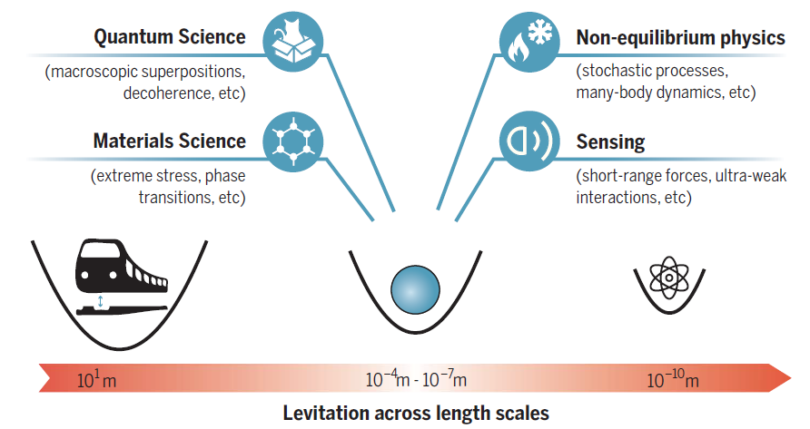
Levitodynamics: trapping & control of micro/nano-objects in vacuum
C. Gonzalez-Ballestero, M. Aspelmeyer, L. Novotny, R. Quidant, O. Romero-Isart, Science 374, 168 (2021)
Convergence from many fields
Optomechanics
Micro/nanomechanics
Atomic physics

Slide 4

Main features of levitated systems
Very high isolation from environment (in vacuum & possibly low T)
$$S_{F}=\frac{4k_{B}Tmω_{0}}{Q}$$
High mechanical Q /Low thermal noise mechanical SENSING
Low mechanical
decoherence
QUANTUM STATES OF MOTION ground state cooling
coupling to qubits or internal degrees of freedom
tests of Quantum Mechanics in the macroscopic limit
High Degree of control
External Potentials (unlike clamped mechanical resonators)
Six well-isolated Degrees of Freedom (Translational + Rotational)
Nonlinearities
Rich and Complex Dynamics

Slide 5
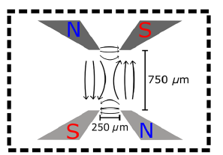
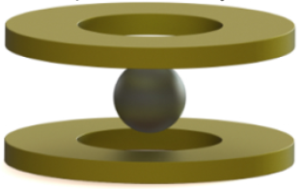
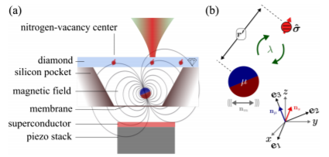
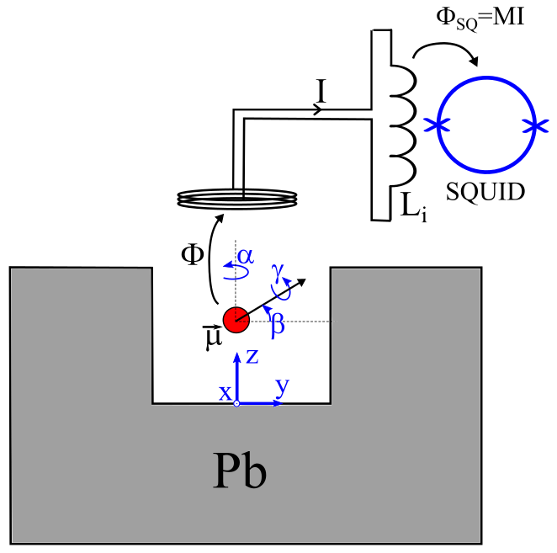
Magnetic trapping
PASSIVE TRAPPING (no heating) ⇒ Compatible with low temperature
Diamagnetic particles
Gravito-magnetic trap
Superconducting particles
chip-based AH coils trap
B. D’Urso et al, Montana
W. Wieczorek et al, Chalmers
M. Aspelmeyer at al, Vienna
Ferromagnets above superconductors
Type II
Type I
Us
(more in this talk)
J. Gieseler et al, Harvard (PRL 124, 163604, 2021)
T. Wang et al, Berkeley (PR Appl 11, 044041, 2019)

Slide 6
Why levitated ferromagnets?
High coupling to Single Spins (NV) or SQUIDs
Readout of mechanical motion using the qubit
Mediate coupling between different qubits
Generation of nonclassical states of motion
Tests of superposition principle/quantum gravity
Coupling to internal degrees of freedom: Magnons
High coupling to External Magnetic Fields Magnetometry and rotational sensing
Gyroscopic behaviour (atom-like Larmor precession regime)
Librational motion (macroscopic regime)
Several applications in FUNDAMENTAL PHYSICS

Slide 7
Trapping micromagnets with
Type I Superconductors

Slide 8
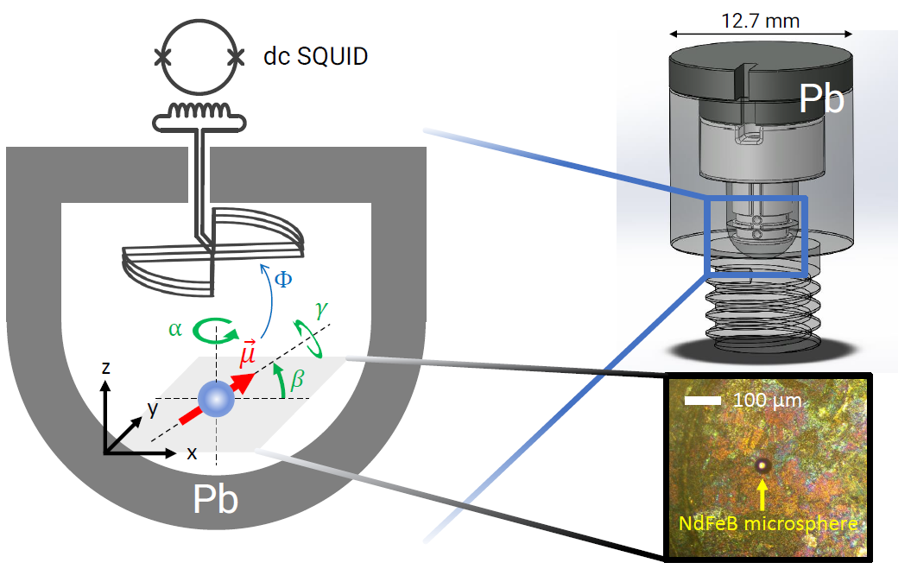
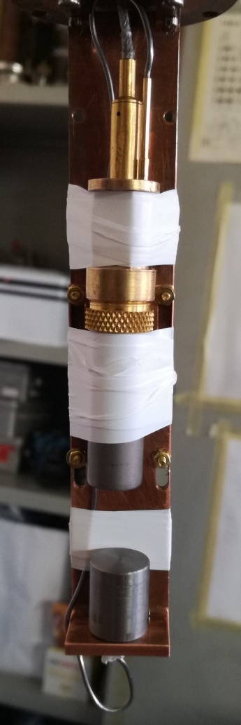
Experimental setup (P=10⁻⁵ – 10⁻¹ mbar, T=4.2 K)
SQUID
Trap
DIPPED
in a liquid He
Transport Dewar

Slide 9
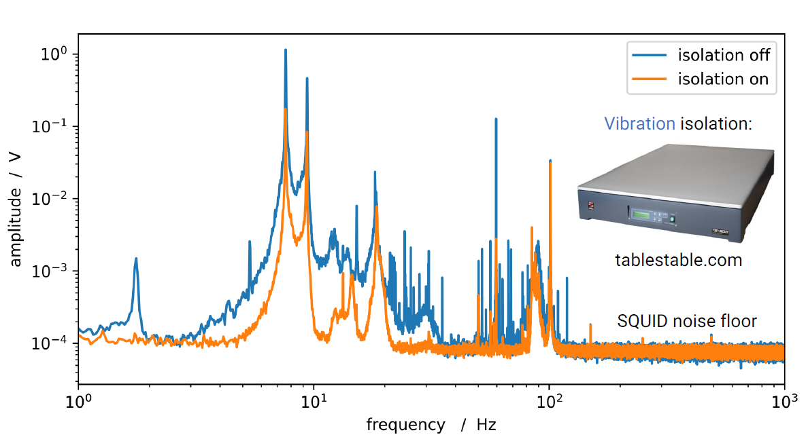
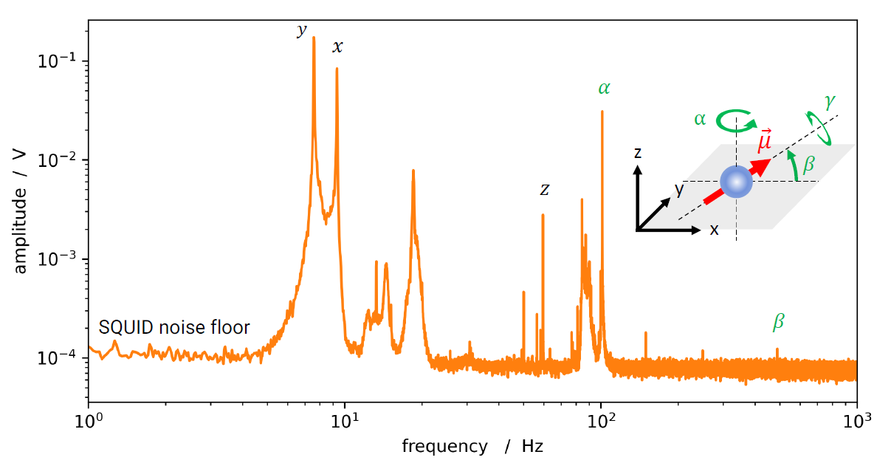
Mode identification

Slide 10
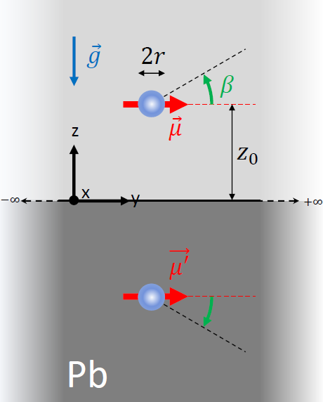
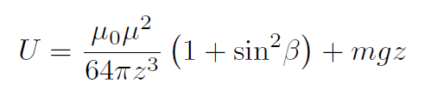
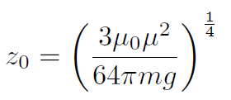

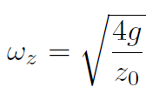

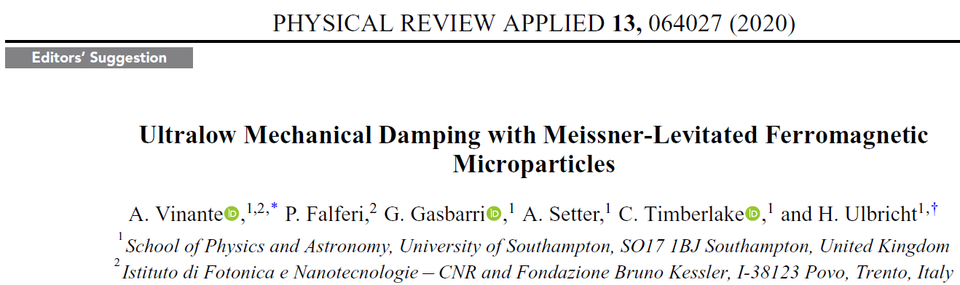
Modelling: image method (z and β)

Slide 11
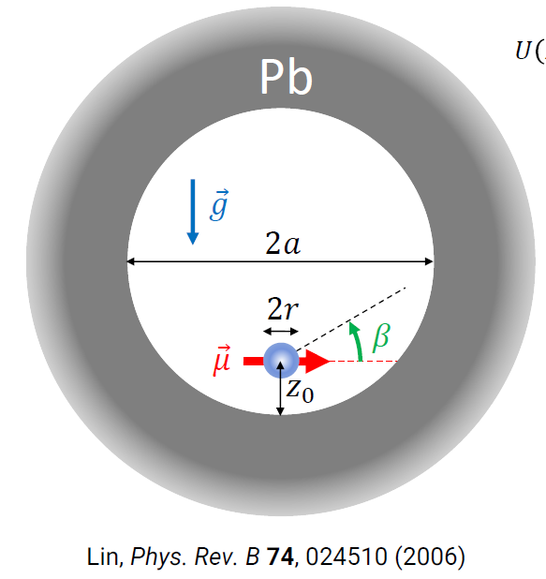
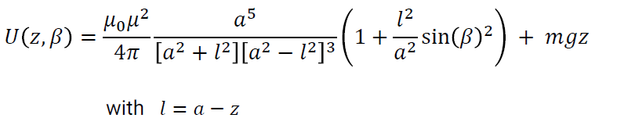
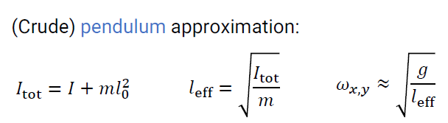
Modelling: image method with sphere
z and β
x and y
For more accurate estimation: FEM simulations

Slide 12
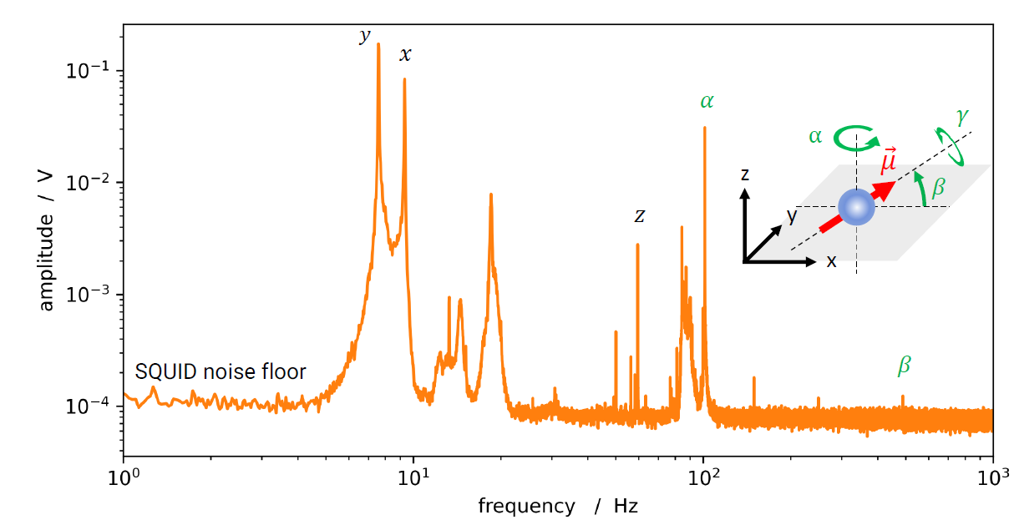
Mode identification
?

Slide 13
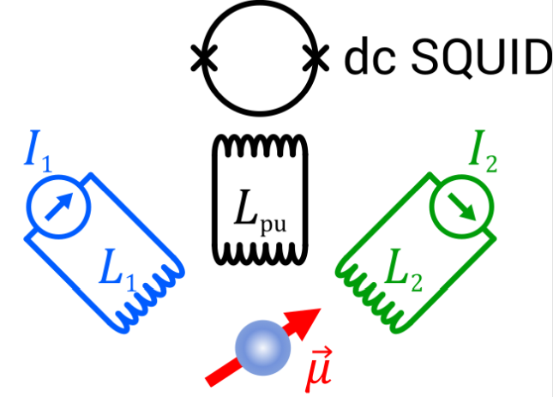
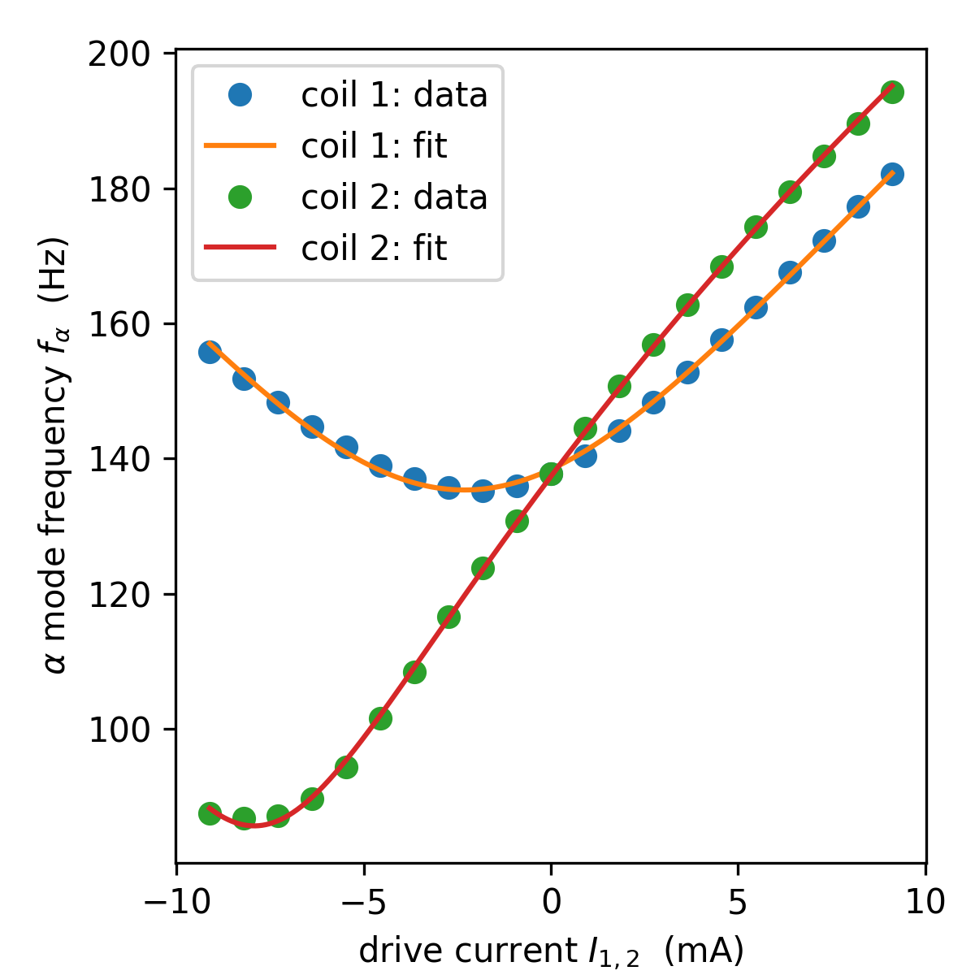

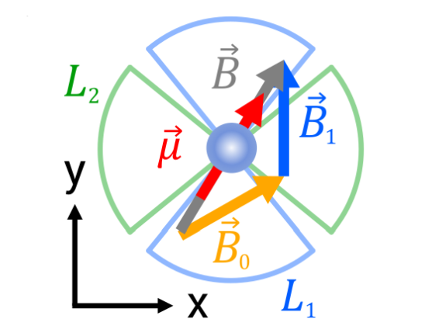



Modeling α mode: frequency tuning
From geometry, α mode should be free (cylindrical symmetry)
Symmetry can be broken by a small residual B₀ field

Slide 14
Application: ultrasensitive magnetometry
(magnetic field sensing)

Slide 15
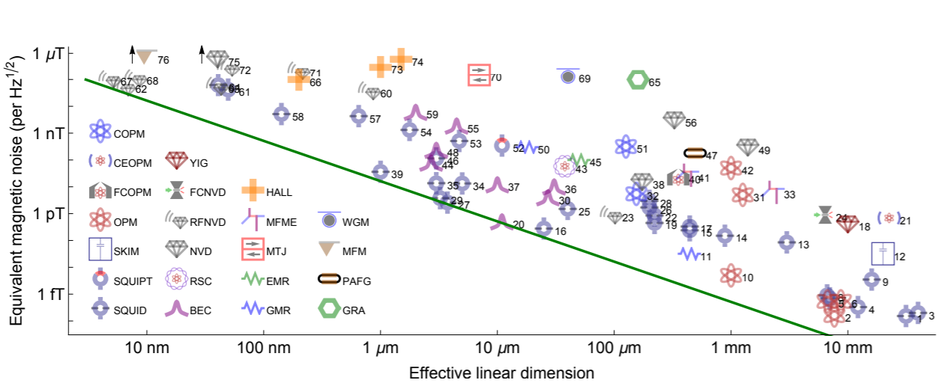
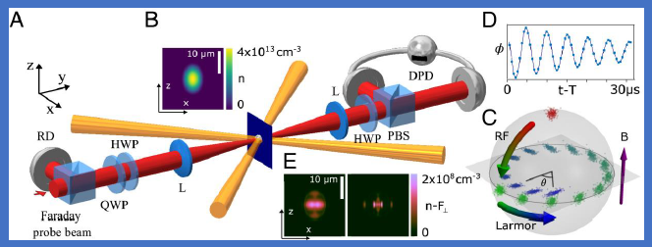
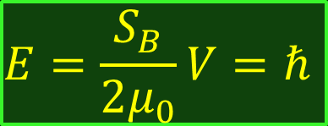
The Energy Resolution Limit: a quantum limit on B sensing?
single-domain spinor Bose–Einstein condensate
Alvarez et al
ERL
M. Mitchell and S.P. Alvarez, Review Modern Physics 92, 021001 (2020)
Alvarez et al., PNAS 119, e2115339119 (2022)
ERL
$$E=\frac{S_{B}}{2μ_{0}}V=ℏ$$
ERL IS NOT A FUNDAMENTAL LIMIT !
CAN BE BEATEN by HIGHLY CORRELATED SPIN SYSTEMS

Slide 16
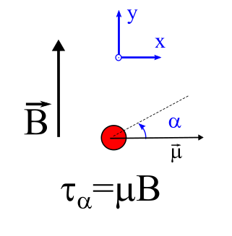

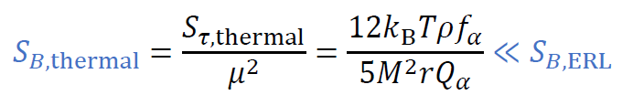
Torque Magnetometry in levitated magnet
Magnetic Field
Torque
CALCULATED FOR OUR SETUP

Slide 17
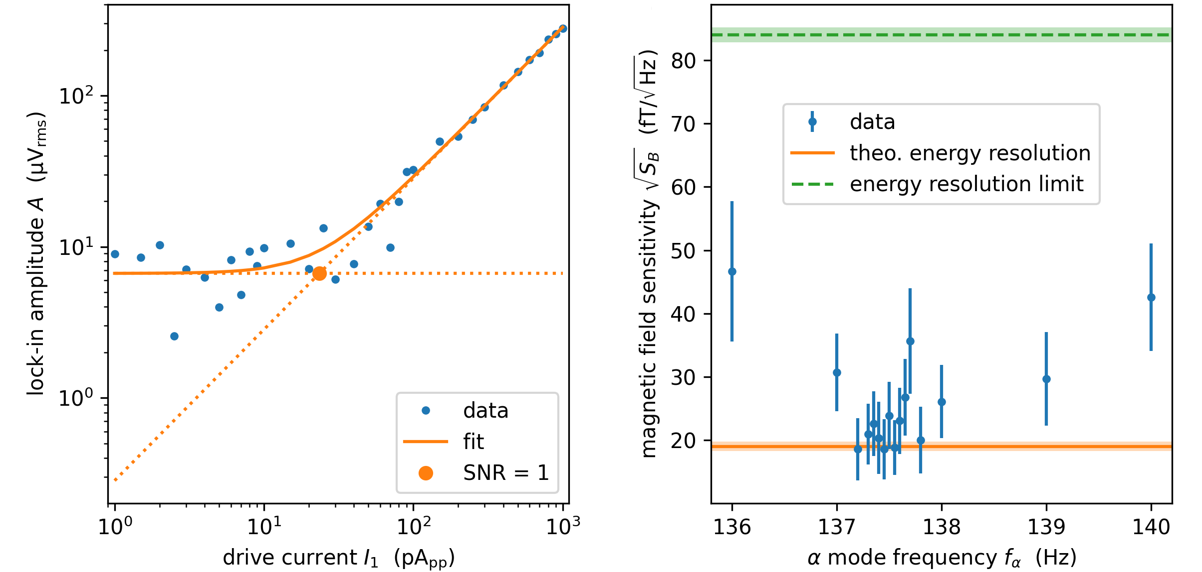
Minimum detectable B in the experiment
Apply a weak sinusoidal signal around resonance
Synchronous detection of the output signal (lock-in)
ERL
Measured Energy resolution: E_{R}=(0.064±0.010) h

Slide 18
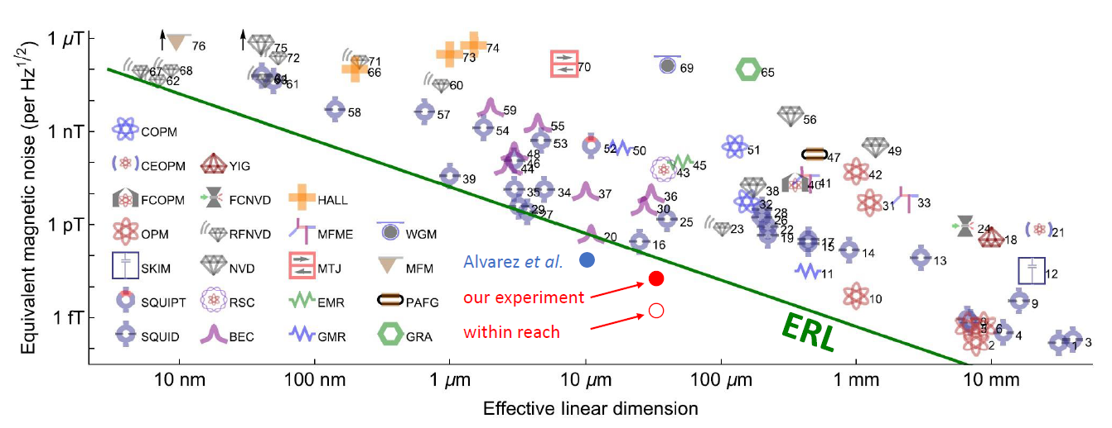


Magnetometry well beyond the Energy Resolution Limit
Current experiment performed at relatively high pressure P=10⁻³ mbar
Damping can be reduced by at least factor > 10² at lower pressure (measured!)
Projected Energy Resolution < 10⁻³ h

Slide 19
(rotationless) gyroscopic effects

Slide 20
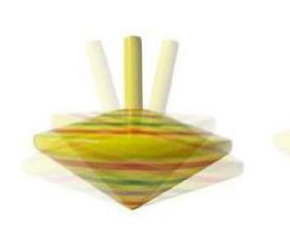
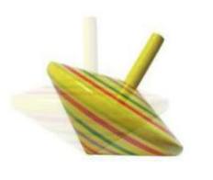
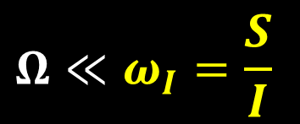


Classical gyroscope
Spinning top under effect of gravity torque
Gyroscopic
Librational
Ω ∝ g
g
g
$$S≫L=IΩ$$
$$S<L$$
Condition to observe gyroscopic behaviour:
$$Ω≪ω_{I}=\frac{S}{I}$$

Slide 21
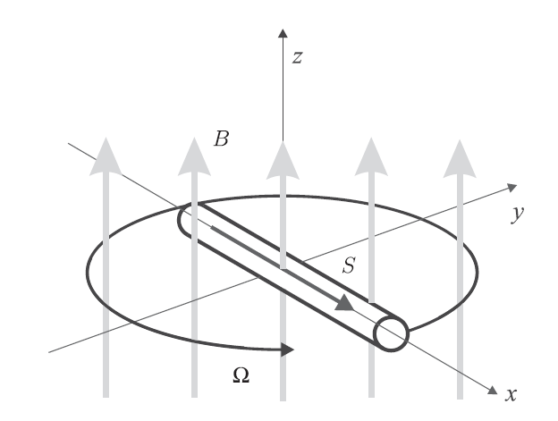

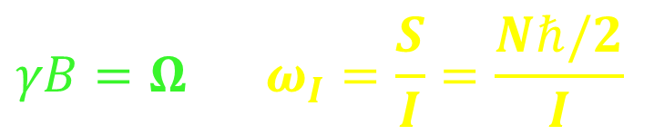

Ferromagnetic spin-gyroscope
Derek Jackson Kimball et al, PRL 16, 190801 (2016)
For sufficiently small magnetic field a ferromagnetic needle
behaves as an atomic spin magnetometer
$Ω=γB$
Macroscopic Larmor precession!
(spins transfer precessional motion to the lattice)
Predicted to beat quantum limits on magnetometry (by orders of mag) !
Naïve explanation: atom-like dynamics it is a system of N highly correlated spins
Hard to observe:
$ω_{I}$ ≈ 200 μHz → B ≈ 5 fT (R = 1 mm sphere FM)
$ω_{I}$ ≈ 2 Hz → B ≈ 0.5 nT (R = 10 μm sphere FM)
$$γB=Ω≪ω_{I}=\frac{S}{I}=\frac{Nℏ/2}{I}$$

Slide 22
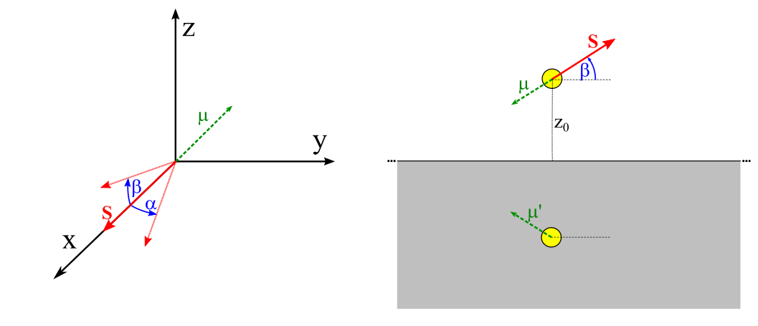
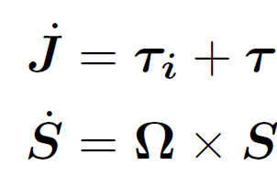
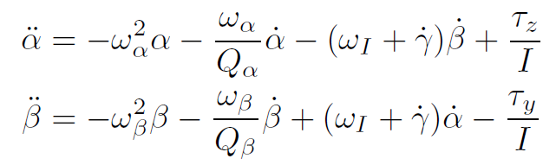


Gyroscopic effects under librational confinement
In our setup, modes are well separated!
GYROSCOPIC
COUPLING
Neglecting dissipation and γ motion:
Quasi-β mode
Quasi-α mode
$$β=β_{0}\sin\left(ω_{β}t\right)$$
$$α=α_{0}\cos\left(ω_{β}t\right)$$
$$α_{0} =β_{0}\frac{ω_{β}ω_{I}}{ω_{β}^{2}−ω_{α}^{2}}$$
$$α=α_{0}\sin\left(ω_{α}t\right)$$
$$β=β_{0}\cos\left(ω_{α}t\right)$$
$$β_{0} =α_{0}\frac{ω_{α}ω_{I}}{ω_{β}^{2}−ω_{α}^{2}}$$
Elliptical motion on (α,β) plane

Slide 23
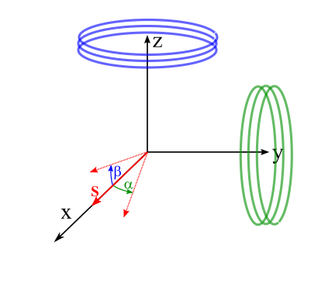
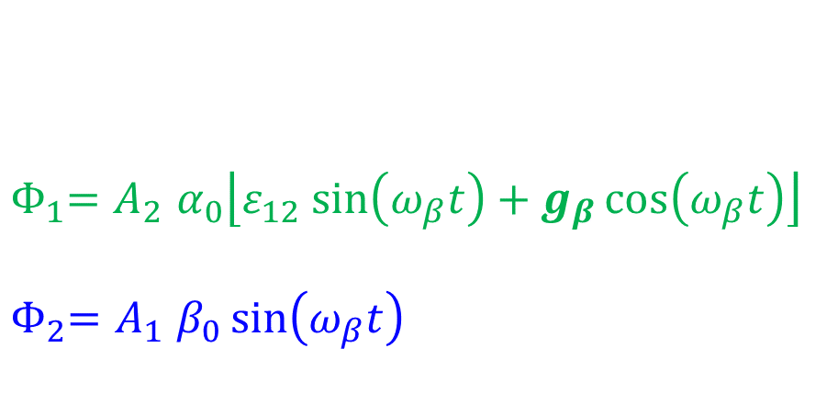

Can we detect elliptical motion ?
Φ₂∝ β
quasi-β mode
${ Φ}_{1}=A_{2}$ $α_{0}\left\lfloor ε_{12} sin\left(ω_{β}t\right)+g_{β}\cos\left(ω_{β}t\right)\right\rfloor$
${ Φ}_{2}=A_{1}$ $β_{0}\sin\left(ω_{β}t\right)$
GYRO
COUPLING
DIRECT
CROSS-COUPLING
Φ₁∝ α
$$g_{α}=\frac{ω_{α}ω_{I}}{ω_{β}^{2}−ω_{α}^{2}}\sim {10}^{−3}$$
GOOD TO HAVE LOW CROSSCOUPLING !
but
CAN USE PHASE INFORMATION
( for magnets ∼ 20 μm radius )

Slide 24
Upgraded setup
Two SQUIDs
2D spatial information
Lower noise
Improved thermalisation
Improved magnetic shielding (x 100)

Slide 25
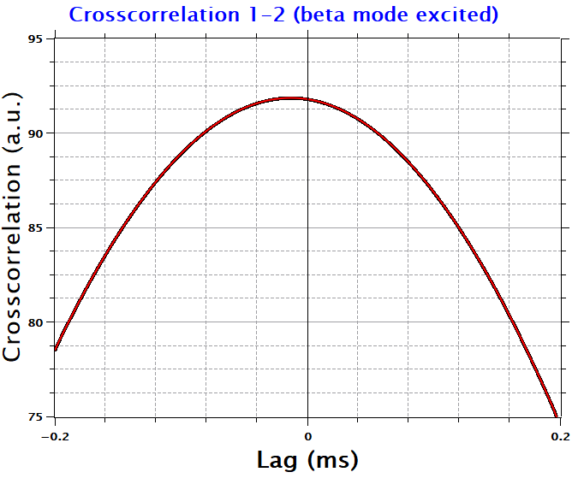
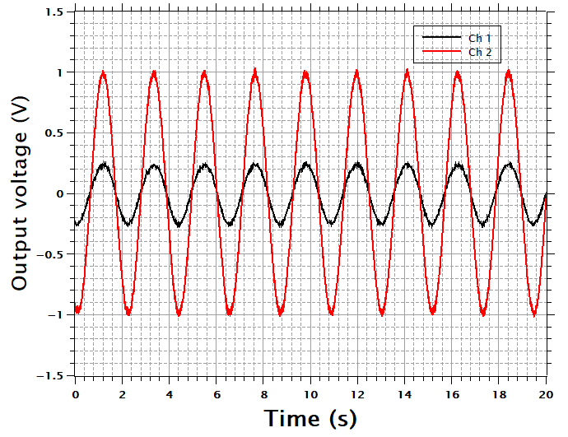
Crosscorrelation
quasi-β MODE
δ = -0.0382 rad ≠ 0
SIGNATURE OF ELLIPTICAL MOTION

Slide 26

Combined measurements of quasi-α and quasi-β correlations
Calibration-free measurement of characteristic frequency
$$ω_{I}=\frac{S}{I}=2π∙0.62 Hz$$
Assuming the moment of inertia is known (and isotropic)
this is an absolute measurement of the intrinsic angular momentum
From indipendent estimations of magnetization, can infer g factor

Slide 27
Fundamental physics

Slide 28
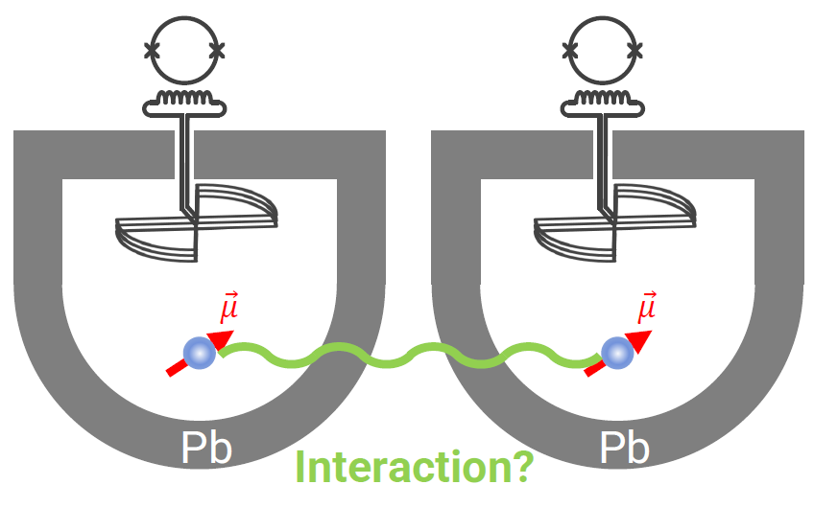
What next: testing fundamental physics
Search for exotic spin-spin interactions beyond standard model (5th force) + dark matter
Test gravity at microscale
Test spontaneous wave function collapse models (single magnet)
Test relativistic frame-dragging (single magnet in space)
Collaboration with H. Ulbricht (Southampton), T. Oosterkamp (Leiden), D. Budker (Mainz) & friends

Slide 29
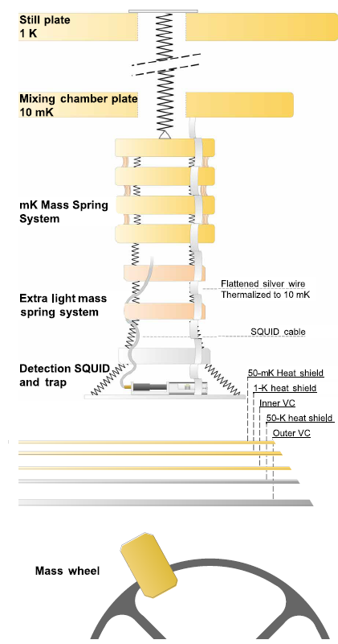
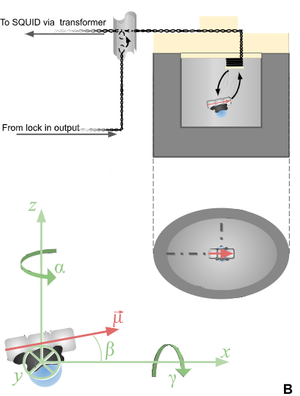
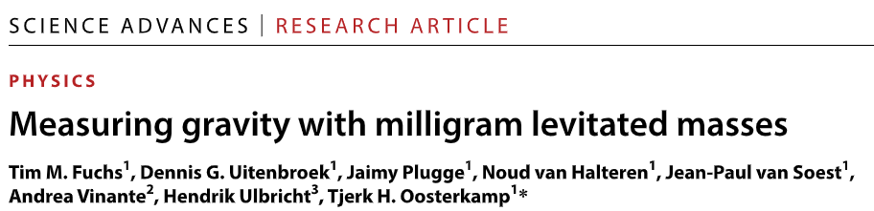
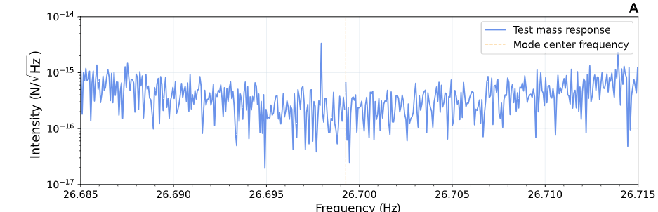
Measuring gravity with sub-mg masses
First direct measurement of gravity with a sub-mg sub-mm mass
Next step: measure gravity between two such masses
Future: test quantumness gravity by using nonclassical states

Slide 30
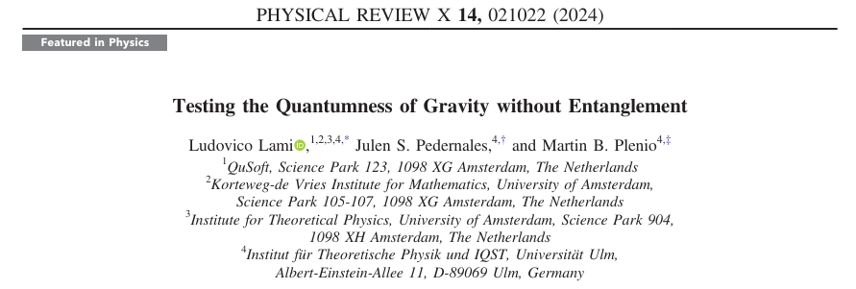
Recent theory breakthrough
Nonclassical states and entanglement may net be necessary to test if gravity is quantum force.
Monitoring dynamics of two interacting mechanical systems prepared in coherent states may suffice
(Numbers still very tough..)

Slide 31
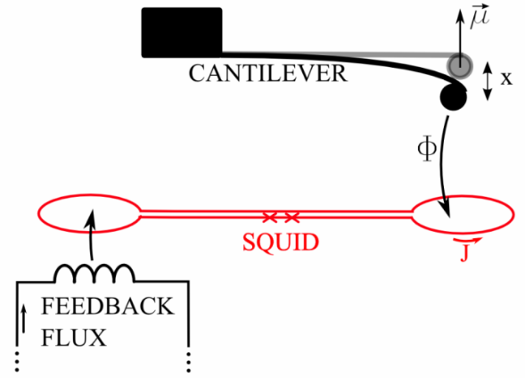
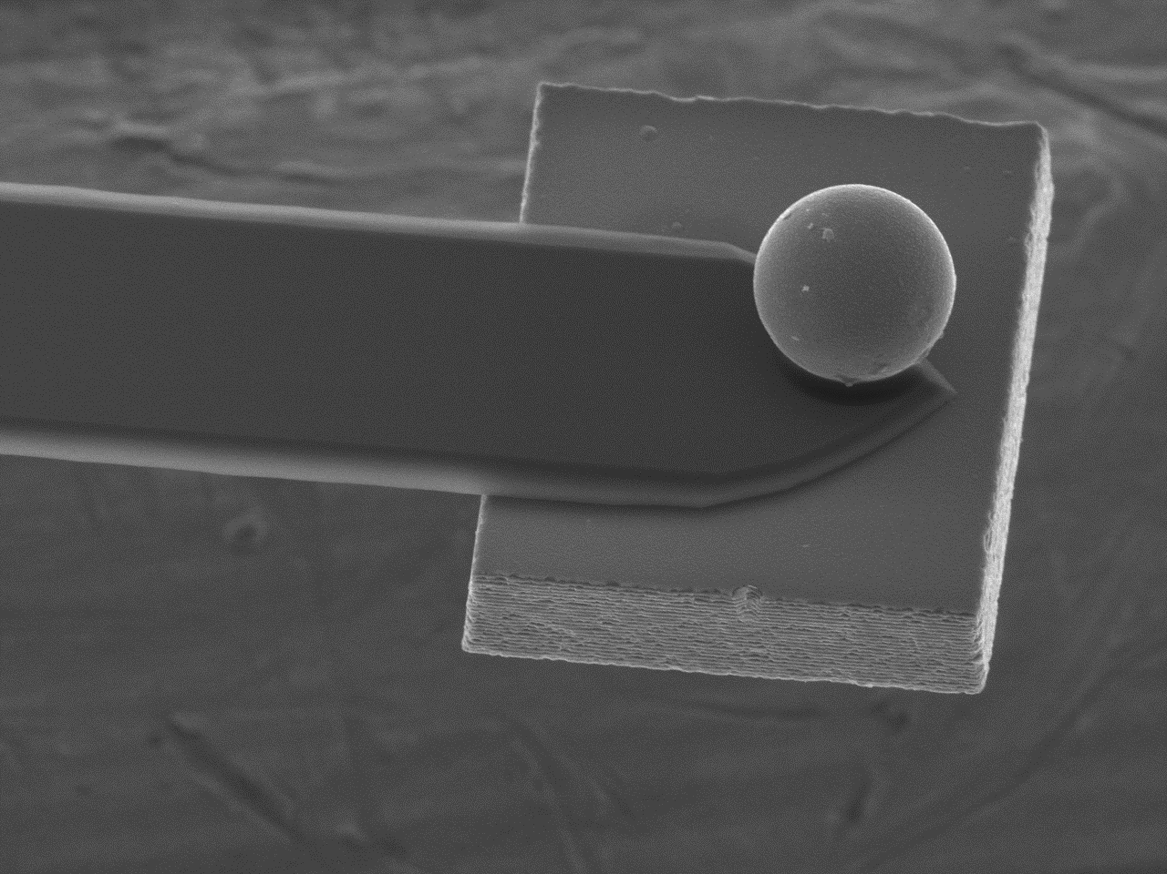
Testing Spontaneous Wavefuction Collapse: the CSL model
( = Continuous Spontanous Localization)
A. Vinante et al, Phys. Rev. Lett. 125, 100404 (2020)
Stochastic modifications of unitary quantum dynamics
GRW & CSL models
(G. Ghirardi et al, PRL 1986)
Explain wave-function collapse through a universal mass-proportional mechanism
Suppression of massive quantum superpositions
BUT ALSO
Violates energy conservation
( = universal force noise on mechanical systems )
CANTILEVER
LISA PTF
GRW

Slide 32
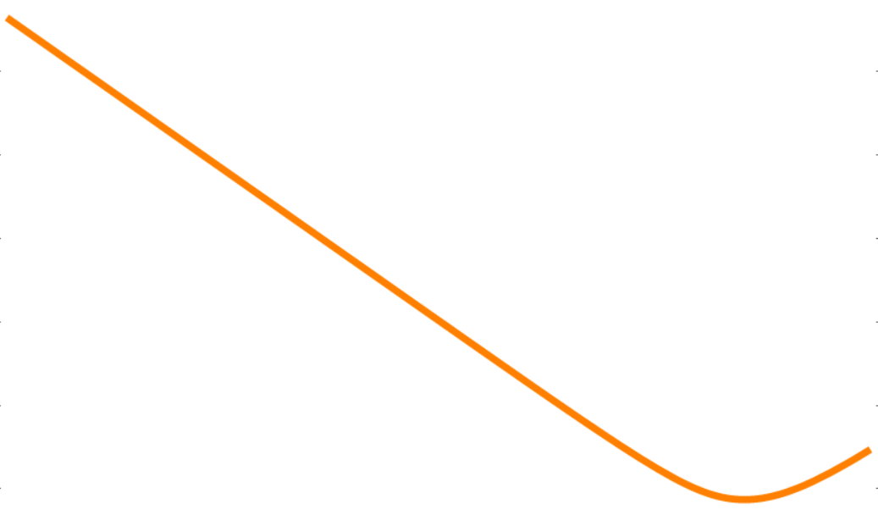
Testing spontaneous wave function collapse models
( = Continuous Spontaneous Localization)
Predicted bound by:
2-sphere dumbbell,
R=20 μm
Librational mode
Thermal noise
T=0.1 K
τ=10⁶ s
CANTILEVER
LEVITATED
MAGNET
LISA PTF

Slide 33
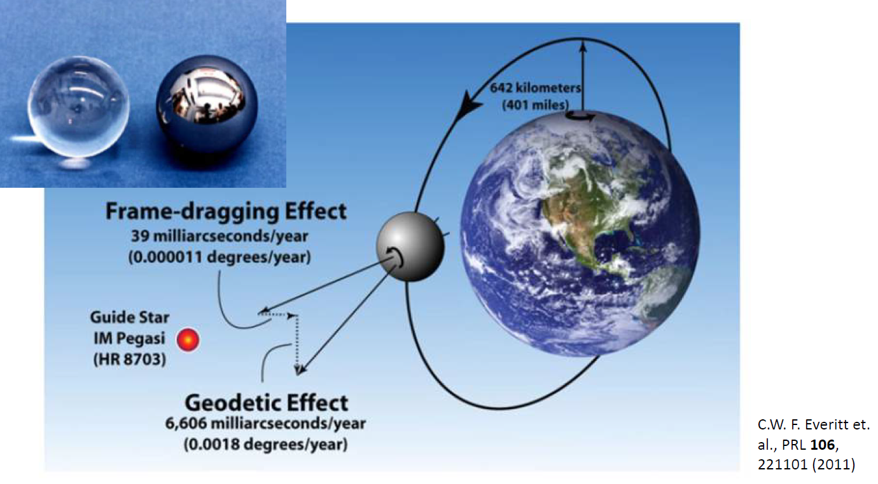
GRAVITY PROBE B

Slide 34


Test GR frame-dragging with a ferromagnetic gyroscope
TEST of GR (Lense-Thirring) using quantum spin angular momentum ( Quantum + Gravity ! )
Ferromagnetic gyroscope
Precession of local inertial frame
For electron spin, rotational motion is equivalent to a magnetic field
B=Ω/γ ∼10⁻²⁵ Τ !!

Slide 35

Testing gravity-quantum connection?
To predict gyro-magnetic factor
g≈2 we had to wait for
Dirac equation + QED
To predict gyro-gravitomagnetic factor we would need quantum gravity!
AND WHAT IF GRAVITY IS CLASSICAL?
SHOULD WE SEE ANY FRAME-DRAGGING ?

Slide 36
Take-home message
Levitated magnets: a new platform for ultrasensitive mechanical sensors
Possibly one of the best magnetometers in terms of energy resolution
A gyroscope without rotations!
Fundamental and quantum physics
  Axion dark matter & exotic interactions
  Gravity at the microscale
  Spontaneous collapse models
  GR tests

Slide 37






Current members
Felix Ahrens
Nicolò Crescini
Paolo Falferi
Benno Margesin
Federica Mantegazzini
Renato Mezzena
Andrea Vinante
FUNDING
The Cryo & Quantum team in Trento: CNR-IFN + FBK + UniTN
ACTIVITIES
Superconducting Quantum Circuits: Fabrication & tests
(Parametric Amplifiers, SQUID, Qubits)
Magnetomechanical systems

Slide 38


LEMAQUME
Levitated Magnets for Quantum Metrology
3-yr project cofunded by EU and National Agencies under the QuantERA 2 program
Partners: CNR-IFN Trento (IT), CNRS Paris, (FR), JGU Mainz,
LUH Hannover, Uni Ulm (DE), Uni Latvia (LV), Ben Gurion Uni (Israel)
External Partners: Southampton (UK), Boston, California East Bay (US)
THREE MAIN PLATFORMS for LEVITATED MICRO/NANOMAGNETS
SUPERCONDUCTING
TRAPS
PAUL TRAPS &
CIRCUIT TRAPS
FREE-FALL
(EINSTEIN ELEVATOR)

Slide 39
Testing GR dragging effects with a ferromagnet
TEST of GR (Lense-Thirring) using quantum spin angular momentum ( Quantum + Gravity ! )
Ferromagnetic gyroscope
Precession of local inertial frame
For electron spin, rotational motion is equivalent to a magnetic field
B=Ω/γ ∼10⁻²⁵ Τ !!

Slide 40
Testing spontaneous wave function collapse models
[ aka Ghirardi-Rimini-Weber theory and similar ]

Slide 41



The Quantum Measurement Problem Paradox
Two different dynamics in Standard Quantum Mechanics
1) Unitary evolution: Linear and Deterministic
2) Measurement process:
Nonlinear (Reduction postulate) & Stochastic (Born Rule)
BUT What is precisely a measurement ?
Paradoxes, if we include observers in a “larger” unitary description
(Schrodinger’s cat – Wigner’s friend …)

Slide 42
Possible answers
1) “Shut-up and calculate”
2) Decoherence = Entanglement system - environment
Explains quantum to classical transition, BUT
No collapse (just more and more entanglement)
Reduction postulate still needed to explain definite outcomes
3) Interpretations (Copenhagen, Many-Worlds , Decoherent Histories, Pilot-wave and a lot more … )
Not experimentally testable
Physics ⇒ Metaphysics
4) Quantum mechanics is an approximated theory Collapse models

Slide 43
Continuous Spontaneous Localization (CSL)
Schrödinger equation + Stochastic term (collapse field)
[ GRW model: Ghirardi, Rimini, Weber, PRD 34, 470 (1986)
CSL model: Ghirardi, Pearle, Rimini, PRD 42, 1978 (1990) ]
Replacing the reduction postulate of standard quantum mechanics!
Leads to “collapse” in position = Localization
Coupling to the system mass
1) negligible at microscale (atoms,molecules, …) ⇒ quantum
2) dominant beyond some mass scale ⇒ classical
Measurement-based “collapse” and Born rule follow from dynamics
( “Measurement = macroscopic” )

Slide 44
Continuous Spontaneous Localization (CSL)
Schrödinger equation + Stochastic term (collapse field)
2 phenomenological constants (free parameters)
Correlation Length r_{C}
conventional “literature value” r_{C} =10⁻⁷ m
Collapse rate λ
    Lower bounds (to guarantee collapse at “macroscopic” or “mesoscopic” scale)
    λ ∼ 10⁻¹⁶ s⁻¹ @ r_{C} =10⁻⁷ m following Ghirardi, Rimini, Weber (GRW)
    λ ∼ 10⁻⁸ s⁻¹ @ r_{C} =10⁻⁷ m following Adler
( N = number density of nucleons, “smeared” over r_{C} )

Slide 45
Experimental test
Collapse models CAN BE TESTED !
(unlike interpretations of quantum mechanics)
1) Direct (Interferometric): collapse of massive quantum superpositions
Experimentally very demanding !
2) Indirect (non-interferometric): violation of energy conservation
X-ray spontaneous emission from free electrons
Spontaneous diffusion / heating / force noise in mechanical resonators

Slide 46






Random Collapses Momentum kicks Stochastic driving force
τ=Q/ω₀
F_{therm}
M
k=Mω₀²
F_{CSL}
S. Nimmrichter et al, PRL 113 020045 (2014)
L. Diosi, PRL 114, 050403 (2015)
A. Vinante et al, PRL 116, 090402 (2016)

Slide 47




What experiments ?
Ultracold Nano/micromechanical systems
Gravitational wave detectors
(LISA Pathfinder)
Levitated nanoparticles

Slide 48


First test (2016): microcantilever at mK
Force noise S_{ff}=5x10⁻¹⁹ N/√Hz @ T_{m}∼25 mK
A. Vinante et al, Phys. Rev. Lett. 116, 090402 (2016)

Slide 49
Most recent results (2020)
A. Vinante et al, Phys. Rev. Lett. 125, 100404 (2020)
CANTILEVER
LISA PTF
GRW

Slide 50
Prospects with a levitated magnet
Predicted bound for:
2-sphere dumbbell,
R=20 μm
Librational mode
Thermal noise
T=0.1 K
τ=10⁶ s
CANTILEVER
LEVITATED
MAGNET
LISA PTF

Slide 51

Towards a chip trap
Advantages
Improved control on geometry
Higher coupling to SQUID
Scalability
Smaller size
Collaboration with H. Ulbricht (Univ Southampton) and R. Folman (Ben Gurion Univ Negev)

