Slide 1
Trento, ECT* 04/06/2024
A Modern Odyssey: Quantum Gravity meets Quantum Collapse
at Atomic and Nuclear physics energy scales in the Cosmic Silence
Cancellation Effects in the Spontaneous Collapse Rate at Low Energy Limit
Simone Manti, Kristian Piscicchia, Sandro Donadi, Angelo Bassi, Maaneli Derakhshani, Lajos Diósi, Catalina Curceanu

Slide 2
Cancelation Effects in the Spontaneous Collapse Rate
Rates for CSL and DP in the Low Energy Limit
Different Approximations in the Low Energy Limit
Outline

Slide 3
Quantum Mechanics: Allows precise predictions, but superposition principle isn't observed in macroscopic systems.
Collapse Models: Propose that quantum mechanics' linearity breaks down at a certain scale to solve the measurement problem.
Key Models:
Continuous Spontaneous Localization (CSL)
Diósi-Penrose (DP)
Goal: Investigate spontaneous electromagnetic radiation in X-rays domain induced by dynamical wave-function collapse.
Donadi, Sandro, et al. "Underground test of gravity-related wave function collapse." Nature Physics 17.1 (2021): 74-78.

Slide 4
Collapse Models introduce stochastic terms in Schrödinger's Equation
Collapse Mechanisms: Both CSL and DP models introduce non-linear, stochastic terms in Schrödinger's equation.
Spontaneous Radiation: Random collapses induce radiation due to random acceleration of charged particles.
Energy Domains: Previous studies focused on γ-rays; this study focuses on X-rays.

Slide 5
Current models need refinement for low-energy behavior analysis
Previous Experiments:
- γ-rays: High purity germanium crystals used to compare measured radiation with theoretical predictions.
- X-rays: Studies at lower energies to probe different aspects of wave-function collapse.
Challenges: Current models' predictions need refinement for accurate low-energy behavior analysis.

Slide 6
Atomic Scale in the CSL model
CSL Model:
- Spontaneous emission rate considering atomic scale.
- Equation involves parameters: λ (strength), r_{C} (correlation length).
- Rate derivation in Donadi, Sandro, et al. "Novel CSL bounds from the noise-induced radiation emission from atoms." The European Physical Journal C 81.8 (2021): 1-10.
Simplest Approximation:

Slide 7
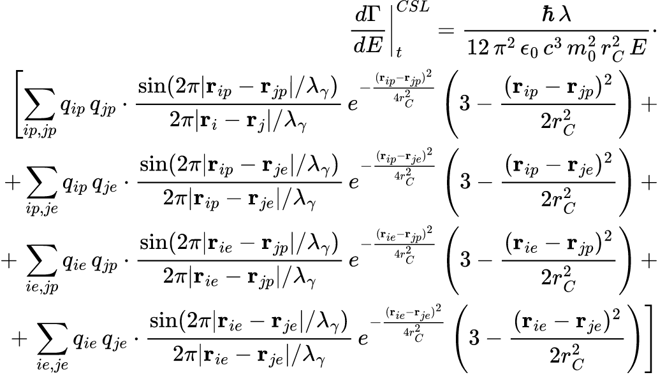
Atomic Scale in the CSL model: Semiclassical Approach
Nucleus-Nucleus:
Nucleus-Electron:
Electron-Electron:

Slide 8
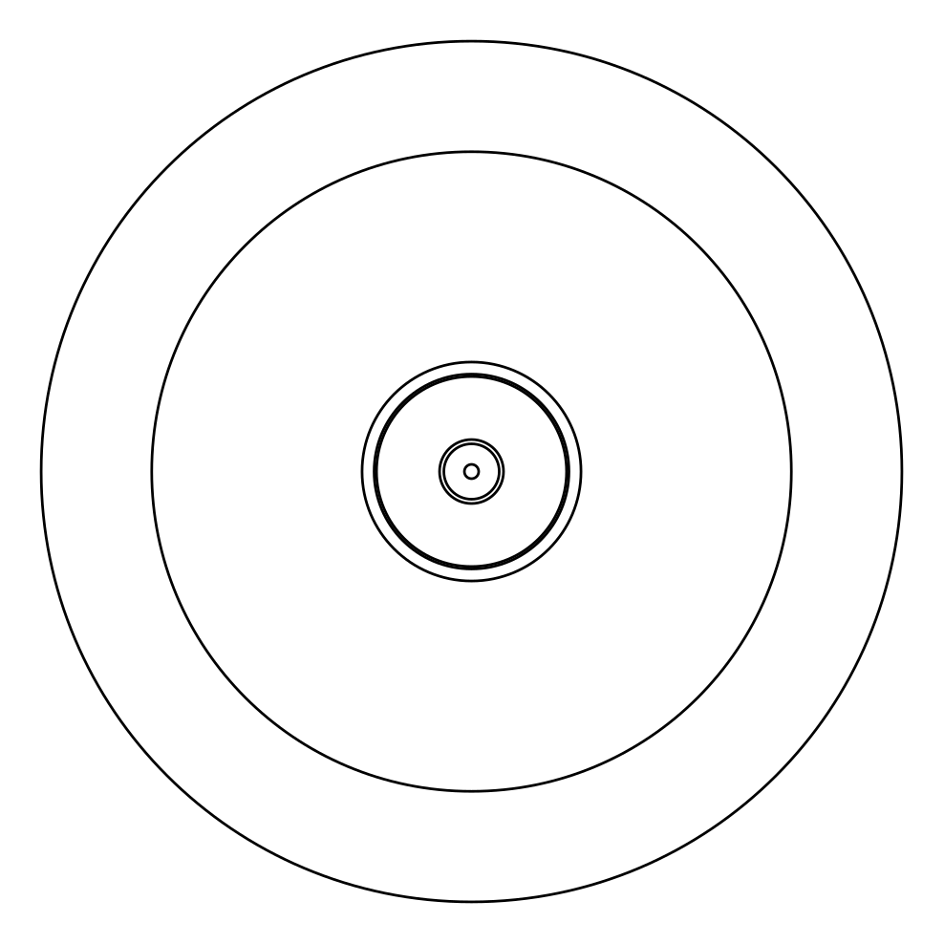
Atomic Scale in the CSL model: Semiclassical Approach
Nucleus-Nucleus:
Nucleus-Electron:
Electron-Electron:

Slide 9
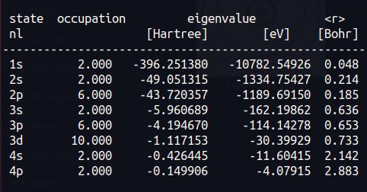
Atomic Scale in the CSL model: Semiclassical Approach
Isolated Ge atom - DFT (LDA)
Parametrizion used: ⍺=2,ꞵ=0

Slide 10
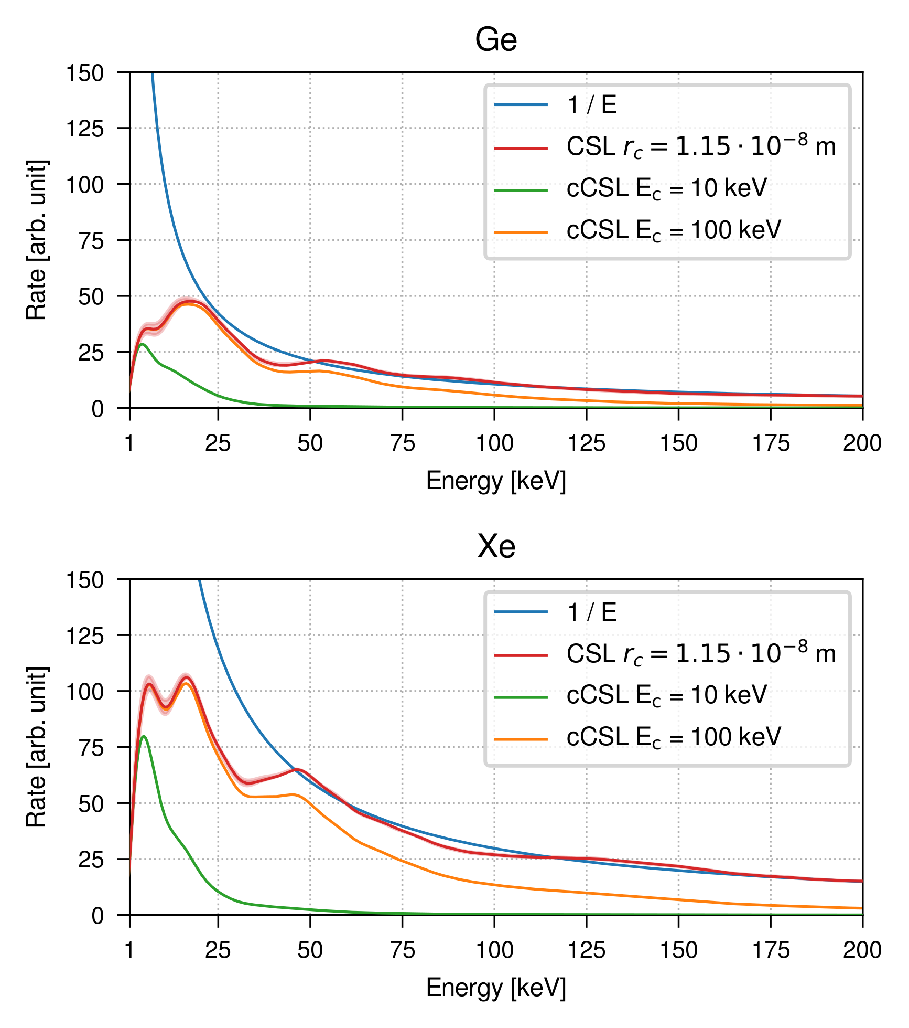
Atomic Scale in the CSL model: Semiclassical Approach
Generalization to the non-Markovian case:

Slide 11
Atomic Scale in the DP model
The Rate for a Markovian DP model has instead:
f_{ij} is a measure of the overlap between the mass densities of the particles i-th and j-th (g_{i,j})
Simplest Approximation:

Slide 12
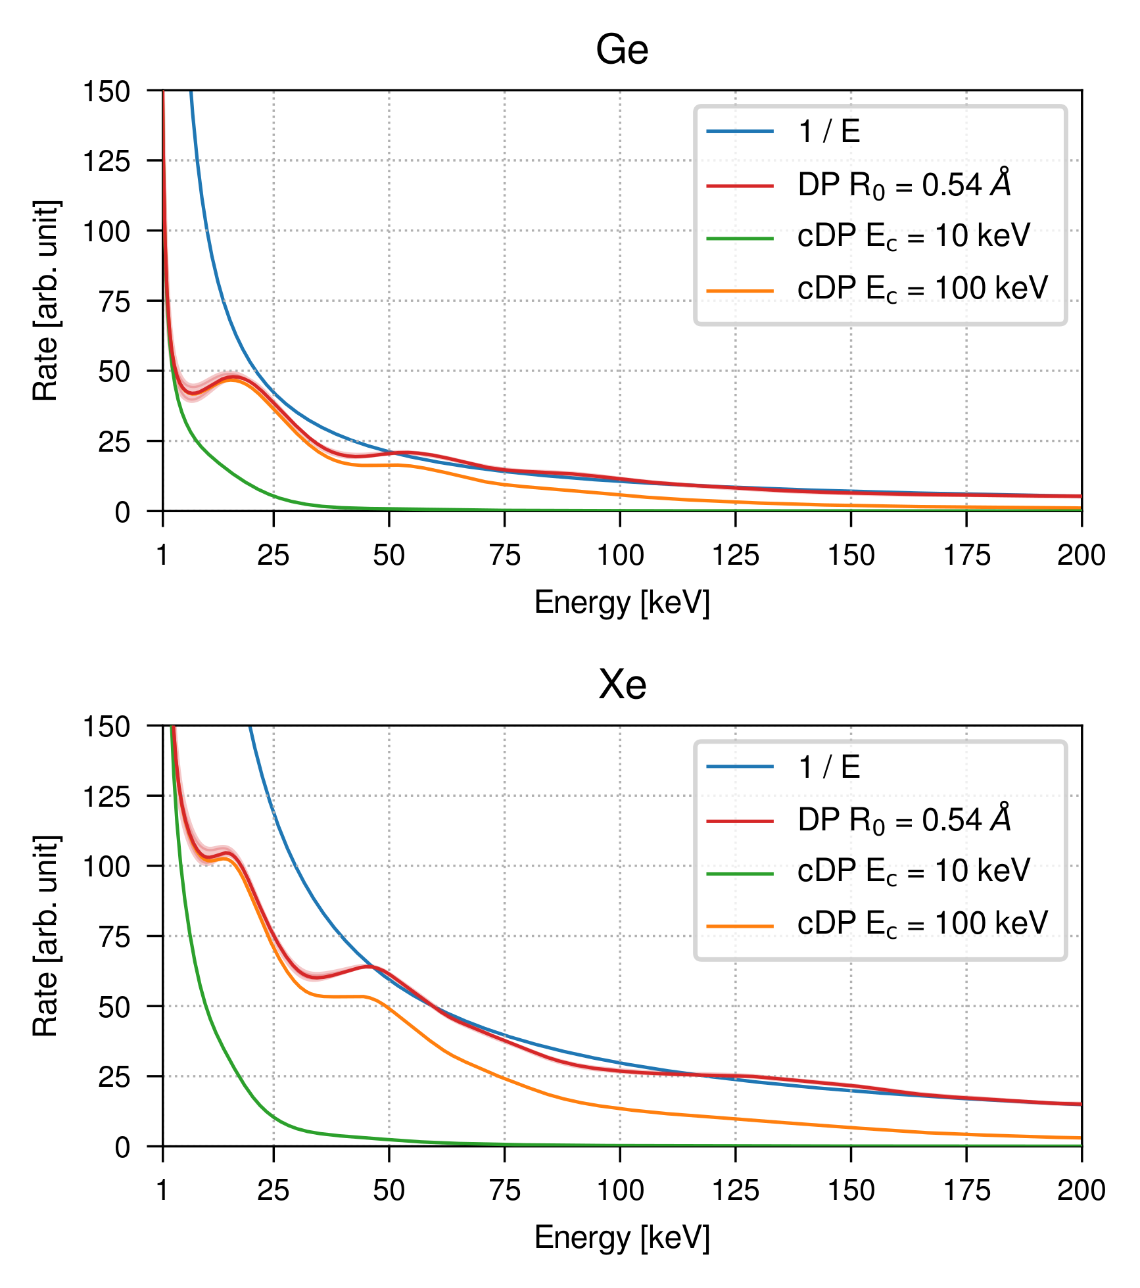
Atomic Scale in the DP model: Semiclassical Approach

Slide 13
Different Models give Different Rates in the Low Energy Limit

Slide 14
Validity of the Semiclassical Approach
Nucleus-Electron:
Electron-Electron:

Slide 15
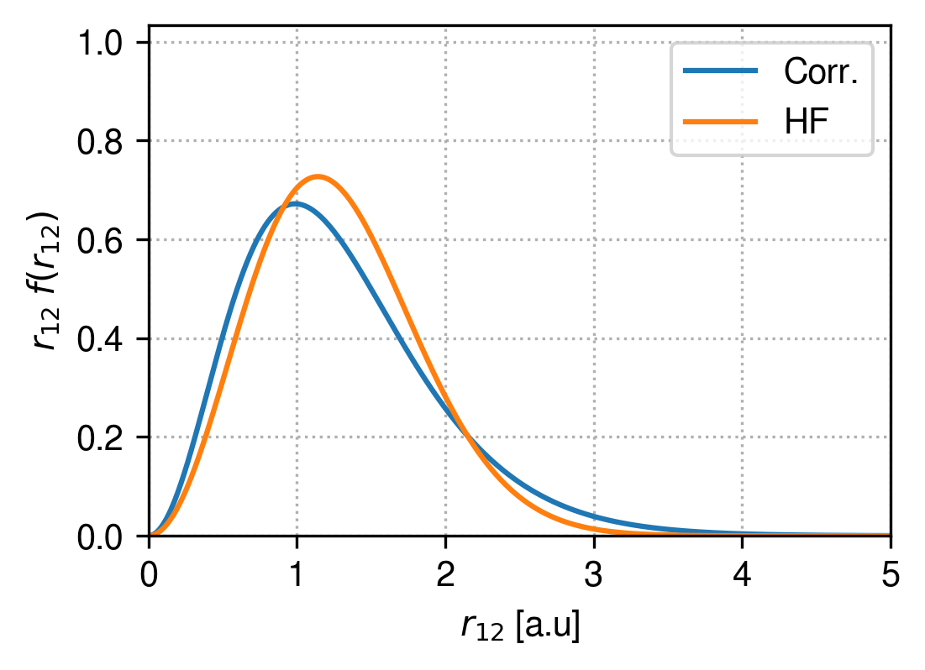
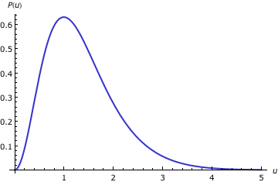
Limits on 𝛼: Helium case (1s²)
Radial Distribution
Function
probability distribution to find two electrons at u
ρ_{1s} [a.u.] | 2ρ_{1s} [a.u.] | <r₁₂>_{uncorrelated} | <r₁₂>_{correlated}
0.946 (1) | 1.892 (2) | 1.30 (1.35) | 1.41 (1.47)

Slide 16
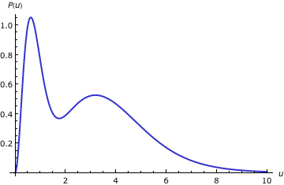
Limits on 𝛼 and 𝛽: Lithium case (1s²2s¹)
Radial Distribution
Function
probability distribution to find two electrons at u
ρ_{1s} [a.u.] | ρ_{2s} [a.u.] | |ρ_{1s}-ρ_{2s}| [a.u.] | <r₁₂>_{1s-1s} [a.u.] | <r₁₂>_{1s-2s}[a.u.]
0.582 | 3.908 | 3.32 | 0.6 | 3.2
ROHF/6-311G

Slide 17
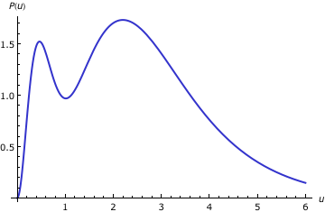
Limits on 𝛼 and 𝛽: Beryllium case (1s²2s²)
Position
intracule
probability distribution to find two electrons at u
ρ_{1s} [a.u.] | ρ_{2s} [a.u.] | |ρ_{1s}-ρ_{2s}| [a.u.] | <r₁₂>_{1s-1s} [a.u.] | <r₁₂>_{1s-2s}[a.u.] | <r₁₂>_{2s-2s}[a.u.]
0.421 | 2.604 | 2.18 | 0.5 | 2.1 | 2.9
ROHF/6-311G

Slide 18
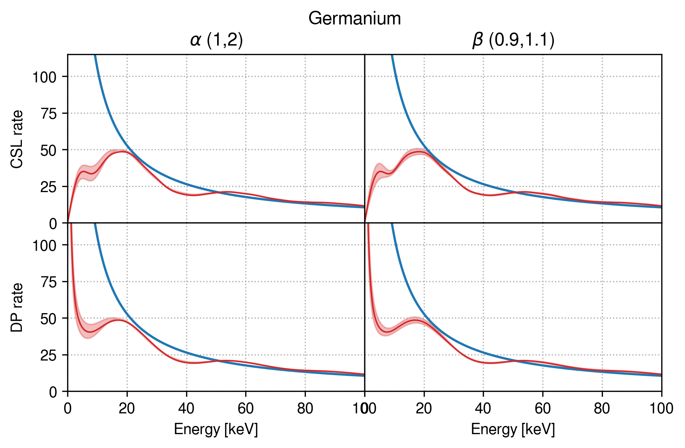
Rate formula Germanium 𝛼=1.5 (1,2) and 𝛽=1 (0.9,1.1)

Slide 19
Fully Quantum approach for Low Energy Limit
The general structure for the formula Rate is:
This can be rewritten in terms of the Radial Distribution Function (RDF) of the emitters:
Where is the probability to find two emitters i and j at distance r
Electron-Nuclear RDF
Electron-Electron RDF

Slide 20
Conclusion
Cancelation Effects due to the atomic scale in the Collapse Rate
Different Rates for CSL and DP due to Cancelation Effects
Fully Quantum Scheme for Rate Calculations with RDF
Thanks for your Attention!

