Slide 1
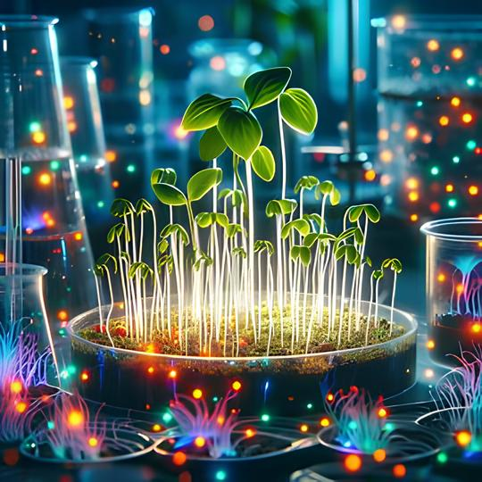

Biophotons: a hard problem
Luca De Paolis (LNF-INFN)
On behalf of the biophotons collaboration
“A Modern Odyssey: Quantum Gravity meets Quantum Collapse at Atomic and Nuclear physics energy scales in the Cosmic Silence”
$$3^{rd}−7^{th}June 2024, {ECT}^{∗}, Trento, Italy.$$

Slide 2
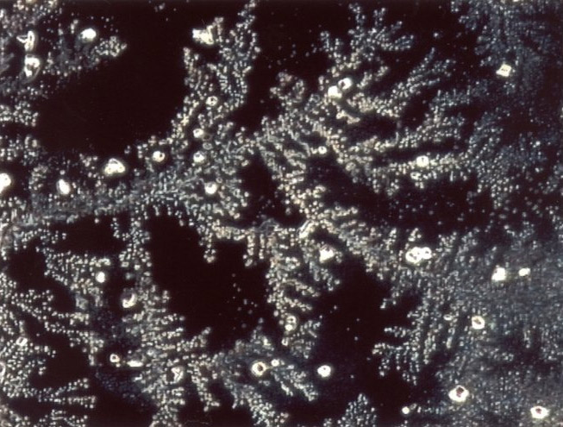
What are Biophotons?
Living organisms emit ultra-weak electromagnetic radiation, ranging from a few to several hundred photons per second per square centimeter of surface area.
The emission occurs in the visible energy range:
Energy → 1.7 eV – 3 eV
Wavelength → 400 nm – 700 nm
If you kill the organism this emission goes away!
Therefore
When the life begins, the emission starts to exist!
This excludes the possibility that it is the product of either some radiative decay produced by traces of radioactive substances present in the organism or by the passage of cosmic rays.
Pictures of biophotons emitted by a leaf.

Slide 3

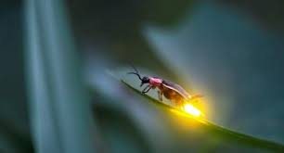
What are Biophotons?
Biophotons are completely different from the photons emitted by normal bioluminescence observed in some organisms:
All living organisms emit biophotons.
The biophotonic emission rate is several orders of magnitude weaker than normal bioluminescence.
Biophotons cannot come from the contribution of thermal radiation in the visible energy
A simple calculation using the Plack distribution tells us that the intensity of this latter radiation is several orders of magnitude smaller than the biophotons contribution.
Mayburov, S.; Biophoton production and communications. Proc. of Int. Conf. on Nanotechnology and Nanomaterials, MGOU Publishing, Moscow, 2009, 351-358

Slide 4
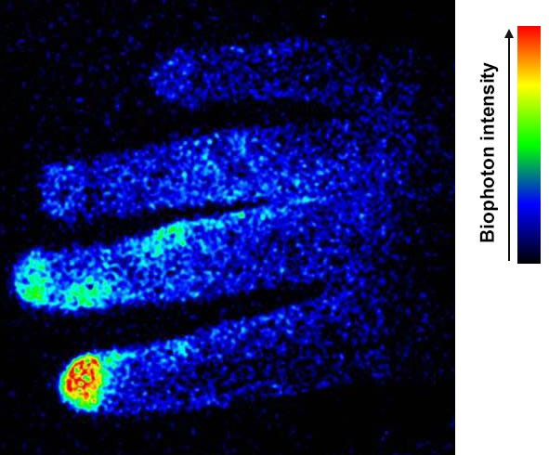
What are Biophotons?
To date, the mechanisms of biophoton generation and their connection to life remain open questions
There are two main hypothesis:
Biophotons are emitted due to random radiative decay of some molecules excited by metabolic events, like, for example, oxidative process and radical reactions, in the cells.
Biophotons come from a coherent electromagnetic field generated within and between the cells by some biochemical reactions in which, perhaps, oxygen atoms are involved.
The two hypotheses are not mutually exclusive and the experimentally revealed emission could have dual origin.
Biophoton image of a person’s right hand.
The bright region of the finger shows the effect of cigarette smoking (https://atlasofscience.org).
Both theories predict that:
any type of perturbation generated by nonspecific stress gives rise to an increase in emission as experimentally observed.

Slide 5
Biophotons: experimental history
A russian biologist A.G. Gurwitsch proposes the presence of an electromagnetic emission to explain some experiments on the germination and development of plants . The obtained results confirmed his hypotesis of a weak radiation from cells, which is able to trigger the growth of other cells (Gurwitsch, A.G.; Die Natur des spezifischen Erregers der Zellteilung. Arch. Entw. Mech. Org. 1923, 100, 11-40).
1920
1954
L. Colli and U. Facchini measured electromagnetic emission coming from living organisms. (Colli, L.; Facchini, U.; Light Emission by Germinating Plants. Il Nuovo Cimento 1954, 12, 150-153).
Fritz-Albert Popp worked with his group to understand more in detail the origin and the meaning of biophotons emission, having a good global resonance.
1980
1990
2006
In Italy the Sicilian group of F. Musumeci worked on biophotons emitted by biological systems. (Brizhik, L.; Scordino, A.; Triglia, A.; Musumeci, F. Delayed luminescence of biological systems arising from correlated many soliton states. Phys. Rev. E 2001, 64, 031902, ).

Slide 6

Biophotons: experimental history
More recently, the experimental evidence that such radiation carries important biological information was pointed out in several works:
Fels, D.; Cellular Communication through light. PLoS ONE 2009, 4, e5086.
Mayburov, S.N.; Photonic Communications in Biological Systems. J. Samara State Tech. Univ. Ser. Phys. Math. Sci. 2011, 15, 260.
Kucera, O.; Cifra, M.; Cell-to-cell signaling through light: Just a ghost of chance? Cell Comm. Signal. 2013, 11, 87
For example:
Biophotons emitted by growing plants or organisms can increase by as much as 30% the cell division rate in similar organisms, the so-called mitogenetic effect (Volodyaev, I.; Beloussov, L.V.; Revisiting the mitogenetic effect of ultra-weak photon emission. Front. Physiol. 2015, 6, 241).

Slide 7
Biophotons: future perspectives
Biophotons are sources of important biological information about healty, growing and communication among living organisms.
Moreover, they represents a non-invasive method for research in biology with application in several fields as:
Toxicology (Gallep, C.M.; Dos Santos, S.R.; Photon-count during germination of wheat (Triticum aestivum) in waste water sediment solution correlated with seedling growth. Seed Sci. Technol. 2007, 35, 607-614)
Human health monitoring (Tessaro, L.W.E.; Dotta, B.T.; Persinger, M.A.; Bacterial biophotons as non-local information carriers: Speciesspecific spectral characteristics of a stress response. Microbiol. Open 2019, 8, e761. 635)
Identification of diseases, especially cancer (Popp, F.A.; Cancer growth and its inhibition in terms of Coherence. Electromag. Biol. Med. 2009, 28, 53-60)
The experimental measurement of biophotons in living organisms could have an important impact on the knowledge of biological systems and for future medical application.

Slide 8
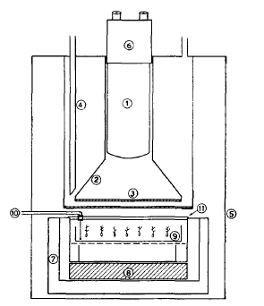
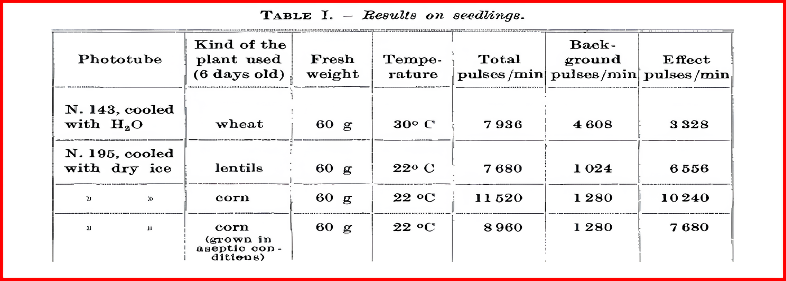
Biophotons: experimental apparata
Colli and Facchini experimental setup (1954)
300 hundred plants in a plate of about 14 cm of diameter – The plants were grown in the dark to avoid any phosphorescence residues.
Scheme of the photomultiplier thermostate setting:
1) Photomultiplier, 2) diffusing light guide, whitened with magnesium oxide, 3) glass, 4) water cooler, 5) light tight box, 6) socket containing the voltage divider, 7) thermostate box, 8) electric heating element, 9) glass plate containing plants under study, 10) thermocouple thermometer, 11) lucite lid

Slide 9
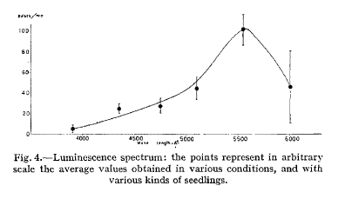
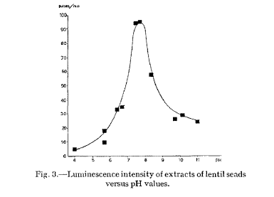
Biophotons: experimental apparata
Colli and Facchini experimental setup
They found that germinating seeds and plant have a weak electromagnetic emission of the order of 100 photon/min per cm² in the visible energy range. Such emission has a slight frequency dependence and is influenced by the types of treatment done on the seeds or plants
Counts/min
Counts/min
100
100
90
80
80
70
60
60
40
50
40
20
30
20
4000
4500
5000
5500
6000
Angstorn
10
Luminescence spectrum: the points represent in arbitrary scale the average values obteined in various conditions, and with various kind of seedings
0
pH
4
5
6
7
8
9
10
11
Luminescence intensity of extracts of lentils seads versus pH values
L.Colli, U. Facchini et al. Experientia 11-12, 479 (1955)

Slide 10
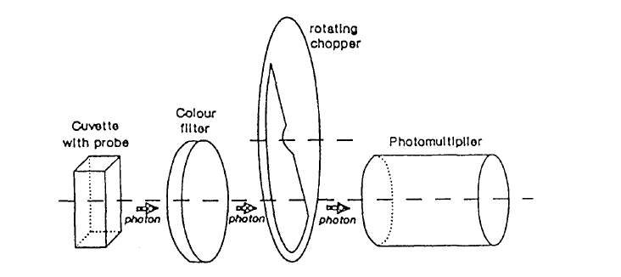
Biophotons: experimental apparata
F. A. Popper experiment ( early 1980 )
Diameter of 44 mm
Photomultiplier in the range 200 – 800 nm – in reality he had an efficency of 30% at 250 nm that goes down at 500 nm to arrive at almost 0 at 850 nm
F.A. Popp et al. Modern Physics Letter B8, 1269 (1994)

Slide 11
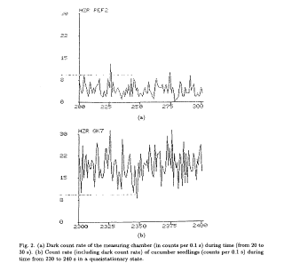
Biophotons: experimental apparata
F. A. Popper experiment ( early 1980 )
Counts/s
Counts/s
30
30
22
22
15
15
8
8
0
0
200
225
250
275
300
2300
2325
2350
2375
2400
Dark count – window of 0.1 sec – measure period 20 – 30 sec.
Signal with cucumber plants - measure period 230 – 240 sec.
Photomultiplier works at low temperature (-30°) to decrease the dark count

Slide 12
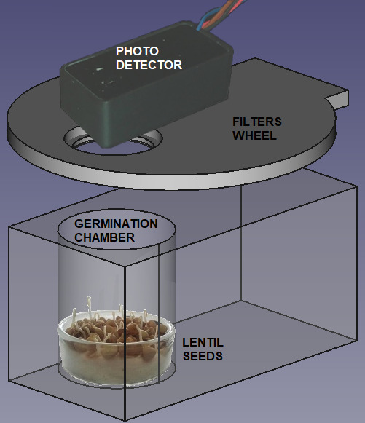
Our experimental apparatus
Our experimental setup was formed by:
A germination chamber
A turning filters wheel
A photon counting system
The turning wheel holding a few long pass glass color filters is placed between the germinating seeds and the detector, to allow energy discrimination. The wheel has eight positions. Six are used for the color filters, one is empty and the last one is closed with a black cap
The whole experimental set-up works as a single counting system and the detector can see a single photon with just the quantum efficiency of the photomultiplier.

Slide 13
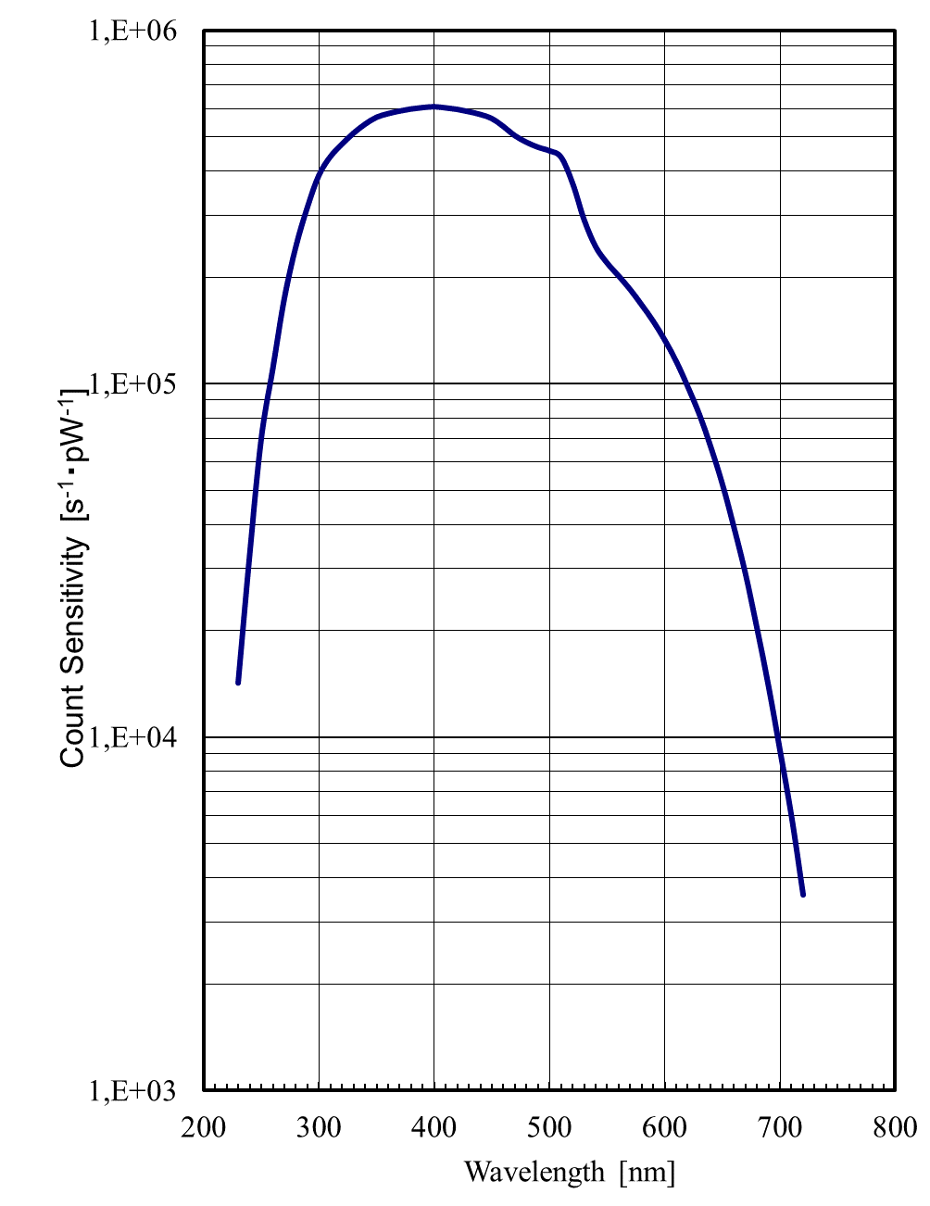
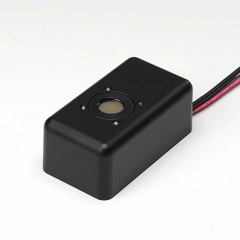
The Detector
The photon counting device is a H12386-210 high-speed counting head (Hamamatsu Photonic Italia S.r.l, Arese (MI), Italy) powered at +5 Vcc.
The phototube is sensible in the wavelength range between 230 and 700 nm with a peak sensitivity at 400 nm
The detector is placed on top of the germination chamber at a distance of 10 cm from the sample.
The diameter of the sensible part is 0.8 cm
The solid angle is about 0.0016 π

Slide 14
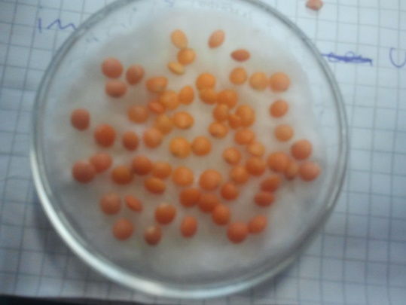
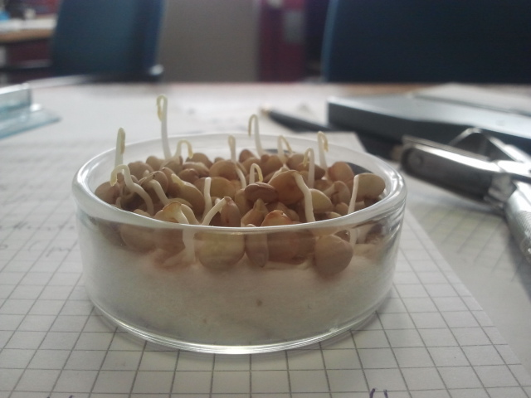
The target: germinating lentil seeds
Lentils seeds are kept in a humid cotton bed placed in a Petri dish.
Without any seed the emission consists in a monotonic decreasing tail due to the residual luminescence of the material, a consequence of the light exposure of the experimental chamber. The emission tail arrives in few hours at the dark counts value.
The acquisition time window is fixed at 1 s and within this window the entire system has a dark count of approximately 2 counts/sec, perfectly in line with the data sheets of this specific photomultiplier which indicates 1.7 counts/sec
The data acquisition and control of the experiment is done via an ARDUINO board and a computer equipped with a LAB-VIEW system (National Instrument, Austin, TX, USA).

Slide 15
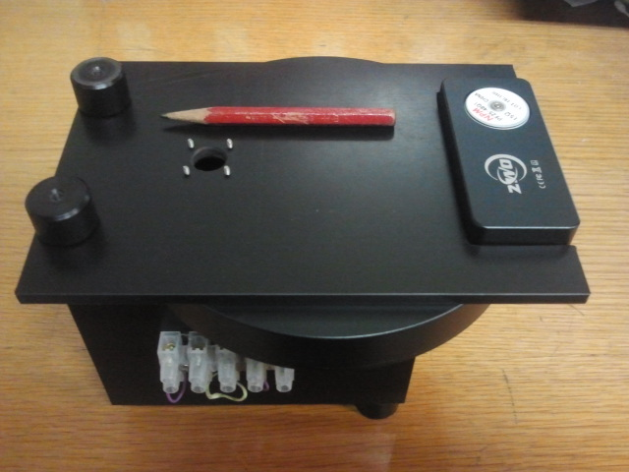
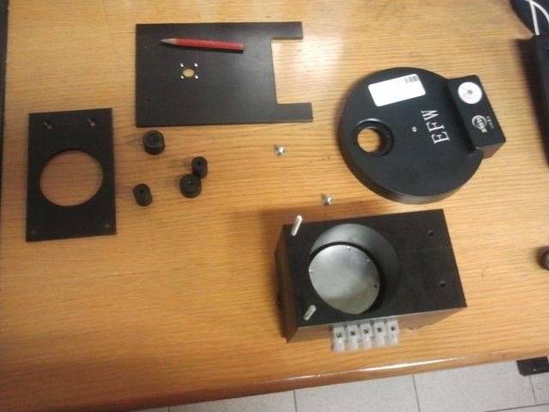
Picture of the apparatus
Monted apparatus
Dismonted apparatus

Slide 16
Picture of the apparatus
Monted apparatus
Dismonted apparatus
Photocounter placed here
Petri dish with lentils placed here
Filter wheel

Slide 17
The dark counts
The weak emission of biophotons can be discriminated only by an apparatus providing a dark condition with extremely low counts.
Here we presents the dark counts of our apparatus, extremely low and suitable for carrying out the measurement.
counting / sec (dark)
The rotation of the filter wheel (8 filters, each exposed 1 minute) produces a bunch every 443 seconds. Very few counts!

Slide 18
Performed measurements
We have used two types of seeds: lentils and bean
Residual Luminescence
76 lentils
One bean
In both cases, the emission was activated by the watering process and analyzed in a wide time interval ranging from the end of the residual luminescence until the time when germination generated roots and leaves.

Slide 19
Performed measurements
The time scales of the 76 lentils are completely different from the time scale of the single bean.
For this reason, to highlight the common characteristics of the two emissions, we rescaled the time scale of the single bean by a factor of 0.164
The two curves have been moved further to have the zero of the time scale positioned in the first minimum.
The two curves have been moved further to have the zero of the time scale positioned in the first minimum.
In this way, it was possible to align the emission maxima of the two cases, the C peaks in the figure.
The time scale of single bean has been multiplied by a factor 0.164

Slide 20
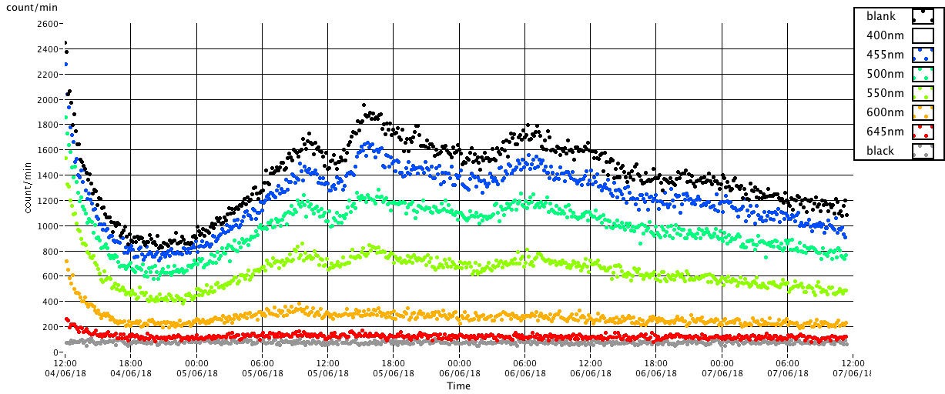
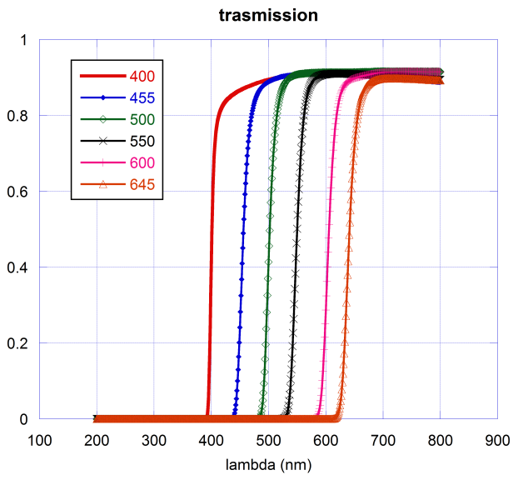
Performed measurements
With the use of the filter weel, we estimated also the different spectral components of the light biophotons produced
76 lentils case
Filters bandwidth

Slide 21
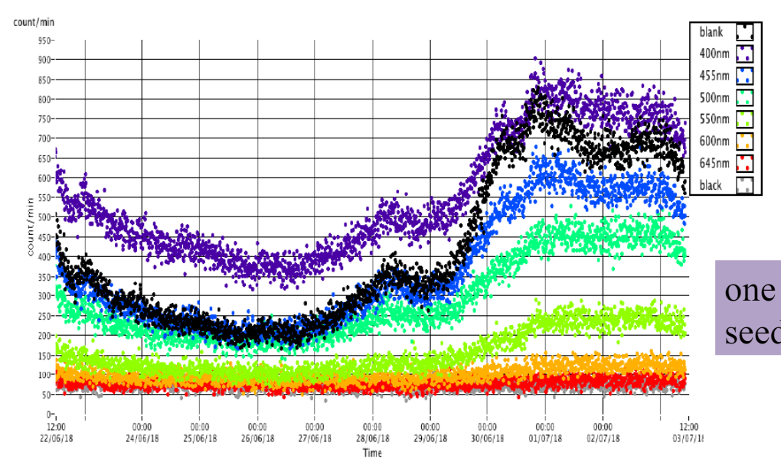
Performed measurements
In the same way, spectral components were estimated also in the one bean measurement:
One bean seed case
Different seeds have different emissions but really similar
The shape is similar to the lentils case but with a completely different time evolution - time distance between the minimum and the first maximum is here about 2 days, while it is 12 hours in the lentils case.

Slide 22
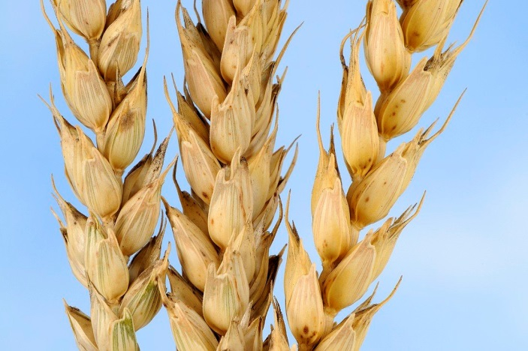
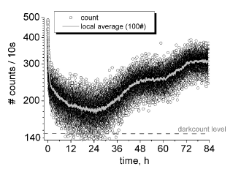
Other measurements on seeds
C.M. Gallep and S.R. dos Santos , Seed Sci. &Technol. 35, 607 (2007)
50 seeds of Triticum aestivum – common wheat
Normalizing for the number of seeds and the time window size we obtain almost the same counts/sec of the lentil seeds

Slide 23
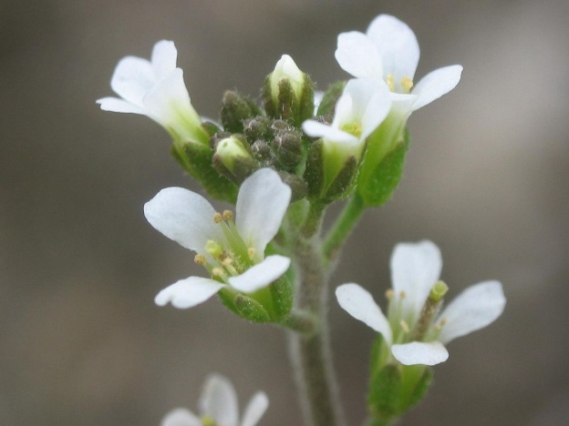
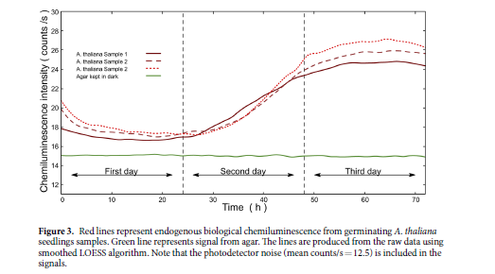
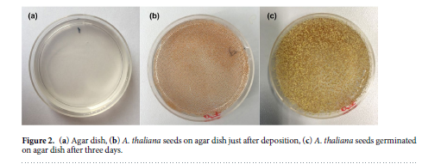
Other measurements on seeds
H. Saeidfirozeh et al. Scientific Reports (2018) 8:16231
7000 seeds of Arabidopsis thaliana placed on a Petri dish with Agar medium

Slide 24
Some Evaluations
The emissions of different seeds seems to have similar shape
The very similar temporal behaviour led us to hypothesize the existence of a sort of generalized logistic equation as a universal property of the connection between the system growth and the photon emission.
The time scale of the germination process it depends both on the type of seed, its quality and probably also on the time of sowing.
Perhaps the emission is proportional to the weight
Do we have the similar biofotons emission process in seeds?

Slide 25
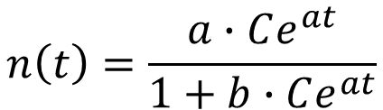

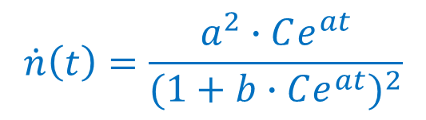

Some Evaluations
The time rescaling procedure used a popular logistic equation to describe the growth of a population which reaches the final steady-state value which is specific for any system.
$$\dot{n}\left(t\right)=a∙n\left(t\right)+b∙n^{2}(t)$$
where n(t) can be thought as the number of cells growing because of watering the seeds and the numbers a and b are constants that depend on the system
$$n\left(t\right)=\frac{a∙Ce^{at}}{1+b∙Ce^{at}}$$
where $C=\frac{n(0)}{a−n(0)∙b}$ depending on the initial condition n(0).
The solution is:
We make the conjecture that the rate of biophoton emission is proportional to the derivative of the number of cells:
$$\dot{n}\left(t\right)=\frac{a^{2}∙Ce^{at}}{{(1+b∙Ce^{at})}^{2}}$$

Slide 26

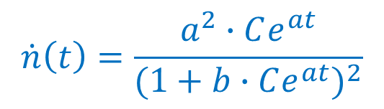
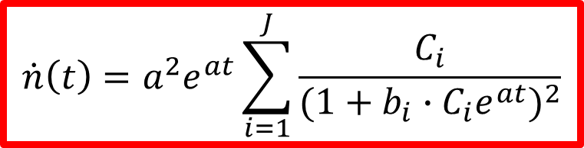

Some Evaluations
Cells can be thought as a kind of interacting units in the living organism, for a single type of unit the time derivative will reach a maximum at a time determined by the parameters a, b and the initial conditions.
The corresponding emission has a regular trend with:
$$\dot{n}\left(t\right)=\frac{a^{2}∙Ce^{at}}{{(1+b∙Ce^{at})}^{2}}$$
A time reached $t_{max}=\frac{1}{a}\ln\left(\frac{1}{β}\right)$
A maximum intensity $I_{max}=\frac{a}{4b}$
with 𝛽 = 𝑏 ∙ 𝐶
Different type of units in the seeds that could be activated at different time with different time scales
$$\dot{n}\left(t\right)=a^{2}e^{at}\sum_{i=1}^{J}{\frac{C_{i}}{{(1+b_{i}∙C_{i}e^{at})}^{2}}}$$
where J represents the number of seed units activated at different times

Slide 27
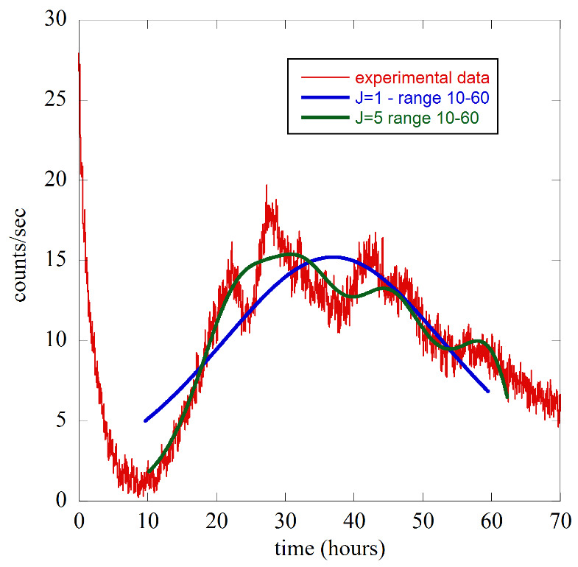
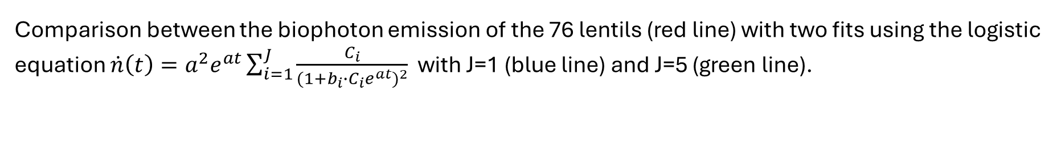
Some Evaluations
Comparison between the biophoton emission of the 76 lentils (red line) with two fits using the logistic equation $\dot{n}\left(t\right)=a^{2}e^{at}\sum_{i=1}^{J}{\frac{C_{i}}{{(1+b_{i}∙C_{i}e^{at})}^{2}}}$ with J=1 (blue line) and J=5 (green line).
The experimental data are counts per second averaged over 1 minutes.
The two fits are done using the experimental data in the time range 10-60 hour.
Only fits made based on many-component functions can qualitatively reproduce the shape of the experimental data, supporting the idea that the germination process can also be thought of as an activation of different cell groups at different time
May be biophotons a communication mechanism among cells?

Slide 28
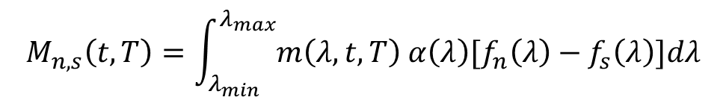
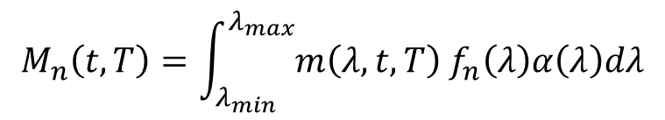
Some Evaluations
Knowing the transmission coefficient $f_{n}\left(λ\right)$ of the filters, we can extract the number of counts at time t, $M_{n}\left(t,T\right),$ for each light chromatic component through the logistic equation
$$M_{n}\left(t,T\right)=\int_{λ_{min}}^{λ_{max}}{m\left(λ,t,T\right) f_{n}\left(λ\right)α\left(λ\right)dλ}$$
where 𝑚(𝜆,𝑡,𝑇) is the number of photons emitted from the sample at time t within the integration window of size T at a given wavelength, and 𝛼(𝜆) is the efficiency of the phototube.
The different spectral components have a very similar shape to the emission without any filters.
To see the possible different behavior of the various spectral components, we can do a monochromatizating calculation of the difference between the counts obtained using two filters with adjacent cutoffs.
$$M_{n,s}\left(t,T\right)=\int_{λ_{min}}^{λ_{max}}{m\left(λ,t,T\right) α\left(λ\right)[f_{n}\left(λ\right)−f_{s}\left(λ\right)]dλ}$$

Slide 29
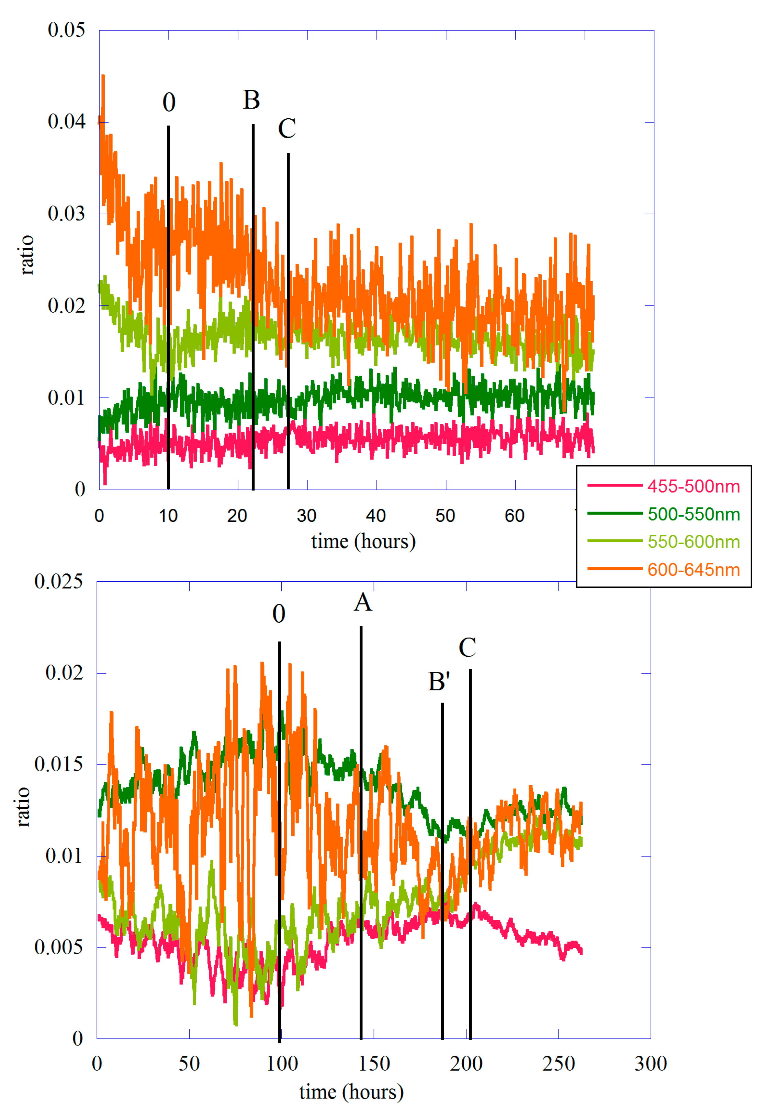
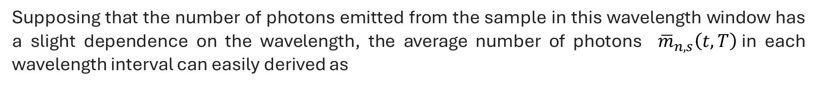
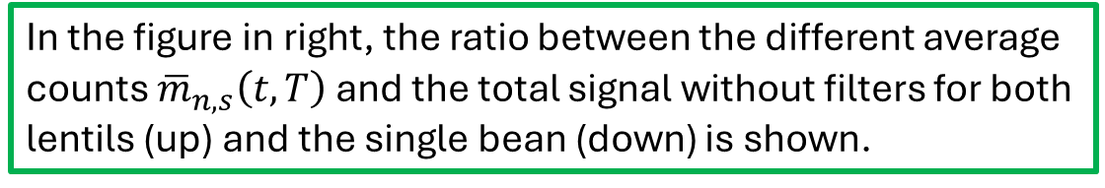
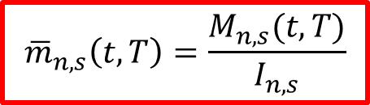
Some Evaluations
Supposing that the number of photons emitted from the sample in this wavelength window has a slight dependence on the wavelength, the average number of photons ${\overline{m}}_{n,s}\left(t,T\right)$in each wavelength interval can easily derived as
76 lentils case
$$M_{n,s}\left(t,T\right)≅{\overline{m}}_{n,s}\left(t,T\right)∙\int_{λ_{min}}^{λ_{max}}{α\left(λ\right)\left[f_{n}\left(λ\right)−f_{s}\left(λ\right)\right]dλ}={\overline{m}}_{n,s}\left(t,T\right)∙I_{n,s}$$
$${\overline{m}}_{n,s}\left(t,T\right)=\frac{M_{n,s}(t,T)}{I_{n,s}}$$
The value of the $I_{n,s}$ integral can be calculated numerically
In the figure in right, the ratio between the different average counts ${\overline{m}}_{n,s}\left(t,T\right)$ and the total signal without filters for both lentils (up) and the single bean (down) is shown.
Bean case
In the case of lentil seeds, the dominant components are those of orange (600–645 nm) and yellow-green (550–600 nm), in agreement with the results of Colli and Facchini.

Slide 30
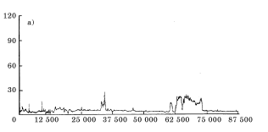
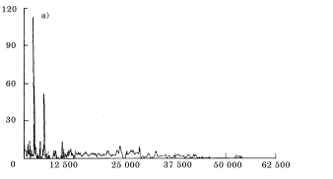
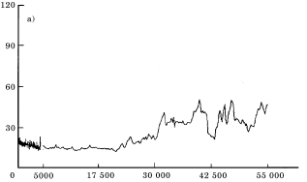
Measurements on bacteria
In a Petri plates with BHI agar the four different bacteria has been inoculated – After 10 minutes the start the measurments.
Streptoccocus suis
Escherichia coli
Staphylococcus aureus
Each bacterium has a well defined type of emission, perhaps following the type of growing – It is completely different from the emission during the germination process
The emission could be linked to the process of unrolling of DNA in the moment of duplication
D. Codazza, U. Facchini et.al. Nuovo Cimento 20, 1767 (1998)

Slide 31
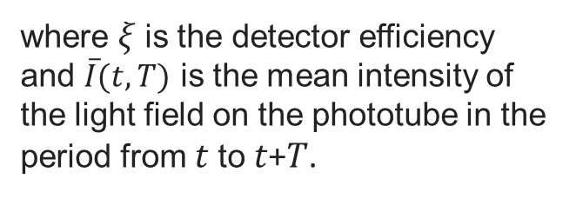

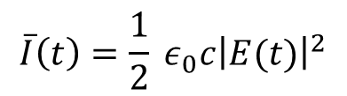
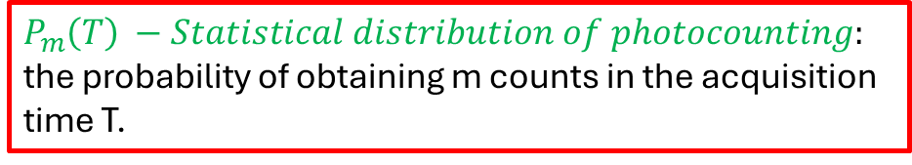
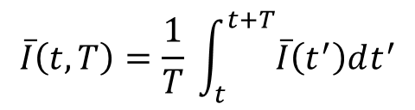
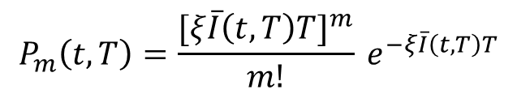
Data analysis - Probability Distribution Function
A photocount experiment consists of a sufficiently large number of measurements of the number of photocounts in the same integration period T.
$P_{m}\left(T\right) −Statistical distribution of photocounting:$ the probability of obtaining m counts in the acquisition time T.
In our case $T$= 1 sec.
It is possible to demonstate that the probability that m photocounting occur in the time interval t to t+T $P_{m}\left(t,T\right)$ can be expressed as:
$$P_{m}\left(t,T\right)=\frac{[ξ\overline{I}\left(t,T\right)T]^{m}}{m!} e^{−ξ\overline{I}\left(t,T\right)T}$$
where
where 𝜉 is the detector efficiency and $\overline{I}(t,T)$ is the mean intensity of the light field on the phototube in the period from 𝑡 to 𝑡+𝑇.
$$\overline{I}\left(t,T\right)=\frac{1}{T} \int_{t}^{t+T}{\overline{I}\left(t^{′}\right)dt^{′}}$$
$$\overline{I}\left(t\right)=\frac{1}{2} ε_{0}c{\left|E(t)\right|}^{2}$$
with
$E\left(t\right)=E_{1}\left(t\right)+ E_{2}\left(t\right)+…+E_{n}\left(t\right)=E_{0}e^{−iωt}\left\{e^{iφ_{1}t}+e^{iφ_{2}t}+ …+e^{iφ_{n}t} \right\}$
Emitted energies

Slide 32


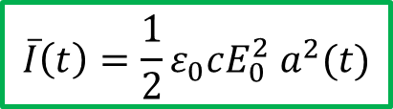

Data analysis - Probability Distribution Function
We suppose we have N atoms that emits with different phases - The beam intensity is calculated by the Poynting vector with a cycle-average at frequency $ω_{0}.$
Fluctuation of intensity:
$$\overline{I}\left(t\right)=\frac{1}{2}ε_{0}cE_{0}^{2} a^{2}(t)$$
Therefore,
$$P_{m}\left(T\right)= \left\langle P_{m}(t,T)\right\rangle$$
The photocounts distribution function is obtained as an average over successive starting time t of the function
The average is over the successive starting time (as in our case) or as a statistical average over the intensity fluctuation of $\overline{I}(t)$
We can define the mean number of counts $\left\langle m\right\rangle$ and a variance:
$$\left\langle m\right\rangle =\sum_{m}{m{ P}_{m}(T)}$$
$${(Δm)}^{2}=\left\langle m\right\rangle + ξ^{2}T^{2}[\left\langle \overline{I}(t.T)^{2}\right\rangle − {\overline{I}}^{2}]$$
R. Loudon, «The Quantum Theory of Light», Oxford Science Pubblication (2000)

Slide 33
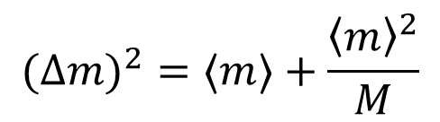

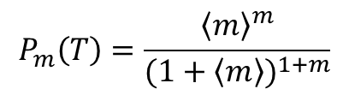
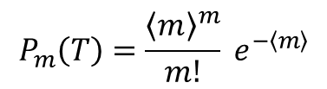



Data analysis - Probability Distribution Function
There are only two opposite cases where the average can be obtained in an analytical form:
1) the emission is a classical stable wave $\overline{I}\left(t,T\right)=\overline{I}$
$$P_{m}\left(T\right)=\frac{{\left\langle m\right\rangle }^{m}}{m!} e^{−\left\langle m\right\rangle }$$
The average is equal to the variance
$$\left\langle m\right\rangle =ξ\overline{I}T$$
$$\left\langle m\right\rangle = {\left(Δm\right)}^{2}$$
Gallep, C.M.; Dos Santos, S.R. Seed Sci. Technol. 2007, 35, 607–614.
2) The emission is a Gaussian-Lorentzian chaotic light
$$g^{1}\left(τ\right)= \frac{\left\langle E^{∗}\left(t\right)E\left(t+τ\right)\right\rangle }{\left\langle E^{∗}\left(t\right)E(t)\right\rangle }\sim e^{−(iω_{0}τ+\frac{π}{2}(τ/{τ_{c}})^{2})}$$
$$P_{m}\left(T\right)=\frac{{\left\langle m\right\rangle }^{m}}{(1+\left\langle m\right\rangle )^{1+m}}$$
Loudon, R. The Quantum Theory of Light; Oxford University Press: Oxford, UK, 2000; ISBN 978-0-19-850176-3.
If we have thermal sources with M modes of similar frequency:
$P_{m}\left(T,M\right)=\frac{\left(m+M−1\right)!}{m!\left(M−1\right)!}{\left(1+\frac{M}{\left\langle m\right\rangle }\right)}^{−m}$ ${\left(1+\frac{\left\langle m\right\rangle }{M}\right)}^{−M}$
$$(Δm)^{2}=⟨m⟩+\frac{{\left\langle m\right\rangle }^{2}}{M}$$
Cifra, M.; Brouder, C.; Nerudova, M.; Kucera, O. Biophotons, coherence and photocount statistics: A critical review. J. Lumin. 2015, 164, 38.

Slide 34


Dark Counts - Probability Distribution Function
$$P_{m}(T)$$
Normalized dark count
i.e the counts measured with the black cap
The Poisson distribution gives an <m> = 0.83±0.03
Poisson fit
The Thermal distribution gives an <m> = 1.16±0.17
Thermal fit
The experimental average is <m>=1.56
consistent with the dark count data of this phototube!
Benfatto, M.; Pace, E.; Curceanu, C.; Scordo, A.; Clozza, A.; Davoli, I.; Lucci, M.; Francini, R.; De Matteis, F.; Grandi, M.; et al. Entropy 2021, 23, 554.

Slide 35

Measurements- Probability Distribution Function
76 lentils
Bean seed
strongly asymmetric
The distribution of the 76 lentil seeds is strongly symmetrical and can be optimally fitted with a Gaussian.
Impossible to have a good fit of it using a Poissonian or a multi-modal thermal type functional form
In 76 lentils, the various seeds have different germination times which therefore give rise to emissions that are not in phase with each other

Slide 36

Measurements- Probability Distribution Function
In the case of single bean data, using a shorter emission period for the calculation of the function 𝑃𝑚(𝑇), we observe a transition to more symmetrical distributions.
Exp - <m> = 11.33, s² = 12.93
Poisson - <m> = 11.24±0.05
Thermal - <m> = 11.30±0.03, M = 50
Single bean – shorter time range
Shorter emission from single bean in range 200h – 265h
This makes it very difficult to discriminate between coherent and thermal states using the photo counting distribution analysis

Slide 37

Data Analysis - The Diffusion Entropy Analysis
Biological systems can be described by the ordinary prescriptions of equilibrium statistical mechanics with an analysis methods that can highlight all the deviations from the canonical form of equilibrium to understand the breakdown of the conditions on which Boltzmann’s view is based: no memory, short-range interaction and no cooperation.
The Diffusion Entropy Analysis (DEA) was introduced into literature in the early 2000s and it is based on converting the experimental time series, like the emission we record with our experimental set-up, into a diffusional trajectory, and then calculate scaling factors.
Any deviation from the canonical form is a measure of the system complexity.
A complex system is formed by several interacting units generating a whole with specific properties such as non-linearity, self-similarity, self-organization, just to quote a few.
The seed can in fact be thought of as a system that self-organizes when it begins to germinate because of watering.

Slide 38



Data Analysis - The Diffusion Entropy Analysis
In the case of experimental detecting of biophotons through a photons counter
We detect the number of photons arrived in a window of size T as a fuction of time (in our case T=1 sec)
The time axis is divided into bins of T size
We have a fluctuating time series $\left\{ξ(n)\right\}$ formed by the number of photon emitted in n-th bin
This series is a random variable of which we want to calculate the statistical properties and the degree of complexity by the study the anomalous scaling of the diffusion trajectory
$$\left\{ξ(n)\right\} → ξ(t)$$
For semplicity it becomes a continuous-time function
Then we can calculate the diffusional trajectory
$$x\left(t\right)= \int_{0}^{t}{ξ\left(t^{′}\right) dt^{′}}+x(0)$$
$$\dot{x}(t)=ξ(t)$$

Slide 39








Data Analysis - The Diffusion Entropy Analysis
It is convenient to consider the $x^{2}(t)$ time series because it is directly related to the correlation function of the original time series
For the standard approach we assume the correlation function $Φ_{ξ}\left(τ\right)$ as stazionary:
$$\left\langle x^{2}\left(t\right)\right\rangle = \int_{0}^{t}{dt_{1}\int_{0}^{t}{dt_{2} \left\langle ξ(t_{1})ξ(t_{2})\right\rangle }}$$
$$Φ_{ξ}\left(τ\right)= \frac{\left\langle ξ(t_{1})ξ(t_{2})\right\rangle }{\left\langle ξ^{2}\right\rangle }$$
$$τ= \left|t_{1} − t_{2}\right|$$
Using the Fractional Brownian Motion and Hurst notation we indicate the scaling factor with the symbol H.
$$\left\langle x^{2}(t)\right\rangle =2\left\langle ξ^{2}\right\rangle \int_{0}^{t}{dτ_{1}\int_{0}^{τ_{1}}{dτ_{2} Φ_{ξ}(τ_{2})}}$$
Differentiating twice with respect to the time and supposing that 𝑥 ∝ 𝑡 𝐻 we get:
We can now relate the complexity of ξ(t) to the anomalous scaling of the diffusion trajectory x(t).
$$Φ_{ξ}\left(τ\right)∝2H\left(2H−1\right)τ^{2H−2}$$
Note that for H=0.5 the correlation function vanishes – any departure from this value indicates an anomalous behaviour
$$Φ_{ξ}(τ)∝±\frac{1}{τ^{δ}}$$
For the long-time limit:
$$δ=2−2H$$
P. Grigolini et al. Fractals 9, 439 (2001)
N. Scafetta et al. Phys. Rev E66, 031906 (2002)

Slide 40





Data Analysis - The Diffusion Entropy Analysis
A key features of most complex systems are the crucial events:
events that have an high impact on the statistical properties of the system. The occurence of such events resets the memory of the system.
The time distance between two consecutive crucial events is described by the waiting time distribution density with important asymptotic scaling properties:
$$ψ(τ)∝\frac{1}{τ^{μ}}$$
With m from zero to $∞$
$$τ= \left|t_{1} − t_{2}\right|$$
Crucial events are events corresponding to the condition 1<μ<3
$$δ=\frac{1}{μ−1}$$
for 2<μ<3 crucial events generates the scaling δ
crucial events with μ > 3 generate the ordinary condition of white noise.
with β=3-μ
for 1< μ <3
$$S(ω)∝\frac{1}{ω^{β}}$$
with β=0
for μ > 3
P. Allegrini et al. Phys. Rev. E 80, 061914 (2009)

Slide 41

Measurements - The Diffusion Entropy Analysis
seeds
dark
Without seeds μ=2.73, close to 3 which is the border of the ordinary statistics, while with seeds μ goes from 2.29 to 2.44 - much less than 3. The difference between dark and seeds is clearly shown

Slide 42

Measurements - The Diffusion Entropy Analysis
μ varies from a value of about 2.6 to one of almost 3.0 going from region #1 to region #6 – the dark counting gives μ=2.96
I.H. von Herbing et al. Entropy 23, 1141 (2021)

Slide 43
Data Analysis Conclusion
The count distributions analysis is not able to asses a clear evidence of coherence or non-classical behavior of biophoton emission.
The DEA analysis of the time series reveals the presence of crucial events. – there is a transition between crucial events and other type of complexit during the germination process
Which impact could have these kind of studies???
For example the analysis of the Electroencephalogram in humens shows that the human brain in good health generates crucials events with m=2, instead μ=3 corresponds to a pathological state.
The DEA analysis on biophotons germinating plants in dark evidenced the pattern from a healthy condition to a pathological state!
Biophotons allows to study and evaluate of healthy condition in living organisms.

Slide 44

Data Analysis Conclusion
All details can be found in this paper published by the biophoton collaboration
M. Benfatto et al. Entropy 23, 554 (2021)

Slide 45
Biophotons: research fields
Seeds and plants
Testing germinal goodness of the seeds
Verify the impact of pests, pollution agents, insecticides, fertilizers, extreme atmospheric conditions on growing plants:
Assessment of the quality of the seed
How fertilizers affect plants
Which parts of the plants emit biophotons
Studies on aimals and humans
Studies emissions by human body
Studies cell cultures growing
Studies tumor cell cultures to discriminate characteristics of the emissions for future identification techniques
Studies of brain, cognitive functions and biophotonic answer in case of Alzheimer, Dementia etc.
Psychological response of the brain
Acupunture
Food and quality
Biophotons are used for quality investigation in eggs and wine
Evaluate the degree of freshness of food
Security of storage of food
Biophotons are used in biomedicine and biotechnology for sensing of protein oxidation generated by pulsed electric field
L. De Paolis, et al., «Biophotons: a hard problem» , arXiv preprint arXiv:2401.17166, 2024.
TO BE PUBLISHED AS SPECIAL ISSUE ON ENTROPY

Slide 46

Future updates and measurements
Updates the experimental setup to increase measurement precision and quality:
Introducing Fresnel lent for a better collection of photons (gain of facton 38 and increase signal/background ratio of a factor between 5-10)
Installation of calibration sources
Installation of infrared camera to monitor the seeds germination
Installation of sensors to monitor temperature and umidity inside the satup, irradiation systems, technical devices to introduce variation of atmosphere or pH and constituents of the soil of the plants, to characterize the spectrometric response of the germinating seeds
Performed measurements of different seeds, in different amount, to check the presence of crucial events in all these cases.
Any
suggestions?
Further developing of the DEA analysis procedure and method
Experiments with bacteria and on cellular cultures

Slide 47
















THANK YOU!!!

Slide 48

Data analysis - Probability Distribution Function
Therefore,
$$P_{m}\left(T\right)= \left\langle P_{m}(t,T)\right\rangle$$
The photocounts distribution function is obtained as an average over successive starting time t of the function
The average is over the successive starting time (as in our case) or as a statistical average over the intensity fluctuation of $\overline{I}(t)$
We can define the mena number of counts $\left\langle m\right\rangle$ and ita variance:
$$\left\langle m\right\rangle =\sum_{m}{m{ P}_{m}(T)}$$
$${(Δm)}^{2}=\left\langle m\right\rangle + ξ^{2}T^{2}[\left\langle \overline{I}(t.T)^{2}\right\rangle − {\overline{I}}^{2}]$$
R. Loudon, «The Quantum Theory of Light», Oxford Science Pubblication (2000)
It has been assumed that the emission is stationary. In our case, this is not strictly true, but this assumption becomes a good approximation for time intervals of the order of an hour or in the growth phase after the germination.

Slide 49


Normalized 76-lentils - time interval 10-70
$P_{m}(T)$
The Poisson distribution gives an <m> = 23.35±0.22
Poisson fit
The Gaussian distribution gives an <m> = 22.90±0.05
σ² = 42.25±0.52
Gaussian fit
the experimental values are <m> = 23.20, σ² = 42.06

Slide 50


Normalized single bean - time interval 82-265
$$P_{m}(T)$$
The Poisson distribution gives an <m> = 7.56±0.37
Poisson fit
The Gaussian distribution gives an <m> = 6.89±0.26
σ² = 23.71±2.04
Gaussian fit
the experimental values are <m> = 7.90, σ² = 19.78

Slide 51


Normalized 4-lentils with lens - time interval 26-167
$$P_{m}(T)$$
The Poisson distribution gives an <m> = 7.47±0.06
Poisson fit
The Gaussian distribution gives an <m> = 7.18±0.04
σ² = 9.67±0.06
Gaussian fit
the experimental values are <m> = 7.62, σ² = 10.1

Slide 52




Single bean
76 lentils
Poisson fit
20-30
170 – 180
Gaussian fit
Exp - <m> = 7.76, σ² = 9.47
Poisson - <m> = 7.67
Gauss - <m> = 7.39, σ² = 8.94
Exp - <m> = 27.25, σ² = 34.01
Poisson - <m> = 27.18
Gauss - <m> = 26.9, σ² = 33.6

