Slide 1
Table-top nanodiamond interferometer towards revealing quantum features in gravity
Fabrizio Piacentini
INRiM – Istituto Nazionale di Ricerca Metrologica, strada delle Cacce 91, 10135 Torino (Italy)
PRIN 2022
AQuTE
Fabrizio Piacentini, ‘‘A Modern Odissey … Silence’’, 3-7 June 2024

Slide 2
Quantum Mechanics + General Relativity
Unification of quantum theory and general relativity
“Holy grail” of contemporary physics
Different models and theories offering possible solutions:
String theory [Sagnotti & Sevrini, Riv. Nuov. Cim. 31, 423 (2008)]
Loop quantum gravity [Rovelli, Liv. Rev. in Rel. 1, 1 (1998)]
Supergravity [Castellani, in “Handbook of Quantum Gravity” (2023)]
Covariant quantum gravity [Percacci, “An Introduction to Covariant Quantum Gravity and Asymptotic Safety” (2017)]
Sum over histories [Ambjørn et al., Phys. Rep. 519, 127 (2012)]
No experimental evidence
Impossible to discriminate among them
Fabrizio Piacentini, ‘‘A Modern Odissey … Silence’’, 3-7 June 2024

Slide 3
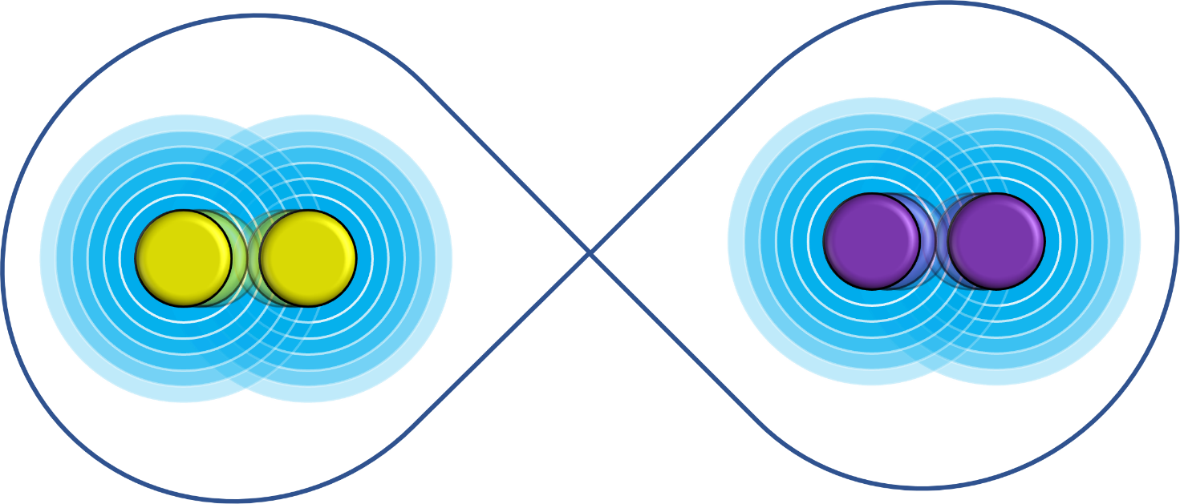
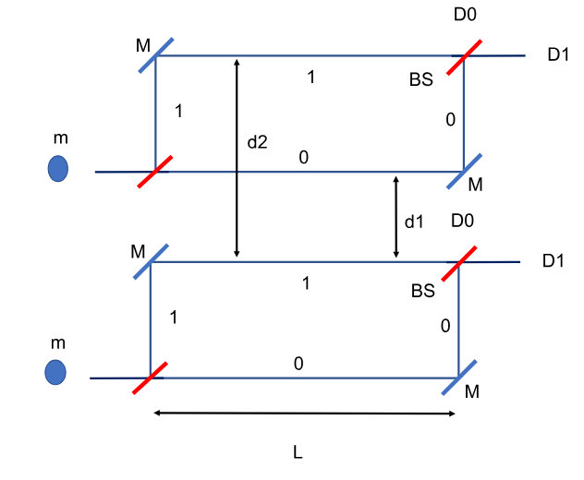
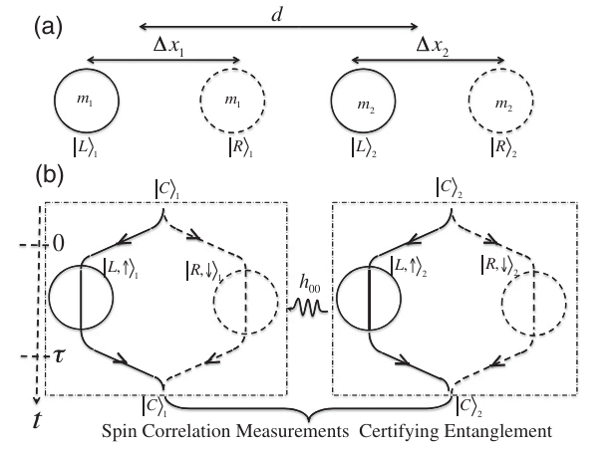
A new era of experimental efforts
Recent proposal(s): revealing quantum features in gravity by observing entanglement between spatially-delocalized superpositions of massive objects:
Gravitational potential induces entanglement
Gravity exhibits quantum traits
Entanglement cannot be generated by local operations & classical communication (LOCC)
[Horodecki x4, Rev. Mod. Phys. 81, 865 (2009)]
Marletto & Vedral, PRL 119, 240402 (2017)
Bose et al., PRL 119, 240401 (2017)
Fabrizio Piacentini, ‘‘A Modern Odissey … Silence’’, 3-7 June 2024

Slide 4
A new era of experimental efforts
Recent proposal(s): revealing quantum features in gravity by observing entanglement between spatially-delocalized superpositions of massive objects:
Gravitational potential induces entanglement
Gravity exhibits quantum traits
Entanglement cannot be generated by local operations & classical communication (LOCC)
[Horodecki x4, Rev. Mod. Phys. 81, 865 (2009)]
Eventually, observing gravity-induced entanglement would rule out semiclassical gravity theories, e.g.:
Quantum field theory in curved space-time [Holland & Wald, Phys. Rep. 574, 1 (2015)]
Hybrid quantum-classical formulations of gravity [Barcélo et al., PRA 86, 042120 (2012)]
Collapse models (Diosi-Penrose, CSL, etc.) predicting collapse at the same energy scale as the experimental entanglement observation
Fabrizio Piacentini, ‘‘A Modern Odissey … Silence’’, 3-7 June 2024

Slide 5
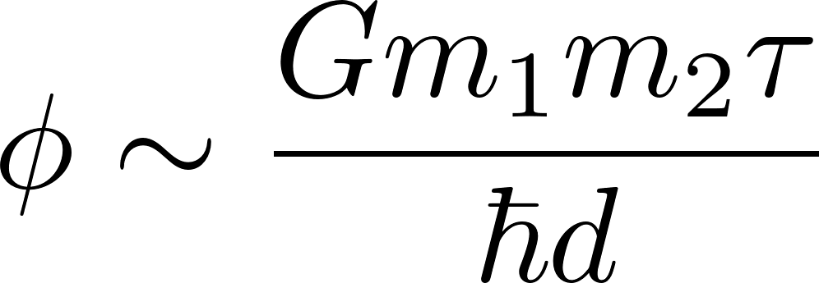
Bose et al. proposal [PRL 119, 240401 (2017)]
Two mesoscopic ($\sim {10}^{−14}$ Kg) masses, each in a spatially-separated ($∆x_{i} \sim {10}^{−4}$ m) superposition, free-falling in adjacent ($d ≳ {3∙10}^{−4}$ m distance) Stern-Gerlach interferometers for a time interval $τ \sim 1$ s.
Initial state:
Final state:
The gravitational potential has entangled the initially separable state of the two NDs
Fabrizio Piacentini, ‘‘A Modern Odissey … Silence’’, 3-7 June 2024

Slide 6
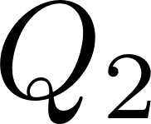
Marletto & Vedral proposal [PRL 119, 240401 (2017)]
Two massive qubits $Q_{1}$ and $Q_{2}$ enter two Mach-Zehnder interferometers, each located so that both masses are subject to the same Earth’s gravitational field.
After the first beam splitter (BS):
Just before the final BS:
Velocity of the two massive qubits within the interferometers
By varying $L$ it is possible to observe $Δφ$-related variations in the D1 outputs of both interferometers, revealing the gravity induced entanglement.
Fabrizio Piacentini, ‘‘A Modern Odissey … Silence’’, 3-7 June 2024

Slide 7
Pros…
First evidence of the quantum behavior of the gravitational potential, with a small-scale experiment and at a much lower energy with respect to Planck’s scale;
Almost within the grasp of current technology;
Paving the way to a new generation of ultrasensitive quantum sensors;
Potentially allowing to find hints of ‘‘new physics’’: other forces playing some role, issues with one (or more) of the assumptions considered, etc.
Fabrizio Piacentini, ‘‘A Modern Odissey … Silence’’, 3-7 June 2024

Slide 8
…and cons
Need for large structures (meters long) with micrometric fabrication features;
Extreme conditions (high-vacuum, cryogenic regime);
Need for massive objects ($≳{10}^{−15}$ Kg) allowing for spatially-delocalized superpositions with high coherence time ($≳1$ s);
Difficulty in selecting, characterizing and manipulating massive quantum objects without affecting their coherence or degrading the samples;
Given the weakness of gravitational interaction, all other forces (including proximity ones, like the Casimir-Polder interaction) must be avoided;
In the free-fall/propagation scenario, samples are lost after the measurement, and new ones have to be selected and prepared: long acquisition times and potential noise due to inhomogeneities among different samples.
Fabrizio Piacentini, ‘‘A Modern Odissey … Silence’’, 3-7 June 2024

Slide 9
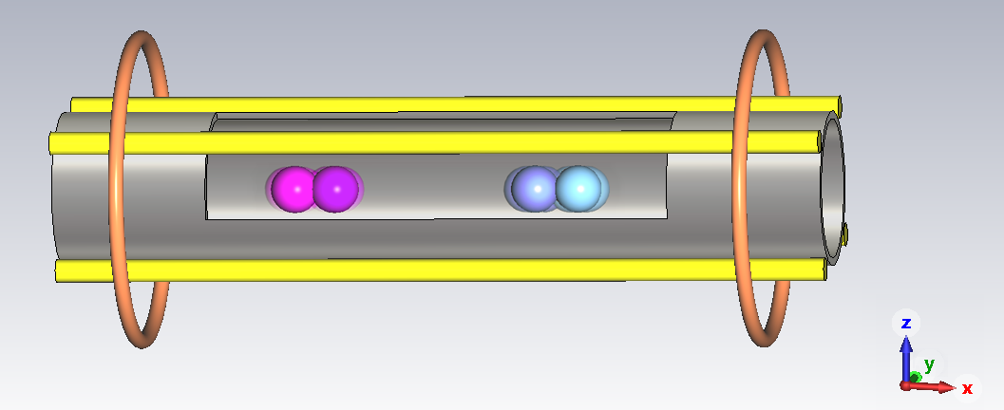
Quantum gravity test with a table-top interferometer
Two single-NV-centre nanodiamonds (NDs) in a spatial superposition, confined by a magnetic potential in the $y$ and $z$ directions but left unconstrained in the $x$ one.
Initial spatial delocalization and final recombination are achieved by implementing a magnetic field gradient along $x$.
No meters-long structure featuring micro-fabrications: magnetic field gradients will be generated by two anti-Helmoltz coils;
A single microwave antenna (instead of $≳{10}^{4}$) for dynamical decoupling: much higher versatility, tunability and control;
Nanodiamonds are NOT lost after each run, but can be re-initialized for the subsequent one: no need to find and characterize new samples, and no experimental noise due to inhomogeneities among NDs.
Fabrizio Piacentini, ‘‘A Modern Odissey … Silence’’, 3-7 June 2024

Slide 10
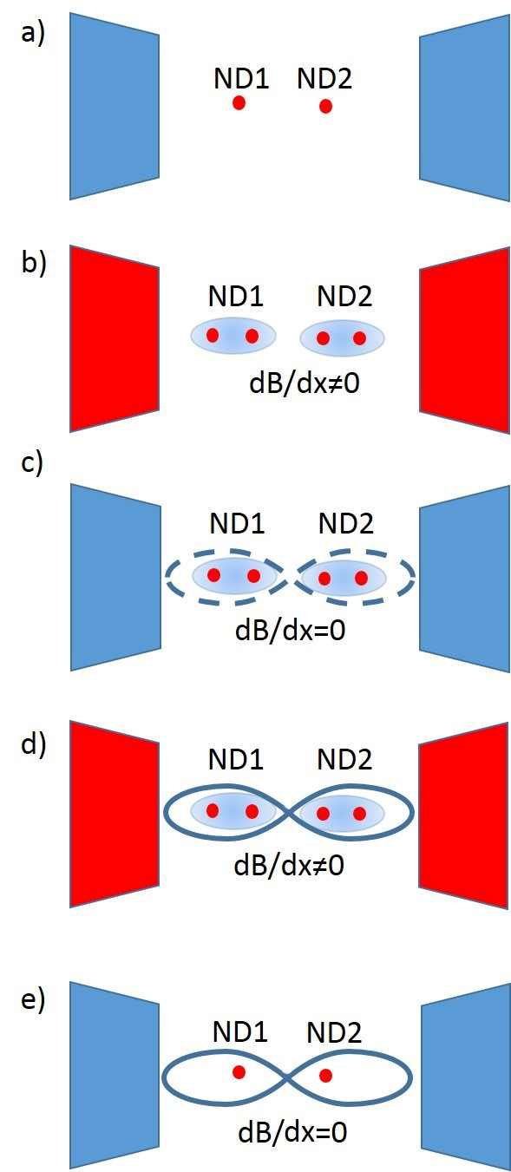
Quantum gravity test with a table-top interferometer
Two single-NV-centre NDs are confined in the same magnetic trap along the $y$ and $z$ directions, leaving the $x$ one unconstrained;
A magnetic gradient $B^{′}=dB/dx$ is generated, allowing to put both NDs in a spatially-delocalized superposition;
The $B′$ gradient is switched off, to leave the two superpositions freely evolve by gravitational interaction;
$B′$ is turned on again, to recombine the spatially-delocalized superposition of both NDs;
$B′$is finally turned off, and an interferometric measurement of the two NV-centres is performed to detect eventual gravity-induced entanglement between them.
Fabrizio Piacentini, ‘‘A Modern Odissey … Silence’’, 3-7 June 2024

Slide 11
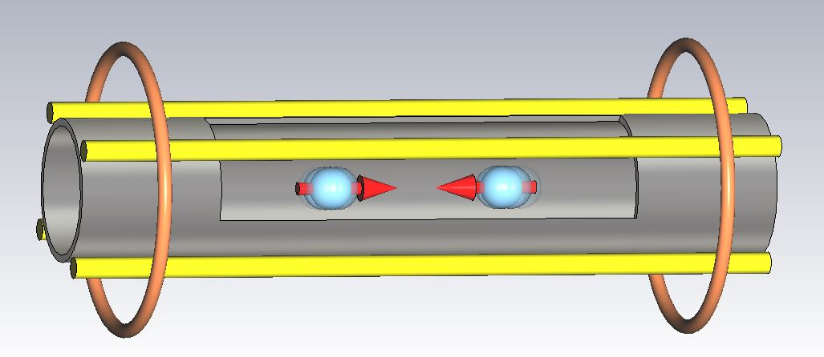
Step 1: table-top single-ND interferometer
NV centre initial spin state ($S_{x}$ component):
Hamiltonian along $x$ for the spatially-delocalized single-NV-centre ND in a magnetic field gradient $B^{′}=\frac{dB}{dx}$ :
$B_{0}:$ $x$ component of the static magnetic field
Quantized hamiltonian:
Eigenstates:
Fabrizio Piacentini, ‘‘A Modern Odissey … Silence’’, 3-7 June 2024

Slide 12
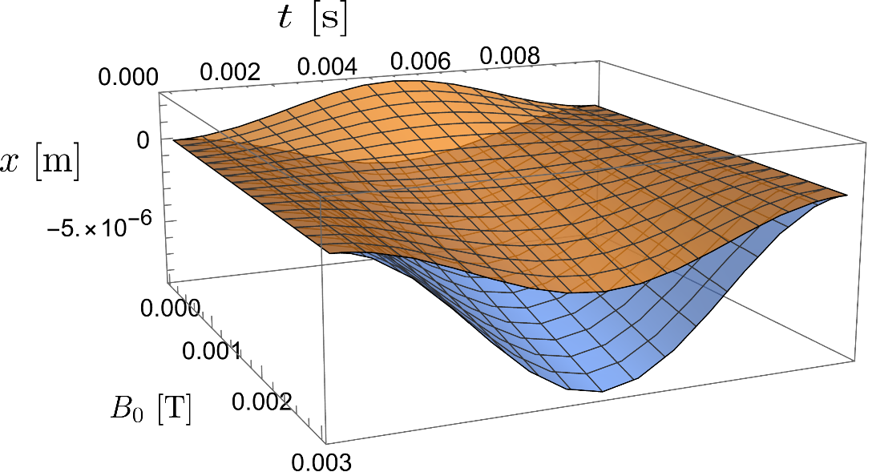
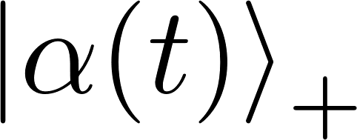
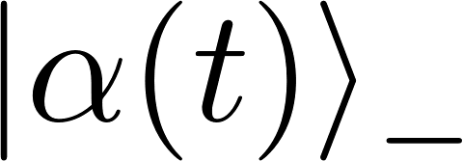
Step 1: table-top single-ND interferometer
ND global initial state:
NV centre spin state
$\left.|0\right\rangle :$ harmonic oscillator ground state
Evolution of $\left.|Ψ_{i}\right\rangle$ under the Hamiltonian $H_{x}$ :
Dynamics along the $x$ axis for a 250 nm diameter ND, considering a magnetic field gradient $B^{′}=1000$ T/m.
Vicentini et al., arXiv:2405.21029 (2024)
Fabrizio Piacentini, ‘‘A Modern Odissey … Silence’’, 3-7 June 2024

Slide 13
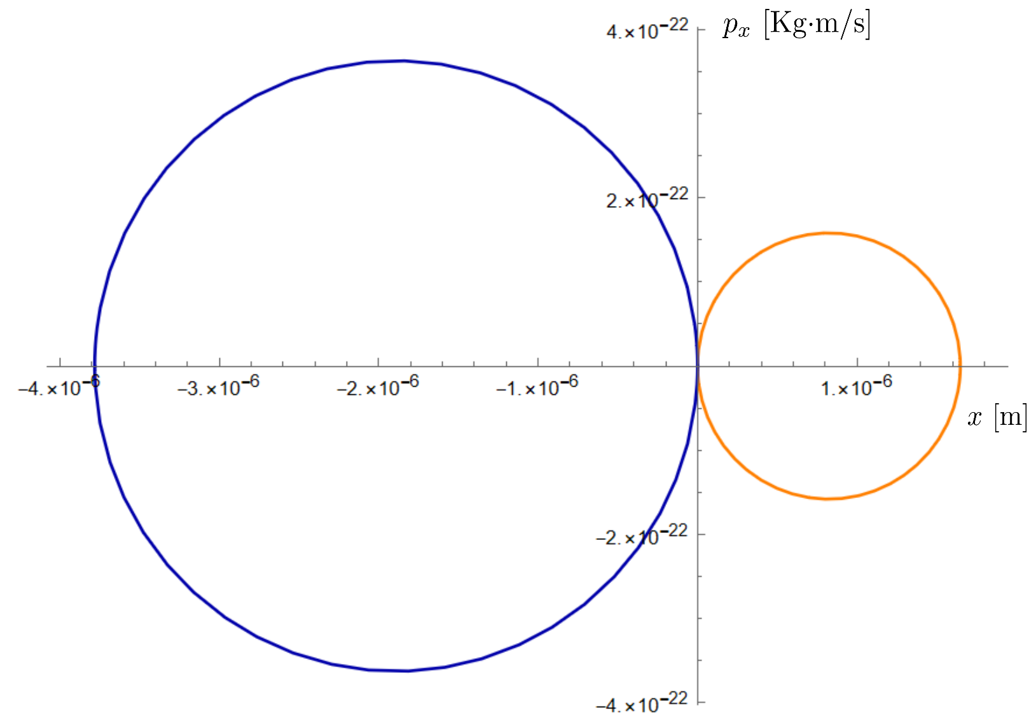
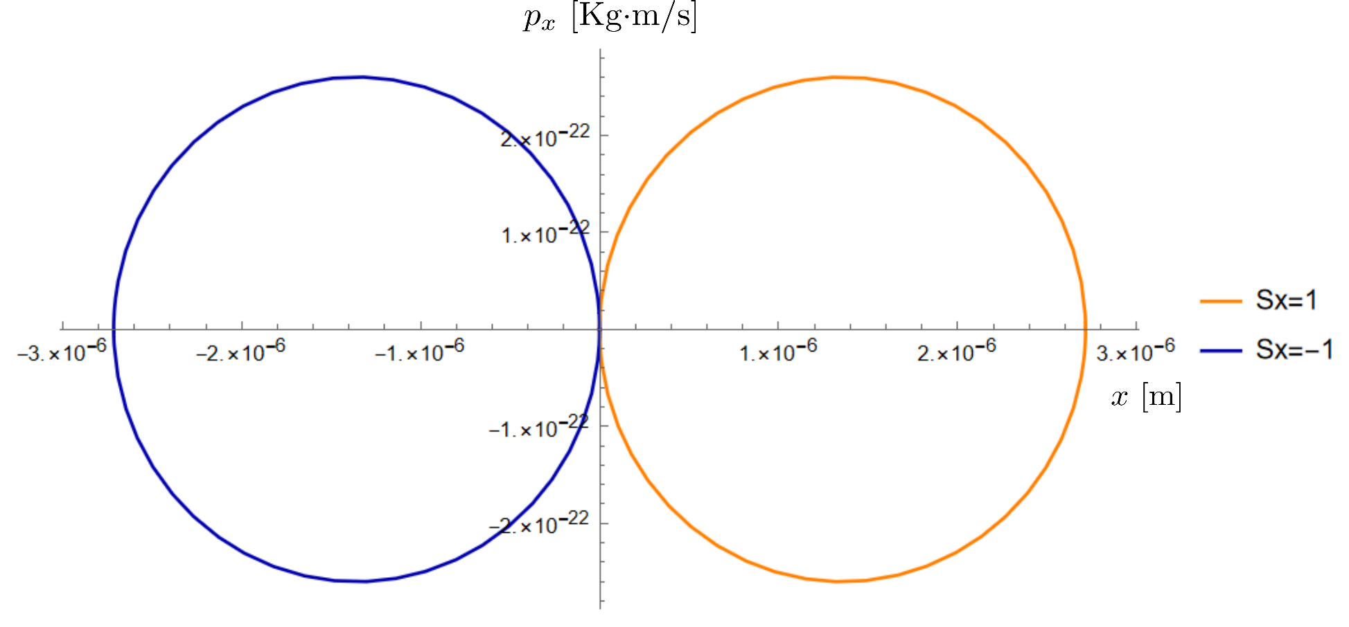
Step 1: table-top single-ND interferometer
Phase space diagram for the ND superposition components:
Vicentini et al., arXiv:2405.21029 (2024)
Phase difference between the two superposition components after one oscillation:
$$B_{0}≃{10}^{−8} T → Δφ≃2π$$
Fabrizio Piacentini, ‘‘A Modern Odissey … Silence’’, 3-7 June 2024

Slide 14
Table-top ND interferometer + Dynamical Decoupling
To increase the coherence time of the ND superposition, dynamical decoupling on its NV centre can be applied.
A series of MW pulses induces subsequent $π$ rotations of the NV spin onto the $Y$ axis, compensating precession effects.
Pulses repetition rate:
Hamiltonian $H_{x}$ time-invariant $⟺$ Both $B_{0}$ and $B′$ flip sign with frequency $ω_{DD}$
What if the static field $B_{0}$ remains fixed?
The system Hamiltonian is equivalent to one where $only B_{0}$ flips sign, with the ND superposition alternatively swapping between the Hamiltonians $H_{x}^{\left(↑\right)}$ and $H_{x}^{\left(↓\right)}$, with $H_{x}^{\left(↑↓\right)}=H_{x}\left(±B_{0}\right)$.
Fabrizio Piacentini, ‘‘A Modern Odissey … Silence’’, 3-7 June 2024

Slide 15
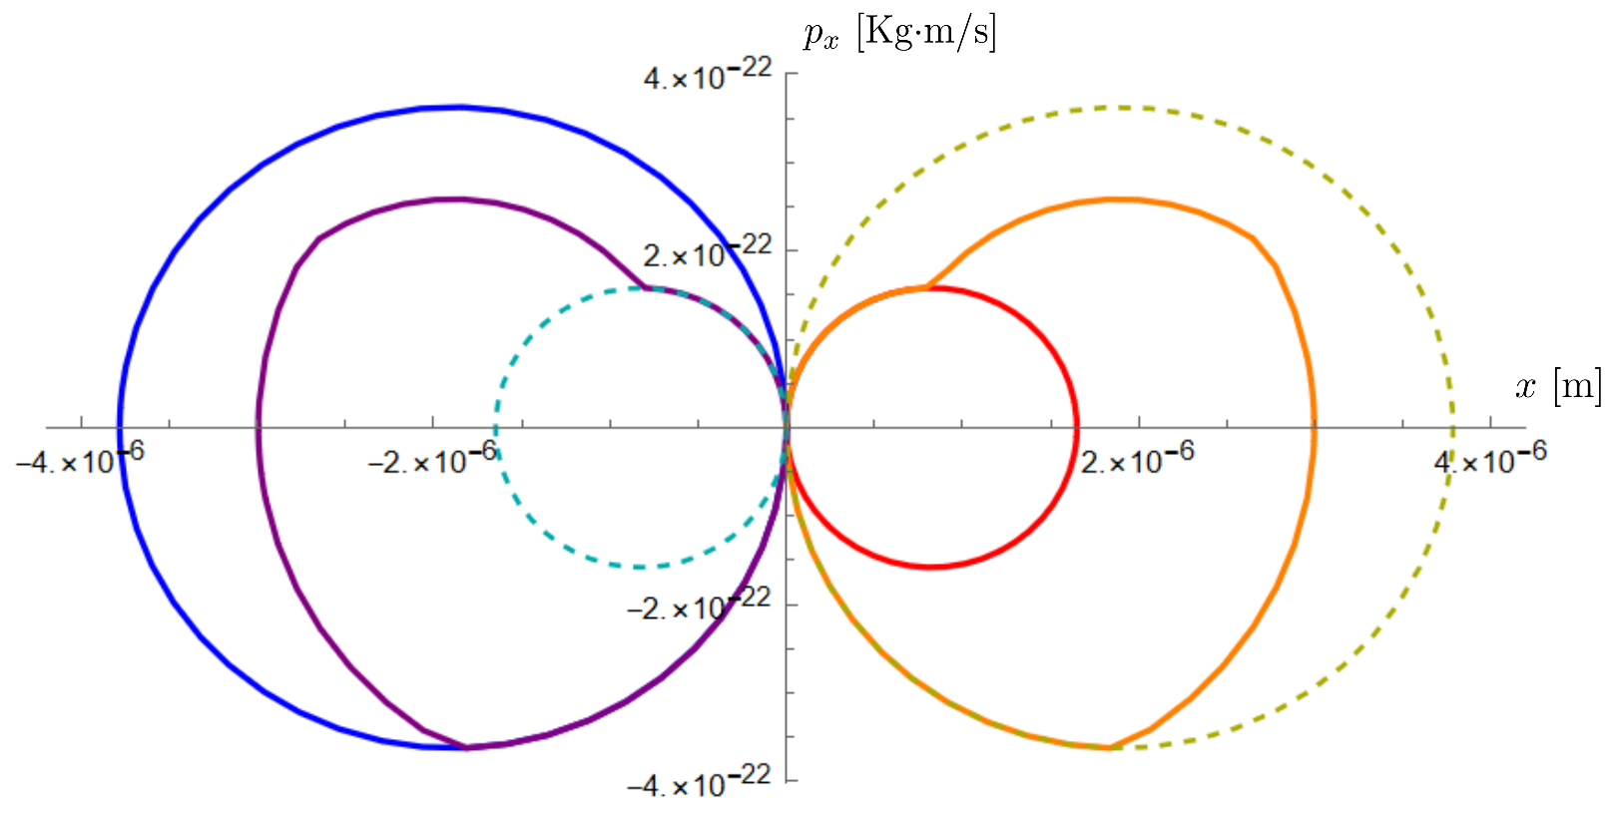
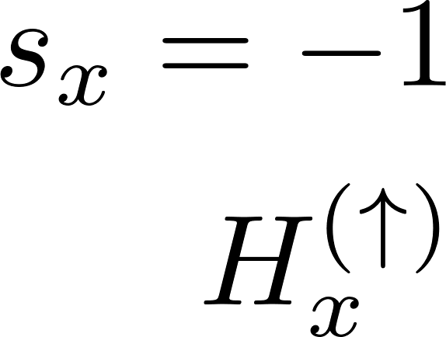
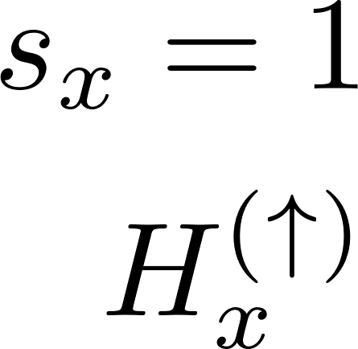
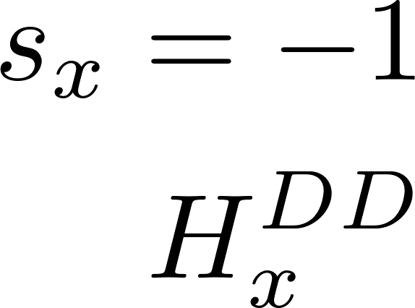
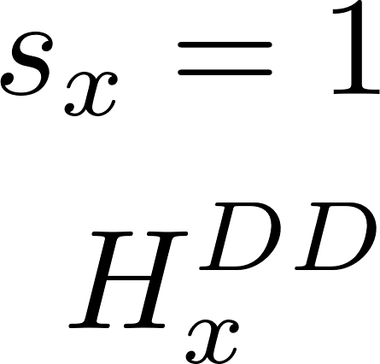
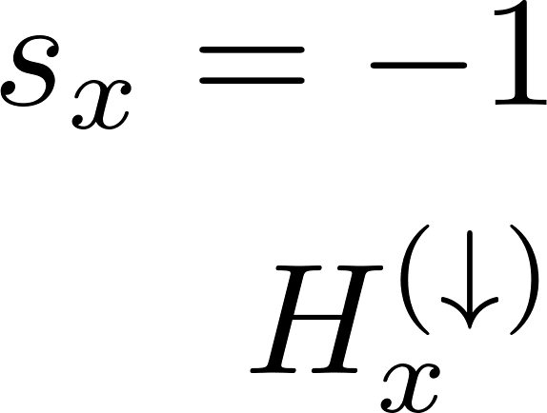
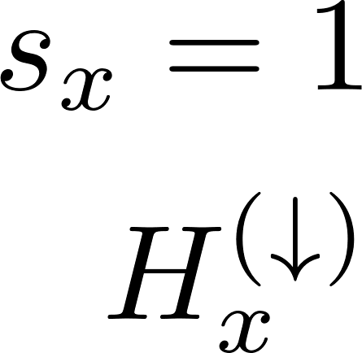
Table-top ND interferometer + Dynamical Decoupling
Phase space diagram for the ND superposition components undergoing $H_{x}^{\left(DD\right)}(t)$ evolution:
Vicentini et al., arXiv:2405.21029 (2024)
Fabrizio Piacentini, ‘‘A Modern Odissey … Silence’’, 3-7 June 2024

Slide 16
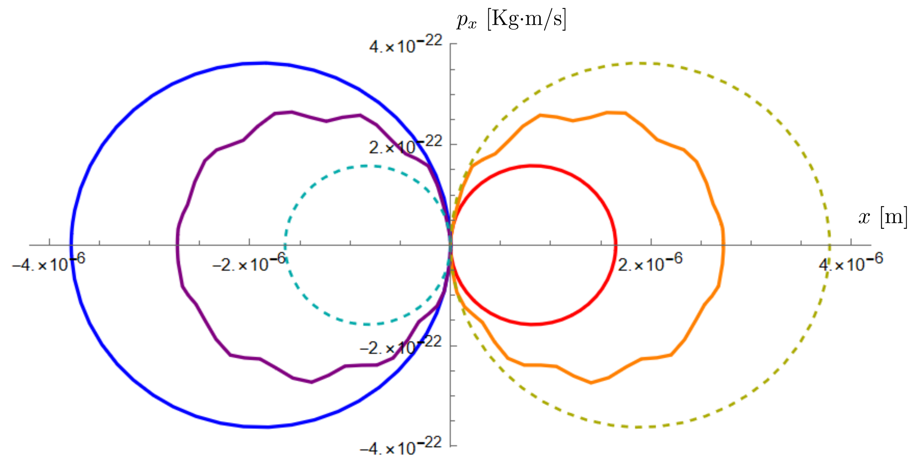
Table-top ND interferometer + Dynamical Decoupling
Phase space diagram for the ND superposition components undergoing $H_{x}^{\left(DD\right)}(t)$ evolution:
Vicentini et al., arXiv:2405.21029 (2024)
Fabrizio Piacentini, ‘‘A Modern Odissey … Silence’’, 3-7 June 2024

Slide 17
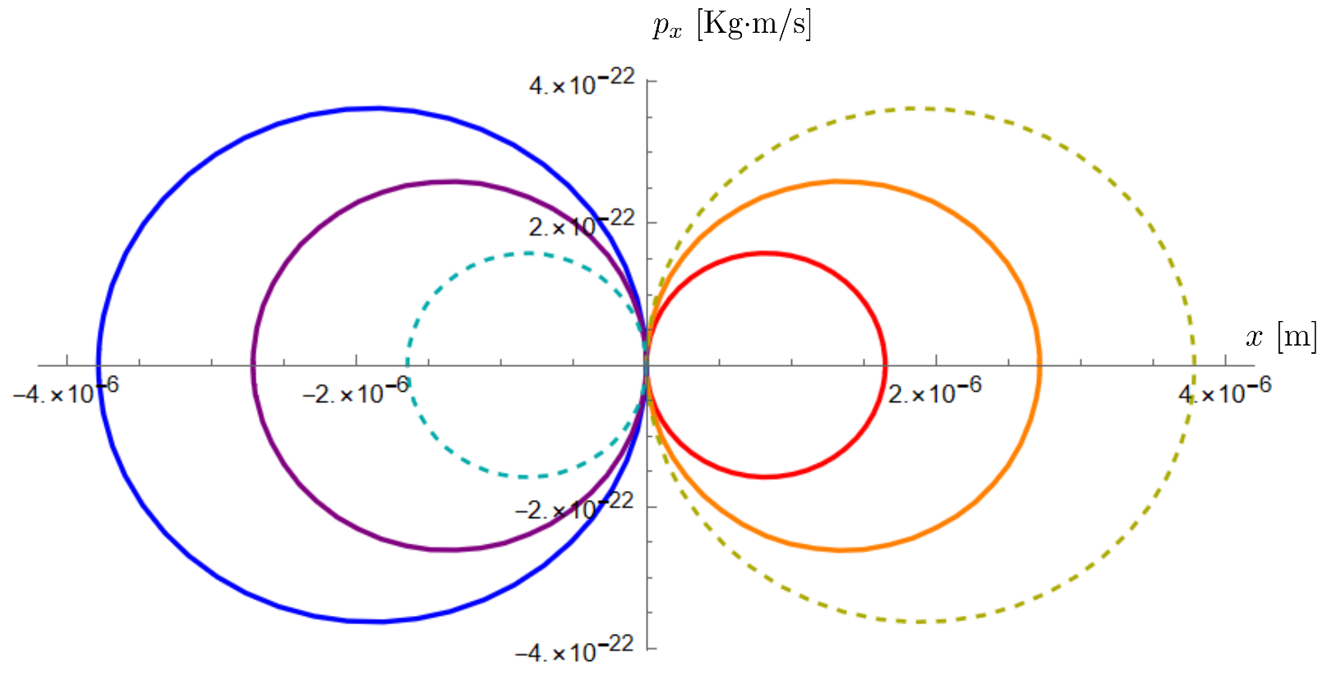
Table-top ND interferometer + Dynamical Decoupling
Phase space diagram for the ND superposition components undergoing $H_{x}^{\left(DD\right)}(t)$ evolution:
Vicentini et al., arXiv:2405.21029 (2024)
Static fields do not induce a phase difference between the $S_{x}=±1$ superposition components
Fabrizio Piacentini, ‘‘A Modern Odissey … Silence’’, 3-7 June 2024

Slide 18
Summary
We propose a table-top solution for testing quantum features in gravity, based on an interferometer hosting two spatially-superposed massive objects.
Our scenario involves single-NV-centre NDs, magnetically constrained in the y and z directions but free along x.
We realized a feasibility study for the single-ND interferometer, showing the ND dynamics in presence of DD (needed to increase the ND superposition coherence time) might be robust against static fields.
Our proposal presents several advantages with respect to previous ones, e.g.:
No need for a meters-long structure with micrometric fabrications, to be kept under high-vacuum and low-temperature conditions.
Only a single MW antenna (instead of $≳{10}^{4}$) needed for DD, allowing for custom pulse shaping granting much higher versatility, tunability and control.
NDs are not lost after the measurement: no need for growing, characterizing and trapping new samples run-by-run, heavily reducing the time consumption and avoiding ‘‘noise’’ due to inhomogeneities among them.
Fabrizio Piacentini, KOBIT 8, 25-26 April 2024

Slide 19
Credits
Thanks for your attention
Fabrizio Piacentini, KOBIT 8, 25-26 April 2024

Slide 20
NV centre Dynamical Decoupling
To increase the coherence time of the ND superposition, dynamical decoupling on its NV centre can be applied.
Carr-Purcell-Meiboom-Gill (CPMG) multi-echo sequence: a series of MW pulses induces subsequent $π$ rotations of the NV spin onto the Y axis, compensating precession.
The coherence time $T_{2}$ of the NV-centre can be enhanced.
Fabrizio Piacentini, ‘‘A Modern Odissey … Silence’’, 3-7 June 2024

