Slide 1


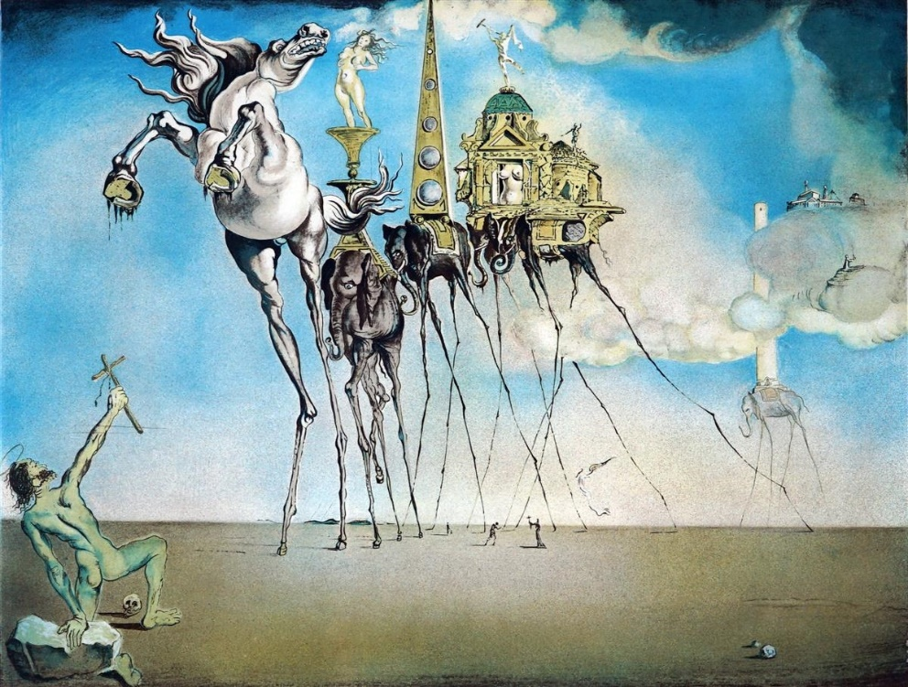

Strangers in a strangeness land
(Three- and four-body hypernuclear resonant states)
A. Deltuva (Vilnius U.), D. Gazda & M. Schäfer (NPI, Rez, Czech Republic), R. Lazauskas (IPHC,Strasbourg)

Slide 2

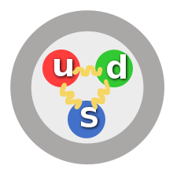
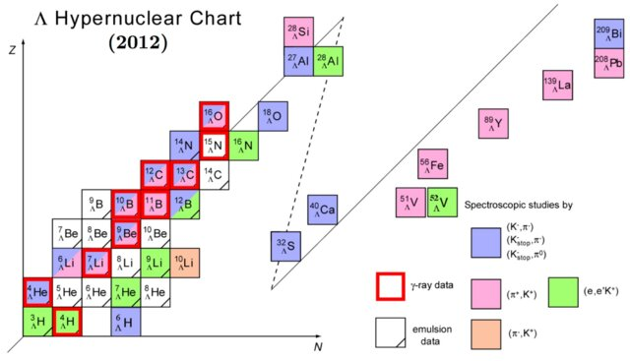
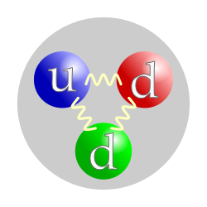
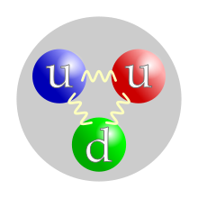
Strange particles (hyperons)
Σ⁺
Σ⁰
Σ⁻
u
d
+80 MeV
Λ⁰
+165 MeV
n
p

Slide 3
Hyperon-nucleon interaction
Z=-1
Z=0
Z=1
Z=2
Σ⁻+n
0
80.5
Σ⁻+p
No 2-body bound states.
36 low-energy data points
77.0
Σ⁰+n
77.0
Σ⁰+p
75.0
Σ⁺+n
0
Σ⁺+p
0
Λ⁰+n
0
Λ⁰+p
J. Haidenbauer et al., Eur. Phys. J. A (2020) 56-91

Slide 4
Hyperon-nucleon interaction
Z=-1
Z=0
Z=1
Z=2
Σ⁻+n
0
80.5
Σ⁻+p
77.0
Σ⁰+n
77.0
Σ⁰+p
75.0
Σ⁺+n
0
Σ⁺+p
0
Λ⁰+n
0
Λ⁰+p
J. Haidenbauer et al., Eur. Phys. J. A 56 (2020) 91

Slide 5
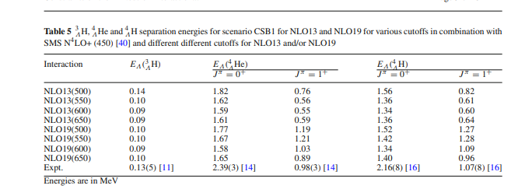
Bound hypernuclei
Λ⁰ separation energies:
Table 4. The separation energies of the most loosely bound particles in the light hypernuclei. The excitation energies lower than those in column 4 lead to γ-decaying states. The last column shows the lightest of the possible targets which may be used for production of a given hypernucleus. Based on the most recent data of the European K⁻-Collaboration [1].
hypernuclei | most loosely bound particles | residual parts | separation energies (MeV) | expected number of gamma;-decaying states | lightest targets
S-shell
Λ3H | Λ | ²H | 0.13±0.05 | ≦1 ? | (³He)
Λ4H | Λ | ³H | 2.04±0.04 | 1 | ⁴He
Λ4He | Λ | ³He | 2.39±0.03 | 1 | ″
Λ5He | Λ | ⁴He | 3.12±0.02 | - | ⁶Li
P-shell
Λ6He | n | Λ5He | 0.17±0.10 | ≦1 ? | ″
Λ7He | n | Λ6He | 3.0 ? | 2 | ⁷Li
Λ7Li | d | Λ5He | 3.93±0.04 | 4 | ″
Λ7Be | 2p | Λ5He | 0.67±0.08 | - | ⁹Be
Λ8He | n | Λ7He | 1.5 ? | 1 ? | ″
Λ8Li | t | Λ5He | 6.15±0.04 | 5 | ″
Λ5Be | ³He | Λ5He | 5.31±0.06 | 5 | ″
Λ9Li | n | Λ8Li | 3.76±0.16 | many^{x)} | ″
Λ9Be | α | Λ5He | 3.50±0.04 | 2 | ″
Λ9B | p | Λ8Be | 1.18±0.16c | 3 | ¹⁰B
Λ10Be | n | Λ9Be | 4.25±0.26 | many | ″
Λ10B | p | Λ9Be | 1.99±0.13 | 3 | ″
Λ11B | p | Λ10Be | 7.53±0.27 | many | ¹¹B
Λ12B | Λ | ¹¹B | 11.37±0.06 | many | ¹²C
Λ12C | Λ | Λ11B | 9.8 | many | ″
J. Haidenbauer et al., Few-Body Syst. 62 (2021) 105

Slide 6
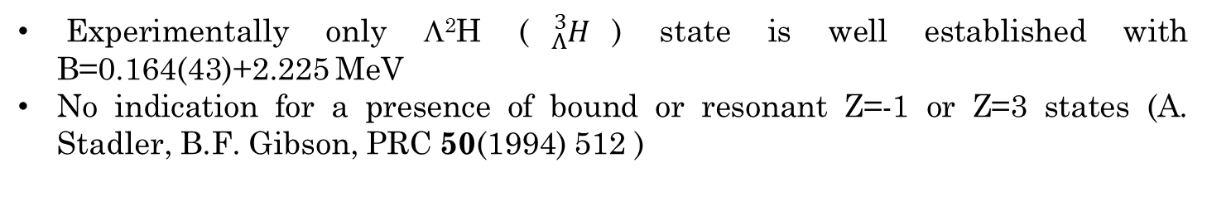
3-body systems
Z=-1
Z=0
Z=1
Z=2
80.5
Σ⁻+pn
Σ⁻+nn
80.5
Σ⁻+pp
0
78.3
Σ⁻+²H
77.0
Σ⁰+nn
77.0
Σ⁰+pn
77.0
Σ⁰+pp
Z=3
75.0
Σ⁺+nn
75.0
Σ⁺+pn
74.7
Σ⁰+²H
72.8
Σ⁺+²H
Σ⁺+pp
0
Λ⁰+nn
0
0
Λ⁰+np
0
Λ⁰+pp
−2.2
Λ⁰+²H
Experimentally only Λ²H (${}_{Λ}^{3}H$) state is well established with B=0.164(43)+2.225 MeV
No indication for a presence of bound or resonant Z=-1 or Z=3 states (A. Stadler, B.F. Gibson, PRC 50(1994) 512 )

Slide 7
3-body systems
Z=1
Z=2
Z=0
80.5
Σ⁻+pn
80.5
Σ⁻+pp
78.3
Σ⁻+²H
77.0
Σ⁰+nn
77.0
Σ⁰+pn
77.0
Σ⁰+pp
75.0
Σ⁺+nn
75.0
Σ⁺+pn
?
74.7
Σ⁰+²H
72.8
Σ⁺+²H
?
?
0
Λ⁰+nn
0
Λ⁰+np
0
Λ⁰+pp
−2.2
Λ⁰+²H
Consensus that Λ⁰nn/ Λ⁰pp are not bound:
R. H. Dalitz, Phys. Rev. 114, 593, 1959; . H. Garcilazo, J. Phys. G: Nucl. Phys. 13, 63, 1987; K. Miyagawa et al., Phys. Rev. C 51, 2905, 1995; H. Garcilazo et al., Phys. Rev. C 76, 034001, 2007; E. Hiyama et al., Phys. Rev. C 89, 061302(R), 2014. A. Gal, Phys. Lett. B 736, 93, 2014; M. Schäfer et al., Phys. Rev. C 103, 025204, 2021.
Ongoing debate about resonant Λ⁰nn & ΣNN states in Z=0 & Z=2 compounds
V. B. Belyaev et al., Nucl. Phys. A 803, 210, 2008; I. R. Afnan, B. F. Gibson, Phys. Rev. C 92, 054608, 2015, M. Schafer et al., Phys. Lett. B 808 (2020) 135614

Slide 8
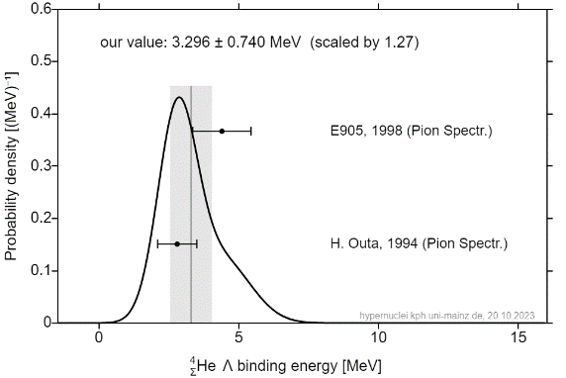

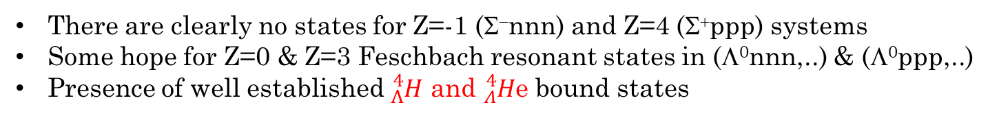


4-body systems
There are clearly no states for Z=-1 (Σ⁻nnn) and Z=4 (Σ⁺ppp) systems
Some hope for Z=0 & Z=3 Feschbach resonant states in (Λ⁰nnn,..) & (Λ⁰ppp,..)
Presence of well established ${}_{Λ}^{4}H$ and ${}_{Λ}^{4}H$e bound states
Z=1
Z=2
75.0
Σ⁺+nnn
Σ⁰+²H+n
74.8
Σ⁰+²H+p
72.7
Σ⁻+³He
72.8
Σ⁺+²H+n
68.5
Σ⁰+³H
69.3
Σ⁰+³He
?
66.5
Σ⁺+³H
0
Λ⁰+nnp
T. Nagae et al., Phys.Rev.Lett.80 (1998)1605
H. Outa et al., Prog. Theor. Phys. Suppl. 117 (1994) 177; R.S. Hayano et al., Phys. Lett. B 231 (1989) 355
−2.2
Λ⁰+²H+n
0
Λ⁰+npp
Λ⁰+³H
−2.2
Λ⁰+²H+p
−8.5
$$J^{π}=1^{+}$$
−7.7
Λ⁰+³He
$$J^{π}=0^{+}$$

Slide 9


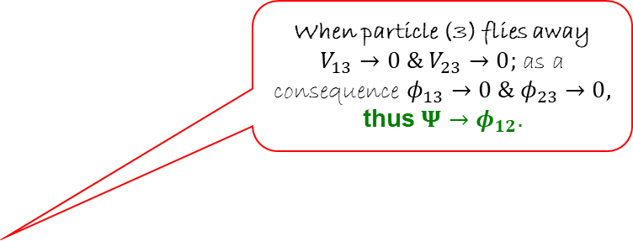


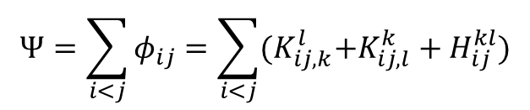

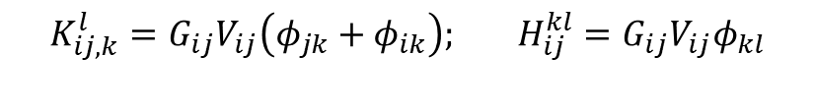
Formalism
When particle (3) flies away $V_{13}→0 \& V_{23}$ $→0;$ as a consequence $φ_{13}→0 \& φ_{23}$ $→0,$
thus $Ψ→φ_{12}.$
3-body
(Faddeev eq.)
4-body
(Faddeev-Yakubovsky eq.)
2
1
j
i
3
j
i
k
$$φ_{12}=G_{0}V_{12}Ψ$$
k
l
l
3
2
1
$$φ_{23}=G_{0}V_{23}Ψ$$
K-type
(12 components)
H-type
(6 components)
1
3
$$φ_{jk}=G_{0}V_{jk}Ψ$$
2
$$K_{ij,k}^{l}=G_{ij}V_{ij}\left(φ_{jk}+φ_{ik}\right); H_{ij}^{kl}=G_{ij}{V_{ij}φ}_{kl}$$
$$φ_{31}=G_{0}V_{31}Ψ$$
$$Ψ=φ_{12}+φ_{23}+φ_{31}$$
$$Ψ=\sum_{i<j}{φ_{ij}=\sum_{i<j}{{(K}_{ij,k}^{l}+{K_{ij,l}^{k}+H}_{ij}^{kl})}}$$
Equations for short-ranged pairwise interactions

Slide 10




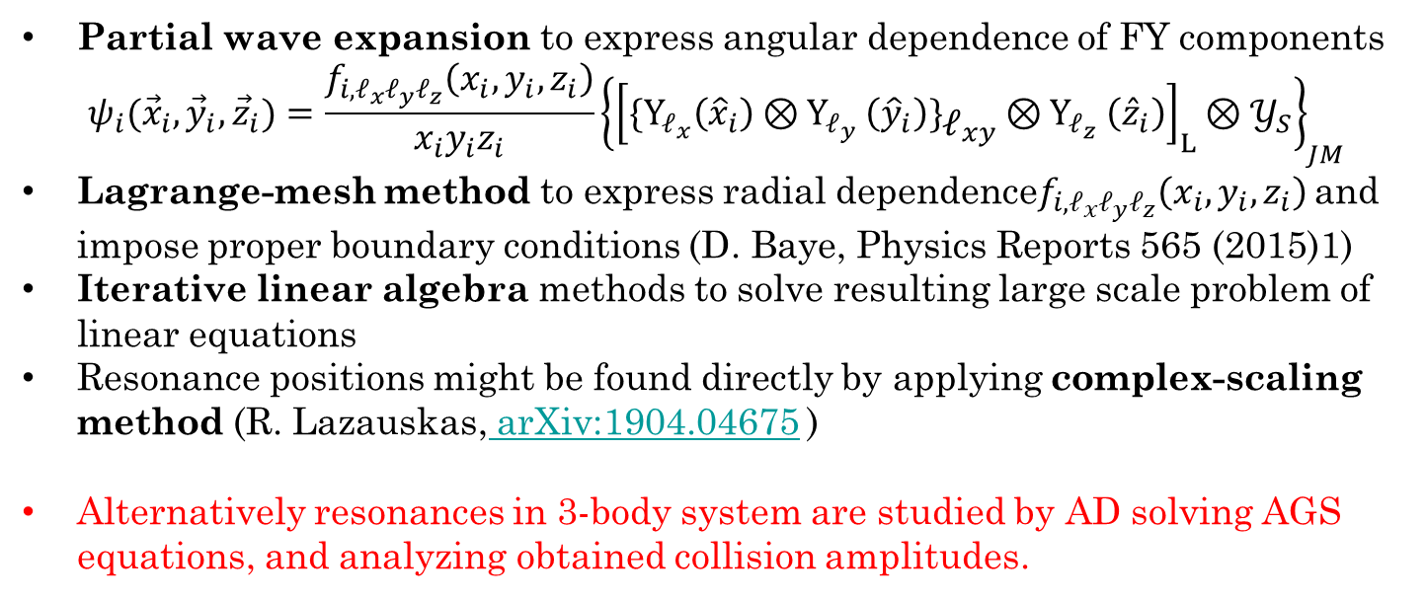



Formalism
3
3
Protons, neutrons and hyperons considered to be different particles
4 coupled-sets, for (Λ⁰,Σ⁰,Σ⁺,Σ⁻)+3Ν, of «18» FY equations are solved
2
$$\vec{y}$$
2
$$\vec{y}$$
$$\vec{z}$$
$$\vec{z}$$
$$\vec{x}$$
4
$$\vec{x}$$
4
1
$$H_{12}^{34}$$
1
Partial wave expansion to express angular dependence of FY components
$$ψ_{i}({{\vec{x}}_{i},{\vec{y}}_{i},{\vec{z}}_{i})=\frac{f_{i,ℓ_{x}ℓ_{y}ℓ_{z}}\left(x_{i},y_{i},z_{i}\right)}{x_{i}y_{i}z_{i}}\left\{{\left[{\{Y}_{ℓ_{x}}\left({\hat{x}}_{i}\right){⊗Y}_{ℓ_{y}}\left({\hat{y}}_{i}\right)\}{\begin{aligned} \\ ℓ\end{aligned}}_{xy}{⊗Y}_{ℓ_{z}}\left({\hat{z}}_{i}\right)\right]}_{L}⊗𝒴_{S}\right\}}_{JM}$$
Lagrange-mesh method to express radial dependence$f_{i,ℓ_{x}ℓ_{y}ℓ_{z}}\left(x_{i},y_{i},z_{i}\right)$ and impose proper boundary conditions (D. Baye, Physics Reports 565 (2015)1)
Iterative linear algebra methods to solve resulting large scale problem of linear equations
Resonance positions might be found directly by applying complex-scaling method (R. Lazauskas, arXiv:1904.04675 )
Alternatively resonances in 3-body system are studied by AD solving AGS equations, and analyzing obtained collision amplitudes.

Slide 11

3-body system, test ${}_{Λ}^{3}H$ b.s.
Z=1
YN int. | LO550 | LO600 | LO650 | LO700
This work | -2.349 | -2.343 | -2.343 | -2.362
Ref. | -2.35 | -2.34 | -2.34 | -2.36
80.5
Σ⁻+pp
77.0
Σ⁰+pn
YN int. 2013 | NLO450 | NLO550 | NLO650
This work | -2.391 | -2.299 | -2.298
Ref. | -2.39 | -2.30 | -2.30
75.0
Σ⁺+nn
74.7
Σ⁰+²H
0
Λ⁰+np
−2.2
Λ⁰+²H
Using Idaho χ−EFT N3LO NN interaction
D.R. Entem et al., Phys. Rev. C 68 (2003) 041001.
Different YN χ−EFT models from
J. Haidenbauer et al., Few-Body Syst. 62 (2021) 105, Eur. Phys. J. A (2020) 56-91
Notes:
It is more complex to exclude possible existence of a resonant state, as it is much less constrained... And first how we define it and what we are really looking for… In experiment some complex reaction are involved with a potential end product of multi-neutron. Then resonance is associated with a presence of rapid variation..
But it appears that fast variation is not sufficient evidence of presence of a resonance..

Slide 12
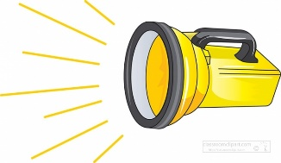
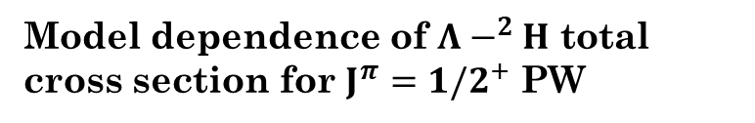
3-body systems
Z=1
80.5
Σ⁻+pp
Model dependence of $Λ−^{2}H$ total cross section for $J^{π}=1/2^{+}$ PW
77.0
Σ⁰+pn
75.0
Σ⁺+nn
74.7
Σ⁰+²H
0
Λ⁰+np
−2.2
Λ⁰+²H

Slide 13
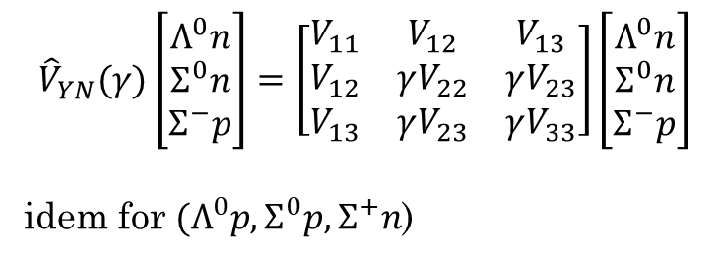

3-body system
Z=1, $J^{Π}=1/2^{+}$ state
$${\hat{V}}_{YN}(γ)\left[\begin{matrix}Λ^{0}n \\ Σ^{0}n \\ Σ^{−}p\end{matrix}\right]=\left[\begin{matrix}V_{11} & V_{12} & V_{13} \\ V_{12} & γV_{22} & γV_{23} \\ V_{13} & γV_{23} & γV_{33}\end{matrix}\right]\left[\begin{matrix}Λ^{0}n \\ Σ^{0}n \\ Σ^{−}p\end{matrix}\right]$$
idem for ${(Λ}^{0}p,Σ^{0}p,Σ^{+}n$)
Z=1
80.5
Σ⁻+pp
77.0
Σ⁰+pn
75.0
Σ⁺+nn
74.7
Σ⁰+²H
0
Λ⁰+np
−2.2
Λ⁰+²H
Preliminary
Using Idaho χ−EFT N3LO NN interaction
D.R. Entem et al., Phys. Rev. C 68 (2003) 041001.
Different YN χ−EFT models from
J. Haidenbauer et al., Few-Body Syst. 62 (2021) 105, Eur. Phys. J. A (2020) 56-91

Slide 14
3-body systems
Z=0
Z=2
80.5
Σ⁻+pn
78.3
Σ⁻+²H
77.0
Σ⁰+nn
77.0
Σ⁰+pp
?
75.0
Σ⁺+pn
72.8
Σ⁺+²H
?
0
Λ⁰+nn
0
Λ⁰+pp

Slide 15

3-body system
Z=2, $J^{Π}=1/2^{+}$ state
Z=2
$${\hat{V}}_{YN}(γ)\left[\begin{matrix}Λ^{0}n \\ Σ^{0}n \\ Σ^{−}p\end{matrix}\right]=\left[\begin{matrix}V_{11} & V_{12} & V_{13} \\ V_{12} & γV_{22} & γV_{23} \\ V_{13} & γV_{23} & γV_{33}\end{matrix}\right]\left[\begin{matrix}Λ^{0}n \\ Σ^{0}n \\ Σ^{−}p\end{matrix}\right]$$
idem for ${(Λ}^{0}p,Σ^{0}p,Σ^{+}n$)
77.0
Σ⁰+pp
75.0
Σ⁺+pn
72.8
Σ⁺+²H
?
0
Λ⁰+pp
Preliminary

Slide 16


3-body systems
(based on NLO700 (2019))
Z=0
Z=1
Z=2
80.5
Σ⁻+pn
?
80.5
Σ⁻+pp
78.3
Σ⁻+²H
77.0
Σ⁰+nn
77.0
Σ⁰+pn
77.0
Σ⁰+pp
75.0
Σ⁺+nn
75.0
Σ⁺+pn
74.7
Σ⁰+²H
72.8
Σ⁺+²H
0
Λ⁰+nn
0
Λ⁰+np
0
Λ⁰+pp
$E_{R}(γ=1.15)=76.65−1.27i$ MeV
−2.2
Λ⁰+²H
$E_{R}=74.09−0.79i$ MeV
$E_{R}=75.06−1.63i$ MeV
Using Idaho χ−EFT N3LO NN interaction
D.R. Entem et al., Phys. Rev. C 68 (2003) 041001.
Different YN χ−EFT models from
J. Haidenbauer et al., Few-Body Syst. 62 (2021) 105, Eur. Phys. J. A (2020) 56-91

Slide 17
3-body system observability of the J=1/2+ resonances?
Σ⁰+²H
Z=1
80.5
Σ⁻+pp
77.0
Σ⁰+pn
75.0
Σ⁺+nn
74.7
Σ⁰+²H
0
Λ⁰+np
−2.2
Λ⁰+²H

Slide 18
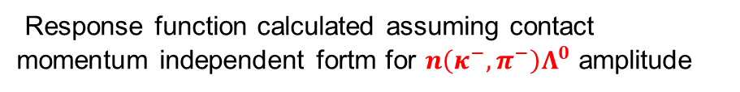

3-body system, Z=1 case primitive simulation of ${}_{}^{3}H\left(κ^{−},π^{−}\right)X$ reaction
Z=1
Response function calculated assuming contact momentum independent fortm for $n\left(κ^{−},π^{−}\right)Λ^{0}$ amplitude
80.5
Σ⁻+pp
77.0
Σ⁰+pn
75.0
Σ⁺+nn
74.7
Σ⁰+²H
0
Λ⁰+np
−2.2
Λ⁰+²H
Preliminary

Slide 19
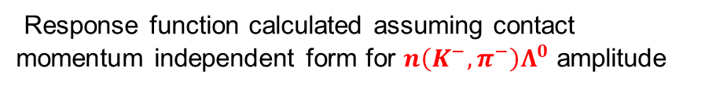

3-body system, Z=1 case primitive simulation of ${}_{}^{3}H\left(K^{−},π^{−}\right)X$ reaction
Z=1
Response function calculated assuming contact momentum independent form for $n\left(K^{−},π^{−}\right)Λ^{0}$ amplitude
80.5
Σ⁻+pp
77.0
Σ⁰+pn
75.0
Σ⁺+nn
74.7
Σ⁰+²H
0
Λ⁰+np
−2.2
Λ⁰+²H
Preliminary

Slide 20

3-body system, Z=2 case primitive simulation of ${}_{}^{3}{He}\left(K^{−},π^{−}\right)X$ reaction
Z=2
Response function calculated assuming contact momentum independent form for $n\left(K^{−},π^{−}\right)Λ^{0}$ amplitude
77.0
Σ⁰+pp
75.0
Σ⁺+pn
72.8
Σ⁺+²H
?
0
Λ⁰+pp
Preliminary

Slide 21


4-body systems
Z=1
Z=2
75.0
Σ⁺+nnn
Σ⁰+²H+n
74.8
Σ⁰+²H+p
72.7
Σ⁻+³He
72.8
Σ⁺+²H+n
68.5
Σ⁰+³H
69.3
Σ⁰+³He
66.5
Σ⁺+³H
0
Λ⁰+nnp
−2.2
Λ⁰+²H+n
0
Λ⁰+npp
Λ⁰+³H
−2.2
Λ⁰+²H+p
−8.5
$$J^{π}=1^{+}$$
−7.7
Λ⁰+³He
$$J^{π}=0^{+}$$

Slide 22

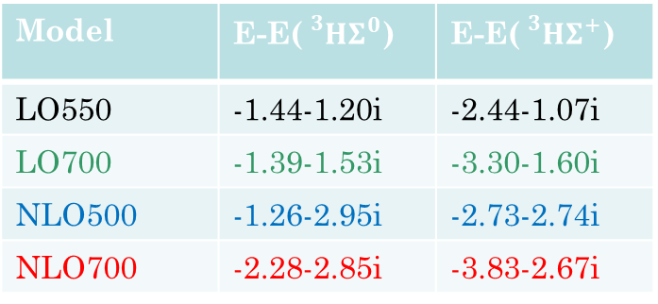
4-body systems $J^{Π}=0^{+}$(preliminary)
Z=1
Z=2
75.0
Σ⁺+nnn
Σ⁰+²H+n
74.8
Σ⁰+²H+p
72.8
Σ⁺+²H+n
Σ⁻+³He
72.7
69.3
Σ⁰+³He
69.3
68.5
Σ⁰+³H
67.3
Σ⁺+³H
66.5
Model | E-E(${{}_{}^{3}HΣ}^{0}$) | E-E(${{}_{}^{3}HΣ}^{+}$)
LO550 | -1.44-1.20i | -2.44-1.07i
LO700 | -1.39-1.53i | -3.30-1.60i
NLO500 | -1.26-2.95i | -2.73-2.74i
NLO700 | -2.28-2.85i | -3.83-2.67i
T. Nagae et al., Phys.Rev.Lett.80 (1998)1605
H. Outa et al., Prog. Theor. Phys. Suppl. 117 (1994) 177; R.S. Hayano et al., Phys. Lett. B 231 (1989) 355

Slide 23


3-body system, Z=1 case
$${\hat{V}}_{YN}(γ)\left[\begin{matrix}Λ^{0}n \\ Σ^{0}n \\ Σ^{−}p\end{matrix}\right]=\left[\begin{matrix}V_{11} & V_{12} & V_{13} \\ V_{12} & γV_{22} & γV_{23} \\ V_{13} & γV_{23} & γV_{33}\end{matrix}\right]\left[\begin{matrix}Λ^{0}n \\ Σ^{0}n \\ Σ^{−}p\end{matrix}\right]$$
idem for ${(Λ}^{0}p,Σ^{0}p,Σ^{+}n$)
$$Λ^{0}+p→Λ^{0}+p$$
$$Σ^{−}+p→Σ^{−}+p$$
Not properly normalized!
Using Idaho χ−EFT N3LO NN interaction
D.R. Entem et al., Phys. Rev. C 68 (2003) 041001.
Different YN χ−EFT models from
J. Haidenbauer et al., Few-Body Syst. 62 (2021) 105, Eur. Phys. J. A (2020) 56-91

Slide 24

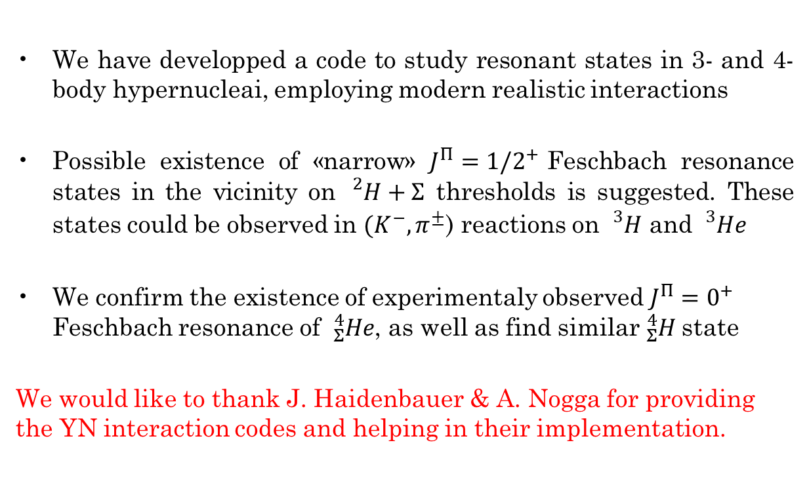
Conclusions
We have developped a code to study resonant states in 3- and 4-body hypernucleai, employing modern realistic interactions
Possible existence of «narrow» $J^{Π}={1/2}^{+}$Feschbach resonance states in the vicinity on ${}_{}^{2}H+Σ$ thresholds is suggested. These states could be observed in ${(K}^{−},π^{±}$) reactions on ${}_{}^{3}H$ and ${}_{}^{3}{He}$
We confirm the existence of experimentaly observed $J^{Π}=0^{+}$ Feschbach resonance of ${}_{Σ}^{4}{He}$, as well as find similar ${}_{Σ}^{4}H$state
We would like to thank J. Haidenbauer & A. Nogga for providing the YN interaction codes and helping in their implementation.
Acknowledgements: We were granted access to the HPC resources of TGCC/IDRIS under the allocation 2023- AD010506006R2 made by GENCI (Grand Equipement National de Calcul Intensif).This work was supported by French IN2P3 for a theory project “PUMA”.

