Slide 1



Ab initio Green's functions approach for homogeneous nuclear matter
Francesco Marino
Institut für Kernphysik and PRISMA+ Cluster of Excellence,
Johannes Gutenberg-Universität Mainz
“The physics of strongly interacting matter: neutron stars, cold atomic gases and related systems”, ECT* (Trento)

Slide 2
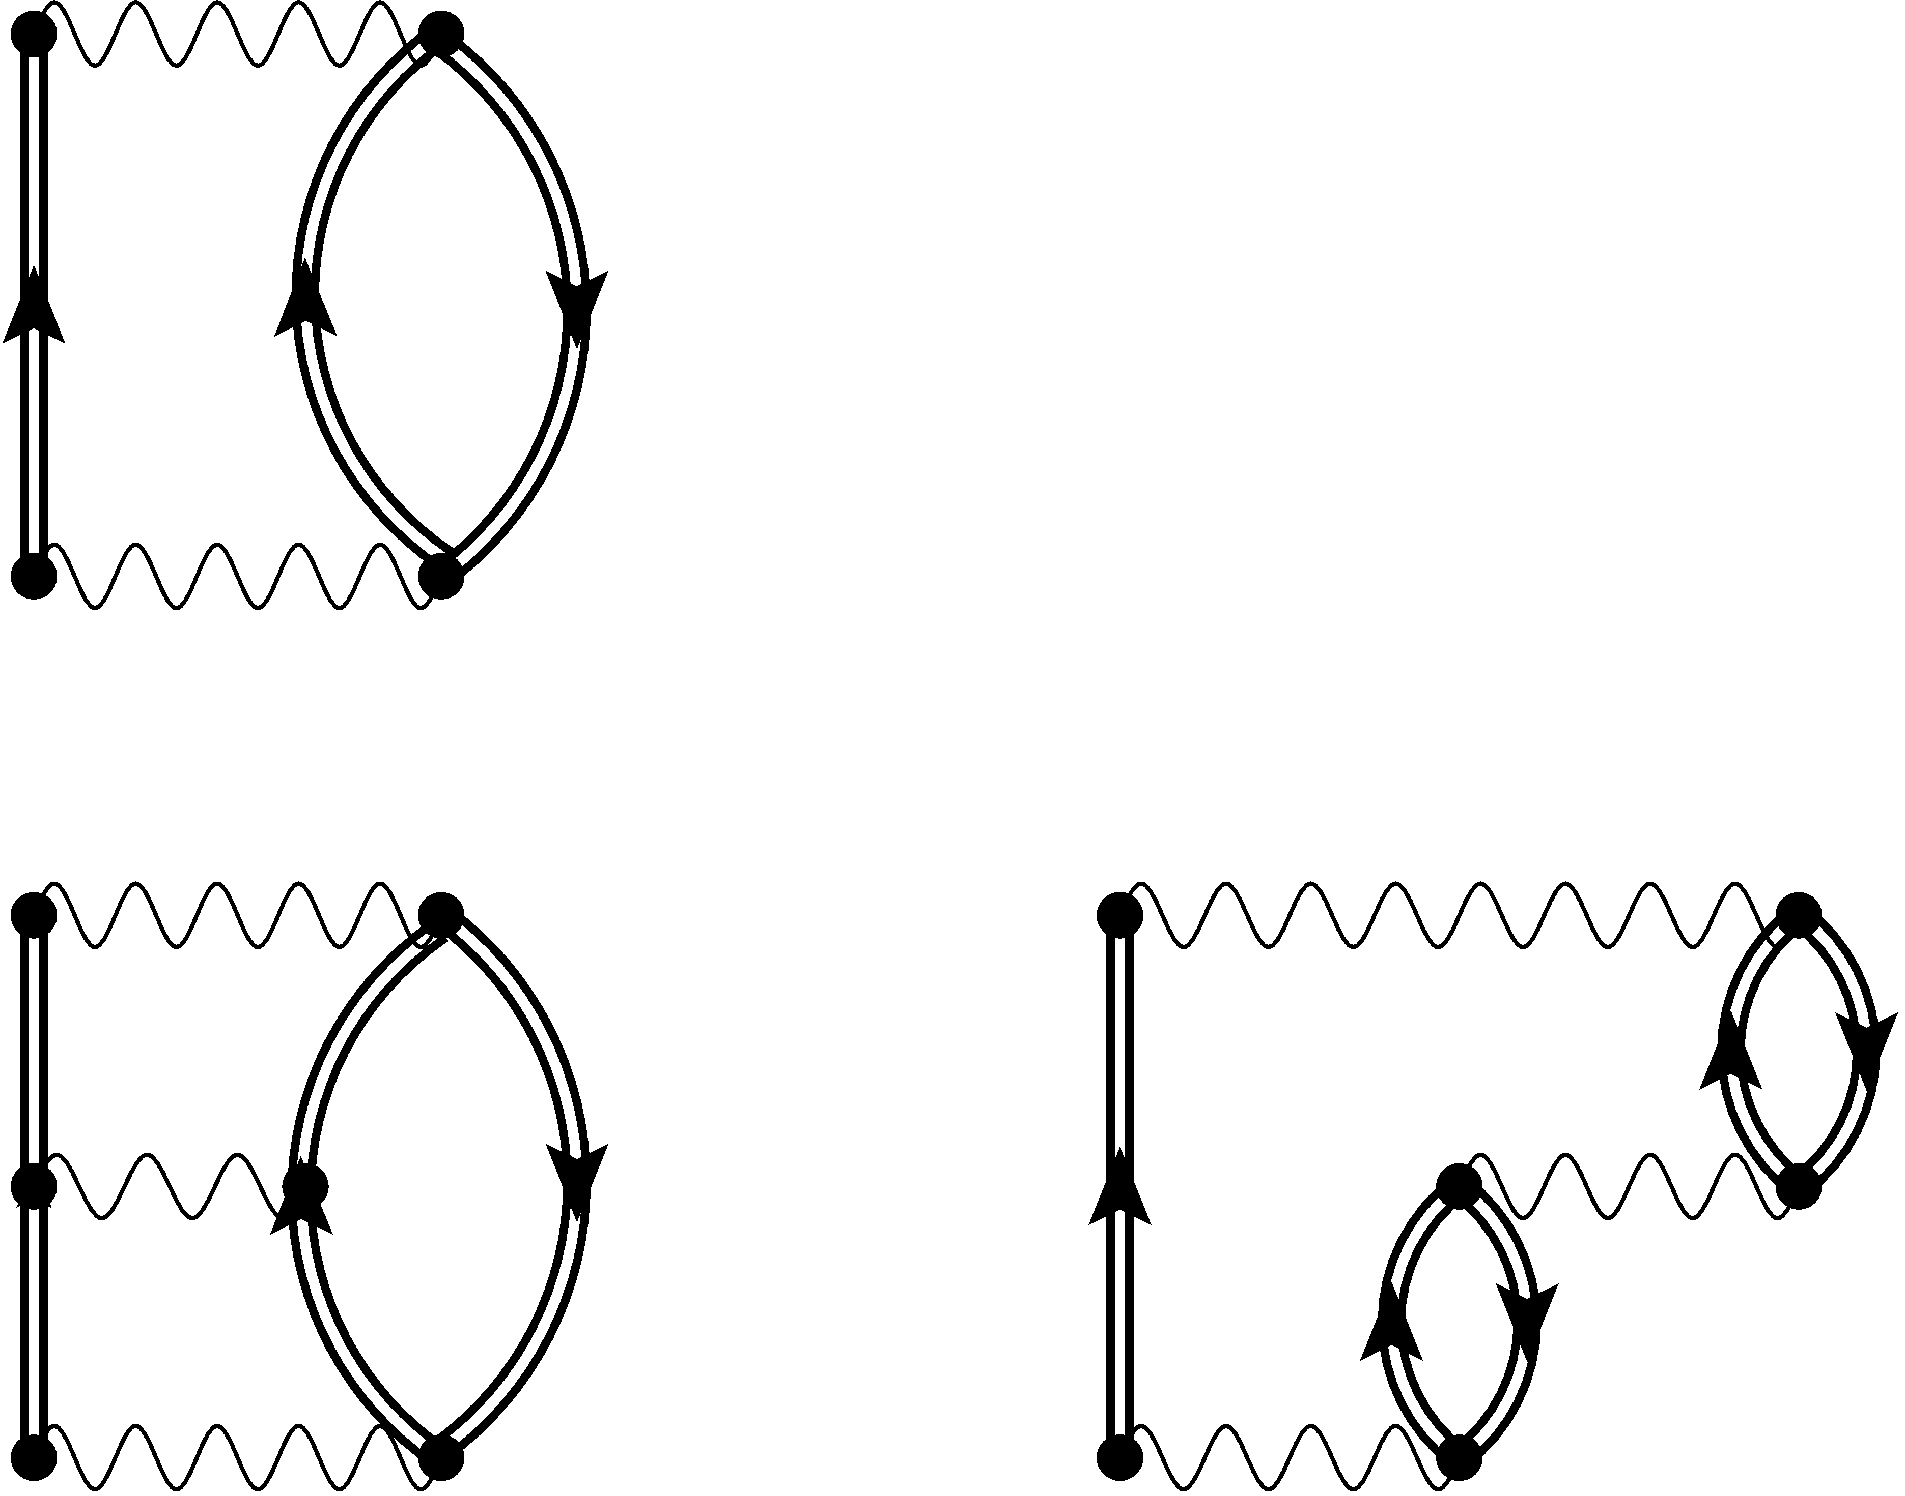
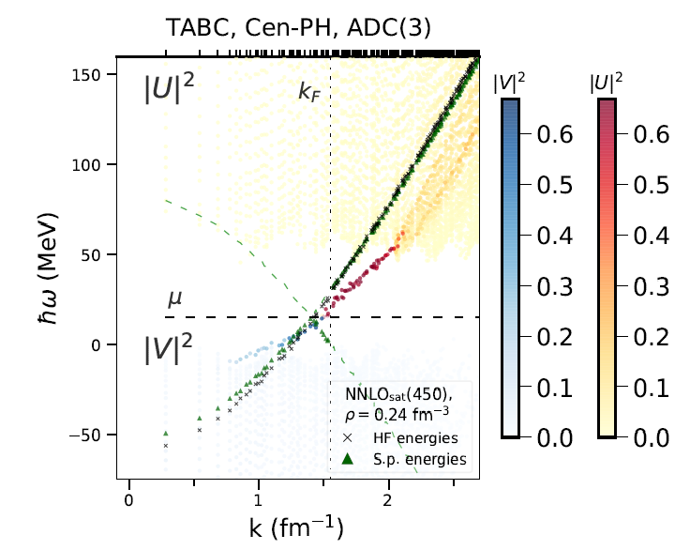
Overview
Infinite nuclear matter is under intense study due to its connections to neutron stars, cold atoms, and finite nuclei
Self-consistent Green’s functions for homogeneous matter

Slide 3
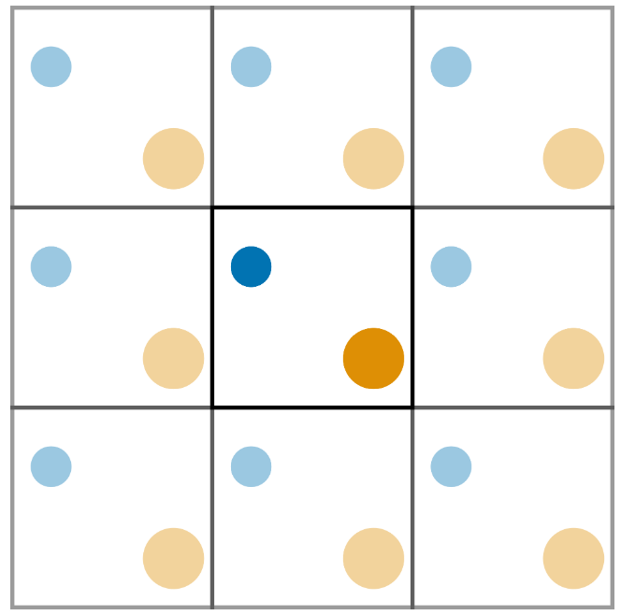
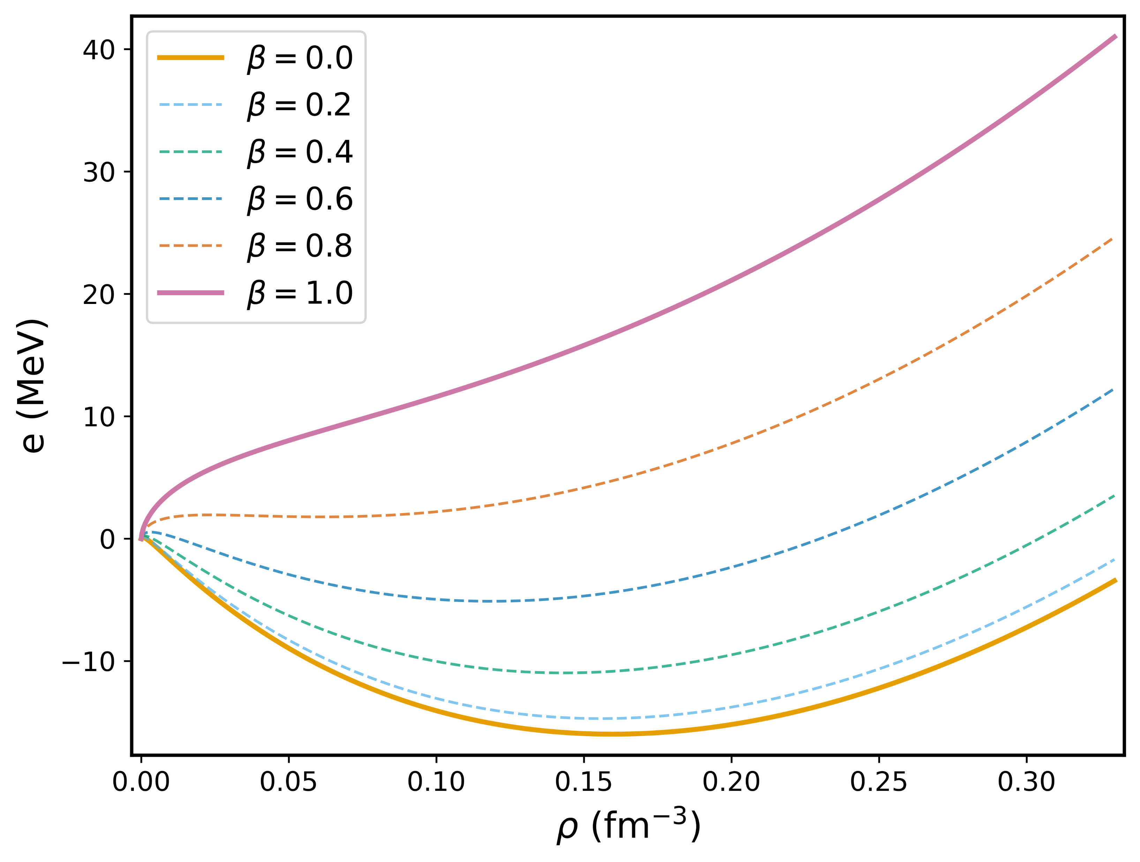
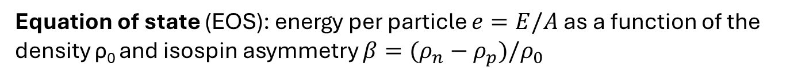
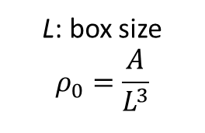
Infinite nuclear matter
Nuclear matter is an infinite system of nucleons that interact through the strong interaction only
We simulate nuclear matter using a finite number of nucleons A enclosed in a cubic box with periodic boundary conditions (PBCs)
Quantized momentum
Equation of state (EOS): energy per particle $e=E/A$ as a function of the density ρ₀ and isospin asymmetry $β=(ρ_{n}−ρ_{p})/ρ_{0}$
L: box size
$$ρ_{0}=\frac{A}{L^{3}}$$
Pure neutron matter (PNM, 𝛽=1)
Typically:
N=66 neutrons in PNM.
A=132 nucleons in SNM
Symmetric nuclear matter (SNM, 𝛽=0)

Slide 4
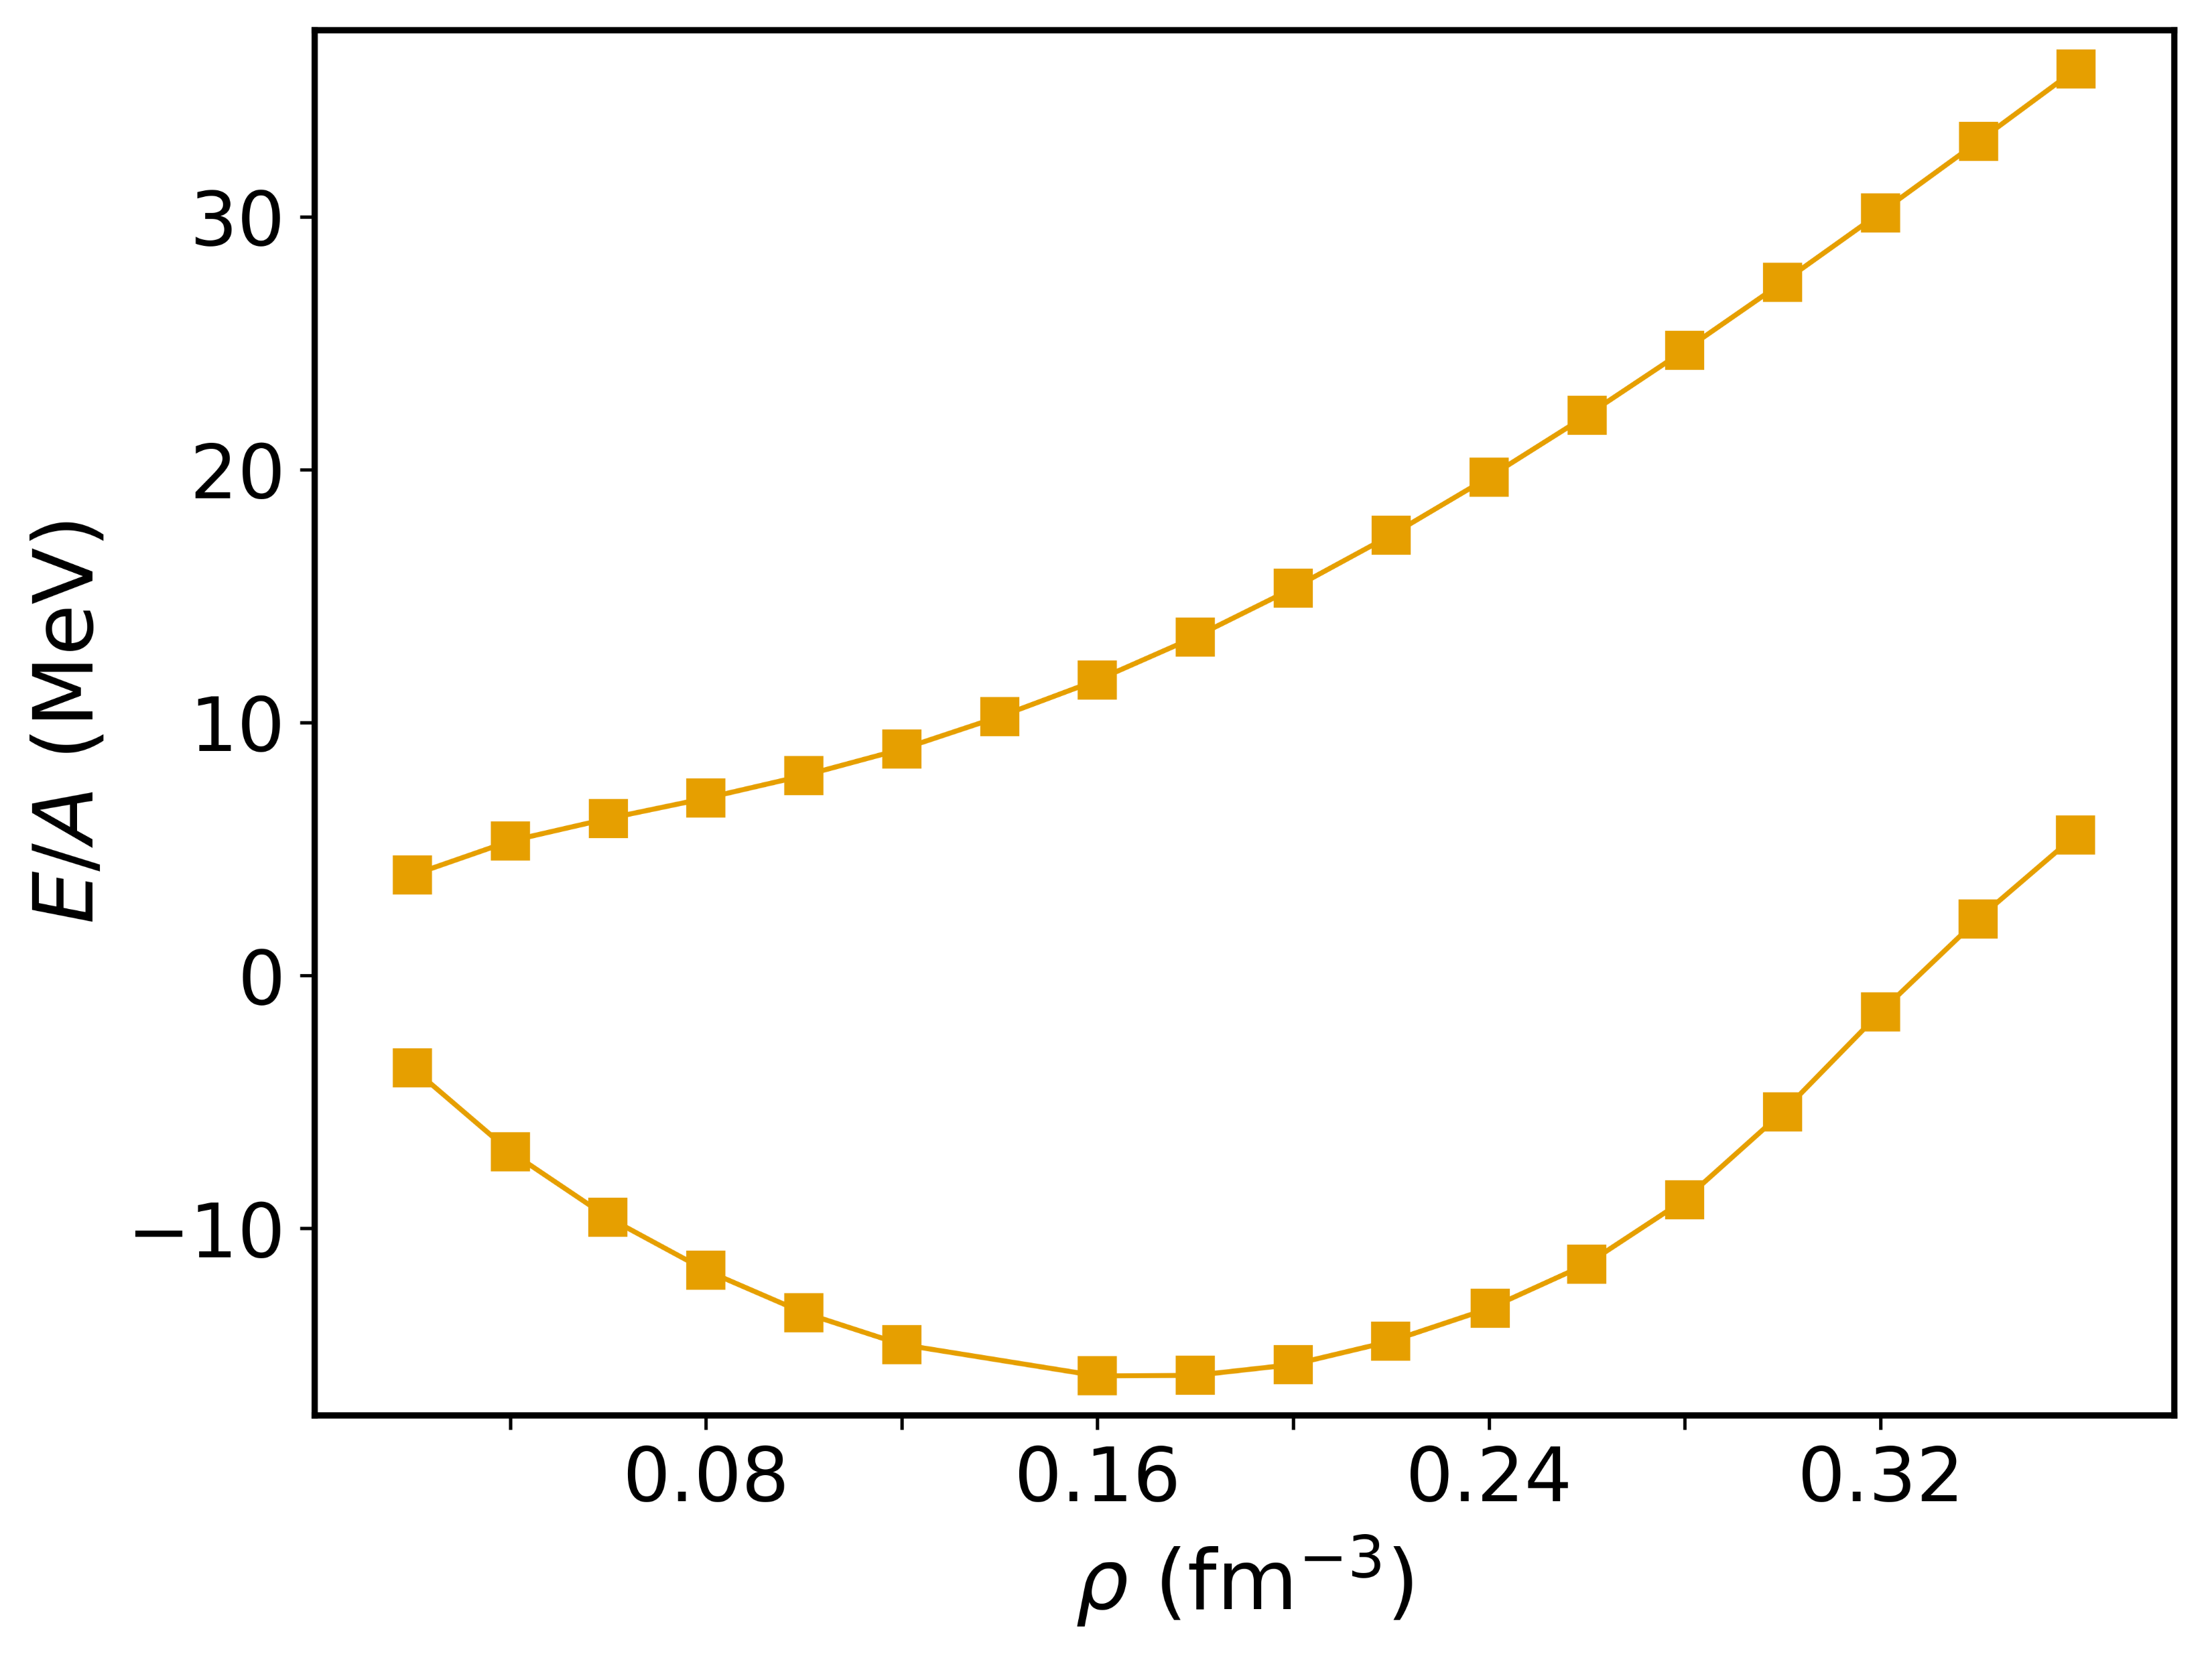
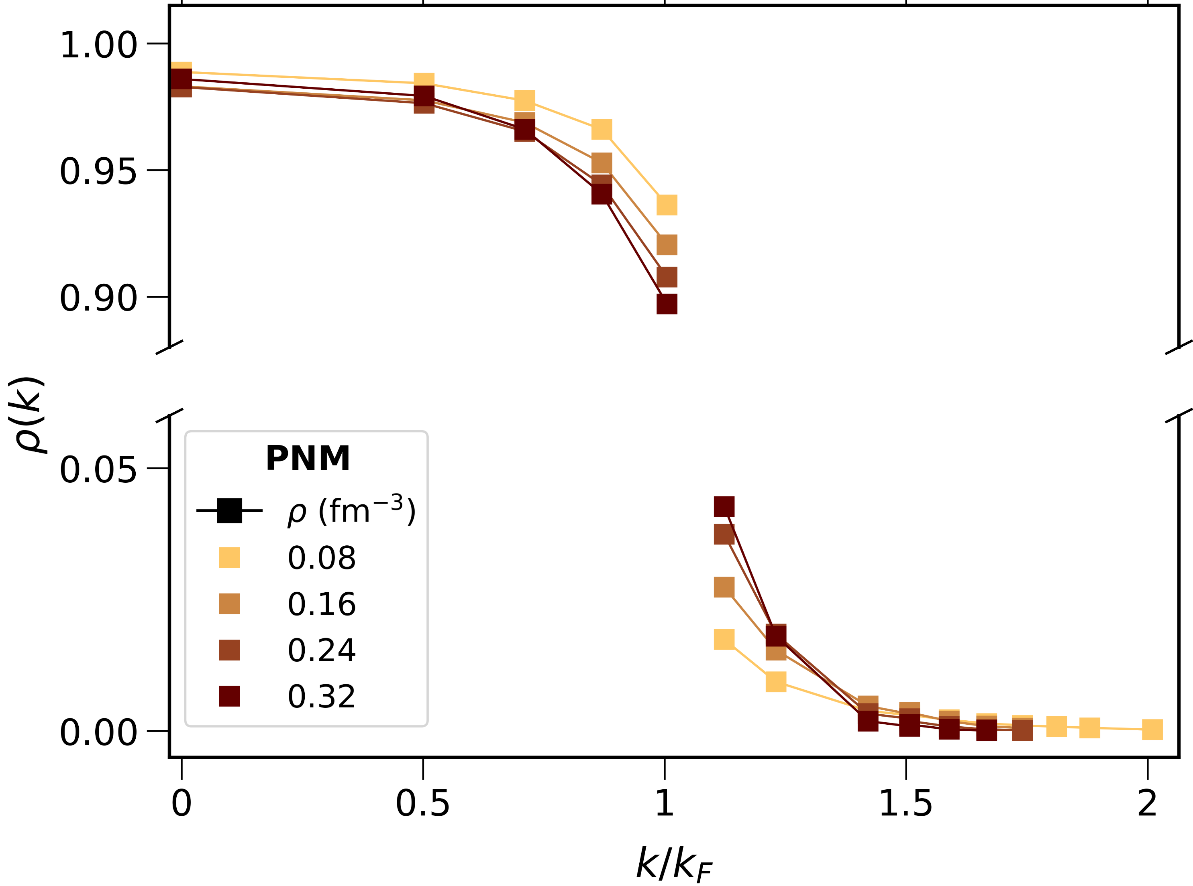
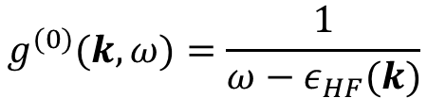
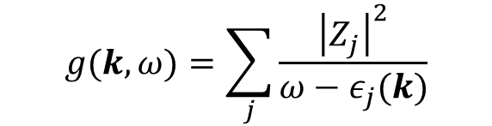
Self-consistent Green’s functions
Equation of state
Dyson equation
$$g(ω) =g^{(0)}\left(ω\right) +g\left(ω\right)Σ^{\left(∗\right)}(ω)g^{(0)}\left(ω\right)$$
PNM
One-body propagator
Self-energy
$g(ω)$ gives access to one-body observables and the total energy
SNM
Reference Hartree-Fock propagator
$$g^{(0)}(k,ω)=\frac{1}{ω−ε_{HF}(k)}$$
Momentum distribution
Spectral representation
$$g(k,ω)=\sum_{j}{\frac{{\left|Z_{j}\right|}^{2}}{ω−ε_{j}(k)}}$$
Full propagator
PNM
Poles ($ε_{j}$) and amplitudes ($Z_{j}$) are obtained from the Dyson equation
Somà, Front. Phys. 8, 340 (2020)
Barbieri, Lect. Notes Phys. 936, 571 (2017)

Slide 5
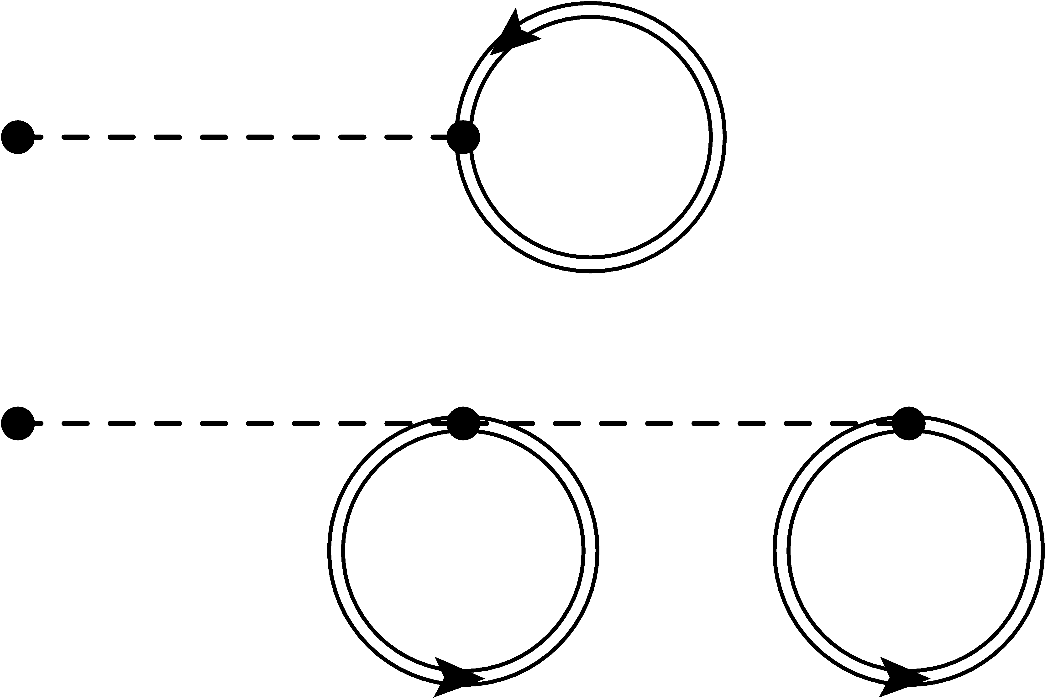

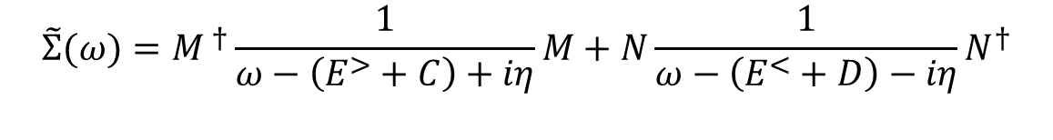




Algebraic diagrammatic construction 1
Self-consistent GF
$Σ^{(⋆)}$ in terms of the dressed propagator $g(ω)$
$$Σ^{\left(⋆\right)}\left(ω\right)=Σ^{(∞)}+\tilde{Σ}(ω)$$
$$Σ^{(∞)}=$$
$$+\frac{1}{2}$$
Static self-energy
Dynamical self-energy
Algebraic diagrammatic construction (ADC)
ADC(2)
ADC(3)
$$\tilde{Σ}(ω)=M^{ †}\frac{1}{ω−\left(E^{>}+C\right)+iη}M+N\frac{1}{ω−\left(E^{<}+D\right)−iη}N^{†}$$
Coupling to intermediate 2p1h configurations
Coupling to intermediate 2h1p configurations
Ladder
Ring
ADC(3) includes third-order perturbation theory, ladders, rings…
Effective two-nucleon interaction
Raimondi, Phys Rev C 97, 054308 (2018)
Barbieri, Phys. Rev. C 105, 044330 (2022)

Slide 6
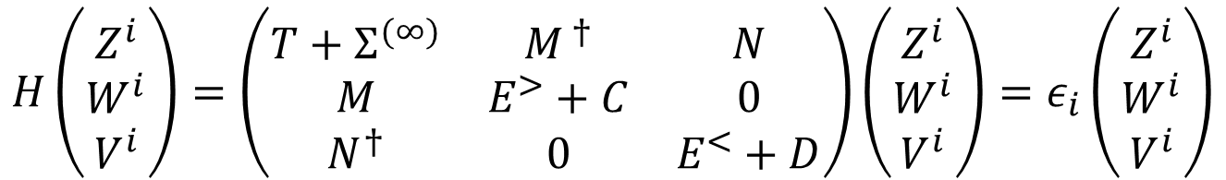

Algebraic diagrammatic construction 2
Self-consistent eigenvalue problem
$$H=H\left[g(ω)\right]$$
Amplitudes
$$H\left(\begin{matrix}Z^{i} \\ W^{i} \\ V^{i}\end{matrix}\right)=\left(\begin{matrix}T+Σ^{(∞)} & M^{ †} & N \\ M & E^{>}+C & 0 \\ N^{†} & 0 & E^{<}+D\end{matrix}\right)\left(\begin{matrix}Z^{i} \\ W^{i} \\ V^{i}\end{matrix}\right)=ε_{i}\left(\begin{matrix}Z^{i} \\ W^{i} \\ V^{i}\end{matrix}\right)$$
ADC(3) problem in the Dyson approach
Poles

Slide 7



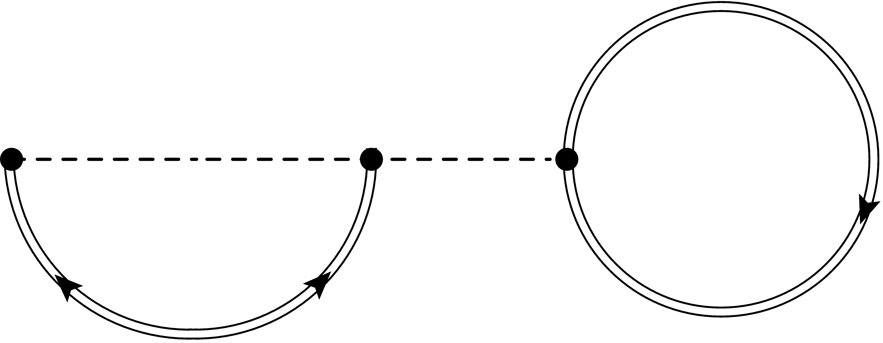
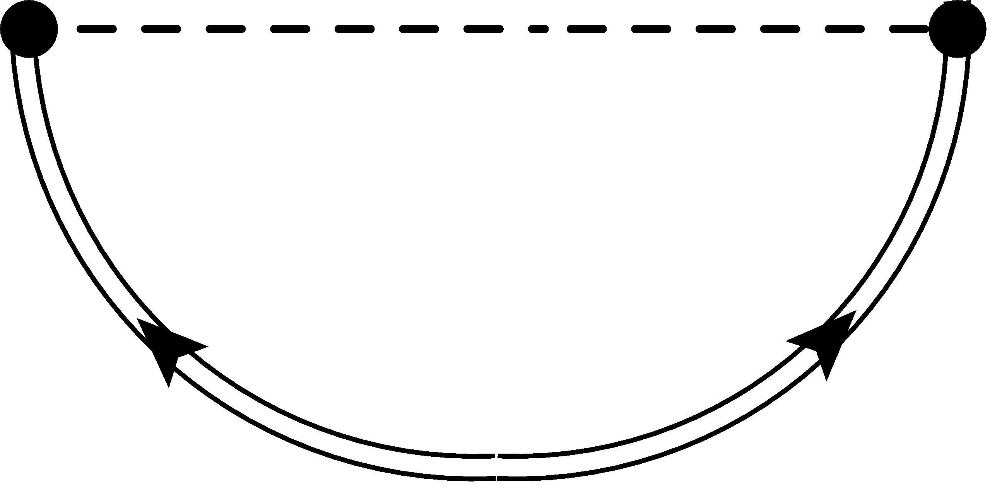
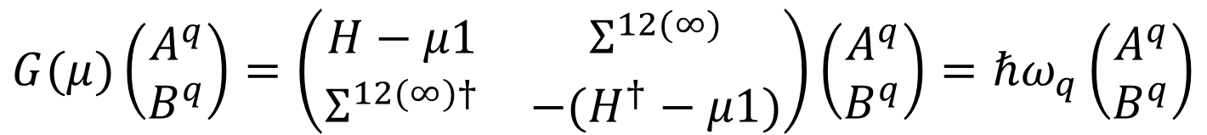
Gorkov correlations
In collaboration with Carlo Barbieri and Gianluca Colò (Milano)
Gorkov approach
Superfluid nuclear matter
Allows to conserve the number of particles
Dyson-ADC(3) dynamical self-energy
+
First-order pairing corrections
Anomalous self-energy
Dyson matrix
Chemical potential
$$G(μ)\left(\begin{matrix}A^{q} \\ B^{q}\end{matrix}\right)=\left(\begin{matrix}H−μ1 & Σ^{12(∞)} \\ Σ^{12(∞)†} & −(H^{†}−μ1)\end{matrix}\right)\left(\begin{matrix}A^{q} \\ B^{q}\end{matrix}\right)=ℏω_{q}\left(\begin{matrix}A^{q} \\ B^{q}\end{matrix}\right)$$
Somà, Phys. Rev. C 84, 064317 (2011)

Slide 8
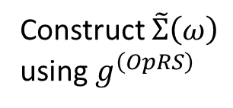
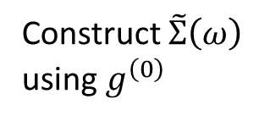



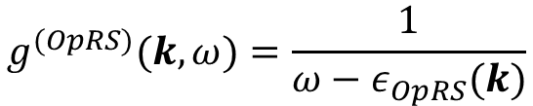





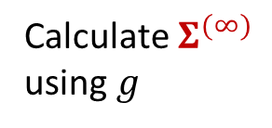
Solution of SCGF equations
Fully self-consistent solution
$$g^{\left(0\right)}(ω)$$
Construct $Σ^{(⋆)}[g]$
$$g(ω)$$
Convergence!
sc0: Iterate only $Σ^{(∞)}$
Construct $\tilde{Σ}\left(ω\right)$ using $g^{\left(0\right)}$
Calculate $Σ^{(∞)}$ using $g$
$$g^{\left(0\right)}(ω)$$
$$g(ω)$$
Convergence!
Barbieri, Lect. Notes Phys. 936, 571 (2017)
sc0 + Optimized reference state (OpRS)
Construct $\tilde{Σ}\left(ω\right)$ using $g^{\left(OpRS\right)}$
$$g^{\left(0\right)}(ω)$$
sc0
Find $g^{OpRS}(ω)$
Convergence!
$$g^{(OpRS)}(k,ω)=\frac{1}{ω−ε_{OpRS}(k)}$$
Barbieri, Phys. Rev. C 79, 064313 (2009)
Marino, PhD thesis (Milano, 2023)
Single-particle energies are adjusted self-consistently

Slide 9
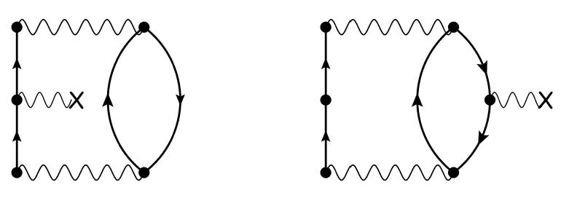

Non-skeleton corrections
When full self-consistency is dropped, additional non-skeleton diagrams
External potential correcting for using an optimized state instead of HF
$${\tilde{U}}^{(1)}=U^{\left(HF\right)}−U^{(OpRS)}$$
Raimondi, Phys Rev C 97, 054308 (2018)
In the following, results for ADC(3) and ADC(3) with non-skeleton corrections

Slide 10
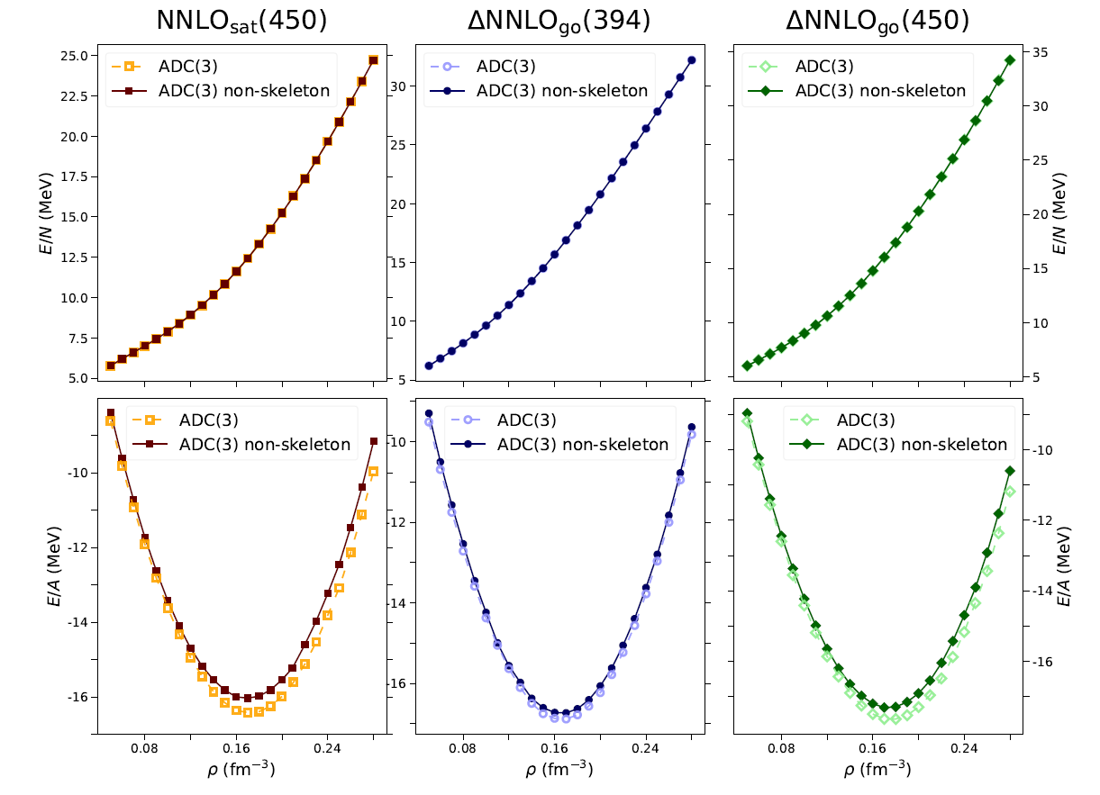
Equations of state
Preliminary!

Slide 11

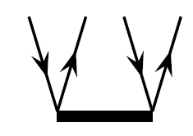

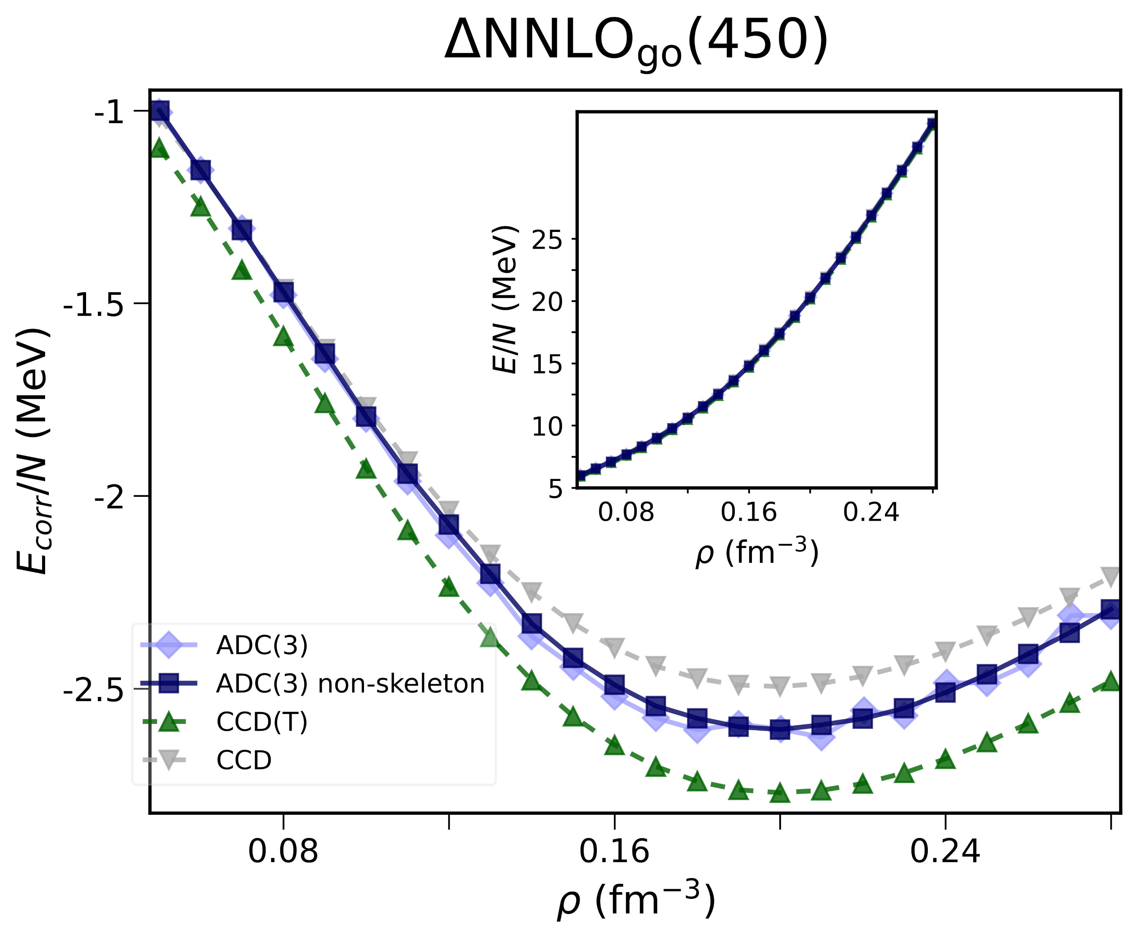
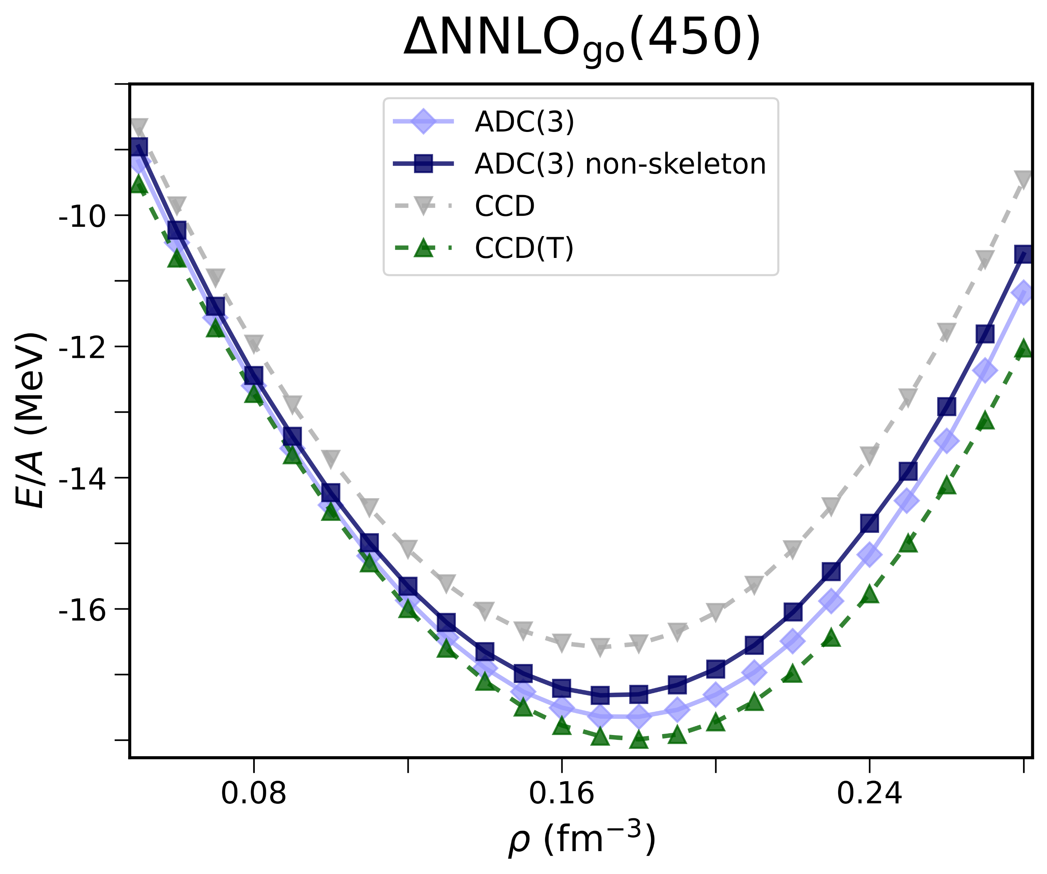



SCGF and coupled-cluster
In collaboration with `
Weiguang Jiang (Mainz)
ADC-SCGF is compared to coupled-cluster (CC) calculations
Sam Novario (St. Louis)
Hagen, Phys. Rev. C 89, 014319 (2014)
$$\left|Ψ\right\rangle =e^{T}|HF⟩$$
CCD → CC at doubles level
CCD(T) → perturbative triples
Correlation energy
Pure neutron matter
Symmetric nuclear matter
$$E_{corr}=E−E_{HF}$$
EOS
Preliminary!
Notes:
PNM e uno di SNM, SCGF e CC. Rivedere figura SNM

Slide 12
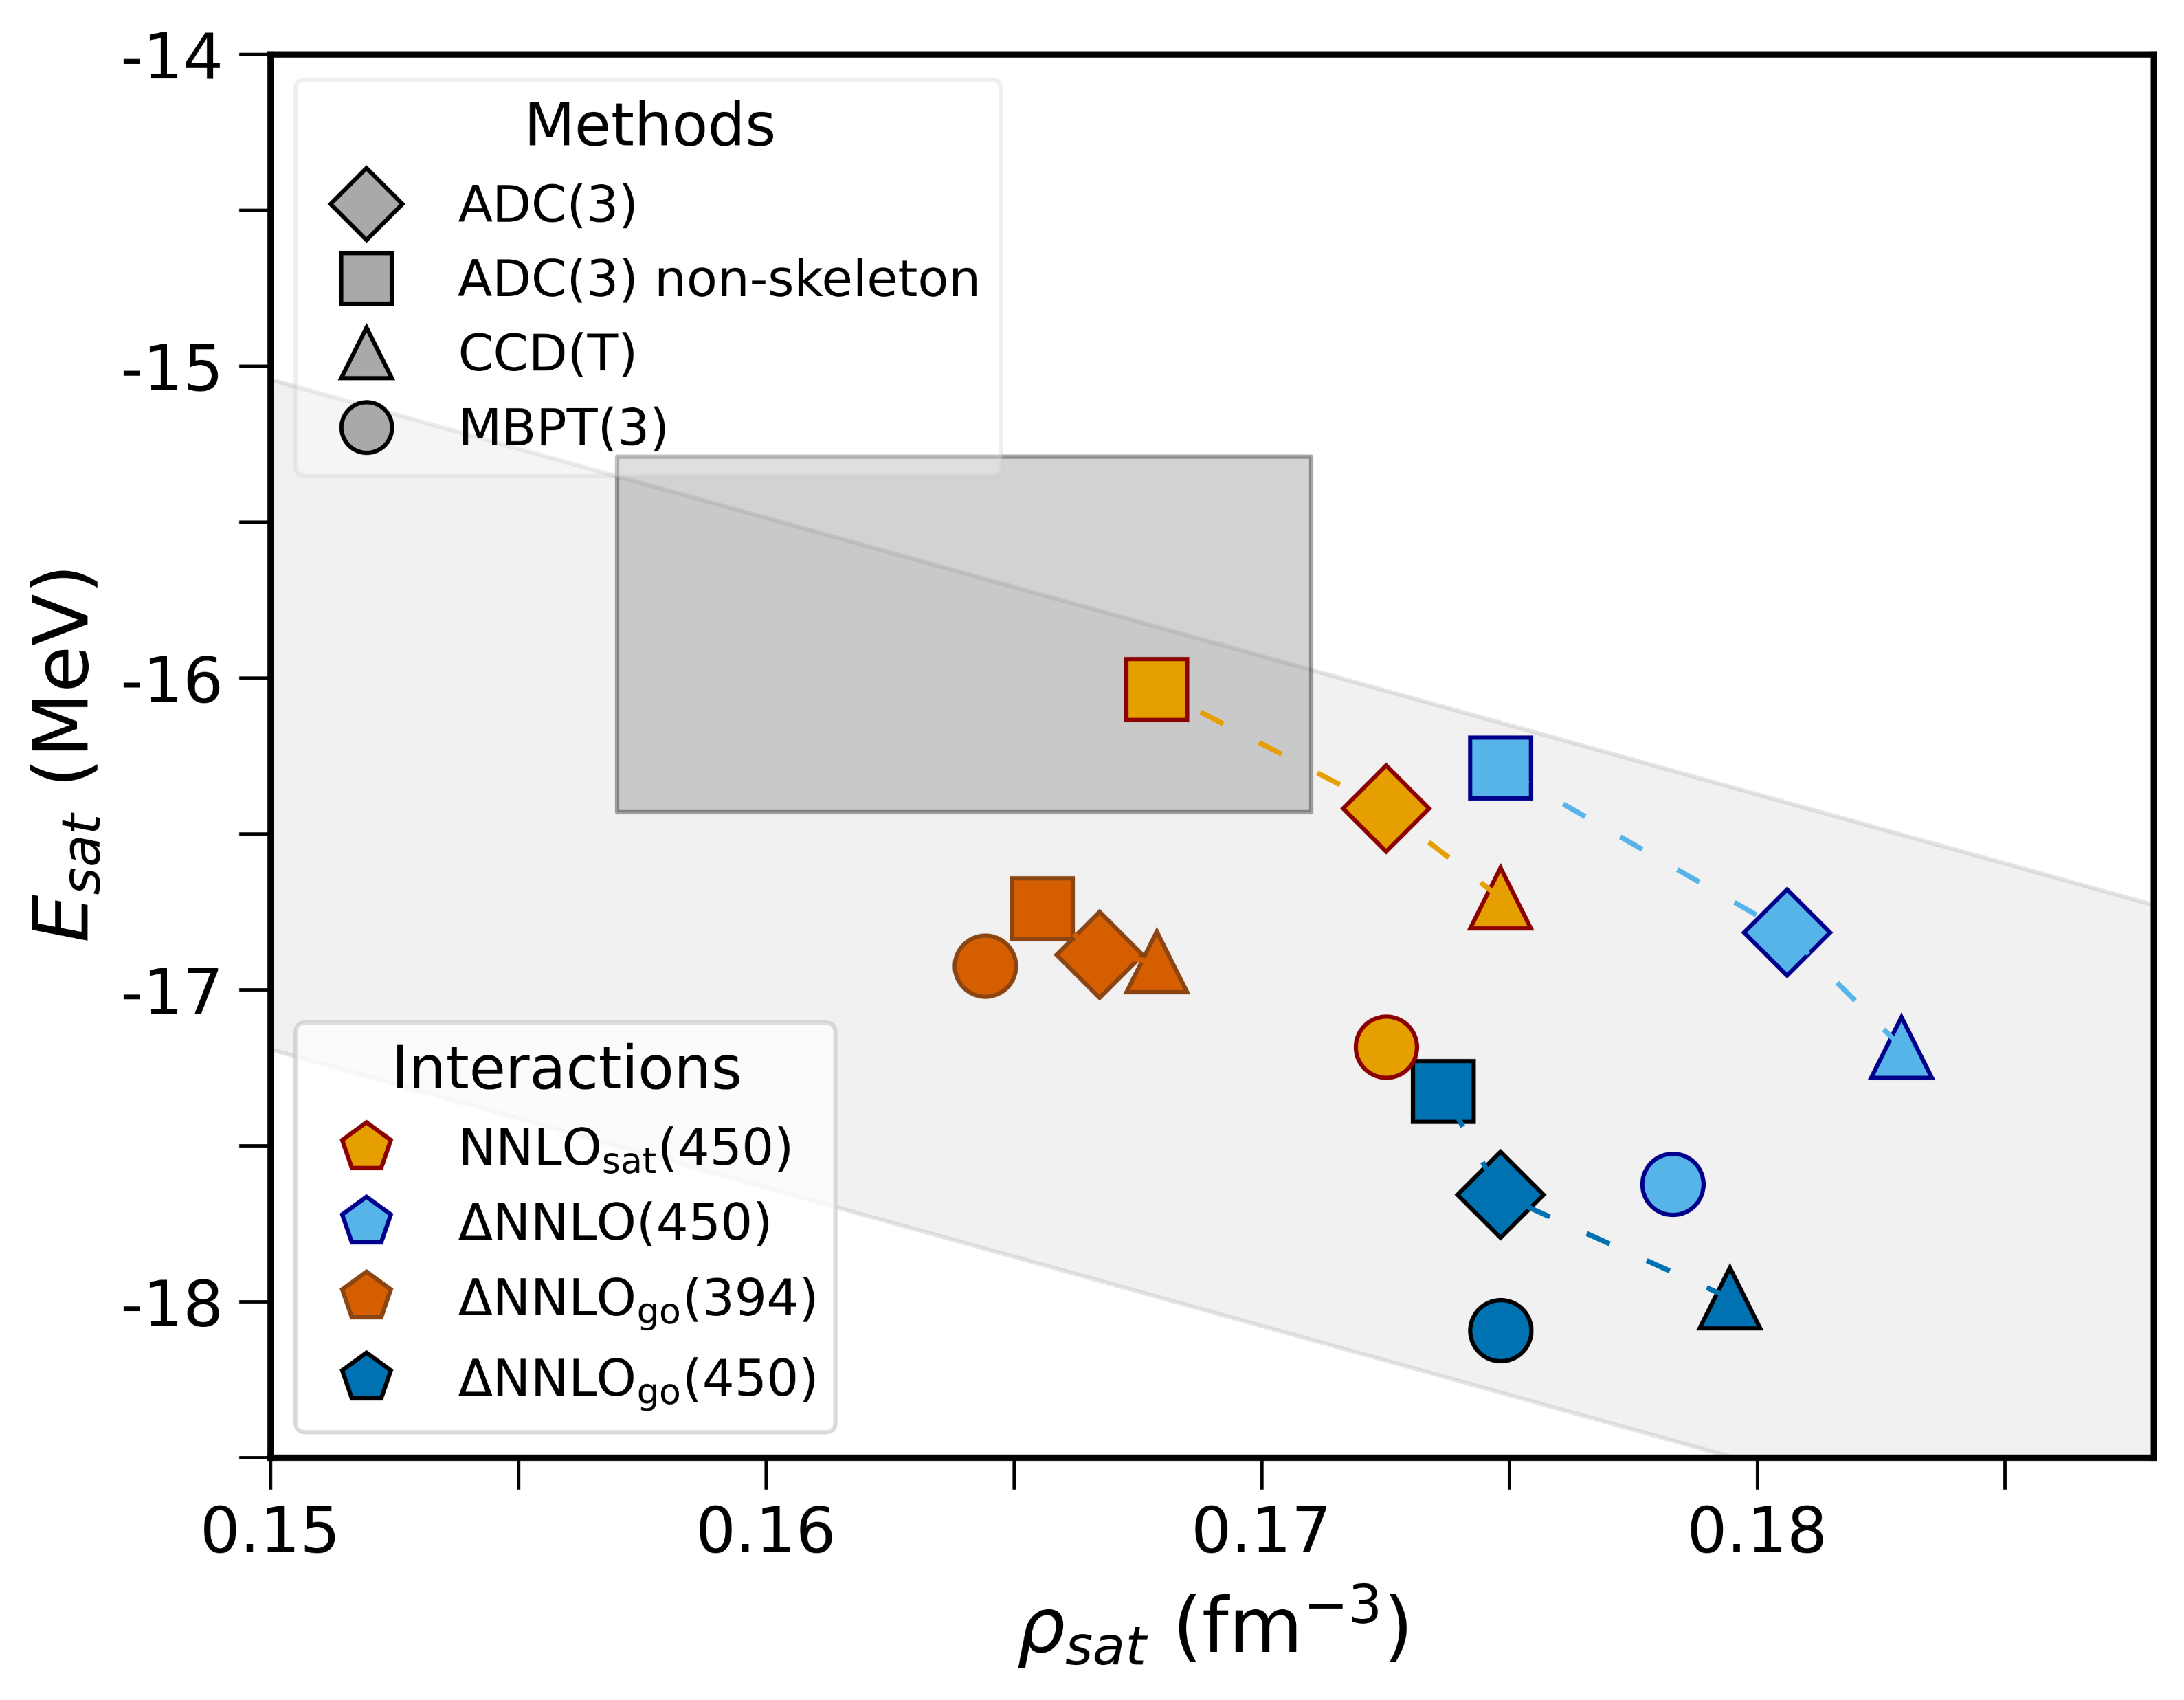
Saturation point of symmetric nuclear matter
MBPT → perturbation theory
Empirical saturation point
Linear correlation between saturation density and energy
Preliminary!
Notes:
Rivedere figura

Slide 13
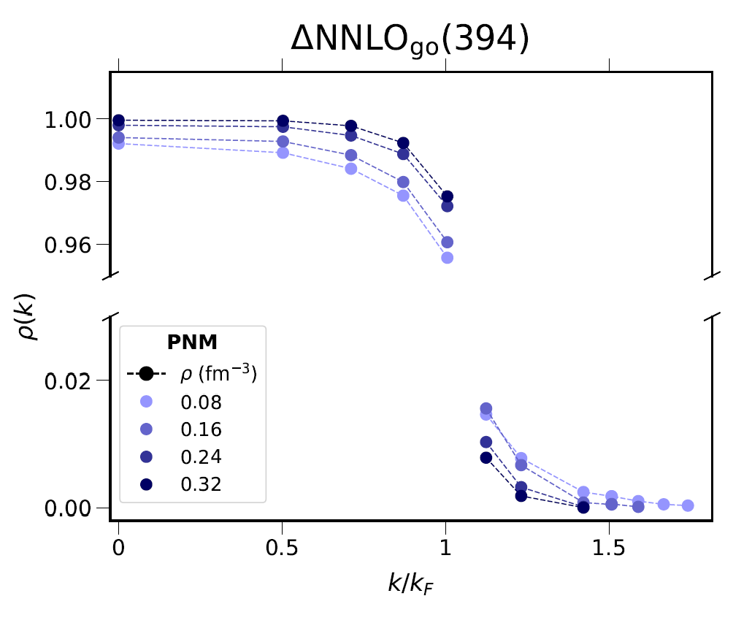
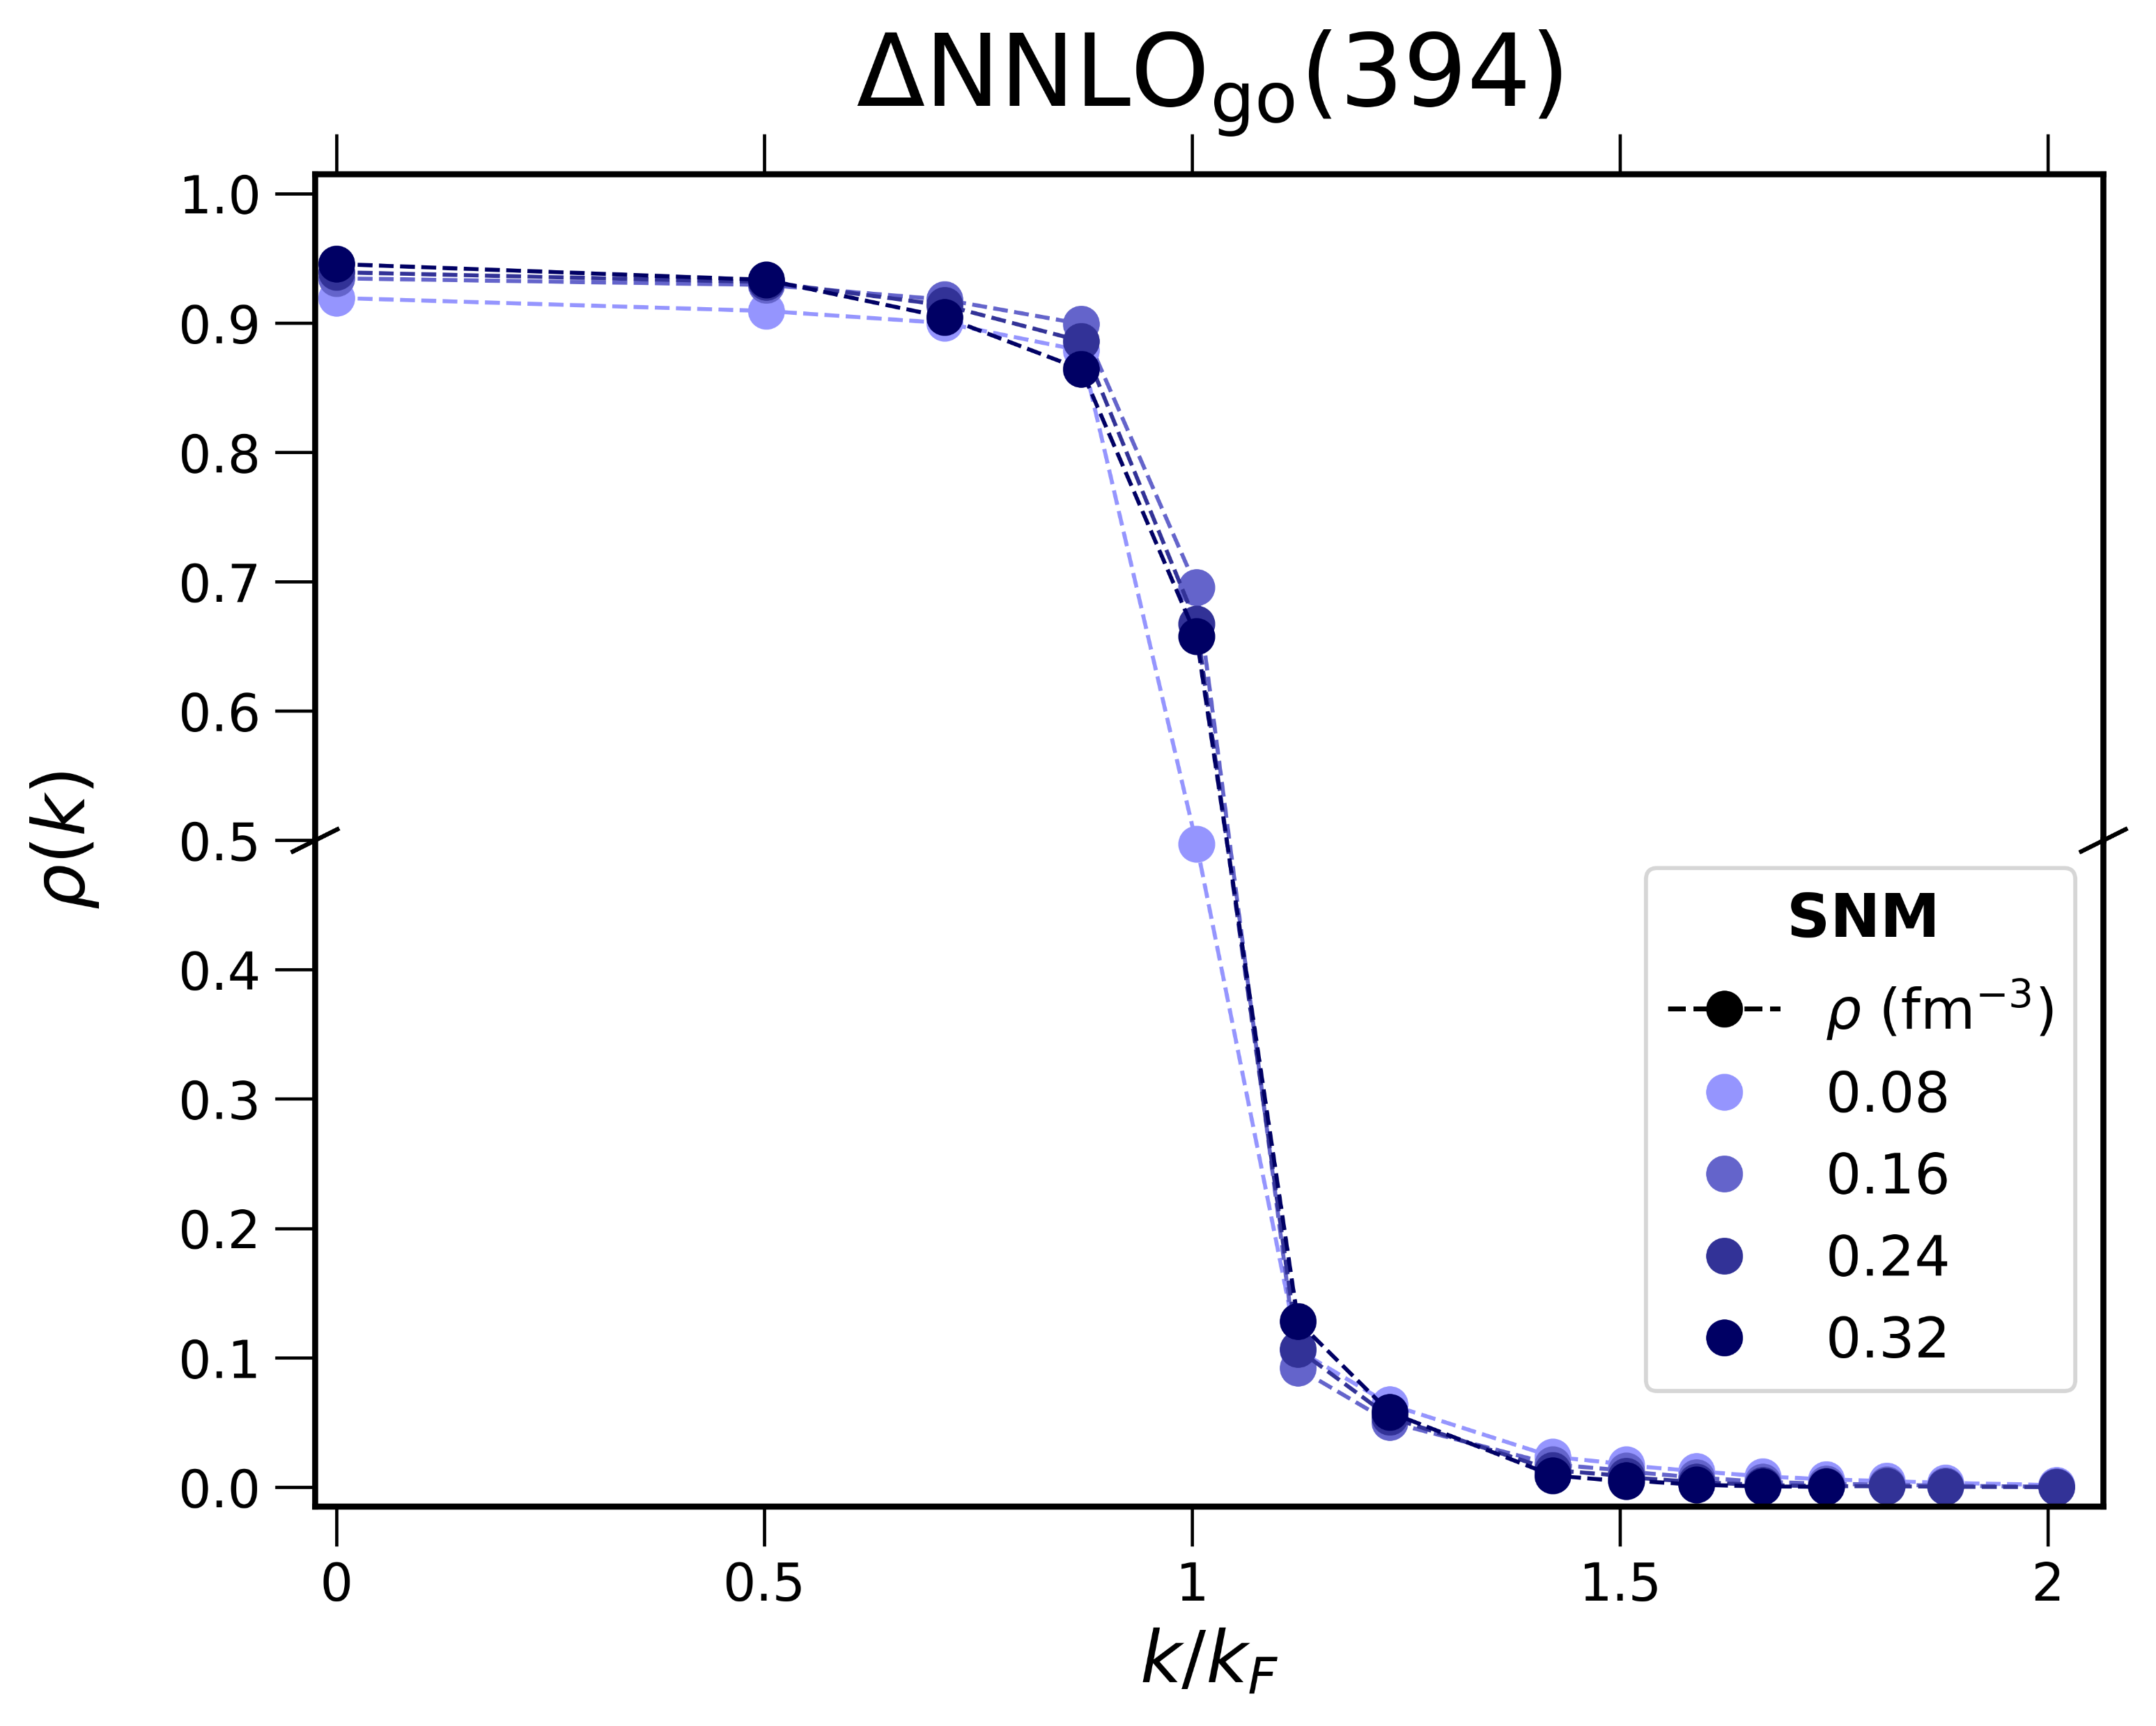
Momentum distributions
Discontinuity at the Fermi surface
High-momentum tail
BCS-like distribution?
Preliminary!

Slide 14
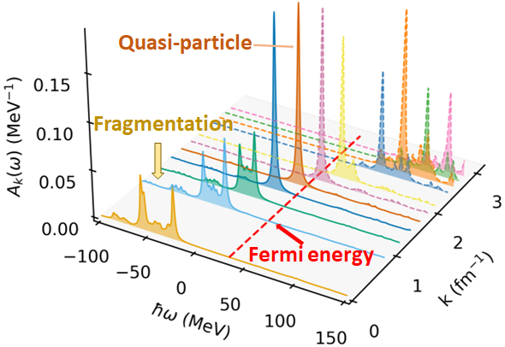
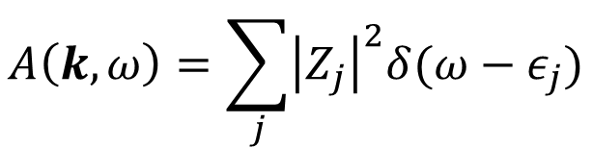

Spectral functions 1
Spectral function
$$A\left(k,ω\right)=\sum_{j}{{\left|Z_{j}\right|}^{2}δ(ω−ε_{j})}$$
PNM, $ρ_{0}=0.16$ fm⁻³ , N=66, NNLO_{sat}

Slide 15
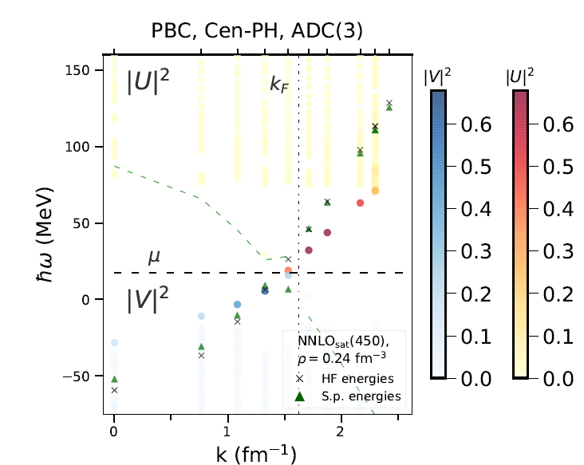

Spectral functions 2
Periodic boundary conditions
Twist-averaged boundary conditions
Particle peaks
Mixed particle - hole character
Hole peaks
SNM, $ρ_{0}=0.16$ fm⁻³ , A=132, NNLO_{sat}

Slide 16
Conclusions and perspectives - SCGF
We have developed a SCGF approach based on the algebraic diagrammatic construction [ADC(3)] that incorporates pairing correlations for homogeneous nuclear matter
The EOS, momentum distributions and spectral functions have been studied
In preparation:
F. Marino, C. Barbieri and G. Colò → methodological paper
F. Marino, W. Jiang, S. Novario et al. → comparison SCGF/coupled-cluster/MBPT(3)
Perspective: dynamical response functions from the polarization propagator

Slide 17


Thank you for your attention!
Collaborators
Argonne: Alessandro Lovato
Mainz: Sonia Bacca, Francesca Bonaiti, Weiguang Jiang
Milano: Carlo Barbieri, Gianluca Colò, Xavier Roca-Maza, Enrico Vigezzi
Trento: Francesco Pederiva

Slide 18
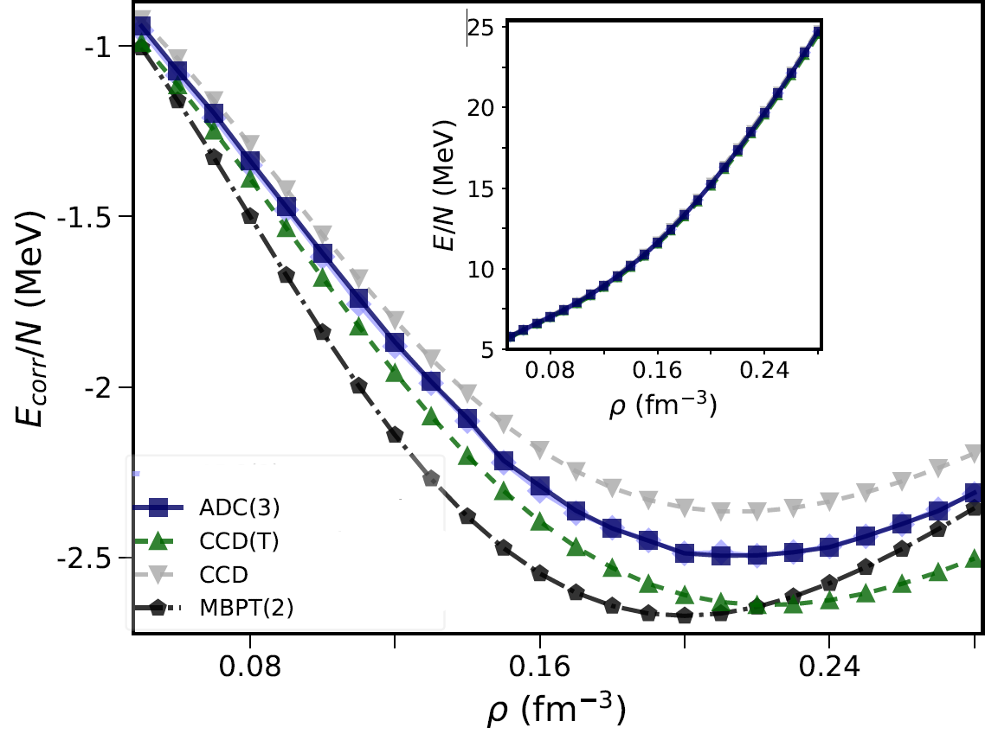
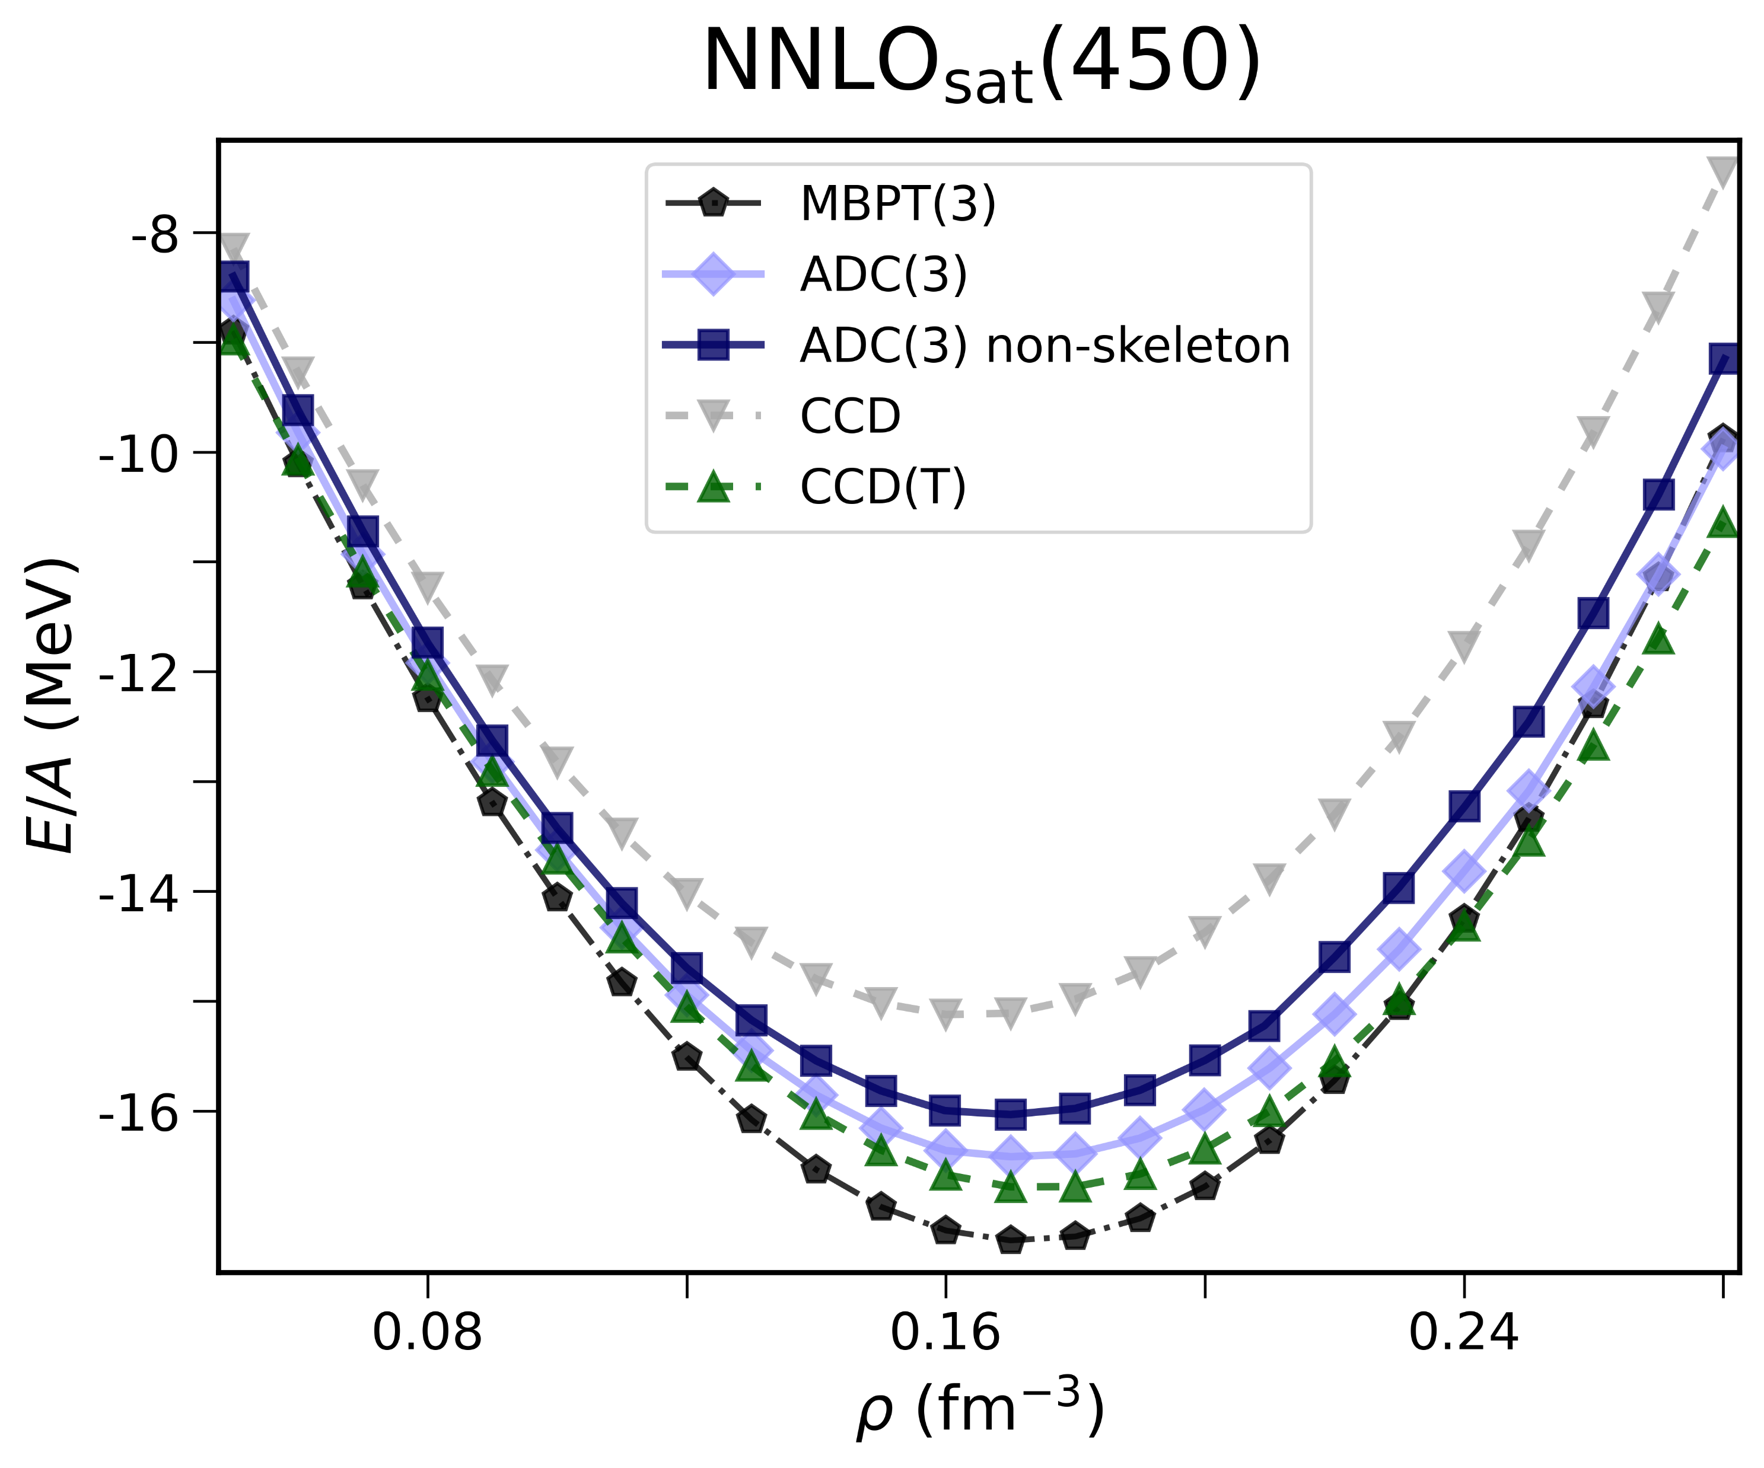


SCGF and coupled-cluster - NNLO_{sat}
ADC-SCGF is compared to coupled-cluster (CC) calculations
Hagen, Phys. Rev. C 89, 014319 (2014)
MBPT → perturbation theory
CCD → CC at doubles level
CCD(T) → perturbative triples
Correlation energy
Pure neutron matter
Symmetric nuclear matter
$$E_{corr}=E−E_{HF}$$
EOS
Preliminary!

