Slide 1

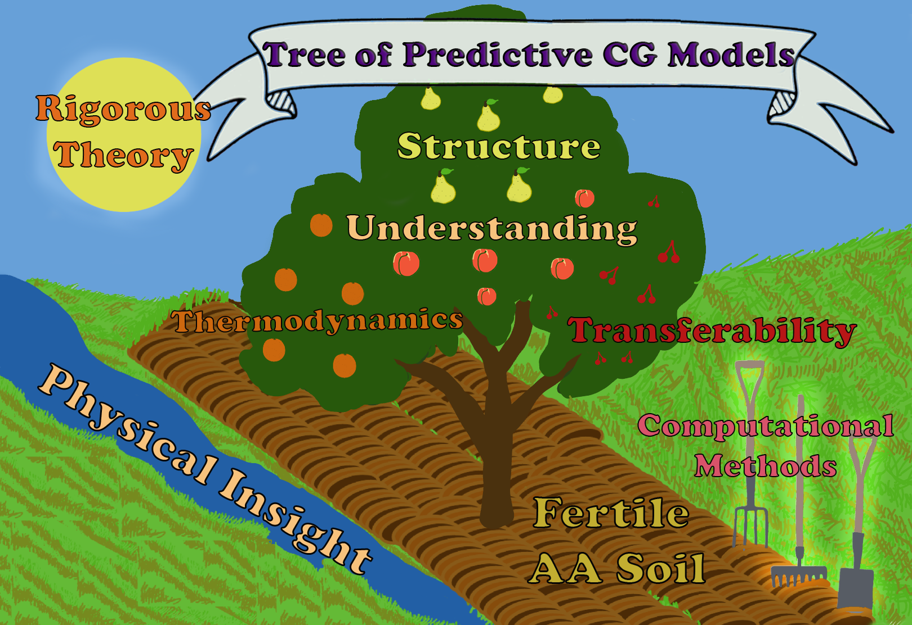
Exploring the landscape of model representations
W. G. Noid
Bridging scales: At the crossroads among renormalisation groups, multi-scale modelling, and deep learning
ECT*
Trento, Italy
18 April 2024
M. Lesniewski
Noid J Phys Chem B 2023

Slide 2
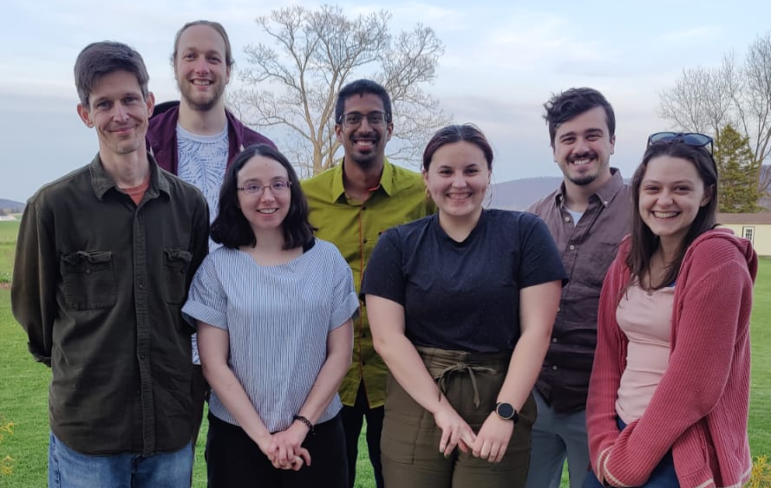

Acknowledgements
Current Members
Katie Kidder
Maria Lesniewski
Lucus Mussi
Sanchay Agarwal
Ben Curlee
Prof. M. Scott Shell Alumni
Ryan Szukalo
Kathleen Krist
Varun Mandalaparthy
Michael DeLyser
Kathryn Lebold
Thomas Foley
(UCSB)
Nick Dunn
Joe Rudzinski
Chris Ellis
Sushant Kumar
(Wayne Mullinax)
BOCS: Bottom-up Open-source Coarse-graining Software
Dunn, Lebold, Delyser, Rudzinski, Noid JPCB 2018
https://github.com/noid-group/BOCS

Slide 3
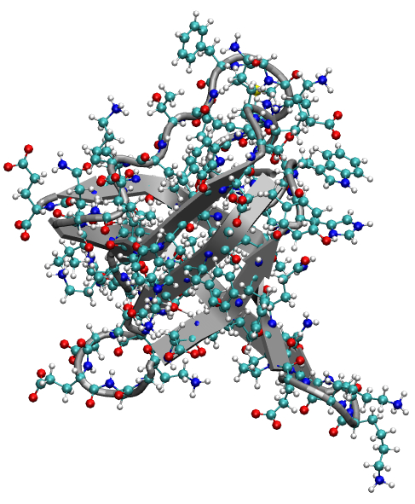
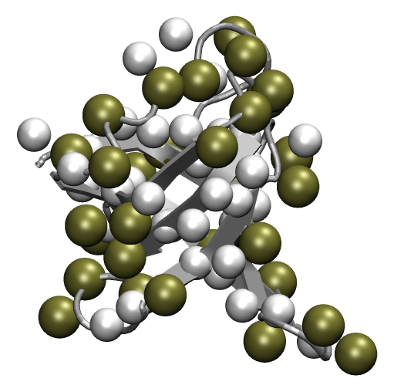
Multiscale Nature of Soft Materials
Polypeptide Collapse
3º Structure Formation
Peptide Bond Rotation
2º Structure Formation
Sidechain Rotation
Allosteric Transitions
Bond Vibrations
Coupled Folding-Binding
Aggregation/Amyloidosis
10⁻¹⁵s
10⁻¹²s
10⁻⁹s
10⁻⁶s
10⁻³s
10⁰s
10³s
“Fundamental
principles”
Emergent
Phenomena
Separation in time scales between atomistic vibrations and emergent phenomena of interest motivate coarse-grained models.

Slide 4
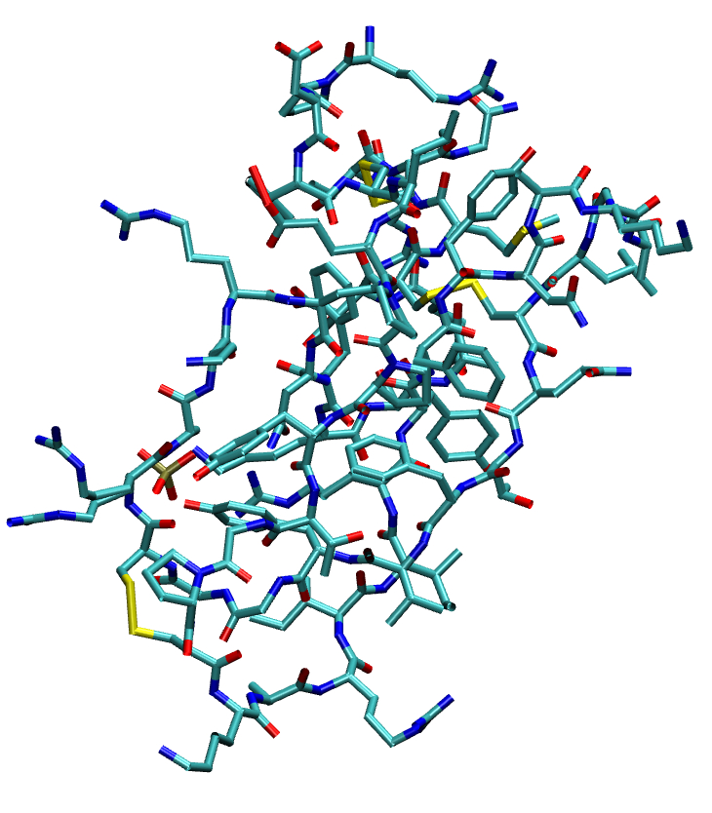
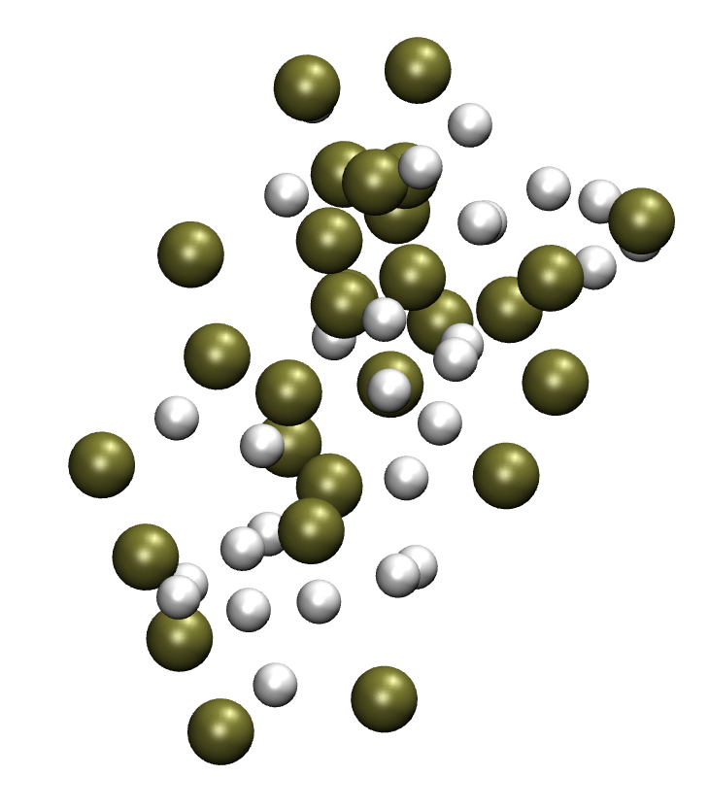
Coarse-grained (CG) Mapping
Atomistic
CG
Mapping
Operator
Noid, Chu, …, Voth, Andersen
J Chem Phys (2008)
The mapping operator transforms an atomistic configuration onto a CG configuration by defining the coordinates of each site as a linear combination of the atomic coordinates associated with the site.

Slide 5
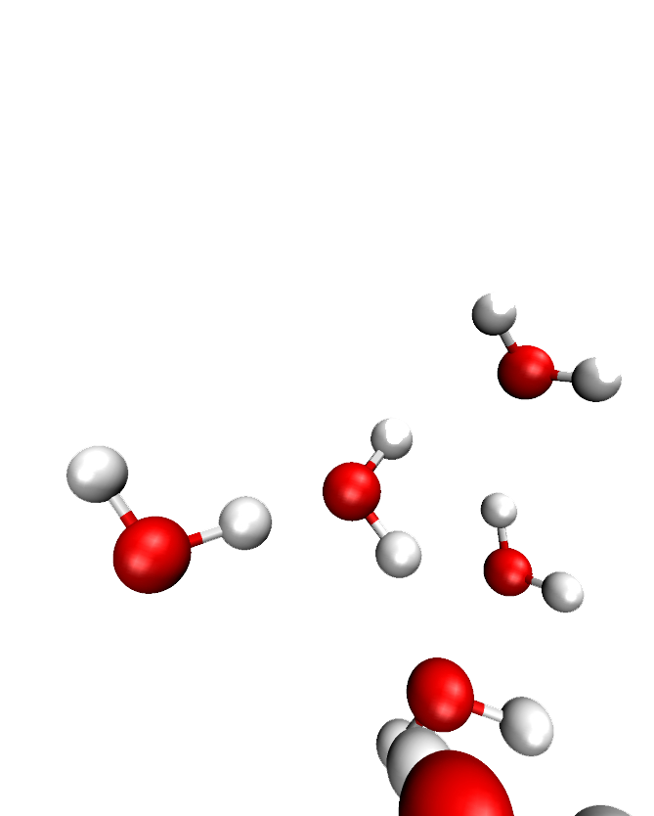
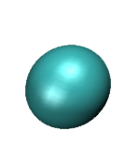
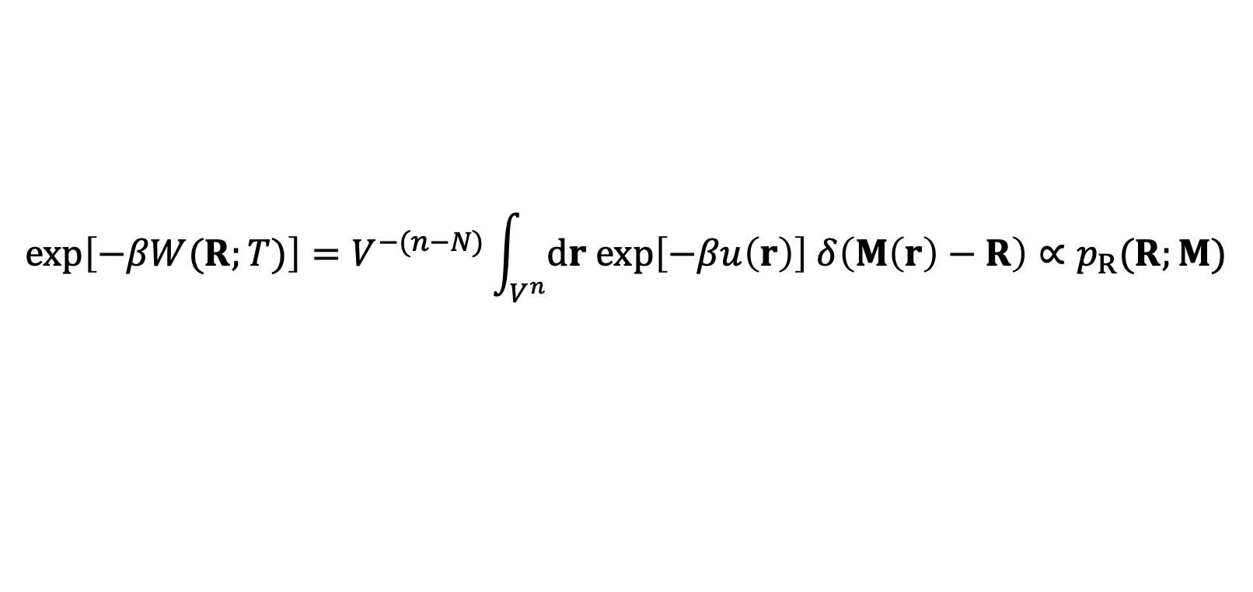
Effective potential: Kadanoff block Hamiltonian
Atomistic Configuration Space
CG Configuration Space
$$\exp\left[−βW(R;T)\right]=V^{−(n−N)}\int_{V^{n}}{dr exp\left[−βu\left(r\right)\right] δ\left(M\left(r\right)−R\right)}∝p_{R}(R;M)$$
The effective potential (PMF) = Kadanoff block-spin Hamiltonian (RG)
= exact energy for generative models (ML)
= a really hard free energy calculation (enhanced sampling)
Kirkwood JCP 1935
Likos Phys Rep 2001
Briels; Scheraga JCP 2001

Slide 6
Coarse-graining perspective
R. Potestio
Giulini et al, Front. Mol. Biosci. 2021
Noid J. Chem. Phys. 2013

Slide 7
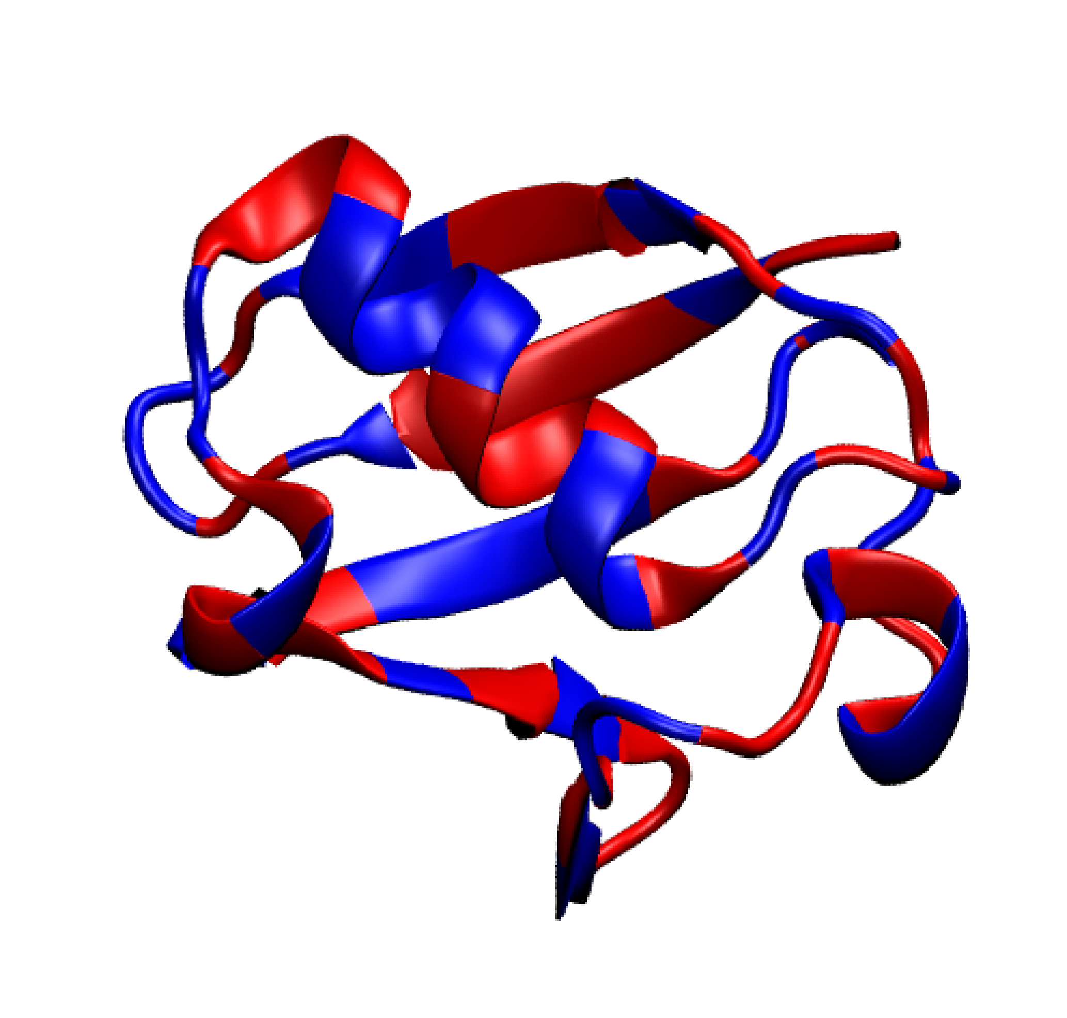
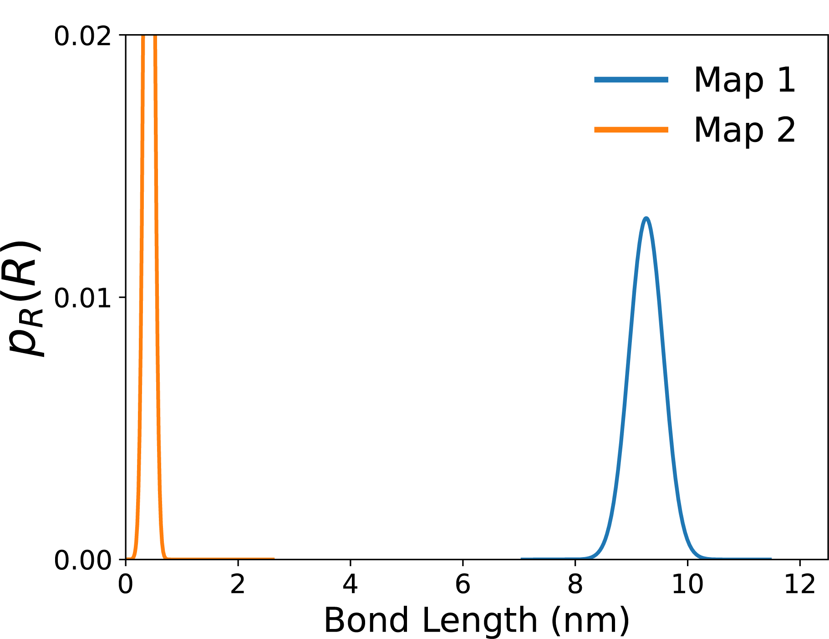
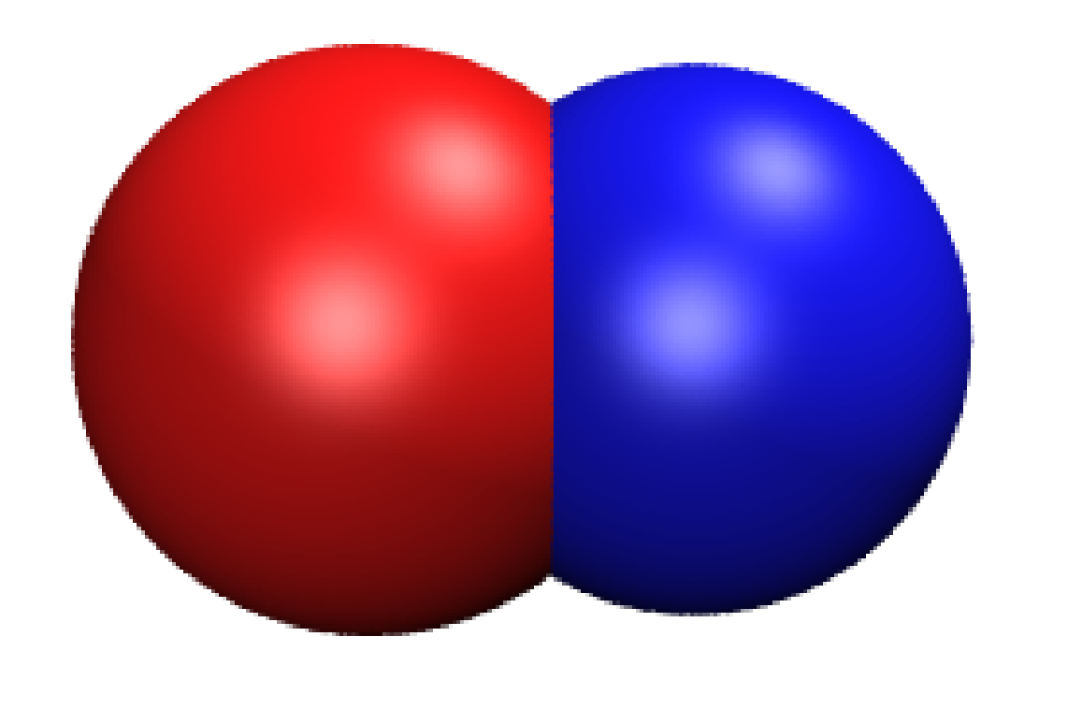
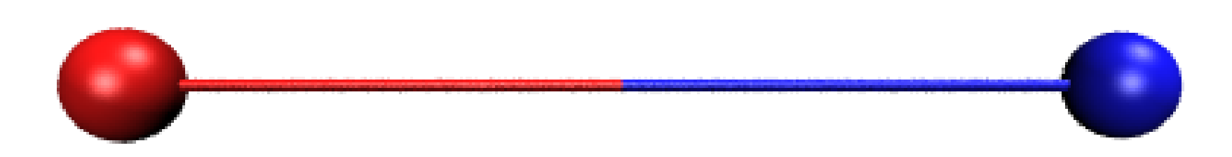
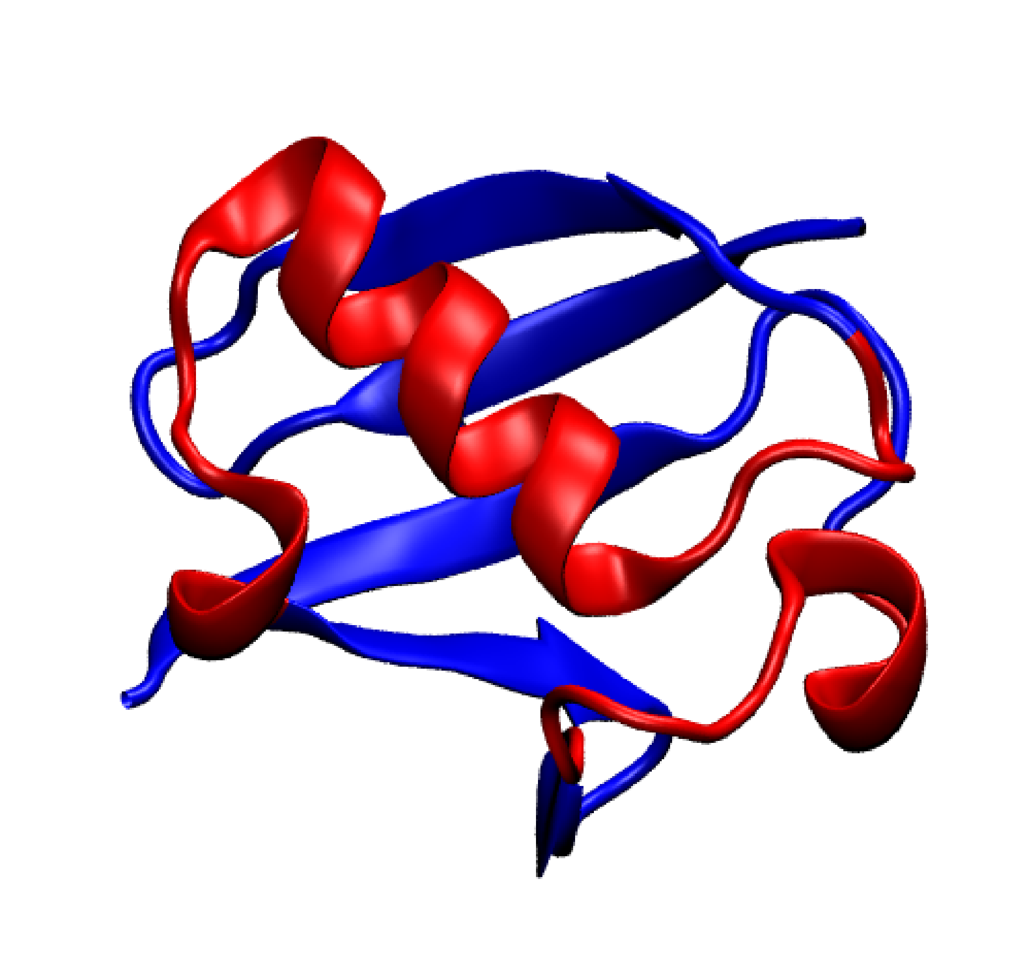
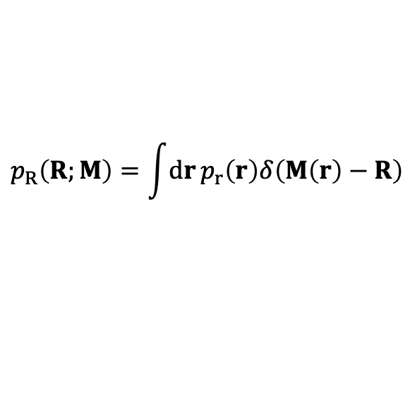
Mapped Ensembles
Map 1
$$p_{R}\left(R;M\right)=\int{dr}p_{r}\left(r\right)δ\left(M\left(r\right)−R\right)$$
Map 2
The mapping profoundly impacts the CG model.
Kidder, Szukalo, Noid EPJB 2021

Slide 8
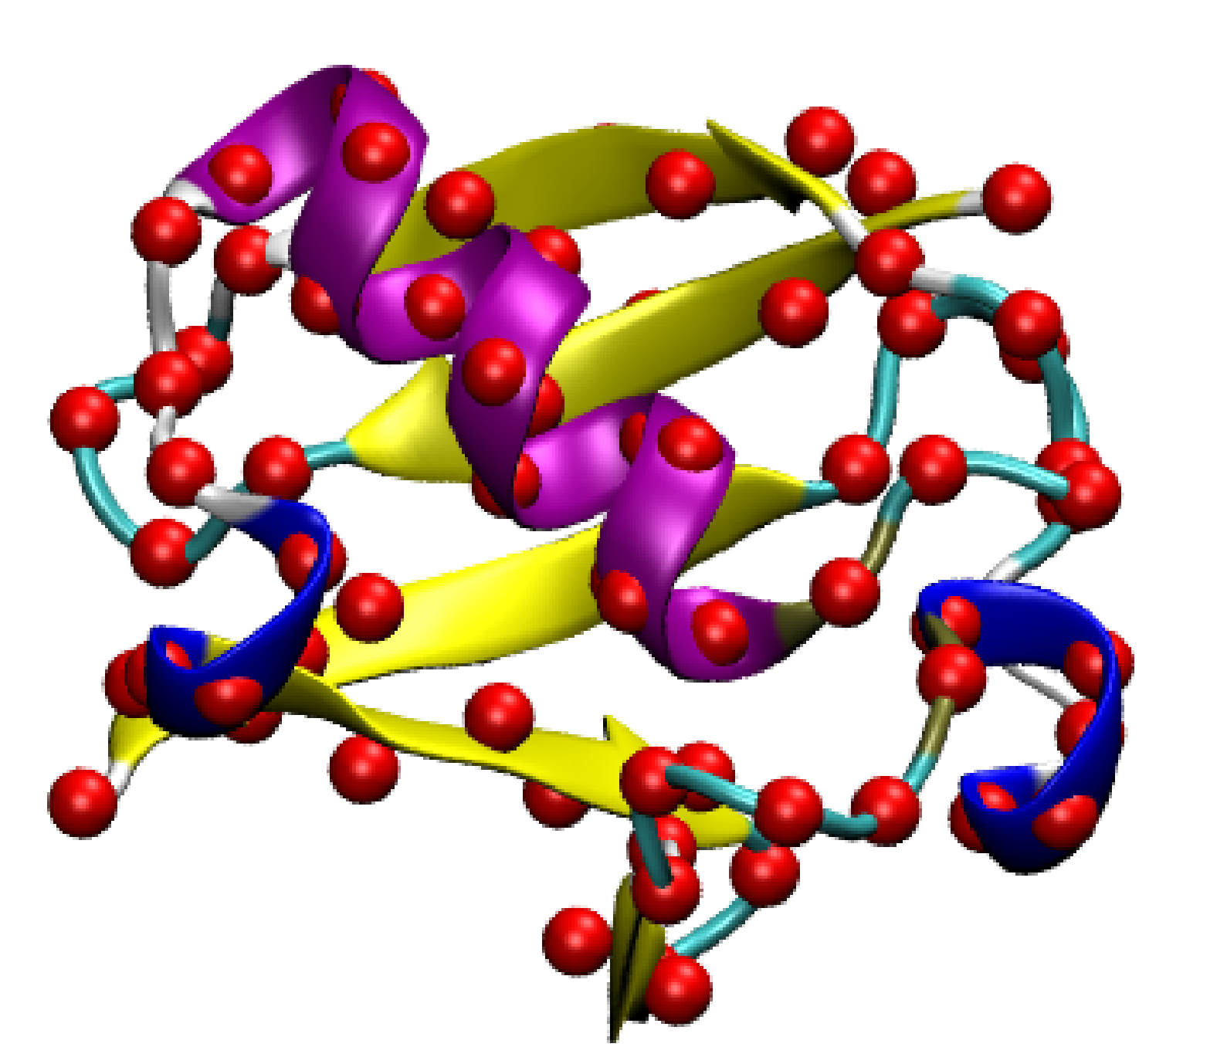
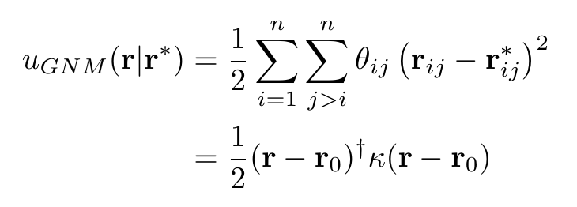
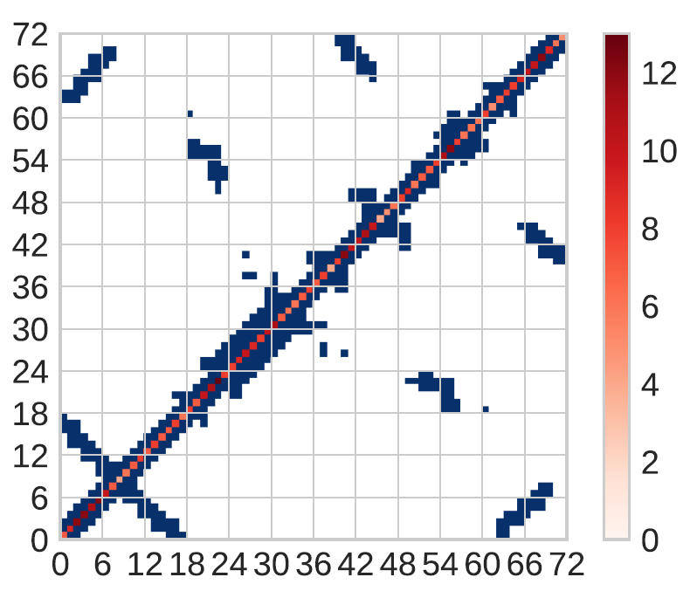
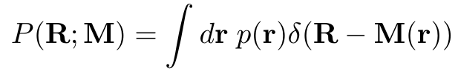


Gaussian Network Model
$$κ_{ij}=n_{i}δ_{ij}−θ_{ij}$$
Mapped Ensemble:
Mapped Distribution
Flory, Gordon, McCrum Proc. Roy. Soc. Lond. A: Math. Phys. Sci 1976
Haliloglu, Bahar, Erman Phys Rev Lett 1997
Foley, Shell, Noid JCP 2015
Foley, Kidder, Shell, Noid PNAS 2020
Kidder, Shell, Noid JCP 2024

Slide 9
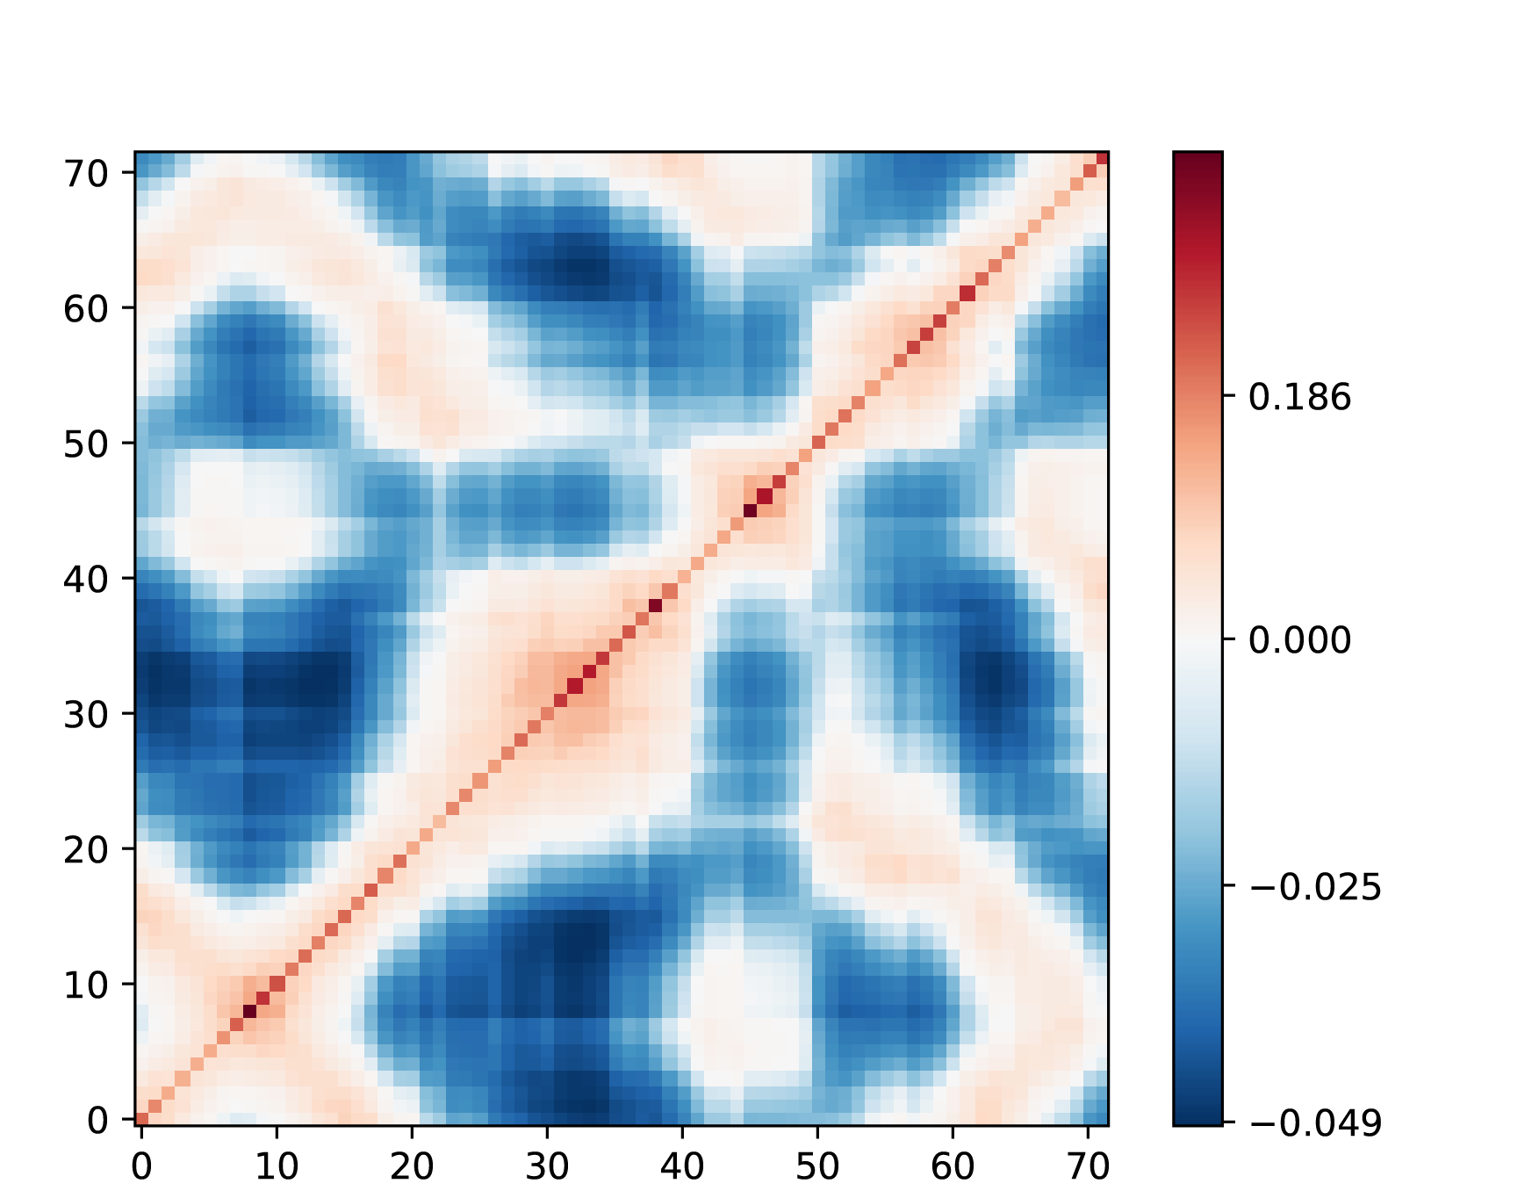
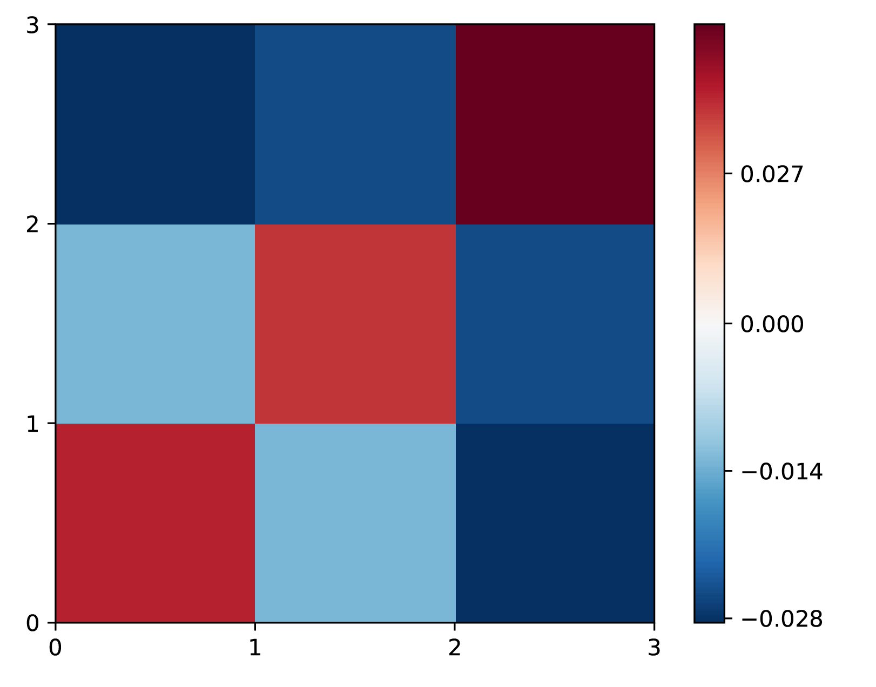
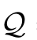

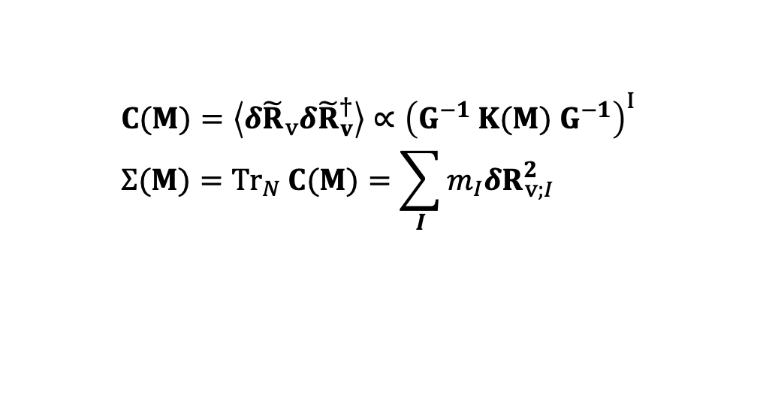
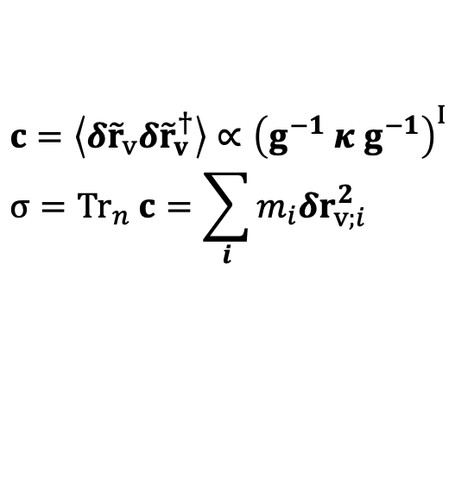
Metrics for CG maps: Spectral quality
Atomistic Model:
$$c=\left\langle δ{\tilde{r}}_{v}{δ\tilde{r}}_{v}^{†}\right\rangle ∝{\left(g^{−1} κ g^{−1}\right)}^{I} \\ σ={Tr}_{n} c=\sum_{i}{m_{i}δr_{v;i}^{2}}$$
Atom Index
CG Model:
Atom Index
$$C(M)=\left\langle δ{\tilde{R}}_{v}{δ\tilde{R}}_{v}^{†}\right\rangle ∝{\left(G^{−1} K(M) G^{−1}\right)}^{I} \\ Σ(M)={Tr}_{N} C(M)=\sum_{I}{m_{I}δR_{v;I}^{2}}$$
CG Site Index
Spectral Quality:
$$Q=Q\left(M\right)=\frac{Σ\left(M\right)}{σ}=\frac{{Tr}_{N}ℚ_{N}GMκ^{I}M^{†}Gℚ_{N}}{{Tr}_{n}ℚ_{n}gκ^{I}gℚ_{n}}$$
(Rayleigh quotient)
CG Site Index
We expect that we should preserve large-scale motions, i.e., max
Foley, Kidder, Shell, Noid PNAS 2020
Kidder, Shell, Noid JCP 2024

Slide 10
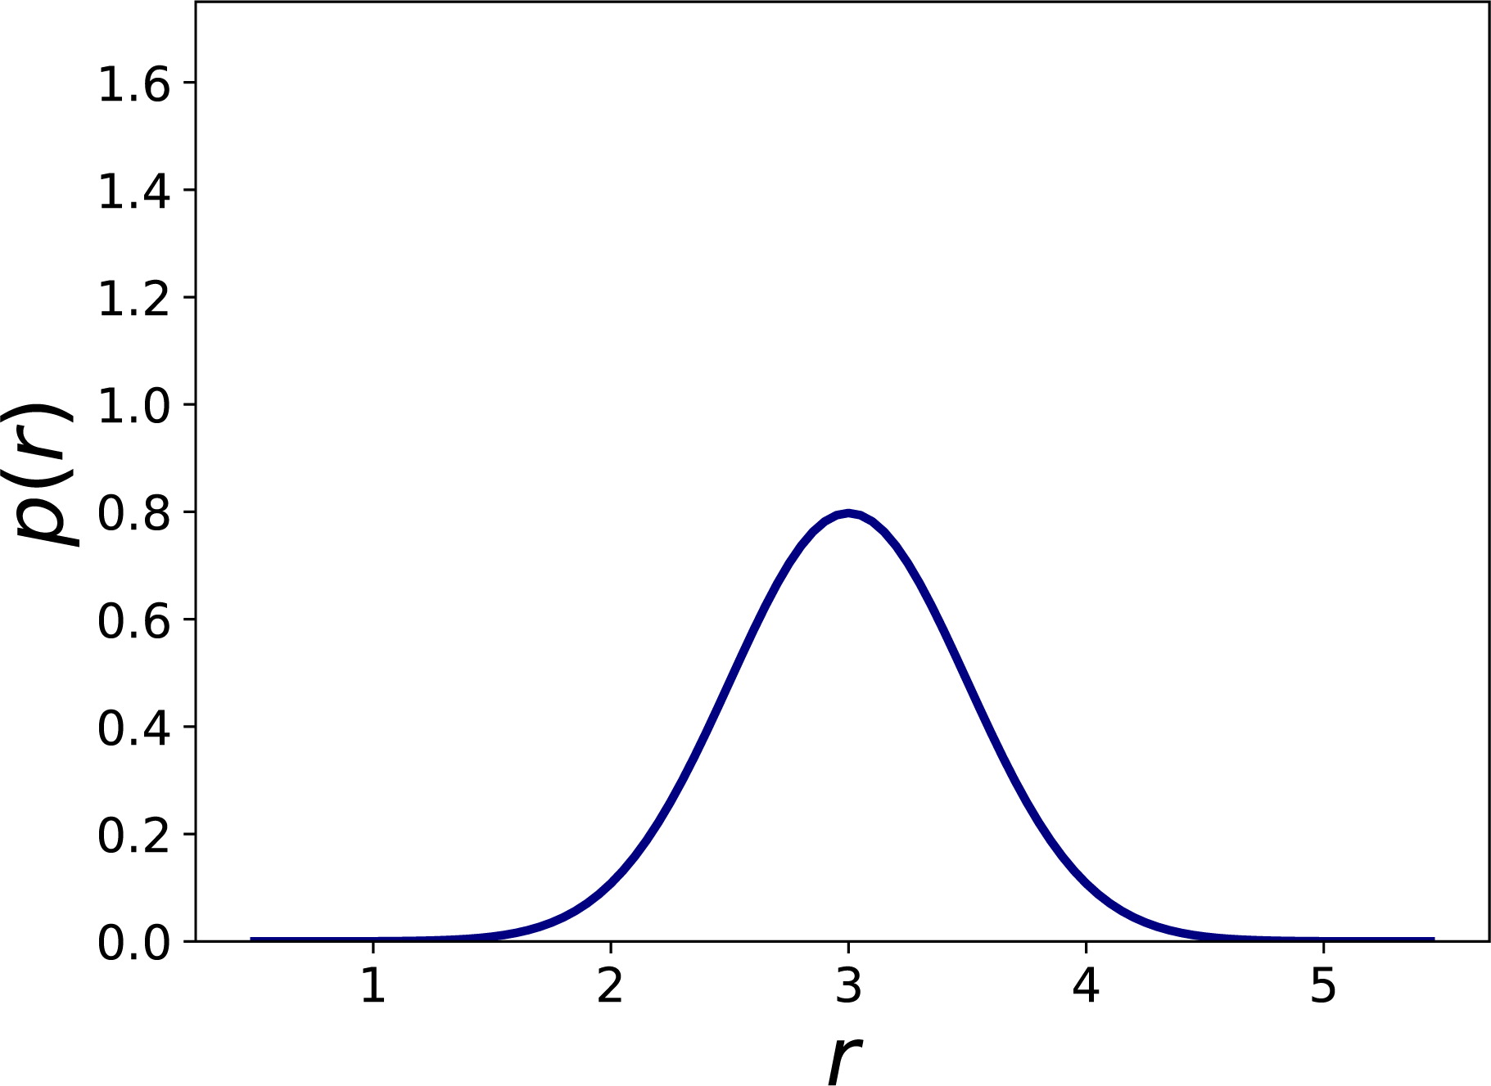
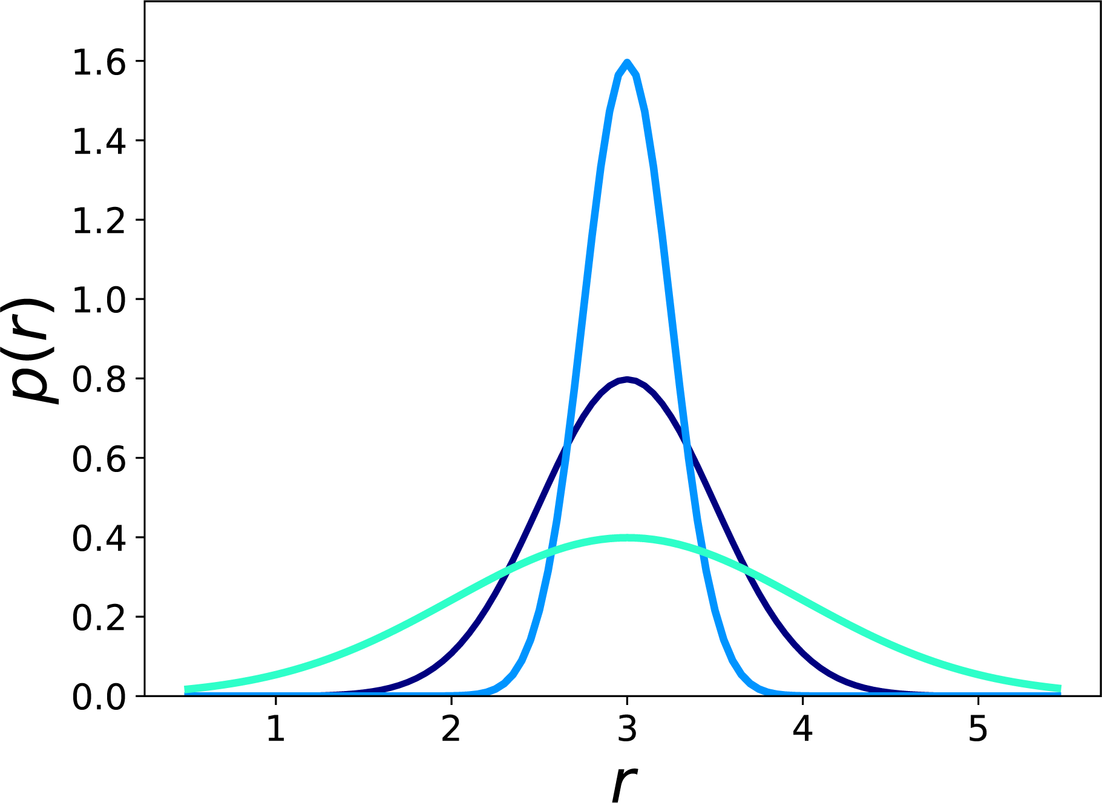

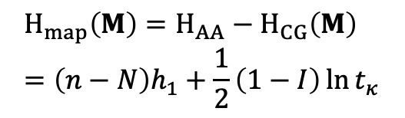
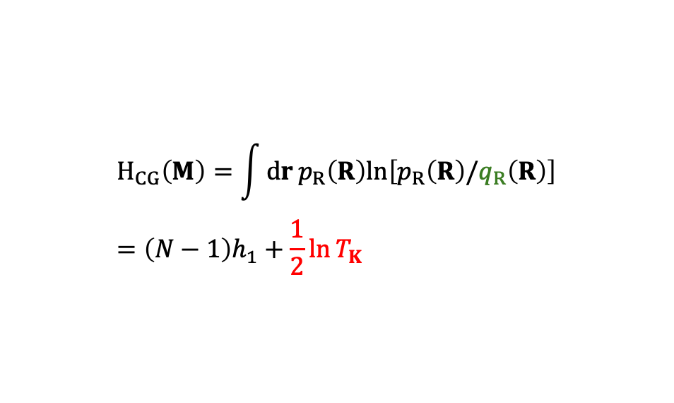
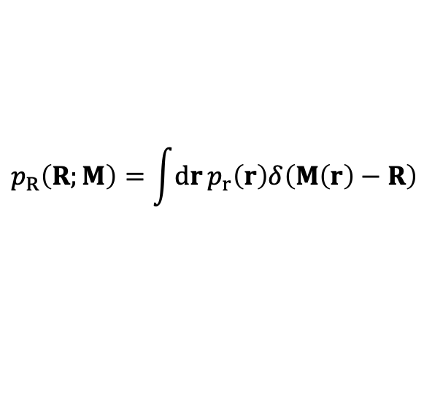

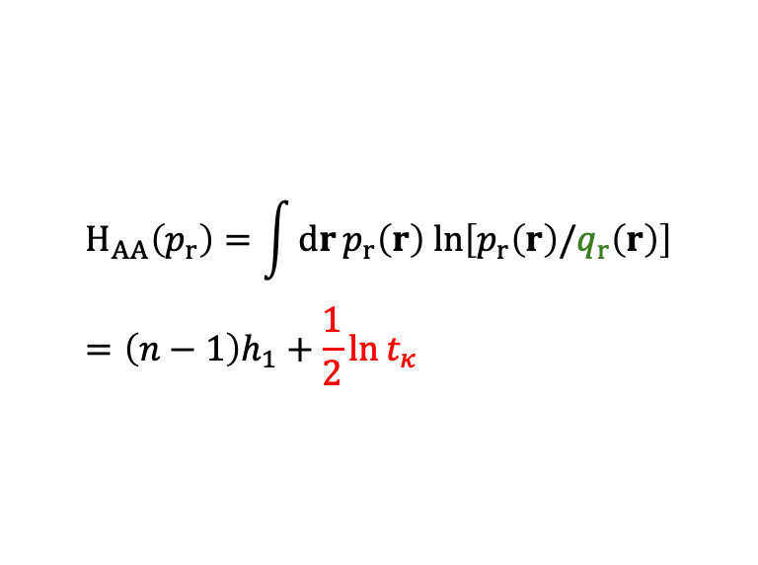


Metrics for CG maps: Information content
$$p_{R}\left(R;M\right)=\int{dr}p_{r}\left(r\right)δ\left(M\left(r\right)−R\right)$$
$$H_{CG}\left(M\right)=\int{dr}p_{R}\left(R\right)ln\left[p_{R}\left(R\right)/q_{R}\left(R\right)\right] \\ =\left(N−1\right)h_{1}+\frac{1}{2}\ln{T_{K}}$$
$$T_{K}=N^{−1}\det{K}\left(M\right)$$
$$q_{r}$$
$$H_{map}\left(M\right)=H_{AA}−H_{CG}\left(M\right) \\ =\left(n−N\right)h_{1}+\frac{1}{2}\left(1−I\right)\ln{t_{κ}}$$
$$H_{AA}\left(p_{r}\right)=\int{dr}p_{r}\left(r\right) ln\left[p_{r}\left(r\right)/q_{r}\left(r\right)\right] \\ =\left(n−1\right)h_{1}+\frac{1}{2}\ln{t_{κ}}$$
$$t_{κ}=n^{−1}\det{κ}$$
$$I\left(M\right)=\ln{T_{K}/\ln{t_{κ}}}$$
Foley, Shell, Noid JCP 2015
Foley, Kidder, Shell, Noid PNAS 2020
Kidder, Shell, Noid JCP 2024
We seek to preserve information, i.e., max $I$ and min $H_{map}$.

Slide 11
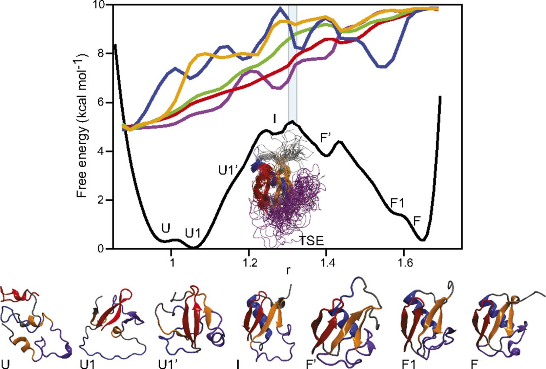

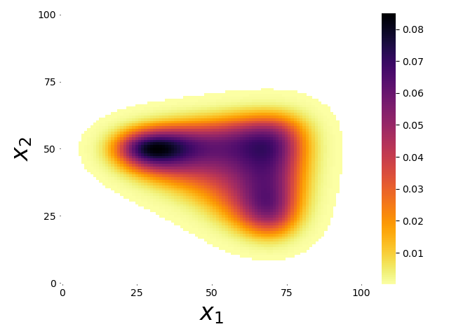


Configuration space
$$p(x_{1},x_{2})$$
Configuration space considers the possible arrangements of the molecule

Slide 12
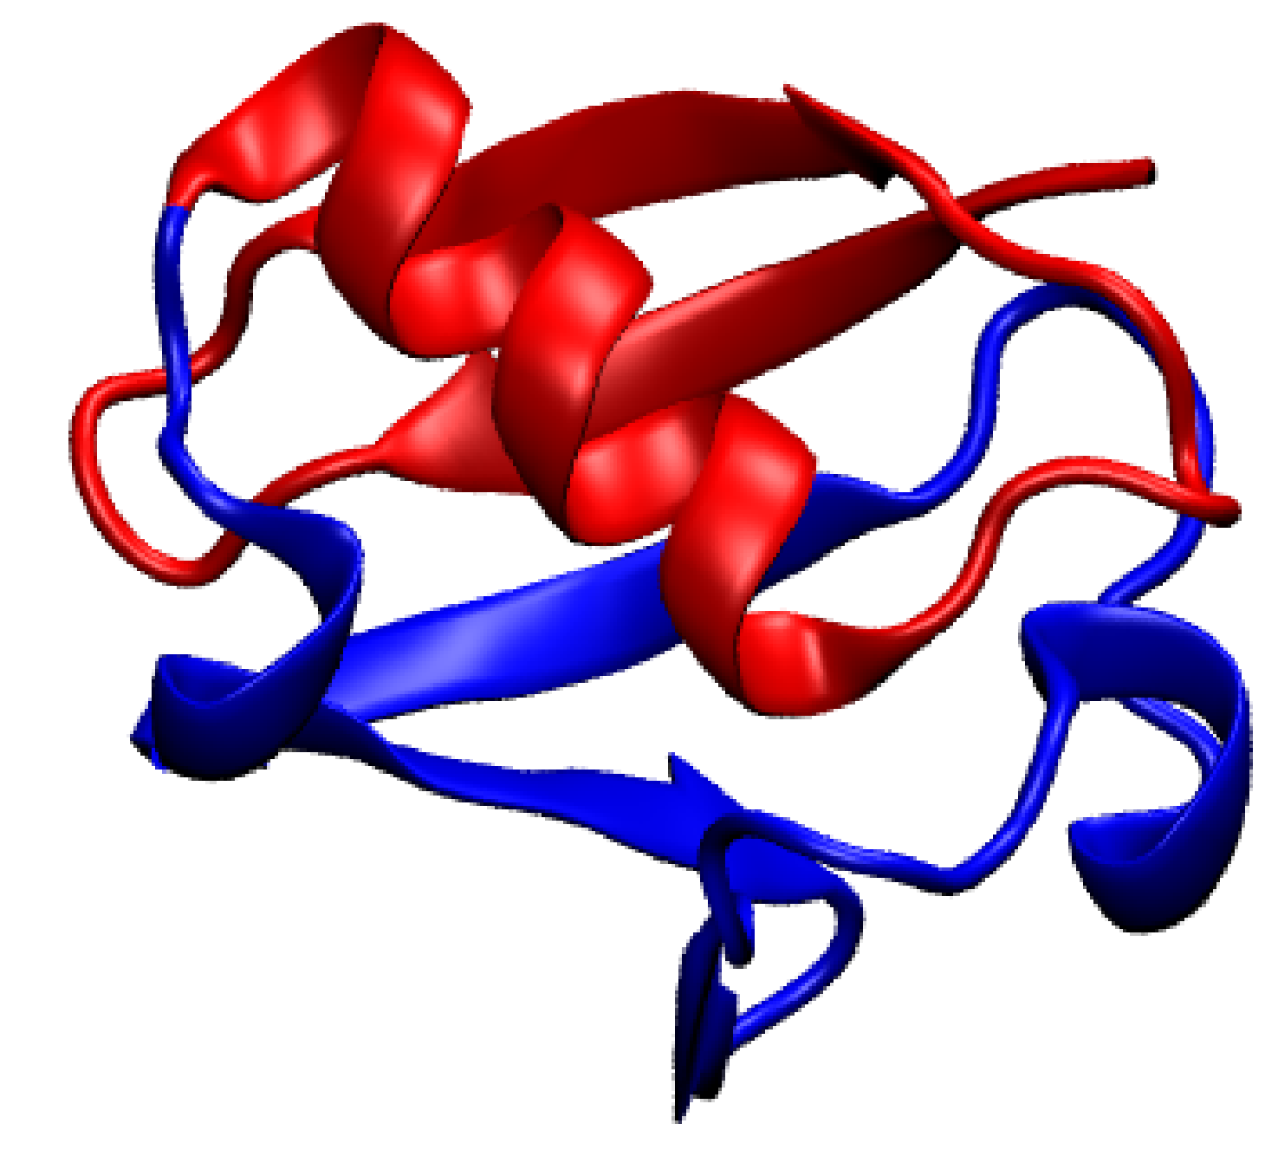

Mapping space
$$p(x_{1},x_{2})$$
Mapping space considers the representations of the molecule

Slide 13
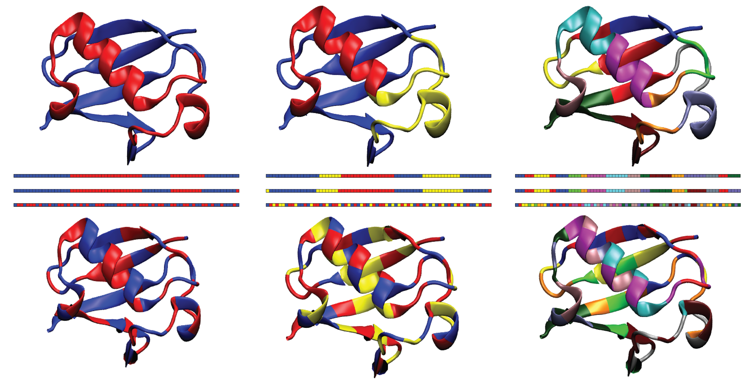
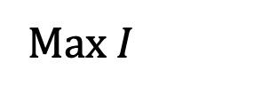
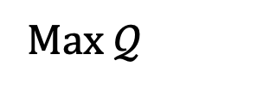
Optimal Representations
Max $𝒬$
Spectrus
Micheletti group Structure 2015
Max $I$
Maximizing $𝒬$ matches physical intuition, while maximizing $I$ does not.
Kidder, Shell, Noid JCP Accepted
Kidder, Shell, Noid JCP 2024

Slide 14
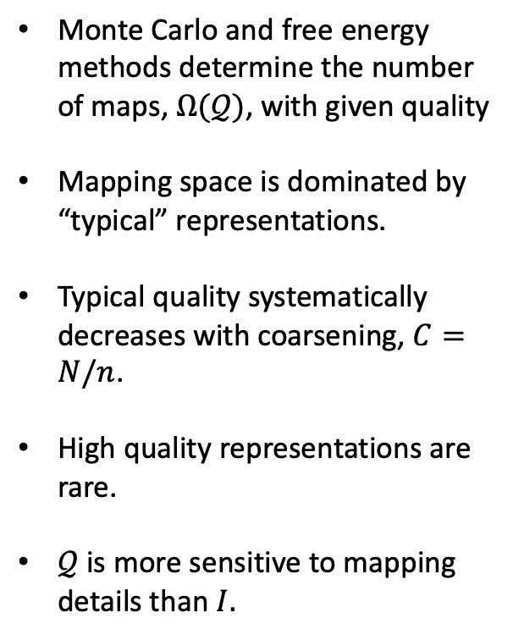
Densities of states for model quality
Monte Carlo and free energy methods determine the number of maps, $Ω(𝒬)$, with given quality
Mapping space is dominated by “typical” representations.
Typical quality systematically decreases with coarsening, $C=N/n$.
High quality representations are rare.
$𝒬$ is more sensitive to mapping details than $I.$
Foley, Kidder, Shell, Noid PNAS 2020
Kidder, Shell, Noid JCP 2024

Slide 15
Spectral quality versus information content
$I$ and $𝒬$ are positively correlated at high resolution, but anti-correlated at low resolution.
Kidder, Shell, Noid JCP 2024

Slide 16
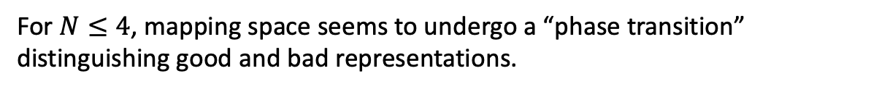
Phase transition in mapping space?
For $N≤4$, mapping space seems to undergo a “phase transition” distinguishing good and bad representations.
Foley, Kidder, Shell, Noid PNAS 2020
Kidder, Shell, Noid JCP 2024

Slide 17
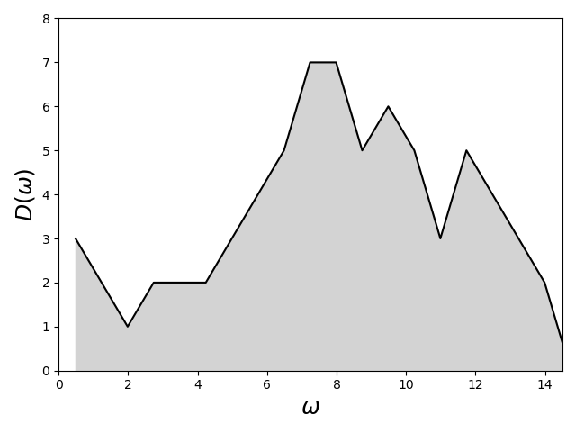
Information:
Physics vs noise
Prior expectation: Maximize the information content of reduced models
BUT most information in high resolution models is noise
High resolution models contain little information about physics
Posterior expectation: Minimize the information content of reduced models
Noise
Physics
 | Physics | Noise
Frequency | Low | High
Amplitude/scale | Large/global | Small/localized
Constraints | Weak | Strong
Information content | Poor | Rich

Slide 18
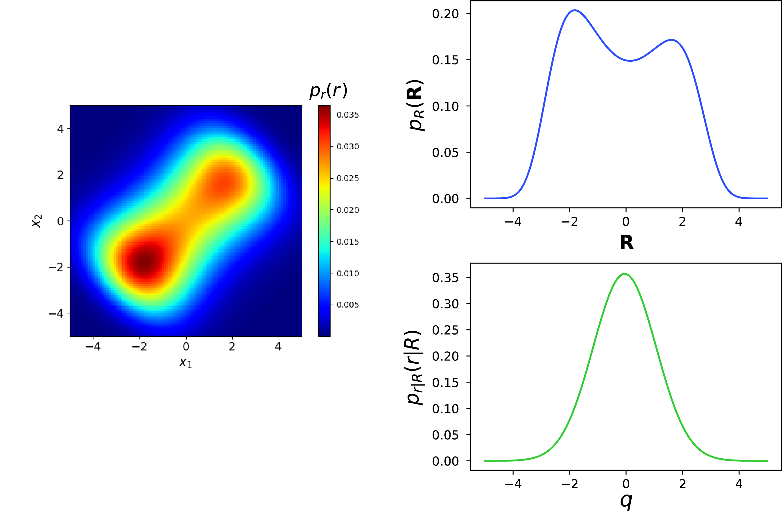
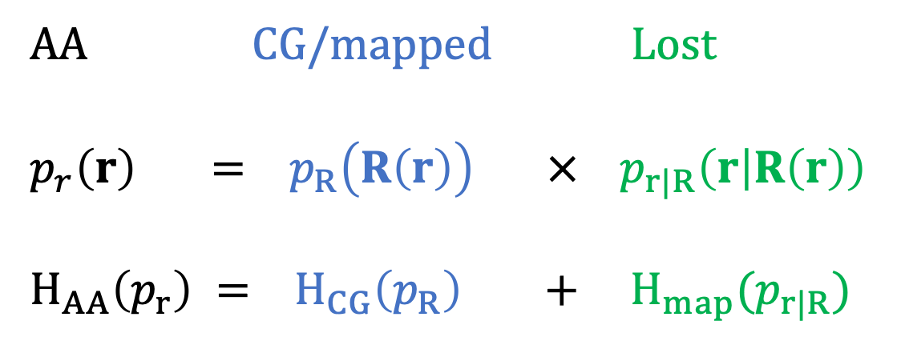
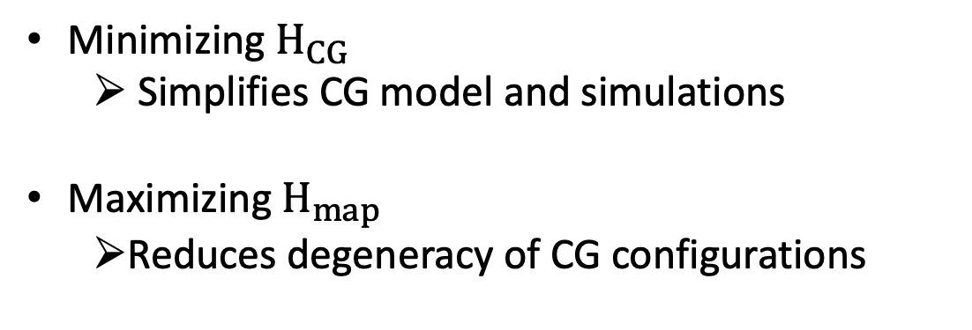
Partitioning information: CG + Lost
AA
AA CG/mapped Lost
$$p_{r}\left(r\right) = p_{R}\left(R\left(r\right)\right) × p_{r|R}\left(r | R\left(r\right)\right)$$
$$H_{AA}\left(p_{r}\right) = H_{CG}\left(p_{R}\right) + H_{map}(p_{r|R})$$
CG/mapped
Lost
Minimizing $H_{CG}$
  Simplifies CG model and simulations
Maximizing $H_{map}$
  Reduces degeneracy of CG configurations
Kidder Noid In prep 2024

Slide 19
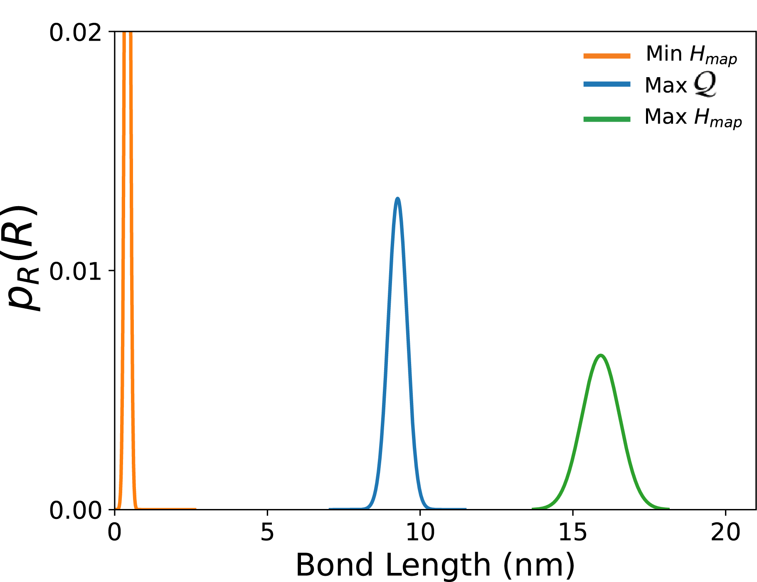
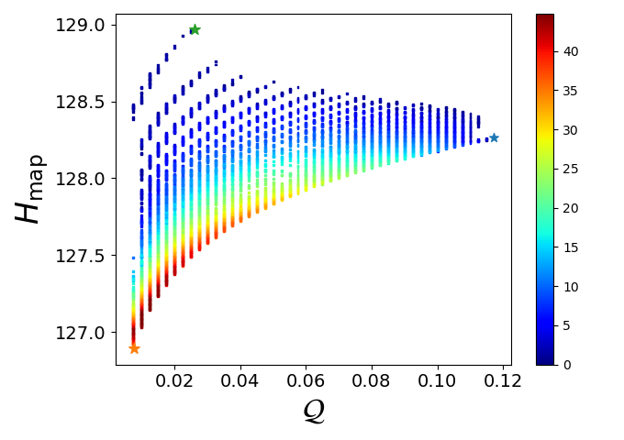
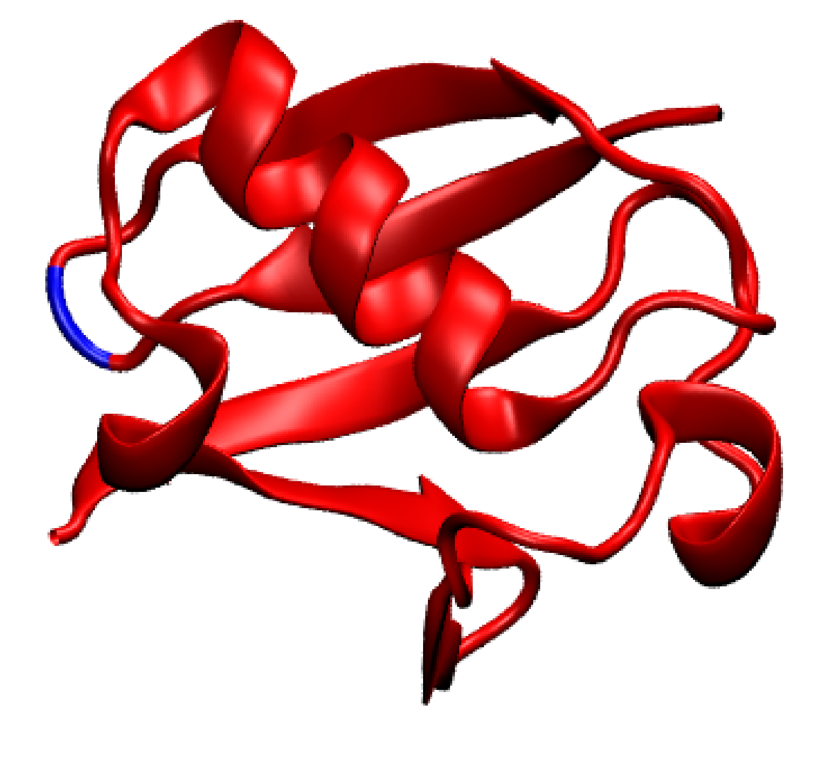


Minimizing or maximizing $H_{map}$?
$N=$2
Neither minimizing nor maximizing $H_{map}∝−I$ agrees with physical intuition.
Kidder Noid In prep 2024

Slide 20
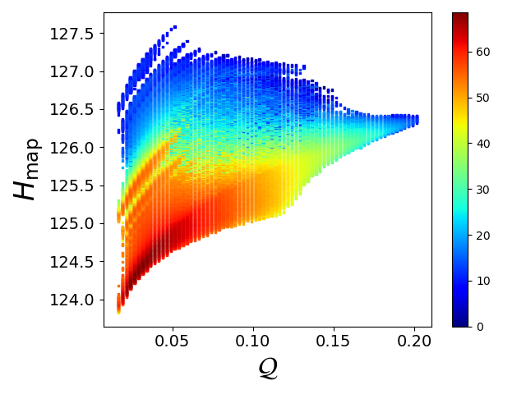
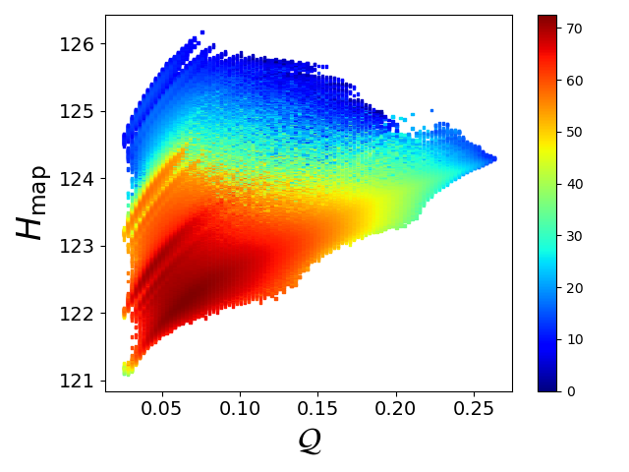
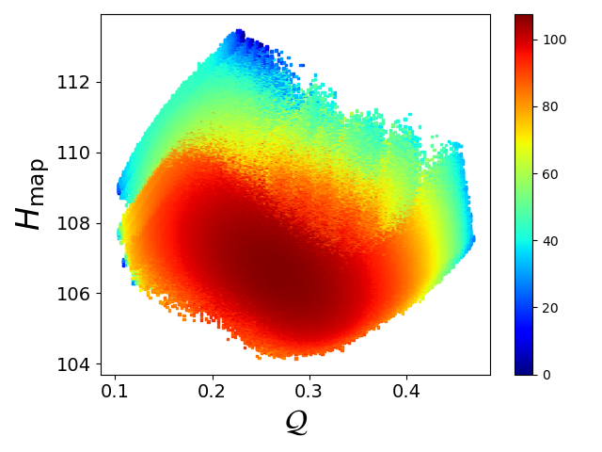
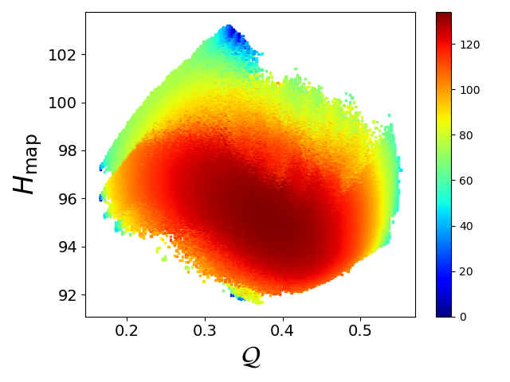




Minimizing or maximizing $H_{map}$?
$$N=3$$
$$N=4$$
$$N=12$$
$$N=18$$
$N=$2
Neither minimizing nor maximizing $H_{map}$ agrees with physical intuition.
Kidder Noid In prep 2024

Slide 21
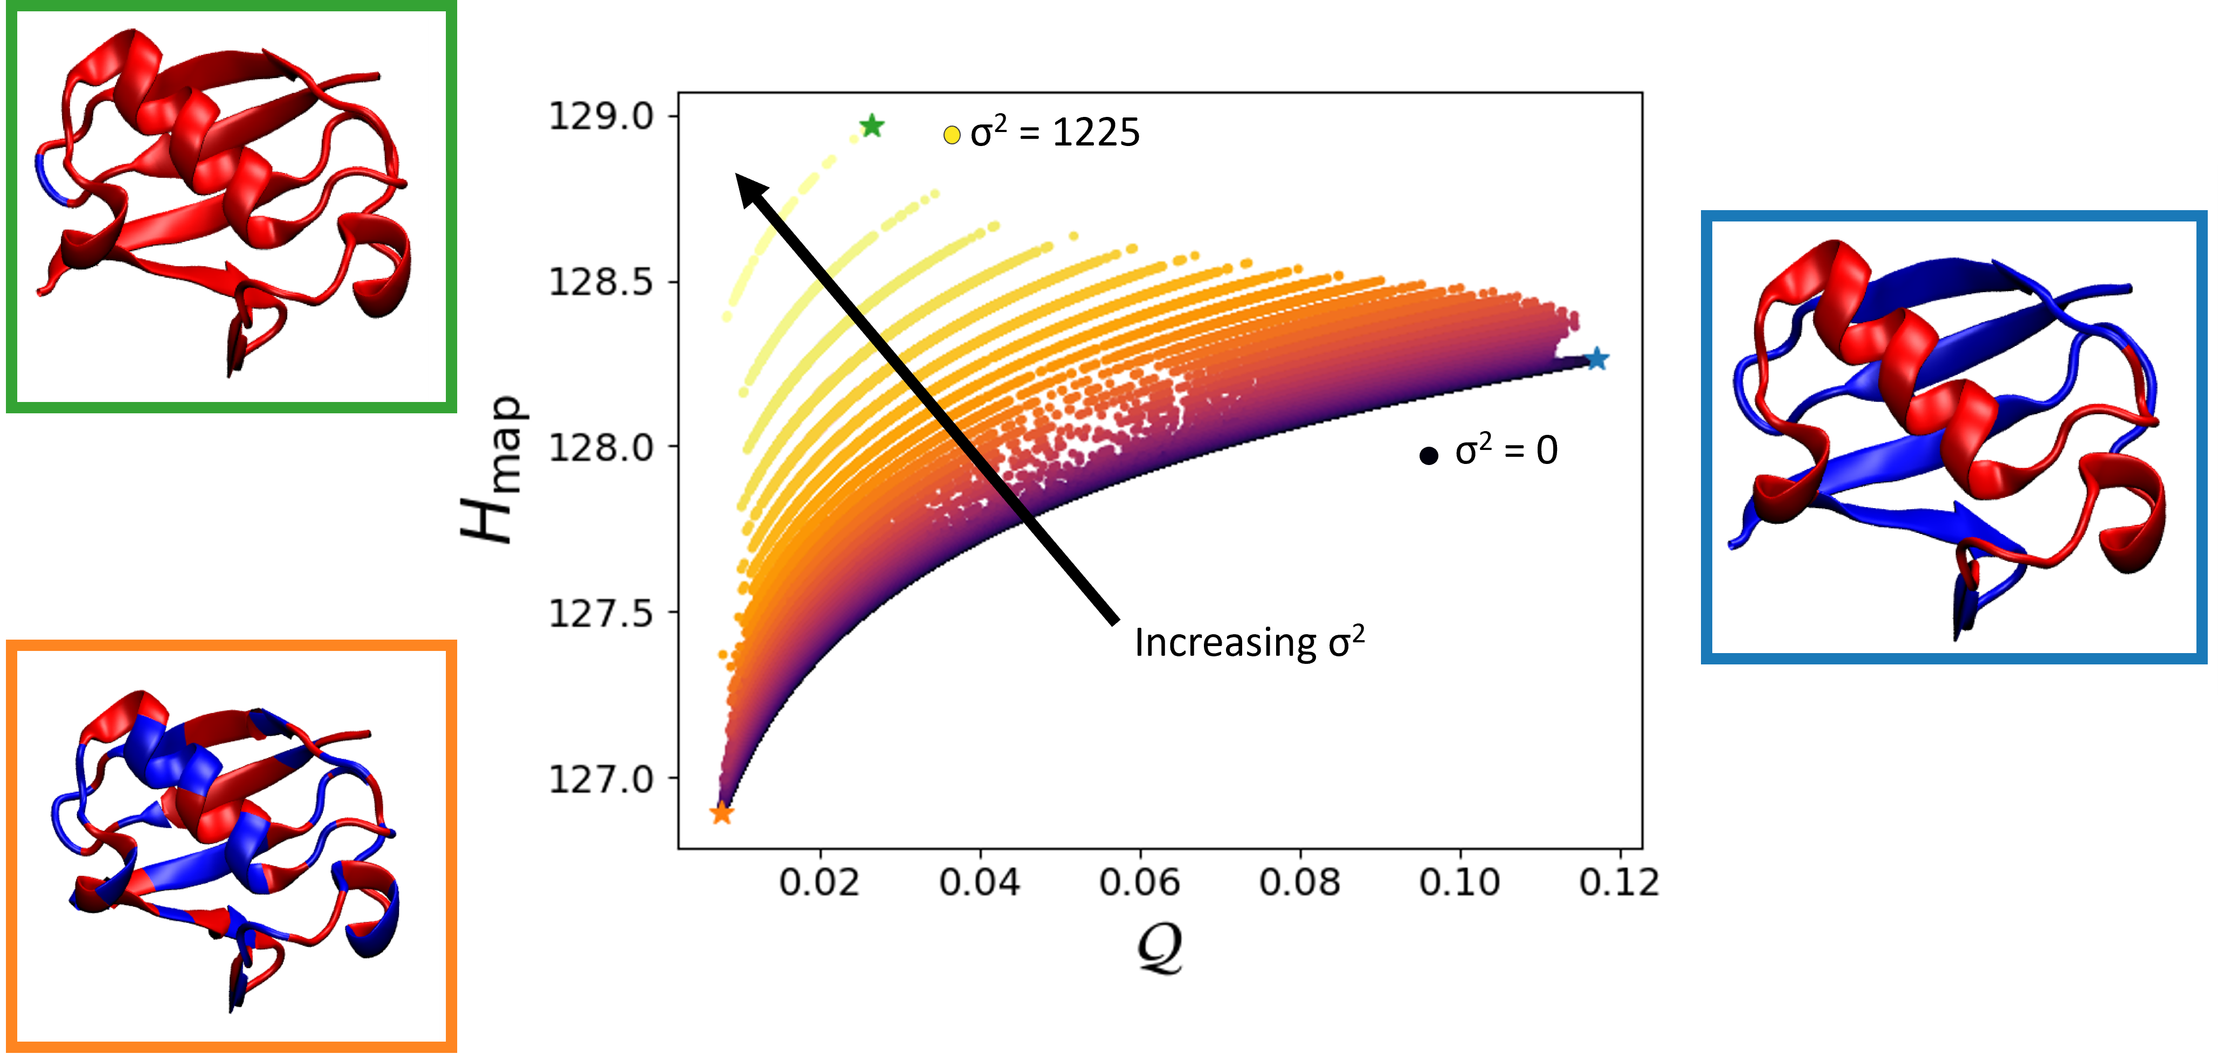

Considering the site heterogeneity
$$=var\left\{n_{I}\right\}$$
$H_{map}$ systematically increases with the site size heterogeneity, $σ^{2}$
$H_{map}$ and $𝒬$ are anticorrelated among representations with a given $σ^{2}.$
Kidder Noid In prep 2024

Slide 22





Considering the site heterogeneity
$$N=3$$
$$N=12$$
$$N=18$$
$H_{map}$ systematically increases with the site size heterogeneity, $σ^{2}=var\left\{n_{I}\right\}$
$H_{map}$ and $𝒬$ are positively correlated among representations with a given $σ^{2}.$
Kidder Noid In prep 2024

Slide 23


The labelling entropy
CG coordinates: $R_{I}=M_{I}\left(r\right)=\sum_{i}{M_{Ii}r_{i}}$
Atomic details: ${\hat{r}}_{k}=\sum_{i}{m_{Ii}r_{i}}$
Jacobian
Labelling
entropy
Translational symmetry
$$r_{i}→r_{i}+d ⇒R_{I}→R_{I}+d$$
$$\sum_{i}{M_{Ii}=1}$$
The CG mapping encodes information about the atoms associated with each site!
Kidder Noid In prep 2024

Slide 24

Accounting for the labelling entropy
2 sites
3 sites
12 sites
18 sites
The labelling entropy restores the expected correlation between ${\hat{H}}_{map}=H_{map}+H_{L}$ and $𝒬$.
Kidder Noid In prep 2024

Slide 25

“Model Resonance”
Coordinate transformation
$$R=Mr \\ \hat{r}=mr$$
Back-mapping
$$r=\tilde{r}\left(R,\hat{r};M \right)=B R+b \hat{r}$$
Partitioning interactions
$$u\left(r\right)=\tilde{u}\left(R,\hat{r};M \right) \\ →U\left(R;M_{∗}\right)+\hat{u}\left(\hat{r};M_{∗}\right)$$
A resonant mapping completely renders the high resolution separable into CG and AA components.
Given a resonant mapping, the CG spring matrix is completely independent of the AA details.
Kidder Noid In prep 2024

Slide 26
Off-resonant mappings: Q walk
The spectral quality quite rapidly decreases as the mapping moves off resonance.

Slide 27
Off-resonant models
The CG spring matrix appears robust with respect to randomizing the atomic springs.

Slide 28
Off-resonant models
The CG spring matrix appears robust with respect to deleting springs.

Slide 29


Exploring the landscape of coarse-grained representations
Choice of representation matters
Information is partitioned between the CG & lost ensembles
Exploring mapping space
  Trade-off between information & physics?
  A critical resolution?
The mapping itself contains information
Are there “resonant” representations?
Future directions
Extension to anharmonic models
Implications for order parameters, big data, ML
The derailment at Gare Montparnasse, Paris, 1895.
http://phys.columbia.edu/~tutorial/
http://www.greendiary.com/entry/futuristic-trains-change-face-public-transportation/

