Slide 1
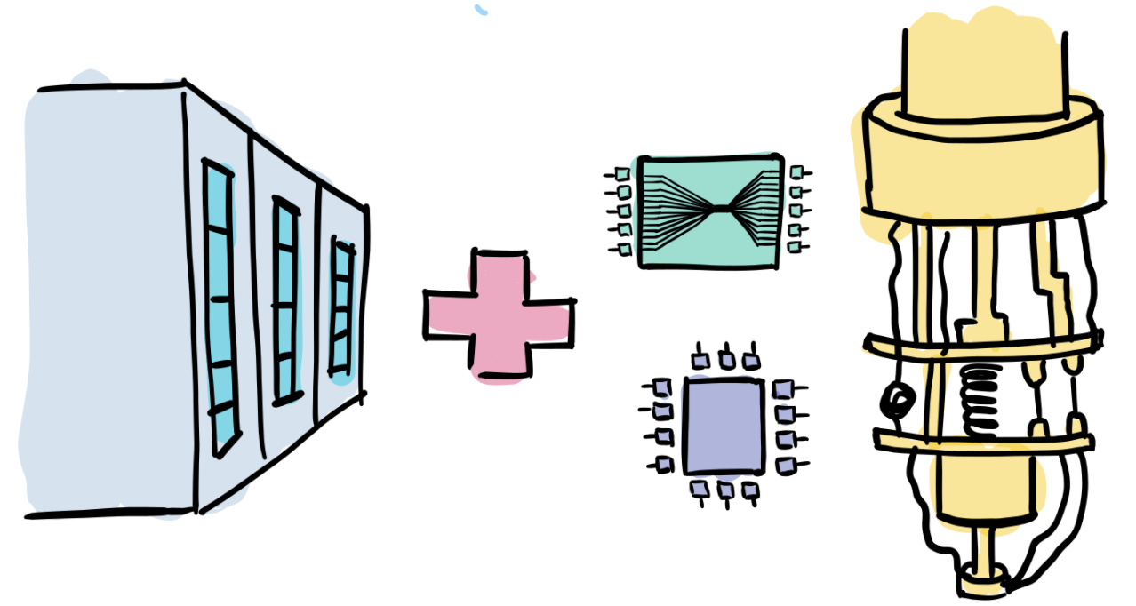
A quantum machine learning perspective on phase transitions
Paper: Monaco, Kiss, Mandarino, Vallecorsa, Grossi, Phys. Rev. B 107, L081105 (2023)
Bridging scales: At the crossroads among renormalisation group, multi-scale modelling, and deep learning
ECT*, Trento , April 2024
Credit: PennyLane

Slide 2
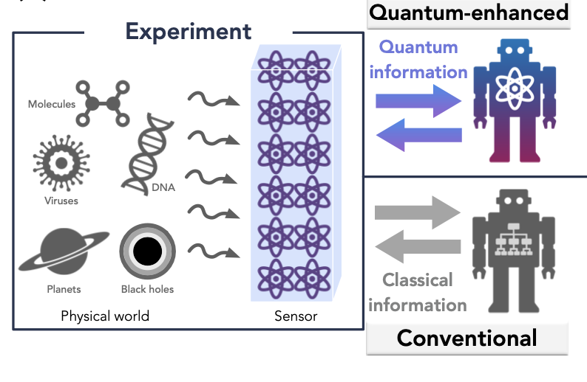
Quantum machine learning for quantum data
Task: Drawing phase diagrams
Supervised classification using a convolutional QNN using the groundstates as input data.
Avoid the measurements of string order parameters.
Bottleneck: we need access to classical training labels!
Work directly with quantum states (possible from experiments).
Bypass any classical processing.
Huang, et al., Science 376, 6598 (2022)
Cong, et al., Nat. Phys. 15, 1273–1278 (2019)

Slide 3
QML in a nutshell
Data and model definition
Results

Slide 4
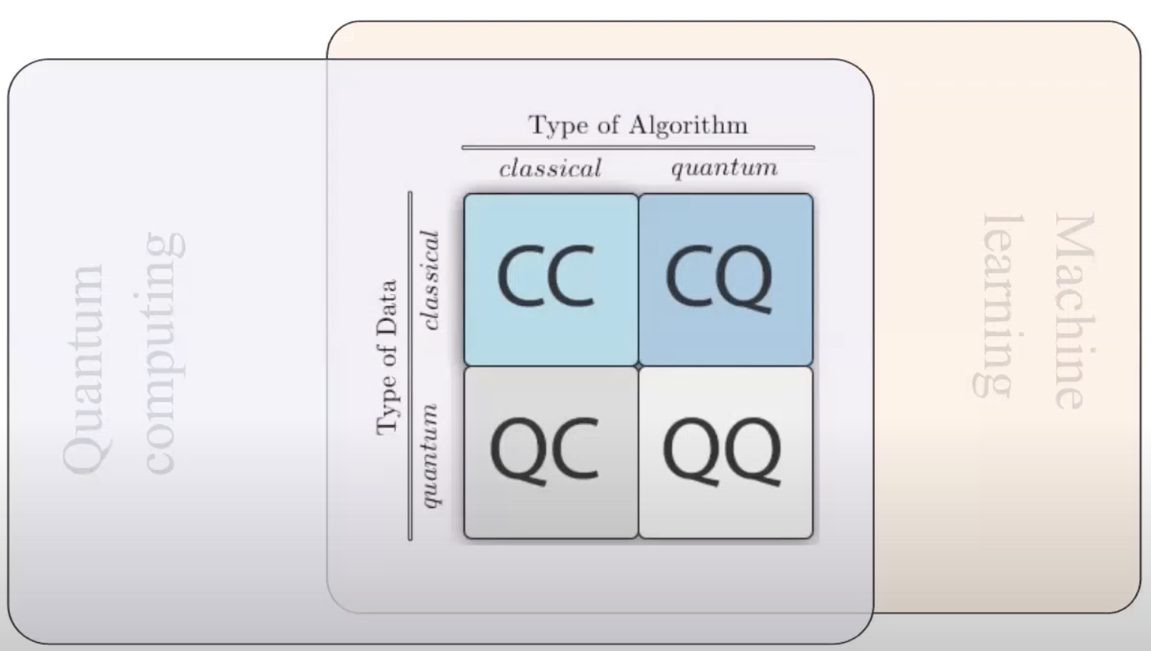
Quantum machine learning
Classical intractability: what useful problems can we solve on a quantum computer that we cannot on a classical computer?
Innovation: what new algorithms can we come up with?
Can quantum avantage be proved with QML (better generalization, less data, les parameters, better performance)?
M.Schuld: QSI Seminar - Encoding Classical Data into Quantum States for ML
Classical ML is better on all standard benchmark!
Bridging Scales Trento (2024)– O. Kiss CERN QTI

Slide 5
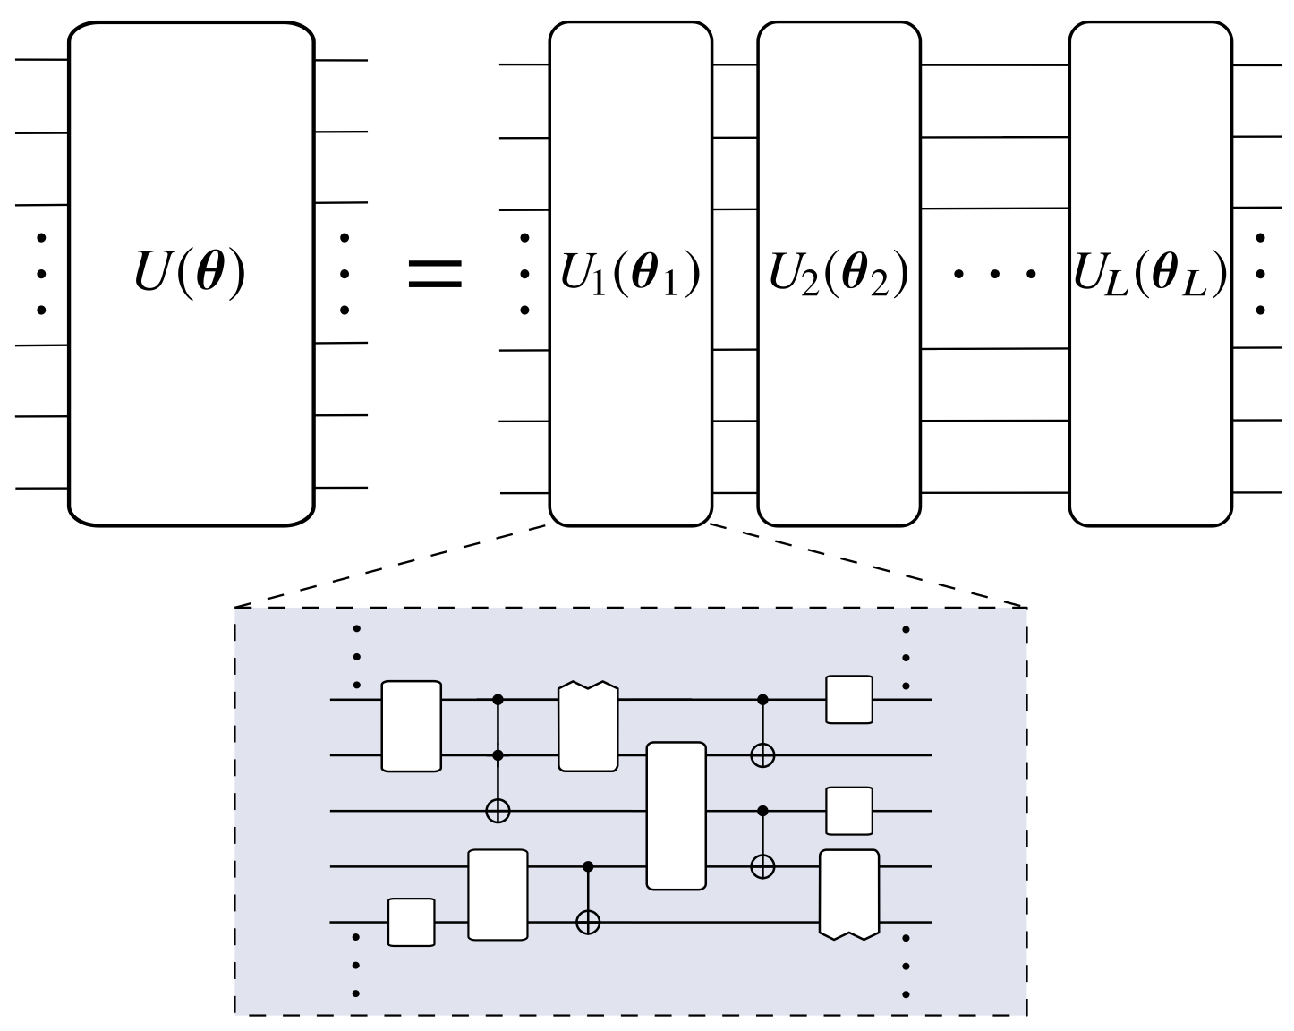
Quantum Machine Learning Model Lifecycle
Data Preparation
Model Definition
Model Training
Model Testing
Model Interpretation
Data Reduction
Data Encoding [1,2,3]
Read Out
Trainability (BP…)
[1] Robust data encodings for quantum classifiers, Ryan LaRose and Brian Coyle, Phys. Rev. A 102, 032420
[2] Quantum convolutional neural network for classical data classification, https://arxiv.org/pdf/2108.00661.pdf
[3] Quantum Support Vector Machines for Continuum Suppression in B Meson Decays, https://arxiv.org/abs/2103.12257
Notes:
In addition to standard complexity

Slide 6
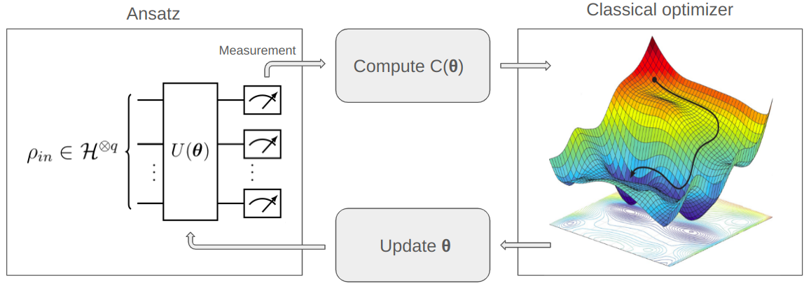
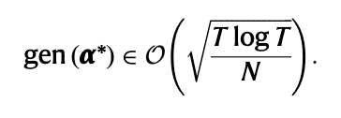
QML models implementations for NISQ
Variational algorithms - EXPLICIT
Universal approximators¹
Flexible parametric ansatz: design can leverage data symmetries²
Can use gradient-free methods or stochastic gradient-descent
Data Embedding plays an important role
Good generalization^{3,4}
Initial state
Parametrized circuit
A linear model in the quantum feature space!
1-M. Schuld et al.,” Effect of data encoding on the expressive power of variational quantum-machine-learning models“ Phys. Rev. A 103, 032430 (2021)
2-J. Meyer et al “Exploiting symmetry in variational quantum machine learning“, https://arxiv.org/abs/2205.06217
3- M.Caro et al., Generalization in quantum machine learning from few training data. Nat Commun 13, 4919 (2022)
4- M. Caro et al., Out-of-distribution generalization for learning quantum dynamics. Nat Commun 14, 3751 (2023)
Bridging Scales Trento (2024)– O. Kiss CERN QTI
Notes:
Geometric Deep learning
fully equivariant with respect to transformations under the Lorentz group, a fundamental symmetry of space and time in physics. The architecture is based on the theory of the finite-dimensional representations of the Lorentz group and the equivariant nonlinearity involves the tensor product.
An explicit quantum classifier, where the label of a data point x is specified by the expectation value of a variational measurement on its associated quan- tum feature state ρ(x).

Slide 7
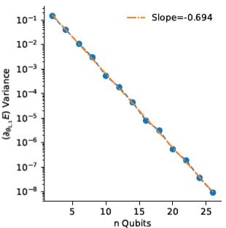
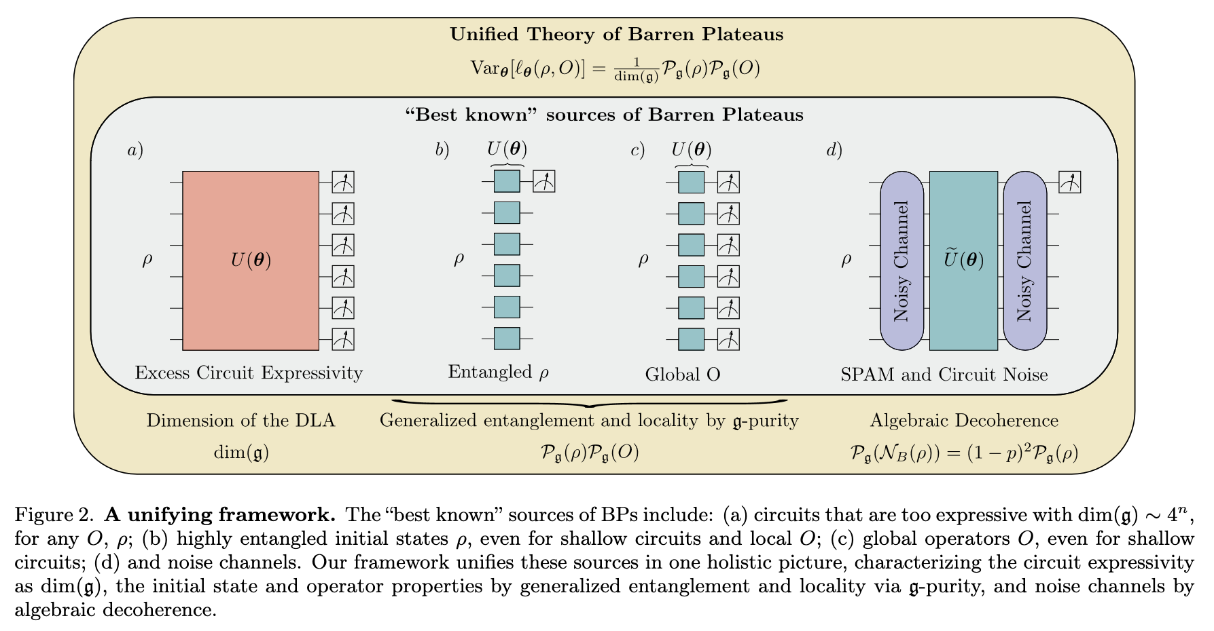
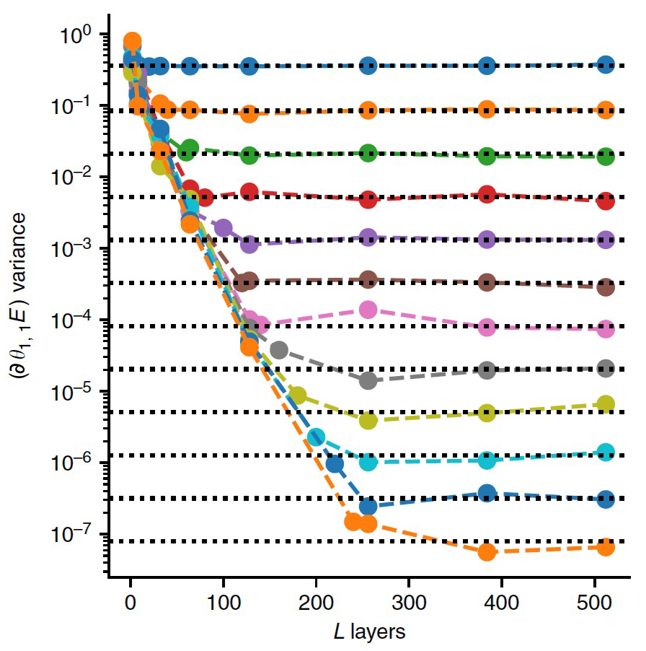
Open Problem
Model Convergence and Barren Plateau
J. McClean et al., arXiv:1803.11173
M. Ragone et al., arXiv:2309.09342
Given the size of the Hilbert space a compromise between expressivity, convergence and generalization performance is needed. Quantum gradient decay exponentially in the number of qubits
Bridging Scales Trento (2024)– O. Kiss CERN QTI
Notes:
Classical gradients vanish exponentially with the number of layers (J. McClean et al., arXiv:1803.11173)
• Convergence still possible if gradients consistent between batches.
As the ans ̈atze used in variational algorithms become more and more complex, trainability issues may arise in the optimization step due to the barren plateau (BP) phenomenon [14], which implies an exponential vanishing of the gradient distribution variance with respect to the number of qubits q in the model. As a consequence, an exponentially increasing number of shots is necessary to effectively navigate the cost landscape of the problem, which is practically impossible to perform.

Slide 8
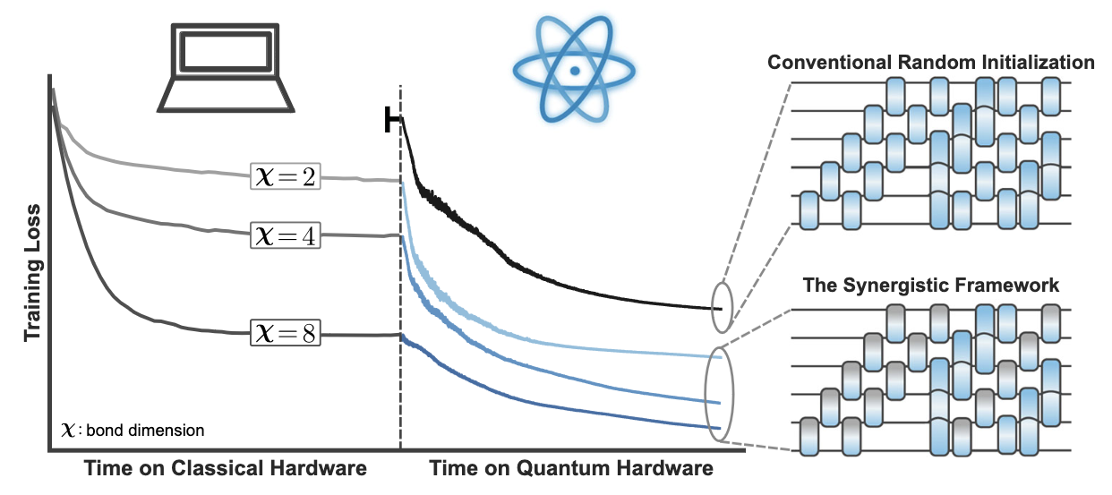
Open Problem
What is next for QML?
Find applications where QML is useful.
Find models that are trainable and not classically simulable.
Find smart initialization strategies.
M. Rudolph et al., Synergistic pretraining of parametrized quantum circuits via tensor networks
Bridging Scales Trento (2024)– O. Kiss CERN QTI

Slide 9
QML in a nutshell
Data and model definition
Results

Slide 10
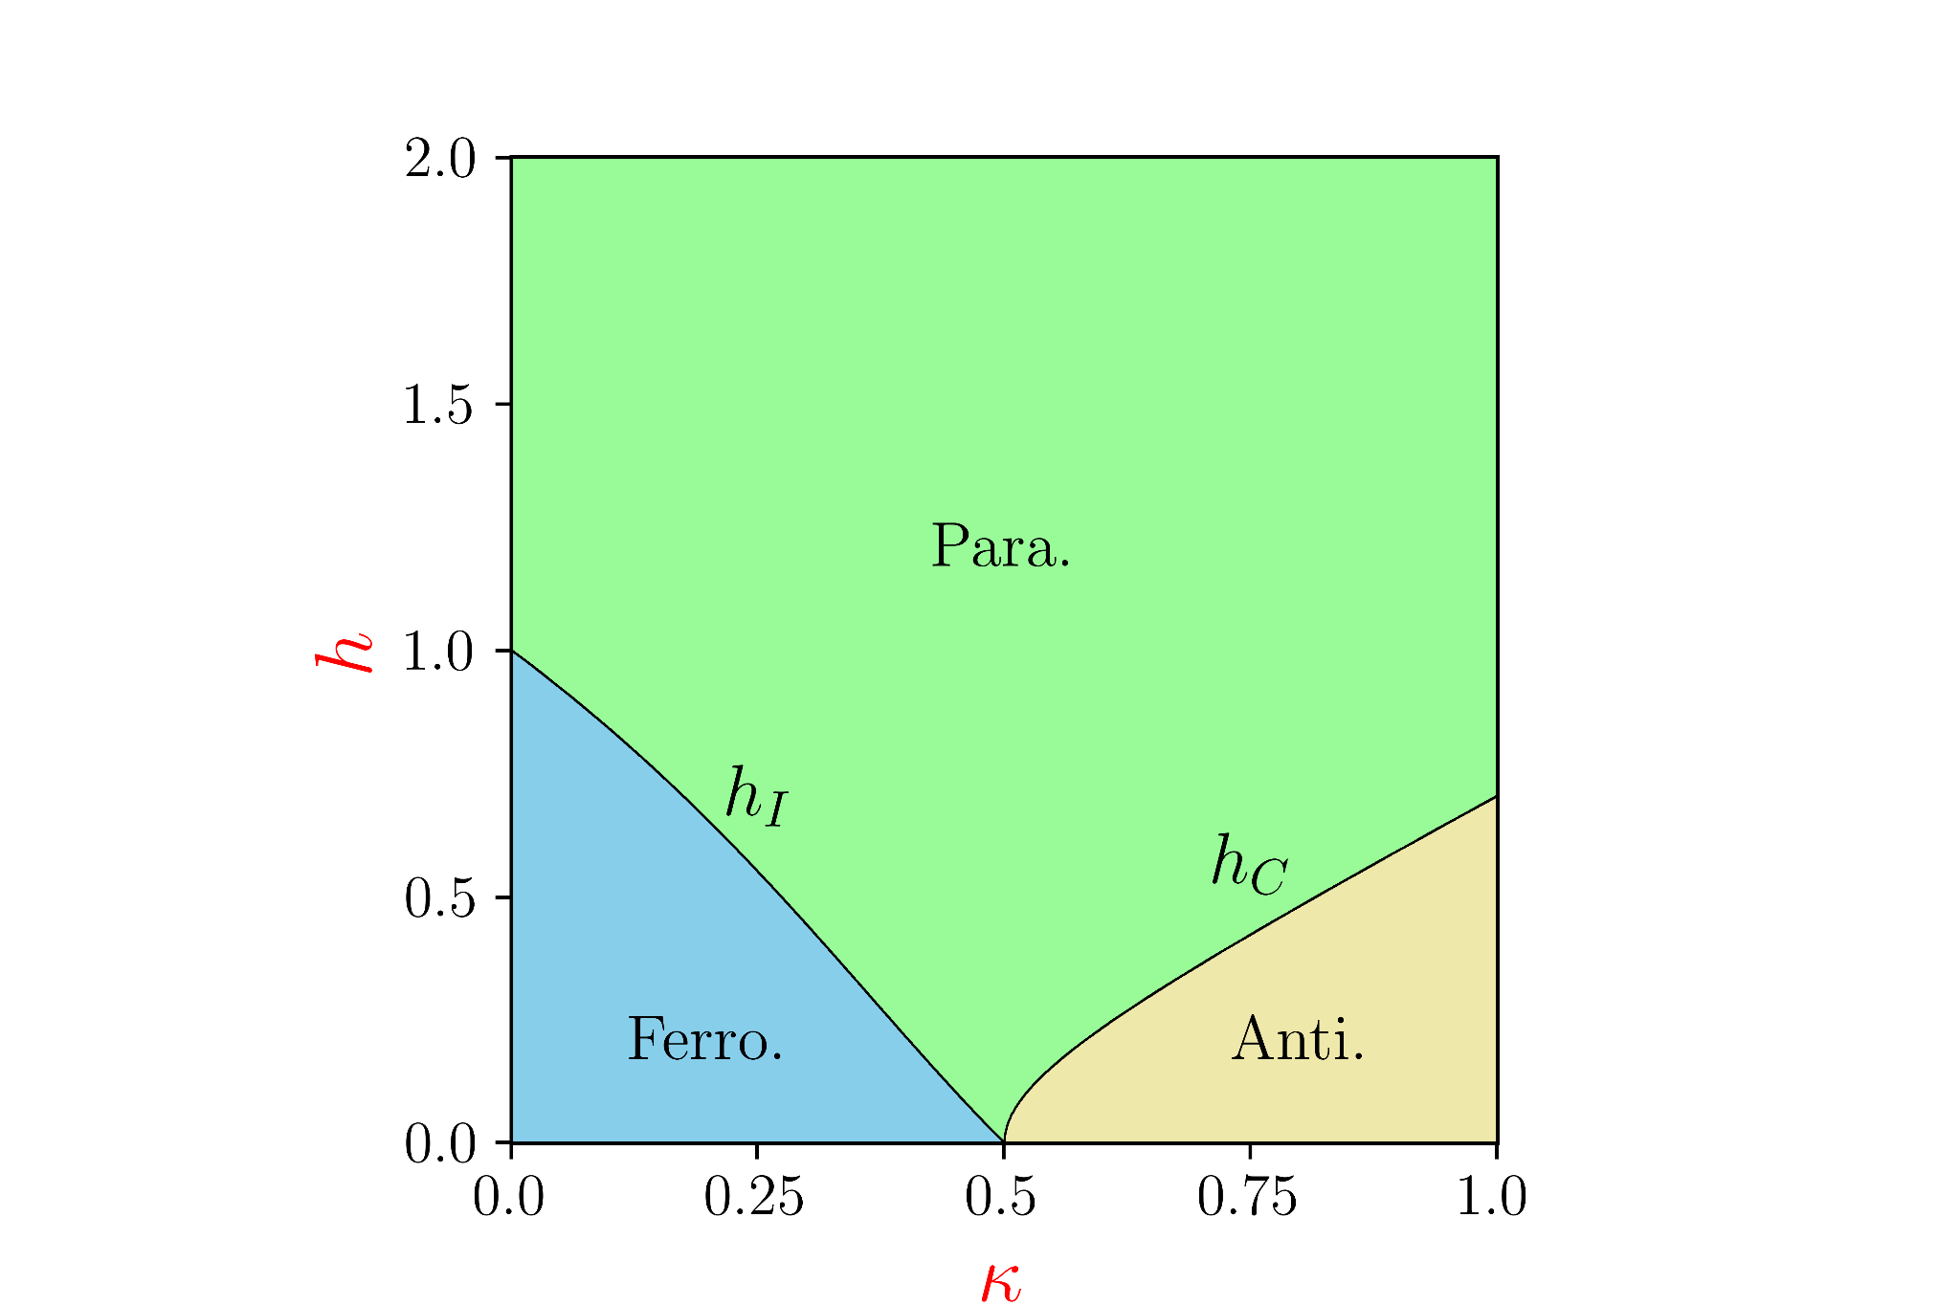
The Physics model: Axial Next Nearest Neighbor Ising (ANNNI)
Senk, Physics Reports, 170, 4 (1988)
μ
N = 6
Integrable only for:
(x-axis)
(y-axis)
Notes:
The studied system is a variation of the standard Ising Chain model in which each particle can interact with its nearest neighbour and next-nearest neighbour, and every particle is subjected to a constant magnetic field
In open boundary conditions. The energy scale of the Hamiltonian is given by the coupling constant J (without loss of generality we set J = 1), while the dimensionless parameters κ and h account for the next-nearest-neighbor interaction and the transverse magnetic field, respectively.
the paramagnetic phase is the disordered one, in contrast with the two ordered phases: the ferromagnetic and the antiphase one

Slide 11
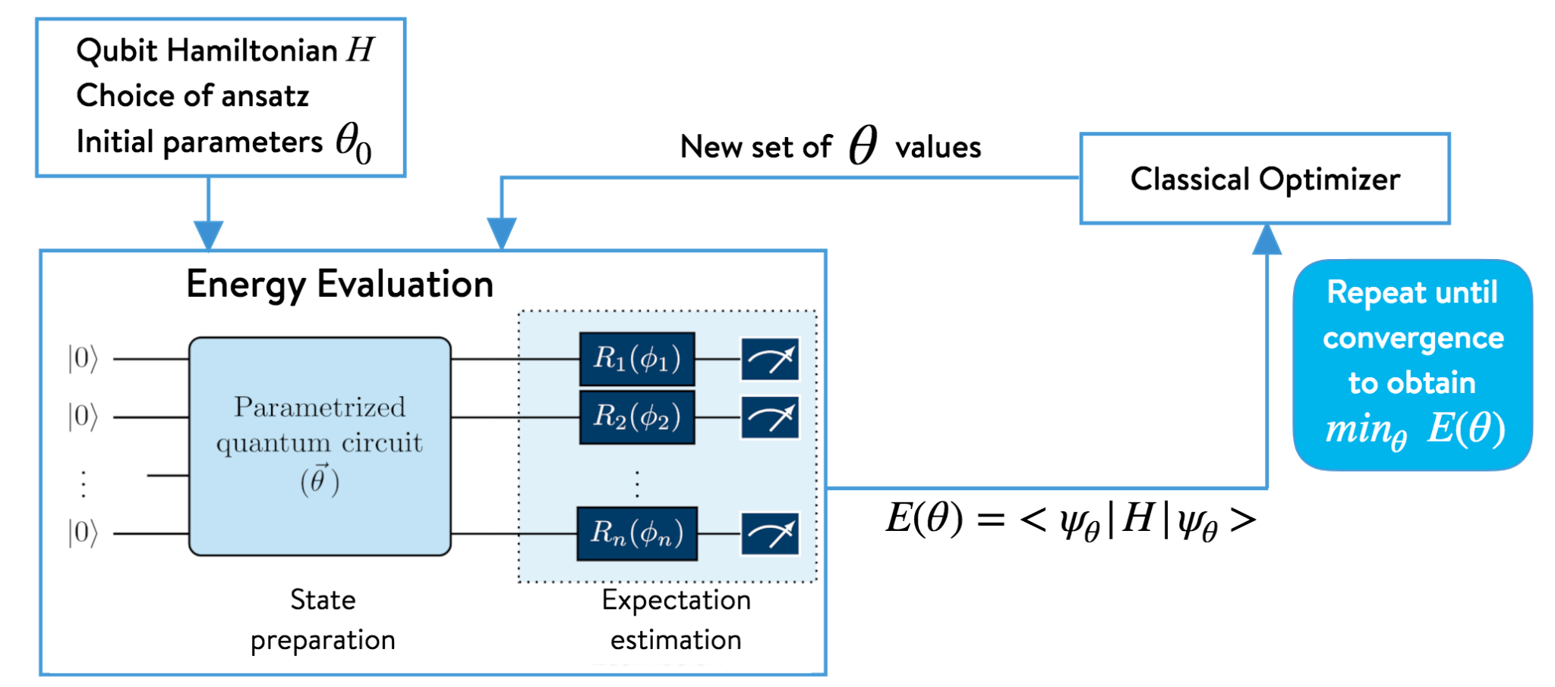
Variational Quantum Eigensolver (VQE)
A. Peruzzo et al., “A variational eigenvalue solver on a photonic quantum processor.”
Nat Commun 5, 4213 (2014)

Slide 12
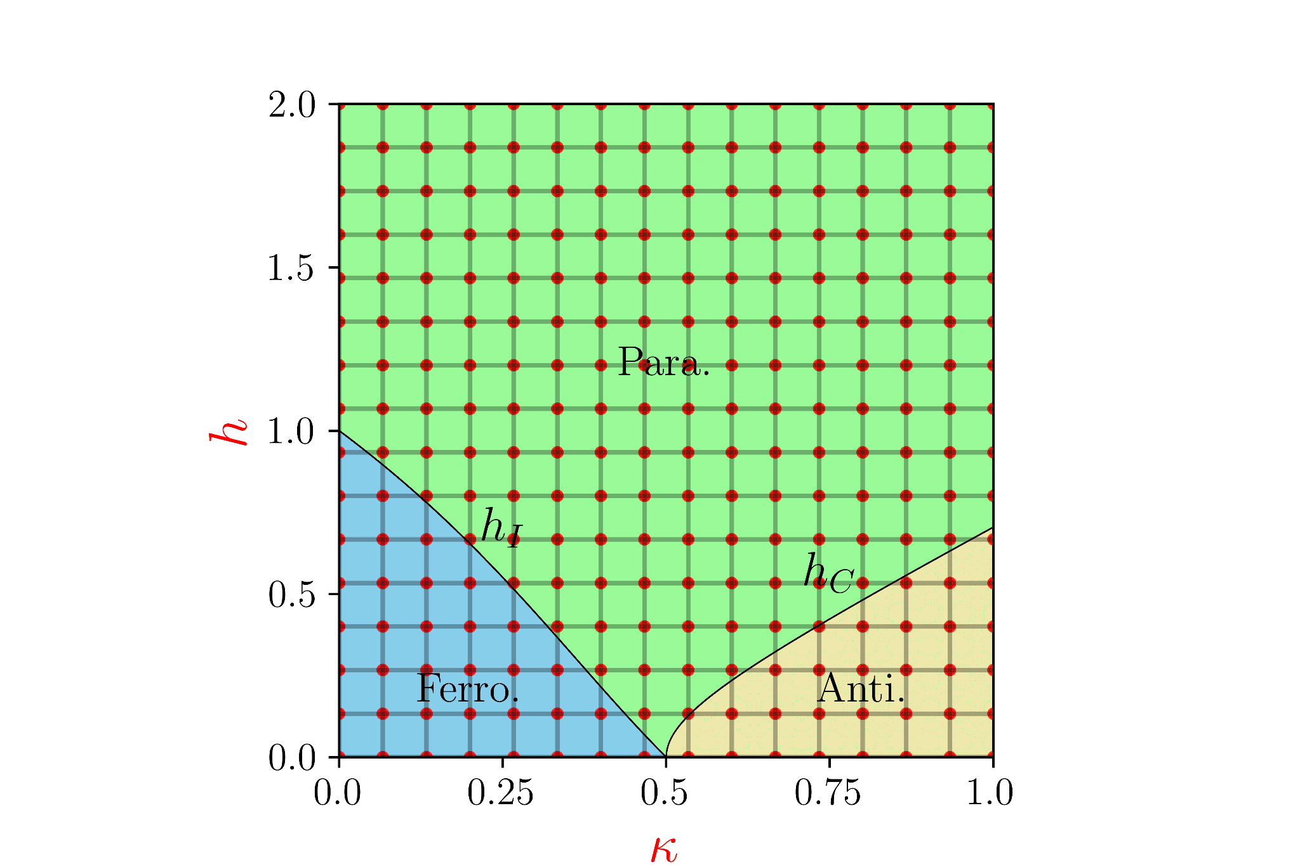
Variational Quantum Eigensolver (VQE)
and can assume 100 values each 10,000 total states to obtain through VQE!

Slide 13
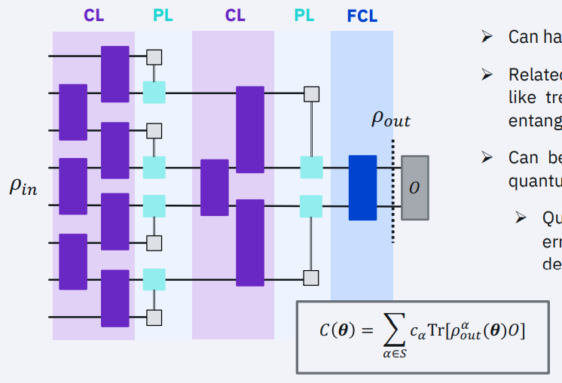
Quantum convolutional networks
Can have as few as $Olog(n)$ parameters
Related to hierarchical quantum circuits like tree-tensor networks and multi-scale entanglement renormalization ansatz
Quantum phase recognition, quantum error correction, entanglement detection, …
QCNNs are “naturally” shallow
QCNNs are resistant to barren plateaus due to their distance from low T2-design (Pesah et al., arxiv:2011.02966)
Grant et al., npj Quant. Inf. 4, 65 (2018)
I. Cong et al., Nature Physics 15, 1273 (2019)
Pesah et al., arXiv:2011.02966 (2020)

Slide 14
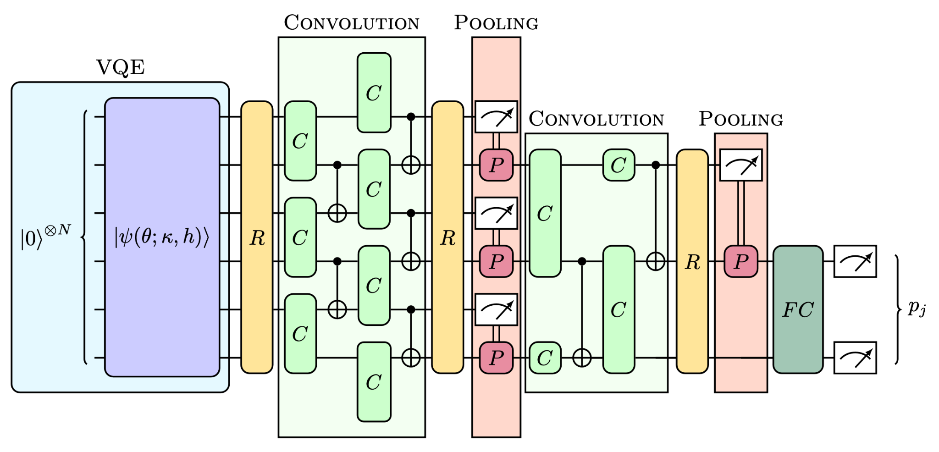
Quantum Convolutional Neural Network (QCNN)
Labels:
[0,1] ferromagnetic
[1,0] antiphase
[1,1] paramagnetic
[0,0] trash label
Binary Cross-entropy
Loss:
Notes:
Convolutional layerwill extract local correlations, while pooling layer allows reducing the dimensionality of the feature vector. In a quantum circuit, the convolutional layer, consisting of a kernel swept along the entire image, is a two-qubit unitary that correlates neighbouring qubits. As for the pooling layer, we will use a conditioned single-qubit unitary that depends on the measurement of a neighboring qubit. Finally, we use a dense layer that entangles all qubits of the final state using an all-to-all unitary gate

Slide 15
QML in a nutshell
Data and model definition
Results

Slide 16
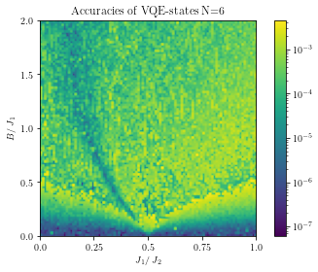
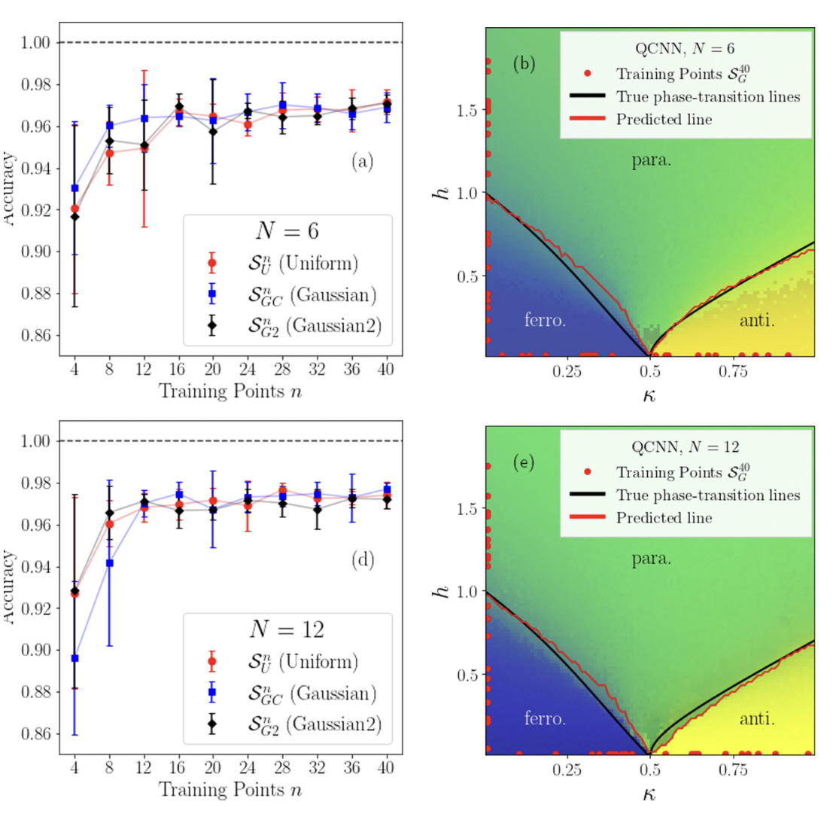
Results: training on the integrable lines
S. Monaco et al., Phys. Rev. B 107, L081105 (2023
Training size
QCNN (95% accuracy)
Normalised (exact diagonalisation – VQE)
The accuracy is always above 99%.
The Peschel-Emery line is exhibited, unravelling new physics by comparing VQE with different approaches, such as DMRG.

Slide 17
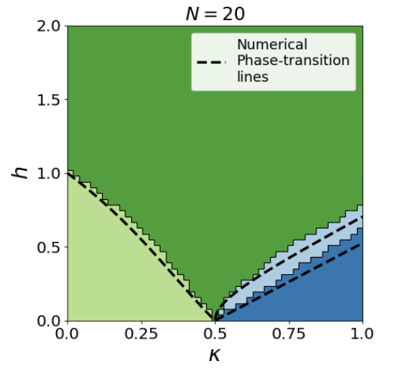
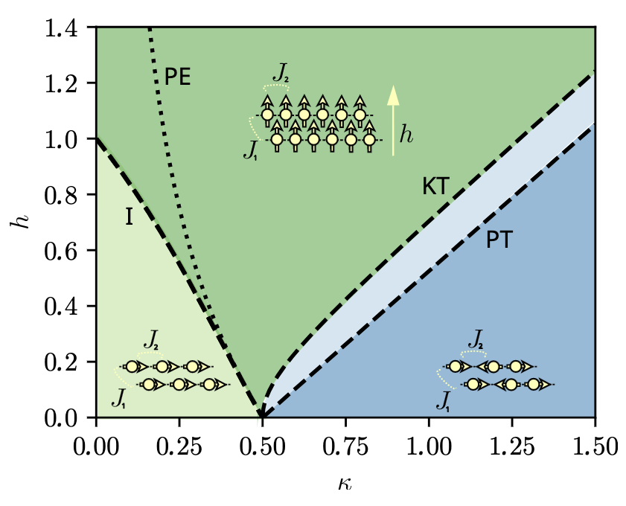
Results: training everywhere
when the system is large enough,
the floating phase appears.
Training data are sampled in the four phases.
M. Cea et al., arXiv:2402.11022

Slide 18
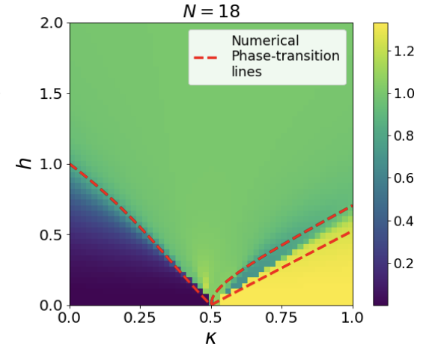
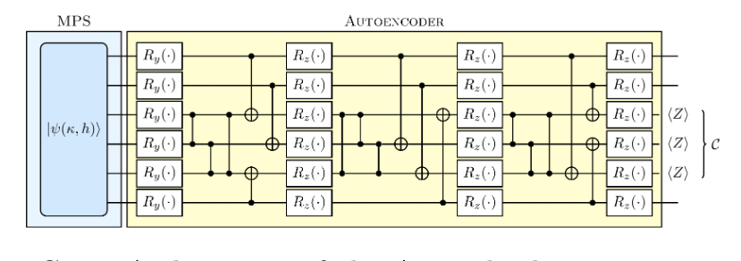
Results: anomaly detection
Unsupervised way:
Compute compression score on the VQE/MPS ground states.
The performance differs for the different phases.
S. Monaco et al., Phys. Rev. B 107, L081105 (2023)
M. Cea et al., arXiv:2402.11022

Slide 19
Conclusion
QCNN trained (NO BP) on few training point for Quantum Phase Recognition.
Directly work with quantum data.
Adresses the bottleneck of needing expensive training labels.
Generalisation from few data .
[M. Caro et al., Generalization in quantum machine learning from few training data. Nat Commun 13, 4919 (2022)]

Slide 20
THANK YOU
oriel.kiss@cern.ch
Paper
Code

Slide 21
NOTE GENERALIZZAZIONE:
more complex models, i.e. models with a larger number of parameters, achieve a lower error on the training data but a higher generalization error. Having more training data, on the other hand, leads to a better approximation of the true expected loss and hence a lower generalization error. generalization error to depend both on the richness of the model class, as well as on the amount of training data available. (REF CARO)
For quantum convolutional neural networks (QCNNs), it is possible to get a more fine-grained bound by including knowledge on the number of gates M which have been reused (i.e. whose parameters are shared across wires)
For the special case of QCNNs, we can explicitly connect the number of samples needed for good generalization to the system size n since these models use O(log(n)) independently parametrized gates, each of which is used at most n times
Notes:
The interplay between the interactions of the particles and the magnetic field creates this phase mapping for the system.
Depending on the values of kappa and h the system can be in one of the three phases:
Ferromagnetic, Paramagnetic and Antiphase

Slide 22
You got your data: what’s next?
Unsupervised
Learning
Supervised
Learning
clustering
anomaly detection
feature reduction
regression
classification
Supervised ML
Labeled data, i.e., data with defined output.
A model is trained giving this data and you have direct evaluation.
Unsupervised ML
Unlabeled data.
ML finds patterns in your data.
Indirect evaluation.
Reinforcement
Learning
Quantum
Computing
Notes:
Unsupervised Learning • The model is not provided with the correct results during the training. • Can be used to cluster the input data in classes on the basis of their sta?s?cal proper?es only. • Cluster significance and labeling. • The labeling can be carried out even if the labels are only available for a small number of objects representa?ve of the desired classes
Supervised Learning • Training data includes both the input and the desired results. • For some examples the correct results (targets) are known and are given in input to the model during the learning process. • The construc?on of a proper training, valida?on and test set (Bok) is crucial. • These methods are usually fast and accurate. • Have to be able to generalize: give the correct results when new data are given in input without knowing a priori the target.

Slide 23
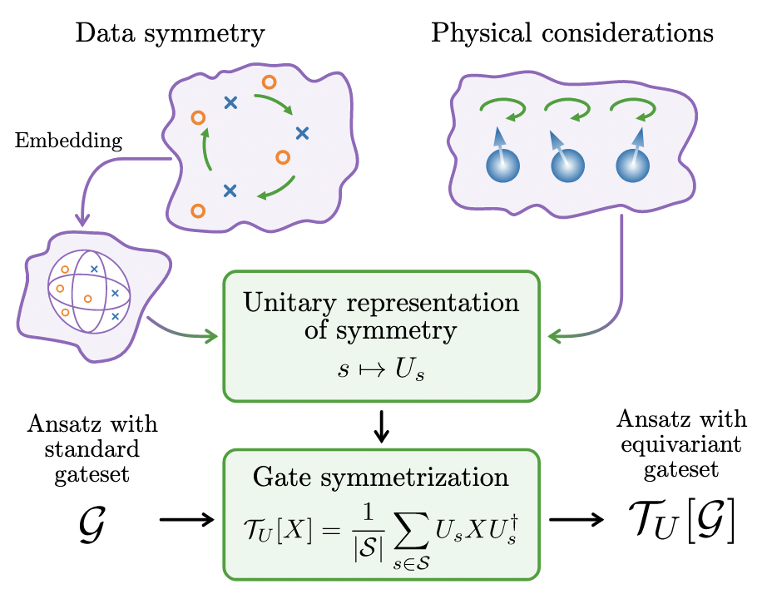
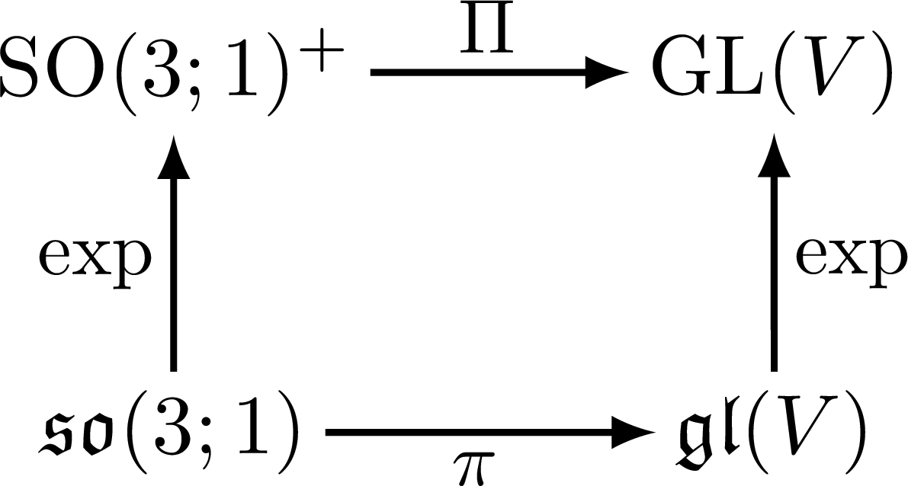
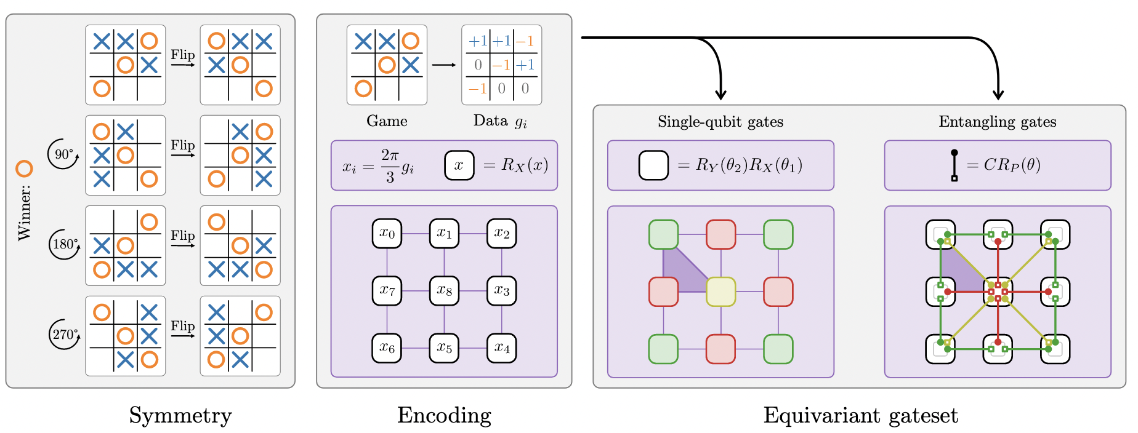
QML models implementations for NISQ
Variational algorithms - EXPLICIT
Flexible parametric ansatz: design can leverage data symmetries^{1,2}
Can use gradient-free methods or stochastic gradient-descent
Data Embedding can be learned
Better generalization^{2,3}
https://github.com/fizisist/LorentzGroupNetwork
A unitary representation of a symmetry group S can arise from data symmetries when the data points are suitably encoded or alternatively from physical considerations of a variational problem².
1-A. Bogatskiy et al. "Lorentz group equivariant neural network for particle physics." PMLR, 2020
2-J. Meyer et al “Exploiting symmetry in variational quantum machine learning“, https://arxiv.org/abs/2205.06217
3-S.Jerbi at all., Quantum Machine Learning Beyond Kernel Methods https://arxiv.org/abs/2110.13162
4- Glick, Jennifer R., et al. "Covariant quantum kernels for data with group structure." arXiv:2105.03406 (2021)
Bridging Scales Trento (2024)– O. Kiss CERN QTI
Notes:
Geometric Deep learning
Neural network architecture that is fully equivariant with respect to transformations under the Lorentz group, a fundamental symmetry of space and time in physics.
fully equivariant with respect to transformations under the Lorentz group, a fundamental symmetry of space and time in physics. The architecture is based on the theory of the finite-dimensional representations of the Lorentz group and the equivariant nonlinearity involves the tensor product.

