Slide 1
Measurement of the electromagnetic dipole moments of the 𝝠 baryons at LHCb
EDMs: complementary experiments and theory connections
ECT* Trento, 07/03/2024
Giorgia Tonani

Slide 2
The 𝝠 baryon
𝝠 baryon identity:
quark model u d s,
mass m = 1115.683 ± 0.006 MeV,
mean lifetime 𝝉 = (2.632 ± 0.020) x 10⁻¹⁰ s
spin ½
𝝠 baryon decays:
𝝠 → p 𝜋⁻ 64%
𝝠 → n 𝜋⁰ 36%
𝝠 → p 𝜋⁻
Decay parameter 𝜶 of the 𝝠 baryon has recently been measured by BESIII [1]
𝜶_{𝝠} = 0.757 ± 0.011 ± 0.008
in disagreement with the previous word average (2018) [2]
𝜶_{𝝠} = 0.642 ± 0.013
[1] Nature Phys. 15 (2019) 631-634 [2] Particle Data Group, Review of particle physics, Phys. Rev.D98 (2018) 030001
Giorgia Tonani 07/03/2024 1

Slide 3
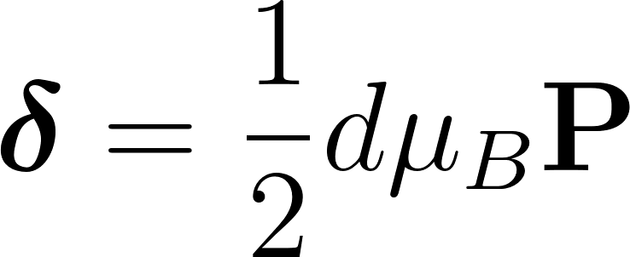
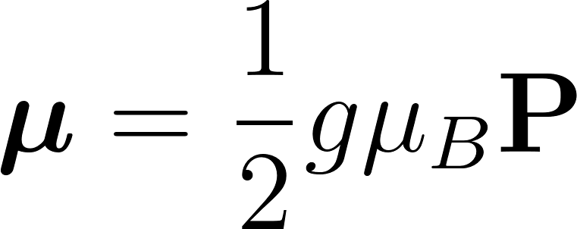
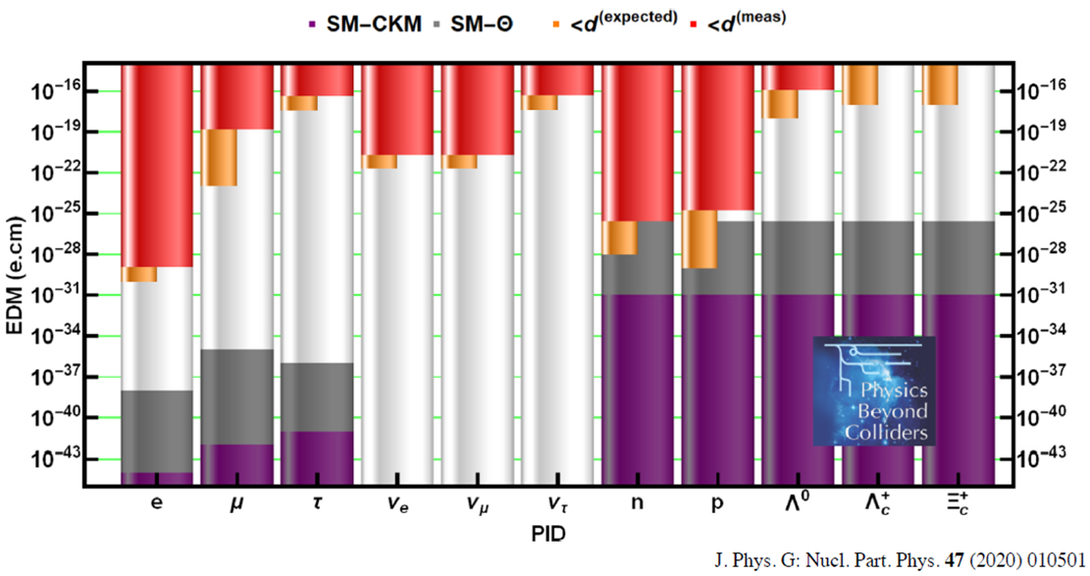
𝝠 electromagnetic dipole moments: why?
In a quantum system, for spin ½ particles:
Electric dipole moment (EDM)
SM prediction (from neutron EDM): EDM < 10⁻²⁶ e cm [1] → sensitive to physics Beyond the Standard Model at the current experimental sensitivity
Magnetic dipole moment (MDM)
MDM measurement of particle and anti-particle → CPT invariance test: never performed for 𝝠 baryons
MDM measurement → experimental test of low-energy QCD models, related to non-perturbative QCD dynamics + sensitive to internal baryon dynamics [2]
[1] Phys. Lett. B 291 (1992) 293
[2] Eur. Phys. J. C (2017) 77:181
Giorgia Tonani 07/03/2024 2

Slide 4
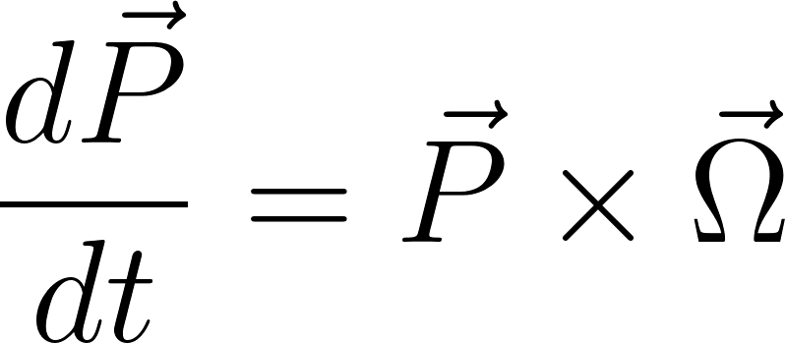
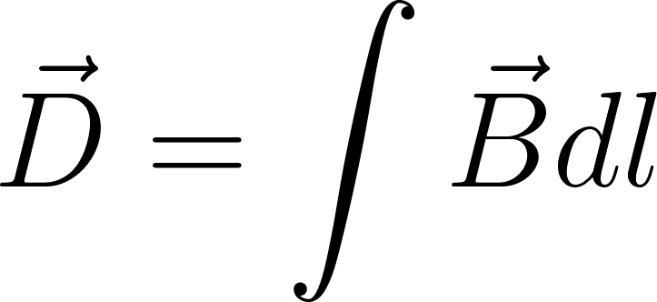
𝝠 electromagnetic dipole moments: how?
[1] Phys. Rev. Lett., 2:435–436, May 1959
METHOD: spin polarization precession in a magnetic field
Dynamics of spin in an external magnetic field given by the T-BMT equations [1], in the lab frame:
MAGNET
π⁻
𝝠
p
𝝠 baryons are neutral particles, assuming E = 0 (as in LHCb detector)
In terms of flight length (l)
T-BMT equation of motion:
Giorgia Tonani 07/03/2024 3

Slide 5
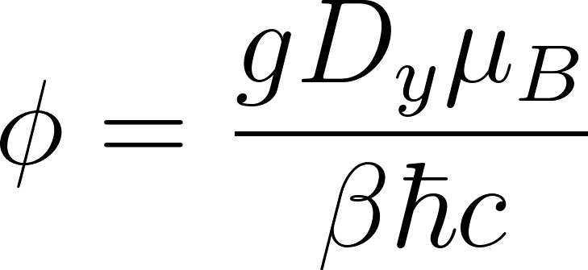
𝝠 electromagnetic dipole moments: how?
METHOD: spin polarization precession in a magnetic field
Dynamics of spin in an external magnetic field given by the T-BMT equations
y
π⁻
MAGNET
Ingredients:
source of polarized
and
magnetic field
detector
z
𝝠
p
Precession angle:
Sensitivity: 𝝈 ∝
[1] Eur. Phys. J. C (2017) 77:181
Giorgia Tonani 07/03/2024 4

Slide 6
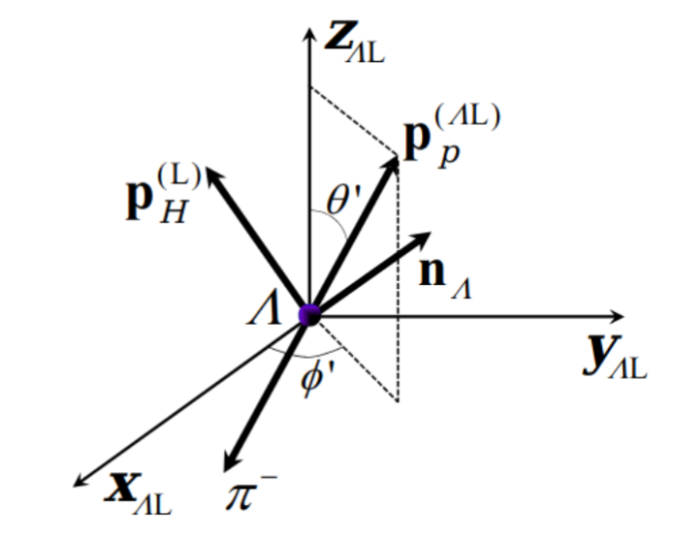
Polarization measurement
Polarization extracted from the angular distribution of the proton in the 𝝠 rest frame (𝝠 → p 𝜋⁻: ½ → ½ 0) [1]
𝜶: decay asymmetry parameter, fixed from world average
: helicity angles of the proton in the 𝝠 rest frame
[1] J. D. Richman, Calif. Inst. Technol., Pasadena, CA, 1984
Giorgia Tonani 07/03/2024 5

Slide 7
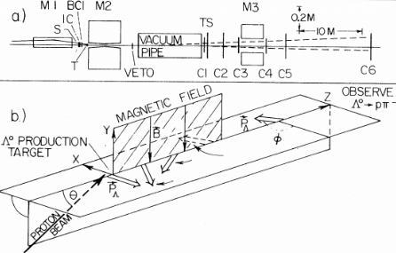
State of the art
Fermilab, 1981 [1,2]
Fixed target p-Be
strong production: Λ polarization normal to the production plane
p ~ 60-250 GeV/c → decay length of 10 m and precession angle of 150°
D max 15 Tm
P₀ ~ 8% , not polarized
~ 3 x 10⁶ signal events
Current Λ EDM limit: Λ EDM < 1.5 x 10 ⁻¹⁶ ecm with 95% C.L.
Current measured Λ MDM: 0.613 ± 0.004 μ_{N}
Performed with the old value of the 𝜶 parameter need to be updated with the new one and improved!
[1] P. Skubic et al., Phys. Rev.D18(1978) 3115 [2]L. Pondrom et al., Phys. Rev. D23 (1981) 814
Giorgia Tonani 07/03/2024 6

Slide 8
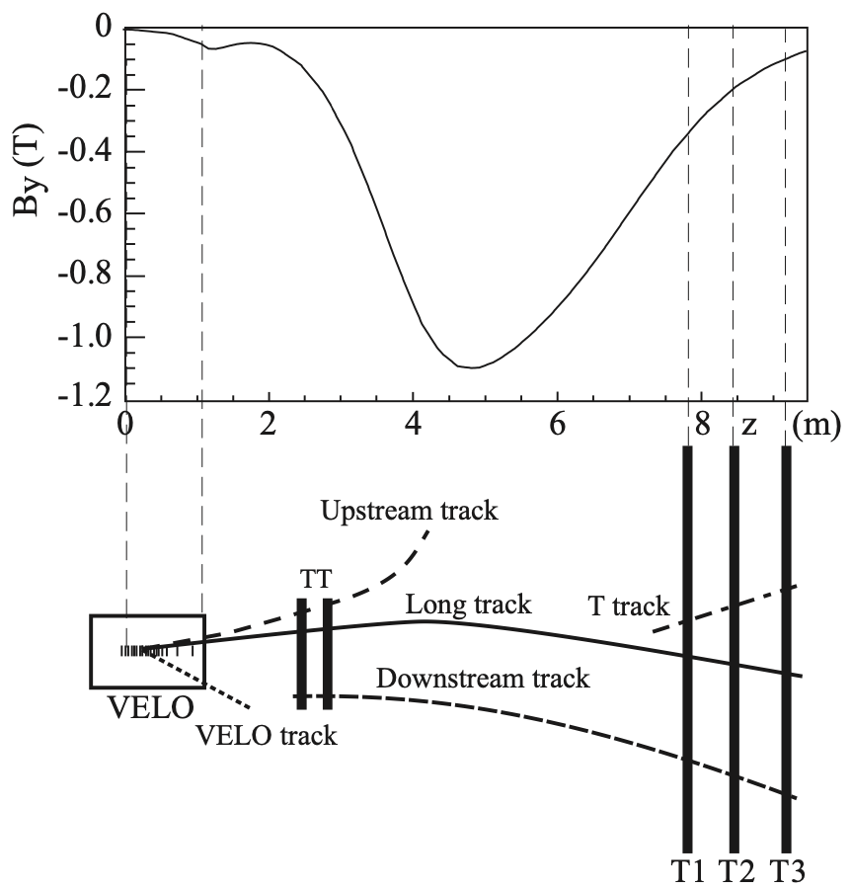
Measurement at LHCb
Ingredients:
Source of polarized and :
weak production from b- and c-baryons decays
→ possibility to access P₀~ 100% → factor 10 in sensitivity
equal production of and baryons
Precession angle: 45°
Magnetic field: dipole magnet, D ~ 4 Tm, precision ~ 4 10⁻⁴
Detector: LHCb experiment
Sensitivity: 𝝈 ∝
[1] Eur. Phys. J. C (2017) 77:181
Giorgia Tonani 07/03/2024 7

Slide 9
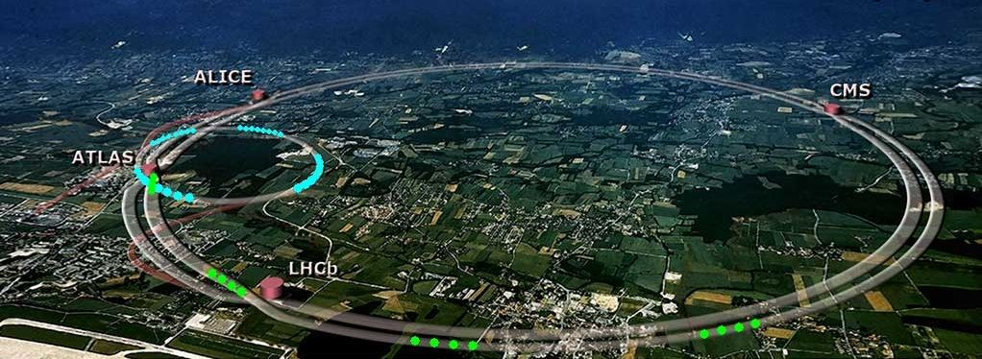
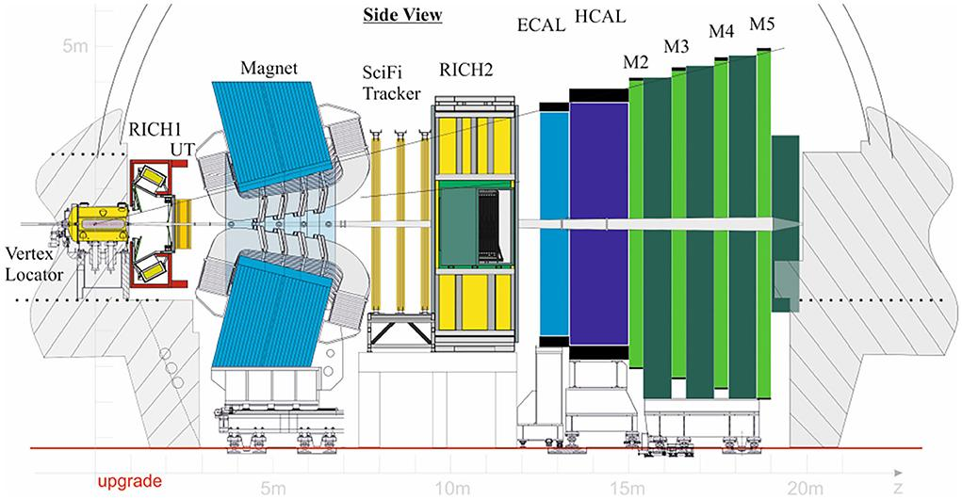
LHCb experiment
General-purpose single-arm forward spectrometer [1]
Pseudorapidity range 2 < 𝜂 < 5
Optimized to study particles containing b and c quarks
Tracking system
Particle Identification system
Fully software trigger
[1] LHCb Detector Performance, Int.J.Mod.Phys.A 30 (2015) 07, 1530022
Giorgia Tonani 07/03/2024 8

Slide 10
Source of polarised 𝝠 baryons: topologies
Produced N_{𝝠} = 1.2 10⁶ / fb⁻¹
Produced N_{𝝠} = 24 10¹⁰ / fb⁻¹
We need to take into account the geometric acceptance, the trigger and reconstruction efficiencies
Giorgia Tonani 07/03/2024 9

Slide 11
First measurement
Two body decay, with 100% initial polarization (P₀) of the 𝝠 baryon already measured by LHCb and ATLAS collaborations [1], [2].
Efficient trigger on J/Ѱ→𝝁⁺ 𝝁⁻, already available during Run 1 and 2 (LHCb Run 1: 2011-2012 3 fb⁻¹ + LHCb Run 2: 2015-2018 6 fb⁻¹)
Analysis ongoing to perform a first proof of principle measurement
Expected to reach a sensitivity comparable to the current experimental best limits on EDM and MDM
[1] LHCb collab, J. High Energ. Phys. 2020, 110 (2020)https://doi.org/10.48550/arXiv.2004.10563
[2] ATLAS Collaboration, Phys. Rev. D, 89:092009, May 2014
Giorgia Tonani 07/03/2024 10

Slide 12
Electromagnetic dipole moments: experimental method
strange
Polarization precession in electromagnetic field: Λ at LHCb experiment
𝝠_{b} → J/𝜓(𝝁⁺ 𝝁⁻)𝝠(pπ⁻)
T1 T2 T3
MAGNET
x [m]
π⁻
UT
B
1
VELO
𝝠
𝝁⁺
p
J/𝜓
𝝁⁻
-1
INITIAL POLARIZATION P₀
z [m]
1 5 10
[1] Eur. Phys. J. C (2017) 77:181
Giorgia Tonani 07/03/2024 11

Slide 13
Electromagnetic dipole moments: experimental method
strange
Polarization precession in electromagnetic field: Λ at LHCb experiment
𝝠_{b} → J/𝜓(𝝁⁺ 𝝁⁻)𝝠(pπ⁻)
T1 T2 T3
MAGNET
π⁻
x [m]
TT
B
1
p
VELO
𝝠
𝝁⁺
J/𝜓
𝝁⁻
-1
INITIAL POLARIZATION P₀
FINAL
POLARIZATION P_{f}
z [m]
1 5 10
[1] Eur. Phys. J. C (2017) 77:181
Giorgia Tonani 07/03/2024 11
Giorgia Tonani 3

Slide 14
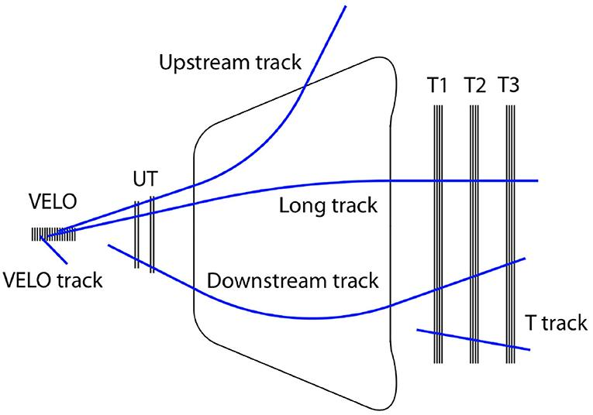
Track reconstruction in LHCb
Need to reconstruct particles downstream of the magnetic field
Use of T tracks → experimental challenge:
developed new ad-hoc reconstruction techniques
Giorgia Tonani 07/03/2024 12

Slide 15
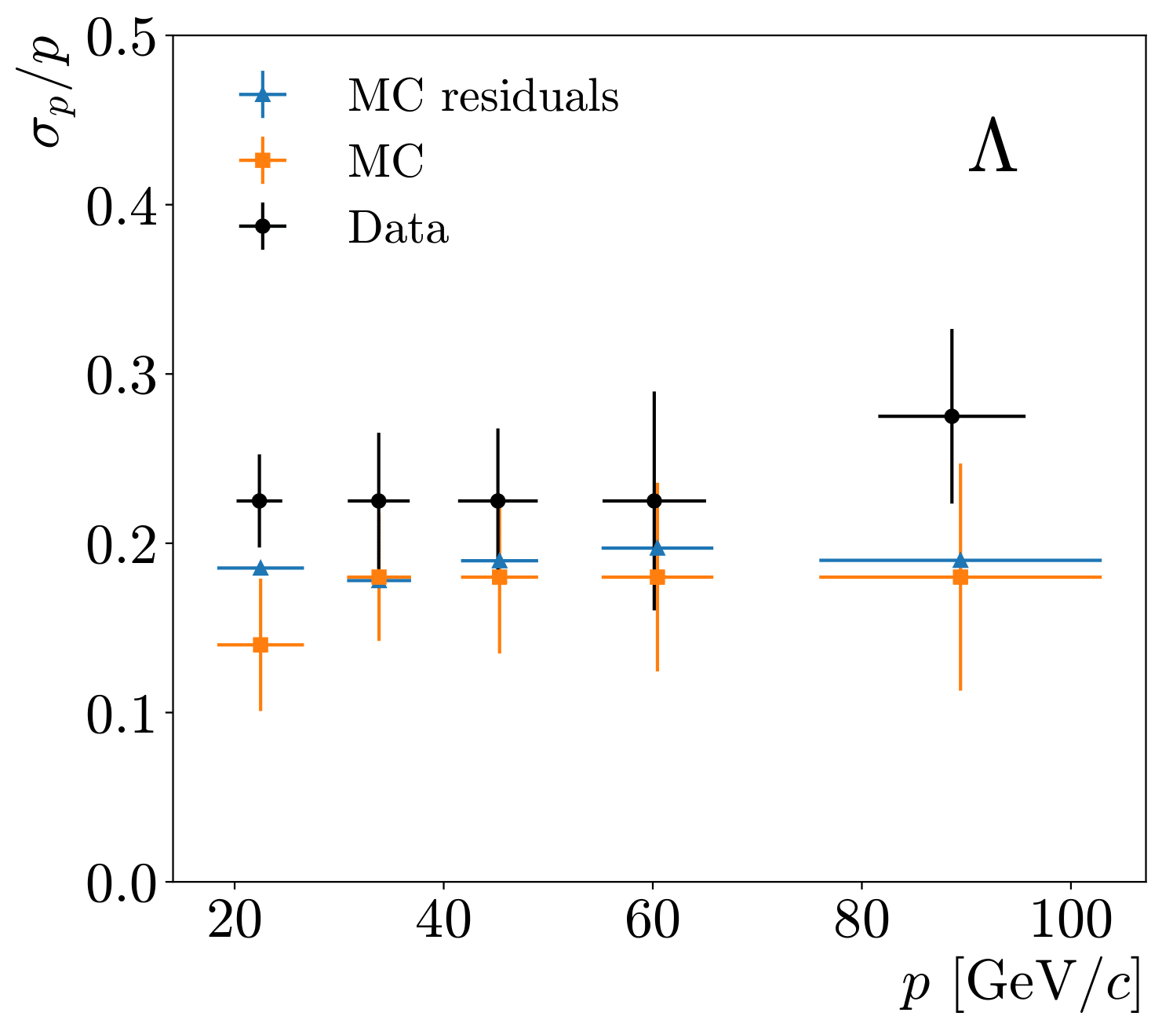
T tracks reconstruction
Reconstruction challenges linked to
low magnetic field
few tracking stations
poor momentum resolution of ~20% (0.5-1% for Long tracks)
[1] LHCb Collab, CERN-LHCb-DP-2022-001
Giorgia Tonani 07/03/2024 13

Slide 16
Improvement of the momentum resolution
bottom-up decay tree fit via a ‘leaf-by-leaf‘ approach
Not in scale
p
π
Velo TT T1 T2 T3
Giorgia Tonani 07/03/2024 14

Slide 17
Improvement of the momentum resolution
bottom-up decay tree fit via a ‘leaf-by-leaf‘ approach
Not in scale
p
π
Velo TT T1 T2 T3
Giorgia Tonani 07/03/2024 14

Slide 18
Improvement of the momentum resolution
bottom-up decay tree fit via a ‘leaf-by-leaf‘ approach
Not in scale
μ-
μ+
p
π
Velo TT T1 T2 T3
Giorgia Tonani 07/03/2024 14

Slide 19
Improvement of the momentum resolution
bottom-up decay tree fit via a ‘leaf-by-leaf‘ approach
Decay Tree Fitter algorithm [1]:
Complete decay chain fitted simultaneously
Possibility to fix mass and primary vertex constraints
Not in scale
μ-
μ+
J/ψ
p
Λ⁰_{b}
Λ
π
Velo TT T1 T2 T3
[1] Hulsbergen W. Nuclear Instruments and Methods in Physics Research Section A, Volume 552, Issue 3, p. 566-575
Giorgia Tonani 07/03/2024 14

Slide 20
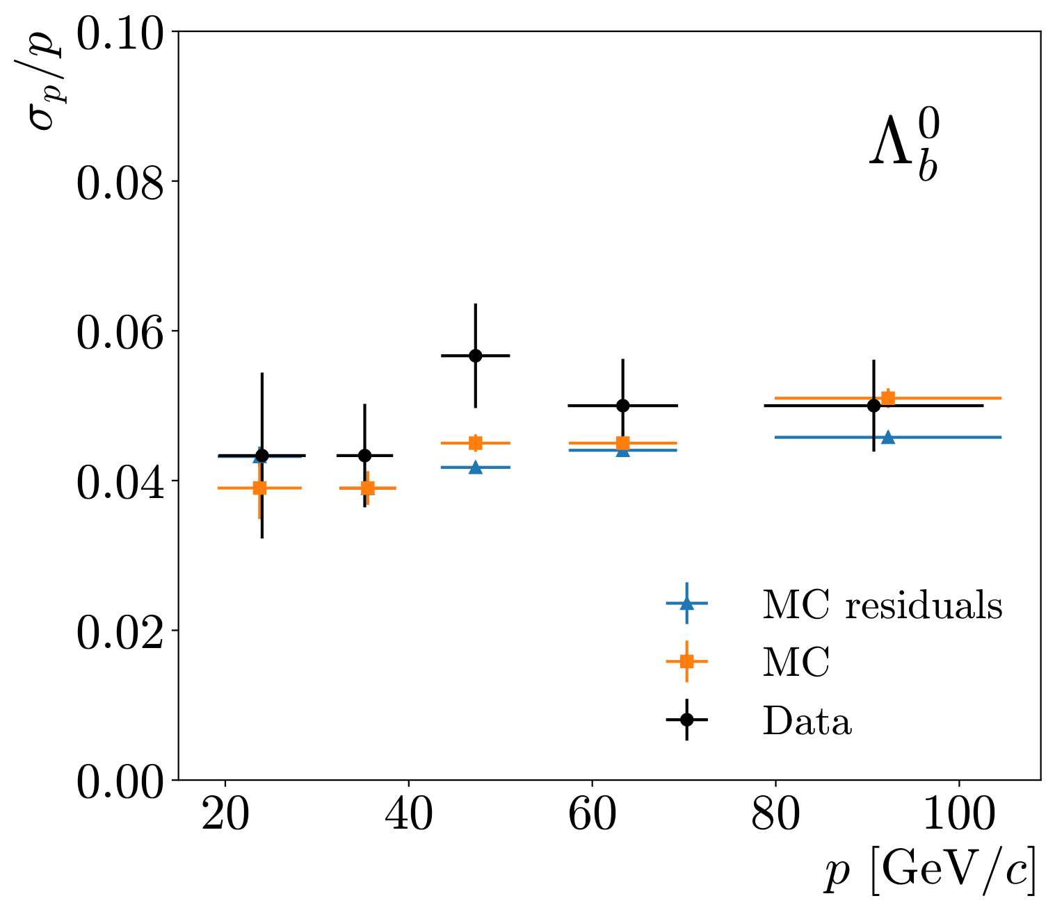
T tracks reconstruction
poor momentum resolution of ~20% (0.5-1% for Long tracks)
Resolution improvement using DTF: ~4.5%
On data we have about a factor 5 improvement
DTF
Giorgia Tonani 07/03/2024 15

Slide 21
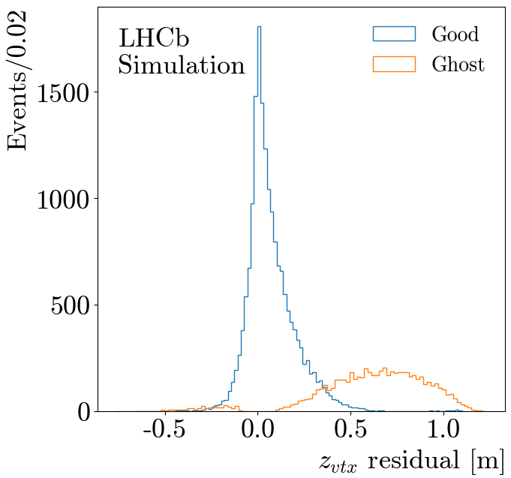
T tracks reconstruction
Reconstruction challenges linked to
low magnetic field
few tracking stations
poor momentum resolution of ~20% (0.5-1% for Long tracks)
vertex reconstruction resolution of 10 cm (100 μm for Long tracks)
Giorgia Tonani 07/03/2024 16

Slide 22
T tracks reconstruction
Reconstruction challenges linked to
low magnetic field
few tracking stations
poor momentum resolution of ~20% (0.5-1% for Long tracks)
vertex reconstruction resolution of 10 cm (100 μm for Long tracks)
closing-track topology for Λ baryons (Ghost vertex)
Giorgia Tonani 07/03/2024 16

Slide 23
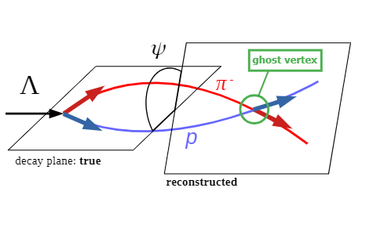
“Ghost vertices” and closing-track topology
low Q-value → small opening angle
poor momentum resolution
Standard vertexing algorithm cannot discriminate between the true and ghost vertex
Giorgia Tonani 07/03/2024 17
Giorgia Tonani 14

Slide 24
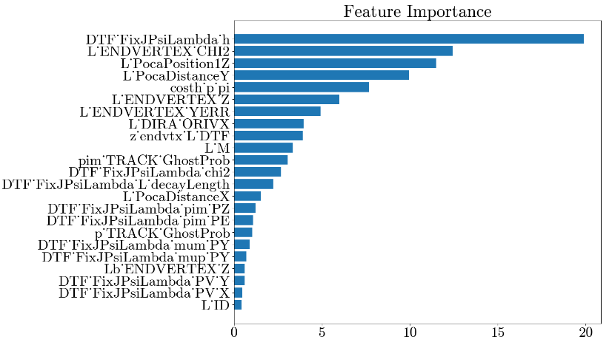
Identifying ghosts with a BDT
CatBoost Classifier
Trained with variable related to the topology: vertices and momenta
AUC = 0.84
After applying the BDT cut: from 30% to 6% of ghosts in the test set
Giorgia Tonani 07/03/2024 18
Giorgia Tonani 19

Slide 25
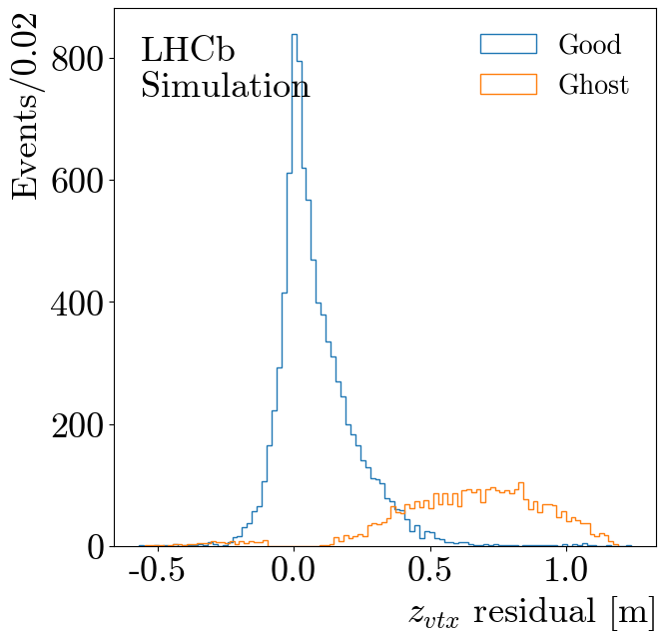
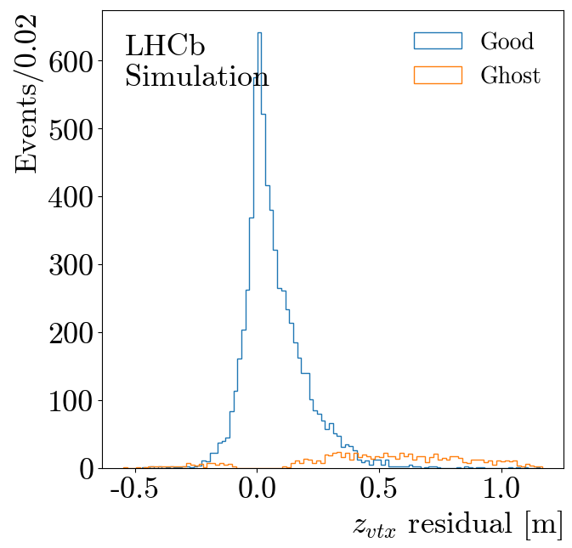
Removing ghosts with a BDT
30%
6%
After BDT
Giorgia Tonani 07/03/2024 19
Giorgia Tonani 19

Slide 26
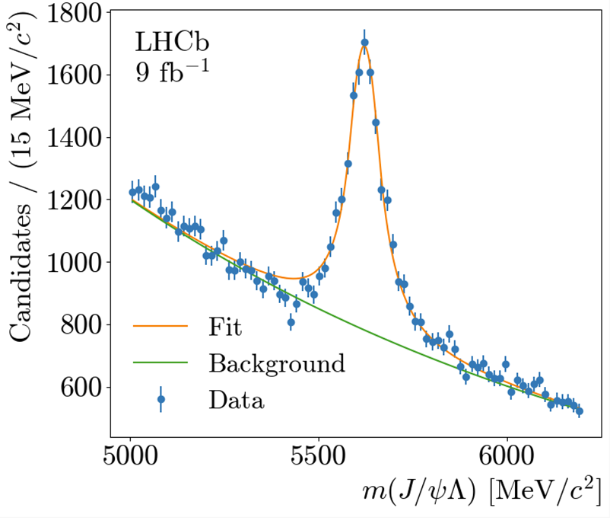
Signal candidates
Core mass resolutions of 7.7 ± 0.4 and 74.4 ± 0.6 MeV/c² for 𝝠 and 𝝠_{b}⁰ respectively
Samples of 9056 𝝠_{b}⁰ → J/𝜓 𝝠 signal events reconstructed
Giorgia Tonani 07/03/2024 20
Giorgia Tonani 3

Slide 27
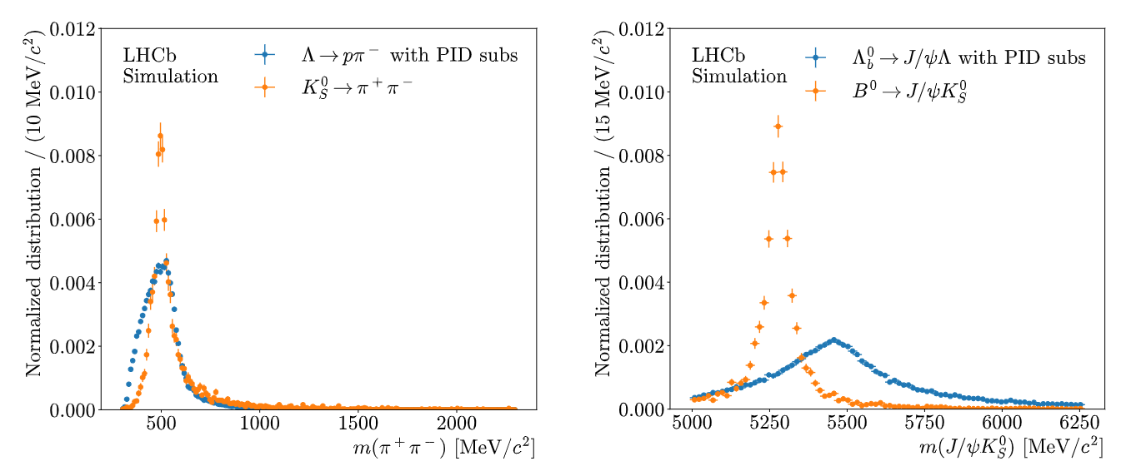
Background rejection improvement
No Particle IDentification information available for T tracks → protons and pions misidentification cross-fed background
Possibility to improve the K_{s}⁰ background rejection with
PID information addition
PID currently added exploiting RICH2 subdetector, new results with PID are not shown in this presentation
Giorgia Tonani 07/03/2024 21

Slide 28
Sensitivity to the final measurement
Angular resolution
flight distance resolution → vertex resolution
statistics
Spin precession
Giorgia Tonani 07/03/2024 22
Giorgia Tonani 12

Slide 29
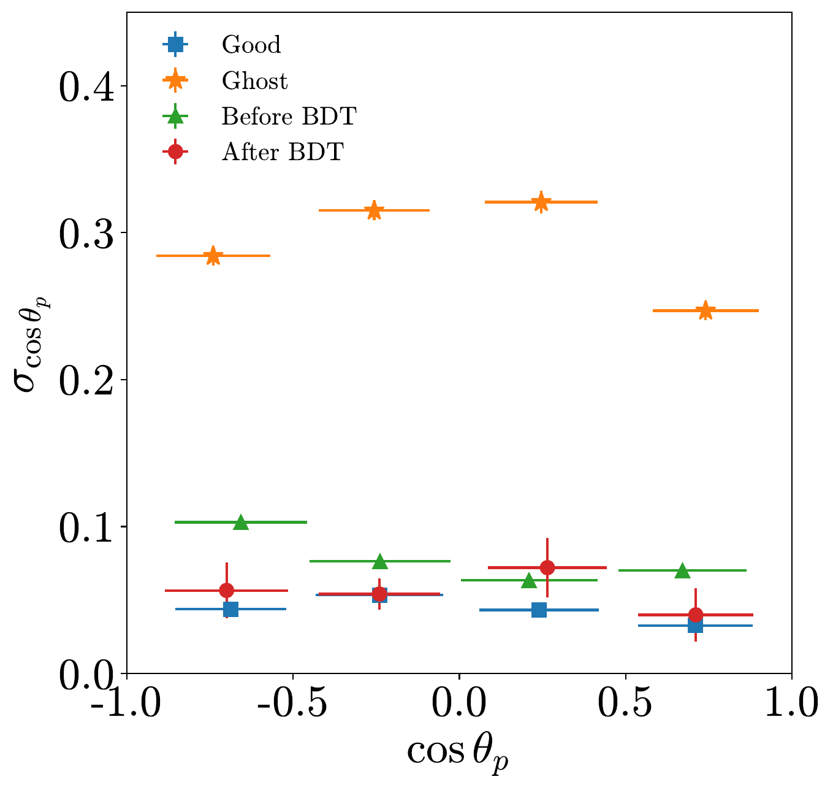
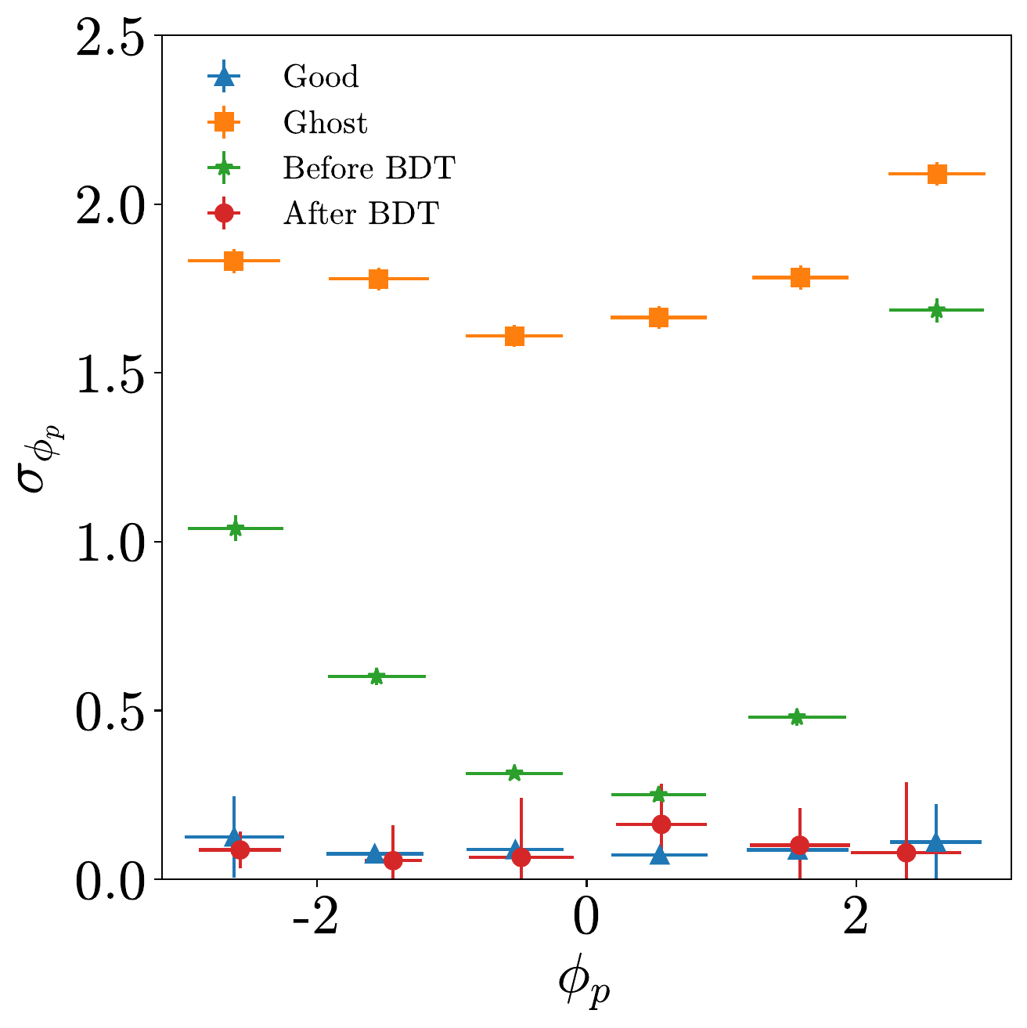
Angular resolution
LHCb
Simulation
LHCb
Simulation
The angular resolution is affected by the “ghost vertex”
Improved resolution after the ghost removal with the BDT algorithm
Giorgia Tonani 07/03/2024 23
Giorgia Tonani 13

Slide 30
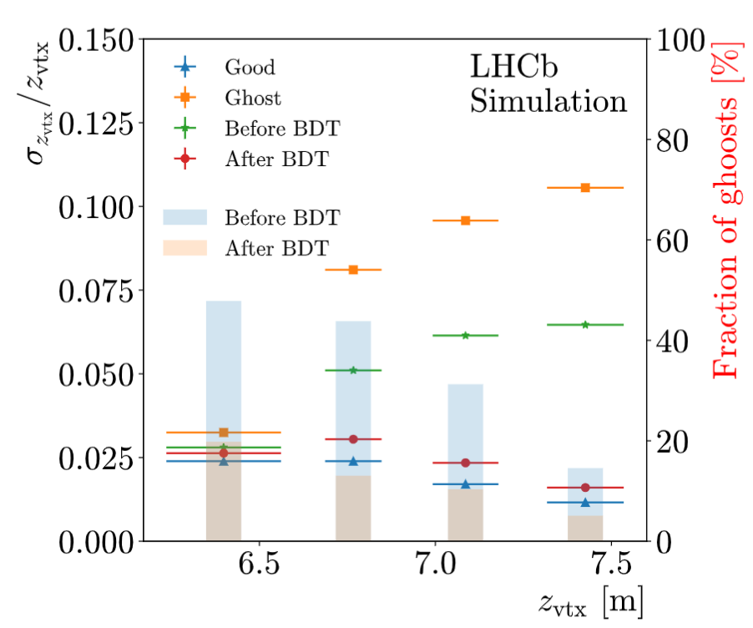
Vertex resolution
Ghost removal impacts significantly also the vertex resolution
Resolution with ghost: 6%
Resolution after ghost removal: 2.4%
Giorgia Tonani 07/03/2024 24
Giorgia Tonani 23

Slide 31
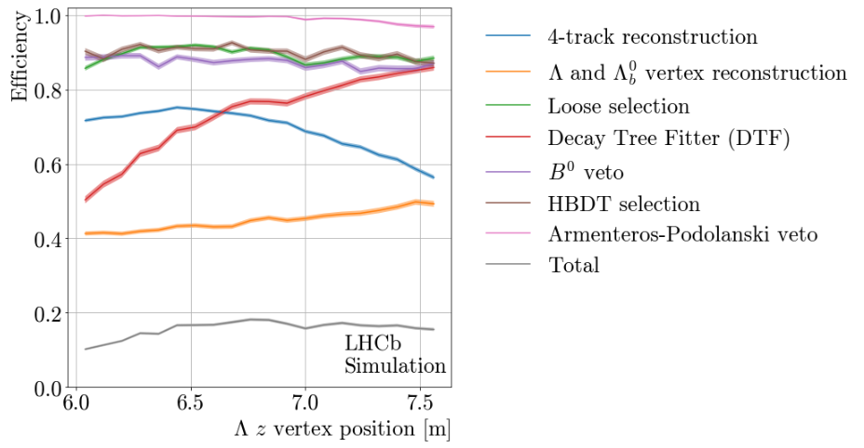
Efficiency recovery: vertexing algorithm
Vertexing algorithm is the bottleneck:
Poor momentum resolution → about 50% failure
use directly DTF +22% signal yield on data
Giorgia Tonani 07/03/2024 25
Giorgia Tonani 23

Slide 32
Towards the dipole moments measurement…
Possibility to measure EDM and MDM of the 𝝠 baryon at LHCb experiment: exploiting the spin precession in LHCb magnetic field
Analysis of the EMDM ongoing for 𝝠_{b} → J/𝜓(𝝁⁺ 𝝁⁻) 𝝠(pπ⁻) decays: expected a sensitivity comparable to literature with Run 1 + 2 (~ 10k events)
To be completed by the end of 2024 for my PhD
Development of techniques scalable to other decays
Possibility to improve the measurement with Run3 data and beyond
Giorgia Tonani 07/03/2024 26
Giorgia Tonani

Slide 33
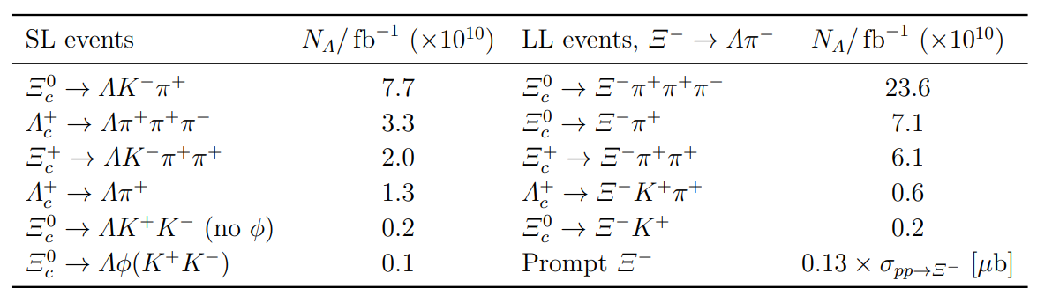
Program of measurements: Run 1+2
Run 1: 2011-2012 3 fb⁻¹ + Run 2: 2015-2018 6 fb⁻¹
beauty decays:
charm decays, higher cross section wrt beauty:
First measurement
Initial polarization measurement ongoing
observed a dilution in the polarization in SL decays, more focus on LL
Final polarization measurement not possible, no trigger for T tracks available
Giorgia Tonani 07/03/2024 27

Slide 34
Program of measurements: Run 3
Run 3: 2022-2025, expected 50 fb⁻¹
New fully software trigger, development of dedicated trigger lines for all the decays:
Charm decays: number of 𝝠 produced is few (2-5) orders of magnitude greater than that in b-decays. Triggers ready for Run 3
Semi-leptonic decays: production ratio factor 200 greater than that in the 𝝠_{b} → J/𝜓(𝝁⁺ 𝝁⁻) 𝝠(pπ⁻) decay. More difficulties in the reconstruction, work in progress
Giorgia Tonani 07/03/2024 28

Slide 35
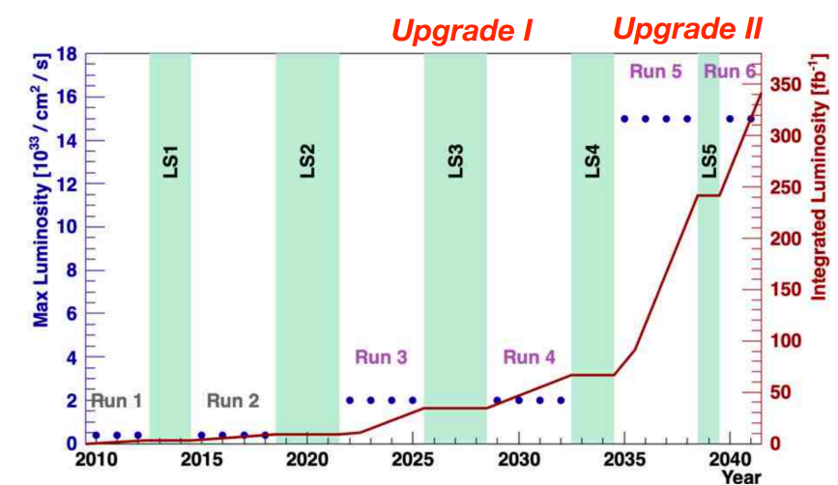
Future prospects
Current limit Λ EDM: Fermilab, 1981, fixed target experiment Λ EDM < 1.5 × 10⁻¹⁶ ecm, with 95% C.L.
Expected improvement Λ EDM: LHCb project, sensitivity reachable σ_{δ} ≈1.3×10⁻¹⁸ ecm
with 50 fb⁻¹ data
Current measured value Λ MDM:
μ = 0.613±0.004 μ_{N}
Expected improvement Λ MDM: sensitivity reachable σ_{μ} ≈ 10⁻⁴μ_{N} with 50 fb⁻¹ data ⇒ first CPT test at 10⁻⁴ level with Λ baryons
LHCb plans to run up to 2041 and reach 300 fb⁻¹ data ⇒ possibility to reach even better sensitivity in a long time scale
Giorgia Tonani 07/03/2024 29

Slide 36
Backup

Slide 37
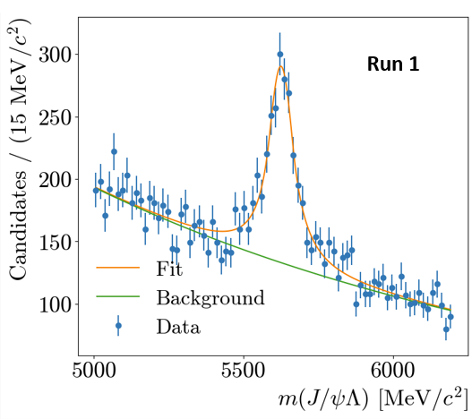
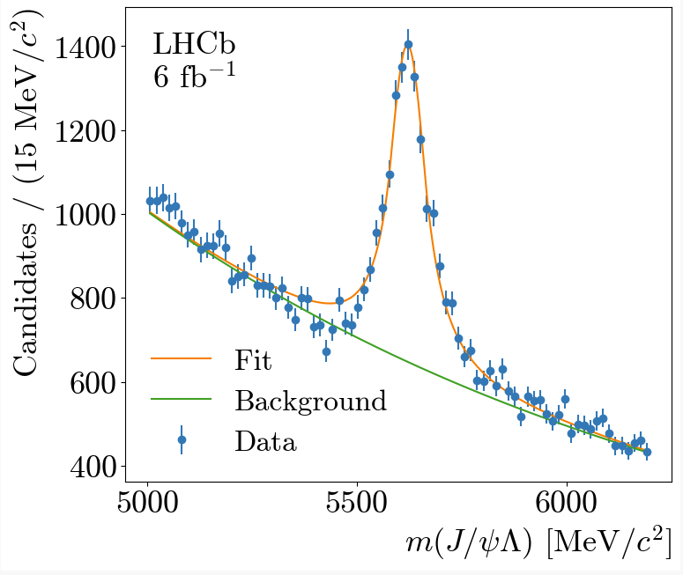
Increase in statistics
VF + DTF
Change of vertexing approach: + 22% increase on data
Run 1 data: + 1500 events
Total of about 9000 signal candidates selected
Proof of principle analysis: expected a sensitivity to EDM comparable to the Fermilab one
DTF only
Sensitivity: 𝝈 ∝
Giorgia Tonani 07/03/2024 21

Slide 38
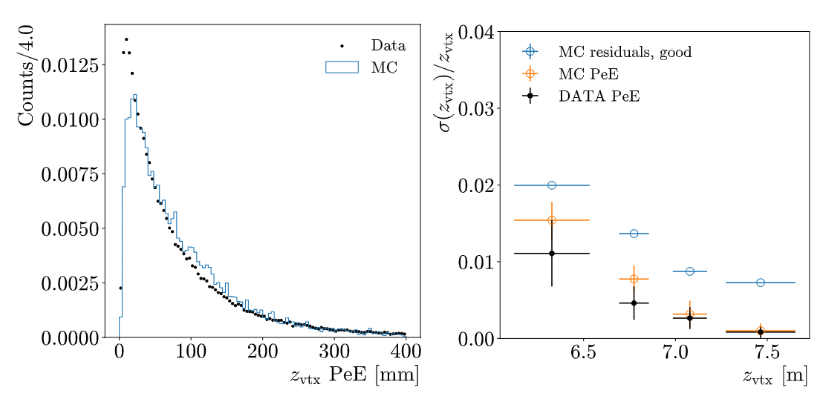
B⁰ → J/𝜓(𝝁⁺ 𝝁⁻) K_{s}⁰(π⁺π⁻) and vertex resolution
Data error bars need to be added
Giorgia Tonani 2

