Slide 1
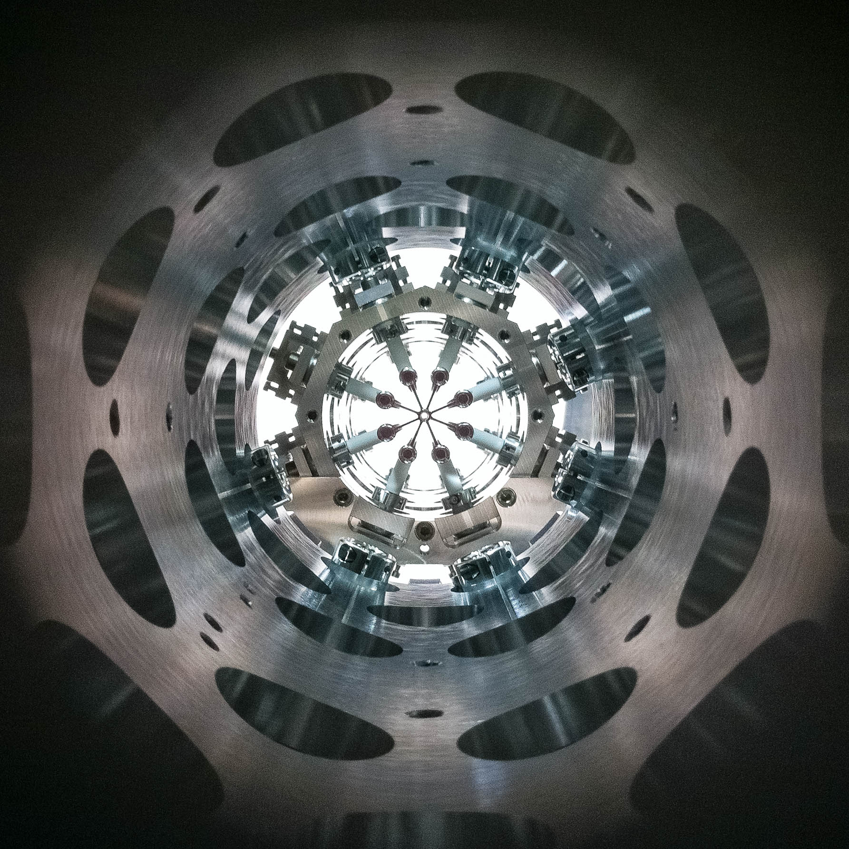
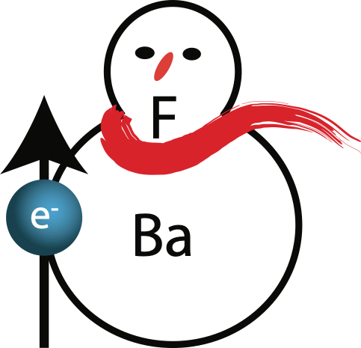
Probing the electron-EDM
with slow and trapped molecules
Steven Hoekstra, University of Groningen and Nikhef, The Netherlands

Slide 2



Probing the electron-EDM
with slow and trapped molecules
Particle physics theory | Quantum chemistry | Experiments
Jordy de Vries Heleen Mulder Rob Timmermans | Anastasia Borschevsky Lukas Pastecka Agustin Aucar Yuly Chamorro Effion Prinsen | Steven Hoekstra Lorenz Willmann Rick Bethlem Wim Ubachs Roman Bause Lucas van Sloten Joost van Hofslot Maarten Mooij Anno Touwen Bart Schellenberg Ties Fikkers Jelmer Levenga
VRIJE
UNIVERSITEIT
AMSTERDAM
Dutch National Institute for (astro)Particle Physics
UvA
Steven Hoekstra, University of Groningen and Nikhef, The Netherlands

Slide 3
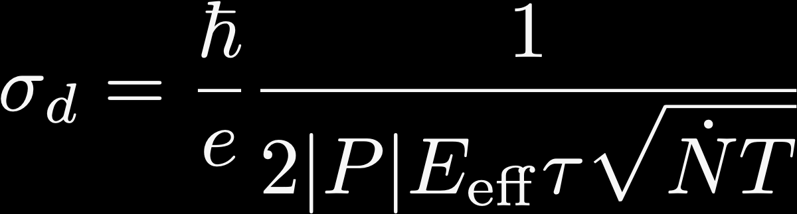




Increasing the eEDM sensitivity
Measure shift of molecular energy level that correlates with electric field direction reversal
statistical error:
Cold Molecules
Number of detected molecules
Effective electric field
Coherent interaction time
F
Ba
polar
molecule

Slide 4



Towards longer coherent interaction times
slow beam
trap
fast beam
fountain
𝜏 ~ 1-10 s
𝜏 ~ 100 ms
L ~ 0.5 mm
𝜏 ~ 1-2 ms
𝜏 ~ 15 ms
L ~ 0.5 m
L ~ 0.5 m
L ~ 0.5 m
v ~ 30 m/s
v ~ 250-500 m/s
L
L
molecules trapped in
laser focus
L
L
Main challenge:
how to maintain N while increasing t
Strongly connected to choice of molecule!
slow vertical beam

Slide 5
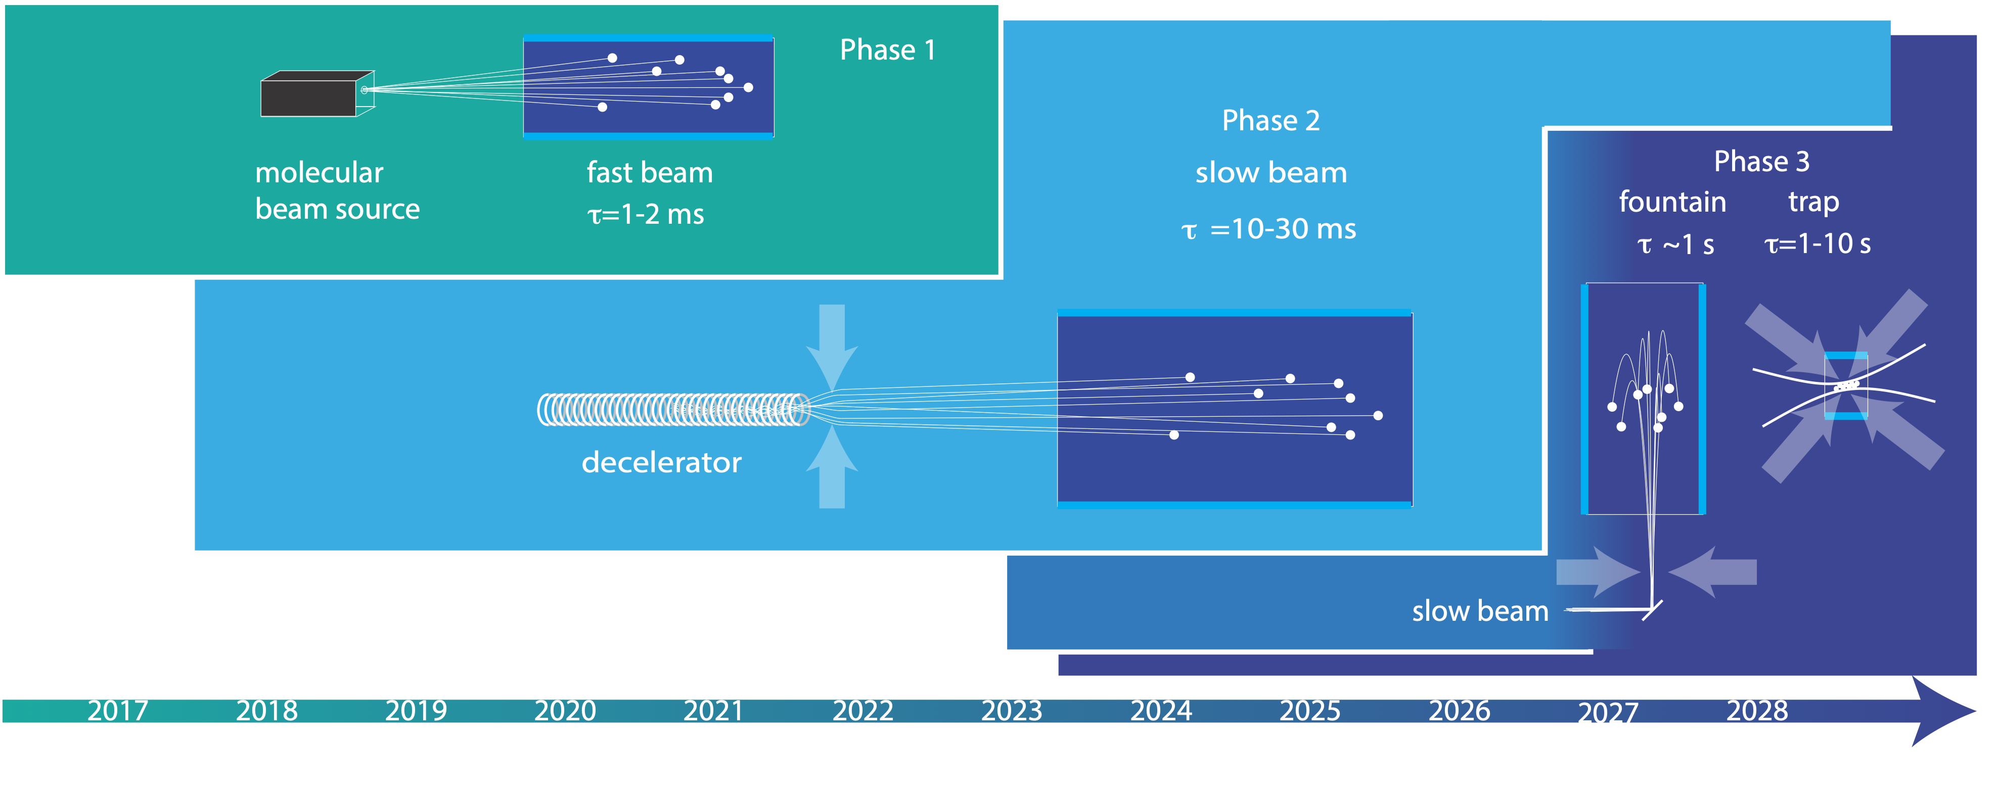
Cold molecules offer longer coherent interaction times
Cryogenic beam
Laser cooling
UvA
Dutch National Institute for (astro)Particle Physics

Slide 6
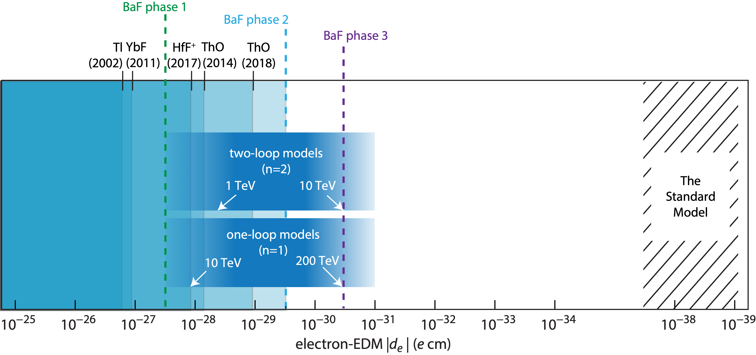
… with a corresponding increase in eEDM sensitivity!
HfF⁺
(2023)
(BaF limits are projected sensitivity)

Slide 7
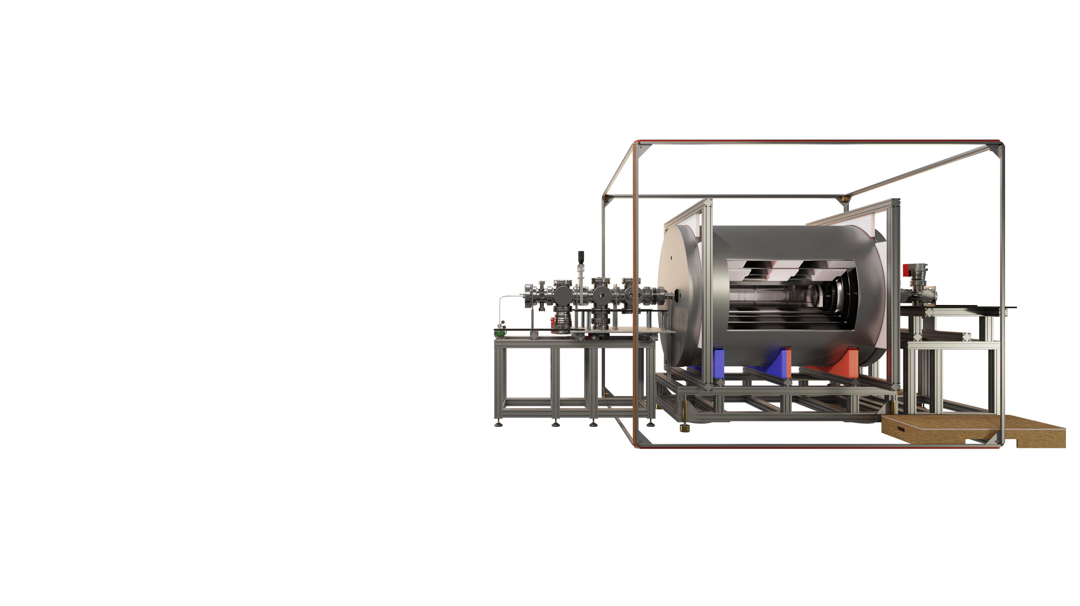
Phase 1: Fast beam
Supersonic beam (600 m/s)
Controlled field environment
Explore molecular structure
Spin interferometer measurement
Understand systematics

Slide 8
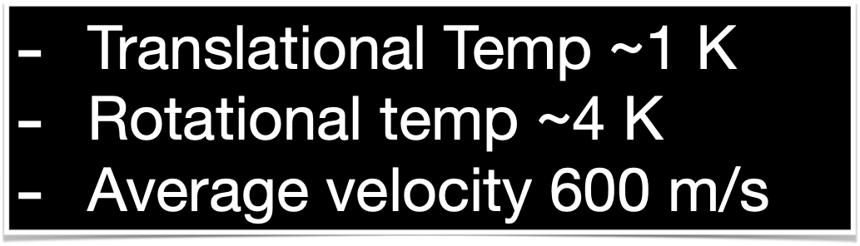
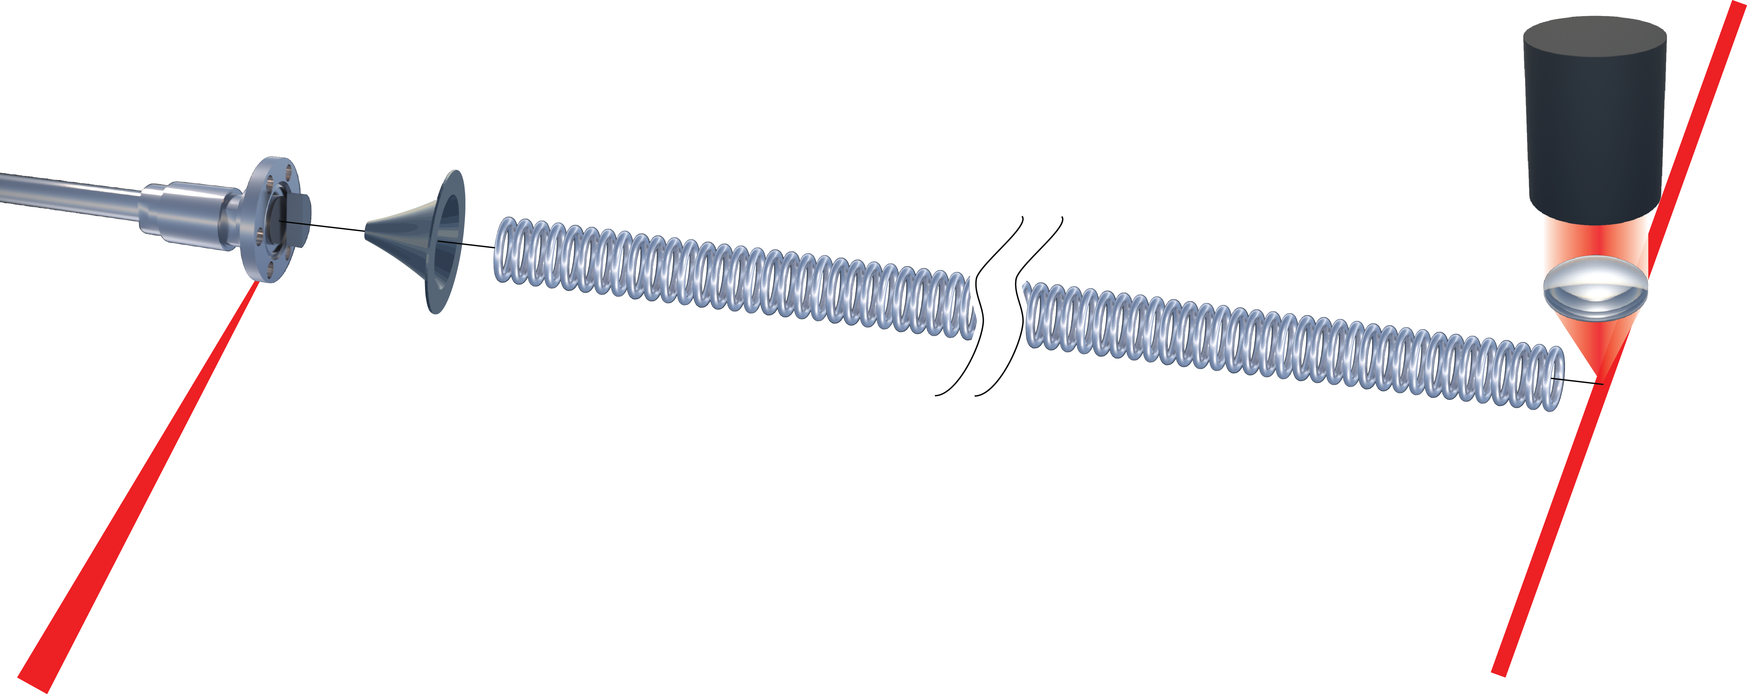

Supersonic beams
of SrF and BaF molecules
Fluorescence detection
Barium
target
Pulsed valve
Argon
SF6
Ablation laser
Detection laser
P. Aggarwal et al. A supersonic laser ablation beam source with narrow velocity spreads. Rev Sci Instrum 92, 033202 (2021).
P. Aggarwal et al. Lifetime measurements of the A ²Π1/2 and A ²Π3/2 states in BaF. Phys Rev A 100, 052503 (2019).

Slide 9
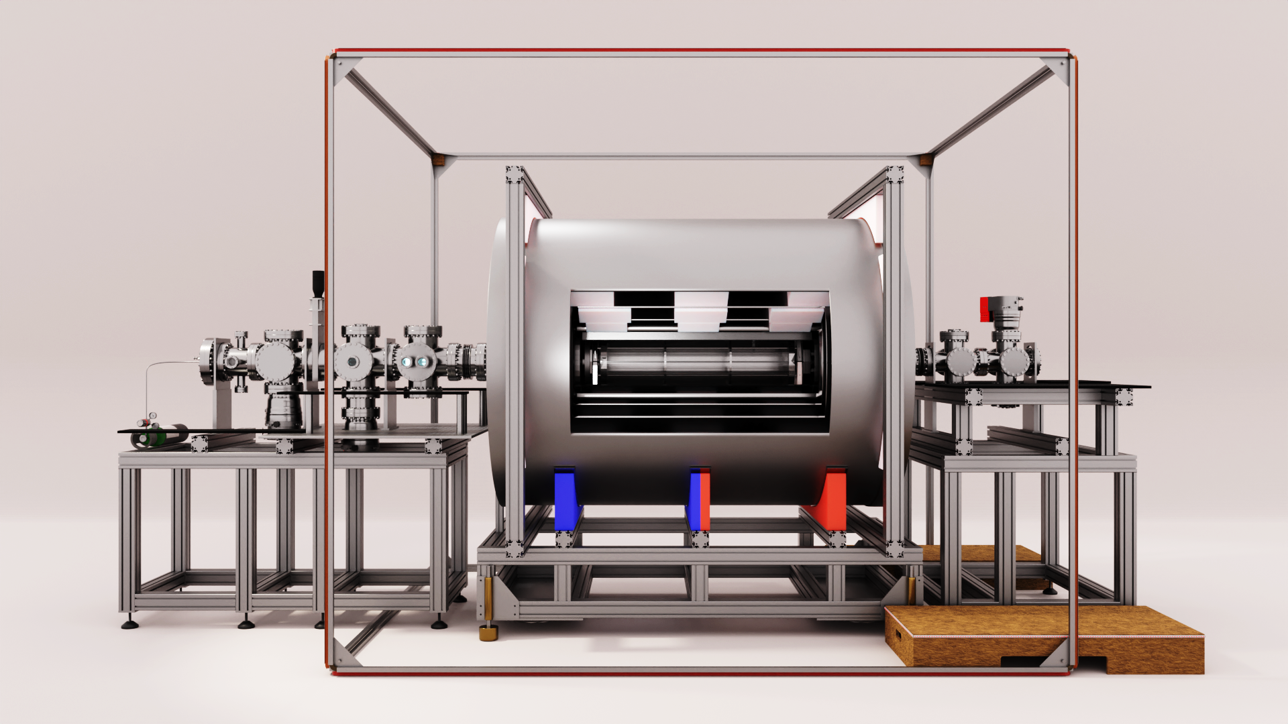
How to read out small energy shifts:
spin interferometer
Molecular beam
20 Hz
Pulsed laserlight

Slide 10
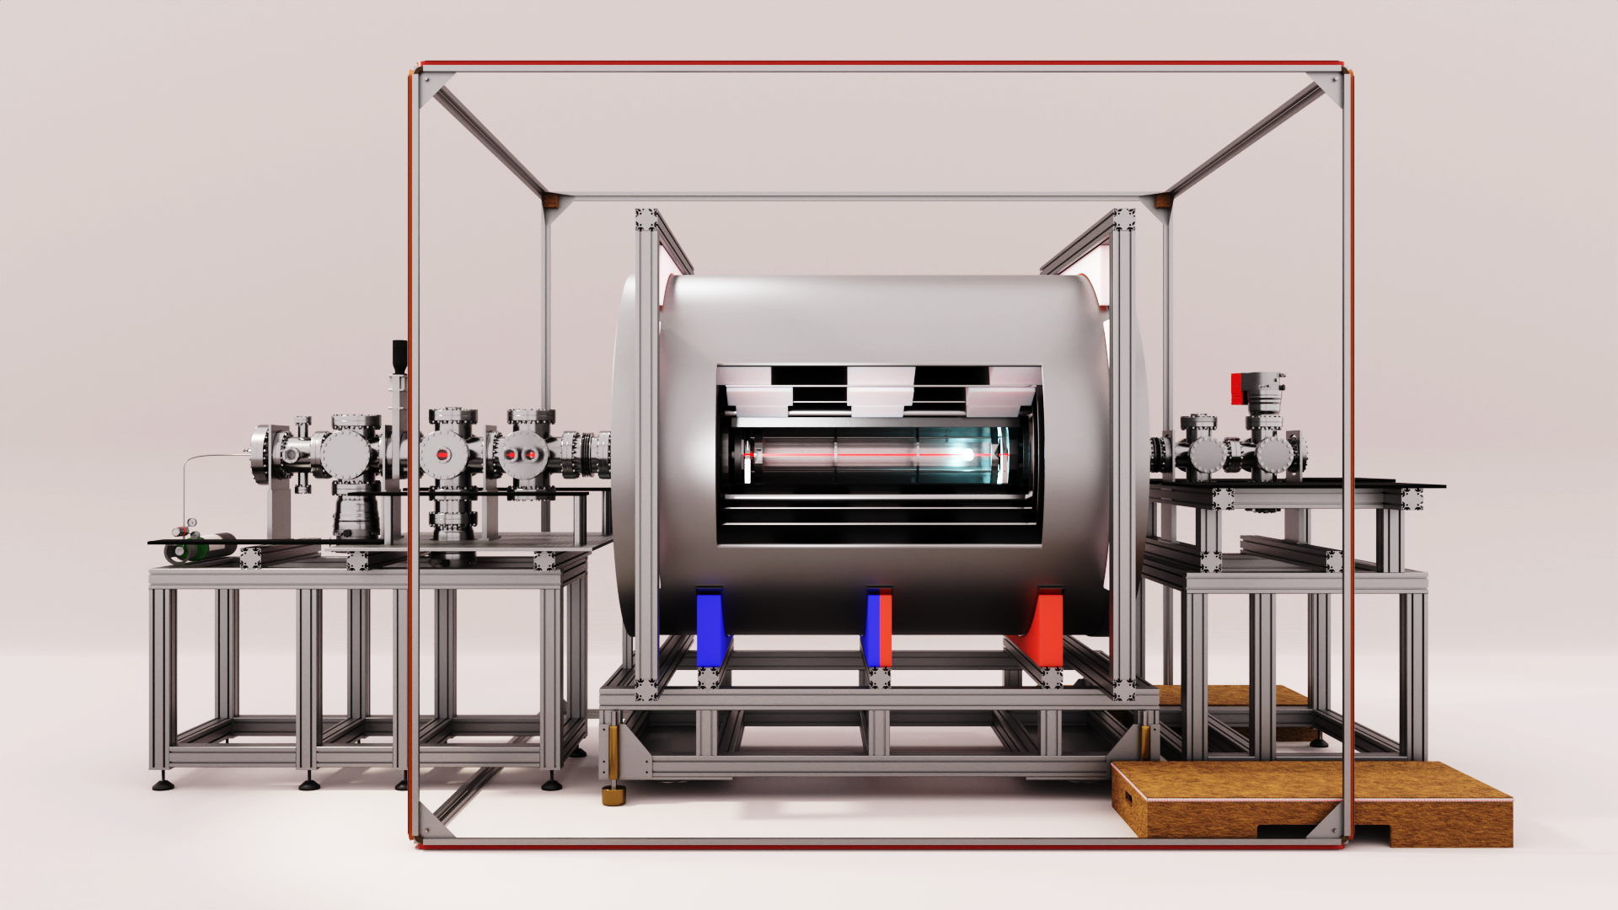
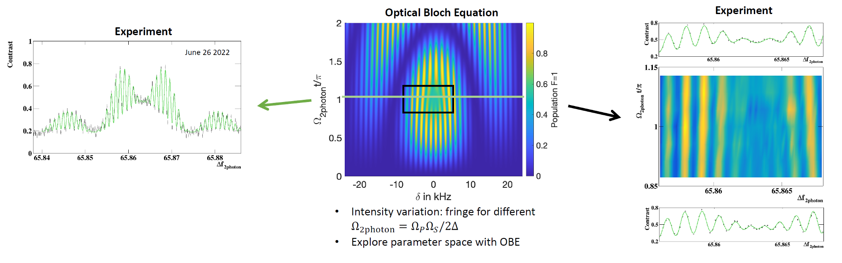

Interference data using fast molecular beam
to demonstrate control over systematic effects
Create molecular beam
Quantum interference
Readout by fluorescence
Compare to theory that includes the full interaction of the molecule with light, electric and magnetic fields
(optical Bloch equations)
Beautiful quantum interference!
Contains all relevant experimental parameters
Crucial for reduction of systematic effects
(A.Boeschoten et al, NL-eEDM collaboration,
arXiv:2303.06402v1)
NL-eEDM

Slide 11
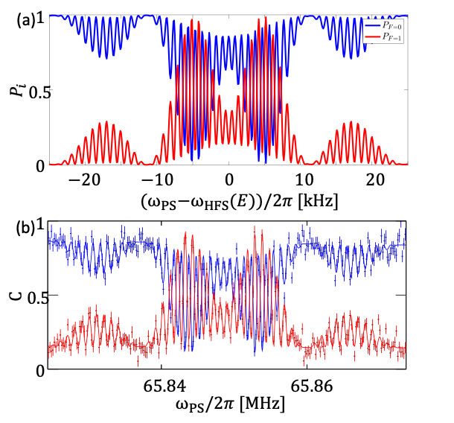
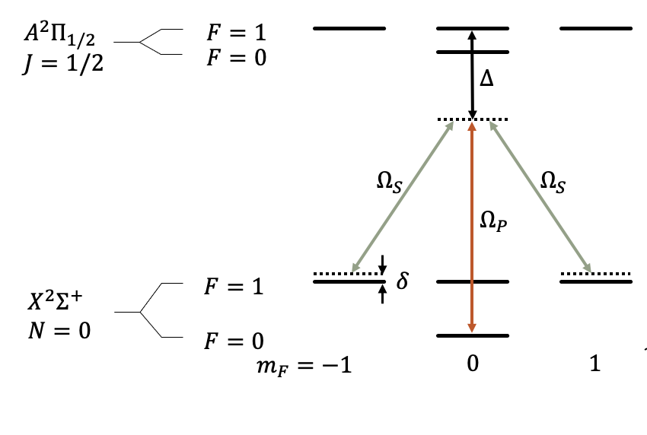
Experiment and theory
Optical Bloch equations

Slide 12
Current status
Phase 1: Fast beam
Construction completed
  source, lasers, magnetic shielding, DAQ, interference fringes
Routinely taking data - and moving to new lab….
Analysing for eEDM limit (expect at ~YbF level)

Slide 13
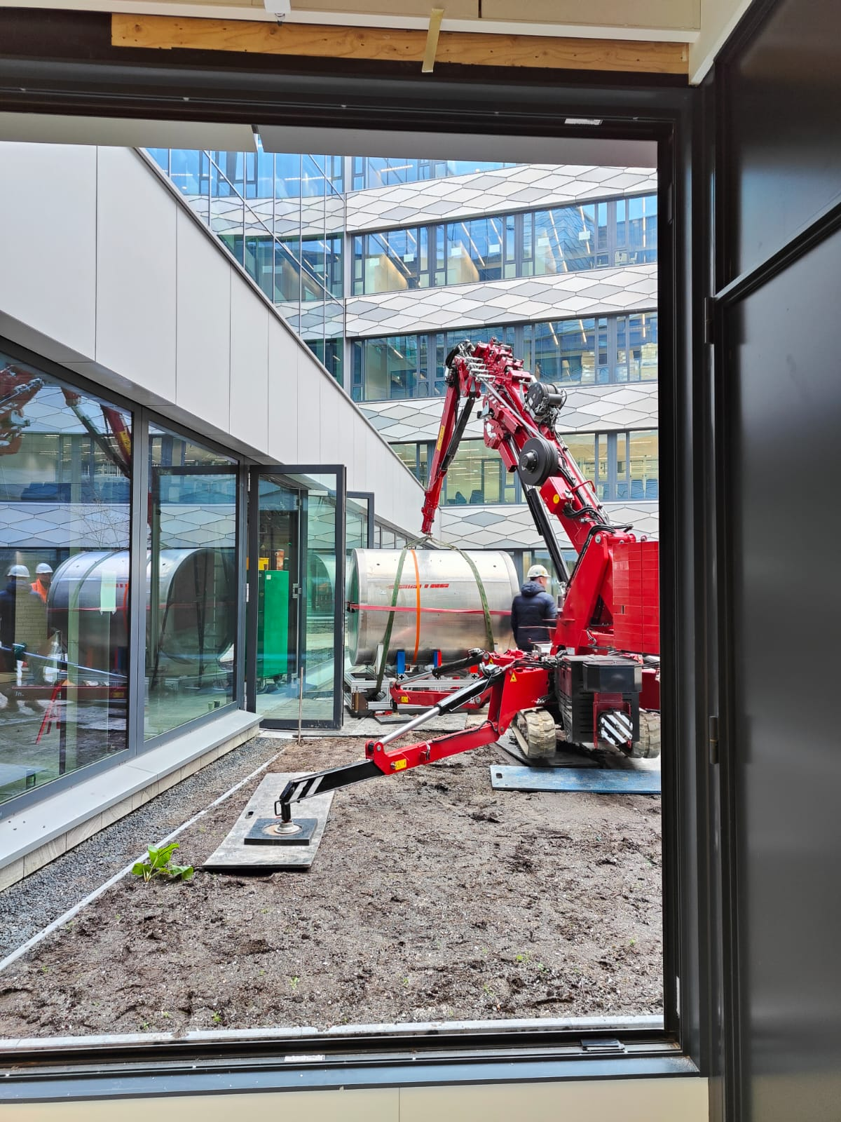
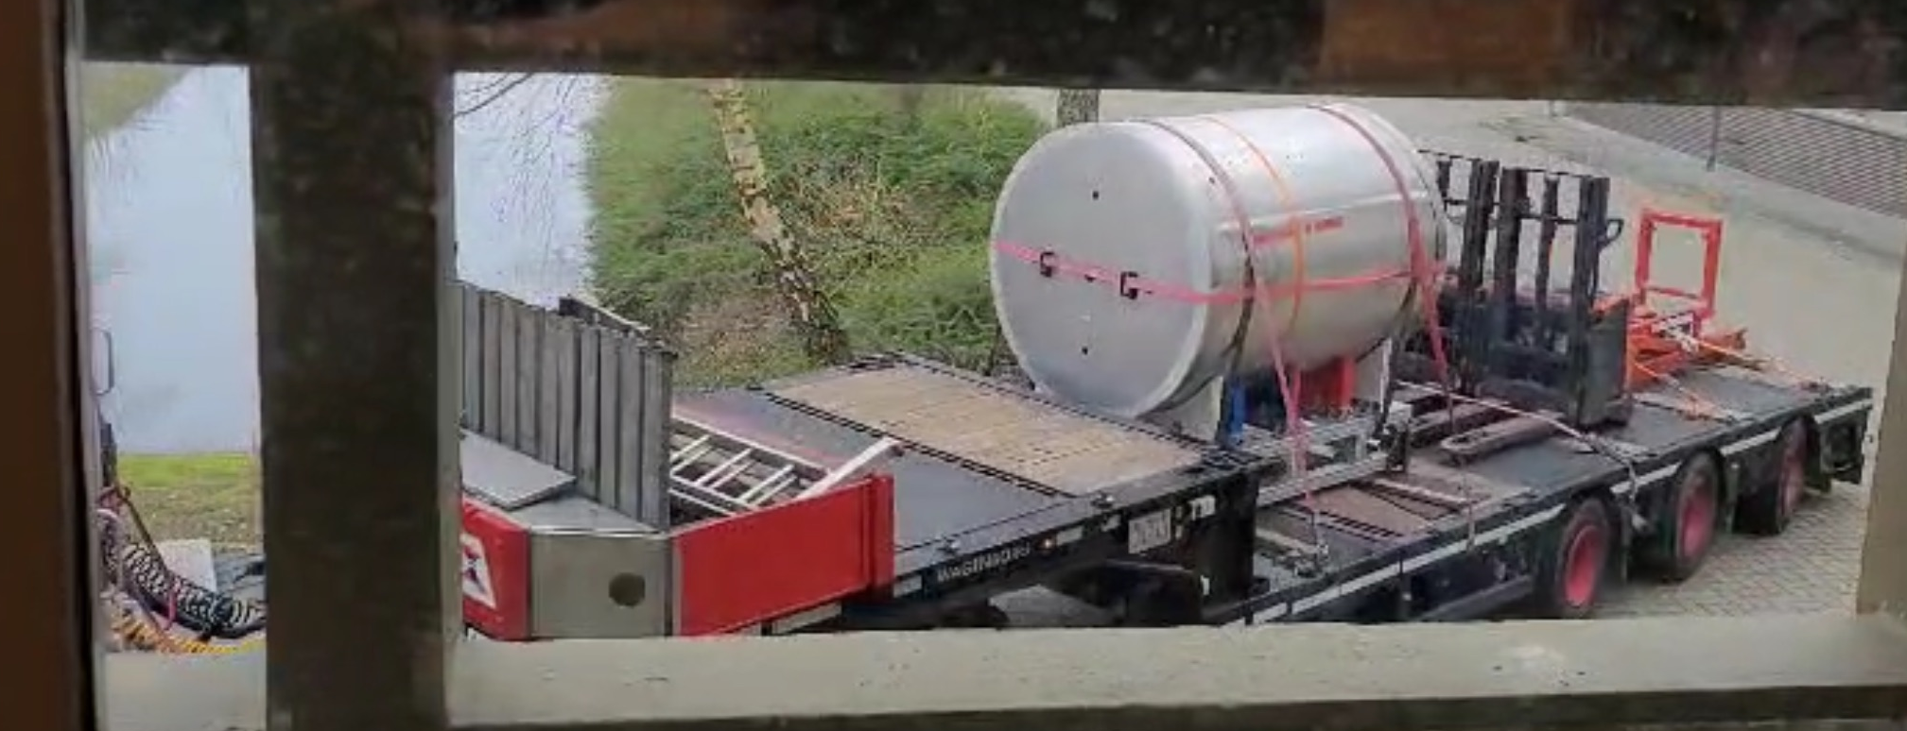
Current status
Moving the magnetic shield
to new lab today

Slide 14
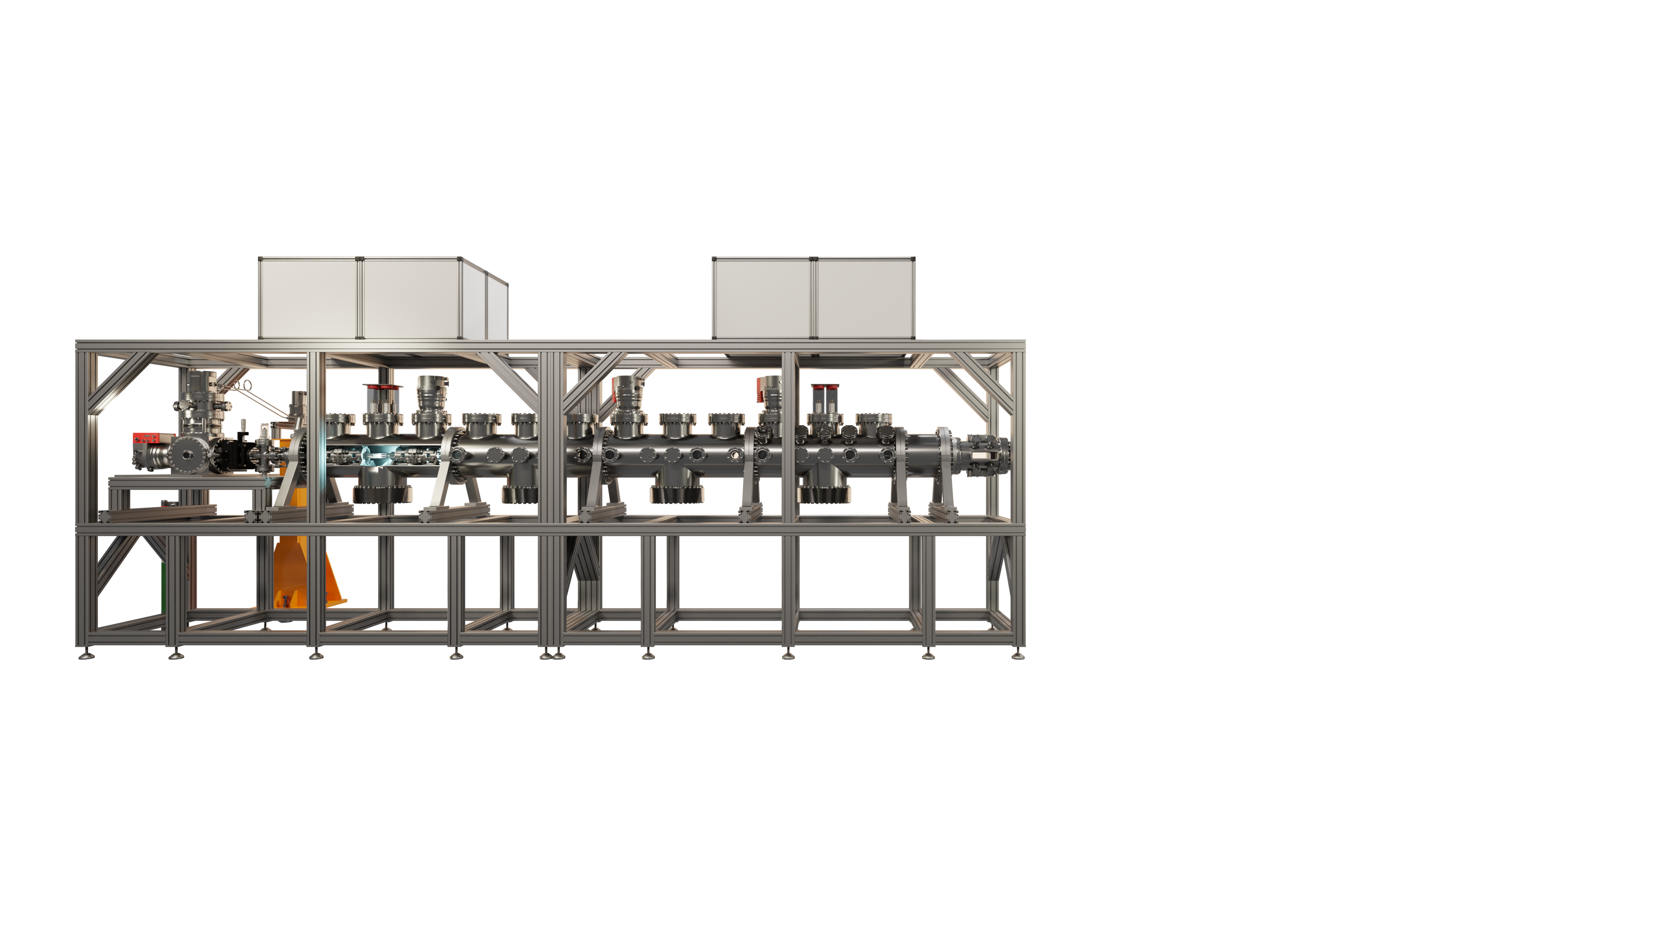
Phase 2: Slow beam
Cryogenic beam (200 m/s)
Transverse laser cooling
Stark deceleration
Increase statistics

Slide 15
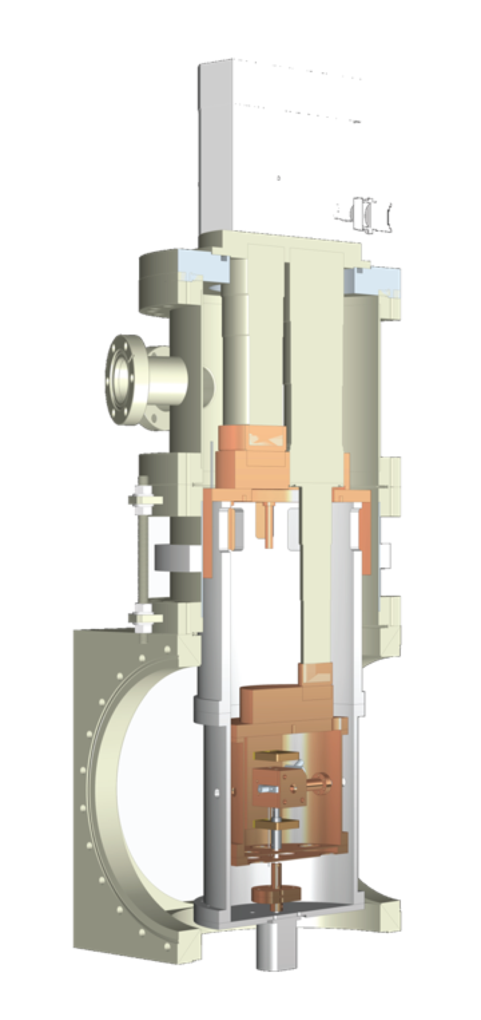
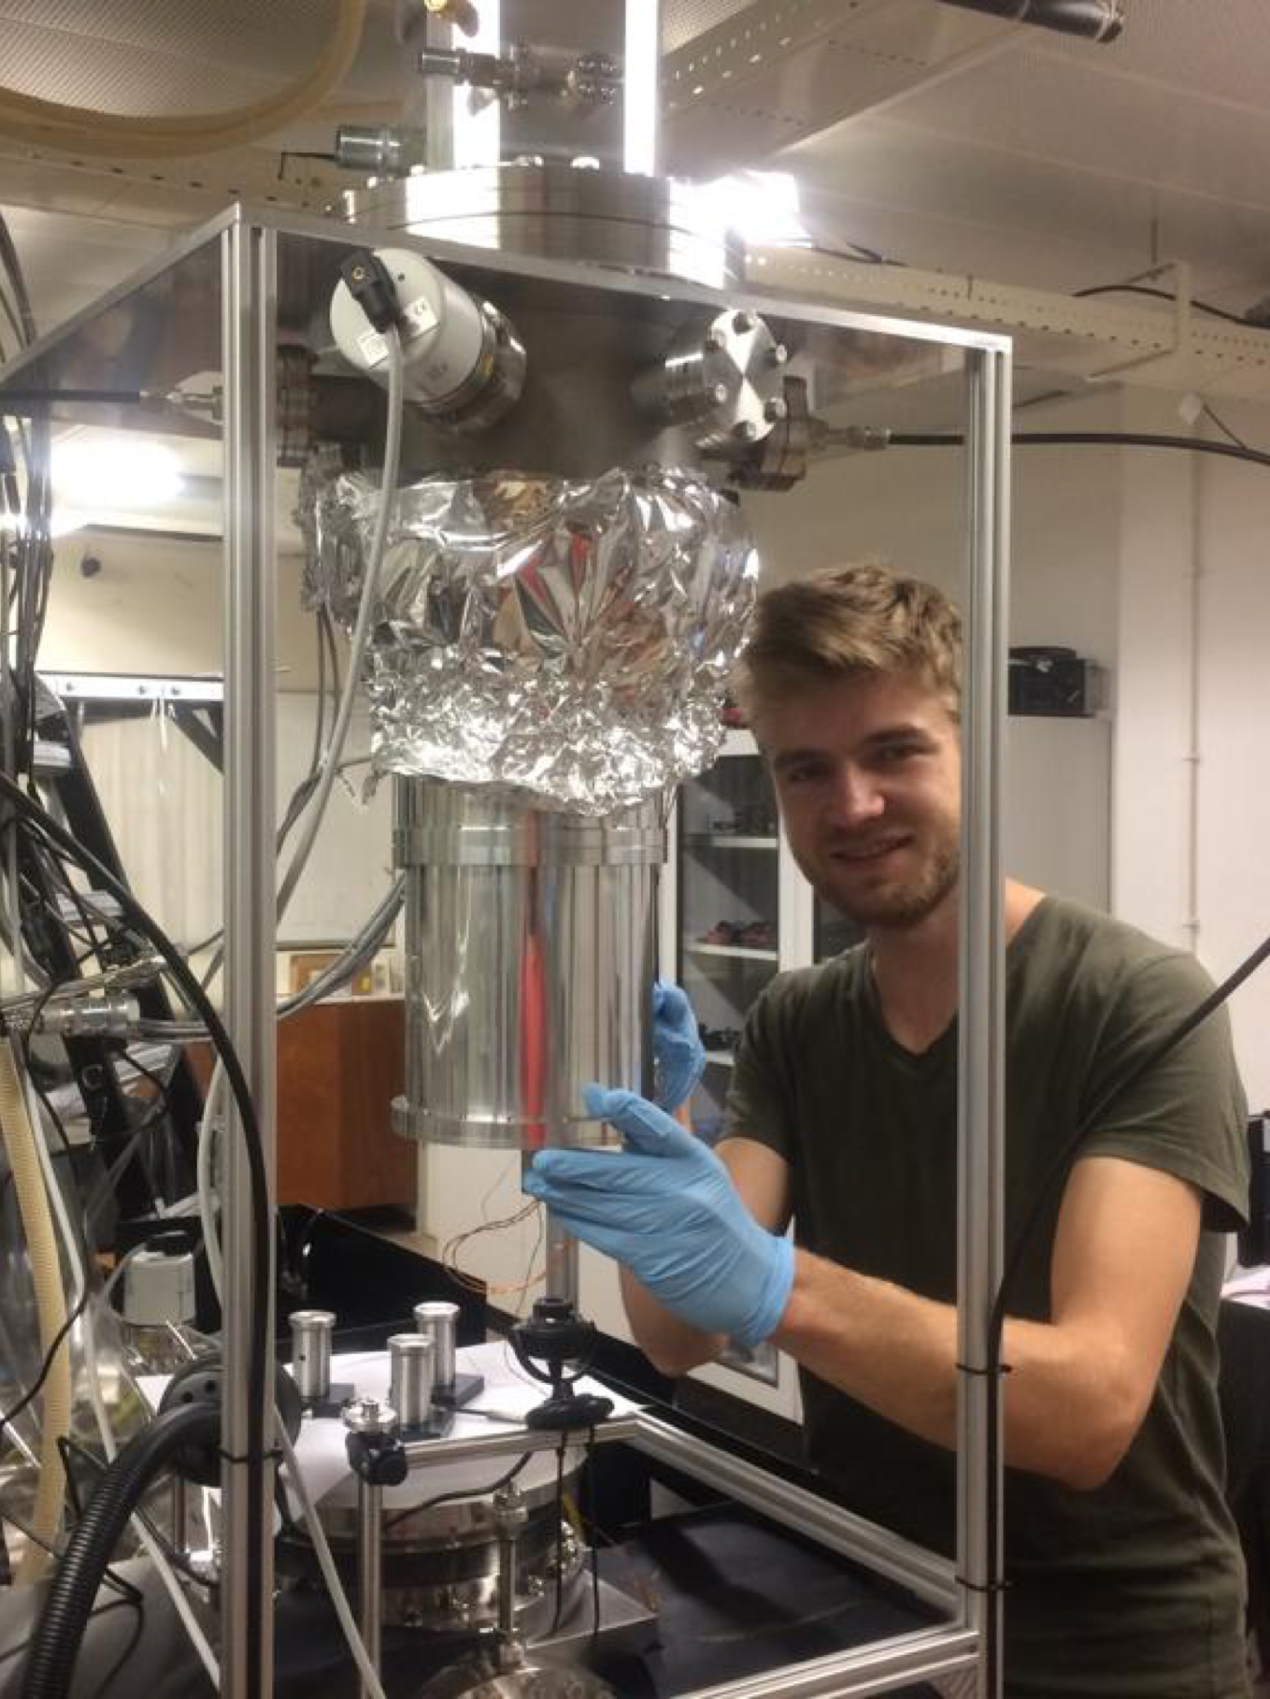
Cryogenic beam
Evaporating metal target
Neon carrier gas + SF6
Velocity 150-200 m/s
Goal: make the most intense source of slow molecules
1 in Groningen (SrF, BaF, production)
1 in A’dam (BaF, optimisation)
1 under construction in Groningen (polyatomic molecules)
Maarten Mooij, Rick Bethlem @ VU Amsterdam
Truppe, S. et al. A buffer gas beam source for short, intense and slow molecular pulses. Journal Of Modern Optics 65, 246–254 (2018).

Slide 16
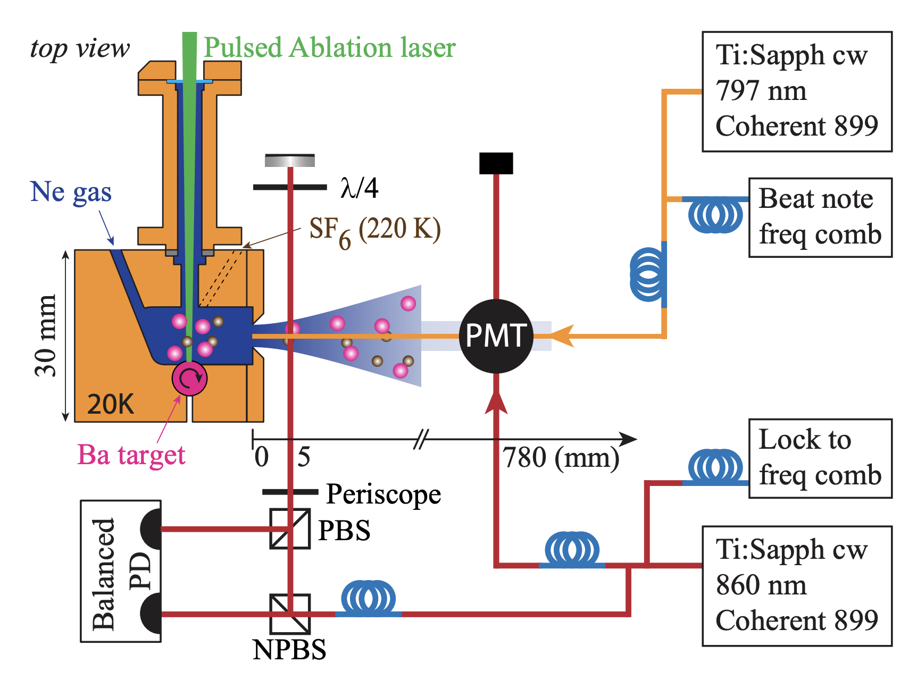
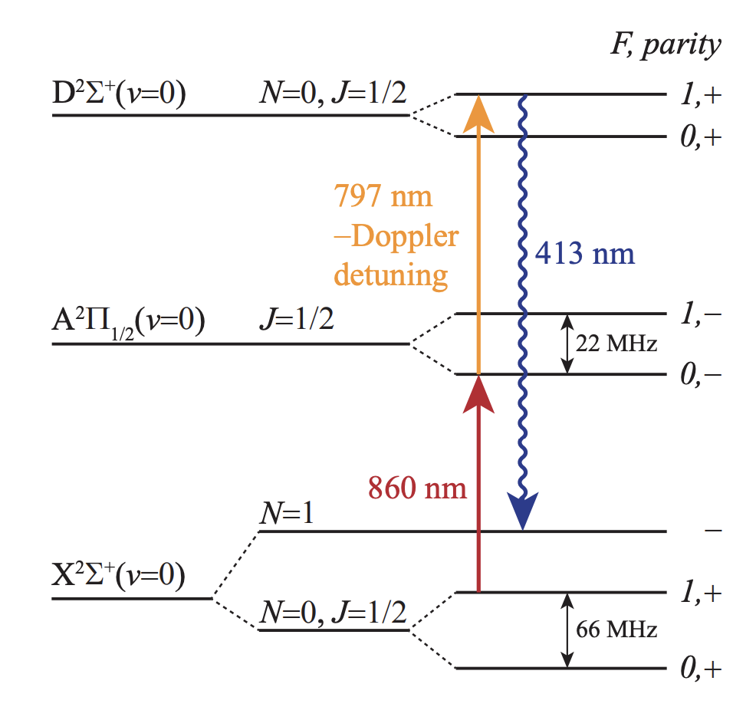
Optimising the molecular beam source
Mooij et al, arXiv:2401.16588 and arXiv:2401.16590

Slide 17
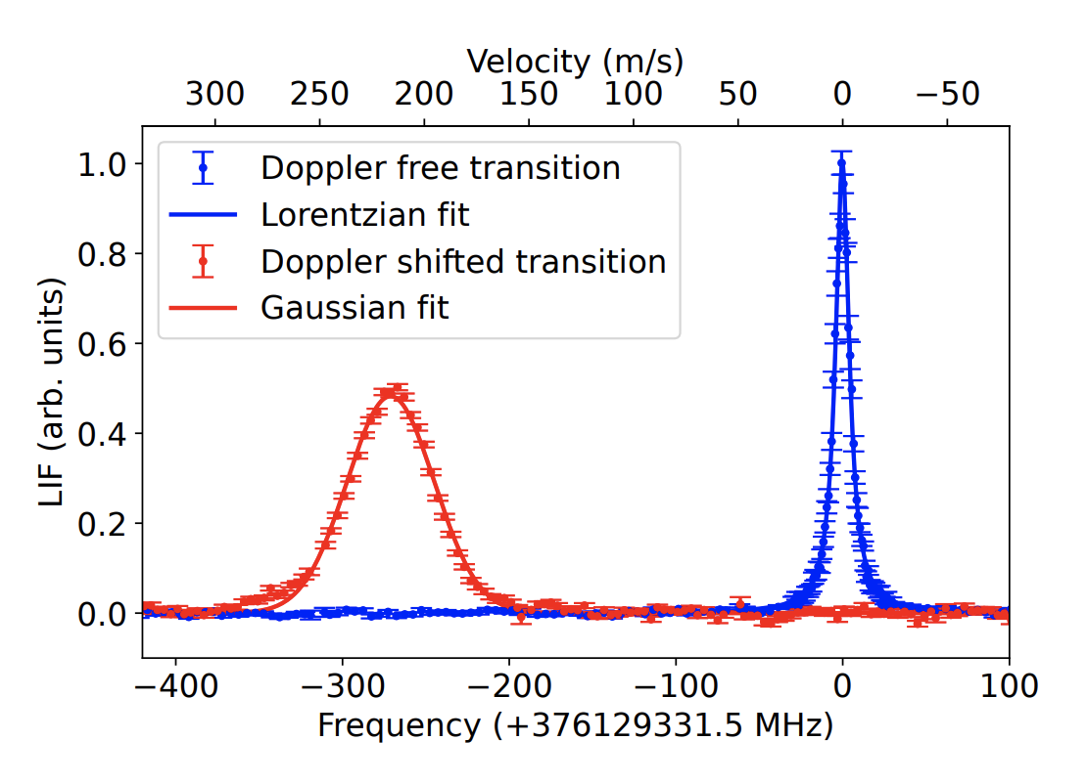
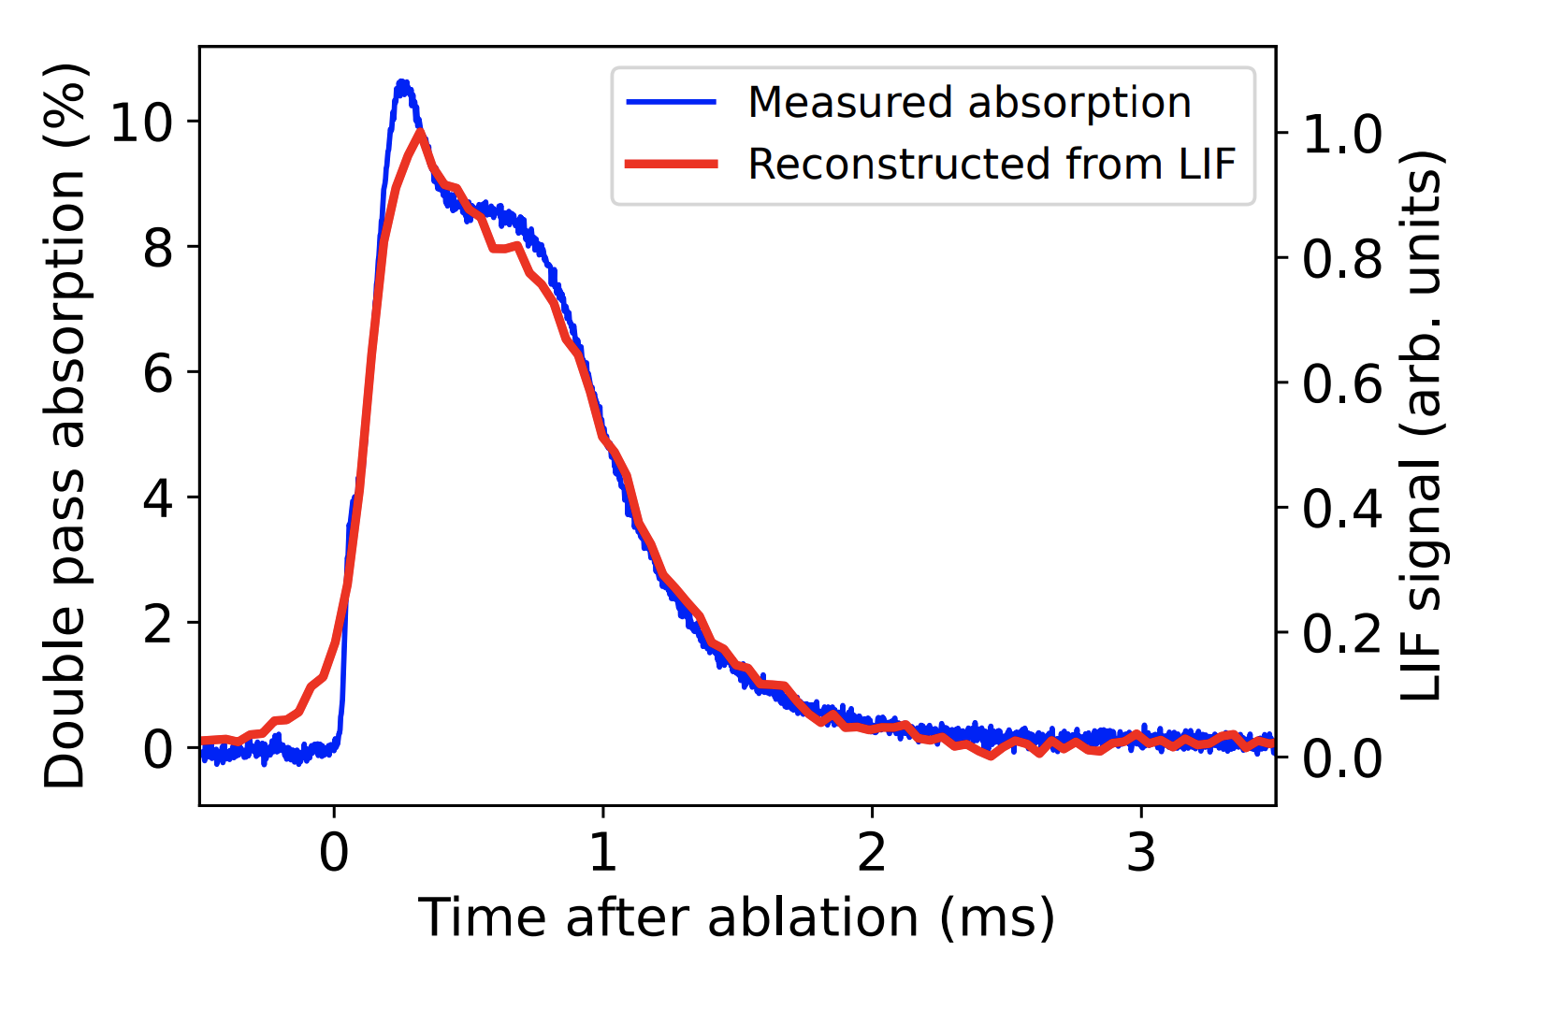
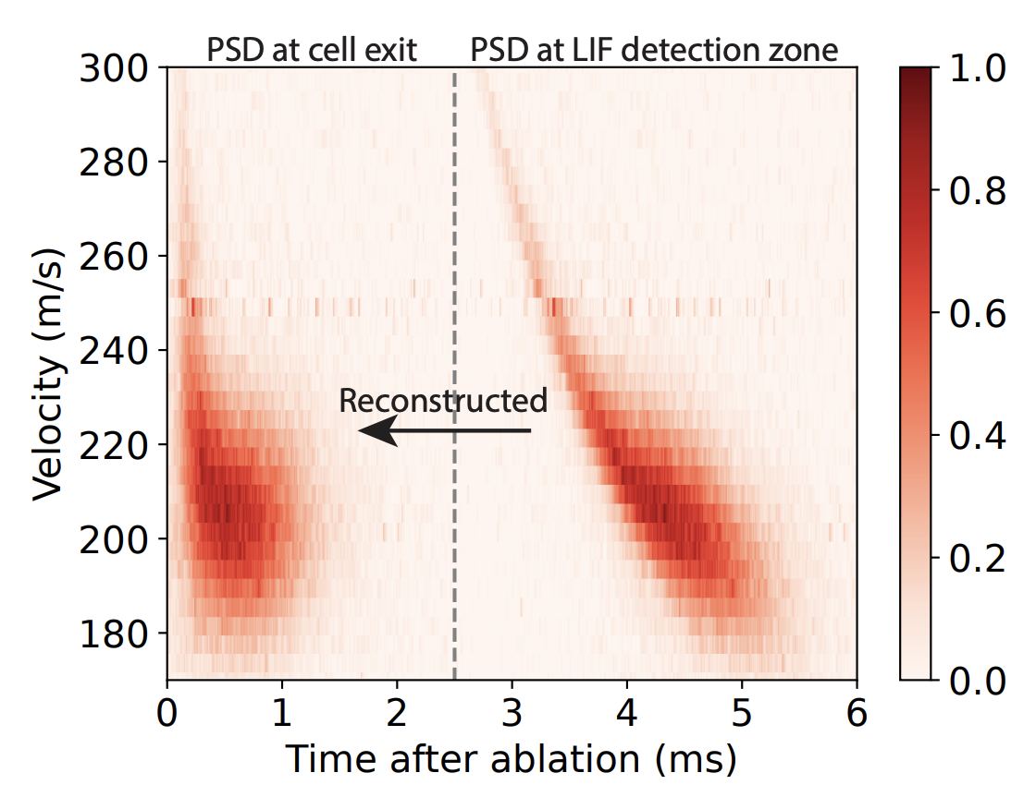
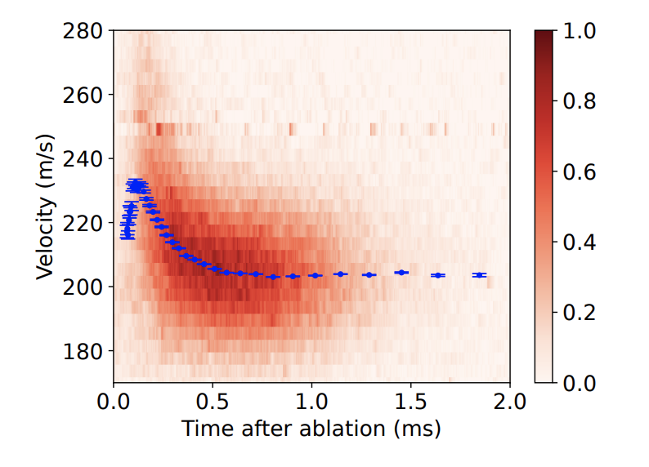
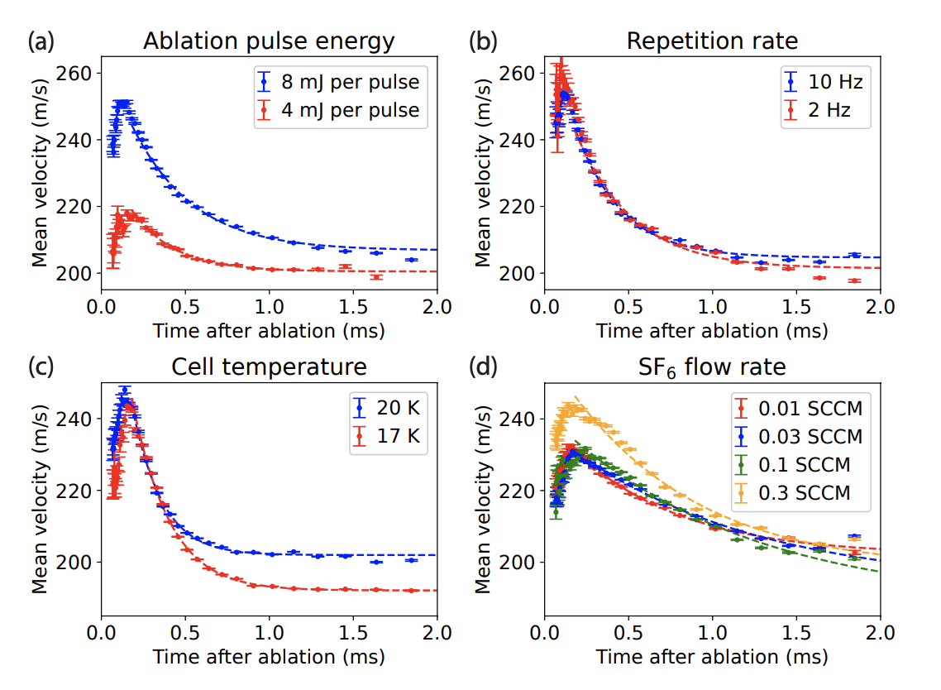
# molecules:
2x10¹⁰ /pulse,
1x10¹¹ /sr/pulse
Combination of arrival time and velocity information gives complete picture
Complete picture allows understanding and efficient optimisation of all parameters

Slide 18
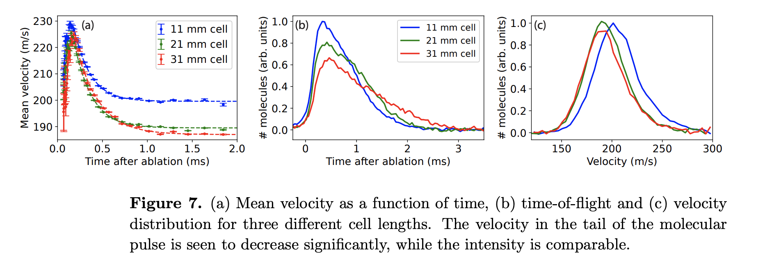
Example: beam cell length

Slide 19
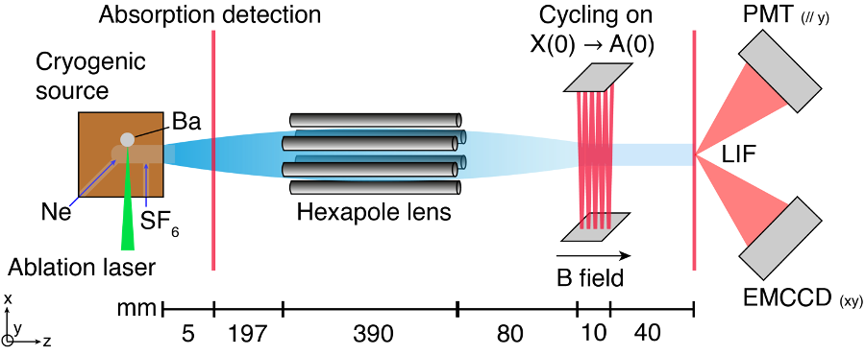
Beam divergence
Hexapole and laser cooling

Slide 20
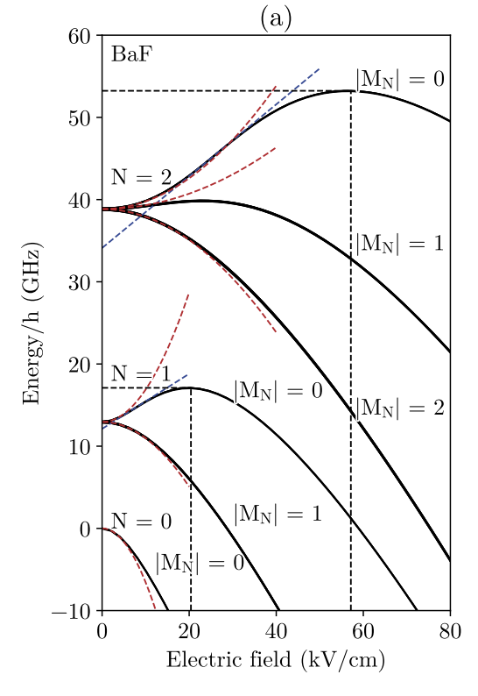
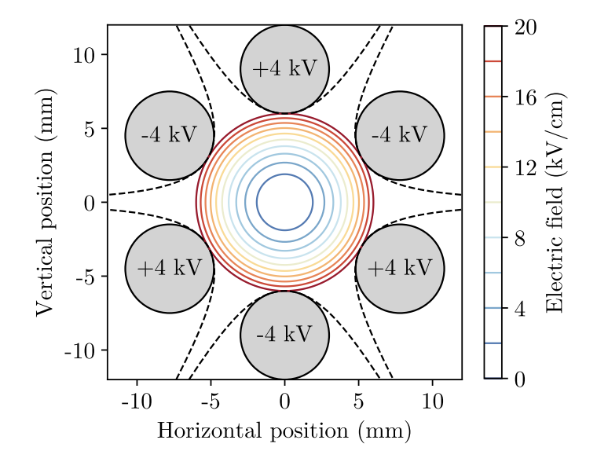
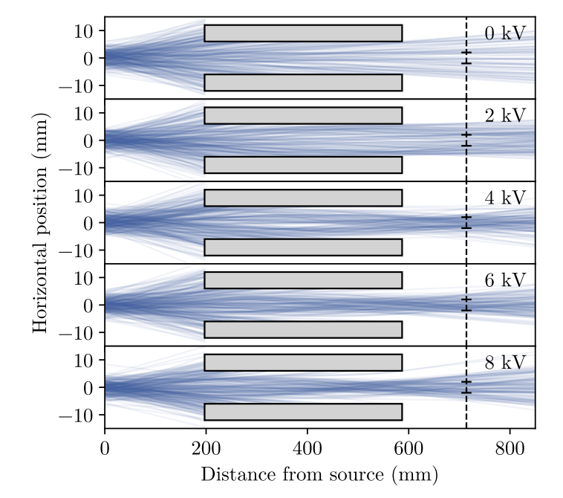
BaF in electric fields
Hexapole (static fields) can focus a beam of neutral molecules

Slide 21
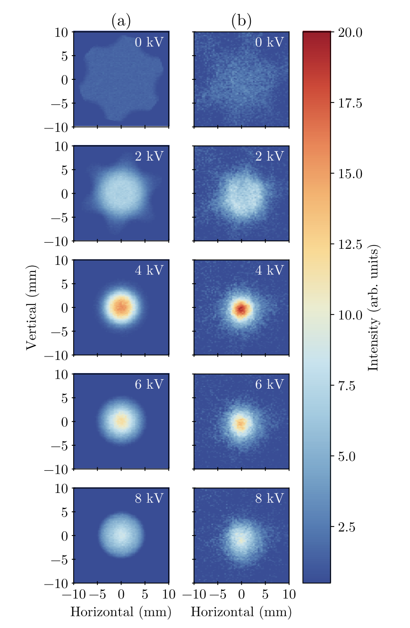
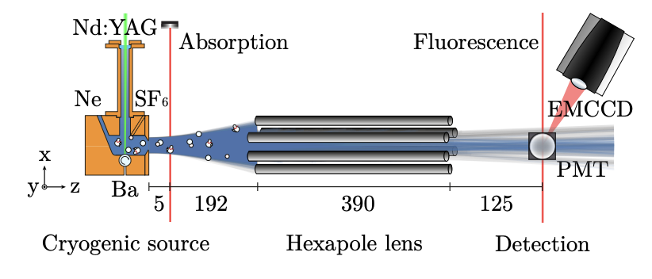
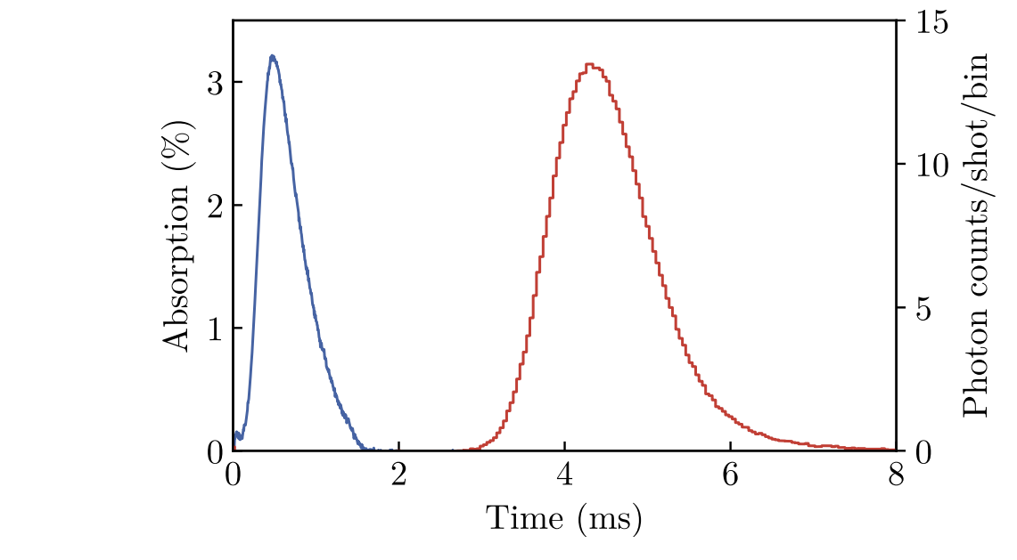
Hexapole focussing
simulation
experiment
Anno Touwen et al, arXiv:2402.09300

Slide 22
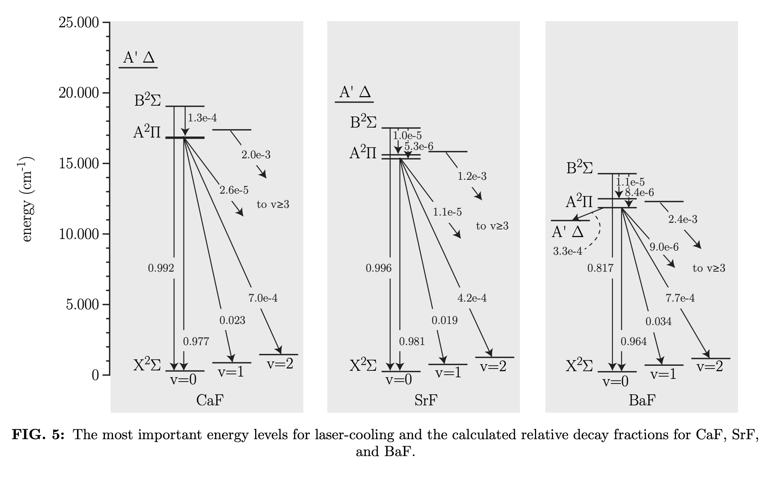
A few words on laser cooling
‘molecule X can be lasercooled’
J. Chem. Phys. 151, 034302 (2019)

Slide 23
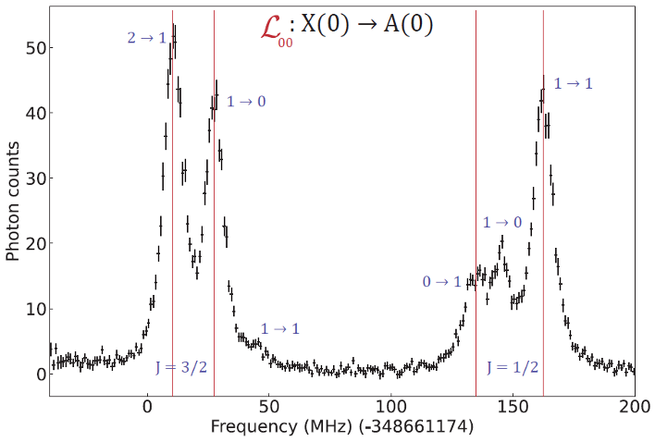
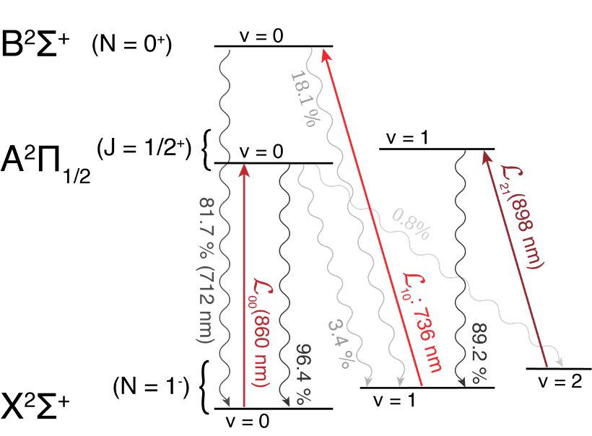
Transitions for laser cooling
In the presence of hyperfine structure
0,08%

Slide 24
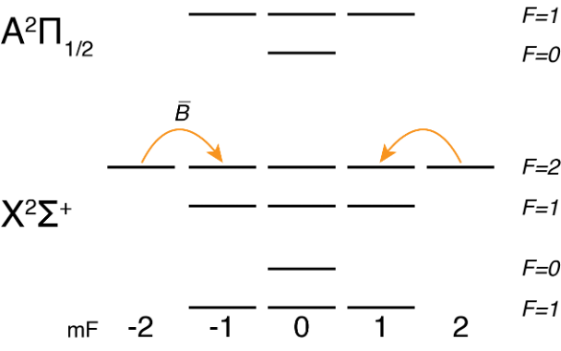
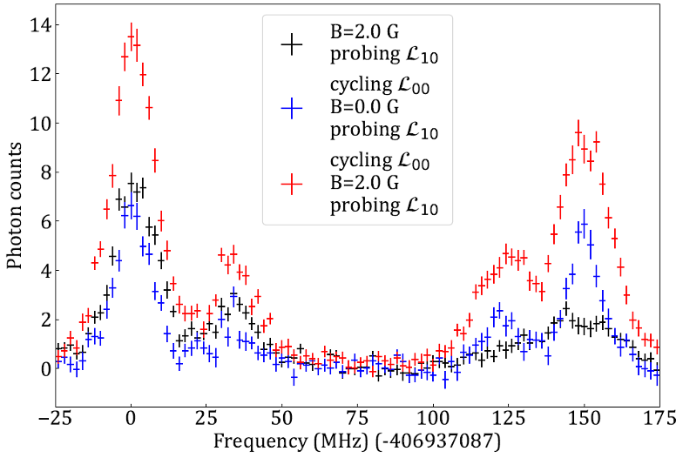
Accumulation in v=1
Dark state remixing
0,08%

Slide 25
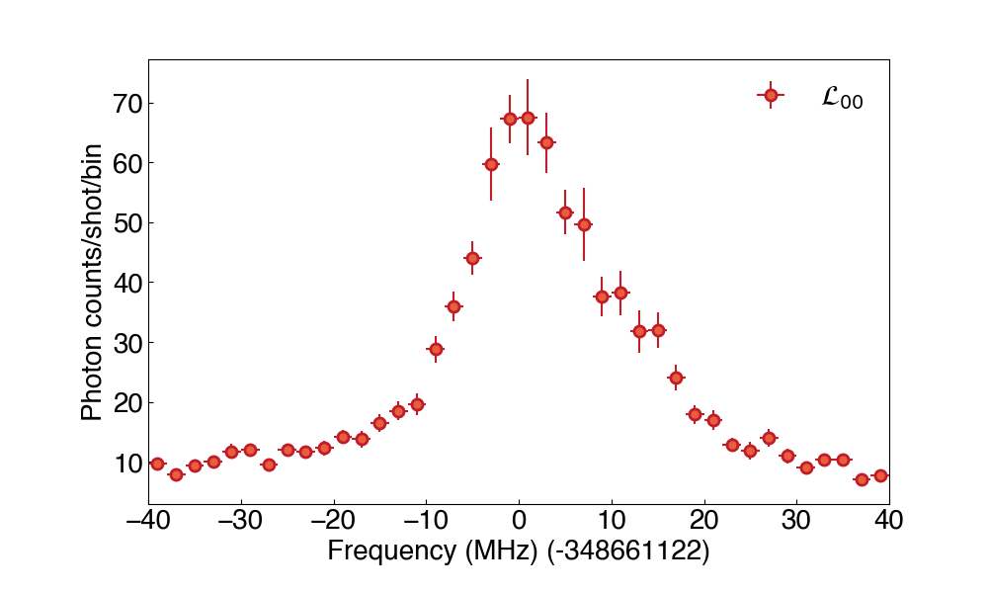
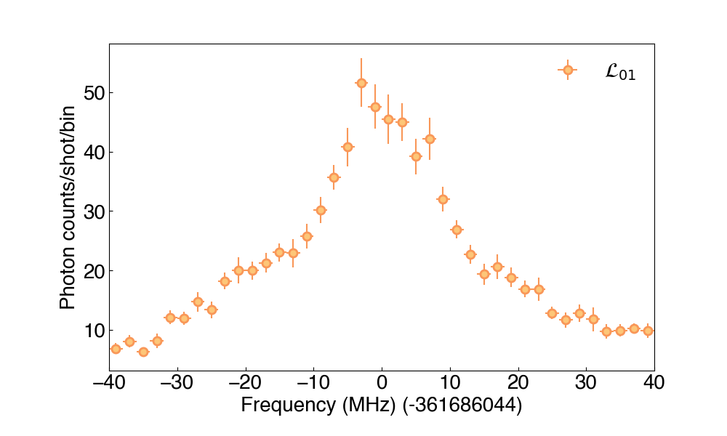
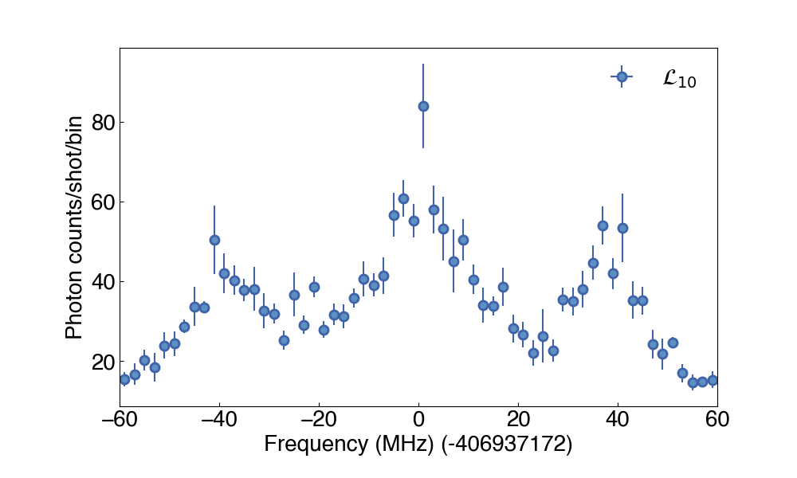
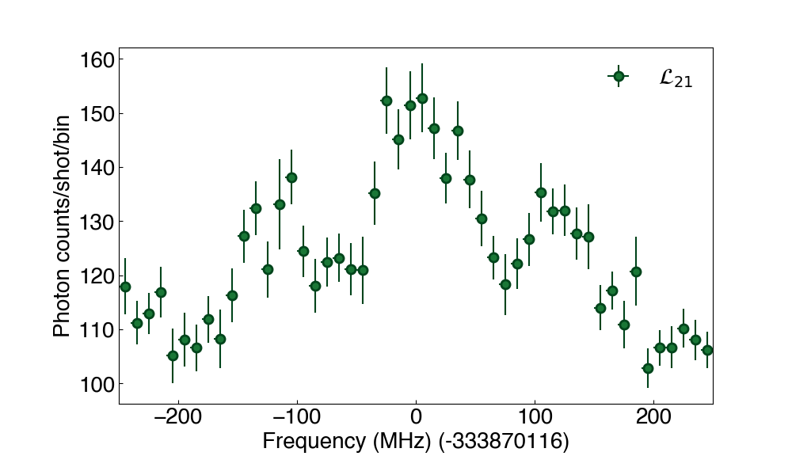
Accumulation in v=1 and v=2
Observation @ 860 nm
0,08%

Slide 26
Current status
Phase 2a: 200 m/s beam
Cryogenic beams optimised, ~10¹⁰ molecules / shot
Hexapole implemented, gain factor ~5
Laser cooling setup completed
Currently extending 1D cooling to 2D transverse cooling
Combine with interaction zone this year

Slide 27
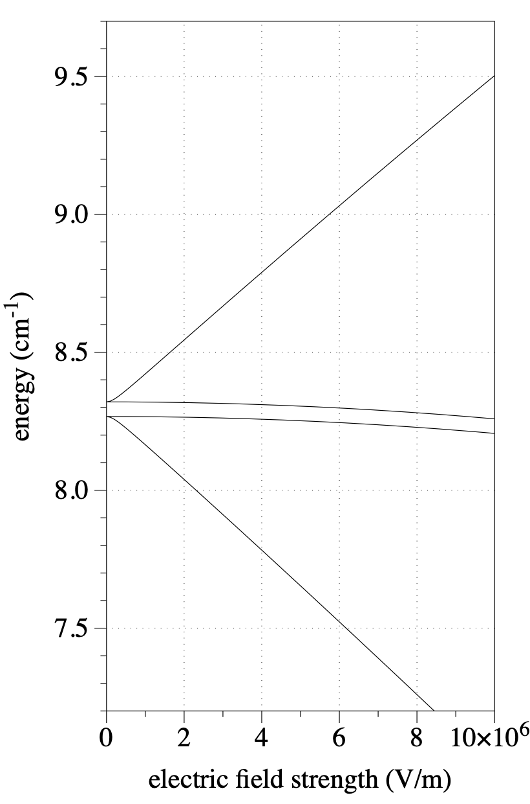
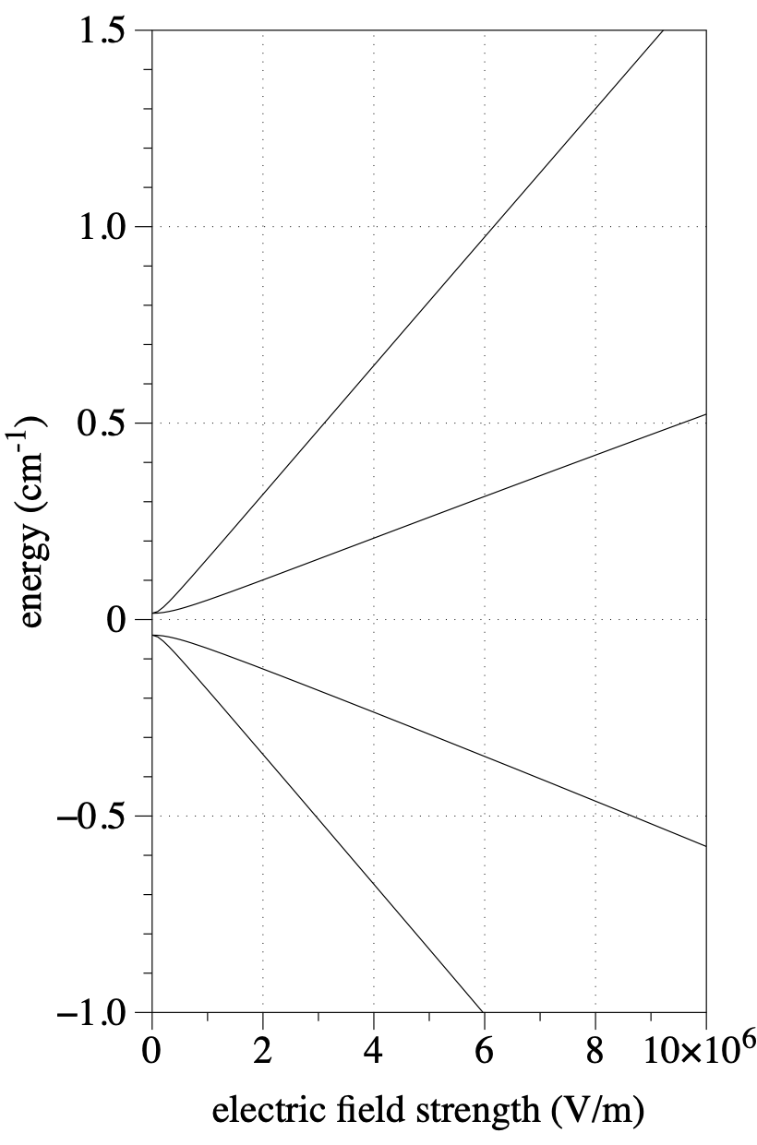
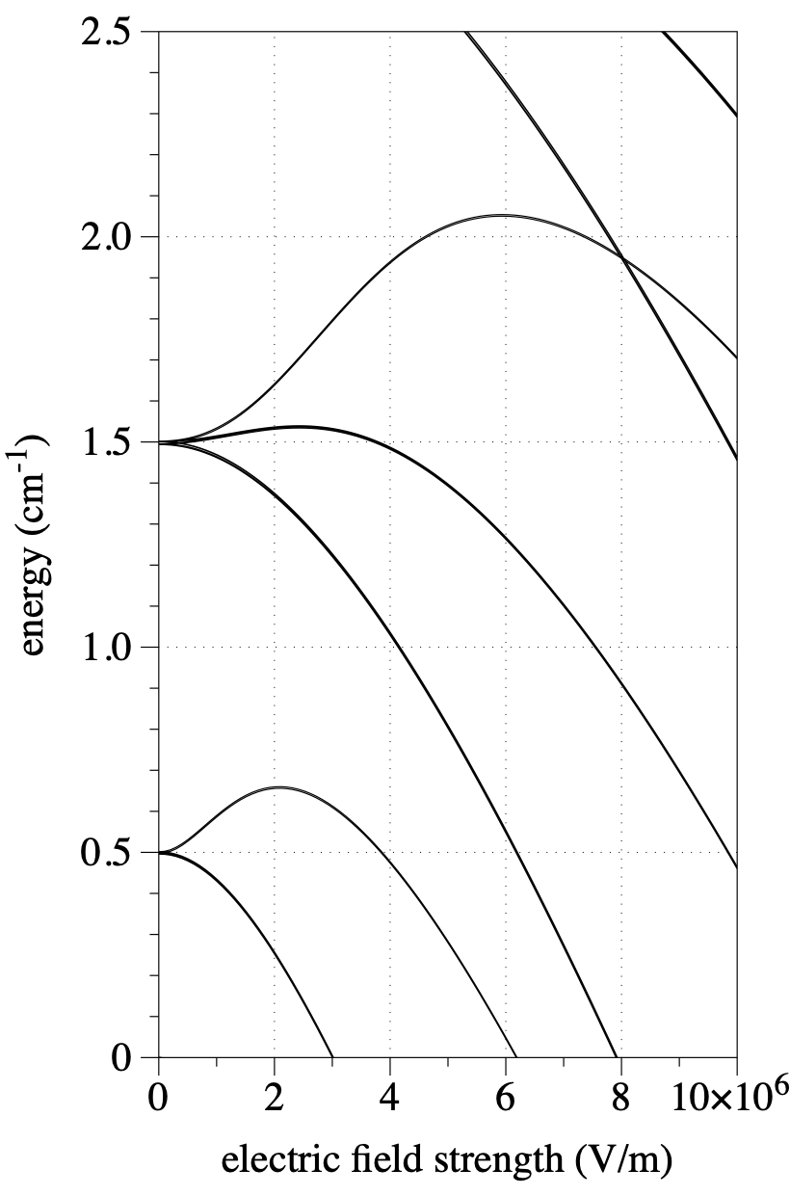
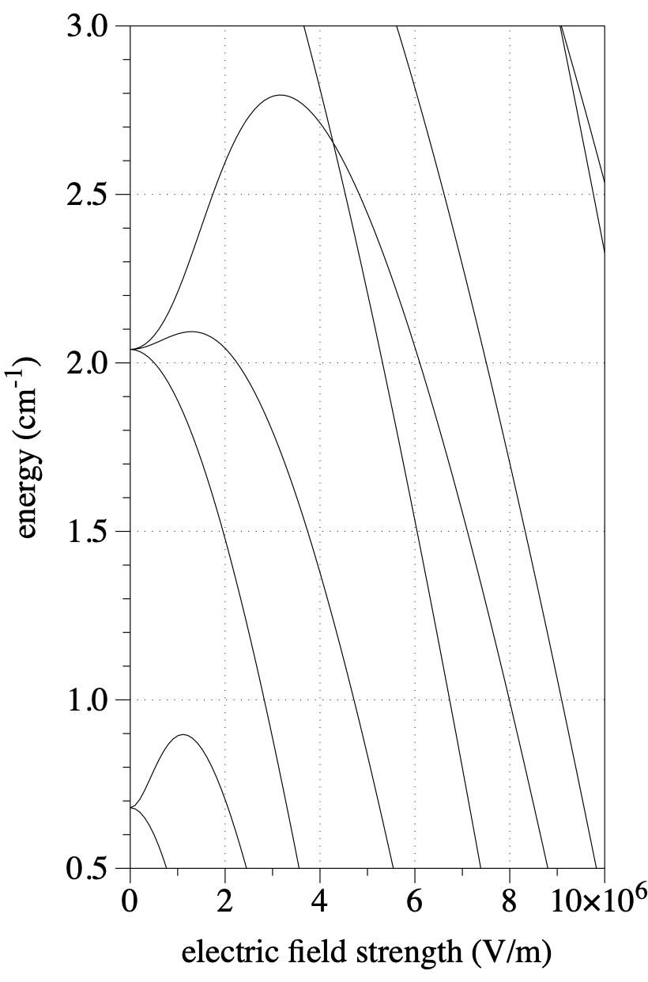
Use Stark shift to decelerate
2.5 cm⁻¹ = 75 GHz = OH @ 60 m/s
0.16 cm⁻¹ = 4.8 GHz = SrF @ 6 m/s
ND3
OH
SrF
SrO
Challenge: extend this technique to heavier species
Deceleration, trapping, collision studies, lifetime measurements
Demonstrated for light molecules: OH, CO, NH3, NH
Science 313 5793 (2006), PRL 98 133001 (2007), PRL 110 133003 (2013)

Slide 28
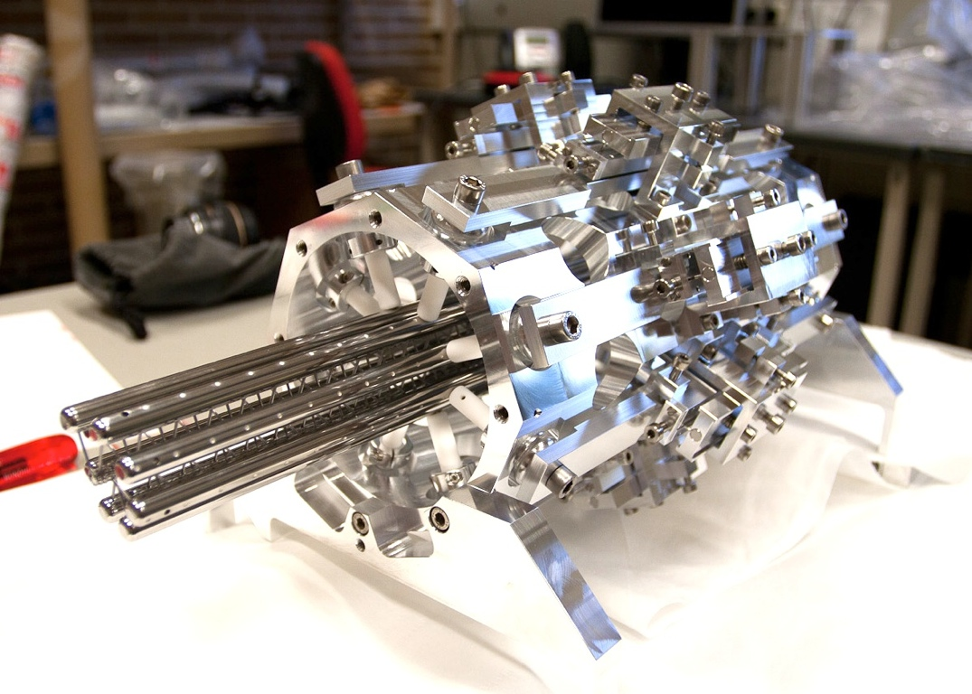
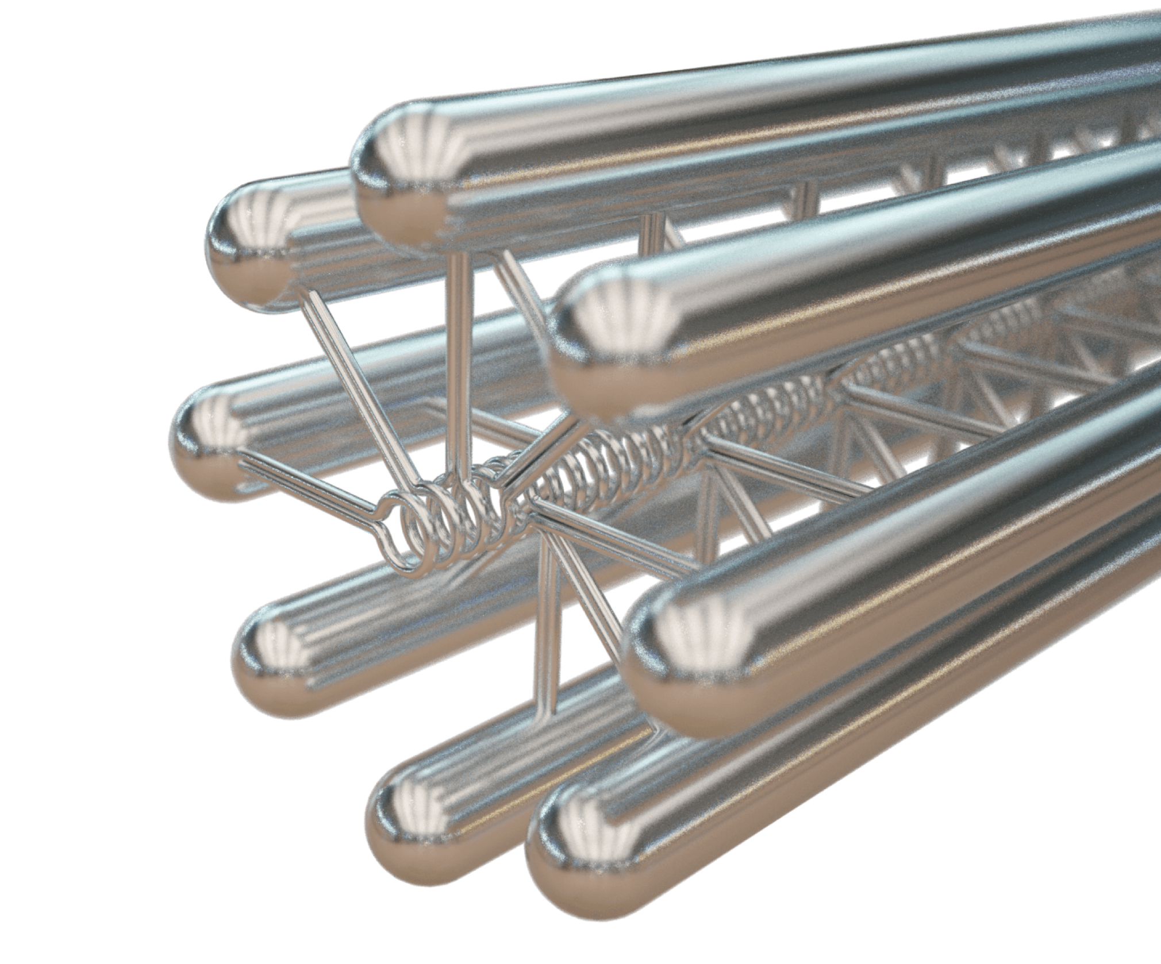

Traveling-wave decelerator: aim for factor 10 increase in interaction time
Main aims:
Capture as many molecules as possible from molecular beam
Bring average beam velocity from ~190 to ~30 m/s
Maintain N during deceleration

Slide 29
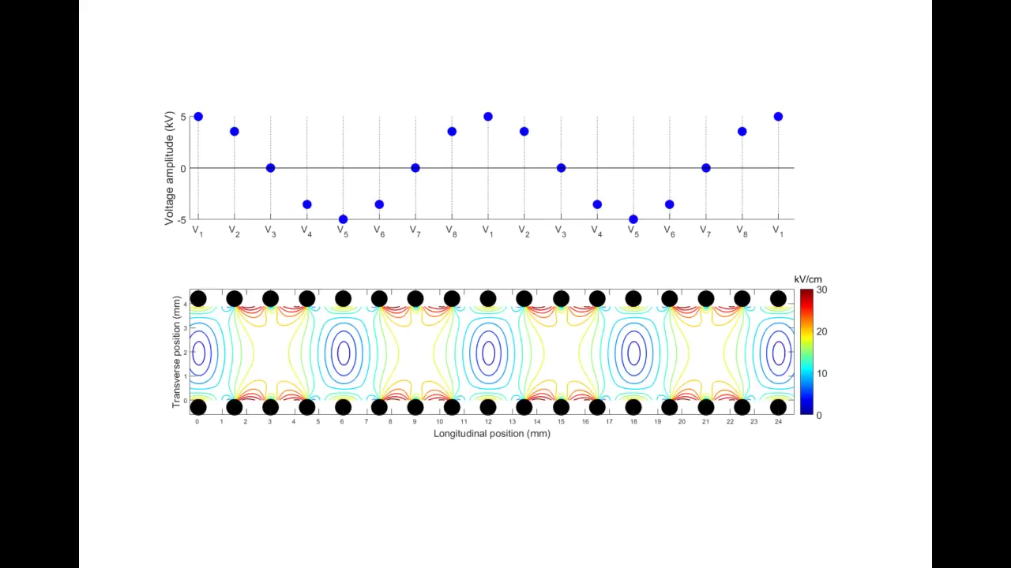
Traveling-wave decelerator

Slide 30
Traveling-wave decelerator
Fluorescence detection
Molecular beam source
Decelerator
4.5 m
Challenges for heavy diatomic molecules:
Heavy -> long decelerator
Rotational structure -> limited Stark shift

Slide 31
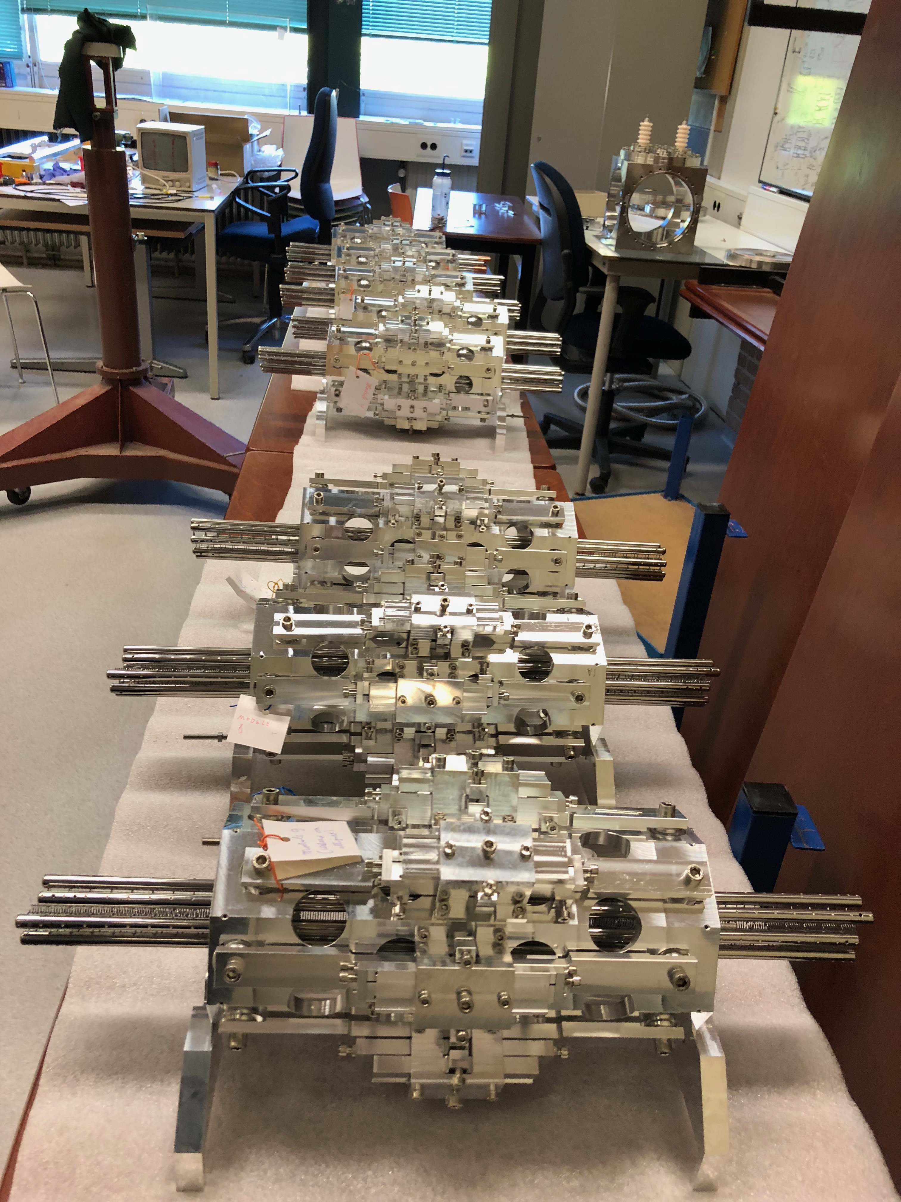

Modular traveling-wave decelerator

Slide 32

Traveling-wave decelerator

Slide 33


A slow beam of molecules
SrF: First combination of deceleration and cryogenic source

Slide 34



Slide 35

Deceleration to standstill
Deceleration of SrF to standstill in 4.2 m, hold there for some time,
accelerate out again to 50 m/s to detect
Deceleration and trapping of SrF molecules
Parul Aggarwal, Yanning Yin et al (NL-eEDM),
PRL 127 173201 (2021)

Slide 36




190 m/s
Improved waveforms:
Not losing molecules in deceleration, but on the way to detection
30 m/s

Slide 37

Deceleration of BaF
Currently upgrading electronics

Slide 38
Current status
Phase 2b: Slow beam
Demonstrated first combination of cryogenic source and decelerator
Deceleration and trapping of SrF, deceleration of BaF
Upgrading decelerator electronics to capture more molecules from beam

Slide 39

Outlook: even longer interaction times
Phase 3: using trapped molecules

Slide 40

Towards an eEDM measurement
in an optical lattice
First BaOH molecules produced!

Slide 41


Summary
Spin interference demonstrated
and understood
Intense and bright slow beam
Deceleration demonstrated

Slide 42

(part of) the team
positions
available
UvA
Dutch National Institute for (astro)Particle Physics

Slide 44

ECFA R&D Roadmap
“The field of high energy physics has been driven to long-term international collaborative efforts on detector R&D by the numerous challenges posed by the very large and costly devices needed for the relevant experiments. Such a common endeavor that would go beyond numerous field-specific efforts in the hugely diverse, highly dynamic, and rapidly evolving field of quantum sensors, with the goal of advancing a wide range of technologies of great benefit to particle physics on a global scale, appears not to have been attempted yet.”
WP 1 Atomic, nuclear and molecular systems and nanoparticles in traps & beams
WP-1a:Exotic systems in traps and beams
WP-1b: Atom interferometry
WP-1c: Networks Signal and Clock distribution
WP-2 Quantum materials (0-,1- and 2-D materials)
WP-3 Cryogenic materials, devices and systems
WP-4 Scaling up “quantum”
Including massive spin polarized ensembles, hybrid devices (scintillators) ensembles and heterostructures, heterodox devices, optomechanical sensors
WP-5 Quantum techniques for sensing including squeezing, back action evasion, entanglement
WP-6 Capacity building including Education platforms (e.g. schools), exchange platforms and shared infrastructures
up-to-date information:
https://doser.web.cern.ch/

