Slide 1

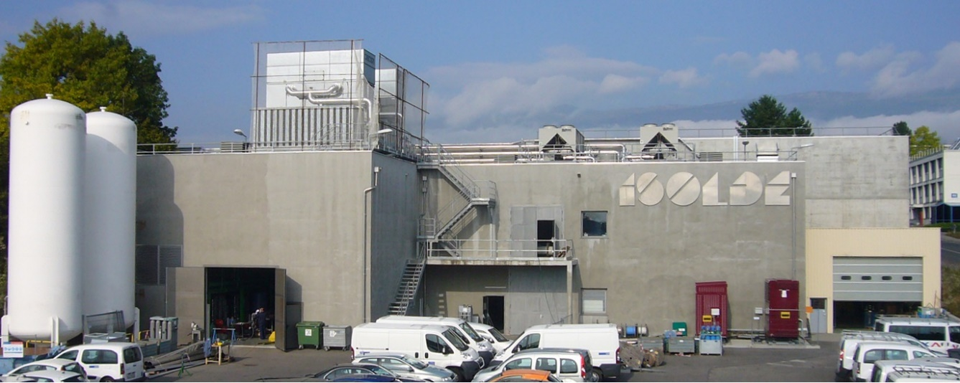
Laser spectroscopy
on exotic atoms and molecules
at ISOLDE-CERN
Gerda Neyens
KU Leuven (Belgium)
(ISOLDE Physics group leader 2017-2021, CERN)

Slide 2
Layout
ISOLDE at CERN
What are ‘exotic’ atoms and molecules (for us at ISOLDE)?
How do we produce exotic isotopes and molecules at ISOLDE
Collinear laser spectroscopy at ISOLDE
Isotope shifts (and charge radii) of long chains of isotopes
First radioactive molecule spectroscopy at ISOLDE (RaF and AcF)
Conclusions and outlook

Slide 3
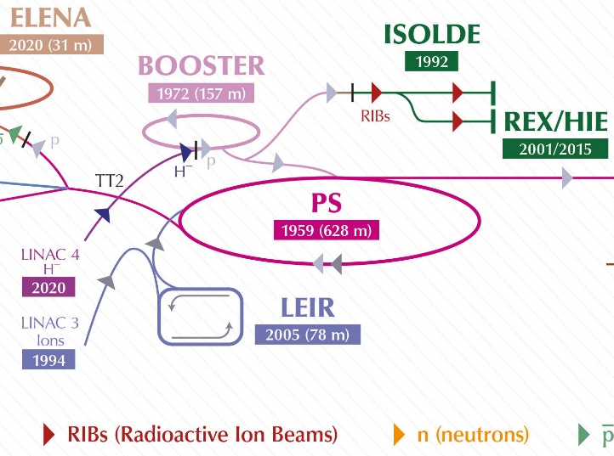
ISOLDE
= CERN’s Radioactive Ion Beam (RIB) facility
>50% of Booster protons are sent to ISOLDE
E_{p} = 1.4 GeV
ISOLDE = Isotope Separation On-Line Device
ISOL is a method to produce and select
beams of short-lived radioactive isotopes
(t_{1/2} down to tens of milliseconds)

Slide 4
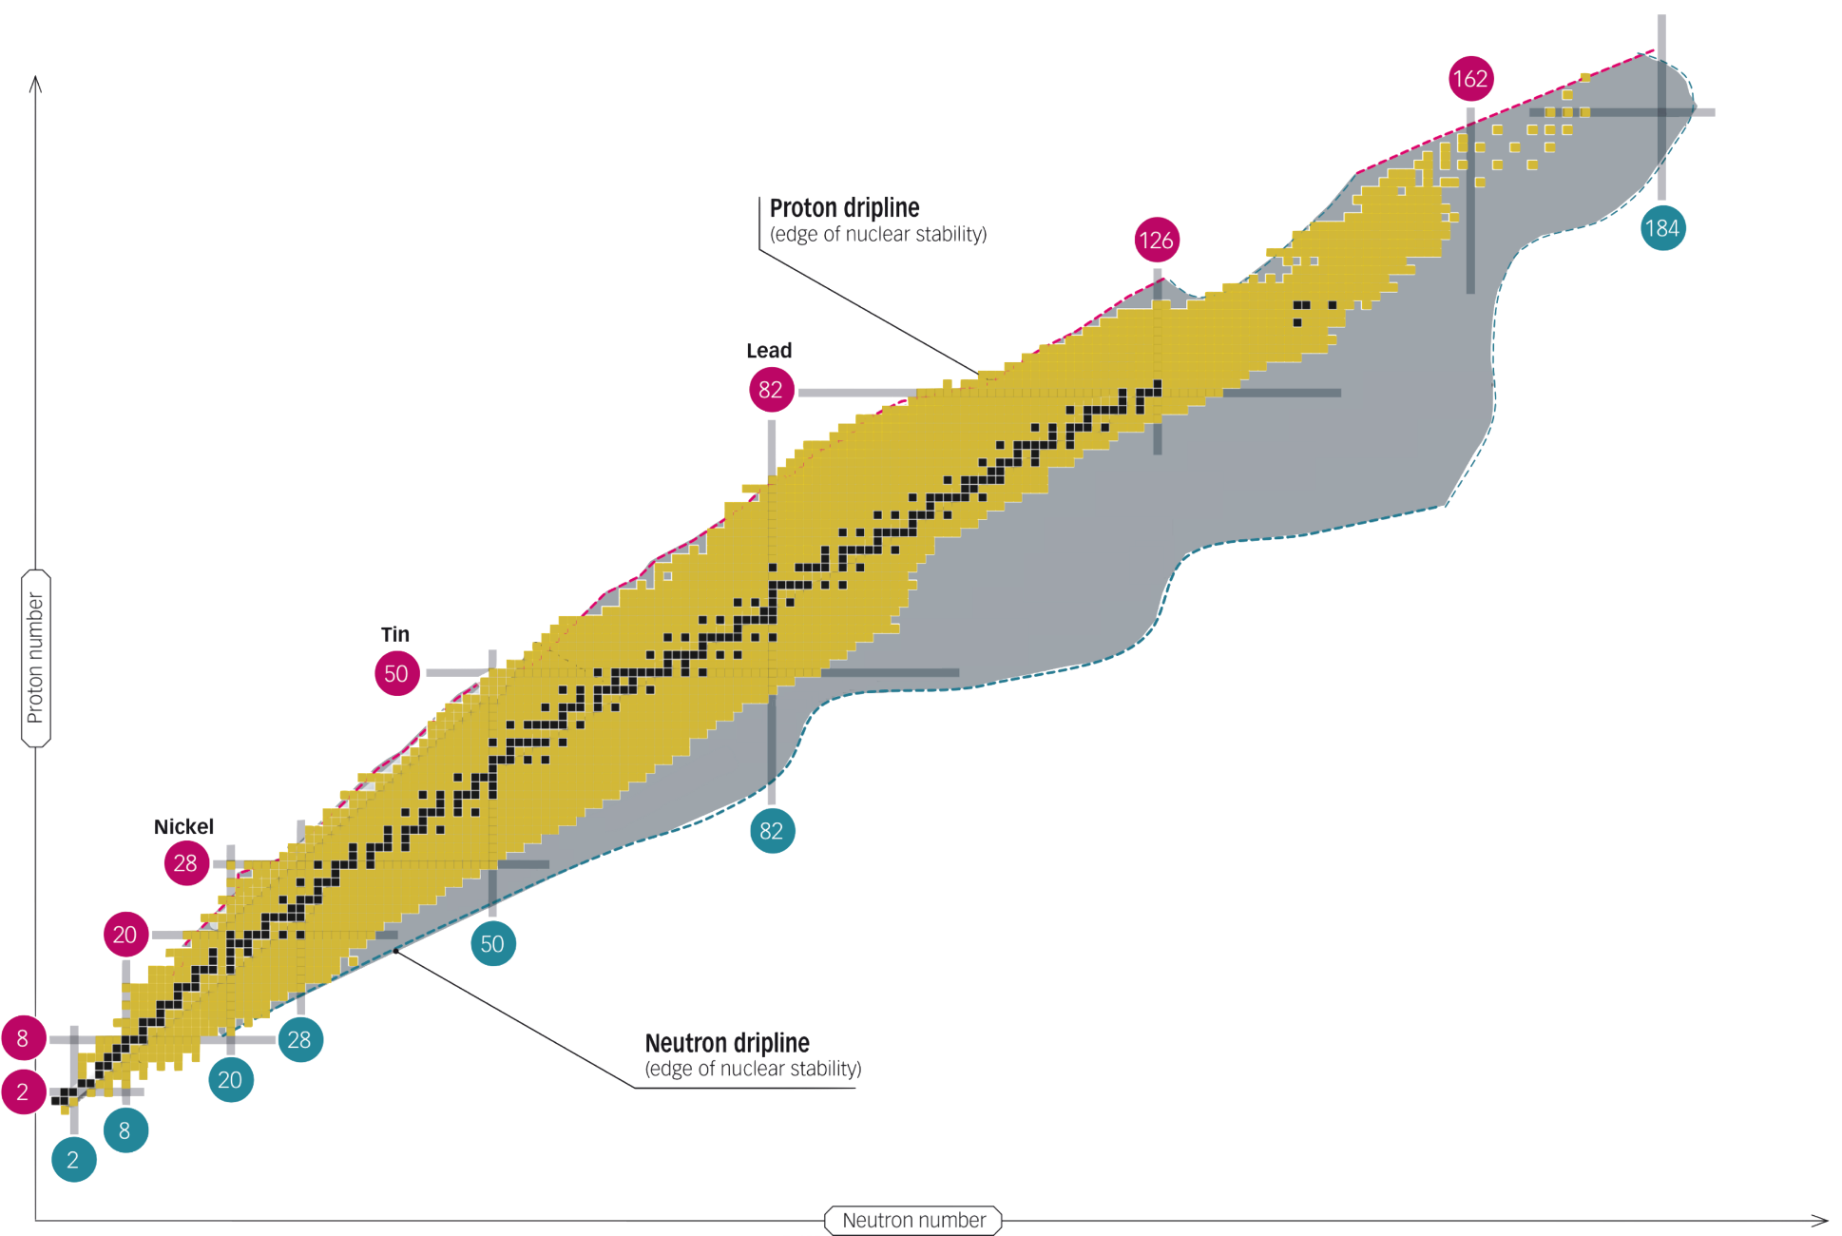
Exotic isotopes
The Nuclear Chart
~ 300 stable isotopes
~ 3300 radioactive isotopes produced at accelerator facilities
Magic numbers: corner stones to develop nuclear theories
➔ Protons in the isotope
¹³²Sn
~ 3000 more predicted by nuclear models (produced in reactions in stars)
⁷⁸Ni
➔ neutrons in the isotope

Slide 5
ISOLDE @ CERN
Cern Courier Sept/October 2020 (on-line available)

Slide 6
Production of RIB’s at ISOLDE
Unique worldwide: high energy protons (1.4 GeV) on thick targets
The (heavy) target nucleus splits in smaller nuclei through
²³⁸U
More than 1300 ‘exotic’ isotopes/isomers of more than 74 chemical elements
Half-life > 10 ms
Spallation
Fission
Fragmentation
Proton beam
hits the target

Slide 7
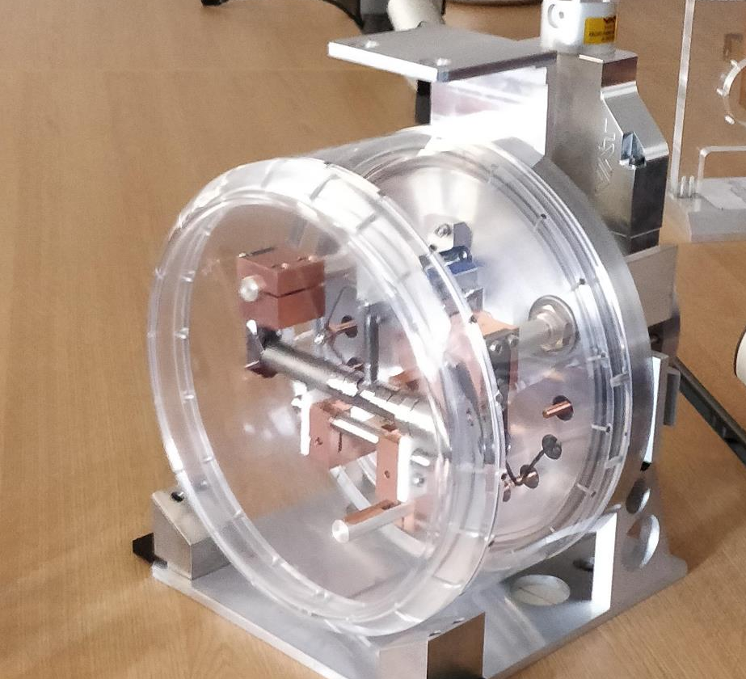
ISOLDE Target Unit
Proton beam
Radioactive isotopes diffuse out of target into ion source
Add a CF₄ gass leak to produce F-molecules
rod (UCx, Ta, SC, …)
diameter ~1 cm
20 cm long

Slide 8

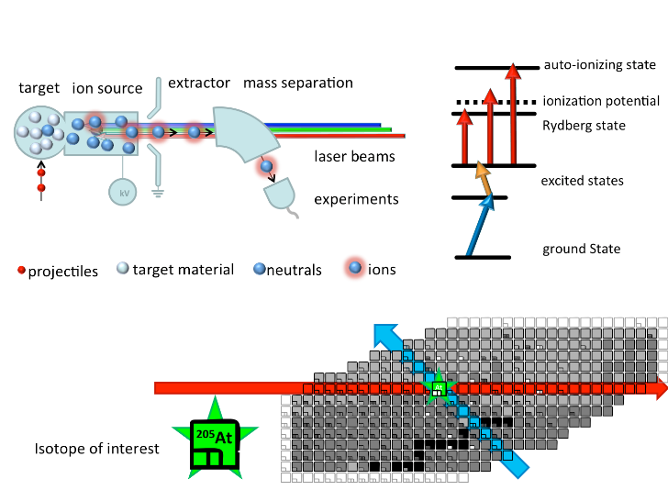
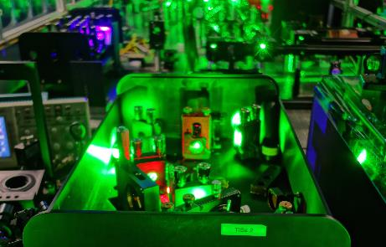

Selection 1 isotope out of hundreds
Resonance Ionization Laser Ion Source RILIS (since 1994)
Selective and efficient ionization of one particular element
Mass separation
Proton beam
Isotope Mass (A=Z+N) selection with dipole magnets
Element selection with lasers

Slide 9
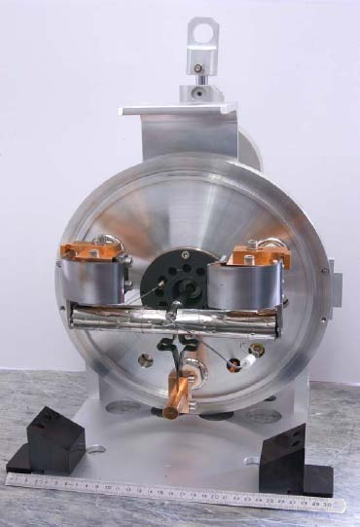
Produced Nuclei: 50+ years of experience
(first beams in 1967)

Slide 10
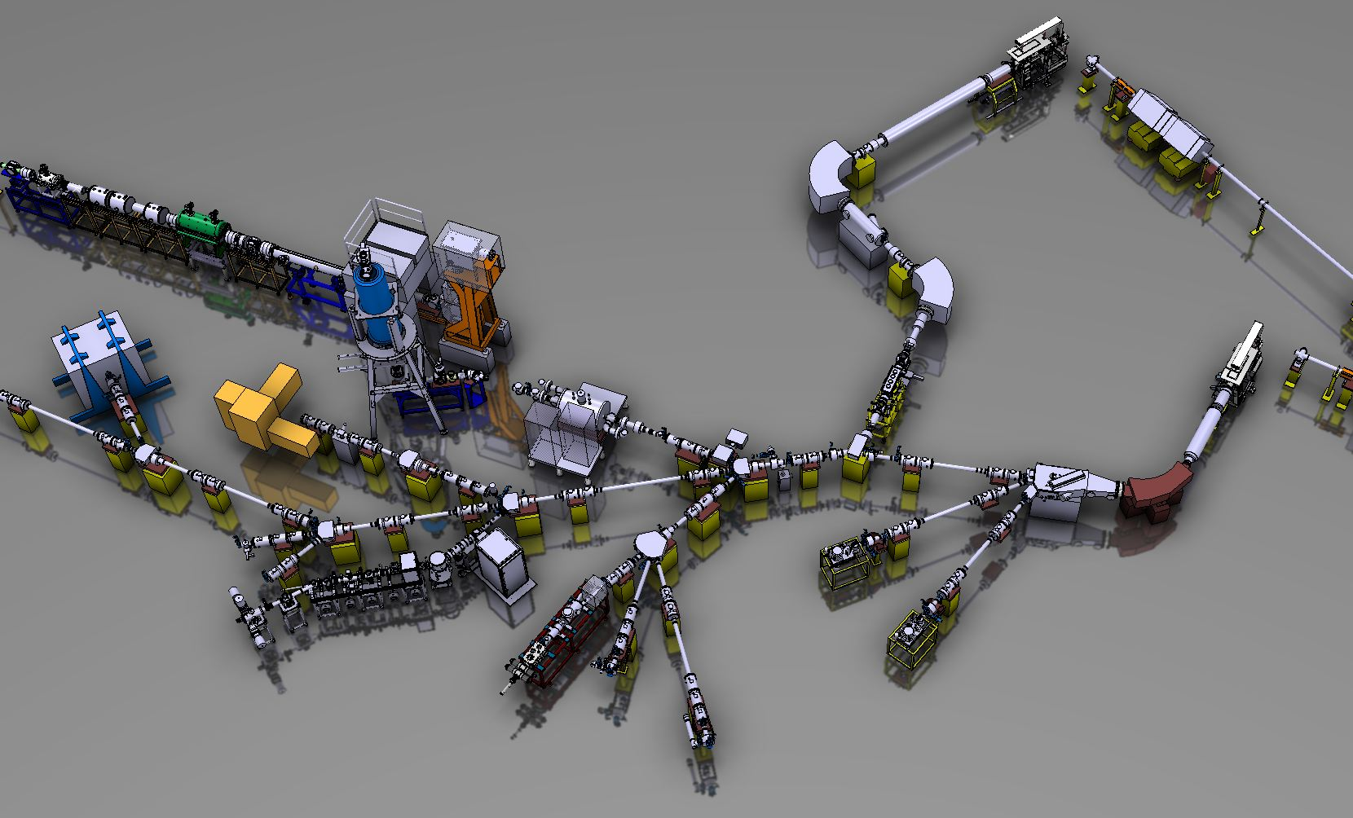
The ISOLDE facility
Each experiment is owned and operated by a collaboration
Proton driver: 1.4 GeV, 2 μA (future: 2 GeV / 4 μA)
Two target stations (partially in parallel)
Ion cooler-buncher (μs bunches, user-defined repetition rate)
Target station 1
p
Post-accelerated beams ~ 10 MeV/u
3 experimental set-ups
HRS
Target station 2
p
ISCOOL
GPS
Low-energy beams
40-60 keV
> 10 permanent set-ups

Slide 11
Several Laser Spectroscopy experiments
Lifetimes: > 10 milliseconds
Production rates: > 10/s
Scientific goals:
Nuclear Structure: nuclear properties of short-lived isotopes
  from Hyperfine Structure and Isotope Shifts in atoms or 1+ ions
    Nuclear spin
    Nuclear moments (wave function and shape, deformation)
    Nuclear charge radii (sizes)
Chemistry: atomic properties of short-lived isotopes (rare elements beyond Bi for which no stable isotopes naturally occur)
Molecular physics: properties of short-lived molecules
  Electronic excitation spectrum
  Vibrational, rotational, hyperfine structure, …
  Ionization potential
    IDEAL LABORATORIES to search for New Physics

Slide 12

Collinear laser spectroscopy at ISOLDE
Collinear laser spectroscopy
Overlap a fast (40-50 keV) ion beam with a narrow band (CW or pulse-amplified) laser beam
High resolution (~ 20 - 100 MHz)
Review: 40 years of experience and upgrades
Neugart et al., Journal of Physics G 44, 064002 (2017)
detect a resonantly excited ion
continuum
Sensitivity ~ few 1000 ions/s (COLLAPS)
  With bunched beams and fluorescence detection of photons:
  K.T. Flanagan et al., PRL 103, 142501 (2009)
λ₂
second step laser photon
excited state
Hyperfine splitting
Sensitivity ~ 20 ions/s (CRIS)
  With bunched beams and collinear RIS + UHV laser-atom interaction
  + deflected ion beam detection (in principle background free)
  K.T. Flanagan et al., PRL 111, 212501 (2013)
  R.P. de Groote et al., PRL 115, 132501 (2015)
  R.P. de Groote et al., Nature Physics 16, 620 (2000)
laser photon
λ₁
detect fluorescence photons

Slide 13
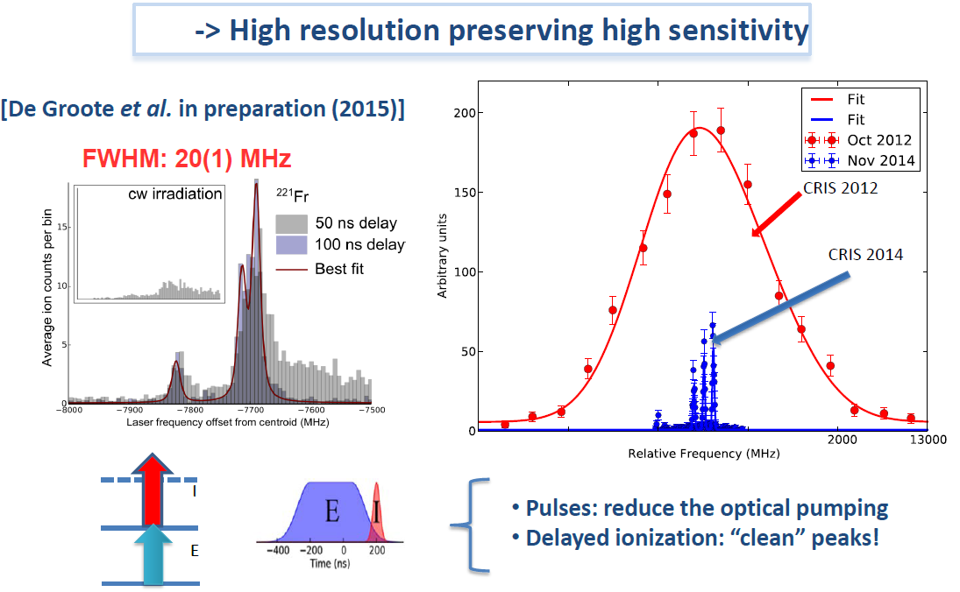
Collinear Resonance Ionization Spectroscopy
(since 2012)
Charge Exchange Cell
to neutralize ions
  K.T. Flanagan et al., PRL 111, 212501 (2013) – 2012
  broadband tunable lasers (GHz)
  R.P. de Groote et al., PRL 115, 132501(2015) – 2014
  narrowband tunable pulsed lasers (MHz)

Slide 14
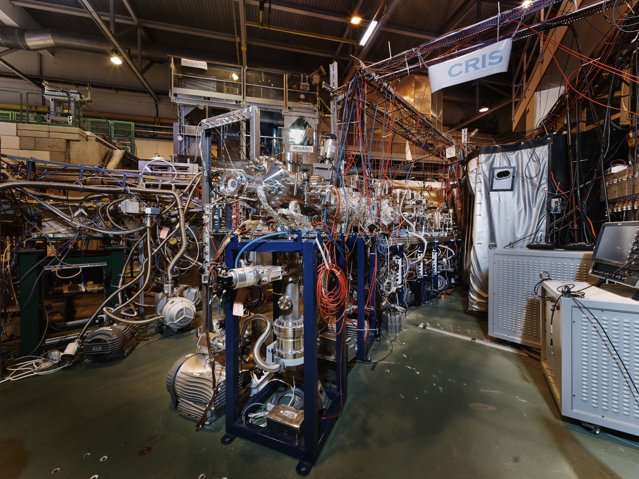
CRIS experiment at ISOLDE

Slide 15
Isotope shifts, charge radii, deformation
¹⁰⁰Sn
(N=50)
Charge radii of Sn isotopes,
from ¹⁰⁴Sn up to ¹³⁴Sn (closed proton shell Z=50)
¹³²Sn
(N=82)
Deformation of the isotopes, extracted from charge radii and from transition probabilities
→ Deformation is not an observable !
PhD Thesis F. Parnefjord-Gustafsson, KU Leuven

Slide 16
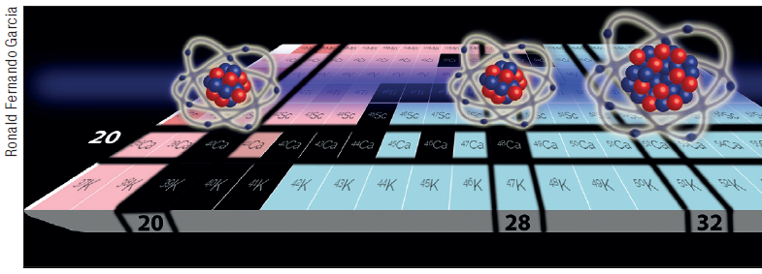
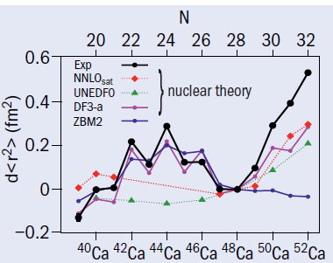
Charge radii of Ca isotopes
Ca (Z=20) closed proton shell
R.F. Garcia Ruiz et al.,
Nature Physics 12 (2016) 594
(PhD, KU Leuven)
Very rich structure
→ Not yet fully captured by nuclear theory

Slide 17
Radioactive molecules research at ISOLDE
Initiated November 2017 – visit of Robert Berger to ISOLDE physics group
  RaF is a particularly interesting molecule to study symmetry-violating moments
    Some Ra isotopes are OCTUPOLE deformed (more sensitive)
    RaF is laser coolable
  But it is radioactive, so how to study it ?
  Only theoretical knowledge about its properties
  Ronald Garcia Ruiz (CERN fellow at ISOLDE): we can do this at CRIS (provided the molecules can be produced)
January 2018: Proposal to the ISOLDE program committee (INTC)
December 2018: first spectroscopy of RaF (last experiment before LS2)
Jan 2019 – March 2021: CERN Long Shutdown 2

Slide 18
Courtesy: R.F. Garcia-Ruiz, Physics Beyond Colliders workshop 2021, CERN

Slide 19
Courtesy: R.F. Garcia-Ruiz, Physics Beyond Colliders workshop 2021, CERN

Slide 20
Courtesy: R.F. Garcia-Ruiz, Physics Beyond Colliders workshop 2021, CERN

Slide 21
Courtesy: R.F. Garcia-Ruiz, Physics Beyond Colliders workshop 2021, CERN

Slide 22
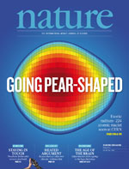
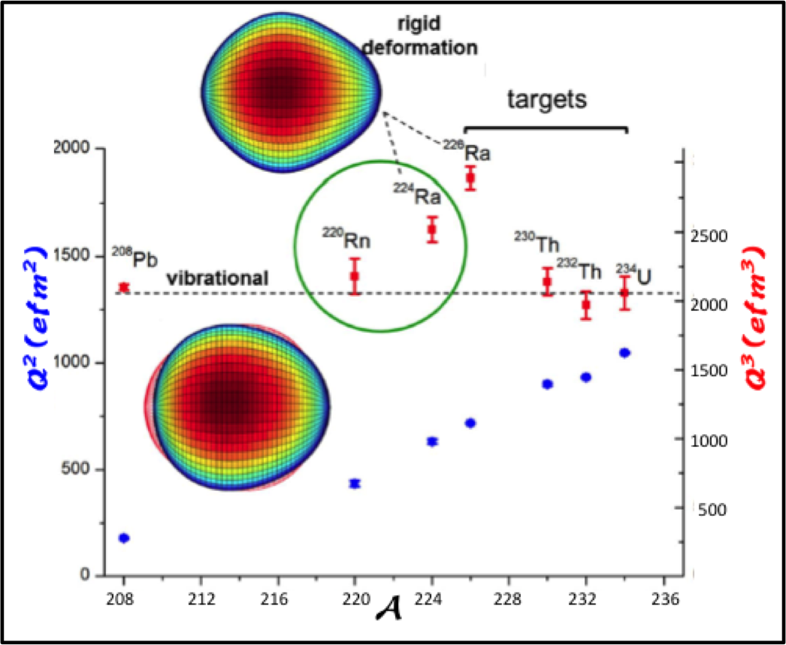
Pear-shaped nuclei established at ISOLDE
Using Coulomb excitation with an accelerated RIB at HIE-ISOLDE
L. P. Gaffney et al., Nature 497, 199–204 (2013)
P. Buttler et al., Phys. Rev. Lett. 124, 042503 (2020)
Octupole deformation
λ = 2
^{222,224,226}Ra are octupole deformed (= pear shaped)
→ Ideal nuclei to search for Physics Beyond Standard Model
λ = 2

Slide 23

Search for RaF excitations using collinear resonance ionization spectroscopy
Making the impossible possible
From production till spectroscopy on neutral RaF
Fully guided by theorists (present at the experiments!)
R.F. Garcia Ruiz, R. Berger et al.,
Nature 581 (2020) 396
?
IP ~ 40.000 cm⁻¹
< 370 nm
²²⁶Ra¹⁹F⁺ (A=245)
~ 13.000(500) cm⁻¹
740 – 800 nm
?
?
?

Slide 24
Search for RaF excitations
using collinear resonance ionization spectroscopy
Enhance the chances for successful resonance search by:
Use broadband lasers (3-9 GHz)
Sending lasers parallel and antiparallel ➔ allows for scanning two different wavelength regions at the same time, thanks to Doppler shift of the accelerated beam
Set-up 3 independent laser systems, to scan simultaneously 3 wave-length regions
IP ~ 40.000 cm⁻¹
< 370 nm
~ 13.000(500) cm⁻¹
740 – 800 nm
➔ Search capability x 6

Slide 25
First RaF spectroscopy at ISOLDE
R.F. Garcia Ruiz, R. Berger et al., Nature 581 (2020) 396
Predicted first excited state
at 13.000 (500) cm⁻¹ (R.Berger)
Vibrational (Δν=0) excitations to 1st excited state at 13.284 cm⁻¹
Exited state half life: t_{1/2}<50 ns

Slide 26
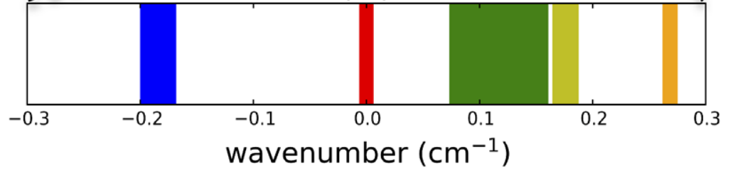
Additional results
Large Isotope shifts observed between RaF isotopologues
²²⁶RaF
²²⁴RaF
²²⁸RaF
²²⁵RaF
²²³RaF
Udrescu et al., PRL 127(3), 033001 (2021)

Slide 27
Follow-up studies
Extract nuclear charge radii from diatomic molecular isotope shifts using a King-Plot analysis with atomic/ionic isotope shifts.
An alternative way to access charge radii of exotic isotopes
Athanasakis-Kaklamanakis et al.,
PRX 13, 011015 (2023)
Yb⁺ and YbF

Slide 28
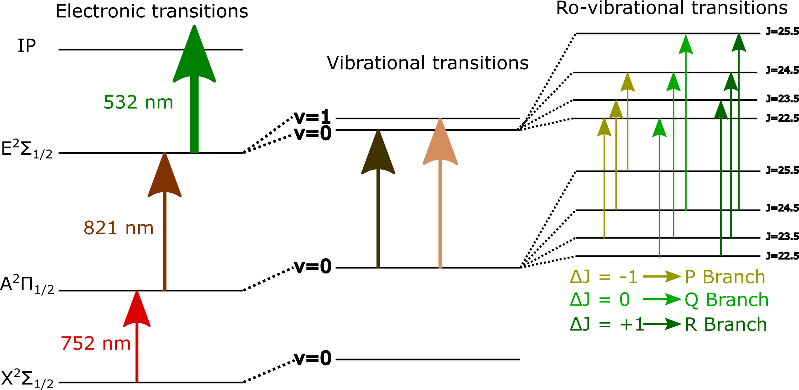
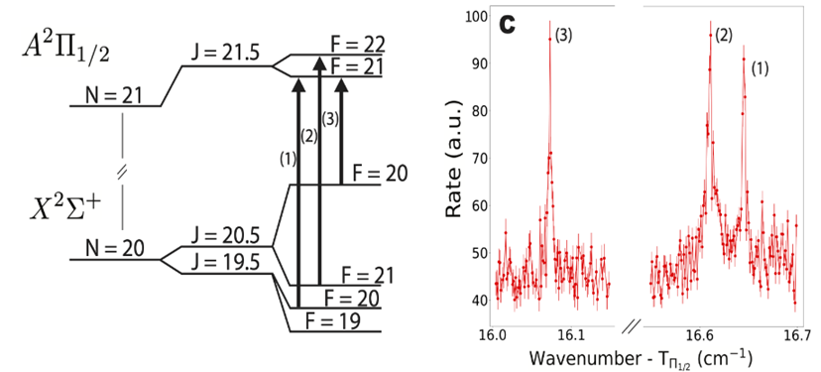
2021: higher resolution and 3-step schemes
Access to higher excitation energies
Access to rovibrational transitions and HFS
Courtesy: M. Athanasakis-Kaklamanakis and Shane Wilkins

Slide 29
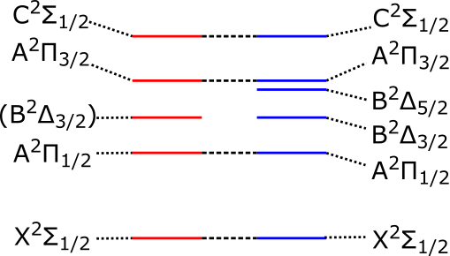
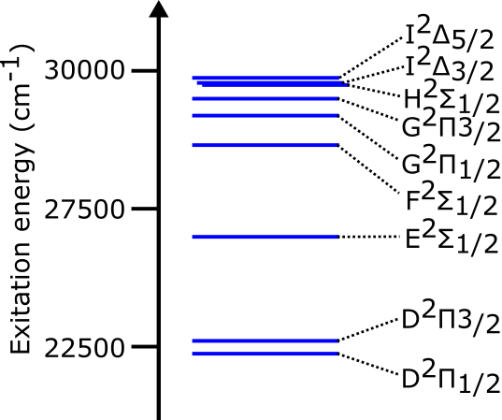
2021: identify excited states up to 30.000 cm⁻¹
(1) Re-measure states below 17.000 cm⁻¹ (1 was not yet seen).
(2) Identify all levels up to 30.000 cm⁻¹
Experiment 2018
Theory 2021
R.F. Garcia Ruiz, R. Berger et al., Nature 581 (2020) 396

Slide 30
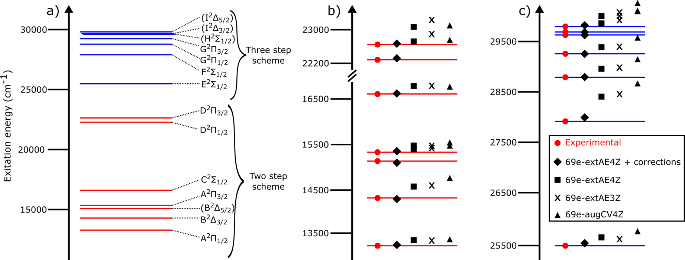
2021+2023: all states identified
Excellent agreement with Fock-space relativistic coupled cluster calculations (FS-RCCSD)
after inclusion of higher order electron correlations (with 69 electrons), extended basis sets, CBS correction of basis set and improvement of the electronic Hamiltonian (to include the Gaunt inter-electron interactions and QED corrections).
Athanasakis-Kaklamanakis et al., under review (2024)

Slide 31
2021: establishing a laser cooling scheme
T_{1/2} < 50 ns (Garcia Ruiz, 2020)
Efficient cooling likely with only 3 lasers !
Udrescu et al., Nature Physics 20 (2024) 202

Slide 32
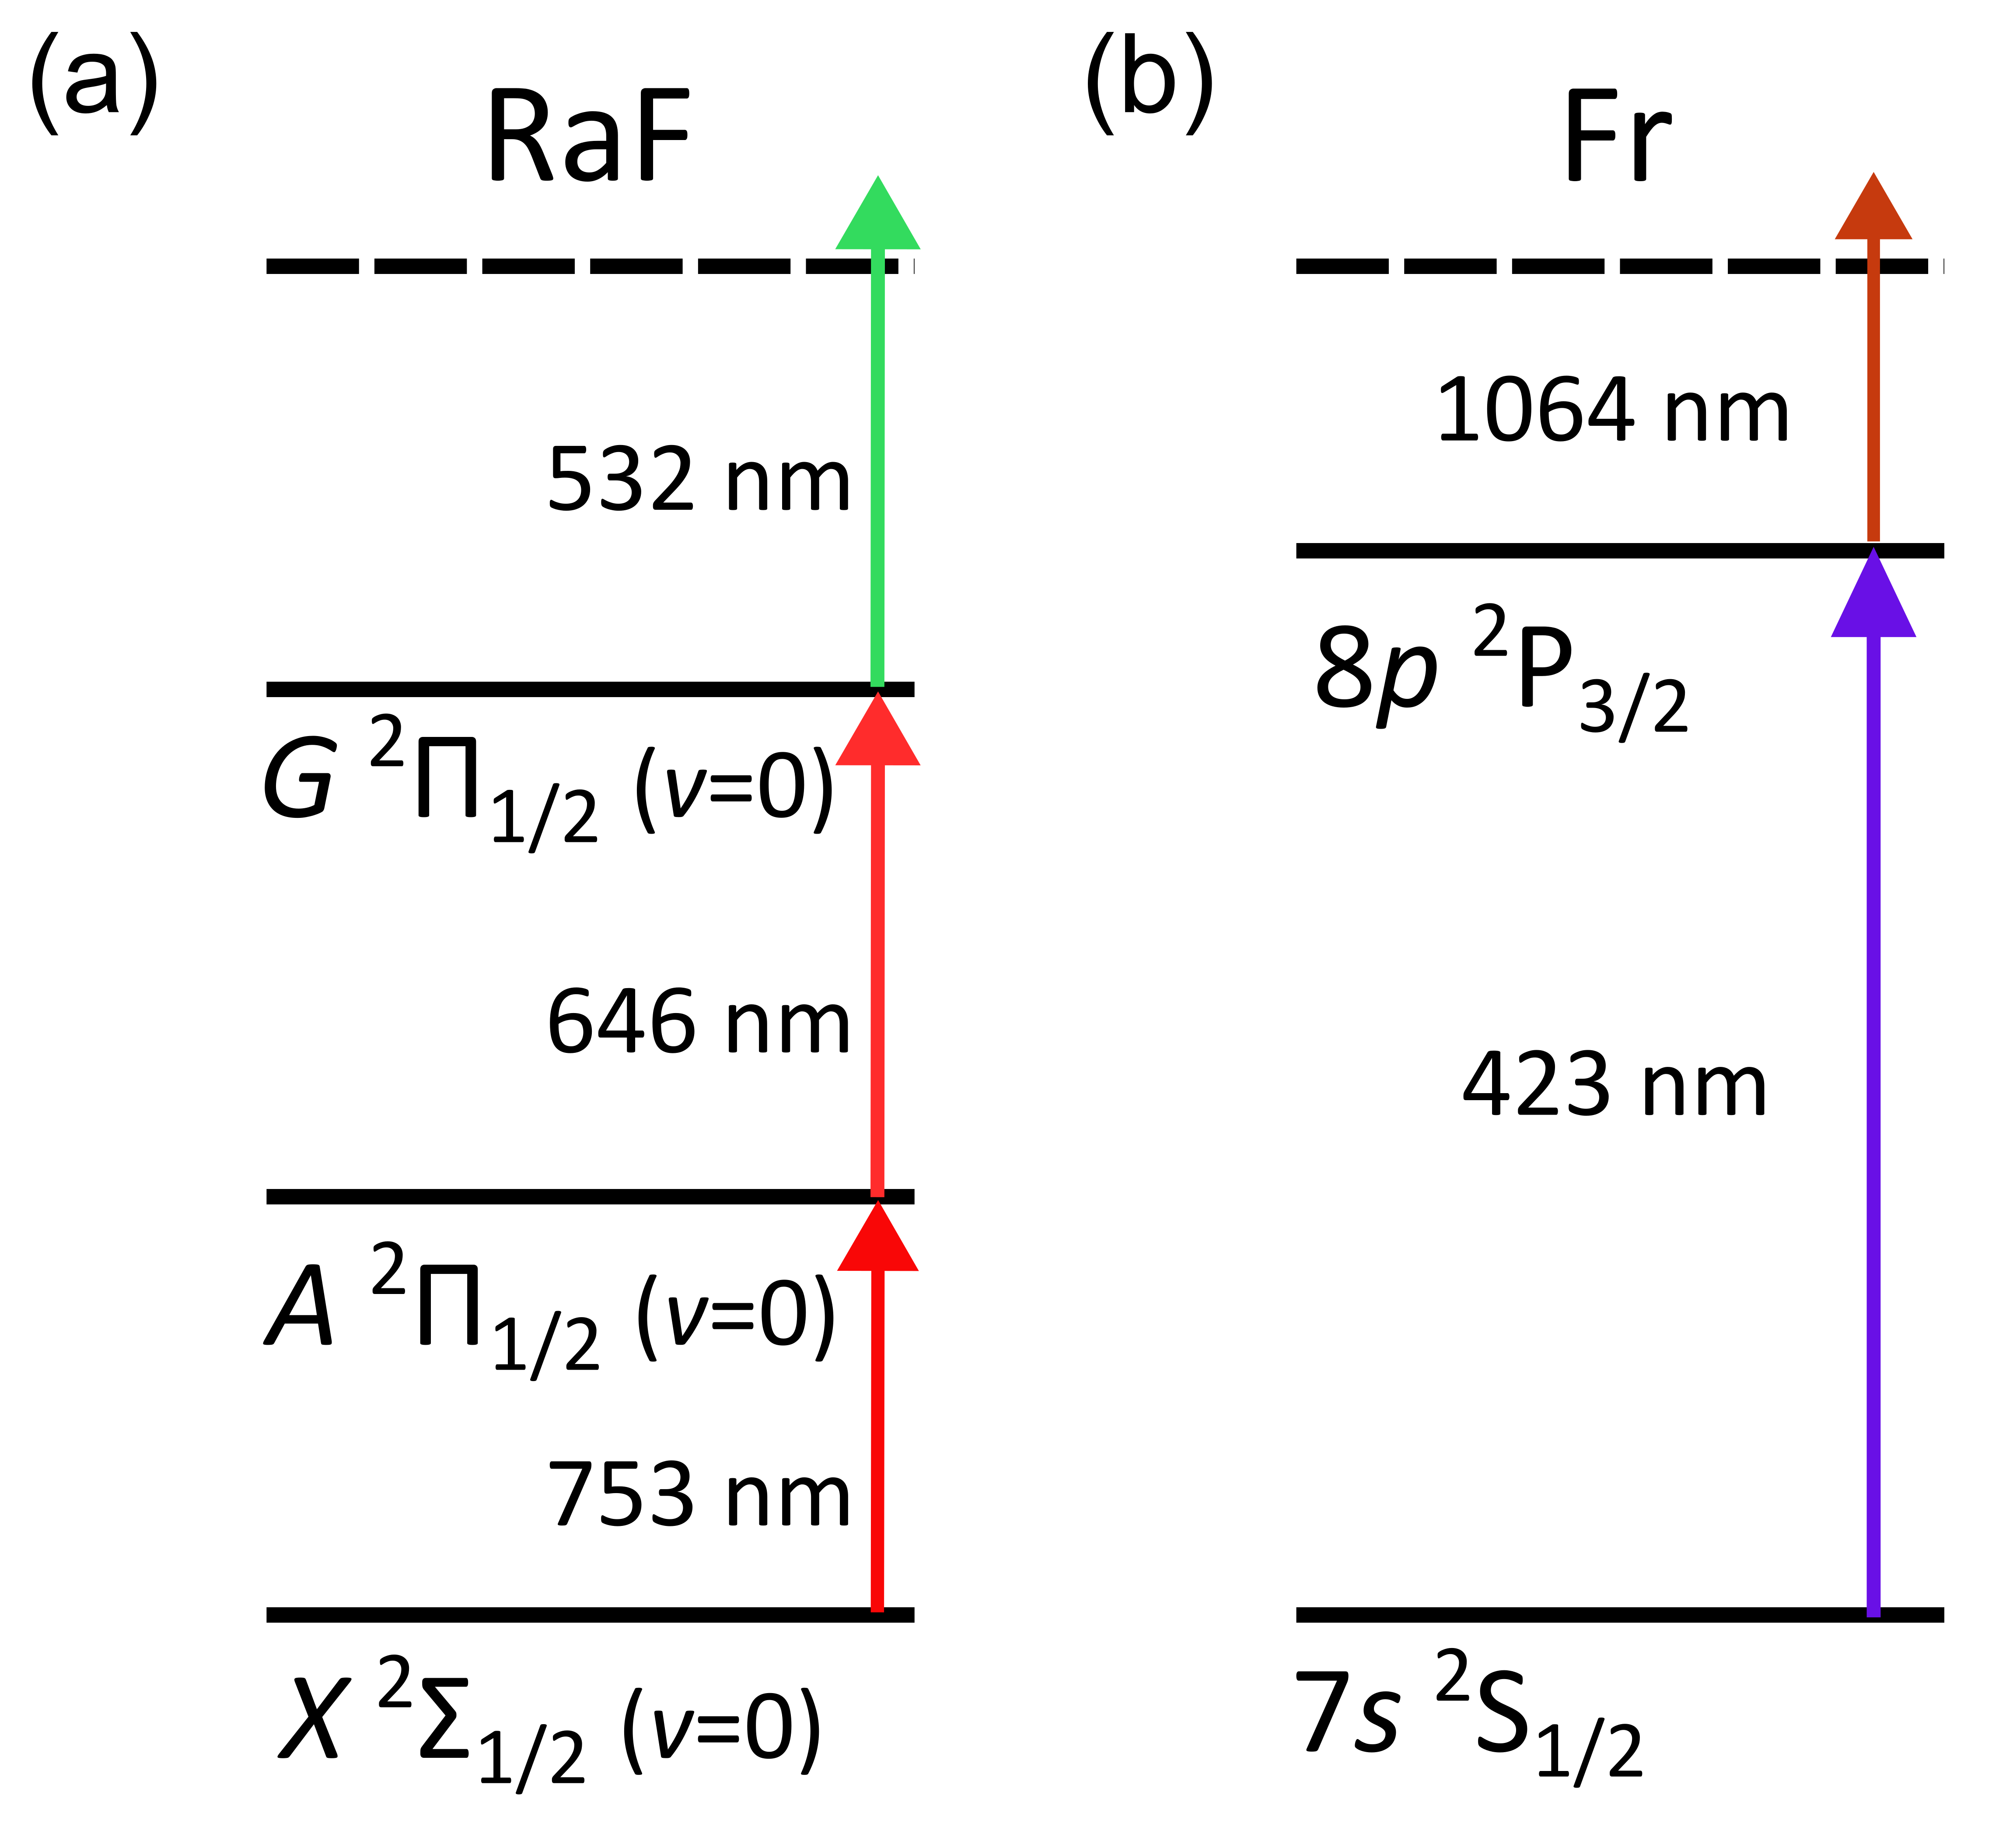
2023: lifetime of the AΠ_{1/2} = 35(2) ns
Delayed ionization spectroscopy
Benchmark method with ²²¹Fr (broadband lasers) – t_{1/2}(8P_{3/2}) = 83.5(1.5) / 82(4) ns
RaF
Natural linewidth Γ/2π = 4.6(8) MHz
Maximum photon scattering rate with 3 lasers: R_{max} = 4.1(7) × 10⁶ s⁻¹.
M. Athanasakis – Kaklamanakis et al., in preparation

Slide 33
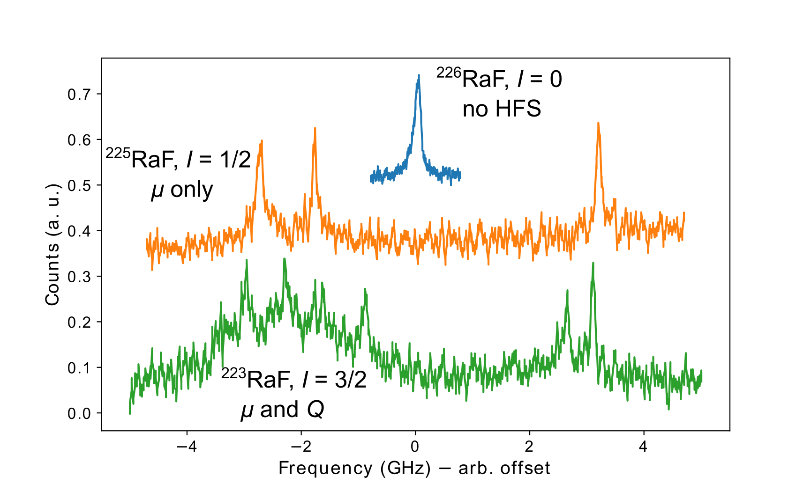
2021/2023: HFS of ²²³RaF and ²²⁵RaF
I=1/2 (225Ra): probe the magnetic dipole interaction (sensitive to BW effect)
  S. Wilkins et al, submitted (2023)
→ I=3/2 (223Ra): probe the quadrupole interaction

Slide 34
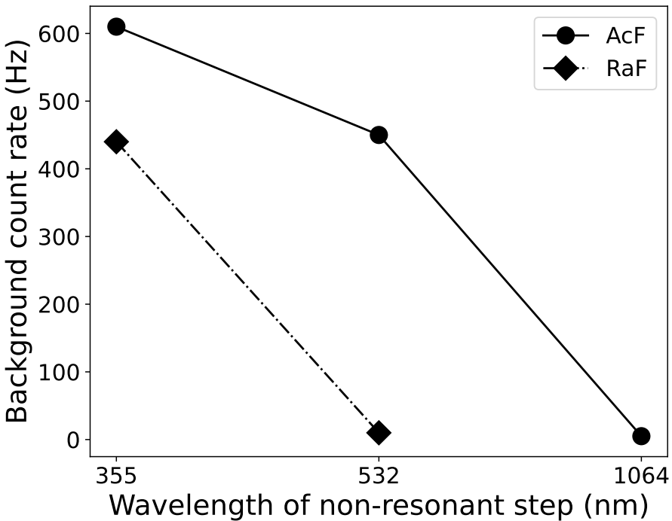
2022: Spectroscopy of ²²⁷AcF
Production challenging
  Realized with hard and creative work by Mia Au and the ISOLDE TISD team
Plasma ion source with CF₄ leak
Neutralization with Na
385 + 355 nm two-step scheme to identify the strongest transition from ground state
Extreme non-resonant background
  → Implies existence of metastable states populated in charge exchange
Slide M. Athanasakis-Kaklamanakis

Slide 35
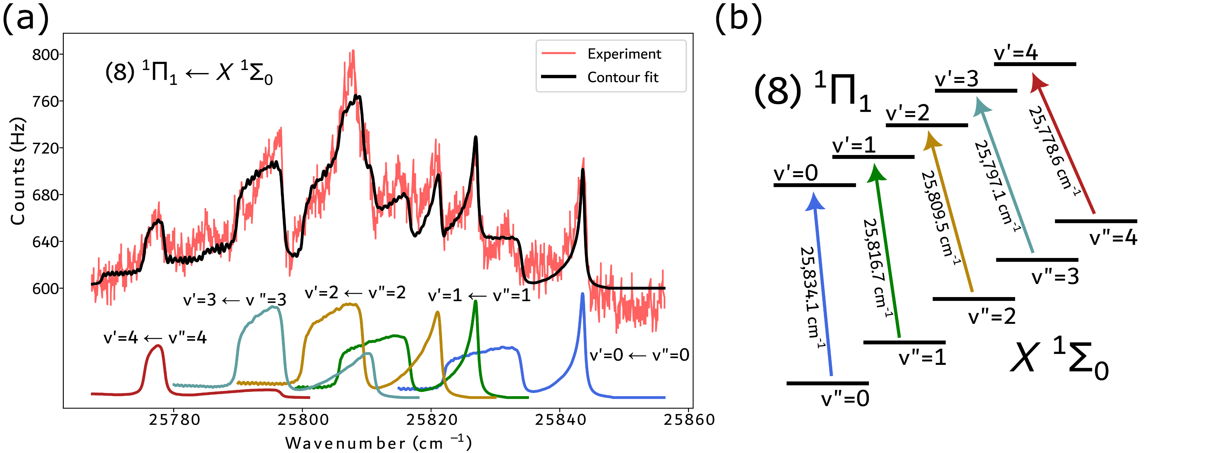
2022: First AcF spectroscopy
Strongest predicted transition from ground state observed, guided by FS-CCSD calculations
Excitation energy in good agreement with theory
Very large laser-induced background prevented observing weaker transitions
M. Athanasakis-Kaklamanakis et. al, in preparation

Slide 36
Conclusions
Radioactive molecules can be produced in a controlled way at ISOLDE – more studies are planned
Detailed spectroscopy of RaF performed, down to HFS level, for several isotopologues
IP of RaF measured (S. Wilkins, in preparation)
First spectroscopy of AcF
To be continued …

Slide 37
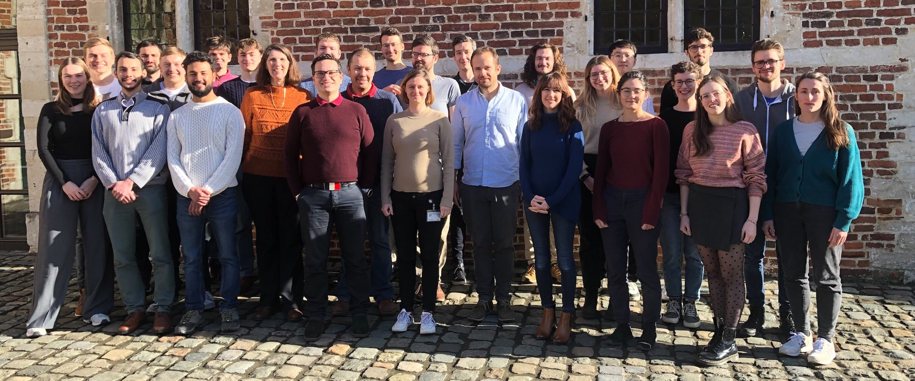
Thanks to all my collaborators at CRIS !

Slide 38
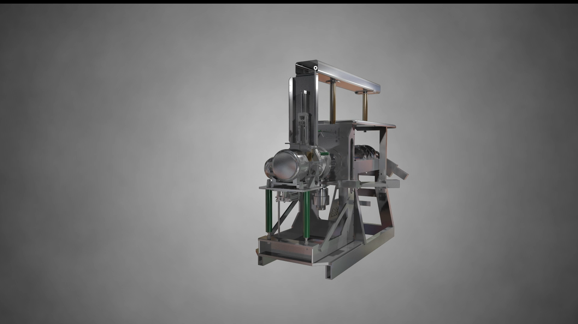
ISOL method
Isotope Separation On-Line method
= isotopes come out of the target in few ms
(diffusion/effusion from heated target at ~2000 degrees)
+ selection of (ideally) 1 specific isotope in microseconds to seconds (element dependent)

Slide 39
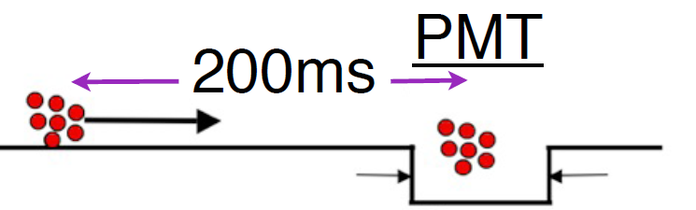
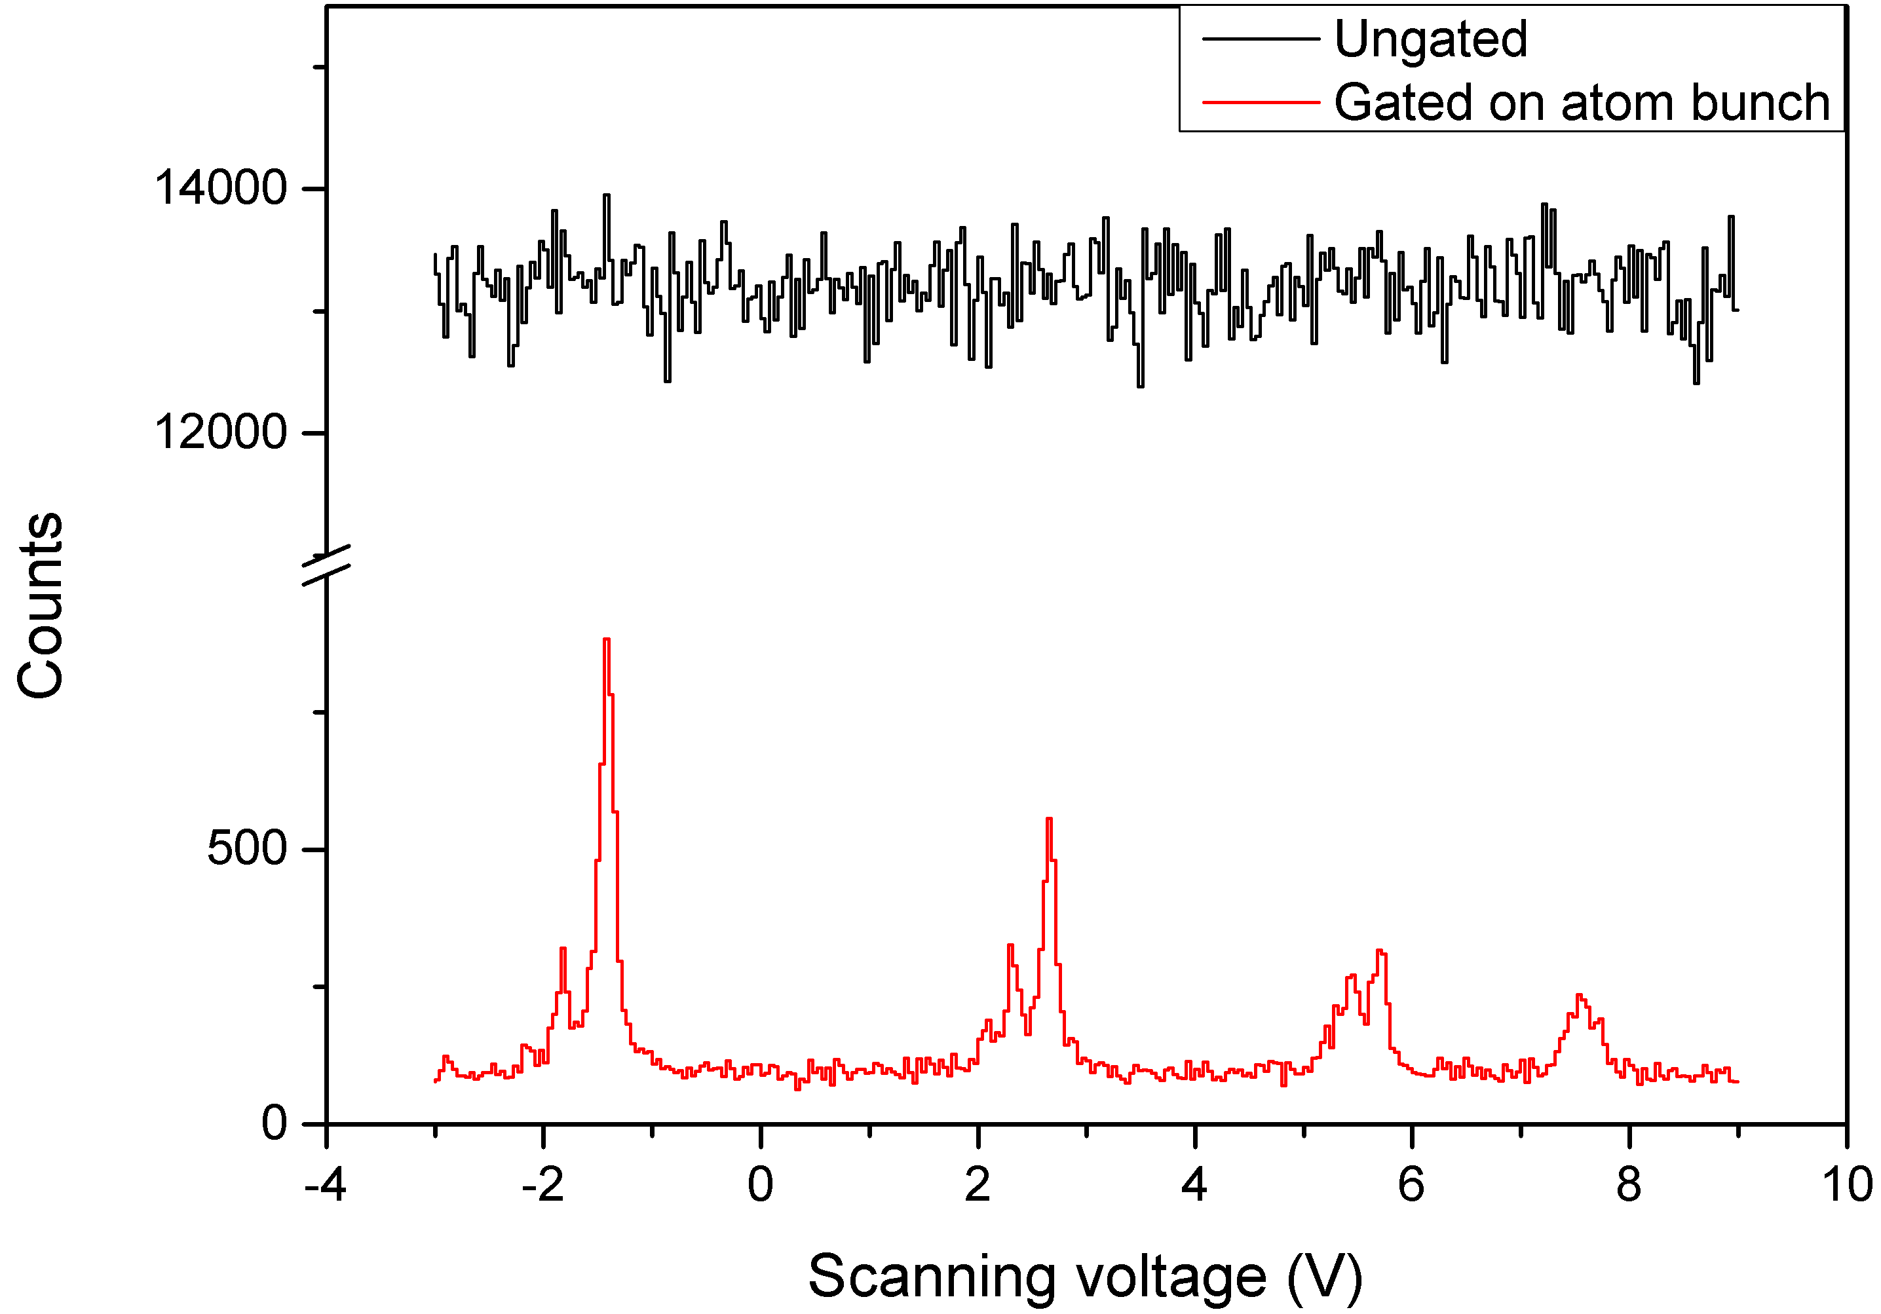
Use of ‘bunched’ beams from RFQ (ISCOOL) is crucial
at COLLAPS (CW lasers)
at CRIS (pulsed lasers)
43 ms
efficiency (duty-cycle) enhanced by factor 1000 by time-overlap between the ion bunch and the laser pulses
6 μs
measure photons
only during the bunch length
CRIS with CW atom beam:
(Schulz et al., J. Phys. B 24, 1991)
efficiency = 0.001 %
CRIS with bunched atom beam:
(Flanagan et al., Phys. Rev. Lett. 111, 212501 (2013)
efficiency = 1 %
(De Groote et al. Phys. Rev. Lett. 115, 132501 (2015))
resolution = 20 MHz !
~10⁴ background suppression

Slide 40
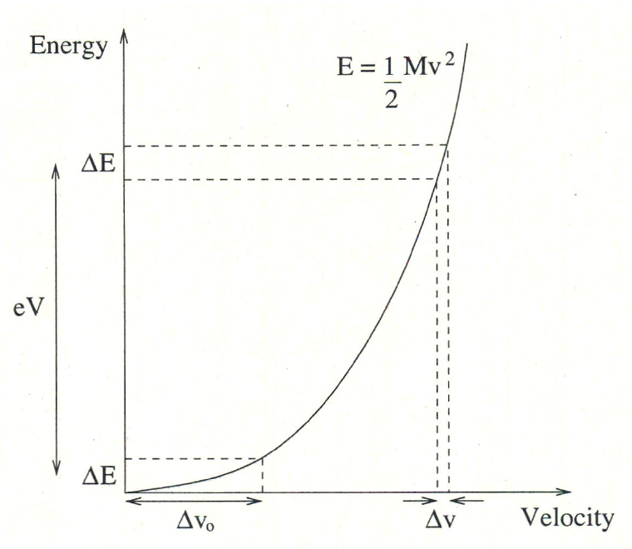
Laser Spectroscopy at ISOLDE
2. Collinear
Collinear laser spectroscopy
Overlap a fast (40-50 keV) ion beam with a narrow band (CW or chopped CW or pulse-amplified) laser beam → relative velocity spread reduces
High resolution (~ 20 - 100 MHz)
40 years of experience and continuous upgrades
Review paper:
Neugart et al.,
Journal of Physics G 44, 064002 (2017)
CRIS in high resolution:
R.P. de Groote et al.
Phys. Rev. Lett. 115 (2015) 132501
CRIS: highest resolution and sensitivity
1700 MHz
20 MHz

Slide 41
Reduce Doppler broadening:
Collinear laser spectroscopy
ion beam from ISOL-target: energy spread due to high temperature
Doppler broadening of the HFS lines == GHz resolution in the ion source
BUT: uncertainty on energy remains constant during acceleration
error on beam velocity decreases with increasing beam energy/velocity:
δE=const=δ(¹/₂mv²)≈mvδv
ΔE = few eV (on 50 keV)
    → very small velocity spread
    → reduction of Doppler broadening
high resolution: 20-60 MHz
resolve all hyperfine peaks
Necessary to extract I, μ, Q, δ<r²>

Slide 42
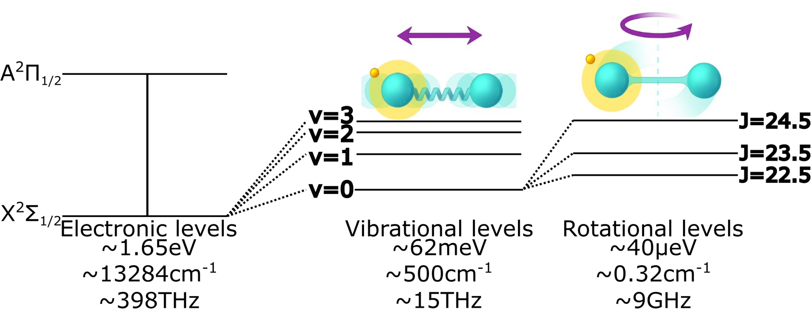


Molecular structure
Molecules feature electronic, vibrational and rotational levels.
1st ex.
g.s
$$E_{v}=hv(v+1)$$
$$E_{J}=hcBJ(J+1)$$
Adapted from Sonja Kujanpää (University of Jyväskylä)
Carlos Fajardo, Master thesis KU Leuven, 2023

Slide 43
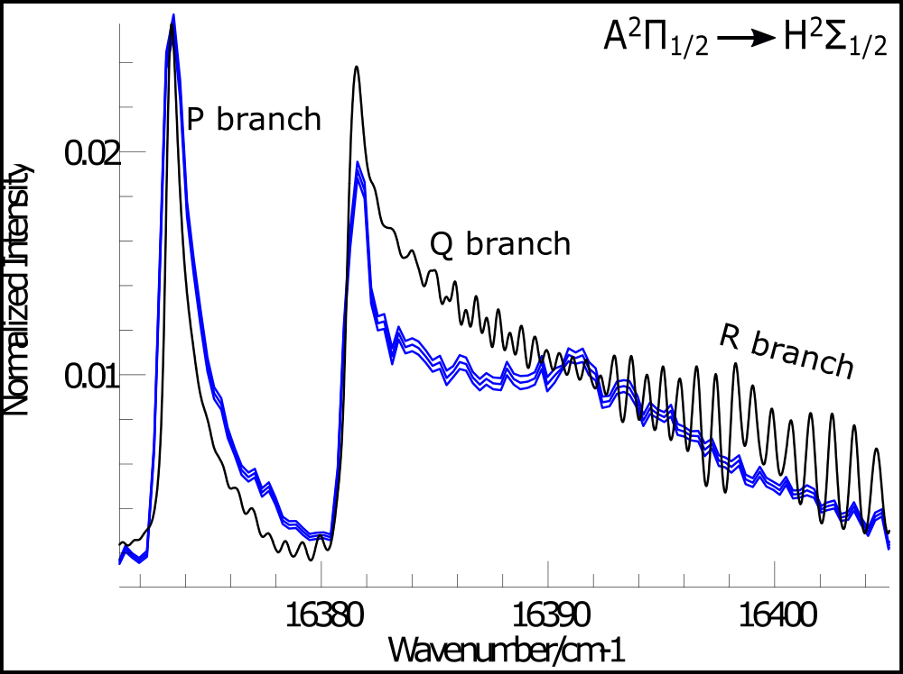
Low-resolution spectroscopy on RaF at CRIS
For first searches of new levels: use broadband lasers (3~9 GHz)
➔ the rotational transitions are not fully resolved, and the three branches are represented by an envelope of all the rotational peaks.
Same spectrum, measured
with low resolution
Experimental spectrum
Fitted spectrum
Carlos Fajardo, Master thesis KU Leuven, 2023

Slide 44
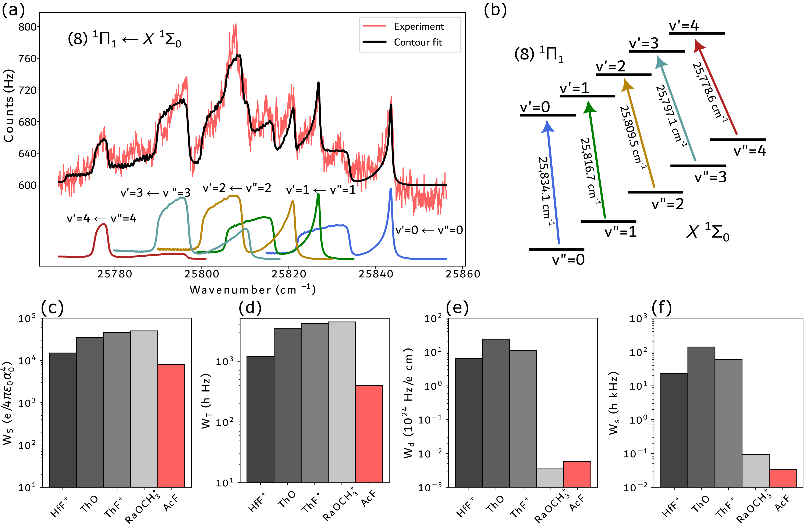
2022: First AcF spectroscopy
M. Athanasakis-Kaklamanakis et. al, in preparation

Slide 45
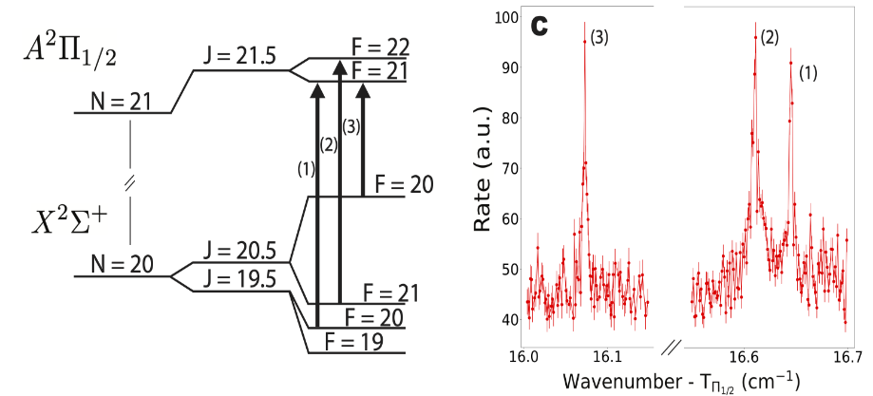
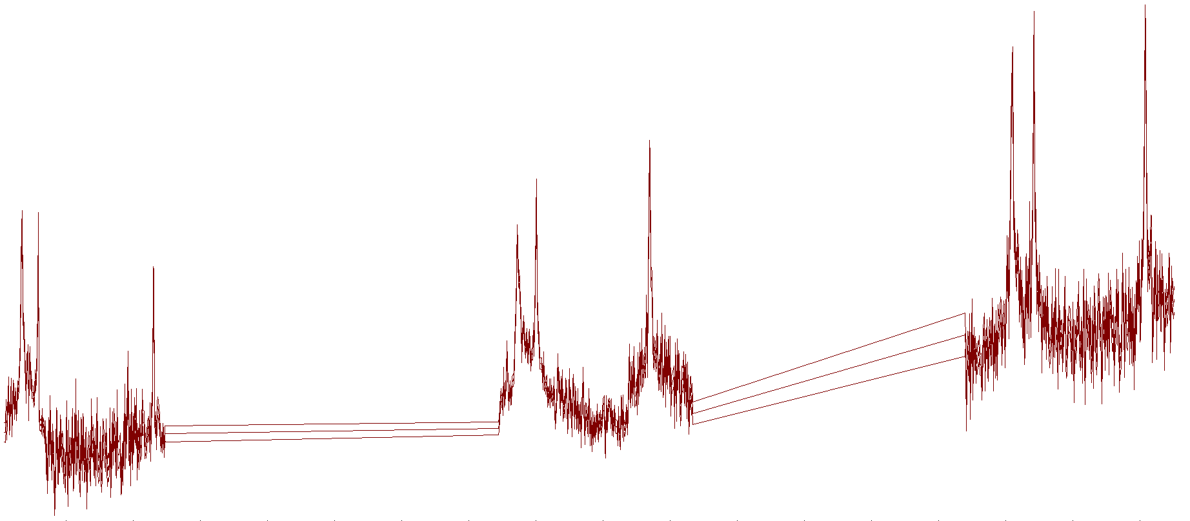
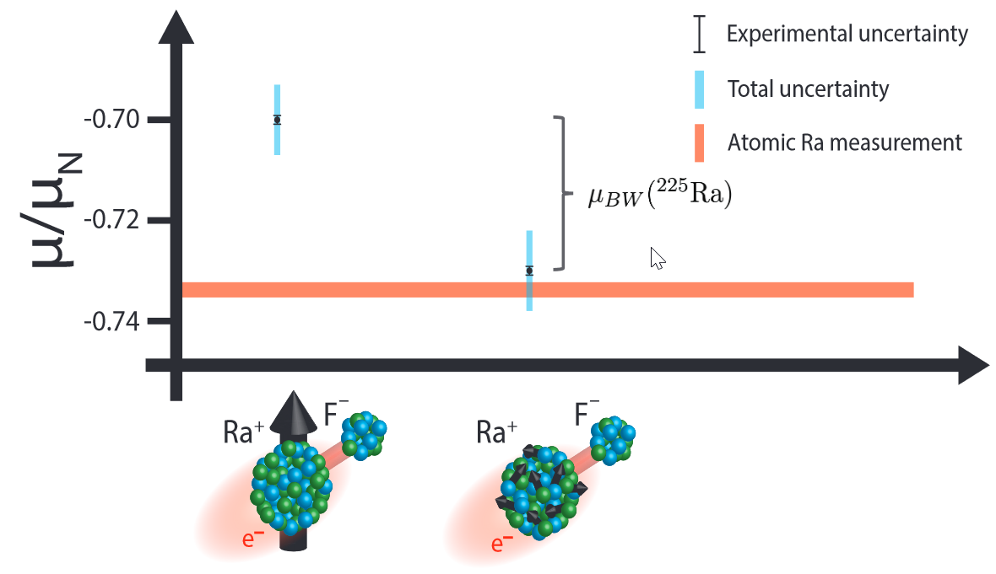

2021: hyperfine structure of ²²⁵RaF (I=1/2)
Spin-1/2 $→$ only magnetic dipole moment
(Credits: S. Wilkins, MIT)
Submitted (2023)
Probe the nuclear magnetization distribution (BW effect)

Slide 46

Pear shapes and vibrating pears
Nature Communications 10, June 2019
P.A. Butler, L.P. Gaffney et al.
Vibrating octupoles: Δi_{x} = 3
➔ ²¹⁸⁻²²⁴Rn isotopes !
Coulomb excitation of ²²²Ra and ²²⁸Ra
P.A. Butler, L.P. Gaffney et al.,
Phys. Rev. Lett. 124, 042503 (2020)
Static octupole deformation: Δi_{x} = 0 ➔ ^{222,224,226}Ra isotopes !
Vibrating octupoles: Δi_{x} = 3
➔ ²²⁸Ra isotopes !

Slide 47
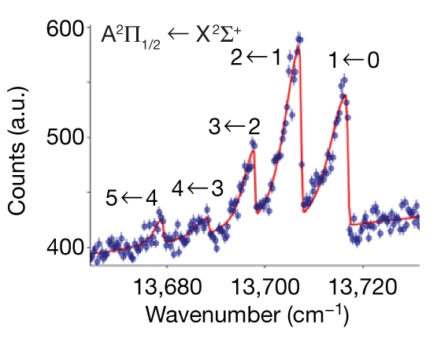
RaF: suited for laser cooling
R.F. Garcia Ruiz, R. Berger et al., Nature 581 (2020) 396
Established level scheme – part 2 (Δν=1)
Conditions for efficient laser cooling:
decay from first excited state back into ground state
(feeding into the other vibrational level is < 5%)
Lifetime of first excited state is < 50 ns (fast enough decay)
Other electronic levels appear > 2000 cm⁻¹ higher in energy
➔ closed cycle

