Slide 1
Spectroscopy of radioactive molecules relevant to EDM research
EDM Workshop 2024
March 2024
Michail Athanasakis-Kaklamanakis
Centre for Cold Matter, Imperial College London

Slide 2
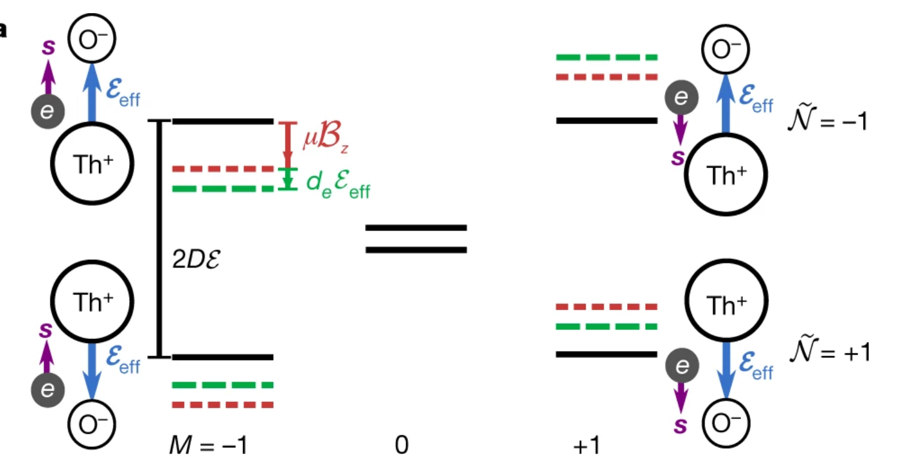
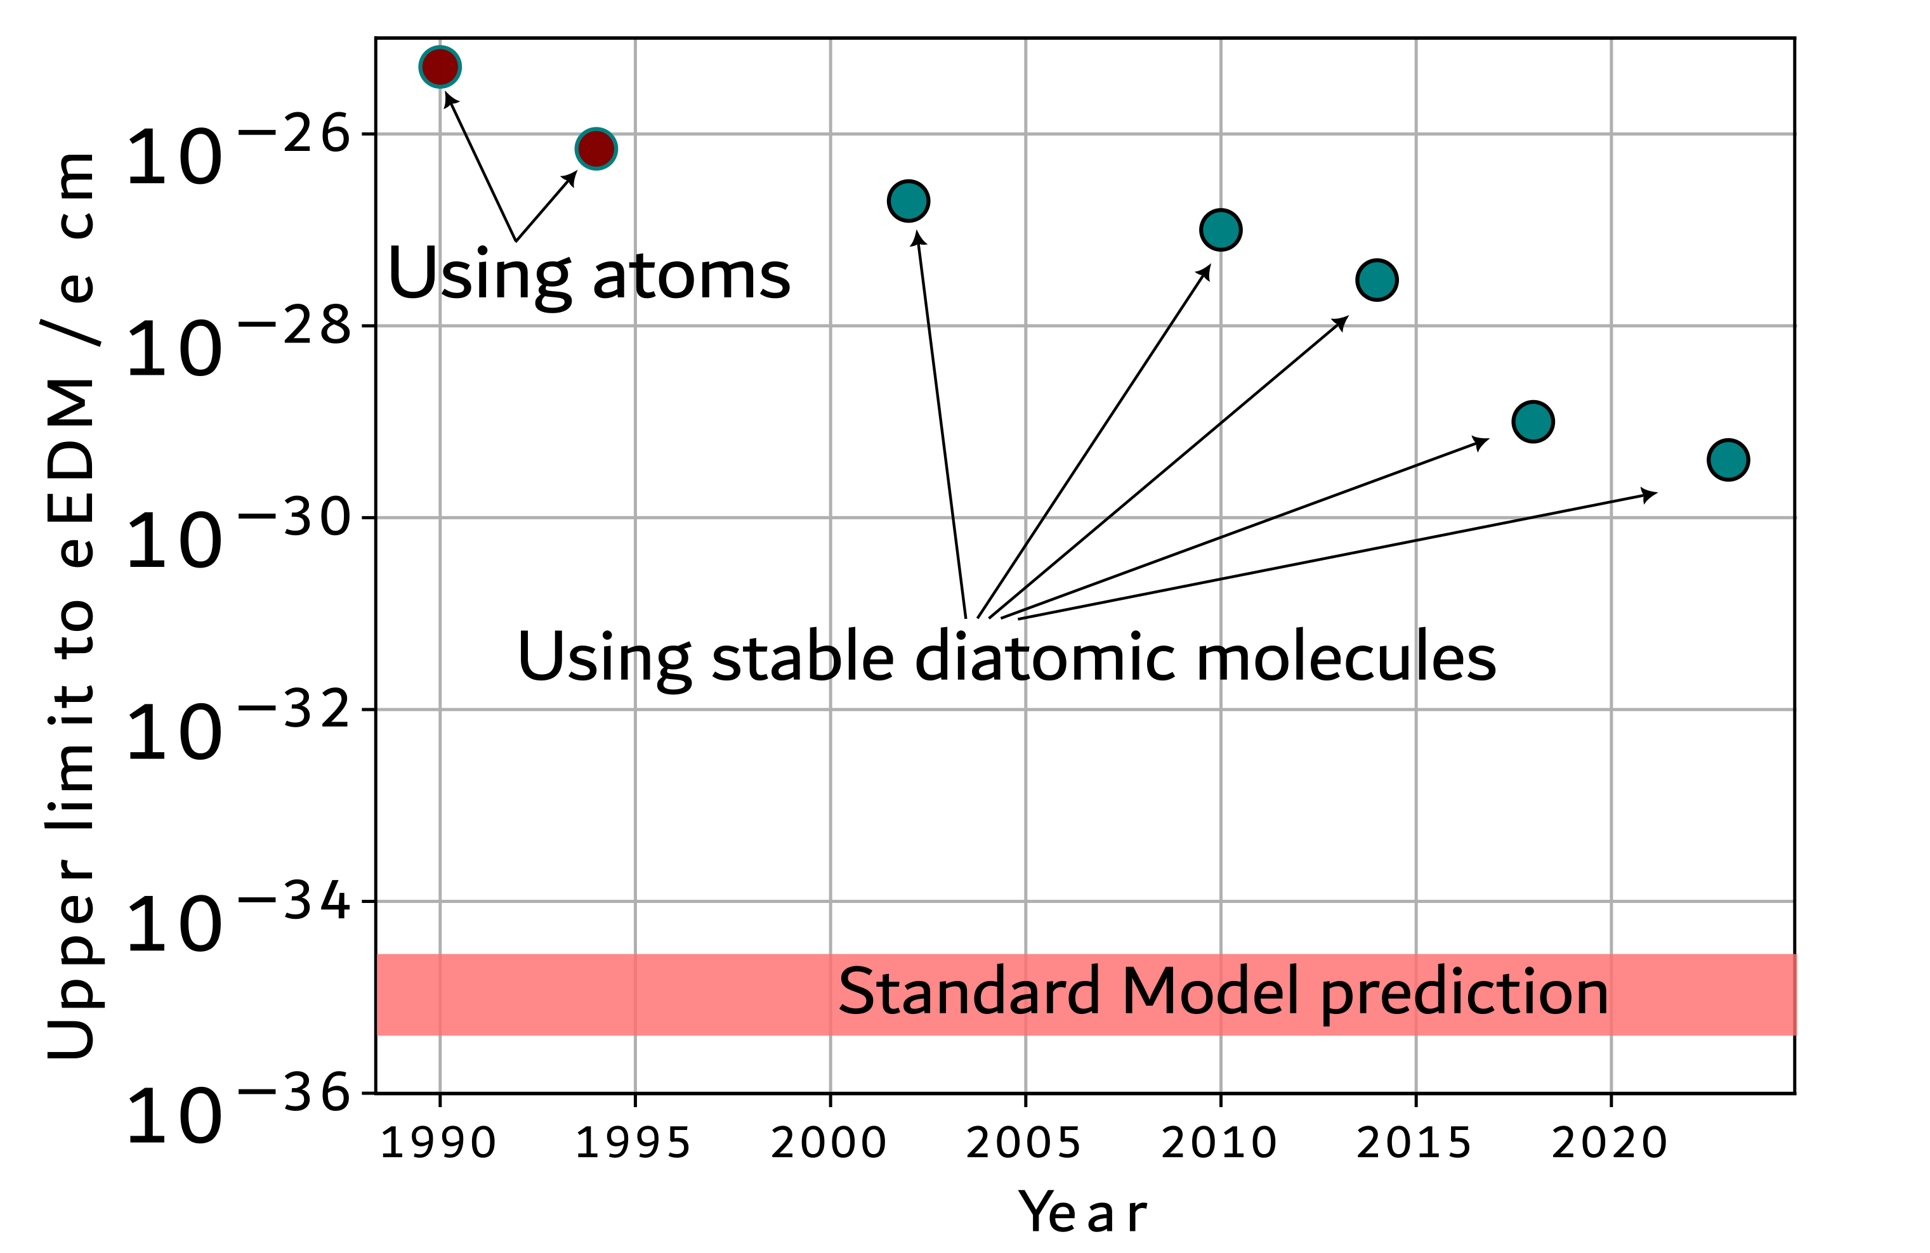
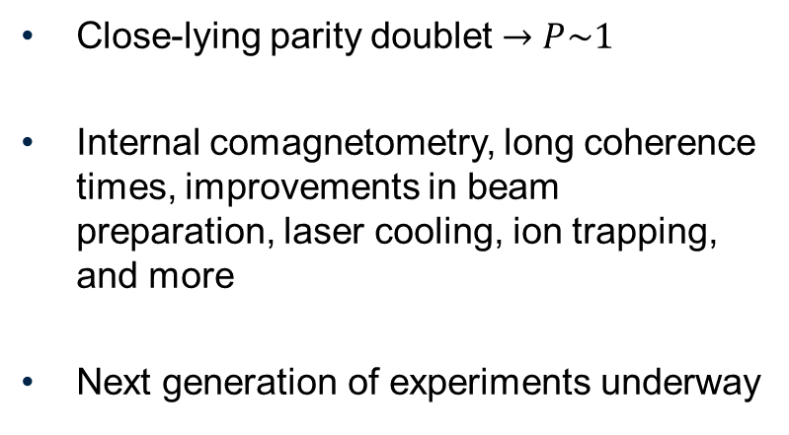
EDM with molecules
Close-lying parity doublet $→P\sim 1$
Internal comagnetometry, long coherence times, improvements in beam preparation, laser cooling, ion trapping, and more
Next generation of experiments underway

Slide 3
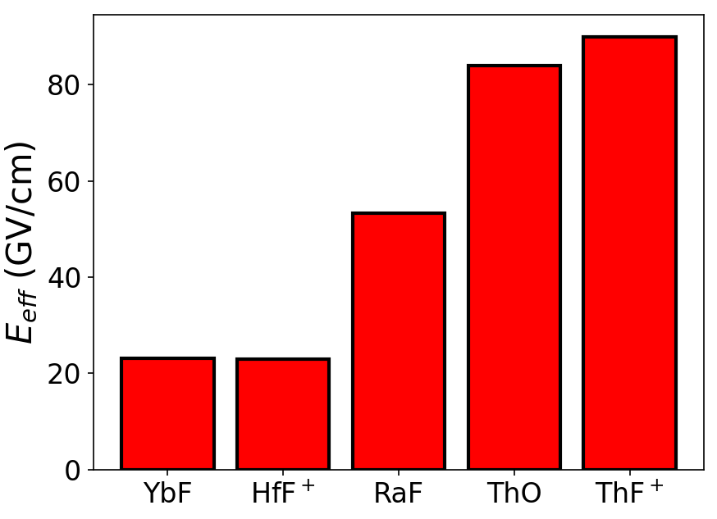
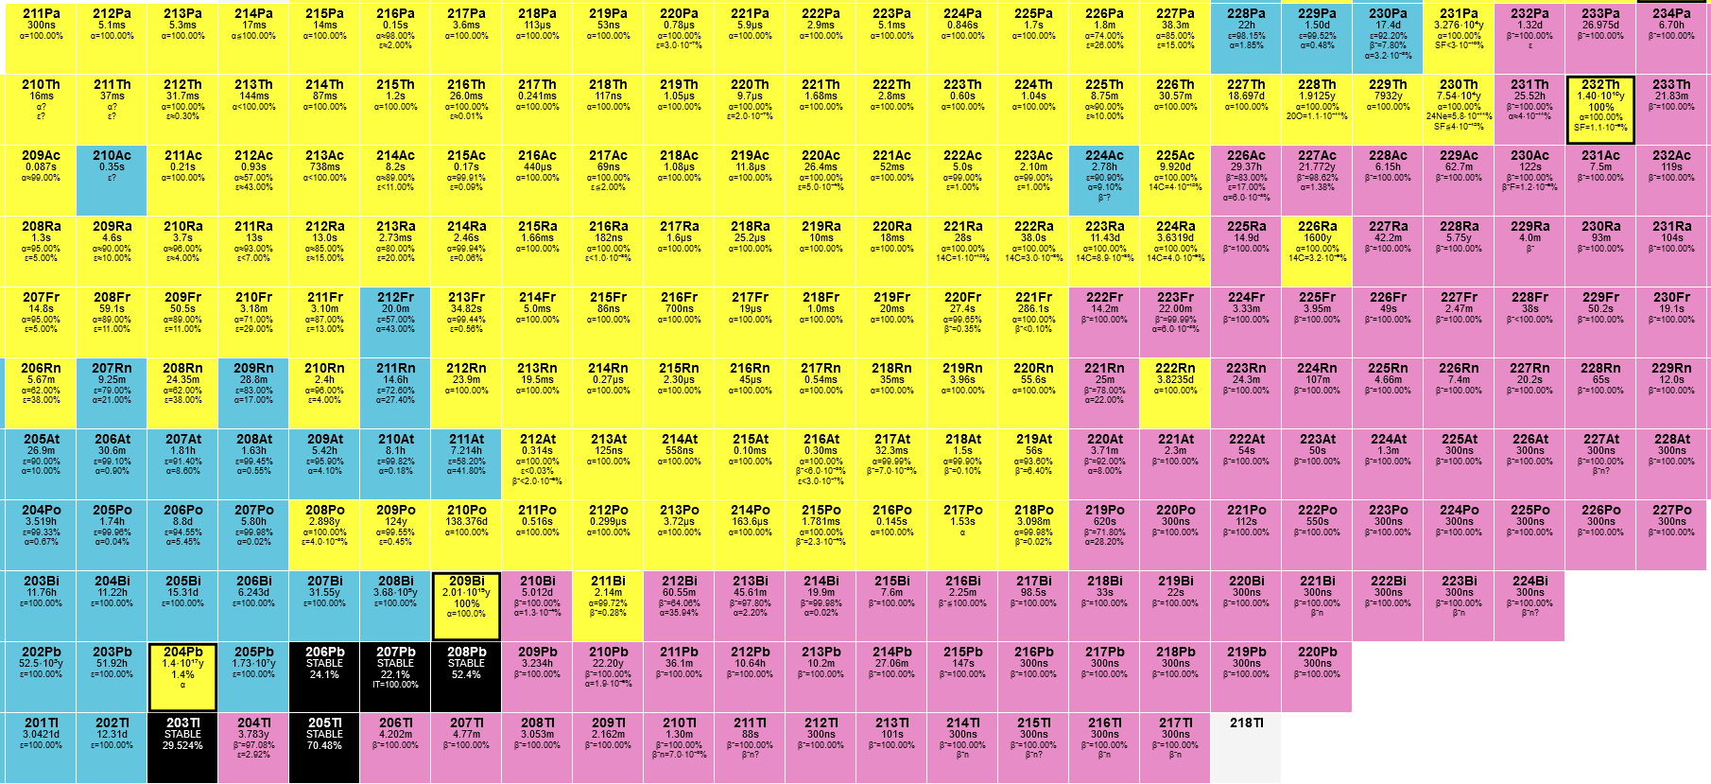
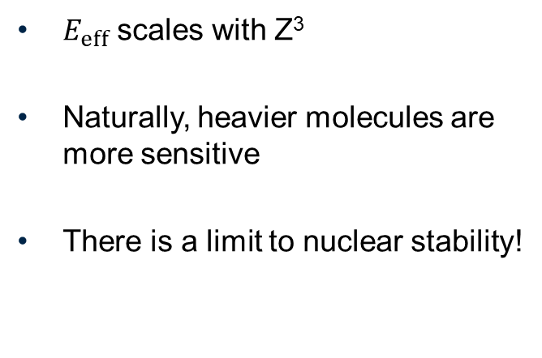
Why radioactive?
Practically stable Th
$E_{eff}$ scales with Z³
Naturally, heavier molecules are more sensitive
There is a limit to nuclear stability!
Pa
Ac
Ra

Slide 4
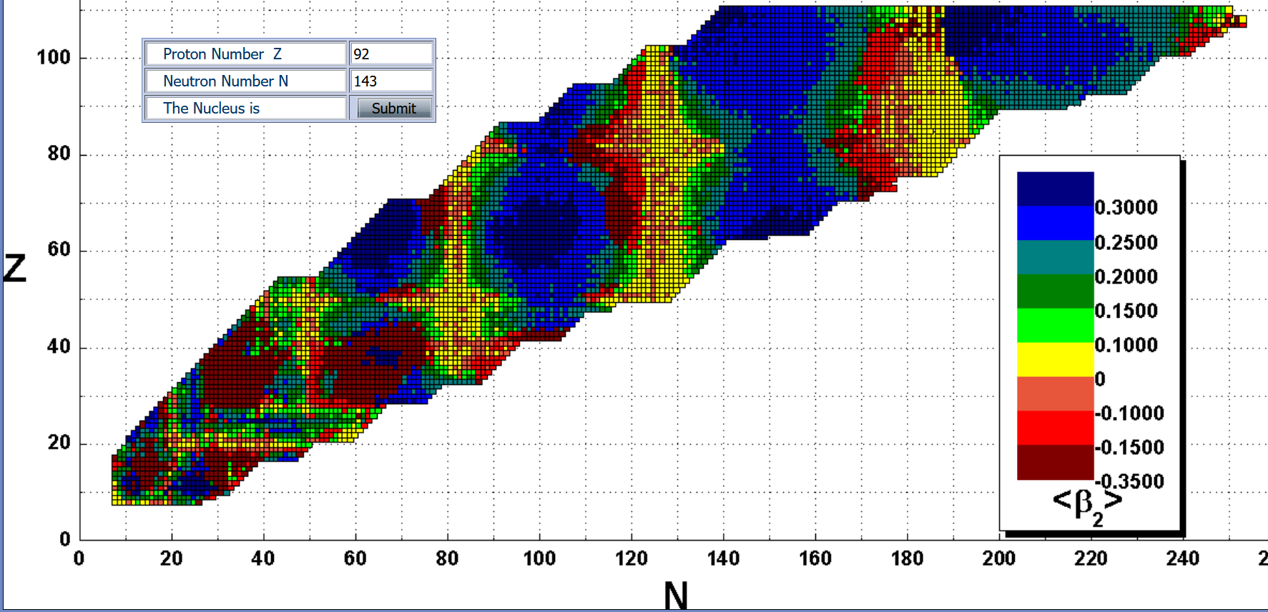
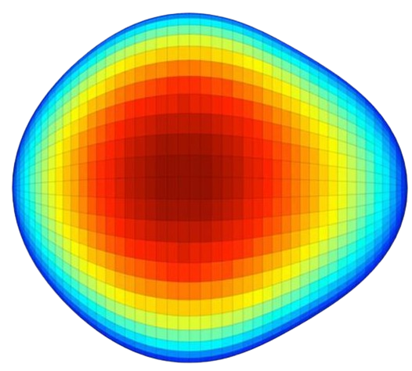


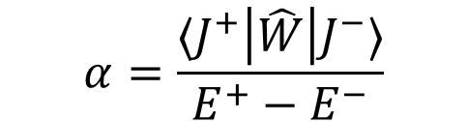
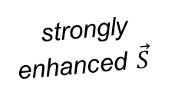
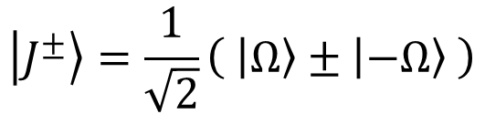

Nuclear deformation
Octupole deformation
Gaffney et al.,
Nature 497 (2013)
Pear-shaped nuclei have enhanced symmetry-violating moments
Nucleon number is correlated with deformation
Both quadrupole ($β_{2}$) and octupole deformation ($β_{3}$) are important components
close-lying opposite-parity rotational doublet
$$\left|J^{±}\right\rangle =\frac{1}{\sqrt{2}}\left( \left|Ω\right\rangle ±\left|−Ω\right\rangle \right)$$
http://www.astro.ulb.ac.be/bruslib/
enhanced P,T-odd
interaction mixing
strongly
enhanced $\vec{S}$
$$α=\frac{⟨J^{+}\left|\hat{W}\right|J^{−}⟩}{E^{+}−E^{−}}$$
$\sim$keV

Slide 5
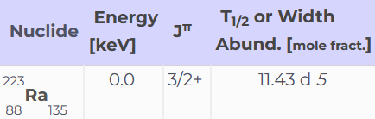
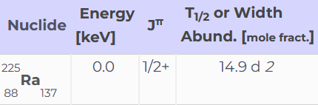
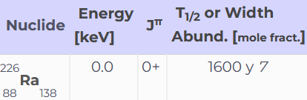
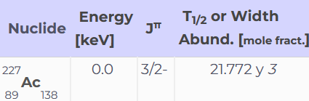
Proposals of radioactive molecules
RaF
AcF
AcF⁺
AcO⁺
PaF³⁺
RaOH
RaOCH₃
RaOCH₃⁺
AcOH⁺
Open-shell molecule
Closed-shell molecule
Laser-coolable

Slide 6
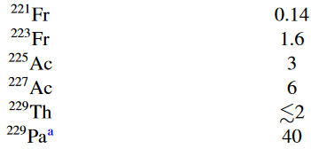
Proposals of radioactive molecules
Schiff moment compared to ²²⁵Ra
Isotope
RaF
AcF
AcF⁺
AcO⁺
PaF³⁺
RaOH
RaOCH₃
RaOCH₃⁺
AcOH⁺
Open-shell molecule
Closed-shell molecule
Laser-coolable
Flambaum and Dzuba, PRA 101, 042504 (2020)

Slide 7
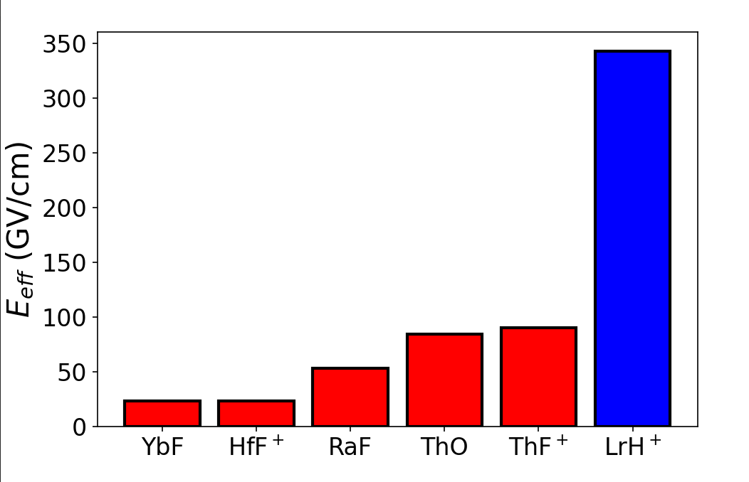
Proposals of radioactive molecules
RaF
AcF
AcF⁺
AcO⁺
PaF³⁺
RaOH
RaOCH₃
RaOCH₃⁺
AcOH⁺
PRA 104, 062801 (2021)
Open-shell molecule
Closed-shell molecule
Laser-coolable

Slide 8
Roadmap for radioactive molecules
1
Theoretical study and proposal
2
Production
3
Spectroscopy
4
Precision experiment

Slide 9
Roadmap for radioactive molecules
1
Theoretical study and proposal
2
Production
3
Spectroscopy
4
Precision experiment

Slide 10
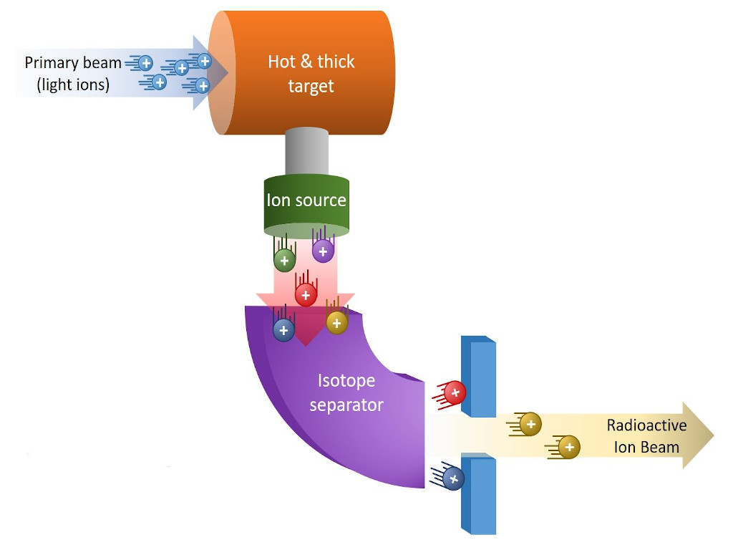
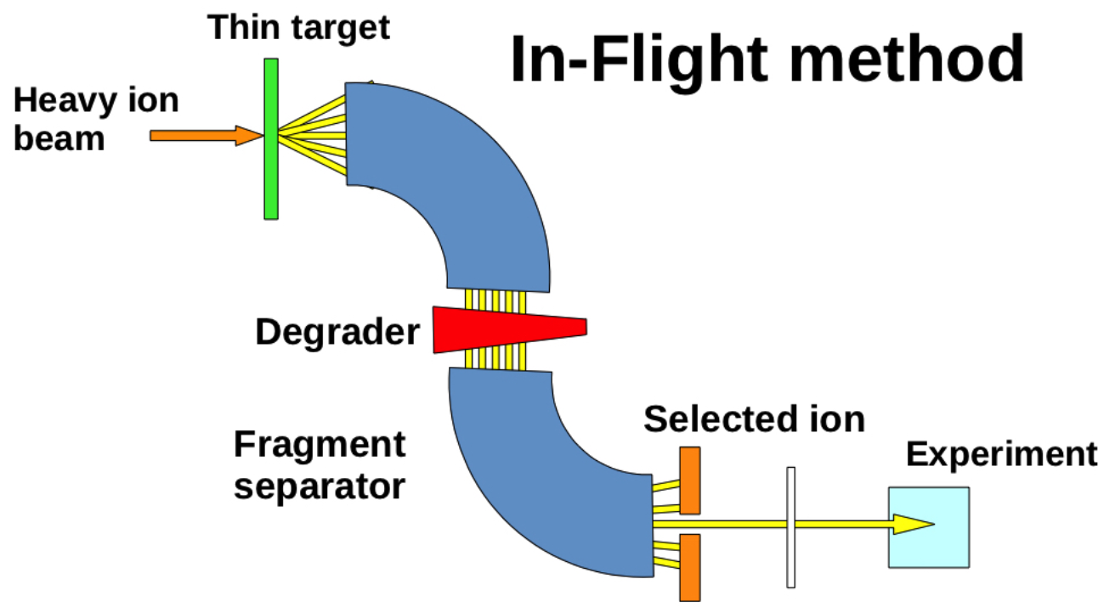
Radioactive beam production
ISOL method
Well-behaved ion beams
All isotopes produced simultaneously
Chemistry crucial
Basis for precision studies
Messy ion beams
Beam-target choice dictates production
Largely chemistry-insensitive
Basis for discovery studies
Figs from ISOLPHARM and Maria Borge

Slide 11

ISOL/IFF
ISOL
IFF
IGISOL
TRIUMF
GANIL
GSI
ISOLDE
IFF
FRIB
ISOL
IFF
Multiple laboratories around the world have now initiated Radioactive Molecules activities

Slide 12
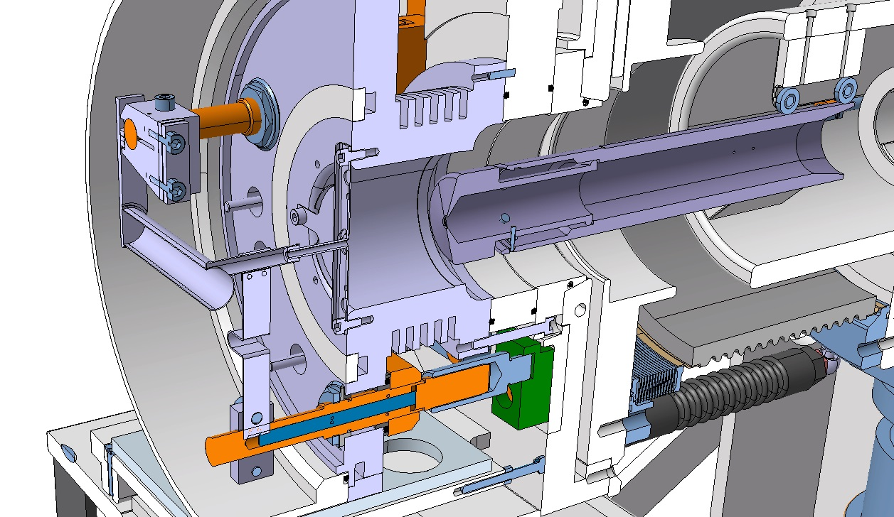
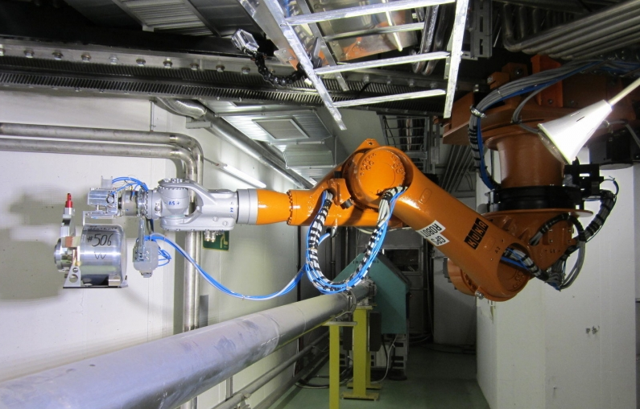
How to produce a molecular beam with ISOL?
Primary beam
Radioisotopes
Ions
Inject gas
Vacuum
Air
~2000 °C
*picture and animation courtesy of M. Delonca

Slide 13
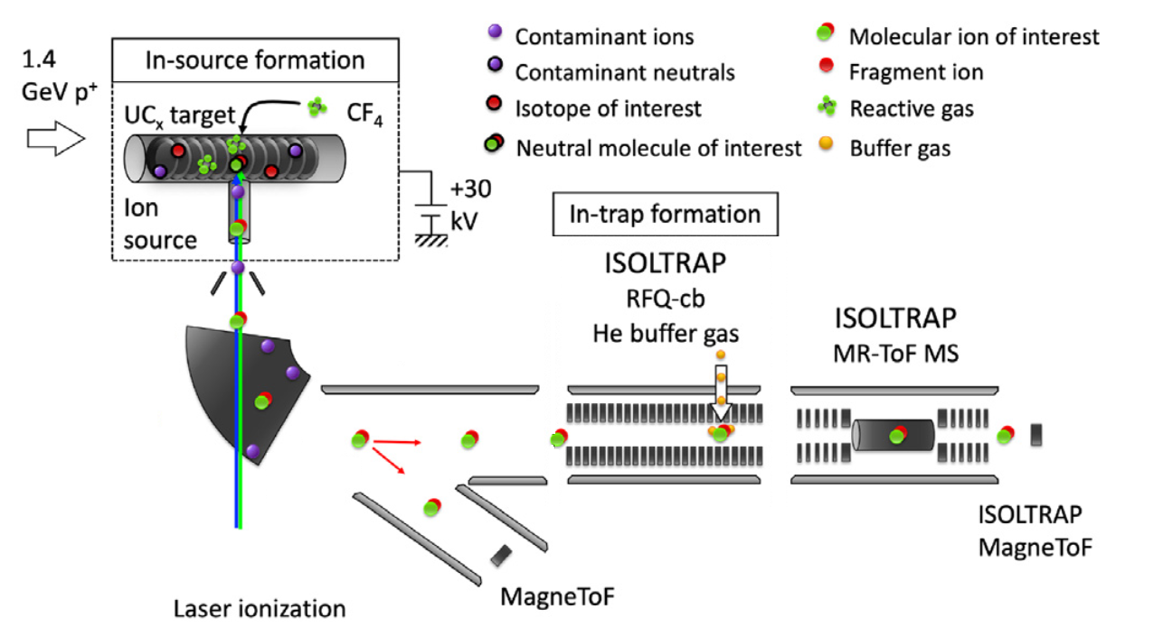
Au et al., NIM B 541, 375-379 (2023)

Slide 14
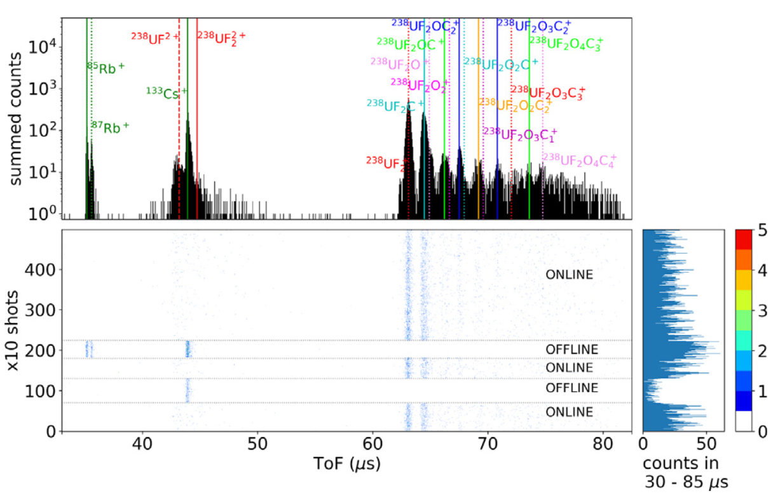
Au et al., NIM B 541, 375-379 (2023)

Slide 15


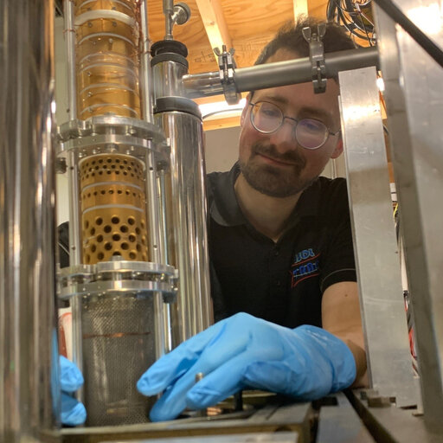
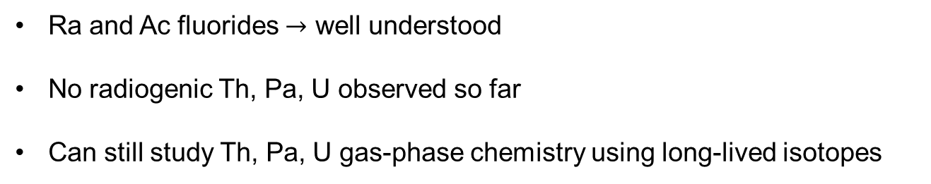
Work so far
Ra and Ac fluorides $→$ well understood
No radiogenic Th, Pa, U observed so far
Can still study Th, Pa, U gas-phase chemistry using long-lived isotopes
Mia Au
CERN
Sebastian Rothe
CERN
Lukas Nies
CERN
Polyatomics: too fragile for hot source environment

Slide 16
Roadmap for radioactive molecules
1
Theoretical study and proposal
2
Production
3
Spectroscopy
4
Precision experiment

Slide 17
Roadmap for radioactive molecules
1
Theoretical study and proposal
2
Production
3
Spectroscopy
4
Precision experiment

Slide 18
How to discover first electronic transitions?
Very challenging
Requires cutting-edge theory
Setups that cost millions with very high efficiency and ultra-low background
Expertise exists within Europe

Slide 19
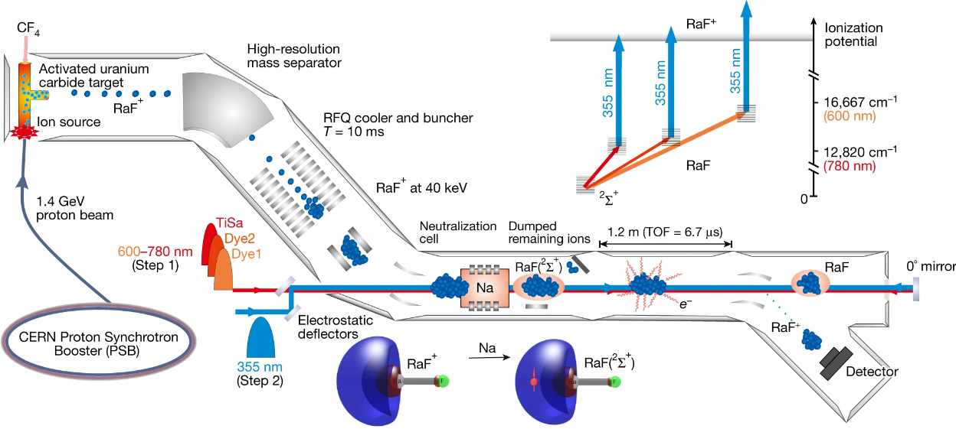
Collinear resonance ionization spectroscopy (CRIS)
Garcia Ruiz et al., Nature 581 (2020)

Slide 20
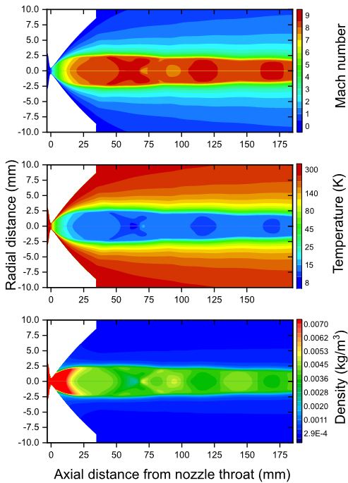
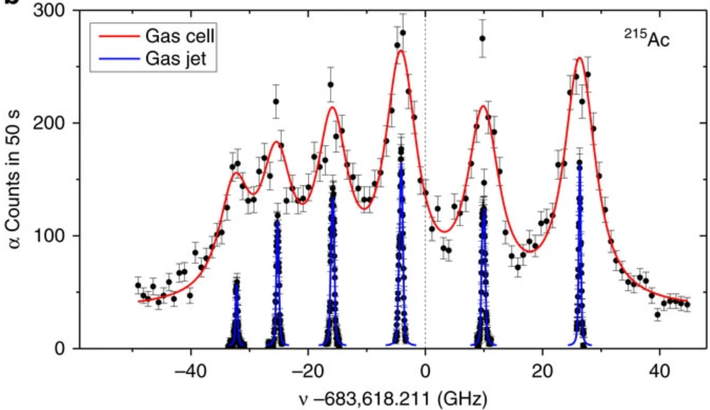
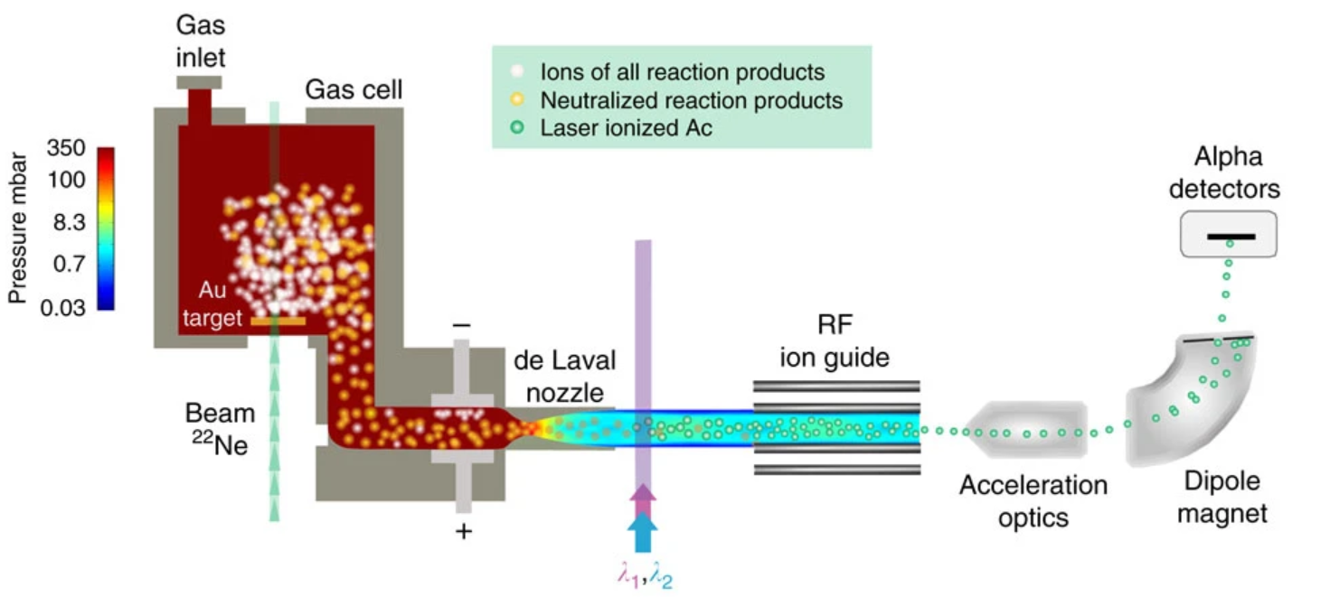
In-gas-jet laser ionization spectroscopy (IGLIS)
Leads:
Piet Van Duppen (KU Leuven)
Rafael Ferrer (KU Leuven)
Ferrer et al., Nature Communications 8 14520 (2017)

Slide 21
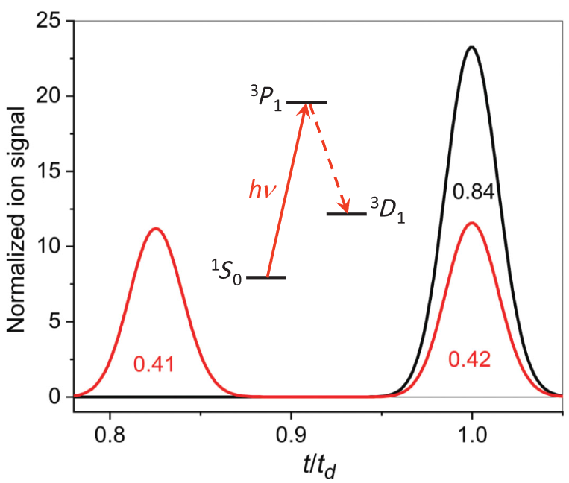
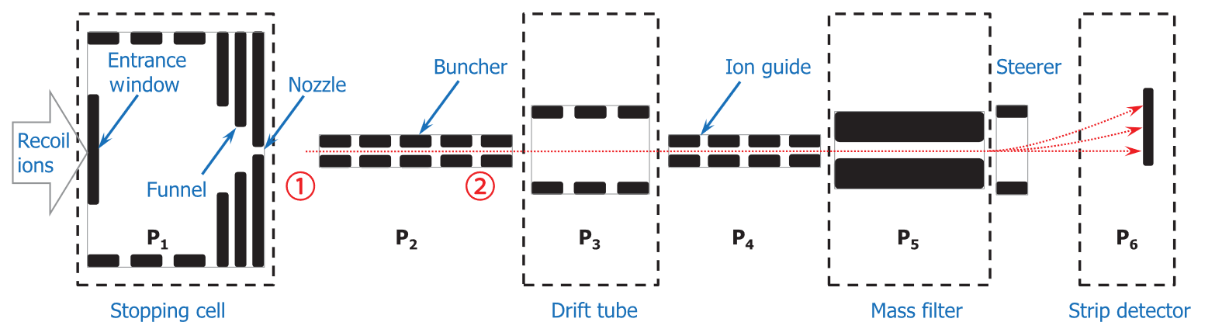
Laser resonance chromatography (LRC)
Lead by Mustapha Laatiaoui (JGU Mainz)
Scan laser while looking at time of flight
Slower ions are deflected with greater angles
Optical pumping in trap
Laatiaoui et al., PRL 125, 023002 (2020)

Slide 22
Roadmap for radioactive molecules
1
Theoretical study and proposal
2
Production
3
Spectroscopy
4
Precision experiment

Slide 23
Roadmap for radioactive molecules
1
Theoretical study and proposal
2
Production
3
Spectroscopy
4
Precision experiment

Slide 24
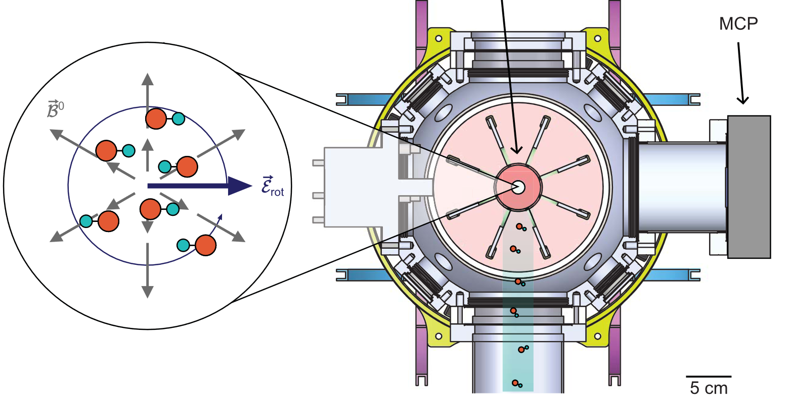
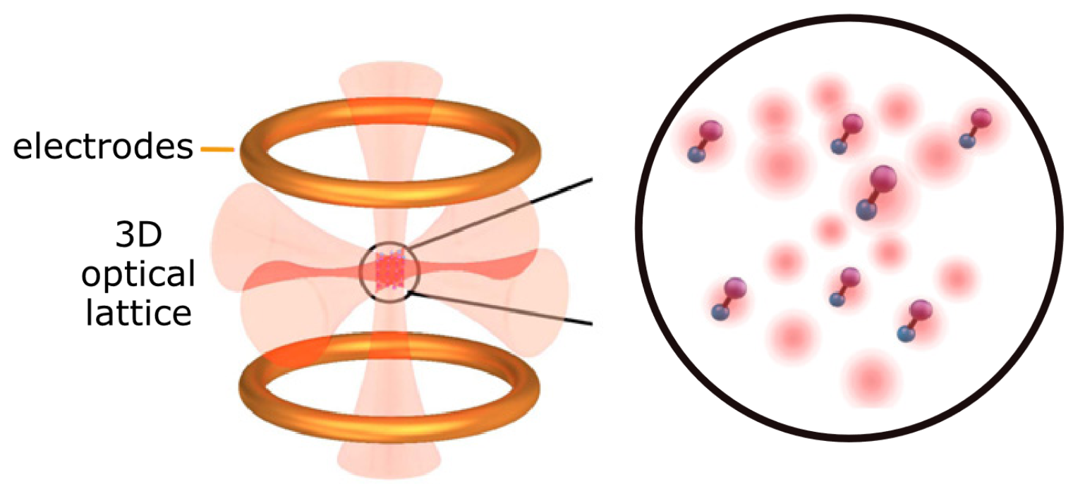

Precision experiments: Where do we go from here?
Realistically: not compatible with beam experiments (one exception?)
Ion trapping
MOT $→$ Optical lattice
Technologically ready
Path to polyatomic molecules
Do radioactives add anything?
No Coulomb-induced decoherence
Needs starting with a lot of neutrals
Roussy et al., Science 381, 46–50 (2023)
Fitch et al., Q.Sci.T. 6, 014006 (2021)

Slide 25
Necessary input from theory
Prediction of electronic transition energies and transition dipole moments
Ionization and dissociation energies
Excited state lifetimes and metastable states
Chemical reaction modeling, charge exchange simulations

