Slide 1


The Muon EDM and New Higgs Bosons at the EW Scale
Andreas Crivellin
PSI & UZH
EDM workshop, 06.03.2024, ECT* Trento

Slide 2
Outline
Introduction
The anomalous magnetic moment of the muon
Dipole moments of fundamental fermions
Chiral enhancement and the muon EDM
Consequences for future measurements
New Scalars at the EW scale
Top quark differential distributions
Conclusions
Andreas Crivellin

Slide 3
Physics Beyond the Standard Model
New particles and interactions exist!
Dark Matter existence established at cosmological scales
  New weakly interacting particles
Neutrinos not exactly massless
  Right-handed (sterile) neutrinos
Matter anti-matter asymmetry
  Additional CP violating interactions
writescience.wordpress.com
The SM must be extended!
What is the underlying fundamental theory?
Andreas Crivellin

Slide 4
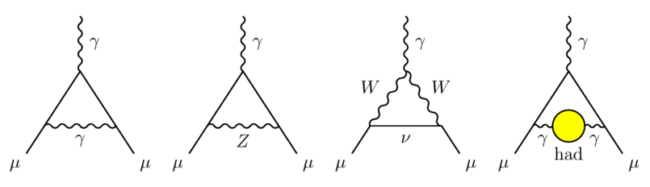
Muon Anomalous Magnetic Moment (a_{μ})
Theory prediction challenging (hadronic effects)
Need NP of the order of the SM EW contribution
Lattice closer to the SM
New measurement from CDF-3 compatible with SM
Electron g-2 requires LFUV
T. Aoyama et al., arXiv:2006.04822
xσ deviation from the SM prediction

Slide 5
Dipoles in the EFT
Effective Hamiltonian
Anomalous magnetic moment
Electric Dipole moment
Radiative Lepton decays
Processes intrinsically connected

Slide 6
Explaining the Muon AMM
Effect of the order of the EW-SM contribution needed
enhancement necessary
Light particles
  Neutral scalars
  Neutral vector (Z’ Dark Photon)
  ALP (axion like particle)
Chiral enhancement: Chirality flip does
not come from the muon mass but rather
from a NP mass inside the loop
Huge literature
See following days and sessions!
Light particles or/and chiral enhancement

Slide 7
Chiral enhancement
Enhancement by the mass of the fermion in the loop
  MSSM: (tan(ß))
  Leptoquarks: m_{t}/m_{μ}
  Model with vector like fermions: m_{Ψ}/m_{μ}
A priori arbitrary phase muon EDM

Slide 8
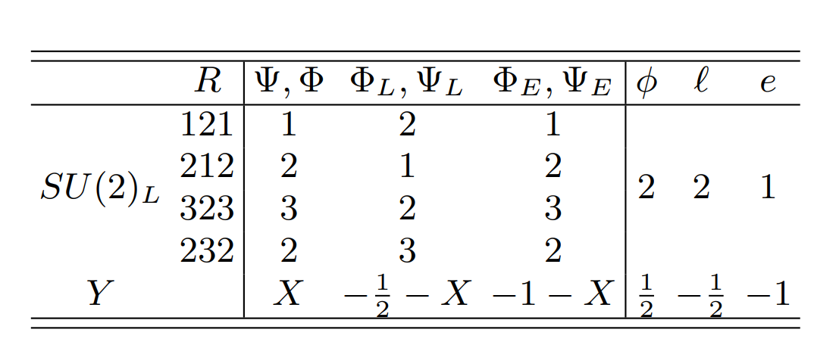
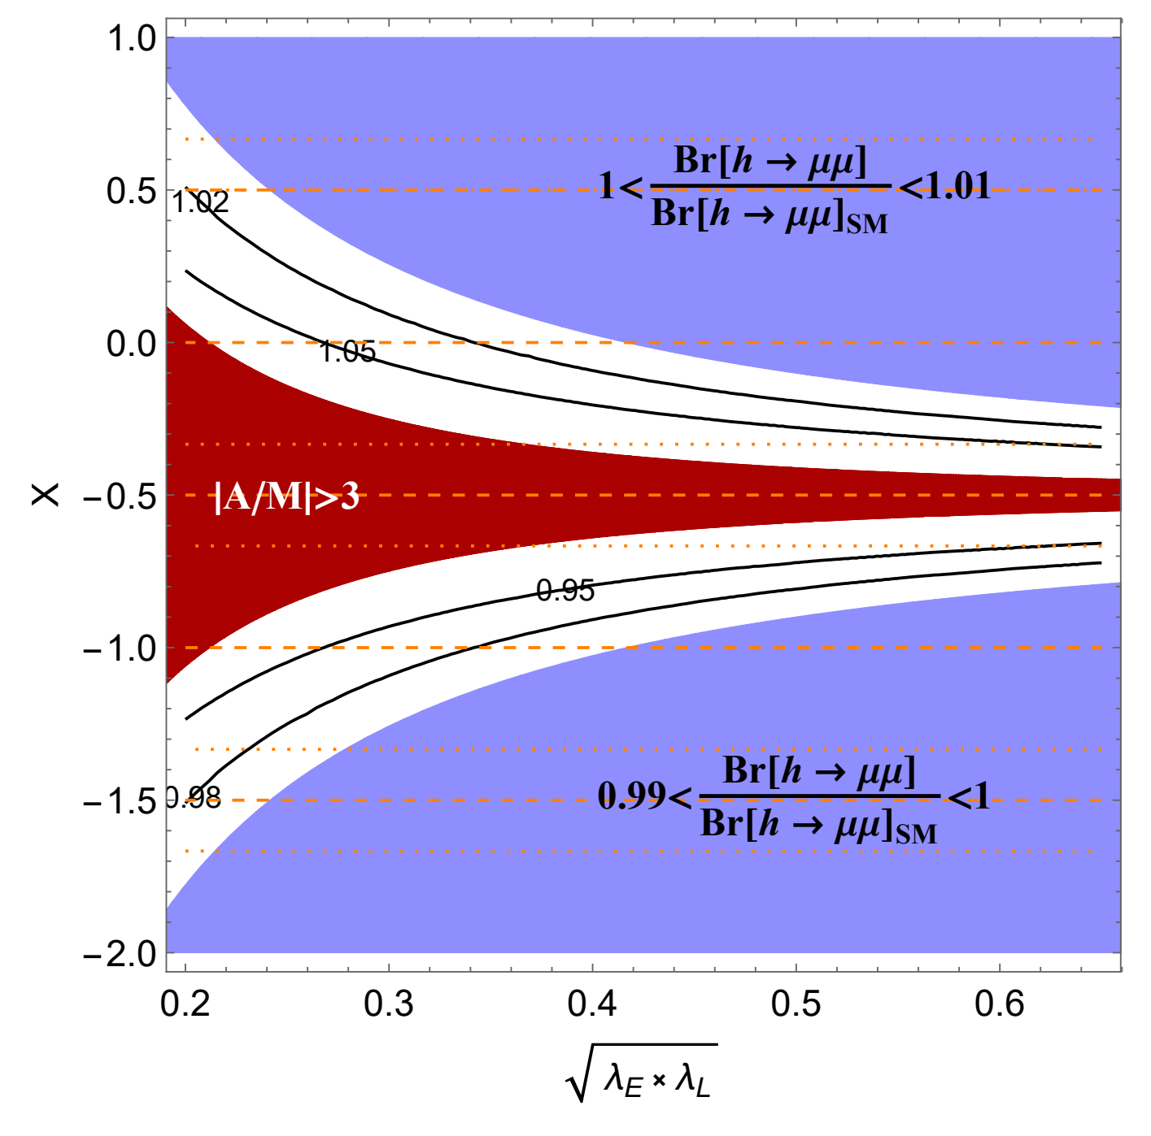
Heavy new scalars and fermions
Chirally enhanced effects requires three fields
SMEFT Matching
Correlations with
  Z→µµ
  h →µµ
A.C., M. Hoferichter, 2104.03202
Z,h→μμ at future colliders
8

Slide 9
Indirect Limit on the Muon EDM
MFV:
Contribution only starts at the 3-loop level
Direct limit
Y. Ema, T. Gao and M. Pospelov,
Phys. Rev. Lett. 128 (2022) no.13, 131803
Improvement of direct limit important

Slide 10
Future experimental sensitivity
Fermilab/J-PARC
PSI (frozen spin)
Dedicated experiment needed!

Slide 11
Future Implications of a_{µ}
τ→µγ
τ→µγ
h→ τµ
Z,h→µµ
d_{μ}
a_{µ}
µ→eγ
µ→eee
Andreas Crivellin

Slide 12
New Higgses
at the EW Scale

Slide 13
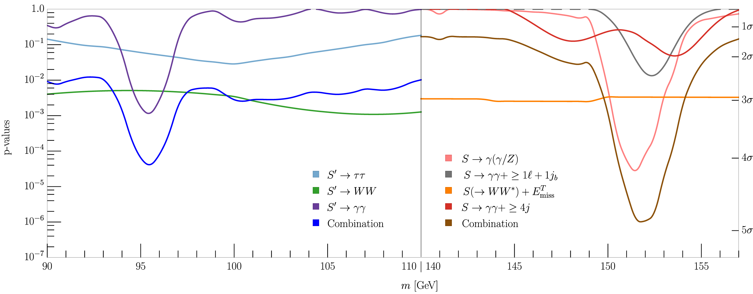
Hints for new Scalars at 95 GeV & 151.5 GeV
At 95 GeV only inclusive searches at LHC
151.5 GeV from Higgs side-bands in associated production channels
S. Bhattacharya, G. Coloretti, A. Crivellin, et al. arXiv:2306.17209
3.8σ & 4.7σ global significance

Slide 14
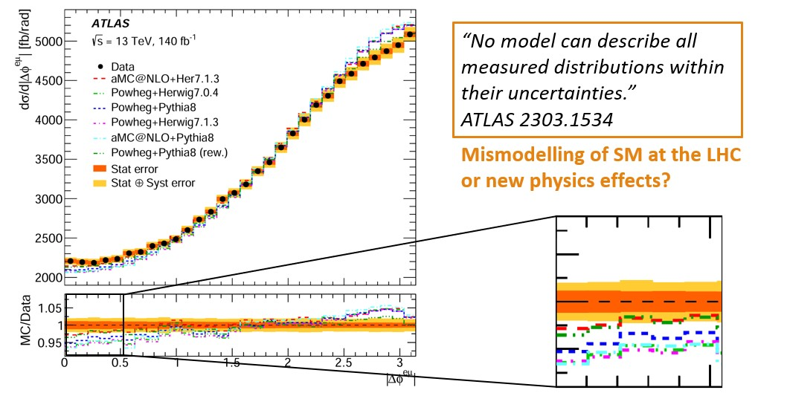
Differential Top-Quark Distributions
ATLAS:
“No model can
describe all measured
distributions within
their uncertainties.”
2303.15340
angle between the letons from the W decays
New Physics pollution of this SM measurement?

Slide 15
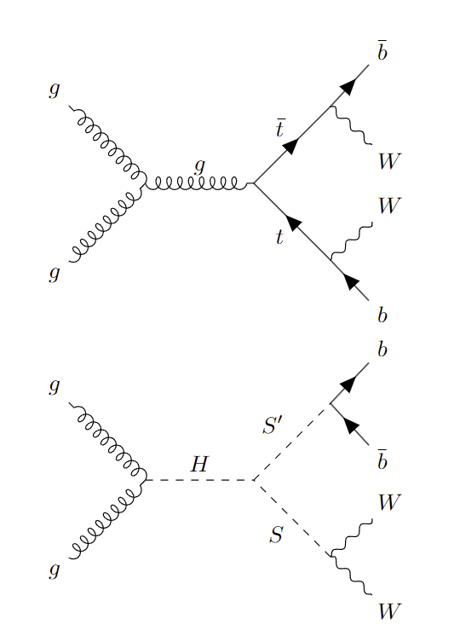
New Physics in Top-Quark Distributions
ATLAS analysis normalized to the total cross section
only sensitive to the shape of NP
Associated production of new scalars decaying
to WW and bb has a
top-like signature
Related to the 95 GeV and 152 GeV hints?

Slide 16
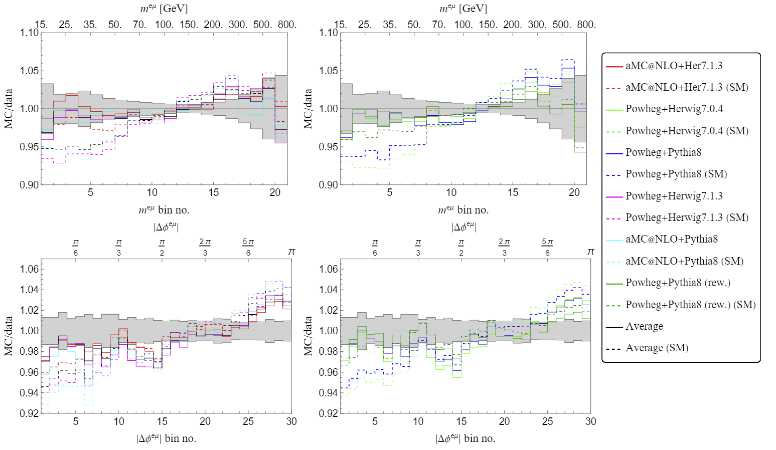
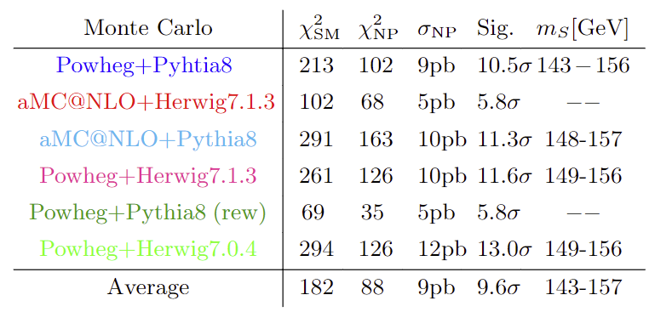
Simplified Model: H→SS’→WWbb
arXiv:2308.07953
Fix m_{S}=152GeV and m_{S’}=95GeV by the hints for narrow resonances. Weak m_{H} (270GeV) dependence.
Agreement with data significantly improved (>5σ)

Slide 17
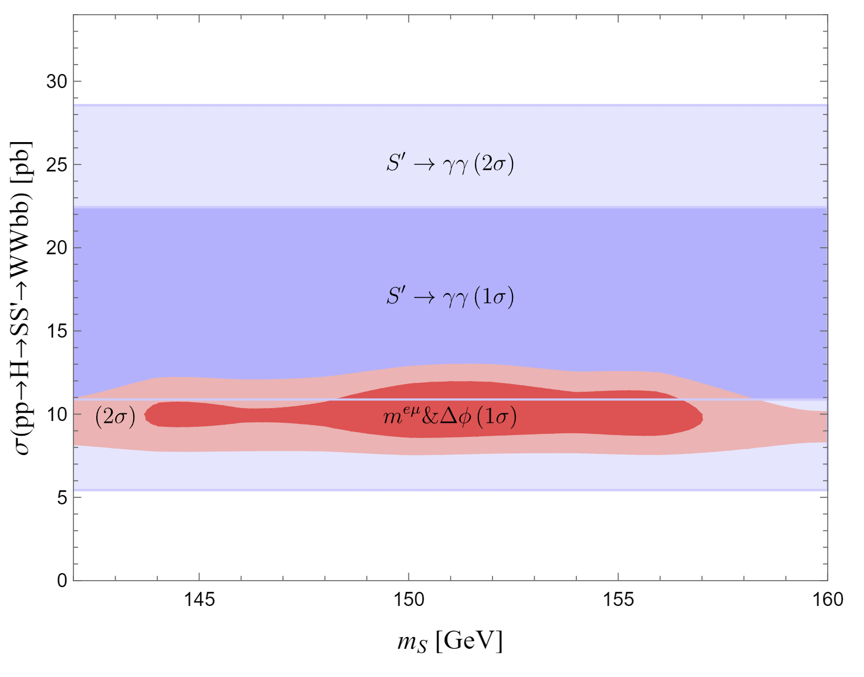
Simplified model for top distributions
S’(95): Singlet
decays
dominantly
to bb
S(152):
decays
dominantly
to WW
Consistent with 95 GeV γγ signal strength &
a mass of 151.5GeV excess for S→WW

Slide 18
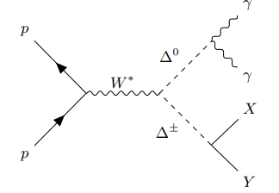
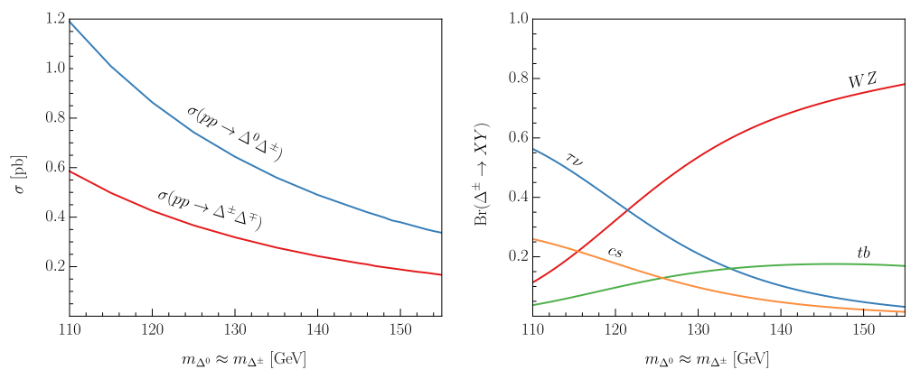
Is the 151.5 GeV Boson a Triplet?
Decays dominantly to WW
and only suppressed to ZZ
Predicts a positive shift
in the W mass
Drell-Yan production at the LHC

Slide 19
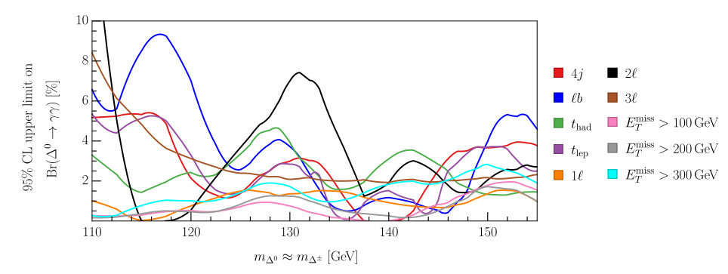
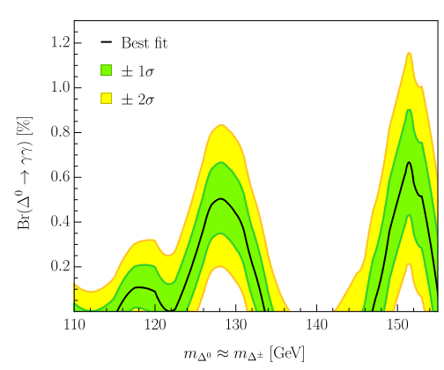
h→γγ+X from ATLAS
2301.10486
Analysis of h→γγ+X
22 channels
10 relevant for the triplet
8 of them show excesses
Only mass and Br to photons
are relevant free parameters
Triplet explains h→γγ+X

Slide 20
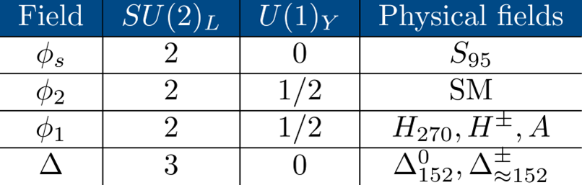
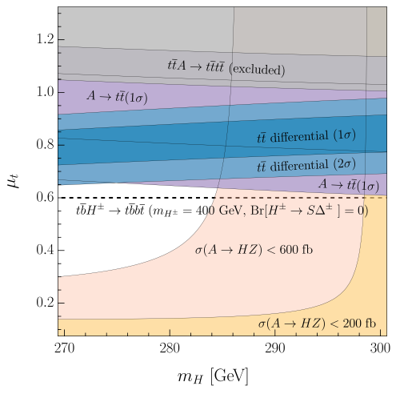
Δ2HDMS and resonant top-quark production
Explains top-quark
differential distributions
Di-photon excesses
Resonant top-quark
production
Elevated 4-top
cross section
Combined explanation possible

Slide 21
Conclusions and Outlook
Chirally enhanced explanation of g-2 leads to a free phase
No reason to expect MFV
Sizable Muon EDM possible and motivated by the g-2
Hints for new scalars at the EW scale
Resonant di-photons
Differential top quark distributions
What is the impact of the new scalars on EDMs?

Slide 22
Backup

Slide 23
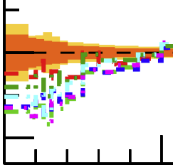
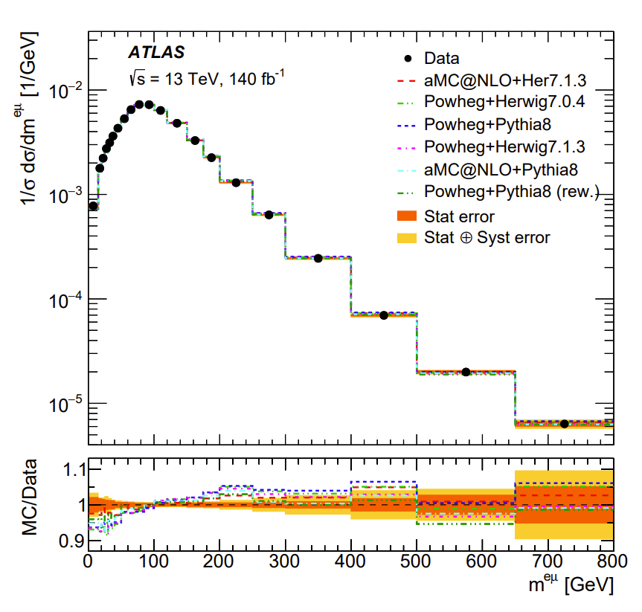
Differential Top-Quark Distributions
2303.15340
ATLAS:
“No model can
describe all measured
distributions within their uncertainties.”
New Physics pollution of this SM measurement?

Slide 24
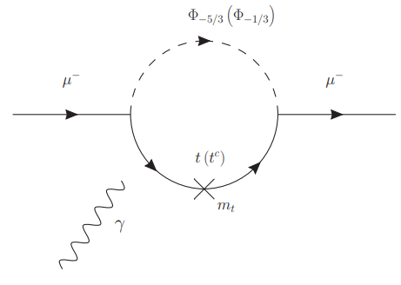
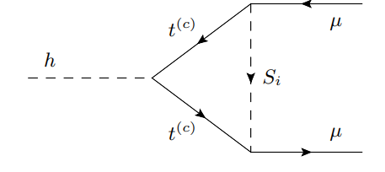
Leptoquarks in a_{μ}
Chirally enhanced effects via top-loops
Mt effect in
enhanced effect in
enhanced effect in
Correlations with h→μμ and Z→μμ
8

Slide 25
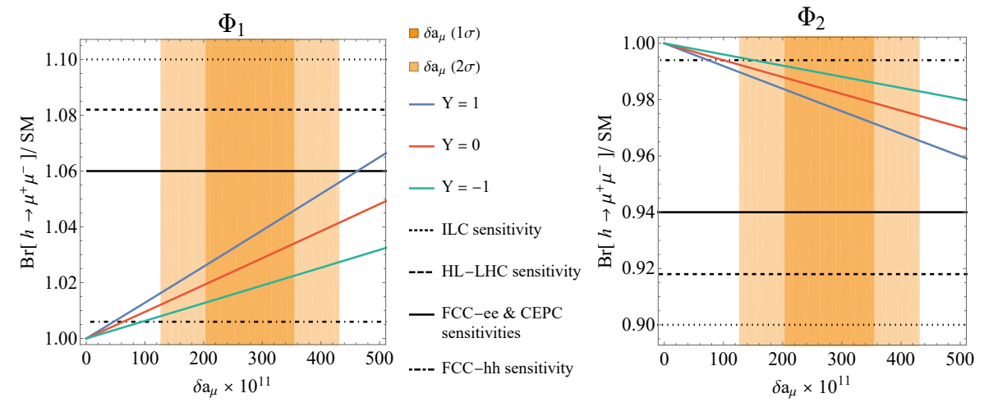
a_{μ} vs h→μμ
Chirally enhanced effects via top-loops
Same coupling structure → direct correlation
A.C., D. Mueller, F. Saturnino, 2008.02643
h→μμ at future colliders
8

