Slide 1
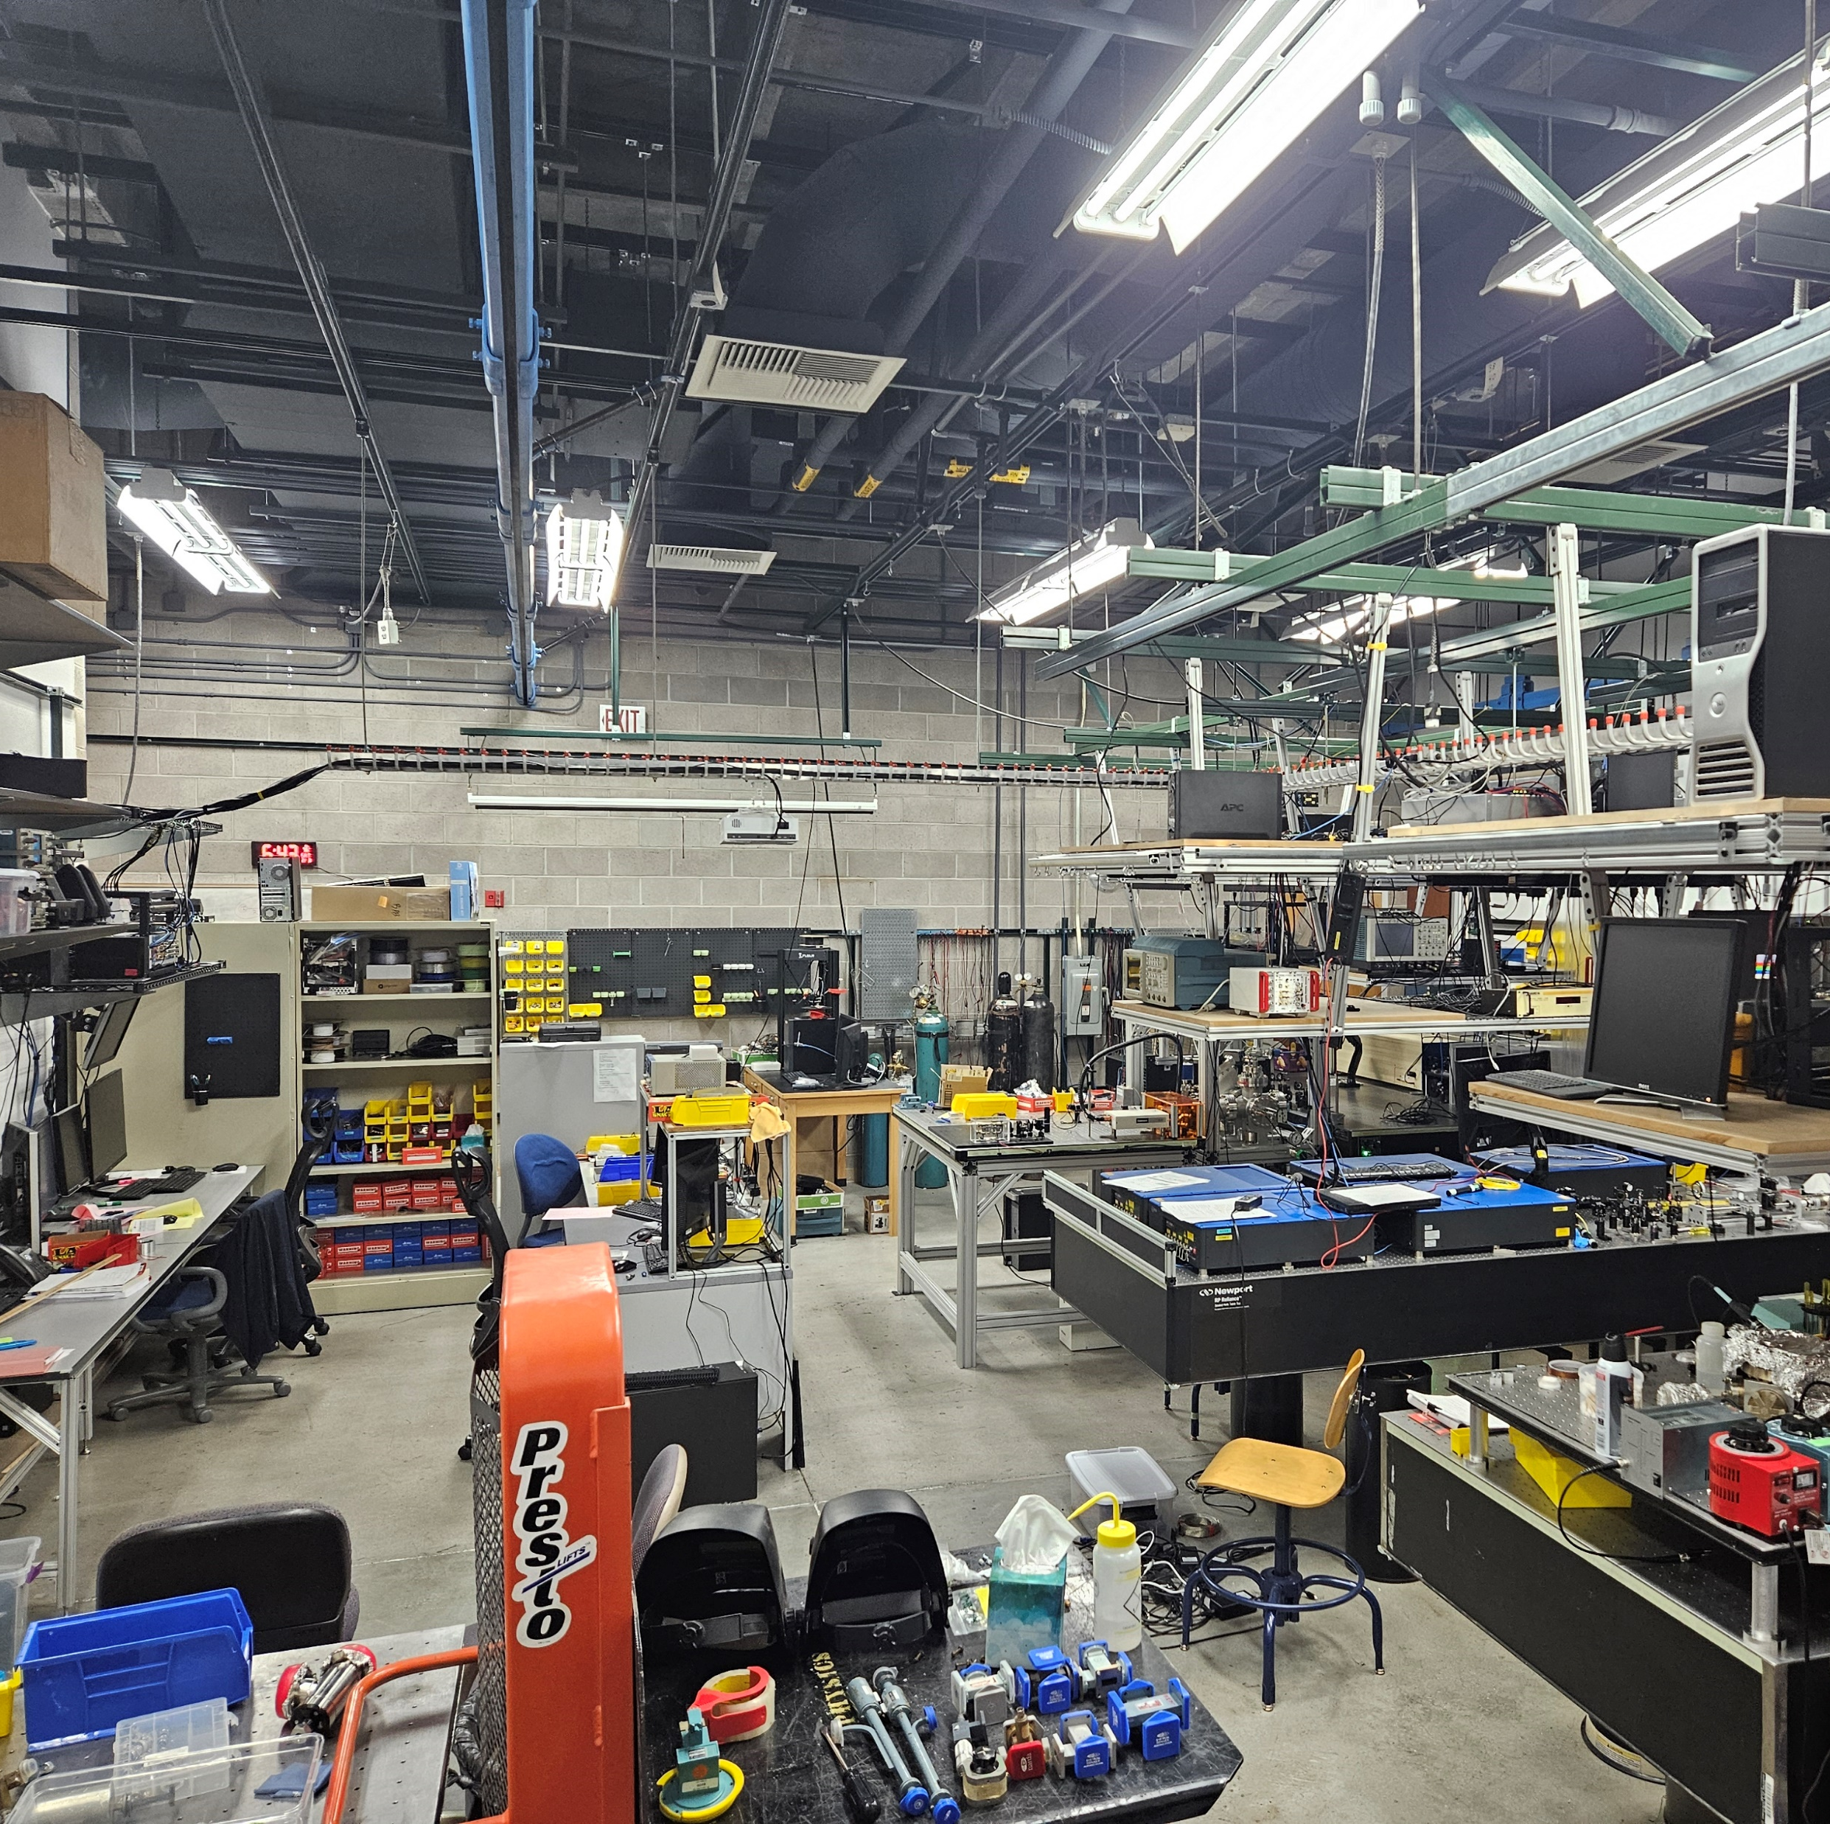
Toward a measurement of nuclear Magnetic Quadrupole Moment (nMQM) using quantum logically controlled molecular ions
Yan Zhou
University of Nevada, Las Vegas
2024.3.4

Slide 2




UNLV and Zhou lab
Molecules – quantum control and spectroscopy
Students
Molecular ions – eEDM & nMQM
Rydberg molecules – RaF
OFC spectroscopy
Ion-radical collisions
Rodrigo Fernandez
Jose Mosquera Ojeda
Govinda Bhandari
Bernardo Gutierrez
Trevor Taylor
Stephanie Letourneau
Xuanyi Wu
Collaborators
Ion storage group, NIST, Boulder
Prof. Garcia-Ruiz and Prof. Field at MIT

Slide 3
Outline
eEDM measurements
Quantum logic spectroscopy
New method in a ring trap
From eEDM to nMQM

Slide 4
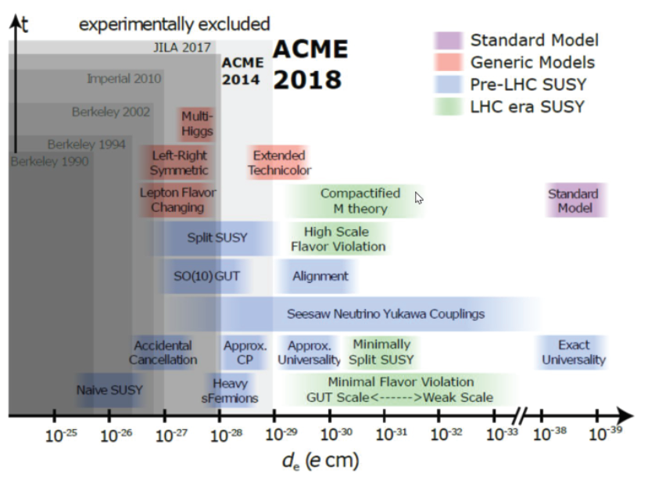
eEDM roadmap
JILA 2023
In the past decade
  250 times improvement
  YbF, ThO, HfF⁺
  10 TeV energy scale
ACME collaboration

Slide 5
eEDM roadmap
JILA 2023
In the past decade
  250 times improvement
  YbF, ThO, HfF⁺
  10 TeV energy scale
In the next decade
  Another 2-order of magnitude
  Toward PeV energy scale
  Far beyond LHC energy
  Cross-verifications
    Species
    Platforms
NL-eEDM
YbF
ACME III
JILA III
EDM³

Slide 6
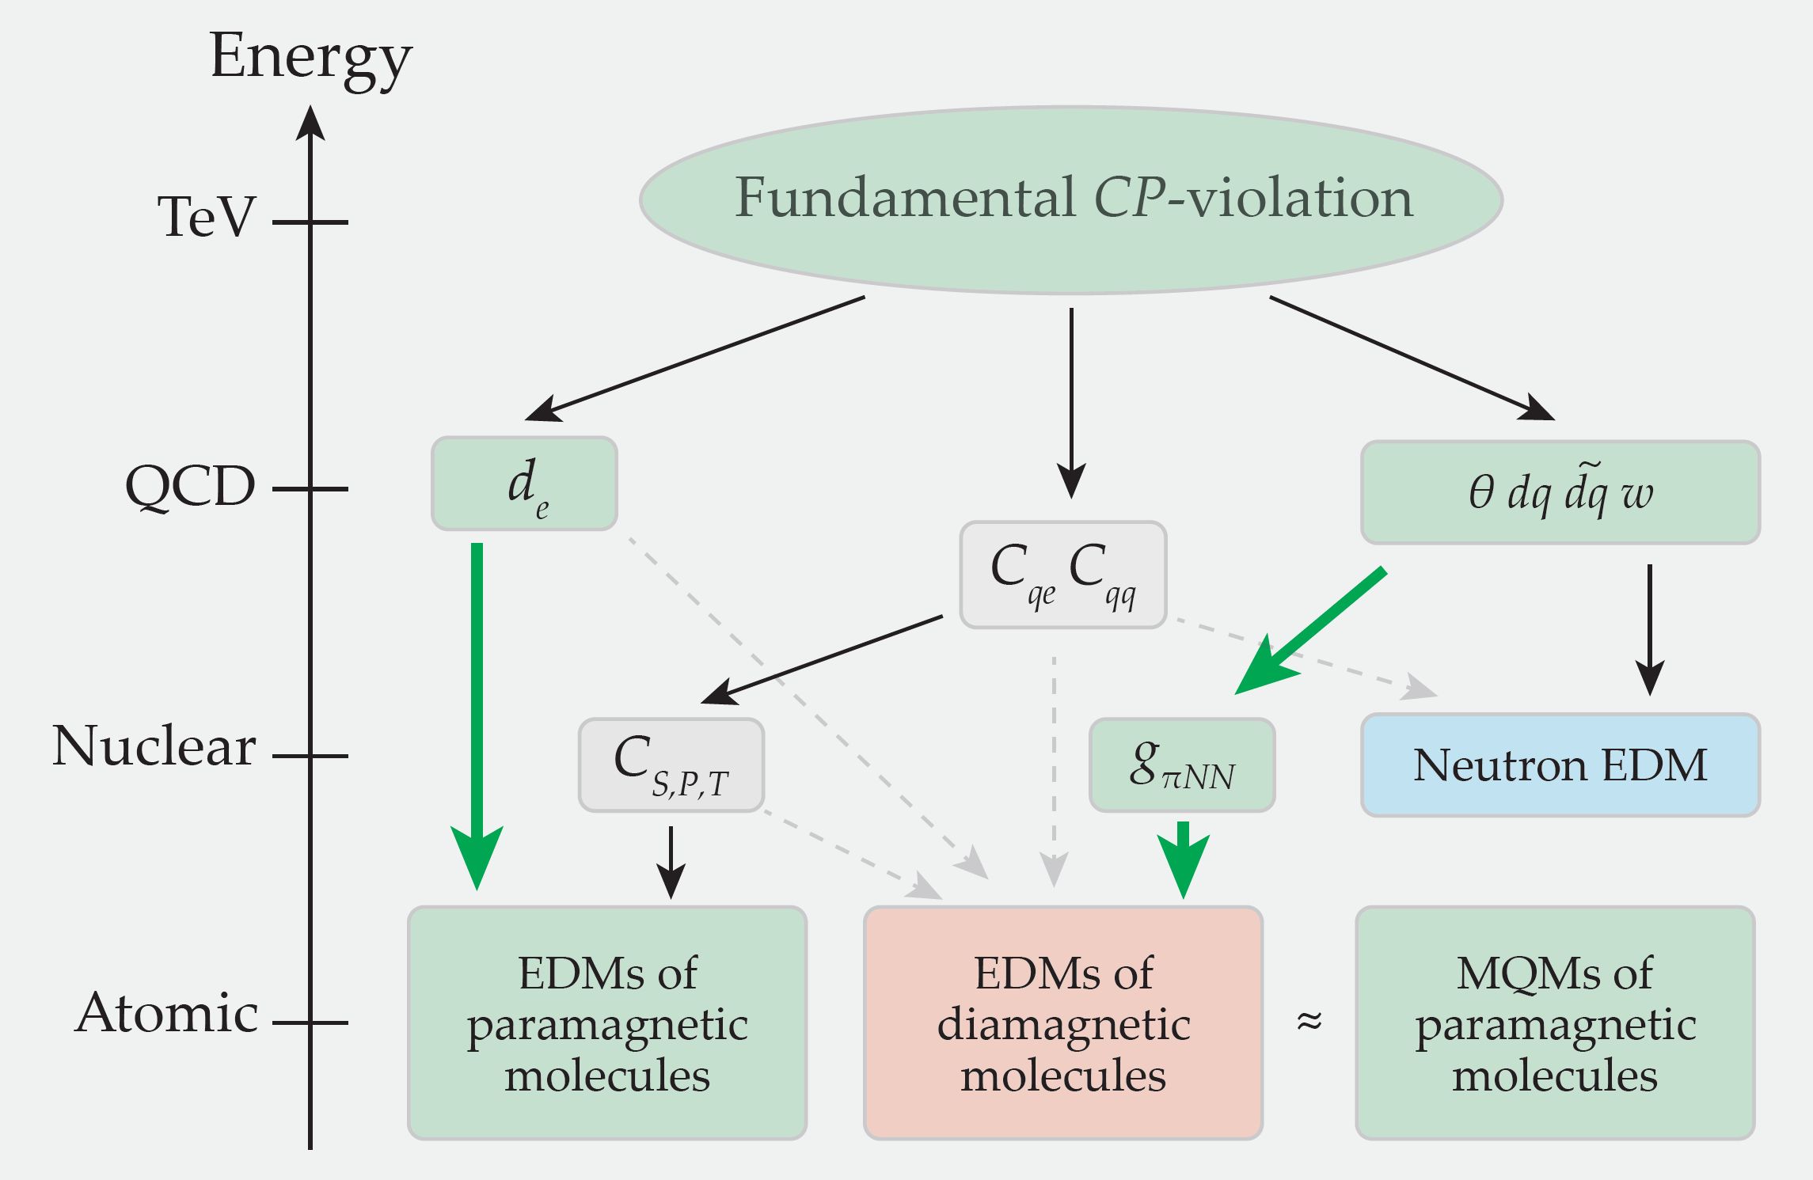
eEDM roadmap
In the past decade
  250 times improvement
  YbF, ThO, HfF⁺
  10 TeV energy scale
In the next decade
  Another 2-order of magnitude
  Toward PeV energy scale
  Far beyond LHC energy
  Cross-verifications
    Species
    Platforms
Hadronic sector of the Standard Model

Slide 7
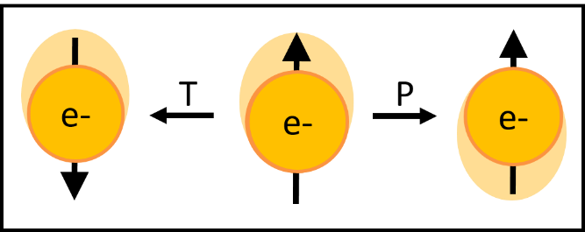

How to measure the eEDM
$$ΔE = μBB$$

Slide 8

How to measure the eEDM
$$ΔE = μBB − deE$$

Slide 9


How to measure the eEDM
$$2d_{e}ℇ$$
$$ΔE = μBB+deE$$

Slide 10

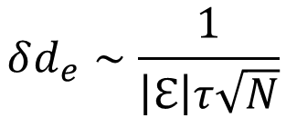


How to measure the eEDM
Large electric field $ℇ$
$$2d_{e}ℇ$$
Many particle counts N
Long coherence time $τ$
$$δd_{e}∼\frac{1}{\left|ℇ\right|τ\sqrt{N}}$$
$$ΔE =μBB+deE$$

Slide 11
How to measure the eEDM
Large electric field $ℇ$
$$2d_{e}ℇ$$
Many particle counts N
Cannot be achieved for
a bare electron
Long coherence time $τ$
$$δd_{e}∼\frac{1}{\left|ℇ\right|τ\sqrt{N}}$$
$$ΔE =μBB+deE$$

Slide 12
Polar molecules, ³Δ₁ state
δ electron orientates molecules
σ electron senses a large electric field
μ_{S} ~ -μ_{L}, small magnetic g-factor
Th²⁺
F–

Slide 13

Polar molecules, ³Δ₁ state
Electric field orientates molecules
Magnetic field orientates electron spin
S
S
Th²⁺
F–

Slide 14


Polar molecules, ³Δ₁ state
Electric field orientates molecules
Magnetic field orientates electron spin
S
S
Th²⁺
F–
DeMille AIP Conf Proc. 596, 72 (2001)

Slide 15
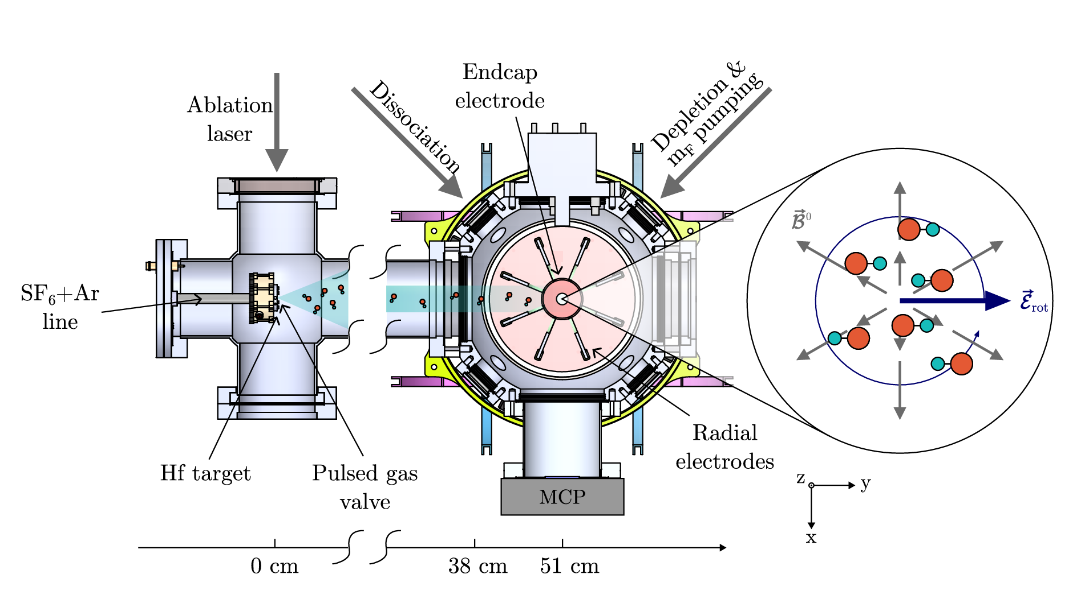
JILA eEDM measurements
Science, 381, 46 (2003)
Notes:
JILA eEDM group use trapped HfF+ ions and rotating electric and magnetic fields. They apply optical pumping to prepare populations either in the upper doublet or the lower doublet. Then, they induce a Ramsey spin-processing and detect the final spin polarization by state-selective photodissociation. This plot shows a typical Ramsey fringe measurement.

Slide 16
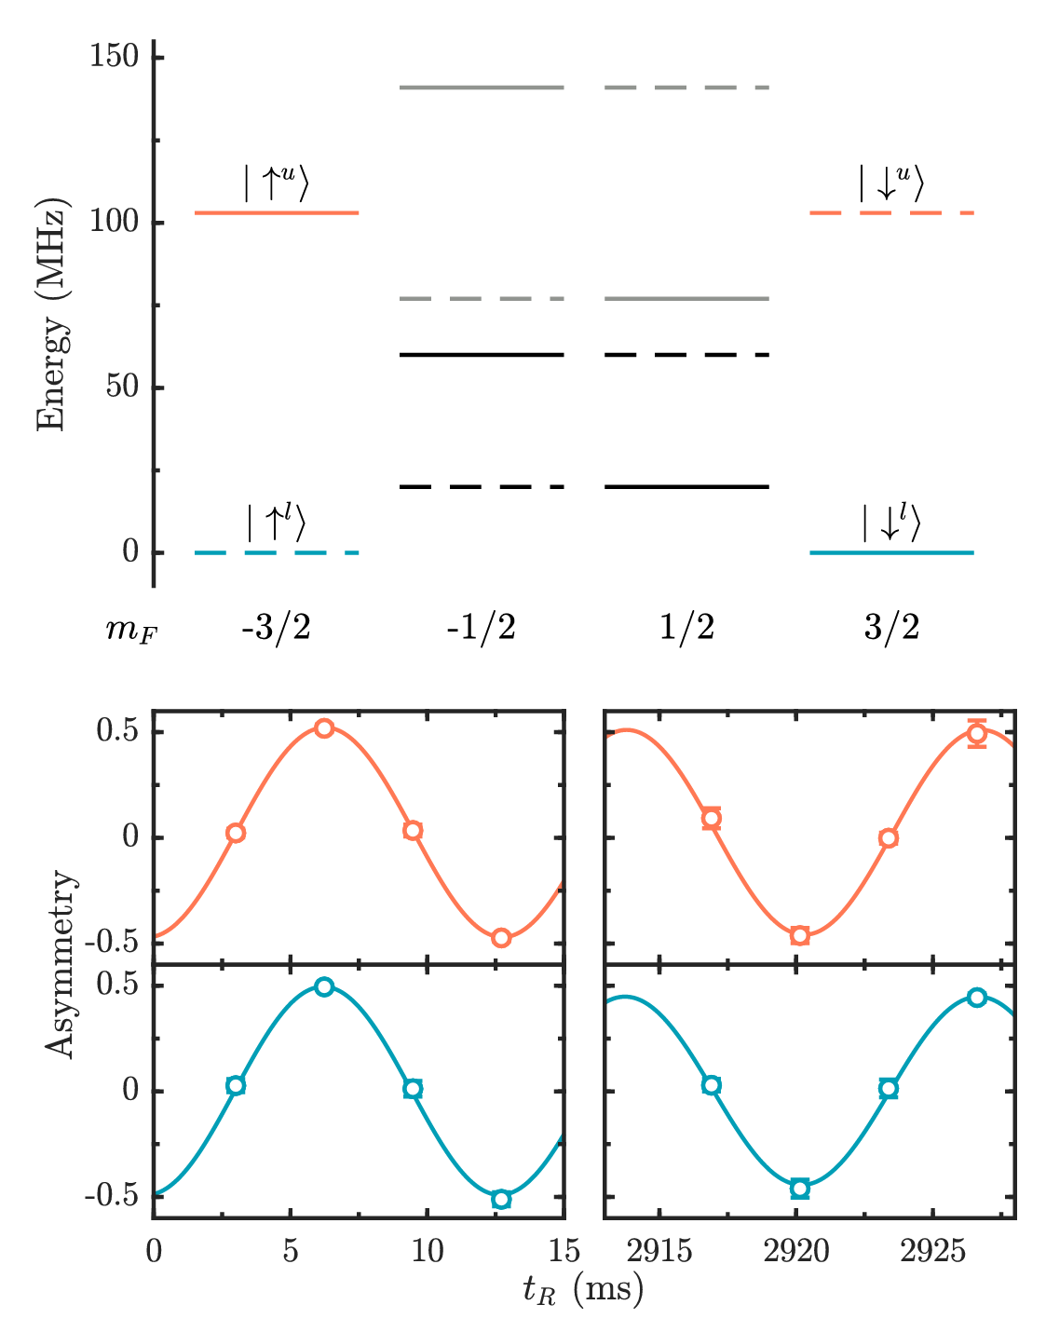
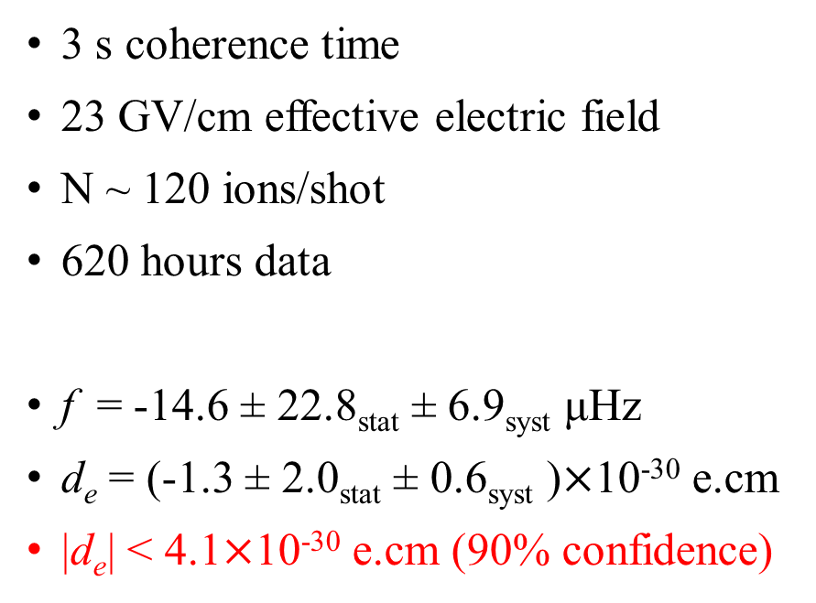
JILA eEDM measurements
3 s coherence time
23 GV/cm effective electric field
N ~ 120 ions/shot
620 hours data
f = -14.6 ± 22.8_{stat} ± 6.9_{syst} μHz
d_{e} = (-1.3 ± 2.0_{stat} ± 0.6_{syst} )$×$10⁻³⁰ e.cm
|d_{e}| < 4.1$×$10⁻³⁰ e.cm (90% confidence)
Science, 381, 46 (2003)

Slide 17
What is next?
JILA – larger ion trap
  Trap more than 10,000 ions, but about 100 ions are detected
  If nMQM measurements with large nuclear spin, 1 ion is detected

Slide 18
What is next?
JILA – larger ion trap
  Trap more than 10,000 ions, but about 100 ions are detected
  If nMQM measurements with large nuclear spin, 1 ion is detected
ACME – longer and more intense beam
  Coherent time is still in millisecond scale
  Large sample consumption (expensive with Th-229 or others)

Slide 19
What is next?
JILA – larger ion trap
  Trap more than 10,000 ions, but about 100 ions are detected
  If nMQM measurements with large nuclear spin, 1 ion is detected
ACME – longer and more intense beam
  Coherent time is still in millisecond scale
  Large sample consumption (expensive with Th-229 or others)
Laser cooling and trapping
  Very exciting prospective
  Very challenging in molecular physics and laser technologies

Slide 20
A new experimental platform
Concentrate 100% population to a single quantum state from hundreds of initial states
An efficient state readout with 100% fidelity

Slide 21
A new experimental platform
Concentrate 100% population to a single quantum state from hundreds of initial states
An efficient state readout with 100% fidelity
Extremely long coherence time – beyond a minute

Slide 22
A new experimental platform
Concentrate 100% population to a single quantum state from hundreds of initial states
An efficient state readout with 100% fidelity
Extremely long coherence time – beyond a minute
Universal platform for different molecular species
Rare isotopes – minimum amount of sample
Repeat measurements of a single ion

Slide 23
A new experimental platform
Concentrate 100% population to a single quantum state from hundreds of initial states
An efficient state readout with 100% fidelity
Extremely long coherence time – beyond a minute
Universal platform for different molecular species
Rare isotopes – minimum amount of sample
Repeat measurements of a single ion
Chip-scale of the experimental device – microfabricated ion trap
Scalability – highly parallel measurements

Slide 24
A new experimental platform
Concentrate 100% population to a single quantum state from hundreds of initial states
An efficient state readout with 100% fidelity
Extremely long coherence time – beyond a minute
Universal platform for different molecular species
Rare isotopes – minimum amount of sample
Repeat measurements of a single ion
Chip-scale of the experimental device – microfabricated ion trap
Scalability – highly parallel measurements
Minimum systematics – inherit reference, quantum sensors

Slide 25
State preparation and detection
²³²ThF⁺
J=3
J=4
J=1
J=2
³Δ₁, v=0

Slide 26
State preparation and detection
²³²ThF⁺
microwave
J=3
J=4
J=1
J=2
³Δ₁, v=0

Slide 27
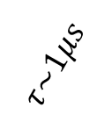
State preparation and detection
²³²ThF⁺
Ω=0⁺, v=0, J=0
microwave
OP lasers
$$τ\sim 1μs$$
J=0
J=1
¹∑⁺, v=0
J=3
J=4
J=1
J=2
³Δ₁, v=0

Slide 28
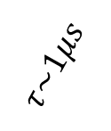
State preparation and detection
²³²ThF⁺
Ω=0⁺, v=0, J=0
microwave
OP lasers
$$τ\sim 1μs$$
J=0
J=1
¹∑⁺, v=0
J=3
J=4
J=1
J=2
³Δ₁, v=0

Slide 29
State preparation and detection
1
²³²ThF⁺
Ω=0⁺, v=0, J=0
microwave
B
OP lasers
$$τ\sim 1μs$$
m_{F}
-1/2
1/2
J=1
¹∑⁺, v=0
J=0
J=3
J=4
J=1
J=2
³Δ₁, v=0

Slide 30
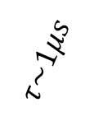

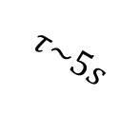
State preparation and detection
1
²³²ThF⁺
Ω=0⁺, v=0, J=0
microwave
B
OP lasers
$$τ\sim 1μs$$
$$30\%$$
¹∑⁺, v=0
-1/2
1/2
J=1
J=0
$$τ\sim 5s$$
F=1/2
J=3
J=4
F=3/2
J=1
J=2
m_{F}
-3/2
-1/2
1/2
3/2
³Δ₁, v=0

Slide 31
State preparation and detection
¹⁷¹Yb⁺
²³²ThF⁺
Ω=0⁺, v=0, J=0
microwave
B
²P_{1/2}, F=0
OP lasers
$$τ\sim 1μs$$
²D_{5/2}, F=2
$$30\%$$
¹∑⁺, v=0
-1/2
1/2
J=1
J=0
$$τ\sim 5s$$
F=1/2
J=3
J=4
F=3/2
J=1
J=2
²S_{1/2}, F=1
m_{F}
-3/2
-1/2
1/2
3/2
³Δ₁, v=0

Slide 32
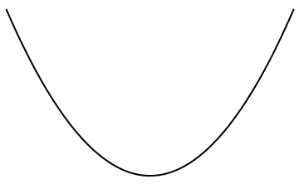
State preparation and detection
We have a harmonic ion trap
Load one Yb⁺ and one ThF⁺ in the trap
Two ion species are linked by the Coulomb force
Notes:
We load two ions in the trap. One is Yb+ that is laser controllable. The other is ThF+ that is sensitive to EDM. The two ions are linked together by strong Coulomb force.

Slide 33
State preparation and detection
We have a harmonic ion trap
Load one Yb⁺ and one ThF⁺ in the trap
Two ion species are linked by the Coulomb force
Laser cools Yb⁺ to the ground motional state
ThF⁺ is sympathetically cooled to the ground motional state
n=1
n=0
Notes:
We apply lasers to cool Yb+ to the ground motional state. At the same time, ThF+ is sympathetically cooled to the ground motional state as well. We use n to label the motional state. We need to notice that the two ion species must be in the same motional state for all the time because they are linked together tightly by Coulomb force. This is essential for the quantum logic technology.

Slide 34
State preparation and detection
We have a harmonic ion trap
Load one Yb⁺ and one ThF⁺ in the trap
Two ion species are linked by the Coulomb force
Laser cools Yb⁺ to the ground motional state
ThF⁺ is sympathetically cooled to the ground motional state
If ThF⁺ is excited to the motional excited state, Yb⁺ is in the motional excited state as well
n=1
n=0
Notes:
We apply lasers to cool Yb+ to the ground motional state. At the same time, ThF+ is sympathetically cooled to the ground motional state as well. We use n to label the motional state. We need to notice that the two ion species must be in the same motional state for all the time because they are linked together tightly by Coulomb force. This is essential for the quantum logic technology.

Slide 35

State preparation and detection
We have a harmonic ion trap
Load one Yb⁺ and one ThF⁺ in the trap
Two ion species are linked by the Coulomb force
Laser cools Yb⁺ to the ground motional state
ThF⁺ is sympathetically cooled to the ground motional state
If ThF⁺ is excited to the motional excited state, Yb⁺ is in the motional excited state as well
This state does not exist
n=1
n=0
Notes:
This state should not exist if we perform good ground state cooling and state purification.

Slide 36


State preparation and detection
¹⁷¹Yb⁺
1
²³²ThF⁺
Ω=0⁺, v=0, J=0
microwave
B
²P_{1/2}, F=0
OP lasers
$$τ\sim 1μs$$
²D_{5/2}, F=2
$$30\%$$
-1/2
1/2
J=1
¹∑⁺, v=0
10$0\%$
motional entanglement
J=0
$$τ\sim 5s$$
F=1/2
J=3
J=4
n=1
F=3/2
J=1
J=2
²S_{1/2}, F=1
n=0
m_{F}
-3/2
-1/2
1/2
3/2
³Δ₁, v=0

Slide 37
State preparation and detection
¹⁷¹Yb⁺
1
²³²ThF⁺
Ω=0⁺, v=0, J=0
microwave
B
²P_{1/2}, F=0
OP lasers
$$τ\sim 1μs$$
narrow laser
Raman lasers
²D_{5/2}, F=2
n=0 - n=1
-1/2
1/2
J=1
¹∑⁺, v=0
motional entanglement
J=0
$$τ\sim 5s$$
F=1/2
J=3
J=4
n=1
F=3/2
J=1
J=2
²S_{1/2}, F=1
n=0
m_{F}
-3/2
-1/2
1/2
3/2
³Δ₁, v=0

Slide 38
State preparation and detection
¹⁷¹Yb⁺
1
²³²ThF⁺
Ω=0⁺, v=0, J=0
microwave
B
²P_{1/2}, F=0
OP lasers
$$τ\sim 1μs$$
narrow laser
Raman lasers
²D_{5/2}, F=2
-1/2
1/2
J=1
¹∑⁺, v=0
motional entanglement
J=0
n=1 - n=0
$$τ\sim 5s$$
F=1/2
J=3
J=4
n=1
F=3/2
J=1
J=2
²S_{1/2}, F=1
n=0
m_{F}
-3/2
-1/2
1/2
3/2
³Δ₁, v=0

Slide 39
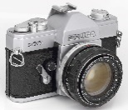
State preparation and detection
¹⁷¹Yb⁺
1
²³²ThF⁺
Ω=0⁺, v=0, J=0
microwave
B
²P_{1/2}, F=0
OP lasers
$$τ\sim 1μs$$
narrow laser
Raman lasers
Cycl lasers
²D_{5/2}, F=2
-1/2
1/2
J=1
¹∑⁺, v=0
motional entanglement
J=0
$$τ\sim 5s$$
F=1/2
J=3
J=4
n=1
F=3/2
J=1
J=2
²S_{1/2}, F=1
n=0
m_{F}
-3/2
-1/2
1/2
3/2
³Δ₁, v=0

Slide 40
State preparation and detection
¹⁷¹Yb⁺
1
²³²ThF⁺
Ω=0⁺, v=0, J=0
microwave
B
²P_{1/2}, F=0
OP lasers
$$τ\sim 1μs$$
narrow laser
Raman lasers
²D_{5/2}, F=2
-1/2
1/2
J=1
¹∑⁺, v=0
motional entanglement
J=0
$$τ\sim 5s$$
F=1/2
J=3
J=4
n=1
F=3/2
J=1
J=2
²S_{1/2}, F=1
n=0
m_{F}
-3/2
-1/2
1/2
3/2
³Δ₁, v=0

Slide 41
State preparation and detection
¹⁷¹Yb⁺
1
²³²ThF⁺
Ω=0⁺, v=0, J=0
microwave
B
²P_{1/2}, F=0
OP lasers
$$τ\sim 1μs$$
narrow laser
²D_{5/2}, F=2
-1/2
1/2
J=1
¹∑⁺, v=0
motional entanglement
J=0
n=1 - n=0
$$τ\sim 5s$$
F=1/2
J=3
J=4
n=1
F=3/2
J=1
J=2
²S_{1/2}, F=1
n=0
m_{F}
-3/2
-1/2
1/2
3/2
³Δ₁, v=0

Slide 42
State preparation and detection
¹⁷¹Yb⁺
1
²³²ThF⁺
Ω=0⁺, v=0, J=0
microwave
B
²P_{1/2}, F=0
OP lasers
$$τ\sim 1μs$$
narrow laser
²D_{5/2}, F=2
-1/2
1/2
J=1
¹∑⁺, v=0
motional entanglement
J=0
$$τ\sim 5s$$
F=1/2
J=3
J=4
n=1
F=3/2
J=1
J=2
²S_{1/2}, F=1
n=0
m_{F}
-3/2
-1/2
1/2
3/2
³Δ₁, v=0

Slide 43
Electric and magnetic fields
No biased electric field, no eEDM sensitivity
We need to apply ~10 V/cm rotating external field to polarize molecules
Notes:
To generate GV/cm effective electric field, we need to apply at least 10 V/cm rotating external field. However, such rotating E-field is incompatible with the quantum logic scheme.

Slide 44
Electric and magnetic fields
No biased electric field, no eEDM sensitivity
We need to apply ~10 V/cm rotating external field to polarize molecules
Rotating E-field is incompatible with QLS
  Send laser beams into a rotating frame
  Excess heating
Notes:
To generate GV/cm effective electric field, we need to apply at least 10 V/cm rotating external field. However, such rotating E-field is incompatible with the quantum logic scheme.

Slide 45
Electric and magnetic fields
No biased electric field, no eEDM sensitivity
We need to apply ~10 V/cm rotating external field to polarize molecules
Rotating E-field is incompatible with QLS
  Send laser beams into a rotating frame
  Excess heating
Solution
  Separate QLS (static frame) and spin-precession (rotating frame)
  A smooth transition between these frames
Notes:
To generate GV/cm effective electric field, we need to apply at least 10 V/cm rotating external field. However, such rotating E-field is incompatible with the quantum logic scheme.

Slide 46
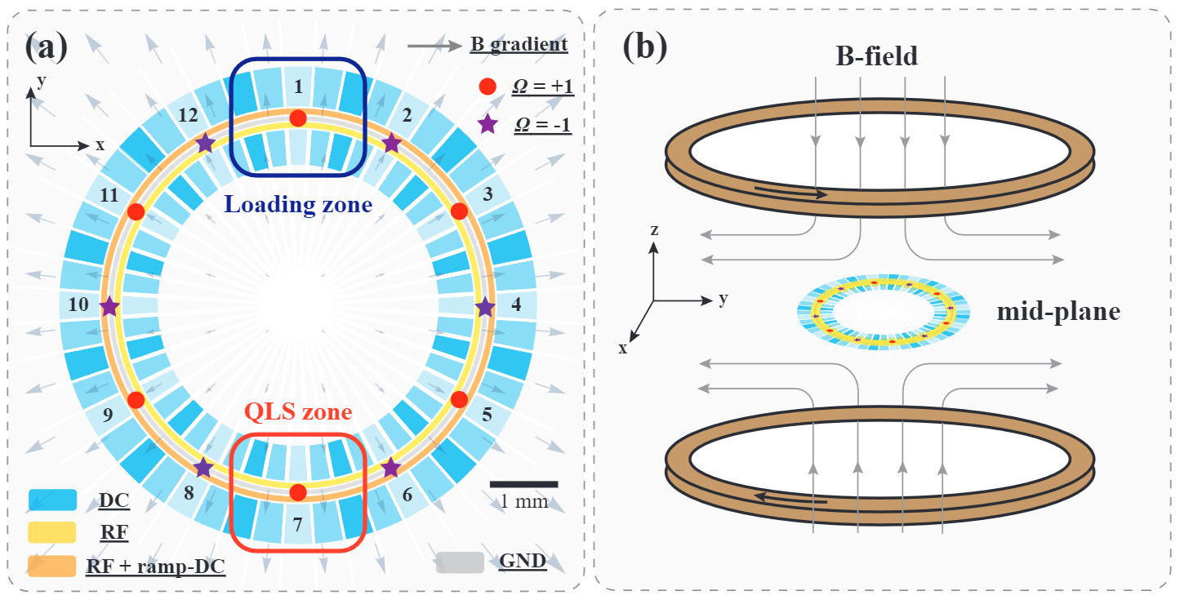
Ring ion trap

Slide 47
Ring ion trap
Property | Value
Radial Freq | 2.5 MHz
Axial Freq | 1 MHz
Rotation Freq | 0-100 kHz
Rotation radius | 3 mm
E-field | 0-32 V/cm
QLS in the static frame
Precision measurement in the rotating frame

Slide 48

Transition from static to rotating frames
static frame
rotating frame
F=1/2
F=1/2
F=3/2
F=3/2
m_{F}
-3/2
-1/2
+1/2
+3/2
m_{F}
-3/2
-1/2
+1/2
+3/2

Slide 49
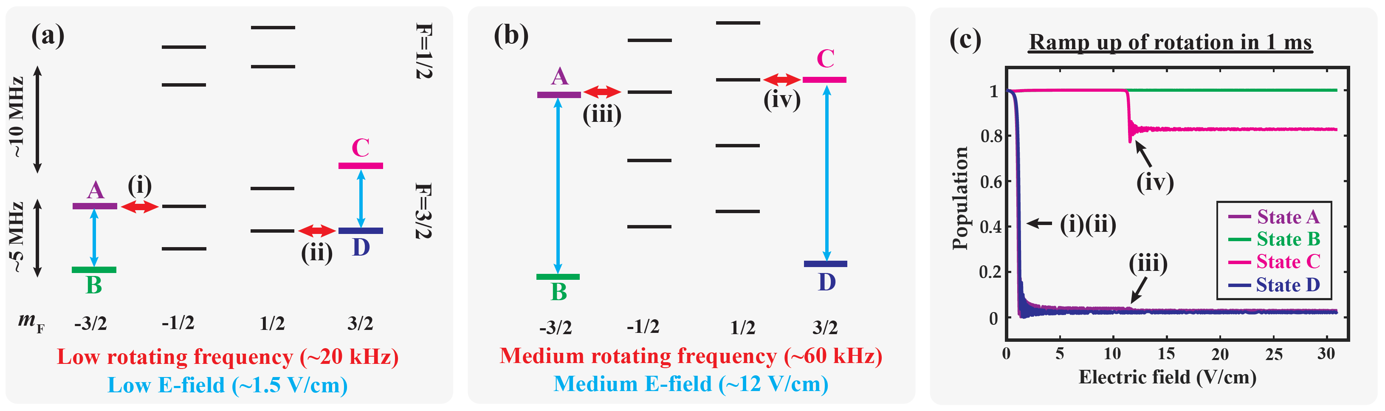
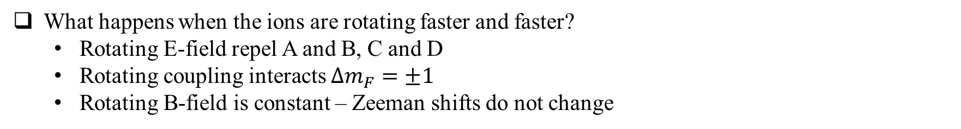
Transition from static to rotating frames
What happens when the ions are rotating faster and faster?
  Rotating E-field repel A and B, C and D
  Rotating coupling interacts $Δm_{F}=±1$
  Rotating B-field is constant – Zeeman shifts do not change

Slide 50
Transition from static to rotating frames
What happens when the ions are rotating faster and faster?
  Rotating E-field repel A and B, C and D
  Rotating coupling interacts $Δm_{F}=±1$
  Rotating B-field is constant – Zeeman shifts do not change

Slide 51
Transition from static to rotating frames
What happens when the ions are rotating faster and faster?
  Rotating E-field repel A and B, C and D
  Rotating coupling interacts $Δm_{F}=±1$
  Rotating B-field is constant – Zeeman shifts do not change

Slide 52
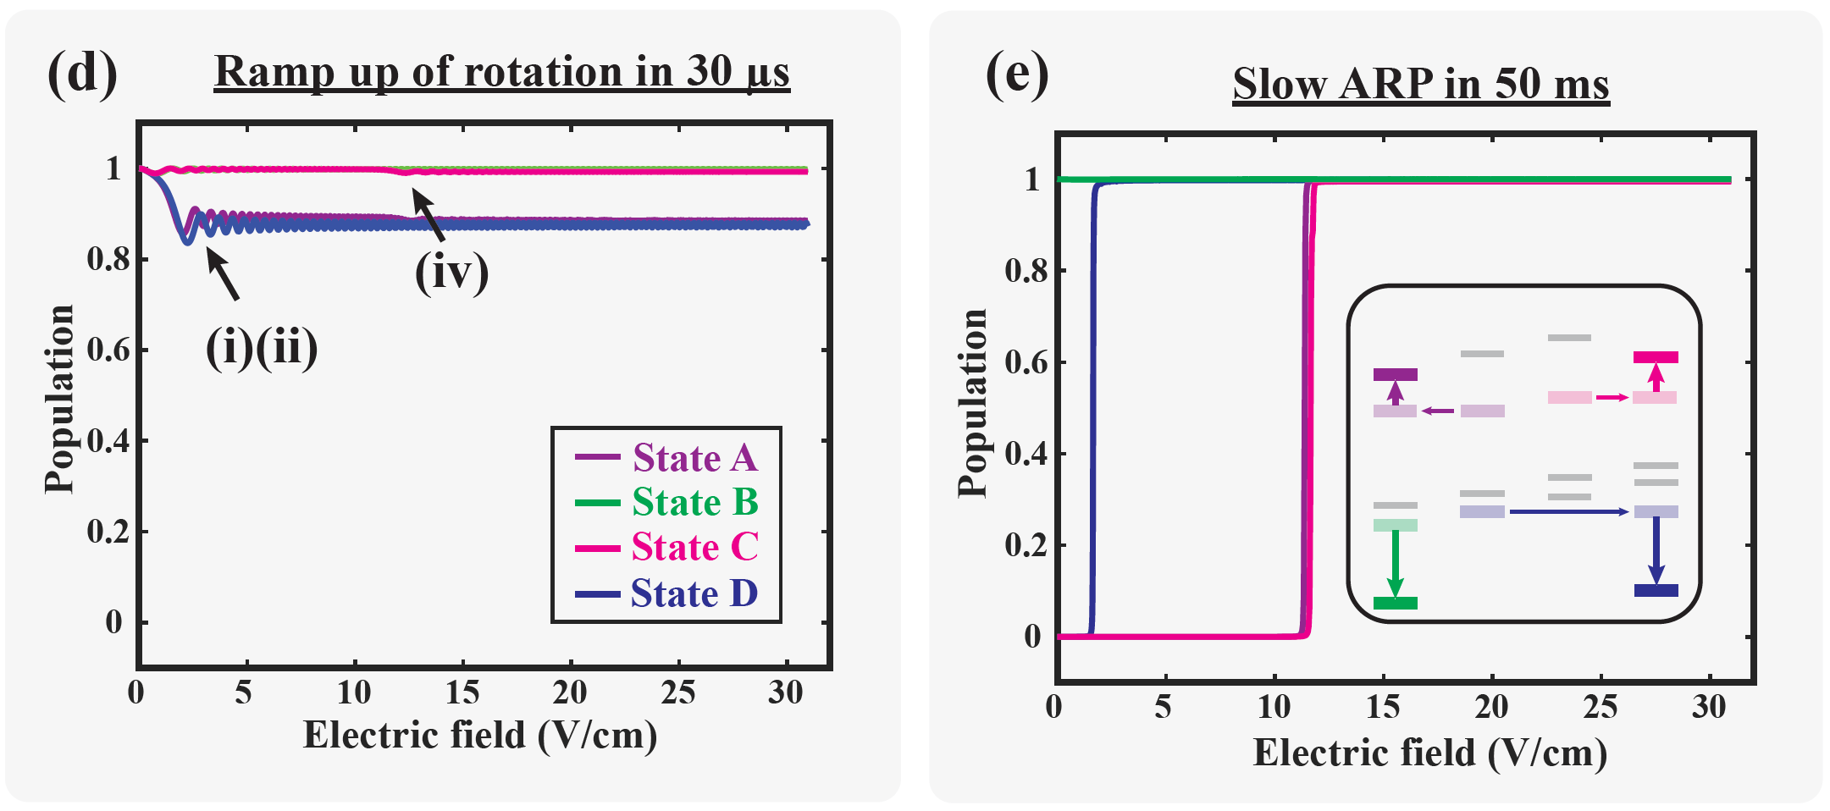
Transition from static to rotating frames
Solution 1: increase the ramp rate

Slide 53
Transition from static to rotating frames
Solution 1: increase the ramp rate
Solution 2: adiabatic population transfer

Slide 54
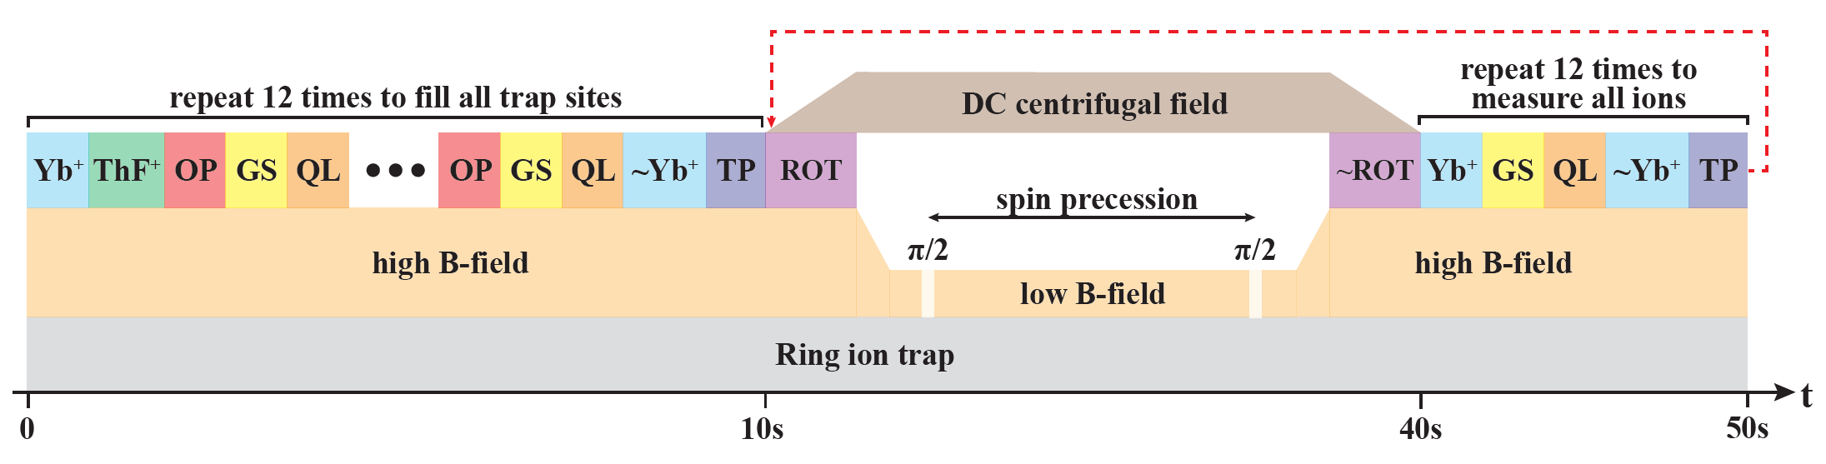
Experimental sequence
State preparation and detection is performed for each ions one-by-one
Spin-precession is for all ions
State readout of one measurement is the state preparation of the next measurement

Slide 55
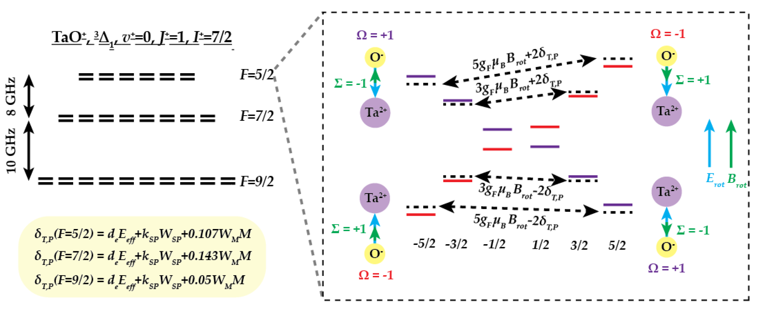
nuclear MQM
More hyperfine states
Rotation-induced couplings are more complicated

Slide 56
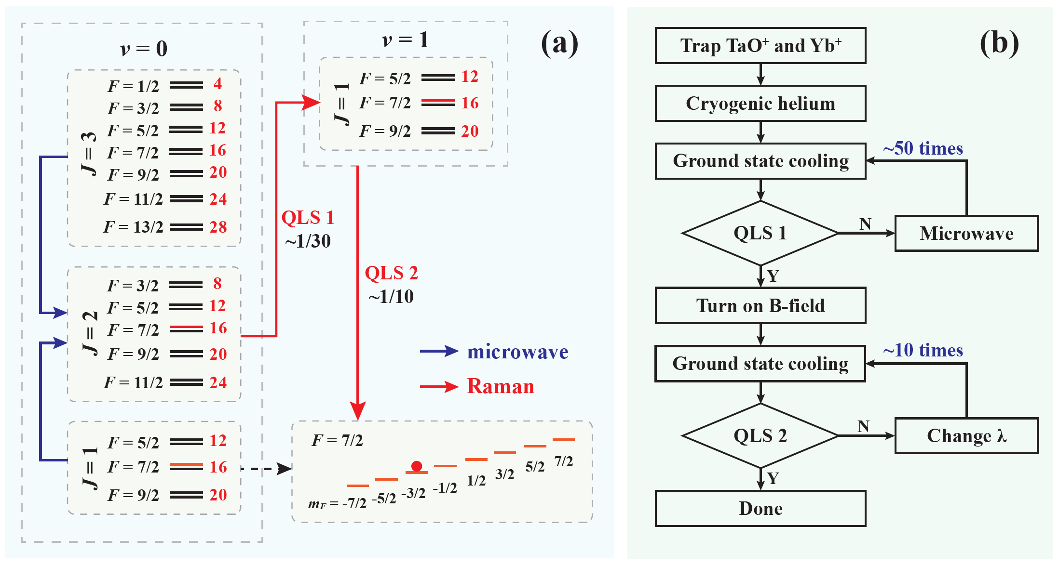
nuclear MQM
Degenerate QLS

Slide 57
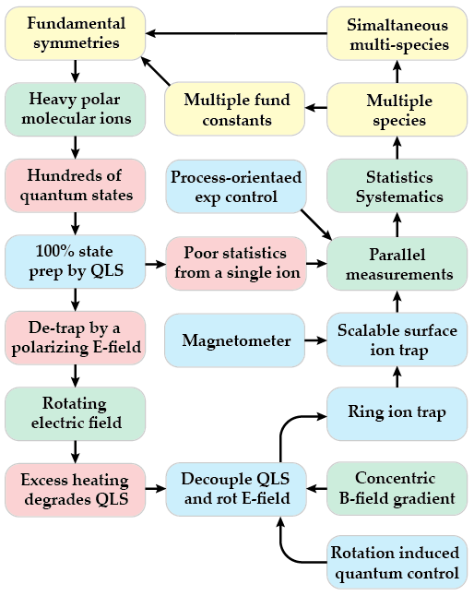
Current status
QLS and degenerate QLS for heavy molecular ions
High-precision simulations
Ring trap fabrication and tests
  3D trap using the laser cutting method
  Surface trap using microfabrication method
Thank you!

