Slide 1
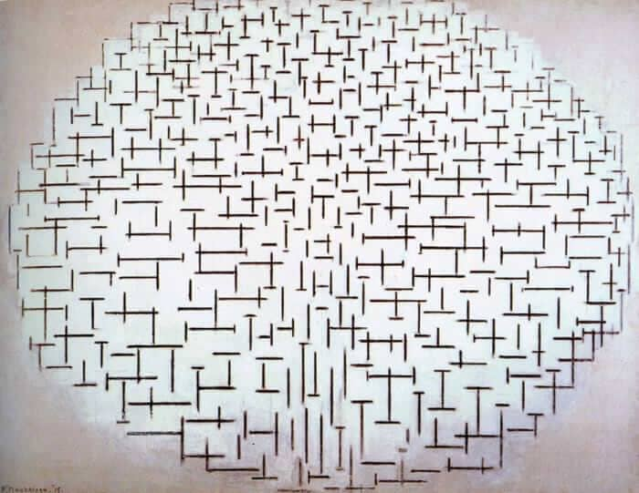
Electron EDM measurements with molecules: current status and future perspectives
EDMs: complementary experiments and theory connections
Mike Tarbutt
Centre for Cold Matter
Imperial College London
4th – 8th March 2024

Slide 2
Electron EDM results and predictions
10⁻²²
Extensions to Standard Model
10⁻²⁴
MSSM
(φ ~ 1)
10⁻²⁶
Left - Right
Multi - Higgs
Other SUSY
YbF beam (Imperial, 2011, [1]):| d_{e} | < 1.0 × 10⁻²⁷ e.cm
10⁻²⁸
ThO beam (ACME, 2014, [2]): | d_{e} | < 9.4 × 10⁻²⁹ e.cm
ThO beam (ACME, 2018, [3]): | d_{e} | < 1.1 × 10⁻²⁹ e.cm
Predicted value of the electric dipole moment (e.cm)
Trapped HfF⁺ (JILA, 2023, [4]): | d_{e} | < 4.1 × 10⁻³⁰ e.cm
10⁻³⁰
10⁻³²
Sensitive to new particles with masses up to 30 TeV
10⁻³⁴
10⁻³⁶
[1] Nature 473, 493 (2011)
[2] Science 343, 269 (2014)
[3] Nature 562, 355 (2018)
[4] Science 381, 46 (2023)
Standard Model

Slide 3
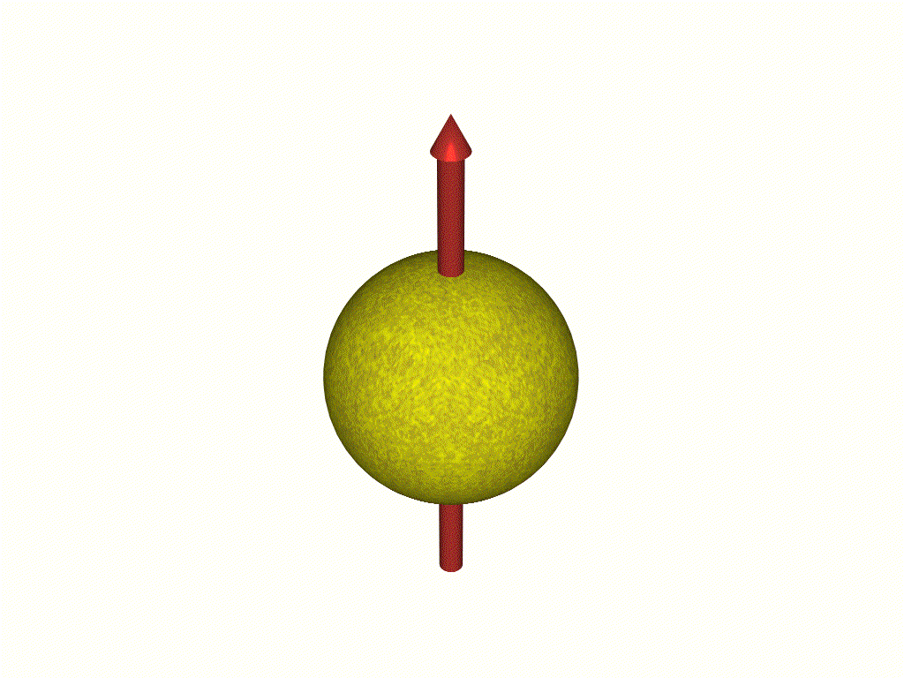
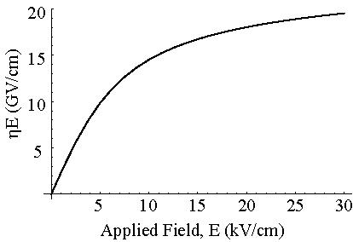
Using atoms or molecules to measure electron EDM, d_{e}
For a free electron in an applied field E, expect an interaction energy -d_{e}.E
For a bound electron, interaction energy = - d_{e} .E_{eff}
E_{eff} = F P
E
Polarization factor
Structure dependent,
̴10 (Z/80)³ GV/cm
Example: YbF molecule
Effective field, E_{eff} (GV/cm)
Electric
Field
Atom / Molecule

Slide 4
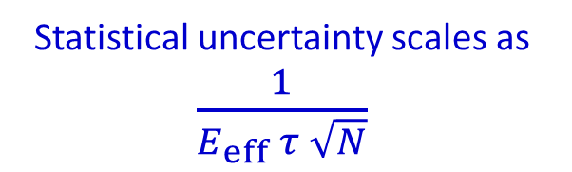
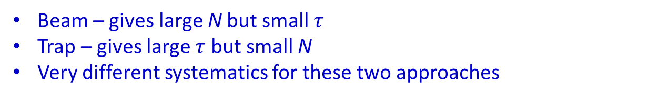
Statistical uncertainty
Statistical uncertainty scales as $\frac{1}{E_{eff} τ \sqrt{N}}$
Effective electric field
Number of particles
Spin precession time
Can be large for neutral species
Enormous for heavy polar molecules
Can be long if particles are trapped
Beam – gives large N but small $τ$
Trap – gives large $τ$ but small N
Very different systematics for these two approaches

Slide 5
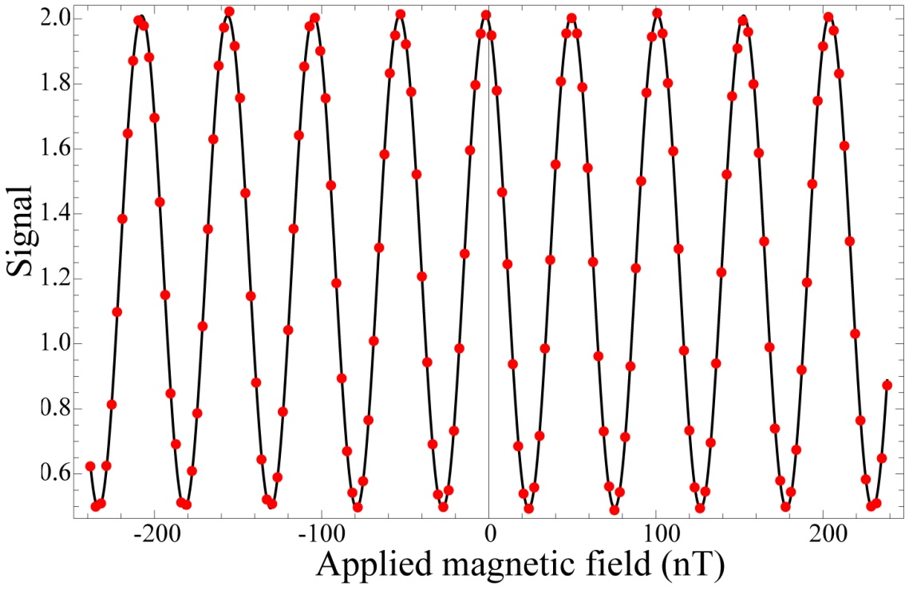
Measuring the electron EDM using molecular beams
Molecular beam
1st rf pulse
E
hf = 2μB
± 2 d_{e} E_{eff}
B
±
Signal α cos² [(μ B ± d_{e} E_{eff} ) τ / ћ]
2nd rf pulse
analyze spin direction

Slide 6
The ACME experiment using a beam of ThO
Use a metastable state of the ThO molecule – a ³Δ₁ state
s
O⁻
O⁻
E_{eff}
E_{eff}
Th⁺
s
Th⁺
positive parity
J=1
E
negative parity
s
Th⁺
Th⁺
E_{eff}
E_{eff}
O⁻
s
O⁻
M=-1
M=0
M=1
Advantages:
Fully polarized in a very small electric field
Can reverse E_{eff} without needing to reverse the applied electric field
The state has a magnetic moment close to zero
Can make a very intense beam of ThO
Disadvantage:
Metastable state limits spin coherence time to a few millesconds

Slide 7
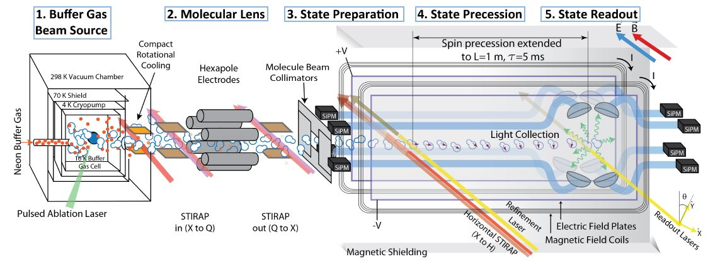
The ACME experiment using a beam of ThO
Result: | d_{e} | < 1.1 × 10⁻²⁹ e.cm

Slide 8
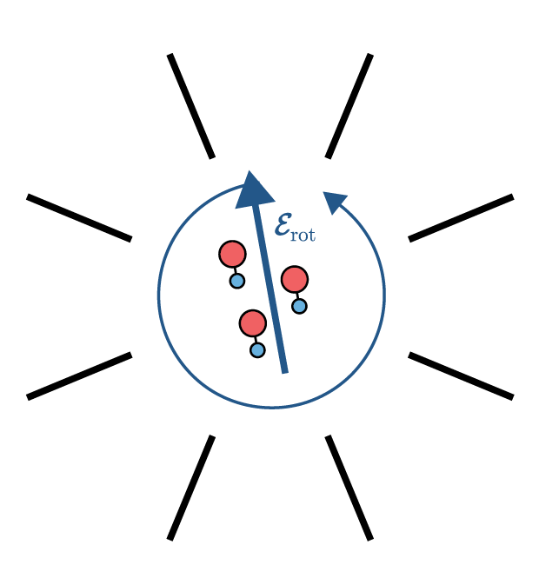
The JILA experiment using trapped HfF⁺ molecular ions
Also use a ³Δ₁ state; but has lifetime of a few seconds
Molecular ions are trapped and then polarized using a rotating electric field
Advantages:
Fully polarized in a very small electric field
Can reverse E_{eff} without needing to reverse the applied electric field
The state has a magnetic moment close to zero
Molecules are trapped, giving spin coherence times of several seconds
Only sensitive to component of B rotating at same frequency as the rotating electric field
Disadvantage:
Can only trap a small number of molecules

Slide 9
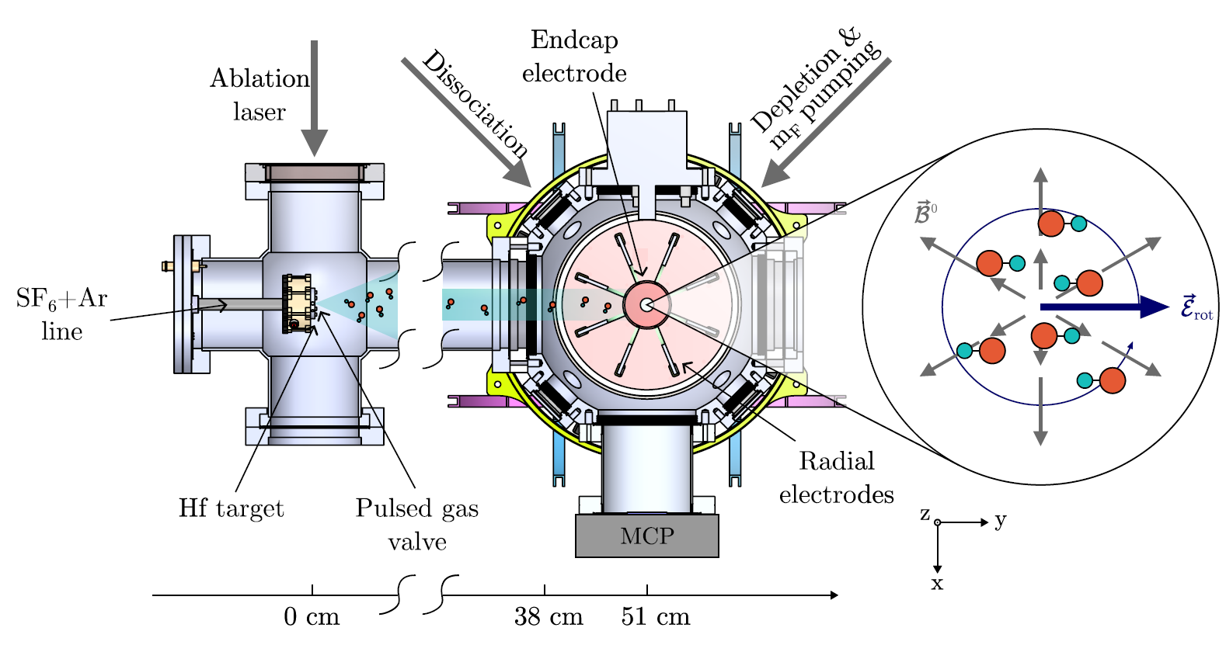
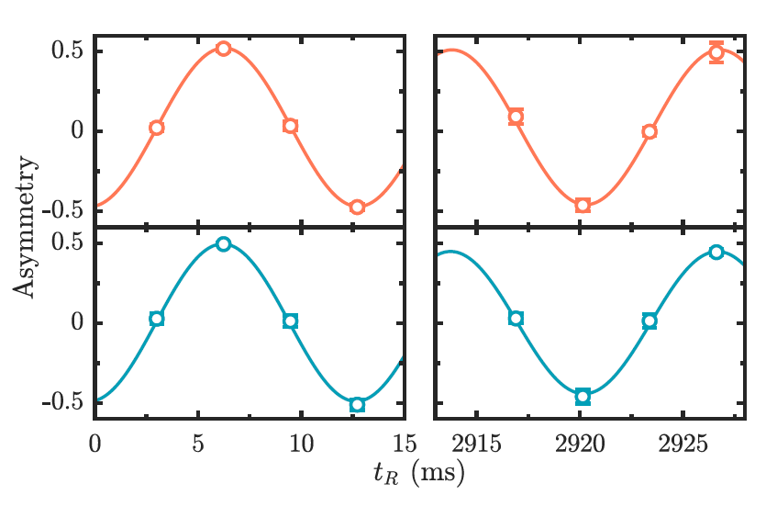
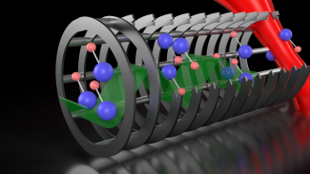
The JILA experiment using trapped HfF⁺ molecular ions
Result: | d_{e} | < 4.1 × 10⁻³⁰ e.cm
Coming soon – ThF⁺ in a “bucket brigade” ion trap
Larger E_{eff}
EDM-sensitive state is the ground state – even longer coherence time
Conveyor belt of ion traps – more ions at once

Slide 10
New directions
Ultracold molecules in beams and traps (this talk and Steven Hoekstra on Thursday)
Polyatomic molecules
Radioactive molecules (several talks at this meeting)
Molecules embedded in crystals, e.g. Ar, H₂ (Marco Guarise on Thursday)
Quantum logic tools (Yan Zhou on Monday)
Other “quantum enhancements”, e.g. spin squeezing, magnetic-insensitive states

Slide 11
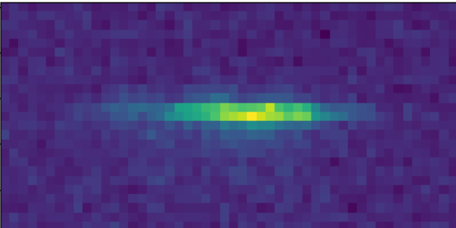
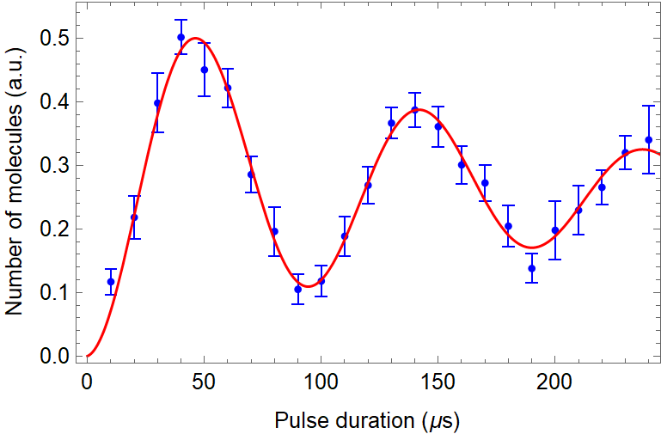
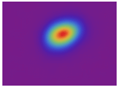
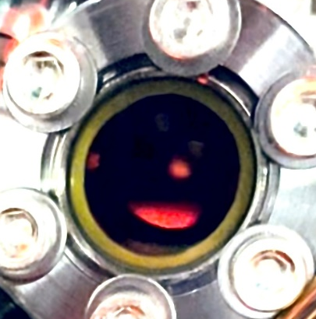
Ultracold molecules by laser cooling
CaF in a 1D optical lattice
Rabi oscillations at 20.5 GHz in an optical lattice
1mm
50
40
T = 5.4 ± 0.7 µK
30
Temperature (μK)
20
10
About 10⁵ CaF molecules
Peak density: 10⁷ cm⁻³
0
0
1
2
3
Time in 2nd molasses (ms)
Results shown are from Imperial. Similar results from Harvard, Princeton, Chicago, JILA

Slide 12
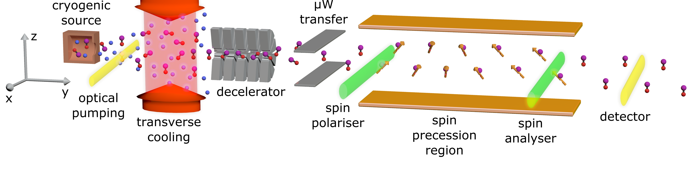
Ways to measure eEDM using ultracold molecules
Sensitivity proportional to spin-precession time
Could have 100 ms in an ultracold beam; perhaps 10 s in a lattice
Need microkelvin molecules
P. Aggarwal et al., Eur. Phys. J. D 72, 197 (2018).
N. J. Fitch et. al. Quantum Sci. Technol. 6, 014006 (2021).
L. Anderegg et al., Science 382, 665–668 (2023)

Slide 13
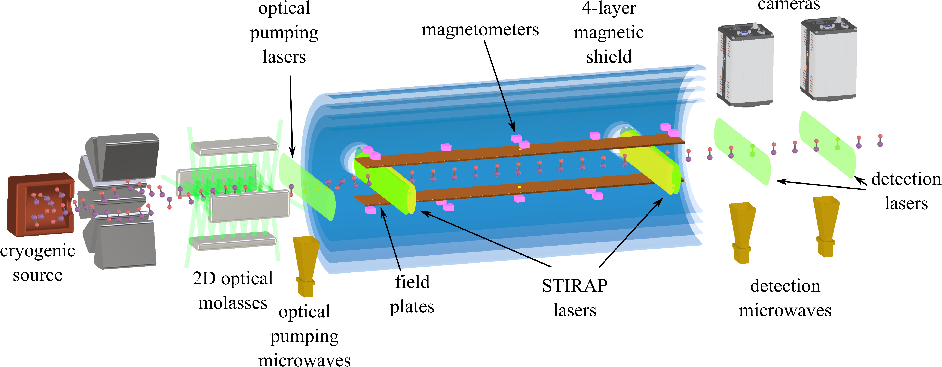
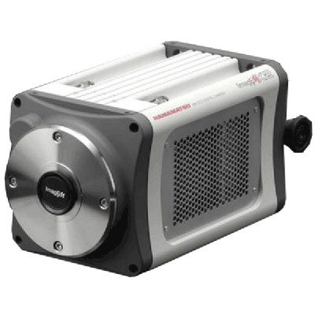
Measuring electron electric dipole moment using ultracold YbF
About 10⁶ ultracold molecules per shot
Sufficient to reach 10⁻³⁰ e.cm
No cooling
1D cooling
2D cooling
N. J. Fitch et. al. Quantum Sci. Technol. 6, 014006 (2021)
X. Alauze et al., Quantum Sci. Technol. 6, 044005 (2021)
Beam brightness increased by at least a factor 300

Slide 14
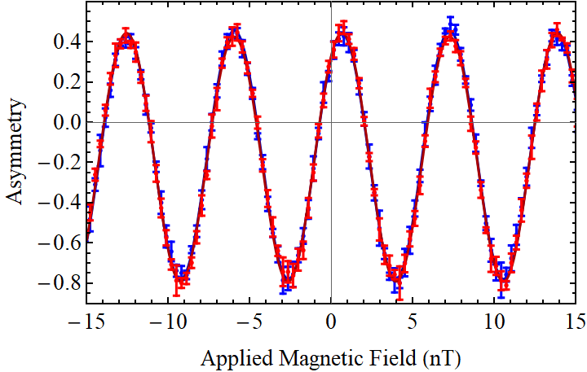
First interference fringes with ultracold YbF

Slide 15
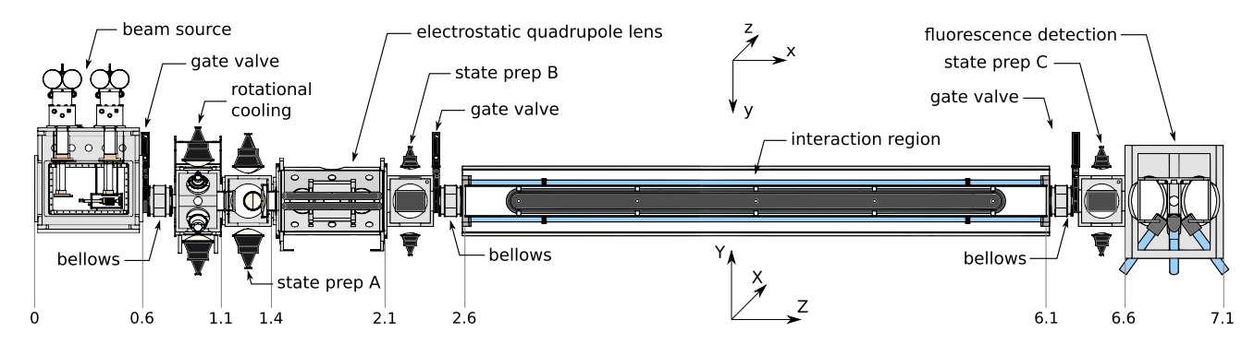
Other EDM experiments with ultracold molecules in a beam
Electron EDM experiment using laser-cooled and Stark decelerated BaF molecules (NL-EDM)
Eur. Phys. J. D 72, 197 (2018).
Schiff moment experiment using laser-cooled TlF molecules (CENTREX)
Quantum Sci. Technol. 6 (2021) 044007

Slide 16
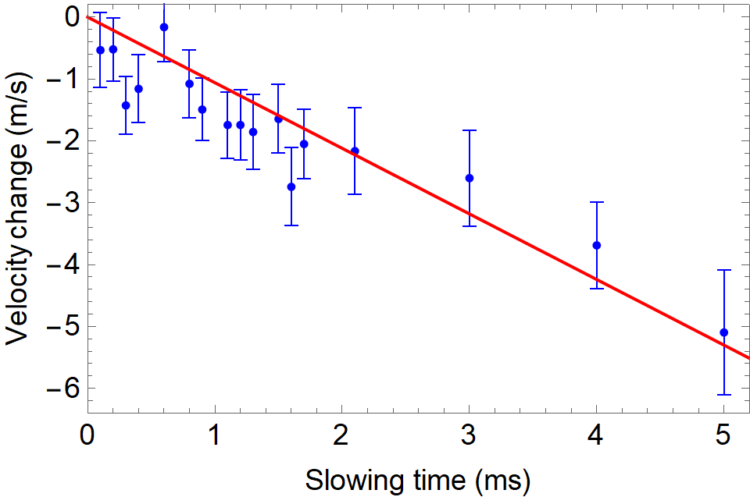
Towards an eEDM experiment using YbF molecules in a lattice

Slide 17
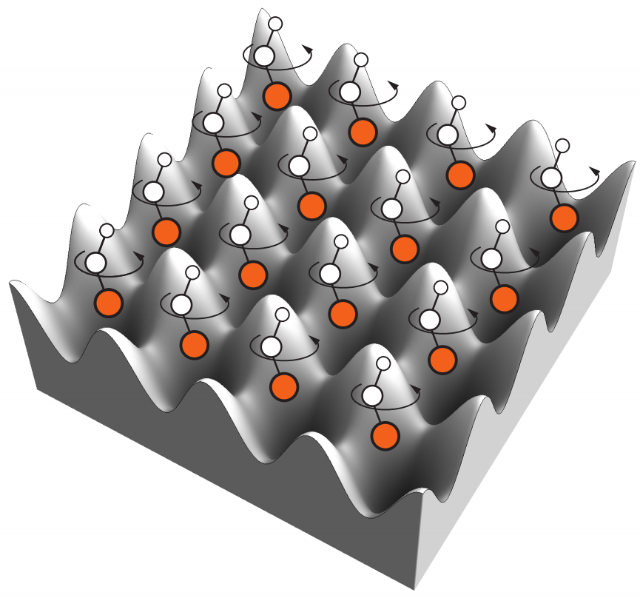
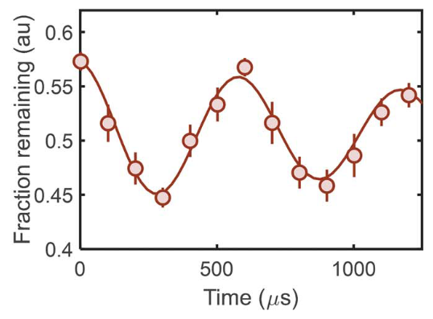

Polyatomic molecules for eEDM and nMQM
Advantages of polyatomic molecules:
Laser-coolable
Closely-spaced parity-doublets in the ground state
Can engineer magnetically-insensitive states
Proof-of principle measurement using trapped CaOH molecules
Now working towards eEDM measurement using SrOH & YbOH
Anderegg et al., Science 382, 665–668 (2023)

Slide 18
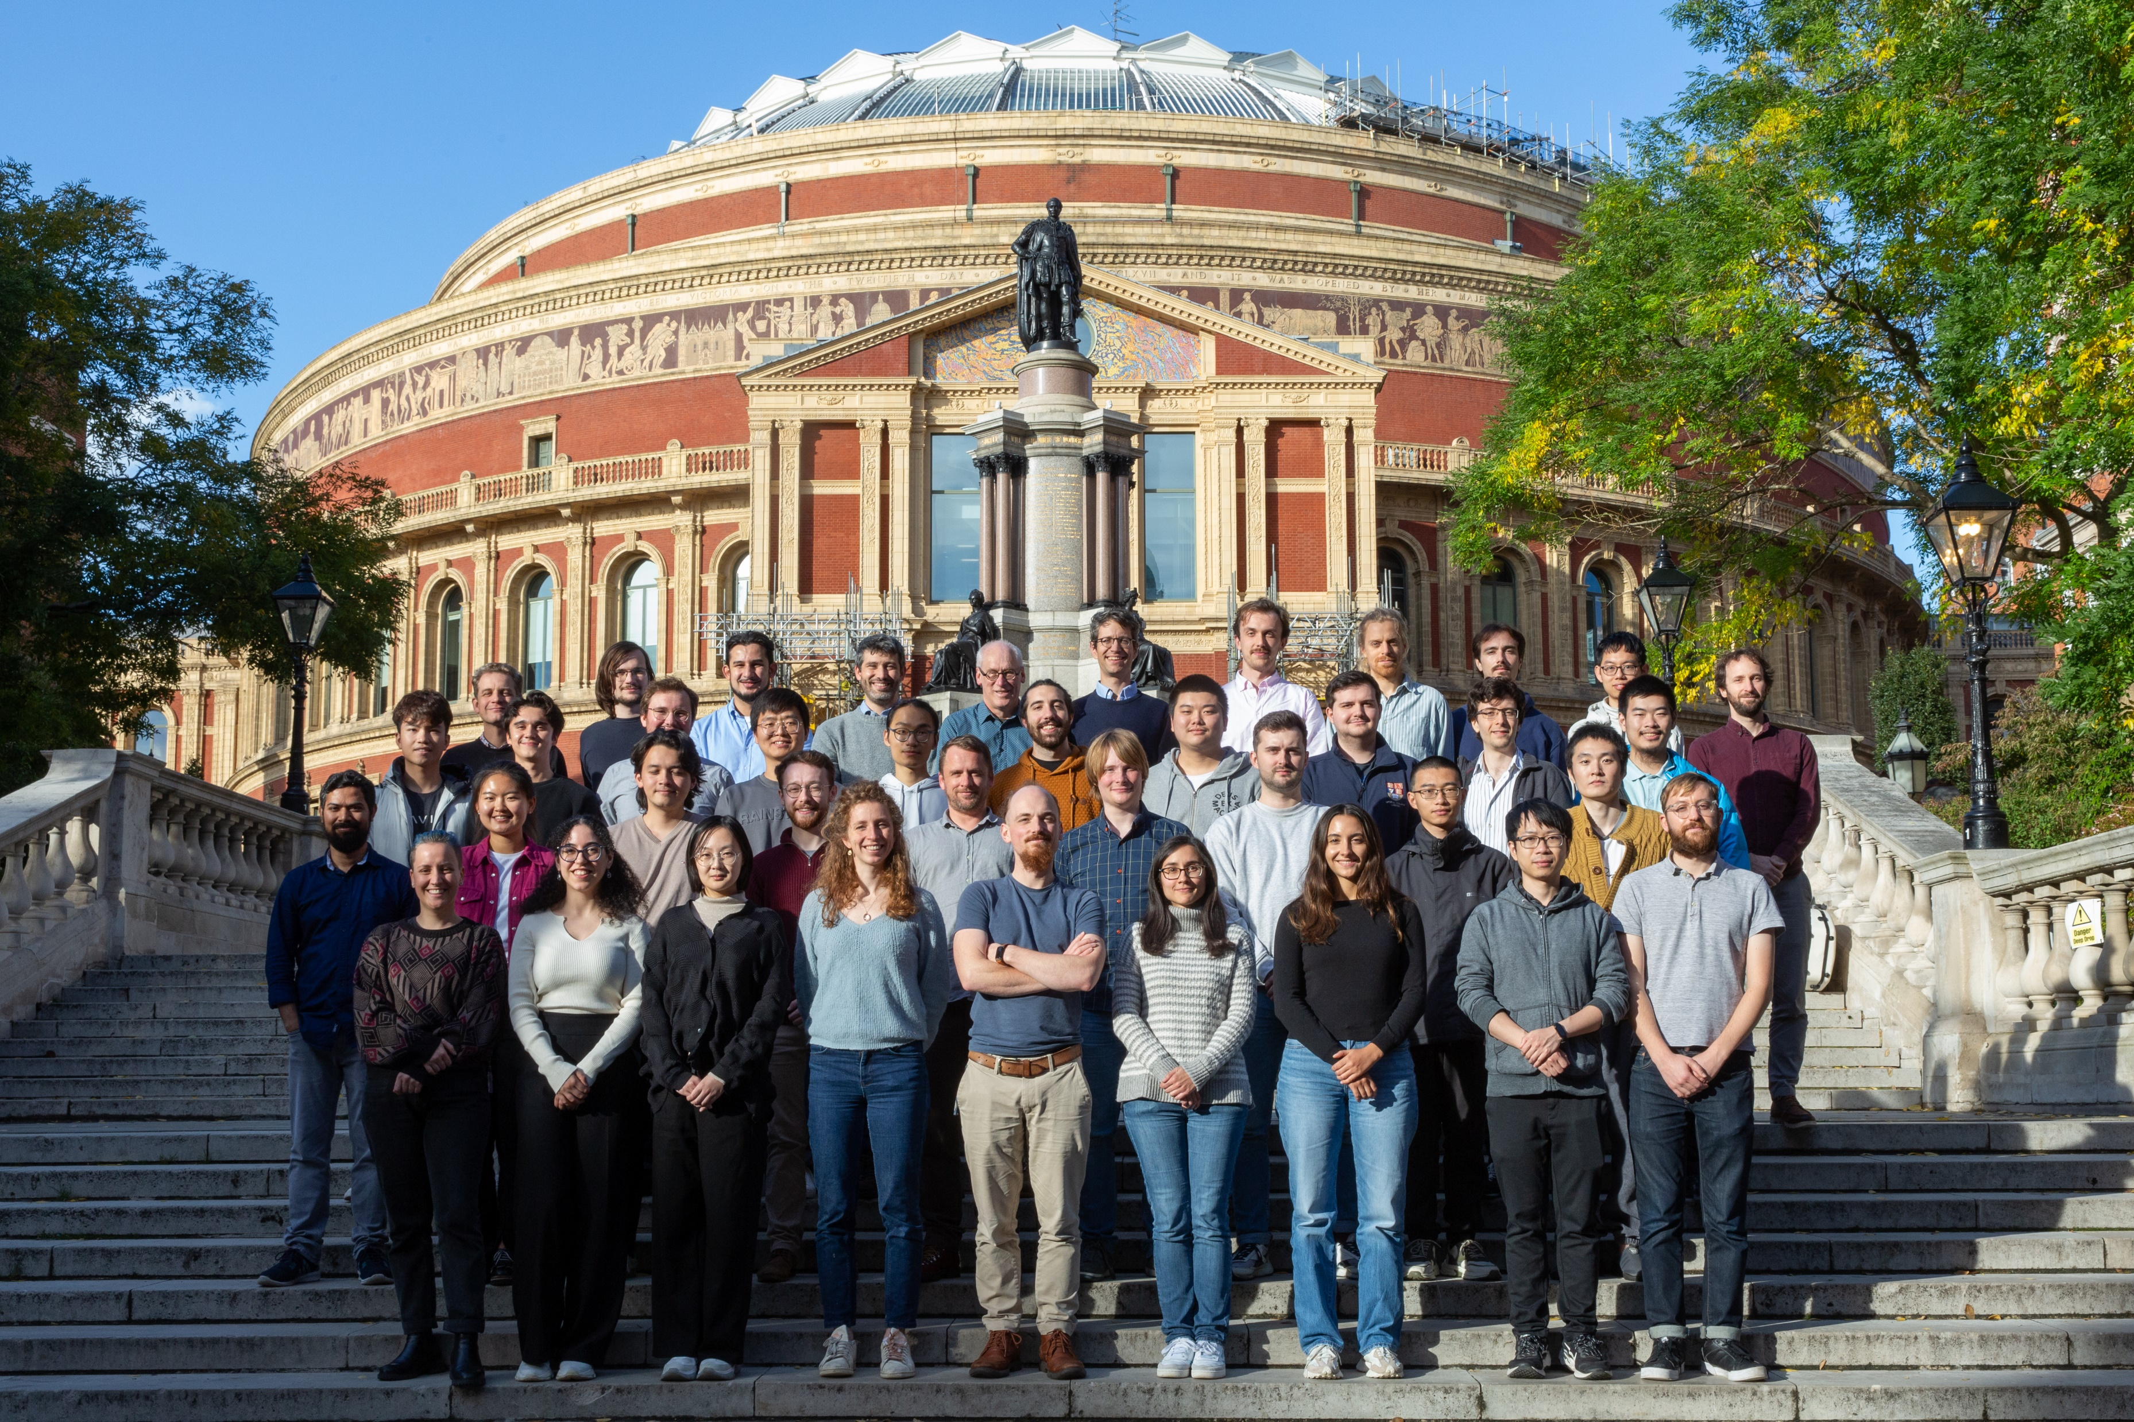



Thanks
Centre for Cold Matter group photo (2023)
Postdoc positions available – please talk to me if interested

Slide 19
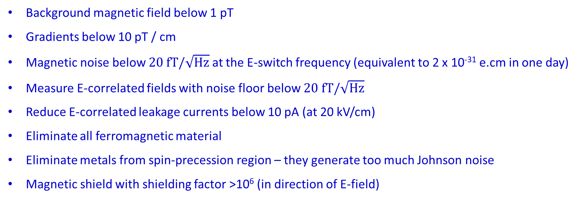
The magnetic field nightmare
Magnetic moment of ground state YbF is 1 µ_{B}
1 fT = 4 x 10⁻³⁰ e.cm
Background magnetic field below 1 pT
Gradients below 10 pT / cm
Magnetic noise below $20 fT/\sqrt{Hz}$ at the E-switch frequency (equivalent to 2 x 10⁻³¹ e.cm in one day)
Measure E-correlated fields with noise floor below $20 fT/\sqrt{Hz}$
Reduce E-correlated leakage currents below 10 pA (at 20 kV/cm)
Eliminate all ferromagnetic material
Eliminate metals from spin-precession region – they generate too much Johnson noise
Magnetic shield with shielding factor >10⁶ (in direction of E-field)

Slide 20
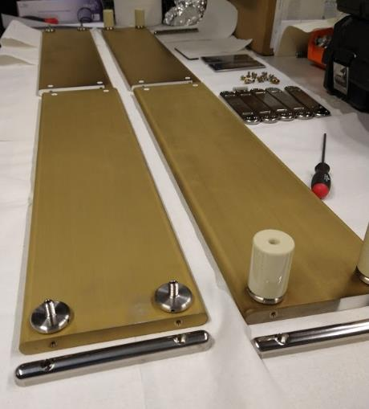
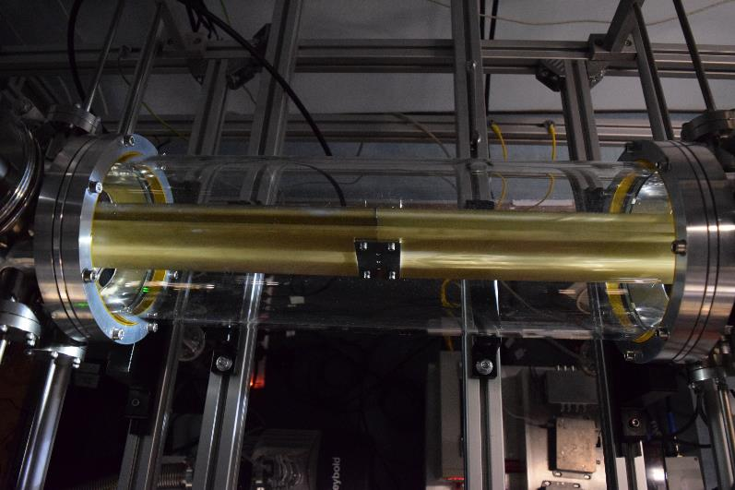
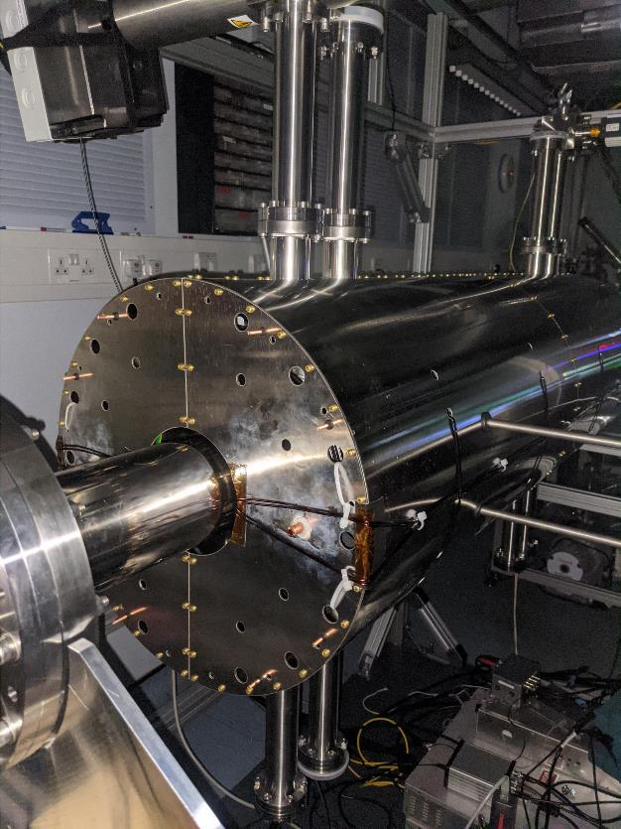
What it looks like
Alumina (Al₂O₃) field plates coated with titanium nitride. Small metal parts are titanium
Mounted inside glass vacuum chamber with titanium chambers at either end
All inside a 4-layer magnetic shield

