Slide 1
Energy-energy correlators in CMS pp and ALEPH e⁺e⁻ data
Yi Chen (Vanderbilt U.) , Hannah Bossi (MIT)
Yen-Jie Lee (MIT)
New jet quenching tools to explore equilibrium and non-equilibrium dynamics in heavy-ion collisions
ECT*, Trento, Italy
13th February, 2024
MIT HIG group's work was supported by US DOE-NP
Notes:
(0:00) I would like to thank the organizer for the kind invitation to talk about what we learned from collectivity searches in smallest systems

Slide 2
Motivation
Monte Carlo generators such as PYTHIA 6, PYTHIA 8, SHERPA and HERWIG are tuned with hadronic event shape observables and hadron spectra in e⁺ e⁻
Then used to predict the jet spectra and substructure in more complicated hadron collisions
EEC in pp:
New tool for α_{s} extraction
Test on pQCD and compared to event generators.
Reference for AA
Jet substructure and EEC in e⁺e⁻:
Utilize the new jet clustering tools developed after LEP operation
Revisit EEC with fine binning and extended it to full event.
Further test of event generators, reference of pp
A
A
e⁻
e⁺
p
p

Slide 3
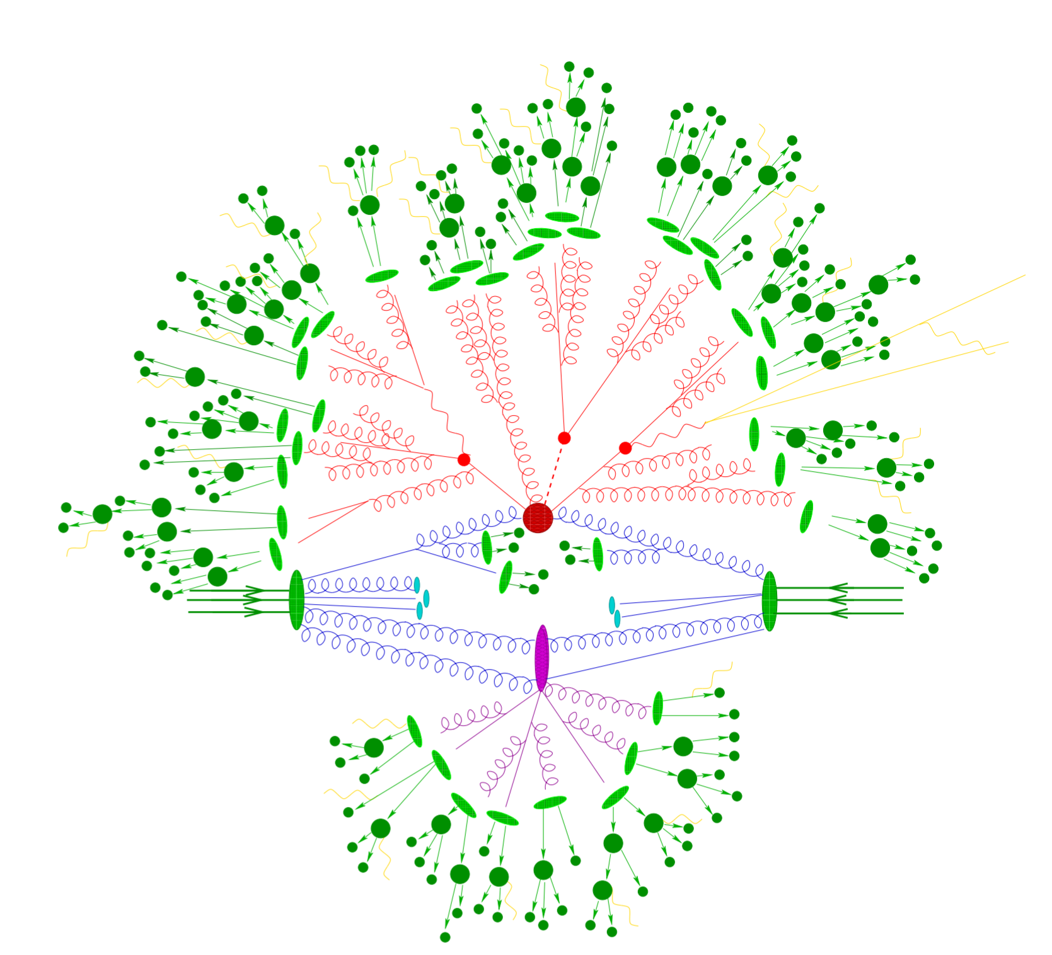
EEC in pp with CMS
Energy-energy correlators in CMS pp
R_{L}
R_{L}
pp

Slide 4
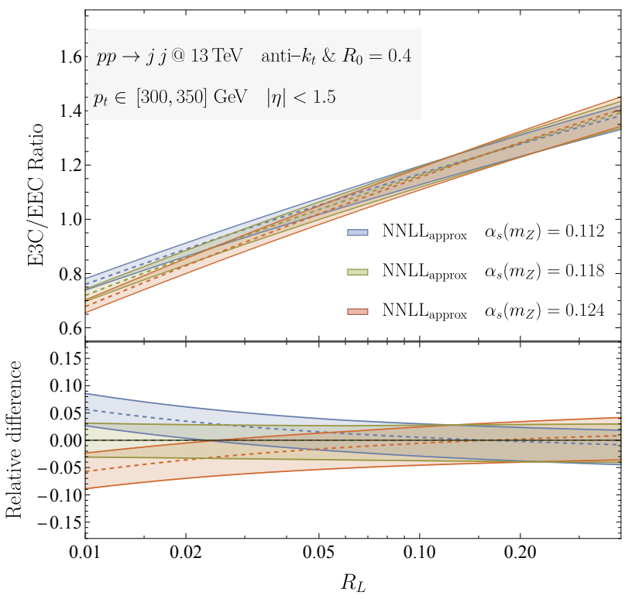
First Measurement of E3C and E3C/E2C in pp
Chen, Gao, Li, Xu, Zhang, and Zhu, arXiv:2307.07510
In QFT at LL, E3C/E2C is a linear function of $α_{s}$
Difficulties in extracting $α_{S}$ from jet substructure:
Degeneracy between q/g fraction and $α_{S}: α_{S}∗C_{i}$
Solution: E3C/E2C ratio mitigates the degeneracy
Former jet substructure $α_{S}$ extraction: ~ 10%, arXiv:1808.07340
$$∝α_{S}(Q)lnx_{L}+O(α_{s}^{2})$$
$α_{S}(M_{Z})$ $↑$ Slope $↑$

Slide 5
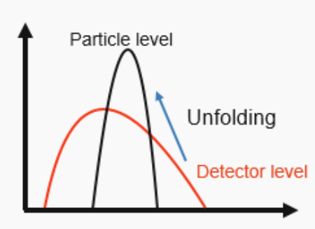
Analysis Procedure
Event selection:
Unfolding:
$$\frac{E_{1}∗E_{2}}{Q^{2}}$$
$$\frac{E_{1}^{′}∗E_{2}^{′}}{Q^{′2}}$$
Dijet events: large cross section
PF jet, $|η|<2.1$, anti-kT with R = 0.4,
CHS (PU charged hadron subtraction)
Particle level
Unfolding
Detector level
$$x_{L}$$
$$x_{L}^{′}$$
$$p_{T}^{jet}$$
$$p_{T}^{jet^{′}}$$
Object selection:
Particle level
Detector level
8 $p_{T}^{jet}$ regions in 97 ~ 1784 GeV
Probe energy scale dependency
Neutral & charged particles with $p_{T}$ > 1 GeV
All particles included, direct comparison with theoretical calculation
Unfolding: detector level -> particle level
Unfold jet constituents instead of distribution:
$p_{T}^{jet}$, $x_{L}$ and energy weight, 3D unfolding
$10∗22∗20=4400$ bins
D'Agostini: iterative bayesian

Slide 6
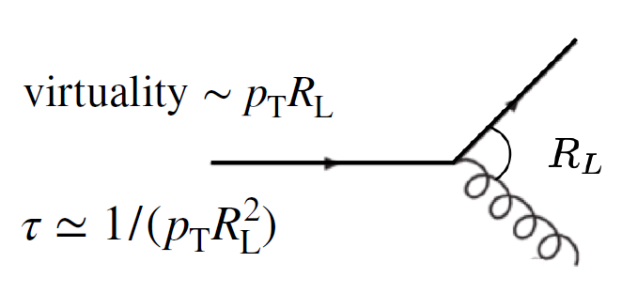
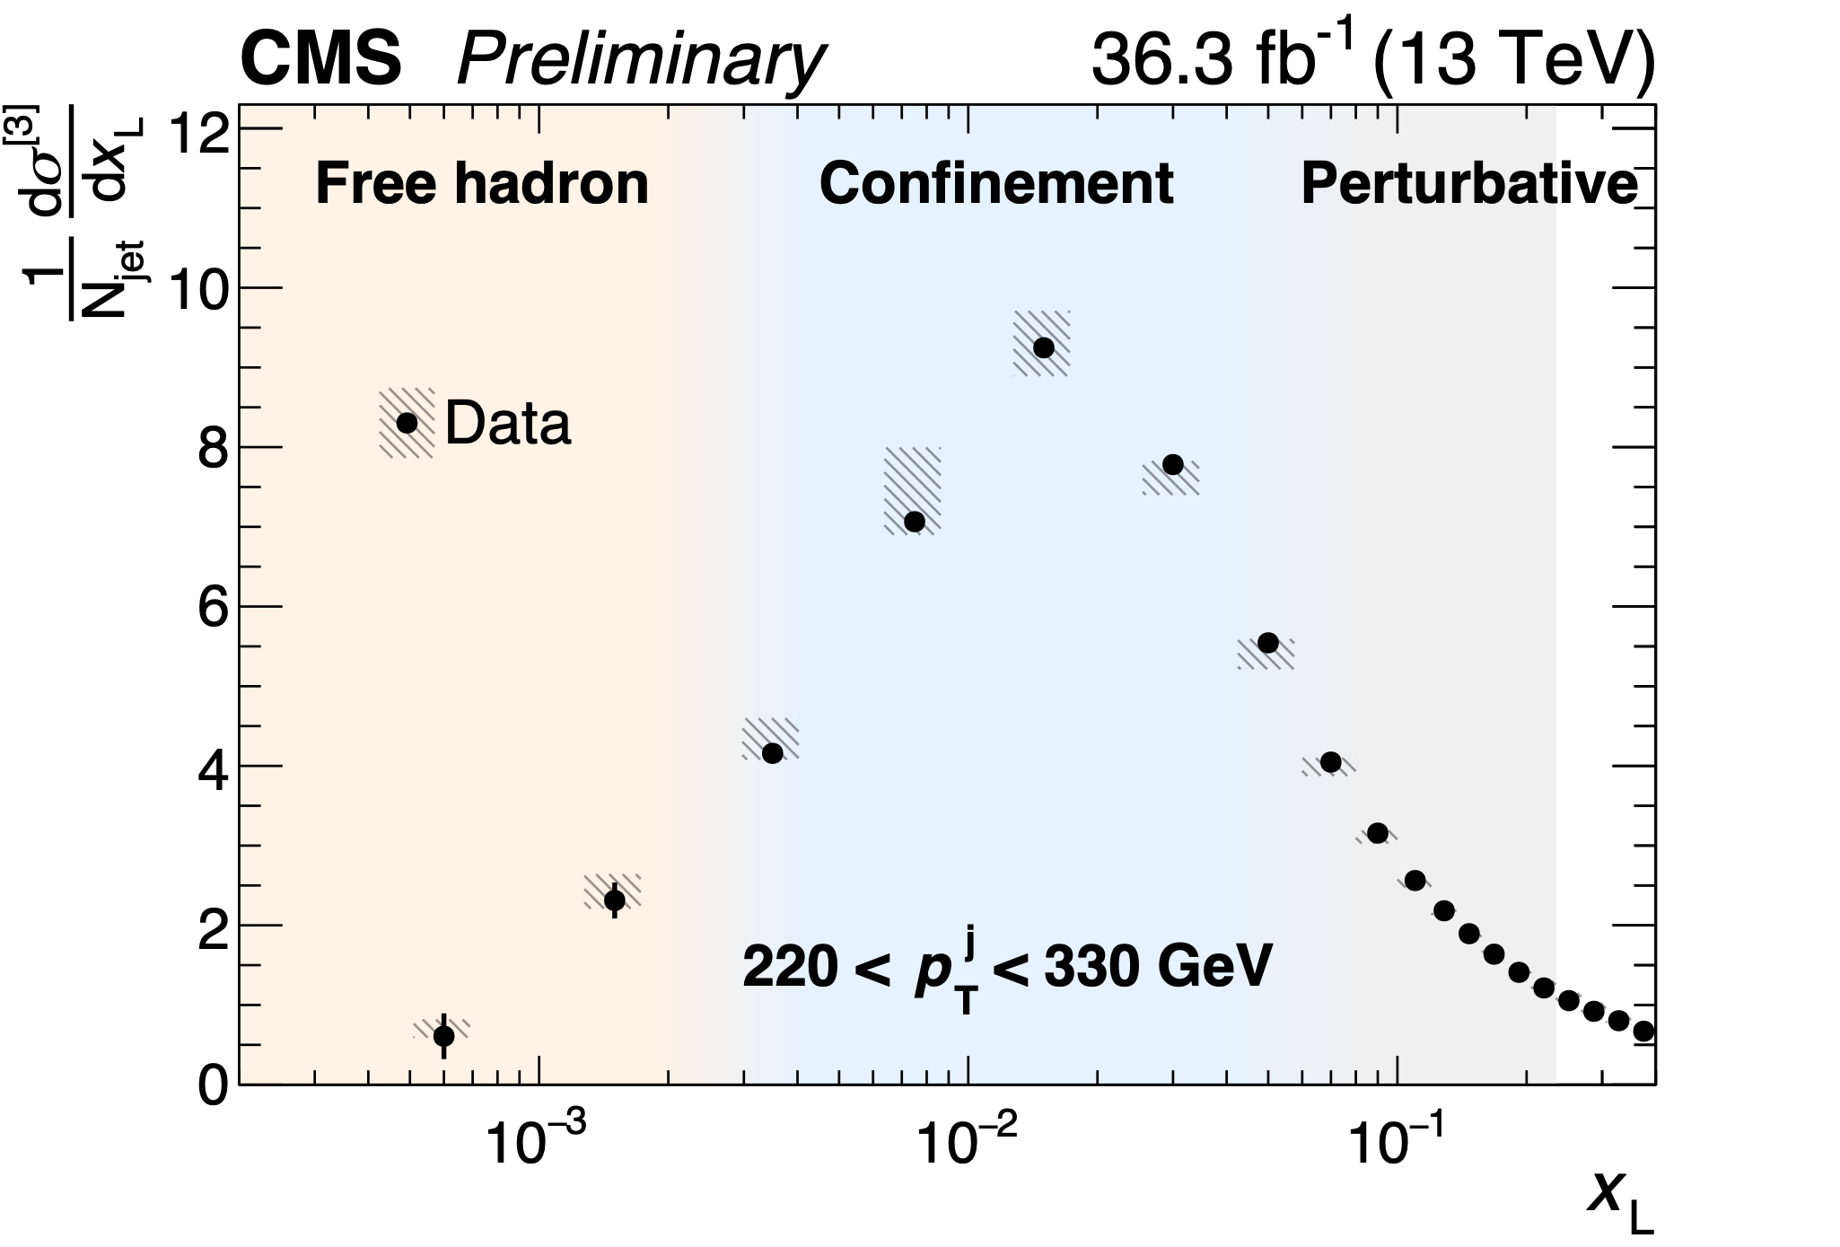
Unfolded E2C in pp at 13 TeV
Confinement
Phase transition
from parton to hadron
6
Non-interacting hadron random distribution integer power-law scaling
Interacting partons non-integer scaling
Time

Slide 7
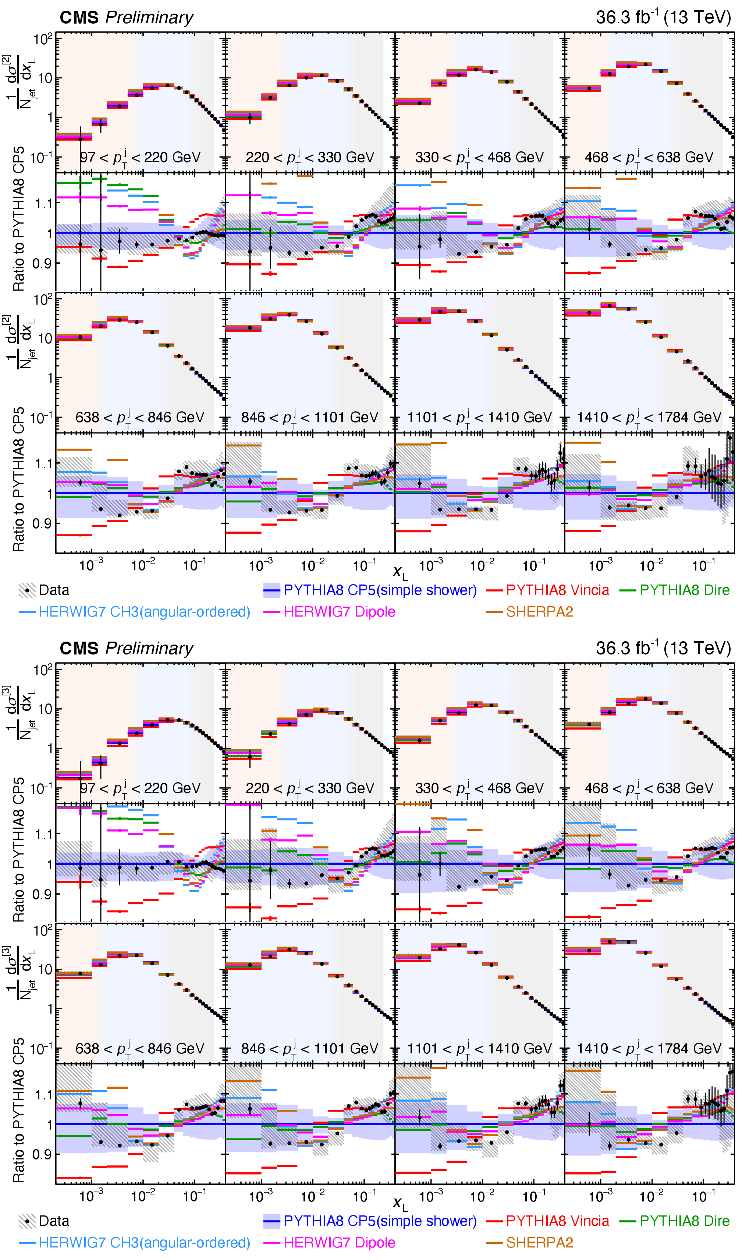
Unfolded E2C vs MC Generators in pp at 13 TeV
Results compared to PYTHIA8, HERWIG and SHERPA2
None of the generator fully describes the E2C data
Spread of the predictions from generators at the 10-20% level
Peak position at around p_{T}X_{L}~ 2-3 GeV

Slide 8
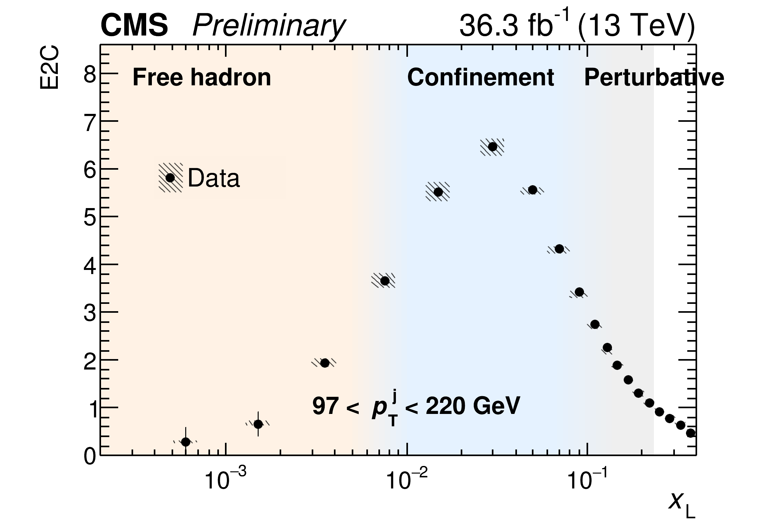
Unfolded E2C vs. Jet p_{T}
Boundary shifts with jet p_{T}
Q$∝x_{L}$*$p_{T}^{jet}$
$p_{T}^{jet}↑$, $x_{L}↓$
8
Boundary
$$x_{L}≈\frac{0.8}{p_{T}^{jet}}$$
$$x_{L}≈\frac{20}{p_{T}^{jet}}$$
Time

Slide 9
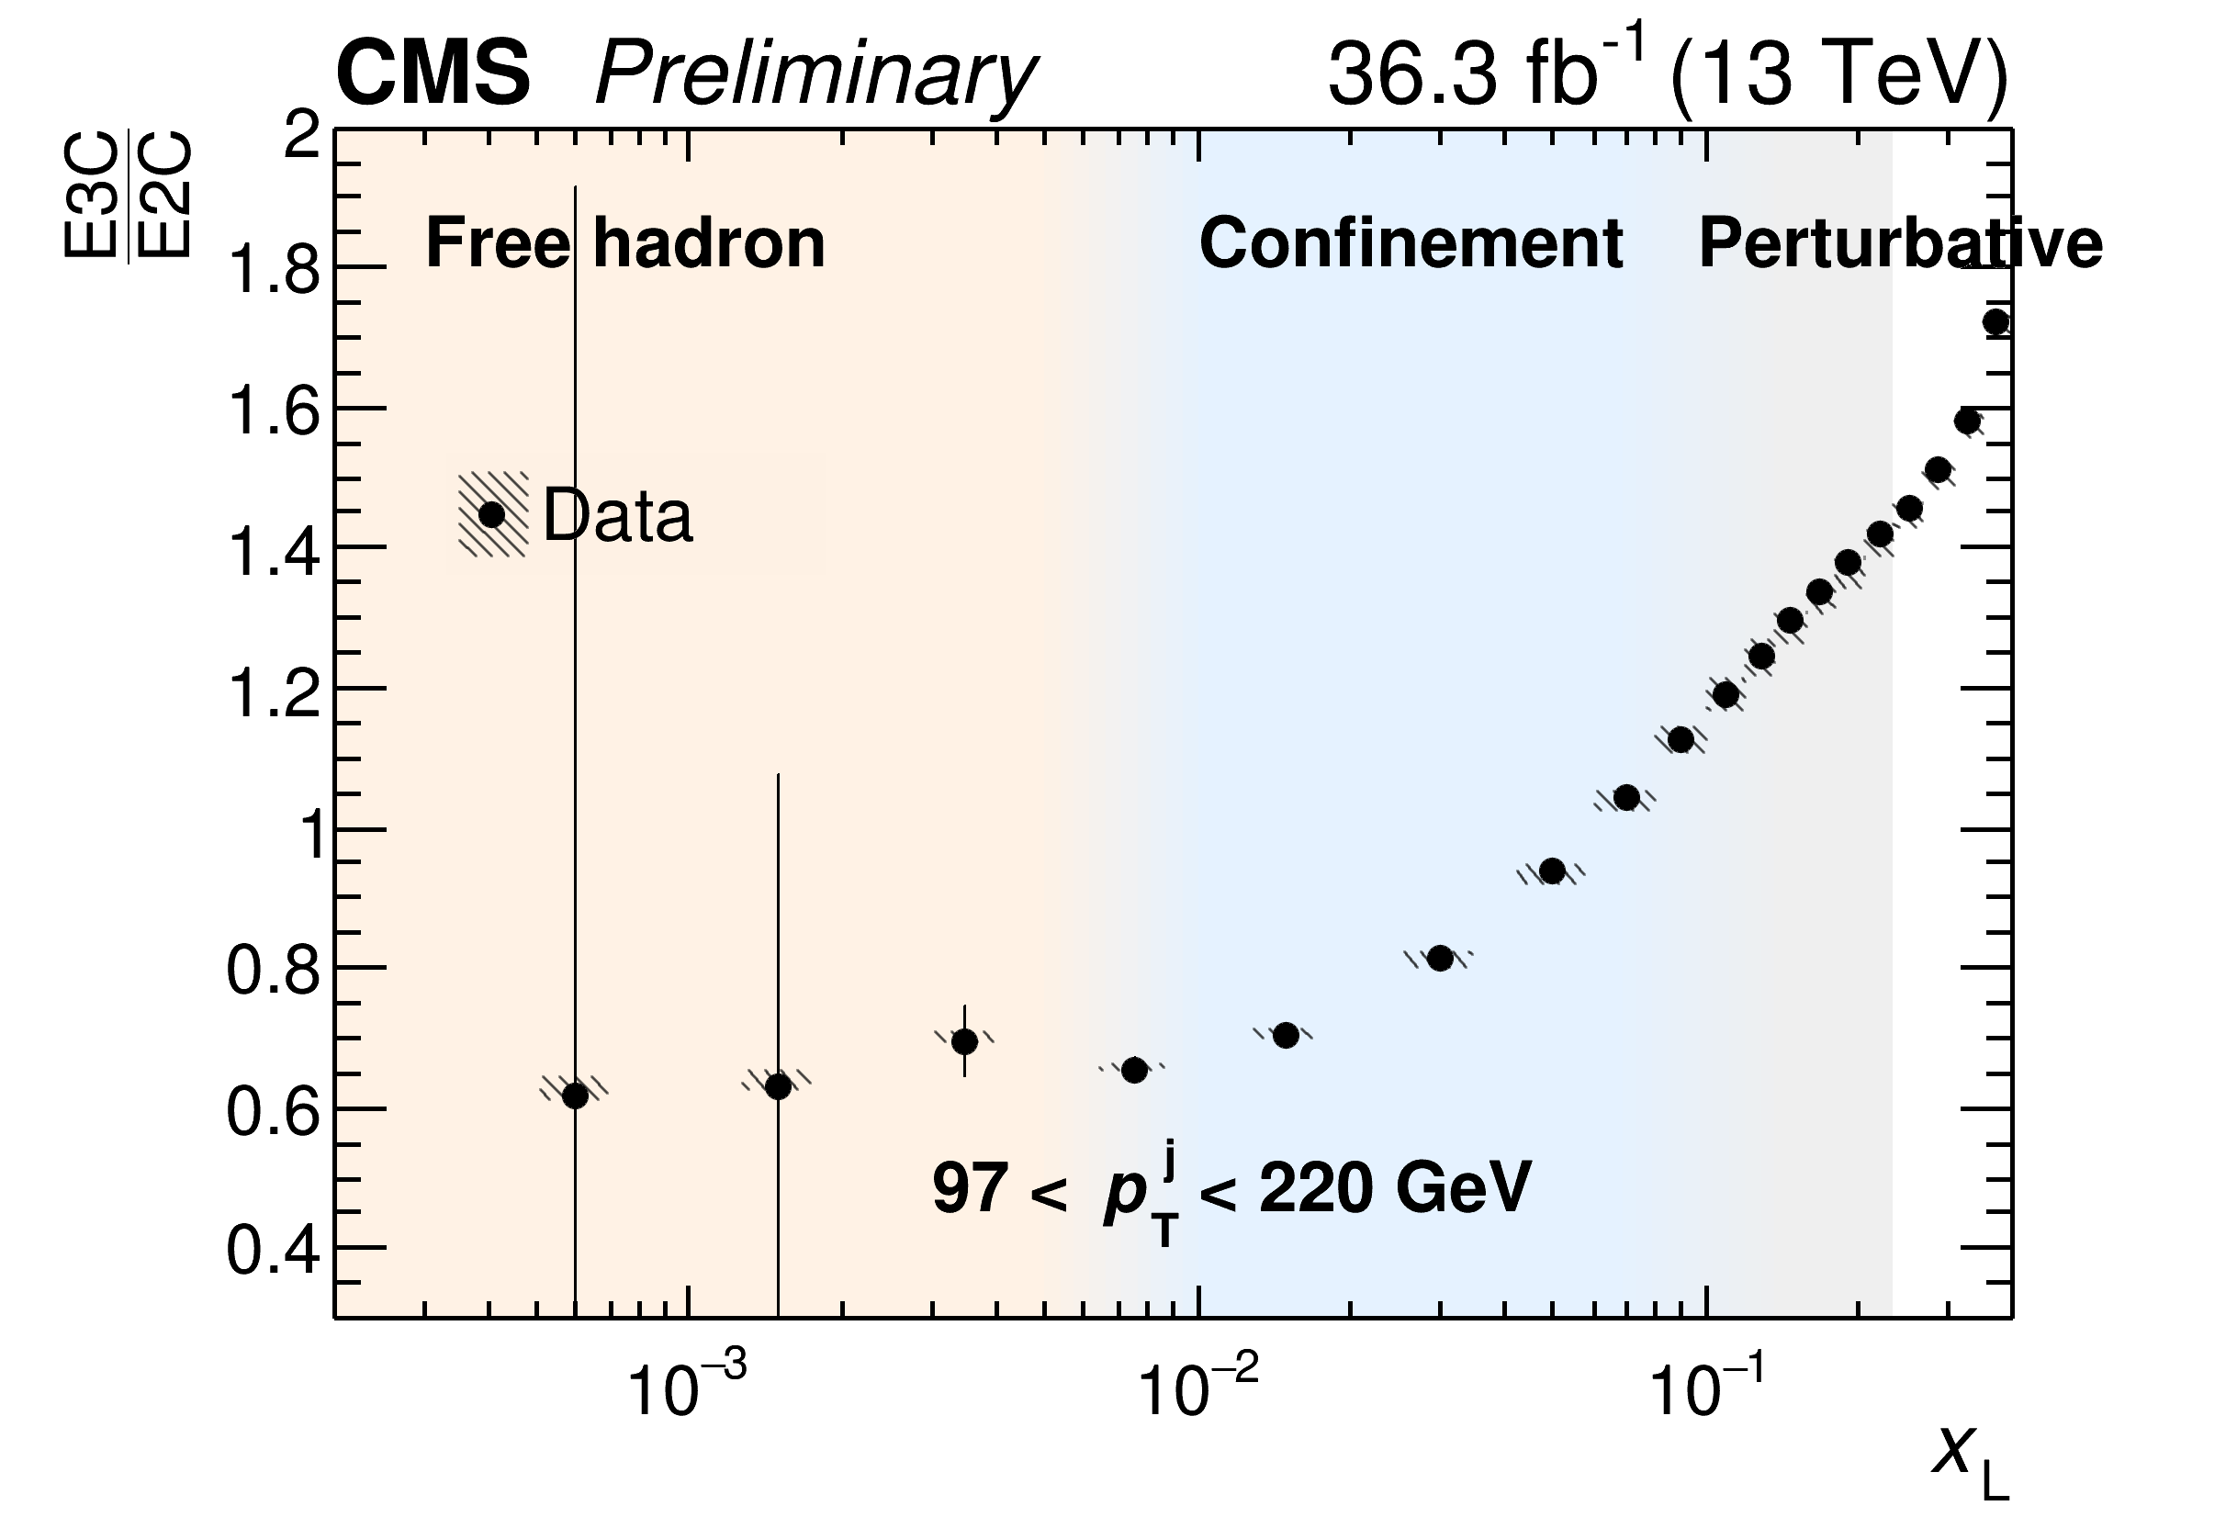
E3C/E2C ratios as a function of Jet p_{T}
$p_{T}^{jet}↑$, Slope $↓$
9

Slide 10
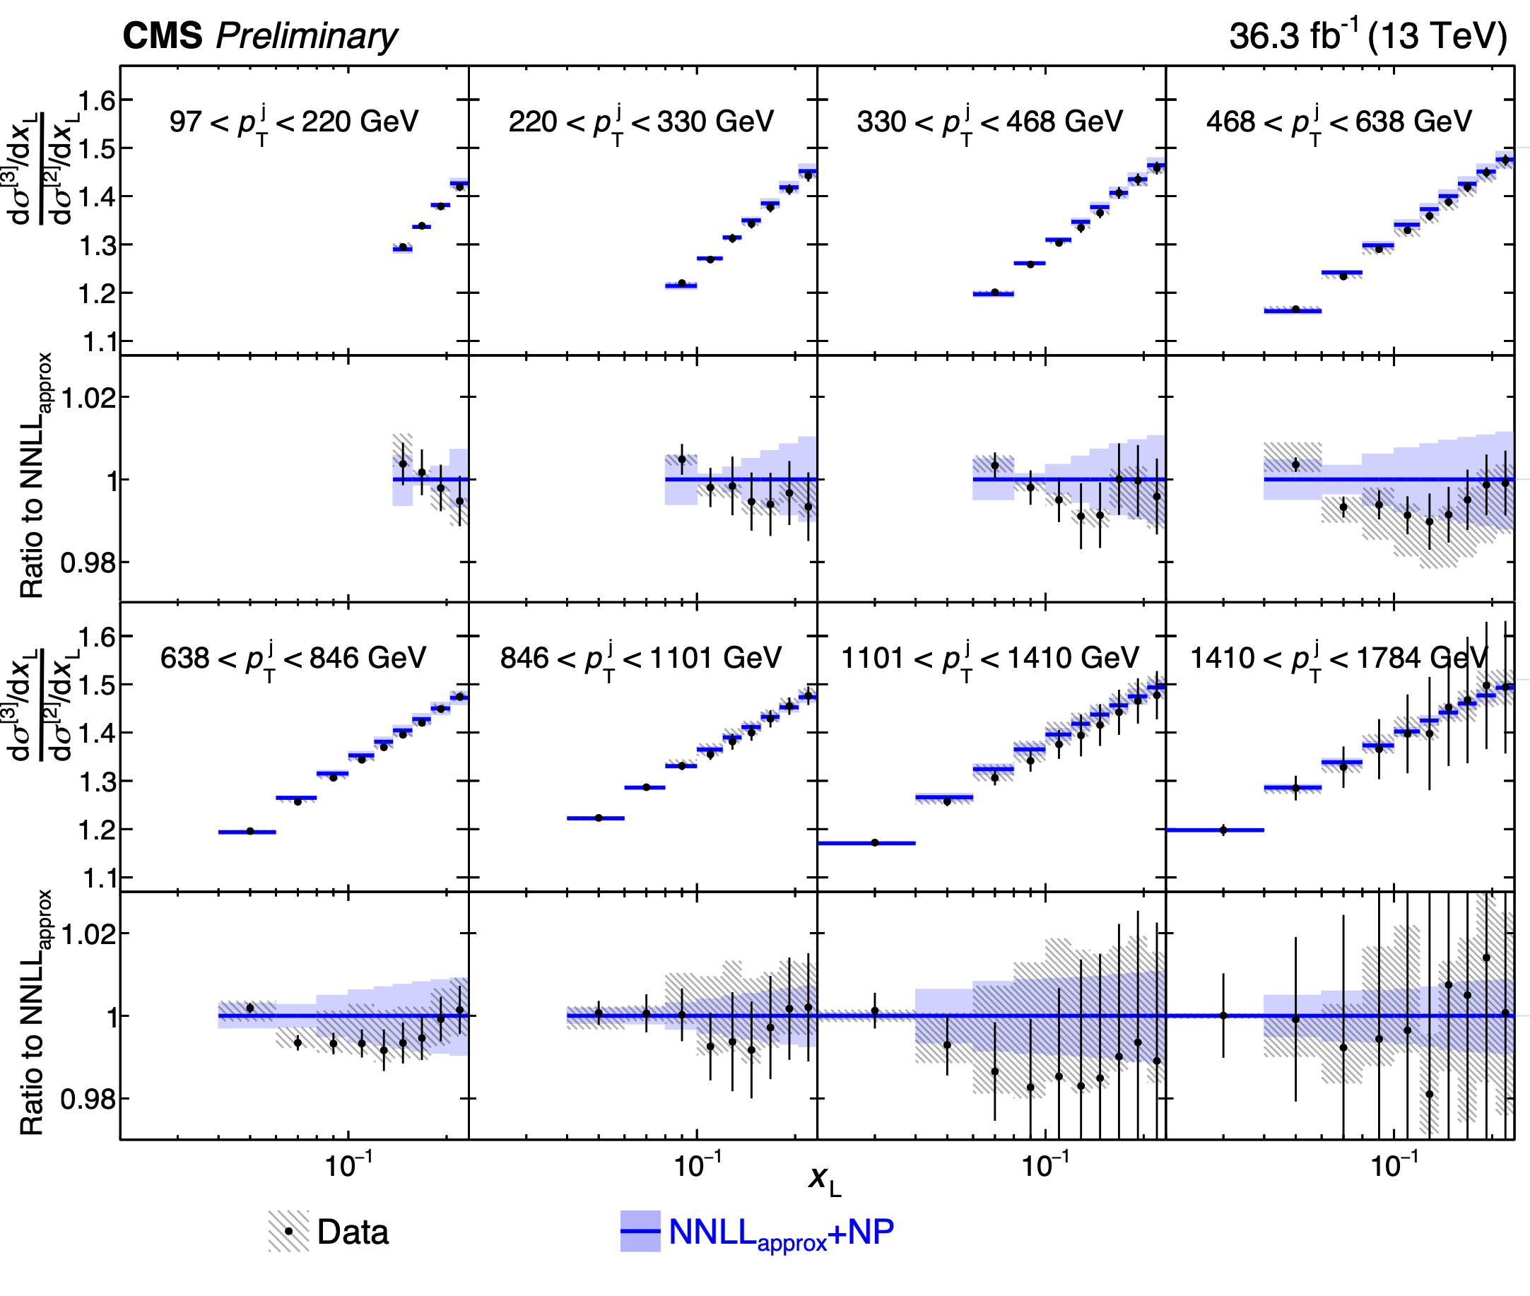
Extraction of α_{s} by data NNLL comparison
Shape of data agrees with within uncertainty
Theory systematics includes:
(shape only，no normalization effect)
QCD scale of NNLL prediction
Hadronization factors
QCD scale in hard scattering
Underlying event + parton shower tune
PDF
Extracted coupling constant:
Error band: shape only
10
$α_{s}(m_{Z})={0.1229}_{−0.0050}^{+0.0040}$
$={0.1229}_{−0.0012(stat.)−0.0033(theo.)−0.0036(exp.)}^{+0.0014(stat.)+0.0030(theo.)+0.0023(exp.)}$
Covariance matrix
QCD scale of ${\text{NNLL}}_{\text{approx}}$
Neutral hadron energy scale
$$α_{s}(m_{Z})=0.118$$

Slide 11
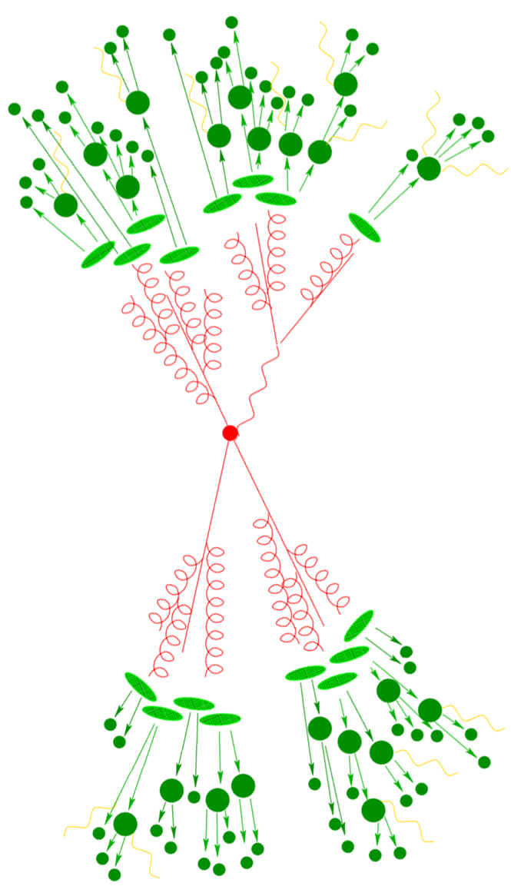
Jets and energy-energy correlators in e⁺e⁻
e⁺e⁻
Yi Chen (Vanderbilt U.)
Hannah Bossi (MIT)

Slide 12
Jet in Electron-Positron Annihilation
Jets in e⁺e⁻ with identical algorithms as those used in hadron colliders are of great interest
No gluonic initial state radiation
No complications of parton distribution functions
No beam remnants and multi-parton interactions
→ Cleanest test of pQCD and phenomenological models
Serve as a reference for the pp and future EIC measurements
Inform the QCD studies at the future FCC.
pp
e⁺e⁻
A
e⁻
e⁺
e⁻
p
p

Slide 13
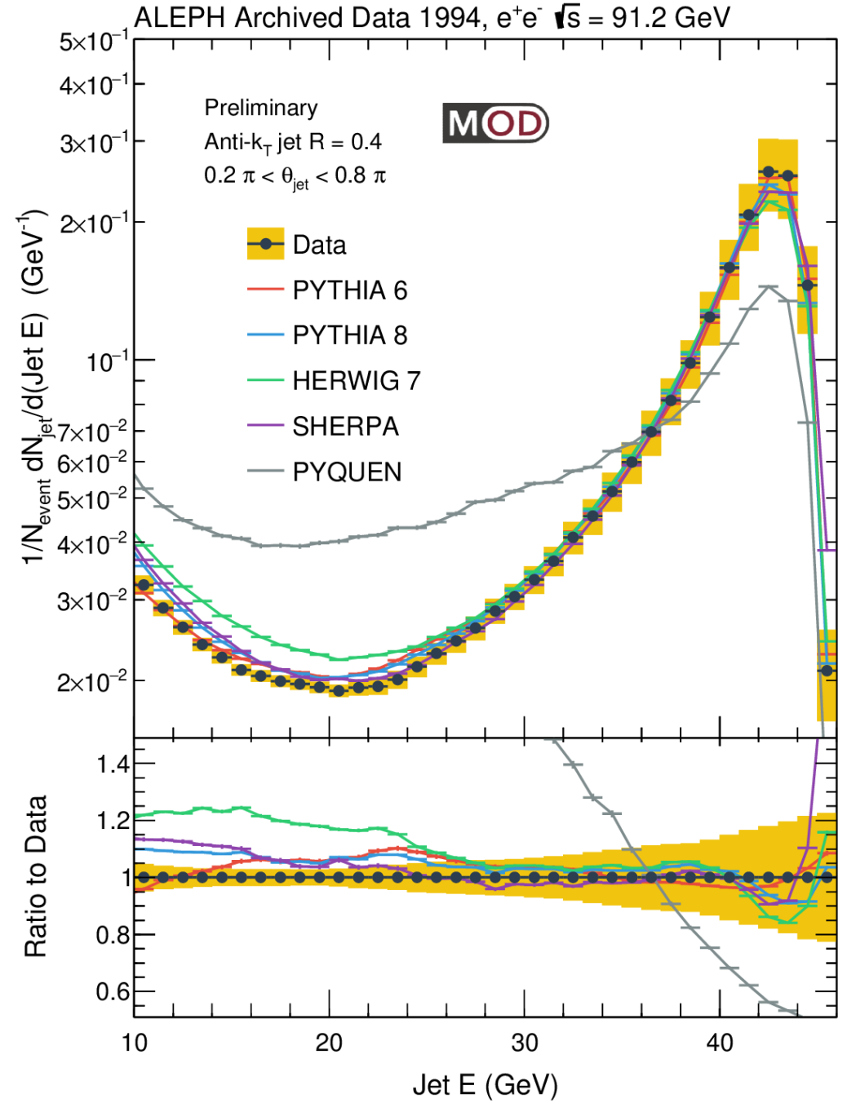
Inclusive Jet Spectrum vs. Generators
The closest observable to the jet spectra analyses in hadron-hadron collisions!
Peak at around 43 GeV: from and parton shower of the (anti-)quark almost fully captured by the anti-k_{T} algorithm with R=0.4
Minimum at around 20 GeV
At low E: increase due to a large number of jets from soft emissions or combinatorial
Generators capture those general features, overpredict the spectra at low jet E
e⁺
e⁻
$$e^{+}$$
$$\overline{q}$$
MITHIG-MOD-21-001
arXiv:2111.09914
JHEP 06 (2022) 008
$$Z^{0}/γ$$
$$e^{−}$$
$$q$$

Slide 14
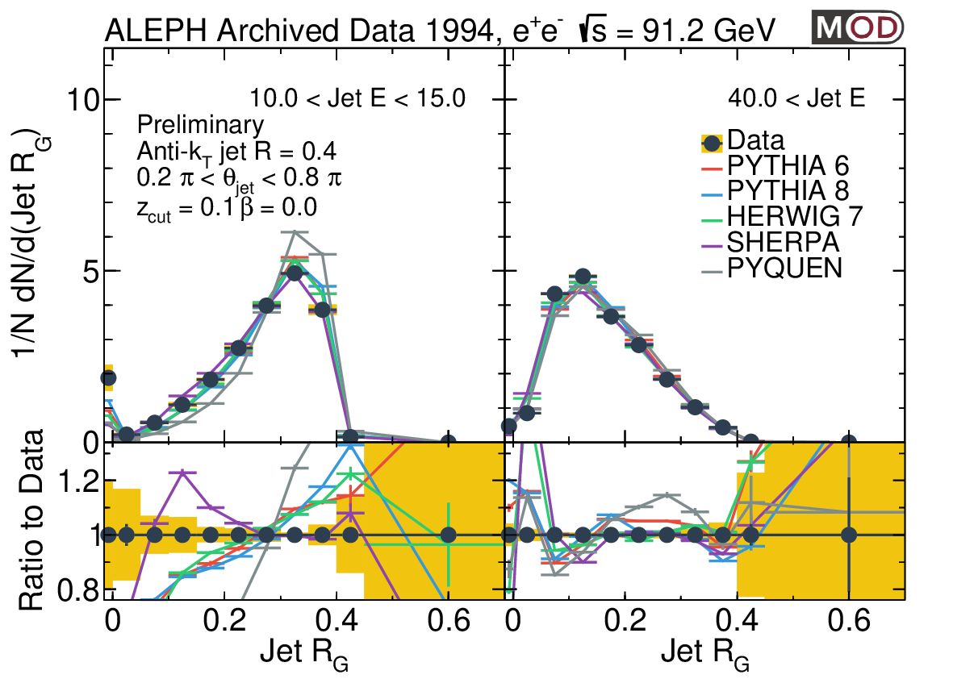
Groomed Jet Radius R_{G} vs. Event Generators
High jet E (mainly quark jets):
Peak at smaller R_{G} value
Generators give a better description of the data
Low jet E (mainly from soft emissions and combinatorial):
Peak at larger R_{G} value as one would expect
SHERPA gives a better description of the data
PYTHIA 6, PYTHIA 8, HERWIG, and PYQUEN overpredict the R_{G}
Low jet E
High jet E
MITHIG-MOD-21-001
arXiv:2111.09914
JHEP 06 (2022) 008

Slide 15
Definition of EEC in e⁺e⁻
No Jet reconstruction, Full event
Sum over pairs of charged particles in the event
Normalize by total energy E in the event (91.2 GeV by definition in LEP1)
Θ_{L} is the opening angle (in rad.) as opposed to the R_{L} or x_{L} which is eta-phi
Average over all events considered
Similar for 3-particle or higher correlators
For N-particle correlators, Θ_{L} is defined as the largest angle of the pairs
Yi Chen (Vanderbilt U.)
Θ_{L}
E2C
E3C
Θ_{L}

Slide 16
EEC in e⁺e⁻: Extending to back-to-back region
Back-to-back (Sudakov Limit)
At Θ ~ π
Study correlations of the full set of particles, not just those within jets
Not possible to explore with jet substructure
Presents a unique opportunity in e⁺e⁻!
Important ingredient into theory calculations to control non-perturbative effect
Similar to collinear limit, this can also be used to study confinement transition and strong coupling constant
Yi Chen (Vanderbilt U.)
e⁺e⁻
Back to back Θ_{L}~ π
Collinear Θ_{L}~ 0

Slide 17
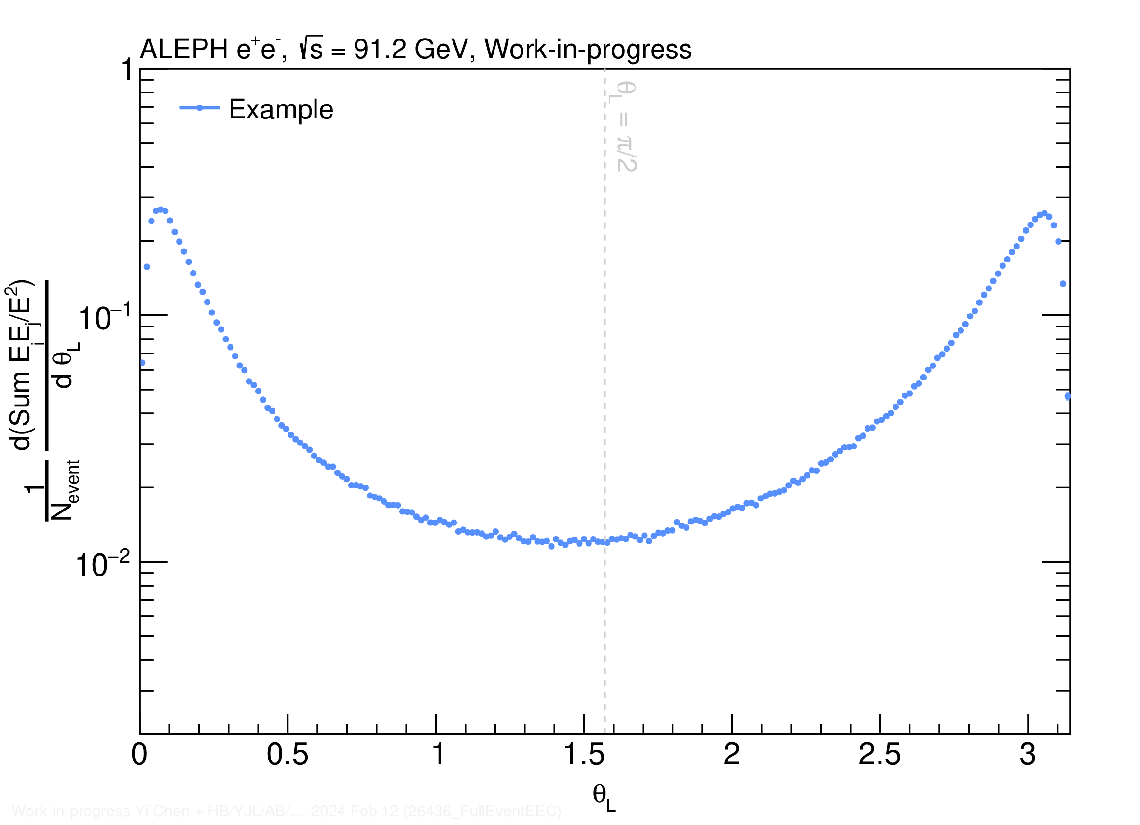
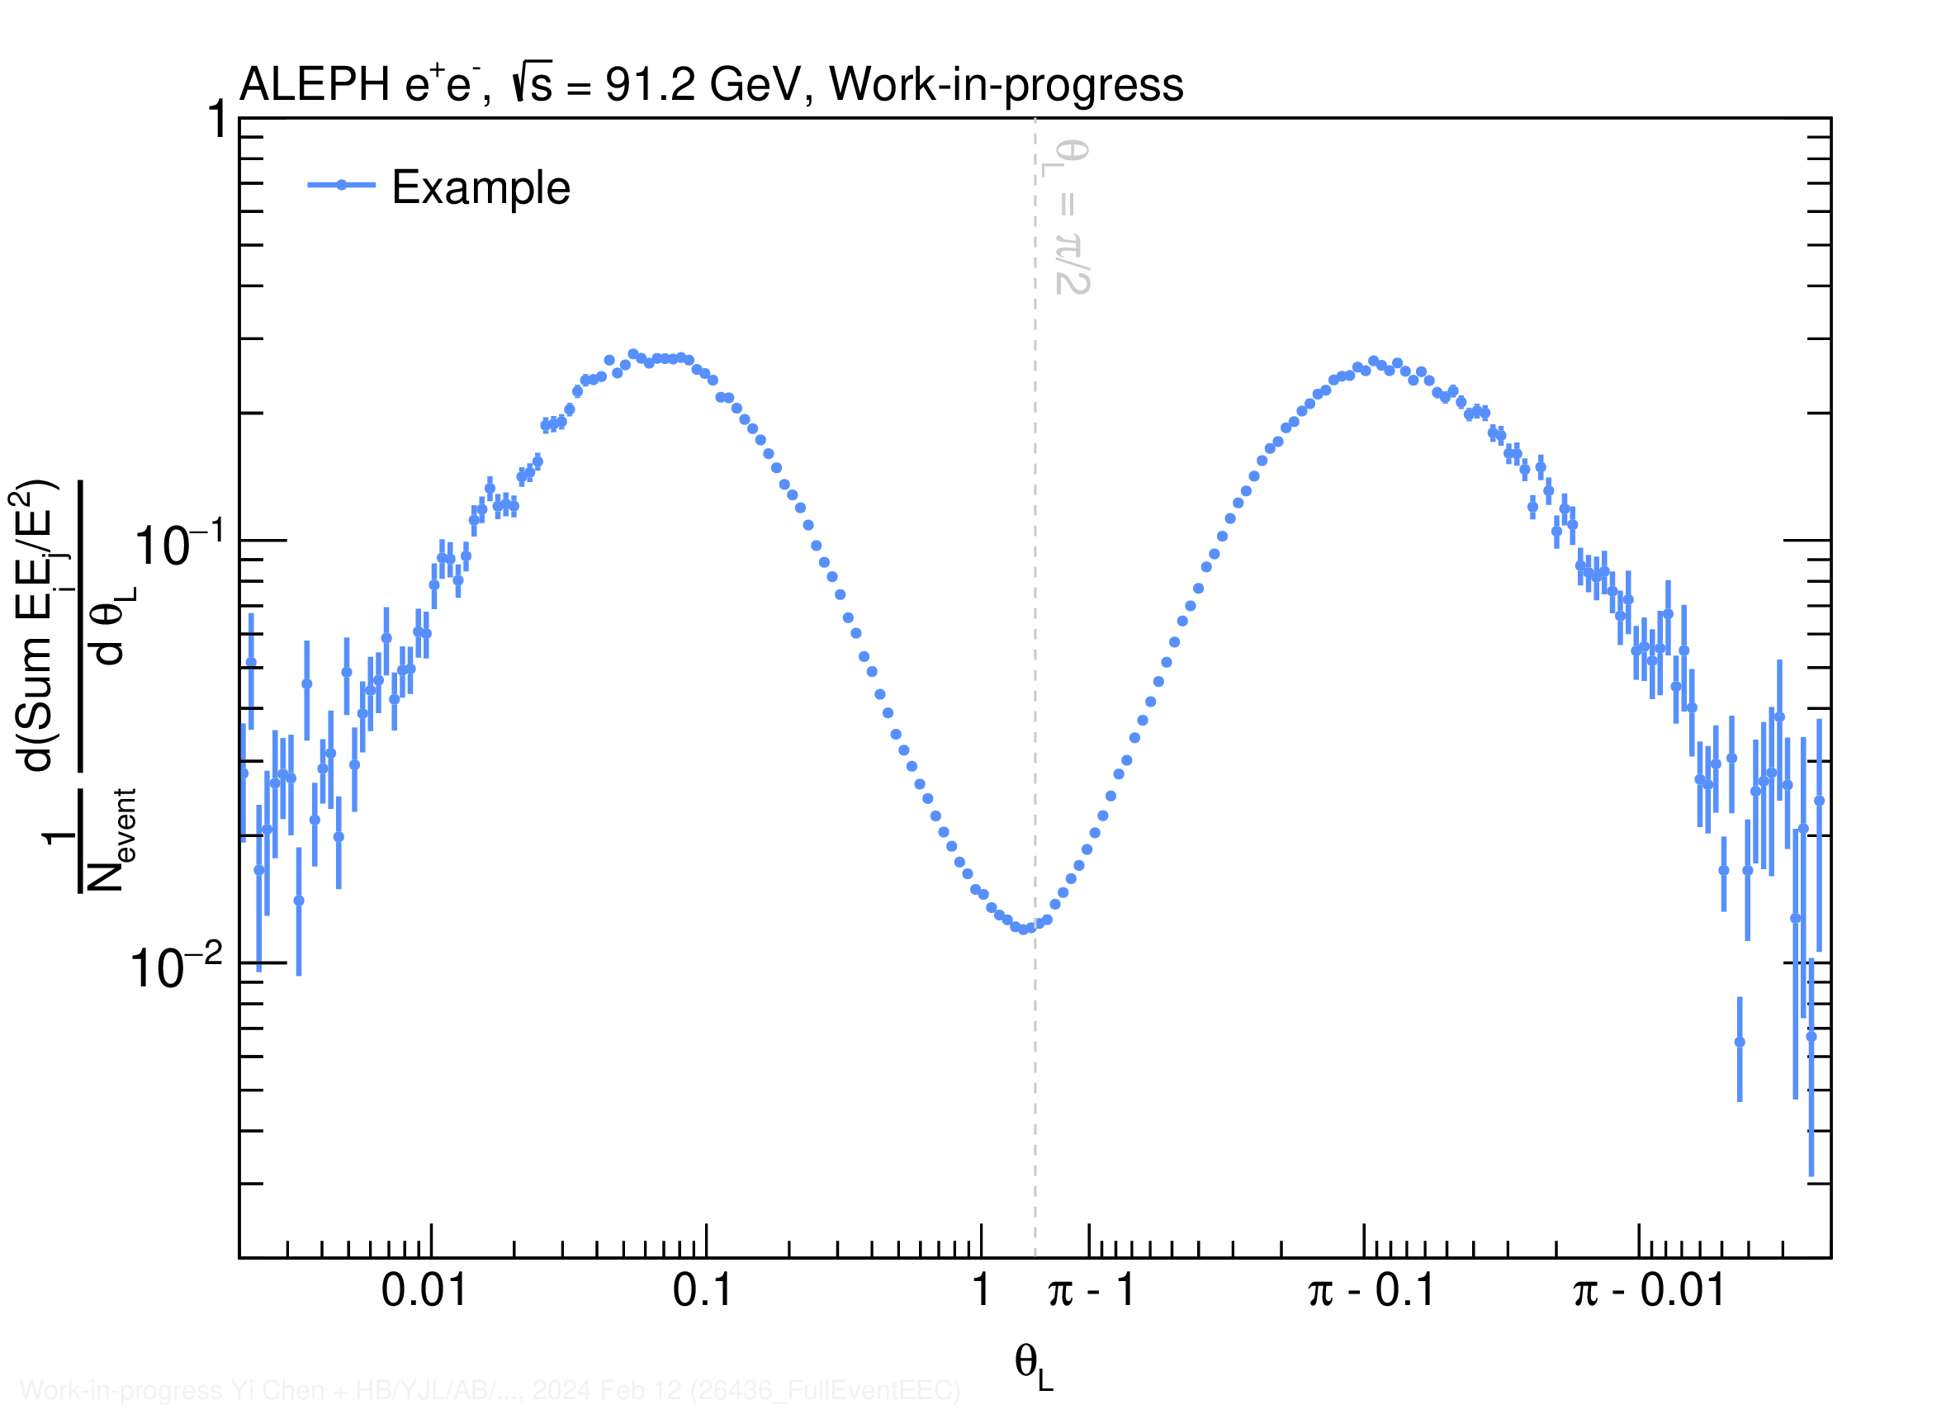
2-Particle EEC (E2C) from Archived MC
Presented in double-log-x scale to focus on the tail region
Log scale​ [0,π/2]
Flipped log scale​ π-[0,π/2]

Slide 18
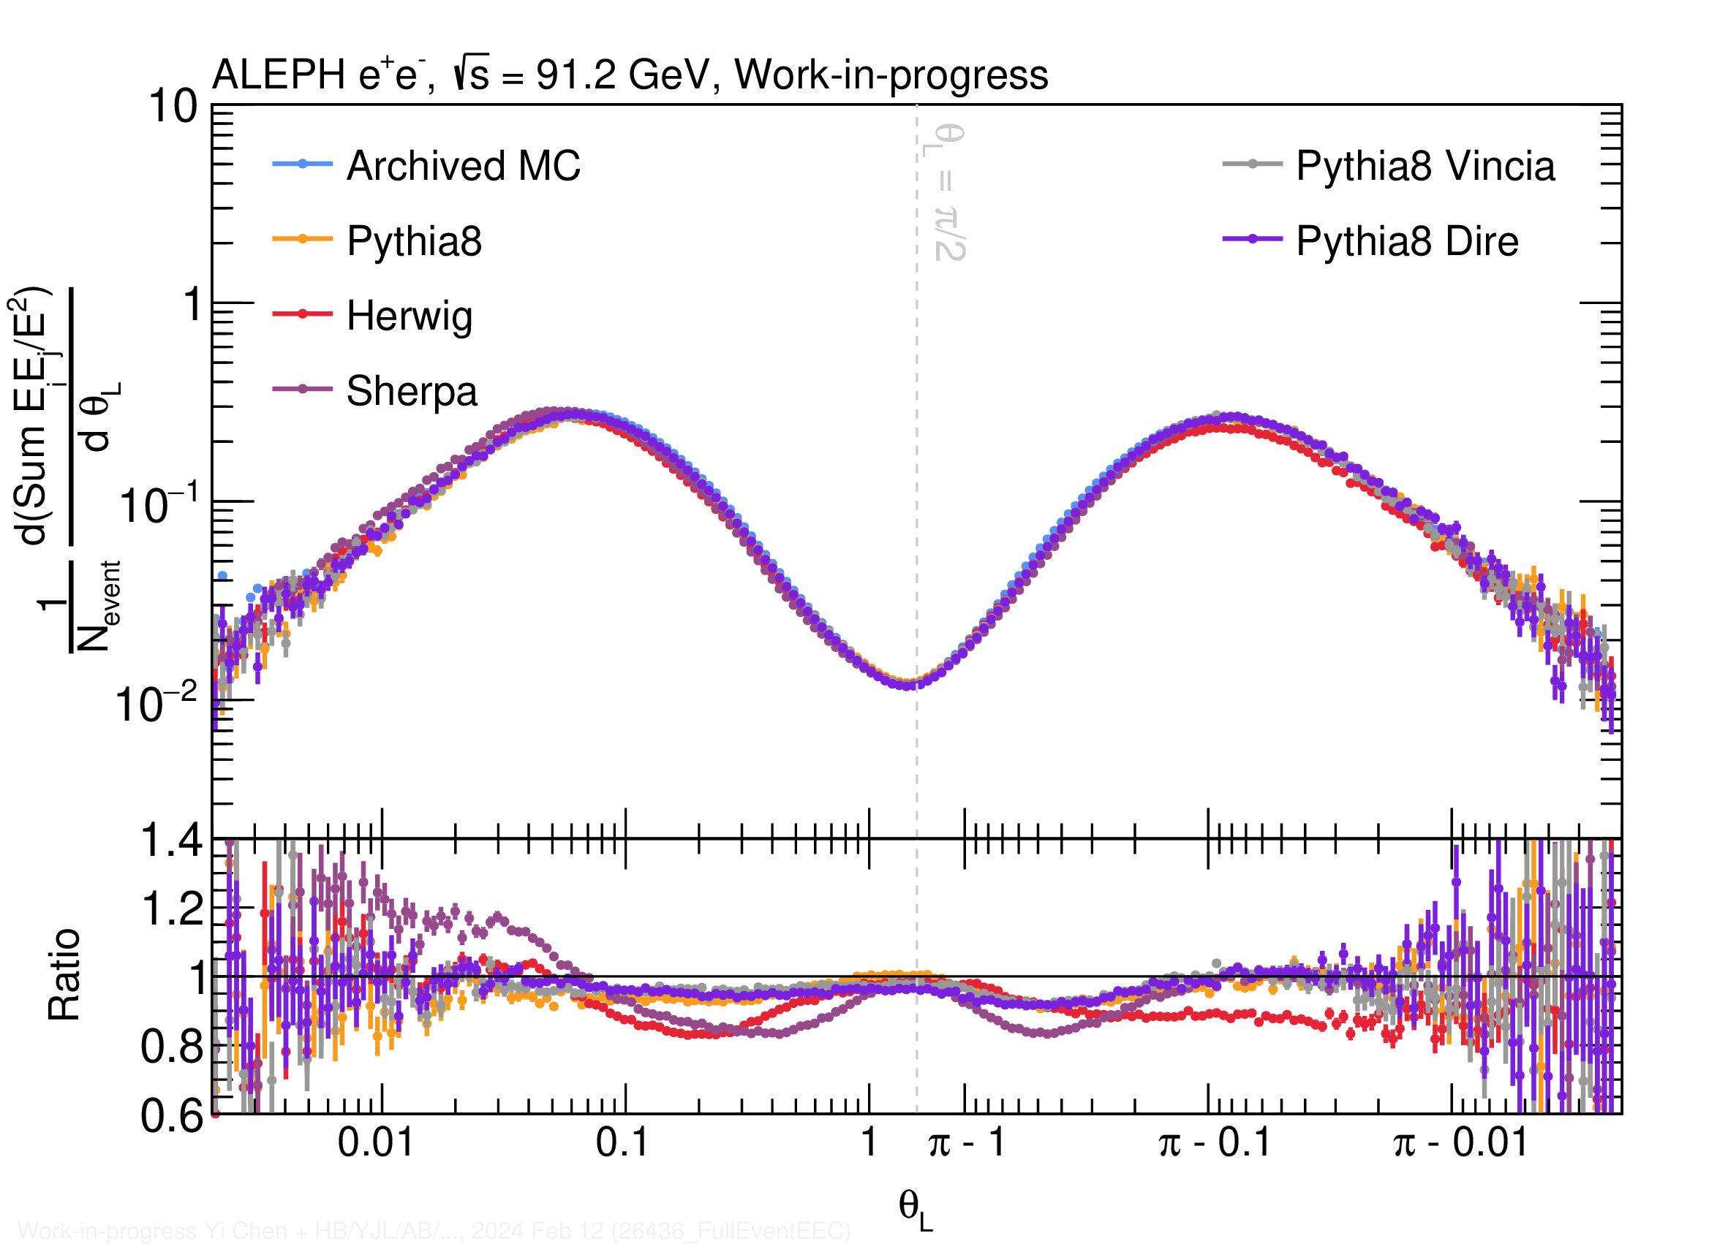
E2C from MC Generators
Dominant structures
Dijet back to back
Left peak is what people are familiar with
No reason to be symmetric a priori
Left peak (collinear)
Parton shower region
Different shower, different slope
Hadronization region
MCs roughly parallel to each other
Peak location
Correspond to 45 GeV scale
Different MC are a bit different
Right peak (back-to-back)
Also a peak and transition between Sudakov limit and parton shower
Θ_{L}

Slide 19
E2C from MC in pp and e⁺e⁻
Similar MC hierarchy between e⁺e⁻ generators and pp generators (SHERPA->HERWIG->PYTHIA)
Larger x_{L} not comparable due to jet boundary effects in pp measurement
CMS
pp 13 TeV
Θ_{L}
R_{L}

Slide 20
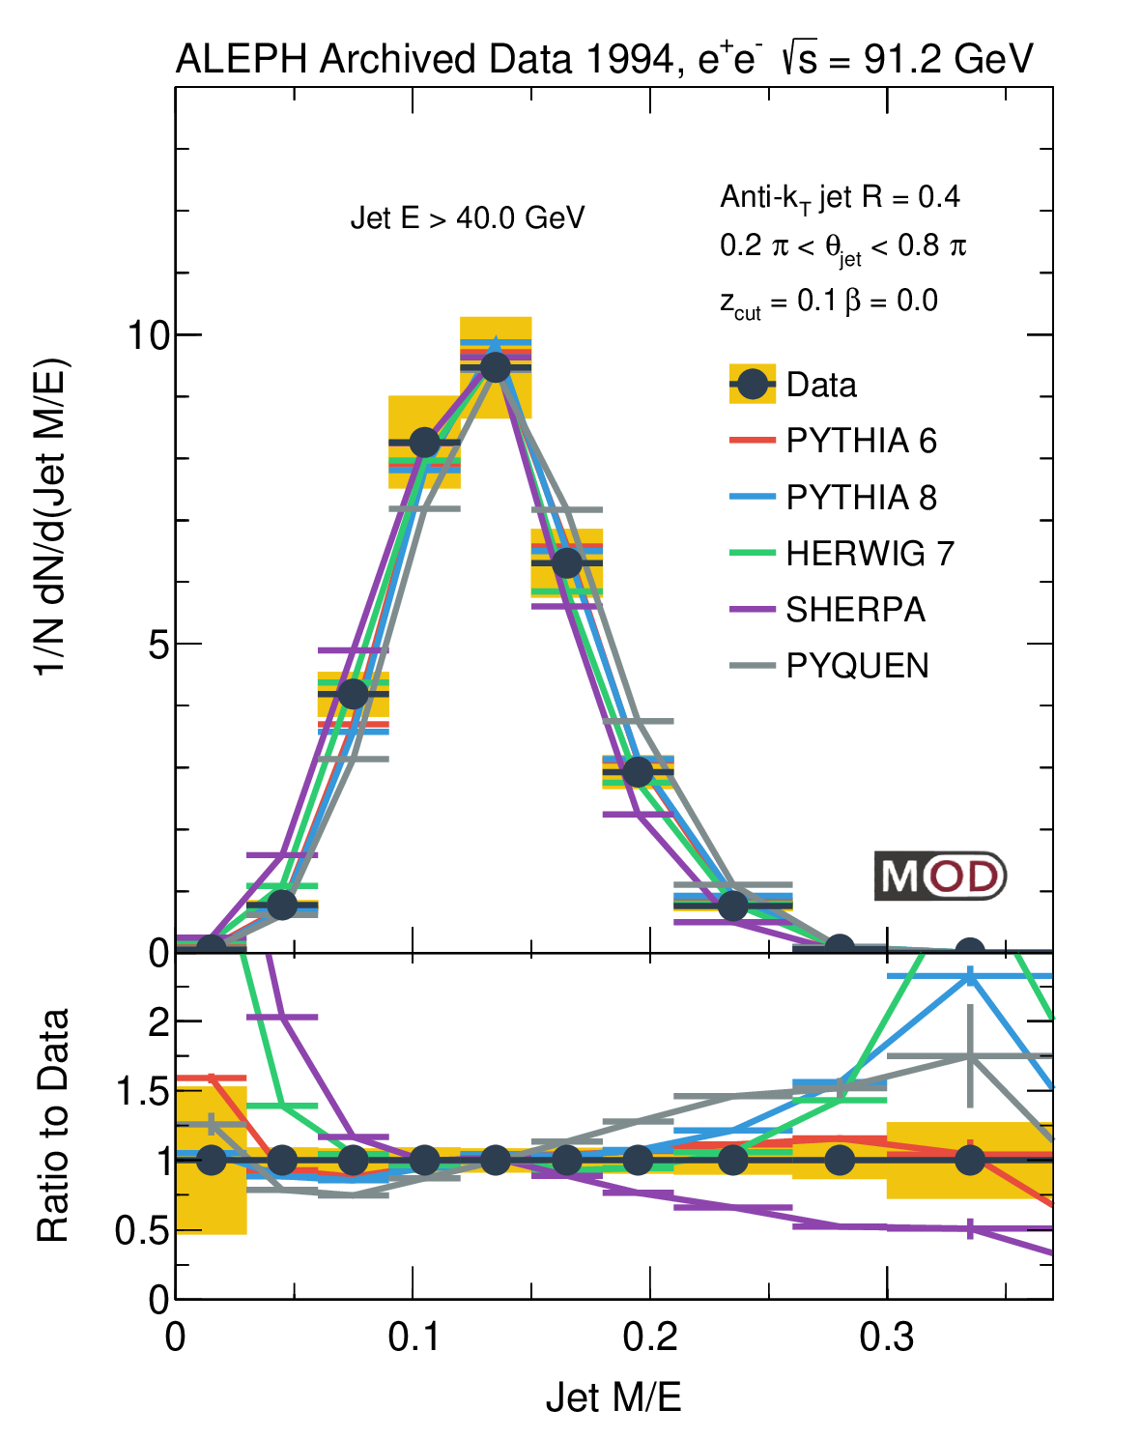
Comparison between E2C with Jet Mass
Mass scale for SHERPA is smaller --> smaller SHERPA angular scale in EEC
Θ_{L}
MITHIG-MOD-21-001
arXiv:2111.09914
JHEP 06 (2022) 008

Slide 21
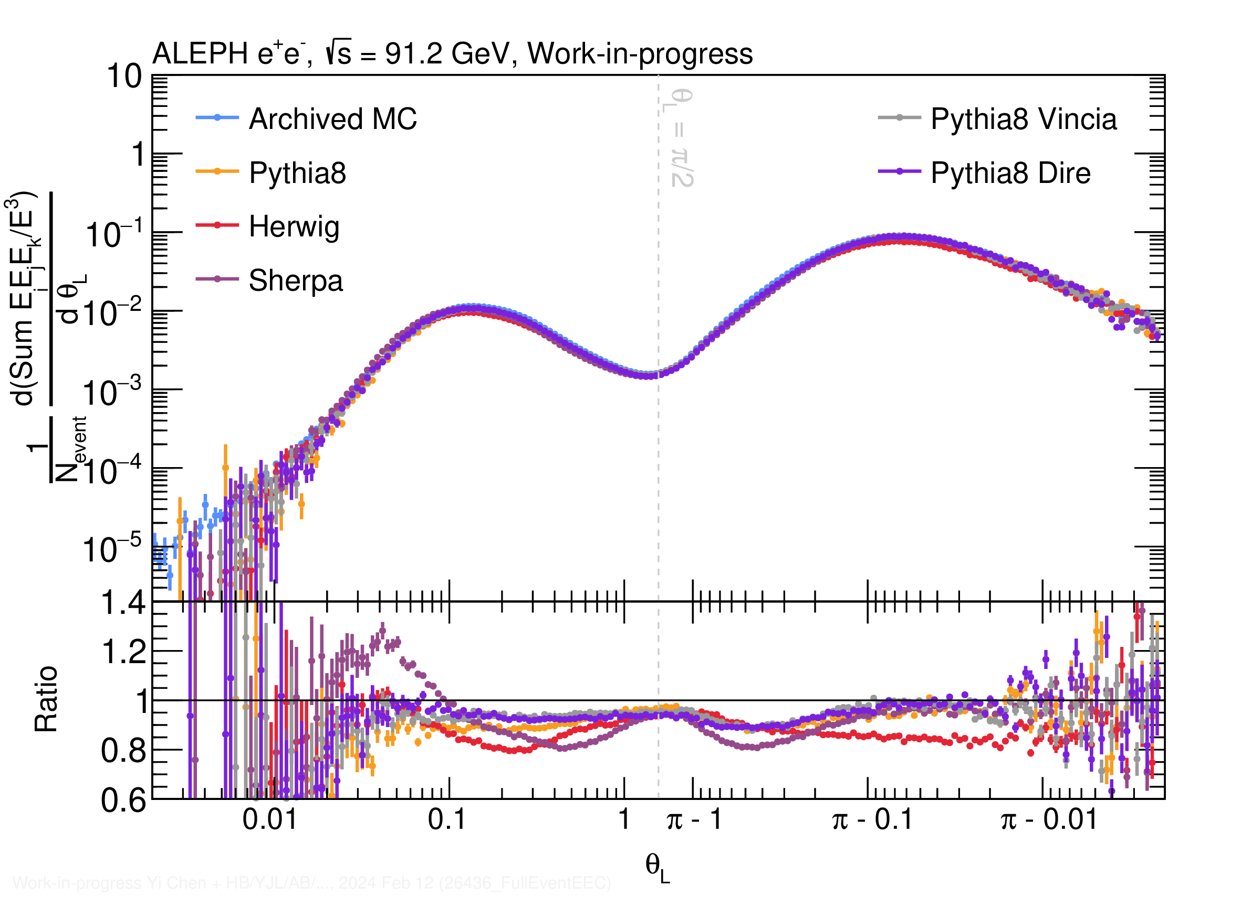
3-particle EEC (E3C) from MC in e⁺e⁻
E3C is by definition not symmetric
Due to intrinsic max(pair)
Other variants of E3C are possible
At the away-side
Dominant contribution from dijet
Mostly 1 particle from one shower + 2 particles from the other shower
Agreement between MC generators similar to E2C:
The predictions differ by up to 20%!
Θ_{L}

Slide 22
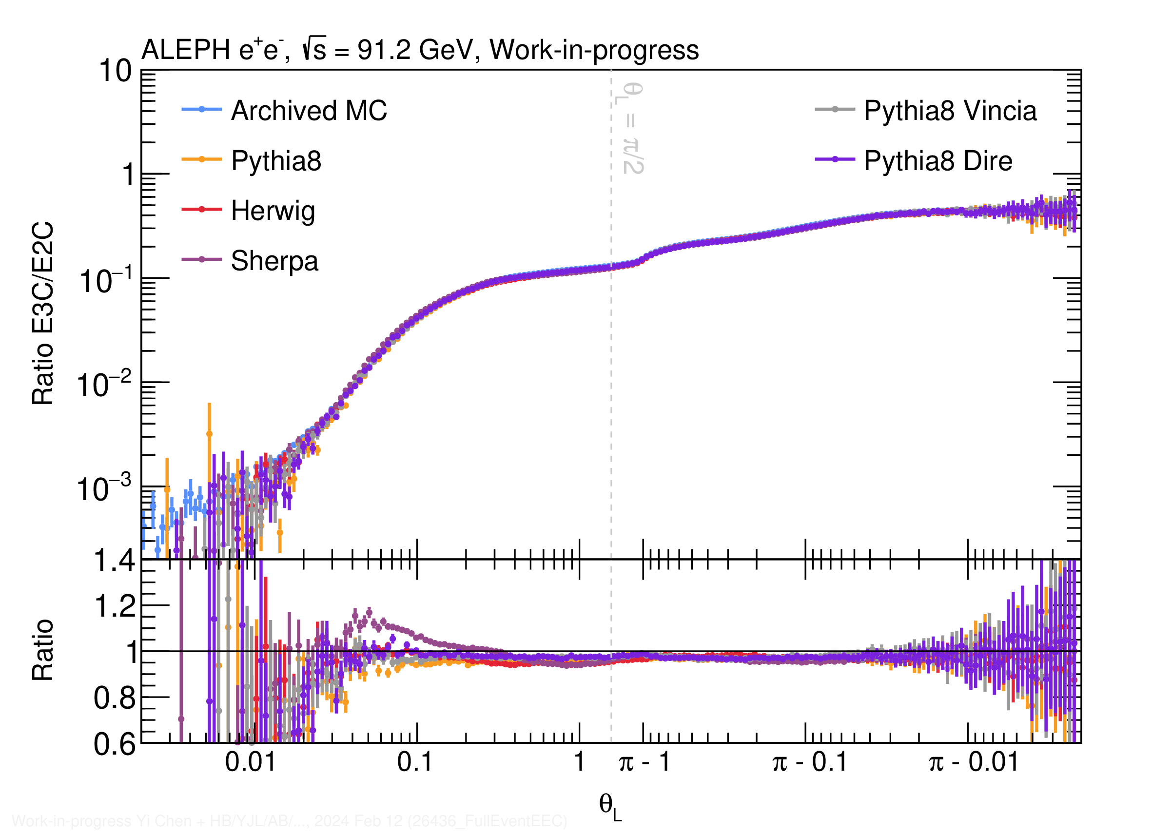
E3C / E2C in e⁺e⁻ at 91 GeV
Observe non-trivial slope in the hadronization region
Away-side (Θ_{L}>π/2) region: roughly flat
A small structure around 2π/3:
Reject 3-jet event removes this particular structure
Further increase beyond 2π/3: di-jet
MCs agree with each other within 5-10%
Except for the small angle region of SHERPA
Θ_{L}

Slide 23
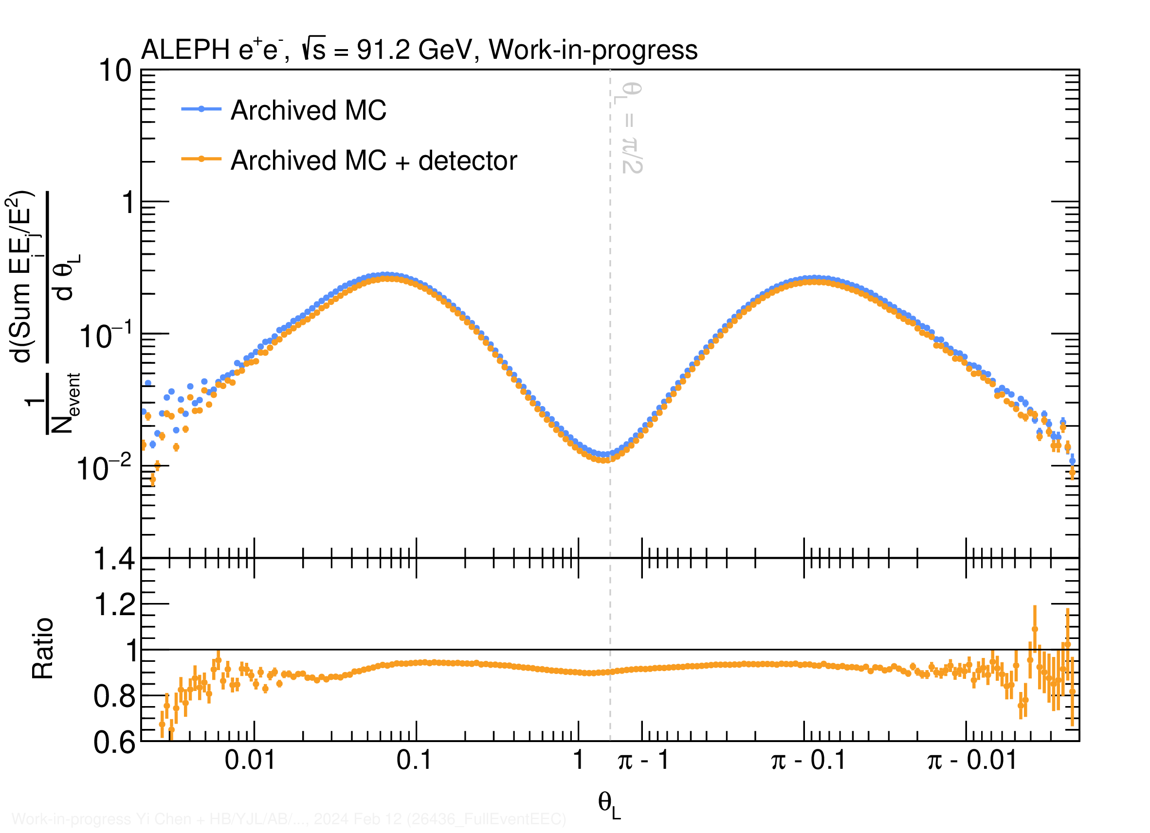
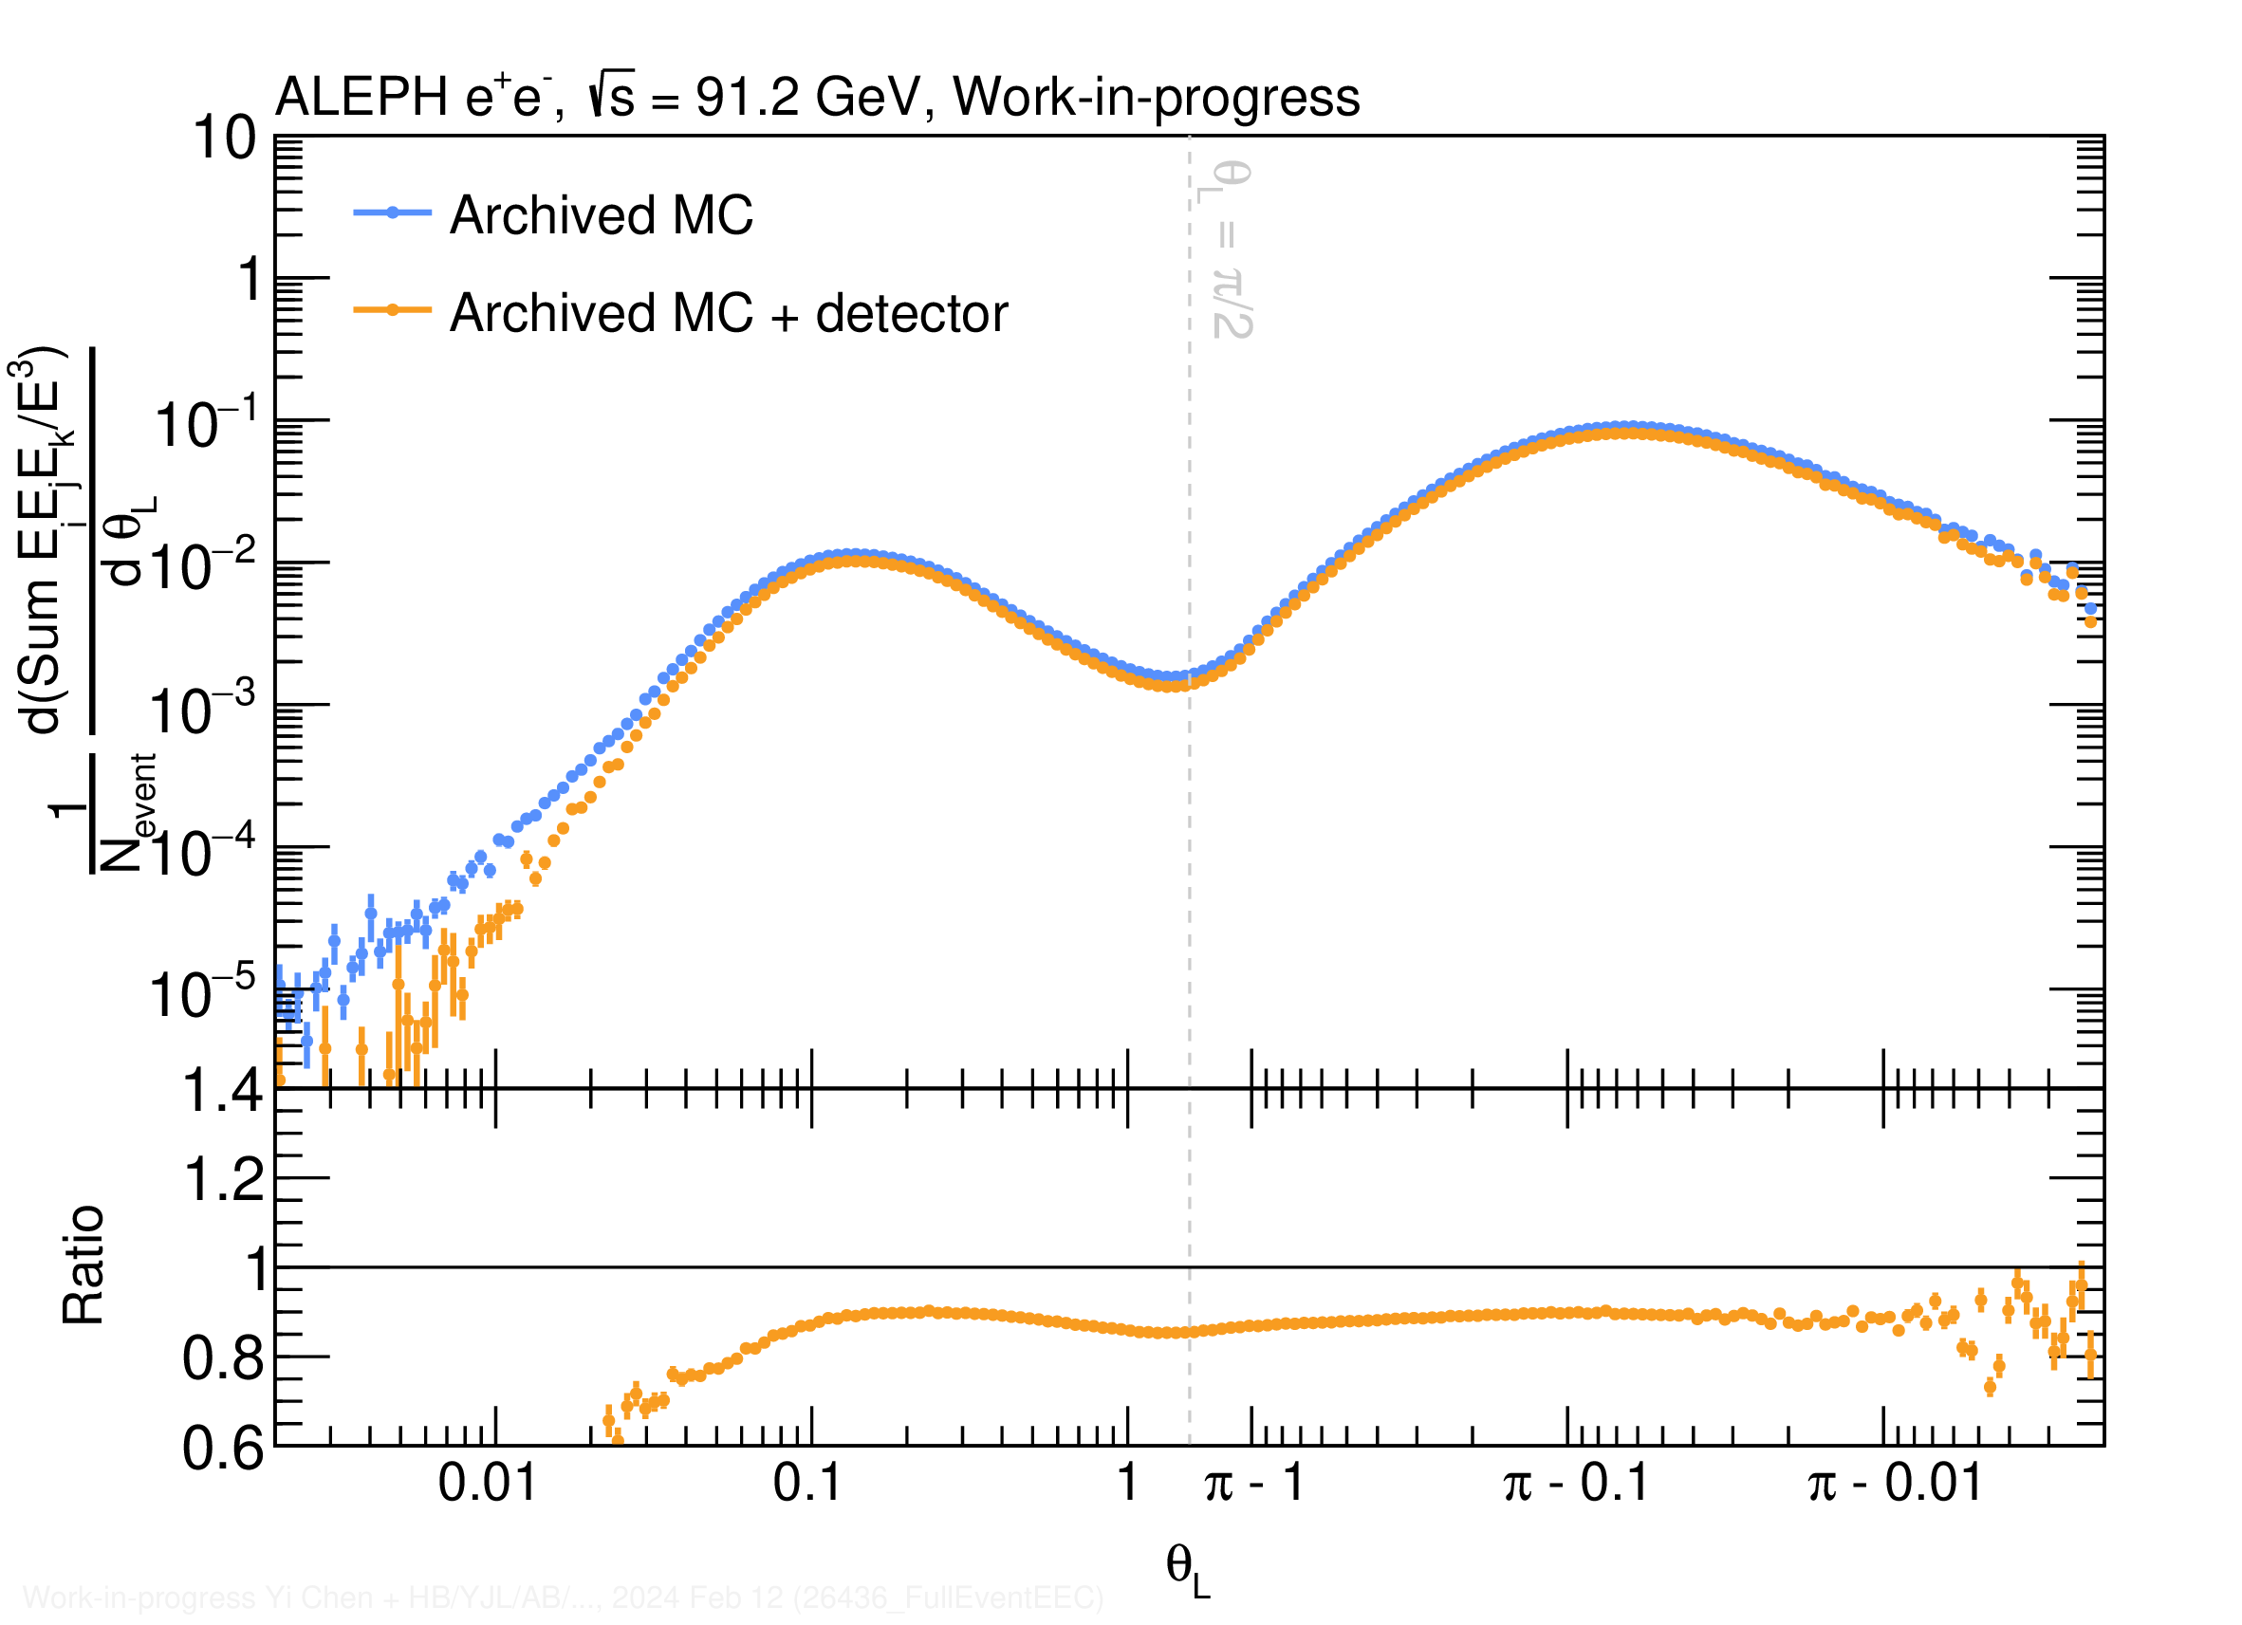
Detector Effects based on Archived ALEPH MC
Will we be able to measure the correlators? Yes!
Generator- and detector-level results are similar over a large phase space
E2C
E3C

Slide 24
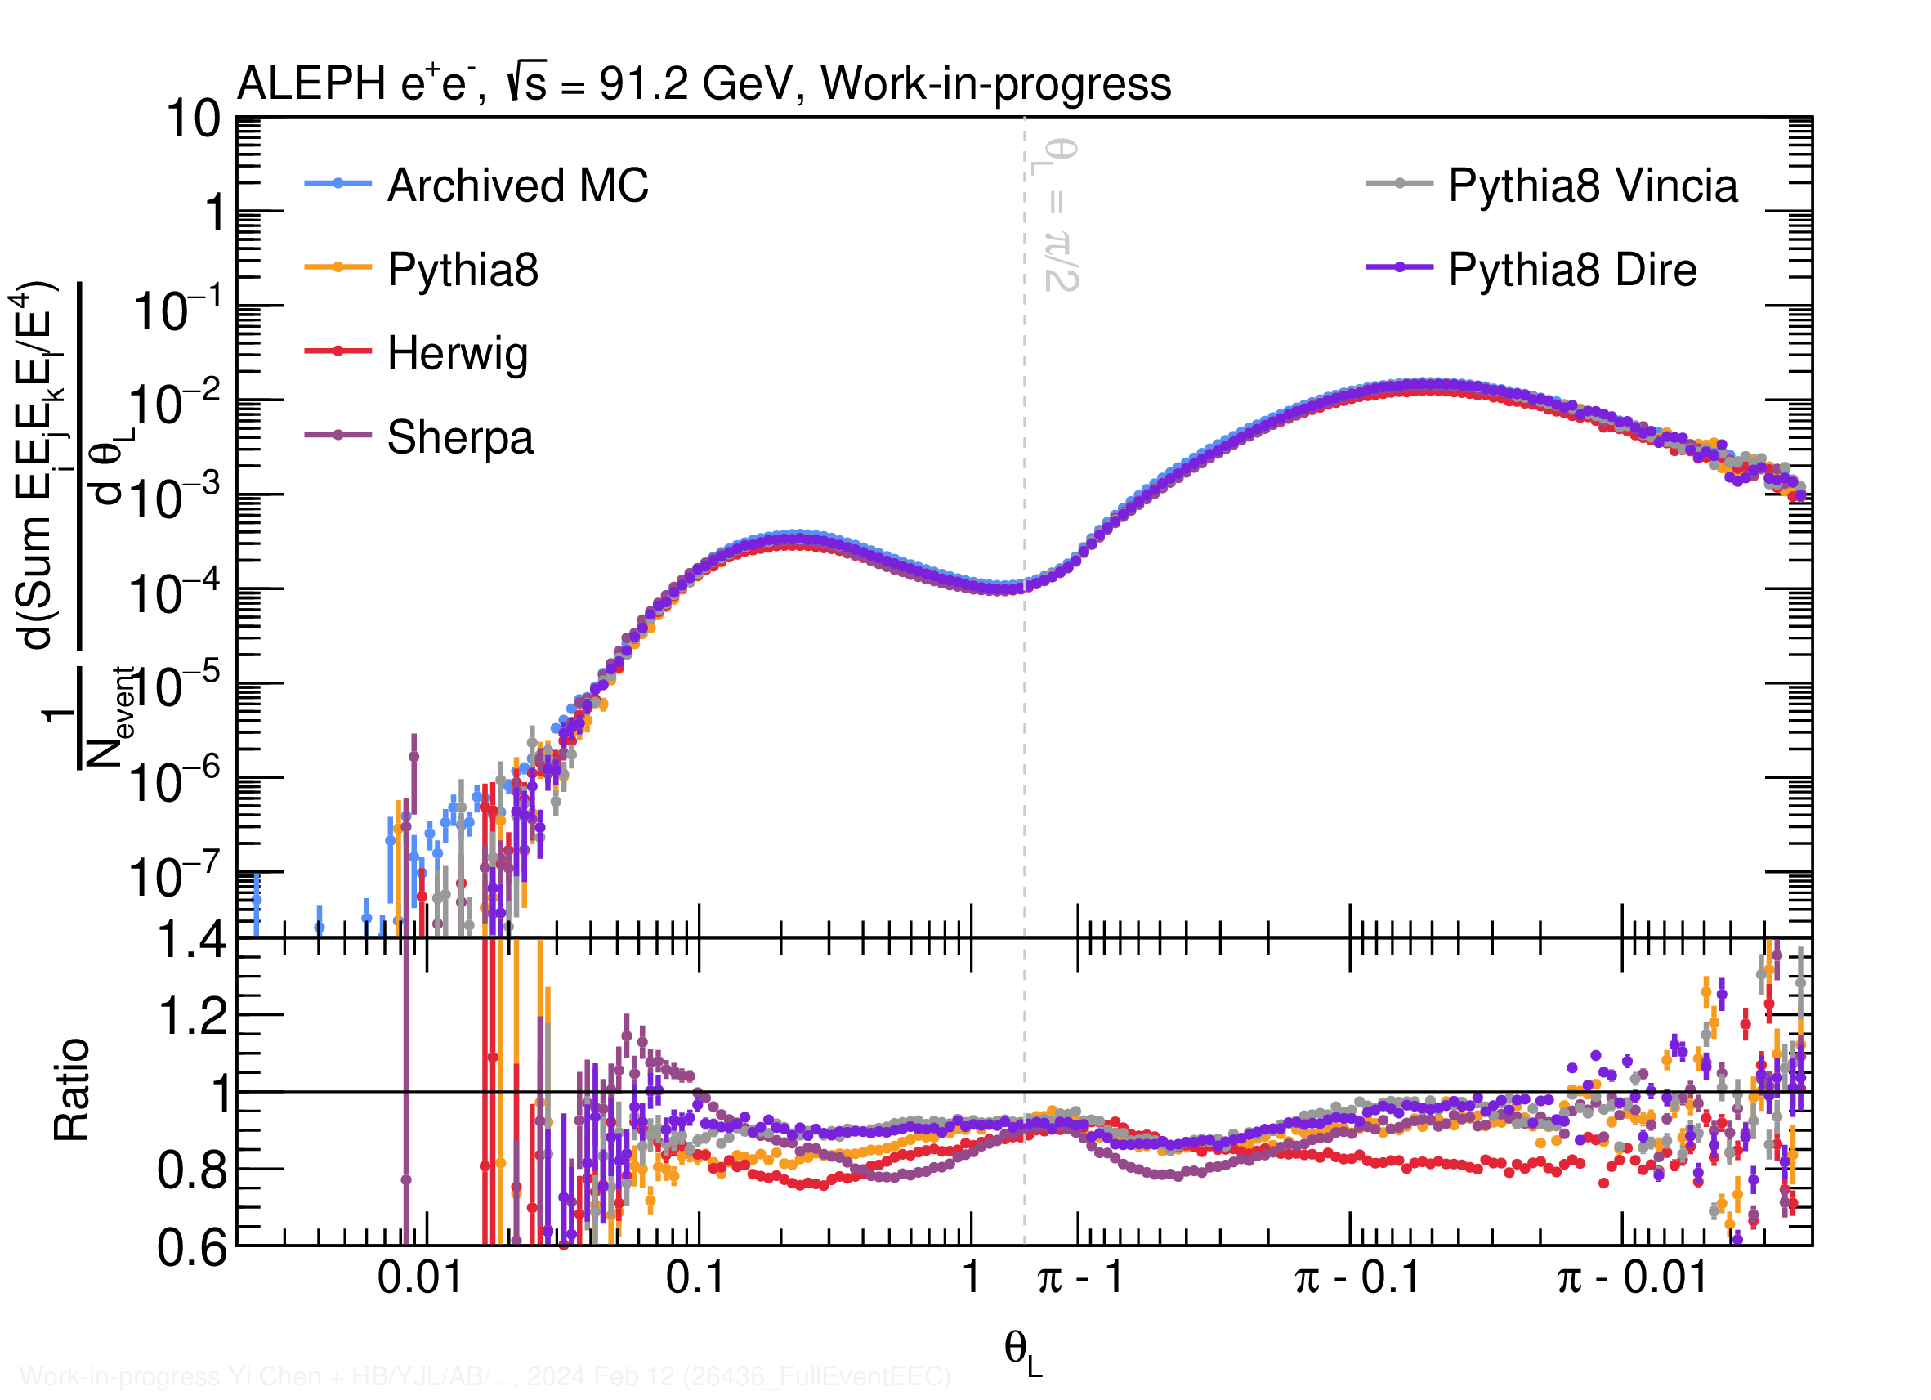
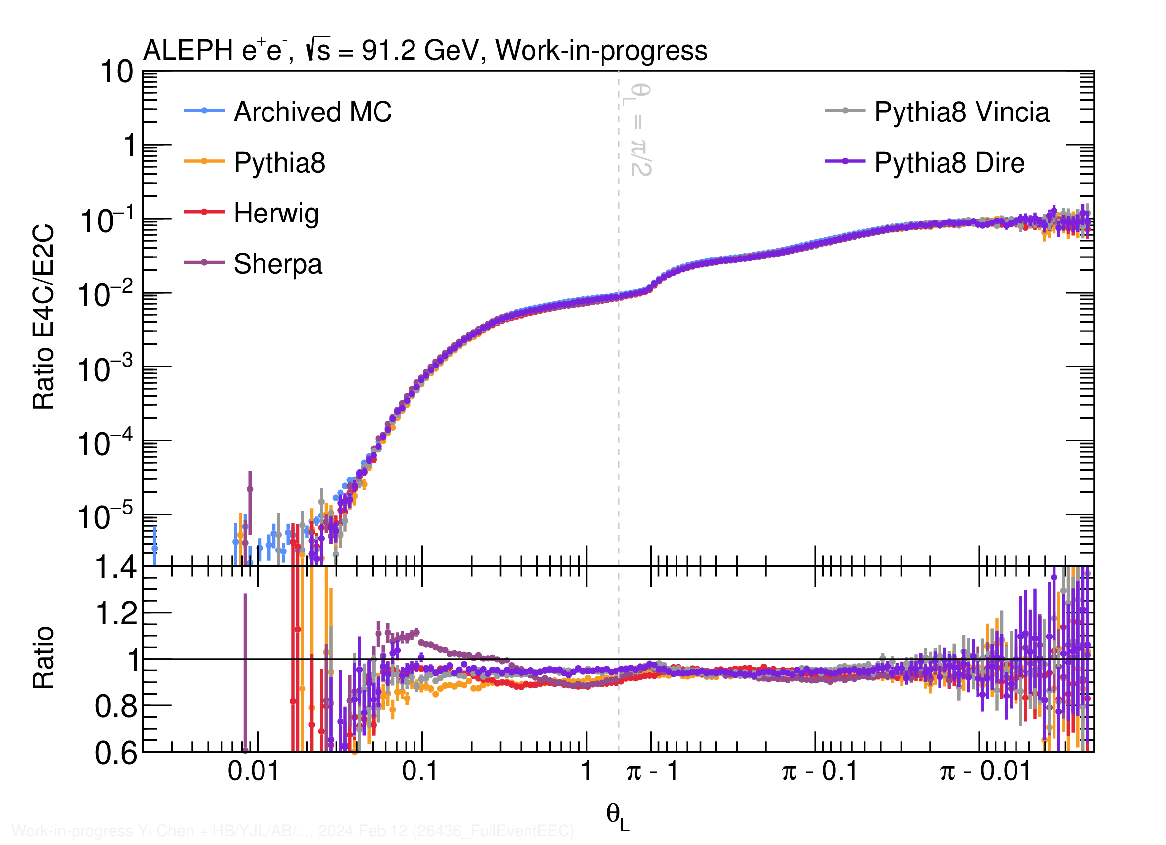
E4C and E4C/E2C ratio in e⁺e⁻
Predictions of E4C and E4C/E2C from event generators
Feasibility check of data analysis in progress

Slide 25
Observable Wishlist in e⁺e⁻
Two point and higher particle correlator (EnC) and their ratios
How high can we go??
Charged Correlators (plus/minus) and Charge-Weighted Correlators
Probes correlations between charges, modification of scaling behavior, and changes in hadronization transitions
E^{n}E^{m} Correlators
Potentially useful for suppressing soft radiation & studying transition region
… also a lot of other possibilities
(As usual we have way too many interesting observables to measure)

Slide 26
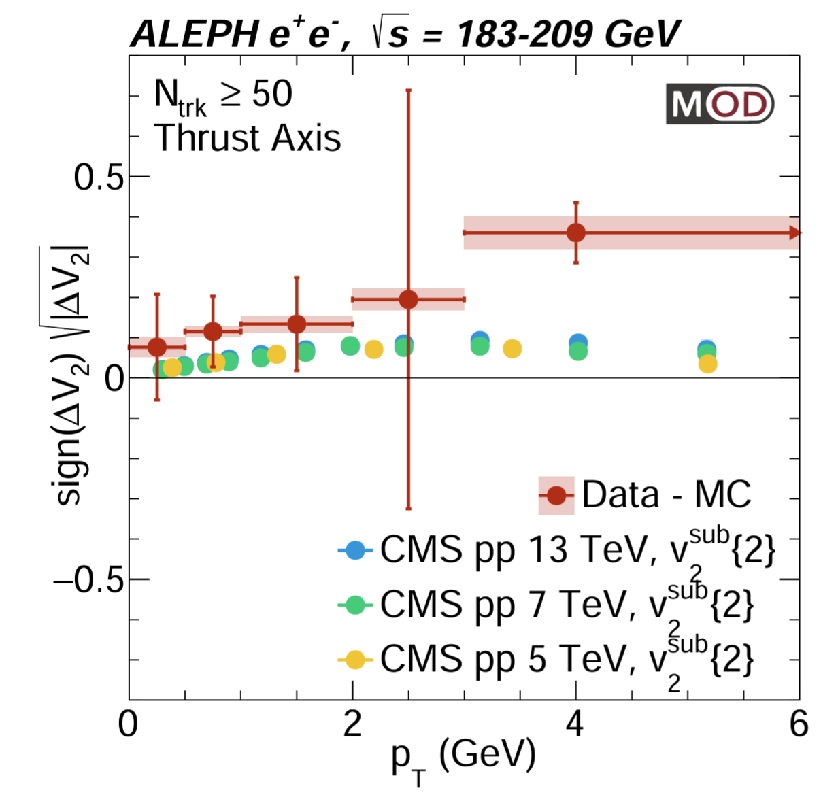
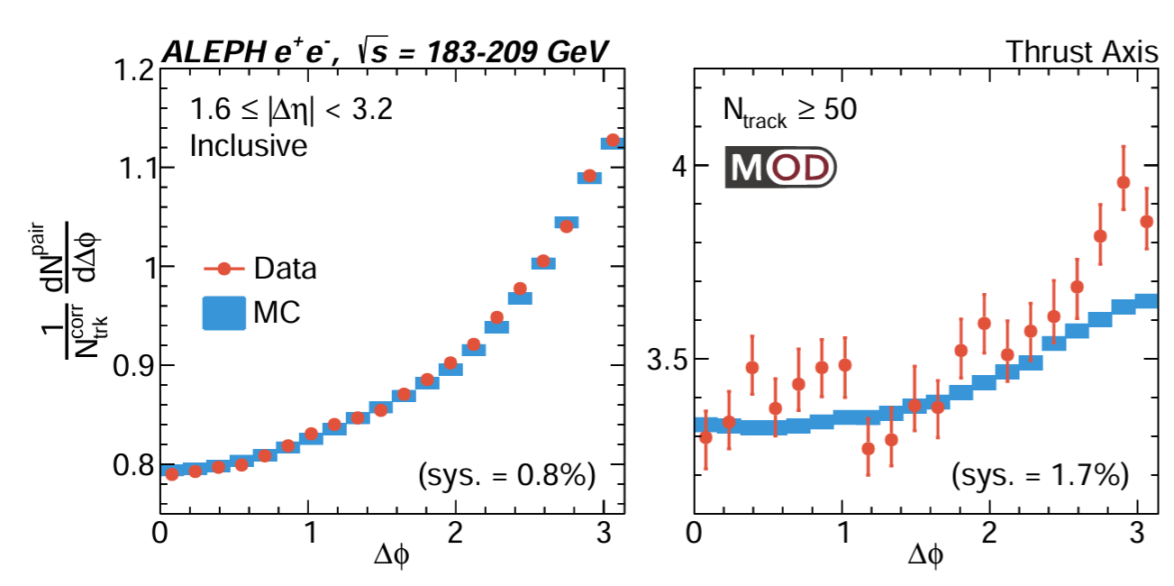
Flow-like Correlation in e⁺e⁻ at LEP2 Energies
Long-range correlation in e⁺e⁻ collisions!
Not described by ALEPH archived MC
May be interesting to study EEC with archived MC in different multiplicity intervals
MIT-MOD-23-001
arXiv: 2312.05084
Submitted to PRL
Yu-Chen "Janice" Chen (MIT)

Slide 27
Summary
CMS pp EEC
Widest p_{T}^{jet} range measurement of E2C, the first measurement on E3C
Multi-dimensional unfolding: accounts for correlation between variables
Features of QCD observed: color confinement, asymptotic freedom
α_{s} Uncertainty ~ 4%, most precise extraction from jet-substructure
e⁺e⁻ EEC with archived ALEPH data
Feasible to measure it with archived ALEPH data
Full event analysis without jet
First exploration of the back-to-back region
Up to 20% spread across MC generators
Identify interesting length scales related to Z mass, 2 and 3 jet event
Collinear regions are consistent with our understanding in pp
Many interesting ideas to come!

Slide 28
Acknowledgement
We would like to thank Roberto Tenchini and Guenther Dissertori from the ALEPH collaboration for the useful comments and suggestions on the use of ALEPH archived data.
We would like to thank Ian Moult, Felix Ringer, Jesse Thaler, Andrew Lakoski, Liliana Apolinário, Ben Nachman, Camelia Mironov, Jing Wang for the useful discussions on the analysis.
The MIT group's work was supported by US DOE-NP

Slide 29
Backup slides

Slide 30
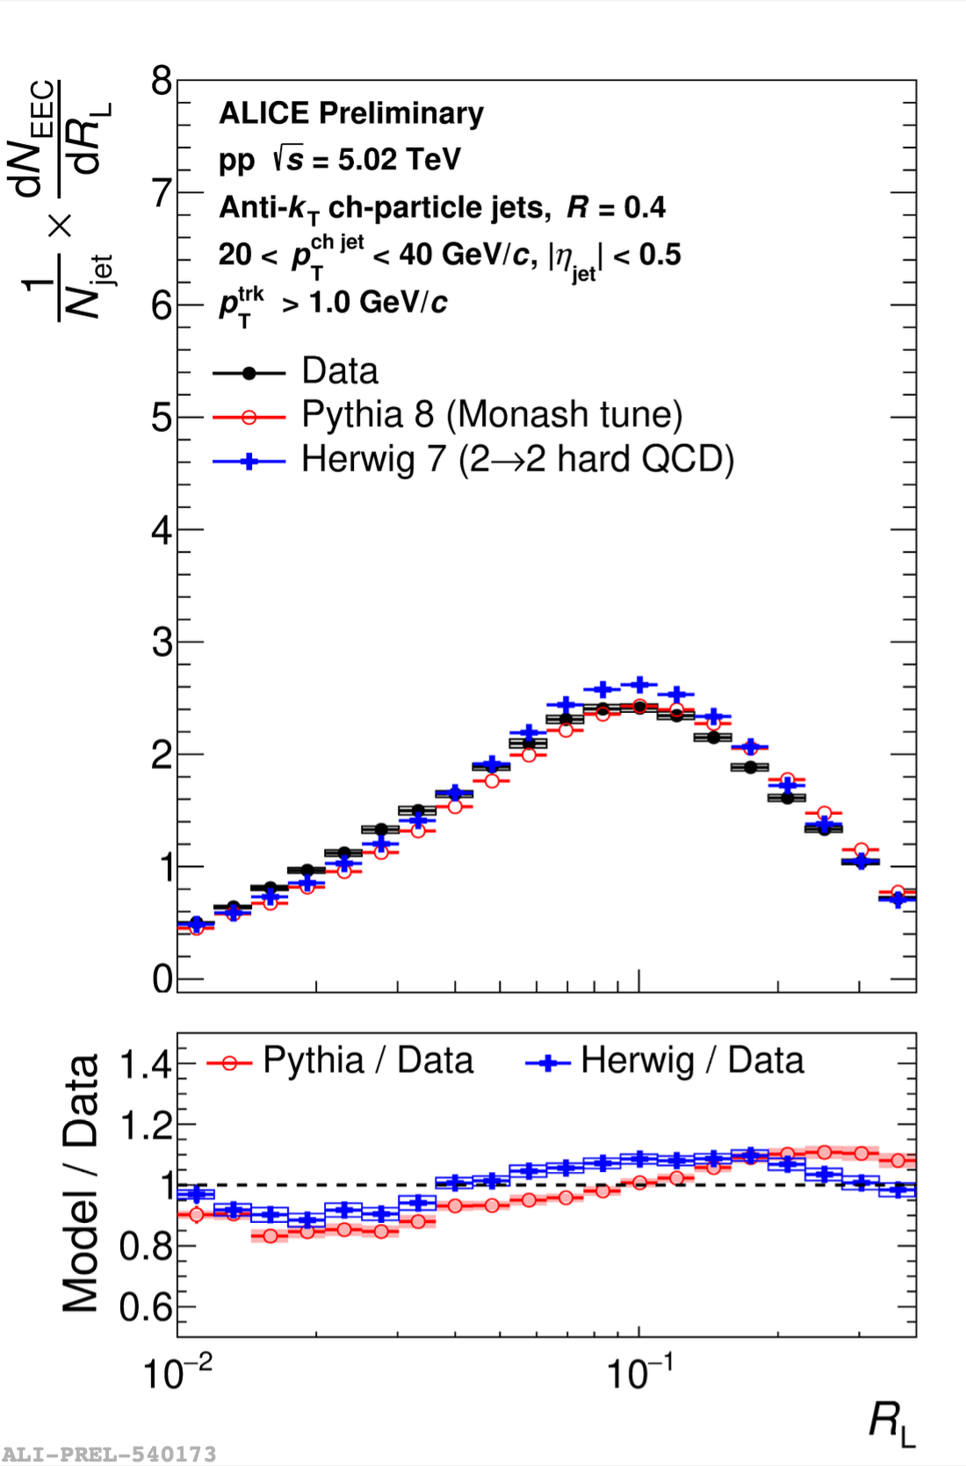
Comparison with ALICE pp
Mostly similar story from MC comparisons

Slide 31
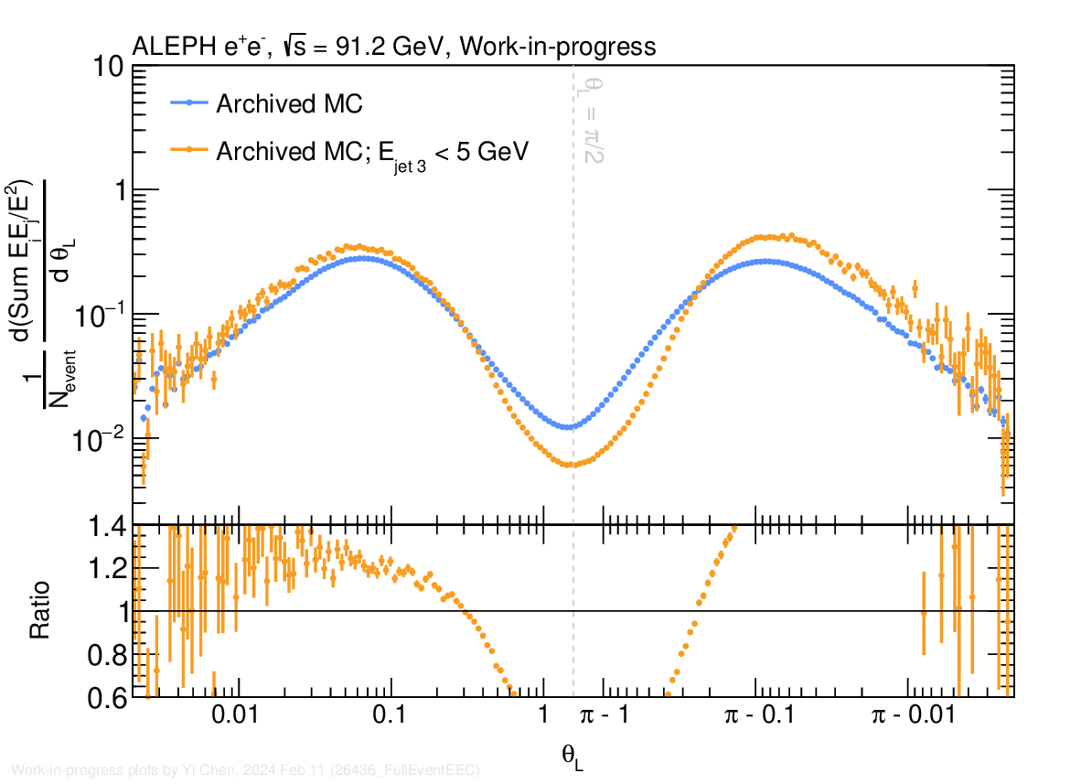
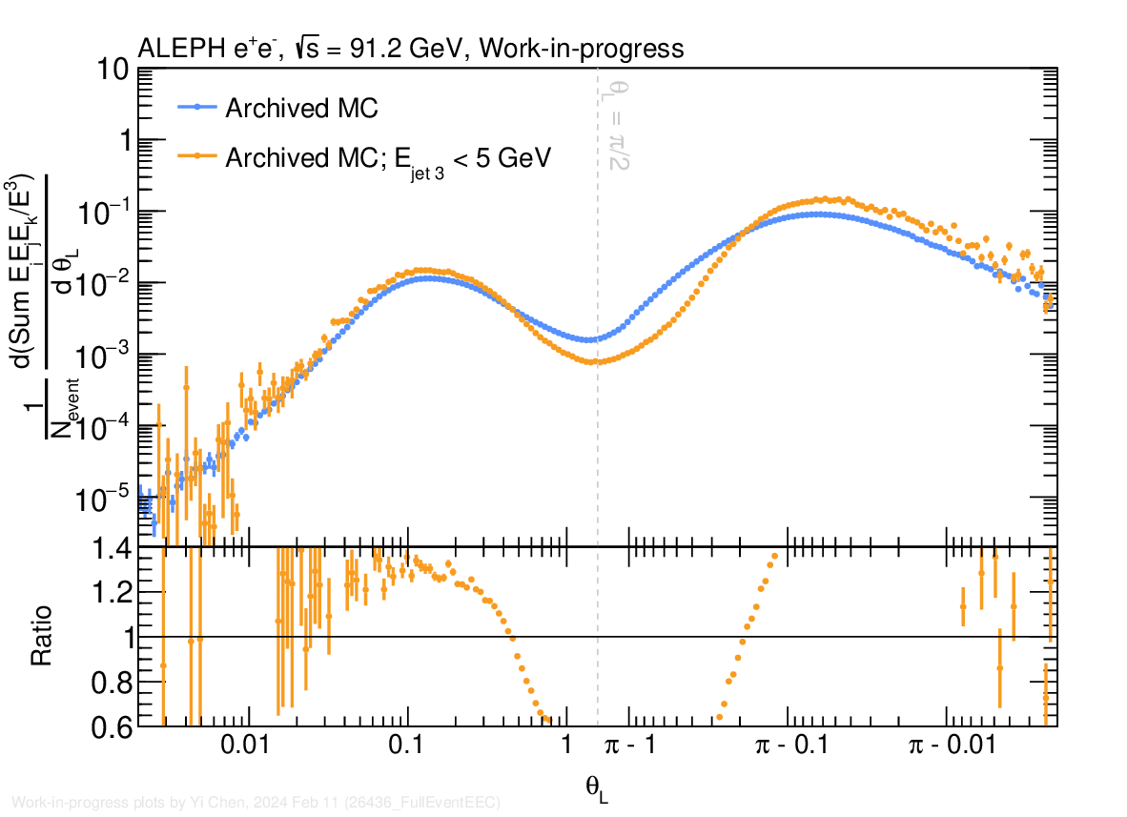
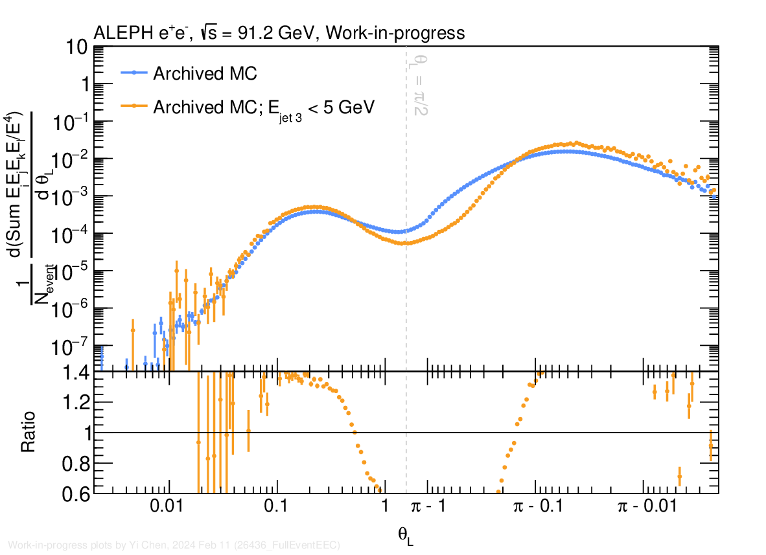
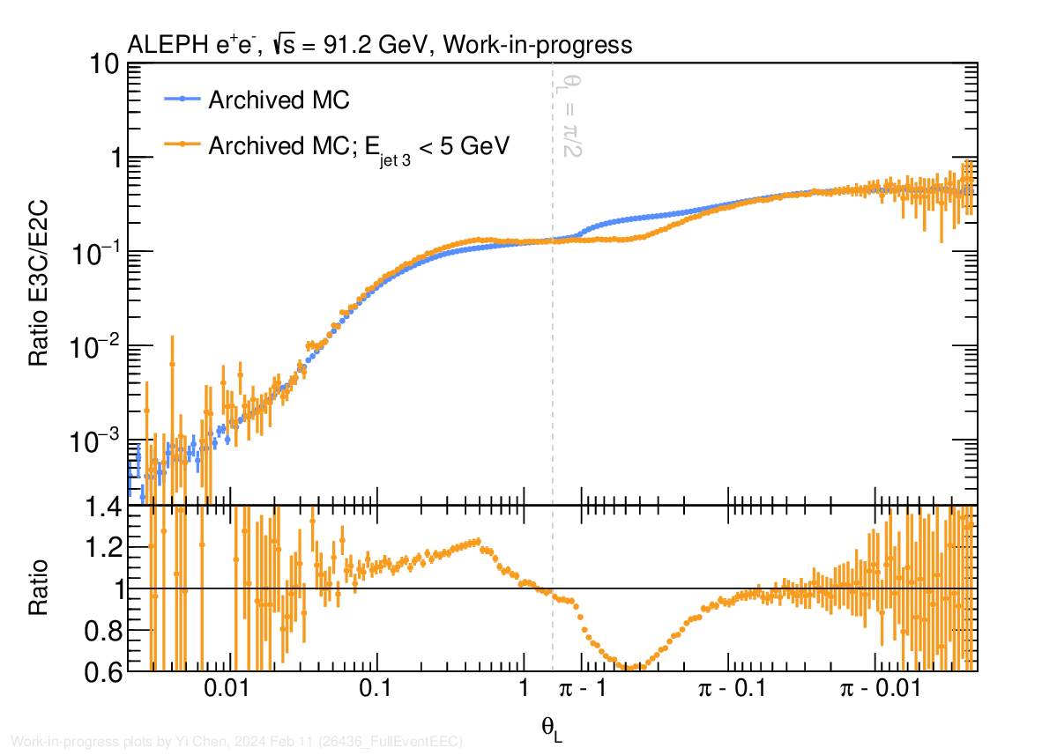
Rejecting 3-jet events in EEC's

