Slide 1
Anisotropic Jet Broadening and the R_{AA} x v₂ Puzzle
Supported in part by DoE Grant (DE-SC0024560)
Supported in part by a start-up grand from NMSU
ECT*
14th February, 2024
In collaboration with Hasan Rahman, Dr. Matthew Sievert, and Dr. Ivan Vitev

Slide 2
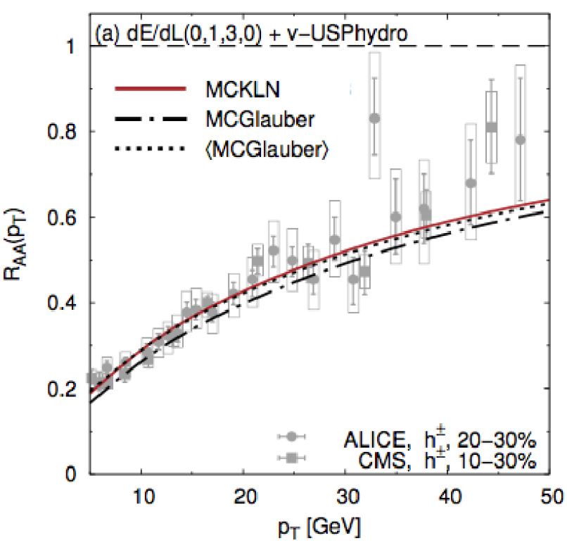
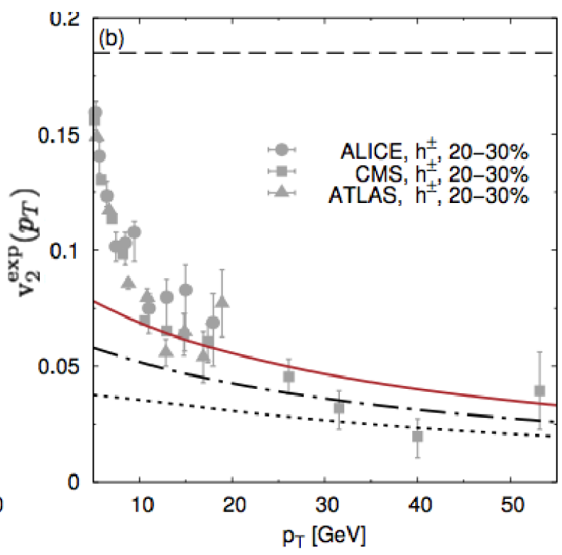
Coupled Observables & the R_{AA} x v₂ Puzzle
R_{AA} Good!
Down to p_{T} > 5 GeV
Coupled descriptions are more discriminating
a simultaneous description of the observables with a single model
pQCD models of R_{AA} x v₂
Enduring challenge…
Success: p_{T} > 10 GeV
Failure: 1 GeV < p_{T} < 10 GeV
Underpredicted anisotropic flow for well-behaved R_{AA}
Something is missing!
Noronha-Hostler et al:
(arXiv: 1602.03788)
Missing v₂!!!
Suspiciously only
around
p_{T} < 10 GeV

Slide 3
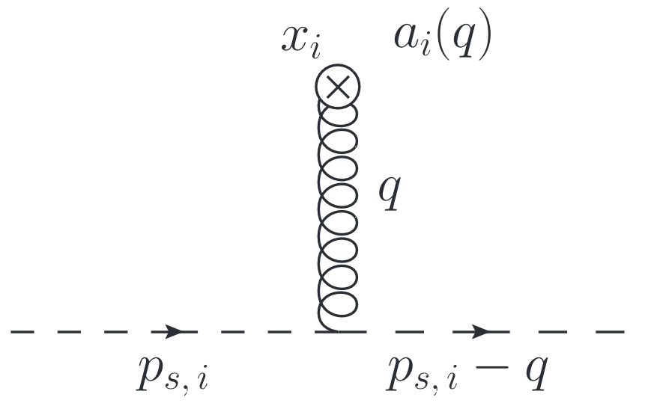
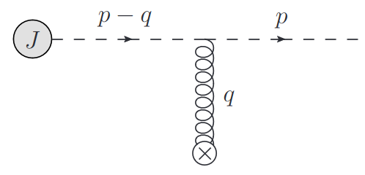
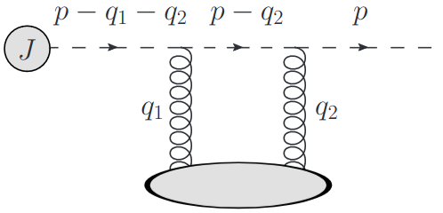
Jet Broadening – Isotropic vs Anisotropic
A. V. Sadofyev, I. Vitev, & M. D. Sievert
Phys.Rev.D 104 (2021)
(arXiv:2104.09513)
Isotropic
No vector info
Difference in setup – constraints on external gluon field
Isotropic
Jet quark moves lightcone (+), medium quark moves lightcone (-)
Anisotropic
Jet quark moves lightcone (+), medium quark moves with medium flow
Two vector directions associated with the medium
Flow
Gradients
Anisotropic
Preferred direction!

Slide 4
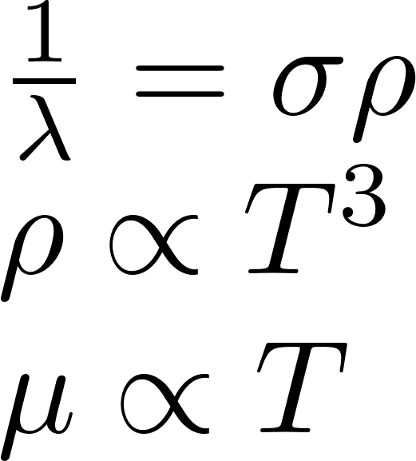
Anisotropic Jet Broadening: “Jet Drift”
"New" class of pQCD effects: asymmetric / anisotropic
Flow-Mediated Drift
Preferential broadening in direction of medium flow
Can use analytic approximation to discuss “trajectory of the average”
L. Antiporda, J. Bahder, H. Rahman & M. D. Sievert
Jet Drift Analytic Phenomenology
Phys.Rev.D 105 (2022) (arXiv: 2110.03590)
Flow enhanced and flow direction controlled
Energy suppressed
Temperature Enhanced

Slide 5
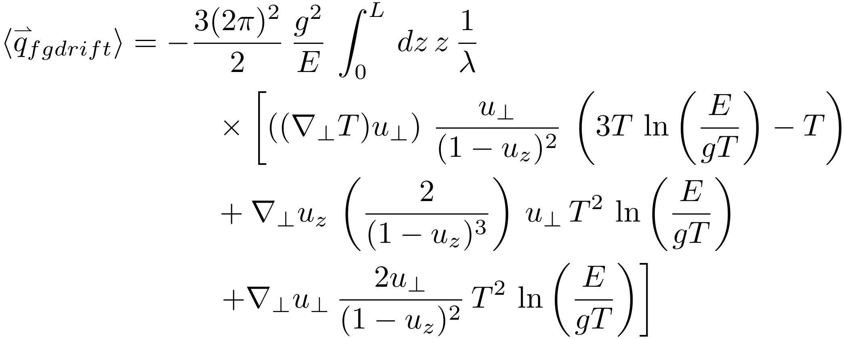
Anisotropic Jet Broadening: Flow-Gradient Mediated
Quadratic in Pathlength
Flow enhanced and flow direction modulated
Energy suppressed
Mixed Flow-Gradient-Mediated Drift
Phenomenology follows flow-mediated drift
Small effect in isolation, couples to enhance flow-mediated drift
A backseat player for now

Slide 6
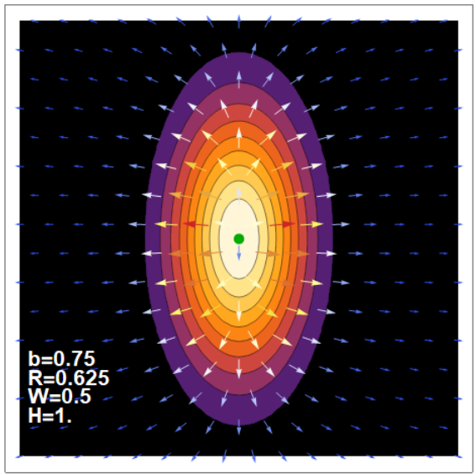
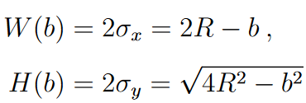
Elliptical Media =?= Elliptic Modulation
2D Gaussian Temperature & Flow
Take an angular sweep of hard partons,
Compute R_{AA} and v₂ for various p_{T}
Drop all scale factors
(no physical scale for medium)

Slide 7
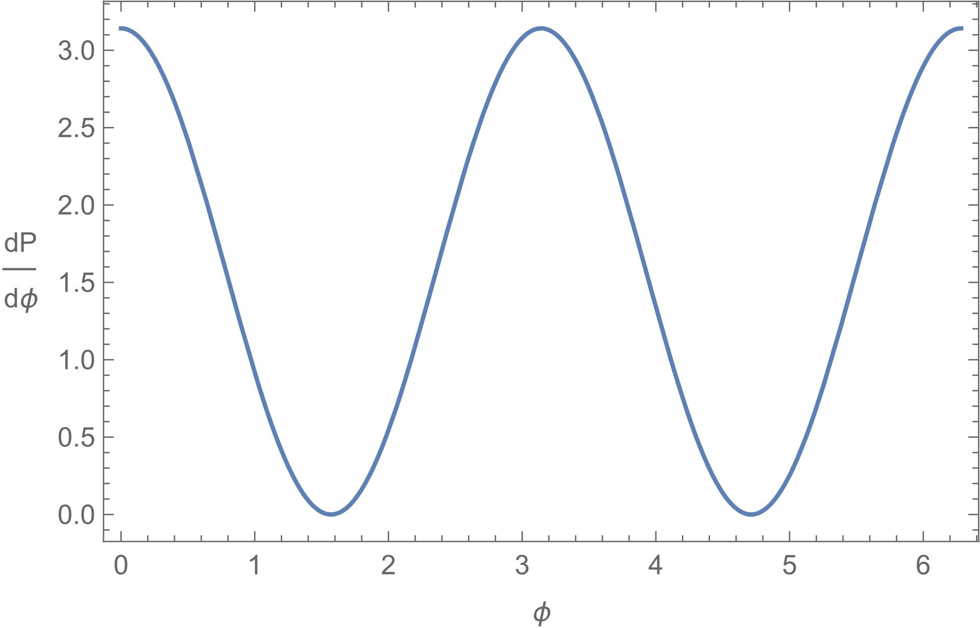
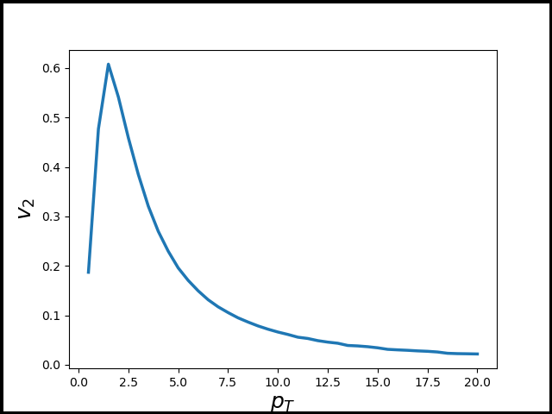
Drift Couples to Event Geometry
Drift strength arbitrarily scaled for visual effect
Jet p_{T} dependence accurate
Elliptic modulation: additional v₂!
Drift is strongest at low p_{T}, matching missing v₂
(1/E) log(E) behavior in p_{T}
Review:
Missing v₂, p_{T} < 10 GeV
Jet Drift enhances v₂ , p_{T} < 10 GeV
… Suspicious, no?

Slide 8
The Well-Trodden: Elliptic Flow from Energy Loss
Noronha-Hostler et al:
(arXiv: 1602.03788)
Need an energy loss model to address R_{AA} (x) v₂ puzzle
Jet quenching responsible for elliptic flow - p_{T} > 10 GeV
Implement analytic approximation to first-order GLV energy loss
Jet quenching goes roughly quadratically in pathlength
Enhances energy suppressed drift at late times
Largest flow values likely seen by jets at late times near plasma "wavefront"
Vitev: (arXiv:0012092)

Slide 9
Vision to Study Realistic Drift
Test effect of addition of jet drift to realistic event-by-event
jet-medium simulations on R_{AA} (x) v₂ puzzle
Realistic 2+1D model of QGP temperature and flow
Perturbative energy loss model
Perturbative drift model
Differential treatment of jet trajectories
Fragmentation to observable particles
Experimental-Type R_{AA} and v₂ measurements

Slide 10
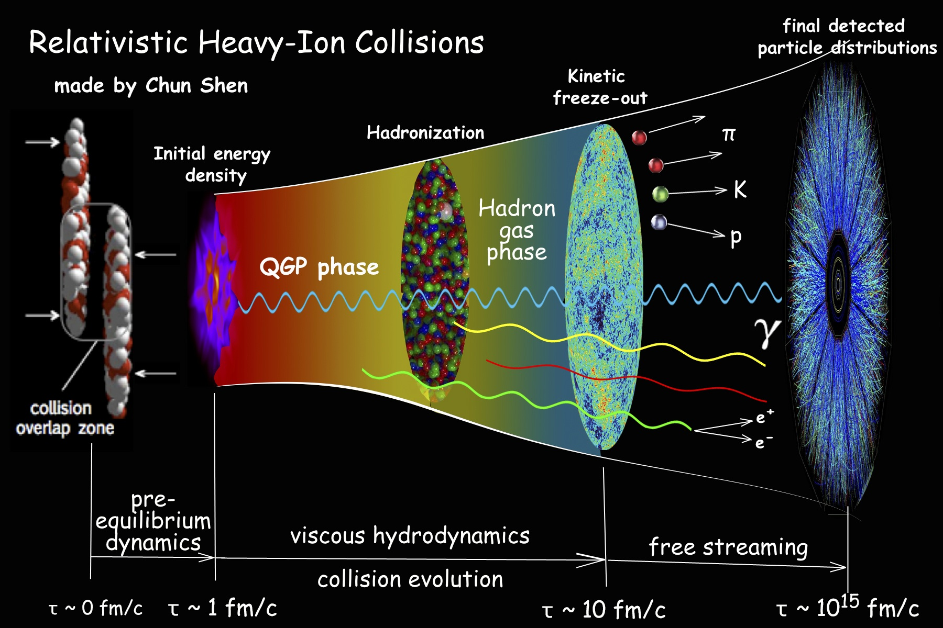
Medium Model
Free Streaming
Freeze Out
UrQMD (Future)
Initial HIC Conditions (Trento)
Initial energy densities
Free streaming
Generating initial flow in the pre-equilibrium phase from gradients
Hydrodynamics (VISHNU)
Relativistic Fluid Eqs. -> EMT Conservation
Freezeout
Cooper-Frye particlization sampler
Trento
VISHNU
Duke QCD – “hic-eventgen”
“hic-eventgen”
(arXiv:1804.06469)
(GitHub)
Chun Shen / OSU / VISHNU Collaboration

Slide 11
JMA Jet Model
(GitHub)
Free Streaming
UrQMD (Future)
Freeze Out
Trento
VISHNU
Jet Physics Wrapper overtop “hic-eventgen”
Partonic Scattering Inputs (Pythia & CNM Theory)
Jet production from pp hard partonic scatterings
Theoretical cold nuclear matter effects from saturation theory
Parton Propagation in QGP (EL & Drift Theory)
Jet energy loss & drift applied to pA products
Fragmentation
Event-by-event Sampling of Fragmentation Functions for hadron momentum fraction
X
π
Pythia Hard Scattering
& Theoretical CNM Effects
Chun Shen / OSU / VISHNU Collaboration
Fragmentation

Slide 12
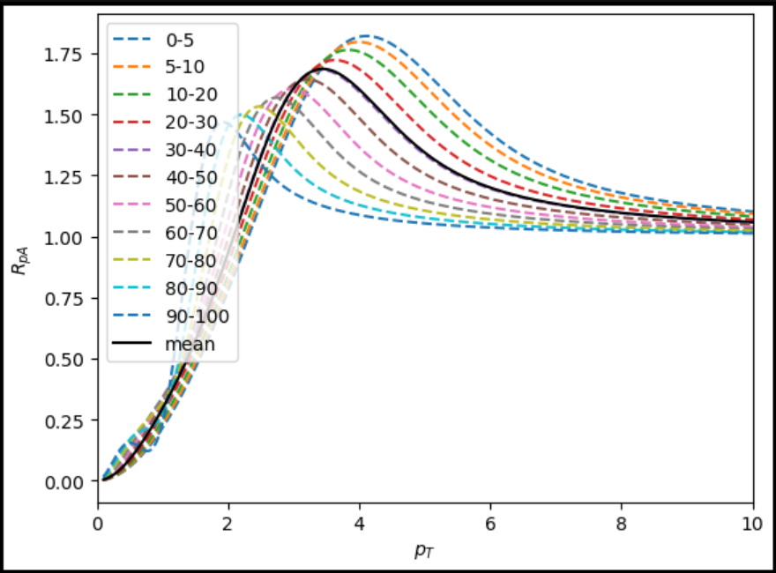
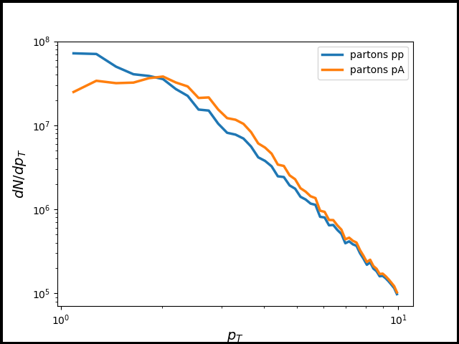
Jet Distribution & Cronin Effect
pp jet distribution from Pythia pp collisions @ 5.02 TeV
All events 2->2 partonic hard products
Dijets (before QGP effects)
Light quarks & gluons
Access to dijet observables
RpA computed from saturation theory
(arXiv: 0307037)
Two parameter, flexible form
Needs modification for gluon jets…
Especially important for drift!

Slide 13
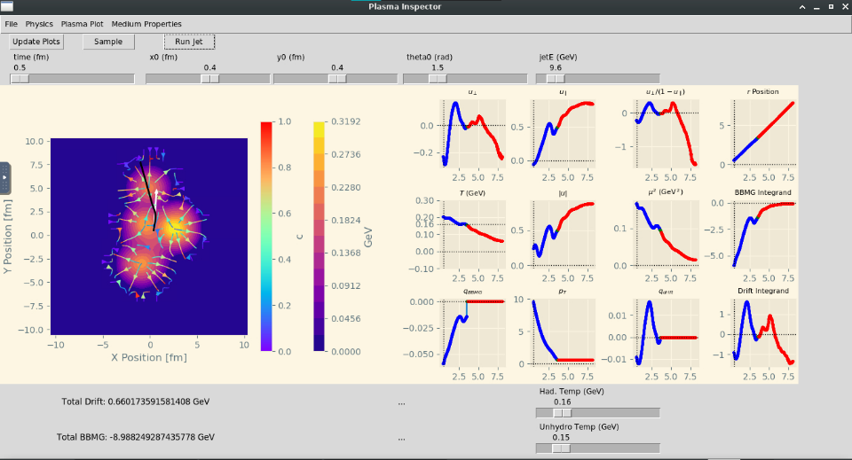
JMA Jet Trajectories
Hard partons - not “jets”
Uncontrolled factorization of hadronization from jet-medium int.
Jet trajectories
Binary collision density weighting of production points
Computed within QGP phase of hydro backgrounds
EL & Drift cut off at T < 155 MeV

Slide 14
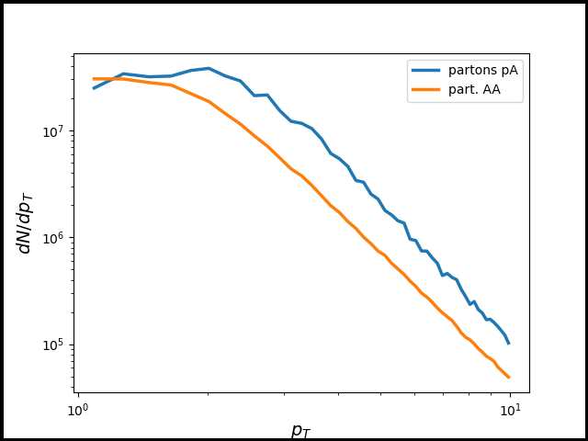
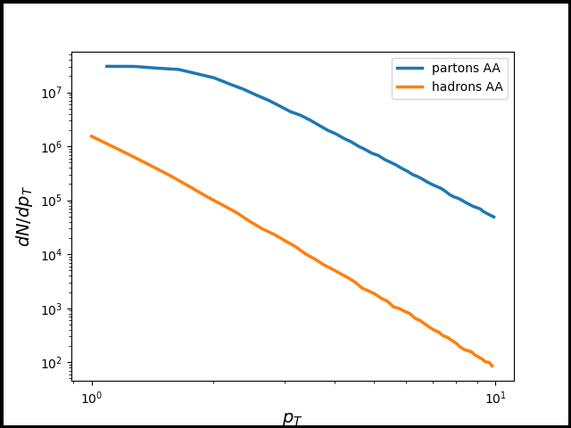
On Free Parameters
DukeQCD “hic-eventgen” medium model parameters set by Bayesian parameter estimation
(arXiv:1804.06469)
Jet spectra set by choice of scattering & CNM theory
Pythia tuned to pp data
2 parameter CNM analytic model
Jet-medium interaction theory fully defined by coupling
Fragmentation
Choice of fragmentation functions
Very non-trivial

Slide 15
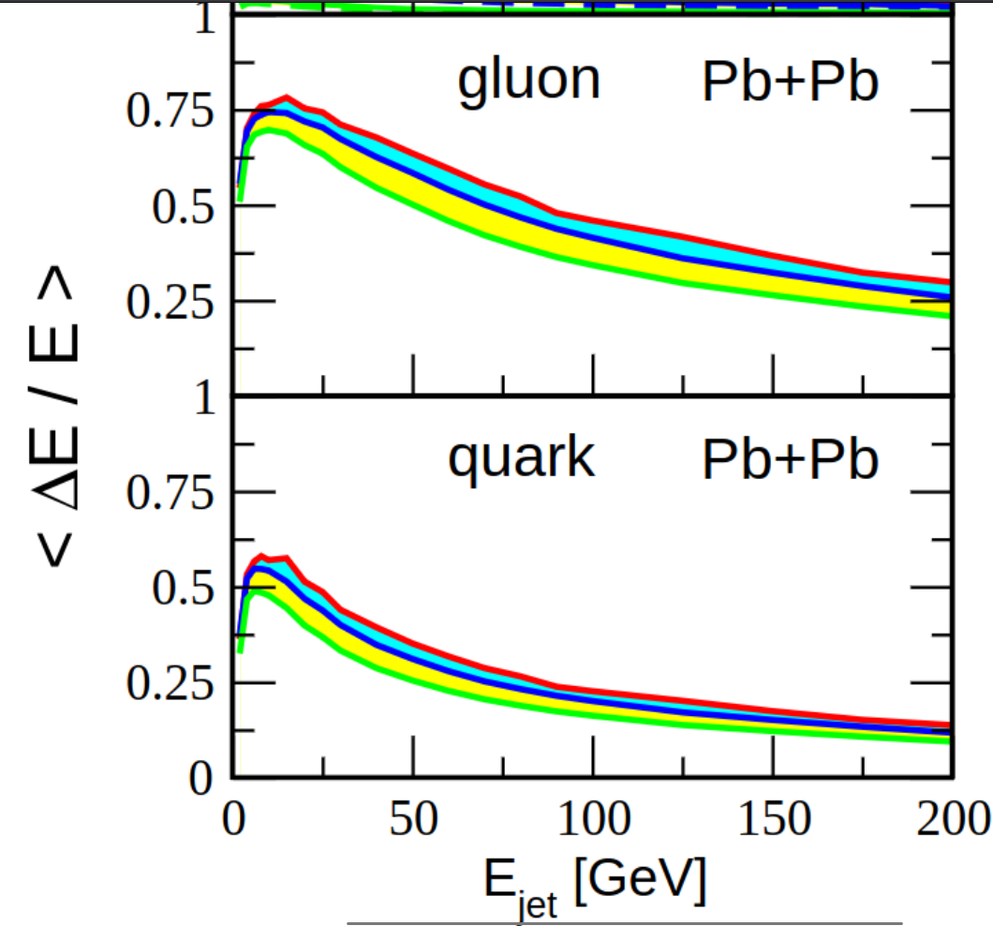
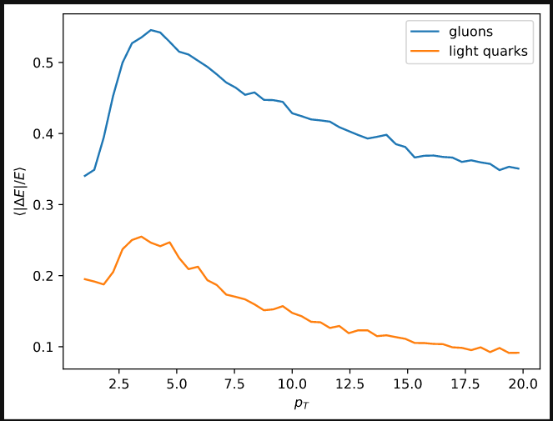
Effect Strengths - EL
Compare JMA (right) to perturbative simulation results in Woods-Saxon Glauber models (left)
Mismatch to simple analyses
Red Flag!
Wait to see R_{AA}
More details shortly
PRELIMINARY
arXiv:0603010

Slide 16
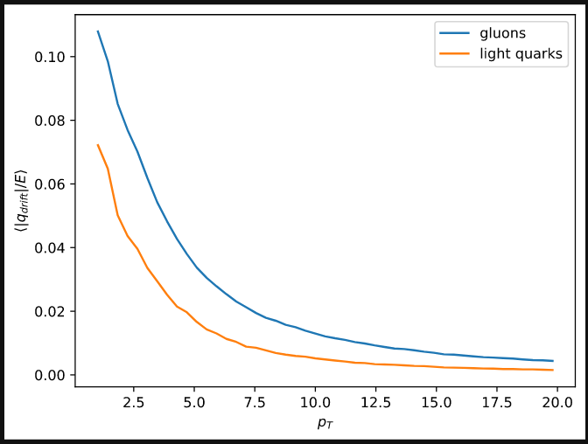
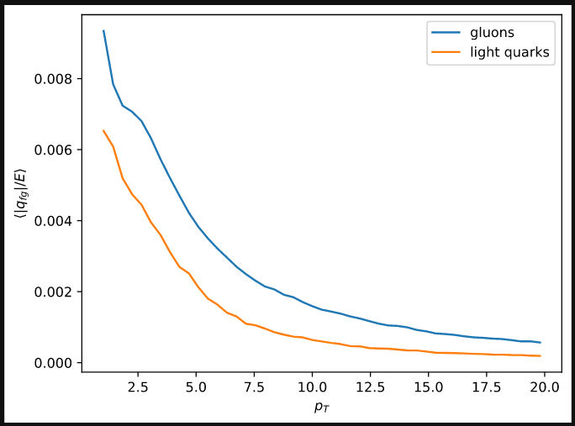
Effect Strengths – Flow & Flow-Grad Drift
PRELIMINARY
PRELIMINARY
Flow-Mediated
Drift
Flow-Grad-Mediated
Drift
Note y-axes scale difference left to right panel
No other perturbative simulation for comparison
We will evaluate when we talk v₂ !

Slide 17
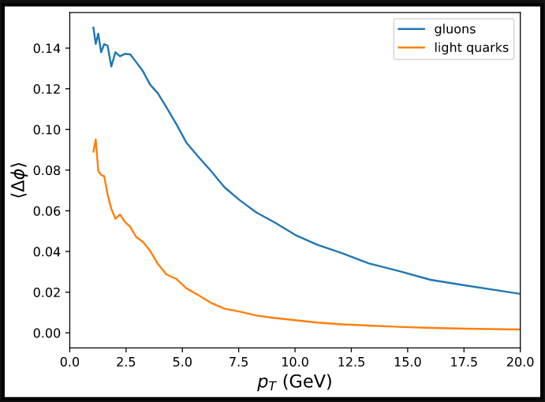
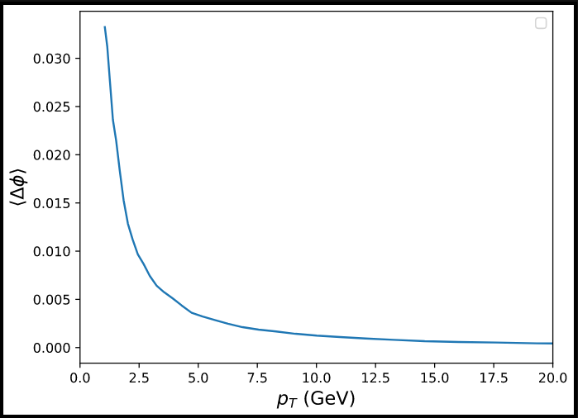
Typical Deflections
PRELIMINARY
PRELIMINARY
Some deflections are experimentally measurable! (0.1 rad ~= 5.7 deg)
Anecdotally: experimentalists have said 5 deg is measureable
Note: Deflections binned in partonic pT
Large numbers of hard partons experience measurable drift deflection!
Fragmentation seems to wash out much of the effect

Slide 18
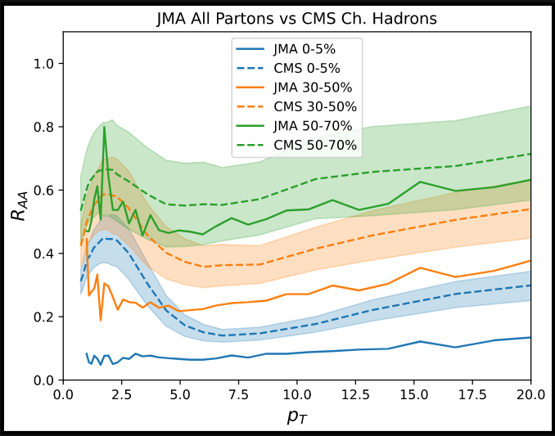
R_{AA} Insights - Partonic
General behavior in the right ballpark
Scale of suppression reduced after fragmentation
“Low end” of hard pT R_AA structure
Probably some sort of nonperturbative / other physics driving R_AA
Small upturn due to CNM effects
PRELIMINARY
CMS: https://doi.org/10.17182/hepdata.77101.v2

Slide 19
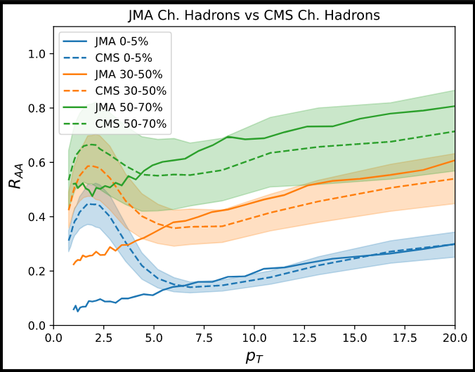
R_{AA} Insights - Hadronic
PRELIMINARY
Coupling g=2 under-predicts suppression
Coupling scans in progress, g=2.2 eyeballed
Centrality scaling accurate-ish, but seems to get worse in peripheral bins
CMS: https://doi.org/10.17182/hepdata.77101.v2

Slide 20
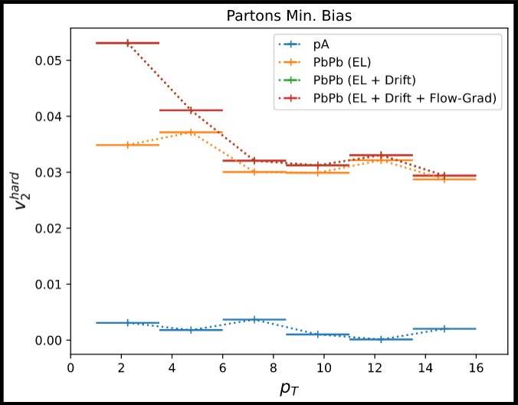
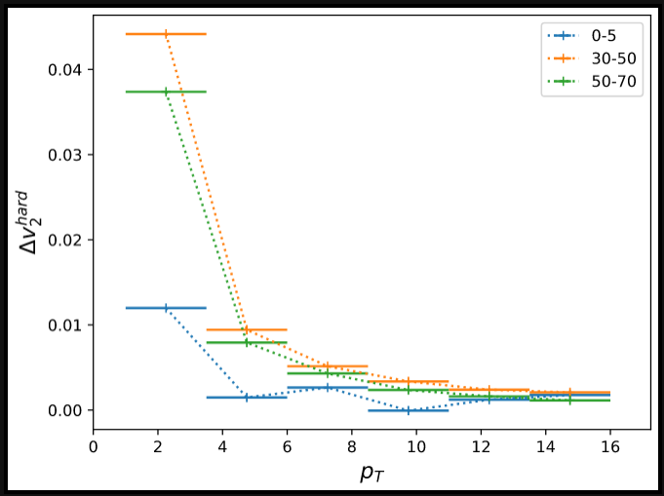
v₂ Insights - Partonic
Elliptic modulation of hard partons is clear and systematic at low pT
Drift effects show nontrivial enhancement over energy loss alone in partonic distribution
Absolute scale uncertain…
Needs convergence testing
Affected by fragmentation, CNM, etc.
PRELIMINARY
PRELIMINARY

Slide 21
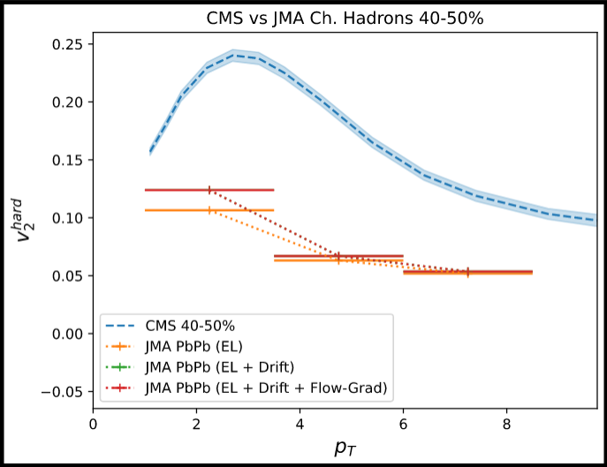
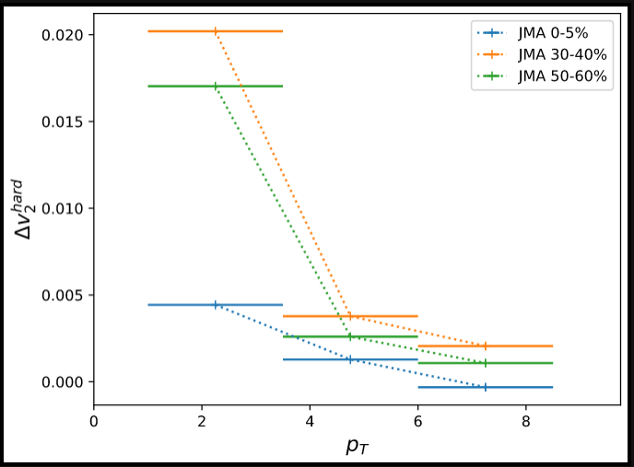
v₂ Insights - Hadronic
PRELIMINARY
Drift enhancement of elliptic flow of charged hadrons is still clear and systematic at low pT
Scale dependent on FF choice, coupling, & sensitive to variation with MC sampling changes
Systematics robust & similar to expected effects
Secretly, this is not the correct quantity to compare to data...
PRELIMINARY
CMS: https://doi.org/10.17182/hepdata.77603

Slide 22
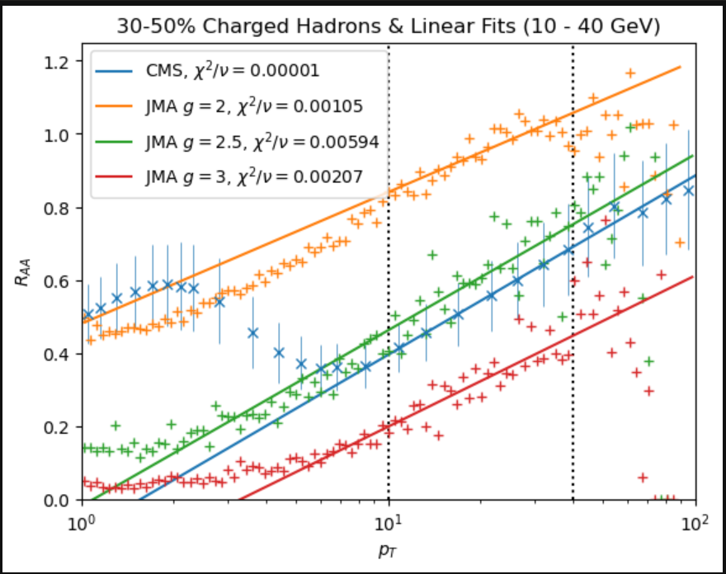
Future: Parameter Fits
g from high pt
Min-bias & max-drift centralities
log fit of high pt region
CNM params from low pt
Fixed coupling…
Bayesian inference against R_{AA} and v₂ data
P
Old & Junky

Slide 23
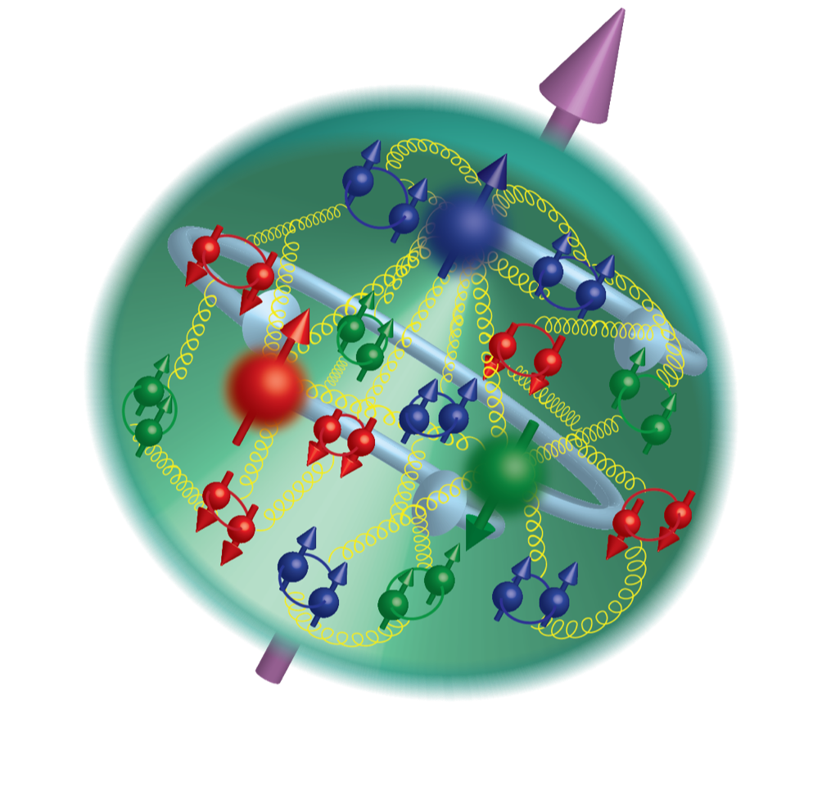
Future: Competing Timescales & Hadron Gas
Jets see substantial pathlengths in hadron gas phase
Plan to form theory of parton-hadron interaction via Parton Distribution Functions (PDFs) for hadrons
Potential parton-hadron drift-like interactions
Possible to have post-fragmentation deflection
Potential hadron-hadron drift-like interactions
Argonne National Lab

Slide 24
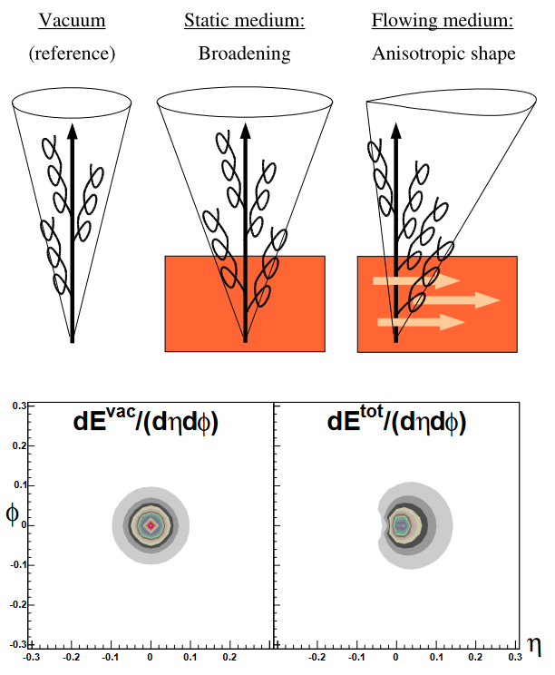
Future: New Observables
“JMA” machinery is robust
Drift likely has implications for many other observables
Jet shapes
See “Jet Drift-Like” effect from Lorentz Boost with medium (arXiv:0405301)
Jet wake asymmetries!
E3C wake imaging could see asymmetric wake!
Wake may couple to parton level – larger drift
Elliptic modulation correlators?
(arXiv:0405301)
Other ideas?

Slide 25
Questions!
The Bottom Line:
“Jet Drift” (Asymmetric Broadening) enhances hard particle v₂ for p_{T} < 10 GeV!
Hot Takes!
Ideas!

Slide 26
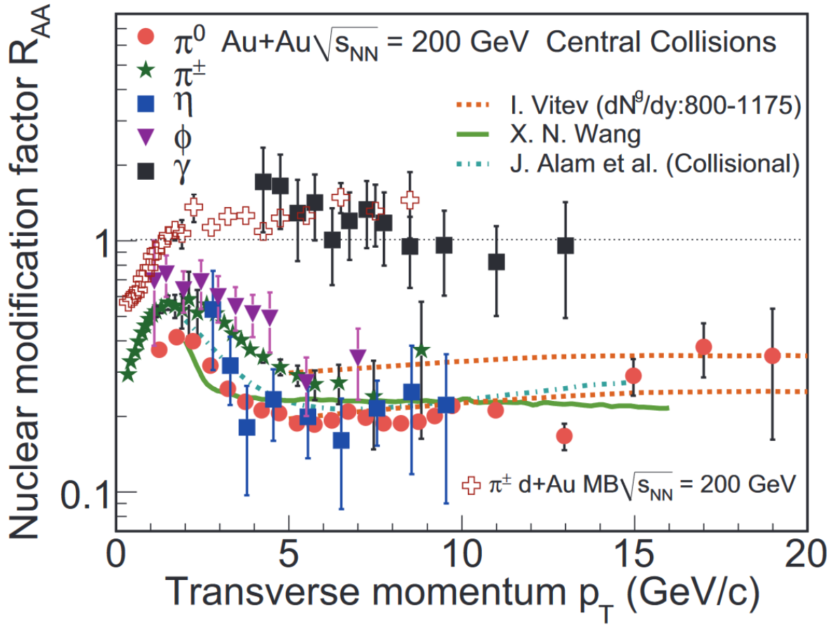
Discriminating Power is Very Limited
What’s wrong?
Observables are essentially model agnostic!
R_{AA} – Nuclear modification factor
Can be fit with many competing models
v_{n}^{hard} – Flow harmonics
Easy to fudge by scaling quenching
Acoplanarities
Excessive background noise
Often impossible to even distinguish broadening from narrowing!
arXiv:1207.7028

Slide 27
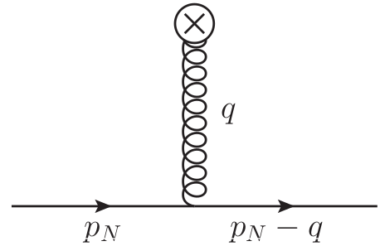
Medium Gluon Field Potentials
Eikonal
delta function
(antiparallel)
v(q)
Static scattering centers
Quark moves with medium
v(q)
Dynamic
directional scattering centers

Slide 28
Jet Spectrum & Cronin Effect
RpA computed from saturation theory
(arXiv: 0307037)
Two parameter, flexible form
Qs0 saturation scale
Lambda – infrared cutoff

Slide 29
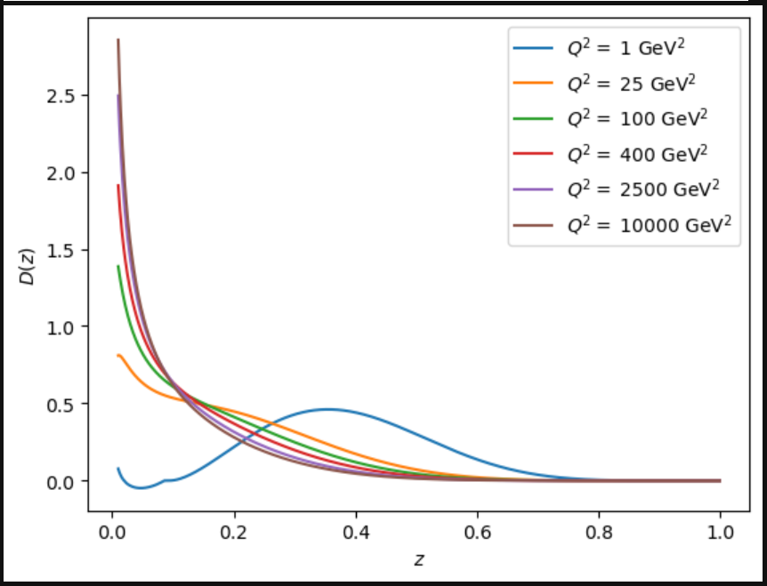
Fragmentation
Fragmentation functions describe probability distribution for hadron momentum, given parton momentum
“JAM20-SIDIS_FF_pion_nlo”
(arXiv: 2101.04664)
Simple sampling… Complicated implications for Drift
Fragmentation downshifts p_{T} of hard particles
Shifts domain of strong drift even farther down

Slide 30
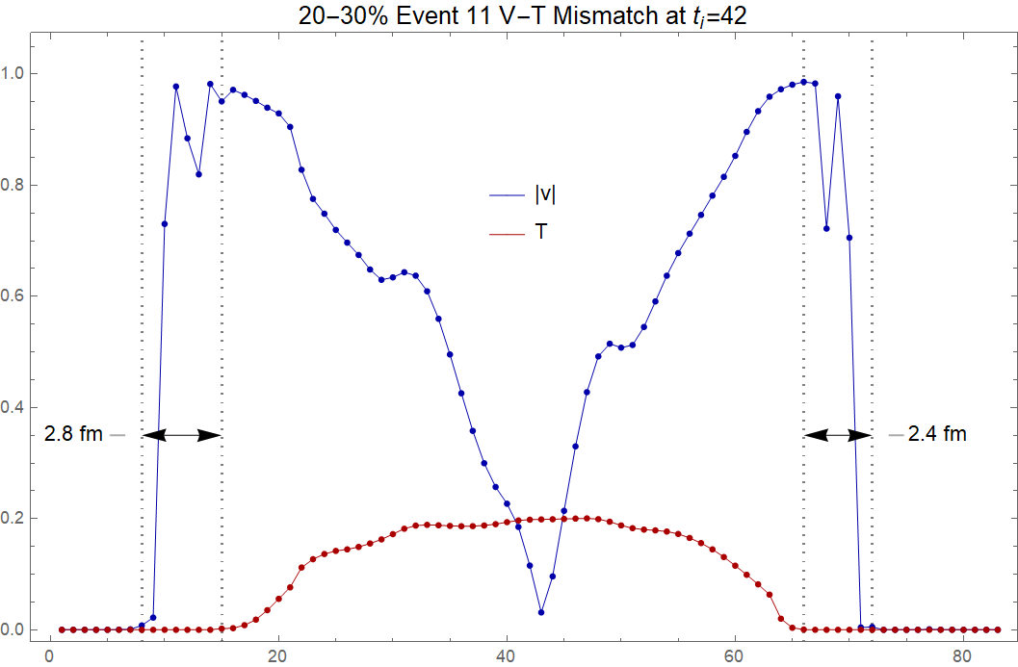
Questions Raised by Hyro
"Velocity spill" may be reflective of problems with event-edge velocity accuracy
Most important region for drift!

Slide 31
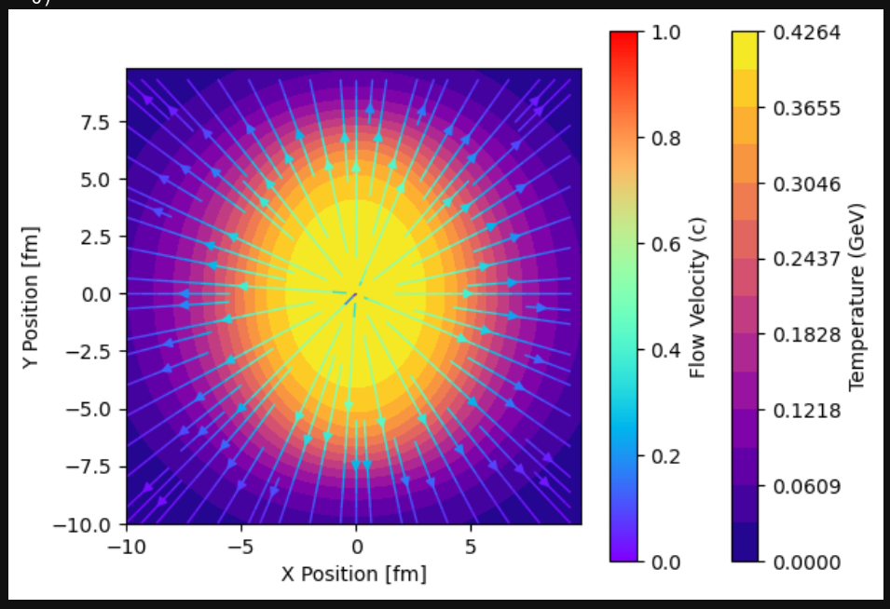
Future: Simple Models
E.G. Woods-Saxon Density Glauber model
Step-wise build-up of realistic optical Glauber models
Gives insights into parts of medium model that affect drift & EL
Time consuming…

Slide 32
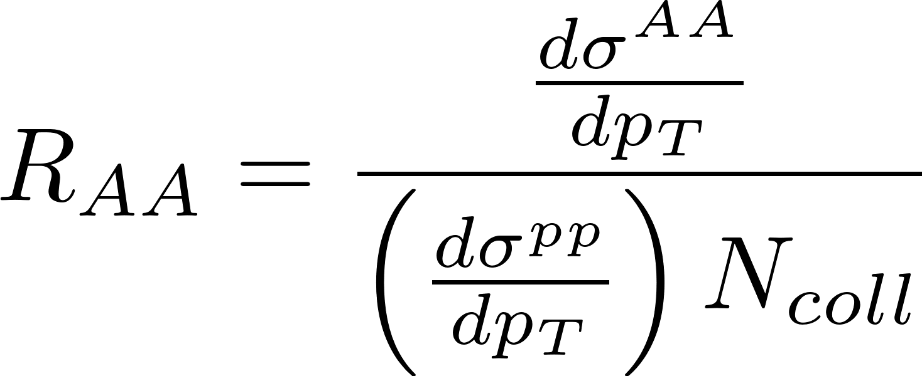
Bread & Butter Jet Observables in QGP
Ratio of yield in AA collisions to scaled yield of pp collisions:
“Jet Suppression via QGP Effects”
R_{AA} – Nuclear modification factor
Measurement of jet energy loss (quenching)
v_{n}^{hard} – Flow harmonics
Measurement of event geometry coupling
Acoplanarities
Measurement of broadening effects
Essentially just Fourier harmonics of the azimuthal distribution of jets:
“Shape of jet azimuthal distribution”
“Relative jet cone broadening measures”

Slide 33
Future: Numerical Energy Loss & Drift
Currently using analytic approximations for average
Numerical calculations may change the proportionality of drift to EL strength
Distinct from coupling shift
Analytic approximations do not predict identical mean strength of EL
PRELIMINARY
arXiv:0603010

Slide 34
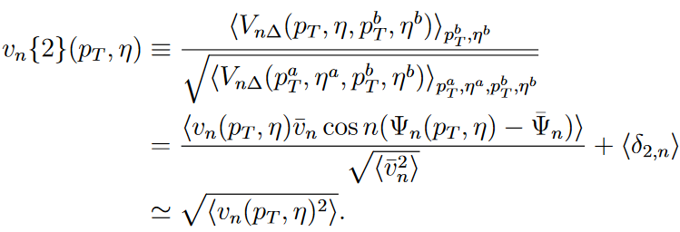
Elliptic modulation vs v₂
Particles are correlated
Dijet events
Nontrivial modification to v₂ as measured in experiment
Mixing of hard and soft v₂
Possible enhancement to v₂
ArXiv:1312.5503

Slide 35
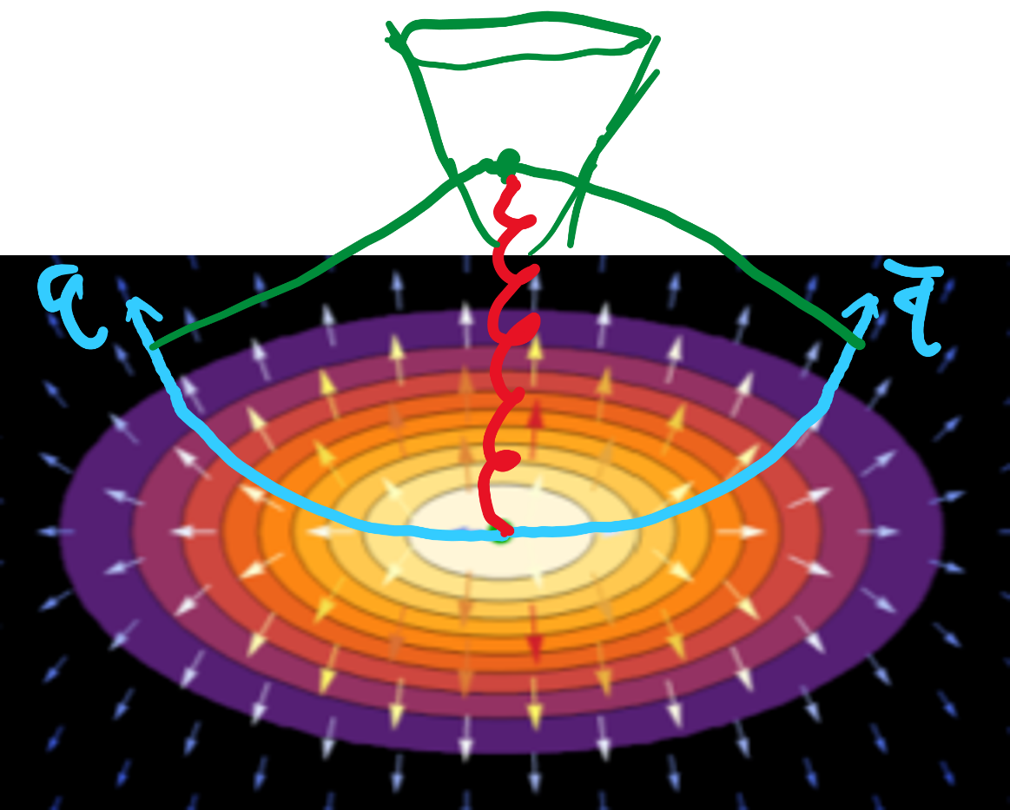
Note on “Coalescence” in Fragmentation
Many in the field believe quark “coalescence” is a source of enhanced v₂ of hard particles
If coalescence is a significant effect, jet drift may enhance it
No perturbative QCD model for fragmentation involving coalescence
Hard to treat on the same footing as our other jet effects
Market model is “Lund String” fragmentation
Curiosity-level tests with Pythia Lund-String fragmentation give evidence of coalescence
Enhanced high “z” hadrons with drift
Plans in the works to do measurements of coalescence significance as function of $Δφ_{jets}$, still not understood

Slide 36
Dataset Info

Slide 37
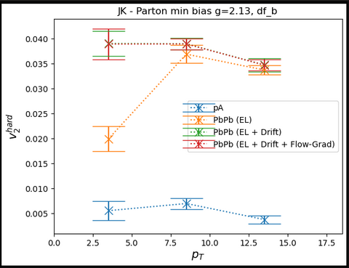
Quick Note on Error Assessment
g=2.2: ~13k Events
Event geometries oversampled by 100x hard processes
11 uniformly sampled angles per production point
~= 16M parton trajectories / case
Error estimates have been done with jack-knife resampling
Time consuming to compute, but shown to correlate with number of trajectories.
Suspect with this dataset we have precision on v2 measurements of +/- < 0.25%, as compared to similarly sized result sets

