Slide 1
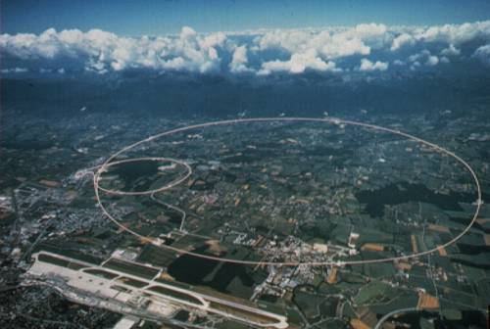
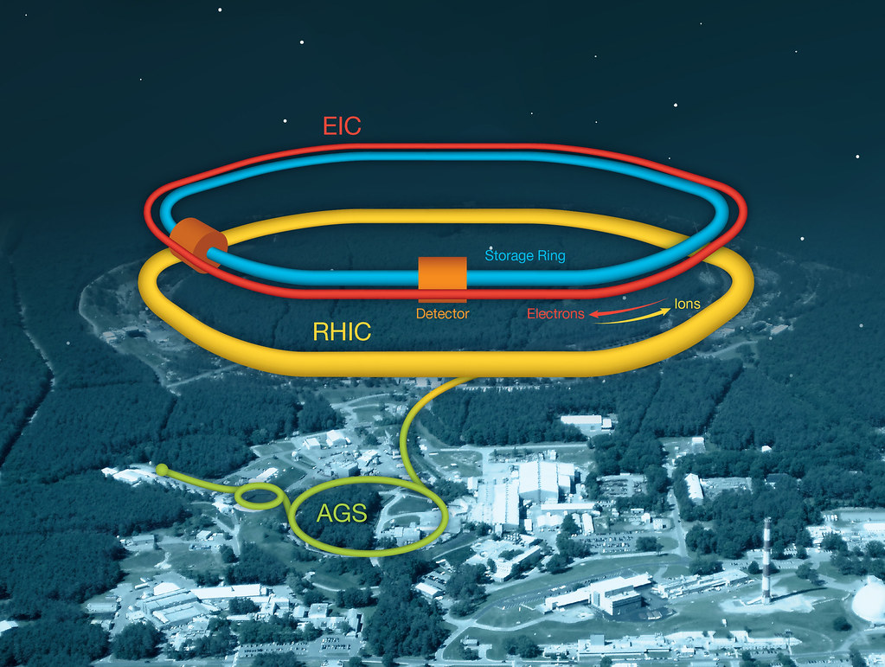
Energy-energy correlators at the LHC and EIC
Barbara Jacak
UC Berkeley & LBNL
February 13, 2024

Slide 2
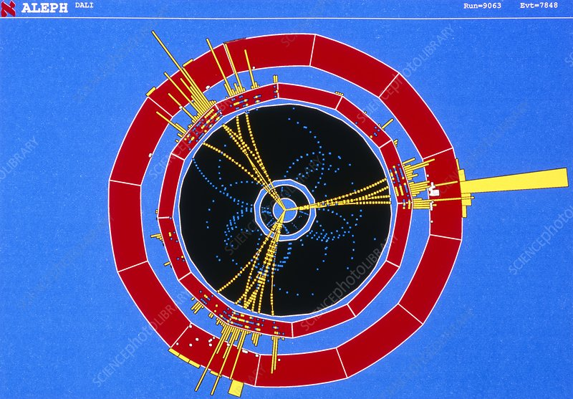
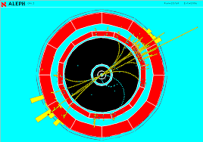

Experimental study of QCD dynamics
QCD shower evolution?
Effects of a medium upon the evolution?
How do hadrons emerge from quarks and gluons?
Use jets as the probes
e⁺e⁻ → q + q

Slide 3
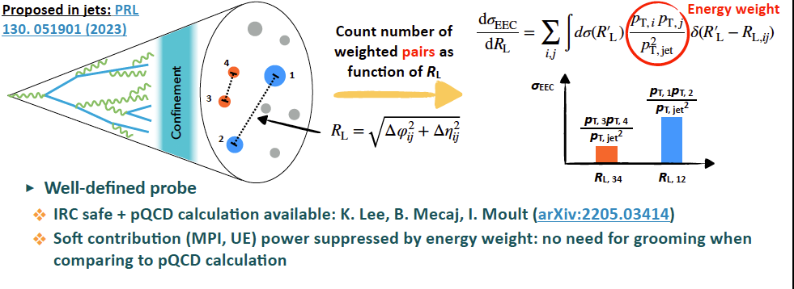
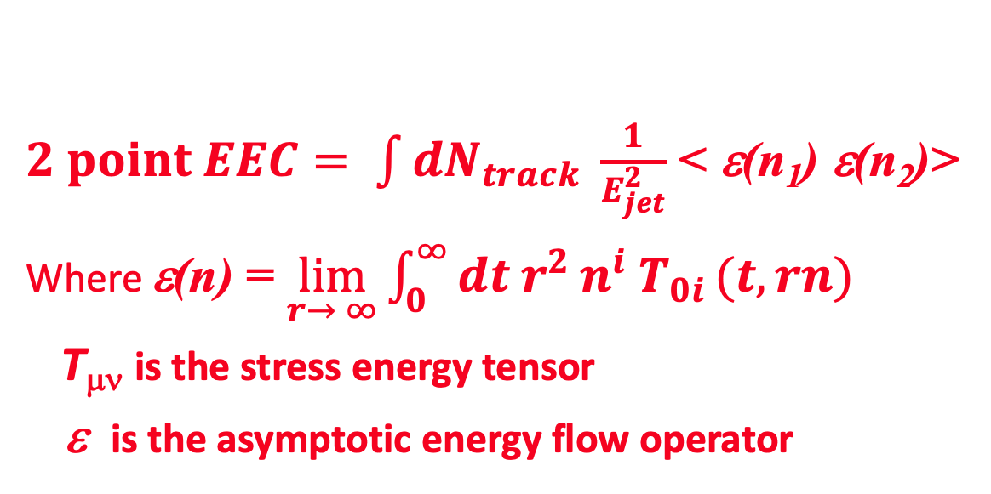
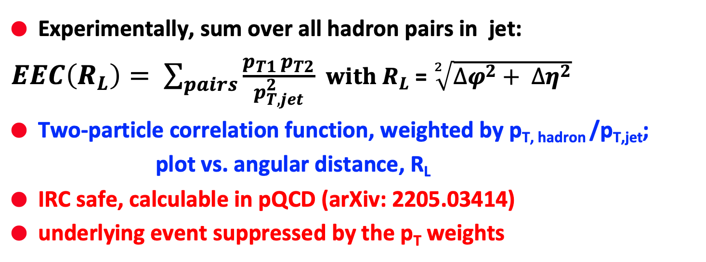
Image energy flow via energy-energy correlators
$2 point EEC= \int{dN_{track} \frac{1}{E_{jet}^{2}}}$ < ε(n₁) ε(n₂)>
Where ε(n) = $\lim_{r→ ∞}{\int_{0}^{∞}{dt{ r}^{2}}}n^{i} T_{0i }(t,rn)$
T_{μν} is the stress energy tensor
ε is the asymptotic energy flow operator
Experimentally, sum over all hadron pairs in jet:
$EEC\left(R_{L}\right)= \sum_{pairs}{\frac{p_{T1 }p_{T2}}{p_{T,jet}^{2}}}$ $with R_{L}$ = $\sqrt[2]{{∆φ}^{2}+ {∆η}^{2}}$
Two-particle correlation function, weighted by p_{T, hadron} /p_{T,jet};
plot vs. angular distance, R_{L}
IRC safe, calculable in pQCD (arXiv: 2205.03414)
underlying event suppressed by the p_{T} weights

Slide 4
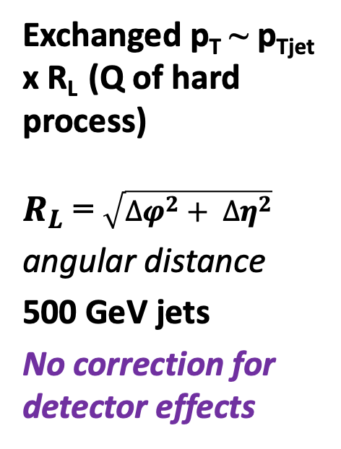
Inside jets: pQCD & non-perturbative region
Komiske, Moult, Thaler, Zhu. arXiv:2201.07800
Exchanged p_{T} ~ p_{Tjet} x R_{L} (Q of hard process)
$R_{L}$ = $\sqrt{{∆φ}^{2}+ {∆η}^{2}}$
angular distance
500 GeV jets
No correction for detector effects
At large R_{L}: universal scaling w/ perturbative quark and gluon interactions
At small R_{L}: uniformly distributed hadrons
R_{L} dσ/dR_{L} ∼ R_{L}²
Transition region = correlator at hadronization

Slide 5
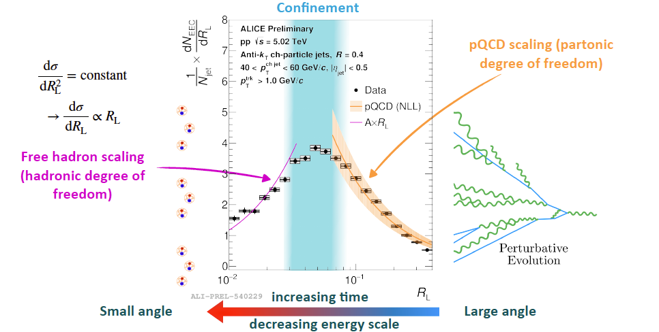
EEC in 5 TeV pp collisions
Fully corrected

Slide 6
Compare to expectations
Deviation between data and NLL: non-perturbative onset
Agreement between data and free hadron scaling: hadron gas phase

Slide 7
What is going on?
Calculation:
Kyle Lee
Idea: When the virtuality approaches 𝓞(ΛQCD), EEC undergo transition into confinement region

Slide 8
Check for scaling in p_{T}R_{L}
Wenqing Fan
Peak in p_{T}*R_{L} ~ virtuality at which radiation stops
Common shape for all jet energies – universal transition! HWHM = 1.8 ± 0.2 GeV/c
Peak at 2.4 GeV. What is magic about that?

Slide 9
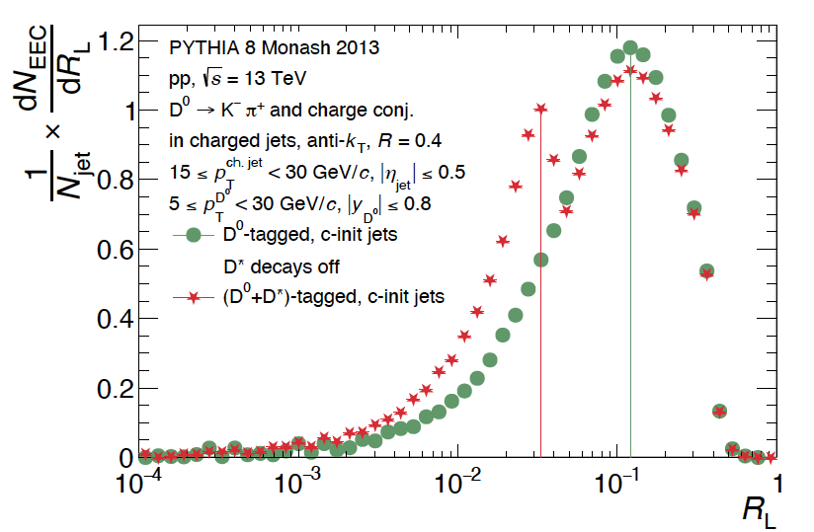
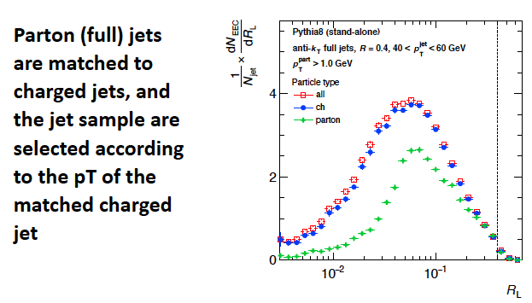
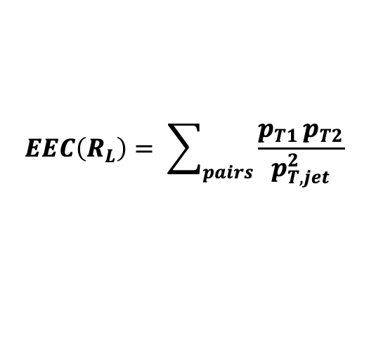
Use Pythia to check regions
Beatrice Liang-Gilman
Red * = D* decays to D⁰ + π
See the hadronic resonance @ late time, small R_{L}, as expected
$$EEC\left(R_{L}\right)= \sum_{pairs}{\frac{p_{T1 }p_{T2}}{p_{T,jet}^{2}}}$$
Hadron EEC
Parton EEC
Using charged p_{T} selects lower energy parton jets. Peaks in same place
Wenqing Fan

Slide 10
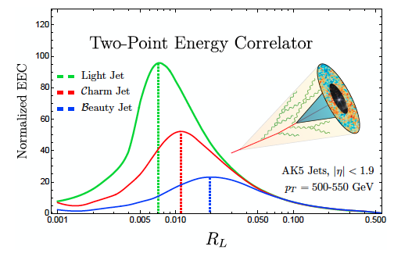
Charm jet EEC
Heavy quarks have “dead” phase space cone angle in which radiation is mass suppressed (“dead cone”)
Data analysis underway!
Craft, Lee, Mecaj, Moult arXiv:2210.09311
Small angle partonic splittings should be missing

Slide 11
What do we expect?
P. Dhankher, Beatrice Liang-Gilman, W. Fan
Dead cone
Lower jet fragment multiplicity

Slide 12
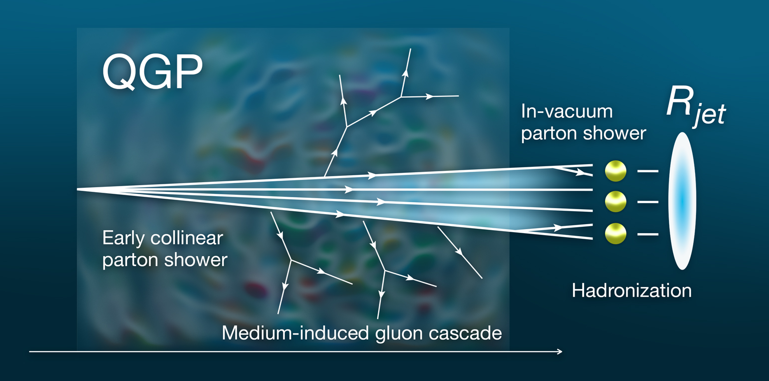
Now let jet traverse quark gluon plasma
Collisions in plasma induce more gluon splitting
Jet deposits some energy into the QGP

Slide 13
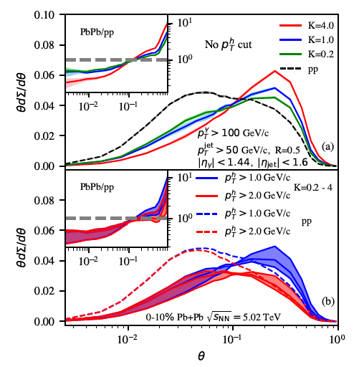
EEC’s are modified!
Yang, He, Moult, Wang arXiv:2310.01500
Medium induced partons. Larger K = larger p_{T} transfer to medium.
LBT default = 1
Energy loss & p_{T} broadening of jet shower partons
(jet fragment multiplicity & p_{T} decrease)
p_{T}^{h} cut to reduce underlying event

Slide 14
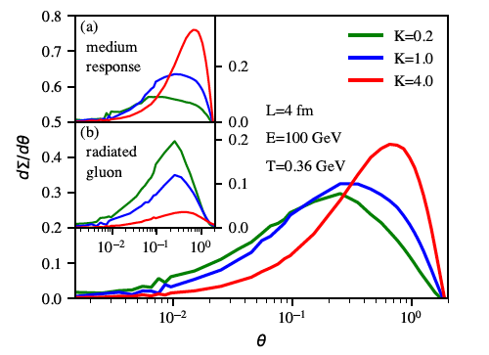
Extra radiation vs. medium response
Yang, He, Moult, Wang arXiv:2310.01500
More p_{T} transfer to the medium (larger K) → more medium response and fewer induced gluon radiations
NB: shows up in the right place in R_{L}; medium response is key
p_{T} cut rejects medium response
EECs in Pb+Pb collision data being analyzed now!

Slide 15
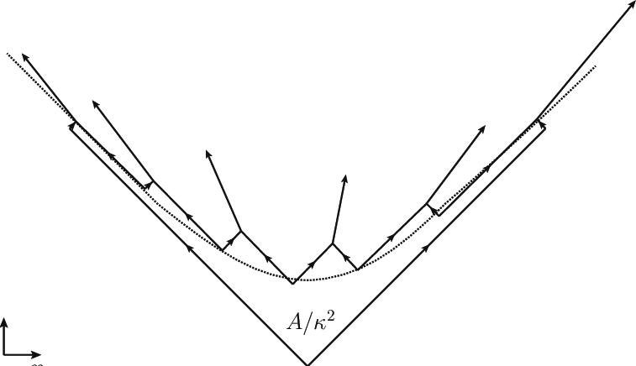
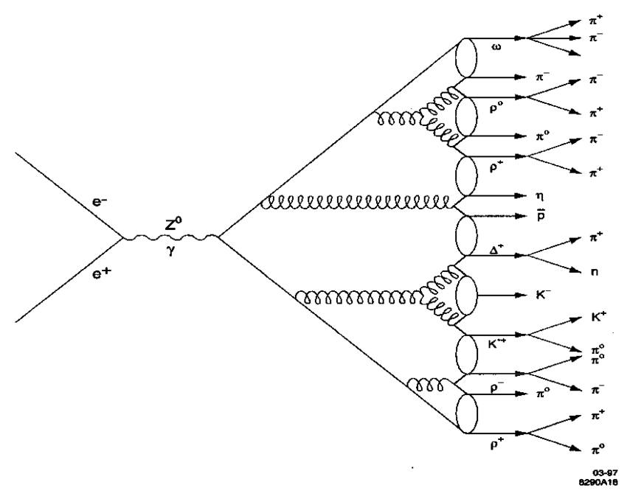
How do the partons become hadrons?
String breaking (e.g. Pythia)
String carries flavor correlations
Partons tunnel out of the string
Cluster hadronization (e.g. Herwig)
Cluster locally connected partons
After the shower is finished
Additional step, takes longer
Coalescence or Statistical Hadronization?
Connect partons which end up close by in phase space

Slide 16
Compare data to models Pythia & Herwig
Herwig closer than Pythia
Data are somewhat broader than Herwig. Longer time needed to form hadrons?!

Slide 17
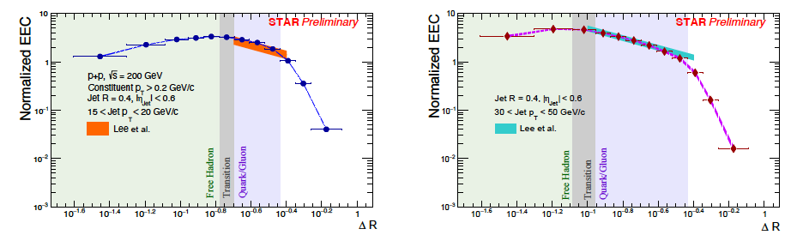
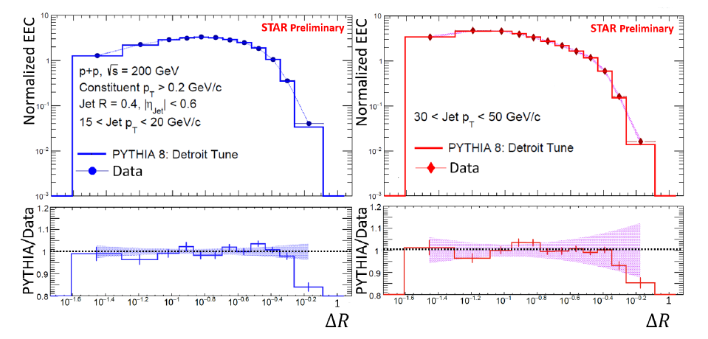
Similar results in 200 GeV pp at RHIC
arXiv:2309.05761

Slide 18
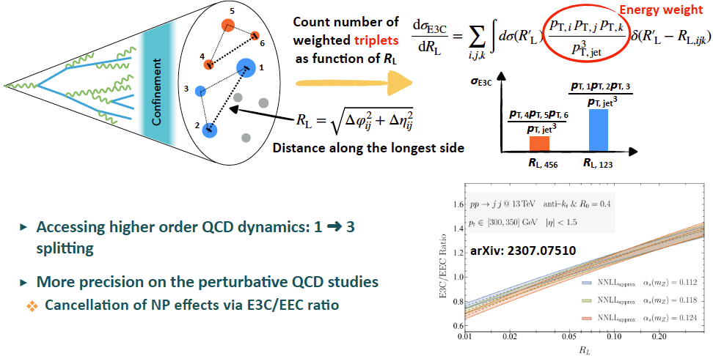
3-point energy correlators
Prediction

Slide 19
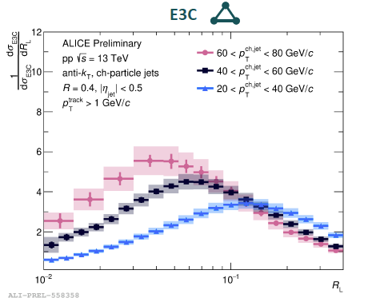
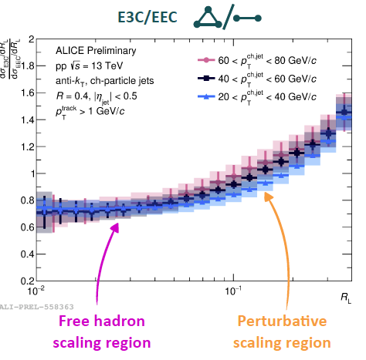
Results in 13 TeV p+p collisions
Ratio cancels NP effects & many systematic uncertainties
Universal curve in free hadron region
Perturbative region sensitive to α_{s}
  Higher jet p_{T} -> higher Q -> smaller α_{s} -> flatter slope

Slide 20
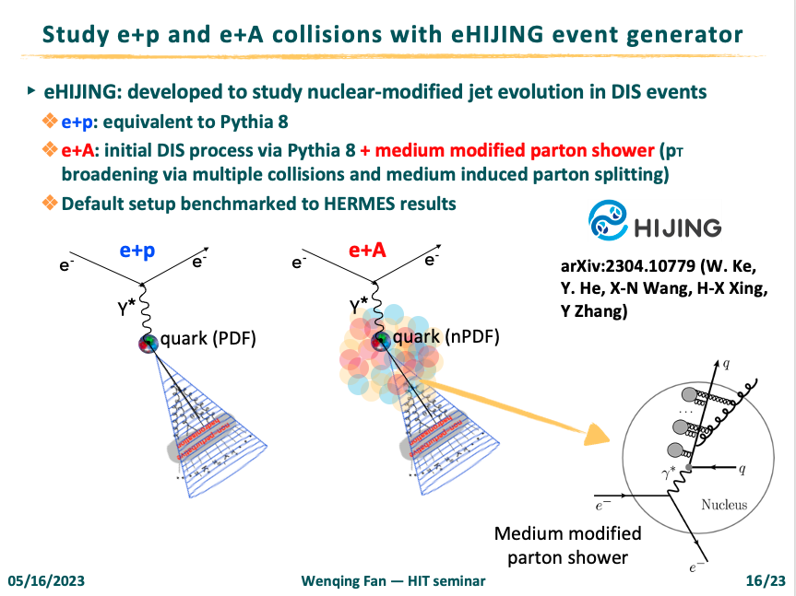

Slide 21
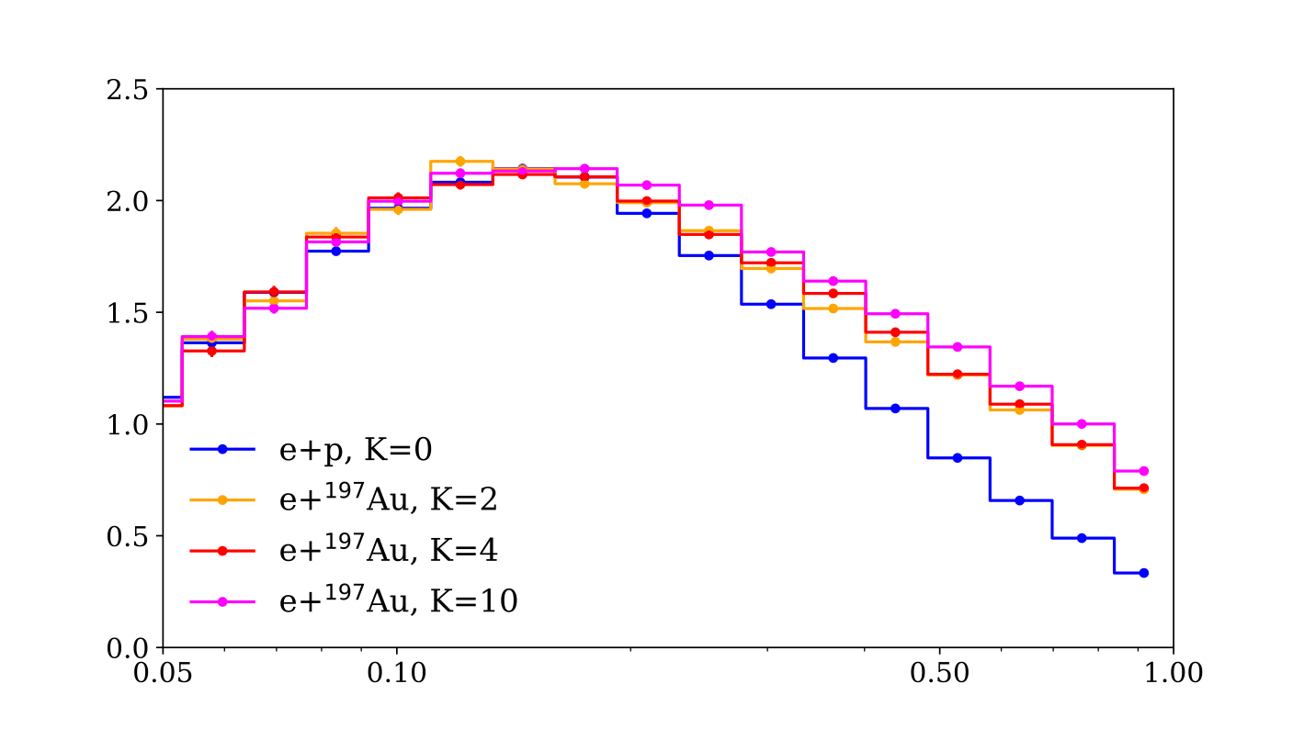
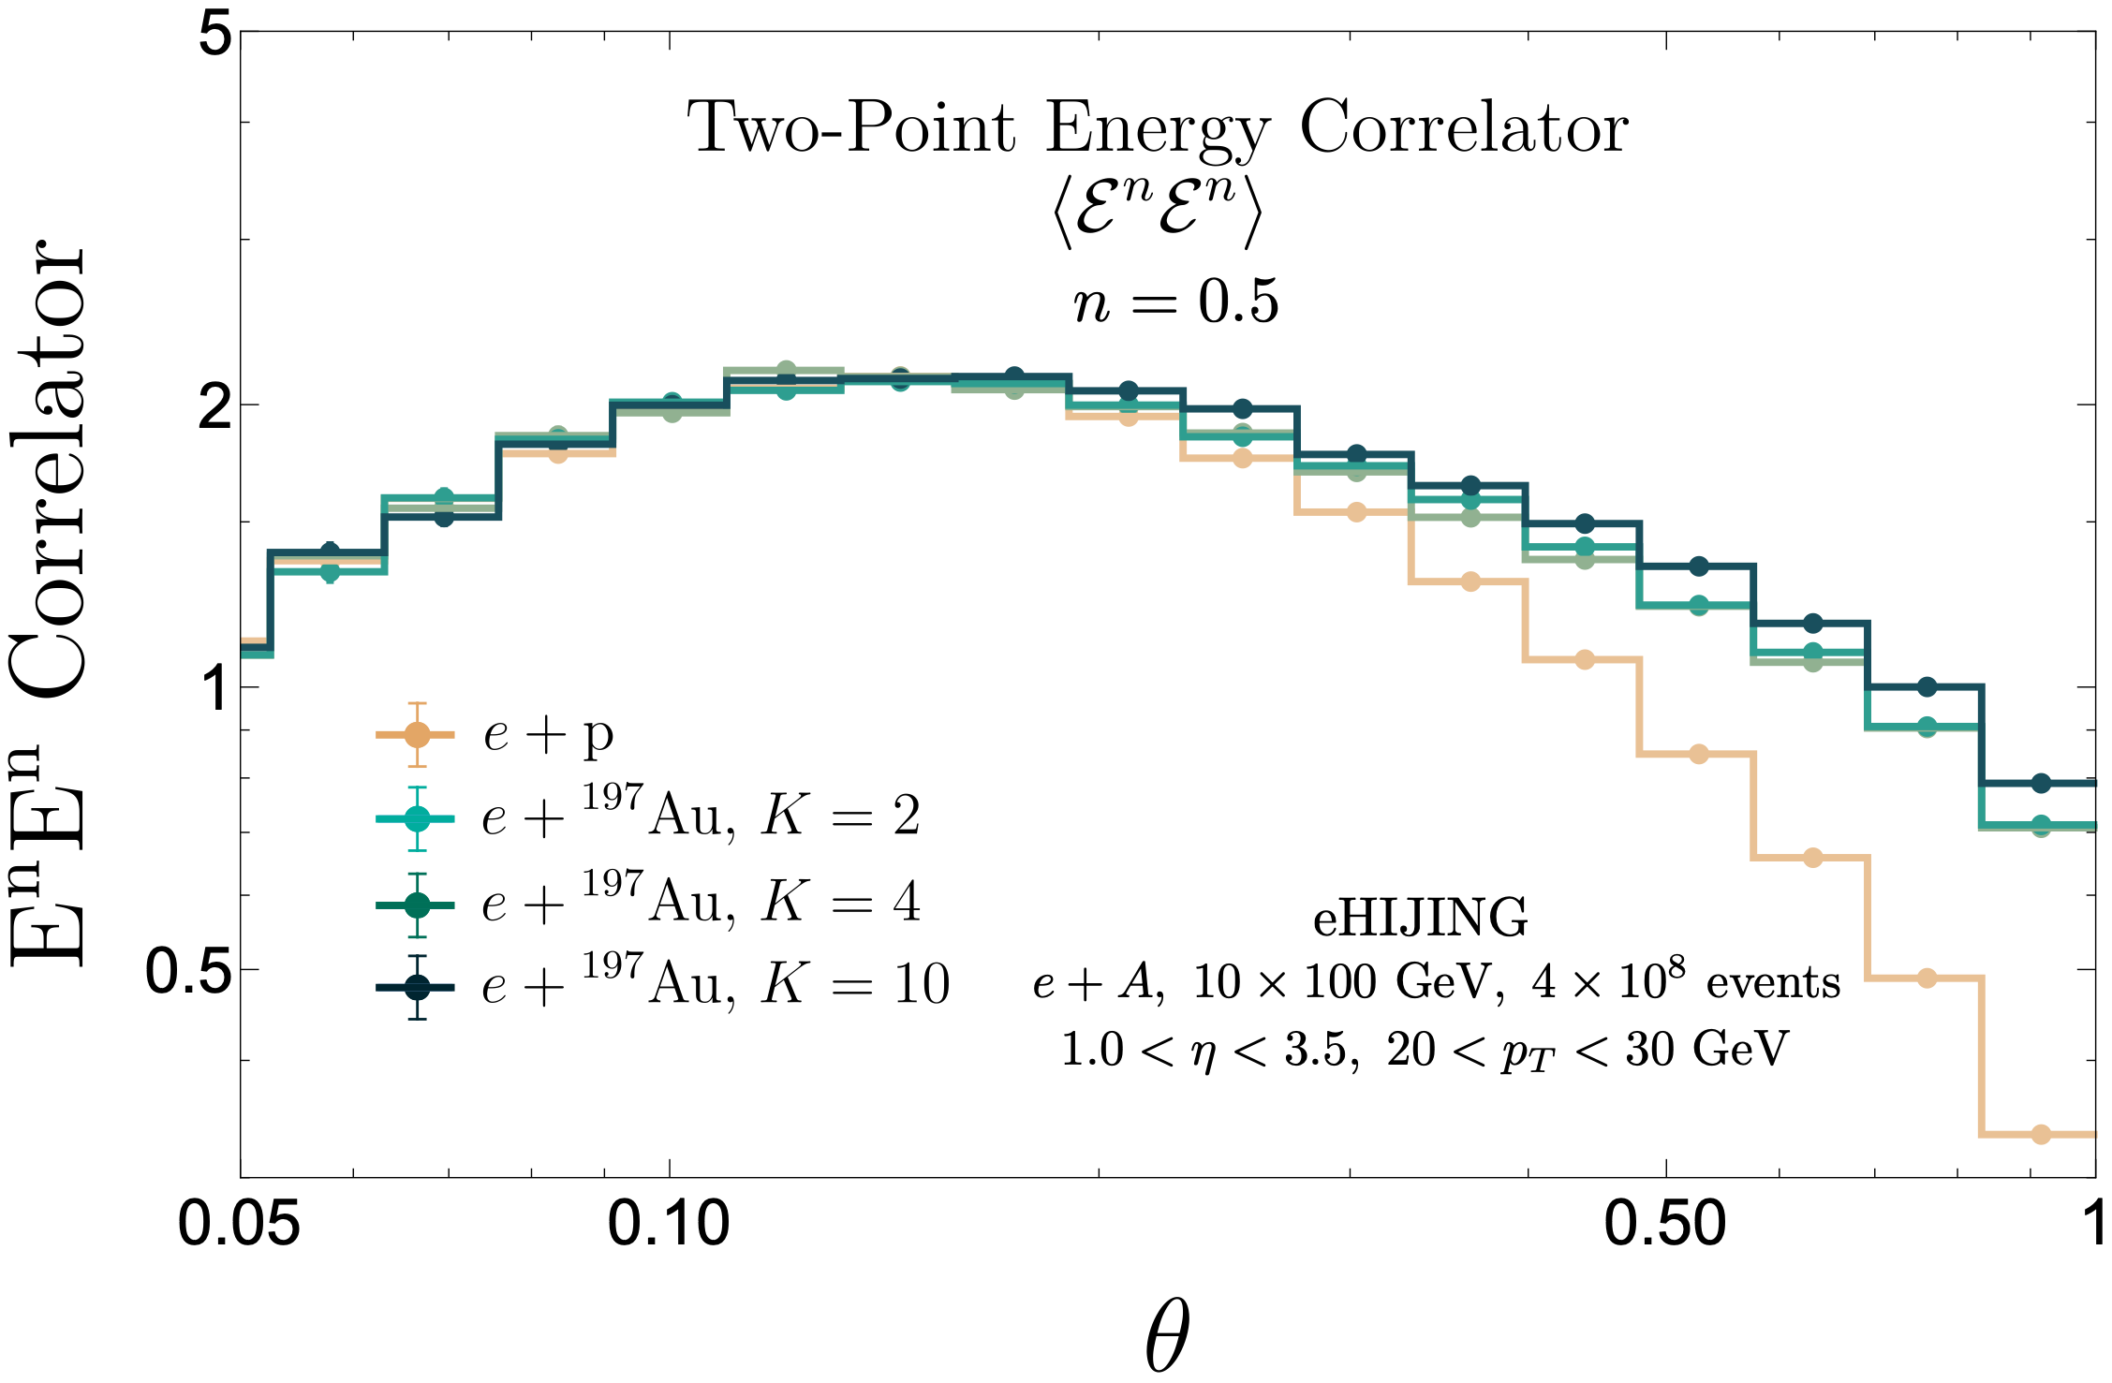
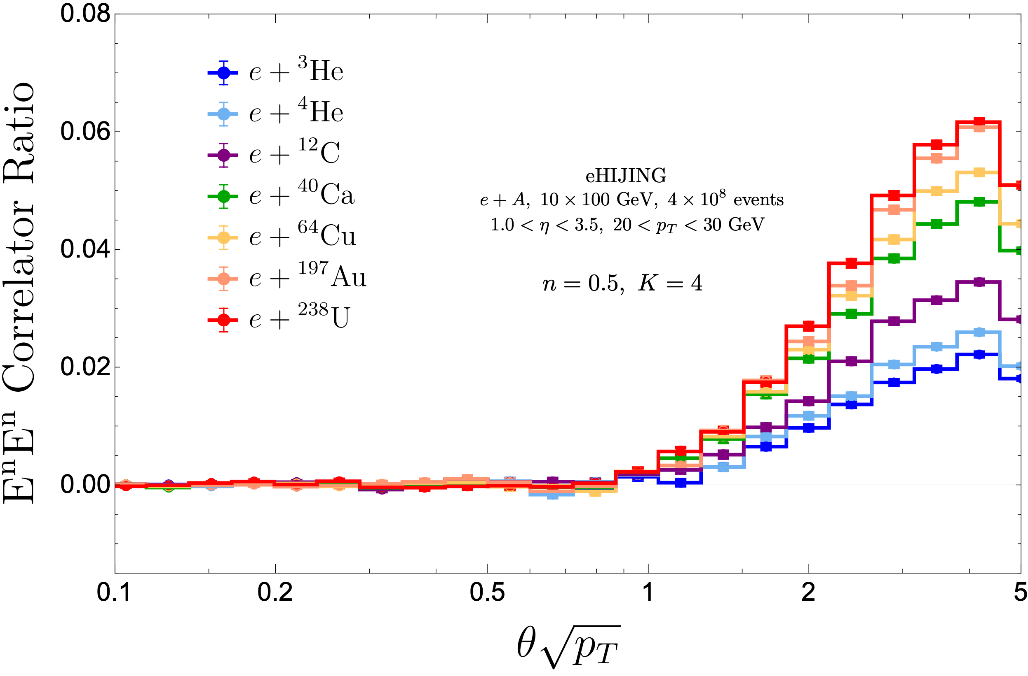

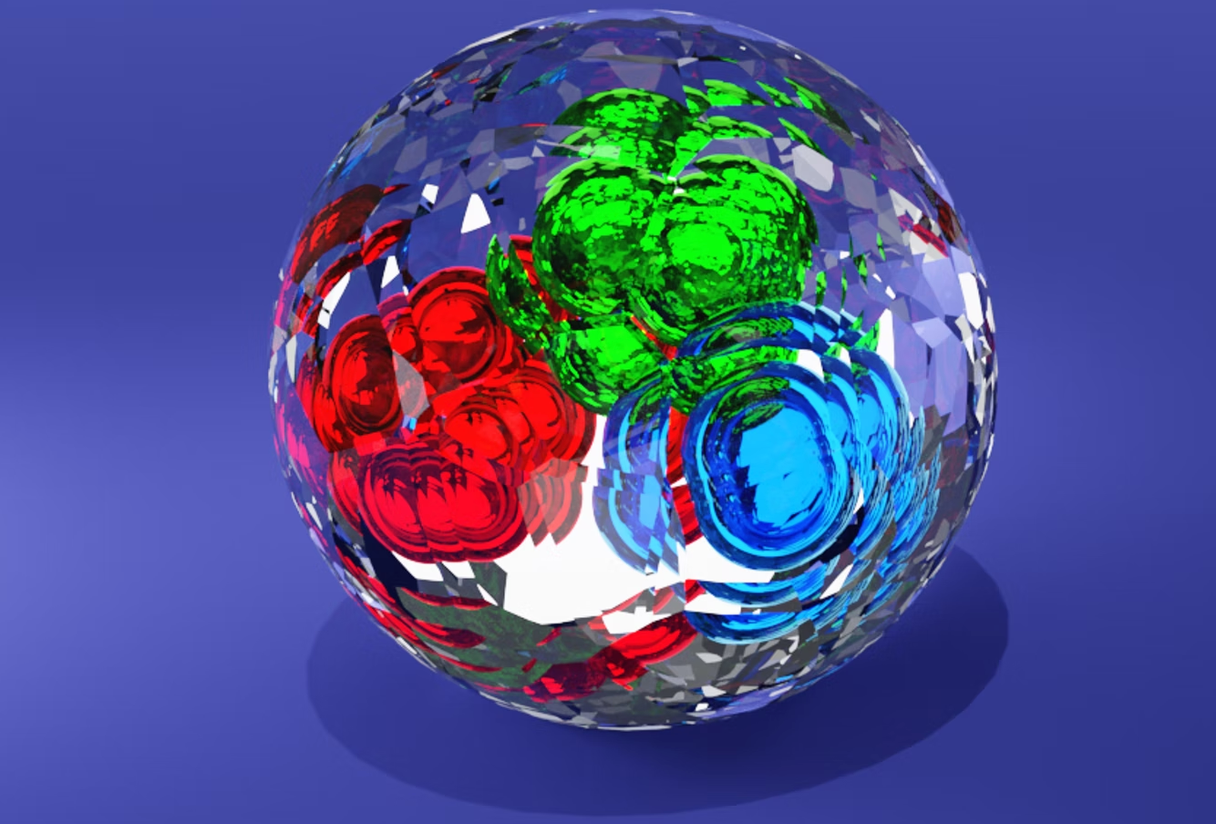
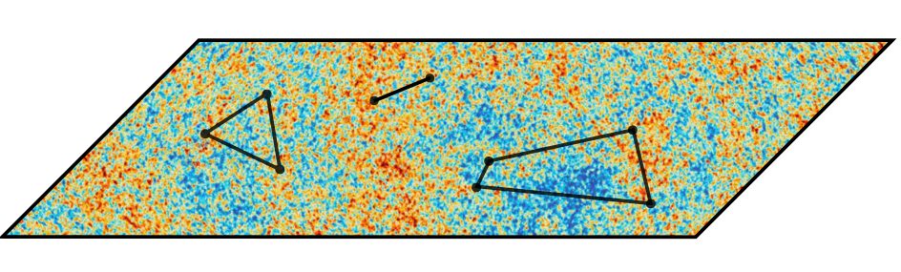
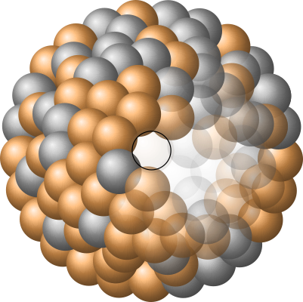

Cold nuclear matter A-dependence
Increasing 𝛕 ~1/pTθ²
Devereaux, Fan, Ke, Lee, Moult arXiv:2303.08143
Jet R=1.0, as e+p/A is cleaner
Raise weight to power n=0.5 to
enhance sensitivity to soft partons
Medium-induced splitting & collisional broadening; little E loss
θL ~ 1/(pTL)^{1/2} ~ 1/(pTA^{1/3})^{1/2}
Larger nucleus
Again more early splittings induced by the medium

Slide 22
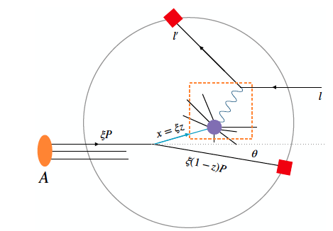
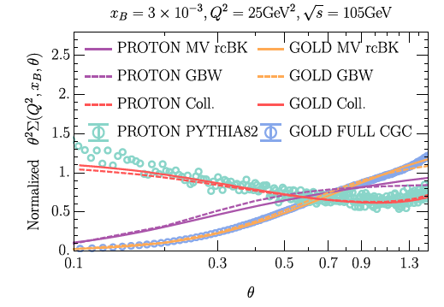
Nucleon EEC in DIS (inclusive EEC) to unveil color glass condensate
Liu, Liu, Pan, Yuan, Zhu arXiv:2301.01788
Initial-final state correlator: partonic angular distribution from intrinsic p_{T} in nucleon
Predict large suppression at small angles due to intrinsic p_{T}~Q_{s} in gluon saturation region (no collinear factorization)
Q_{s} -> deviation from monotonic
Q_{s}^{proton} ~ 𝛳 Q ~ 0.75-1.0 GeV
Q_{s}^{Au} ~ 𝛳 Q ~ 2.0-2.5 GeV

Slide 23
Summary
Energy-energy correlators → experimental QCD dynamics!
EECs in jets allow to separate scales, with R_{L} ~ 1/τ_{formation}
  Parton splittings, hadronization, hadron interactions
In pp collisions:
  Universal shape in p_{T}R_{L} (jet virtuality)
  Hadronization at p_{T}R_{L} ~ 2.4 GeV
  Heavy quark radiation patterns being studied now
Use EECs to study QCD in strongly coupled regimes
  QGP effects on parton splitting
  Measure α_{s}
  Understand hadronization
At the EIC, EECs will allow us to probe the cold nuclear matter medium, and search for saturation signals

Slide 24
backup slides

Slide 25
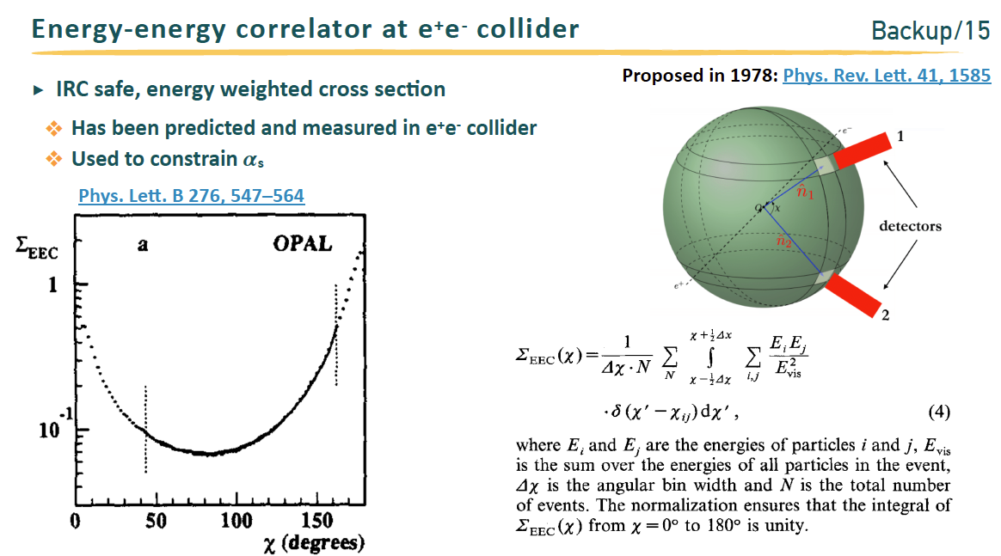
EECs first measured in e+e- collisions
Using all particles in the event

Slide 26
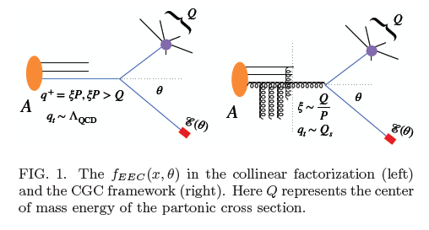
NEEC and saturation

Slide 27
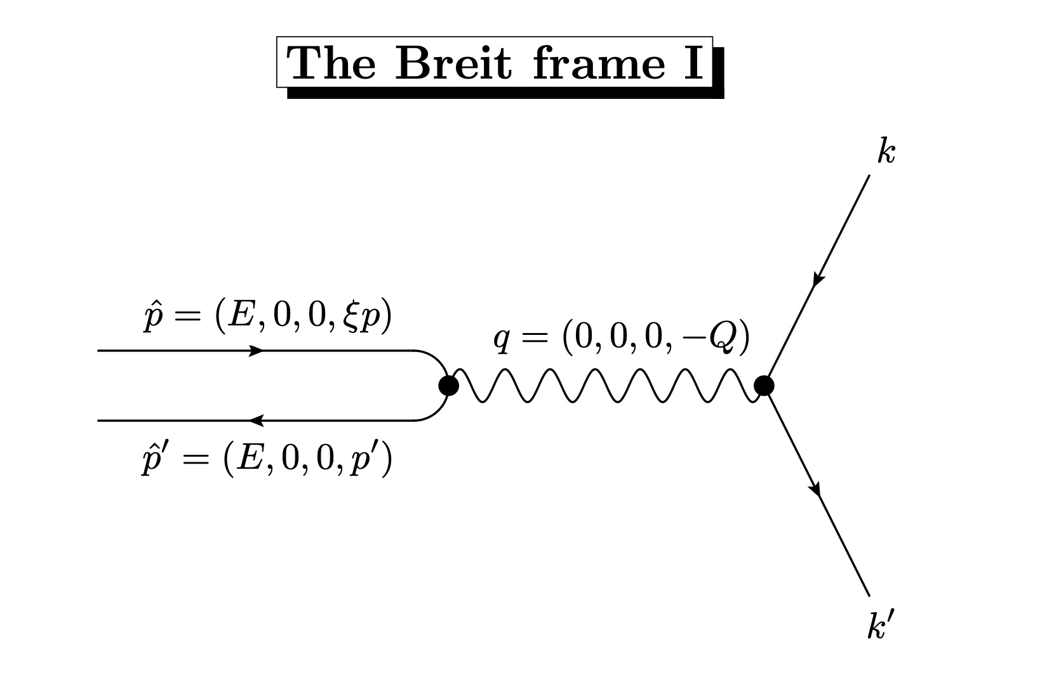

Slide 28
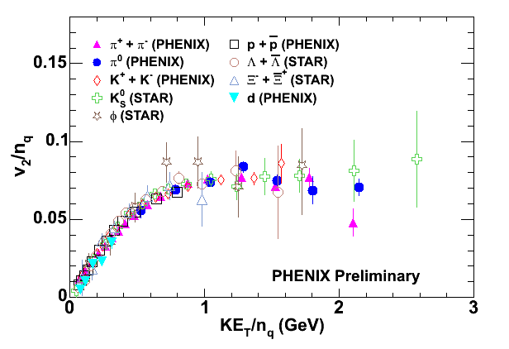
Coalescence in quark gluon plasma
valence quarks, not hadrons, are present when collective flow develops
Recombination from thermal distribution:
Fries, Mueller, Nonaka & Bass, PRC68, 044902 (2003)
Fries, J. Phys. G32, S151 (2006)
transverse KE
dressed quarks are born of flowing field
hadronize by (simple) coalescence of co-moving valence quarks
quarks (miraculously?) dressed by gluons

Slide 29
eHIJING simulations
K = 2 to 10 ➜ qhat = 0.063 to 0.172 GeV²/fm
at xB = 0.1 and Q² =1GeV²
(default tuning K=4 benchmarked to HERMES data)

Slide 30
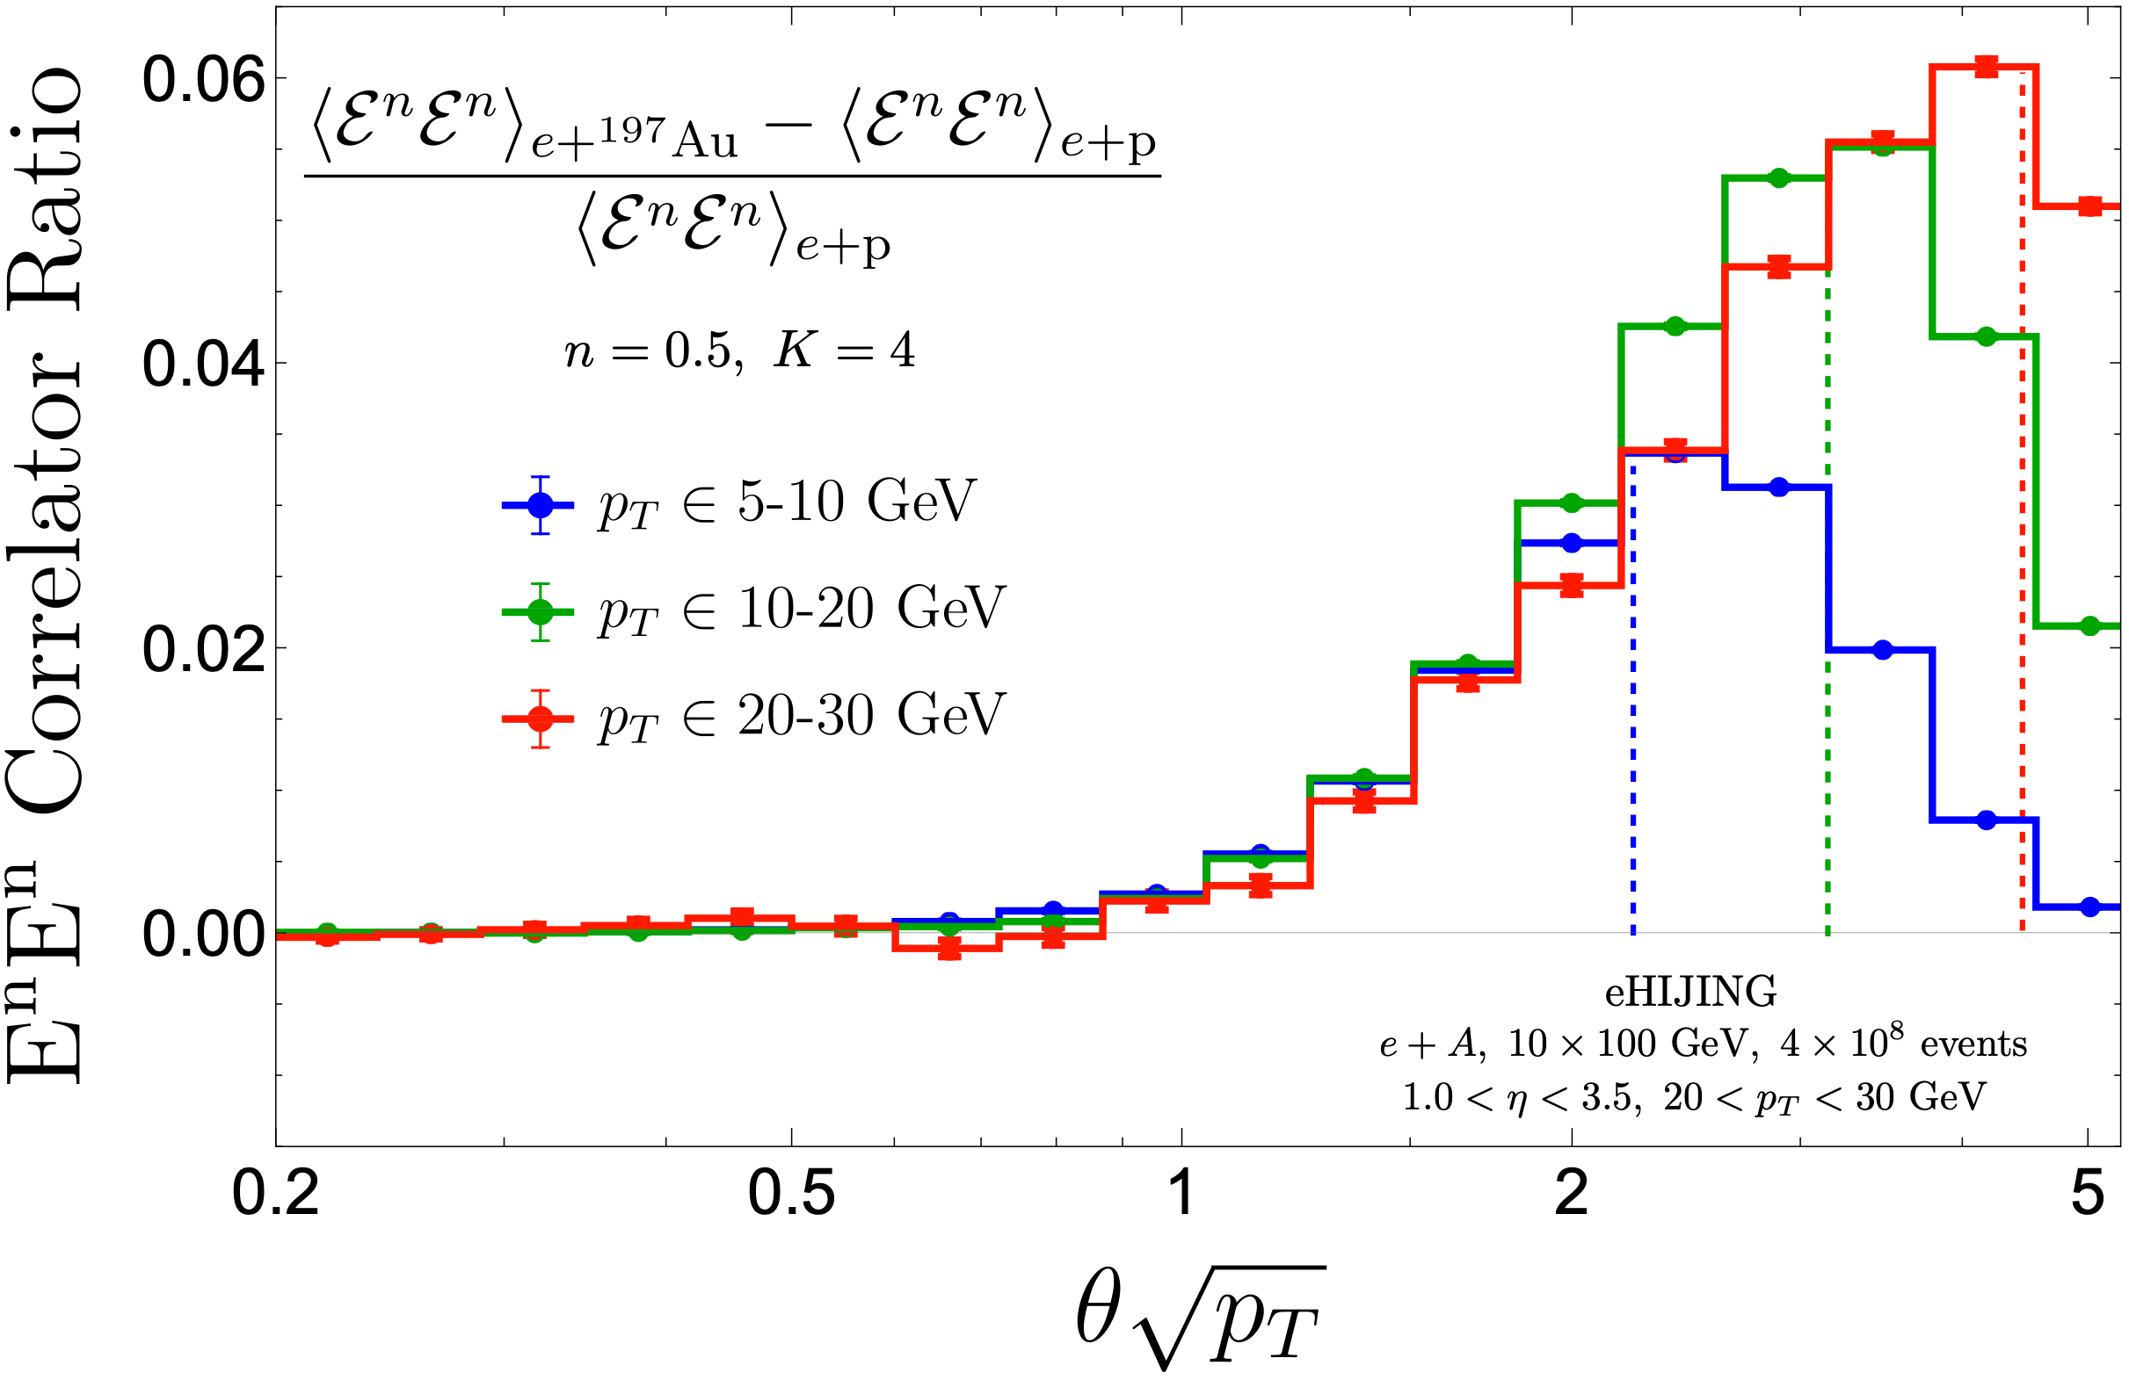
Scaling behavior of onset angle θL with jet pT
nuclear size: L
Increasing 𝛕 ~1/pTθ²
Small θ
Large θ
Onset of modification expected at 𝛕 ~ L ➜ θL ~ (pTL)^{-1/2}
Similar onset position for different jet pT after scaling θ by pT^{1/2}
Peak width further broadened by collisional effect
Edge effect from finite jet R

Slide 31
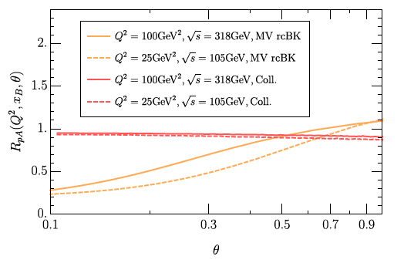
Ratio of e+p to e+A
Liu, Liu, Pan, Yuan, Zhu arXiv:2301.01788

Slide 32
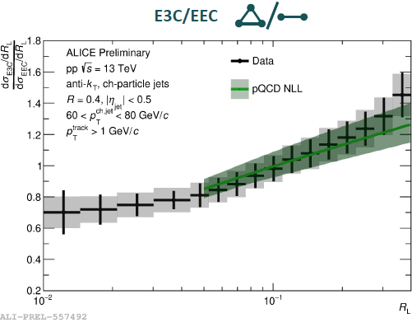
Agreement with pQCD prediction

