Slide 1
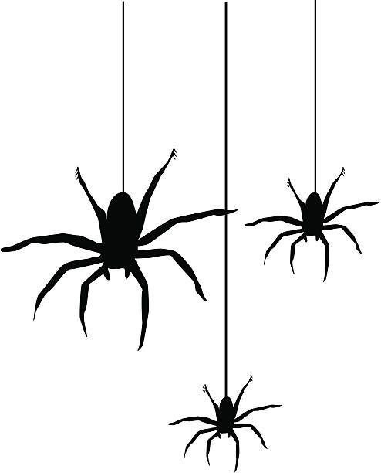
Spiders, entanglements, and RNA structure prediction
STRUCTURE AND TOPOLOGY OF RNA IN LIVING SYSTEMS
Trento, January 30 – February 2, 2023
Marta Szachniuk
Poznan University of Technology, PL
Institute of Bioorganic Chemistry PAS, PL

Slide 2
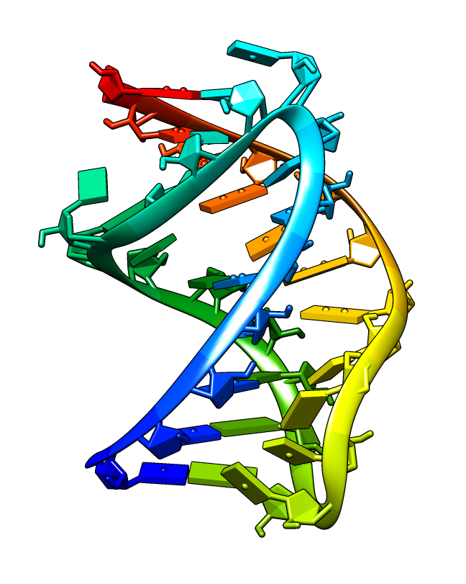
In silico prediction of RNA 3D structure
UUGGGUUCCCUCACCCCAAUCAUAAAAAGG
Ab initio folding
Homology modeling
Fragment assembly Deep learning-based prediction

Slide 3
Tools for automated prediction of RNA 3D structure (2007-2022)
Ab initio folding |  | Homology modeling |  | Fragment assembly |  | Deep Learning |  | Unknown approach
FARNA/FARFAR iFold/iFoldRNA NAST¹ SimRNA DMD² Vfold Manifold^{2,3} |  | ModeRNA CoMMiT^{2,3} |  | MC-Fold/MC-Sym RNAComposer 3dRNA |  | FARFAR-ARES DeepFoldRNA³ E2Efold-3D/RhoFold³ VQ-VAE² OpenComplex-RNA^{2,3} trRosettaRNA^{2,3} |  | LeeServer² Dfold²
¹ no more available (1 tool)
² unavailable, not yet published (8 tools)
³ not used in RNA-Puzzles, applied in CASP15 (6 tools)
20 computational methods found
8 new ones (dated 2021-2022)
6 DL-based predictors
10 available

Slide 4
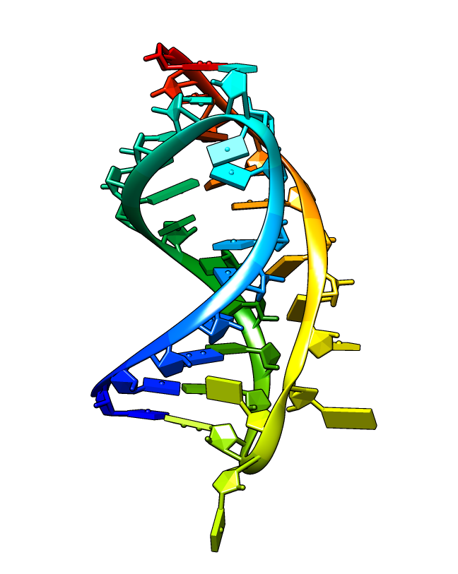
Evaluation of RNA 3D structure prediction
UUGGGUUCCCUCACCCCAAUCAUAAAAAGG
experimental structure
(reference)
predicted model
get
predict
compare
compute similarity and distance measures
INF (interaction network fidelity)
LCS (longest continuous segments)
TM-score (template modeling score)
RMSD (root mean square distance)
MCQ (mean of circular quantities)
DI (deformation index)
example measures

Slide 5
Evaluation of RNA 3D structure prediction
Can we consider the prediction as good/reliable if we only have similarity/distance measures?
What if the distance>0 (similarity<1)?
What if we do not have the reference structure?
YES, iff
reference structure is good (accurate, correct),
distance measure ≈ 0 or similarity ≈ 1.
prediction OK
reference prediction
We can evaluate the 3D structure model based on
structure parameters: clash score, bond lengths, angles, polymer linkage, chirality, planarity, handedness of helices, base-pairing geometry…
topology: structure elements and specific motifs, pseudoknots, knots, entanglements…
prediction good or not ?

Slide 6
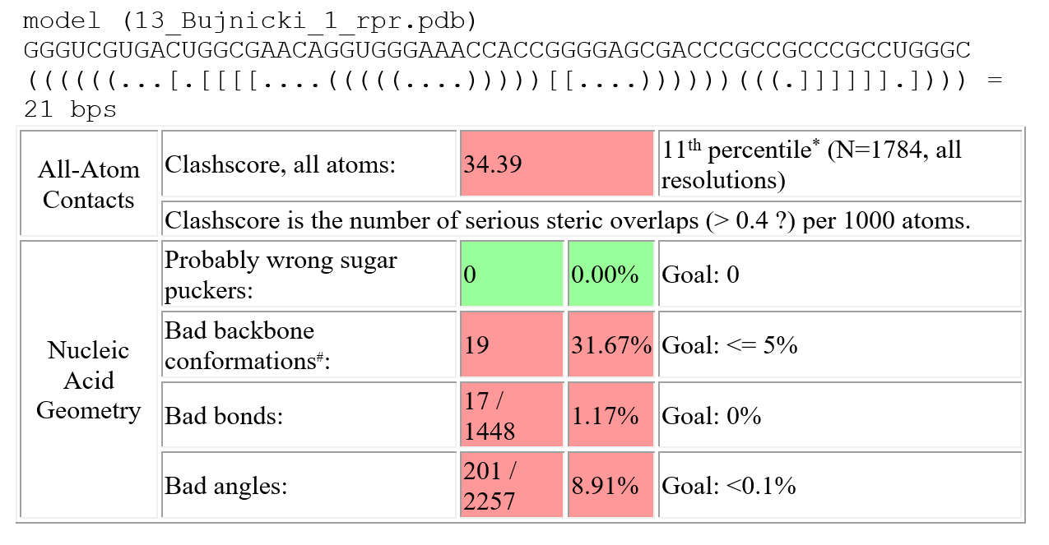
Stereochemistry-wise evaluation
MolProbity output for example RNA 3D model (scores)
Å
MolProbity | RestraintLib | RNApdbee
MAXIT | BARNABA | X3DNA/DSSR
Small local errors can be automatically corrected e.g. by MolProbity, energy minimization protocols (XPLOR, CYANA, NAMD, GROMACS…).
clash score bond lengths torsional angles
polymer linkage chirality planarity
handedness of helices geometry of base pairs
Carrascoza et al. (2022) Evaluation of the stereochemical quality of predicted RNA 3D models in the RNA-Puzzles submissions, RNA 28(2):250-262

Slide 7
Topology-wise evaluation
Does the model contain the expected structural elements or motifs (apical loops, bulges, tetrads etc)?
Does the model contain entanglements of structure elements? Are they structural anomalies?
Does the model contain pseudoknots? Should it be pseduknotted or not?
Does the model contain molecular knots?

Slide 8
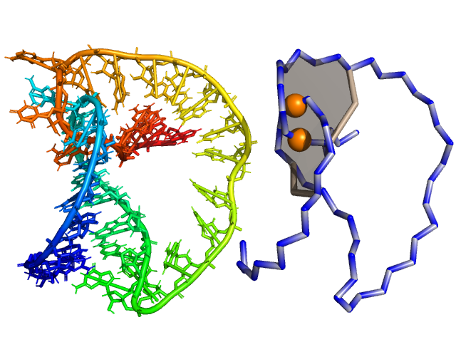
Entanglements of structure elements
structure elements
entanglement
one element threads through the other
dinucleotide step (2 consecutive bps)
loop
single strand, not closed by base pair(s)

Slide 9
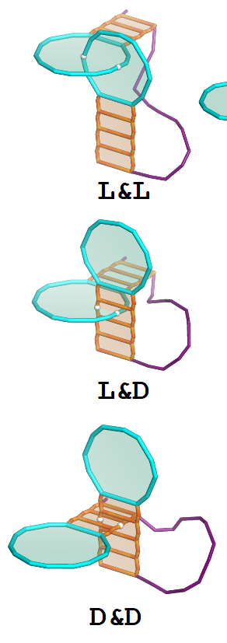
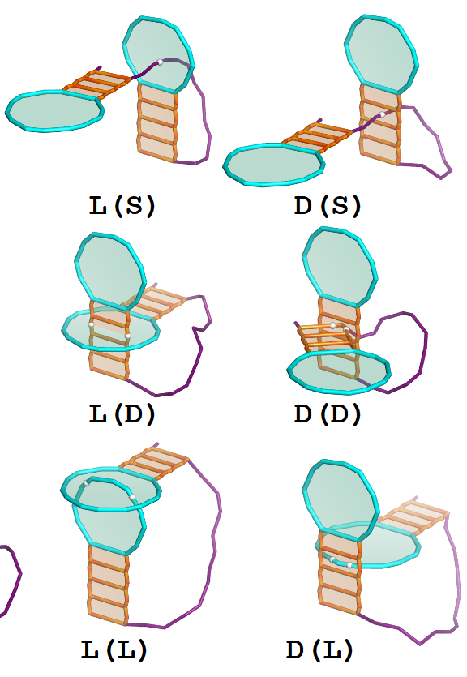
Types of entanglements
interlace
lasso
Entanglement classification
by topology
& interlace
() lasso
by structure element
L loop
D dinucleotide step
S single strand
Popenda et al. (2021) Nucleic Acids Res 49(17):9625–9632
In molecular chemistry:
catenane (interlace)
rotaxane (lasso with no possibility to disentangle)

Slide 10
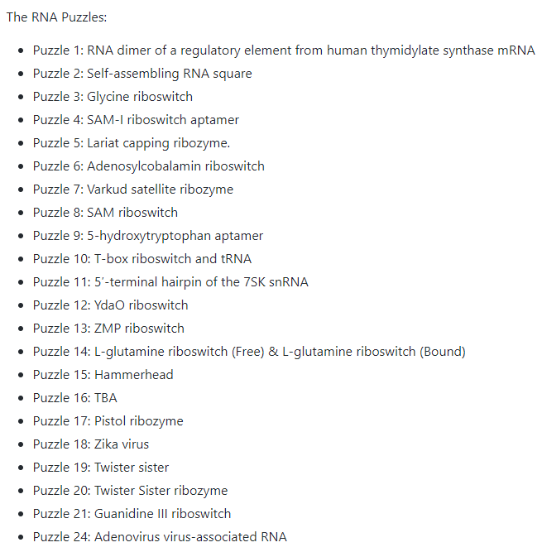
Looking for entanglements in predicted RNA structures
https://github.com/RNA-Puzzles
Magnus et al. (2020) Nucleic Acids Res 48(2):576–588
Github repository
22 challenges
22 target RNA structures (X-ray)
1,028 predicted RNA 3D models
Test set (predicted models)
995 non-redundant RNA 3D structures
226 predictions in webserver category
769 predictions in human category

Slide 11
Entanglements in predicted RNA structures
Entangled structures
Entanglements
14%
201
structures with entanglements
entanglements in 138 models
68%
have 1 entanglement
18%
Interlaces
L&L, D&L, D&D
23%
have 2 entanglements
4%
have 3 entanglements
82%
Lassos
L(S), L(D), L(L), D(D)
not found: D(S), D(L)
3.6%
have 4 entanglements
0.7%
have 5 entanglements

Slide 12
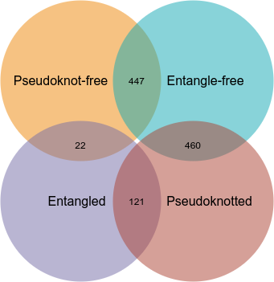
Occurrence of entanglements
No correlation with RMSD, Clash score, molecule size
Strong correlation with pseudoknots
(469)
(907)
73% of all lassos
60% of all interlaces
The probability of entanglement in pseudoknotted RNA is 4x higher than in non-pseudoknotted structure.
formed in the pseudoknotted structures
(143)
(581)

Slide 13
Which methods predict entangled structures?
In fragment assembly-based methods
In ab initio folding methods when they use coarse-grained models
full-atom reconstruction stage
assembly stage

Slide 14
Looking for entanglements in experimental RNA structures
PDB repository (data downloaded: August, 2022)
5348 RNA structures
3356 from X-ray
1282 from Electron Microscopy
710 from NMR
https://www.rcsb.org/

Slide 15
Entanglements in experimental RNA structures
Dataset of experimental structures analyzed for entanglements
 | The number of structures by experimental method |  |  | Total
 | Electron Microscopy | NMR | X-ray diffraction
Entangled | 426 | 1 | 538 | 965
Non-entangled | 856 | 709 | 2,818 | 4,383
Total | 1,282 | 710 | 3,356 | 5,348
18%
Number of identified entanglements by type
Type | D&D | D&L | L&L | D(S) | D(D) | D(L) | L(D) | L(S) | L(L) | Total
Number | 2 | 2 | 7 | 1 | 4 | 4 | 18 | 2,026 | 38 | 2,102
interlaces
0.5%
lassos
95.5%

Slide 16
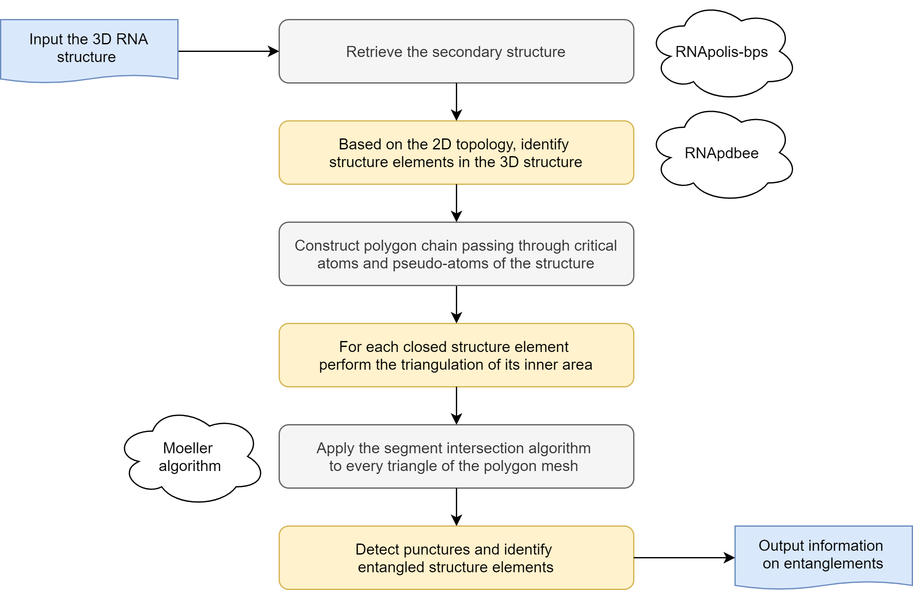
Spider algorithm: find punctures, detect entanglements

Slide 17
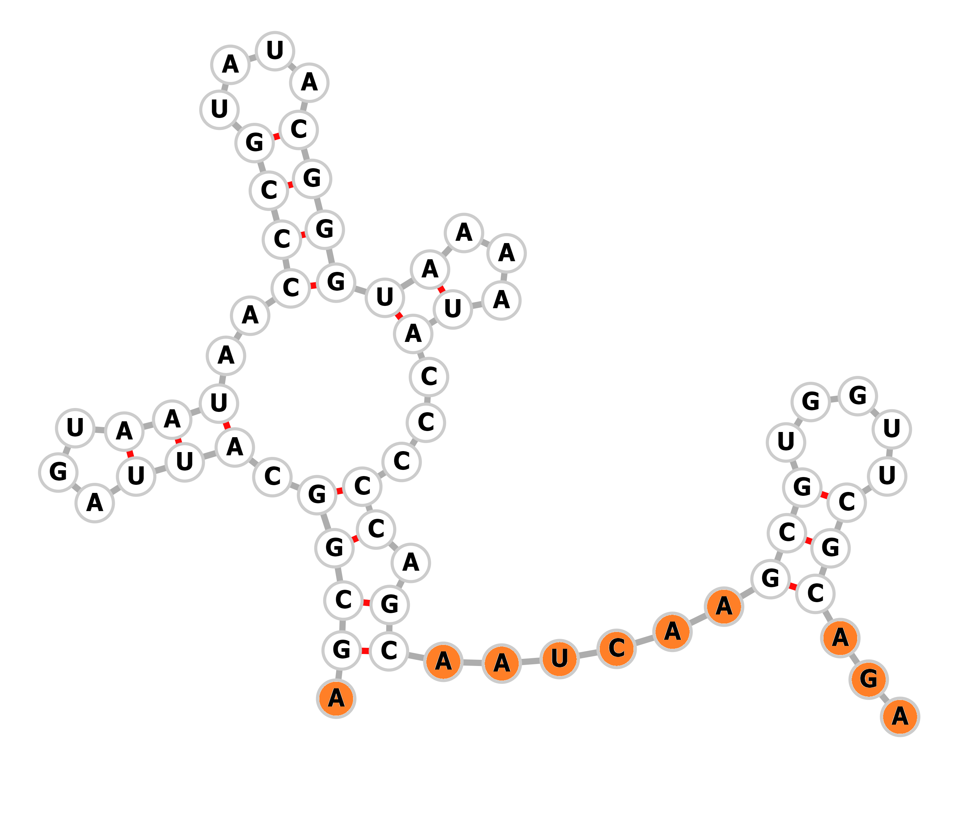
Open and closed structure elements
Closed elements
loop
dinucleotide step
Open elements
dangling end
single strand between the motifs

Slide 18
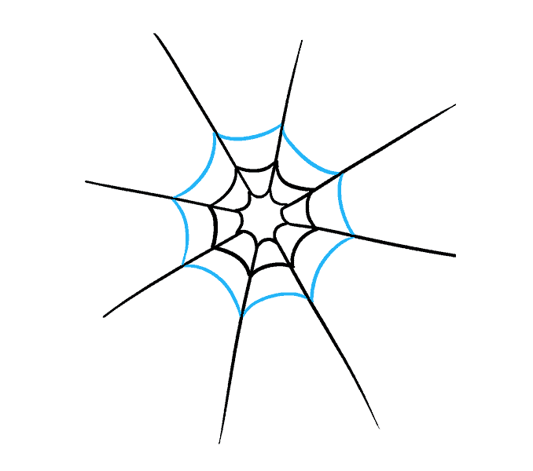
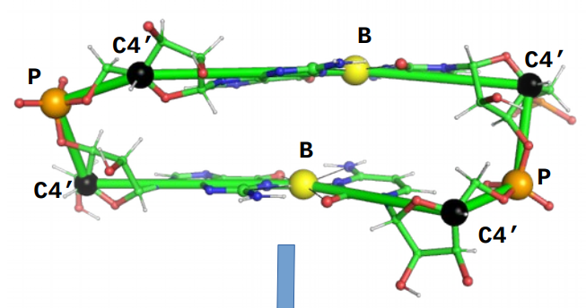
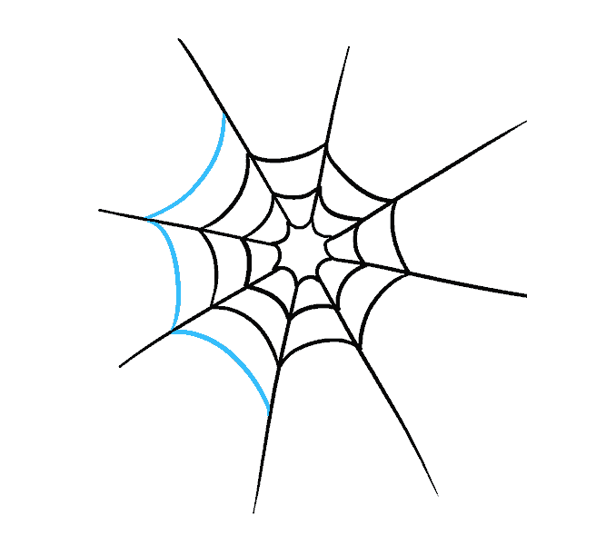
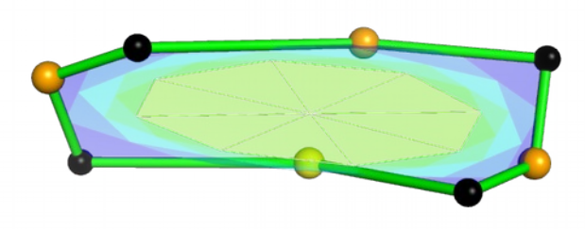
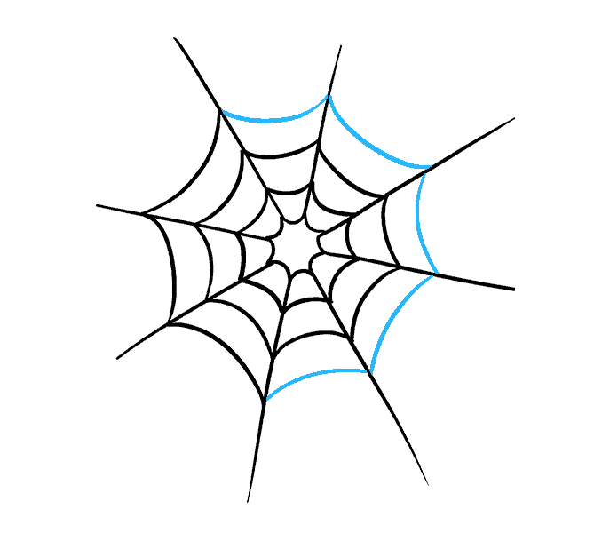
Triangulation procedure
Create the simplified representation of every structure element (e.g., poligon chain through selected atoms of the backbone).
Every point in the poligon chain = vertex₀.
Add all vertices labelled as vertex₀ to the vertex set V.
For each vertex in V create a triangle: v_{i} in V = one vertex of the triangle, middle point of every edge adjacent to v_{i} =second and third vertex of the triangle.
Add all new vertices to V.
Repeat steps 4-5 recursively.

Slide 19
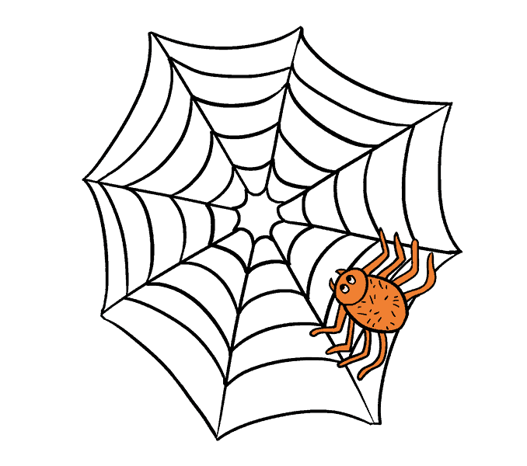
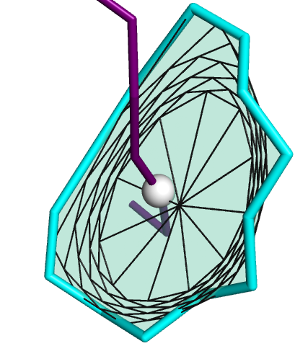
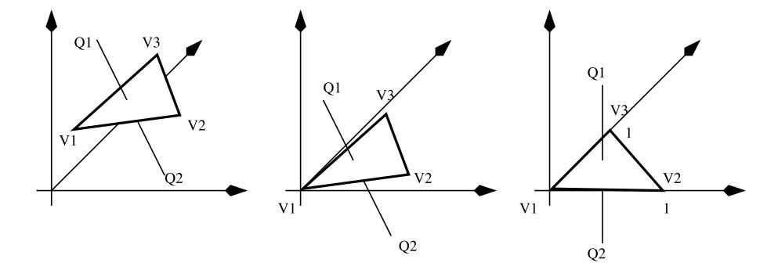
Puncture detection
Moeller algorithm to find is the ray intersects the triangle
project the 3D coordinates to 2D,
compute coordinates of the intersection point,
find whether the intersection point lies within the triangle
Moeller and Trumbore (2005) Fast, minimum storage ray/triangle intersection. In ACM SIGGRAPH 2005 Courses on - SIGGRAPH’05. ACM Press.
Jiménez et al. (2010) A robust segment/triangle intersection algorithm for interference tests. Efficiency study. Computational Geometry: Theory and Applications 43: 474492.

Slide 20
Identifying entanglements of structure elements

Slide 21
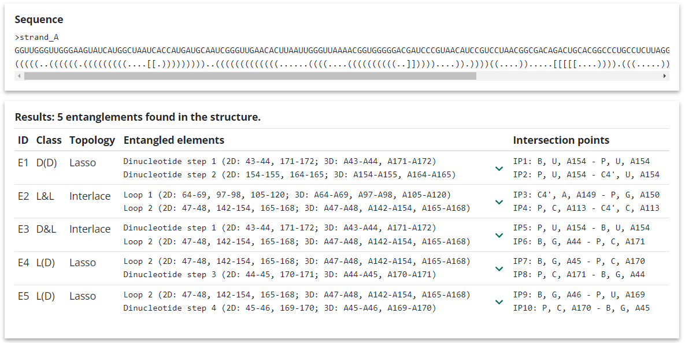
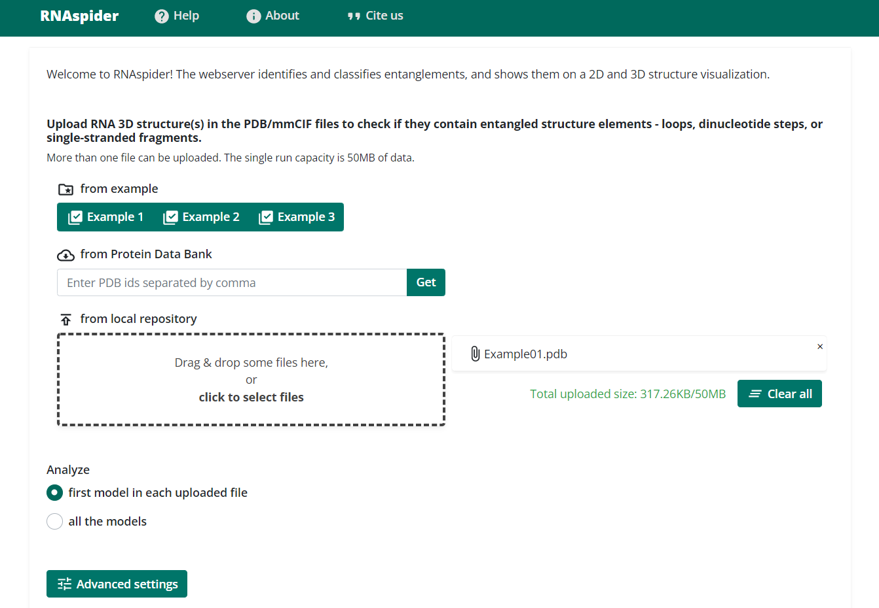
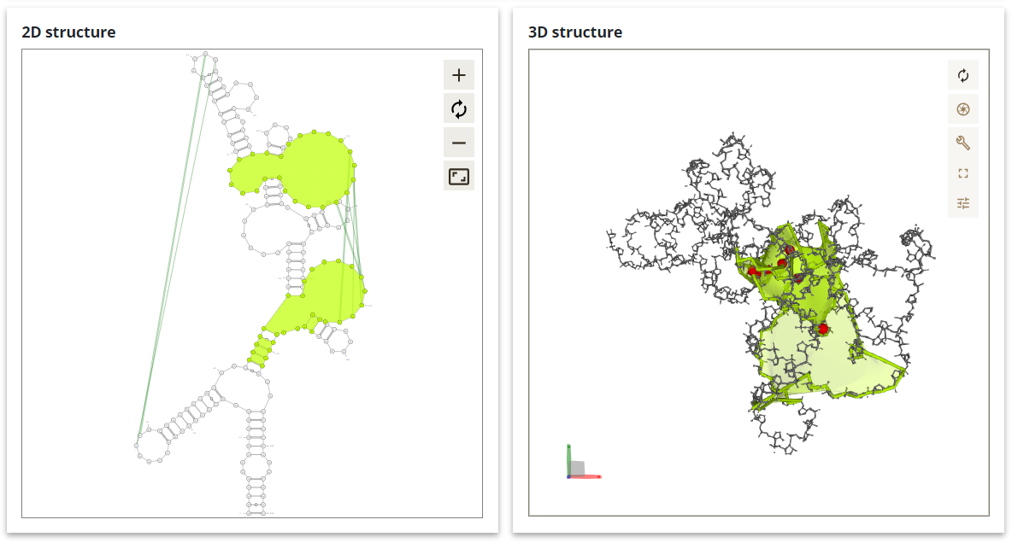
RNAspider: https://rnaspider.cs.put.poznan.pl
Luwanski et al. (2022) RNAspider: a webserver to analyze entanglements in RNA 3D structures, Nucleic Acids Research 50(W1):W663-W669

Slide 22
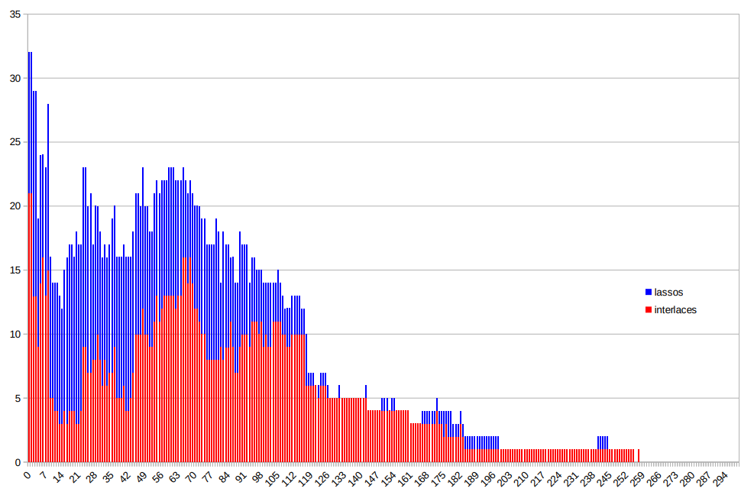
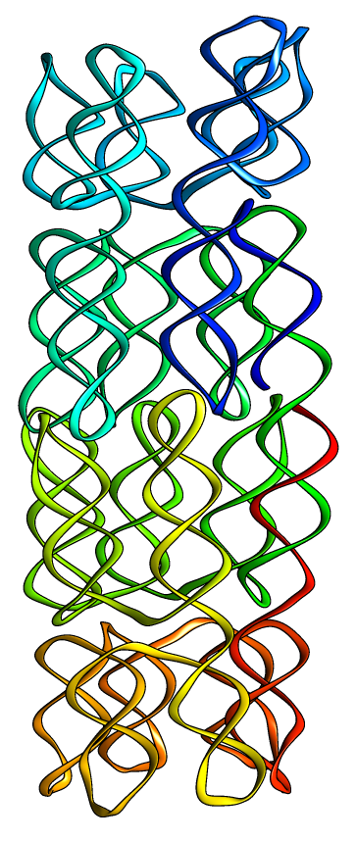
Can we automatically remove entanglements?
Some of them can be removed during energy minimization.
Example from CASP15
Target R1138, 720nt
our final
3D model
Number of entanglements in consecutive iterations of energy minimization by CYANA
minimization
entanglements
55
↓
0
INF
0.912
↓
0.984

Slide 23
Final remarks: knots and entanglements
Knots found in organic molecules are of two types:
spliknots
pseudoknots.
None of these categories are topological knots.
First organic knots
DNA - found by Liu et al. in 1981.
proteins - suggested by J. Richardson in 1977 and confirmed by M. Mansfield in 1994.
Chemically synthesized molecules can contain other types of knots.
First synthesized knot reported by Sauvage et al. in 1989.
KnotProt – a database of proteins with knots (Jamroz et al., 2015) https://knotprot.cent.uw.edu.pl/
If there’s anything you want to know about topological knots in RNA, ask Cristian Micheletti
Pseudoknot: helix formed by base-pairing of two structure elements (e.g., two loops, loop and single stranded fragment)
Slipknot: twisted loop is pierced through another loop
A slipknotted protein (PDB ID: 2J85, chain A).
Figure from PhD thesis by A. Jarmolinska, 2019.

Slide 24
Final remarks: knots and entanglements
How are molecular knots identified?
knot_pull traces molecule backbone, the secondary structure is not taken into account
Knot_pull cannot identify all types of entanglements of structure elements.
How are entangled structure elements identified?
RNAspider examines the mutual alignment of structural elements. It takes into account both the backbone and pairings of nucleotides.
RNAspider can detect slipknots and all other types of knots identified by knot_pull. It is because all of them have punctures.
http://github.com/dzarmola/knot_pull
https://rnaspider.cs.put.poznan.pl
Jarmolinska et al. (2020) Knot_pull—python package for biopolymer smoothing and knot detection, Bioinformatics 36(3): 953-955
Luwanski et al. (2022) RNAspider: a webserver to analyze entanglements in RNA 3D structures, Nucleic Acids Research 50(W1):W663-W669

Slide 25
Take home messages
Entanglements of structure elements are found in the experimental and predicted RNA 3D structure models.
Possible reasons of the occurence of „unwanted” entanglements:
poor resolution → experimental
improper fragment assembly → predicted
careless convertion from coarse-grained to atomic structure → predicted
Automated identification of entanglements is possible with RNAspider
webserver: https://rnaspider.cs.put.poznan.pl
computing scripts: https://www.cs.put.poznan.pl/mantczak/spider.zip
Some entanglements are removed during energy minimization process.

Slide 26
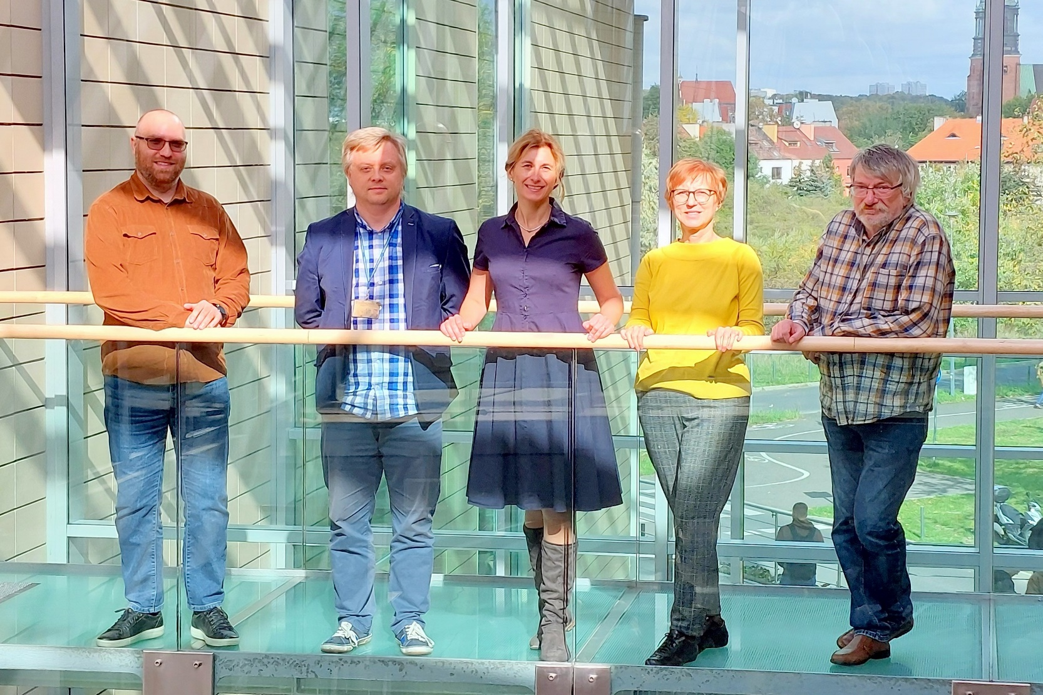
Acknowledgments
Team in the RNAspider project
Maciej Antczak
Mariusz Popenda
Joanna Sarzyńska
Tomasz Zok
Marta Szachniuk
Funding parties
National Science Center, Poland [2019/35/B/ST6/03074]
Poznan University of Technology [0311/SBAD/0705]
Institute of Bioorganic Chemistry, PAS

