Slide 1







Reservoir Computing Model For Multi-Electrode Electrophysiological
Data Analysis
ALPACA workshop, Trento 20-24 November 2023
Ilya Auslender, University of Trento

Slide 2
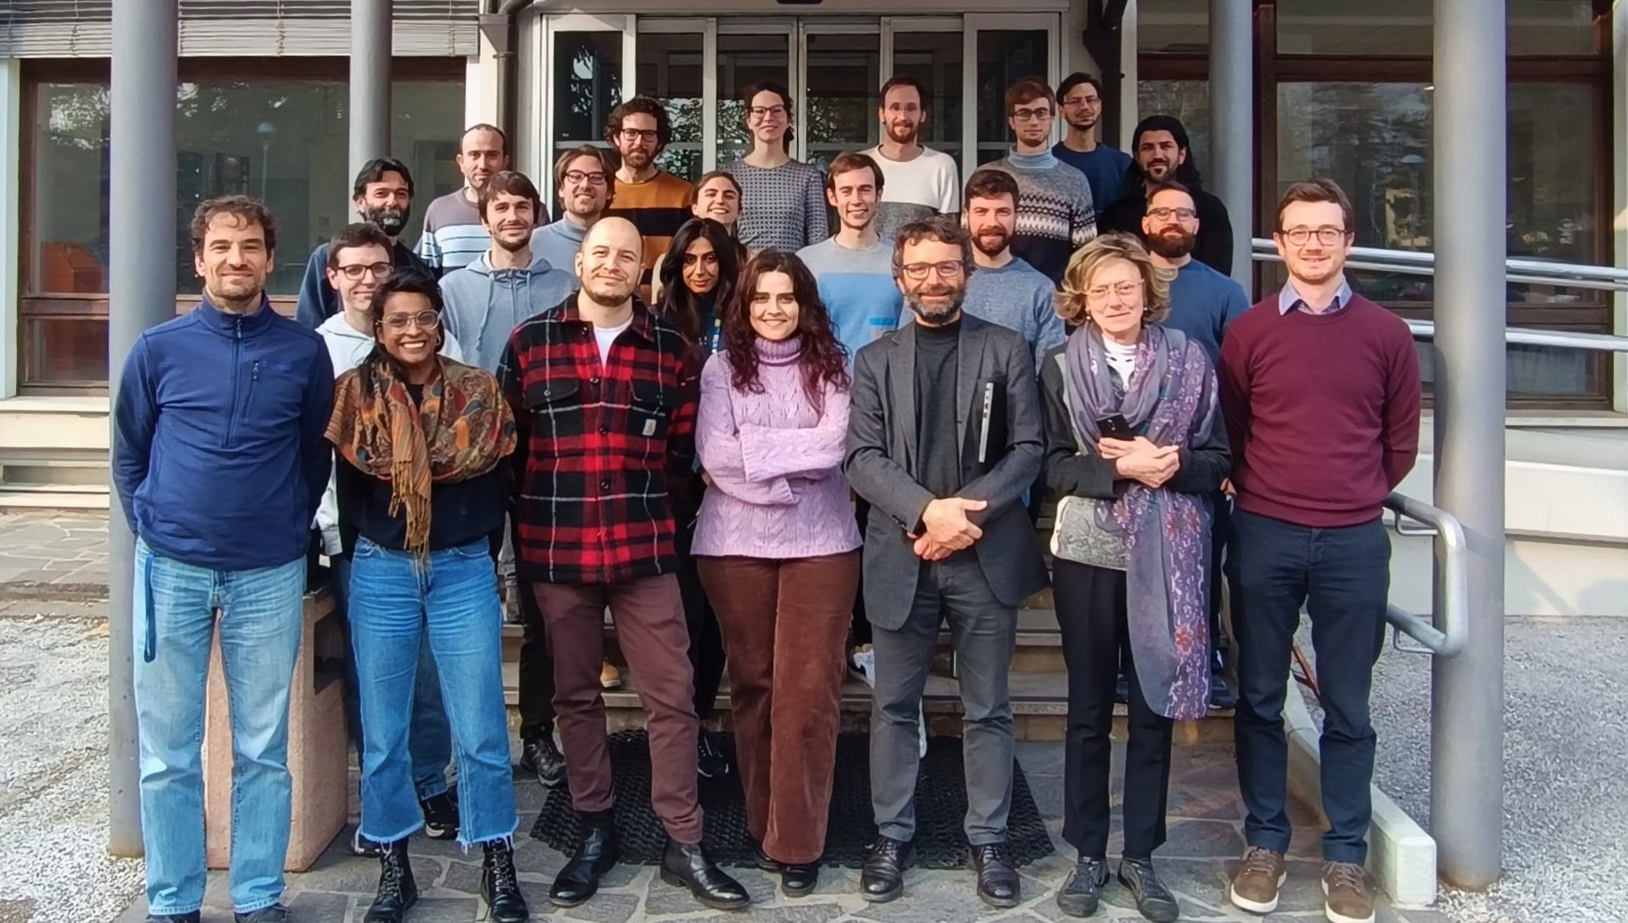

Slide 3

This Photo by Unknown Author is licensed under CC BY-NC-ND

Slide 4
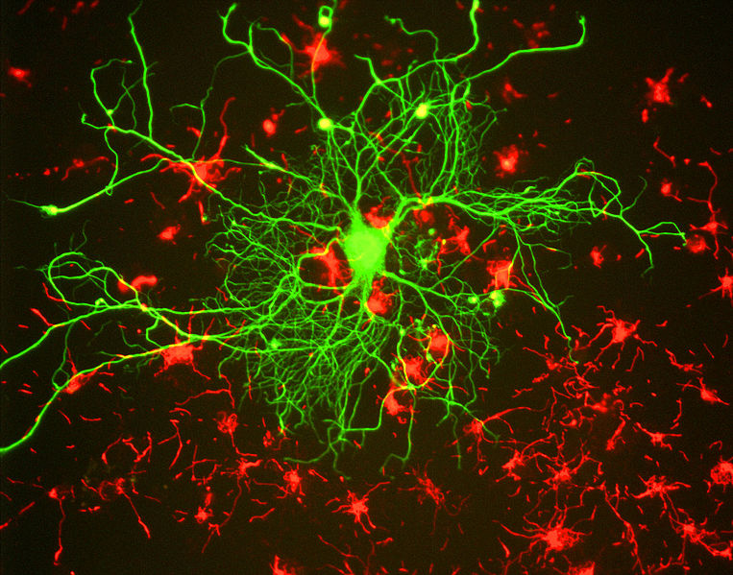
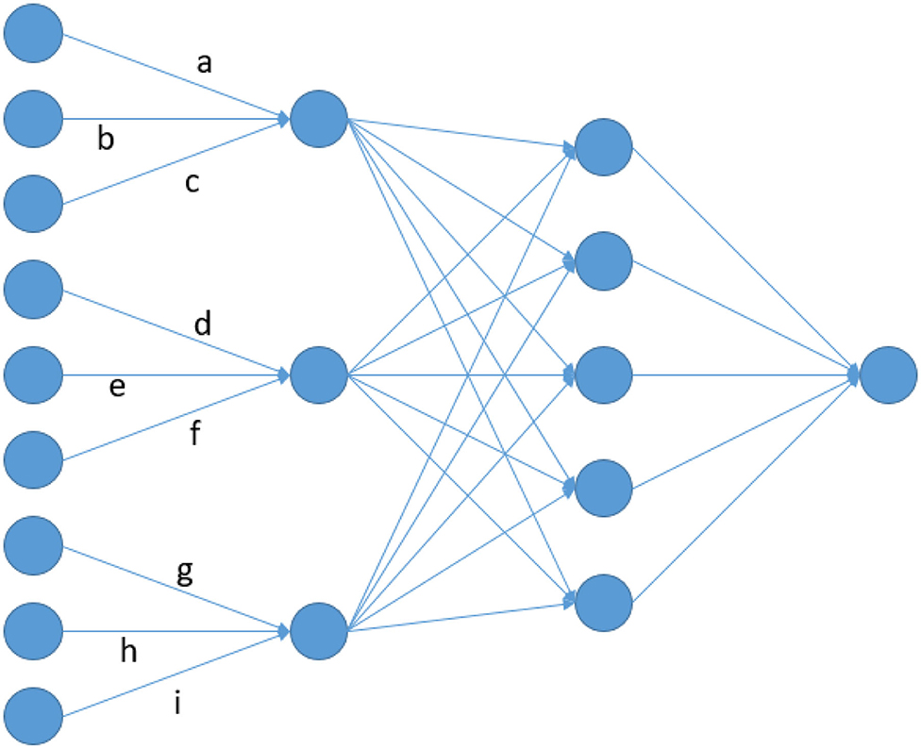
Biological Vs. Artificial NN
Biological neural network
Artificial neural network
Are they interchangeable?
Can `they interact?

Slide 5
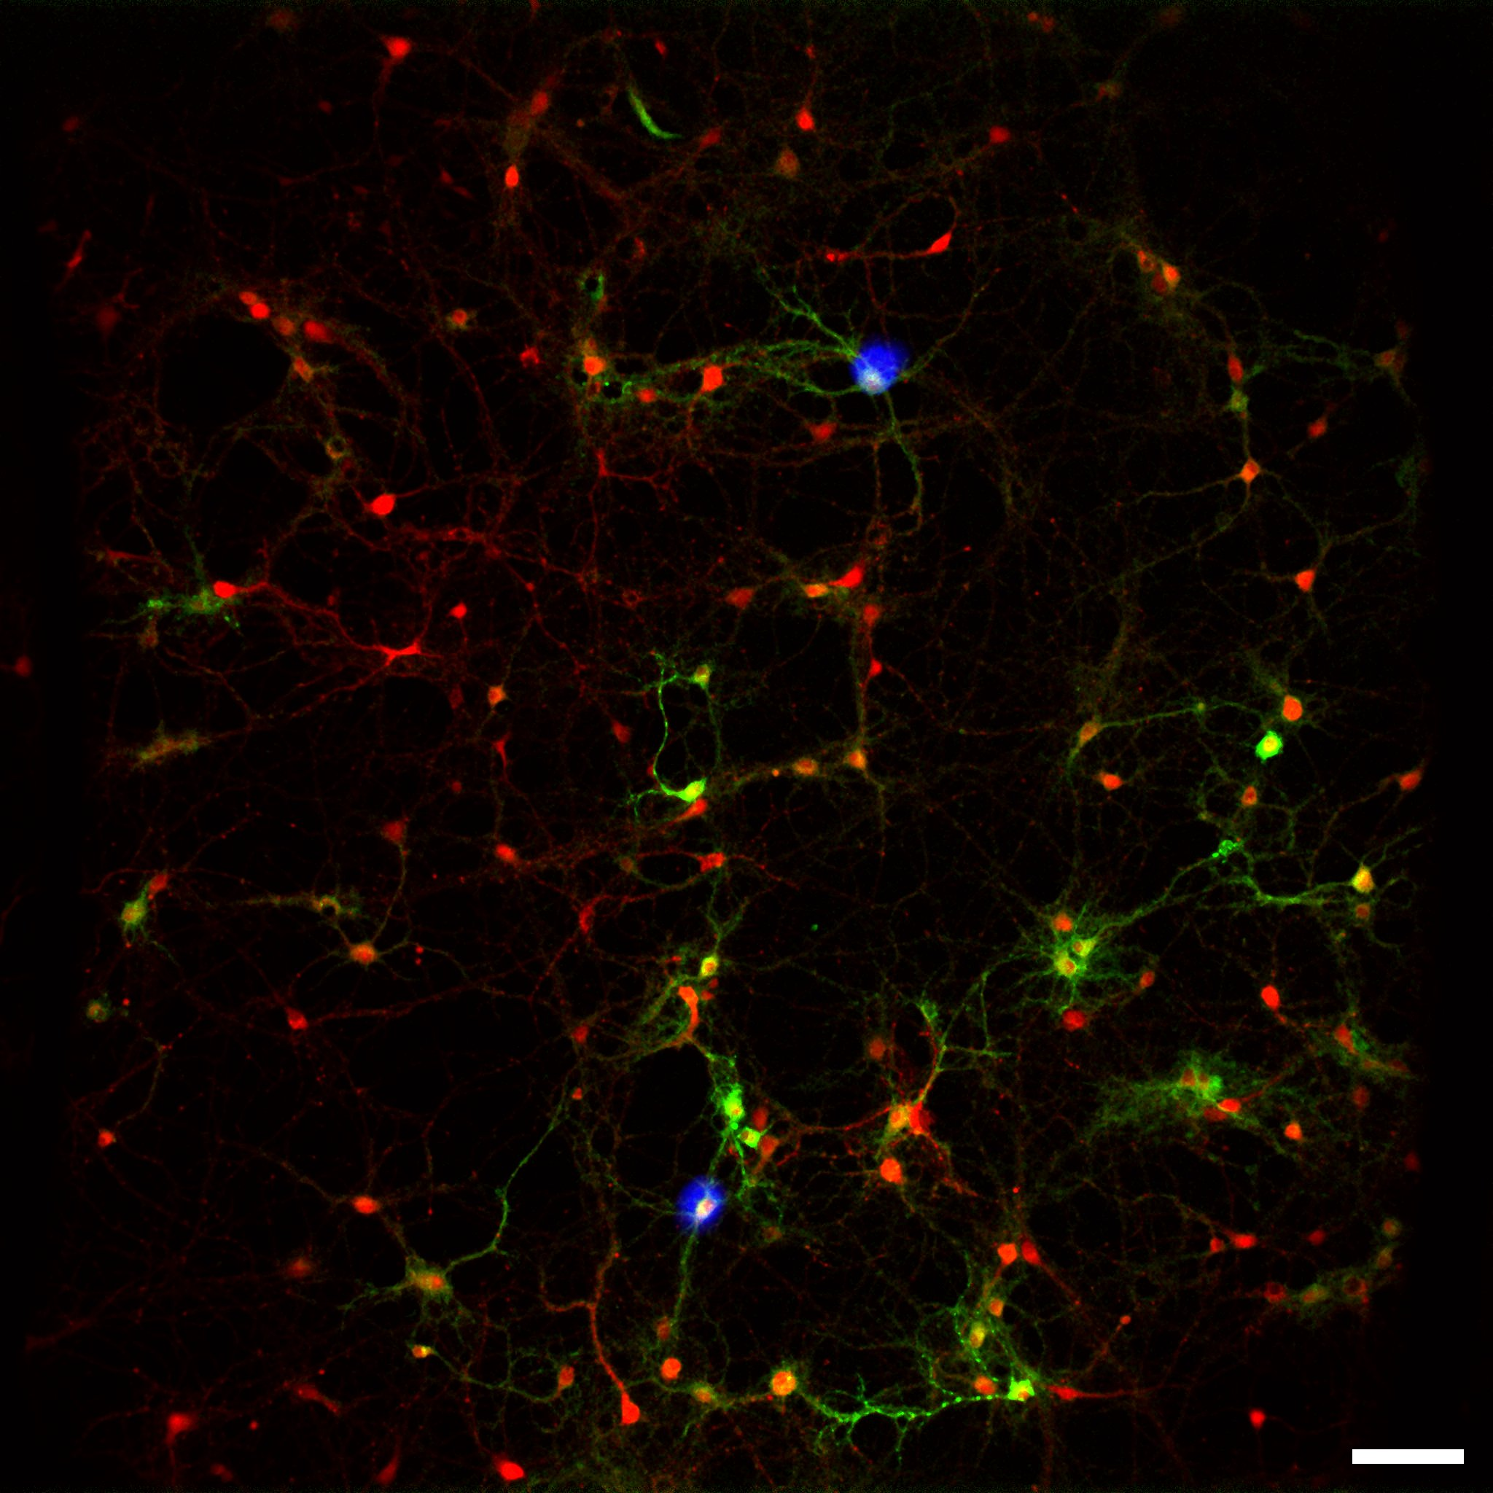
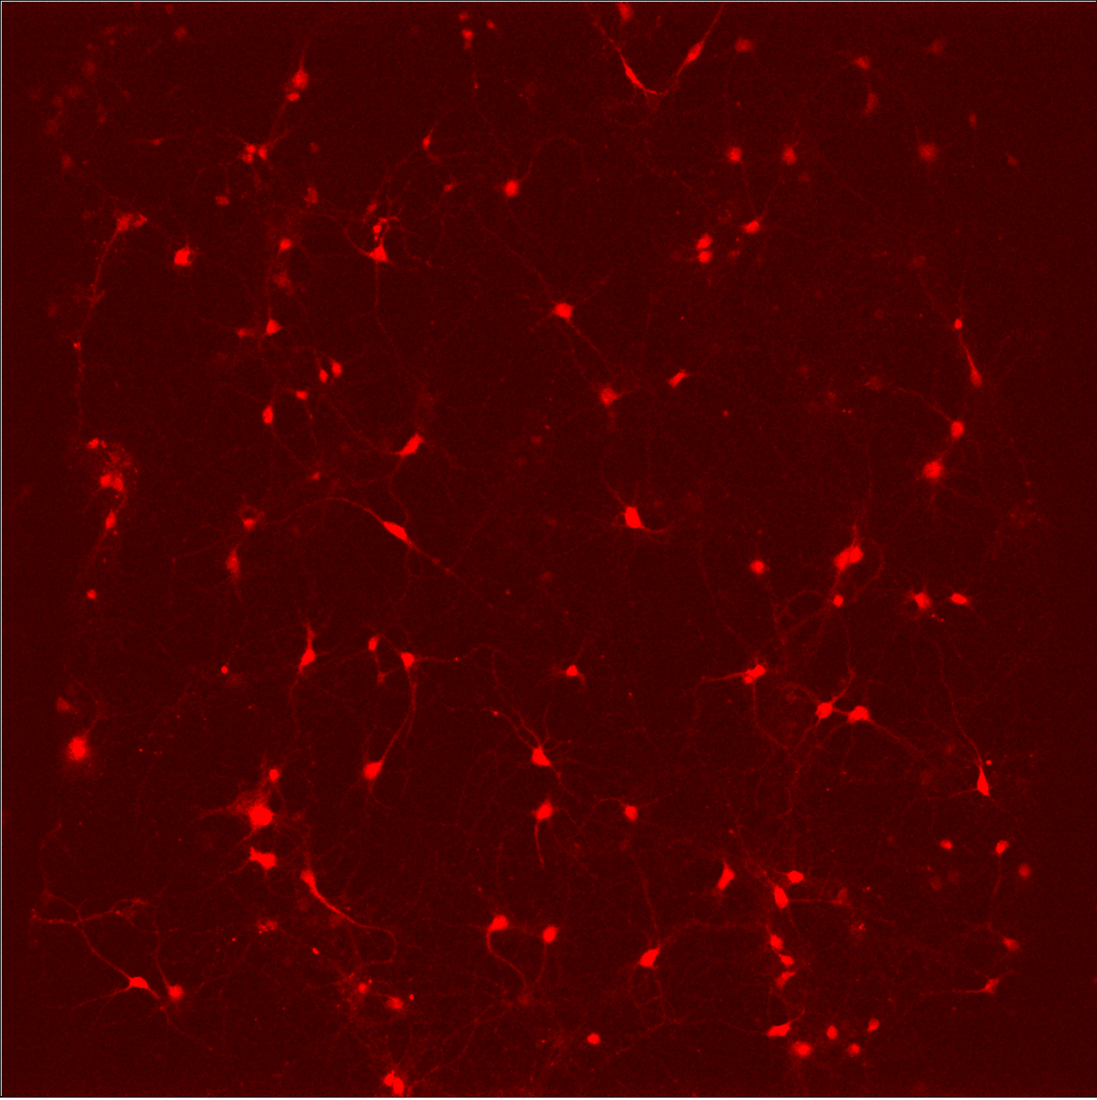
Studies of biological NN at NanoLab (UNITN)
Optical imaging
Optical imaging
Electrophysiology

Slide 6
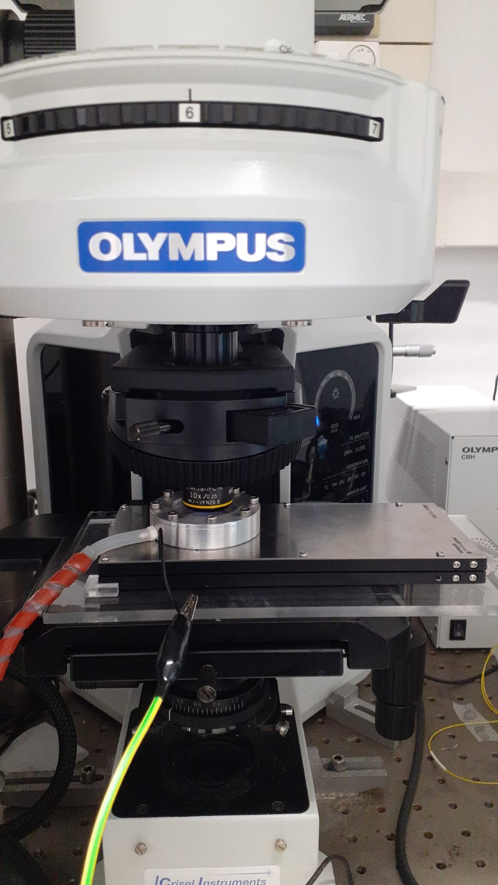
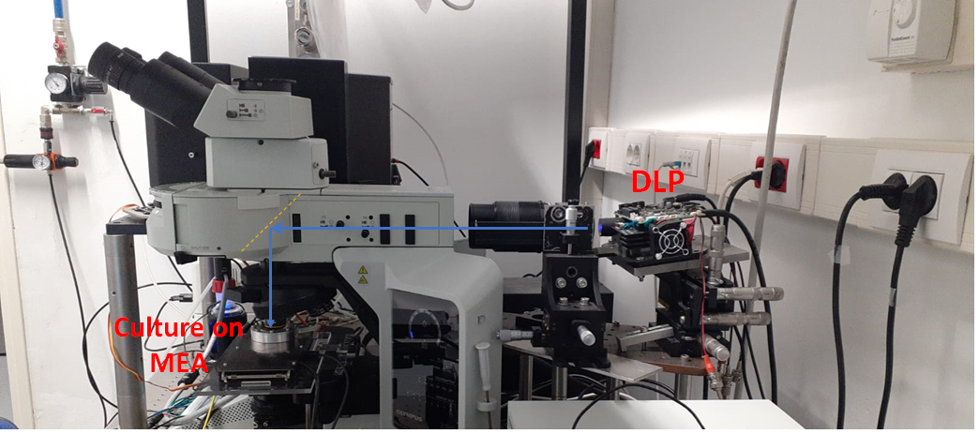
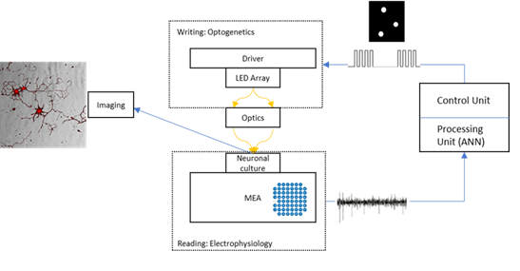
Optogenetic stimulation + Electrophysiological recording

Slide 7
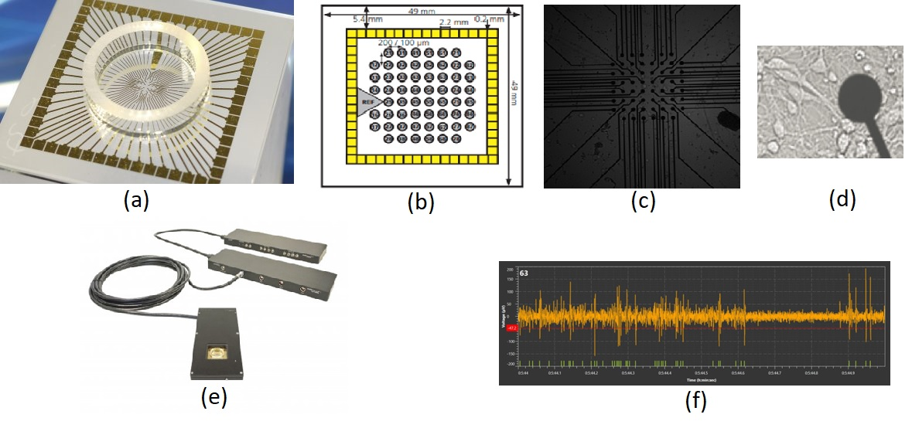
Microelectrode Array (MEA)

Slide 8

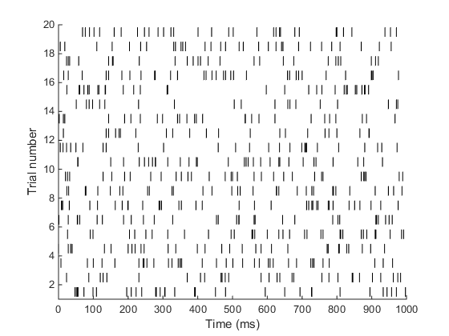

Slide 9
What can we learn?
Neuronal interactions macroscopically- Network of neuronal populations!
Function of the network.
Structural dynamics.

Slide 10
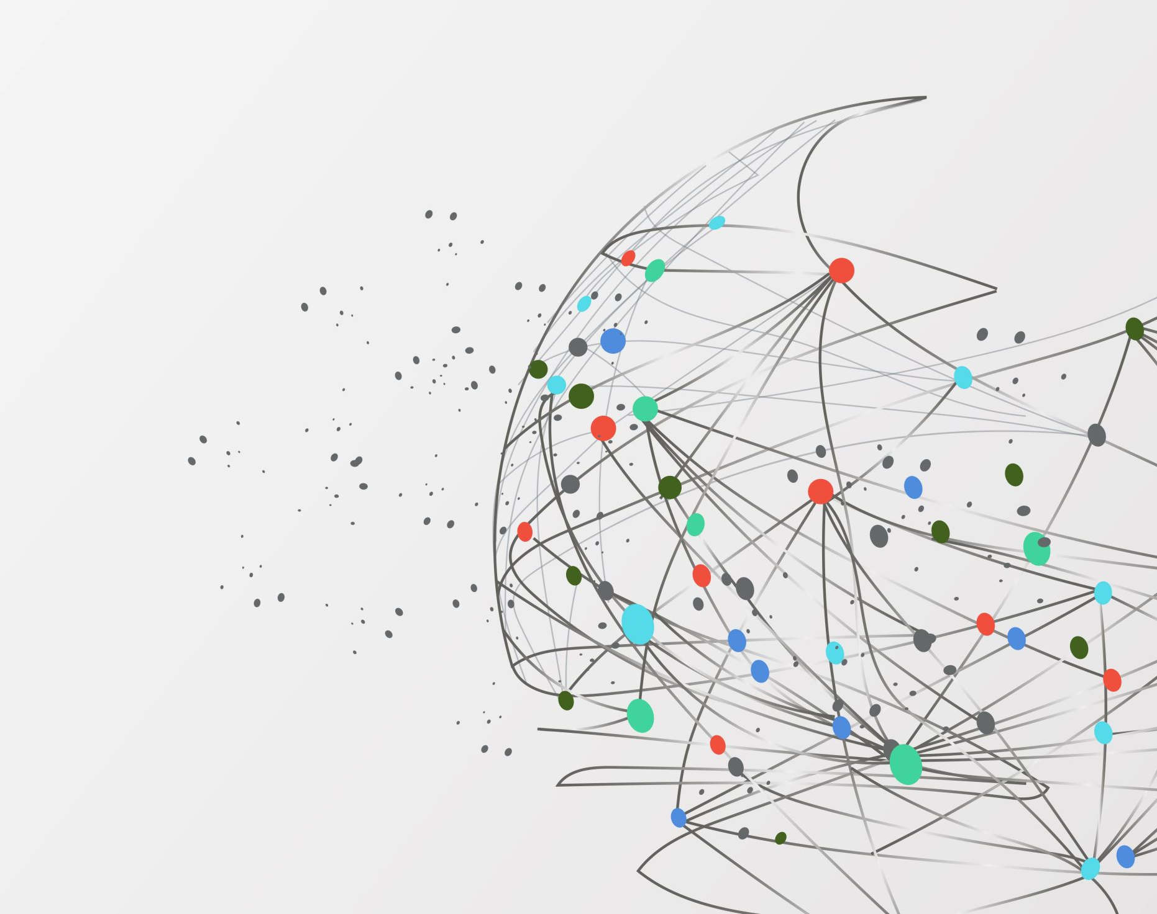
RC Model

Slide 11
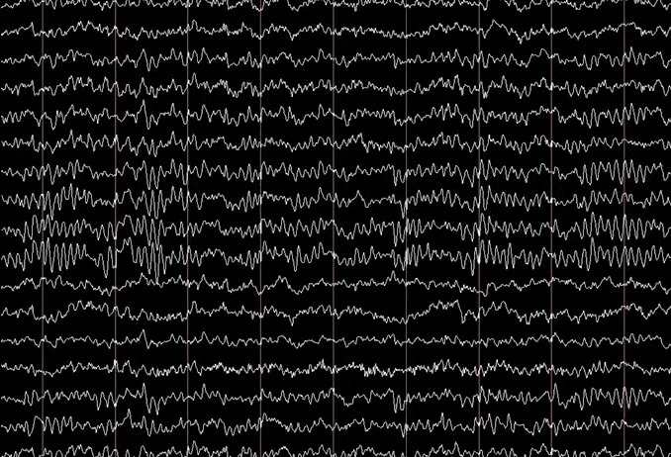
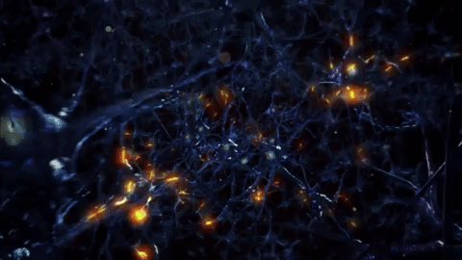
Neuronal signals measurement
Network structure
Network simulation

Slide 12
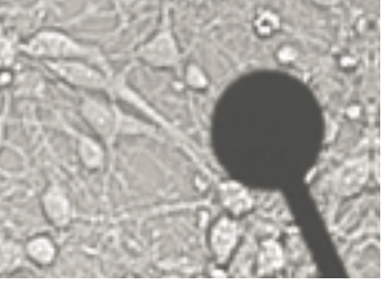
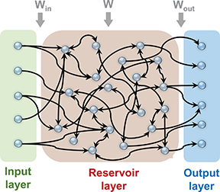
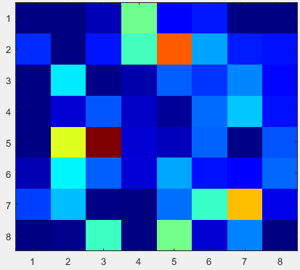
Neuronal populations- complex circuits.
Rate coded information.
Recurrent (Spiking) Neural Network

Slide 13
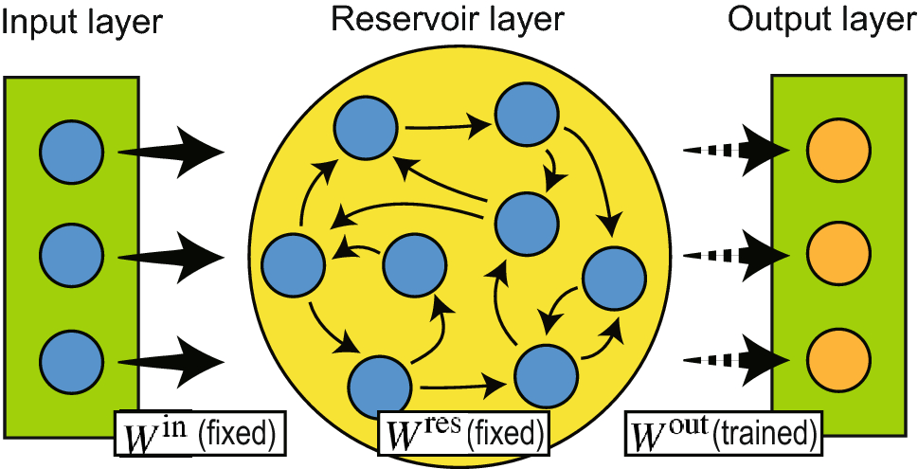
Reservoir Computing Network
* Taken from: Sakemi, Y., Morino, K., Leleu, T. et al. Model-size reduction for reservoir computing by concatenating internal states through time. Sci Rep 10, 21794 (2020). https://doi.org/10.1038/s41598-020-78725-0

Slide 14
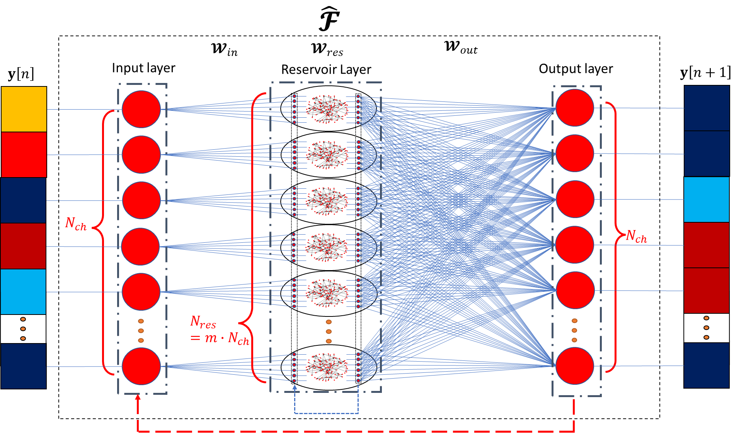
Memory/Plasticity/Integration
Recurrency

Slide 15
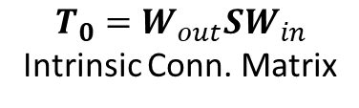
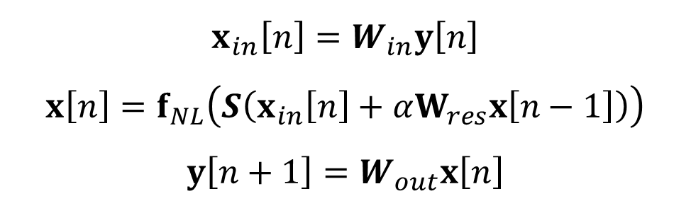


Dynamics
$$x_{in}$$
$$x_{}$$
$$x_{in}\left[n\right]=W_{in}y\left[n\right]$$
$$x\left[n\right]=f_{NL}\left(S\left(x_{in}\left[n\right]+αW_{res}x\left[n−1\right]\right)\right)$$
$$y\left[n+1\right]=W_{out}x\left[n\right]$$
Linear
Nonlinear
$$T_{0}=W_{out}SW_{in}$$
Intrinsic Conn. Matrix
$$y\left[n+1\right]=T_{0}y\left[n\right]+Q\left(x\left[n,n−1,n−2,n−3…\right]\right)$$

Slide 16
Data
Raw data
Filter
Spike detection
Training data
Network Burst detection
Modeling

Slide 17
Data

Slide 18


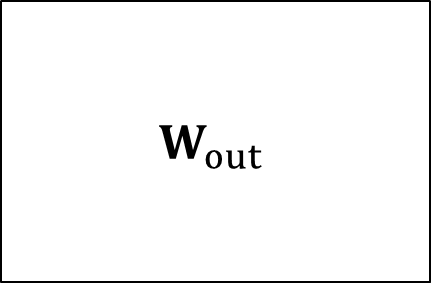


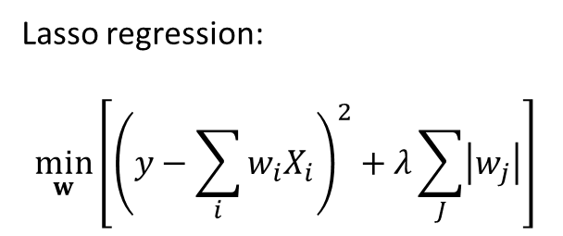
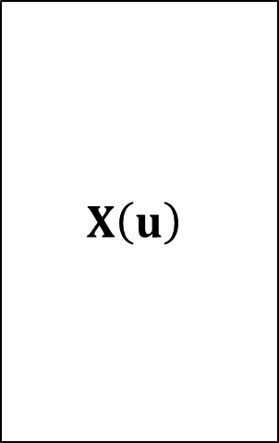









Training
Regression problem
$$y_{i}\left[n\right]=\sum_{j=1}^{N_{res}}{W_{out}^{i,j}x_{j}\left[n\right]}, n=1,…,N_{t}×N_{batch}$$
Only the linear output layer is trained!
$$N_{t}×N_{batch}$$
$$N_{res}$$
$$N_{t}×N_{batch}$$
Lasso regression:
$$\min_{w}\left[{\left(y−\sum_{i}{w_{i}X_{i}}\right)}^{2}+λ\sum_{J}{\left|w_{j}\right|}\right]$$
$$W_{out}$$
$$Y$$
$$w_{out}^{i}$$
$$y_{i}\left[n\right]$$
$$X\left(u\right)$$
$$x\left[n\right]$$
$$N_{ch}$$
$$N_{ch}$$
$$i=1,…,N_{ch}$$
$$N_{res}$$
Trainable weight matrix
$n=1,…,N_{t}$ $×N_{batch}$

Slide 19
MEA experiments
RC Model
Training & Validation
DATA
NEST simulation (synthetic data)
Connectivity Map
Network Simulation
Test
(Benchmark)
Test
(Stimulation response)

Slide 20
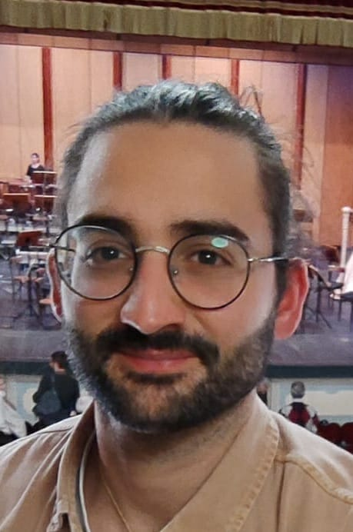
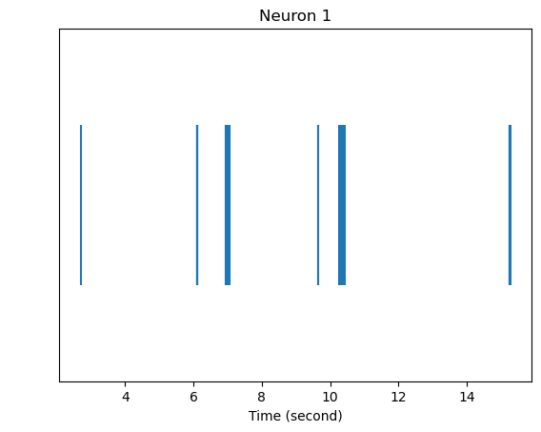
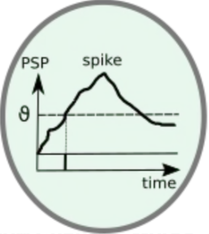
Simulation of neuronal culture for benchmarking
networks of point-process neurons
Try to replicate the spiking dynamic shown by in-vitro culture
Point-Process Neuron
Giorgio Letti
Simplified neuron model
Modelling basic phenomena
No extracellular potential can be simulated
Background activity
Computationally cheap
Spiking time
Network dynamic
20

Slide 21
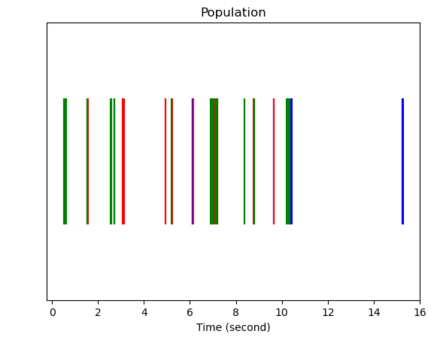
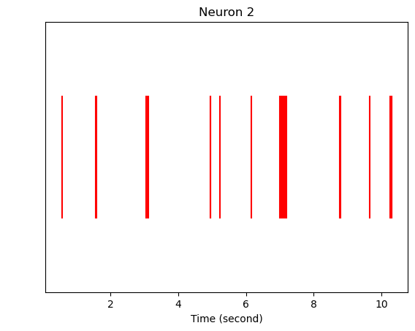
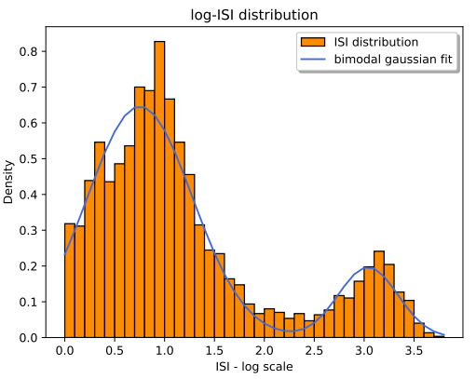
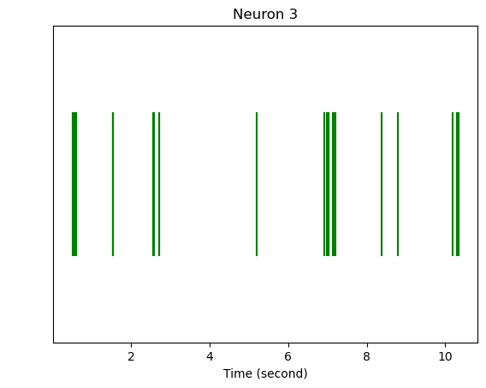
Simulation of neuronal culture for benchmarking
Population Model
Giorgio Letti
Multiple Izhikevich neuron model
Collect Spike train of each neuron
Merge and temporally sort the Spike trains
Output:
  Spiking time and Inter-spike interval (ISI) distribution of the Population
21

Slide 22
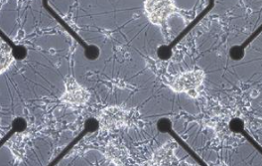
Simulation of neuronal culture for benchmarking
Giorgio Letti
Population 1
Connection types:
Population 2
Connection parameters:
Weight = synapse weight (pA)
Delay = synapse delay (ms)
= Intra-population connections
Assumptions
MEA electrode = Population
Perfect Electrode
= Inter-population connections

Slide 24

Results
WORK IS STILL IN PROGRESS

Slide 25

Connectivity Map

Slide 26
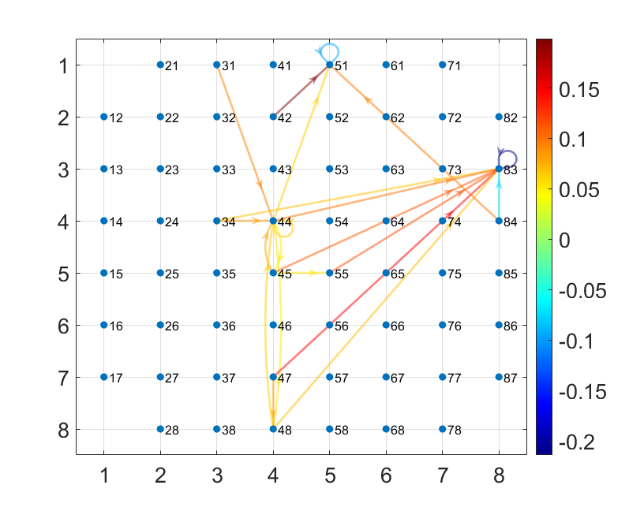
Connectivity Map
Weighted connections
Excitatory/Inhibitory connections

Slide 27
Connectivity
Performance Evaluation
Binary Classification:
Connection/No Connection
ROC curve:
AUC
Weights prediction
Pearson correlation

Slide 28
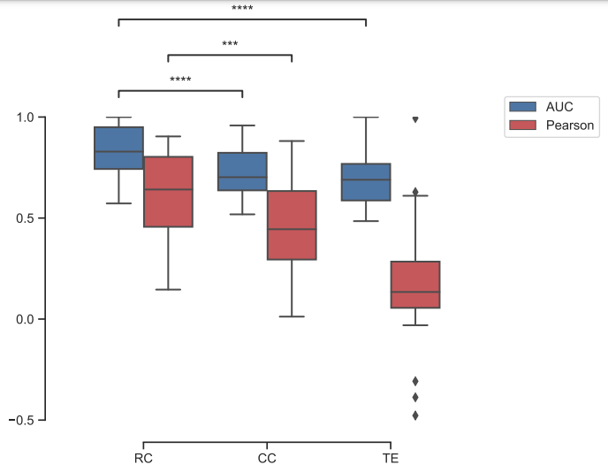
Connectivity- Results

Slide 29
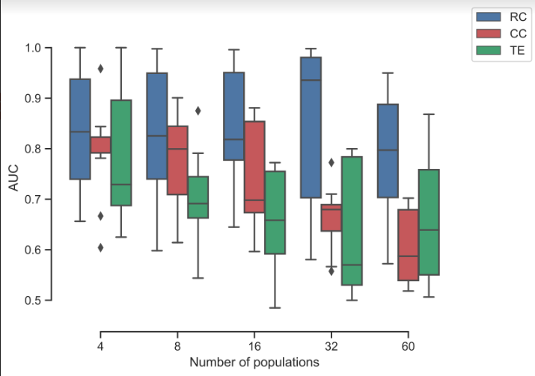
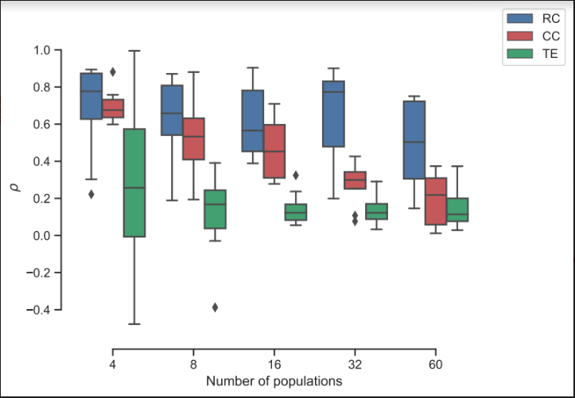
Connectivity- Results

Slide 30
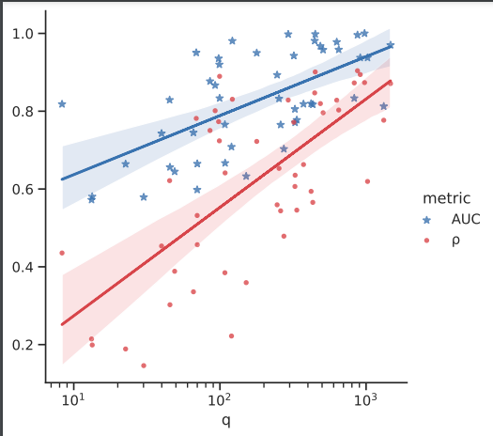
Connectivity- Results

Slide 31
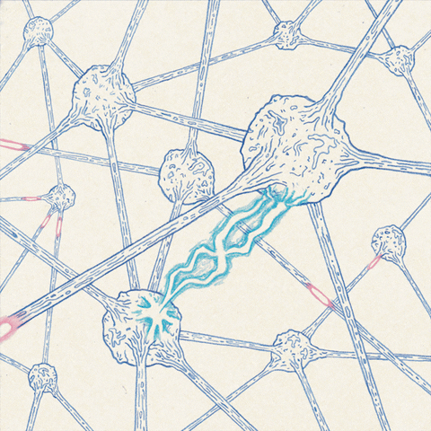


Response test
Localized stimulus
Response/Signal propagation
RC Model
$$y\left[0\right]$$
$$y\left[n\right]$$

Slide 32
Response test
Training: Spontaneous activity
Test:
Stimulus response

Slide 33
Response test
Experiment
Model
Spike rate [Sp/s]
time [sec]

Slide 34
Response test
Performance Evaluation
Binary Classification:
Electrode responded/Not Responded
ROC curve:
AUC
Time trace prediction
XRMSE
Ilya Auslender, @ALPACA workshop
24.11.2023

Slide 35
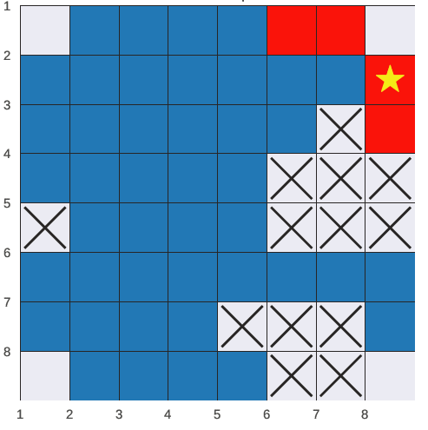
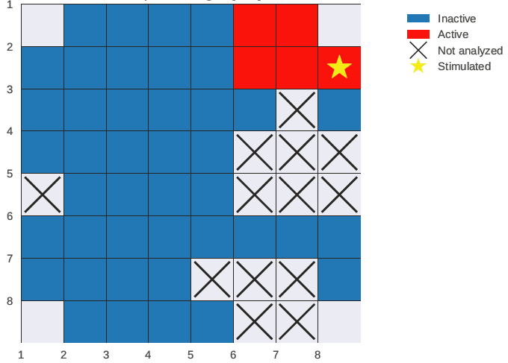
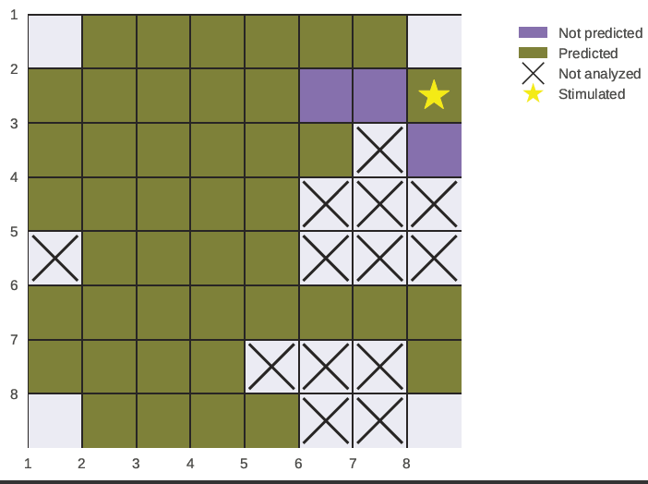
Binary classification
Experiment
Model Prediction
Performance evaluation
ROC curve - AUC

Slide 36
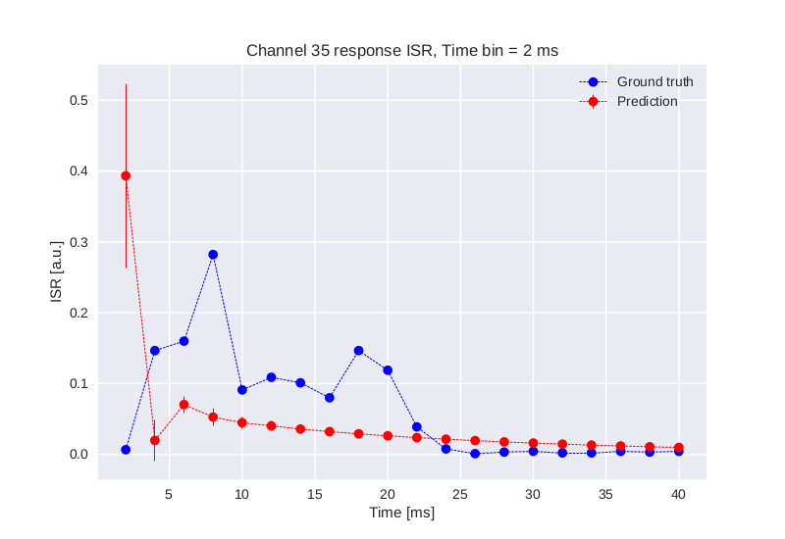
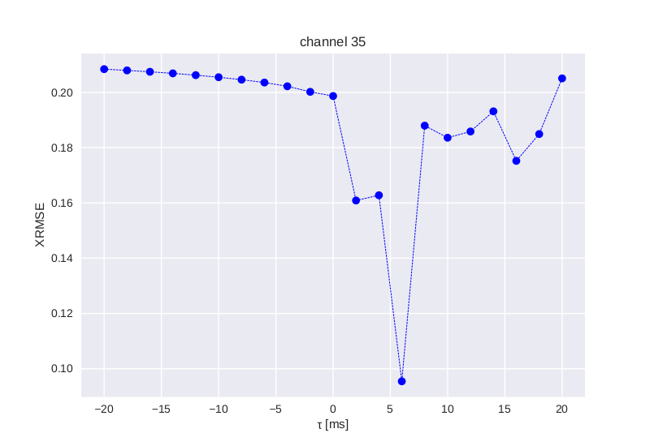
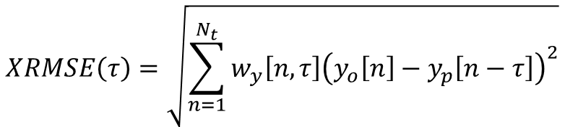
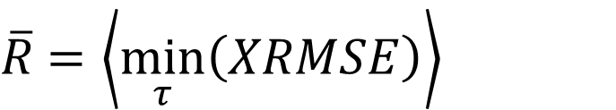
$$XRMSE\left(τ\right)=\sqrt{\sum_{n=1}^{N_{t}}{w_{y}\left[n,τ\right]{\left(y_{o}\left[n\right]−y_{p}\left[n−τ\right]\right)}^{2}}}$$
$\overline{R}$ $=\left\langle \min_{τ}\left(XRMSE\right)\right\rangle$

Slide 37
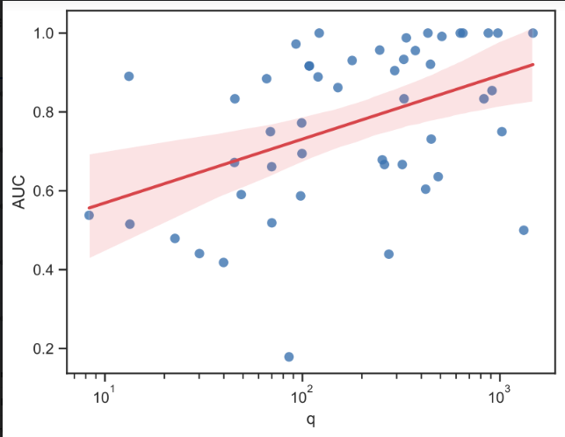
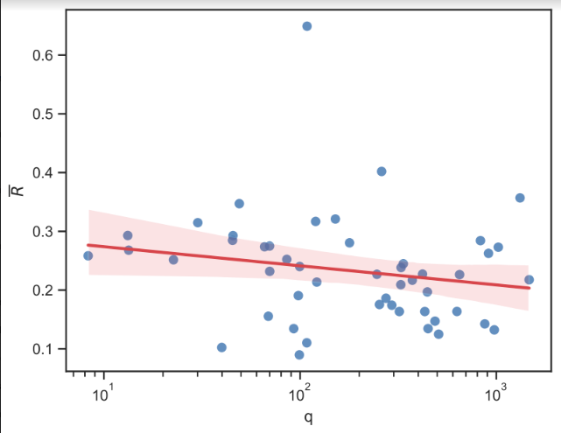

Slide 38
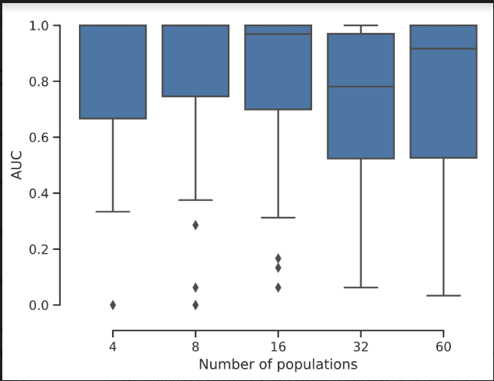
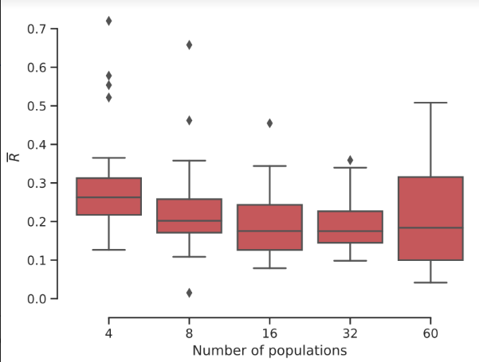

Slide 39
Conclusion
Neuronal dynamics is complex and hard to interpretate.
We developed a model, based on RCN approach to decode the information stored in time sequences of neuro electrophysiological signals.
The model can extract the connectivity map on a macroscopic scale with higher accuracy than the existing “classical” methods.
The model is able to predict the response of the network to a given input (such as localized stimulation).

Slide 40
This work has received funding from the European Union’s Horizon 2020 research and innovation programme under
the Marie Sklodowska-Curie grant agreement No 101033260 (project ISLAND).
the European Research Council (ERC) grant agreement No 788793 (project BACKUP).

Slide 41

Thank you!

