Slide 1
Machine Learning in SIDDHARTA-2:
the monitoring challenge
Simone Manti
21 November 2023
Notes:
-Thanks
-Prelimary
-Come from other field
-Connection theory experiment

Slide 2
Outline
Kaonic atoms in SIDDHARTA2
Modelling the atomic cascade
Anomaly Detection in SIDDHARTA2

Slide 3
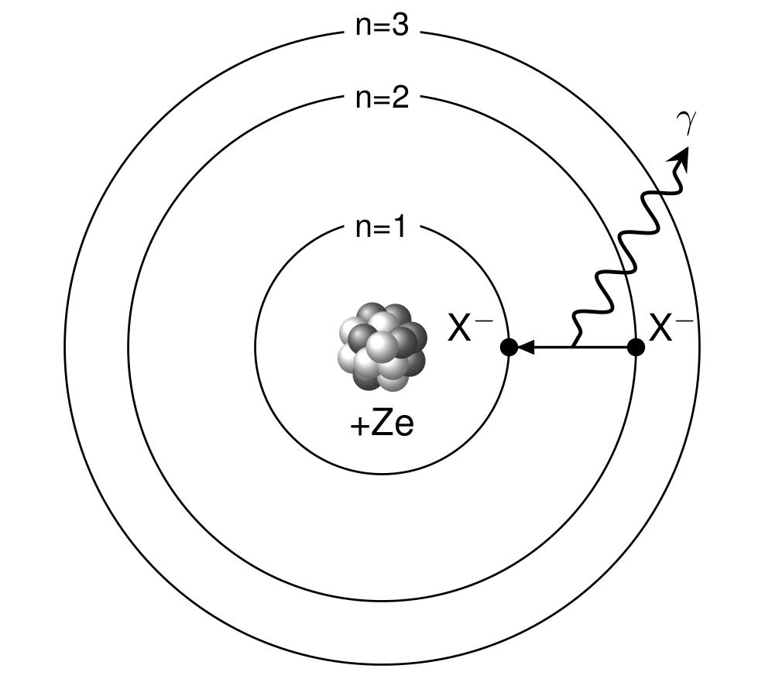
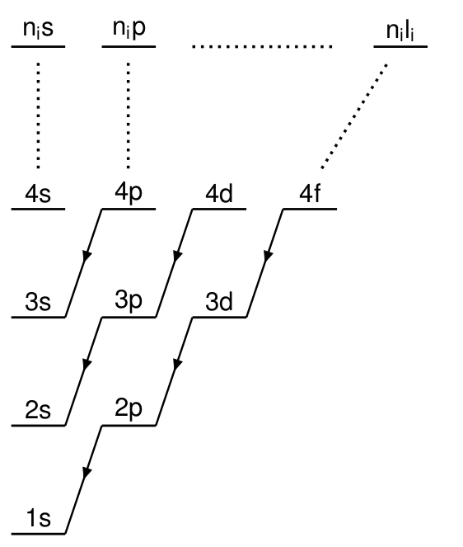

Slide 4
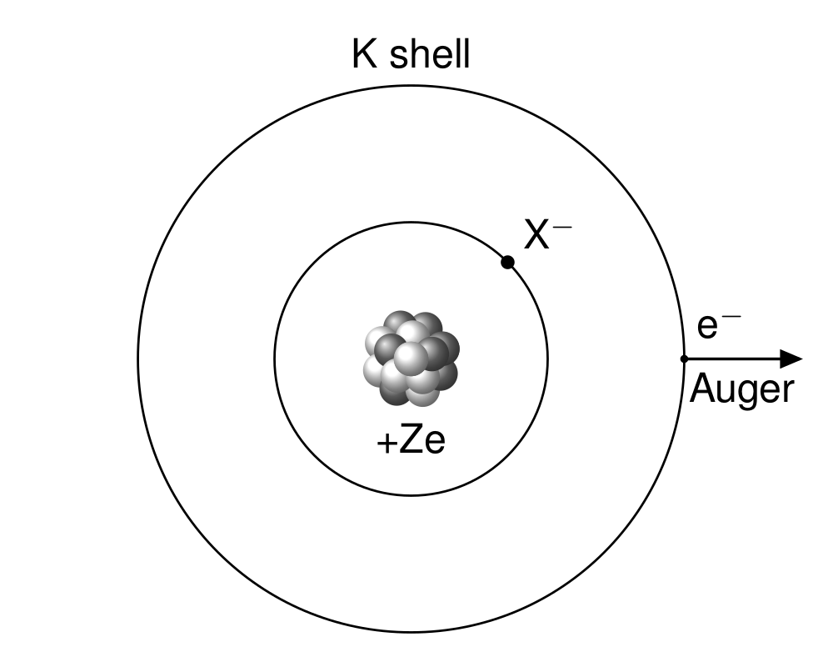
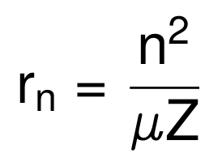
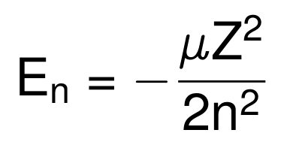
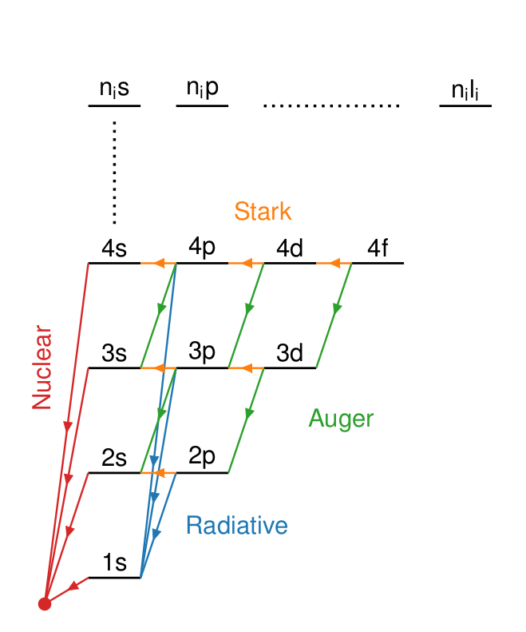
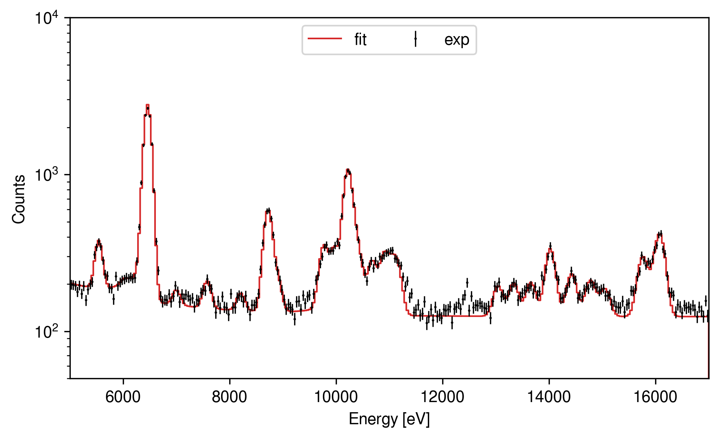
Cascade model for exotic atoms (KN)
Exotic atom = Atom + X⁻
X⁻ = μ⁻, π⁻, K⁻,

Slide 5
Cascade models connect theory and experiment

Slide 6
Model the cascade of the exotic atom with a Monte Carlo
1962 - M. Leon and H. A. Bethe, Phys. Rev. 127, 636
1980 - E. Borie and M. Leon, Phys. Rev. A 21, 1460
1989 - G. Reifenröther, E. Klempt, Nucl. Phys. A, 503, 3–4
1997 - T. P. Terada and R. S. Hayano, Phys. Rev. C 55, 73
2002 - Jensen T., Markushin V., Eur. Phys. J. D 21, 271–283
???

Slide 7
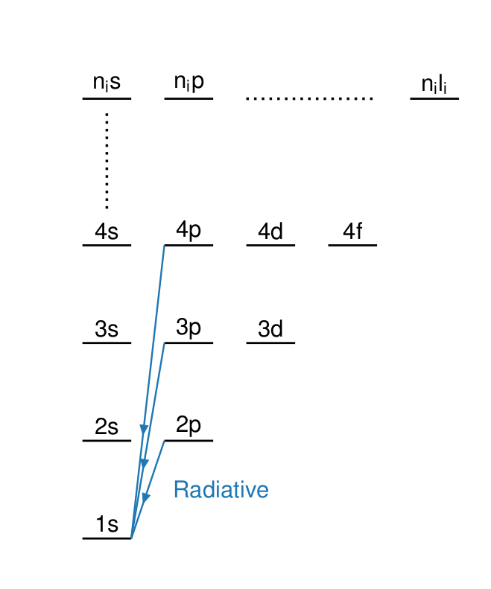
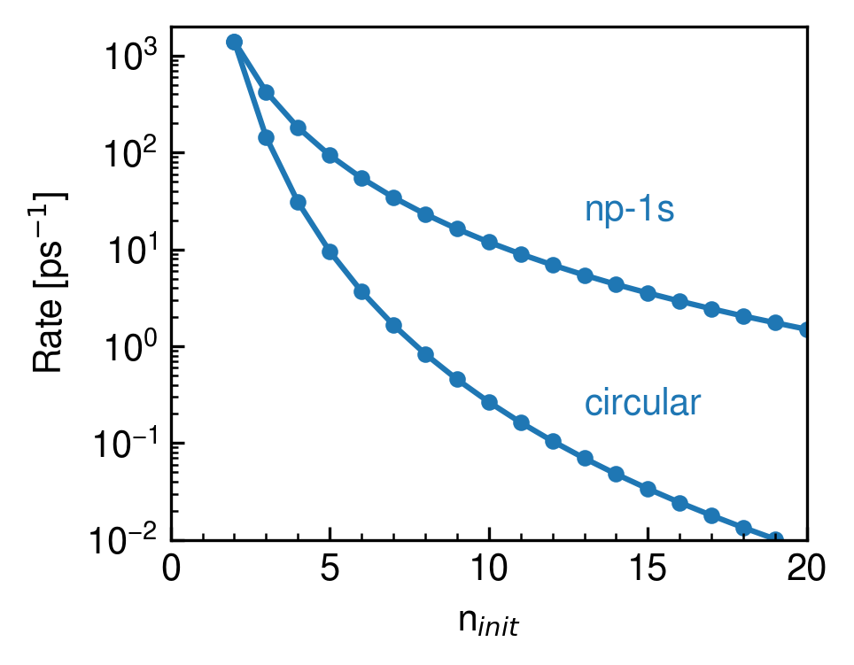
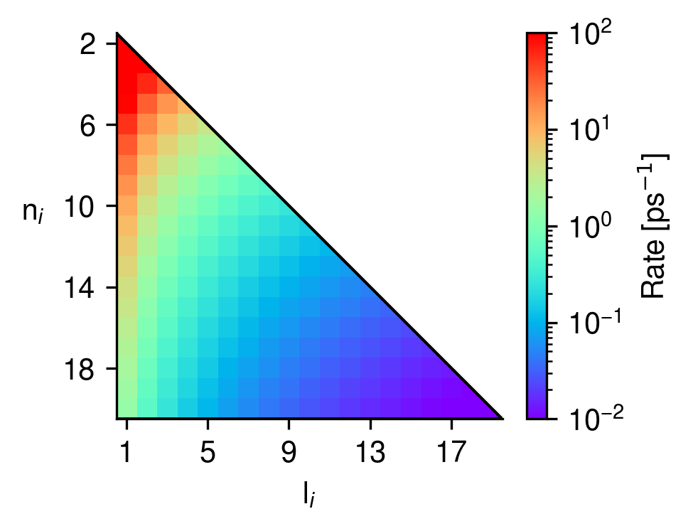
Radiative rate from scaling the (Z,μ) hydrogen rate

Slide 8
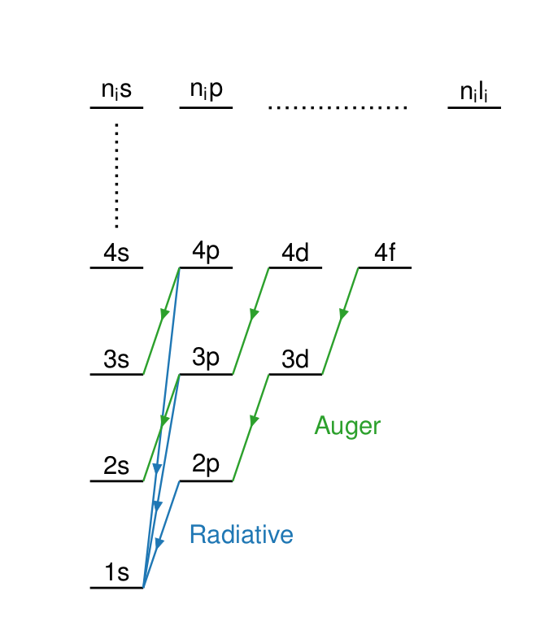
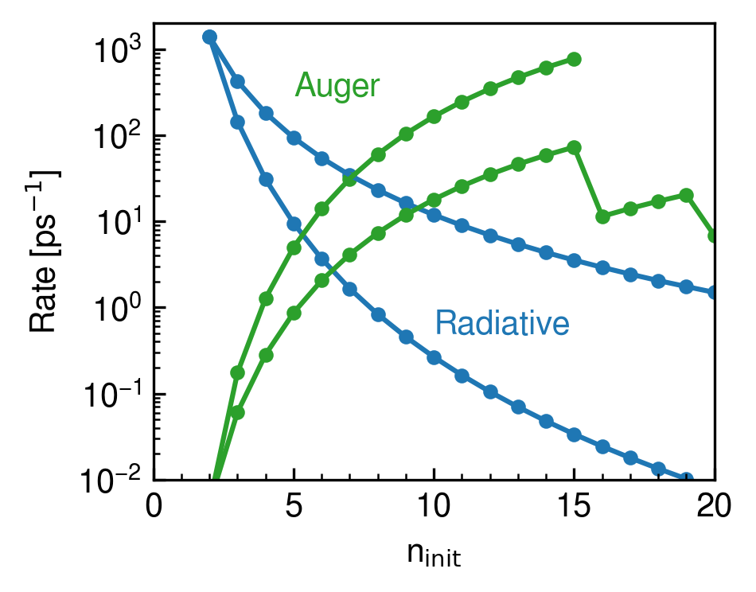
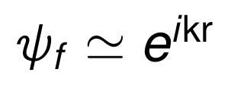
Auger rate from the e-K coulombic interaction
G. R. Burbidge and A. H. de Borde, Phys. Rev. 89, 189 -1953

Slide 9
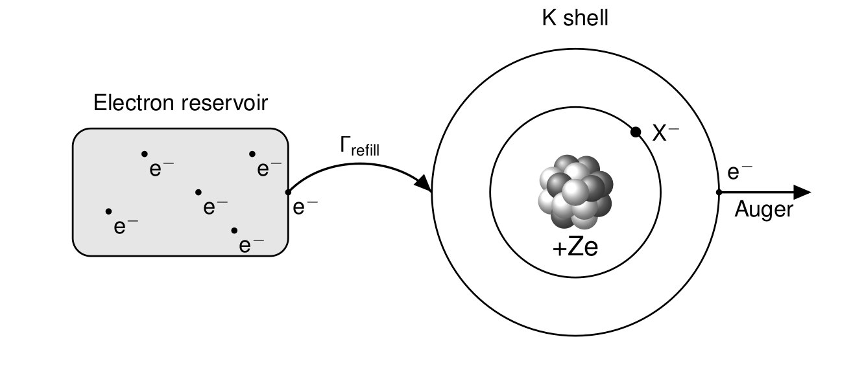
Auger rate from the e-K coulombic interaction

Slide 10
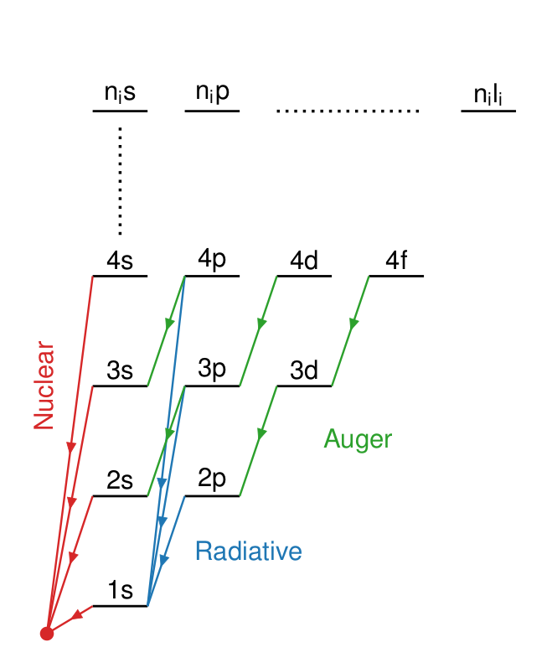
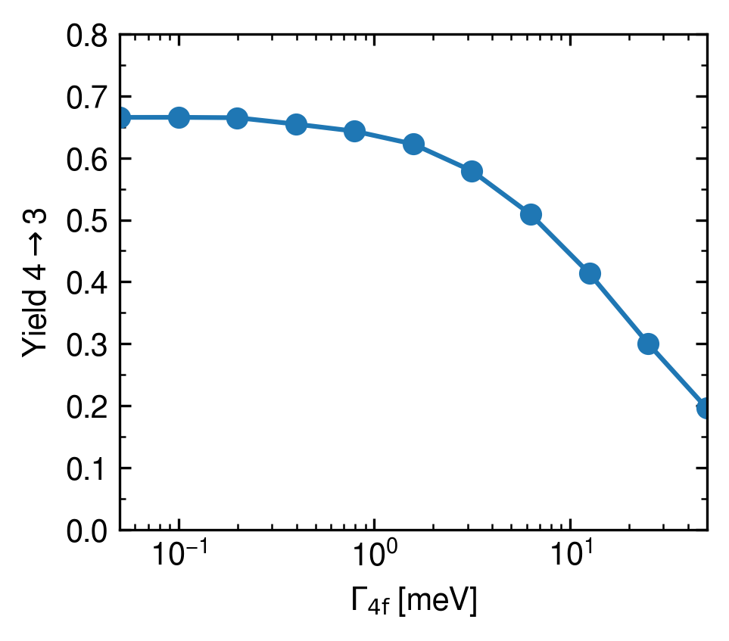
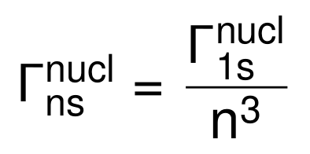
Nuclear absorption rates from absorption models
J. Óbertová, E. Friedman, J. Mareš, “First application of a microscopic K−NN absorption model in calculations of kaonic atoms”, arXiv:2208.14946
Z | Г_{1s} | Г_{2p} | Г_{3d} | Г_{4f}
- | [keV] | [keV] | [eV] | [meV]
C | 100 | 1.7 | 1 | 0.1-10
N | 100 | 2.7 | 3.5 | 0.1-10
C.J. Batty, Nuclear Physics A, 372, 3, - 1981

Slide 11
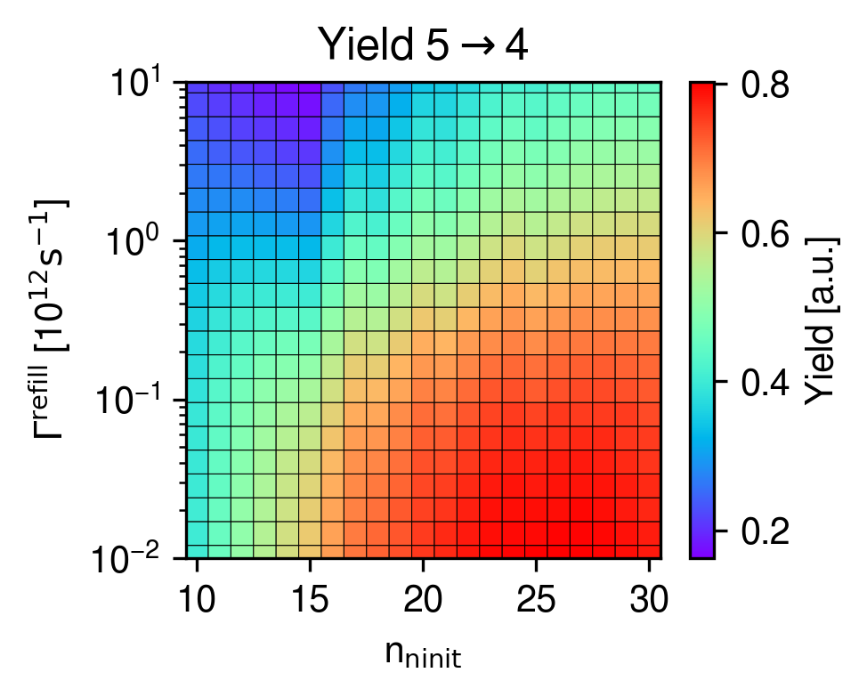
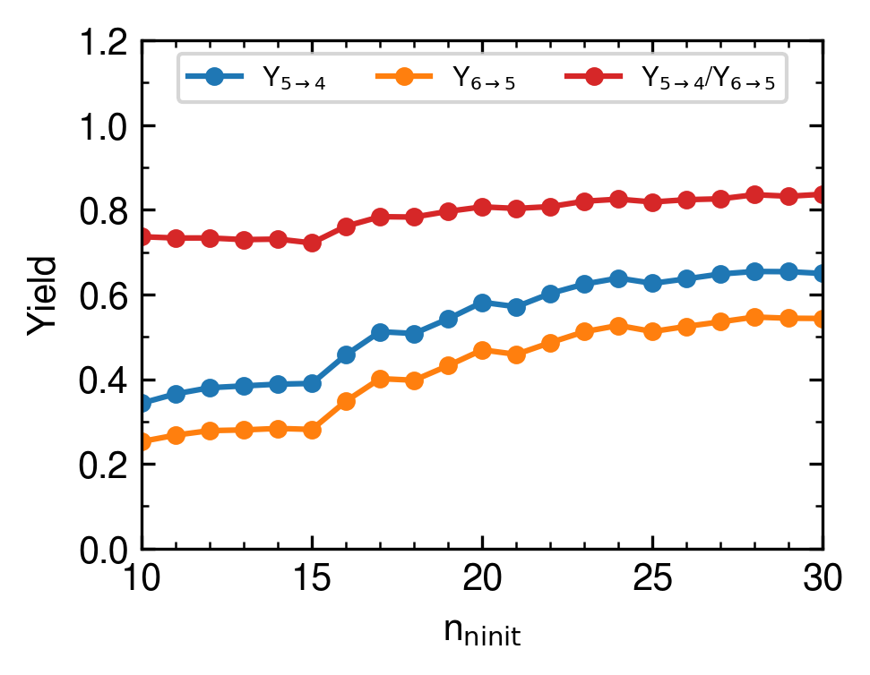
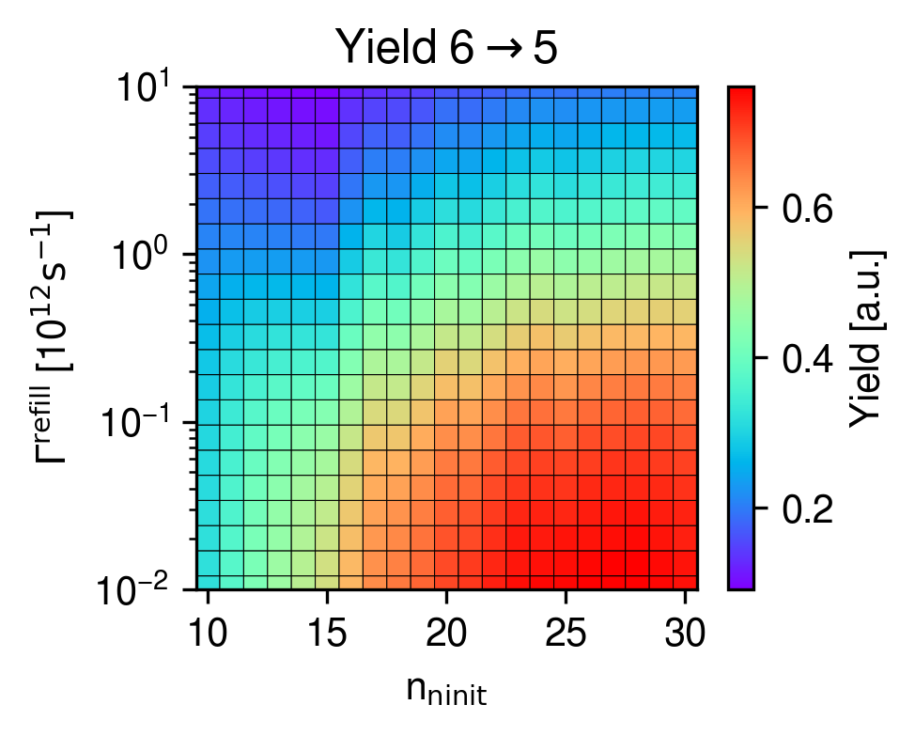
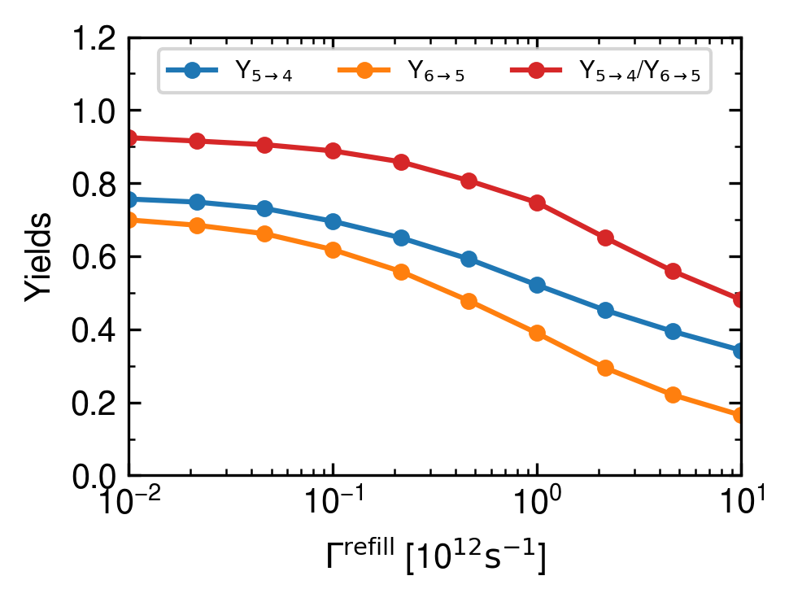
Yields of interest as function of the n_{init} and Г^{refill}

Slide 12
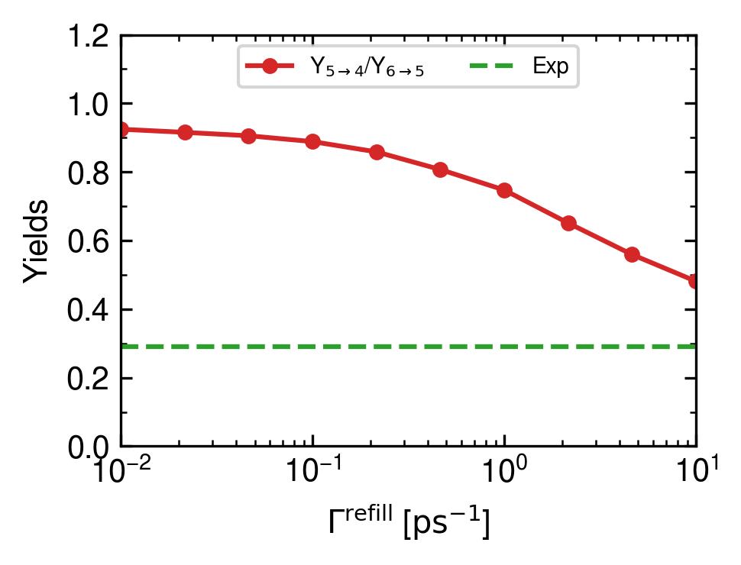
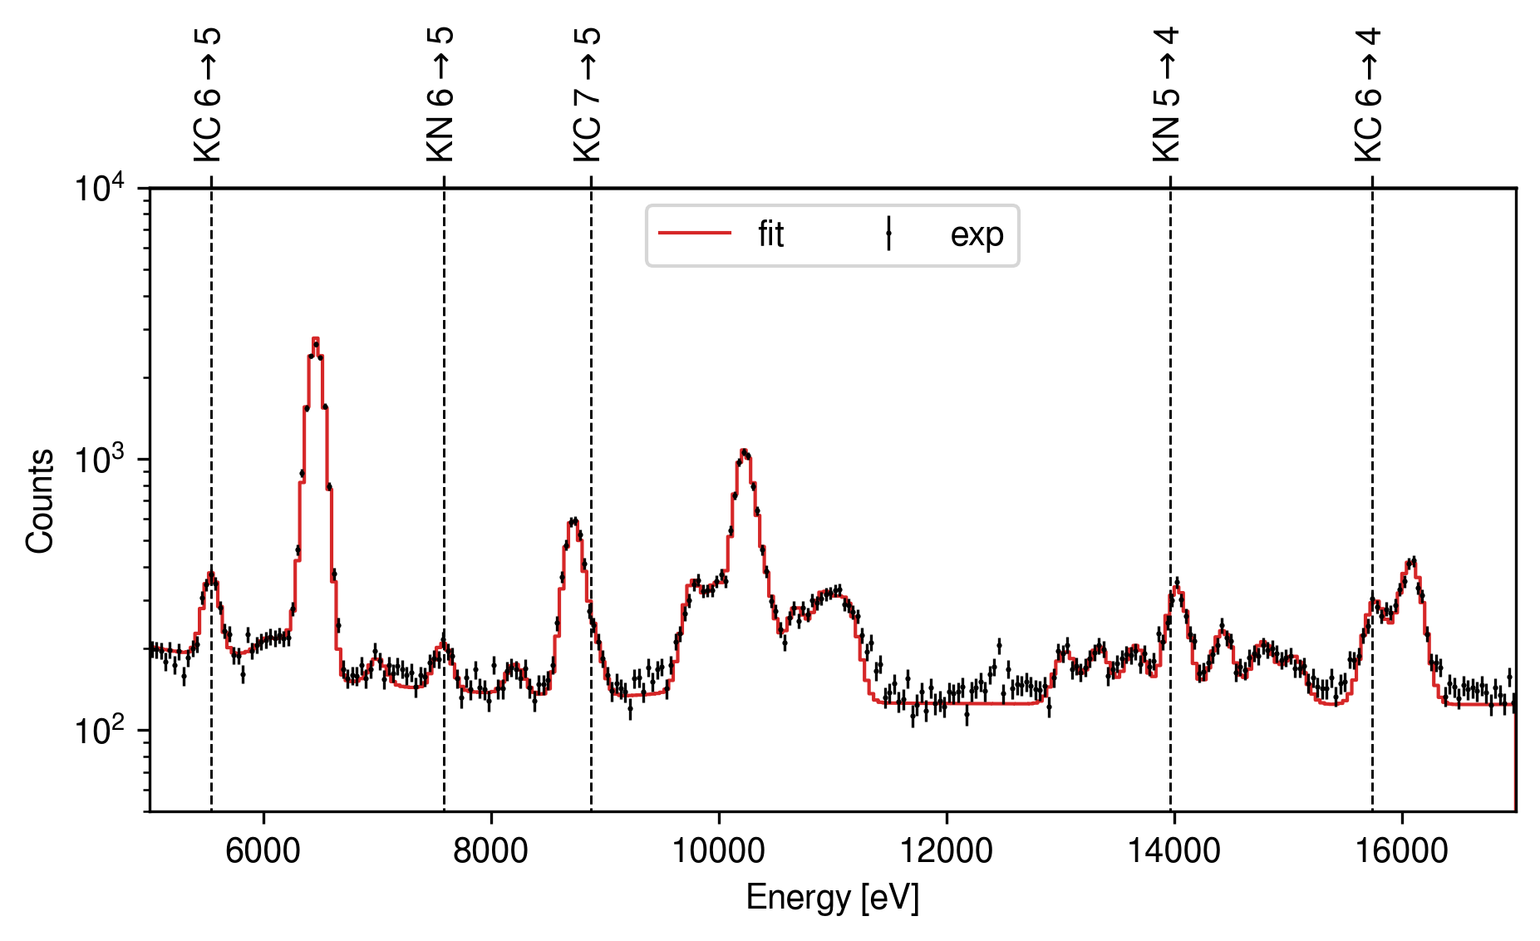
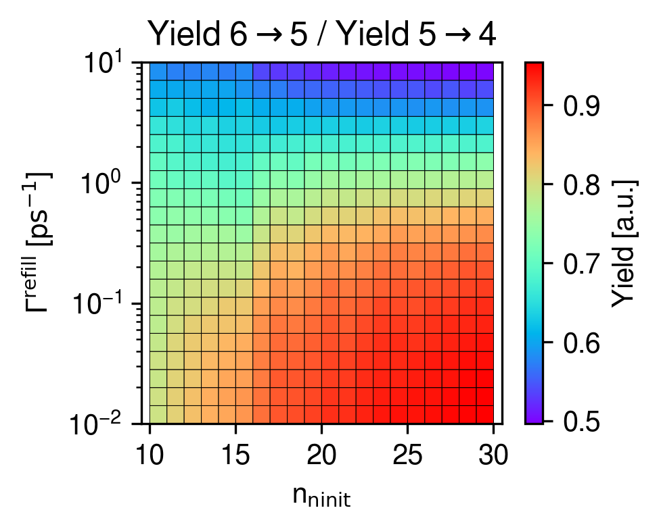
Cascade results: comparison with experiment
Experimental Yield 6,5 / Yields 5,4 = 0.29

Slide 13
Outline
Kaonic atom in SIDDHARTA2
Modelling the atomic cascade
Anomaly Detection in SIDDHARTA2

Slide 14
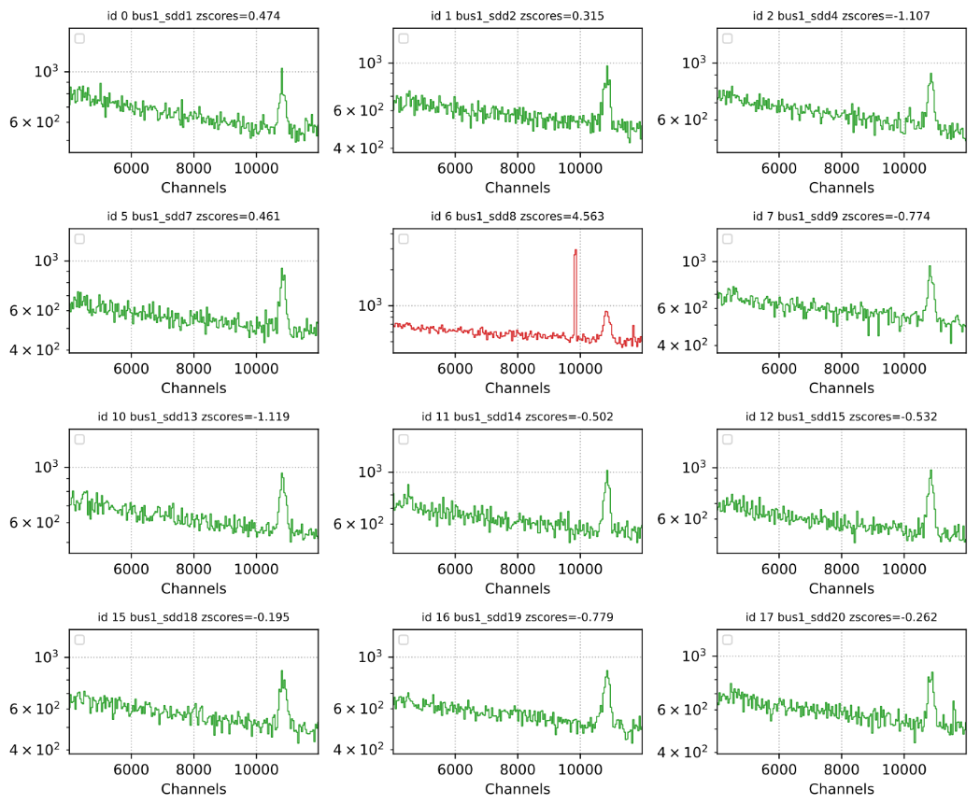
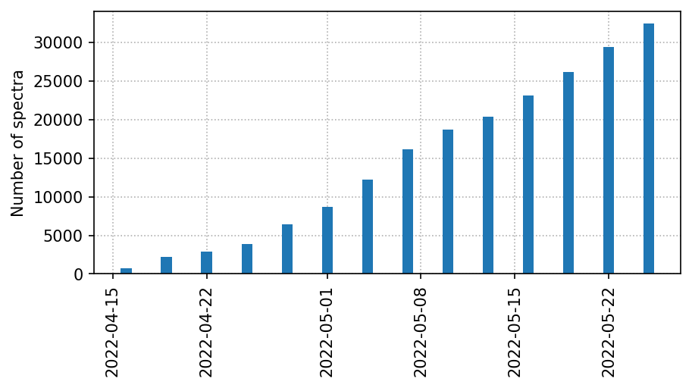
The monitoring challenge in SIDDHARTA2

Slide 15
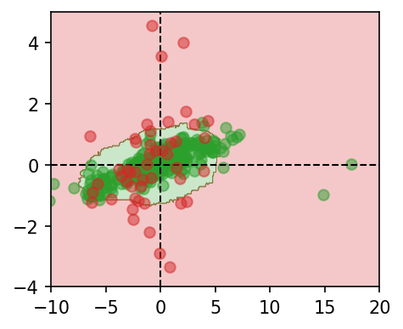
A simple PCA is failing in detecting anomalies

Slide 16
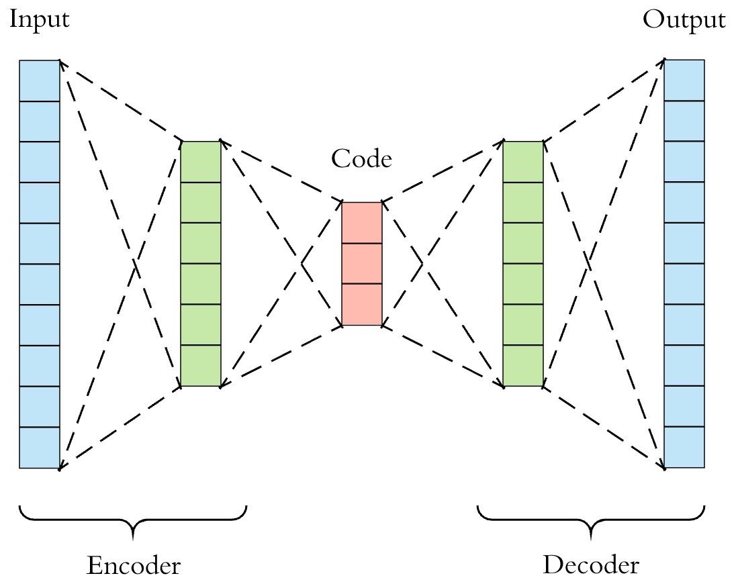
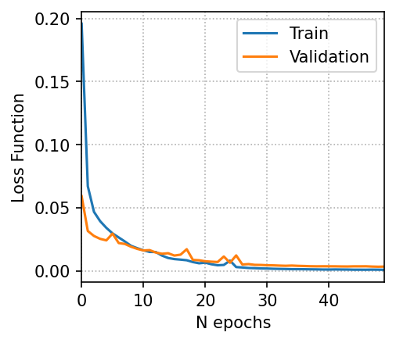
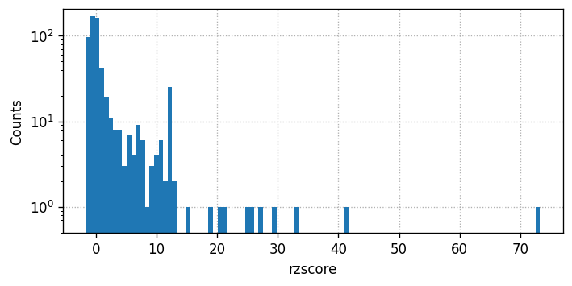
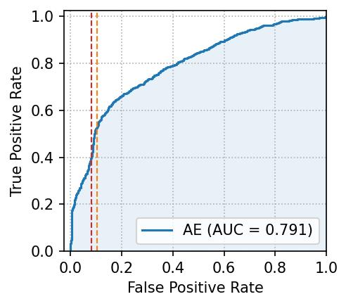
Autoencoder to include non-linearity
zscore = (x-x_{avg})/σ

Slide 17
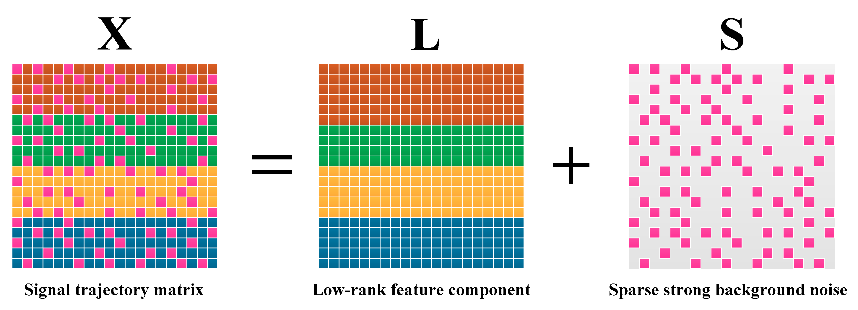
Robust PCA to detect anomalies

Slide 18
Robust PCA to detect anomalies
X_{sc}
Design Matrix X_{sc}

Slide 19
Robust PCA to detect anomalies

Slide 20
Robust PCA to detect anomalies
S

Slide 21
Outline
Kaonic atoms in SIDDHARTA2
Modelling the atomic cascade
Anomaly Detection in SIDDHARTA2
Thanks for your attention!

