Slide 1

The SIDDHARTA-2 experiment at DAΦNE
Florin Sirghi o behalf of SIDDHARTA-2 Collaboration
Trento, 20-24 November 2023

Slide 2
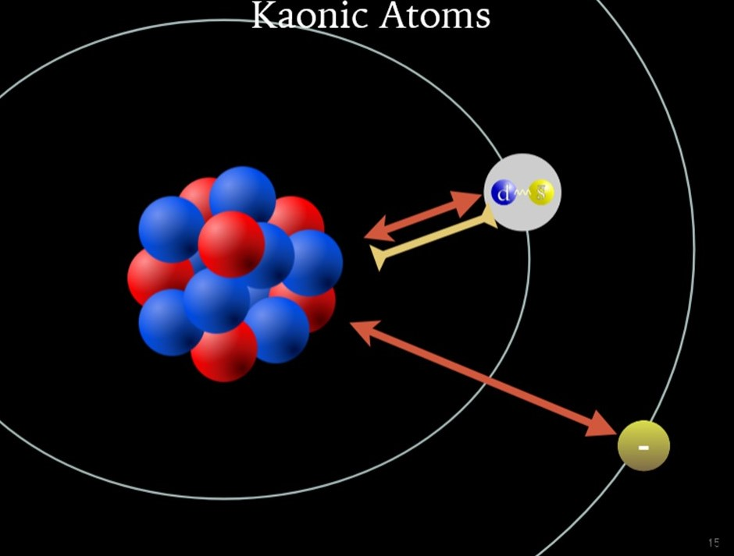
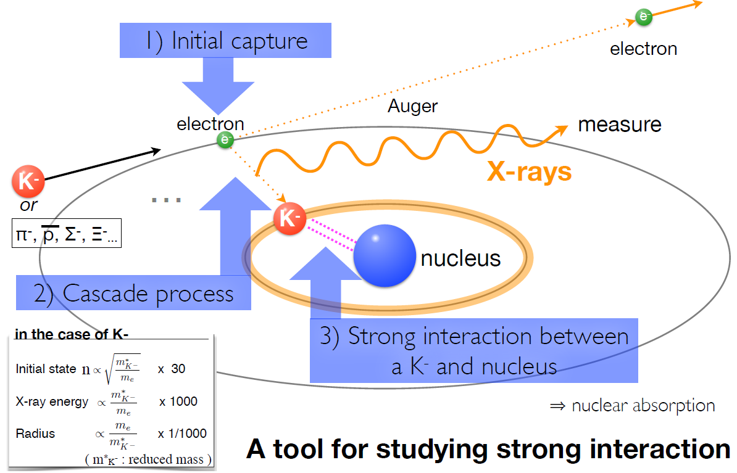
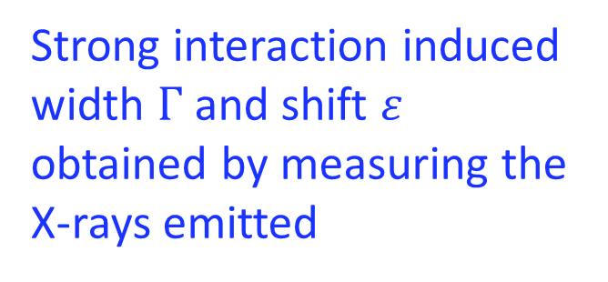
Kaonic atoms are formed
by stopping a
negatively charged kaon
in a target medium
H, He, D, N, …
Li, Be, C, Al, ...
Strong interaction induced
width $Γ$ and shift $ε$ obtained by measuring the X-rays emitted

Slide 3


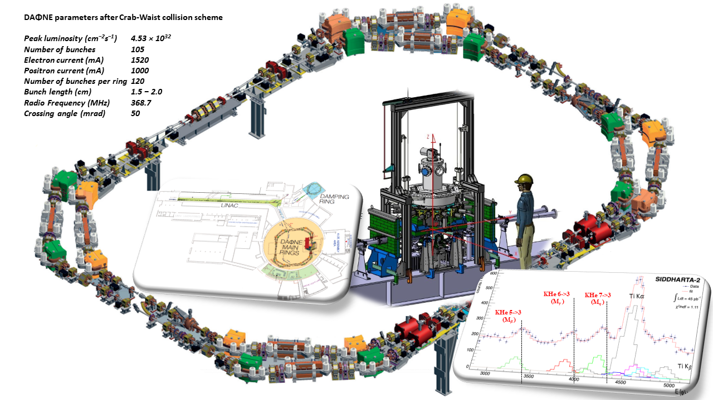
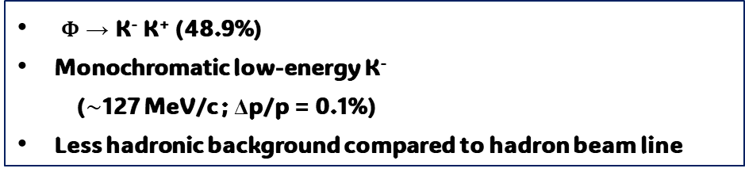
SUCCES
Quality kaon beam
DAΦNE at Laboratori Nazionali di Frascati
© Designed by Freepik
Φ → K⁻ K⁺ (48.9%)
Monochromatic low-energy K⁻
($\sim$127 MeV/c ; Δp/p = 0.1%)
Less hadronic background compared to hadron beam line

Slide 4
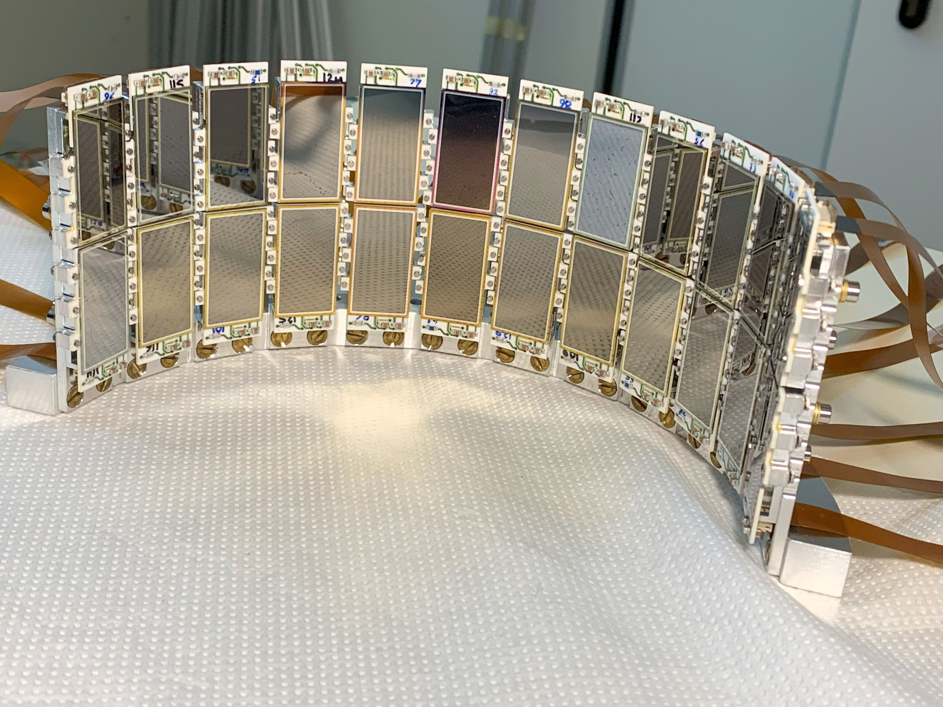
SUCCES
Quality kaon beam
Efficient x-ray detector system
© Designed by Freepik
Silicon
Drift
Detectors

Slide 5
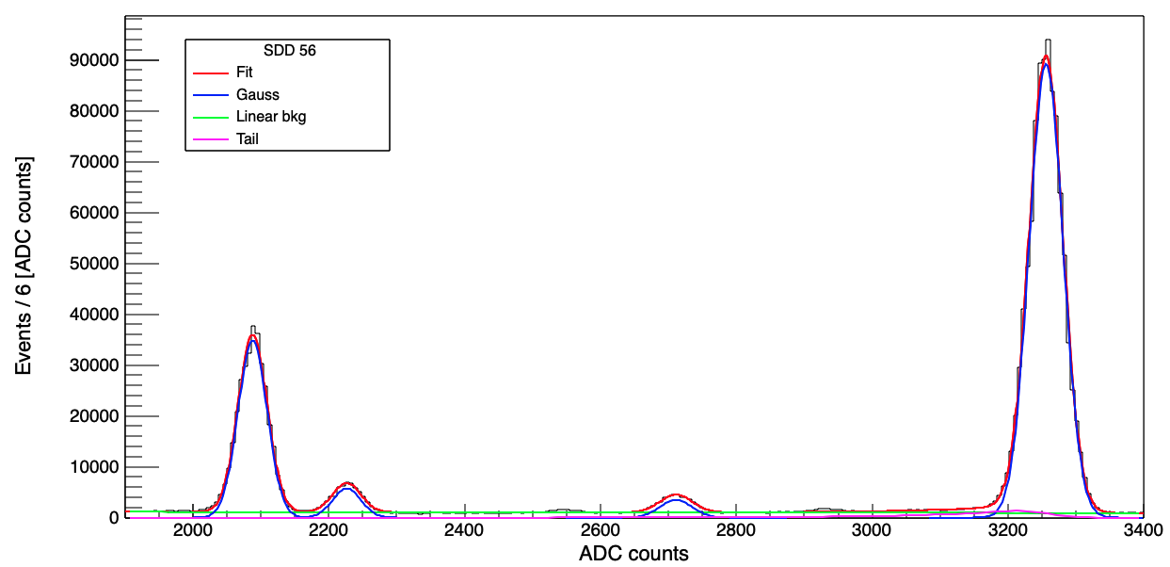




SUCCES
Quality kaon beam
Efficient x-ray detector system
Powerful analysis tools
© Designed by Freepik
Cu $K_{α}$
Monte Carlo simulations,
modern algorithms and machine learning techniques
Optimization of the setup and detectors response (trigger, SDDs, veto, …)
SDD Calibration
Ti $K_{α}$
Ti $K_{β}$
Fe $K_{α}$

Slide 6

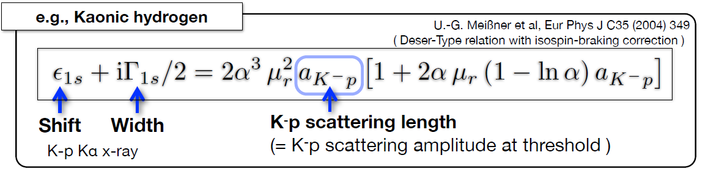
Scientific Goal of SIDDHARTA-2
  The first measurement of kaonic deuterium transitions to the fundamental 1s level
  to extract the antikaon-nucleon isospin dependent scattering lengths (using also the measurement of kaonic hydrogen performed by SIDDHARTA)
Experimental determination of the isospin-dependent
K-N scattering length

Slide 7
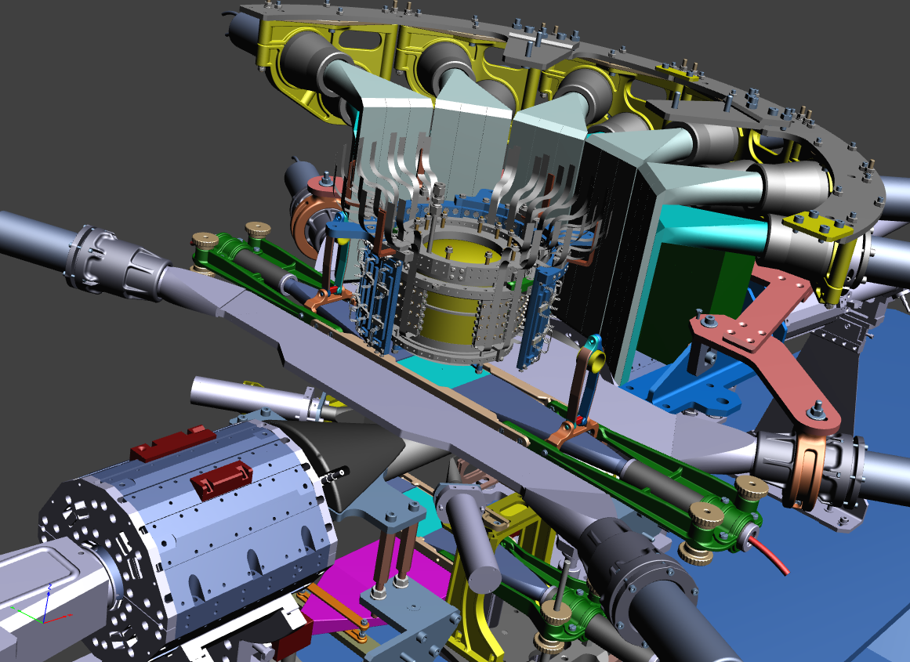
SIDDHARTA-2 apparatus
Veto-1
Target
Veto-2
384 SDDs
Kaon Trigger
Veto-3
Charged kaon

Slide 8
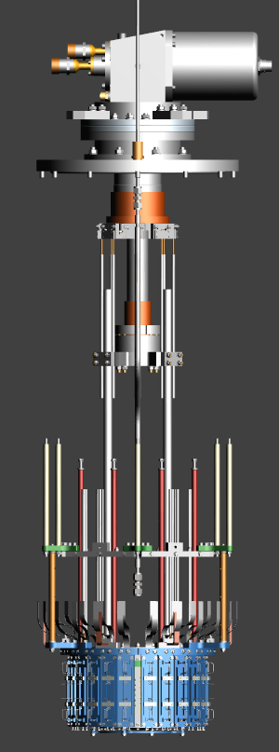
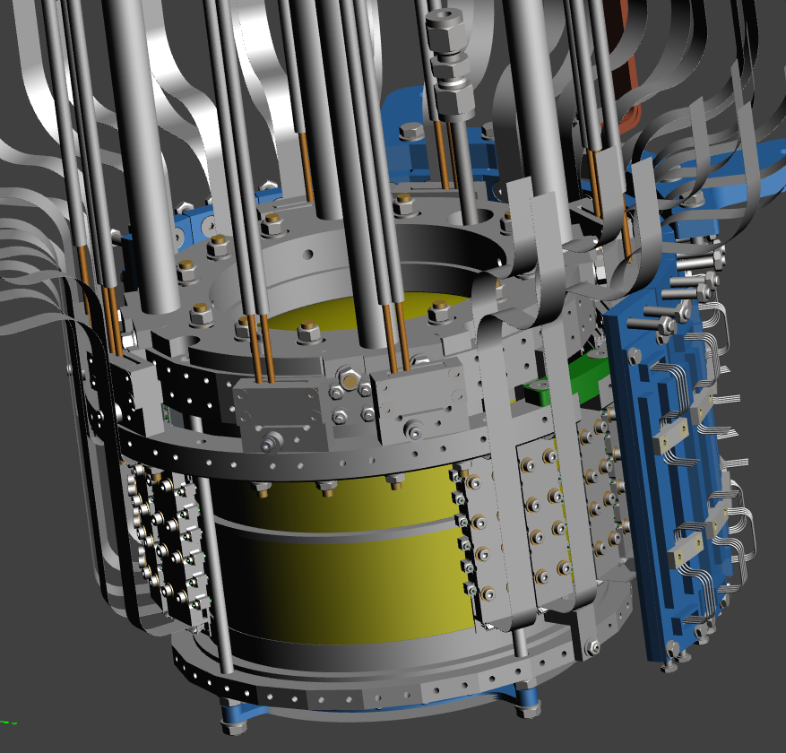
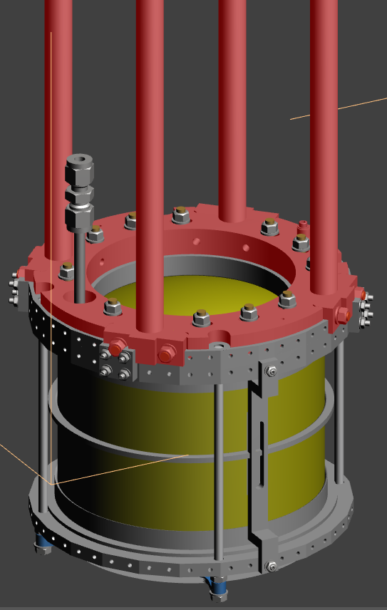
Optimization of SIDDHARTA-2 setup
new solutions for the cooling scheme - target and SDD
Better control of target parameters (pressure, temperature, density,….)
Second stage
dedicated to target cooling
Target + SDD cooling
Leybold MD10 – 18 W @ 20 K
target cell and SDDs are cooled
via ultra pure aluminum bars
T_{TC} = 20-30 K
T_{SDD} ~ 130 K

Slide 9
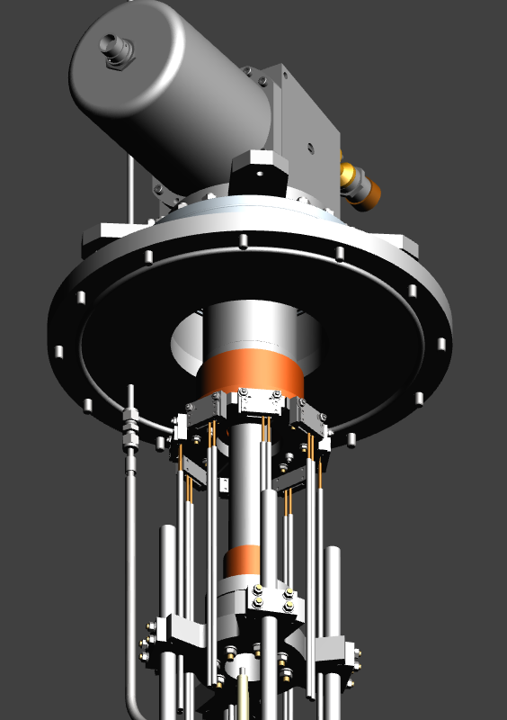
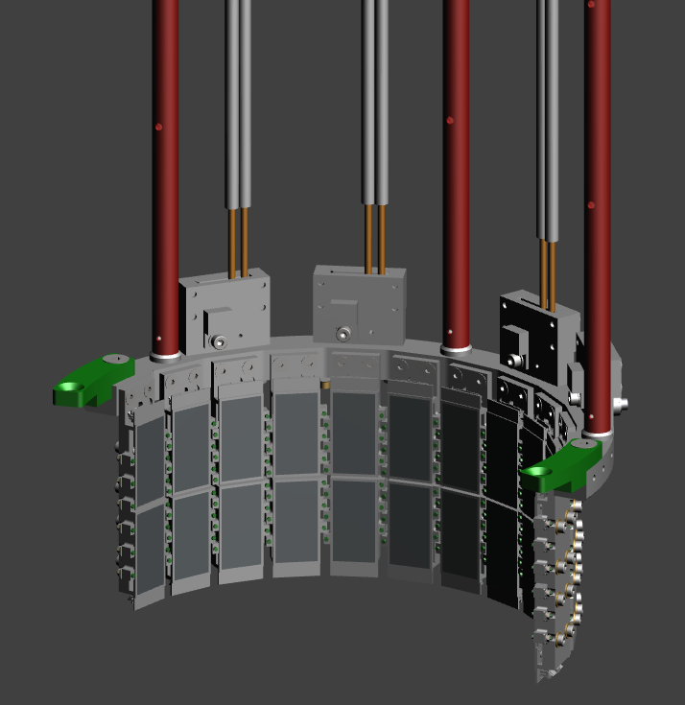
Optimization of SIDDHARTA-2 setup
new solutions for the cooling scheme - target and SDD
Better control of target parameters (pressure, temperature, density,….)
First stage
dedicated only to SDD cooling
Cooling power
1st stage ~ 115 W @ 80 K
2nd stage ~ 18 W @ 20 K

Slide 10
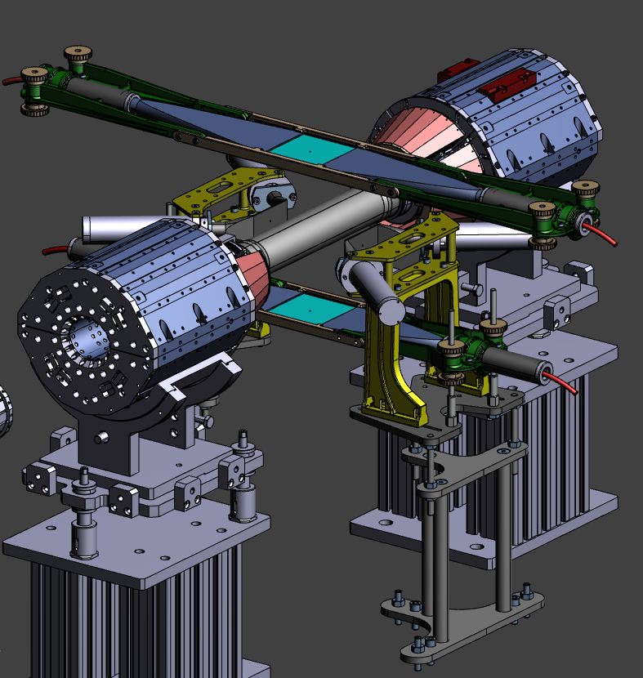
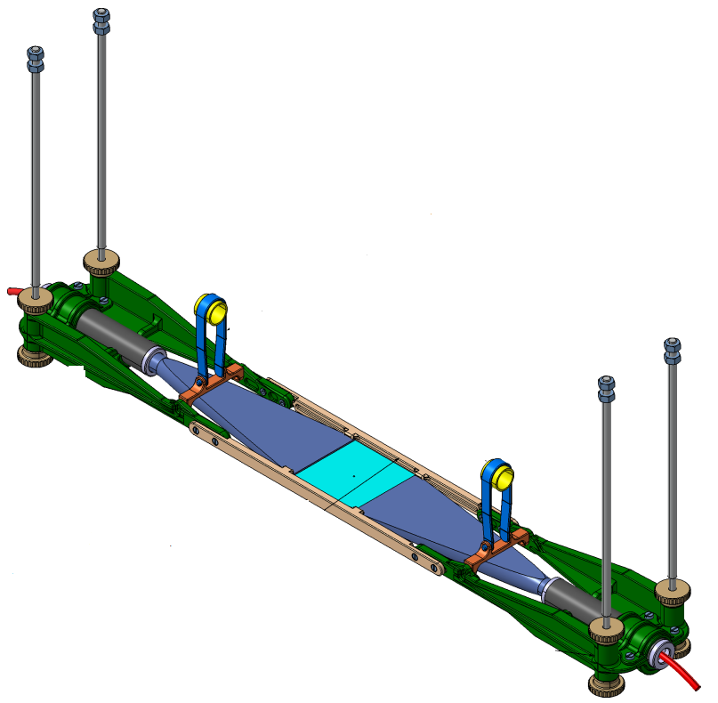
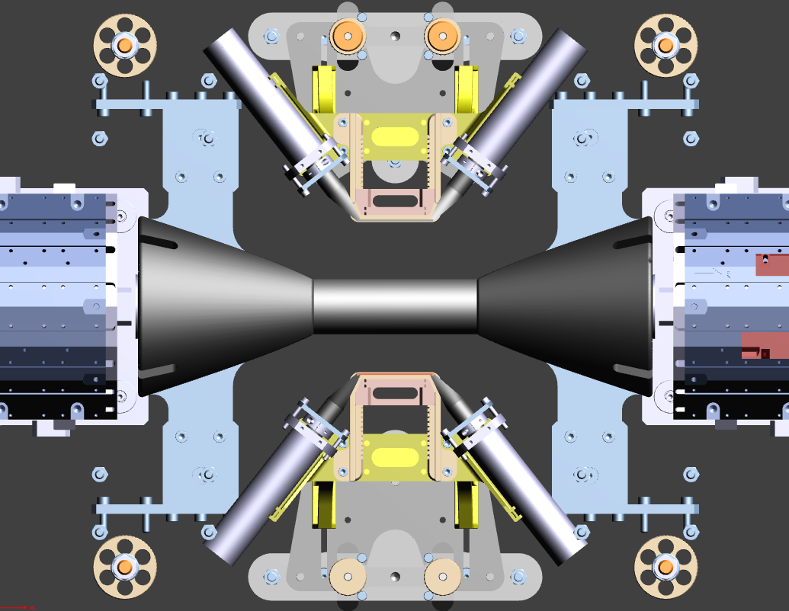
Optimization of SIDDHARTA-2 setup
Kaon Trigger consists of two plastic scintillators read by PMT’s placed above and below the IR.
New support structures
The Luminosity monitor consists of two plastic scintillators in the horizontal plane

Slide 11
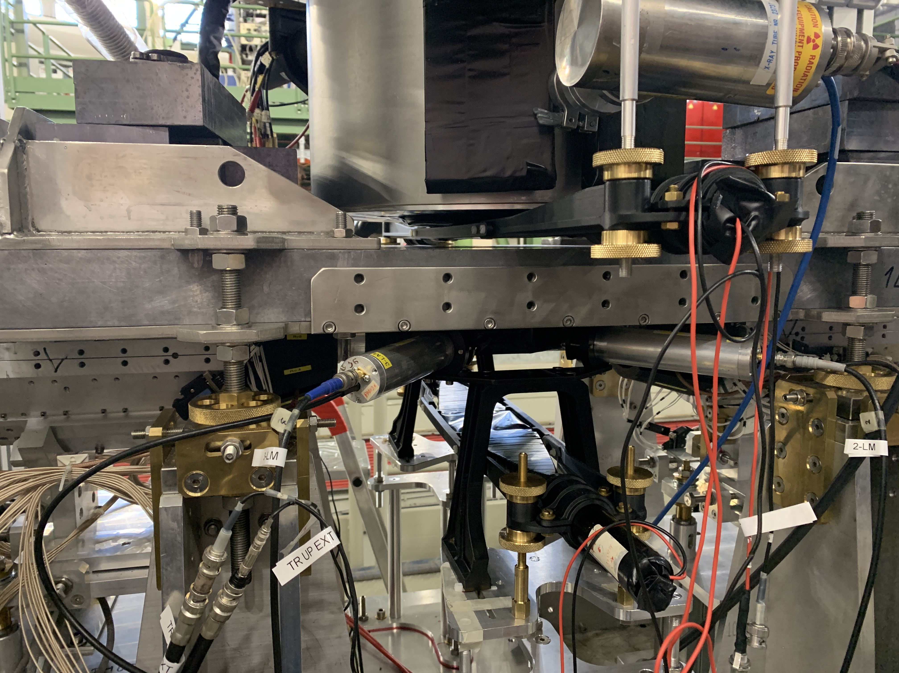
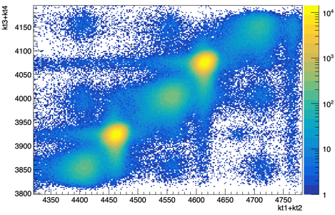



Optimization of SIDDHARTA-2 setup
Kaon Trigger – event selection
Kaon trigger up
$$K^{−}$$
Kaons
MIPS
e⁻
e⁺
$$K^{+}$$
Kaon trigger down
The ToF is different for Kaons, m(K)~ 500 MeV/c² and light particles
originating from beam-beam and beam-environment interaction (MIPs).
Can efficiently discriminate by ToF Kaons and MIPs!

Slide 12
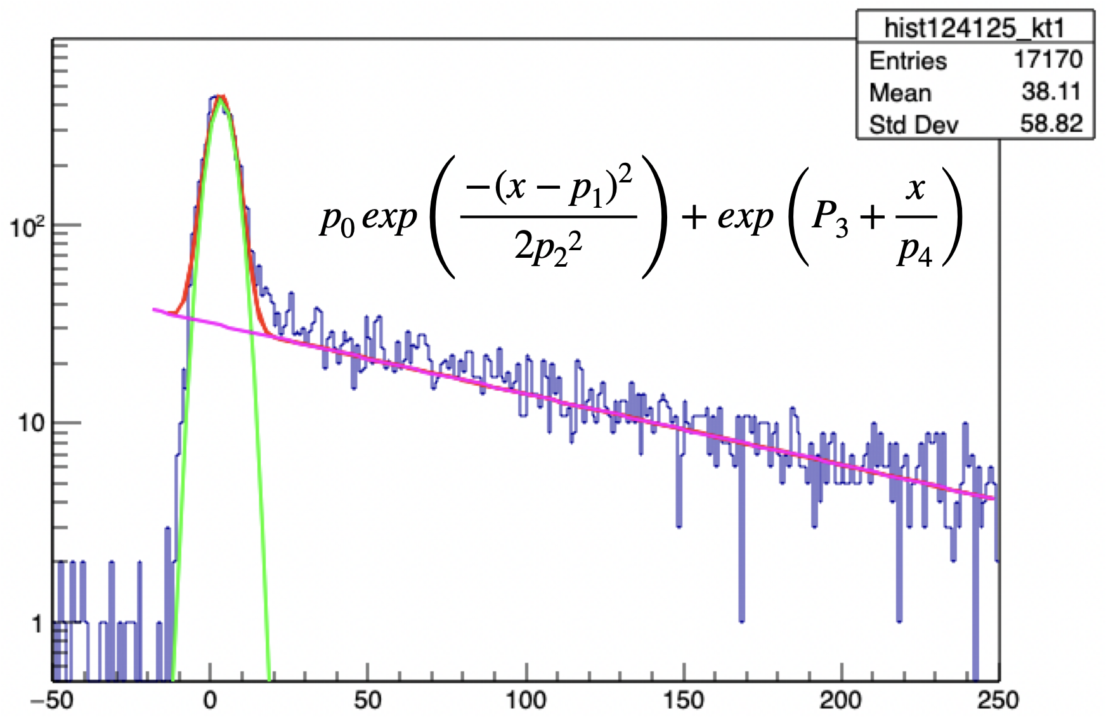
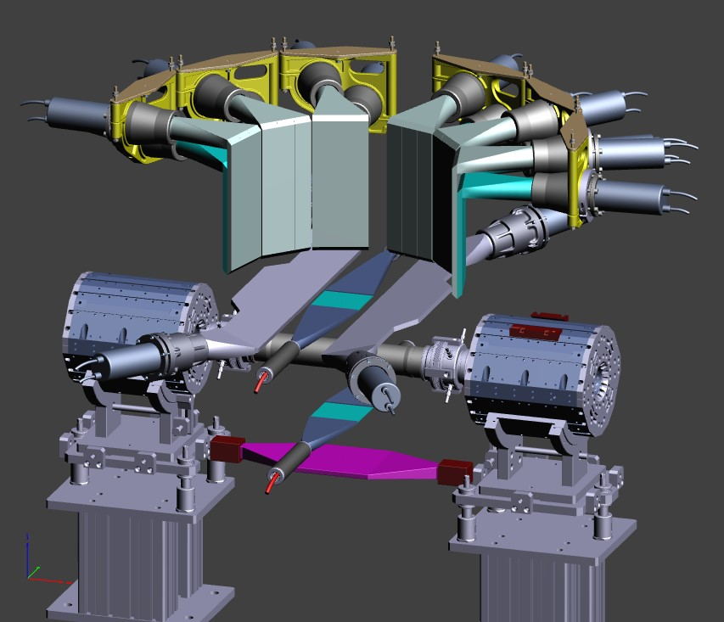
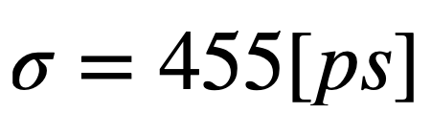



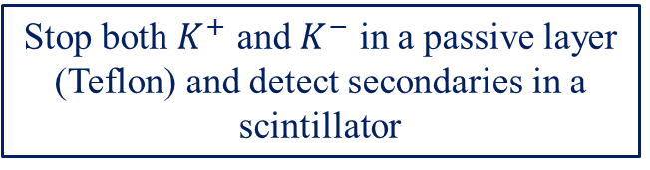
Optimization of SIDDHARTA-2 setup
Stop both $K^{+}$ and $K^{−}$ in a passive layer (Teflon) and detect secondaries in a scintillator
Charged Kaon Detector
$$K^{−}$$
Count
$$K^{+} decay$$
Charged Kaon
tdc (1 ch=100 ps)

Slide 13
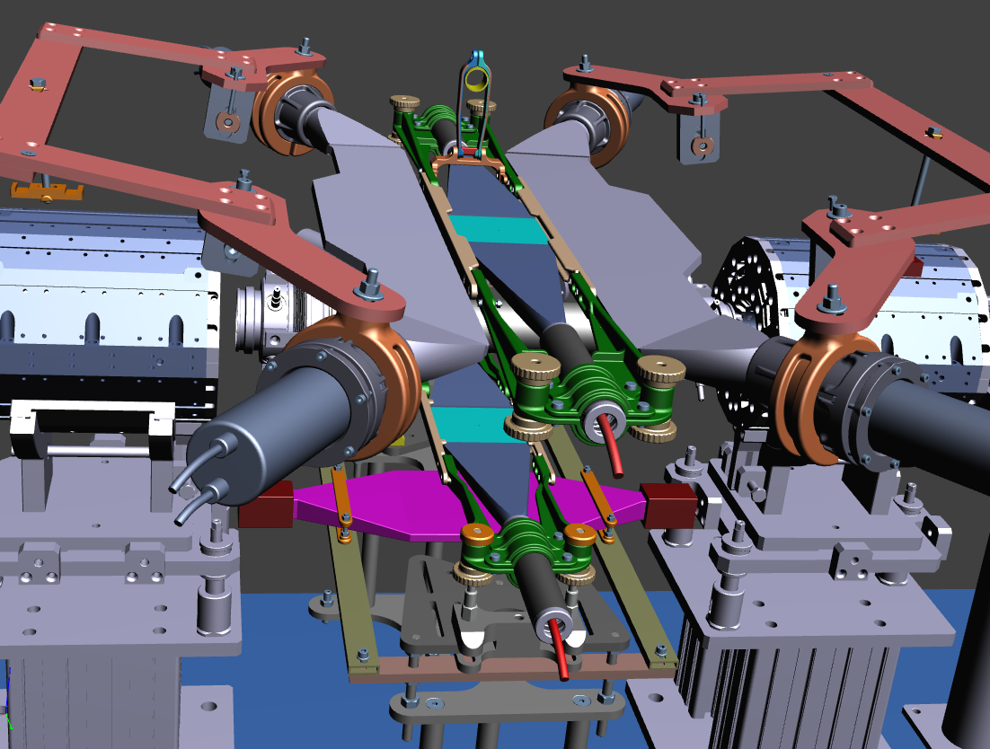
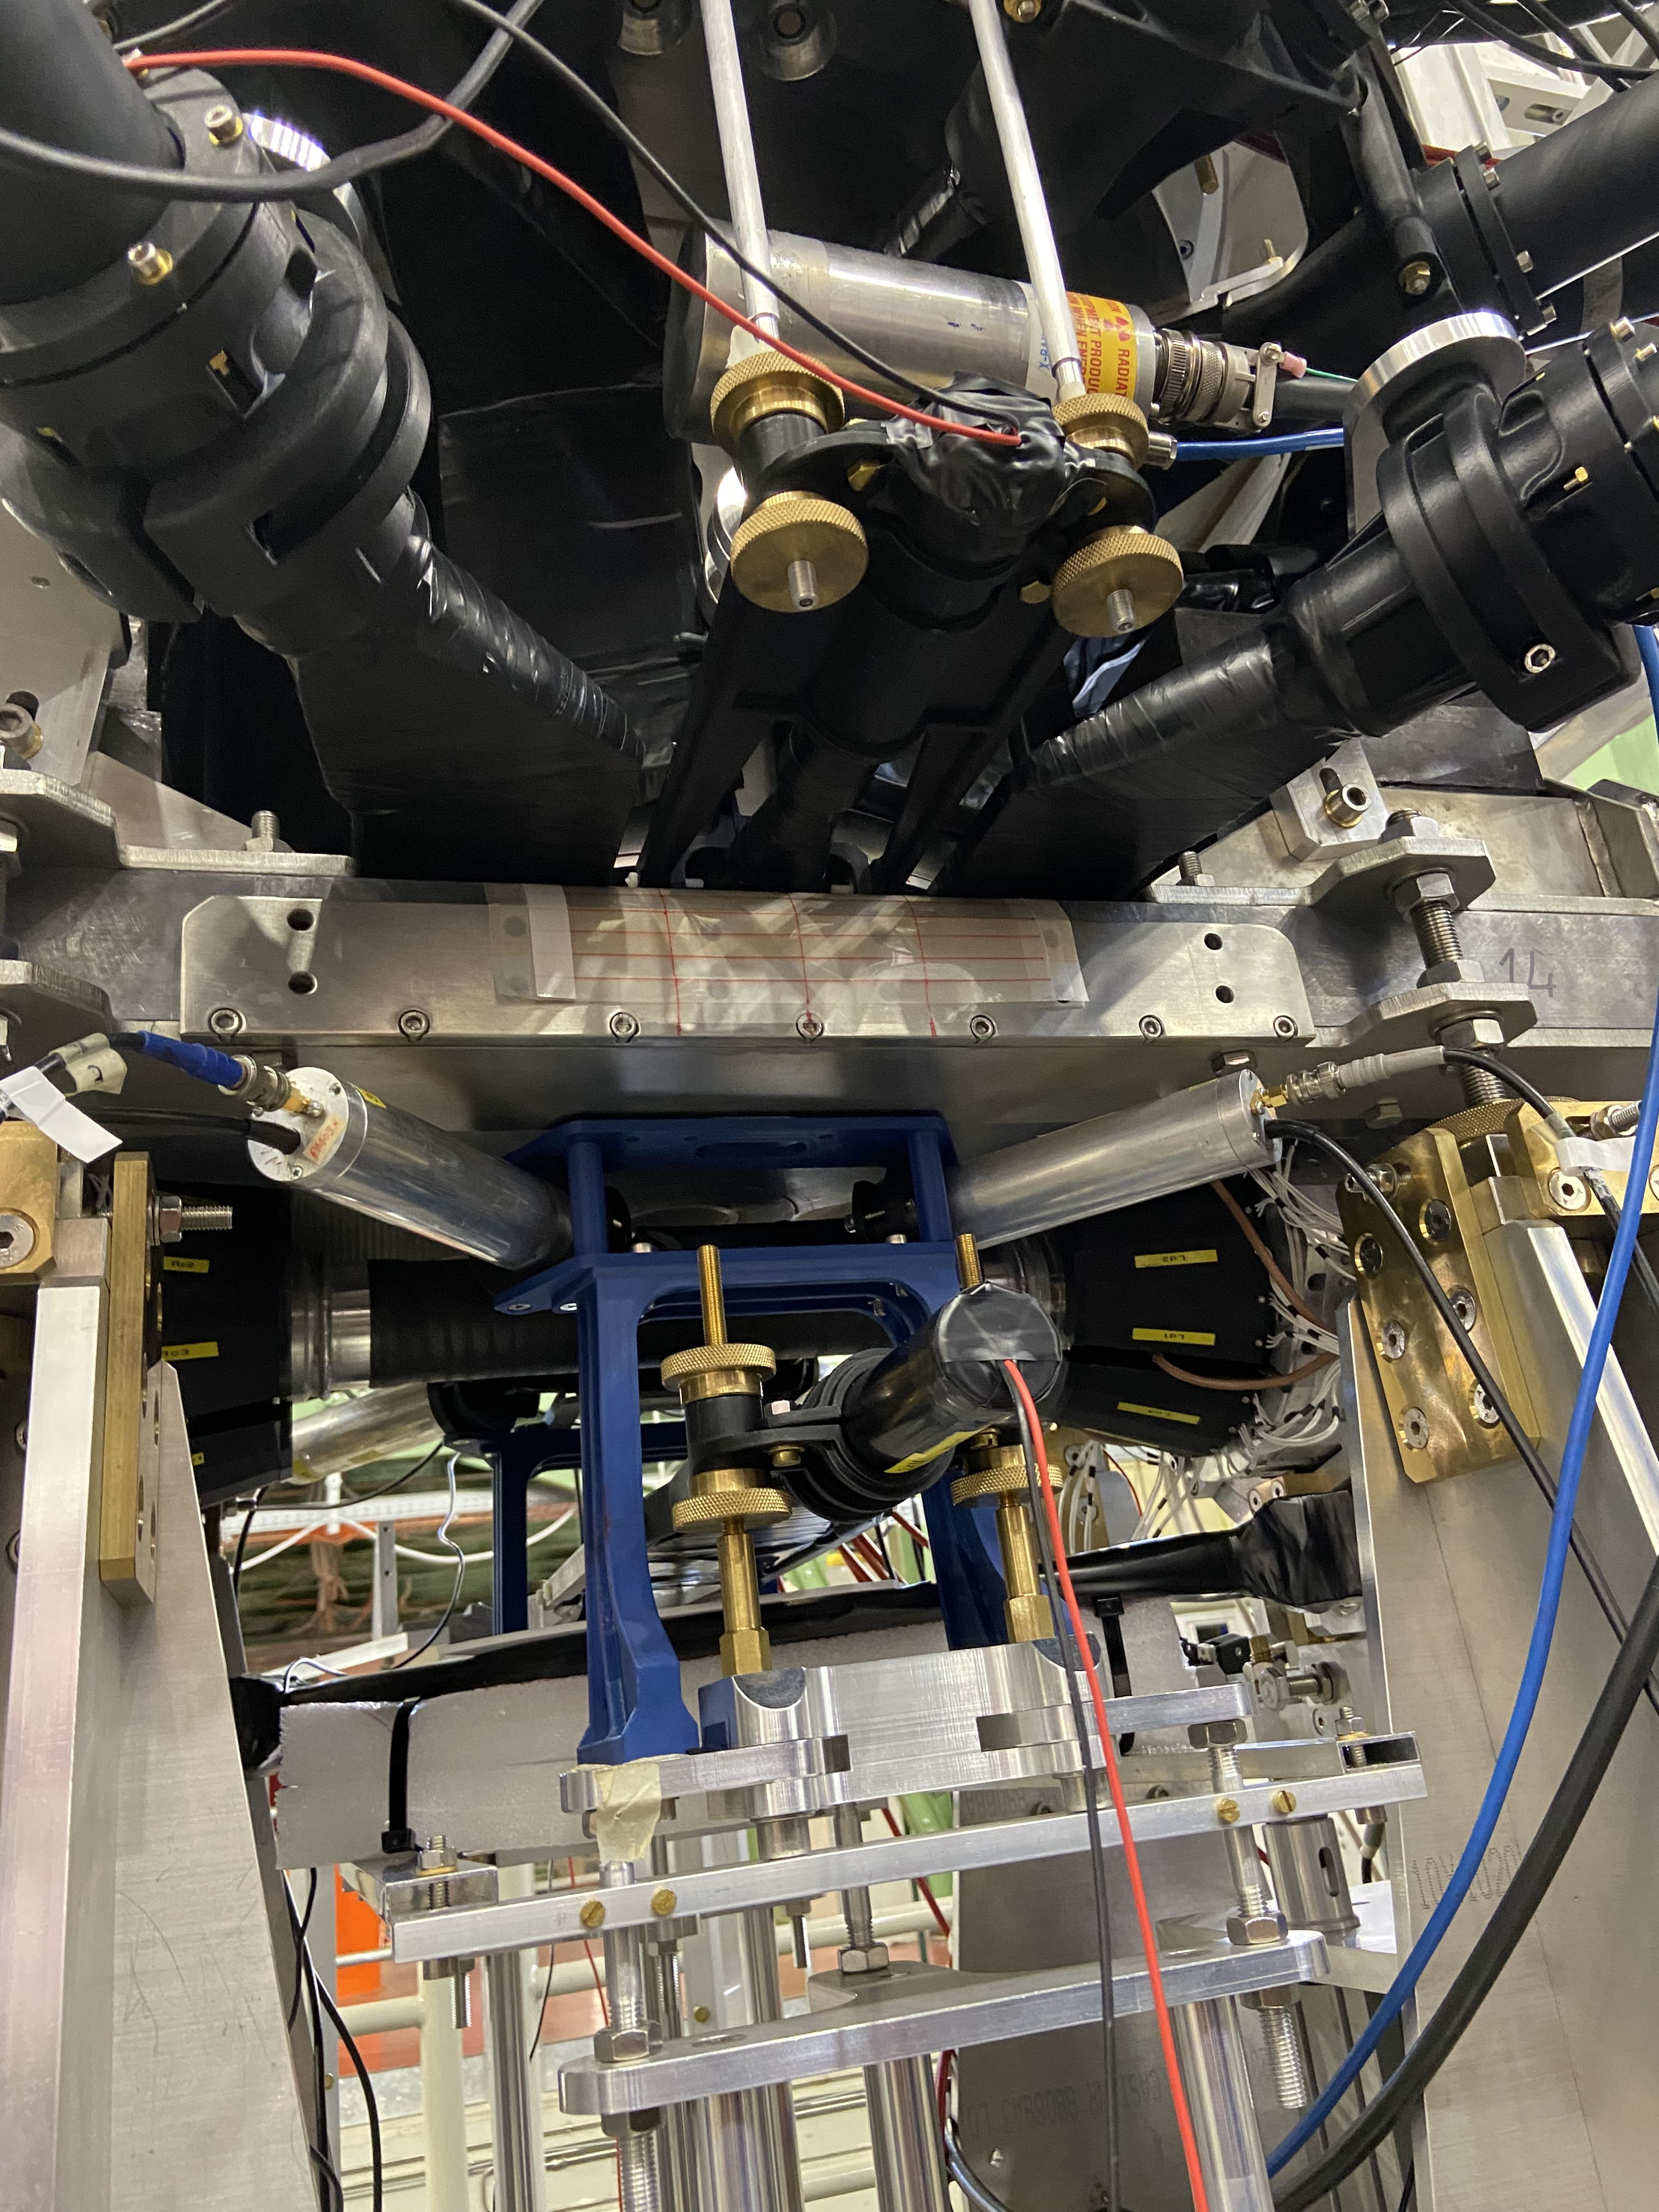
Optimization of SIDDHARTA-2 setup
● 2 pairs of scintillator
640 x 130 x 10 mm³ Scionix EJ-200
● R10533 PMTs Hamamatsu
VETO system adds – VETO3
● light-guides
● Al tube + μMetal (0.1mm)
● reflective and light proof foil
● optical cement

Slide 14
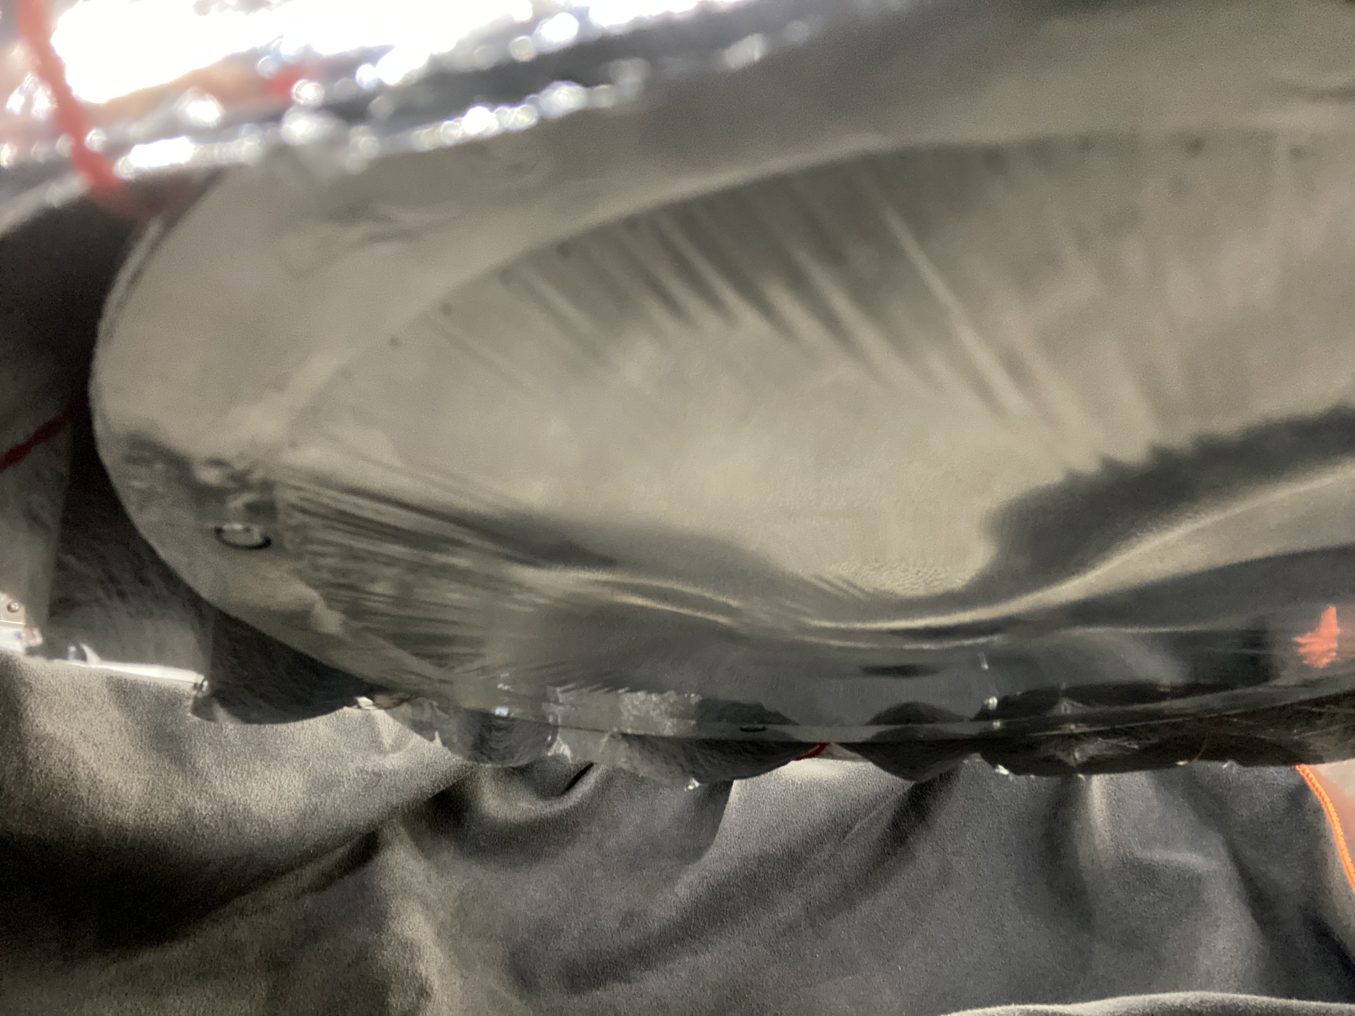
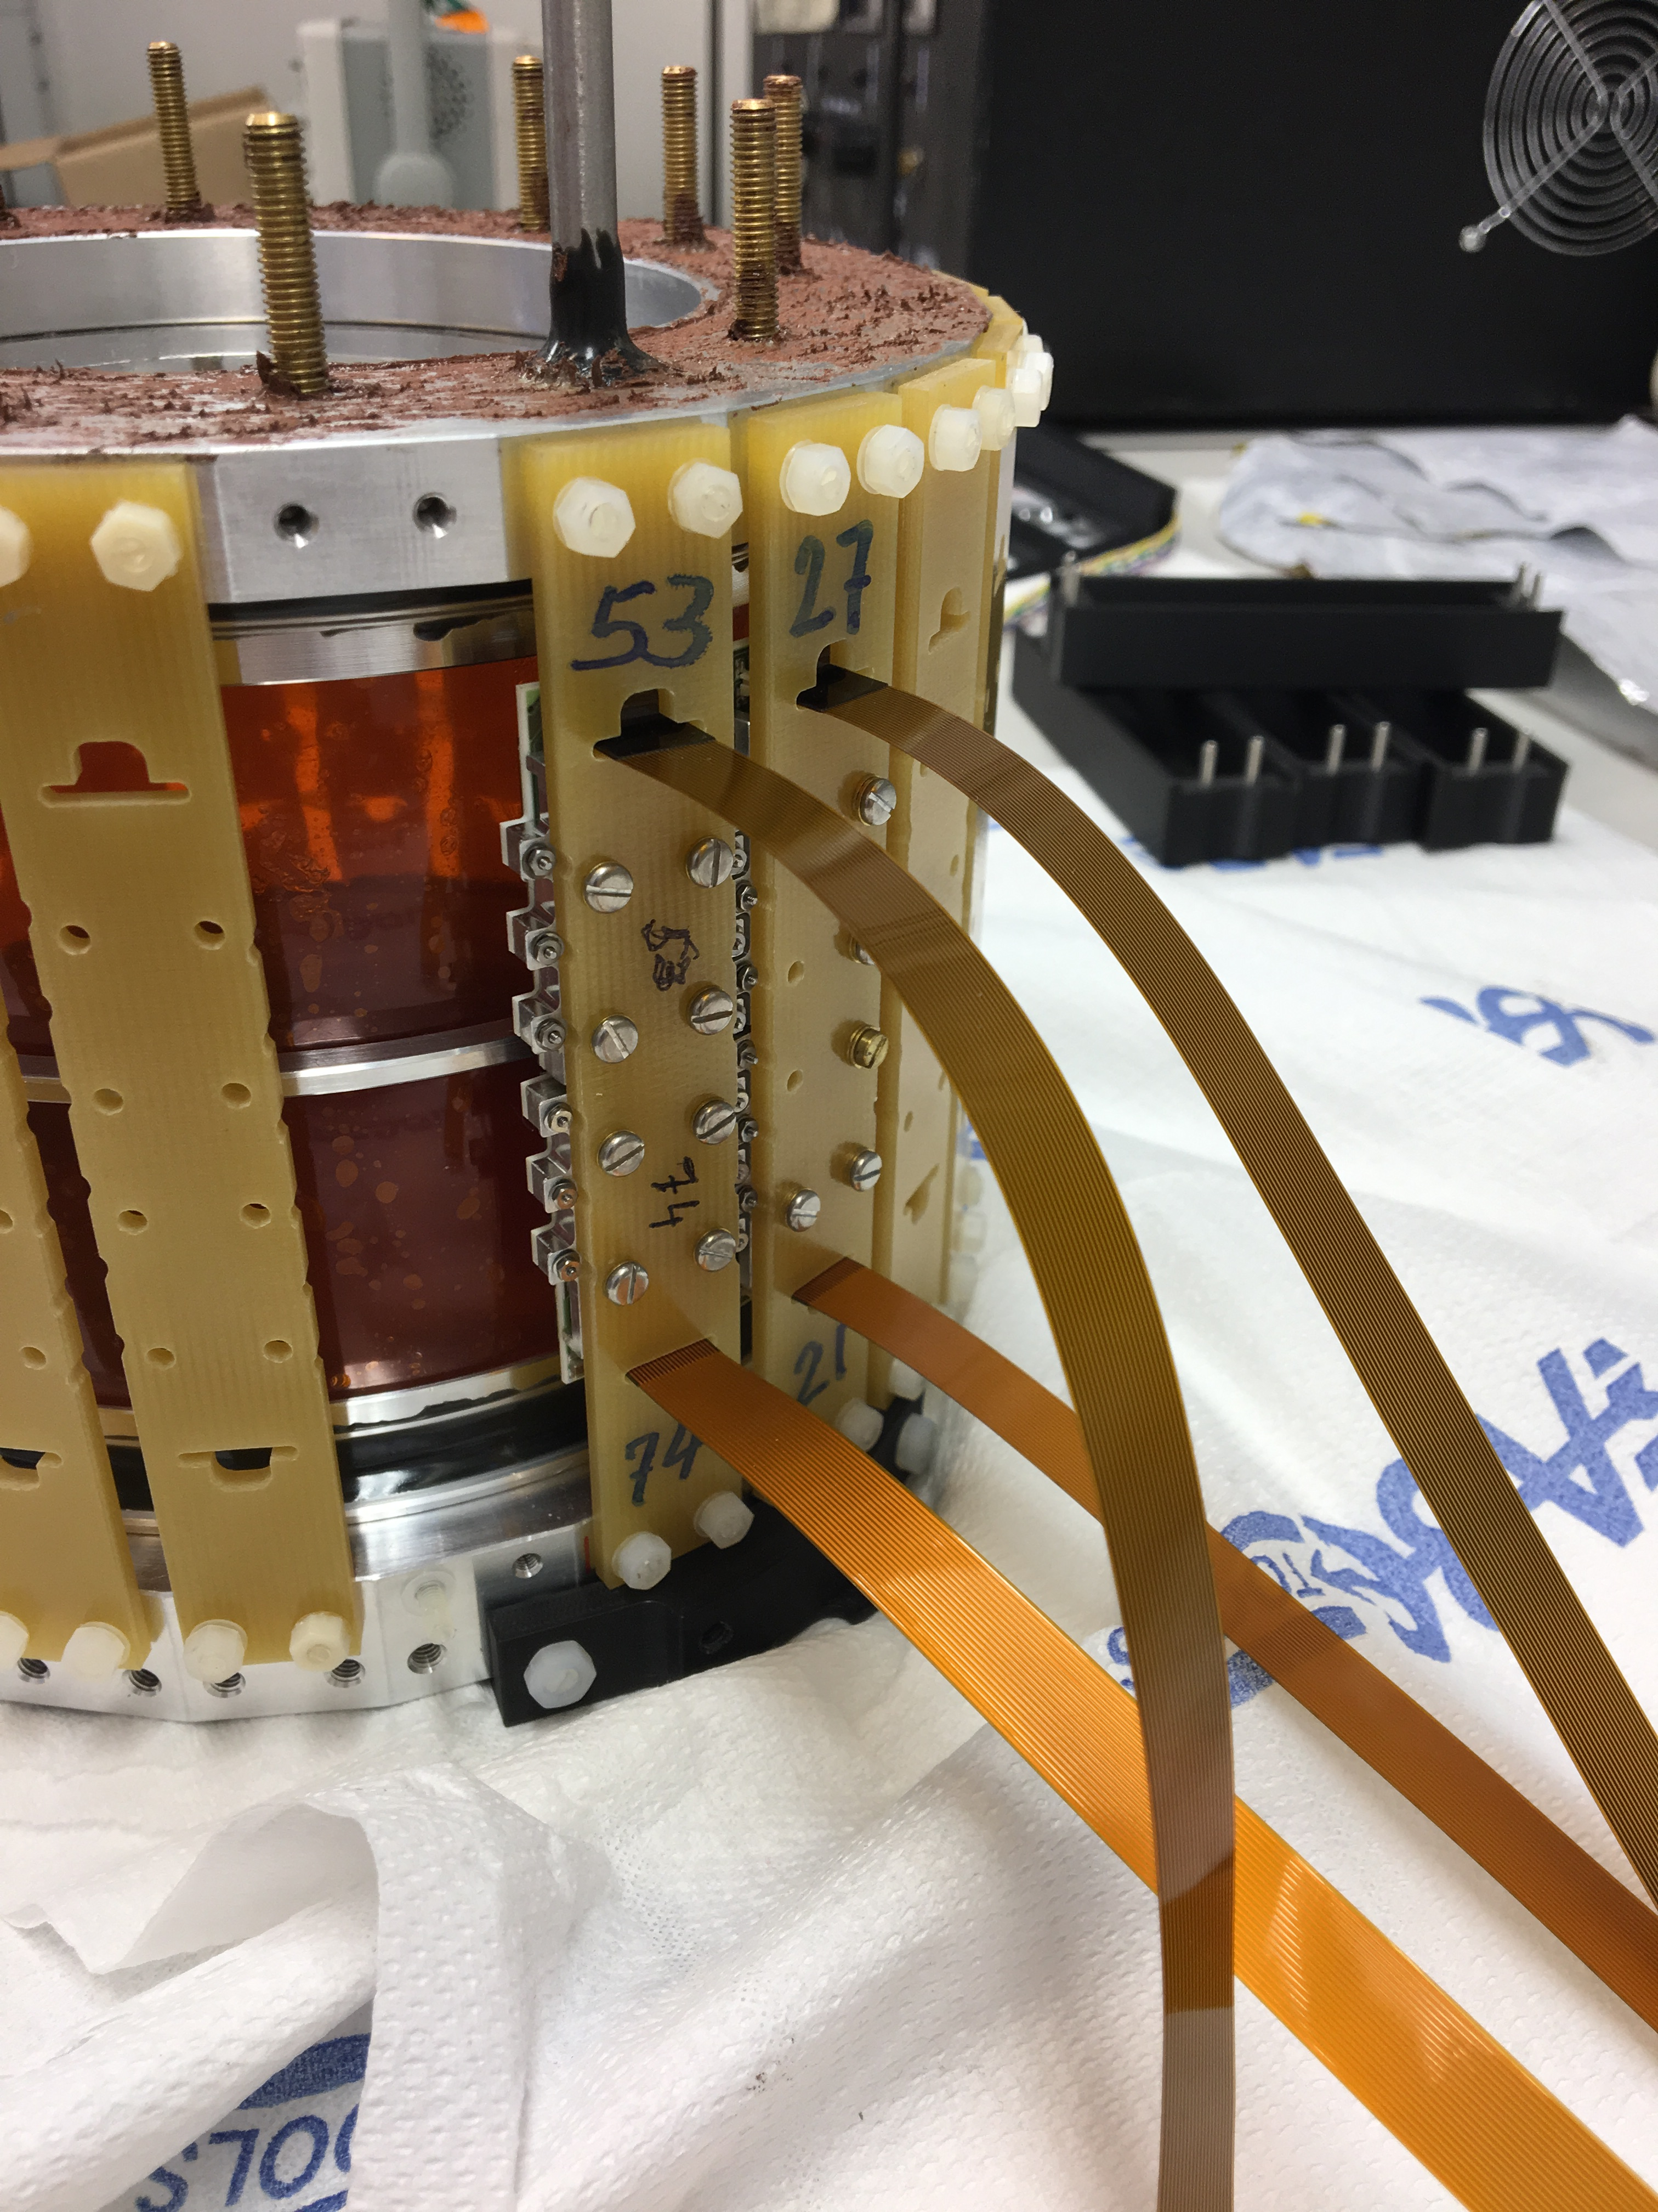
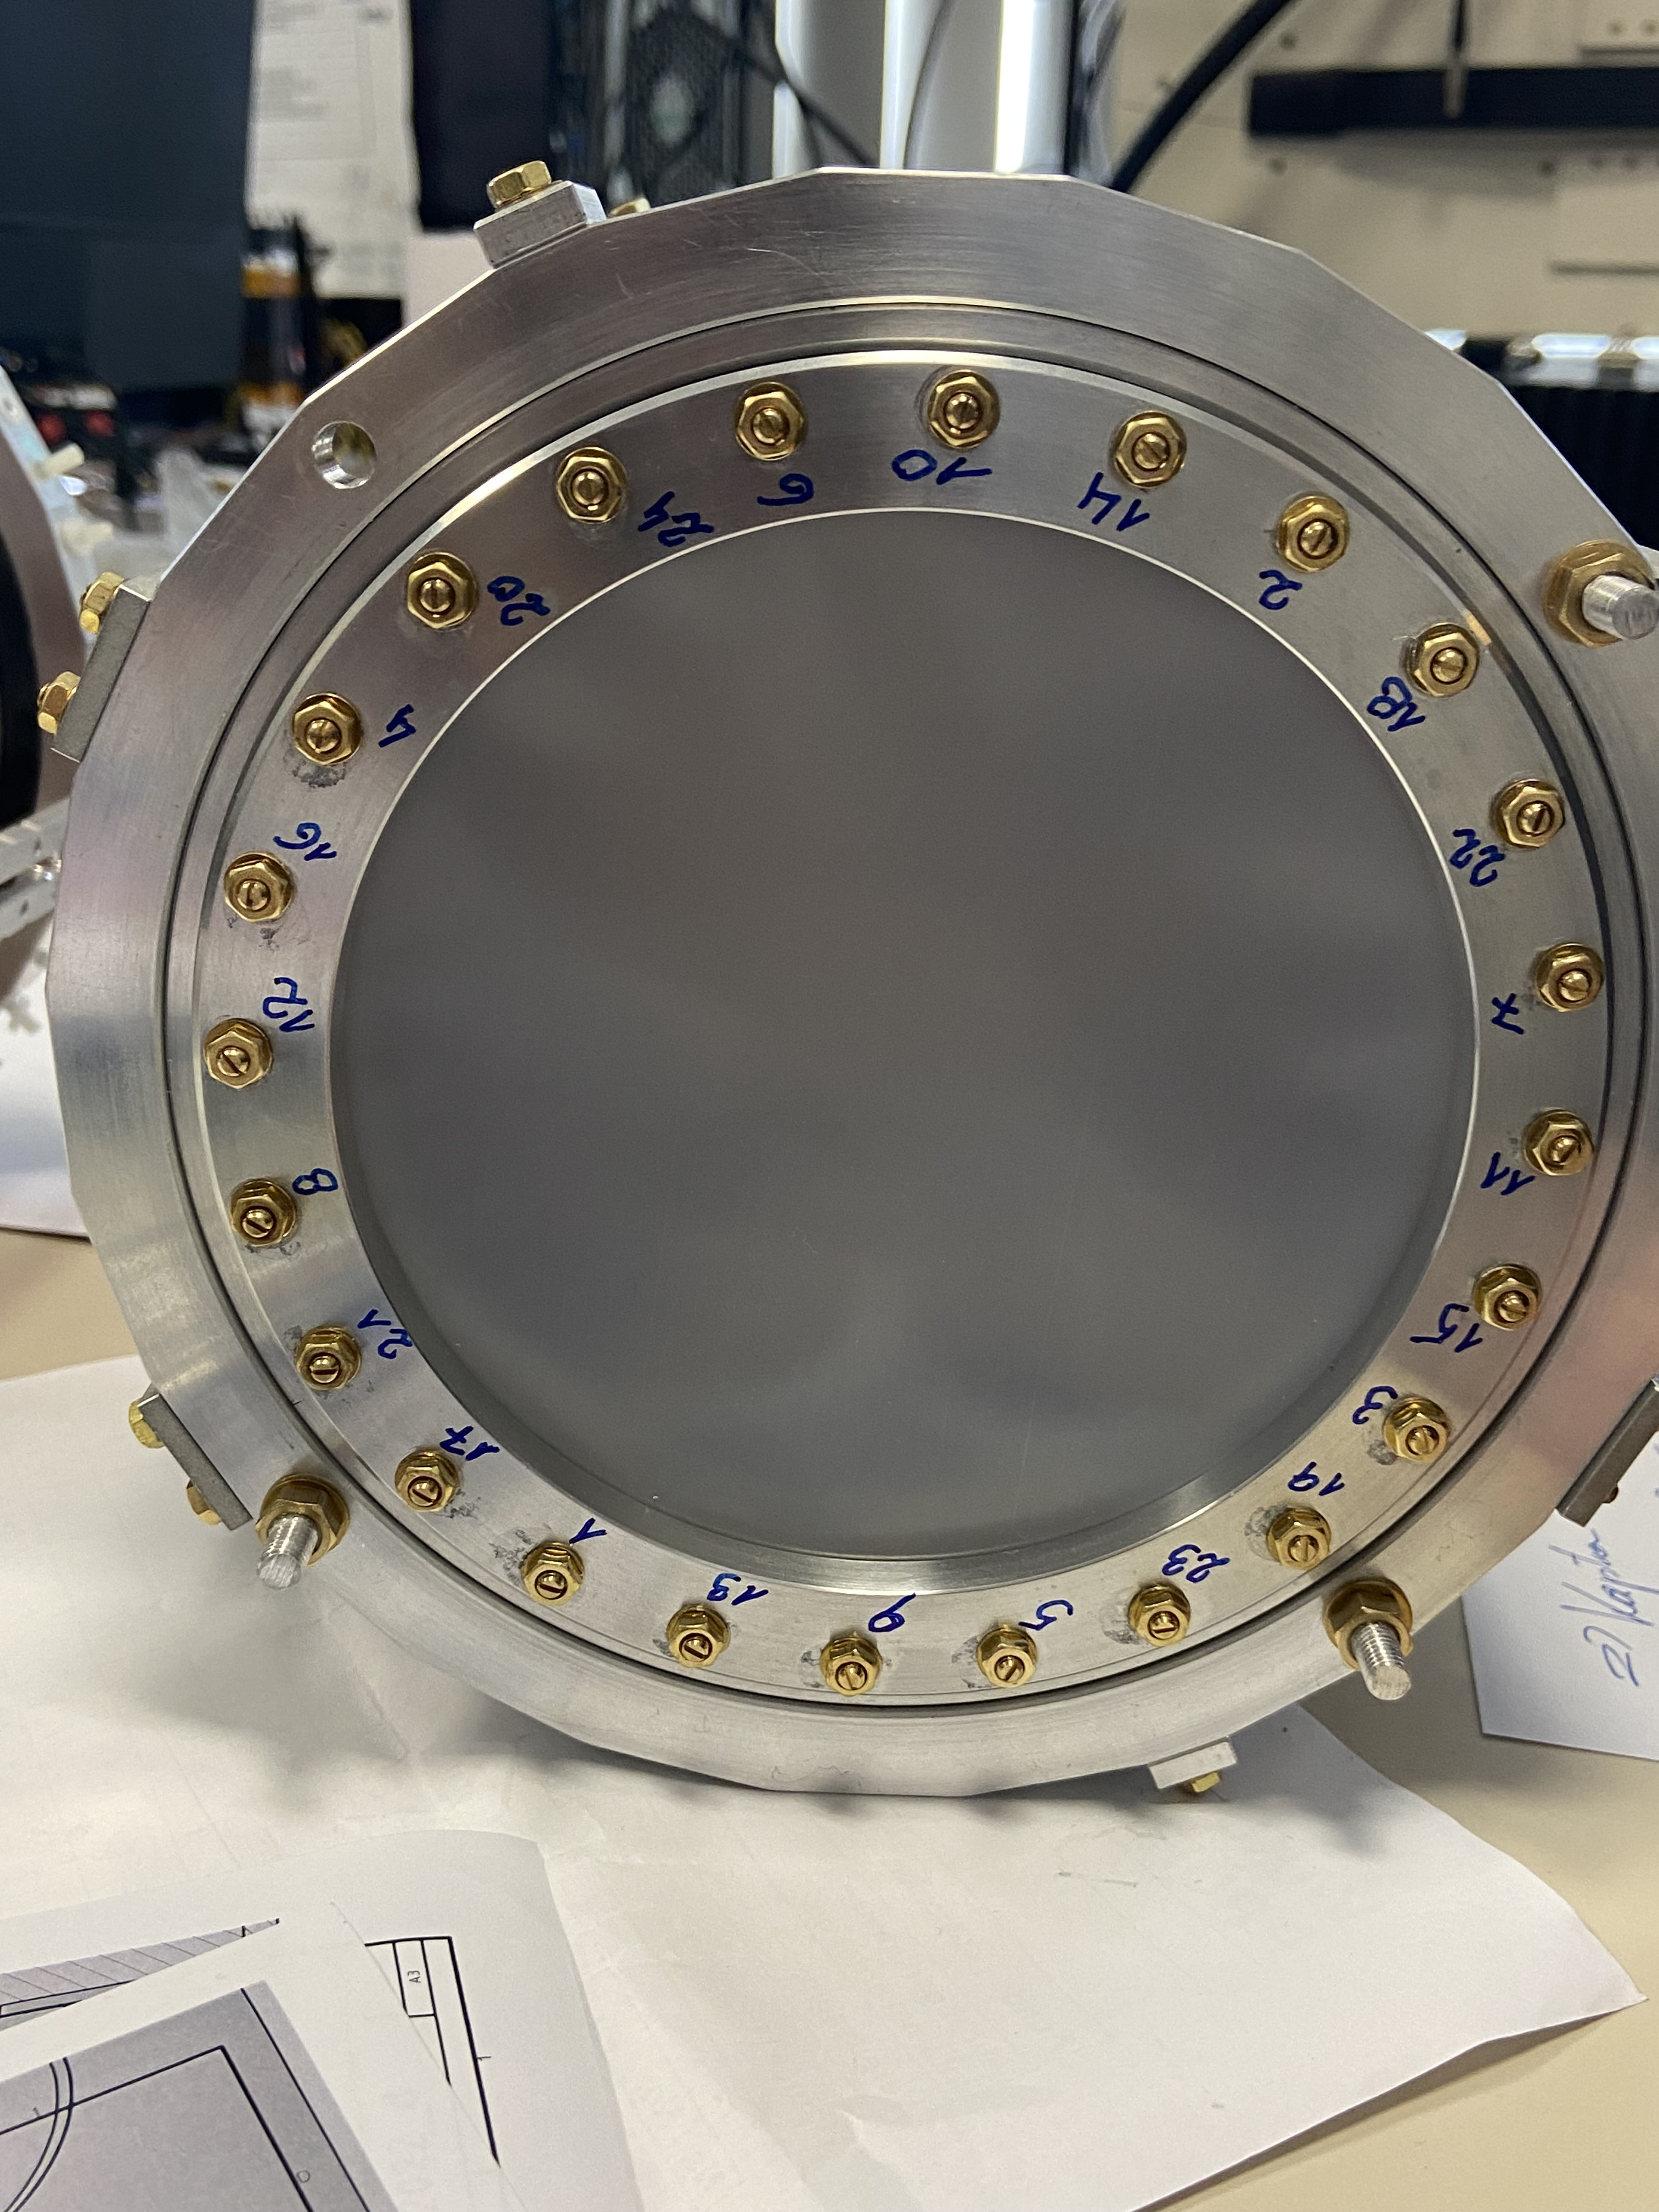
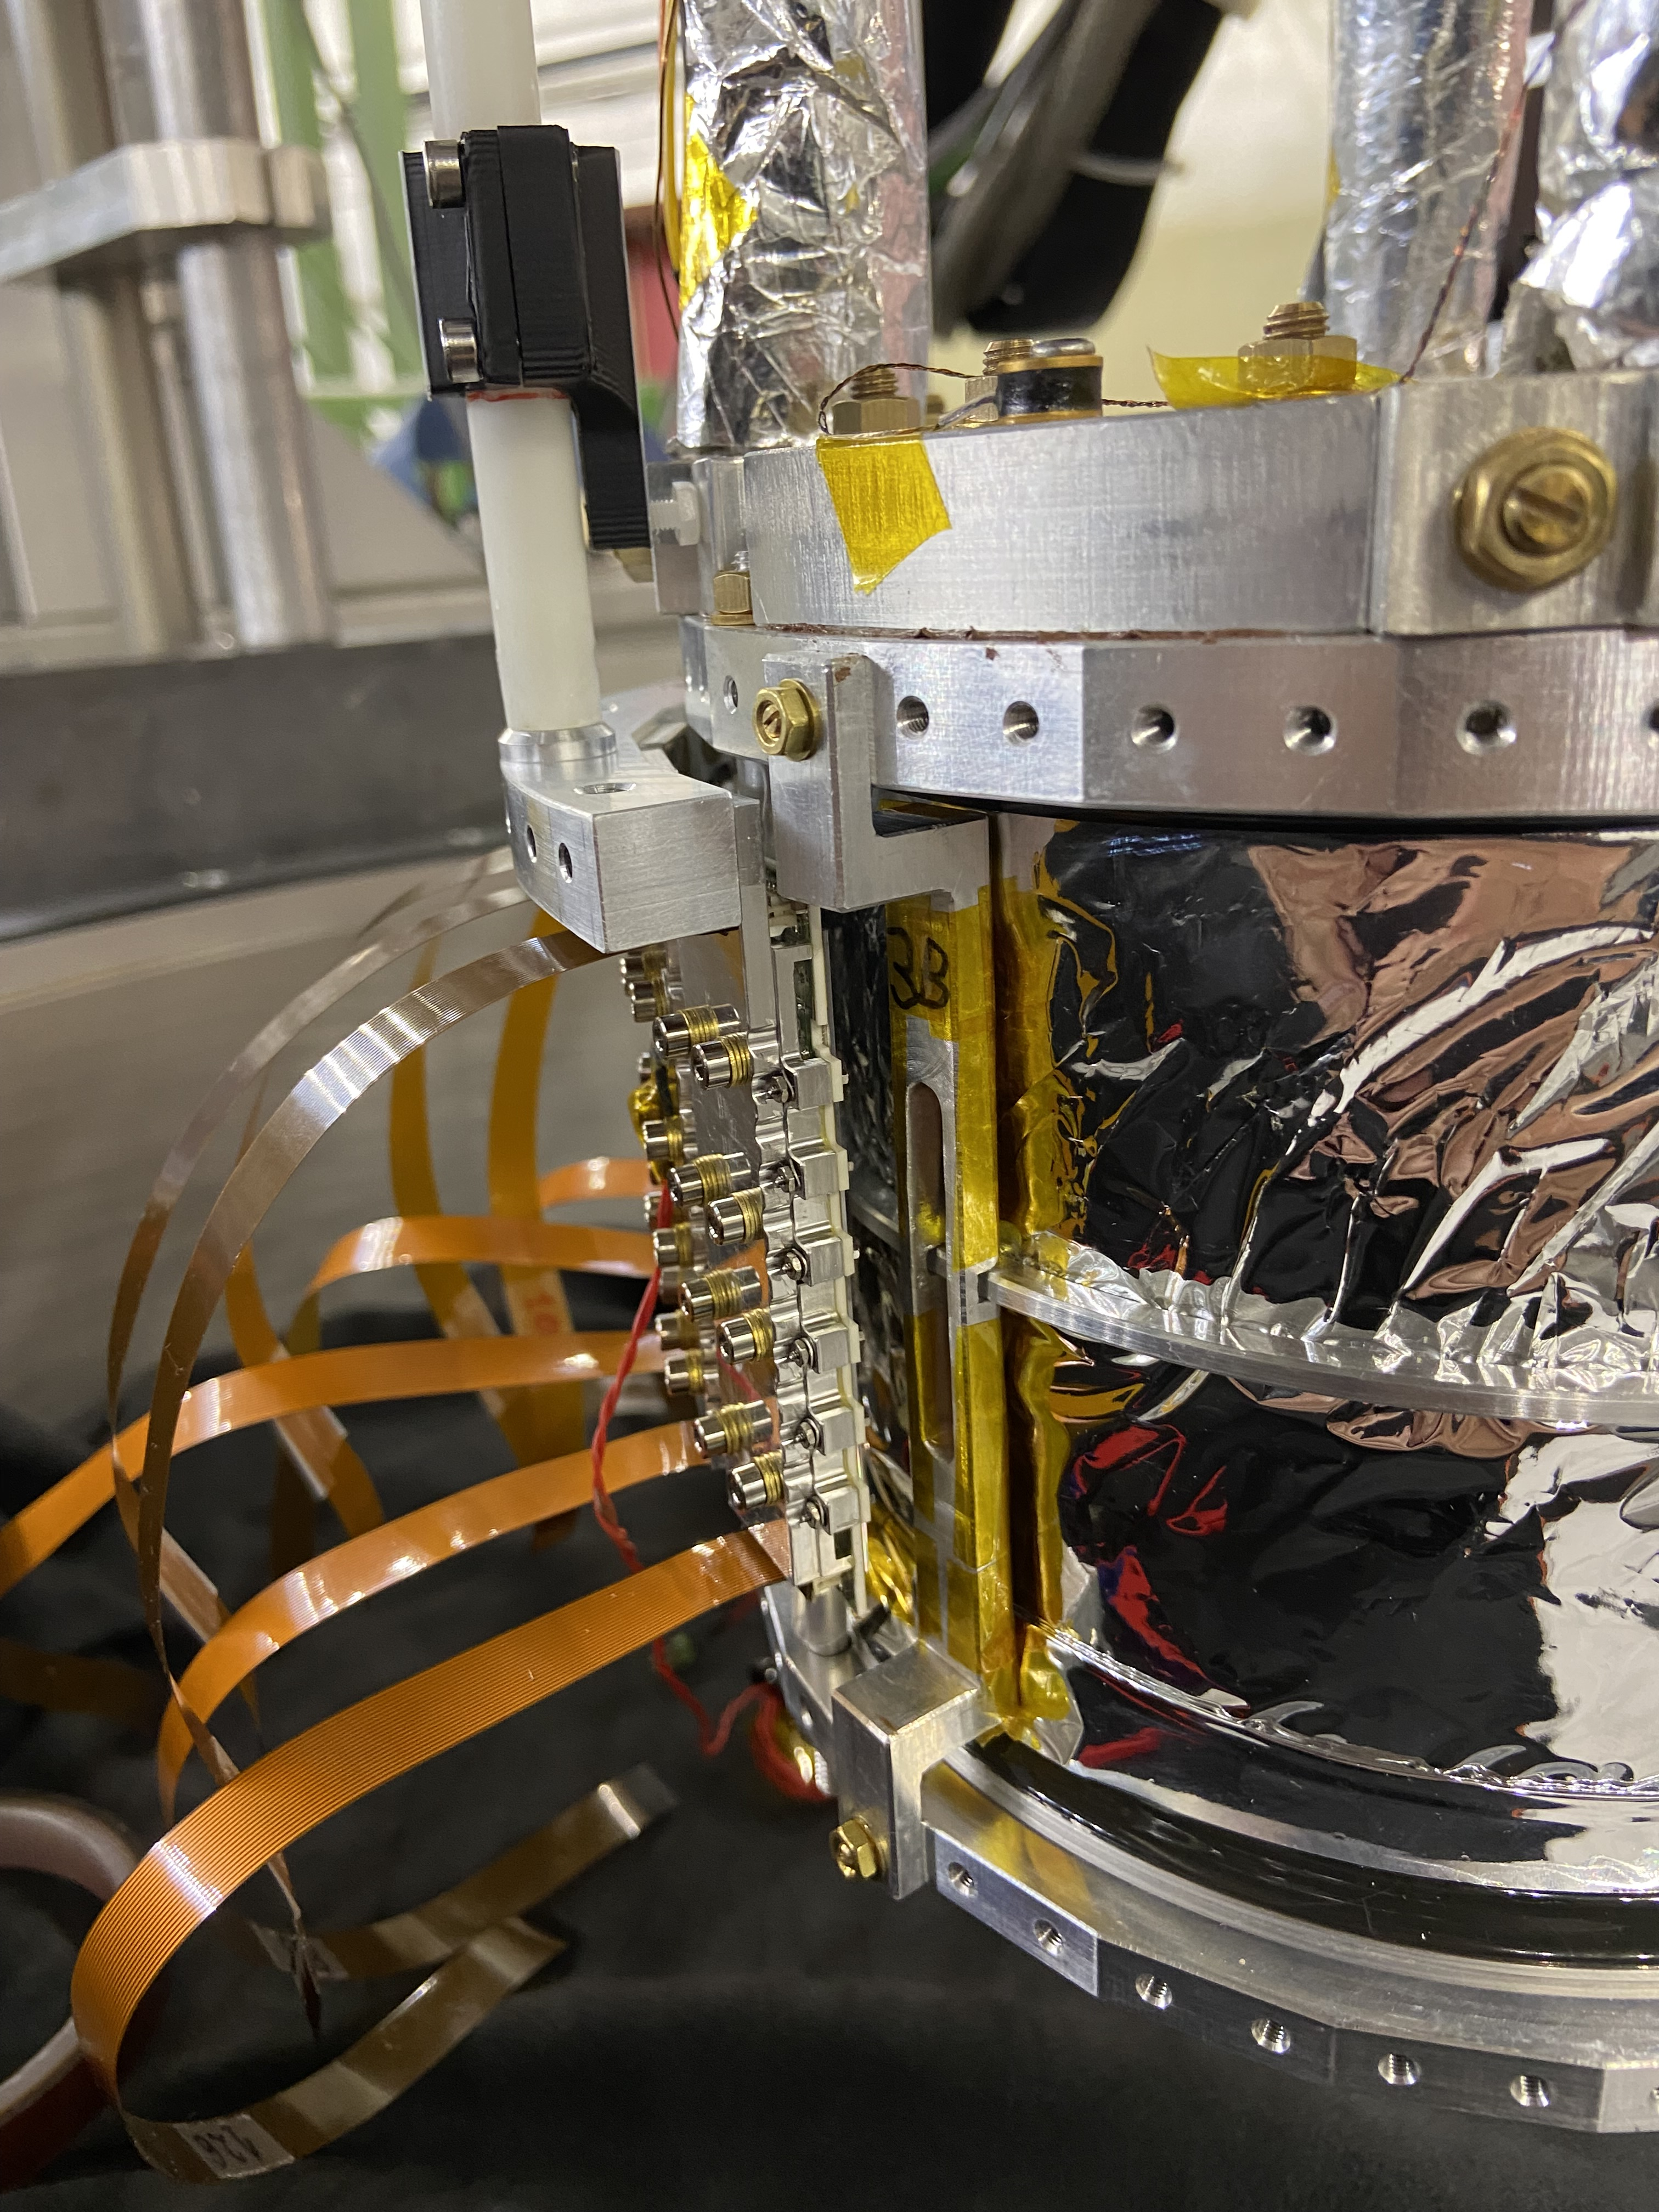
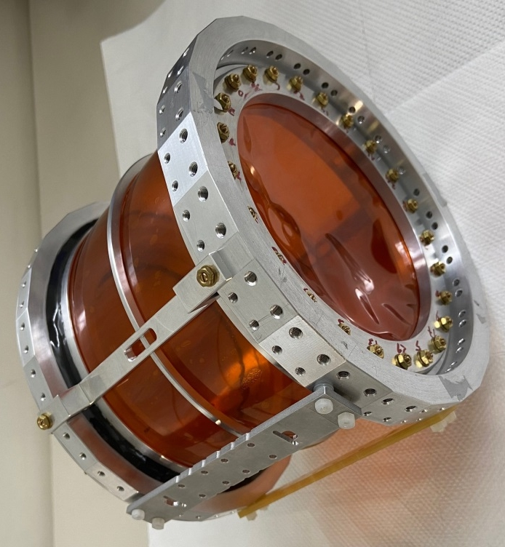

Optimization of SIDDHARTA-2 setup
Selected materials in different configuration:
vacuum entrance windows
target walls
cooling supports
would eliminate Nitrogen and Oxygen contamination

Slide 15
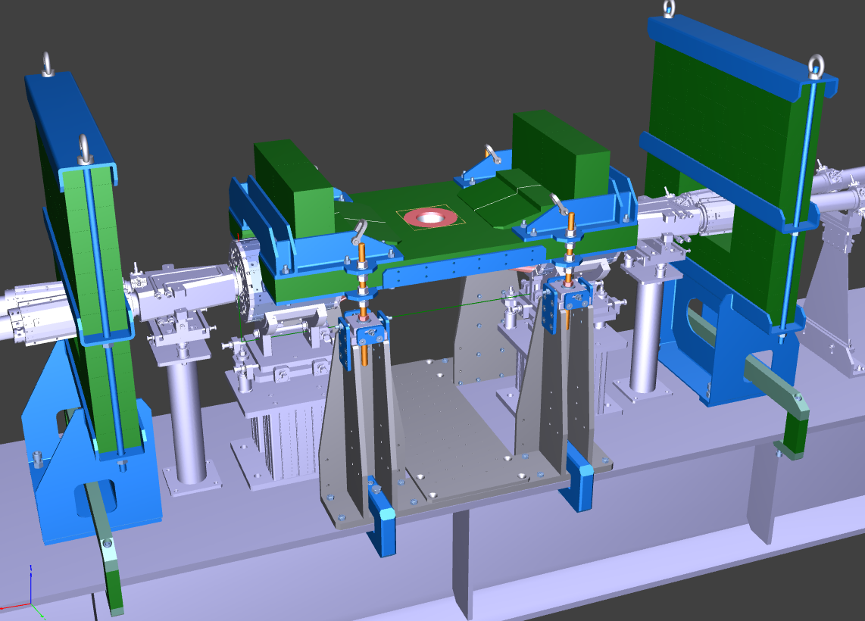
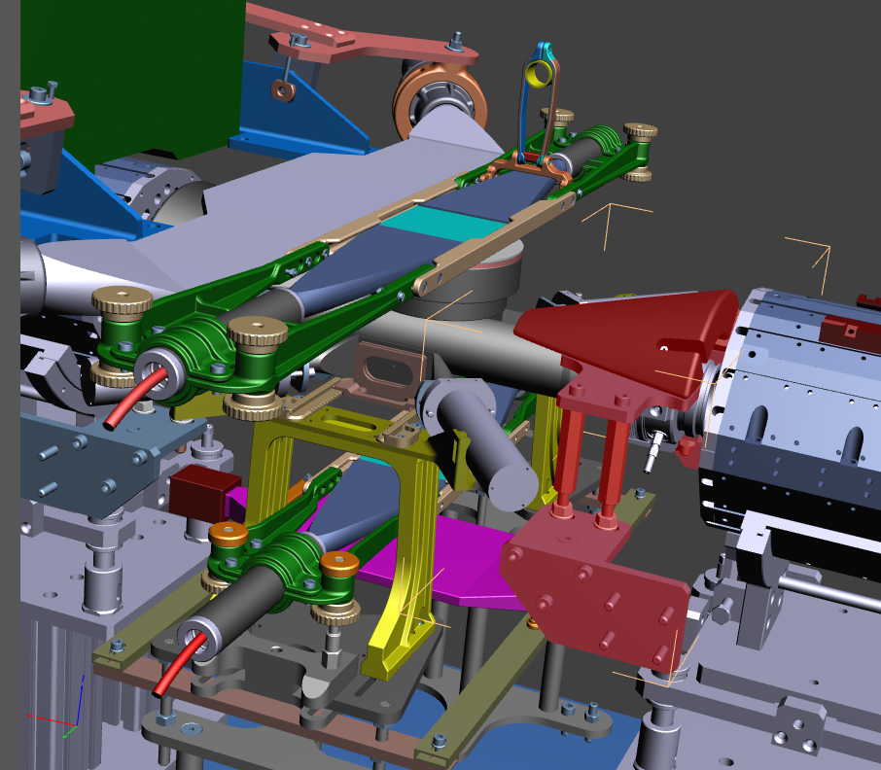
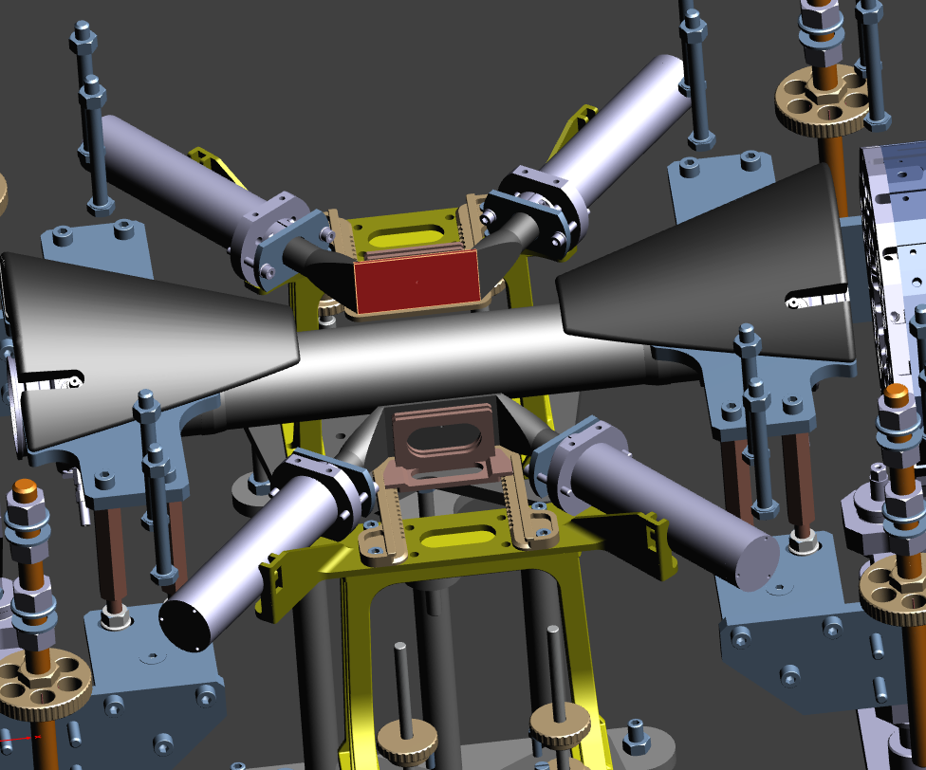
Optimization of SIDDHARTA-2 setup
Improve the lateral shielding around the vacuum chamber after adding VETO3 detector
Redesign and complete the bottom shielding near to IR

Slide 16
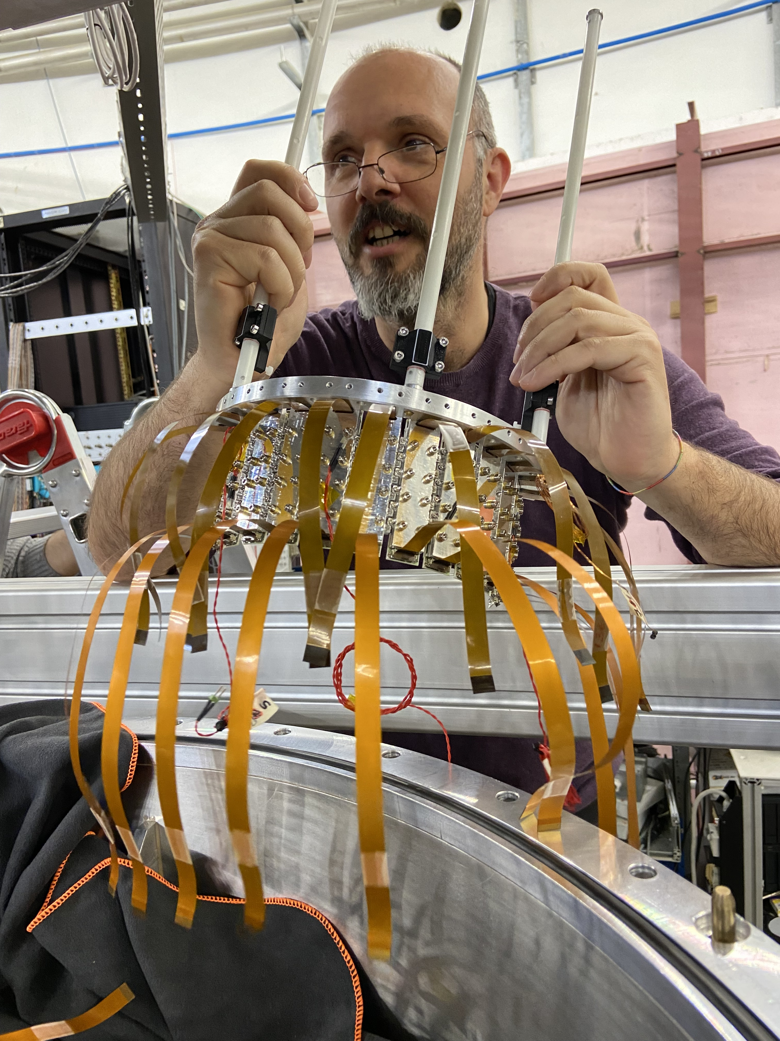
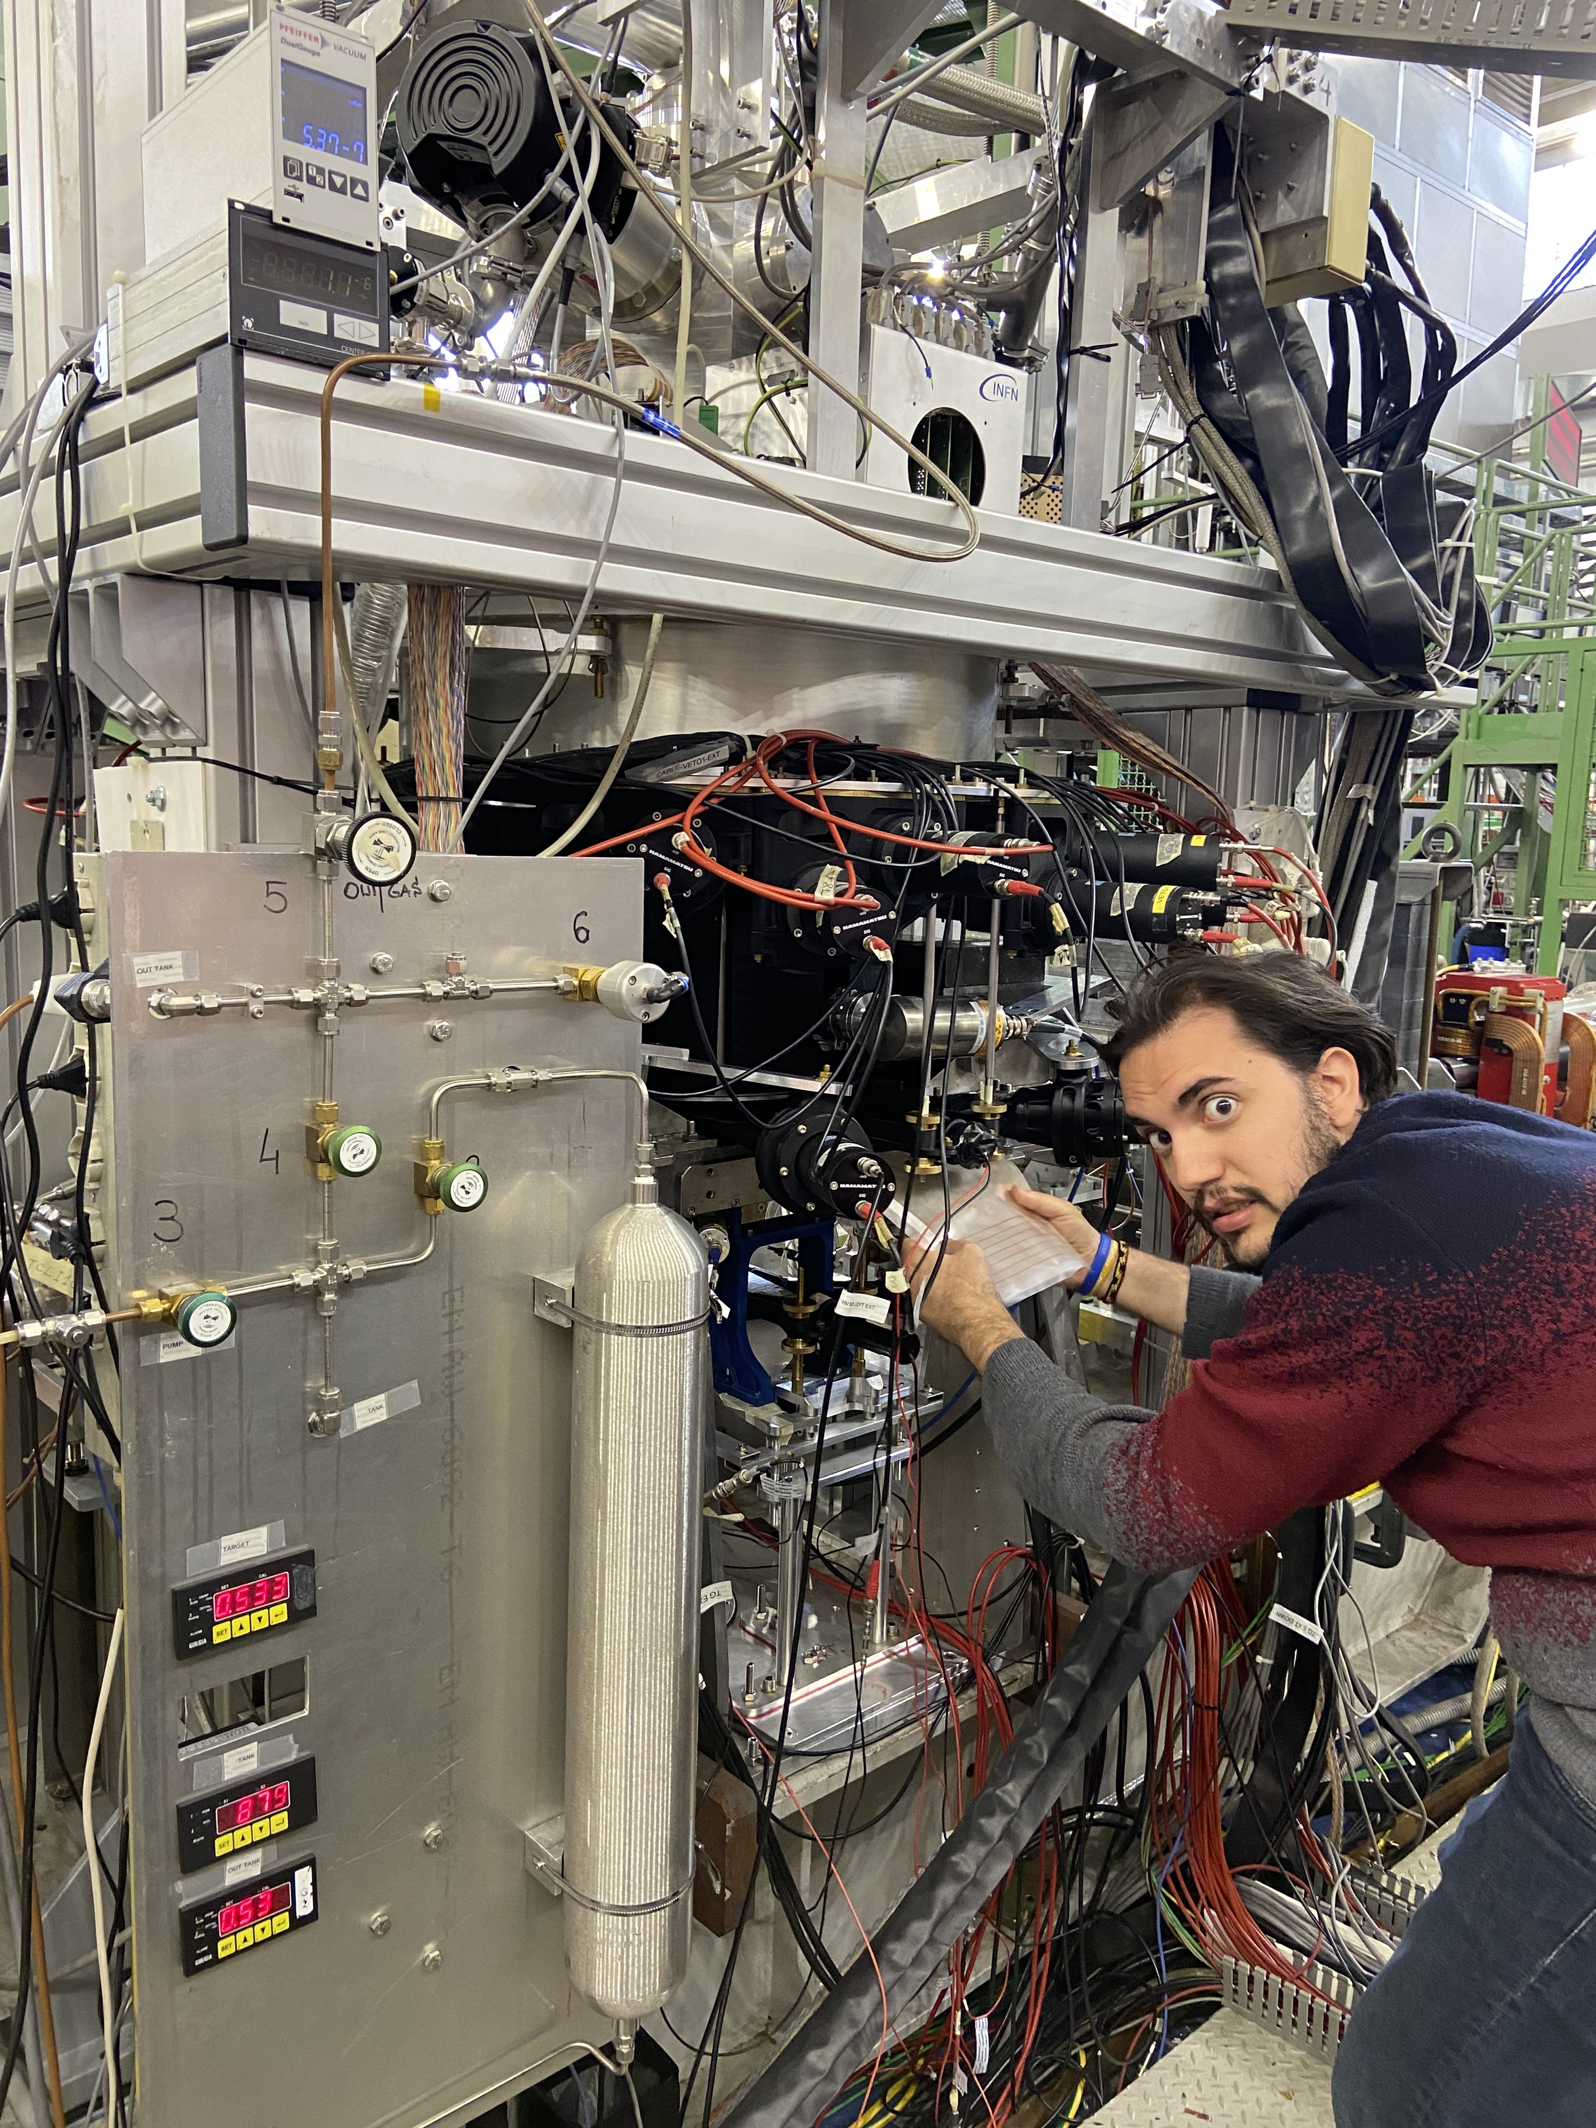
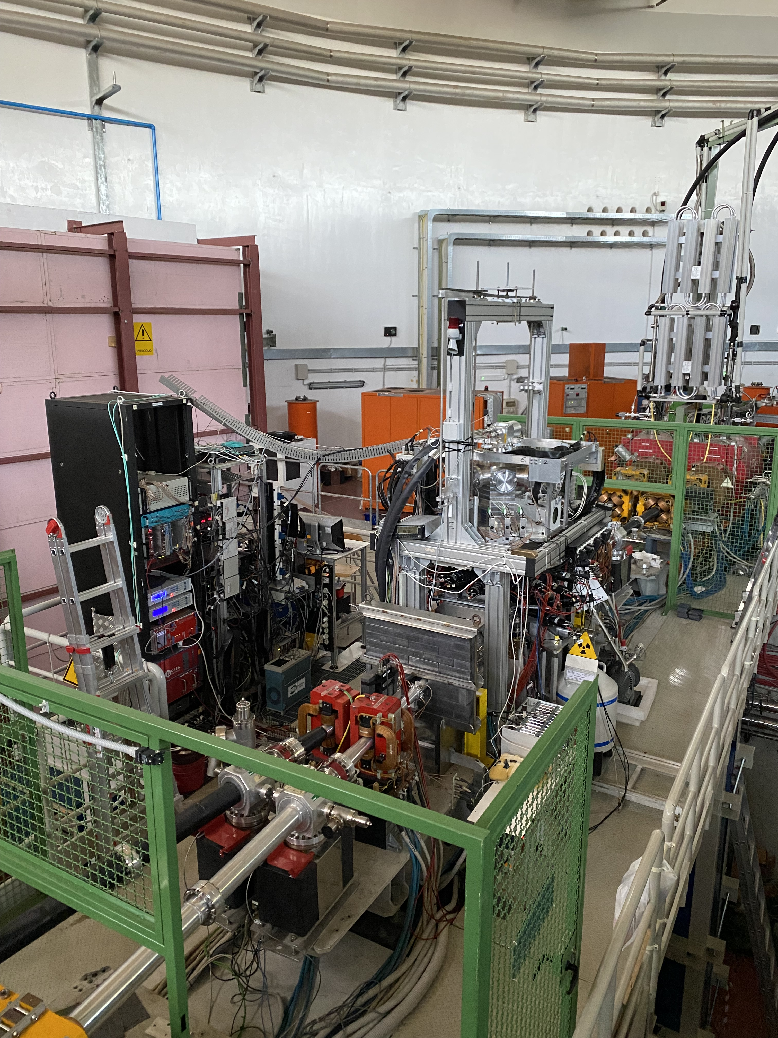
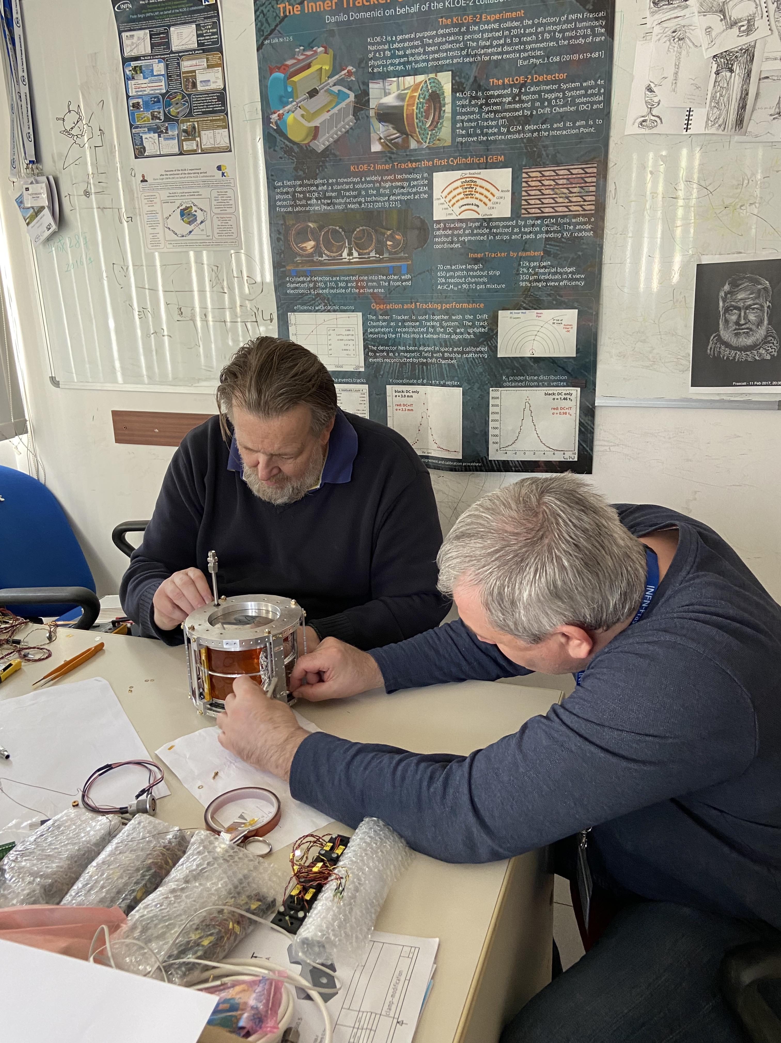
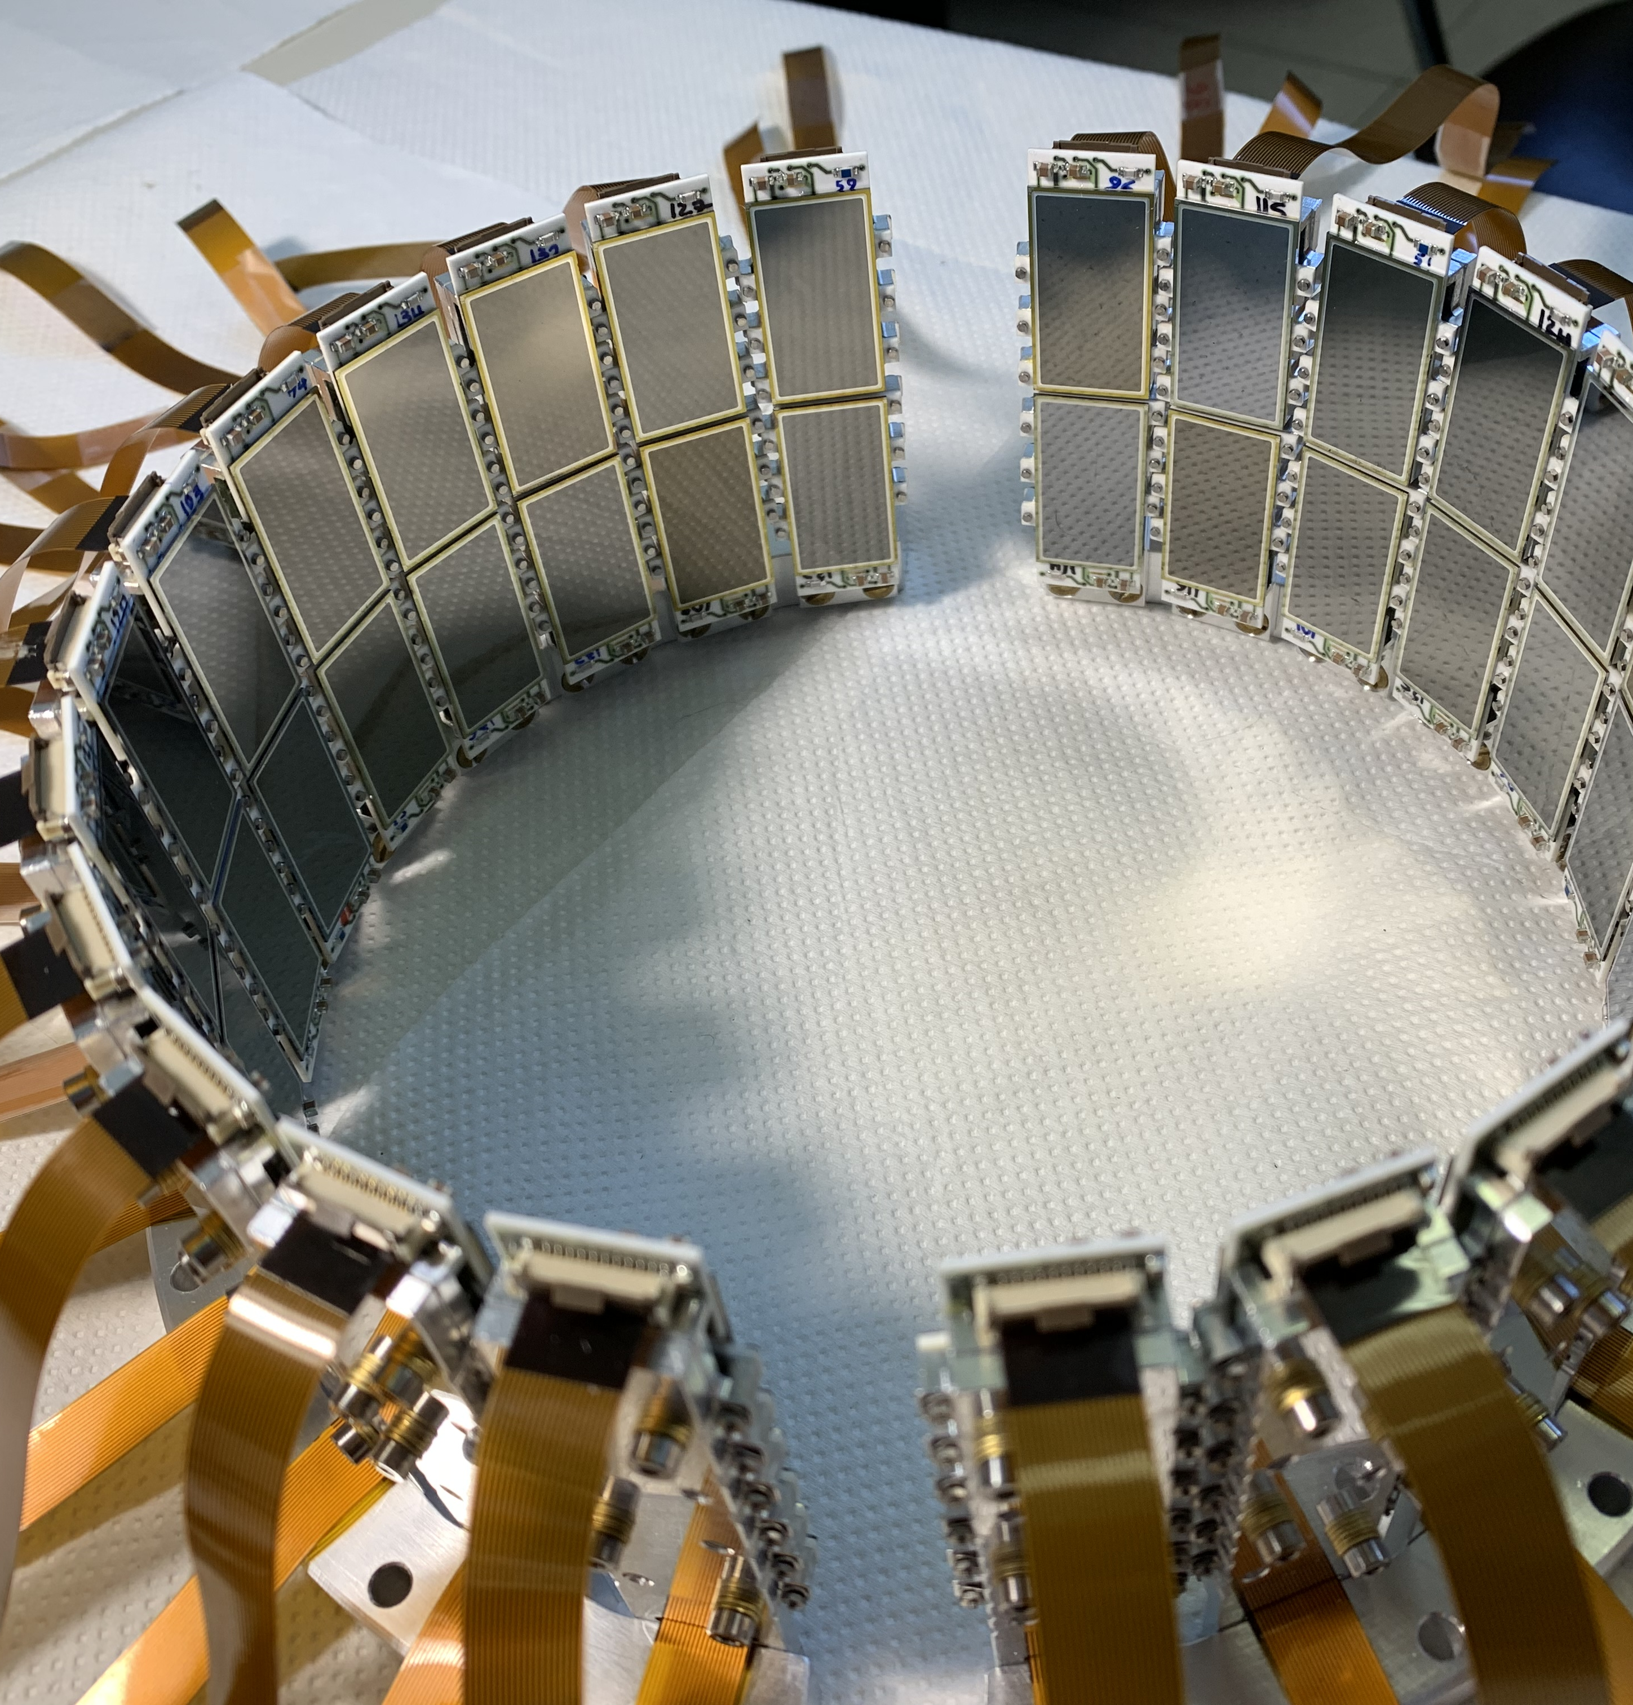

Slide 17
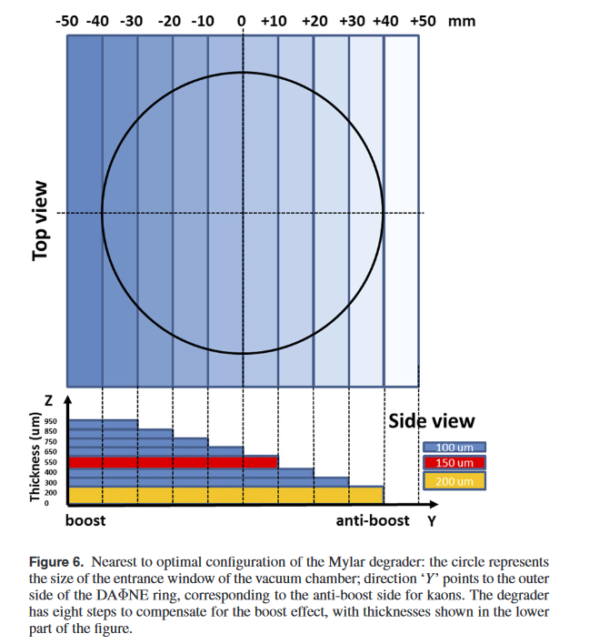
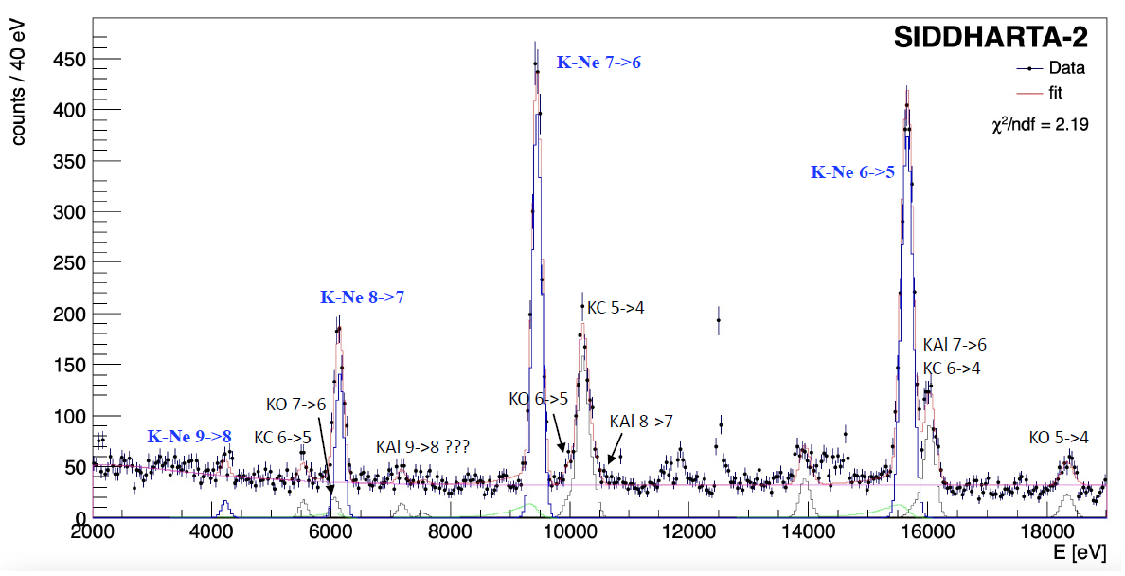
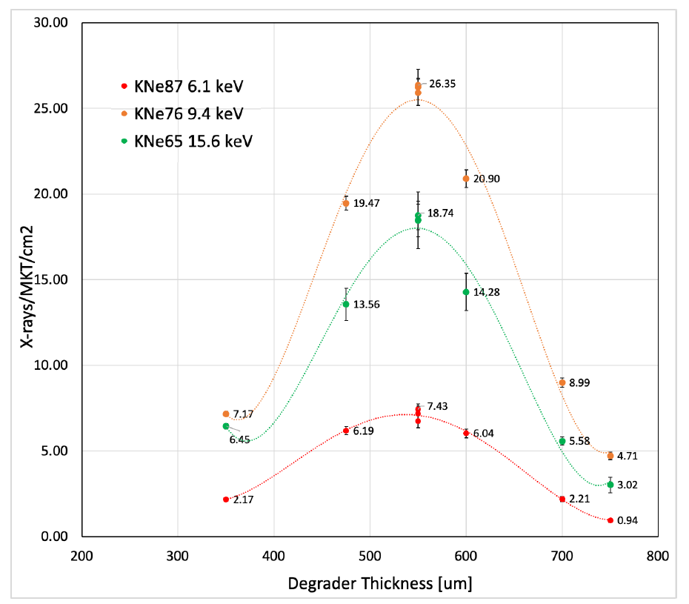
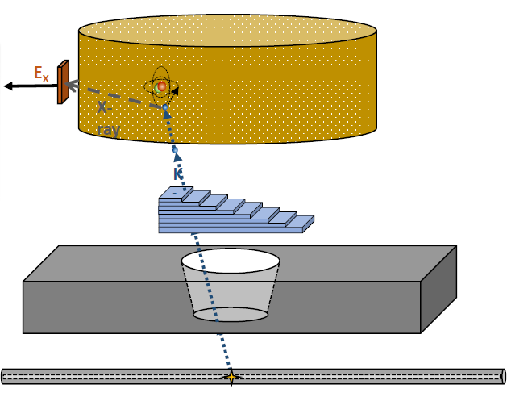
Optimization of SIDDHARTA-2 setup
Degrader optimization for Kaonic Neon
Sample data for
one degrader
thickness

Slide 18
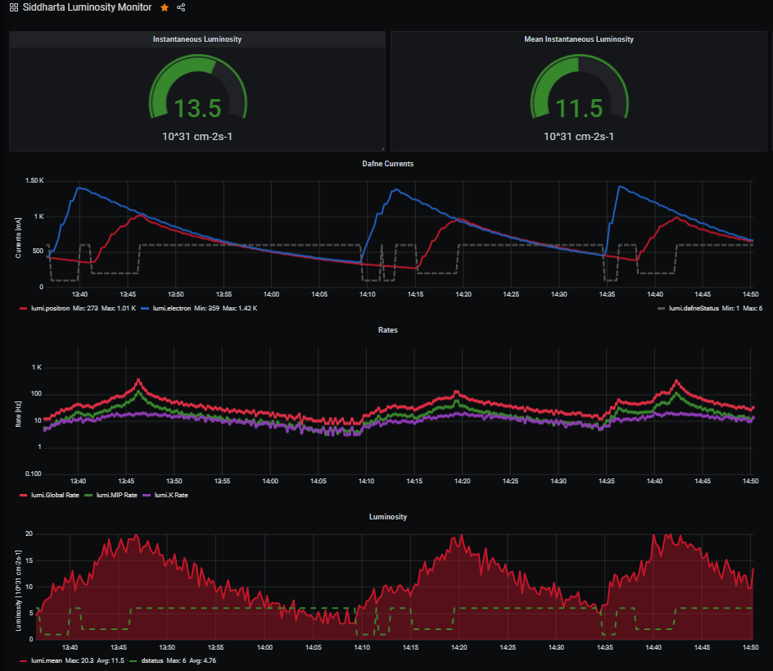
Optimization of SIDDHARTA-2 setup - results
Online monitoring tools for fast feedback
Dafne currents
Reduce background and improve KAON/SDD ratio

Slide 19
Optimization of SIDDHARTA-2 setup - results
Online monitoring tools for fast feedback
Dafne currents
Background estimation
Reduce background and improve KAON/SDD ratio

Slide 20
Optimization of SIDDHARTA-2 setup - results
Online monitoring tools for fast feedback
Dafne currents
Background estimation
Luminosity estimation
Reduce background and improve KAON/SDD ratio

Slide 21

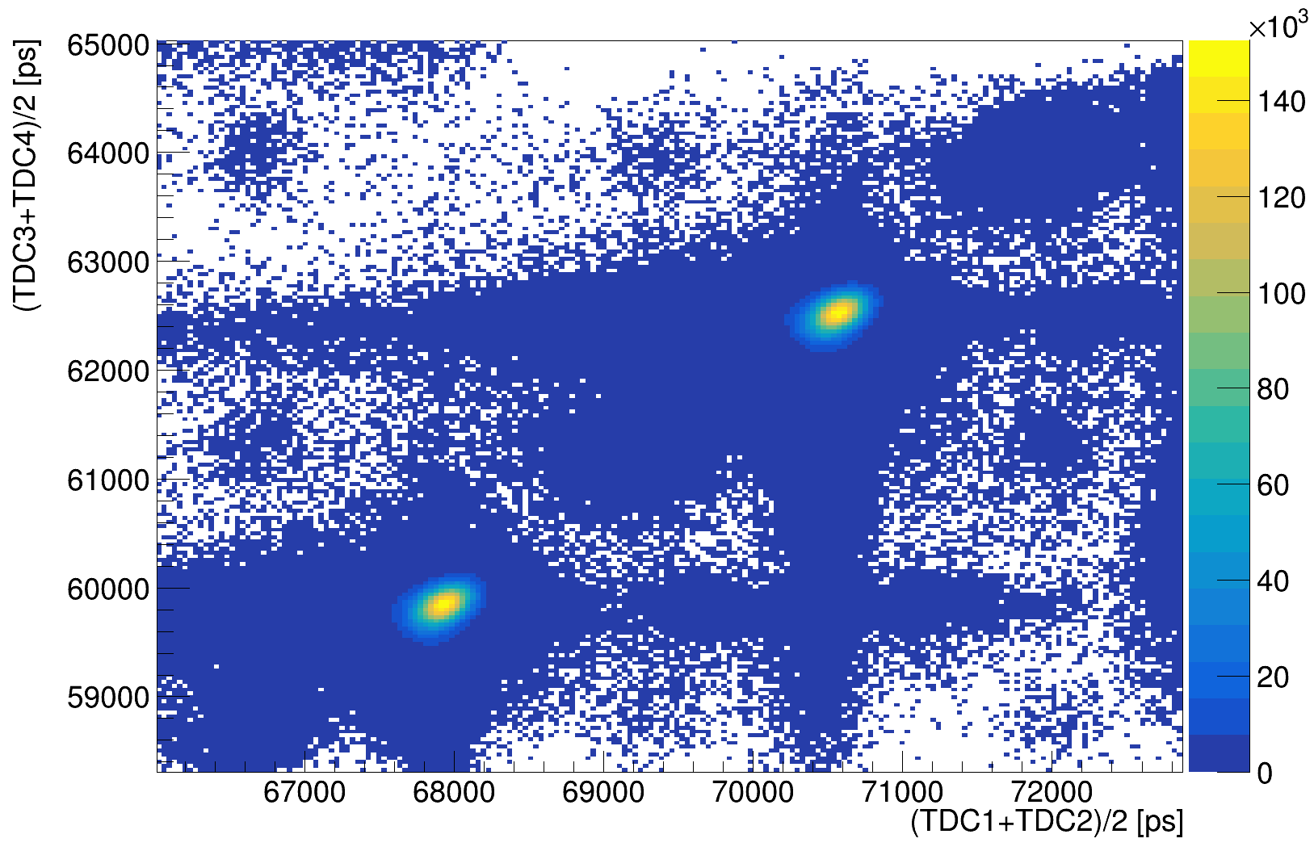
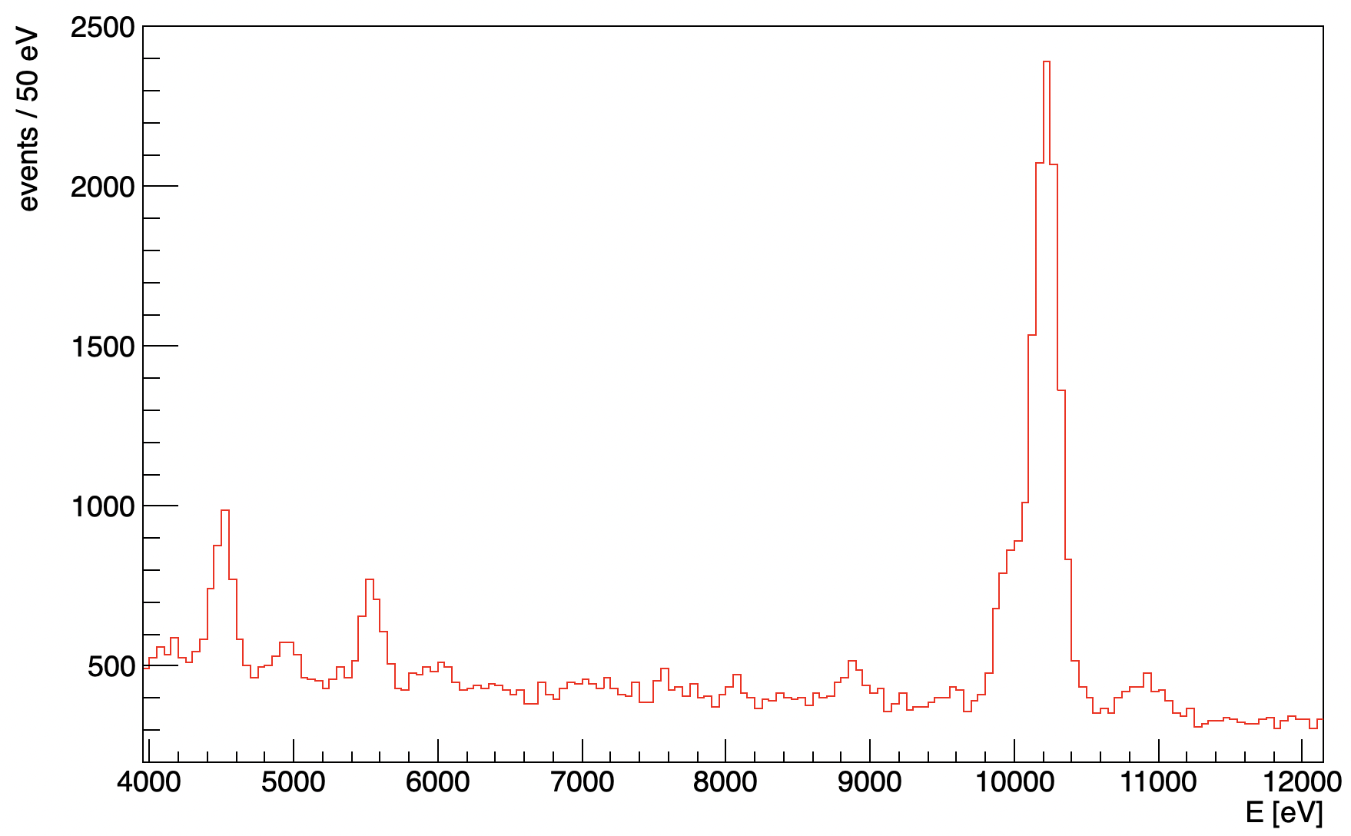
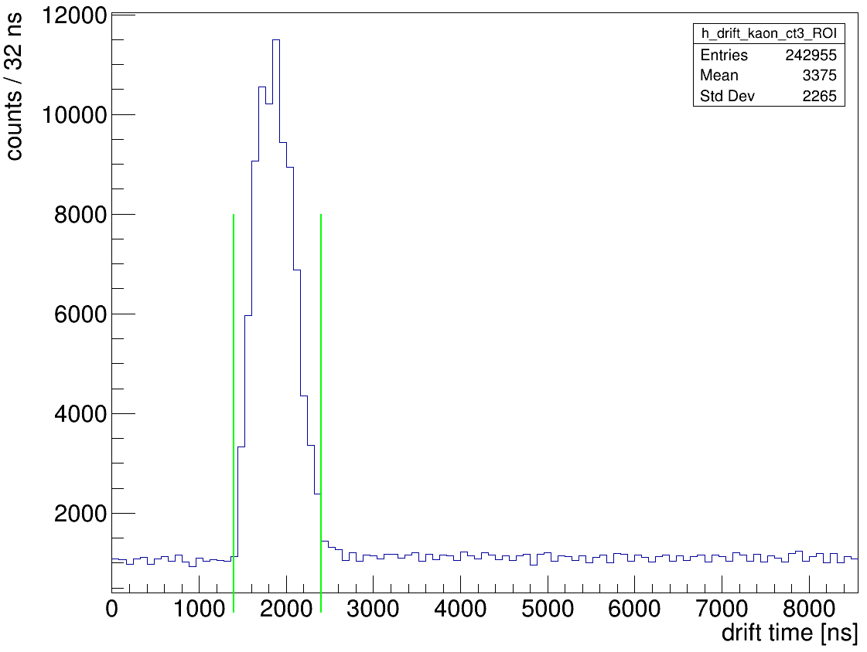



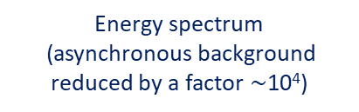




Powerful analysis tools
the steps in data analysis
KAON TRIGGER
© Designed by Freepik
$$K^{−}$$
e⁻
e⁺
SDD Calibration
Cu $K_{α}$
kaons
$$K^{+}$$
Ti $K_{α}$
kaons
Ti $K_{β}$
Fe $K_{α}$
Energy spectrum
(before background rejection)
modern algorithms and machine learning techniques
Energy spectrum
(asynchronous background reduced by a factor $∼$10⁴)
SDDs
Drift Time

Slide 22
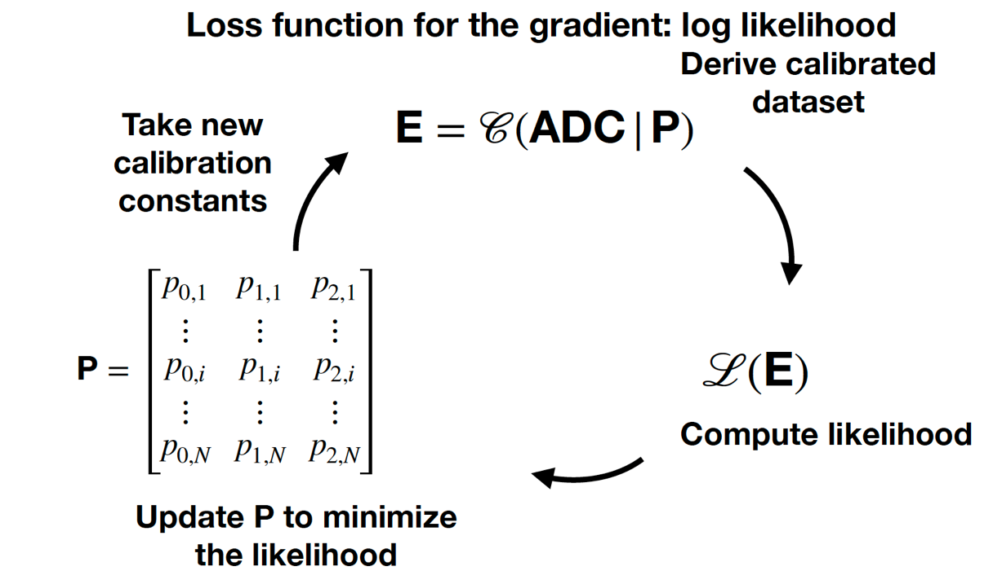
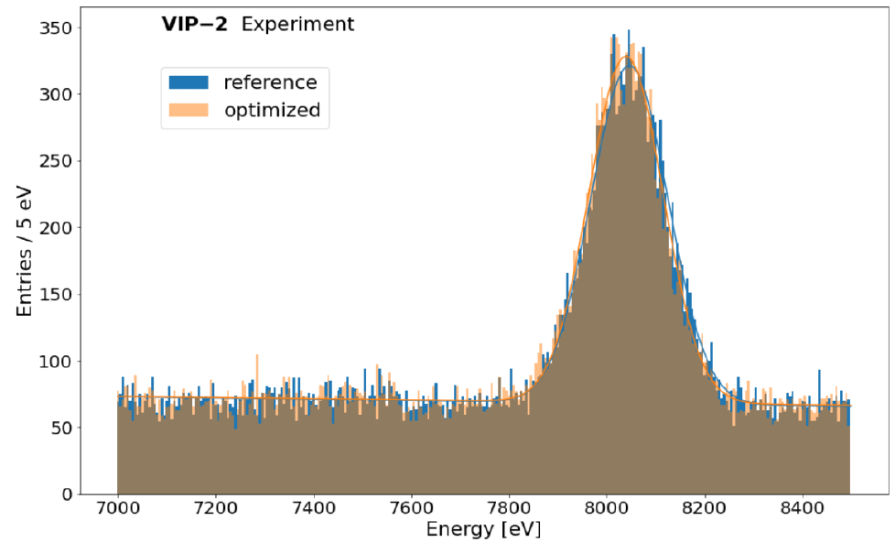
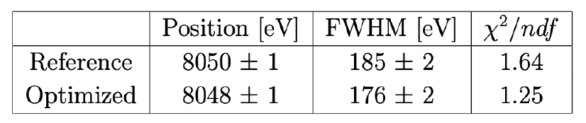

SDD energy calibration with ML and Differential Programming
The method can correct for miscalibration improving the systematic error and the energy resolution allowing to perform high precision measurement with an accuracy below 1 eV
Cu $K_{α}$
Fabrizio Napolitano et al 2023 Meas. Sci. Technol. in press https://doi.org/10.1088/1361-6501/ad080a
… see the talk of S. Manti and F. Napolitano

Slide 23






The Kaonic Neon measurement (2023)
First measurement of kaonic neon X-ray transitions ( record of precision $<1$ eV )
Line | Energy [eV]
K-Ne 9$⟶$8 | 4206.35$±$ 3.75 (stat)
K-Ne 8$⟶7$ | 6130.86 $±$ 0.71 (stat) $±$ 2 (sys.)
K-Ne 7$⟶6$ | 9450.08$±$ 0.41 (stat) $±$ 2 (sys.)
K-Ne 6$⟶5$ | 15673.30 $±$ 0.52 (stat) $±$ 5 (sys.)
K-Ne 7->6
K-Ne 6->5
K-Ne 8->7
KO 6->5
KC 5->4
K-Ne 9->8
KAl 7->6
KC 6->4
KC 7->5
KAl 8->7
KO 5->4
Paper in preparation
23

Slide 24




The (charged) Kaon mass puzzle and kaonic Neon
Kaon mass (K-Ne $8⟶7$and K-Ne $7⟶6$) = $493.671 ±0.021 \left(stat\right) MeV$
(stat. error $\sim 15$keV including the K-Ne $6⟶5$ )
GALL 88
DENISOV 91
Preliminary
SIDDHARTA-2
Kaon mass discrepancy
BACKENSTO 73
The kaonic Neon measurement to determine the K⁻ (K⁺) mass
Particle Data Group, 2020, 083C01 (2020)
CHENG 75
BARKOV 79
LUM 81
Less systematic uncertainty with respect to DENISOV 91 and GALL 88 measurements, thanks to the use of a low Z gas (Ne) target
Kaon mass [MeV]
Impact on the charmonium spectrum and on all processes in which charged kaons are involved
It could solve the kaon mass discrepancy issue

Slide 25


Kaonic deuterium shift and width (Theoretical predictions)
Scientific goal: first measurement ever of kaonic deuterium X-ray transition to the ground state (1s-level) such as to determine its shift and width induced by the presence of the strong interaction, providing unique data to investigate the QCD in the non-perturbative regime with strangeness.
achievable precision
Liu 2020
Monte Carlo Simulation
ROI
Weise 2017
Oset 2001
Mizutani 2013
Meißner 2011
Gal 2007
Shevchenkov 2012
Monte Carlo simulation for an
integrated luminosity of 800 pb⁻¹

Slide 26


Conclusions
The SIDDHARTA-2 NEON run (technical run)
(application of modern algorithms and machine learning techniques)
First Kaonic deuterium run done - from May to July 2023
(optimized setup for about 110 pb⁻¹ integrated luminosity) – analysis ongoing
We are confident in machine performance, ready and very motivated to continue the SIDDHARTA-2 program
Second Kaonic deuterium run – ongoing
(with optimized shielding, readout, veto, trigger, ….. for the remaining integrated luminosity: 600-700 pb⁻¹ in 2023/2024)

Slide 27
SPARE

Slide 28

SIDDHARTA-2
Kaonic deuterium measurement plan
First Kaonic deuterium run finished in July
optimized setup for about 110 pb⁻¹ integrated luminosity
Second Kaonic deuterium run started in September
with optimized shielding, readout, veto, trigger, …..
(for the remaining integrated luminosity: 600-700 pb⁻¹ in 2023/2024)
Calibration/technical runs
KHe, Neon, solid targets Li, Be

Slide 29

EXKALIBUR
SIDDHARTA-2
SIDDHARTA
DEAR

Slide 30

Future plans
proposal to perform fundamental physics at the strangeness frontier at DAΦNE for a 3-years period (post-SIDDHARTA-2)
EXtensive
Kaonic
Atoms research: from
LIthium and
Beryllium to
URanium
Kaonic Hydrogen: 200 pb⁻¹ – with SIDDHARTA2 setup – to get a precision < 10 eV (KH)
Selected light kaonic atoms (LHKA)
Selected intermediate and heavy kaonic atoms charting the periodic table (IMKA)
Ultra-High precision measurements of Kaonic Atoms (UHKA)
Dedicated runs with different types of detectors:
SDD 1mm, CZT detectors, HPGe, crystal HAPG spectrometer-VOXES project
C. Curceanu et al., arXiv:2104.06076 [nucl-ex](2021)
C. Curceanu et al., Front. Phys. 11 (2023)
EXKALIBUR

Slide 31

Future plans
Gantt chart
possible implementation of the kaonic atoms measurements
Total integrated Luminosity:
200 + 400 (200) + 400 (200) + 400 pb-1
Fast, handy and significant physics measurements with very low costs and human efforts

