Slide 1
Analysis of positronium decays by the J-PET detector for the medical and fundamental studies
K. Dulski on behalf of the J-PET collaboration
20.11.2023
ALPACA: modern algorithms in machine learning and data analysis: from medical physics to research with accelerators and in underground laboratories

Slide 2
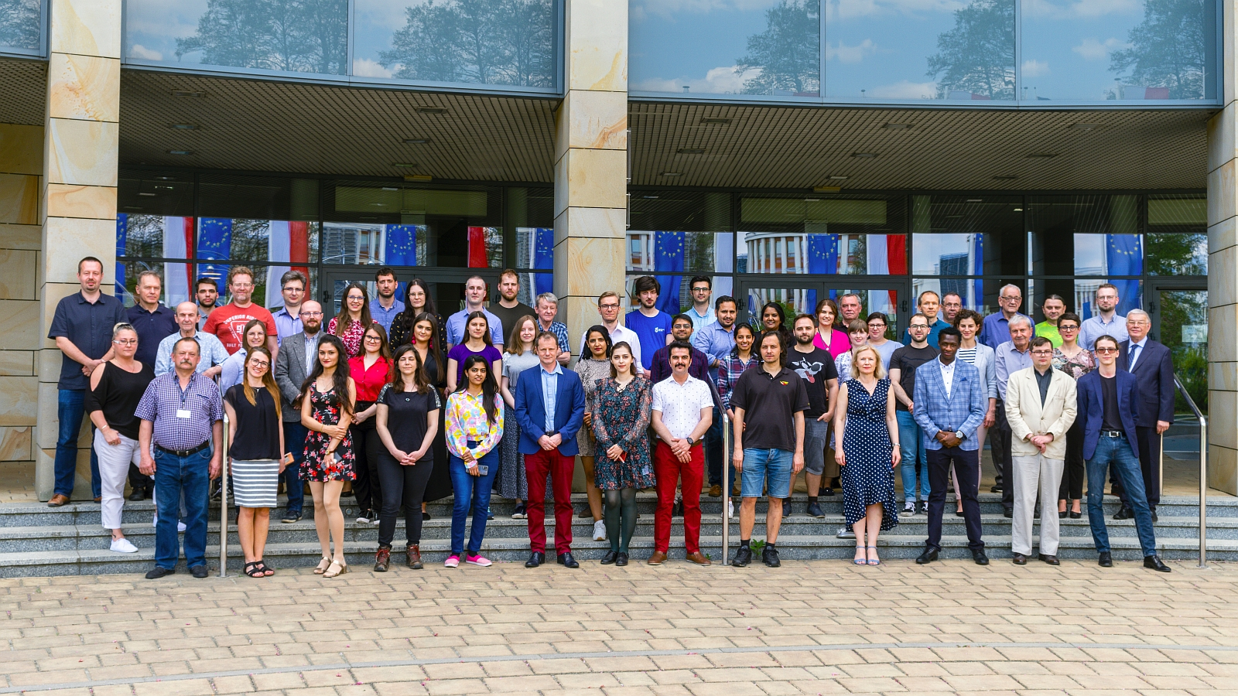
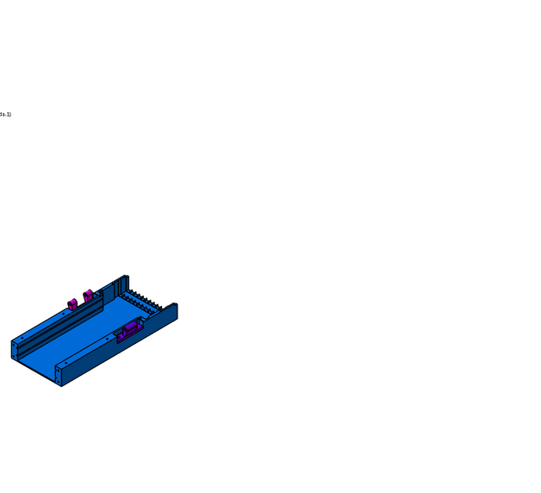
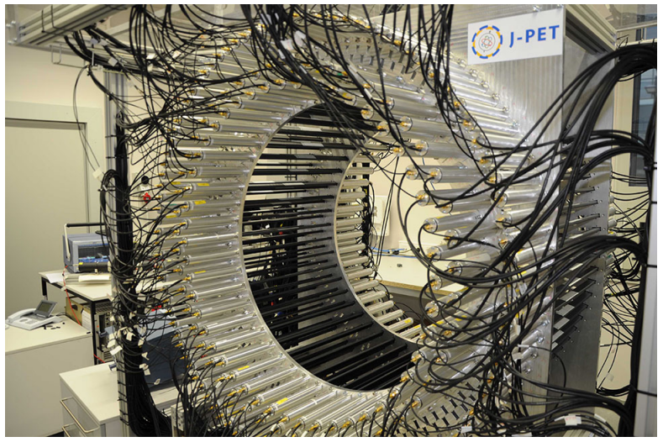
Jagiellonian Positron Emission Tomography (J-PET)

Slide 3
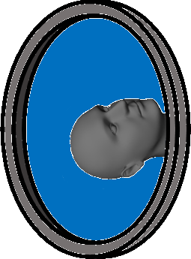
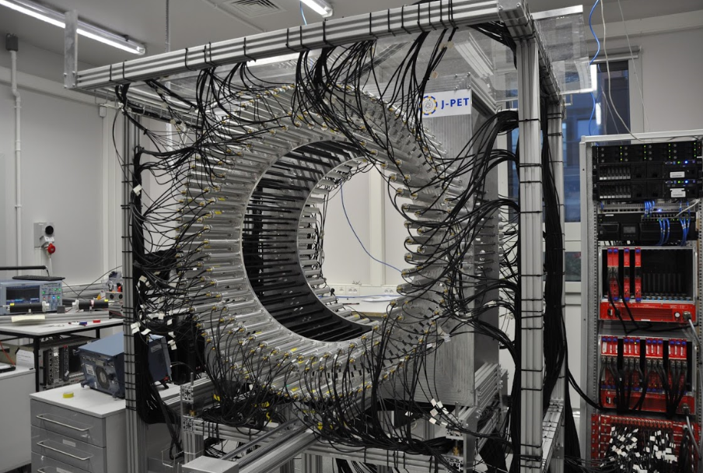
p-Ps
$τ$ = 0.125 ns
S=0
e⁺
Ps
e⁻
S=1
o-Ps
$τ$ = 142 ns
https://sciencebasedmedicine.org/pet-scans-predict-coma-outcome/
DOI: 10.1016/j.cub.2016.04.024

Slide 4
p-Ps
$τ$ = 0.125 ns
Analysis procedure:
- Data reconstruction
- Data selection
- Advanced refinements
S=0
e⁺
Ps
e⁻
S=1
o-Ps
$τ$ = 142 ns
https://sciencebasedmedicine.org/pet-scans-predict-coma-outcome/
DOI: 10.1016/j.cub.2016.04.024

Slide 5
Triggering?
The J-PET DAQ based on FPGA works in a trigger-less mode in order to maximize potential of measurements into different types of analysis
Time window

Slide 6
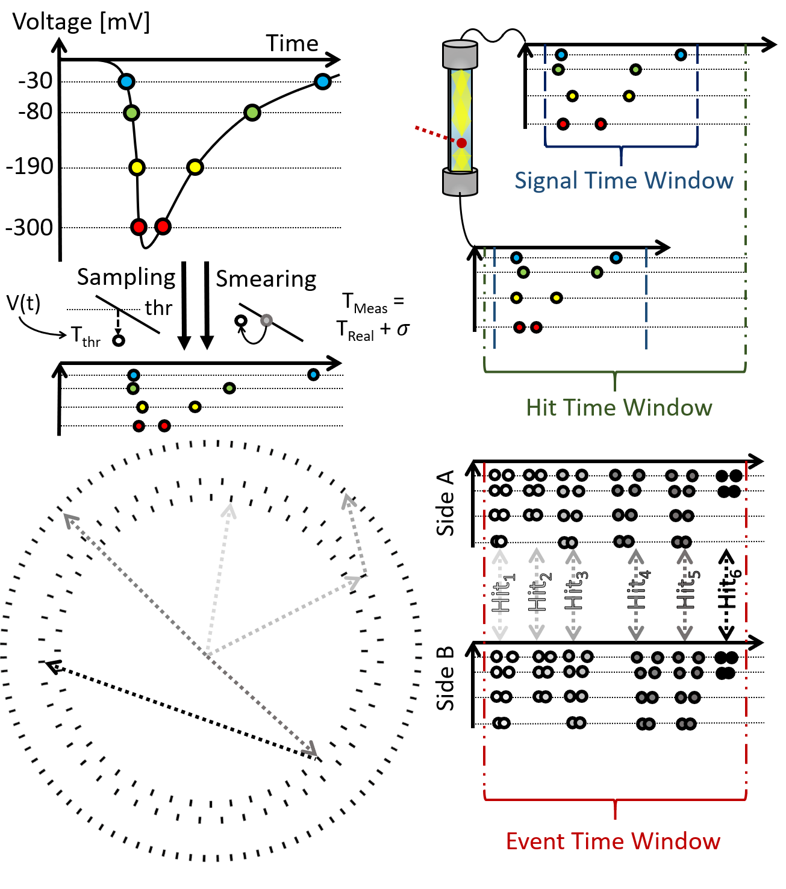
Data reconstruction
K. Dulski, PhD thesis
S. Niedźwiecki et al., Acta Phys. Polon. B 48 (2017) 1567

Slide 7
Data reconstruction
S.Sharma … K. Dulski et al. EJNMMI Phys. 7 (2020) 39
K. Dulski, PhD thesis

Slide 8
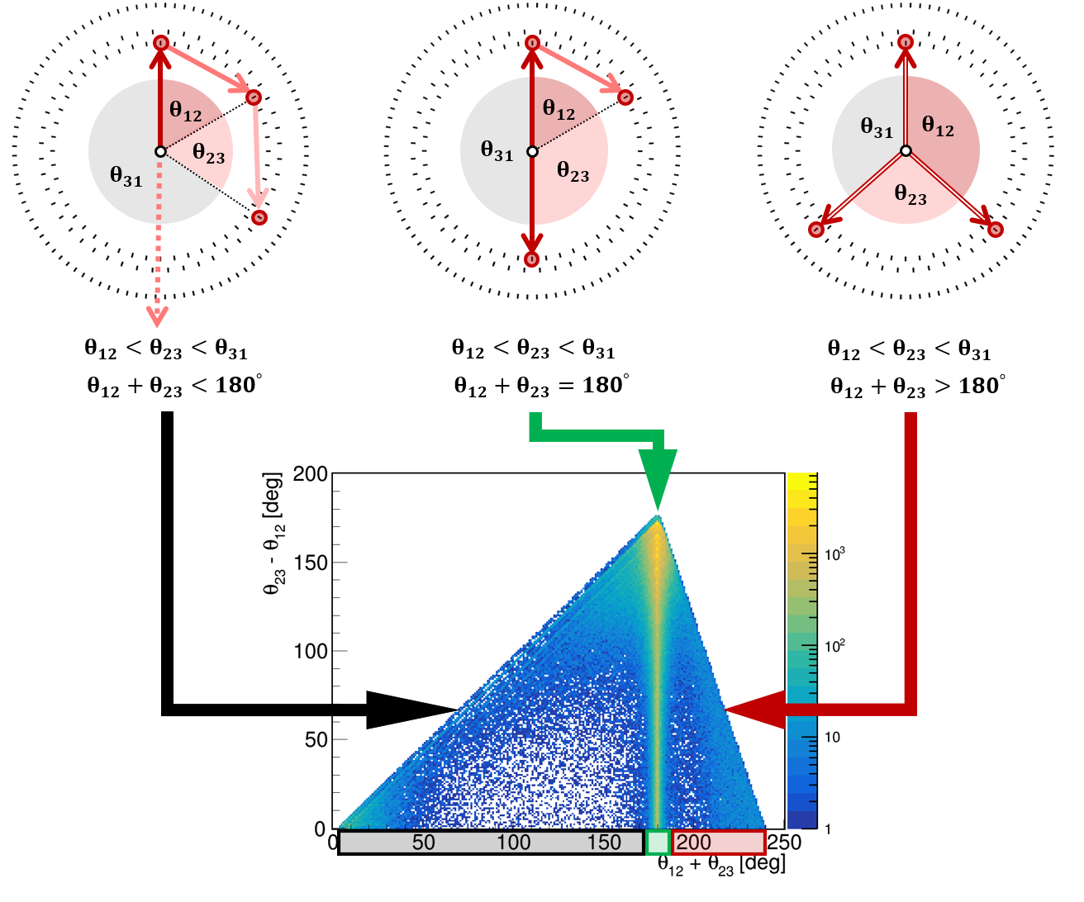
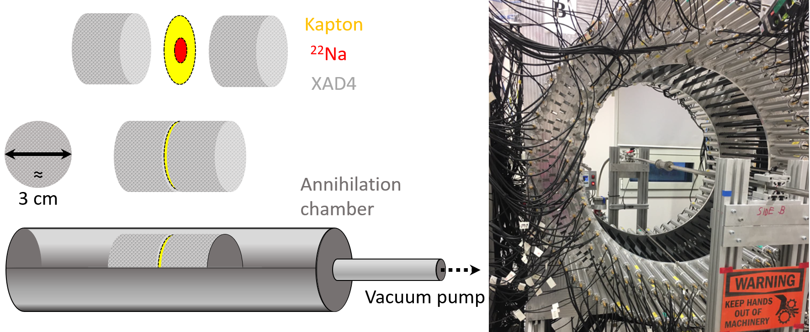
Data selection
Chamber in the centre (0,0,0) of the detector
(3G)
K. Dulski, PhD thesis
K. Dulski et al., Nuclear Inst. and Methods in Physics Research, A 1008 (2021) 165452
K. Dulski et al., Hyperfine Interact. 239 (2018) 40
(2G)
+ Prompt
+ Prompt

Slide 9
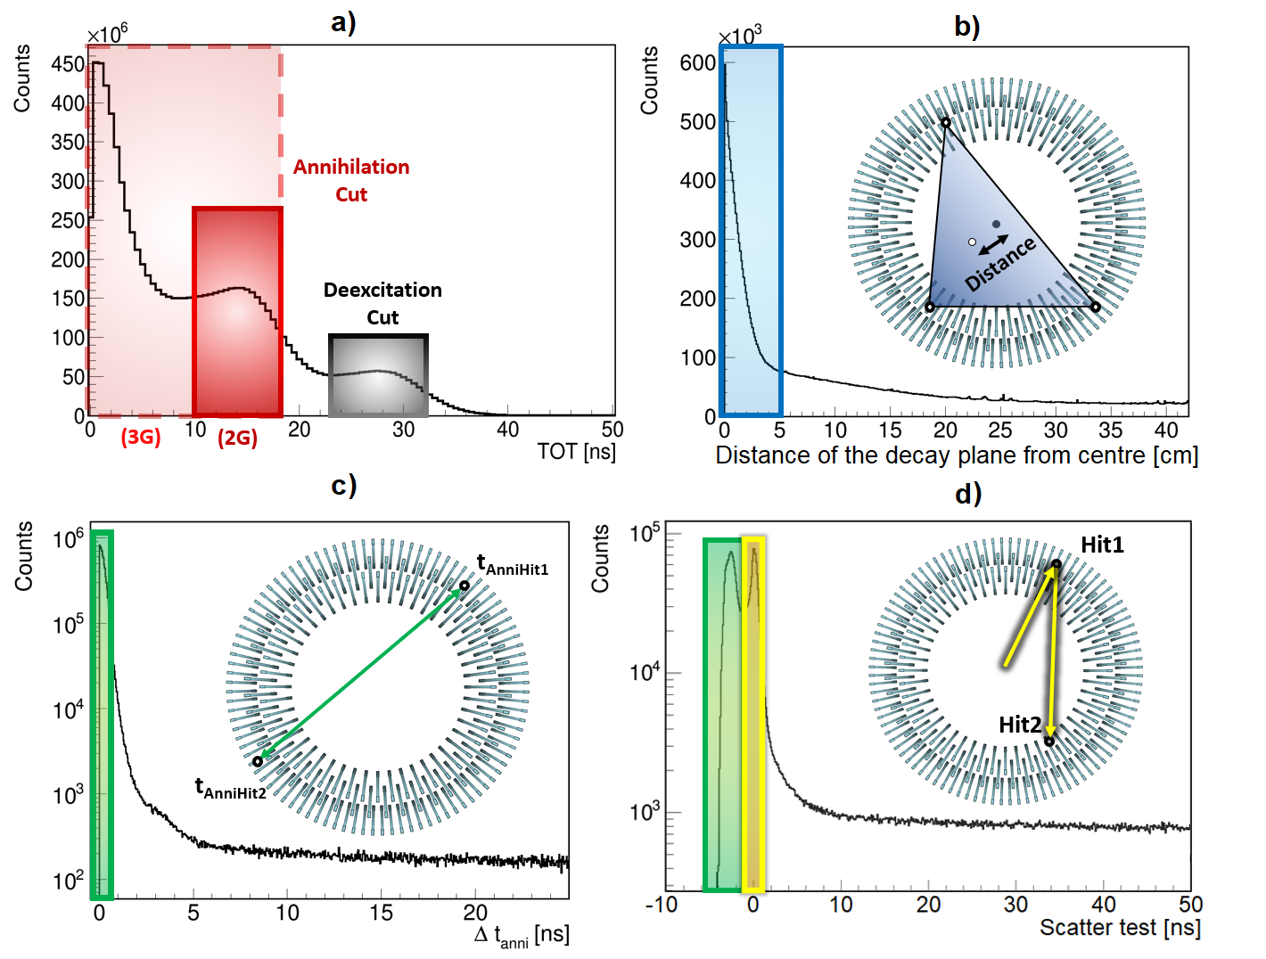
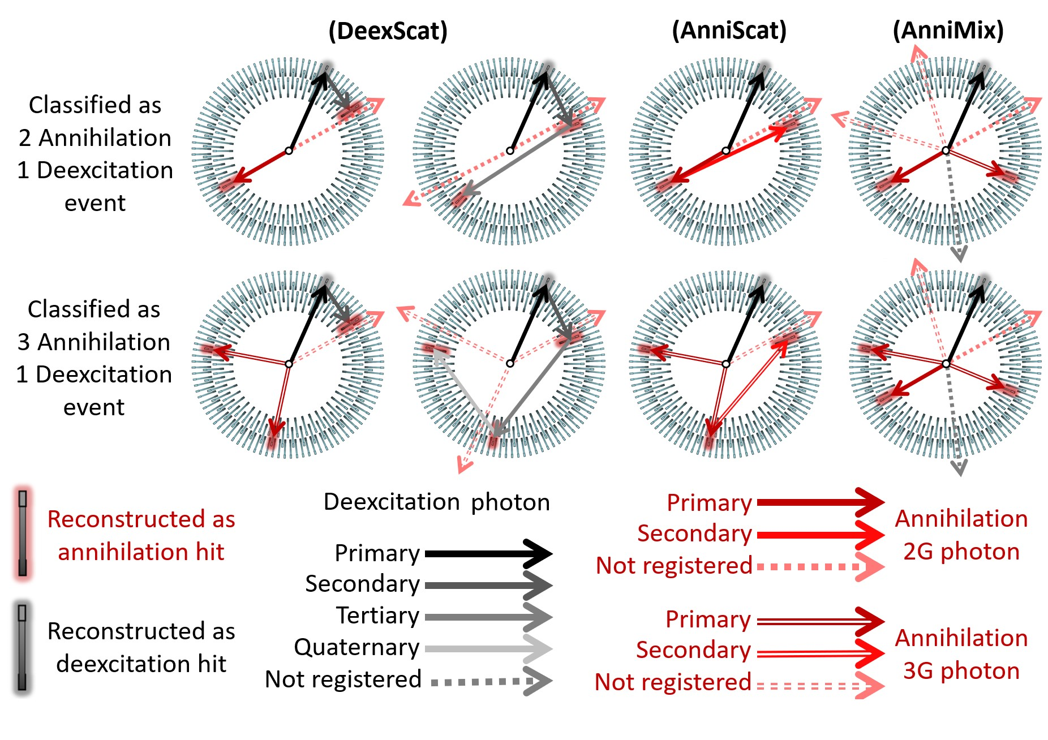
Data selection
+ Prompt
+ Prompt
K. Dulski, PhD thesis
K. Dulski et al., Nuclear Inst. and Methods in Physics Research, A 1008 (2021) 165452
K. Dulski et al., Hyperfine Interact. 239 (2018) 40
$$Scatter test=∆t−\frac{distance}{c}$$

Slide 10
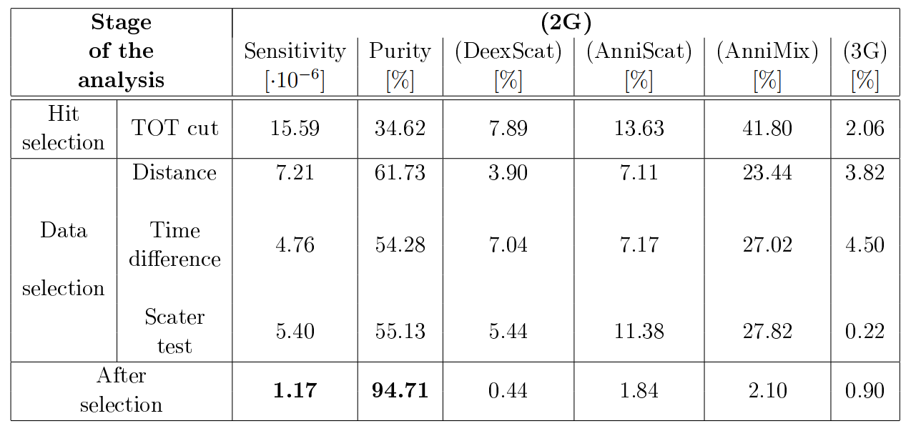
Data selection
+ Prompt
K. Dulski, PhD thesis
K. Dulski et al., Nuclear Inst. and Methods in Physics Research, A 1008 (2021) 165452
K. Dulski et al., Hyperfine Interact. 239 (2018) 40

Slide 11
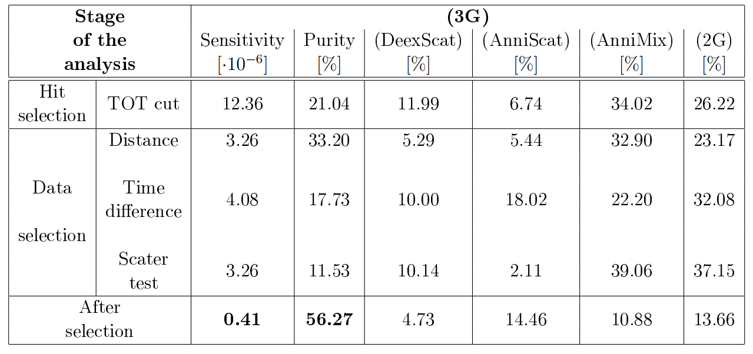
Data selection
+ Prompt
K. Dulski, PhD thesis
K. Dulski et al., Nuclear Inst. and Methods in Physics Research, A 1008 (2021) 165452
K. Dulski et al., Hyperfine Interact. 239 (2018) 40

Slide 12
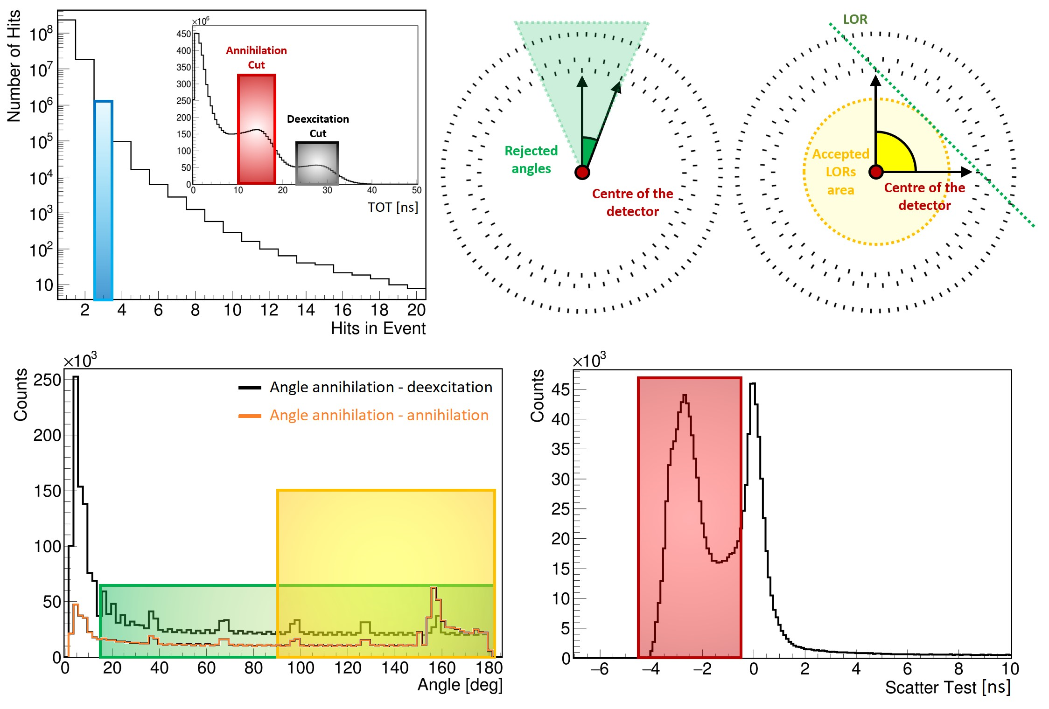
Data selection – positronium imaging
K. Dulski, PhD thesis
K. Dulski et al., Nuclear Inst. and Methods in Physics Research, A 1008 (2021) 165452
K. Dulski et al., Hyperfine Interact. 239 (2018) 40
$$LF=\frac{t_{anni1}+t_{anni2}}{2}−t_{deex}$$

Slide 13
Data selection – positronium imaging
K. Dulski, PhD thesis
K. Dulski et al., Hyperfine Interact. 239 (2018) 40
P. Moskal, K. Dulski et al., Science Advances 7 (2021) eabh4394

Slide 14
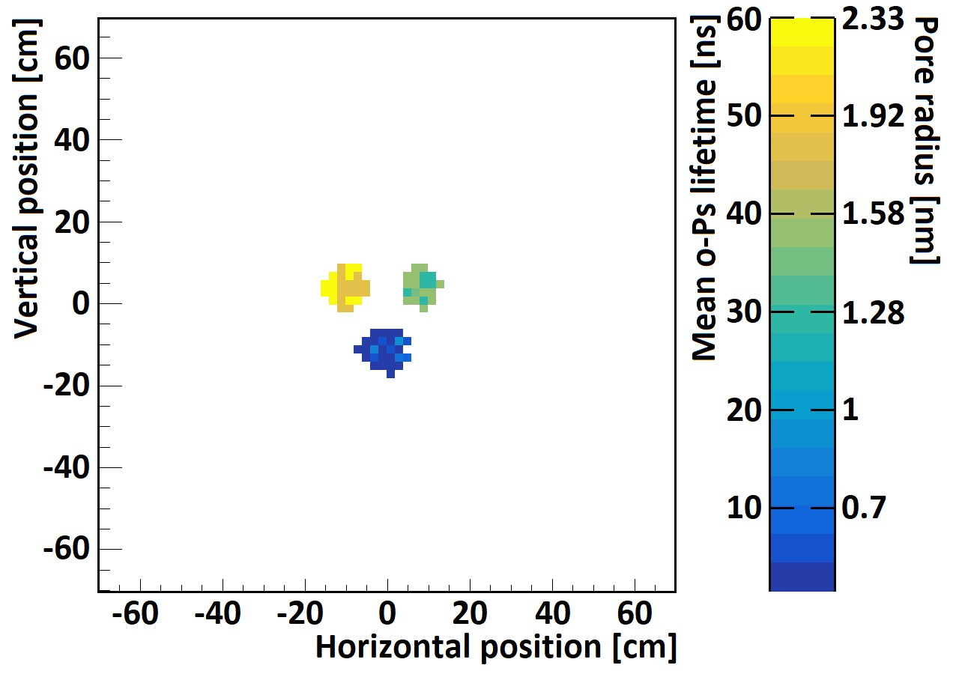
Advanced refinements – positronium imaging
K. Dulski, PhD thesis
K. Dulski et al., Hyperfine Interact. 239 (2018) 40
P. Moskal, K. Dulski et al., Science Advances 7 (2021) eabh4394
Fitting with PALS Avalanche:
K. Dulski et al., Acta Phys. Pol. A 132 (2017) 1637
K. Dulski, Acta. Phys. Pol. A 137 (2020) 167
Study of positronium lifetime in different tissues:
P. Moskal et al., EJNMMI Phys. 10 (2023) 22

Slide 15
Advanced refinements – positronium imaging
R. Shopa and K. Dulski, Bio-Algorithms and Med-Systems 2022; 18(1): 135-143
K. Dulski PhD thesis

Slide 16
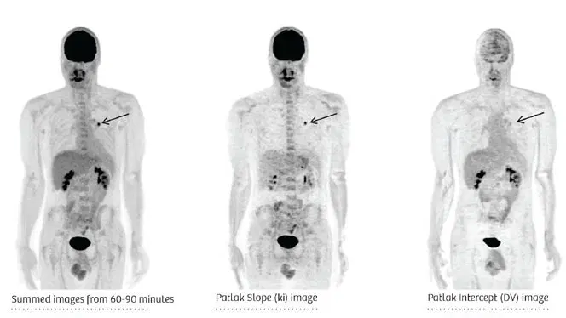
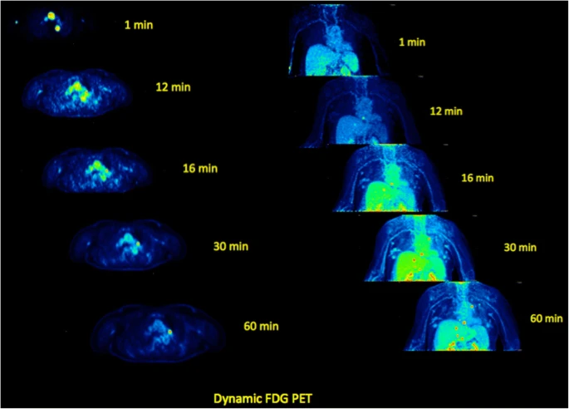
Advanced refinements – future advancements in imaging
Parametric and dynamic imaging
Total body J-PET
Siemens Healthineers
A. Strauss et al., Eur. J. Nucl. Med. Mol. Imaging 48 (2021) 21
P. Moskal, E.Ł. Stępień, Front. Phys. 10 (2022) 969806
P. Moskal et al., Phys. Med. Biol. 66 (2021) 175015
P. Moskal, E.Ł. Stępień, PET Clin. 15 (2020) 439-452

Slide 17
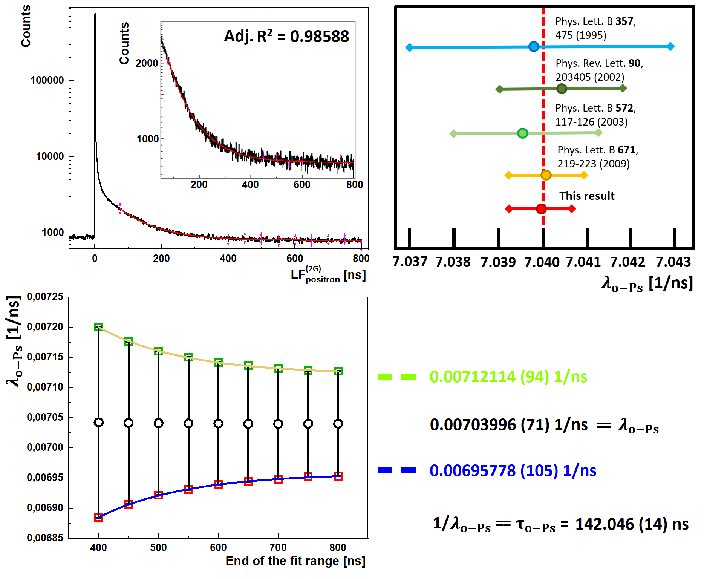
Advanced refinements – positronium physics
K. Dulski, PhD thesis
$$\frac{(2G)}{(3G)}=$$

Slide 18
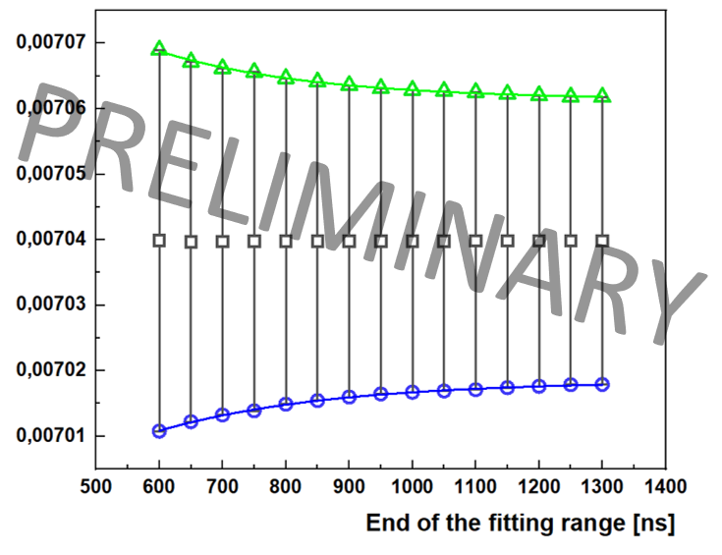
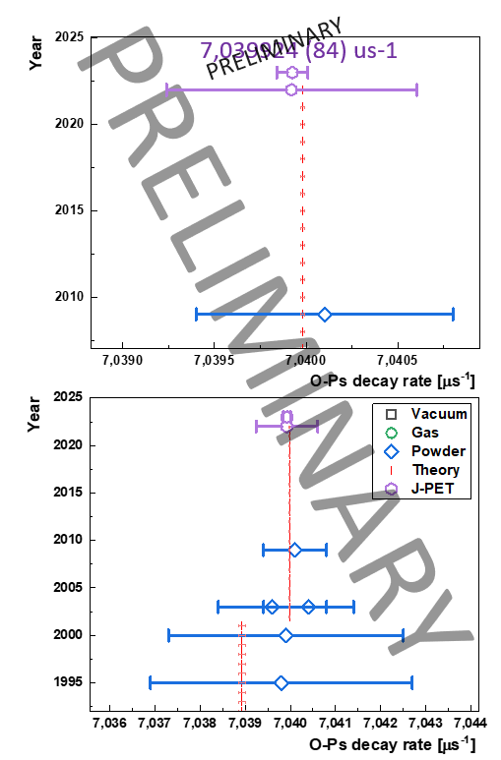
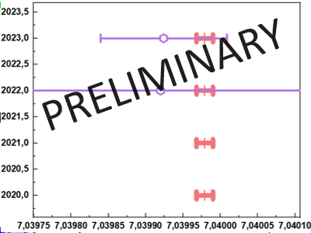
Advanced refinements – positronium physics
Theoretical prediction
7.039979(11) μs⁻¹
- Part of Run11
- Run4

Slide 19
Advanced refinements – positronium physics
P. Moskal, A. Gajos et al., Nature Comm. 12 (2021) 5658
Operator | C | P | T | CP | CPT
$$\vec{S}∙{\vec{k}}_{1}$$ | + | - | + | - | -
$$\vec{S}∙\left({\vec{k}}_{1}×{\vec{k}}_{2}\right)$$ | + | + | - | + | -
$$\left(\vec{S}∙{\vec{k}}_{1}\right)\left(\vec{S}∙\left({\vec{k}}_{1}×{\vec{k}}_{2}\right)\right)$$ | + | - | - | - | +
$${\vec{k}}_{2}∙{\vec{ε}}_{1}$$ | + | - | - | - | +
$$\vec{S}∙{\vec{ε}}_{1}$$ | + | + | - | + | -
$$\vec{S}∙\left({\vec{k}}_{2}×{\vec{ε}}_{1}\right)$$ | + | - | + | - | -
Using photon polarization
trilateration method (like in GPS) A. Gajos et al., NIM A 819 (2016) 54-59

Slide 20
Advanced refinements – positronium physics
k₁
k₂
S
k₃
P. Moskal, A. Gajos et al., Nature Comm. 12 (2021) 5658
Operator | C | P | T | CP | CPT
$$\vec{S}∙{\vec{k}}_{1}$$ | + | - | + | - | -
$$\vec{S}∙\left({\vec{k}}_{1}×{\vec{k}}_{2}\right)$$ | + | + | - | + | -
$$\left(\vec{S}∙{\vec{k}}_{1}\right)\left(\vec{S}∙\left({\vec{k}}_{1}×{\vec{k}}_{2}\right)\right)$$ | + | - | - | - | +
$${\vec{k}}_{2}∙{\vec{ε}}_{1}$$ | + | - | - | - | +
$$\vec{S}∙{\vec{ε}}_{1}$$ | + | + | - | + | -
$$\vec{S}∙\left({\vec{k}}_{2}×{\vec{ε}}_{1}\right)$$ | + | - | + | - | -
Using photon polarization
trilateration method (like in GPS) A. Gajos et al., NIM A 819 (2016) 54-59

Slide 21
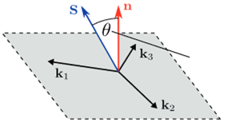
Advanced refinements – positronium physics
Total number of events $\sim$2x10⁶
Statistical uncertainty = 0.00033
Systematic uncertainty = 0.00014
Analyzing power P = 37.4%
$$C_{CPT}=0.00067±0.00095$$

Slide 22
Advanced refinements – positronium physics
k₁
k₂
S
k₃
P. Moskal, A. Gajos et al., Nature Comm. 12 (2021) 5658
Operator | C | P | T | CP | CPT
$$\vec{S}∙{\vec{k}}_{1}$$ | + | - | + | - | -
$$\vec{S}∙\left({\vec{k}}_{1}×{\vec{k}}_{2}\right)$$ | + | + | - | + | -
$$\left(\vec{S}∙{\vec{k}}_{1}\right)\left(\vec{S}∙\left({\vec{k}}_{1}×{\vec{k}}_{2}\right)\right)$$ | + | - | - | - | +
$${\vec{k}}_{2}∙{\vec{ε}}_{1}$$ | + | - | - | - | +
$$\vec{S}∙{\vec{ε}}_{1}$$ | + | + | - | + | -
$$\vec{S}∙\left({\vec{k}}_{2}×{\vec{ε}}_{1}\right)$$ | + | - | + | - | -
Test of the CP symmetry by J-PET -> see talk by K. Eliyan (next talk)
Using photon polarization
trilateration method (like in GPS) A. Gajos et al., NIM A 819 (2016) 54-59

Slide 23
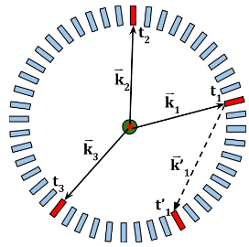
Advanced refinements – forbidden and raredecays
Study of the forbidden decays (p-Ps -> 3 photons)
- conjugation symmetry
Work by M. Skurzok
Acta. Phys. Polon. A 137 (2020) 134
J. Raj, PhD thesis
Study of the T symmetry
J. Raj, D. Kisielewska and E. Czerwiński, Acta. Phys. Polon. A 137 (2020) 137
P. Moskal, E. Czerwiński, et al., under revision in Nature Communication
Operator | C | P | T | CP | CPT
$$\vec{S}∙{\vec{k}}_{1}$$ | + | - | + | - | -
$$\vec{S}∙\left({\vec{k}}_{1}×{\vec{k}}_{2}\right)$$ | + | + | - | + | -
$$\left(\vec{S}∙{\vec{k}}_{1}\right)\left(\vec{S}∙\left({\vec{k}}_{1}×{\vec{k}}_{2}\right)\right)$$ | + | - | - | - | +
$${\vec{k}}_{2}∙{\vec{ε}}_{1}$$ | + | - | - | - | +
$$\vec{S}∙{\vec{ε}}_{1}$$ | + | + | - | + | -
$$\vec{S}∙\left({\vec{k}}_{2}×{\vec{ε}}_{1}\right)$$ | + | - | + | - | -
Study of the invisible decays (Ps -> no photons)
(Possible application of machine learning)
Work by E. Perez del Rio
Acta Phys. Polon. A 142(3) (2022) 386-390

Slide 24
Conclusions
Analysis by the J-PET detector consists of various algorithms in order to reconstruct the data, select proper events, reduce the background and finally to apply dedicated refinement
Presented analysis procedures were conducted for medical and fundamental physics fields. Obtained results show potential of the J-PET detector
Further advancements, and in particular application of machine learning, could improve obtained results even further

Slide 25
Thank you for your attention

